Slide 1


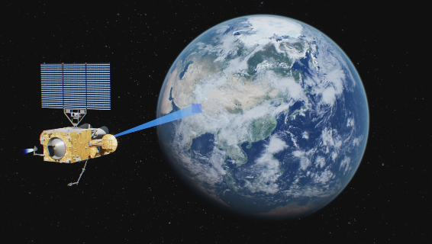




GSICS Annual Meeting
IR Breakout Session 10b
20 Mar. 2025, 08:30-08:50
Overview of FY-4C/GIIRS Instrument Status and L1 Processing System Design
Lu Lee^{1*}, Weichu Yu*, Yaopu Zou^{2*}, Libing Li^{2*}, Yu Zhu², Liguo Zhang³, Changpei Han², Chengli Qi¹, Lei Ding² , Feng Lu¹
*FY-4C GIIRS Calibration and Validation Team
1. National Satellite Meteorological Center (NSMC), CMA
2. Shanghai Institute of Technical Physics (SITP), CAS
3. Shanghai Institute of Satellite Engineering (SISE), CASA
FY-4C/GIIRS on-orbit
courtesy of SISE
Mar. 17-19, 2025, Changchun, China

Slide 2
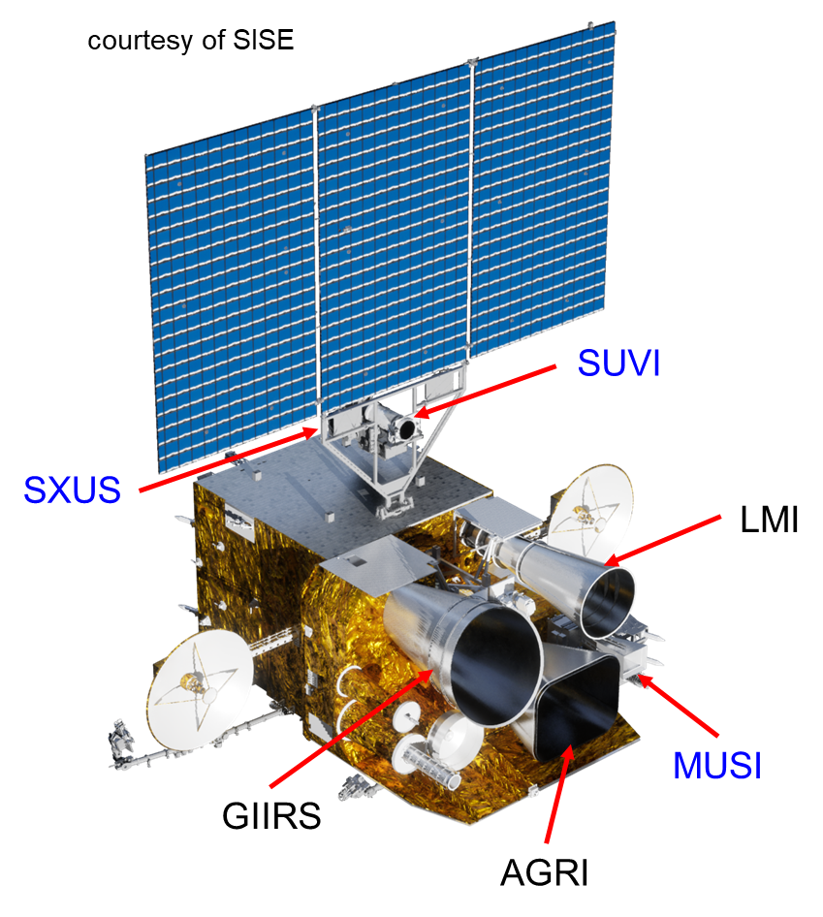
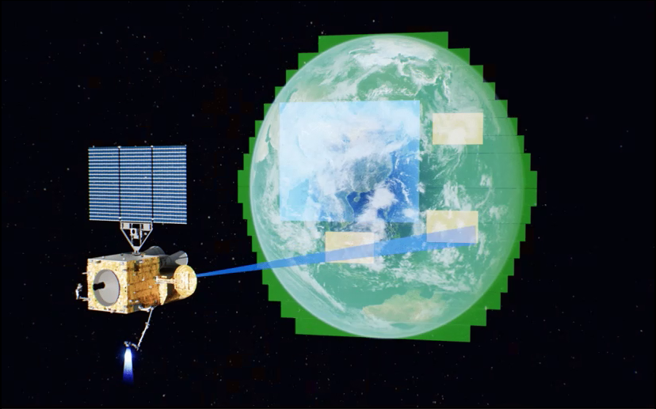
1. FY-4C Mission Overview
GIIRS/CN Region
AGRI/Full DIsk
AGRI/Mesoscale
FY-4C on-orbit, courtesy of SISE
FY-4C is the third satellite in China's second-generation geostationary meteorological satellite series (FengYun-4), and is scheduled to be launched in Dec., 2025.
As an operational meteorological satellite, it will provide operational continuity of GEO-satellite-based observations.
The measurements from the six instruments are used for planetary and space weather monitoring and research, including atmospheric temperature and humidity sounding, sea-surface temperature, cloud and aerosol properties, regional ozone levels, atmospheric ionosphere and solar activity.
Acronym | Full name
AGRI | Advanced Geostationary Radiation Imager
GIIRS | Geostationary Interferometric Infrared Sounder
LMI | Lightning Mapping Imager
MUSI | Multiband Ionospheric Ultra-Violet Spectrum Imager
SUVI | Solar Extreme-UltraViolet Imager
SXUS | Solar X-EUV Irradiance Sensor

Slide 3
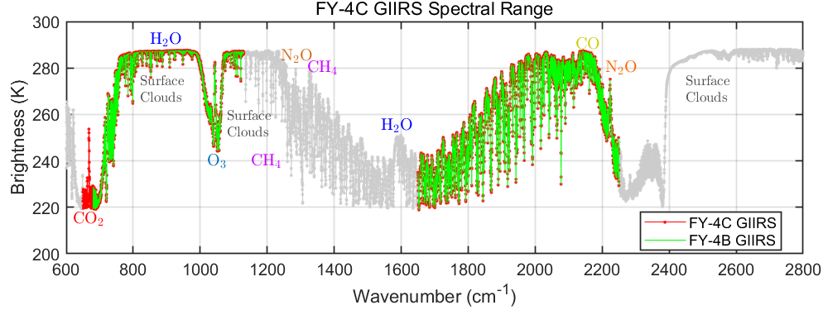
2. FY-4C/GIIRS Overall Design: Requirement Update
Requirement | FY-4B | FY-4C
Spectral Range | LWIR: 680~1130 cm⁻¹ MWIR: 1650~2250 cm⁻¹ | LWIR: 650~1130 cm⁻¹ MWIR: 1650~2250 cm⁻¹
Spectral Sampling | 0.625 cm⁻¹ | 0.625 cm⁻¹
Noise (NEdR) | LWIR: less than 0.5 r. u. MWIR: less than 0.1 r. u. | LWIR: less than 0.5 r. u. MWIR: less than 0.1 r. u.
Spectral accuracy | 7 ppm | 5 ppm
Radiometric accuracy | 0.7 K | 0.5 K
Detector Matrix | 16×8, sparse layour | 64×64, FPA
IR Spatial Sampling | 12 km @ s.s.p. | 8 km @ s.s.p.
Dwell Duration | 10.4s for a 384km × 192km area | ~10s for a 256km × 256km area
Observation Coverage | China and its surroundings @ 105°E (2024.02~now) | China and its surroundings @ 133°E (undetermined)
Repeat Cycle Duration | 1.5 hours | ~1 hour
VIS Spatial Sampling | 1 km @ s.s.p. | 0.5 km @ s.s.p.
The objectives of the GIIRS are to:
Provide information on vertical structure of water vapor, temperature and wind at high spatial, temporal, and vertical resolution (8 km, 1 h, 1 km).
Support air chemistry and air quality applications.
Support regional climate variable records (LST/SST).
r. u.: radiance unit, mW/[m²·sr·cm⁻¹]
s.s.p.: sub-satellite point

Slide 4
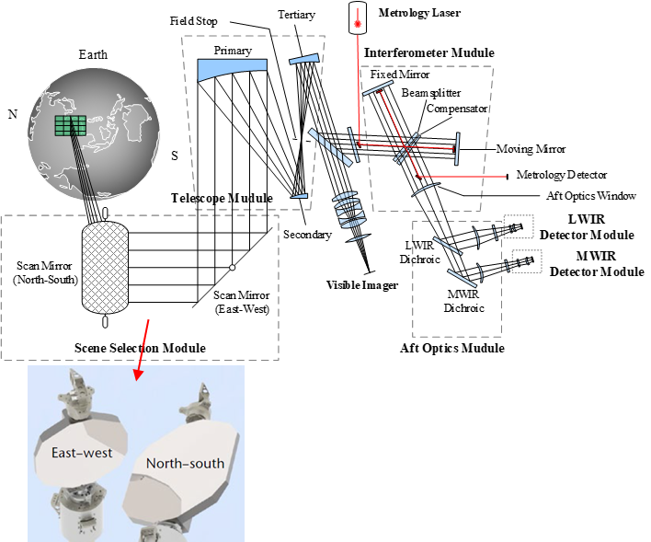
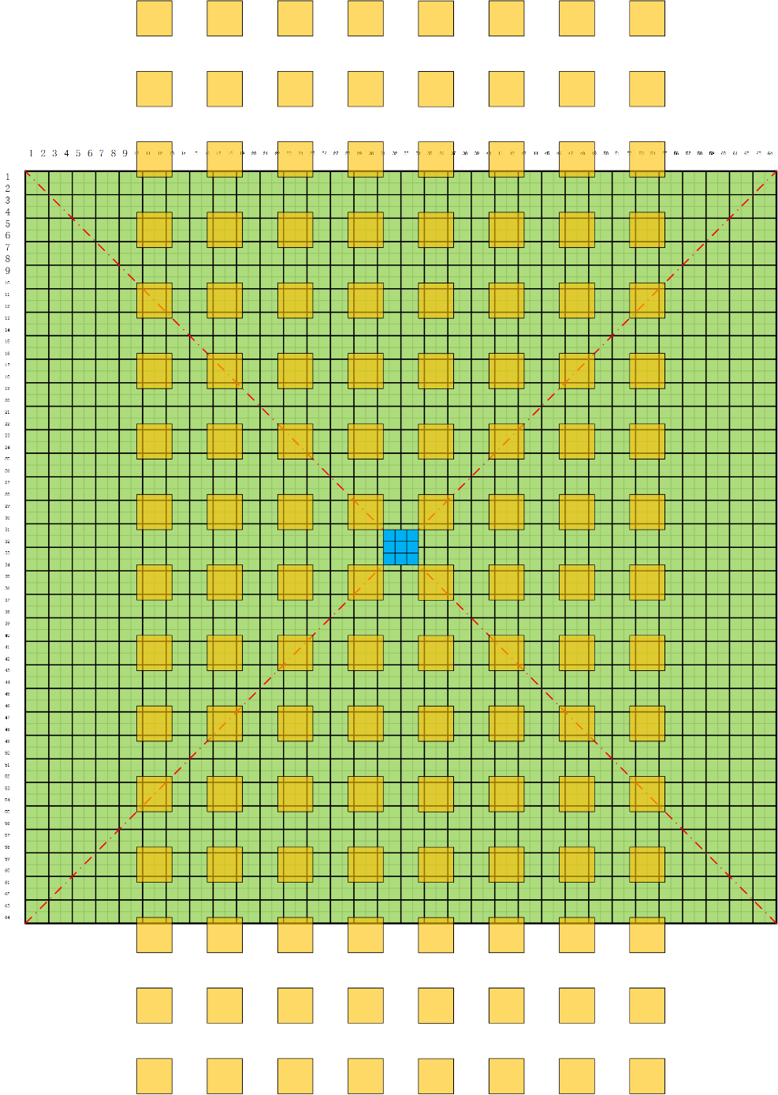


2. FY-4C/GIIRS Overall Design: Requirement Update
FY-4C/GIIRS
1 Superpixel = 2x2 subpixels
45 μm pitch
FY-4B/GIIRS Optical Layout
FY-4B/GIIRS
1 pixel is equivalent to 2.67x2.67 subpixels of GIIRS-C
FY-4C/GIIRS consists of an IR FTS and a visible-light integrated imager.
Main Update: 32x32 superpixels with 90 μm pitch for IR sounding

Slide 5
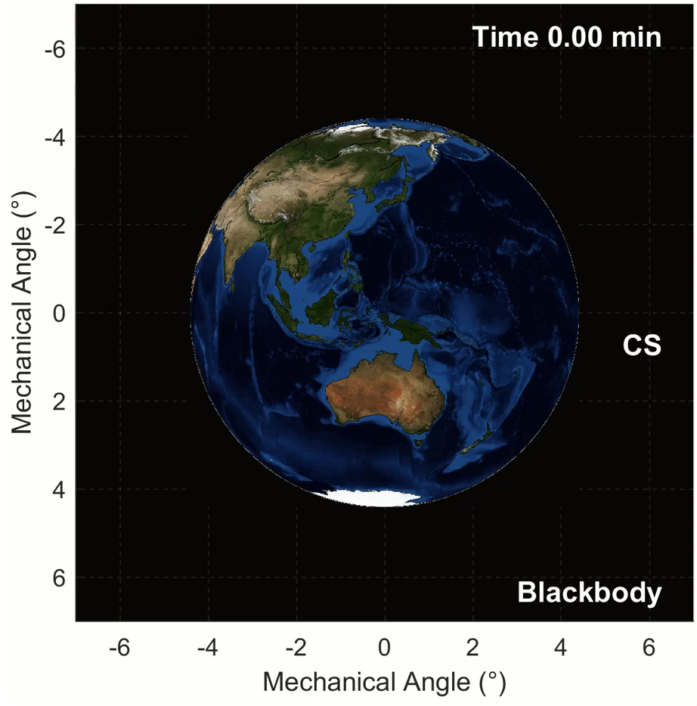
3. FY-4C/GIIRS Observation Mode
32×8 km = 256 km
~224 μrad
8 km
4 km
~112 μrad
FY-4C/GIIRS 1-hourly observation mode.

Slide 6
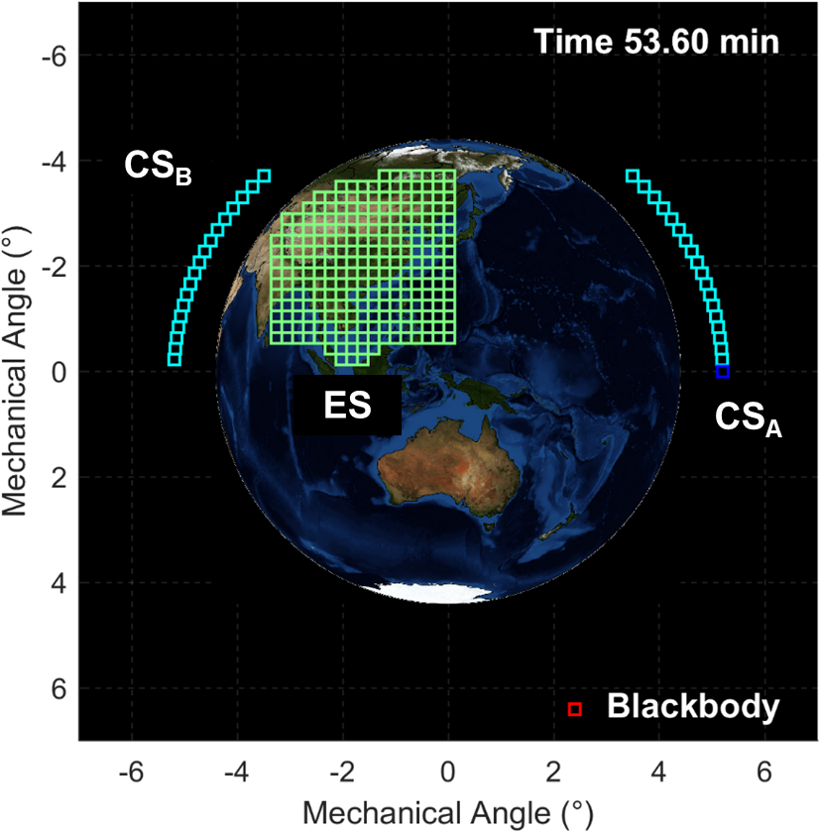
3. FY-4C/GIIRS Observation Mode
In the Earth observation sequence, four kinds of interferograms are measured:
Earth View (ES): Earth scene observation through front baffle;
Blackbody (BB): Internal blackbody observation;
Cold Space-A (CS_{A}): Cold space observation along a fixed LOS, used for radiometric calibration;
Cold Space-B (CS_{B}): Cold space observation at the beginning and end of each scan row, used for radiometric deviation correction.
The blackbody is embedded inside the instrument, and the position in the figure is only a schematic, not a real pointing

Slide 7
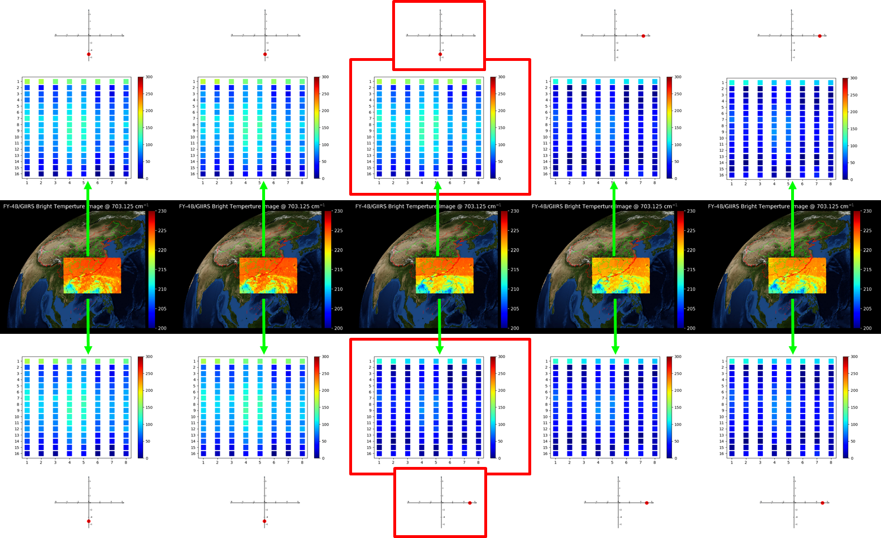
3. FY-4C/GIIRS Observation Mode: design motivation
FY-4B/GIIRS brightness time series wrt DS pointing

Slide 8
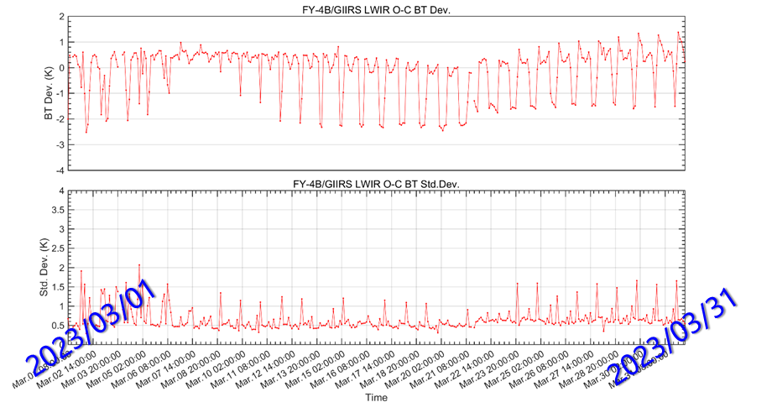
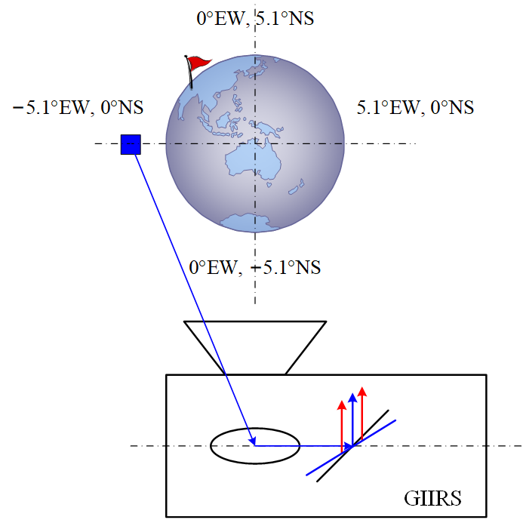
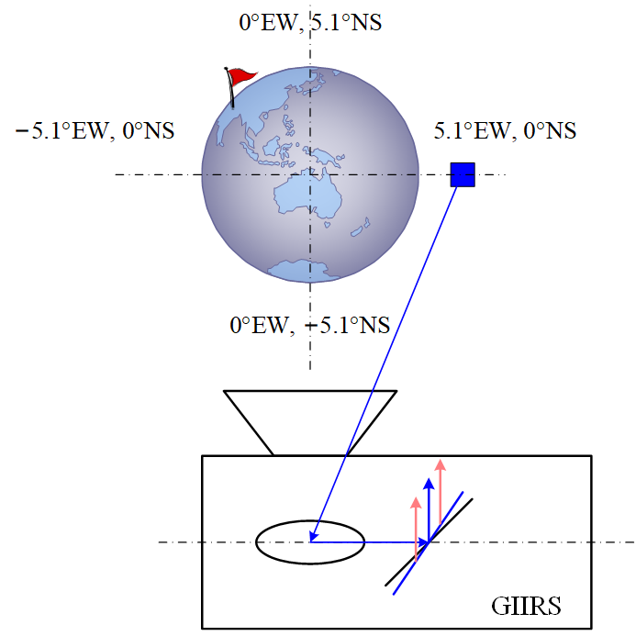
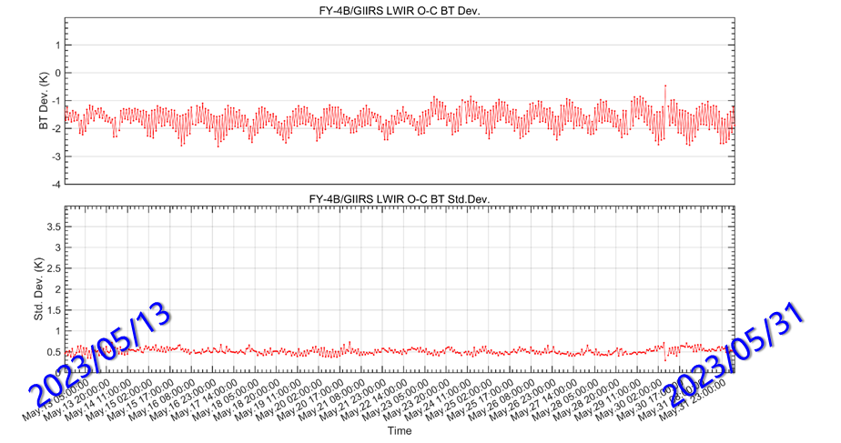
3. FY-4C/GIIRS Observation Mode: design motivation
more self-emission into FOV
less self-emission into FOV
More details in
Lu Lee. Report in IASI-2024 Conference, Dec. 02-06, 2024, Nancy, France.
Lu Lee et al. (2025). FengYun-4B GIIRS on-orbit performance, postlaunch calibration and validation activities, and its measurements quality. Manuscript submitted for publication

Slide 9
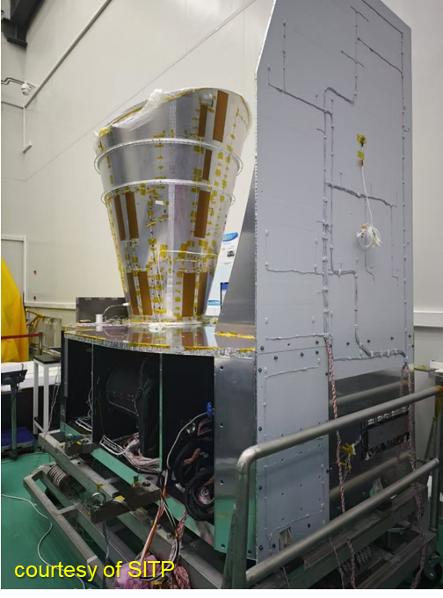
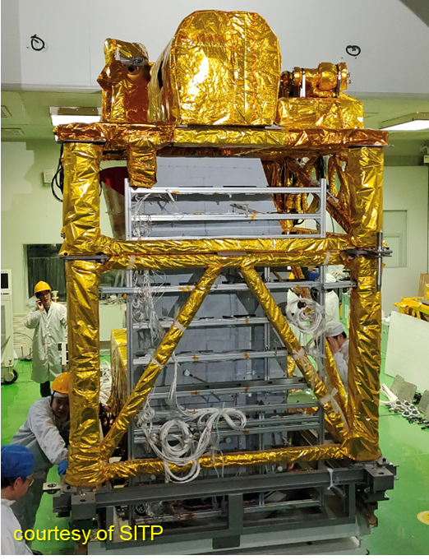
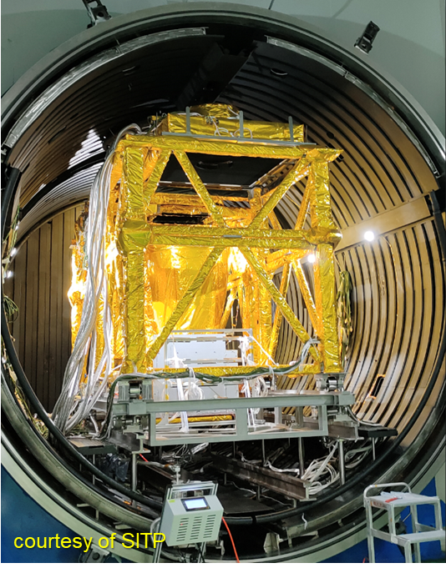
4. FY-4C/GIIRS Instrument Current Status
Prototype Model Integration
Preparation for TVAC test
Prototype Model in the TVAC Chamber

Slide 10
4. FY-4C/GIIRS Instrument Current Status
FY-4C/GIIRS Schedule in 2025
2025.03, GIIRS flight model integration
2025.06, spacecraft test with flight model installation
2025.07, Shock and vibration tests of spacecraft
2025.08, GIIRS flight model TVAC test (Optics, Geometry, Spectral and Radiometric test)
2025.10, satellite will leave Shanghai space site and to be transport to the rocket launch site
2025.12, launched from the Xichang Space Launch Site

Slide 11
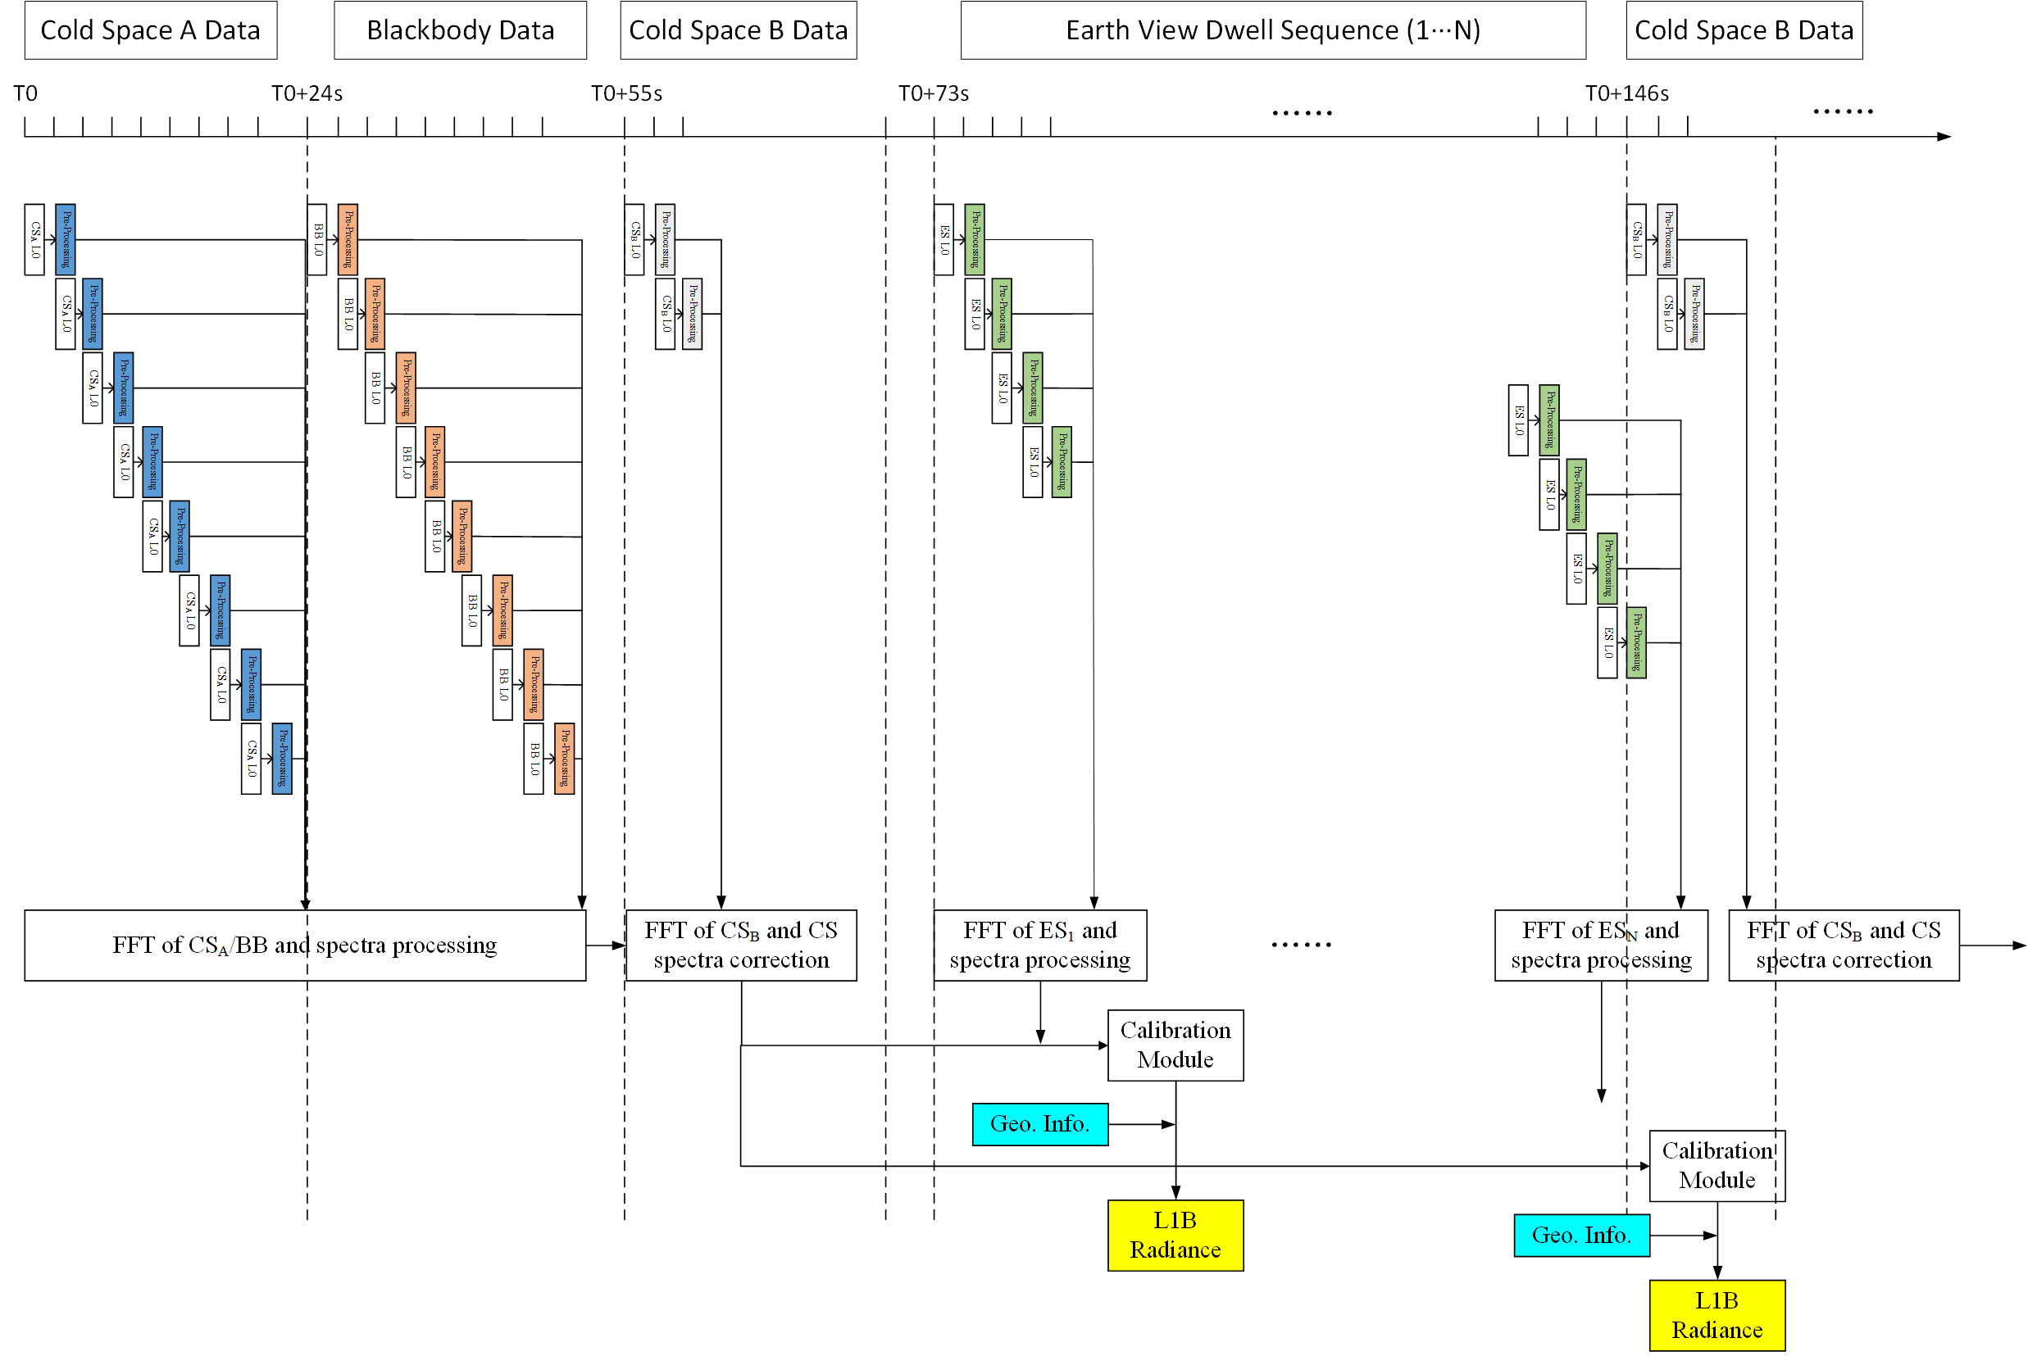
5. Level-1 Processing System Design
pipeline architecture of GIIRS-C Level-1 processing

Slide 12
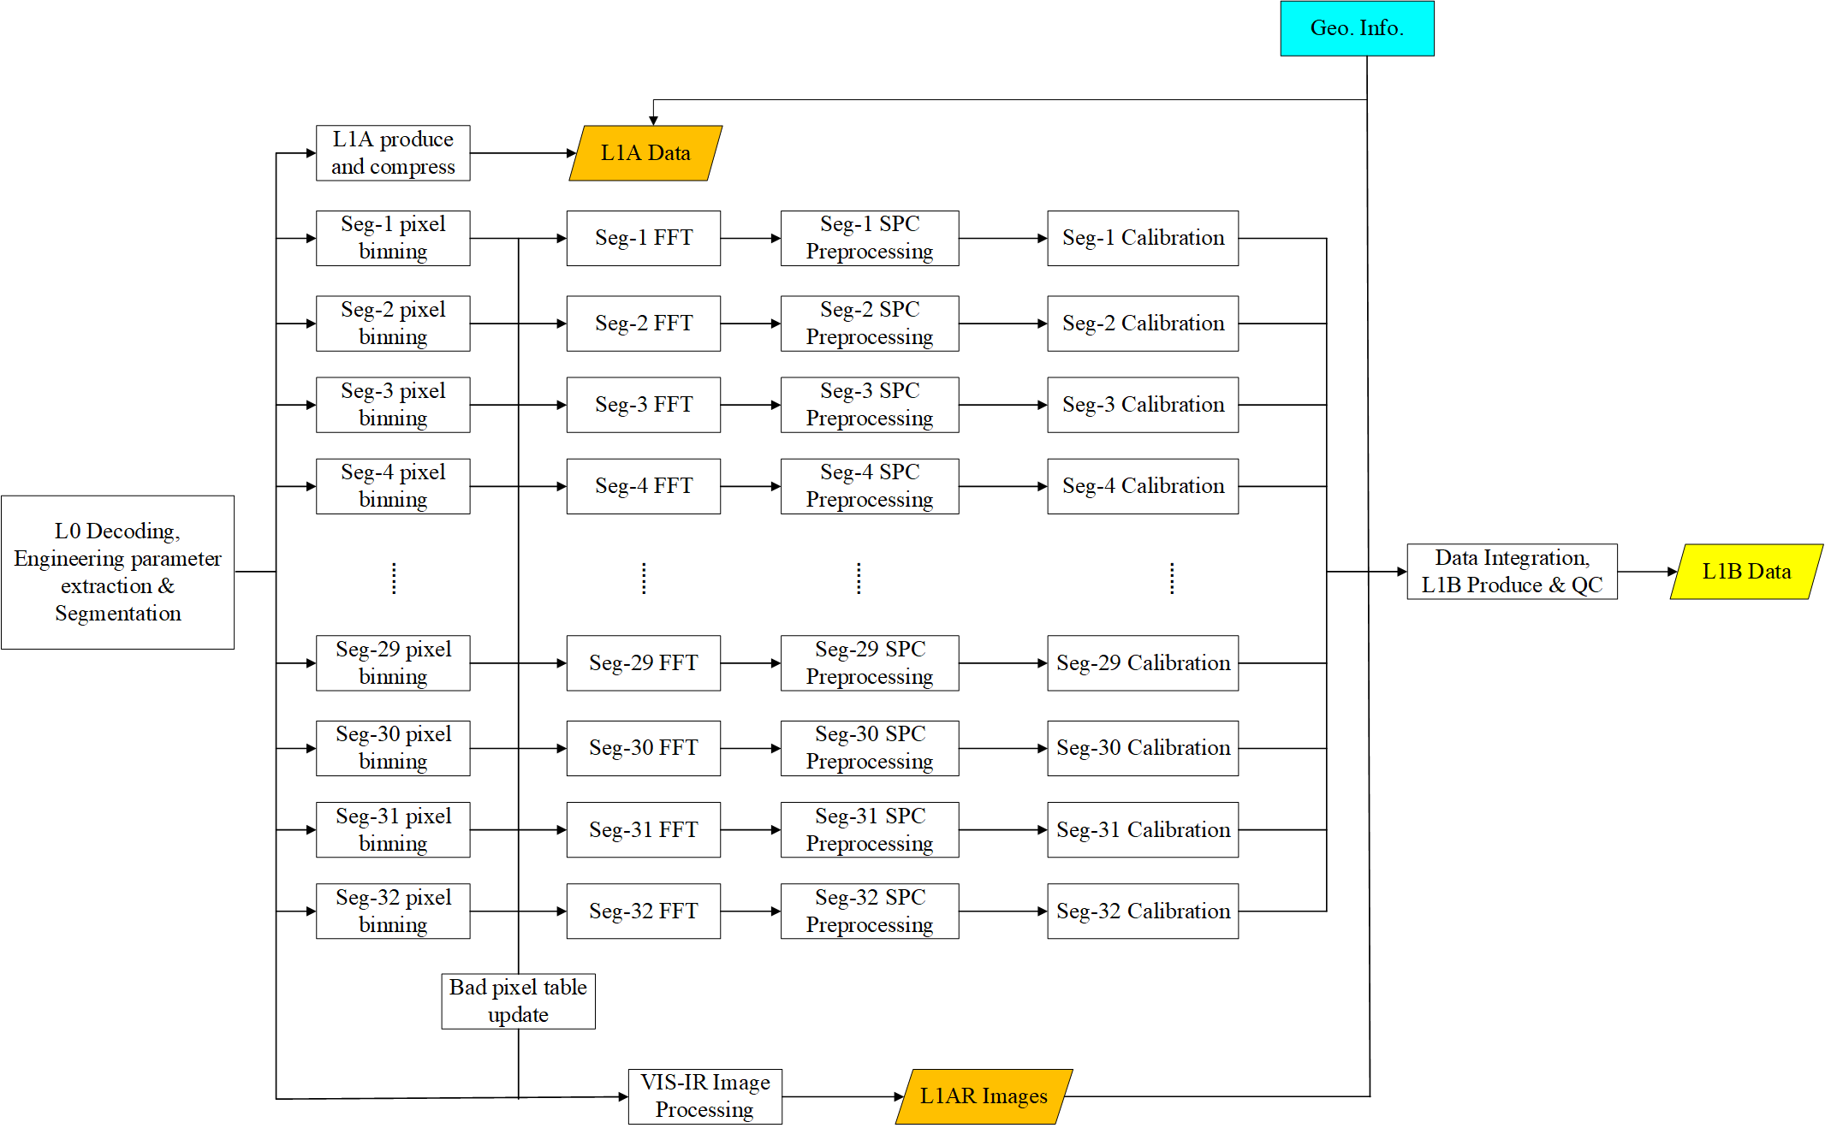
5. Level-1 Processing System Design
The 64 columns of FPA with total 4096 pixels were divided into 32 groups per group of two columns (64×2) , and assigned to 32 computer CPU units.

Slide 13
Fin
That’s all Folks
Thank you for your attention
Lu Lee
lilu@cma.gov.cn

