Slide 1
Computing Lunar Geometry for CrIS Observations
Likun Wang
Cooperative Institute for Satellite Earth System Studies (CISESS)
Earth System Science Interdisciplinary Center (ESSIC),
University of Maryland, College Park, Maryland
Email address: wlikun@umd.edu

Slide 2
Summary
Under current orbital configuration, the Moon enters the CrIS Space View every ~27.3 days.
It is very interesting to see how the CrIS space view spectra in three bands response differently when the Moon passes over the Space View.
Now we treat it as lunar intrusion contamination
It should be realized that the IR sounder have relatively large filed of view.
CrIS FOV size: 0.963 Degree
Moon Angular Diameter : 0.54 Degree
CrIS FOV cannot resolve the Moon, and the Moon cannot fully cover the FOV
However, how this data can help for current calibration is not clear yet.

Slide 3
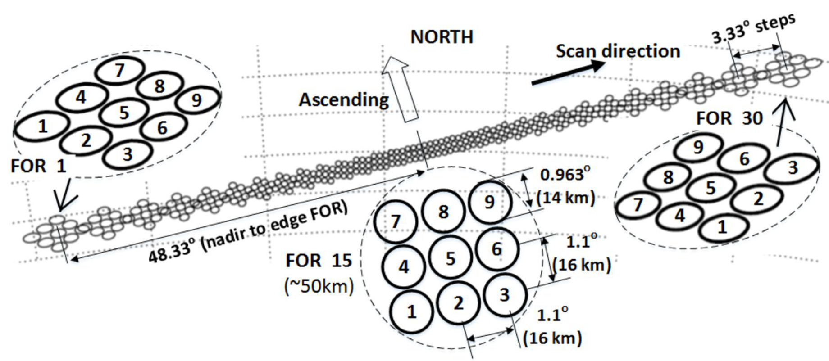
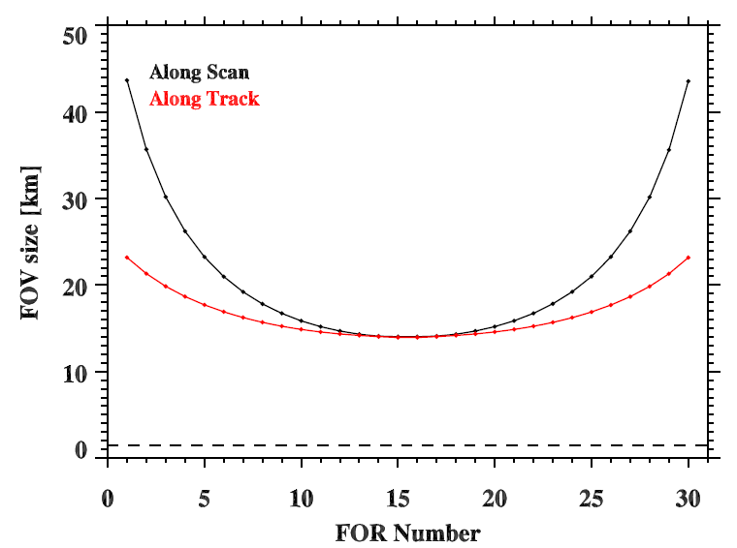
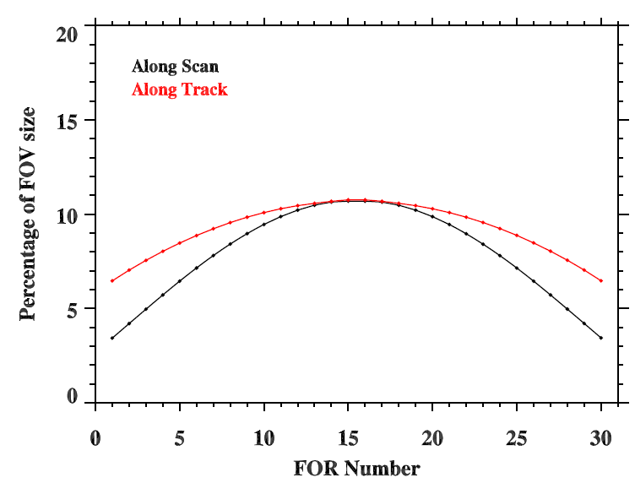
CrIS Scan Patterns and Specification
FOV 5 size change with Scan
Percentage of FOV size
1.5 km (1 sigma)

Slide 4
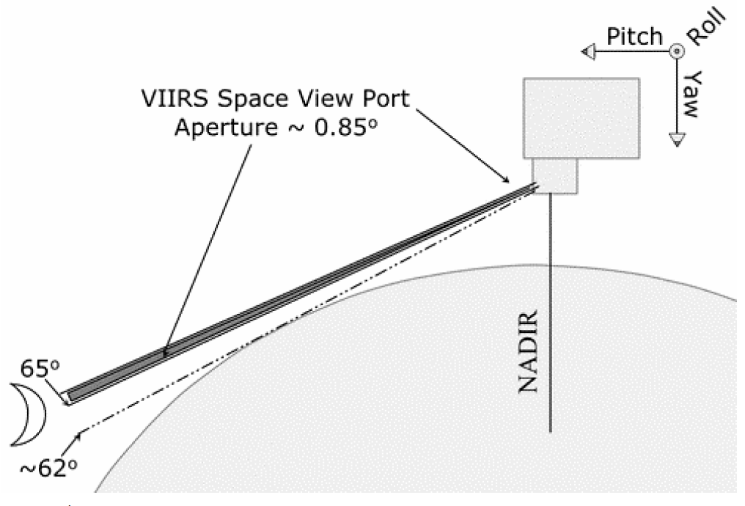
Moon in Space View
CrIS Space View FOV Aperture ~ 0.968
FOR Aperture: 3.3 Degree
70.3±0.04
Pitch
Roll
Y_{orb}
X_{orb}
Yaw
Z_{orb}
Modified from Patt et al. (2005)

Slide 5
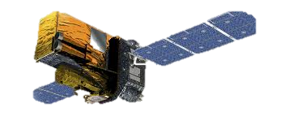
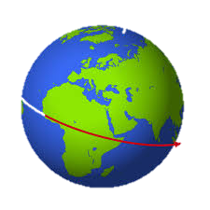
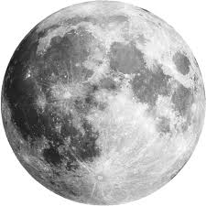
Lunar intrusions in SPV
70.3±0.04 Space View Angle
Ecliptic Equator
Space views project circles around celestial equator.
The lunar views occur when the Moon’s position falls between the two circles, dependent on seasons
Celestial Equator
SPV
Circle

Slide 6
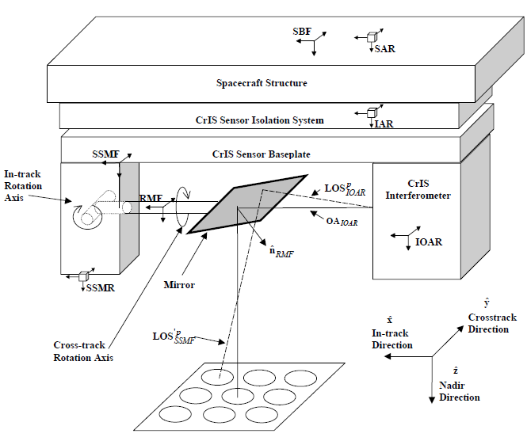
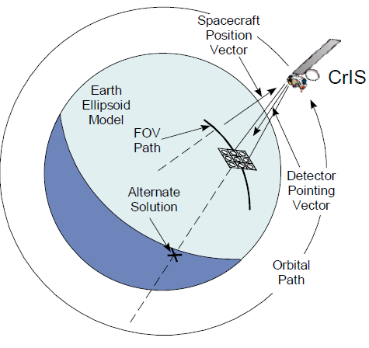
CrIS Geometric Calibration Algorithm
Sensor Specific Algorithm
Common Geo Algorithm
Compute the LOS relative to S/C for each FOV (3x3) at each scan position (30)
Resolve LOS intersection with Earth Ellipsoid (LOS, mounting matrix, satellite attitude and ephemeris)

Slide 7
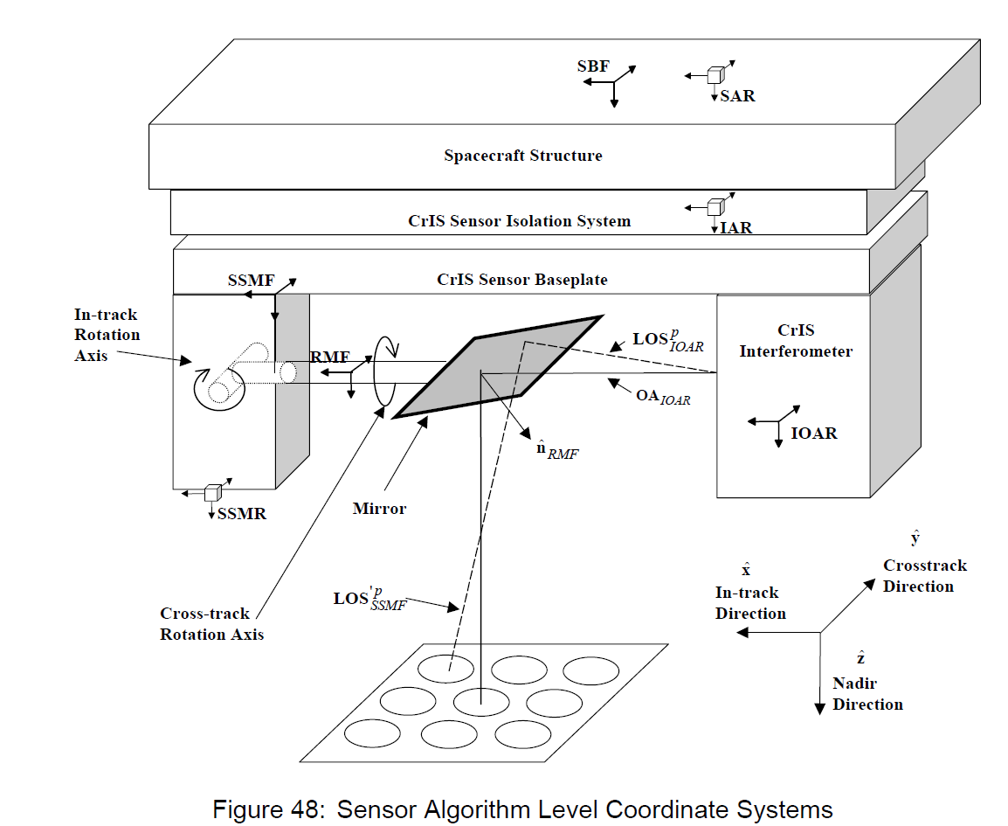
CrIS Geometric Calibration Algorithm Sensor Specific Algorithm
SDR Algorithm Process
LOS in IOAR coordinate = ILS parameters (3x3)
Convert from IOAR to SSMF coordinate
3) Compute normal to SSM mirror in SSMF (30 Scan Pos)
4) Apply SSM mirror rotation to get LOS in SSMF coordinate
5) Convert from SSMF to SSMR coordinate
6) Convert from SSMR to IAR coordinate
7) Convert from IAR to SAR
8) SAR coordinate = SBF coordinate

Slide 8
NOVAS Library
The Naval Observatory Vector Astrometry Software (NOVAS) is a software library for astrometry-related numerical computations. It is developed by the Astronomical Applications Department, United States Naval Observatory. Currently, NOVAS has three different editions, for C, Fortran, and Python.
Using for NOAA JPSS satellite geometry and geolocation calculations

Slide 9
Calculate Lunar Vector
Using NOVAS library to compute Lunar Vector in ECI coordinate (time, x, y, z)
Convert Lunar Vector in ECI to one in the orbit coordinate using satellite position and speed (time, x y, z)
Convert Lunar Vector in the orbit coordinate to one in the spacecraft coordinate using satellite attitude (time, x y, z)

Slide 10
FOV vectors in IOAR
3x3 2 angles
70.3±0.04
2 angles
SSM normal vector
at space view (SPV)
FOV vectors in SSMF
Reflected from SSM mirror
SPV FOV vectors in SSMF
3 angles
SPV FOV vectors in SSMR
3 angles
Common Geo
SPV FOV vector in IAR
IET
3 angles
Lunar vector in ECI
SPV FOV vector in SAR/SBF
Sat POS, VEL, ATT
mounting matrix
Lunar vector in S/C
SPV FOV vector in S/C
CrIS SDR
Check angle between two vectors
Old procedures
<= FOV angle or FOR
Moon in FOVs or FORs
New codes
No
Yes

Slide 11
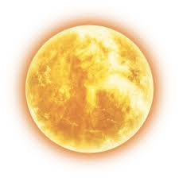
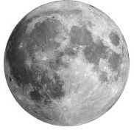
Geometric calculation
Sun Vector
β : the separation angle between sun and moon vector, which can be converted into lunar phase or lunar illumination
β
α
α: the separation angle between space view
and moon vector. (<3.3 Degree in FOR, < 0.963
In FOV)
Moon Vector
Space View Vector

Slide 12
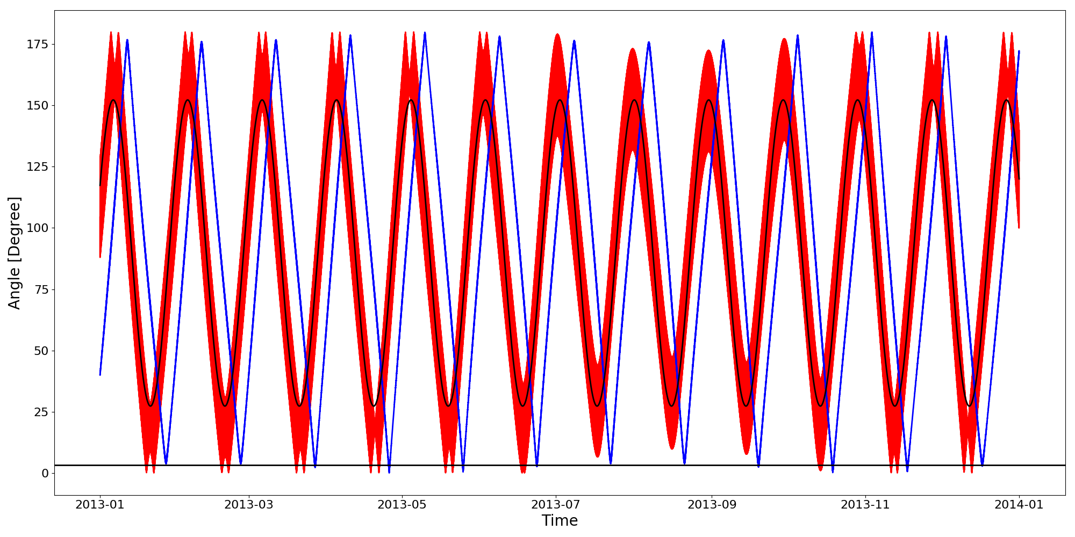
Model Predicted Lunar Intrusion: 2013
Lunar phase
Angle between SPV and moon
Periodic fitting line

Slide 13
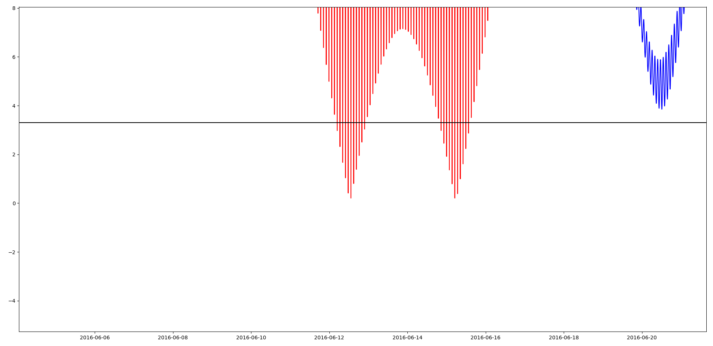
Pattern (1)
Moon Trajectory
space view

Slide 14
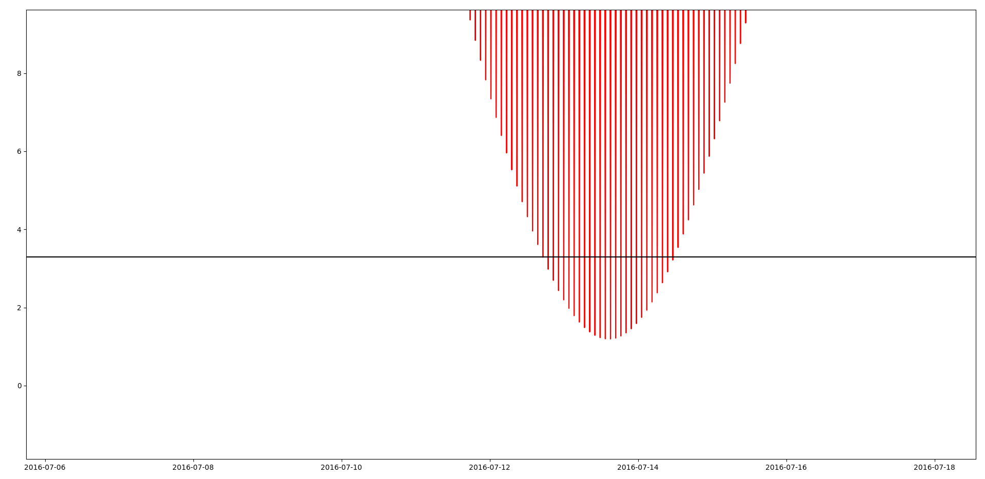
Pattern 2
Moon Trajectory
space view

Slide 15
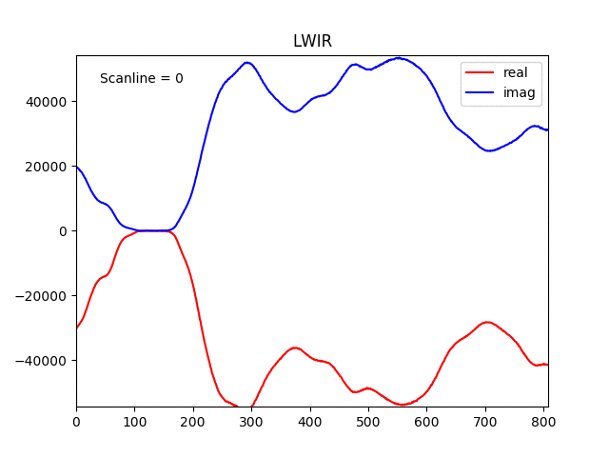
Lunar Intrusion Animation in LWIR Space View: Spectrum changes with Moon moving in and out
Counts
Channel number

Slide 16
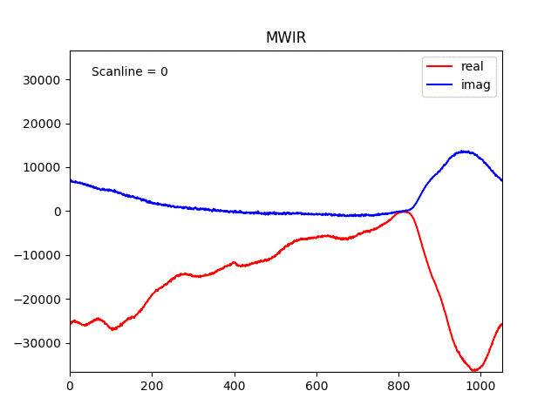
Lunar Intrusion Animation in MWIR Space View: Spectrum changes with Moon moving in and out
Counts
Channel number

Slide 17
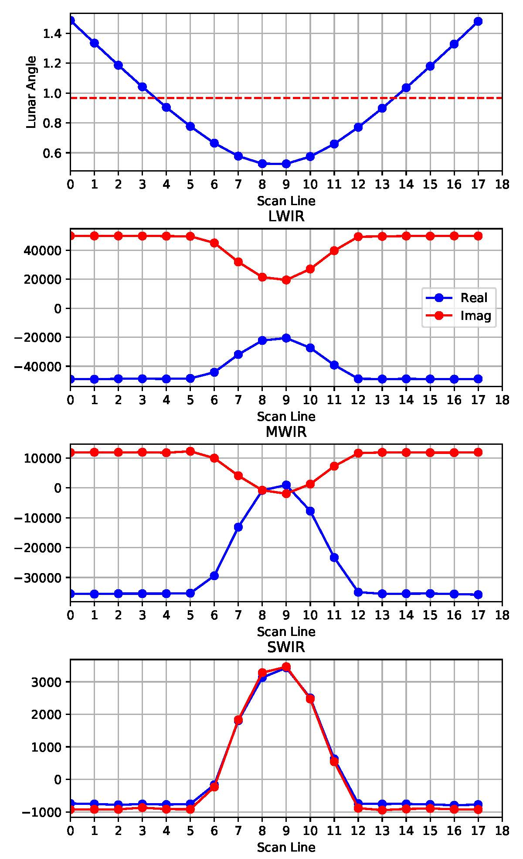
Angles between
FOV and lunar vectors
Geometric Calculation
LWIR
Space View counts
MWIR
SWIR
At specific channel

Slide 18
Angles between
FOV and lunar vectors
At specific channel
Geometric Calculation
LWIR
Phase of Space View
MWIR
Im
Lunar contaminated
SPV
SWIR
Re
Normal SPV

Slide 19
Discussion
How can the lunar calibration help for IR calibration?
Radiometric calibration: compared to the inter-calibration
Spectral calibration: compared to the model calculations
Geometric calibration: compared to the imager inter-calibration
What IR lunar models are needed?
Band models? Spectral models? Different geometric configurations?
What lunar data are needed collected for IR sounders?
Geometric? Counts? blackbody? Telemetry data?

