Slide 1
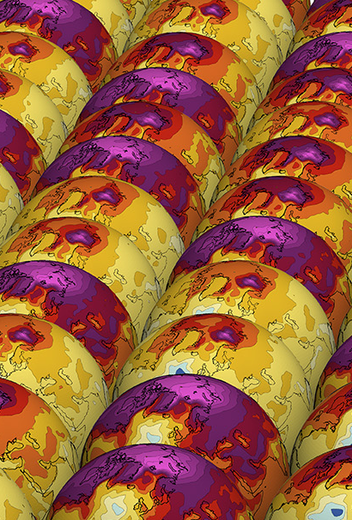

Innovative Ideas in Lunar Calibration for IR
Dr. Martin Burgdorf
20.03.2025
Foto: UHH/CLICCS

Slide 2
Agenda
Introduction
Radiometric reference: CrIS on Suomi
Example: Calibration Check of HIRS
Spatially Resolved Observations of the Moon
Future Projects
Summary and Discussion

Slide 3
Introduction
1
Foto: UHH/CLICCS

Slide 4
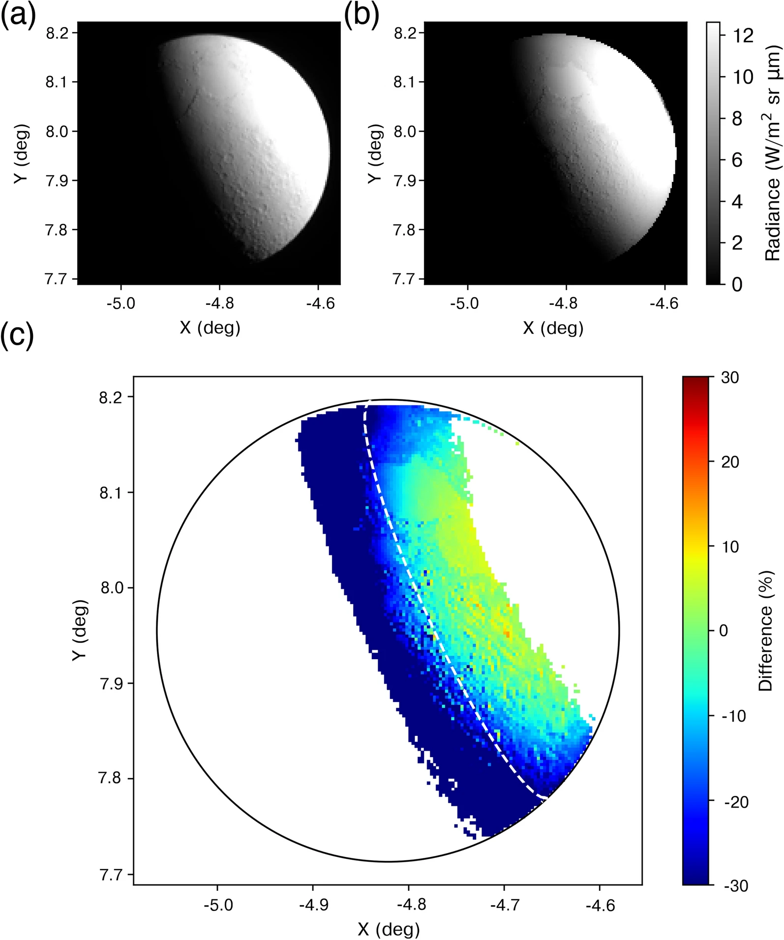
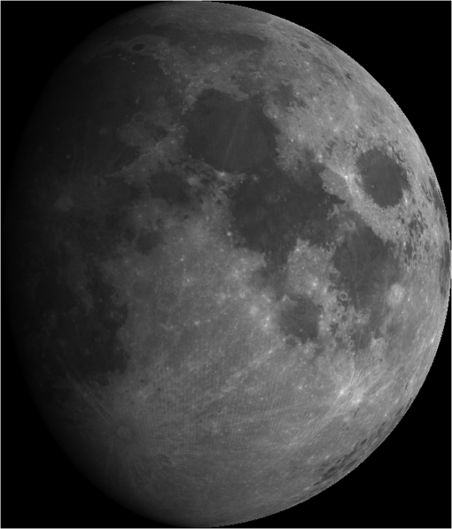
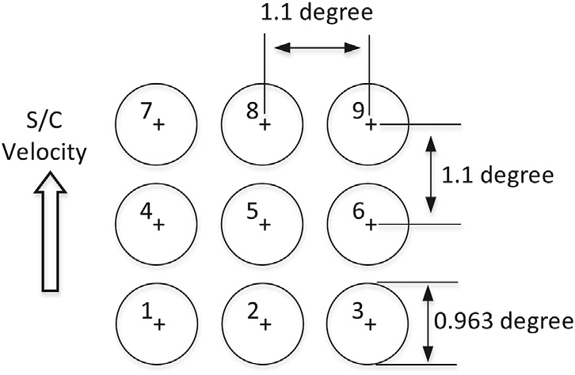
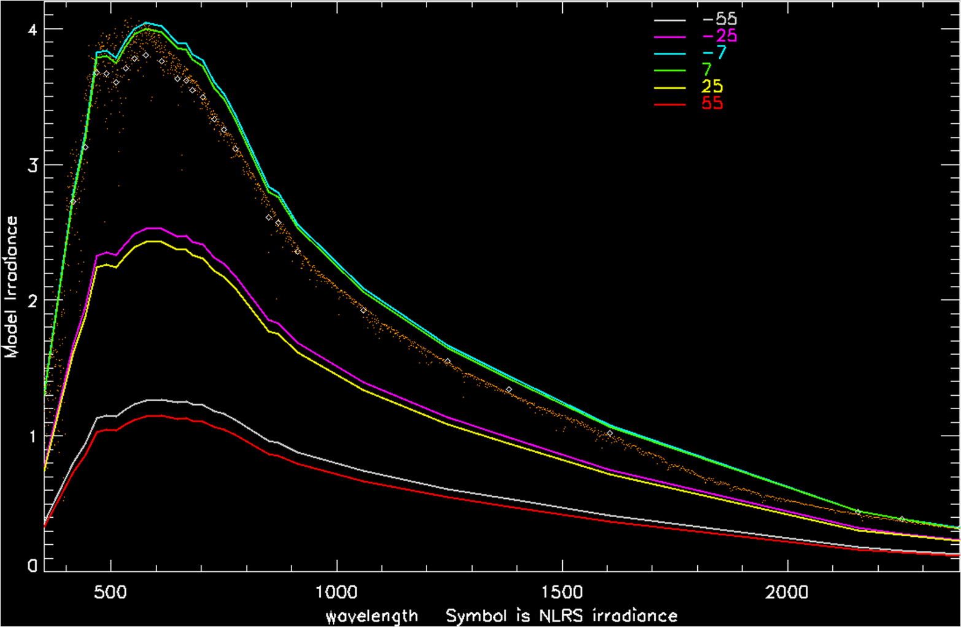
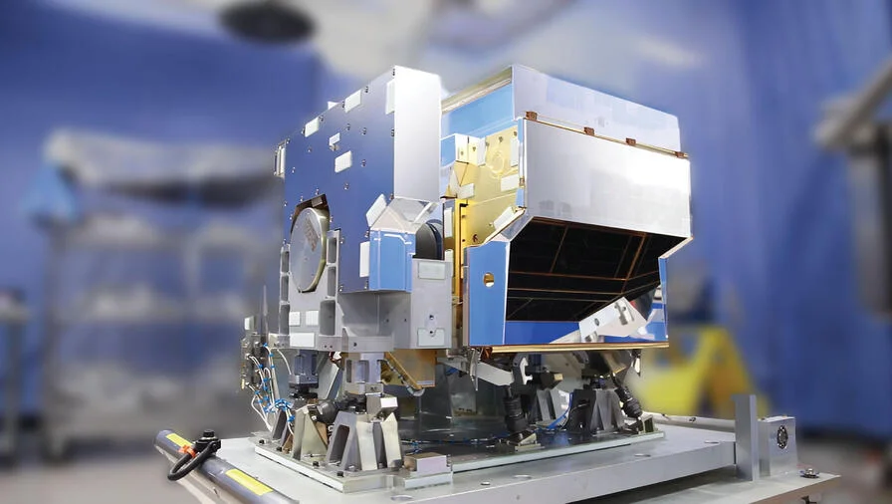
Establish the Moon as Radiometric Reference in IR
Cal. Landsat with Moon suggested `85
Probl. With mid-IR: large contrast
Solution: Disk-averaged irradiance
One reference:
CrIS
Main aim: check radiometric stability

Slide 5
Radiometric Reference
2
Foto: UHH/CLICCS

Slide 6
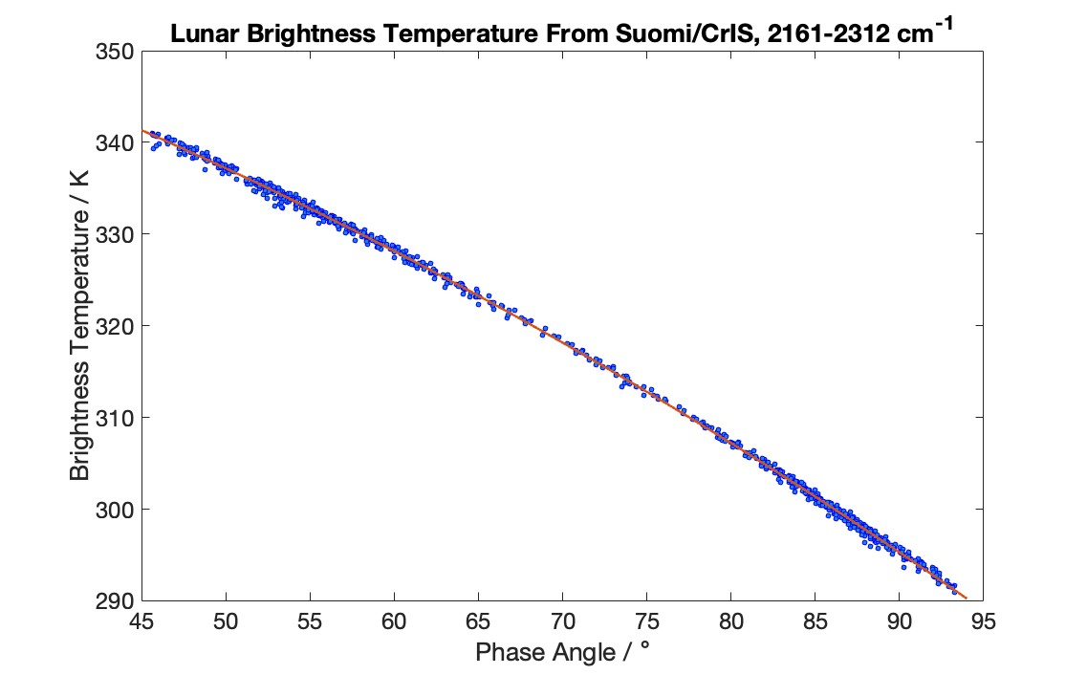
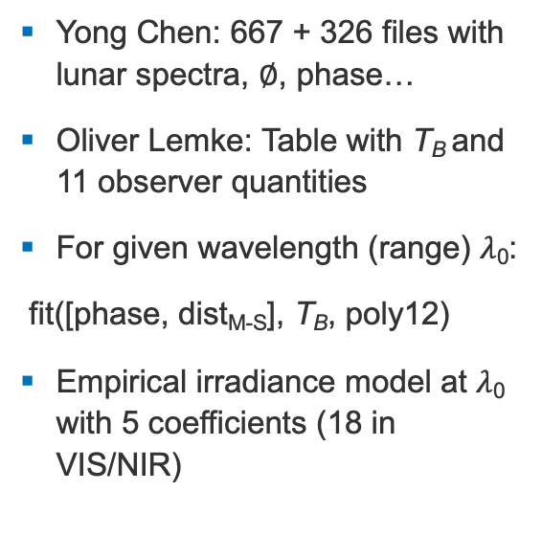
Reference: CrIS on Suomi
Yong Chen: 667 + 326 files with lunar spectra, $∅$, phase…
Oliver Lemke: Table with T_{B} and 11 observer quantities
For given wavelength (range) $λ$₀:
fit([phase, dist_{M-S}], T_{B}, poly12)
Empirical irradiance model at $λ$₀ with 5 coefficients (18 in VIS/NIR)

Slide 7
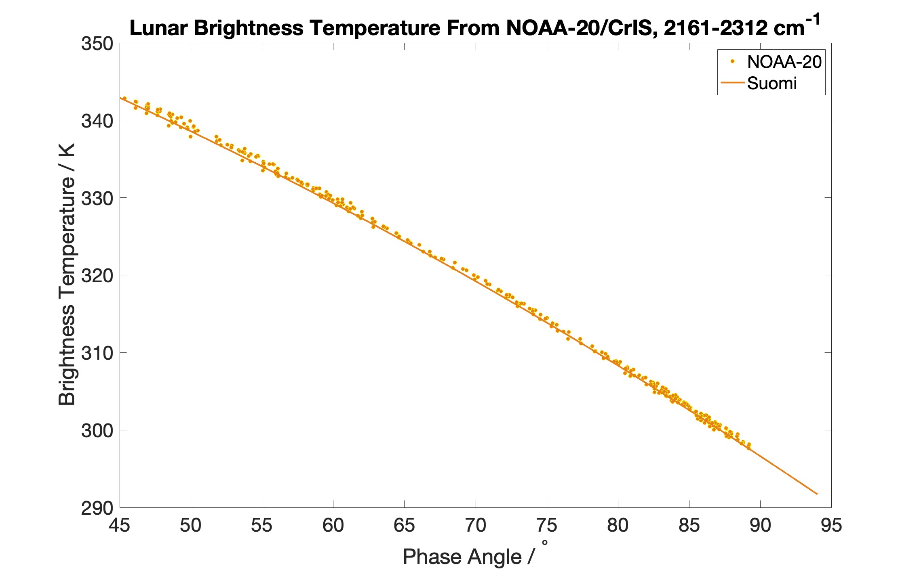
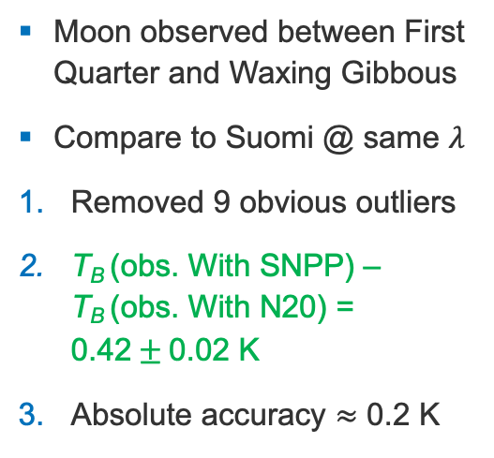
Example: Comparison to CrIS on NOAA-20
Moon observed between First Quarter and Waxing Gibbous
Compare to Suomi @ same $λ$
Removed 9 obvious outliers
T_{B} (obs. With SNPP) – T_{B} (obs. With N20) = 0.42$±$0.02 K
Absolute accuracy $≈$ 0.2 K

Slide 8
Check the Calibration of HIRS
3
Foto: UHH/CLICCS

Slide 9
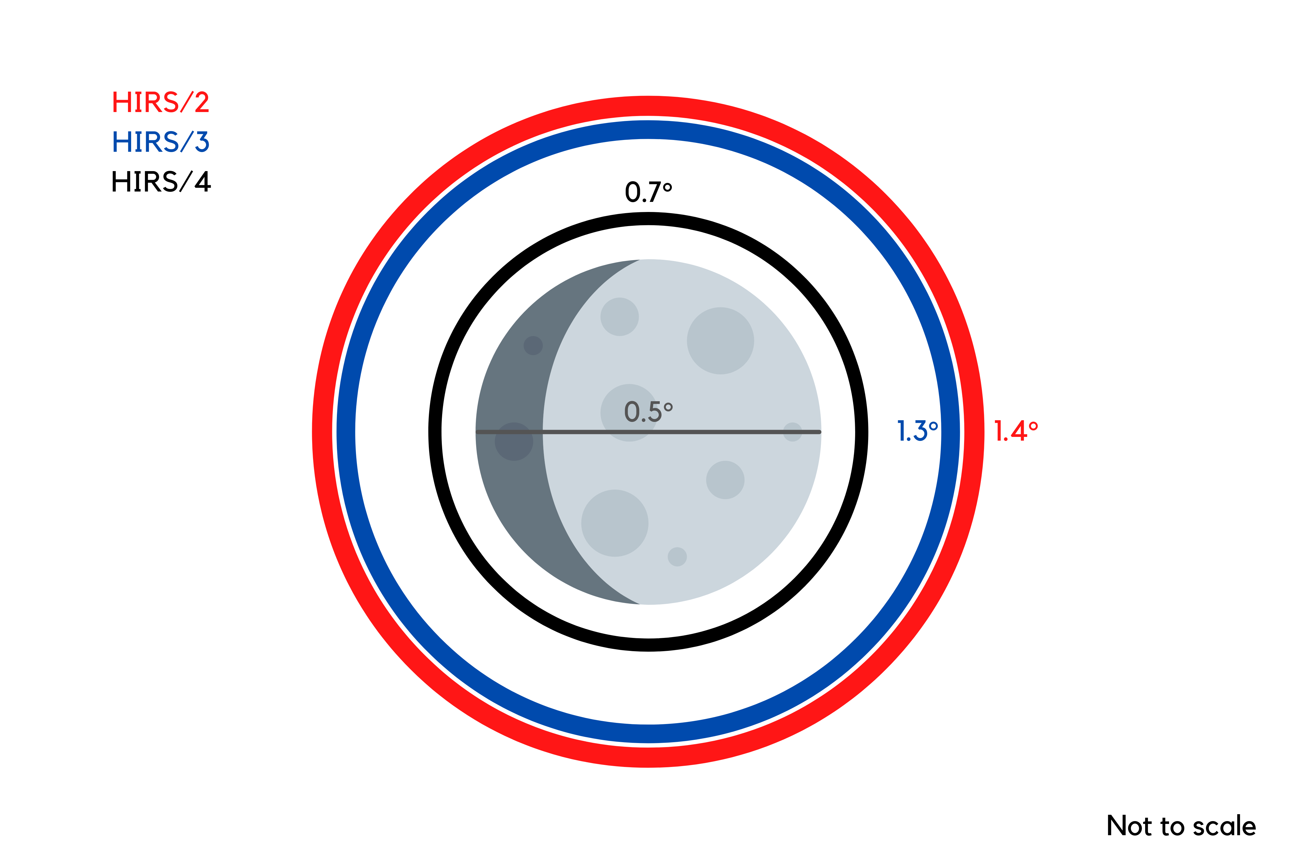
Example: Check Radiometric Calibration of HIRS/4
Moon observed with HIRS since end of seventies
HIRS/4 FoV = 2x Moon (area)
Method in C. Seibert‘s master thesis
Dataset at
https://zenodo.org/records/6865664

Slide 10
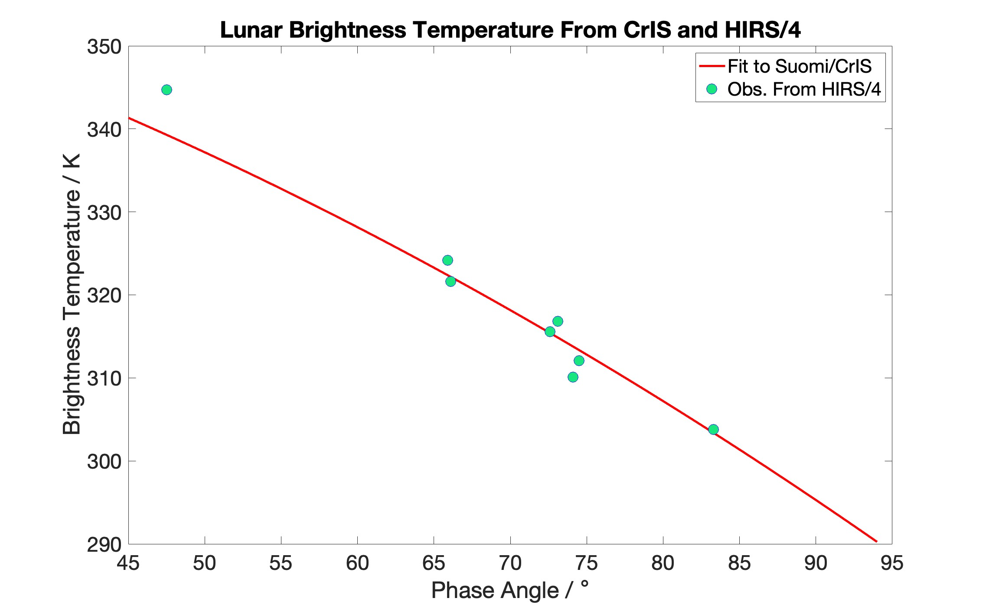
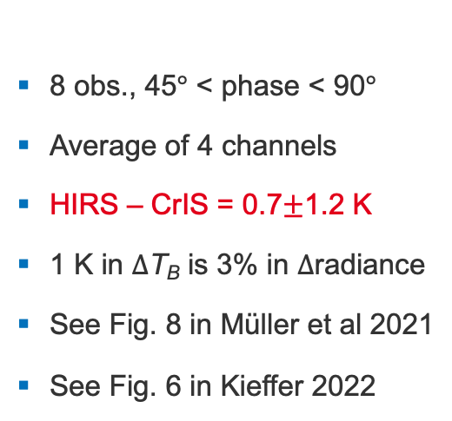
Do Measurements of CrIS and HIRS/4 Match Well?
8 obs., 45$°$ < phase < 90$°$
Average of 4 channels
HIRS – CrIS = 0.7$±$1.2 K
1 K in $Δ$T_{B} is 3% in $Δ$radiance
See Fig. 8 in Müller et al 2021
See Fig. 6 in Kieffer 2022

Slide 11
Spatially Resolved Observations of the Moon
4
Foto: UHH/CLICCS

Slide 12
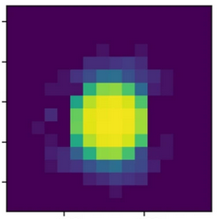
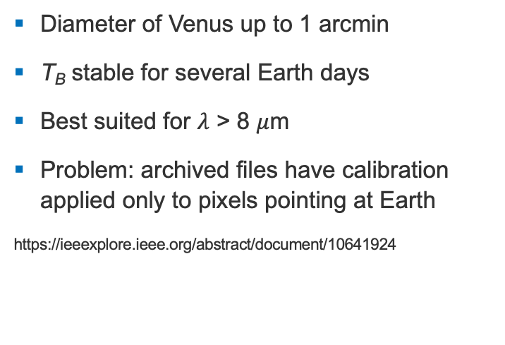
Central Pixel on Venusian Disk - an Alternative
Diameter of Venus up to 1 arcmin
T_{B} stable for several Earth days
Best suited for $λ$ > 8 $μ$m
Problem: archived files have calibration applied only to pixels pointing at Earth
https://ieeexplore.ieee.org/abstract/document/10641924

Slide 13
Future Projects: Far IR
5
Foto: UHH/CLICCS

Slide 14

Radiance of the Moon According to Model by Thomas Müller (MPE)
One complete lunation covered
$α$ is phase angle
Validate model with infrared and microwave sounder
Spectral features of Ilmenite or fool‘s gold at 300 – 600 cm⁻¹?

Slide 15
Summary
6
Foto: UHH/CLICCS

Slide 16
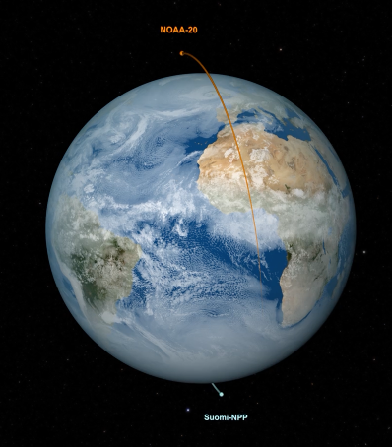
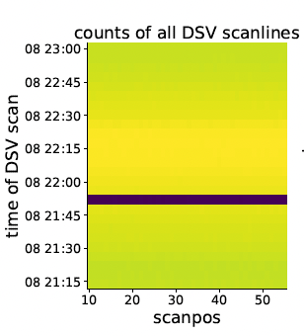
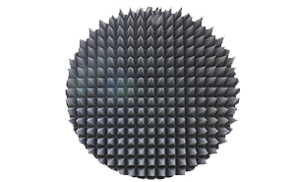
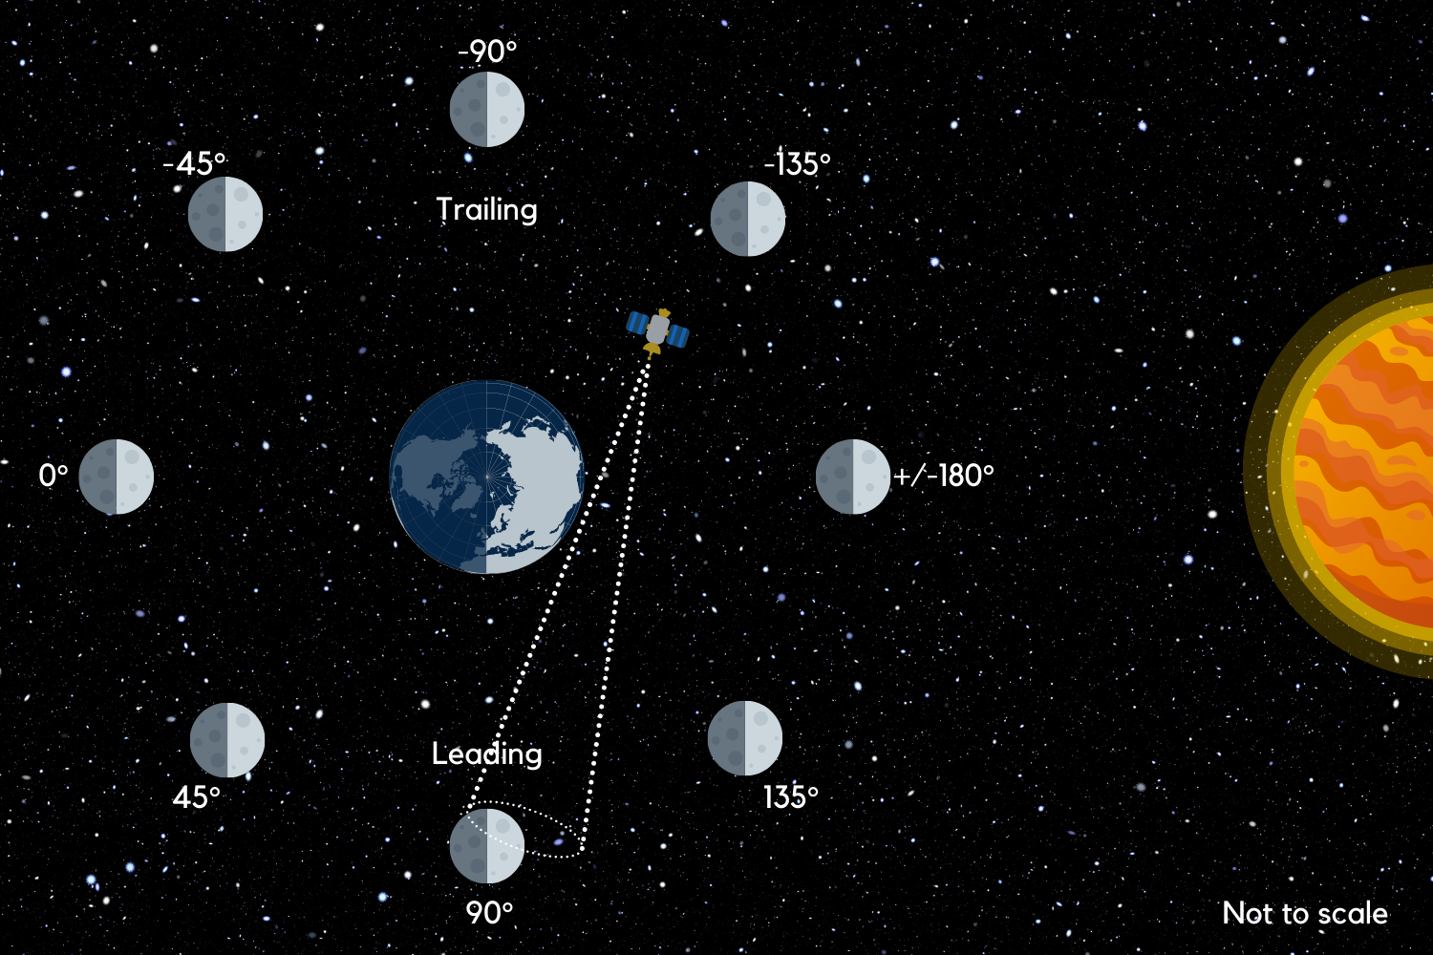
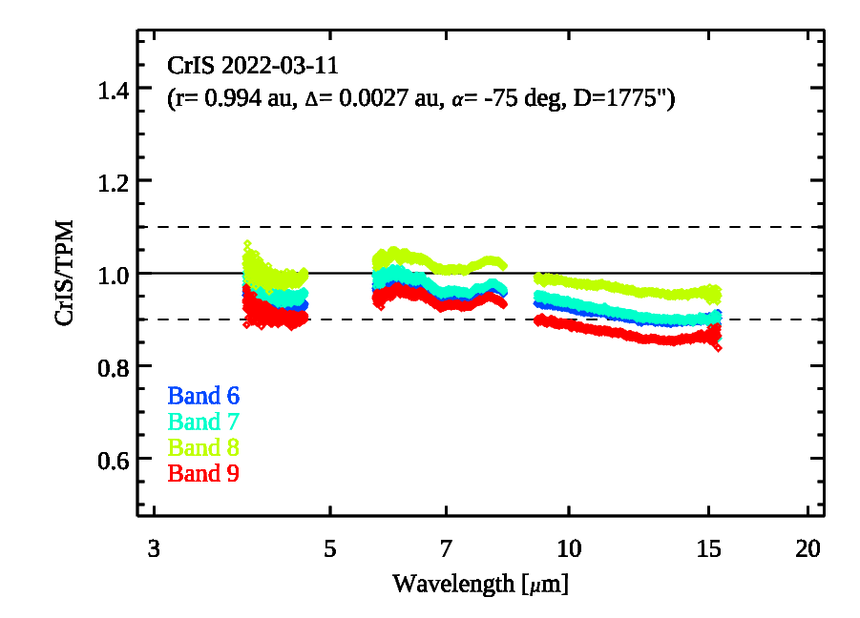
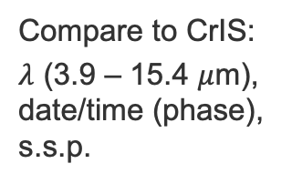
Radiometric Calibration Check in one Day (LEO)
ID Moon in DSV – cal. rejects or manoeuvres
Calculate radiance for max. signal
Compare to CrIS:
$λ$ (3.9 – 15.4 $μ$m), date/time (phase), s.s.p.
No need for SNOs, check abs. cal., stability, non-lin., pointing, diameter of FOV,…
Blackbody still needed?

Slide 17
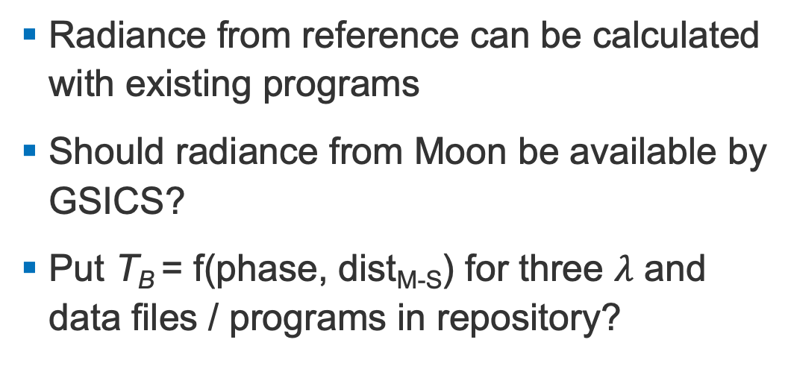
Open Questions and Discussion
Radiance from reference can be calculated with existing programs
Should radiance from Moon be available by GSICS?
Put T_{B} = f(phase, dist_{M-S}) for three $λ$ and data files / programs in repository?

Slide 18

Contact
Martin Burgdorf Research Scientist
Centrum für Erdsystemforschung und Nachhaltigkeit (CEN)
Universität Hamburg Bundesstraße 53 20146 Hamburg
+49 40 42838-8121 martin.burgdorf@uni-hamburg.de

