Slide 1


Navigation Registration and Radiometric Calibration for Lunar Observation of Geostationary Meteorological Satellites
Peiwen Chen¹, Hongchun Zhu¹, Yong Zhang^{2*}
1 College of Geodesy and Geomatics, Shandong University of Science and Technology, Qingdao, China
2 National Satellite Meteorological, China Meteorological Administration, Beijing, China
Notes:
Good morning everyone, I am honored to share my research work with experts here. My name is chenpeiwen, and I am a graduate student at Shandong University of Science and Technology. The topic of my report today is Navigation Registration and Radiometric Calibration for Lunar Observation of Geostationary Meteorological Satellites.

Slide 2
Outline
Research Background
Navigation Registration for Lunar Observation of Geostationary Meteorological Satellites
GOES-R and FY-4 Thermal Infrared Band Radiation Calibration of TBOL Based on Diviner Radiometer
Conclusions and Discussions
Notes:
This study is mainly conducted from the following four aspects : Research Background、Navigation Registration 、Diviner Radiometer and Conclusions

Slide 3
Part1
Research Background

Slide 4
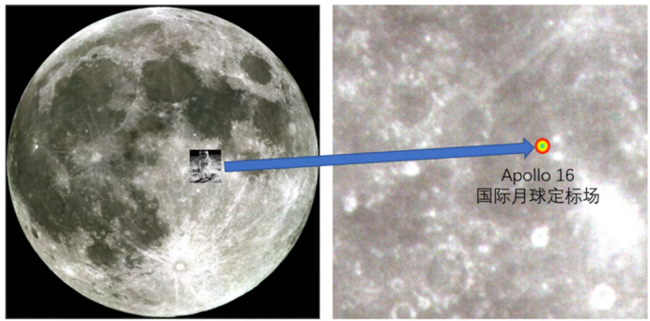
Research Background
The main purpose of the lunar data from earth observation satellites is to calibrate sensors. However, these lunar data do not have location information. The calibration method usually chooses to calculate the full moon irradiance, and then selects a suitable lunar irradiance model as a reference to achieve the purpose of calibration. The lunar irradiance models include ROLO model, MT2009 model, SP model, etc. Selecting a suitable irradiance model can also meet the calibration accuracy requirements.
However, assigning coordinate information to lunar data is a good choice. Unlike the lunar irradiance model, which is greatly affected by the lunar phase angle and libration, using lunar data with coordinate system information can provide more diverse options for lunar calibration and has a high research prospect.
Notes:
Lunar data is used for calibration. Currently, most calibration methods are based on irradiance models such as ROLO and MT2009. However, using the aligned lunar data for calibration is also a good choice, which can bring many new methods to lunar calibration.

Slide 5
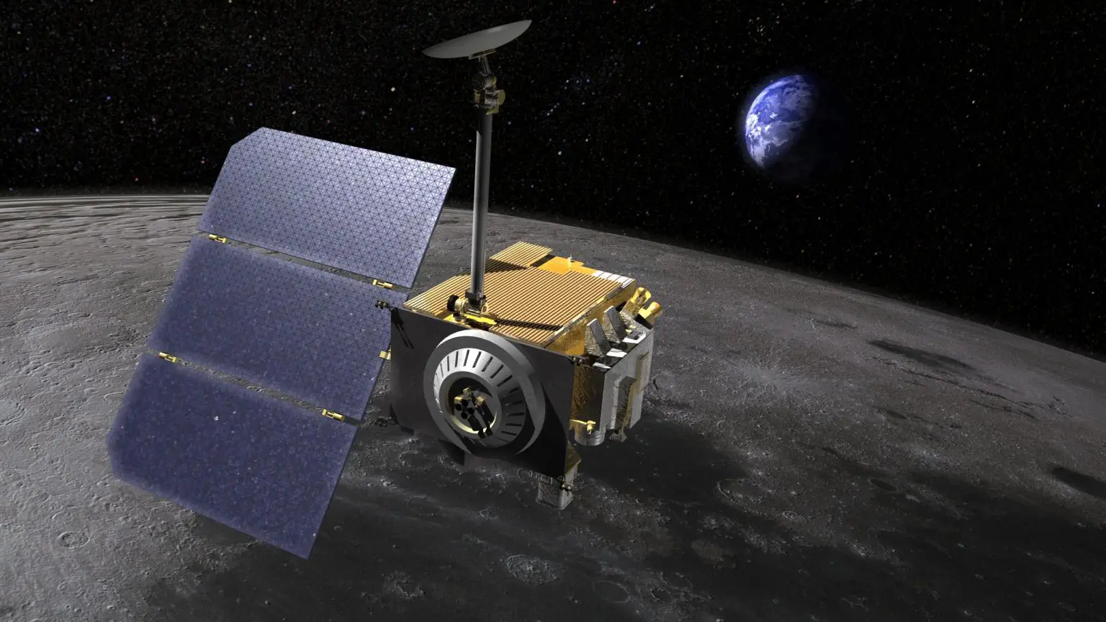
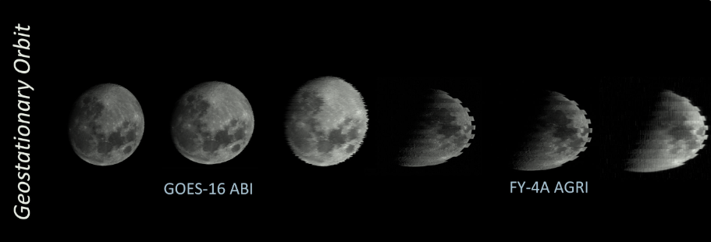
Research Background
Existing research areas：
Lunar ground products based on lunar satellite data, such as the full moon temperature model, use the full moon temperature model as the standard brightness temperature of the lunar surface to calibrate the radiation of the orbiting satellite.
Cross-calibration between satellites in geostationary orbit only requires ensuring the geometric matching of the data. Different instruments observe the same location at different times, ensuring the stability and consistency of the calibration results.
Notes:
For example, the following two aspects: first, use the existing lunar brightness temperature model for calibration; second, use data from different earth observation satellites for cross-calibration

Slide 6
Navigation Registration for Lunar Observation of Geostationary Meteorological Satellites
Part2

Slide 7
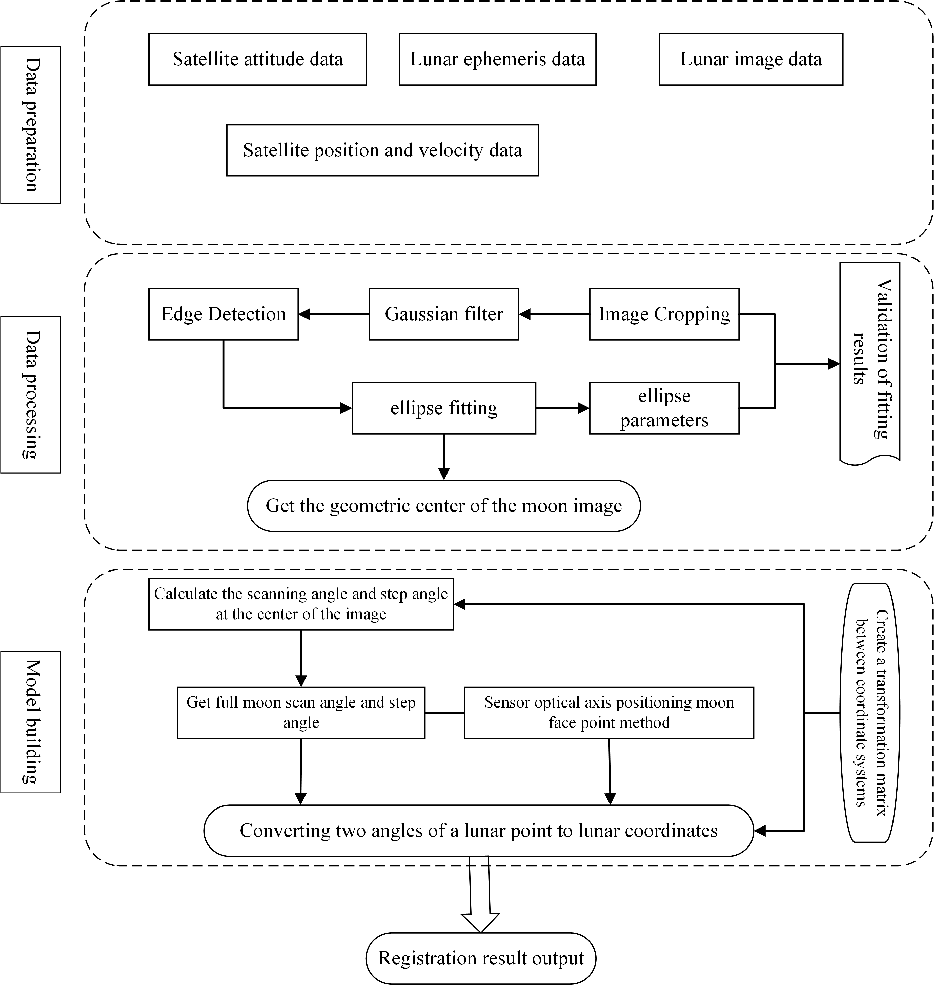
Navigation Registration
Navigation registration process：
Ancillary data preparation
Data preprocessing
— Geometric center of the Moon image
Geometric model construction and result output
Notes:
The main process of navigation registration includes the preparation of auxiliary data, data preprocessing to find the Geometric center of the Moon image, geometric model construction and result output

Slide 8
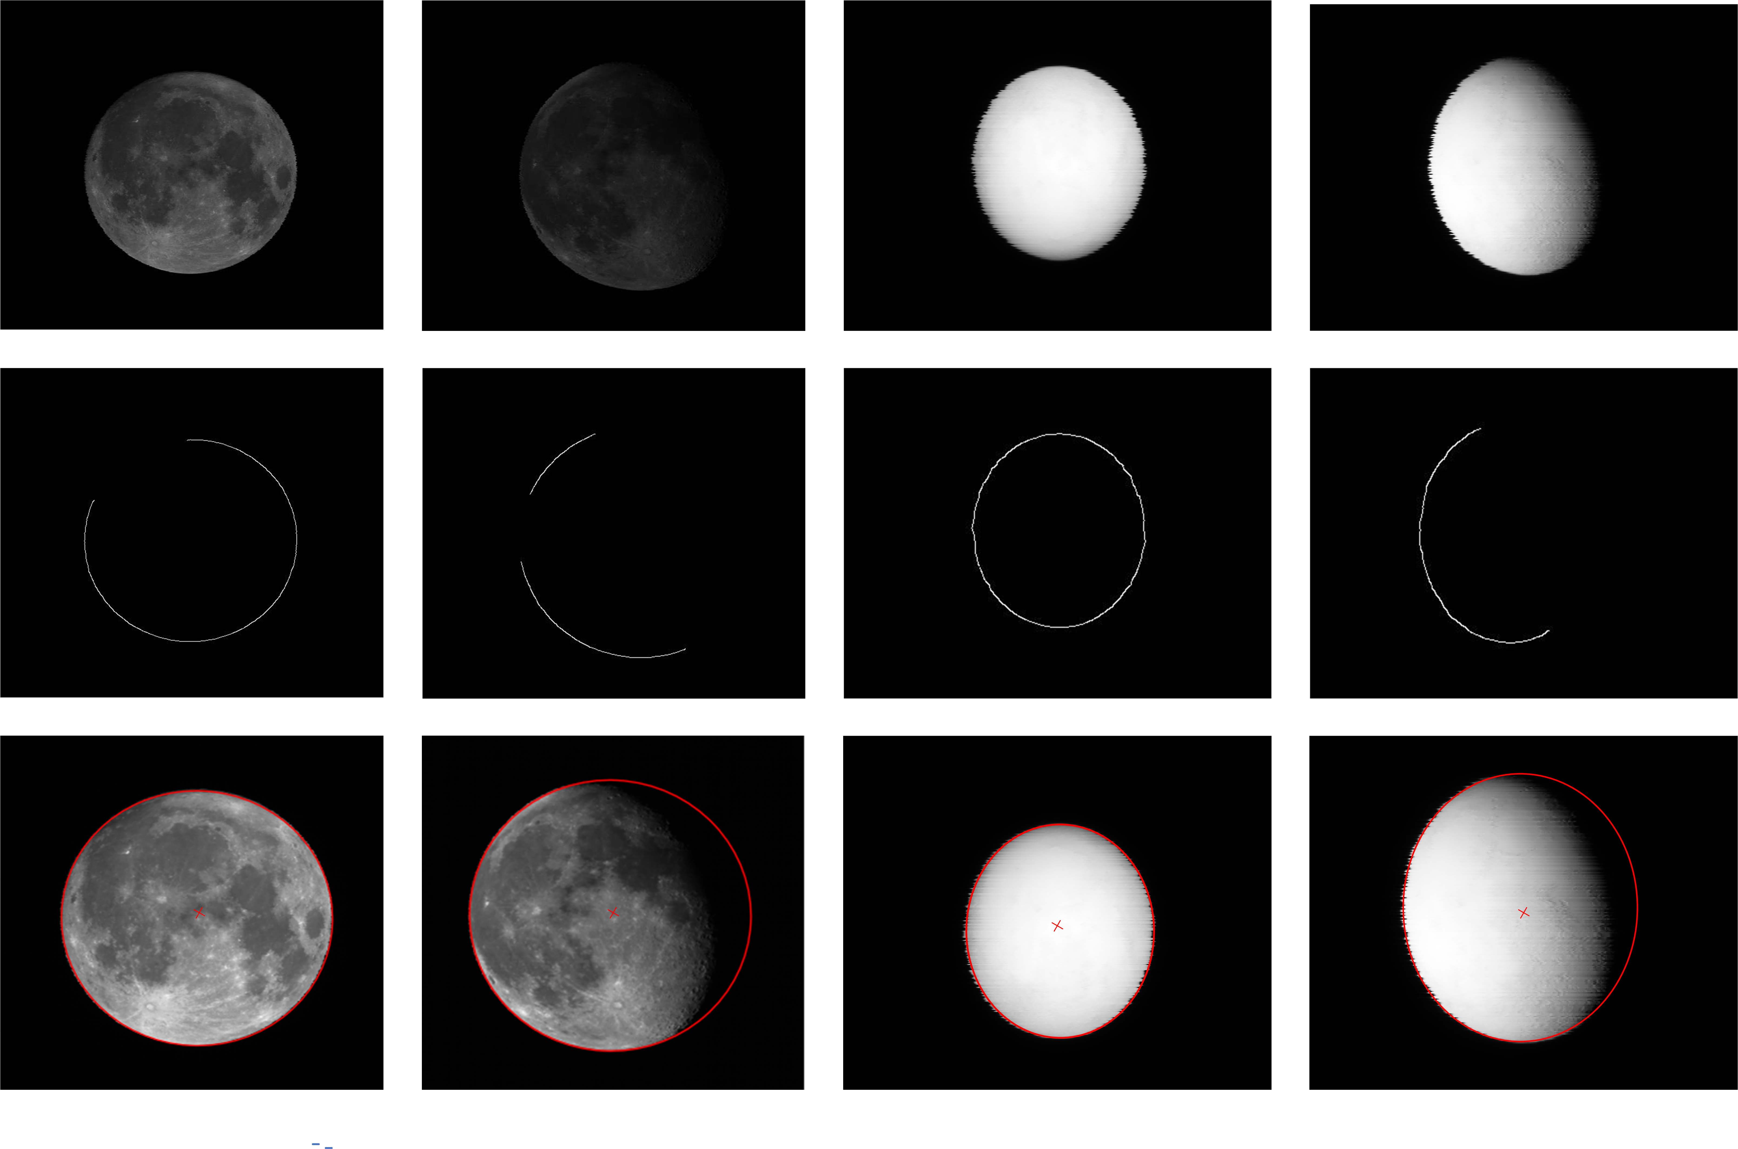
Navigation Registration
  Data preprocessing, find the Geometric center of the Moon image
  Edge Detection
  Ellipse Fitting
Moon phase angle options are 8.48° and 45.66°
Crop out the non-moon part
The ellipse fitting algorithm is used to obtain the ellipse parameters and geometric center that conform to the edge of the moon.
The thermal infrared band image is elliptical, which is due to the different sampling angles between east and west and north and south. This situation is taken into account in the calculation process.
Notes:
First, data preprocessing includes edge detection and ellipse fitting. The phase angles of the selected lunar images are 8.48° and 45.36°. The main purpose is to find the appropriate ellipsoid and ellipsoid parameters, and finally obtain the geometric center of the lunar image. The thermal infrared image is elliptical, and this situation is taken into account in the calculation process.

Slide 9
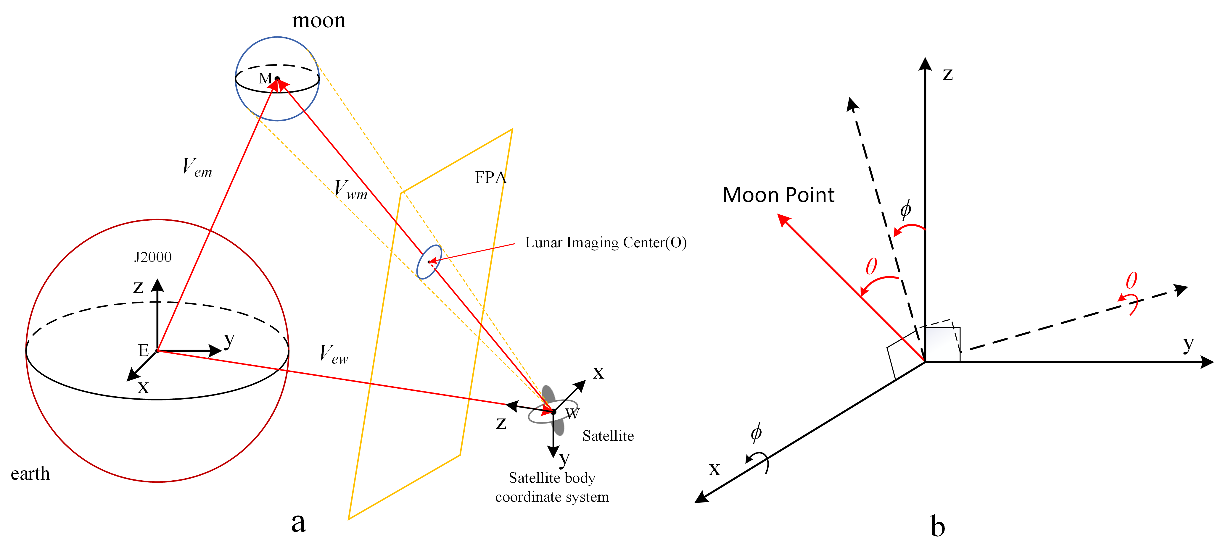


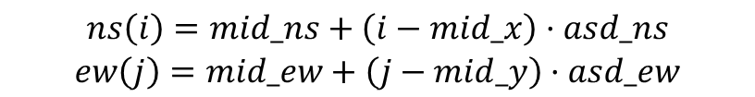
Navigation Registration
  The center of the lunar image represents the point of the nadir. The geometric position in the satellite coordinate system is calculated based on the row and column numbers of the geometric center of the lunar image.
  Coordinates of the lunar center(x,y,z)：
  Calculate the EW scan angle and NS step angle
$$V_{wm}=V_{em}−V_{ew}$$
$$∅,θ$$
Calculate the full month using the following formula
$$\begin{matrix}ns\left(i\right)=mid_ns+\left(i−mid_x\right)·asd_ns \\ ew\left(j\right)=mid_ew+\left(j−mid_y\right)·asd_ew\end{matrix}$$
Figure (a) Lunar imaging geometry (b) Satellite body coordinate system
min_x, min_y represent the row and column numbers of the moon center, mid_ns, mid_ew represent the scanning angle and step angle of the moon center, asd_ns, asd_ew represent the band sampling distance
Notes:
According to the lunar imaging geometry, we need to calculate the coordinates of the point at the center of the lunar image, and then calculate EW scan angle and NS step angle according to the formula, and finally extend it to the whole moon.

Slide 10
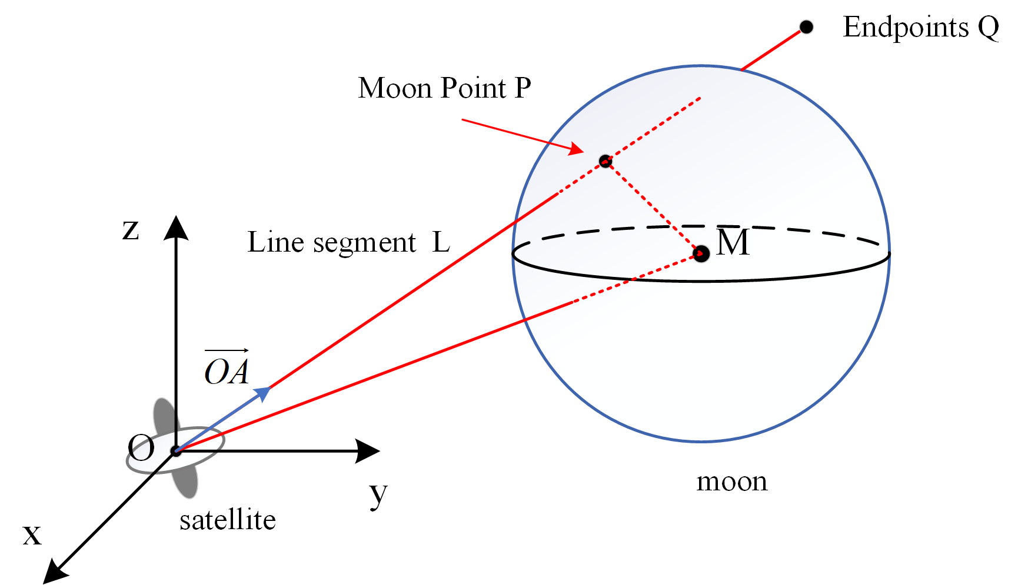
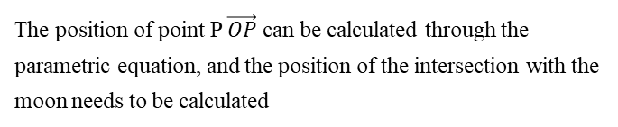
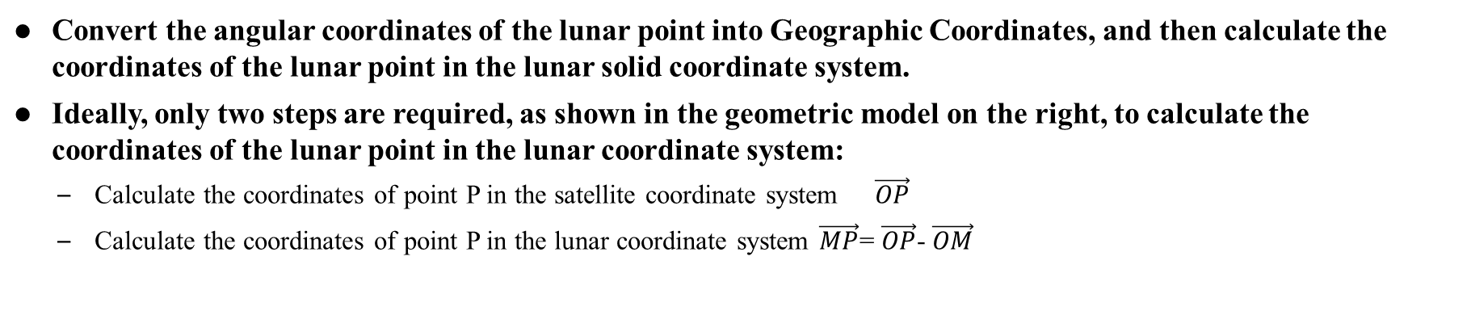
Navigation Registration
  Convert the angular coordinates of the lunar point into Geographic Coordinates, and then calculate the coordinates of the lunar point in the lunar solid coordinate system.
  Ideally, only two steps are required, as shown in the geometric model on the right, to calculate the coordinates of the lunar point in the lunar coordinate system:
  Calculate the coordinates of point P in the satellite coordinate system $\vec{OP}$
  Calculate the coordinates of point P in the lunar coordinate system $\vec{MP}$= $\vec{OP}$- $\vec{OM}$
The actual situation is more complicated. The satellite coordinate system and the lunar coordinate system are not based on the same reference. A series of coordinate conversions are required. The overall calculation formula is as follows:
The position of point P $\vec{OP}$can be calculated through the parametric equation, and the position of the intersection with the moon needs to be calculated
Most geostationary satellites can calculate the coordinates of lunar points in this way
Notes:
The satellite position OA is calculated by the scanning angle and step angle of the lunar point, as shown in the figure, to determine the actual distance of point P from the satellite, and then use the coordinates to calculate the lunar geographic coordinates of point P. The overall formula is as follows. Most geostationary satellites can calculate the coordinates of lunar points in this way.

Slide 11
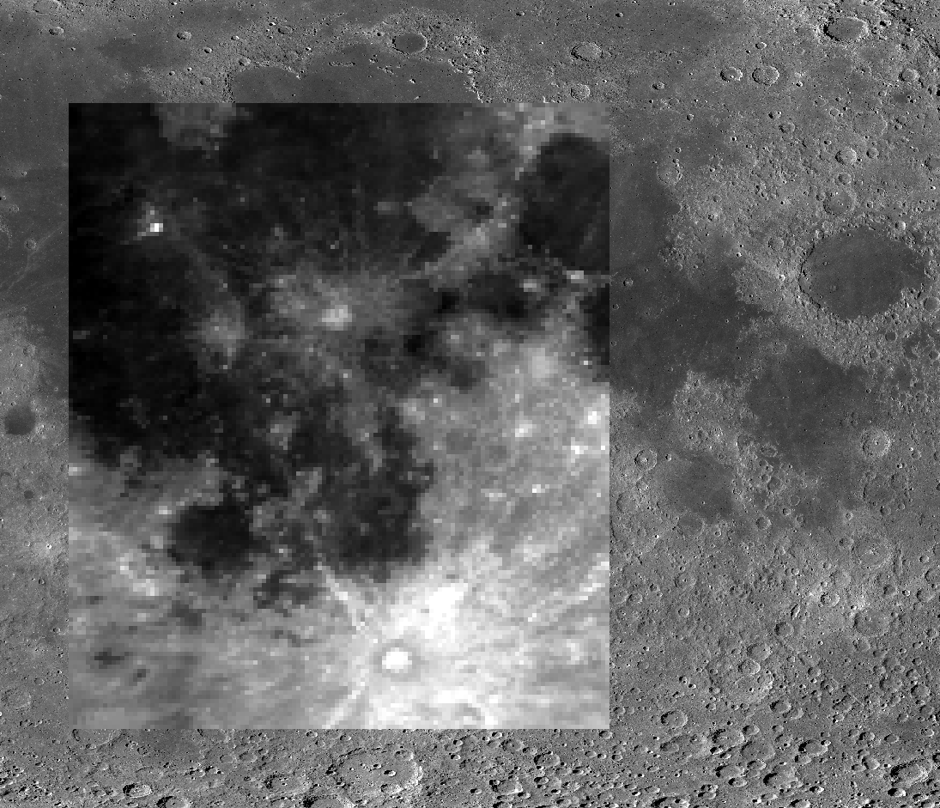
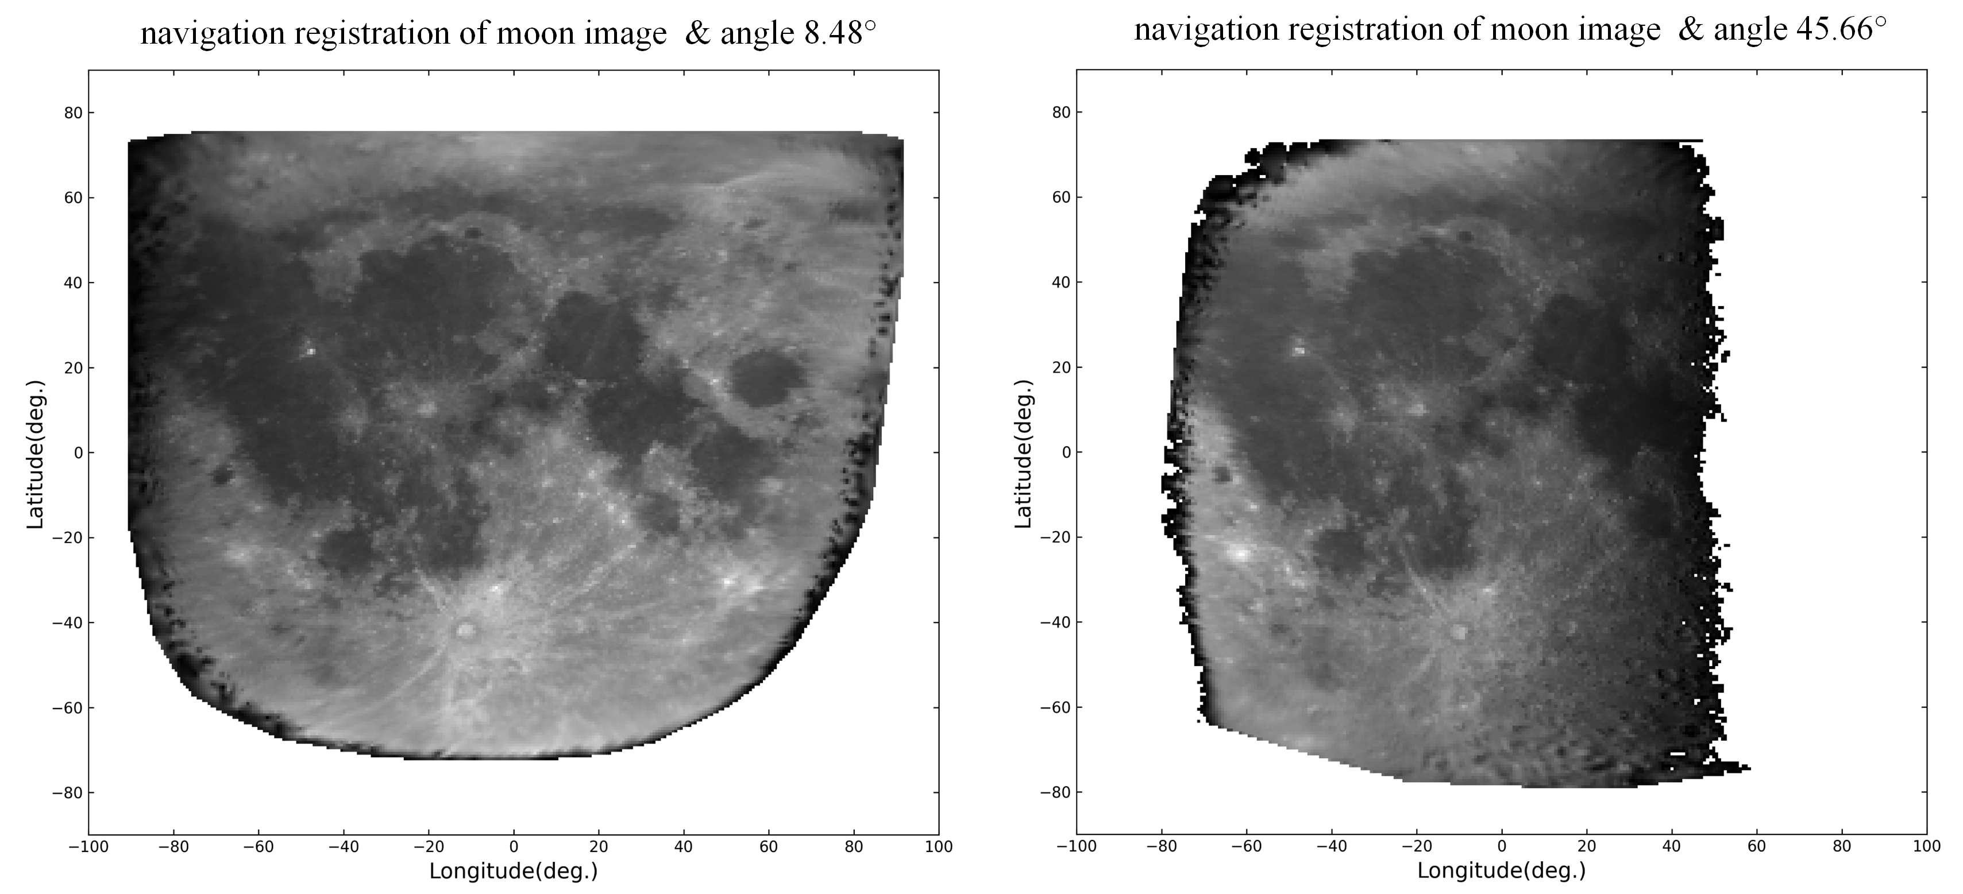
Navigation Registration
The figure below shows the navigation registration result of the lunar image in the visible light band. It can be roughly seen that the matching result is relatively ideal. By comparing it with the lunar global morphology mosaic map, it can be seen that it basically corresponds to the actual image.
https://astrogeology.usgs.gov/search/map/Moon/LRO/LROC_WAC/Lunar_LRO_L ROC-WAC_Mosaic_global_100m_June2013
Notes:
The results are shown in the figure，and By comparing it with the lunar global morphology mosaic map, it can be seen that it basically corresponds to the actual image

Slide 12
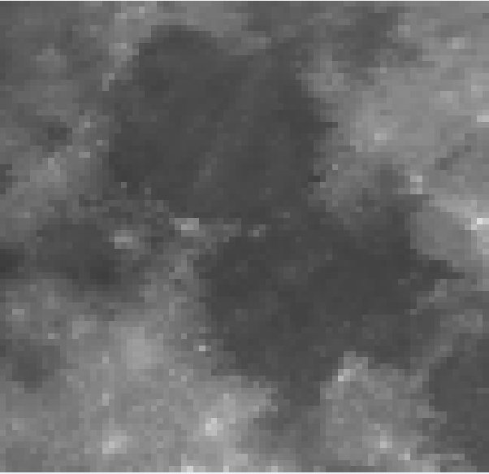
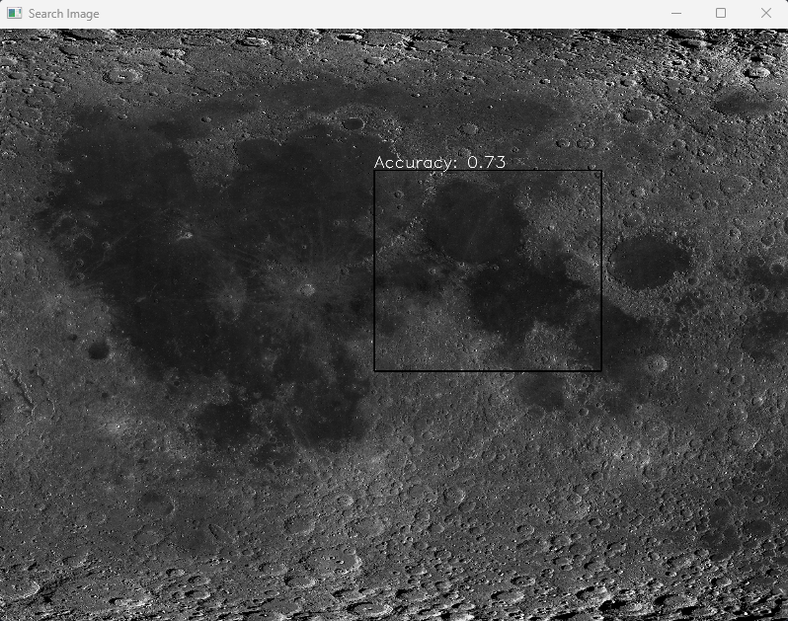
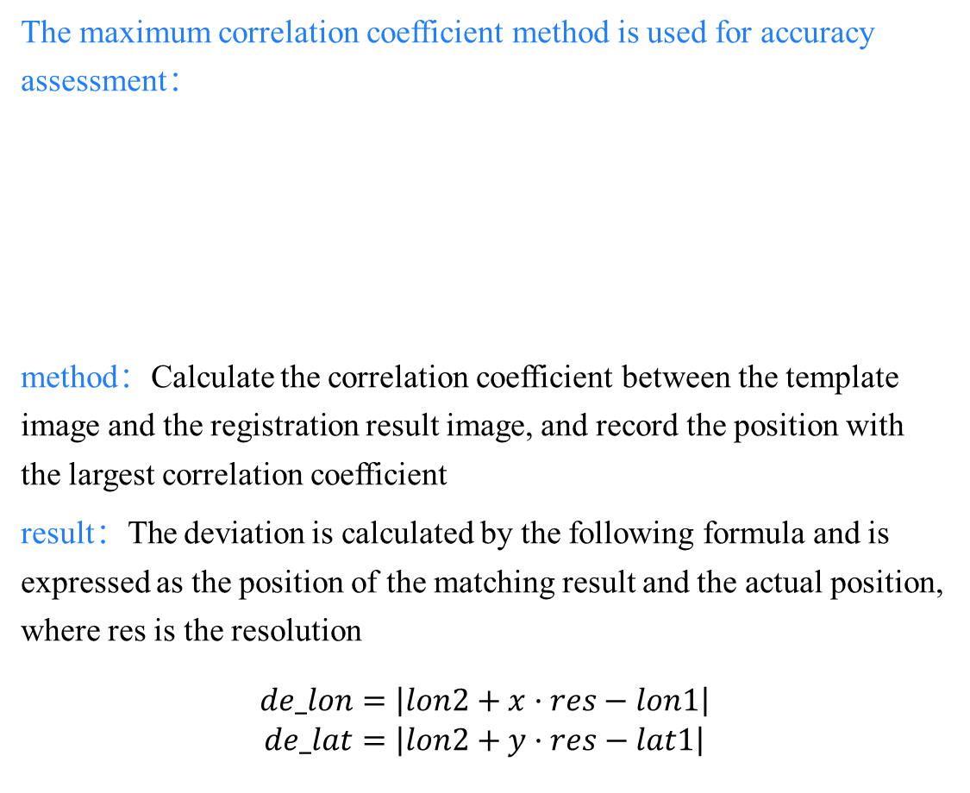
Navigation Registration
The maximum correlation coefficient method is used for accuracy assessment：
method：Calculate the correlation coefficient between the template image and the registration result image, and record the position with the largest correlation coefficient
result：The deviation is calculated by the following formula and is expressed as the position of the matching result and the actual position, where res is the resolution
$$\begin{matrix}de_lon=\left|lon2+x·res−lon1\right| \\ de_lat=\left|lon2+y·res−lat1\right|\end{matrix}$$
The right side is the calculation picture
The bottom side is the template picture
Lunar_LRO_L ROC-WAC_Mosaic_global_100m_June2013
bias (pixel) ： 2.019477190515,7.96359673910
bias (degree) ：0.1312660173835,0.517633788041
Notes:
Calculation of registration accuracy based on the maximum correlation coefficient method, The right figure shows the location with the largest correlation coefficient. The deviations in the EW and NS directions are both around zero point five degrees.

Slide 13
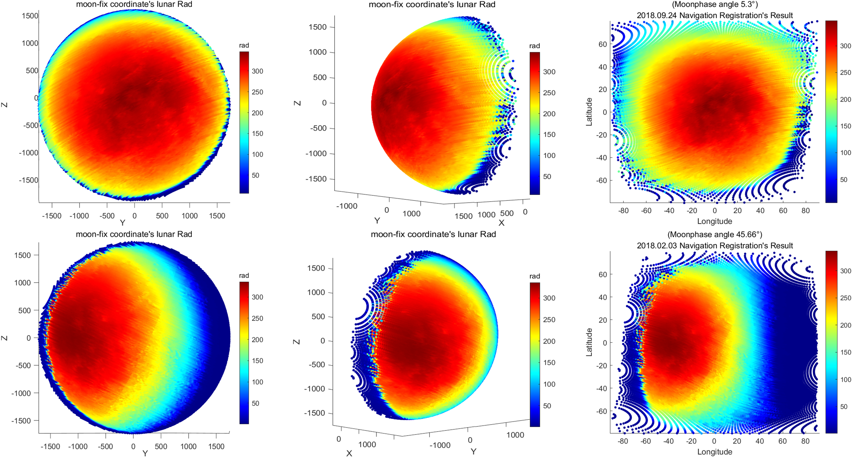
Navigation Registration
This is the result of the navigation registration of thermal infrared data, in the ME lunar Cartesian coordinate system and the ME lunar longitude and latitude coordinate system.
In different coordinate systems, the closer to the edge of the moon, the larger the interval between points. This is caused by the way the sensor collects data. The blue part in the figure is the 0 value area.
In the Cartesian coordinate system, navigation registration restores the plane data to the three-dimensional structure of the moon, and conforms to the characteristic that the larger the sampling interval is, the closer the geometric center of the principle image is under the observation geometry.
This observation geometry principle is more clearly highlighted in the longitude and latitude coordinate system.
Notes:
The calculation results of the infrared band are displayed in two different coordinate systems. It can be seen that the rectangular coordinate system restores the original three-dimensional structure of the moon. In the plane coordinate system, the farther away from the geometric center, the larger the interval between sampling points, which is in line with the principle of sensor data collection.

Slide 14
Part3
GOES-R and FY-4 Thermal Infrared Band Radiation Calibration of TBOL Based on Diviner Radiometer

Slide 15
Selection of research methodology
Normal lunar data is obtained by calculating the irradiance of the entire moon and comparing it with the existing model to calibrate the sensor.
The lunar data after navigation registration can have more uses and greatly facilitates lunar calibration.
Compare with existing lunar brightness temperature models of lunar orbiters to study the radiation response of earth-based satellite sensors
Select a specific calibration site on the moon, and use different earth-based satellites to observe the same area for cross-calibration
Notes:
The lunar data after navigation registration can have more uses and greatly facilitates lunar calibration, in this paper, I choose the first method

Slide 16
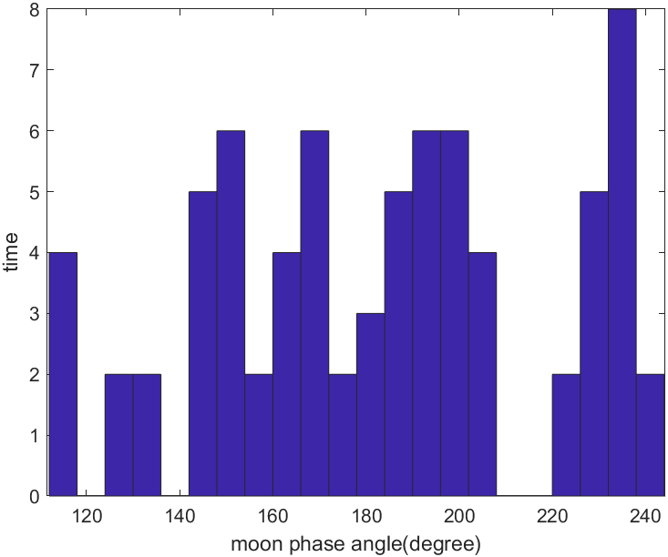
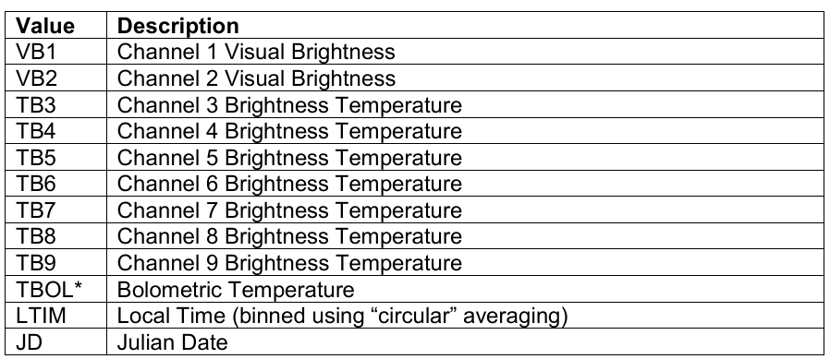
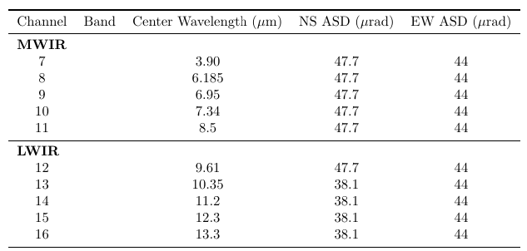
Radiometric Calibration Based on TBOL
This method uses the TBOL model of the Diviner lunar surface brightness temperature to calibrate the Goes satellite.
Select the GDR2 level data of the Diviner radiometer and the ABI lunar data of the Goes satellite in 2018
Goes full year data moon phase angle distribution chart
TBOL is computed from the measured brightness temperatures in Diviner infrared channels as follows:
Where is the average radiance-weighted measured brightness temperature for a region in Diviner channel i, and:
diviner GDR2 data content
the full infrared band's GOES data to calculate TBOL, select channels 7-16
GOES satellite abi sensor infrared channel parameters
Notes:
The TBOL of the goes data is calculated using the TBOL calculation principle of the DIVINER radiometer. The goes lunar data of 2018 is selected. The phase angle distribution is shown in the figure. A total of 10 infrared bands are selected.

Slide 17
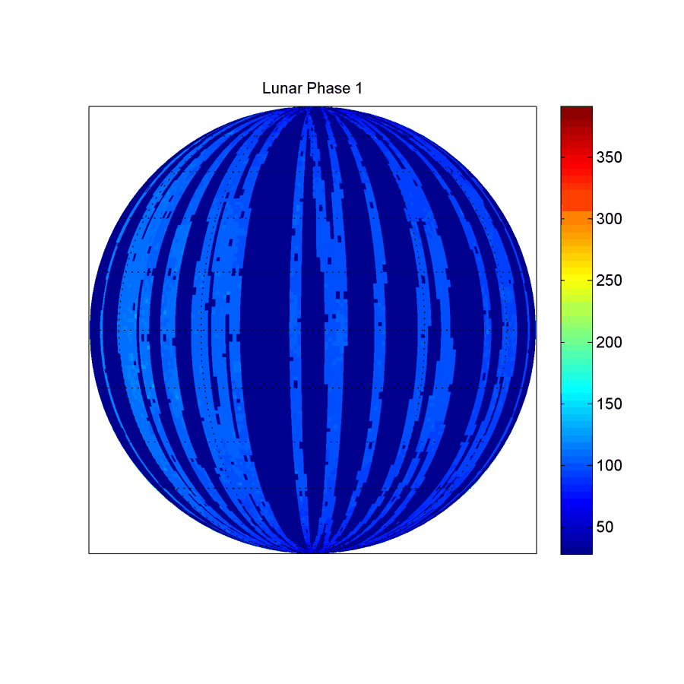
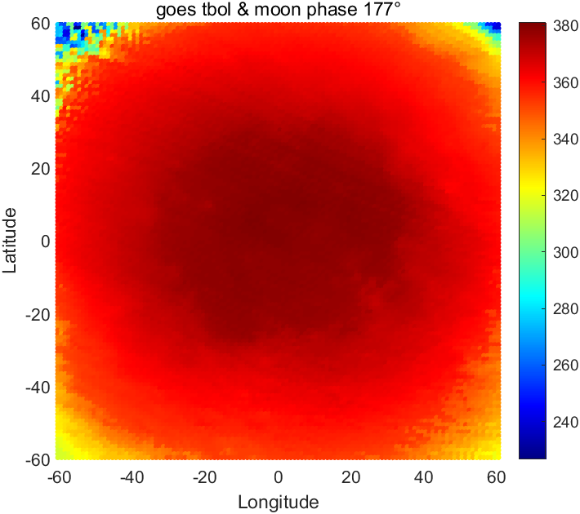
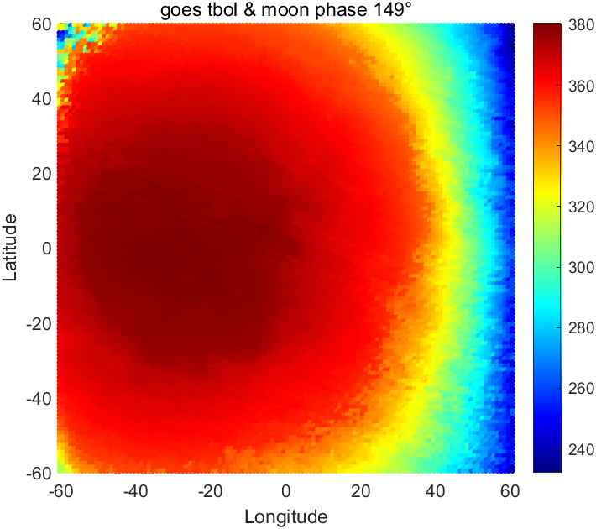
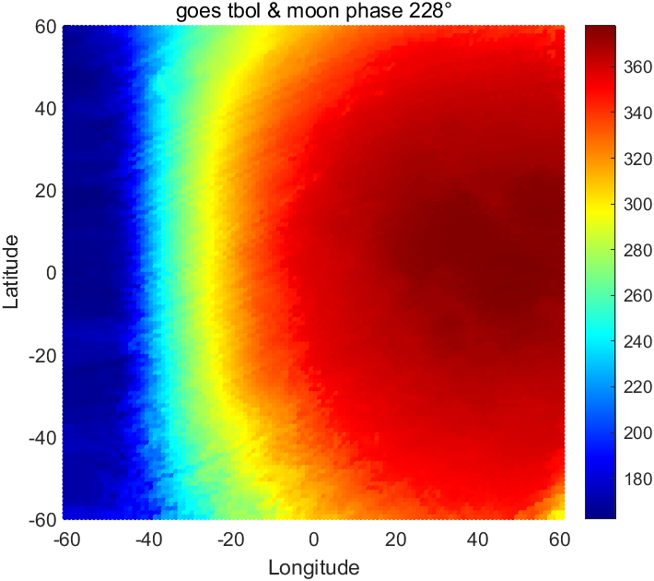
Radiometric Calibration Based on TBOL
Statistics of Diviner radiometer GDR secondary data TBOL values ​​of 1° to 360° moon phase angles, dynamic display
Calculated TBOL of the infrared band of the Goes satellite, selected part to display
Notes:
TBOL display of two satellites, On the right is the tbol value of Diviner divided by the lunar phase angle. Below is the tbol calculation result of GOES for several lunar phase angles.

Slide 18
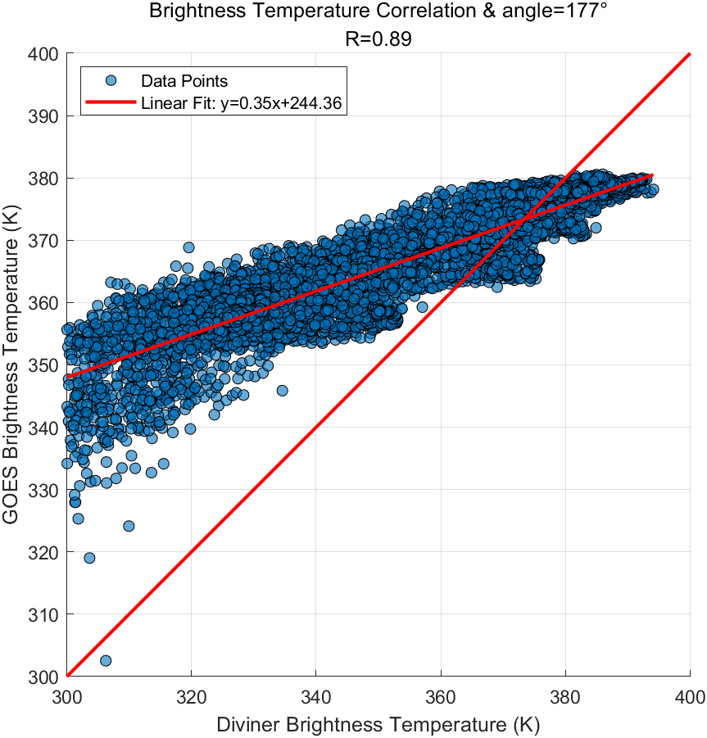
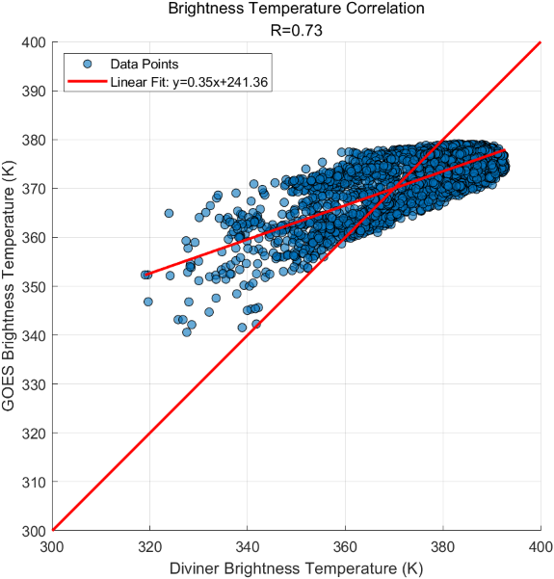
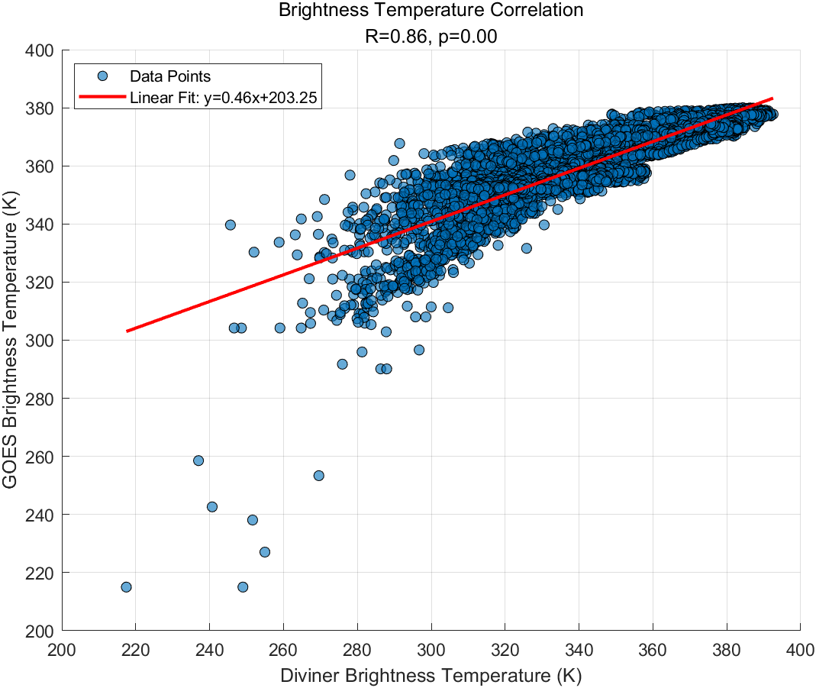
Radiometric Calibration Based on TBOL
Comparison of the results of the Goes satellite TBOL and the Diviner radiometer TBOL under selected moon phases
Notes:
By comparing the results of Goes and Diviner at the same phase angle, it can be seen that there is a linear relationship between the tbol of the two satellites.

Slide 19
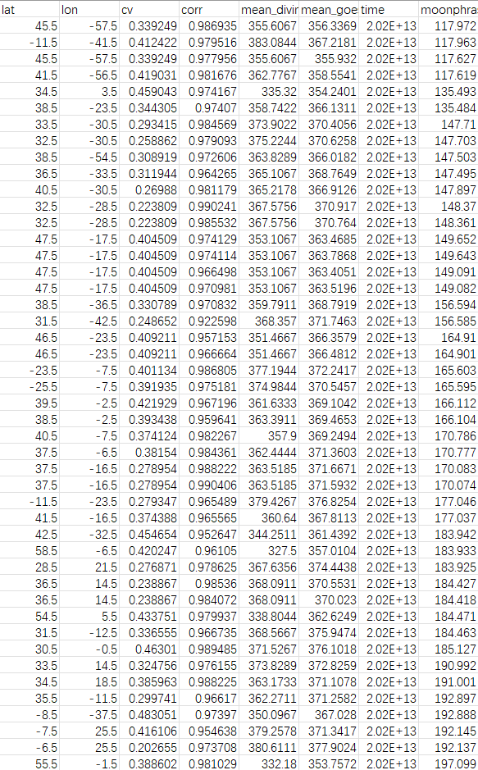
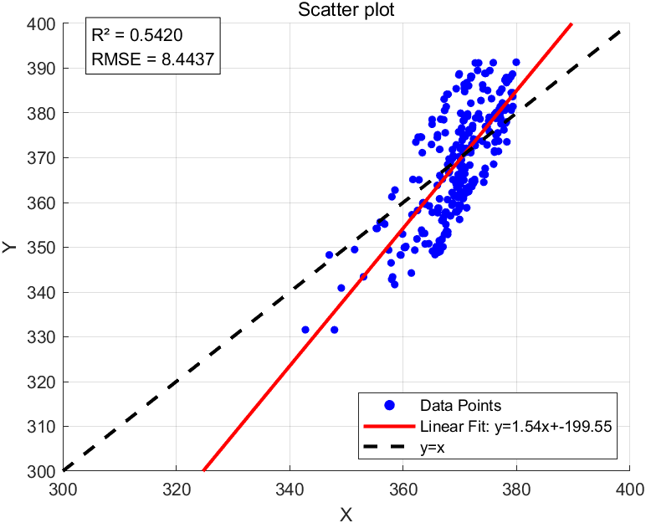
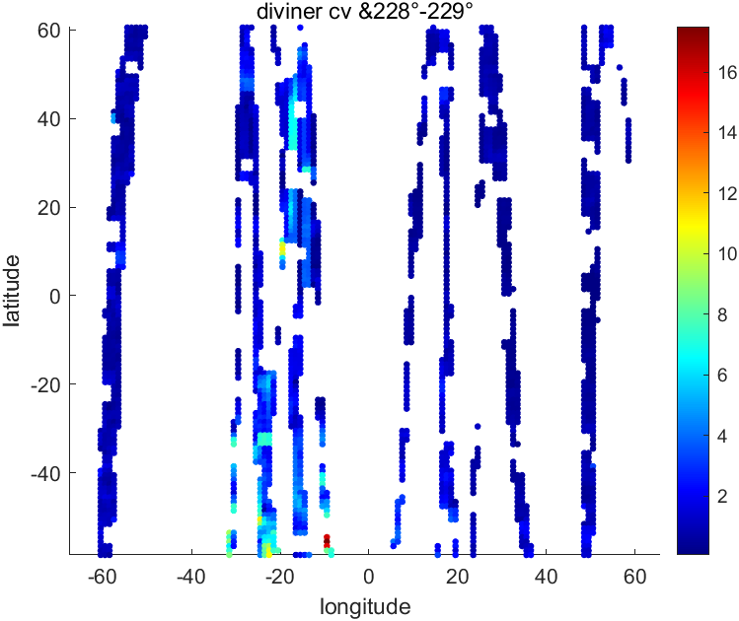
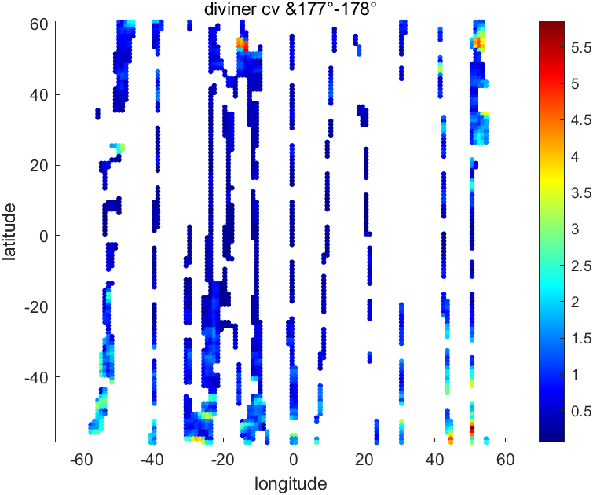
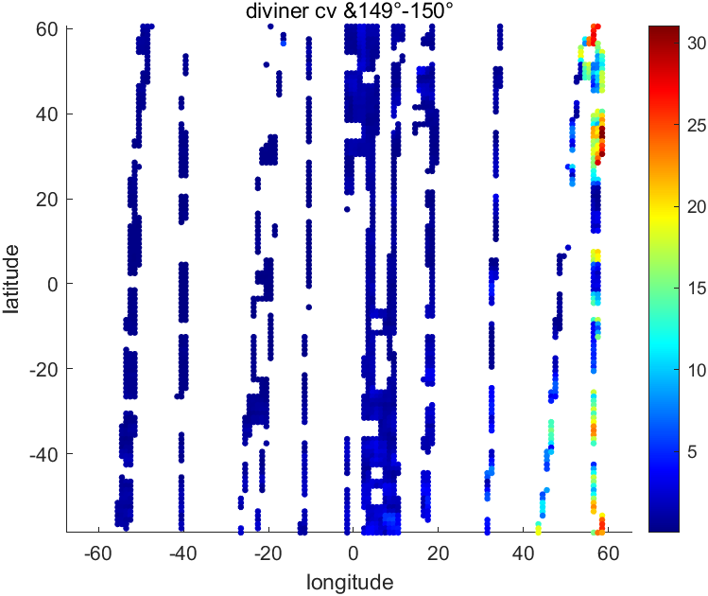
Radiometric Calibration Based on TBOL
Calculate the correlation coefficient of diviner and goes data corresponding to the moon phase angle
Calculate the CV value of different moon phase data of Diviner
cv value is selected to be less than 0.5
The correlation coefficient is selected to be greater than 0.90
Notes:
First, perform feature matching of the two data, using CV less than 0.5 and correlation coefficient greater than 0.9 as the standard, and find the results of all matching images. The bottom picture is the CV result, and the table on the right is the matching area and temperature. Based on these, draw a scatter plot to find the relationship between goes and diviner's tbol.

Slide 20
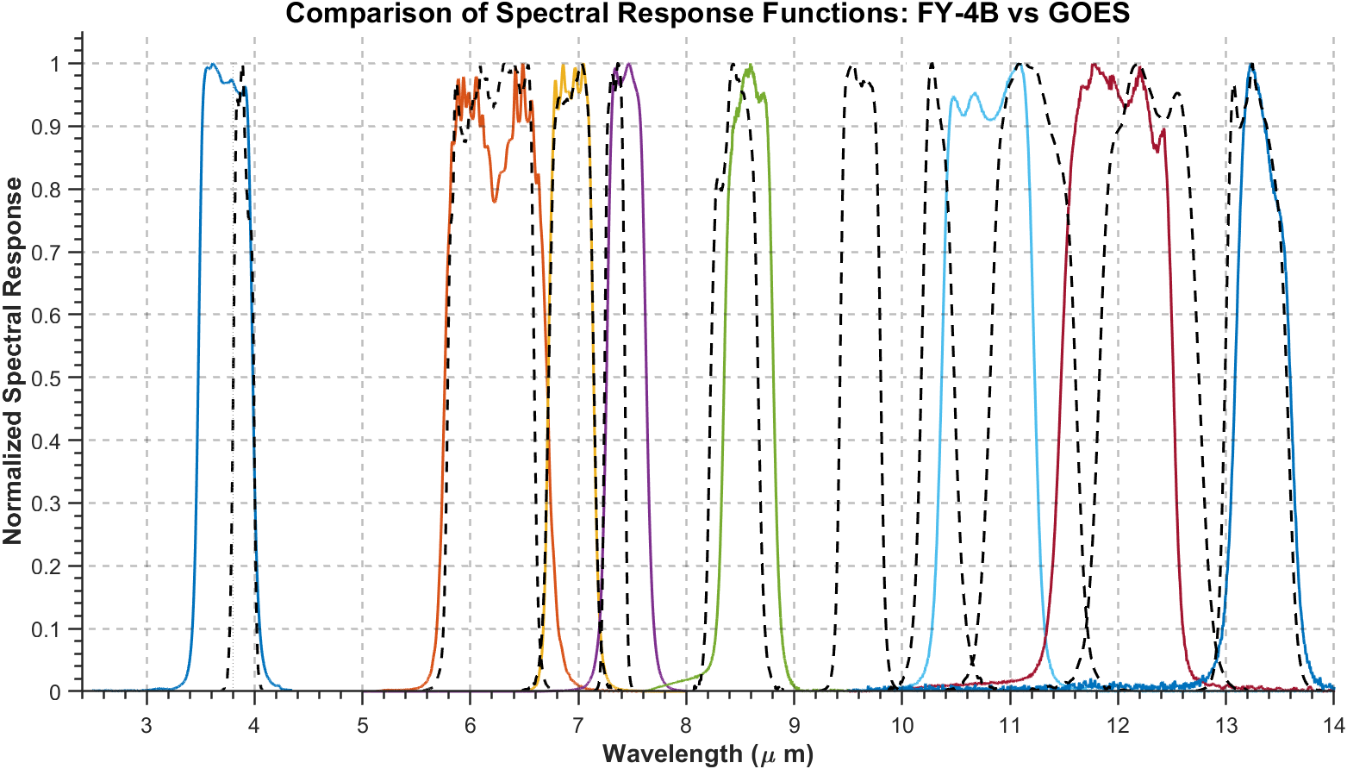
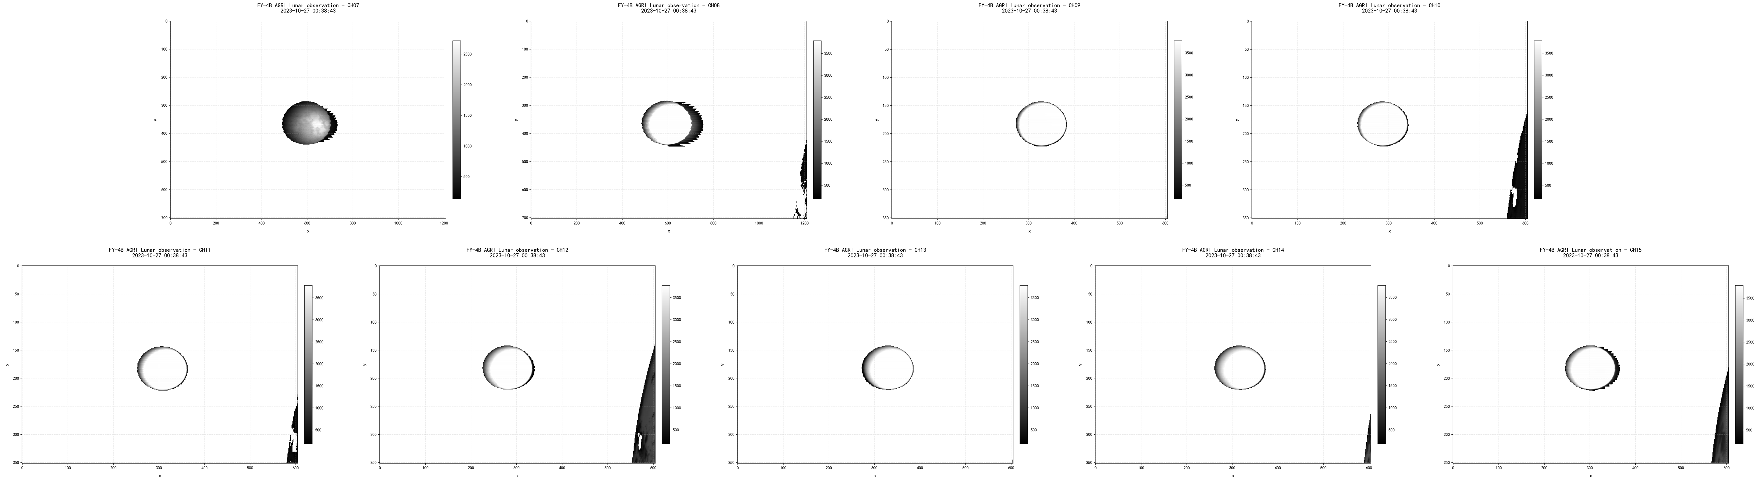
Prospect of Fy-4
Advanced Geostationary Radiation Imager (AGRI) is one of the main payloads of the FY-4B geostationary meteorological satellite. Its infrared band spectral response function is similar to that of the GOES satellite in multiple channels, so we can try the first cross-calibration scheme.
Data matching and navigation registration
Finding a suitable infrared band calibration area on the lunar surface
Spectral matching and cross calibration
Sensor mounting frame
Satellite positioning data
Navigation Registration of FY-4
Satellite attitude parameters
ECI TO ORF
Additional requirements for FY-4B satellite data processing:
- Eliminate stray light effects
- Image Registration
Notes:
Regarding the second method, it was found that the FY-4 and GOES satellites have similar spectral responses in the infrared band, which can achieve cross-calibration in the infrared band. In the future, we will focus on the navigation registration and cross-calibration of Fengyun satellites, observe the infrared images of FY-4, and do some additional processing before registration, such as stray light elimination and image registration. After that, we will use these position parameters to complete the navigation registration of FY-4.

Slide 21
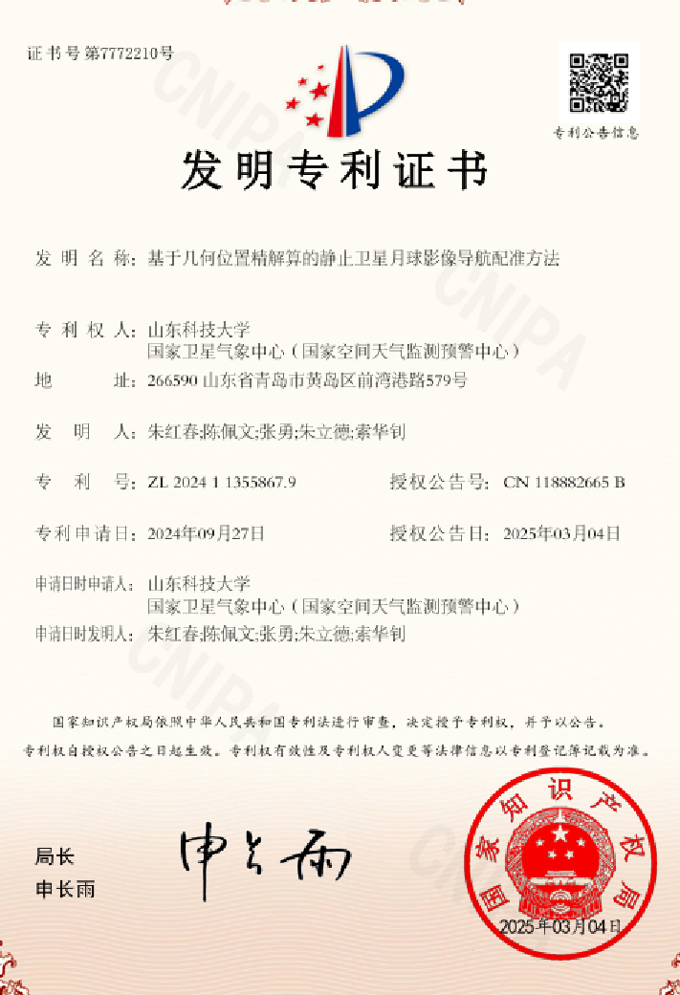
Conclusions and Discussions
A navigation registration calculation model was proposed to achieve navigation registration of lunar data in the visible light and thermal infrared bands. A patent was published based on this research.
Based on the registered lunar data, the radiation calibration is performed using the Diviner radiometer TBOL data.
The next step will be to apply the navigation registration method to the FY4B satellite, and then match the lunar observation data of two earth observation satellites of the same category to implement a cross-calibration scheme.
Notes:
The navigation registration work of this study has been published in a patent. There is still a long way to go in radiation calibration, and more work needs to be done in the future. My experiment may be insufficient in some aspects. Experts are welcome to point out. If you have any questions about my research, experts are welcome to contact me by email. That’s all, thank you for your attention!

Slide 22
Thank you for your attention !
Reporter ： Peiwen Chen
Correspondence : 202282020052@sdust.edu.cn

