Slide 1
Comprehensive Analysis of the Airborne HIRAS Validation Experiment
Yiqi Zhu
2025.3

Slide 2
Index
Project Overview
Instrument Introduction
Airborne Experiments
Results and Discussion
Prospect

Slide 3
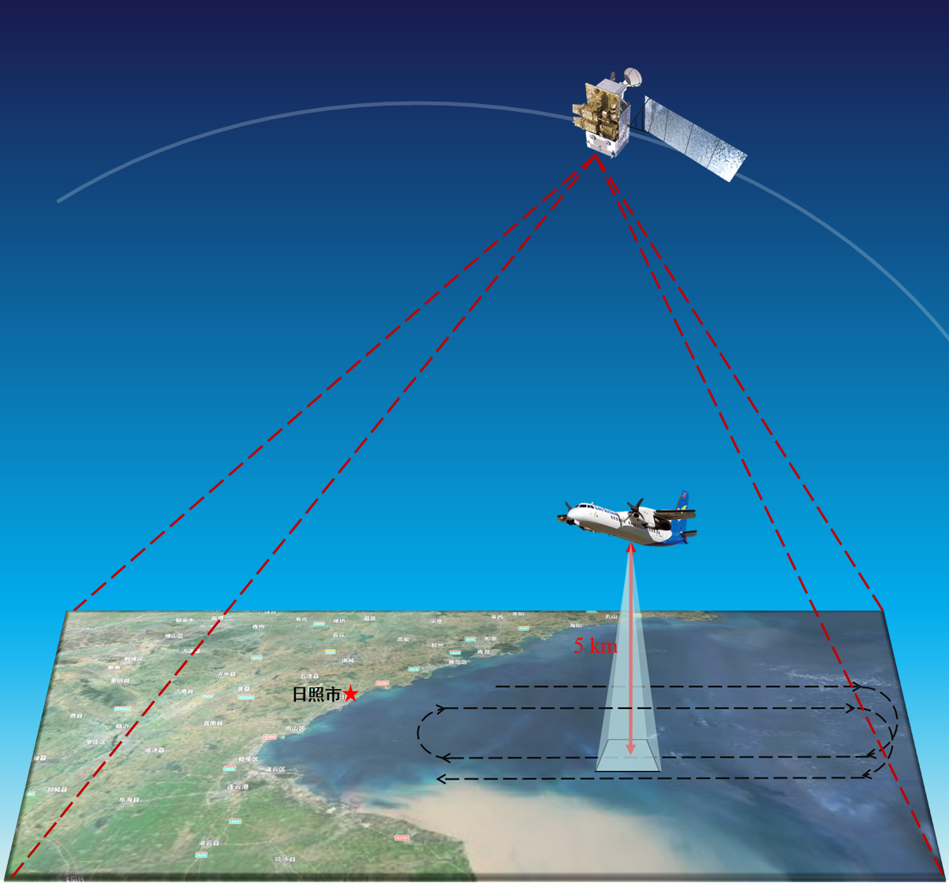
Project Overview
This validation experiment uses an infrared hyperspectral instrument mounted on an airborne platform to conduct synchronized observations with the HIRAS instrument on the FY-3 satellite. This experiment aims to achieve synchronized observations across space, air, and ground, ensuring mutual validation between instruments.

Slide 4
Project Overview
Difference with spaceborne:
Blackbody not in vacuum
Heat convection in cold air
Low levelness and strong vibration

Slide 5
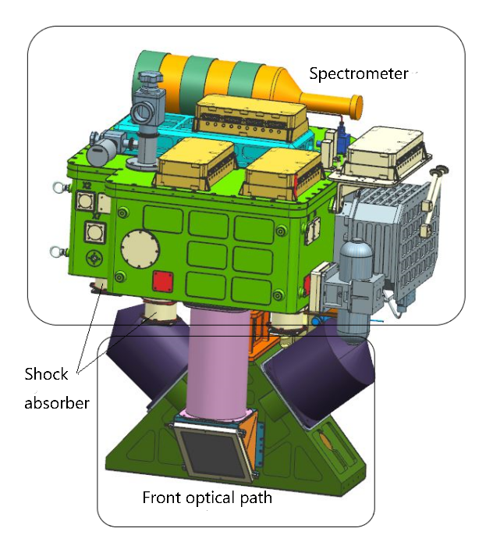
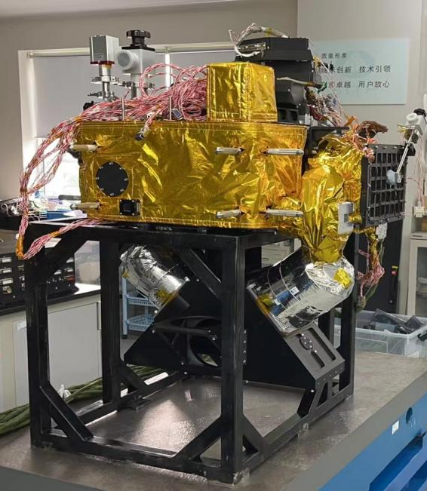
Instrument Introduction
The instrument includes a spectrometer and the front optical path. A special front optical path was designed to guide the light into the instrument. The shock absorbers were between the plane floor and the instrument, to reduce the vibration.

Slide 6
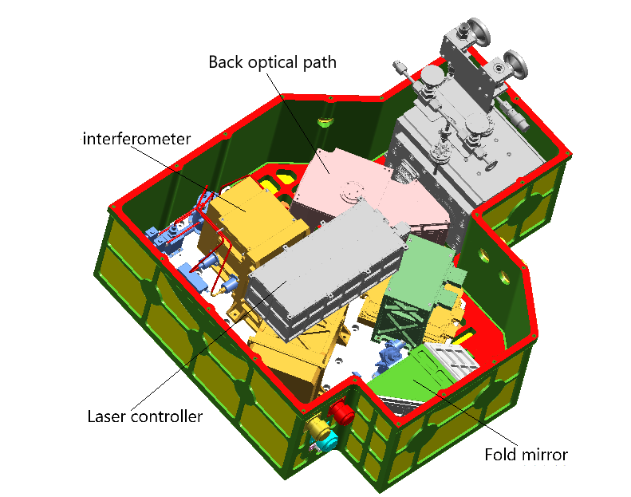
Instrument Introduction
Type: FTIR
Spectral range: 650~2550cm-1
Spectral resolution：0.625cm⁻¹
NEDT:0.3K
Pixel: 3×3
Scan angle: ±30.6°

Slide 7
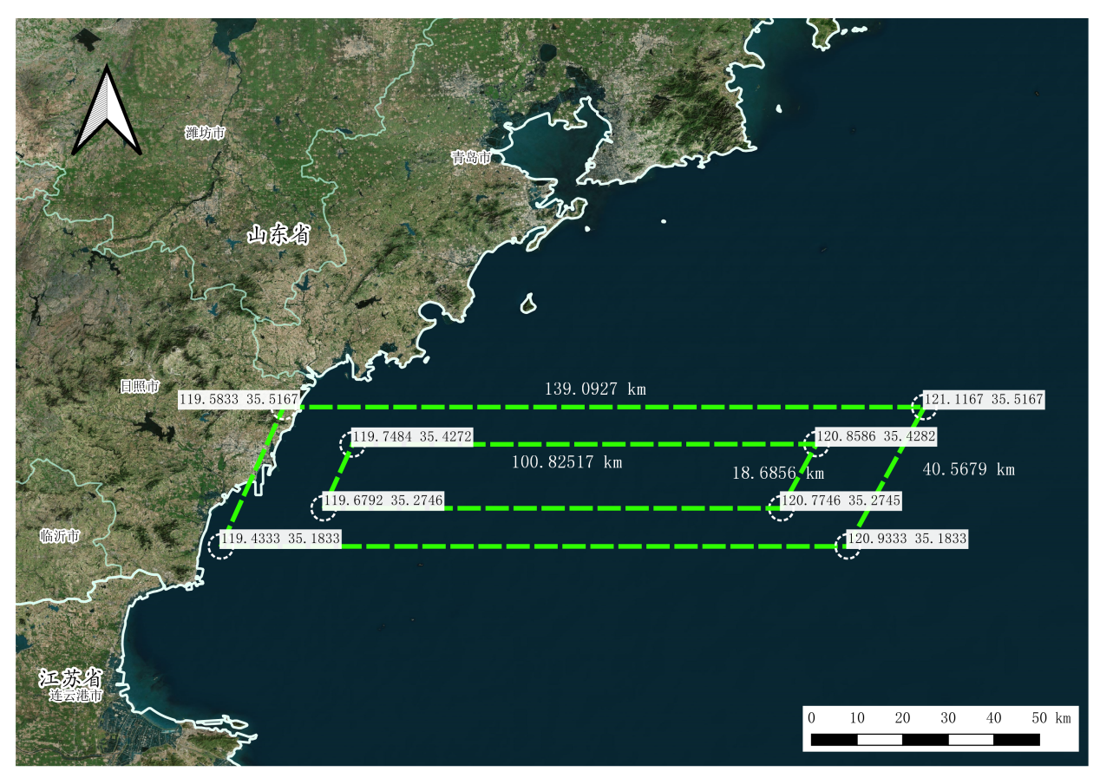
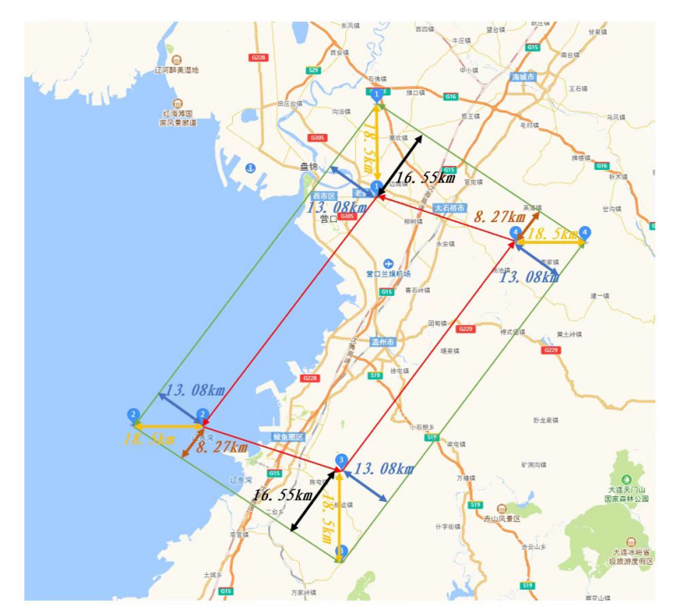
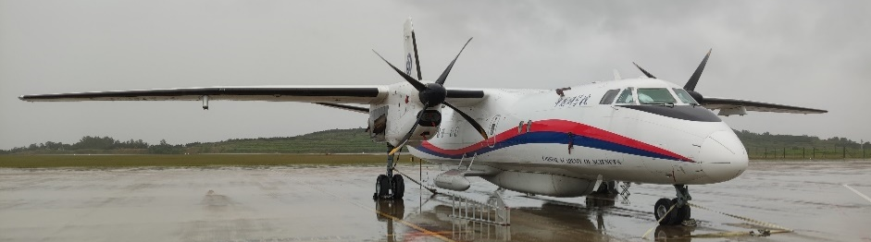
Airborne Experiments
Location and season:
Rizhao, Shandong (Summer)
Yinkou, Liaoning (Winter)
Plane:
Xinzhou 60 plane
5km flight height

Slide 8
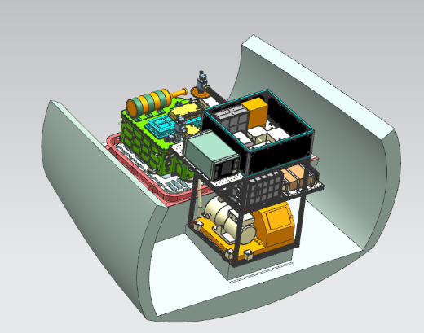
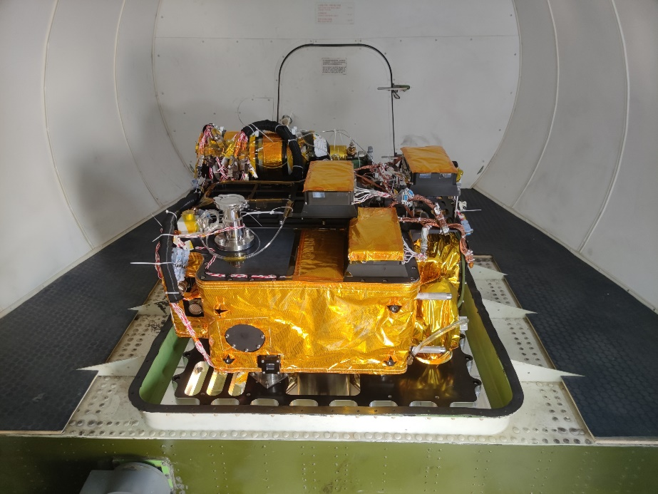
Instrument Introduction
The instrument was equipped at the back of the plane. There is a special platform designed for different instruments, which is isolated from the internal space of the plane, using an airtight cover.

Slide 9
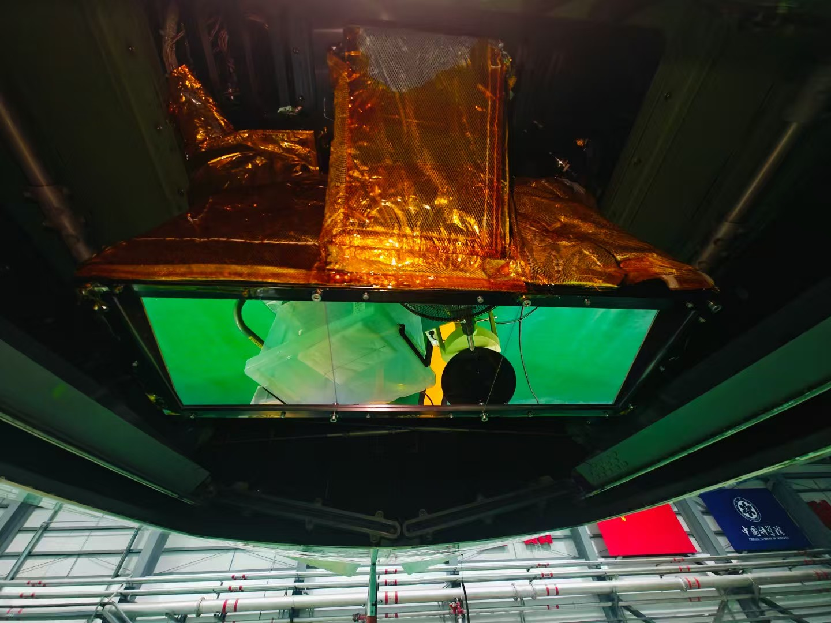
Instrument Introduction
The bottom of the plane can be opened to detect below. A combined ZnSe infrared window was at the bottom of the front optical path, to reduce influence of the external cold wind.

Slide 10
Airborne Experiments
The spatial resolution of the Fengyun is about 10km, while the swath width of the airborne instrument is about 3km. The plane will perform a circular flight within the flyable airspace.

Slide 11
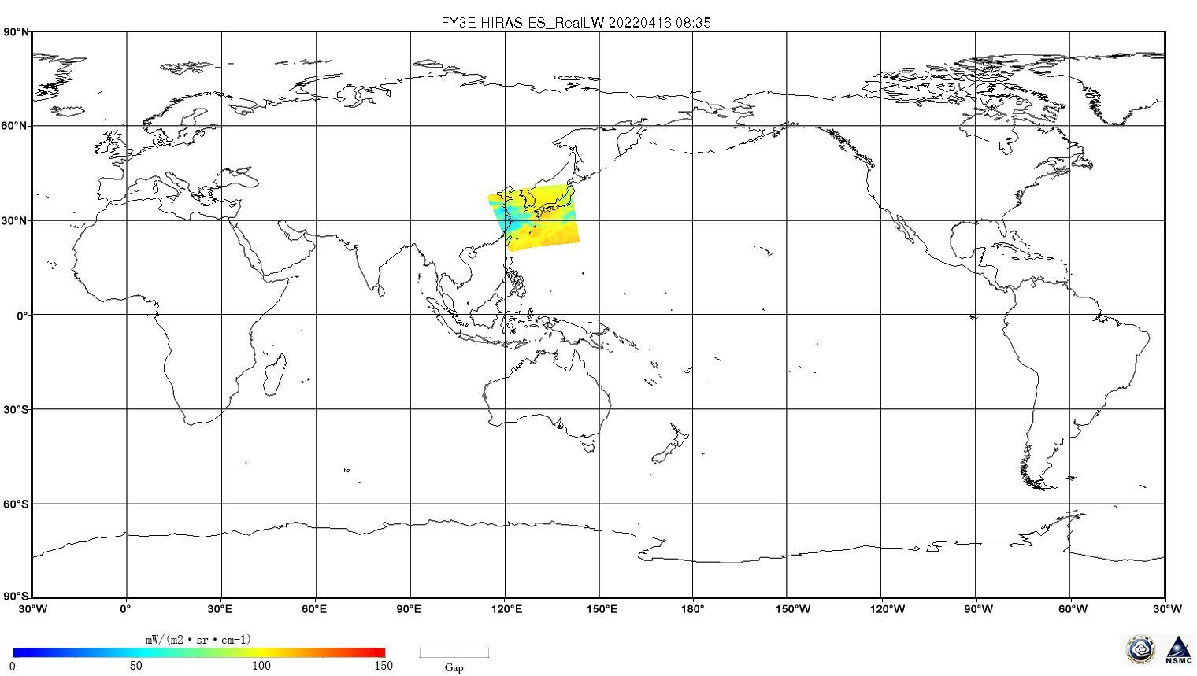
Airborne Experiments
The flight area was within the satellite's scan area and occupied several pixels. . The comparison is between the airborne data and the satellite data from these pixels.
The satellite's scan area within 5 minutes

Slide 12
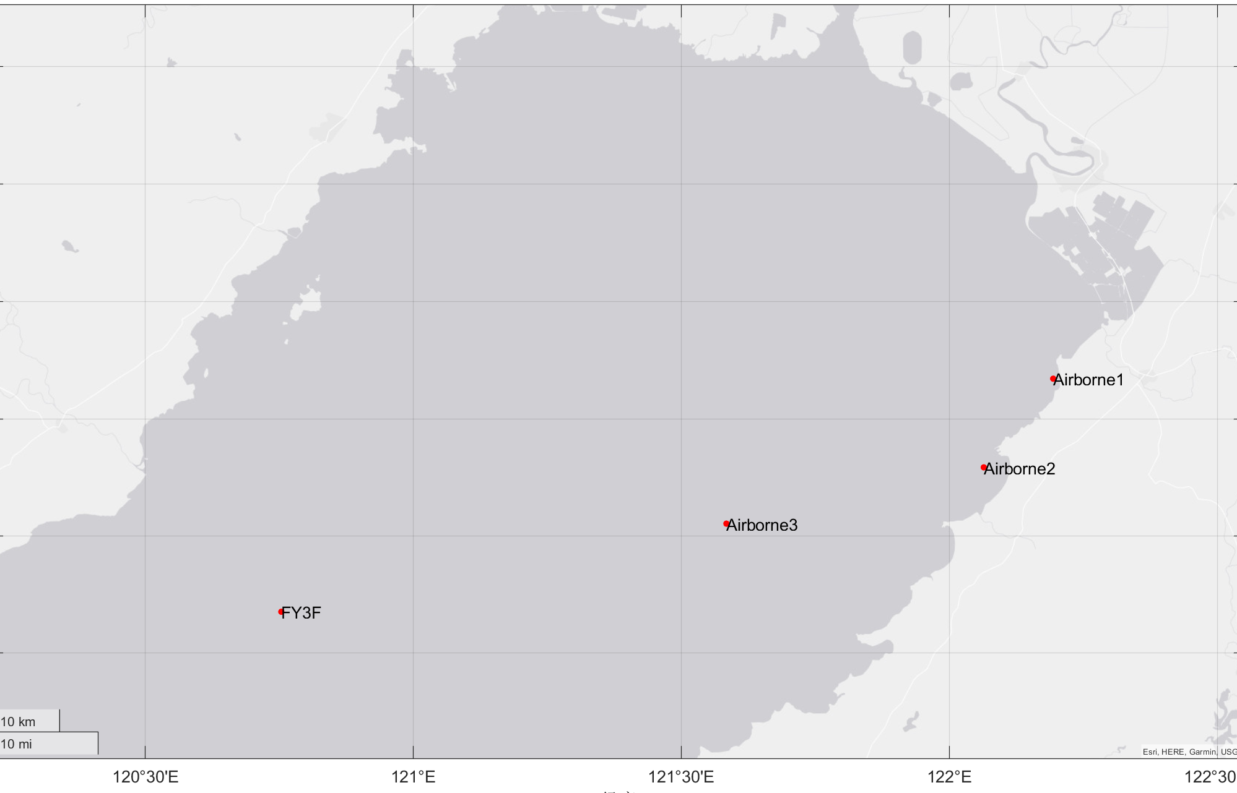
Airborne Experiments
The plane reached certain location when the satellite passed nearby area. The results are used to compare with satellite-synchronized observation data from nearby areas.

Slide 13
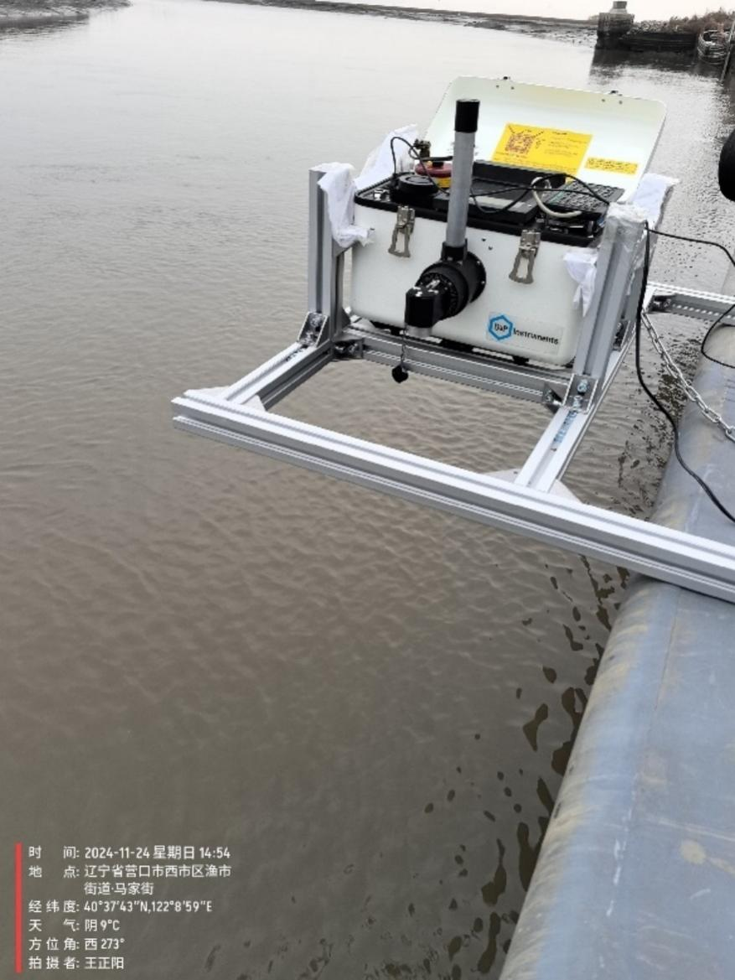
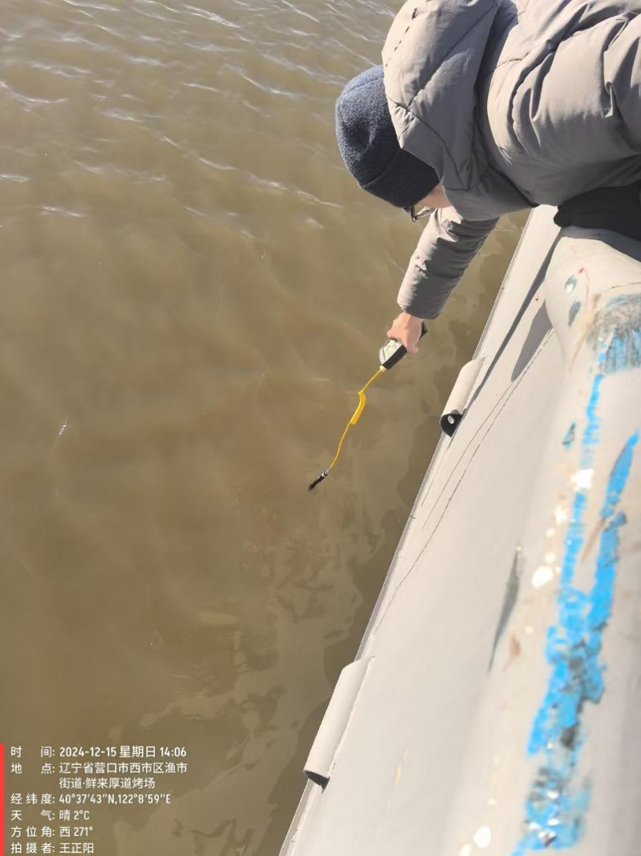
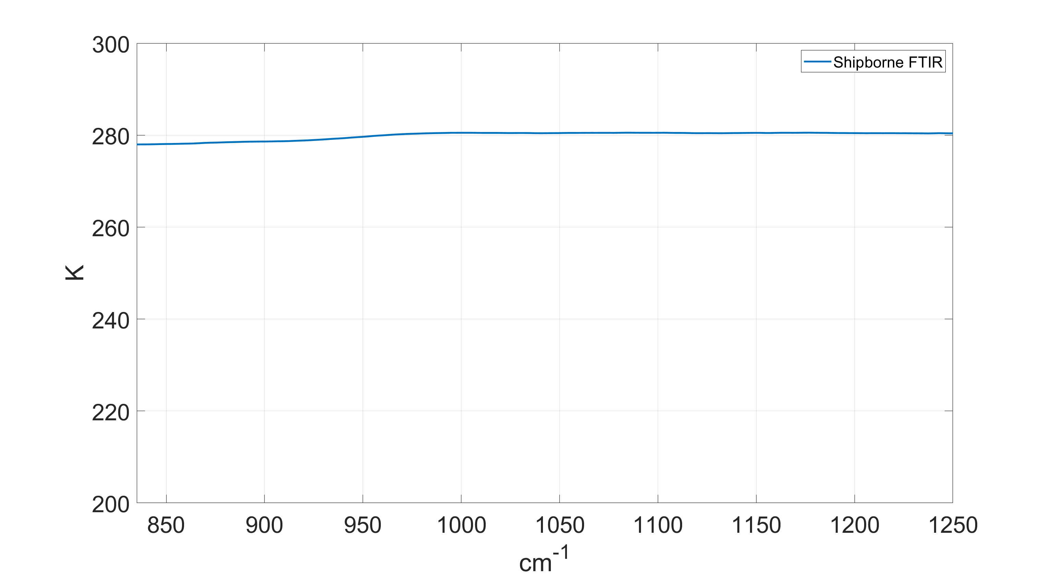
Airborne Experiments
Shipborne FTIR brightness temperature
handheld thermometer： 280.65K
Supplementary experiment：Measuring sea surface spectrum and temperature on the ship using a FTIR and a handheld thermometer.

Slide 14
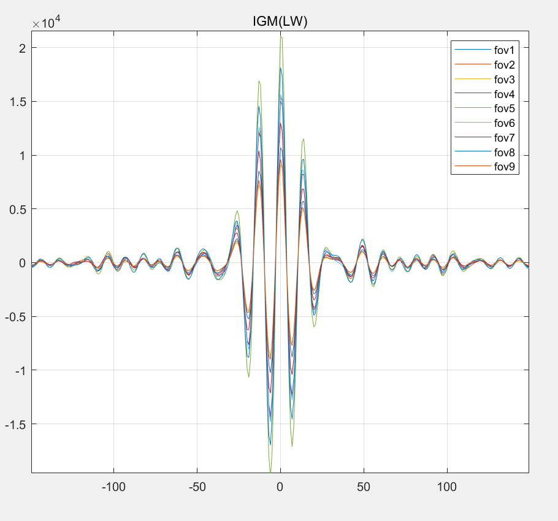
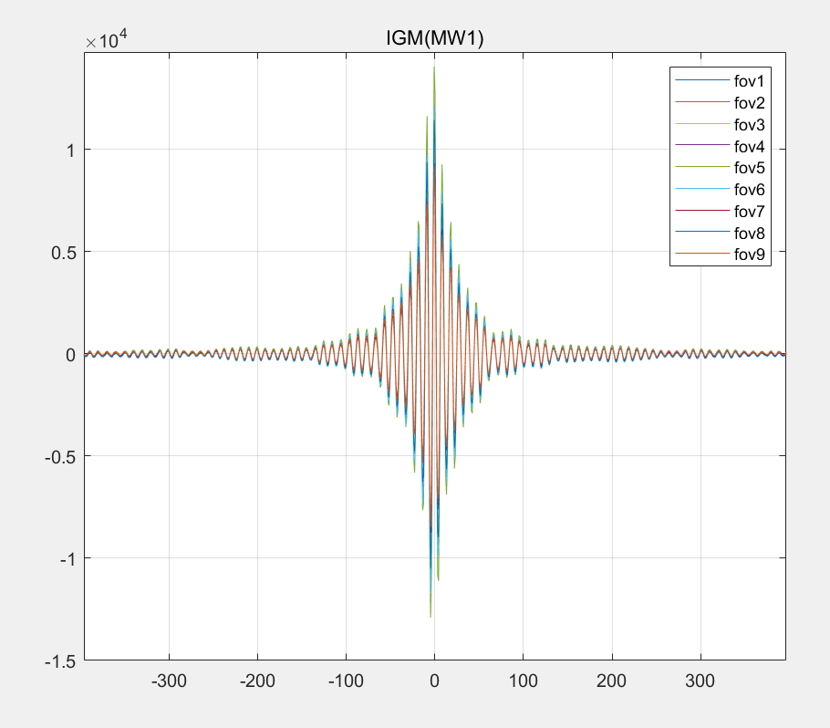
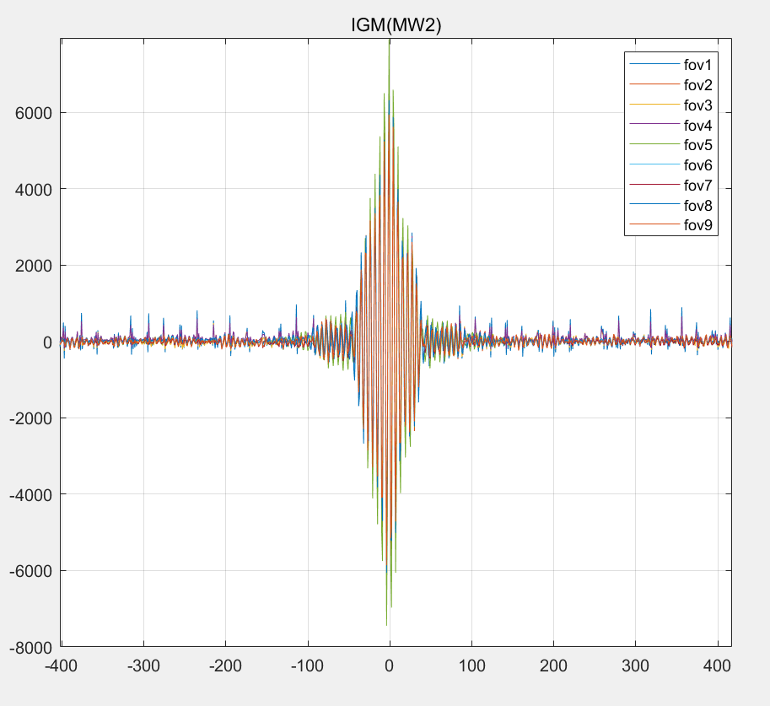
Results and Discussion
The spectrometer has 3 detectors and each detector has 9 pixels.
The instrument gives interferograms of longwave and midwave band.
650-1136cm⁻¹
1210-1750 cm⁻¹
2155-2550 cm⁻¹

Slide 15
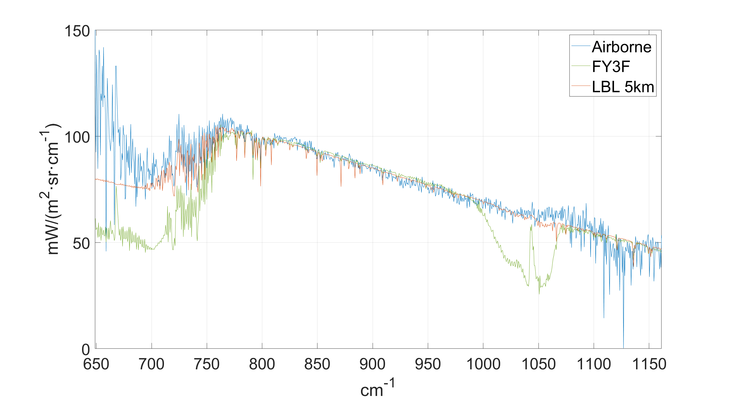
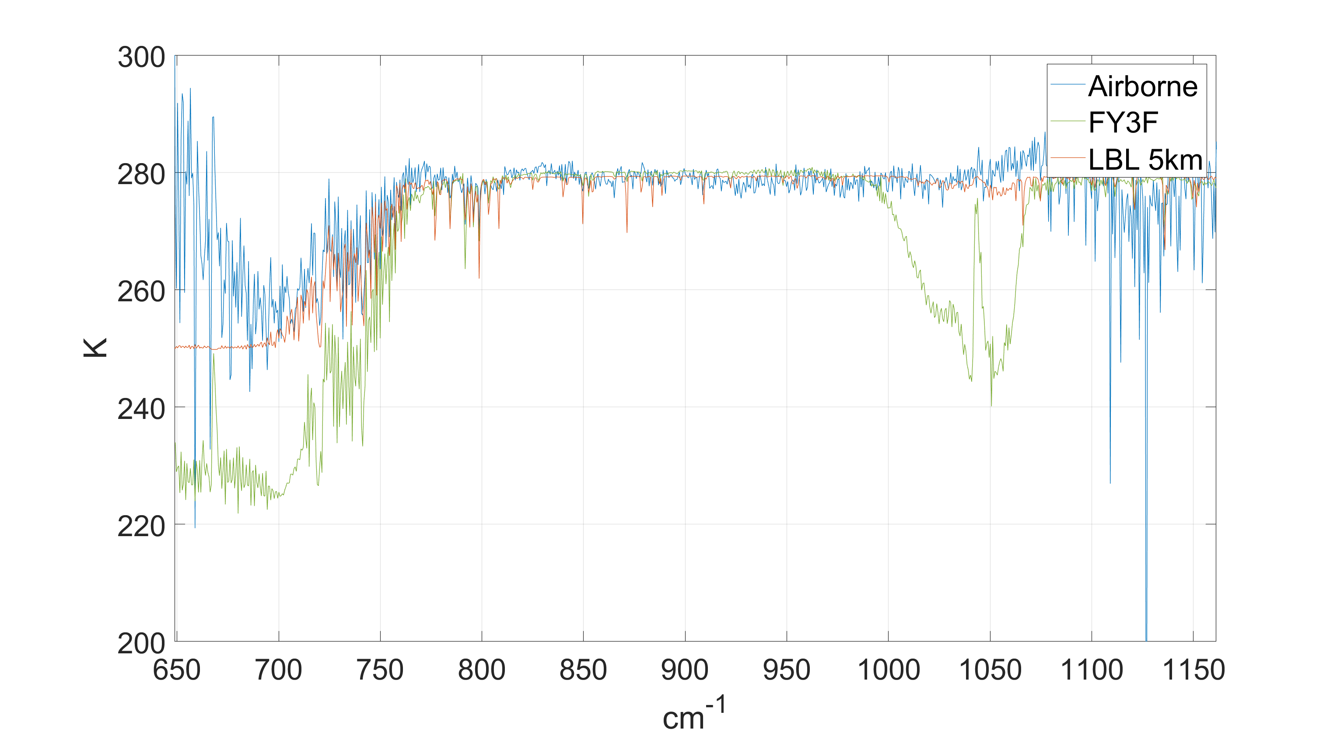
Results and Discussion
The radiative spectrum collected in winter is compared with the simulated forward modeled radiation from LBL and the corresponding Fengyun satellite HIRAS data.
The forward simulation conditions are as follows: atmospheric model, mid latitude, winter, flight altitude 5 km.

Slide 16
Results and Discussion
The difference between airborne data and Fengyun satallite data shows the CO₂ absoption at 650cm⁻¹ to 770cm⁻¹ and the ozone absoption at 1000cm⁻¹ to 1070cm⁻¹.
Ozone absorption lines
CO₂ absorption lines

Slide 17
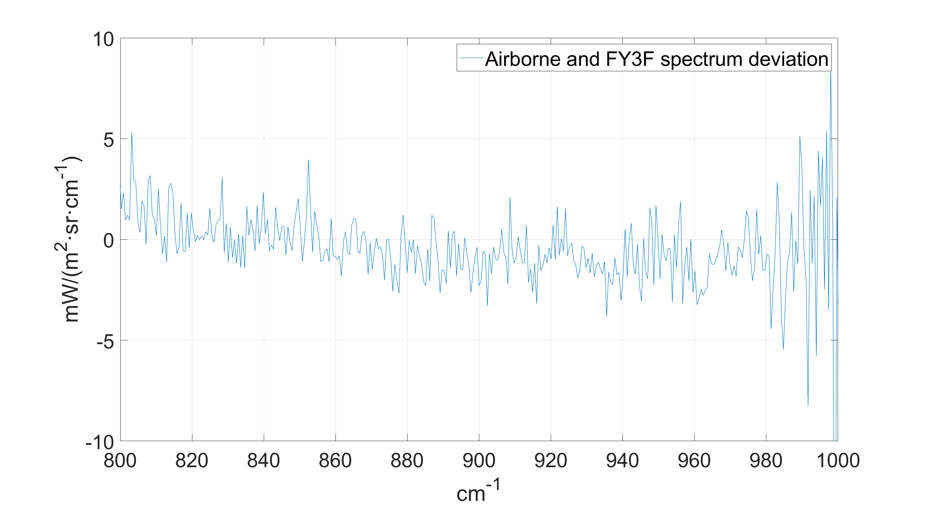
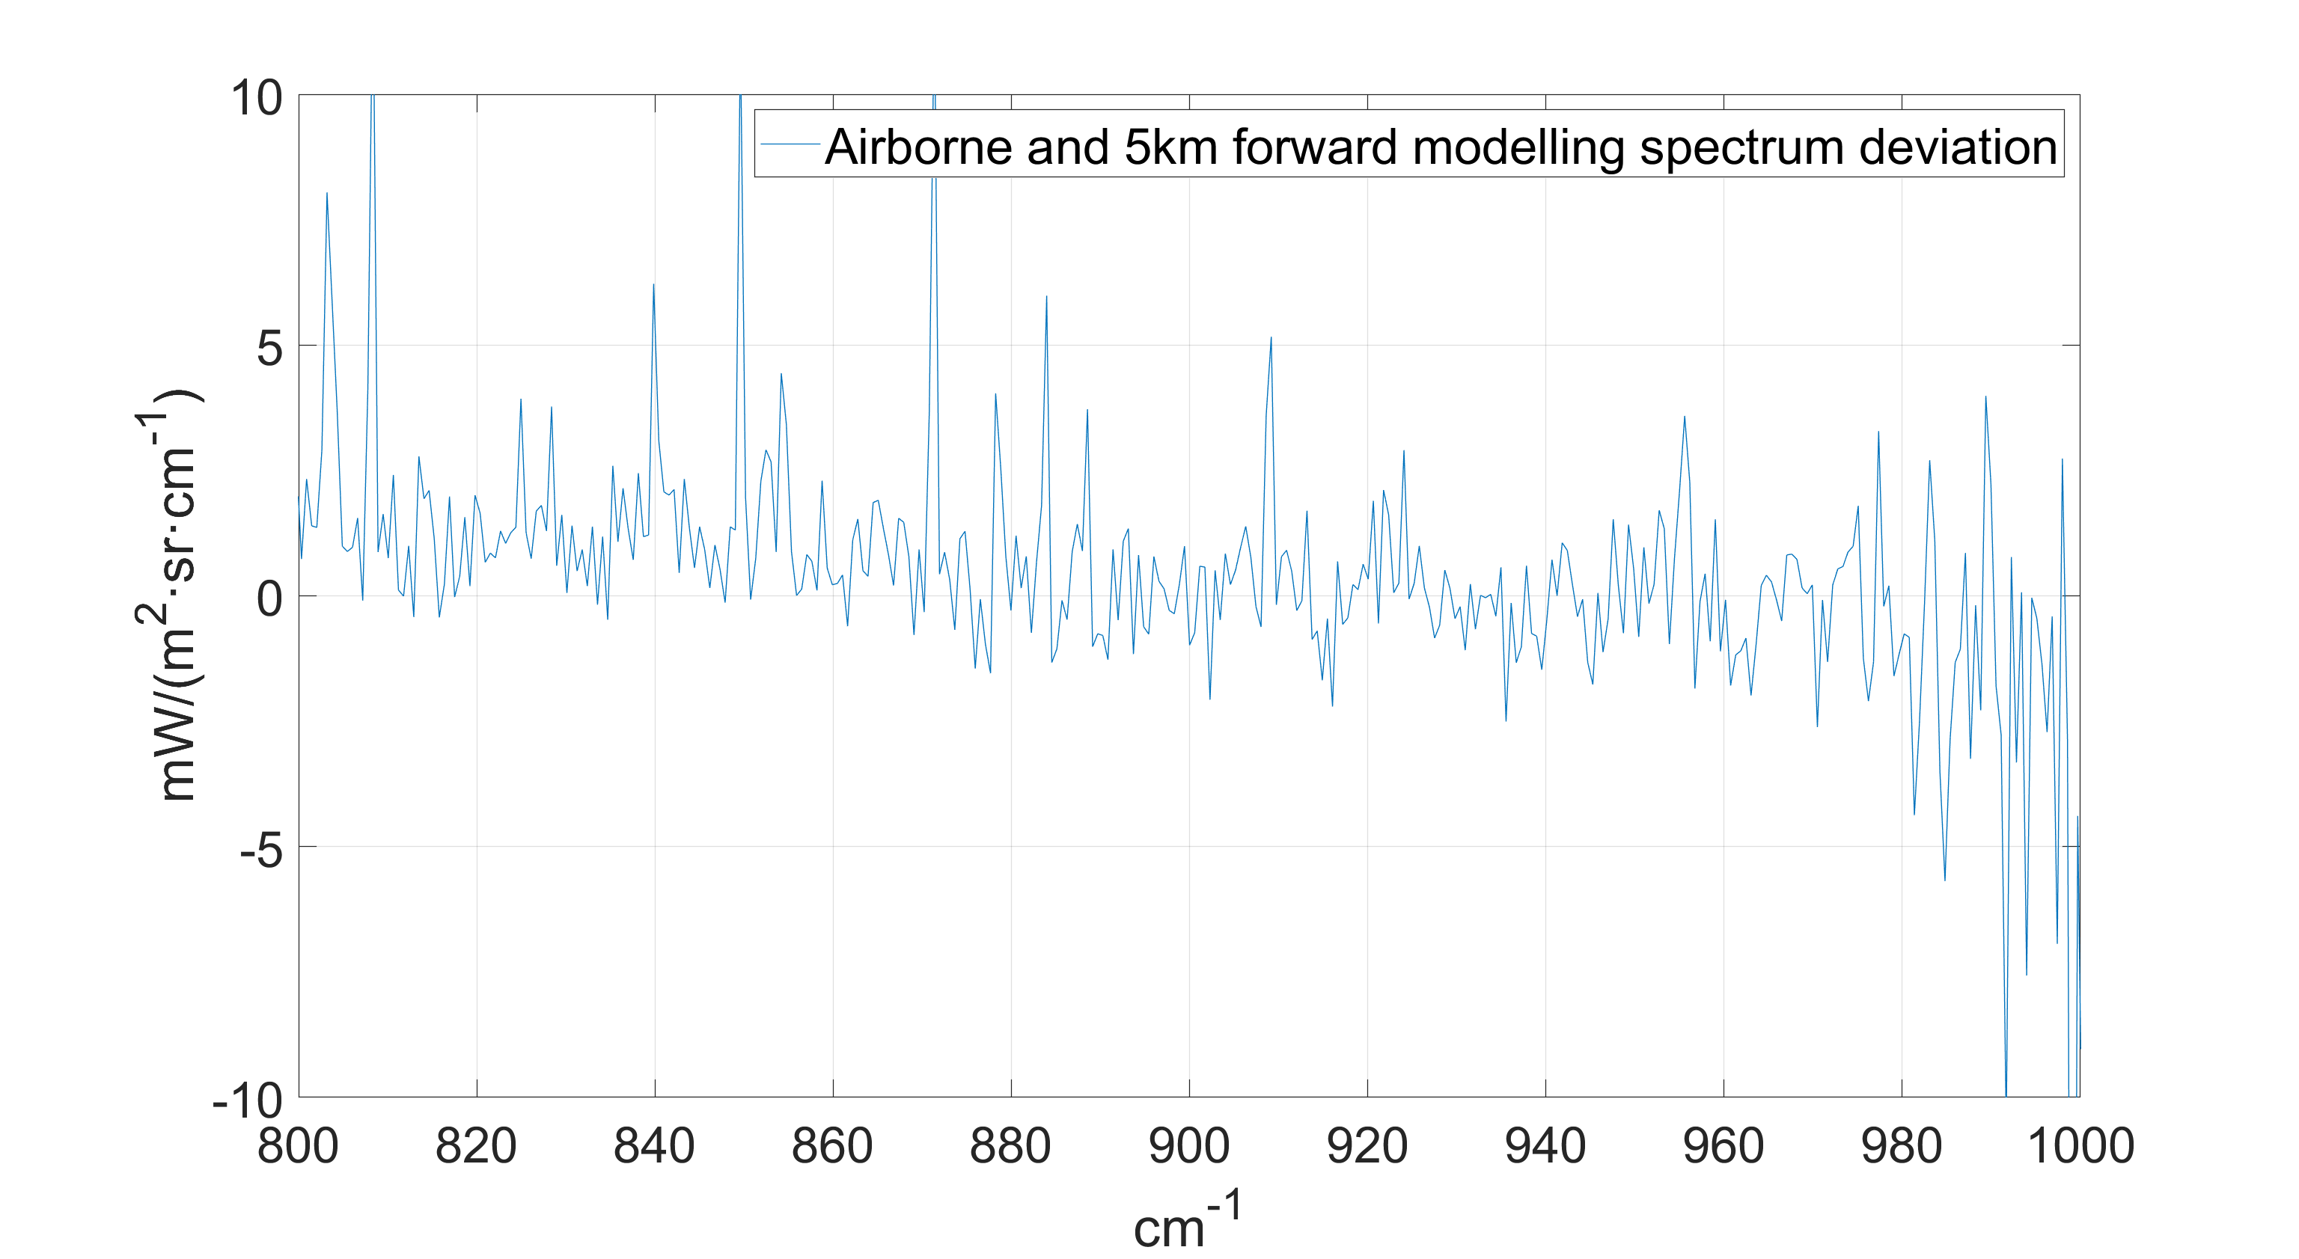
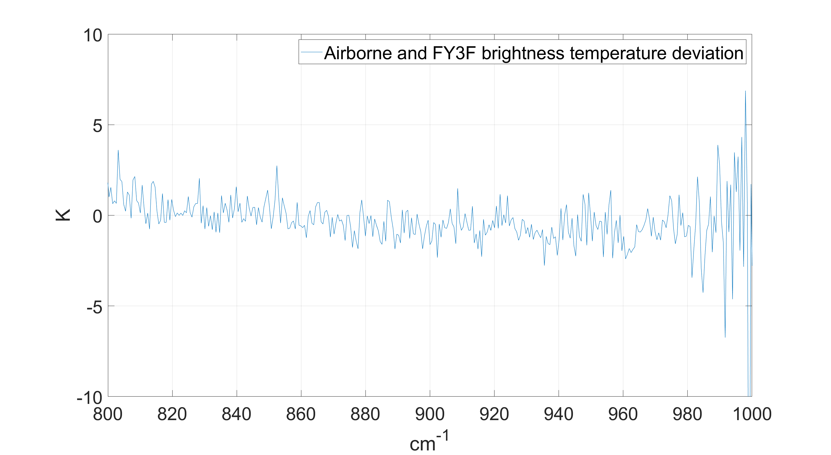
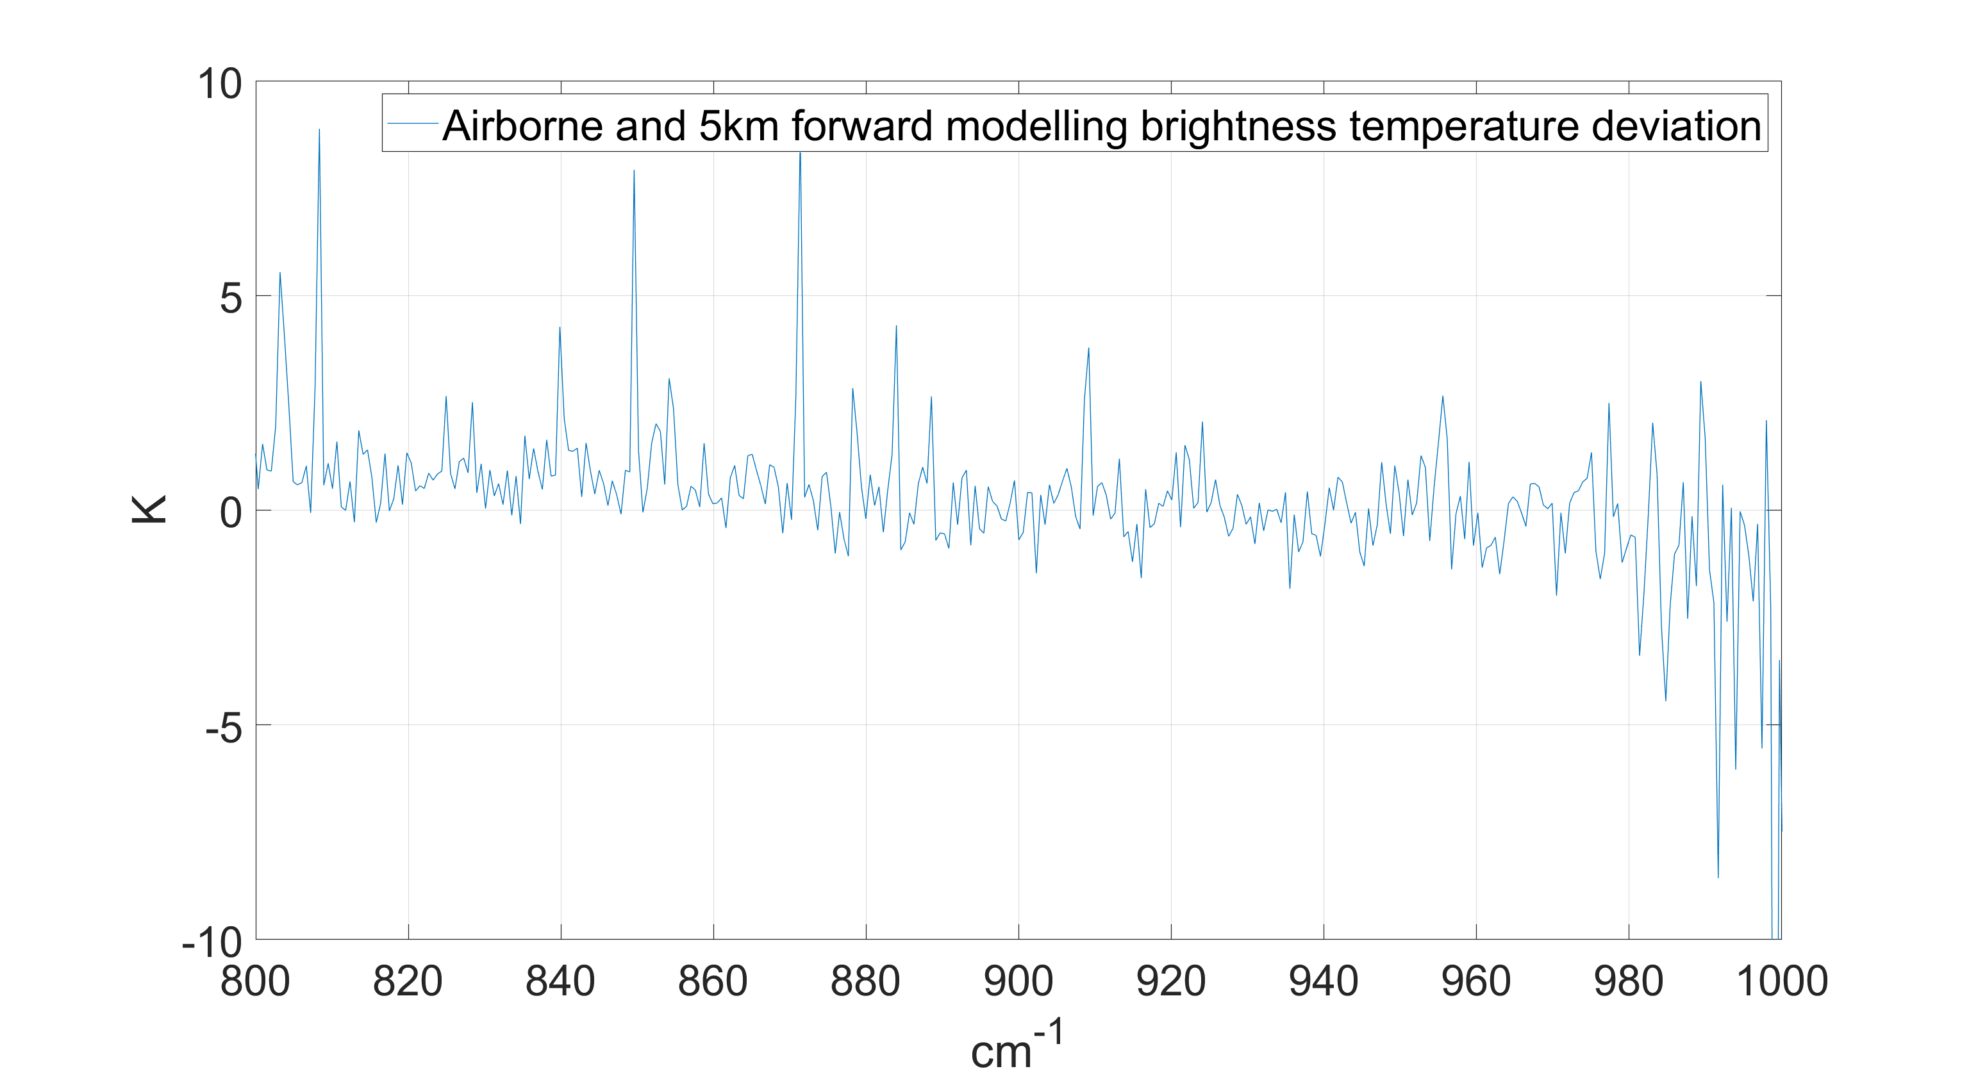
Results and Discussion
The spectrum and brightness temperature difference in the window region of 800–1000 cm⁻¹ between airborne data, Fengyun satellite HIRAS data and LBL data are shown.

Slide 18
Results and Discussion
In the window region of 800–1000 cm⁻¹, when compared with Fengyun satellite data, the std of the brightness temperature deviation is 1.8K. When compared with forward simulation data, the std of the brightness temperature deviation is 2.2K

Slide 19
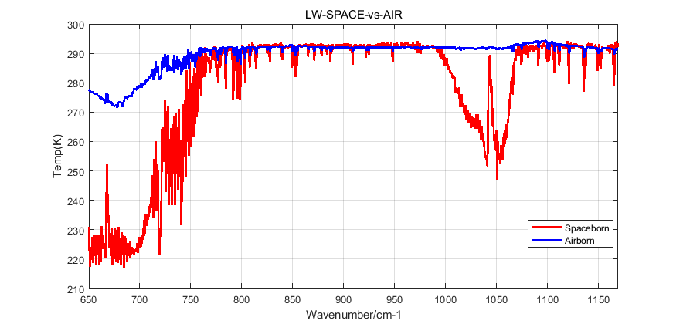
Results and Discussion
The experiments in summer yield similar results.

Slide 20
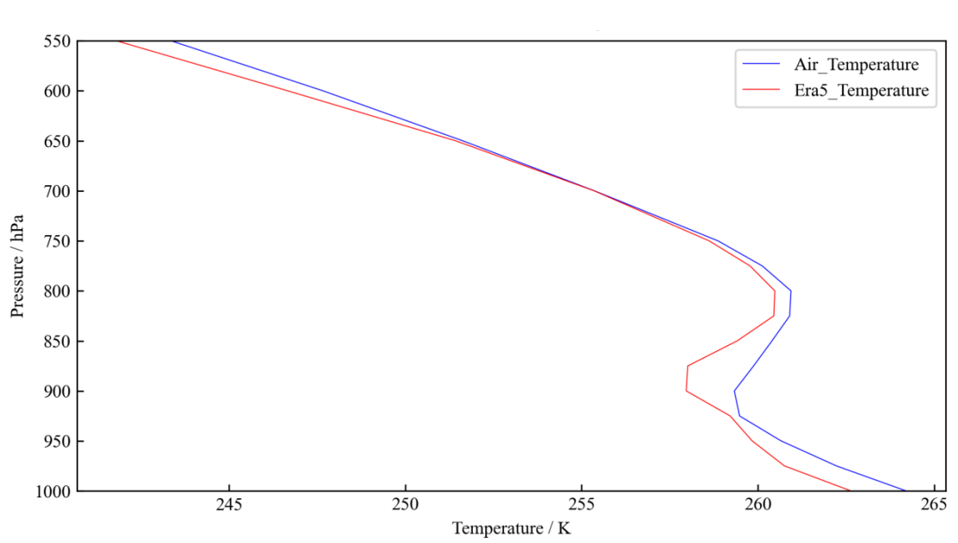
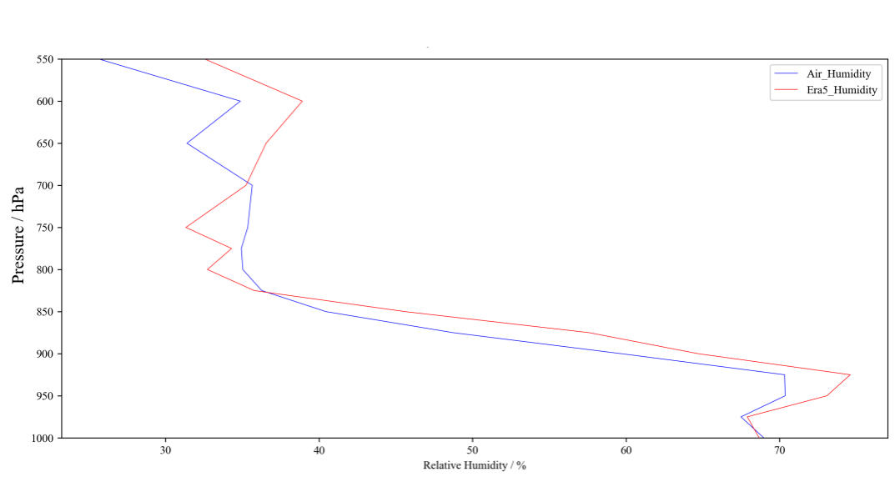
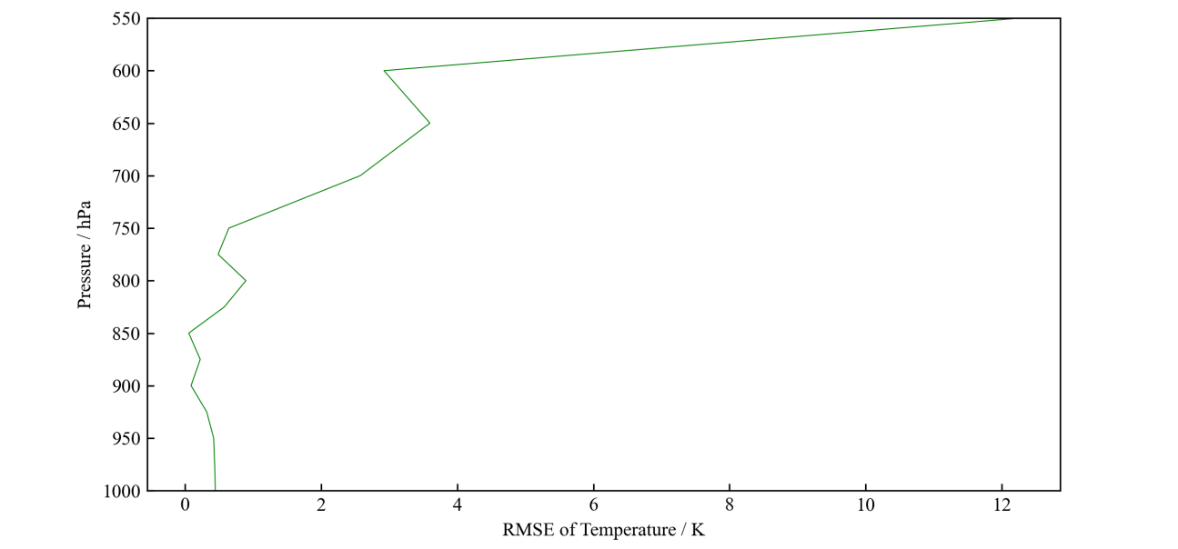
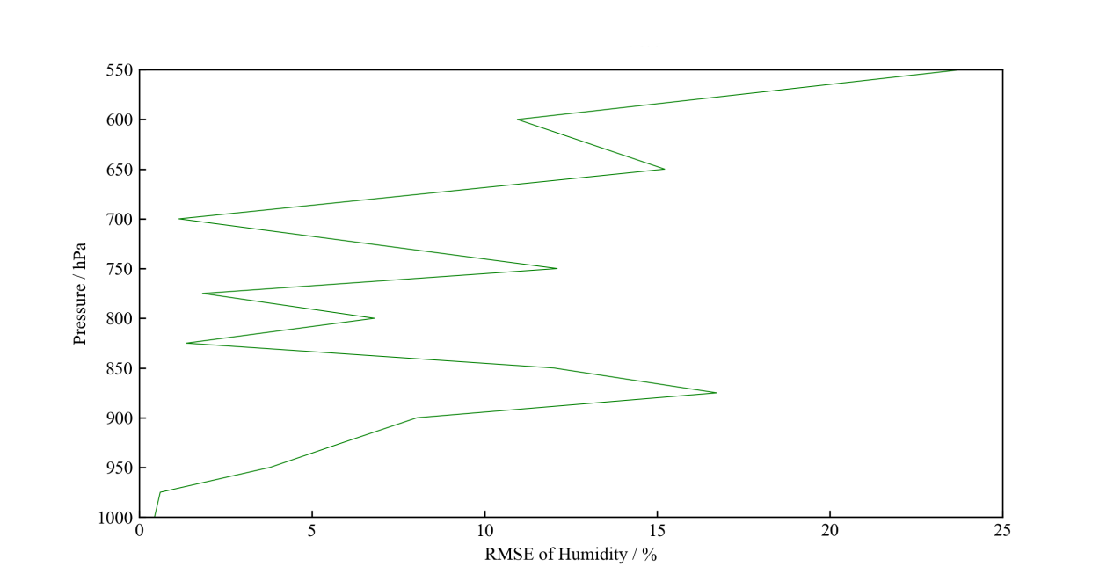
Results and Discussion
The temperature and humidity profile can be calculated based on these data. The results are compared with the era5 data.

Slide 21
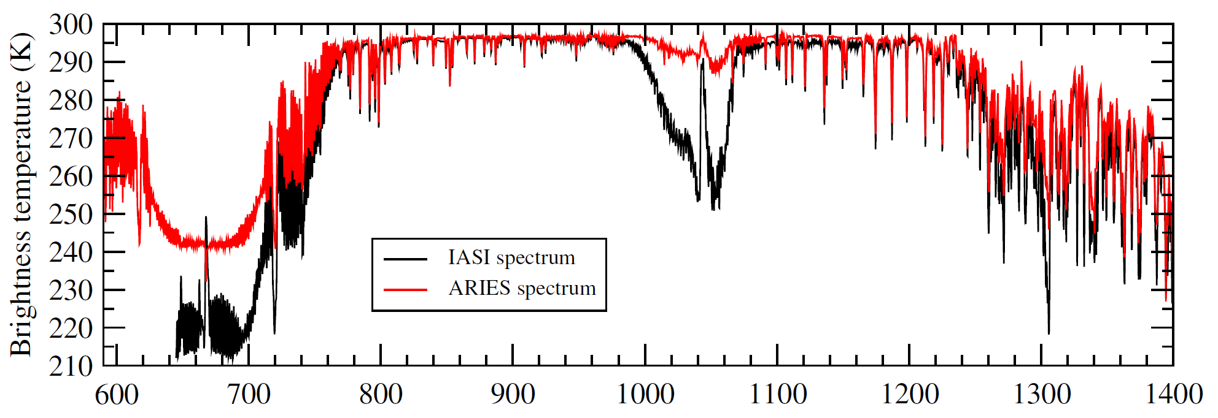
Results and Discussion
In the past, similar airborne experiments were carried out for IASI in Europe. The results were close to the results achieved in this experiment.

Slide 22
Prospect
In the future, there will be more airborne experiments:
Instrument improvement (TEC cooling, auto leveling system...)
Plane with a higher flight limit
More different locations

Slide 23
Thanks for watching

