Slide 1
Absolute Measurement System for TErrestrial reflected spectral Radiance
(AMSTER)
Professor Xin Ye
2025-03-17
Changchun institute of optics, fine mechanics and physics,
Chinese academy of science

Slide 2
Outline
Background
Conclusion
AMSTER
Principle

Slide 3
Outline
Background
Conclusion
Principle
AMSTER

Slide 4
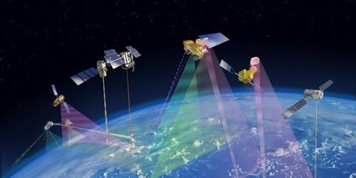

Climate Research
The world is facing severe environmental challenges. The phenomena of glacier melting, sea level rise, land drought and more extreme weather show that the climate system is changing.
Solar irradiance is reflected back into space from the earth's atmospheric system. Through the changes of snow cover, sea glaciers, land use, aerosol and cloud characteristics, etc, it constitutes a rich, variable and highly variable climate system.
Temporal and spatial analytic observation of reflected solar band by using space optical remote sensing instrument can provide reliable analytical data for the changing climate system.

Slide 5
Climate Research
However, in the field of climate research, the establishment of climate models needs high accurate data of solar reflected spectrum. Space spectral instruments for observing these weak changes from space must have high accuracy and long-term stability.
At present, the space remote sensors are difficult to trace to SI on orbit, and can not fully meet the requirements of climate research.
Observation of Reflected Solar Band ：0.3%
Space remote sensing is facing new challenges!

Slide 6
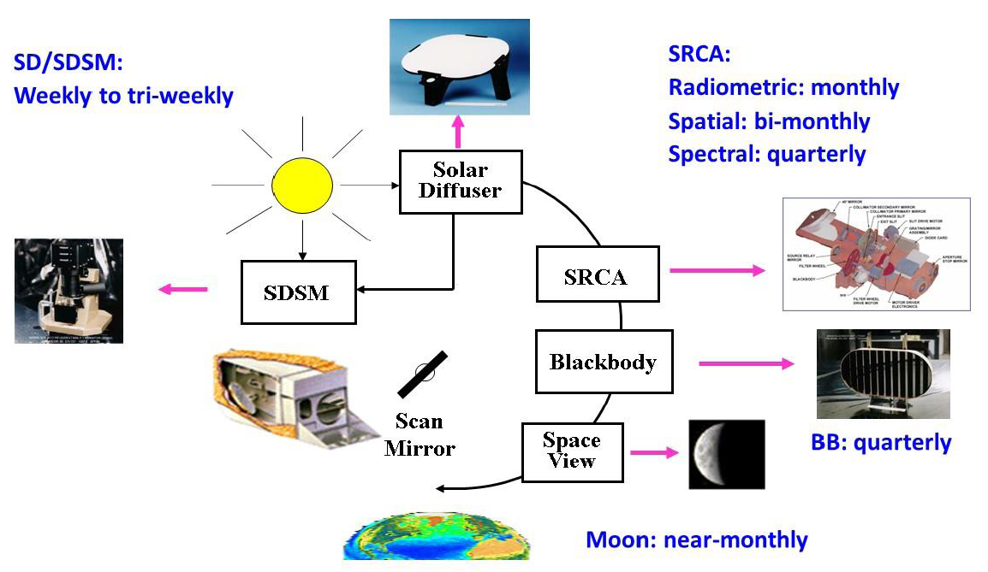
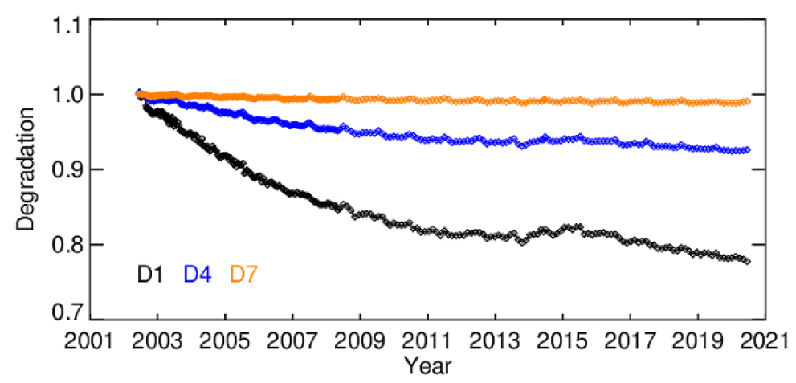
Challenges in Terrestrial radiometric measurement
Analyzing long-term climate cycles and trends demands terrestrial reflected radiance measurements with radiometric uncertainty of 1% or better. It is essential to detect small changes—like ice melt or cloud cover shifts—over decades
Solar diffusers, standard lamps, and vicarious calibration are affected by the launch process and long-term degradation, preventing in-orbit traceability to SI.
Xiaoxiong Xiong，Remote Sensing，2020
The uncertainty of reflectance and radiance for the Moderate Resolution Imaging Spectroradiometer (MODIS) can only reach 2% and 5%, respectively.

Slide 7
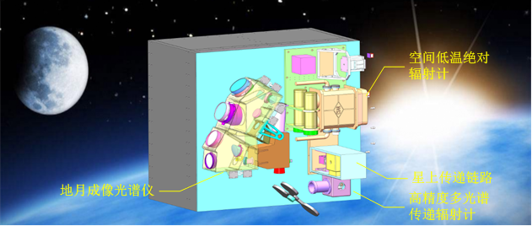
Absolute Measurement for Terrestrial reflected spectral Radiance
This report proposes a SI-traceable Radiometric measurement system is, aiming to enhance the measurement uncertainty of terrestrial reflected spectral radiance with long-term stability.
We are currently achieving absolute radiation measurements in space, and an on-orbit traceable reference for the reflected solar band is being established
Our team is advancing on-board SI-traceable transfer technology to enhance the accuracy and long-term stability of Earth-Moon spectral radiation measurements.
Cross-calibration protocols are being implemented to unify the on-board radiation scale across our measurements

Slide 8
Outline
Background
Conclusion
Principle
AMSTER

Slide 9
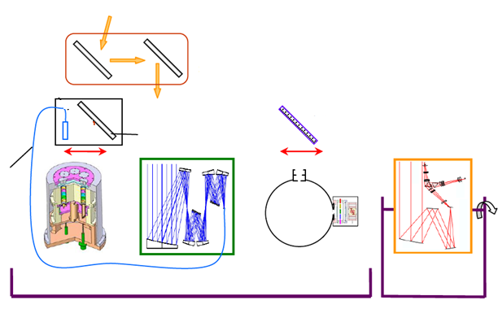
Space-Based Solar Spectral Irradiance Reference
the Space-Based Solar Spectral Irradiance Reference was developed under the support of the 863 Program from 2015 to 2017.
sunlight
Operating Principle
The space cryogenic radiometer is utilized as the primary radiation reference.
Monochromatic beams is directed into the cryogenic radiometer to calibrate their power.
The transfer radiometer is then calibrated using these calibrated monochromatic beams.
A Lambertian source is created by directing the beams into an integrating sphere.
The transfer radiometer observes the integrating sphere source, transferring the radiance standard to establish a radiance reference.
integrating sphere
Imaging Spectrometer
mirror
optical
fiber
transfer
radiometer
SCAR
monochromator
satellite
satellite

Slide 10
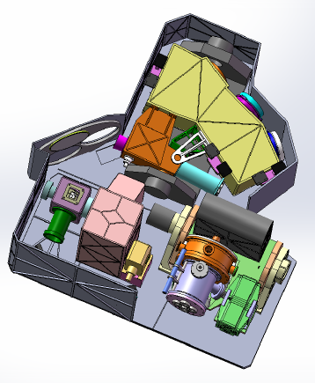
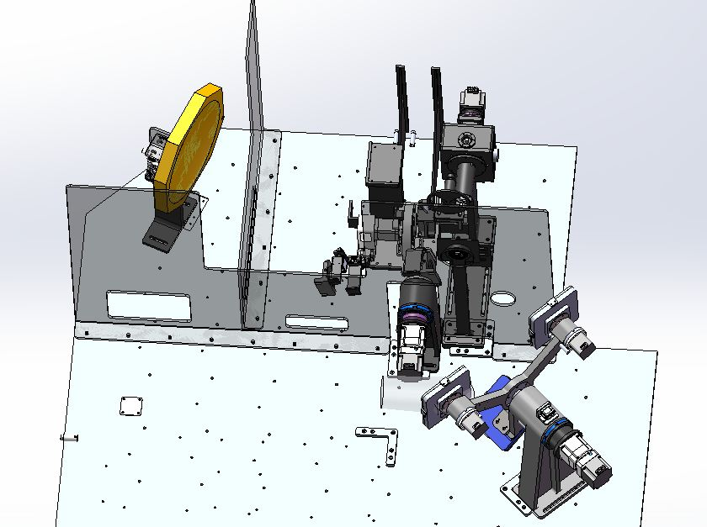
Earth-moon observation instrument
From 2018 to 2023, the Earth-Moon Observation Instrument was developed under the support of the National Key Research and Development Program
Earth-moon observation instrument in solar reflected band includes space cryogenic radiometer, earth-moon imaging spectrometer and radiometric calibration chain.
Space cryogenic radiometer
Radiometric Calibration Chain
A laser is calibrated by directing it into cryogenic radiometer.
The transfer radiometer is then calibrated laser by the calibrated laser beam.
The multispectral radiance of a broadband light source is measured using the transfer radiometer
hyperspectral radiance is reconstructed from the multispectral data
On-orbit radiation reference
mirror
transfer radiometer
laser
broadband light source
Earth-moon imaging spectrometer
diffuser
Earth Spectral Radiation Observation
Lunar Spectral Radiation Observation
The radiometric calibration chain primarily consists of a multi-spectral source, broadband light source, a transfer radiometer, a diffuser, and a beam steering arm

Slide 11
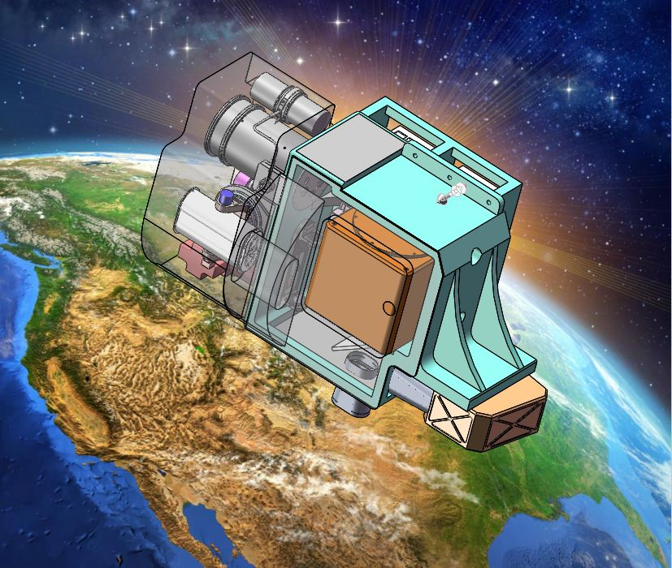
AMSTER
AMSTER has been conducted under the support of the National Key Research and Development Program Since 2023
AMSTER includes space cryogenic absolute radiometer(SCAR) earth-moon imaging spectrometer(EMIS) and radiometric calibration chain
The radiometric calibration chain primarily consists of a transfer radiometer, a monochromator, an integrating sphere, and a beam steering arm
space cryogenic radiometer
radiant power reference
radiometric calibration chain
establish radiance standard
earth-moon imaging spectrometer
earth and moon observation
10

Slide 12
AMSTER
Operating Principle of AMSTER
The primary radiant power reference is SCAR
The monochromator disperses the incident sunlight into monochromatic light at discrete wavelengths sequentially
The transfer radiometer is used to transfer the primary radiant power reference to radiance standard
The integrating sphere converts collimated input radiation into a Lambertian source
The steering mirror is used to point the imaging spectrometer to the Earth, lunar, and integrating sphere targets is measured respectively
The imaging spectrometer is used to measure the Earth and lunar
Notes:
放到前面，整机后面

Slide 13
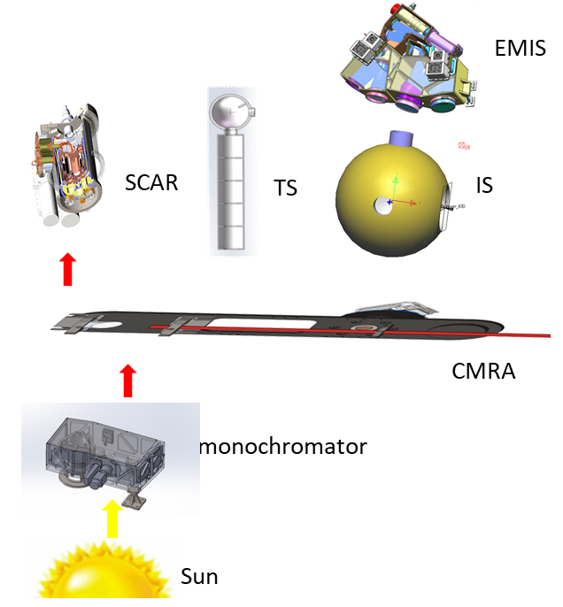
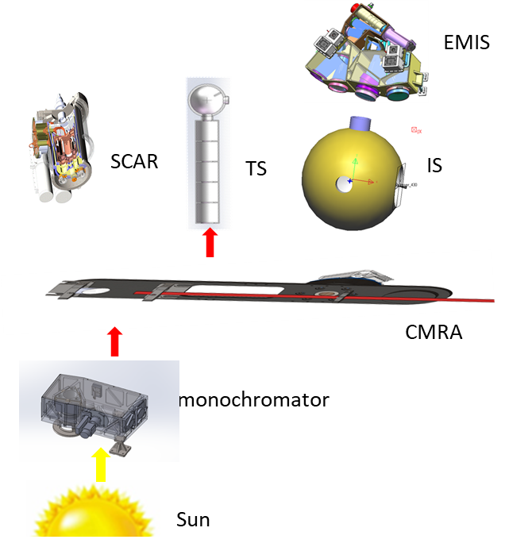
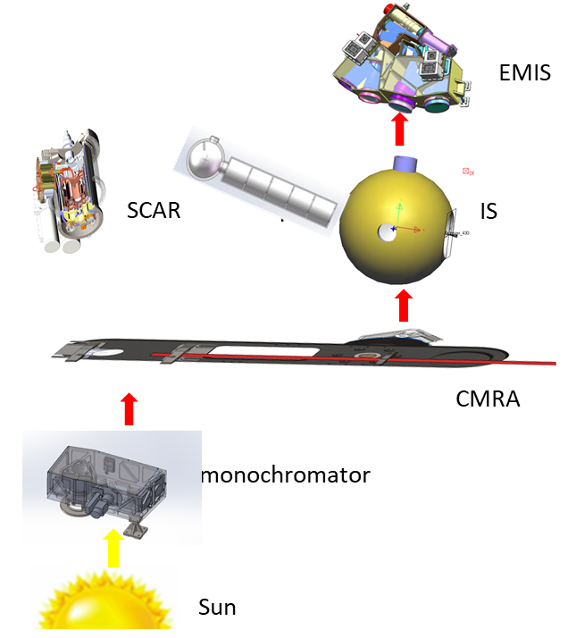
AMSTER
on-orbit traceability process
The monochromatic light is calibrated by incident into the SCAR via steering arm
The transfer radiometer is calibrated by directing the calibrated monochromatic light into it
The EMIS is calibrated by observing the sphere with transfer radiometer​ simultaneously

Slide 14
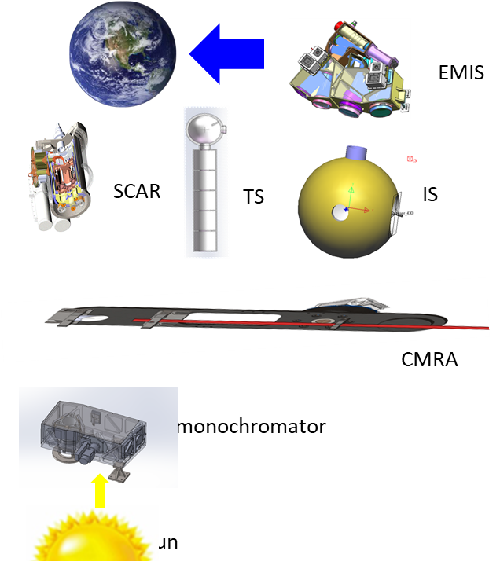
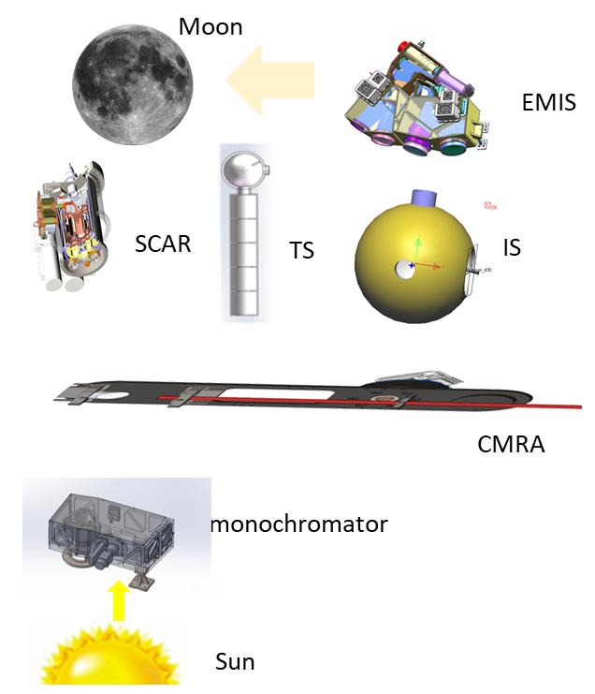
Earth and moon Observation
Terrestrial reflected spectral Radiance and Lunar reflected irradiance is measured by pointing the spectral imager to the earth and the moon, respectively
earth

Slide 15
Operating mode
Four operational modes are established in AMSTER, including self-calibration, solar observation, nadir viewing, uniform field observation, and lunar observation

Slide 16
Outline
Background
Conclusion
Principle
Development and challenges
AMSTER

Slide 17
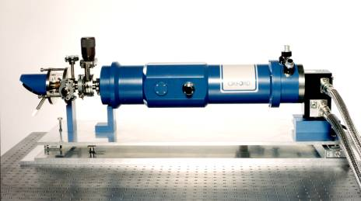
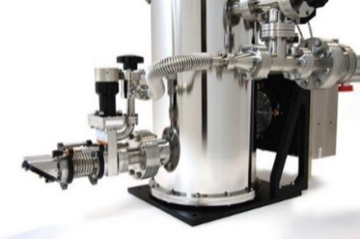
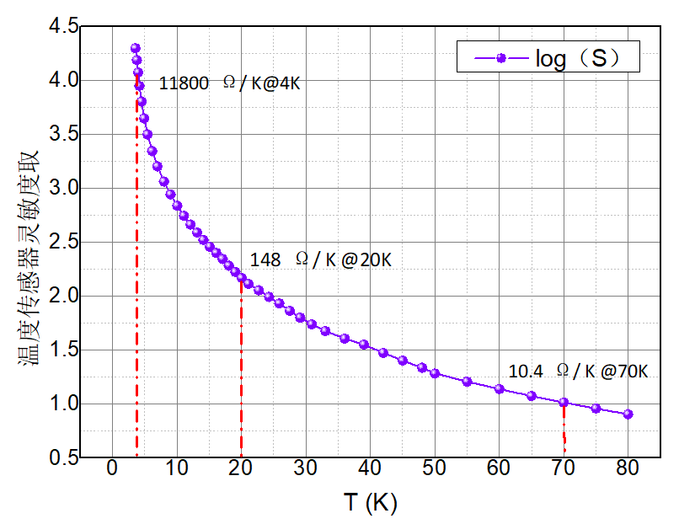
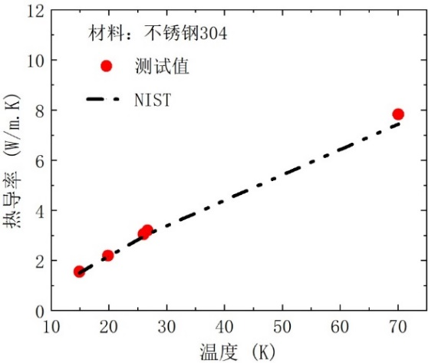
Space Cryogenic Absolute Radiometer Challenges
Due to mass, volume, and cooling constraints, the application of a 4K cryogenic radiometer in space presents significant challenges.
Operating temperature increased to 20K to reduce satellite resource requirements
Solve the problem of component and material characteristics degradation caused by operating temperature increase
Reproduce the Optical Fundamental Quantity Candela by Cryogenic Absolute Radiometer in space
disadvantages of cryogenic material characteristics at 20K compared with at 4K
sensitivity of thermometers decreases by two orders of magnitude
thermal conductivity of materials doubles at 20K
heat capacity of oxygen-free copper increases by an order of magnitude

Slide 18
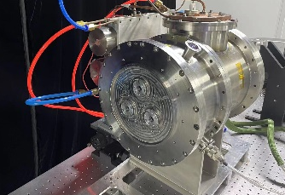
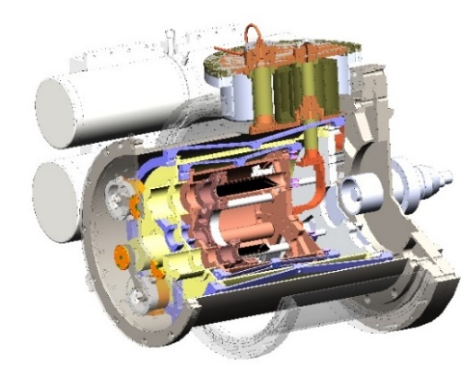
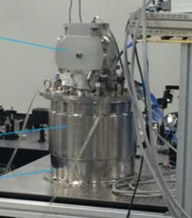
Research project of 20K Space Cryogenic Absolute Radiometer
2012-2017
Technical validation prototype
2018-2022
Principle Prototype
2023~2026
engineering prototype
Work at 20K-30K by a two-stage pulse tube cooler
Opitcal power measurement uncertainty is 0.03%
Work at 20K by a two-stage pulse tube cooler
Opitcal power measurement uncertainty is 0.028%
Verified by the Indirect comparison experiment with the L1-CAR of NIM
Work at 20K by pulse tube cooler and liquid nitrogen
Opitcal power measurement uncertainty is 0.029% for 0.4mW

Slide 19
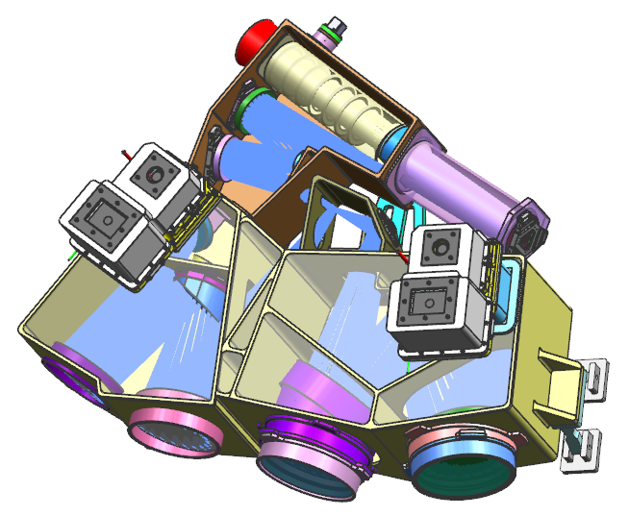
Earth-Moon Imaging Spectrometer
The earth-moon imaging spectrometer is used to measure reflected solar irradiance, including the earth and moon
The earth-moon imaging spectrometer consists of VNIR and SWIR spectrometers, spectral range coverage 400nm-2300nm
Swath width: > 60km @ 600km
Spatial resolution: < 250m
Spectral range: 400nm-2300nm
Spectral calibration accuracy: < 0.5nm
Spectral resolution: <8nm
Polarization responsivity: 1%
Signal-to-noise ratio: > 300
Telescope system
VNIR spectrometer
  400nm-1000nm
SWIR spectrometer
  950nm-2300nm
18

Slide 20
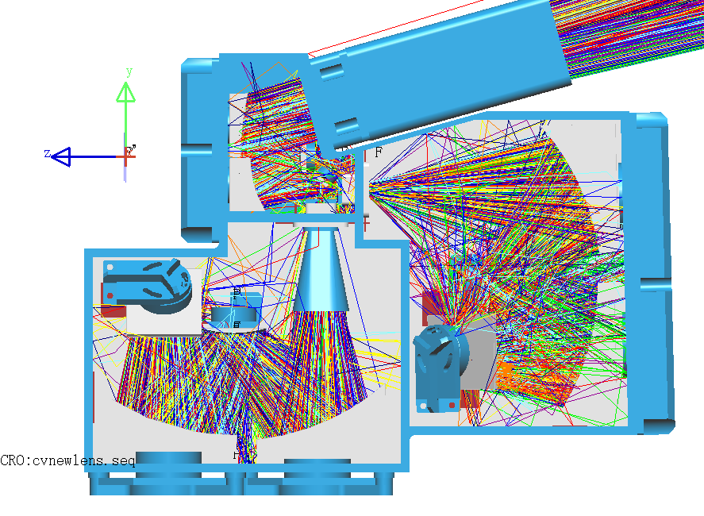
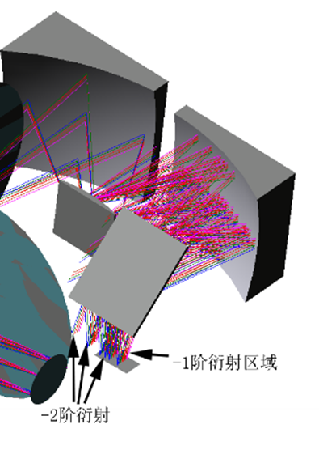
Earth-Moon Imaging Spectrometer
Stray light mainly includes stray light outside the field of view, secondary spectrum and infrared background radiation
Stray light outside the field of view suppressed by a light extinction cylinder , and the level of stray light is lower than 0.12%
The long wave pass filter suppresses the secondary spectrum, and the level of stray light in the secondary spectrum is less than 0.2%
extinction cylinder
 |  | Stray light ratio
NO filter | Primary Optical Path | 37.5%
 | Stray optical path
With filter | Primary Optical Path | 0.2%
 | Stray optical path
Notes:
杂散光是影响测量精度的误差来源，需要进行抑制

Slide 21
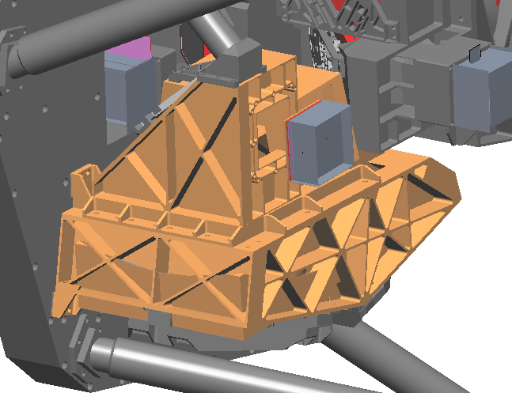
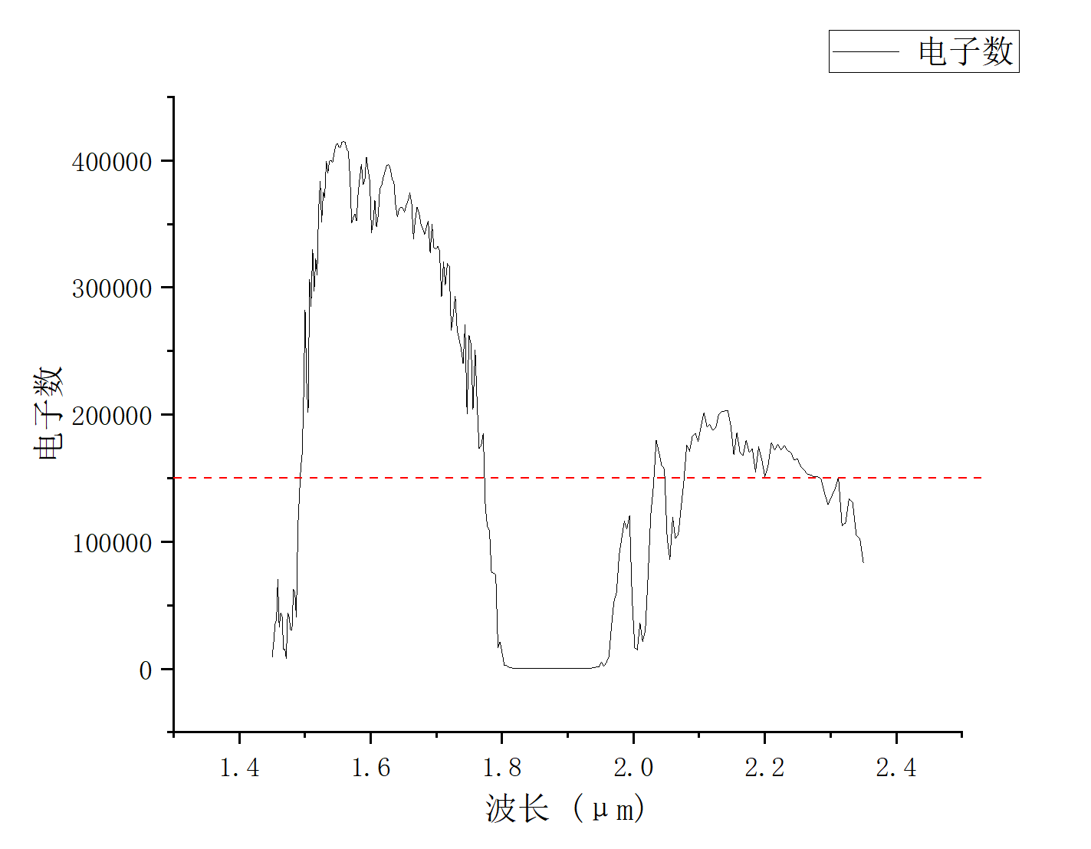
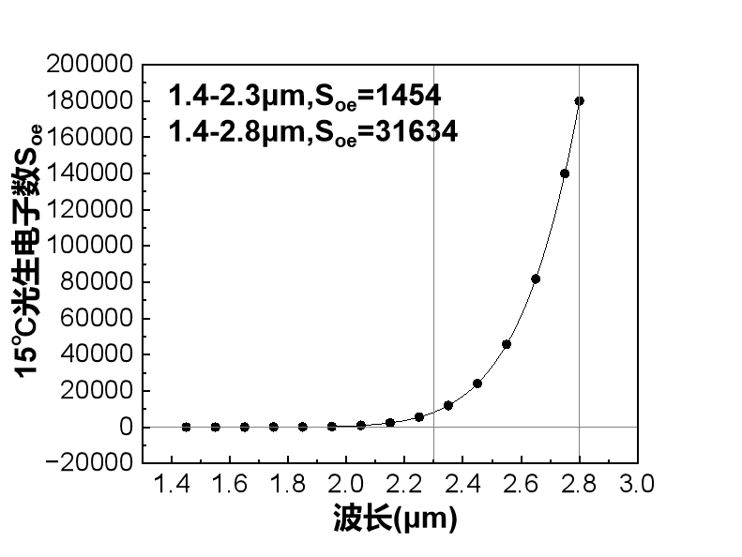
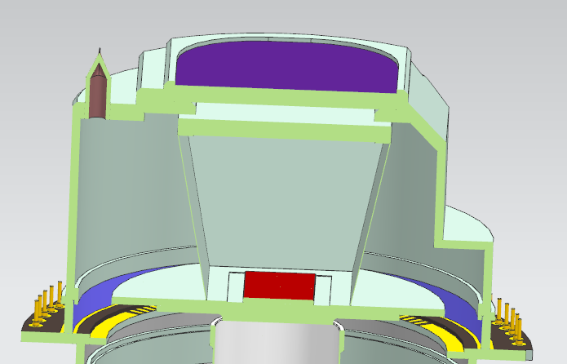
Earth-Moon Imaging Spectrometer
The SWIR background thermal emission exhibits comparable intensity to effective optical signals under ambient temperature conditions
The opto-mechanics assembly and optical baffles are stabilized at 288K±0.5K and 90K respectively. The effective signal electrons fluctuates by about 0.3% due to the infrared background radiation
Sub-frame
detector
fold mirror
primary mirror
main frame
Tertiary mirror
Cryogenic Baffle 90K
Dewar coating
typical condition signal electron counts
Electron counts at window temperature
Notes:
在短波红外波段，红外背景辐射是重要的杂散光来源，采用冷光阑和探测器制冷，降低红外背景辐射和探测器背景噪声

Slide 22
Solar Monochromator
The solar radiation is dispersed into quasi-monochromatic beams by the monochromator
The quasi-monochromatic beams are directed into both the cryogenic radiometer and the transfer radiometer, transferring the power reference from SCAR to the transfer radiometer
The quasi-monochromatic beams are directed into the integrating sphere, and the transfer radiometer measures the sphere to establish the radiance reference

Slide 23
Solar Monochromator
The small pupil realizes the small spot and small divergence Angle, and realizes the transfer of power reference from the SCAR to the transfer radiometer
The large pupil realizes the high radiant flux, improves the radiance of the calibration source, and improves the in-orbit traceability accuracy of the imaging spectrometer

Slide 24
Outline
Background
Conclusion
Principle
AMSTER

Slide 25
Conclusion
Establishing on-board absolute measurement system for terrestrial reflected spectral radiance， improving absolute measurement accuracy and providing key data basis for the study of Earth climate change
AMSTER
AMSTER
Nadir scanning
cross calibration

Slide 26
Thank you for attention！

