Slide 1
Research Progress on Infrared Benchmark Payload：
Highly accurate FTIR
Lei DING^{1,3}, Shijie XIN^{1,3}, Minjian GU¹，Xiaopeng HAO² ，etc.
¹ Shanghai Institute of Technical Physics, CAS
² National Institute of Metrology
³ National Key Laboratory of Infrared Physics
March 2025

Slide 2
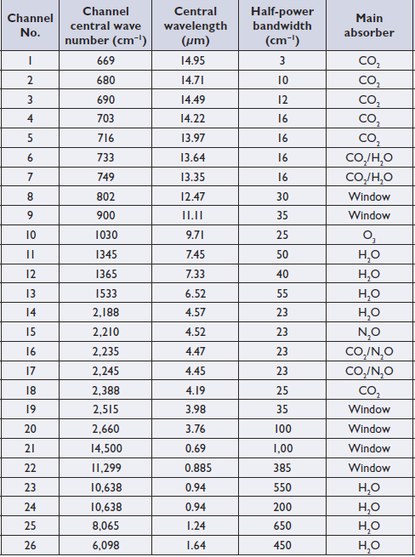
Infrared sounder for FY-3
IRAS
Spectral range: 0.69 ~ 15.5 μm, channel numbers: 26,
cross-track scanning: ±49.5°
(2172 km),
Spatial resolution: 17.0 km
→ HIRAS
channel numbers: >1300
Spectral resolution: 0.625cm⁻¹
Spatial resolution: 17.0 km
Accruacy: <1K
2

Slide 3
Infrared sounder for FY-3
HIRAS instrument specification improvement for FY-3 D/E/F
Band | Spectral Range (cm⁻¹) | Spectral Resolution (cm⁻¹) | Sensitivity (NEΔT@280K) |  |  | Num of Channels
 |  |  | FY-3D | FY-3E
LWIR | 650～1136 （15.38μm～8.8 μm） | 0.625 | 0.15(Expectation) 0.4K(Requirement) | 650 ～667 cm⁻¹ | 0.8K | 778
 |  |  |  | 667～689 cm⁻¹ | 0.4K
 |  |  |  | 689～1000 cm⁻¹ | 0.2K
 |  |  |  | 1000～1136 cm⁻¹ | 0.4K
MWIR1 | 1210～1750 （8.26μm～5.71 μm） | 1.25 | 0.1(Expectation) 0.7K(Requirement) | 1210～1538 cm⁻¹ | 0.2K | 433
 |  |  |  | 1538～1750 cm⁻¹ | 0.3K
MWIR2 | 2155～2550 （4.64μm～3.92 μm） | 2.5 | 0.3(Expectation) 1.2K(Requirement) | 2155～2300 cm⁻¹ | 0.3K | 159
 |  |  |  | 2300～2550 cm⁻¹ | 0.5K
3

Slide 4
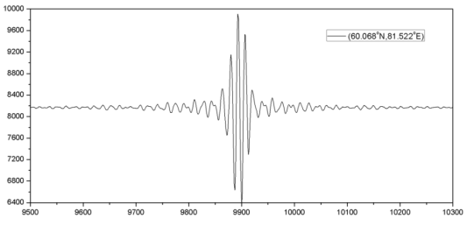
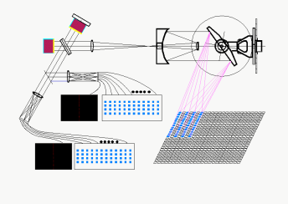
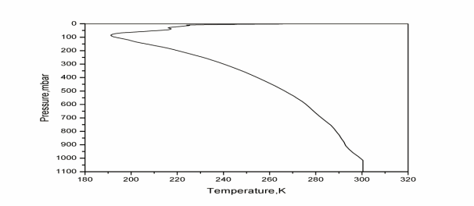
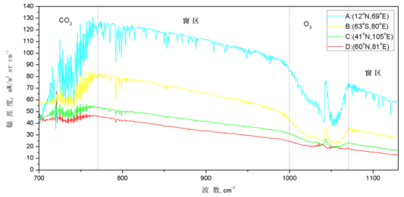
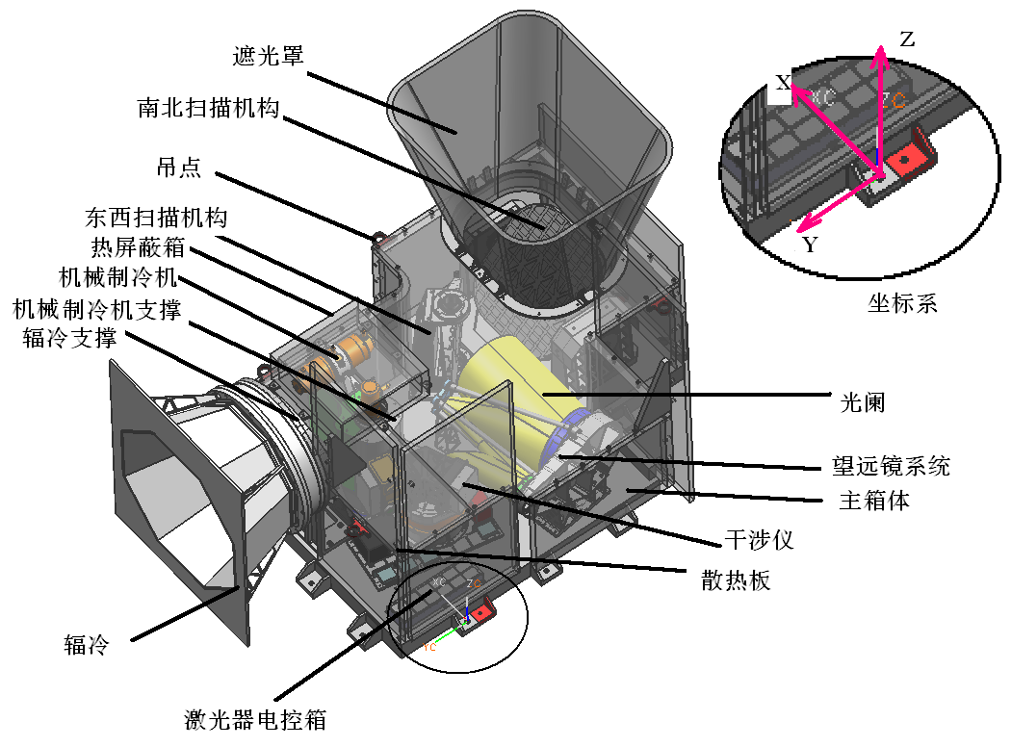
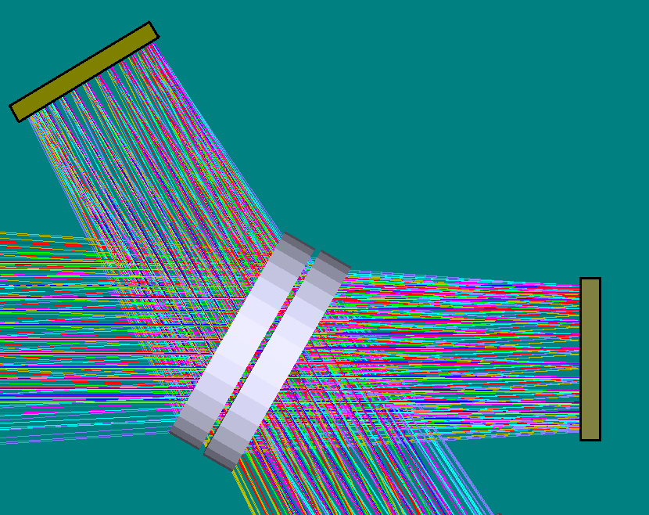
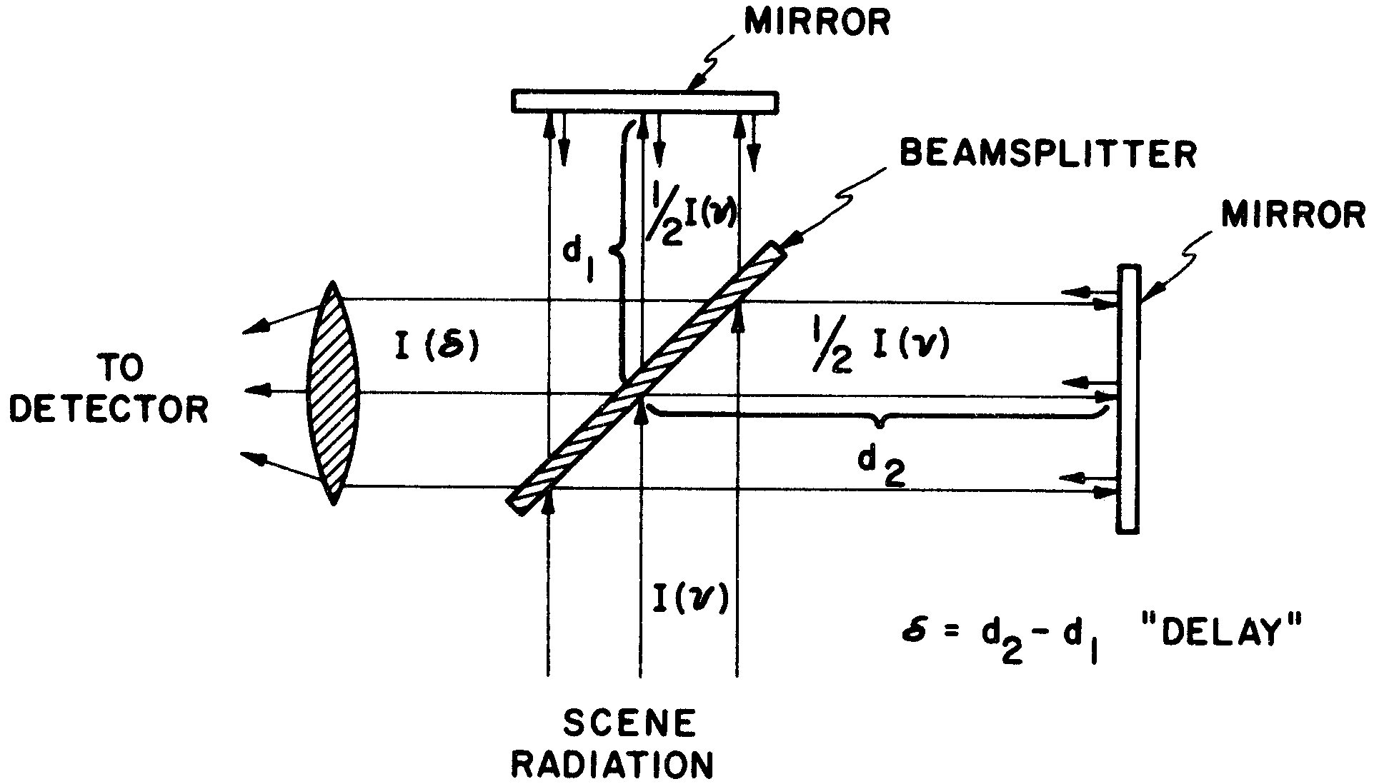
Infrared sounder for FY-4
Geostationary Interfering InfraRed Sounder (GIIRS)
4.44μm－6.06μm、8.85μm－14.3μm
Resolution: 0.625 cm-¹
Spectral stability：<10ppm
67min, 5000km×5000km
Recording
Calibration accuracy 0.7K@300K
4

Slide 5
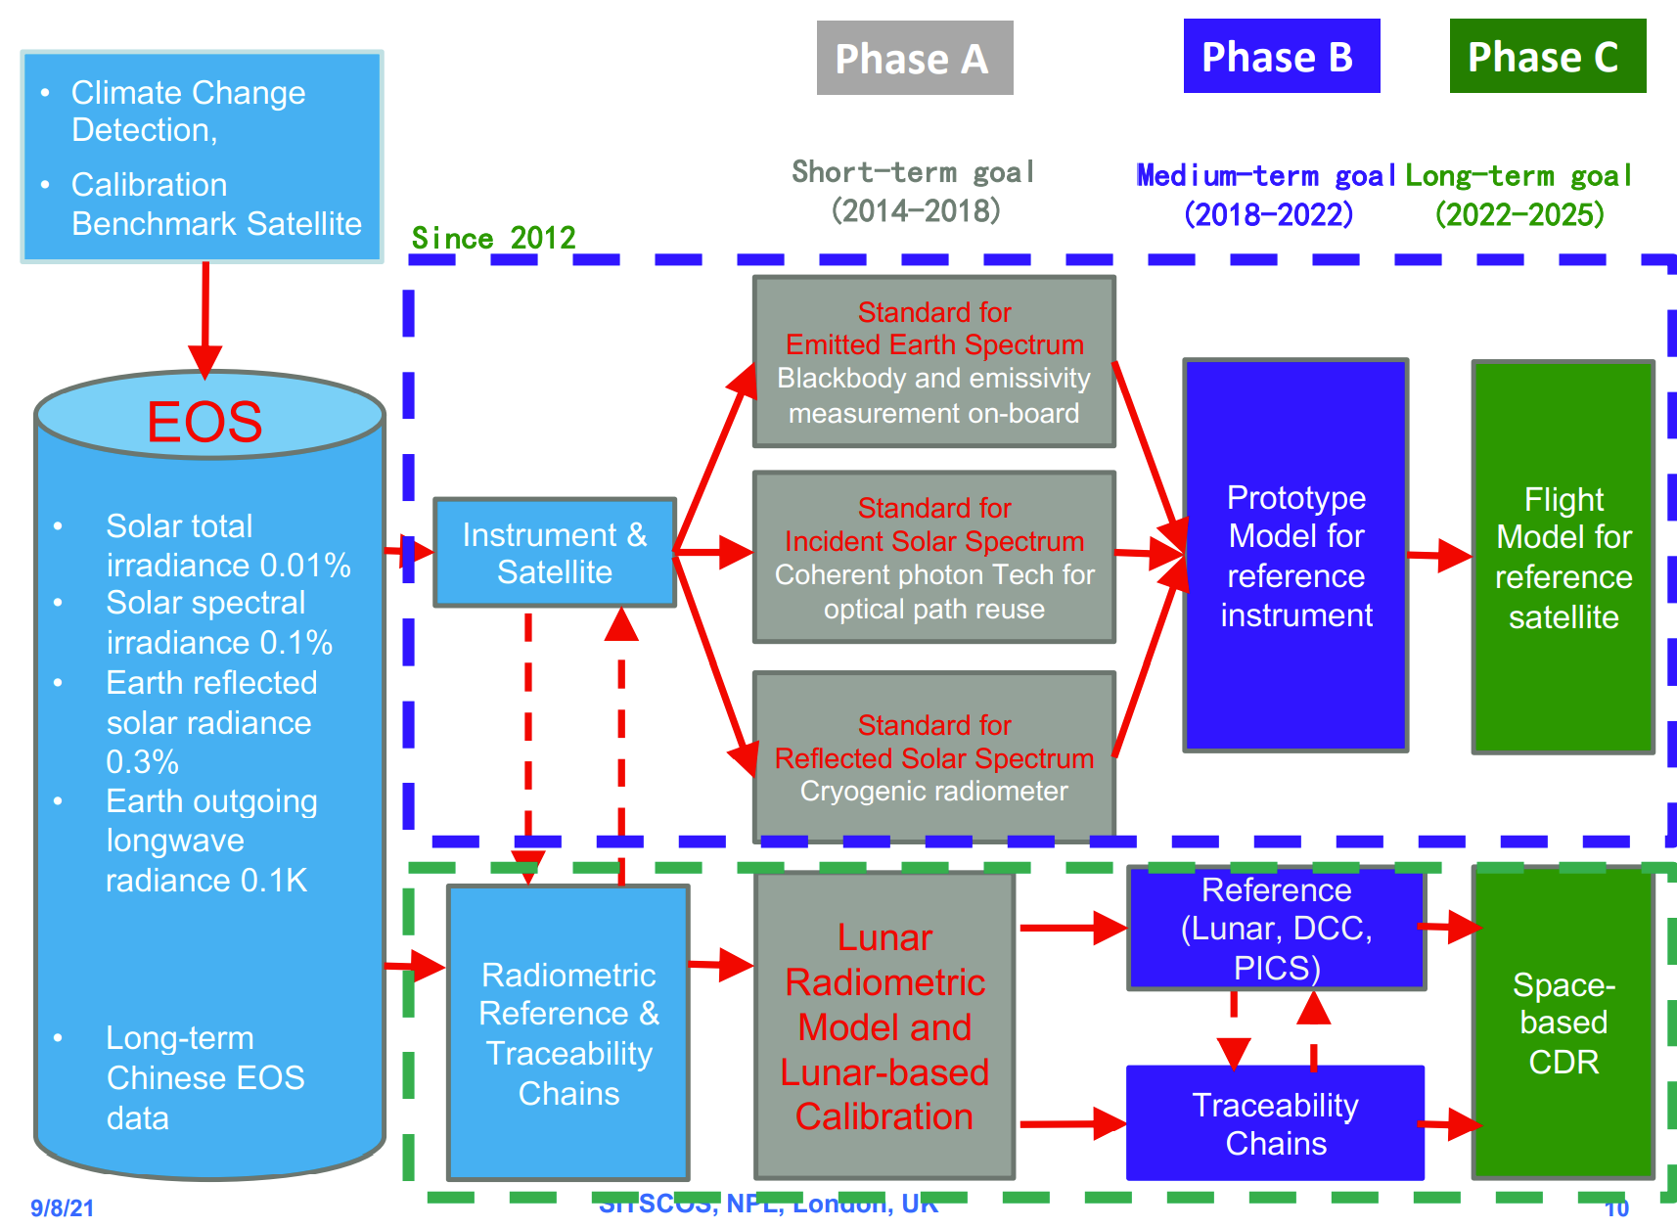
Steps for CRABS
From P. Zhang 2019, at NPL
Development of Chinese RAdiometric Benchmark Satellite
CRABS
Infrared Spectral Segment
From P. Zhang
5

Slide 6
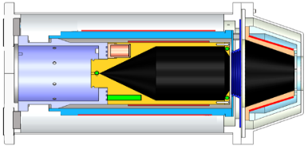
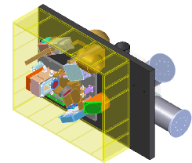
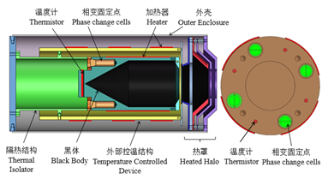
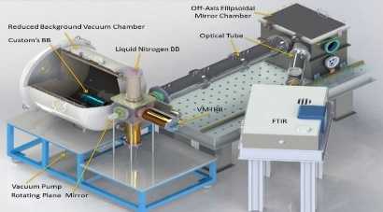
Space Radiometric Benchmark Reference of Infrared Spectral Segment
Remote sensing instruments must be accurate and stable - quantification of remote sensing data
Space-borne Infrared Radometric Reference Payload
Infrared Radiometric Benchmark Reference Source
On-orbit IR source
SI trace in laboratory
Traceable FTIR Prototype
On orbit payload
On-orbit calibration
Benchmark transmission
Benchmark Reference Satellite
6

Slide 7
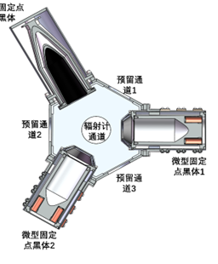
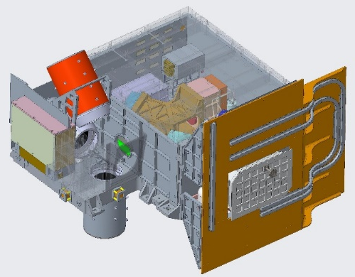
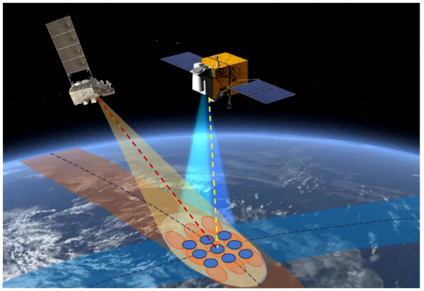
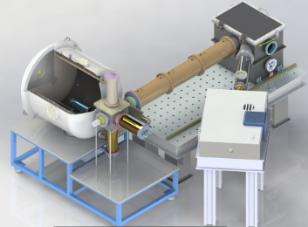
Space Radiometric Benchmark Reference of Infrared Spectral Segment
辐射定标基准传递
sensors
Traceable Infrared Spectral Segment
Traceable
Source
Calibration sources
FTIR
SI Traceable DATA
Inter-calibration
tobe
calibrated
SI基准星地传递
RAW
DATA
Calibration
Model
Groud
Facility
Flight model for reference satellite
On-orbit
Application
7
Notes:
第三部分是总体的研究路线
利用中国计量院的地面基准装置，实现SI基准的星地间传递，红外光谱仪获取原始的观测数据，通过仪器定标和误差订正模型，得到SI可溯源的定标数据，再利用交叉定标及辐射基准传递模型，最终实现红外辐射测量基准载荷与待测仪器间的辐射定标基准传递。

Slide 8
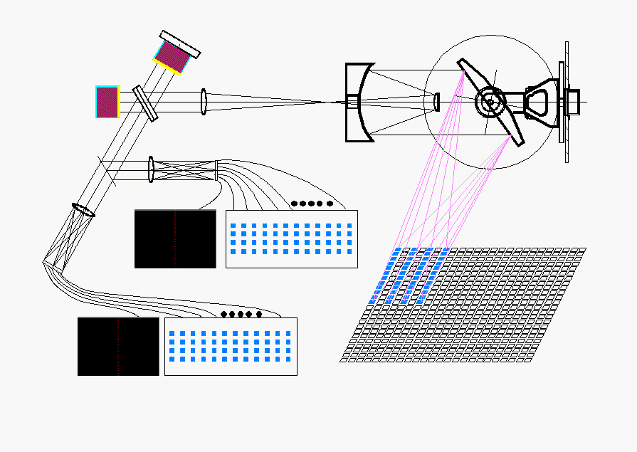
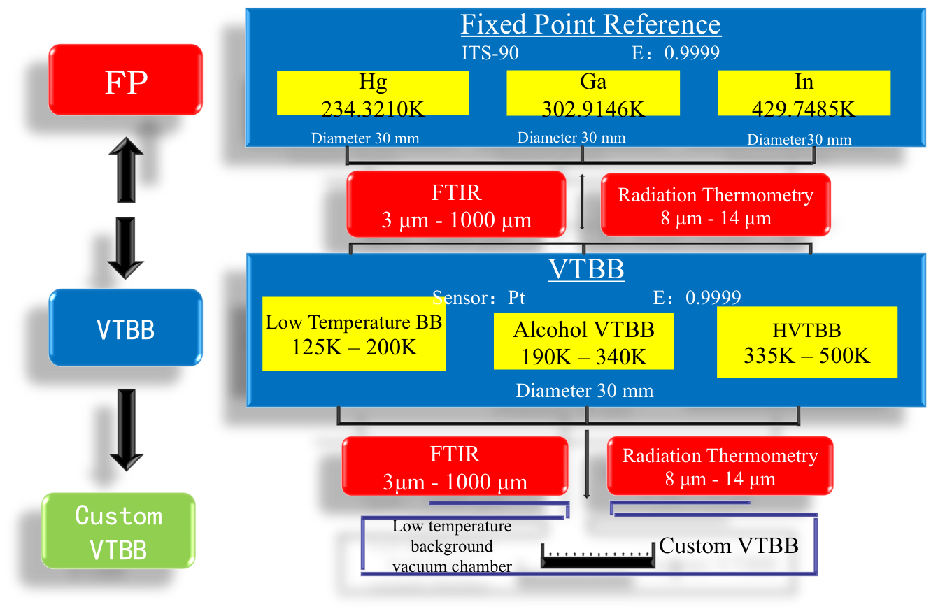
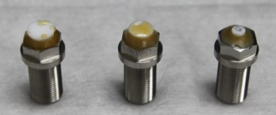
Space Radiometric Benchmark Reference of Infrared Spectral Segment
Key technologies for Infrared SI-traceable payload
Hyper-spectral infrared sounder
  Interferometer for space
  Detectors
  Temperature control
SI traceable blackbody
  miniature fixed point
  SI benchmark transfer
Vacuum Radiance Temperature Standard Facility
8

Slide 9
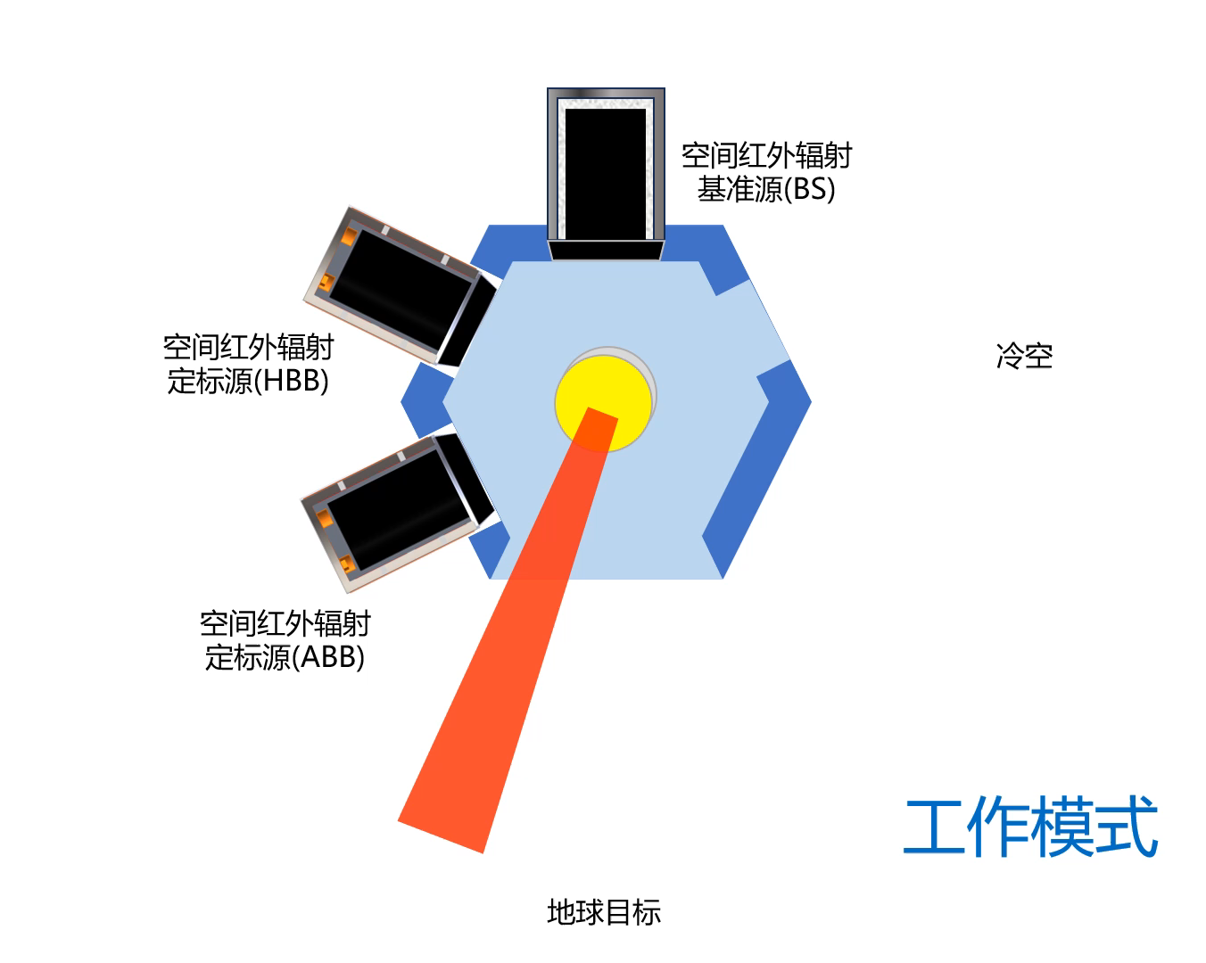
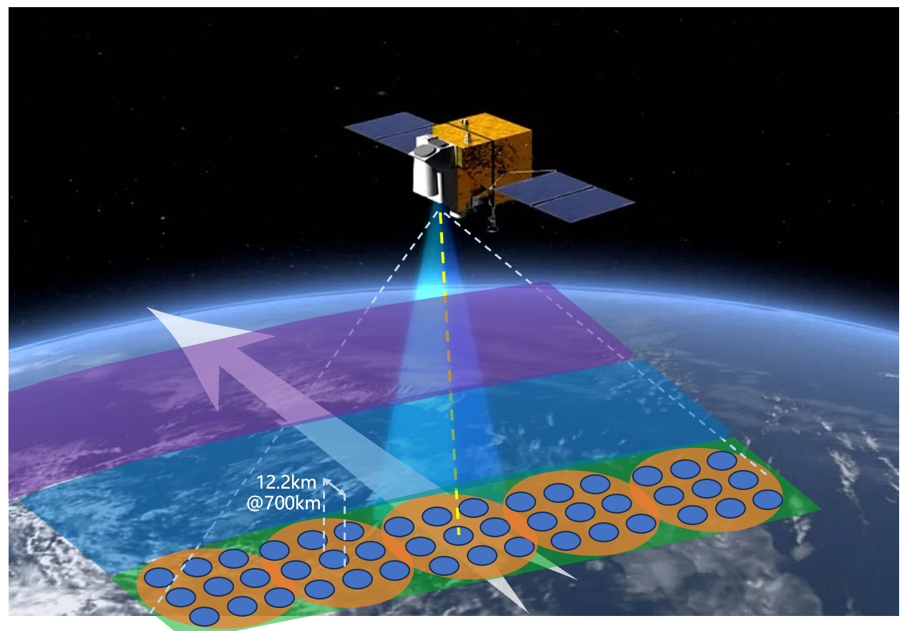
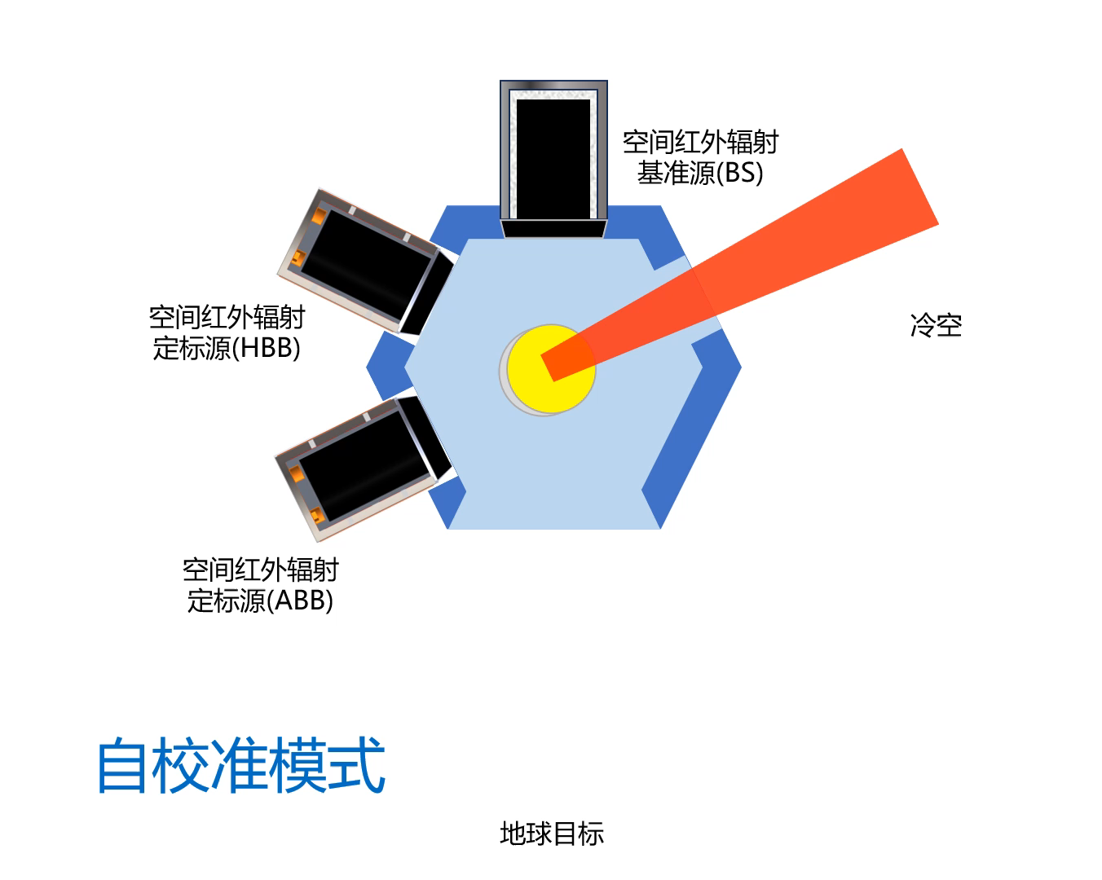
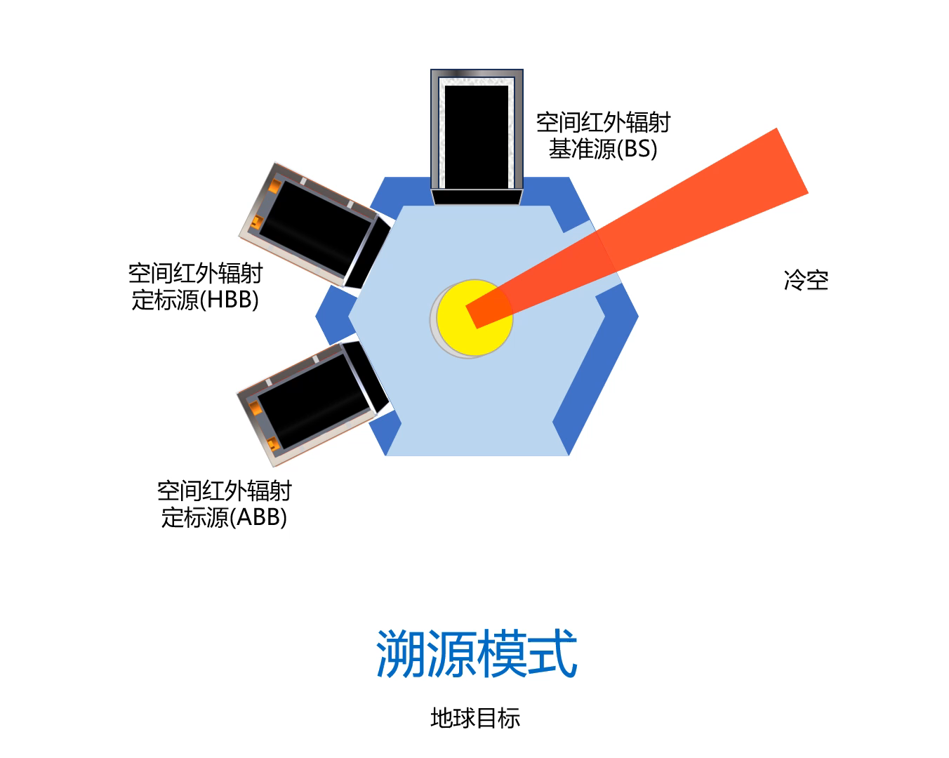
Space Radiometric Benchmark Reference of Infrared Spectral Segment
Technical Approach
Several modes
9
Notes:
左图是载荷电子学设计，其中包括二维扫描镜控制、干涉仪动镜控制、制冷系统控制、干涉信号获取及电子学管理与检测等。
右侧是工作模式，分为对地观测模式、自校准模式和溯源模式三种
这张是载荷结构示意图，分为空间红外辐射基准源、空间红外辐射变温定标源、低温定标源、望远镜、冷箱、制冷机、扫描镜和干涉仪

Slide 10
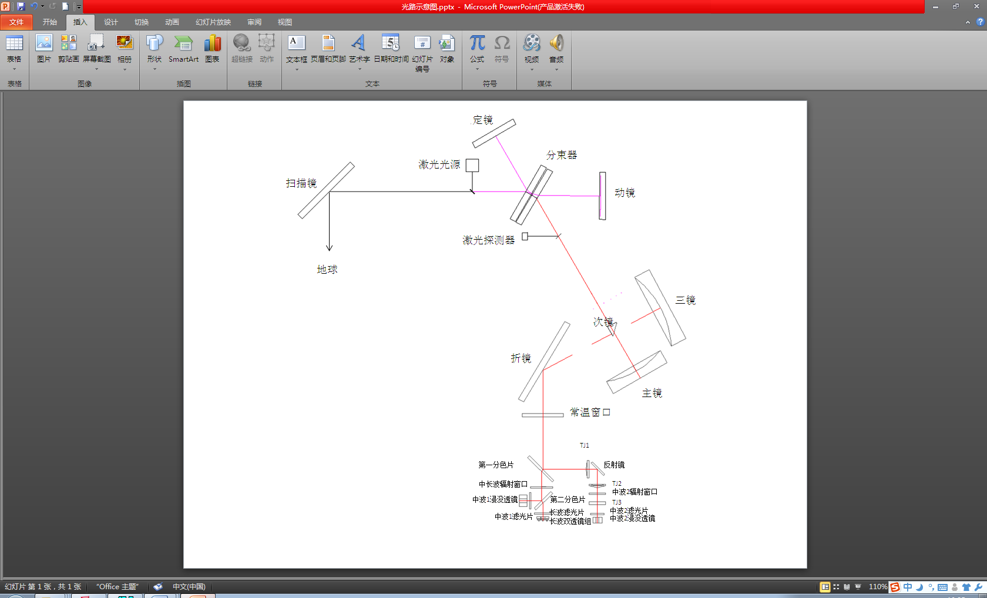
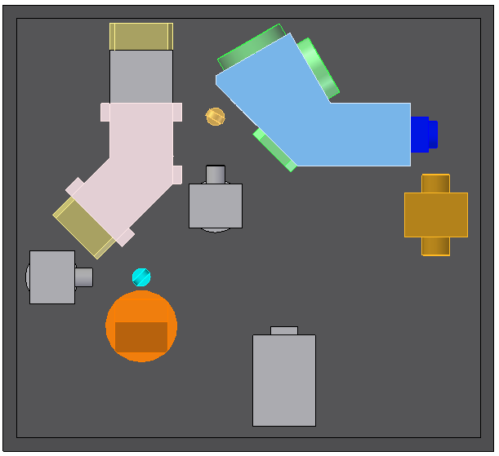
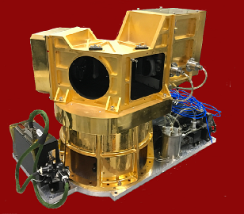
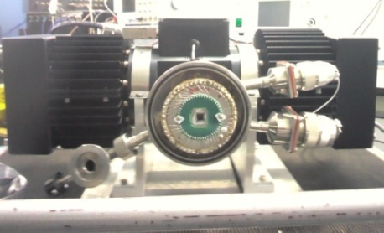
Space Radiometric Benchmark Reference of Infrared Spectral Segment
Uncertainty 0.085K (k=1)
Foreward interferometer
0.5cm⁻¹ resolution (±10mm)
0.852 μm diode laser for interferogram sample control
< 1ppm
10

Slide 11
Space Radiometric Benchmark Reference of Infrared Spectral Segment
Technical Approach
Scientific goals
Multi-source infrared remote sensing data is difficult to trace back to a common spectral radiance benchmark
Develop an infrared spectral radiation benchmark payload engineering prototype that can work in a vacuum and low temperature environment
Uncertainty evaluation model of infrared radiation source traceability based on cross-calibration time and space parameters
Interfero-meter
Optical system
Sensor
Electronics
Mechanics
Thermal Control
Radiation reference source
Research content
Key techno-logies
Weak signal detection
Mid- and long-wave infrared high-sensitivity detector
Nonlinear compensation
Low temperature integrated low power preamplifier
Flutter Isolation Structure
Temperature correlation control of multi-temperature zone structures
Spurious Immuno-Optical Surface Materials
Lightweight integration of traceability structure
Rapid traceability process design

Slide 12
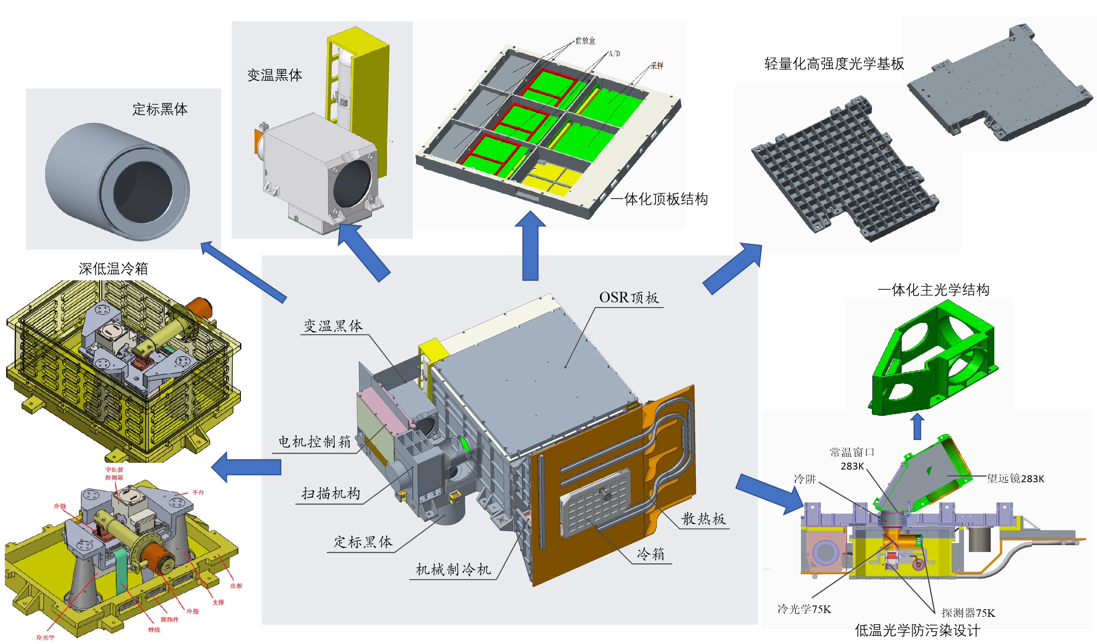
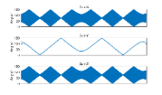
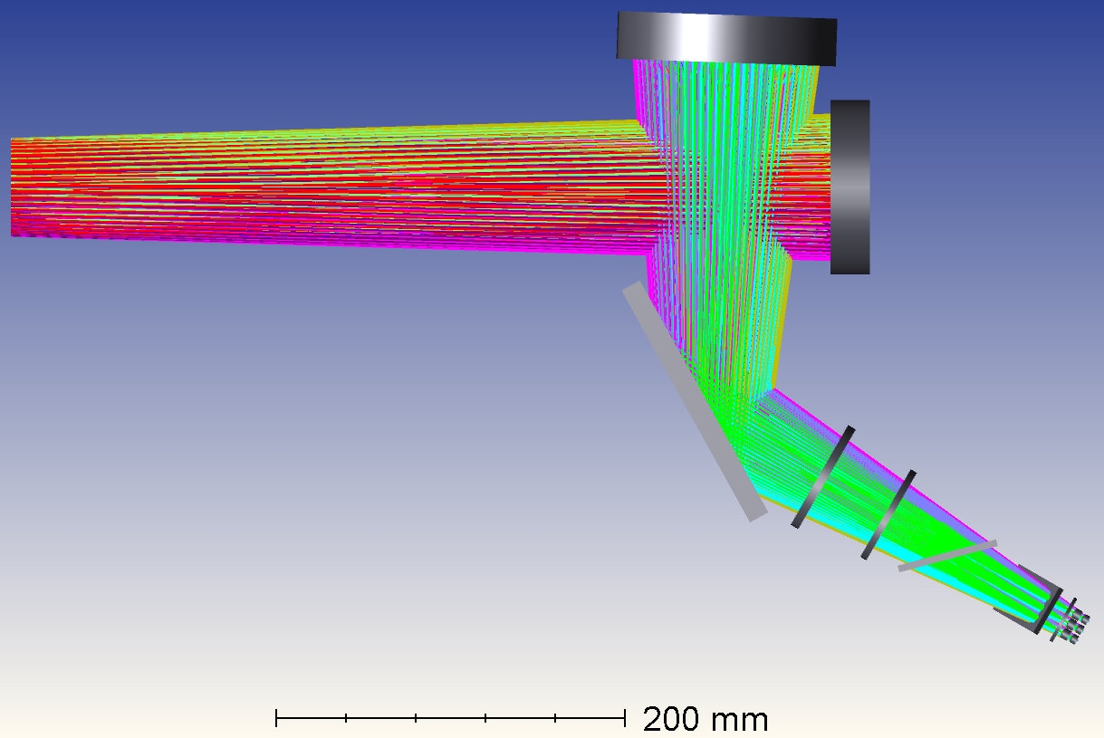
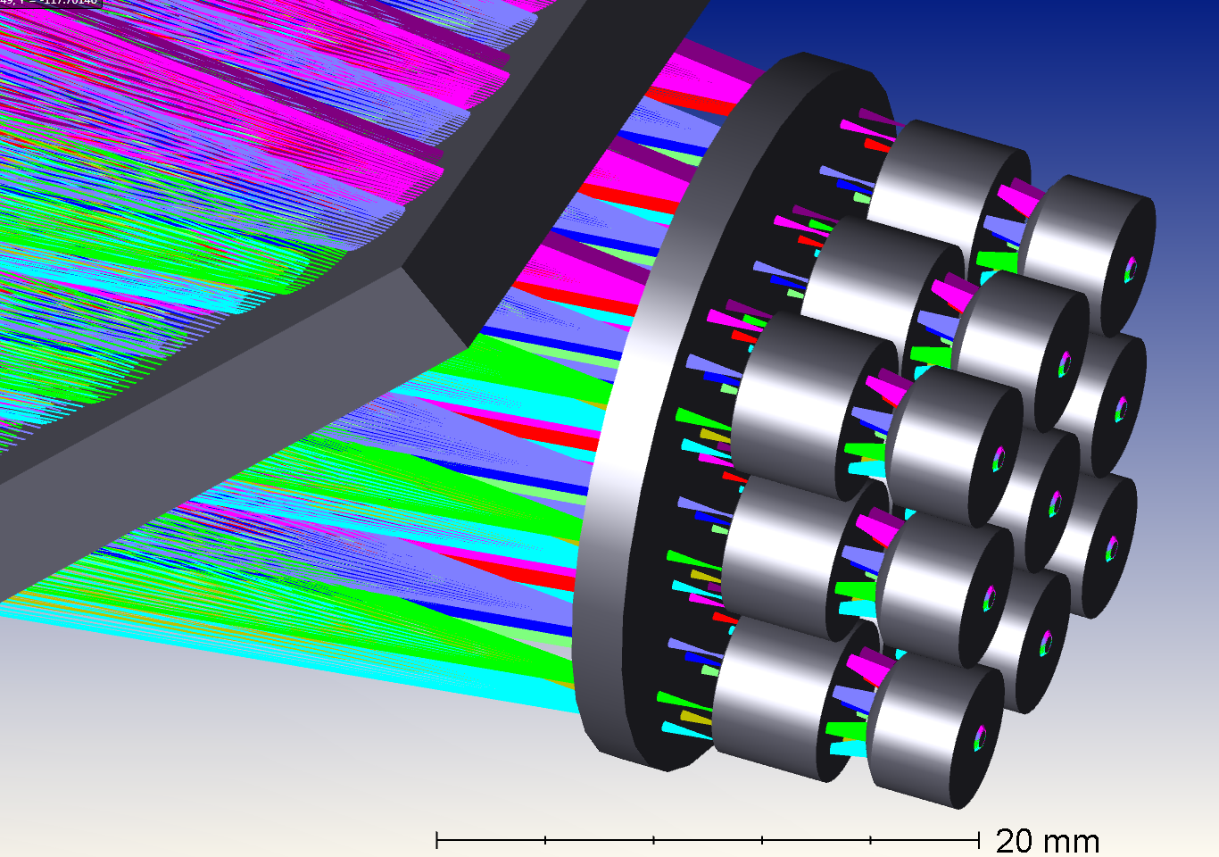
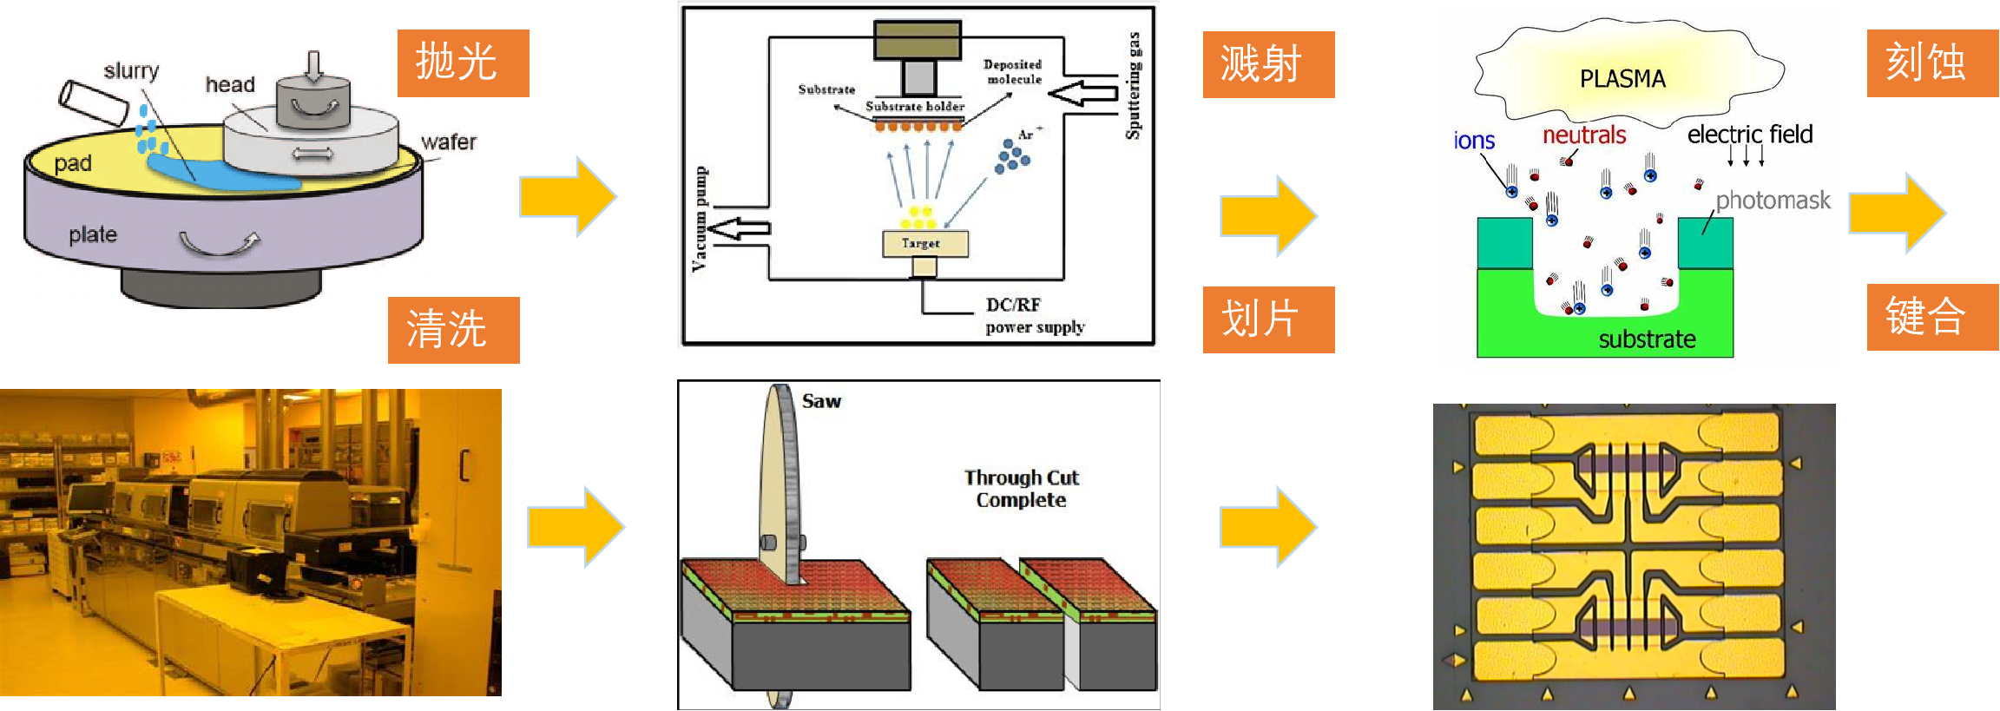
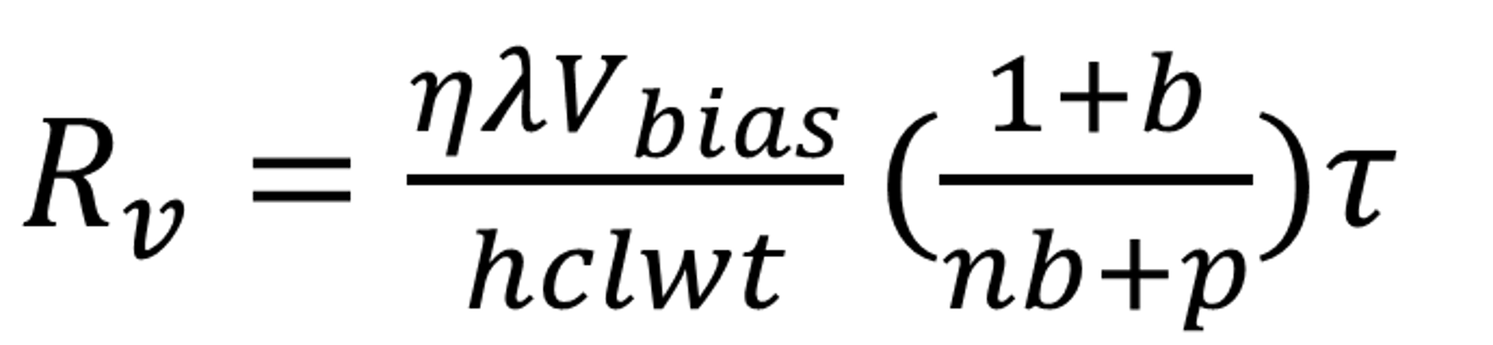
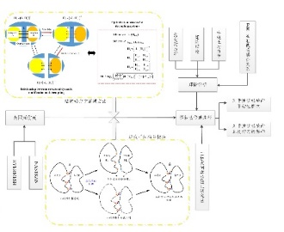
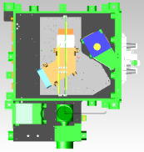
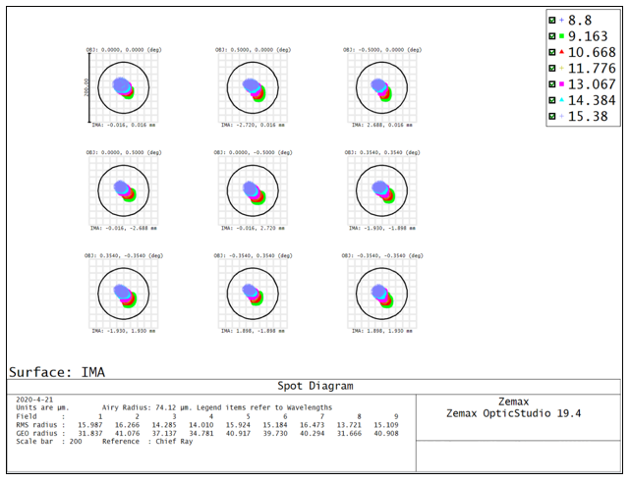
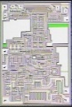
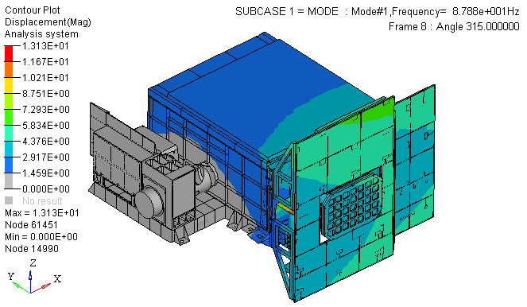
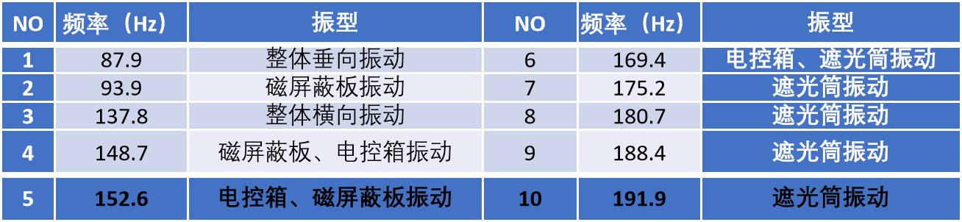
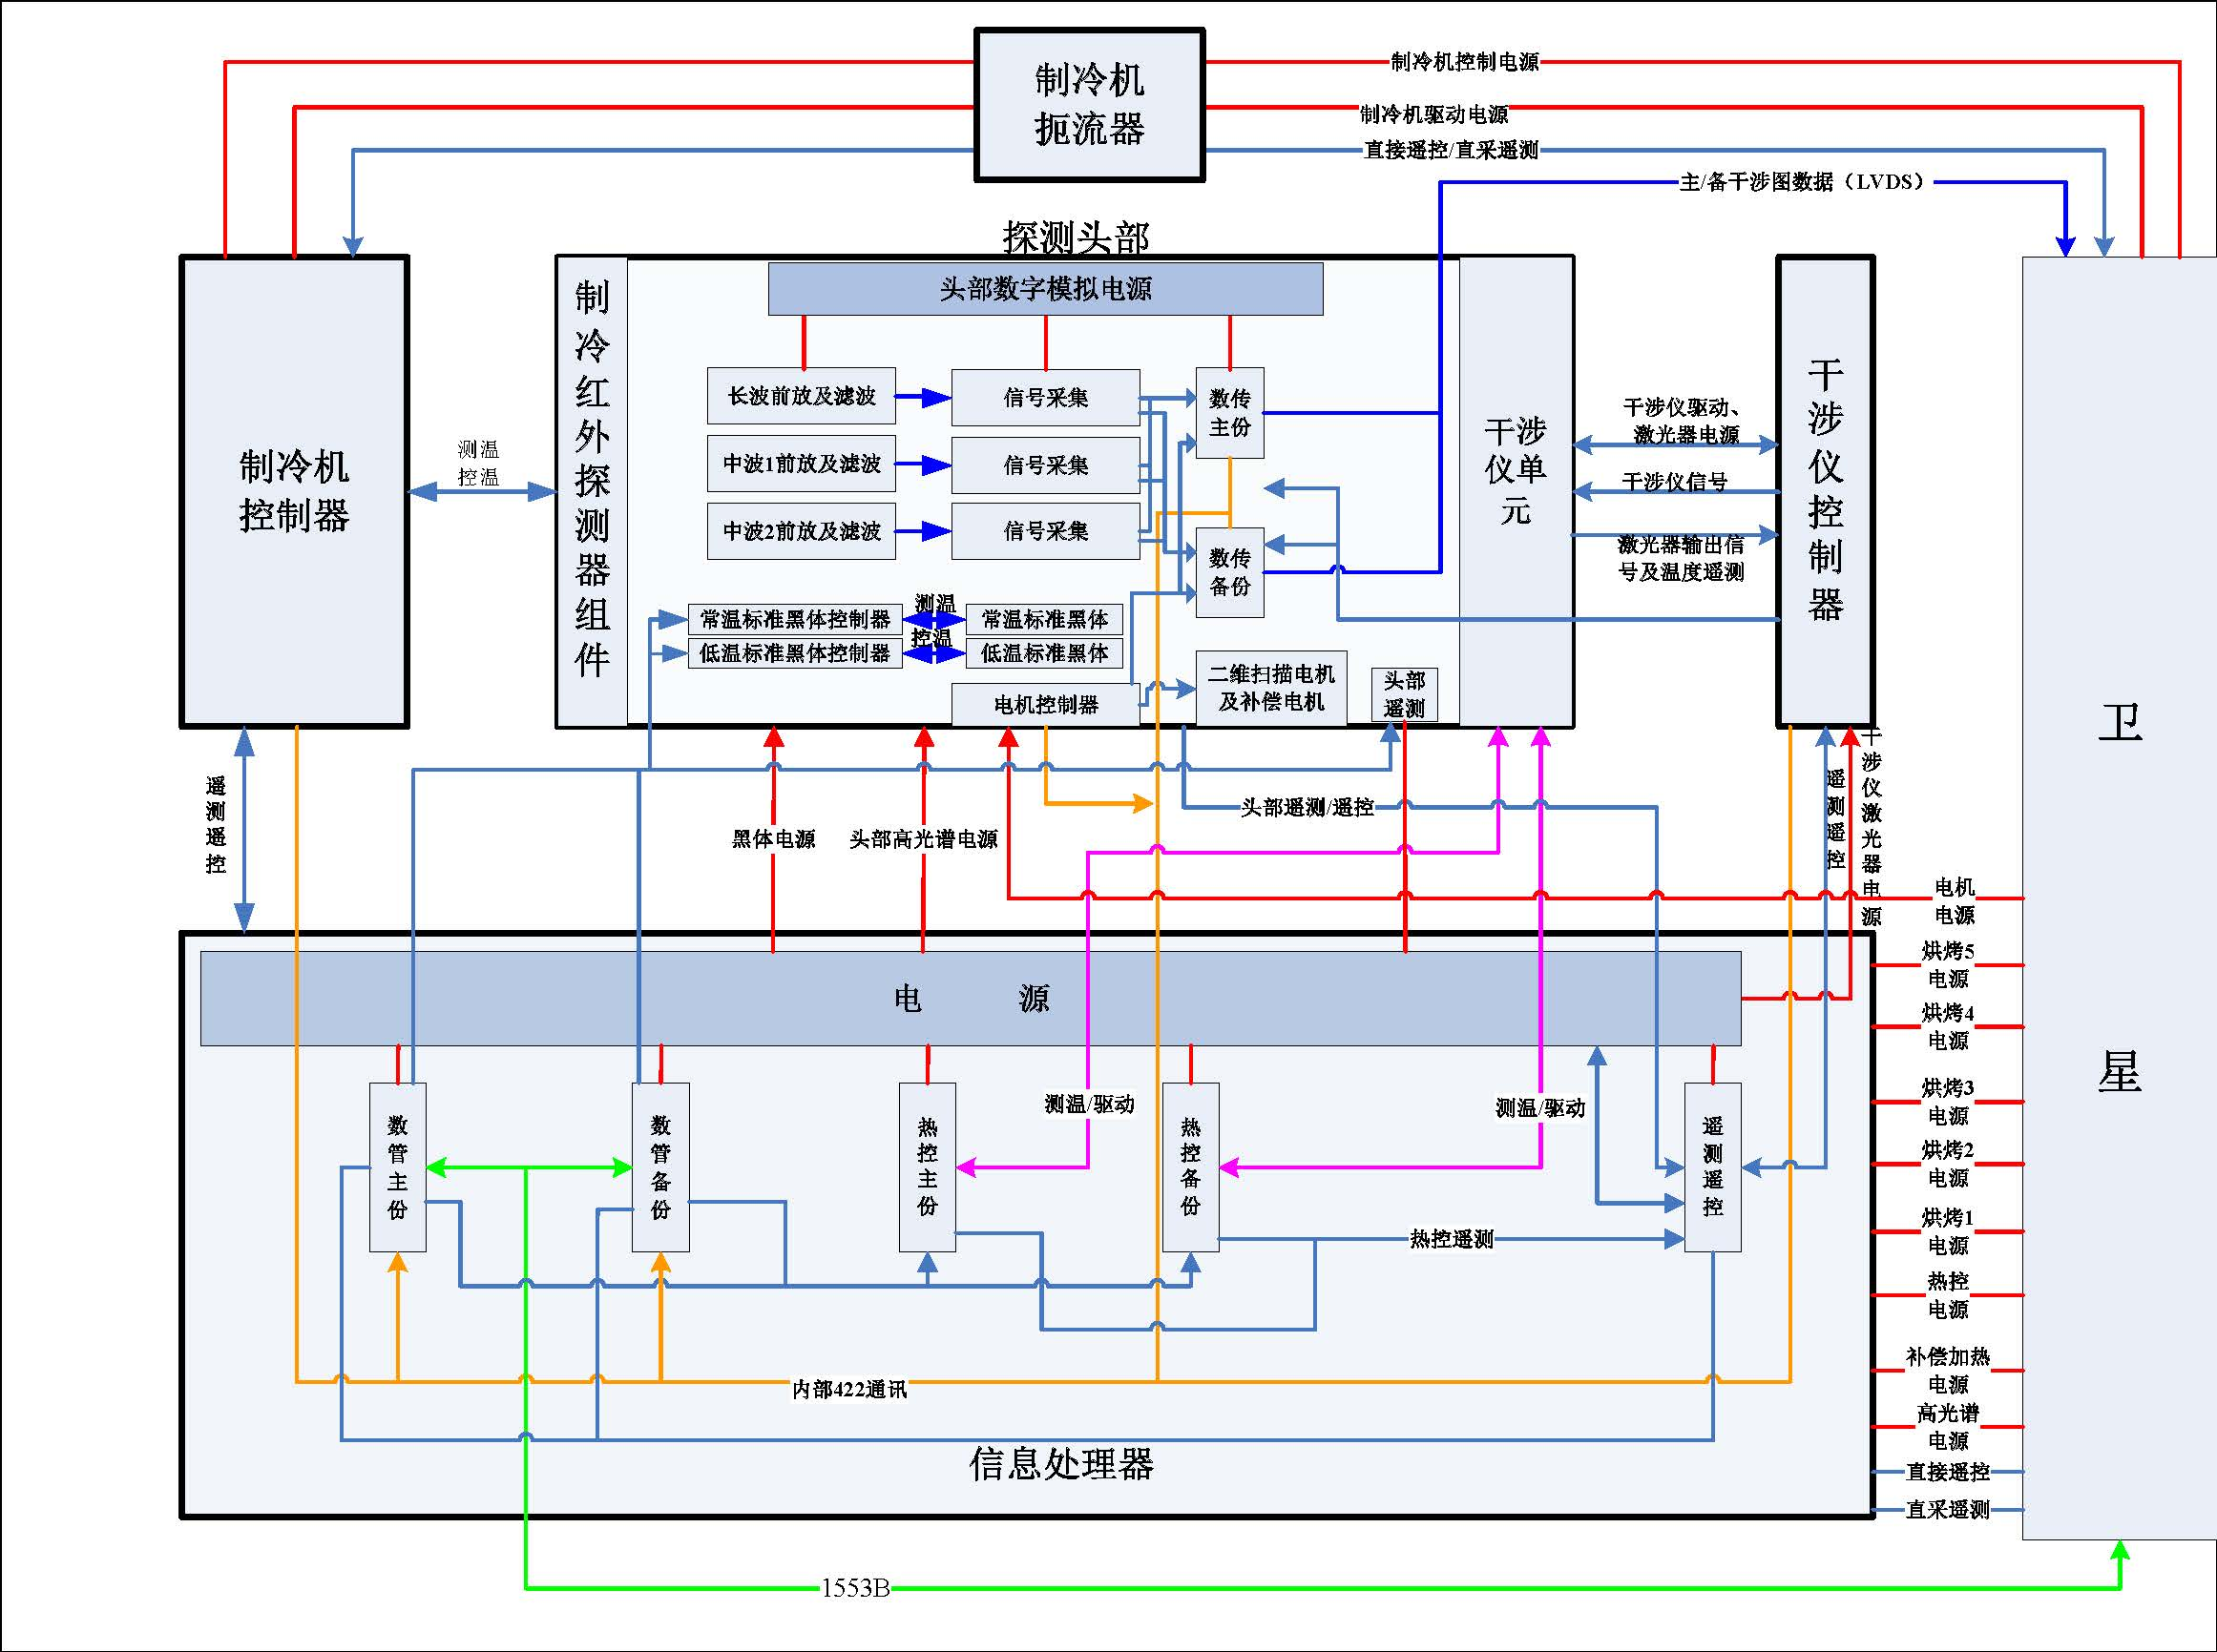
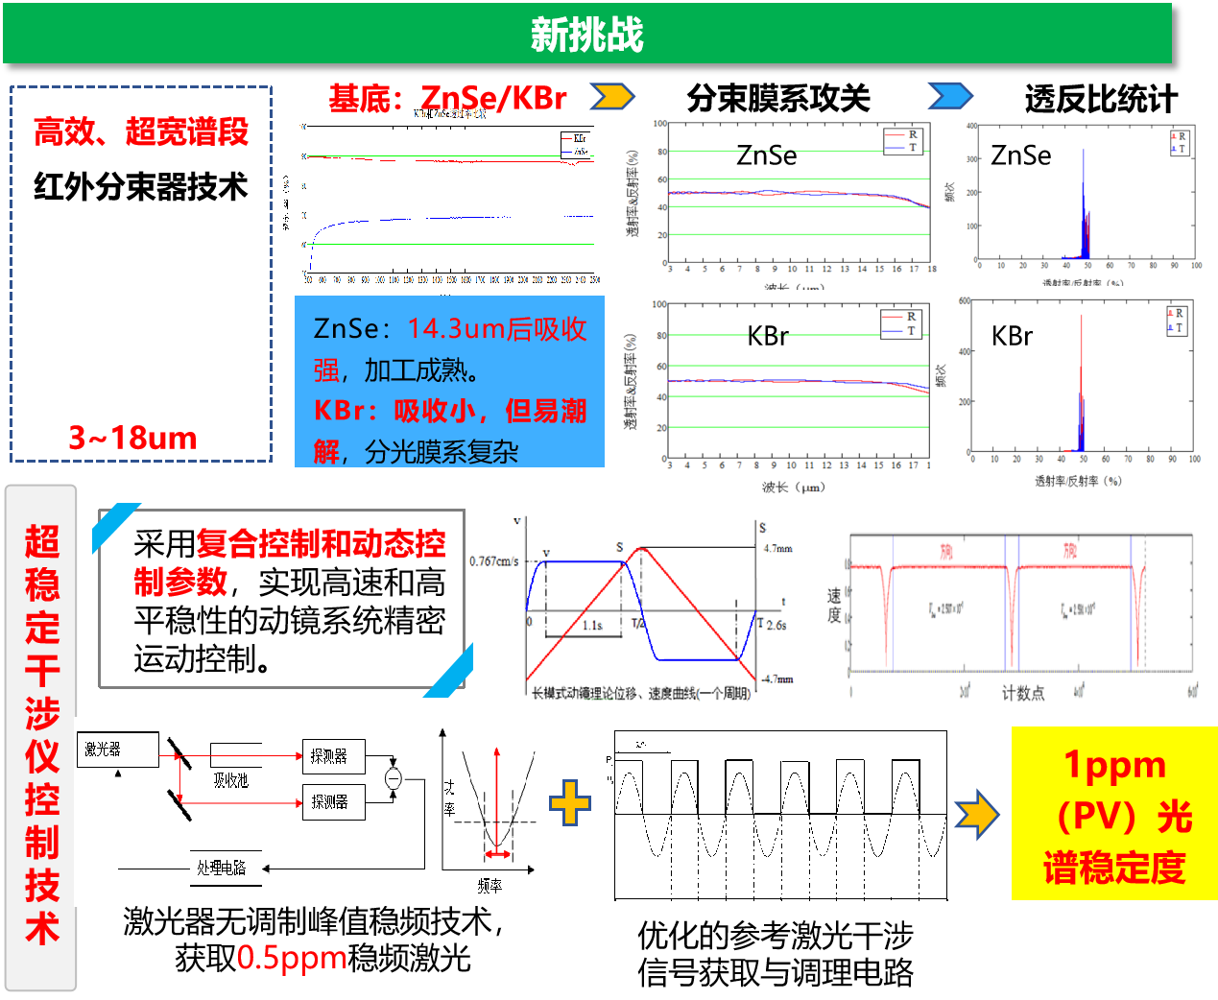
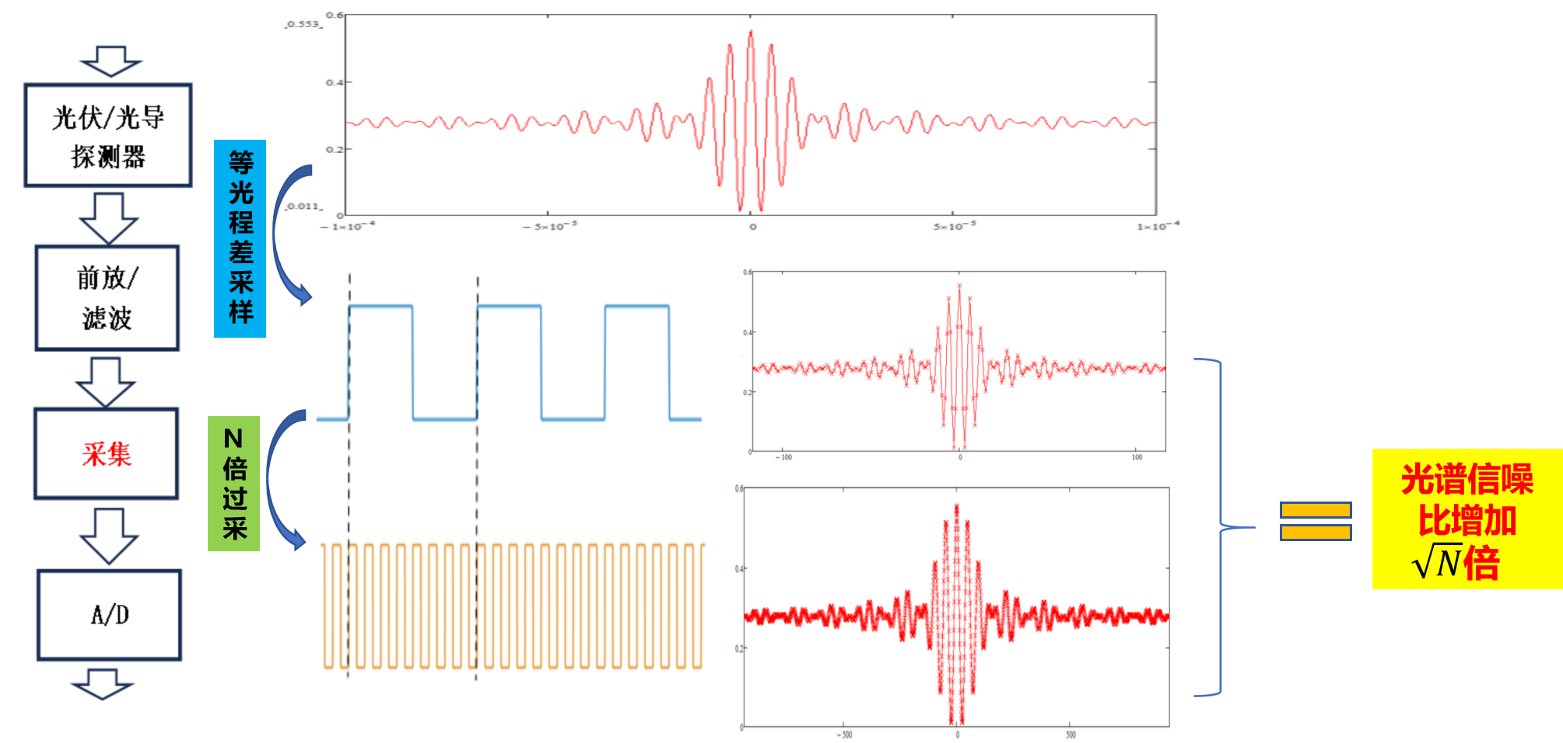
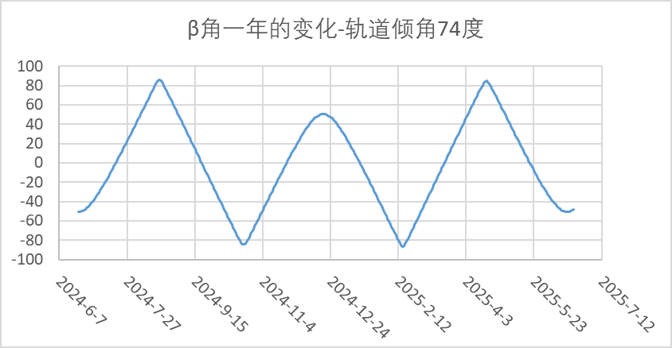
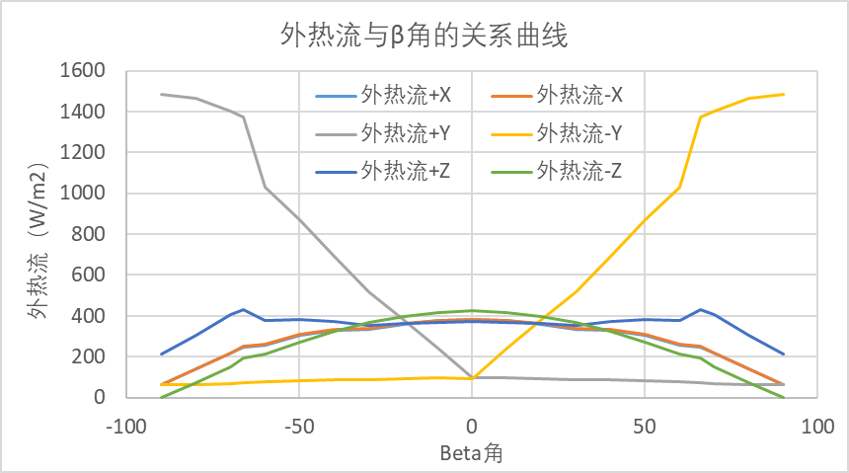
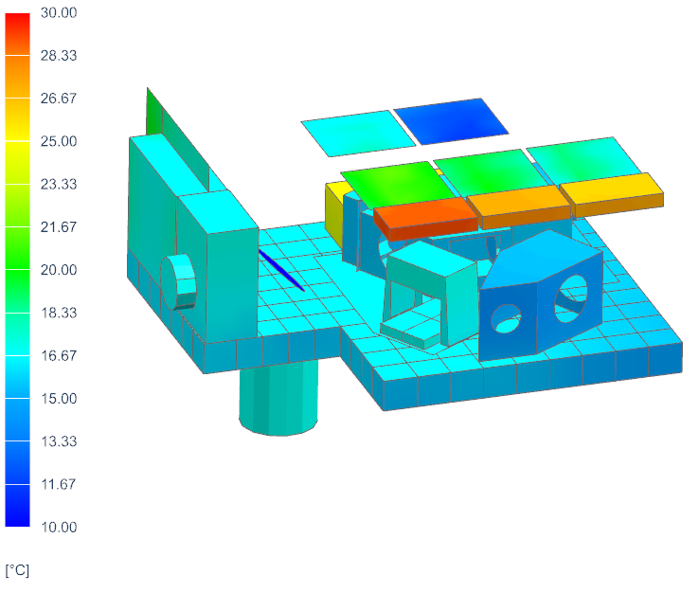
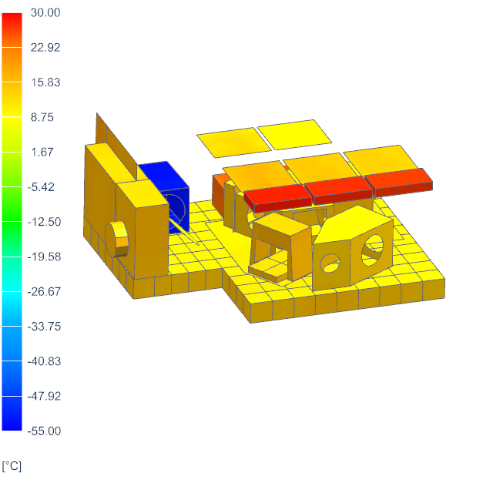
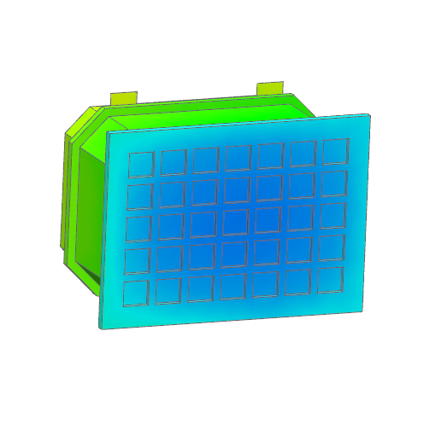

Space Radiometric Benchmark Reference of Infrared Spectral Segment
Technical Approach
Optics
IR detector
Mechanics
空间复杂外部杂散光识别与抑制
光学设计和仿真
甚长波红外
探测器
响应非线性物理机制和测试
震动耦合链路仿真与抑制
结构设计和仿真
低温前置放大和集成
Electronics
Interferometer
微弱信号极限探测原理
Temperature control
全年外热流仿真
多温区热控仿真
12
Notes:
对载荷关键子部件的技术难点识别与攻关，最终可实现红外辐射基准载荷的红外探测器、分束器、光学薄膜等全部组件的自主研制

Slide 13
Space Radiometric Benchmark Reference of Infrared Spectral Segment
Progress & Achievements
Uncertainty evaluation of space infrared radiation benchmark payload
Uncertainty System Analysis
Type | Items | Uncertainty Sources
Radiometric Calibration Uncertainty | u(T_{R,ICT}) | System temperature stability and non-uniformity
 | u(T_{R,ST})
 | u(a₂) | FTS uncertainty relation
 | u(C_{ICT}) | Interferometric efficiency uncertainty, detector temperature stability, measured complex spectral noise
 | u(C_{ECT})
 | u(C_{ST})
 | u(V_{ICT})
 | u(V_{ECT})
 | u(V_{ST})
 | SCR*R_{ECT} | Stray light
Uncertainty of infrared radiation reference source | Temperature u1 | Thermometer calibration, phase change reproducibility, temperature control stability, temperature uniformity, measurement noise
 | Emissivity u2 | Blackbody temperature, heated halo temperature & emissivity, ambient temperature, radiation measurement noise, radiation angle coefficient
 | Ambient temperature u3 | measurement noise
The uncertainty u_{a2} of the nonlinearity of the system response is recorded as the uncertainty of the nonlinear contribution a2.
The combined uncertainty of the DC quantities V_{ECT},V_{ICT},V_{ST} is u_{v}.
The combined uncertainty of the radiation spectra C_{ECT},C_{ICT},C_{ST} is u_{C}.
There are uncertainties u_{εICT}, u_{εST} , u_{TICT}, u_{TST} of the high-temperature & the low-temperature calibration radiation source.
Temperature changes of the temperature field inside the instrument will also introduce uncertainty u_{TR}.
Notes:
本团队针对空间红外辐射基准载荷的辐射测量不确定度进行了详细设计评估，从辐射定标方程的角度进行工程化适配，分解并识别各子项不确定度来源，如非线性、探测直流量、辐射光谱、载荷内部高温定标源和低温定标源的发射率和温度不确定度，仪器内部温度场等

Slide 14
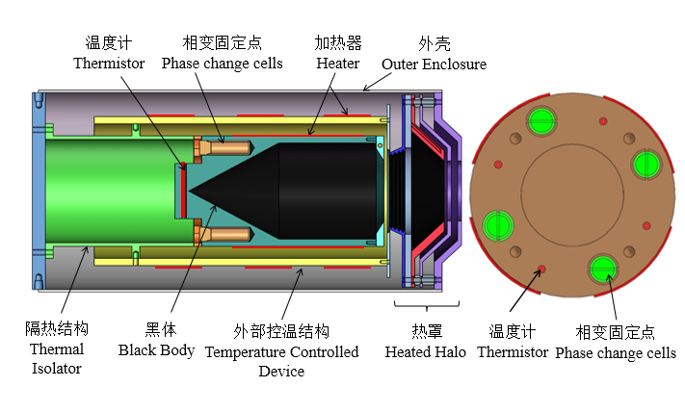
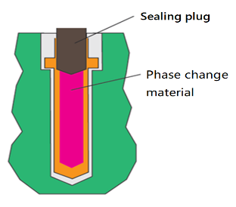

Phase change cells
Quantitative traceability technology
Design of Miniature Phase Change Cells
Miniature Phase Change Cells Perfusion system
Perfusion and encapsulation
Electron beam welding
Leakage
Tightness test
Data acquisition system
Temperature reproducibility measurement
Temperature controller
The Power Supply
Standard platinum resistance thermometer
Value comparison between Micro Phase Change Cells and National temperature reference
Miniature Phase Change Cells
Miniature phase change gallium fixed point variable temperature space reference black body
14

Slide 15

Phase change cells
Miniature Gallium Fixed Point
There are 4 crucibles filled with gallium and fixed on the bottom of the blackbody.
Designed heating circuit is used to provide stable heat flow into the blackbody.
The temperature of gallium is very stable during the phase change process.
A system of miniature gallium fixed point onboard blackbody radiation source was added on HIRAS of FY-3E satellite.
15

Slide 16

Phase change cells
Phase change cells' stability testing has been carried out
Miniature Ga phase change cell
Miniature Ga-In phase change cell
16

Slide 17




Phase change cells
4 temperature miniature fixed point from 270K to 350K；
With 4 high stable PT；
Measuring the whole range with calibrated PT
Temperature Uncertainty of the blackbody ≤84 mK（k=2）
类别 性能 | H₂O | Ga-Sn | Ga | 水杨酸苯酯
稳定性（mK） | 3.9 | 1.5 | 2.0 | 1.0
温坪值（K） | 273.339 | 293.779 | 303.262 | 315.137
Phase change fixed points,
stability ≤10 mK（k=2）
17

Slide 18

Phase change cells
Facility
计算机
18

Slide 19

Phase change cells
Simulation Emissivity
Material | Al
Diameter of cavity | 44 mm
Diameter of Aperture | 24 mm
Depth | 79 mm
Angle | 60°
E of coating | 0.92
STEEP3 0.9970
19

Slide 20
Phase change cells
Result
DATE | BB T（K） | HH T（K） | Diff HH BB（K） | A T（K） | RT T（K） | E
2014/11/6 | 305.09 | 364.34 | 59.25 | 299.25 | 305.40 | 0.9963
 | 303.60 | 379.28 | 75.69 | 299.65 | 304.04 | 0.9955
2014/11/5 | 303.01 | 347.24 | 44.24 | 299.55 | 303.45 | 0.9958
 | 303.39 | 363.31 | 59.92 | 300.15 | 303.87 | 0.9959
 | 305.92 | 381.65 | 75.73 | 300.45 | 306.33 | 0.9958
2014/11/4 | 302.95 | 347.01 | 44.06 | 300.05 | 303.38 | 0.9962
 | 303.22 | 379.06 | 75.85 | 299.85 | 303.70 | 0.9951
2014/10/17 | 301.36 | 361.38 | 60.02 | 295.85 | 301.55 | 0.9967
2014/10/15 | 301.86 | 359.91 | 58.05 | 295.75 | 301.97 | 0.9974
2014/10/14 | 294.33 | 356.93 | 62.60 | 294.75 | 294.46 | 0.9965
平均值 |  |  |  |  |  | 0.9961
标准差 |  |  |  |  |  | 0.07%
10 times measurements during 20 days. The average of E is 0.9961，SD 0.07 %。
20
Notes:
基于以上的实验装置，在20天内测量了10次黑体空腔发射率，发射率的平均值为0.9961，标准偏差为0.07 %。

Slide 21


Phase change cells
Facility
21

Slide 22

Phase change cells
Miniature Fixed Point
Ga miniature fixed point
Fixed points are used to define the ITS-90.
The miniature fixed points as the standard are used to calibrate the thermometers working on the on-orbit blackbody.
Platform 2 h
Melting point at 303.113 K with SD 1 mK.
The bath keep at 302.75 K
Heat the cavity with 0.1W.
22

Slide 23
Phase change cells
The curve of melting at different power
The bath keeps at 302.75 K，the power of cavity heater is 0.066 W，0.0466 W and 0.033W
Ga melting point temperature （111.573 Ω）。
23
Notes:
固定点腔内金属的含量是一定的，相同质量的金属完全相变吸收的能量是相同的，所以加热功率越大金属相变的时间就会越短。同时随着加热功率的增加，黑体的升温速率也会变快，黑体的热惯性变大。
应该使用小加热功率加热黑体保证黑体的升温速率足够小。

Slide 24


Data colletced in experiment
The momentary temperature when the phase change is finished is called the inflection point.
The inflection point has a relationship with the heating power. For unchanged heating power, the inflection point will have a good reappearence.
In the experiment with the blackbody only, the reproducibility of the inflection point is better than 0.03K.
In the on-orbit mearsurement, inflextion point can be observed clearly. When the heating power is 4.11W, the inflextion point is 304.1K.
The relationship between the heating power and the inflection point is being analyzed with modeling.

Slide 25


Space Radiometric Benchmark Reference of Infrared Spectral Segment
Stability of the thermometer
Thermometry bridge
Test Methods: Precision platinum resistance thermometer placed in a temperature annealing furnace (150At ℃) annealing from about2h /Times, by accurately measuring the temperature of the bridge at the triple point of waterResistance thermometerR_{tp}; Then place it into-80Alcohol ℃ of the bath to about annealed 2h /Times, and then measured in the temperature measuring bridge triple point of waterResistance thermometerR_{tp}. Upper and lower limits for the heat treatment after a heating cycle, thermal cycling of the thermometer by multiple triple point of waterR_{tp}Precision measurements to calculate the stability of platinum resistance thermometer.
data processing: Multiple triple point of waterResistance thermometerR_{tp}Measurements to calculate the standard deviation.
Annealing furnace
National benchmarks Water Triple Point
time | R_{tp}/Ω
 | 2017078 | 2017073
2017.04.18 | 99.95399 | 99.79355
2017.10.19 | 99.94917 | 99.79591
2018.01.11 | 99.95041 | 99.79589
2018.01.19 | 99.94864 | 99.79627
average value/Ω | 99.95030 | 99.79541
standard deviation/mK | 4.8 | 3.1
Low-temperature alcohol groove
25

Slide 26



Space Radiometric Benchmark Reference of Infrared Spectral Segment
System Scheme
Broadband, large field of view infrared interferometer
Broadband, large size & small array infrared sensors
Multi-temperature zone infrared cryogenic optics technology
Efficient refrigeration for 50K temperature technology
Infrared interferometer
Response spectrum: 600 cm⁻¹~2700cm⁻¹
Spectral resolution: 0.5cm⁻¹
Infrared sensors
Circular center symmetry sensor
Effective detection of focal plane without metal reflective layer
Detection rate: 5×10¹⁰cmHz^{1/2}W⁻¹@77K
Cutoff wavelength: 17μm@77K, 18μm@60K
HgCdTe Infrared Sensor
26

Slide 27


Infrared sensors
Progress & Achievements: Broadband, large size & small array infrared sensors
Response spectrum test curve at 77K temperature
Chip performance has been greatly improved
Detection rate: 5×10¹⁰cmHz^{1/2}W⁻¹@77K≈ 1.7 × [3×10¹⁰cmHz^{1/2}W⁻¹D@77K(Last year)]
Cutoff wavelength: 17μm@77K
According to the study of the law of HgCdTe performance changing with temperature: 1×10¹¹cmHz^{1/2}W⁻¹ @60K
Cutoff wavelength: 18μm@60K in real test
27

Slide 28



Space Radiometric Benchmark Reference of Infrared Spectral Segment
Progress & Achievements: Interferometer system
Performance experiment of interferometer system at room temperature
Observe 80℃ and 130℃ black bodies respectively
Full band
Frequency stabilized narrow linewidth CO2 laser
Long wave end
Response spectrum:
600 cm⁻¹~2700cm⁻¹
Spectral resolution:
0.5cm⁻¹
Integrating sphere uniform light
Collimator
Short wave end
Infrared sensor
Fourier inversion
28

Slide 29



Space Radiometric Benchmark Reference of Infrared Spectral Segment
空间红外辐射基准载荷全链路不确定度评估
Uncertainty of Prototype
< 0.085K（k=1）
29
Notes:
根据红外辐射基准载荷辐射测量合成标准不确定度公式，可以得到载荷的各谱段不确定度结果，如图所示

Slide 30

谢谢！
www.sitp.ac.cn

