Slide 1


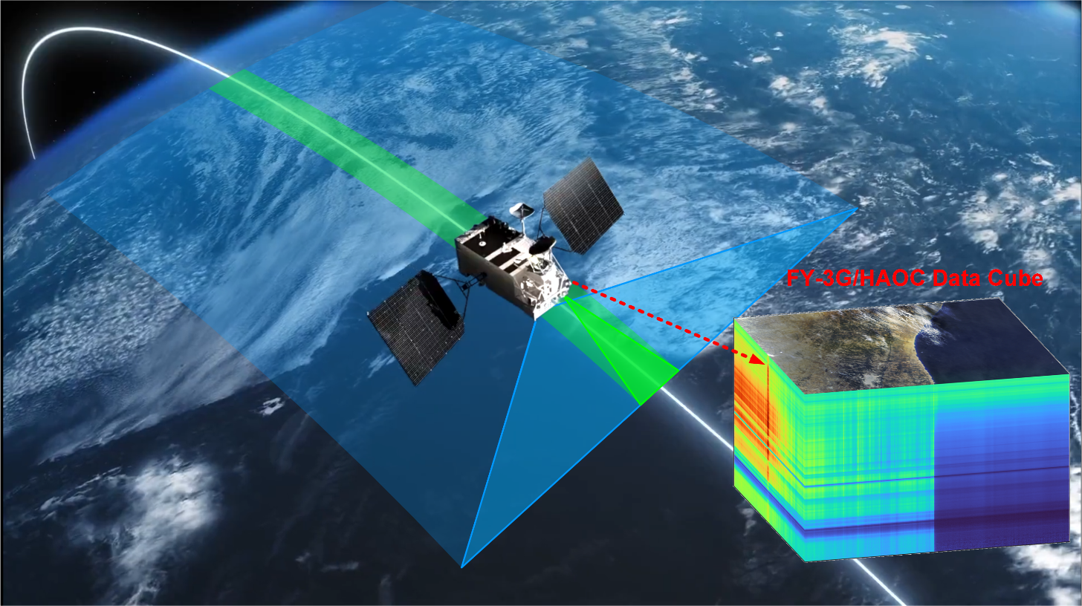



GSICS Annual Meeting
Mini Conference 1h
17 Mar. 2025, 10:05-10:25
Overview of FY-3G/HAOC Instrument and On-orbit Performance
Lu Lee^{1*}, Feng Jiang^{2*}, Weichu Yu*, Lei Ding², Xingwei He^{1*}, Jian Shang¹, Xiuqing Hu¹
*FY-3G HAOC Calibration and Validation Team
1. National Satellite Meteorological Center (NSMC), CMA
2. Shanghai Institute of Technical Physics (SITP), CAS
Mar. 17-19, 2025, Changchun, China

Slide 2
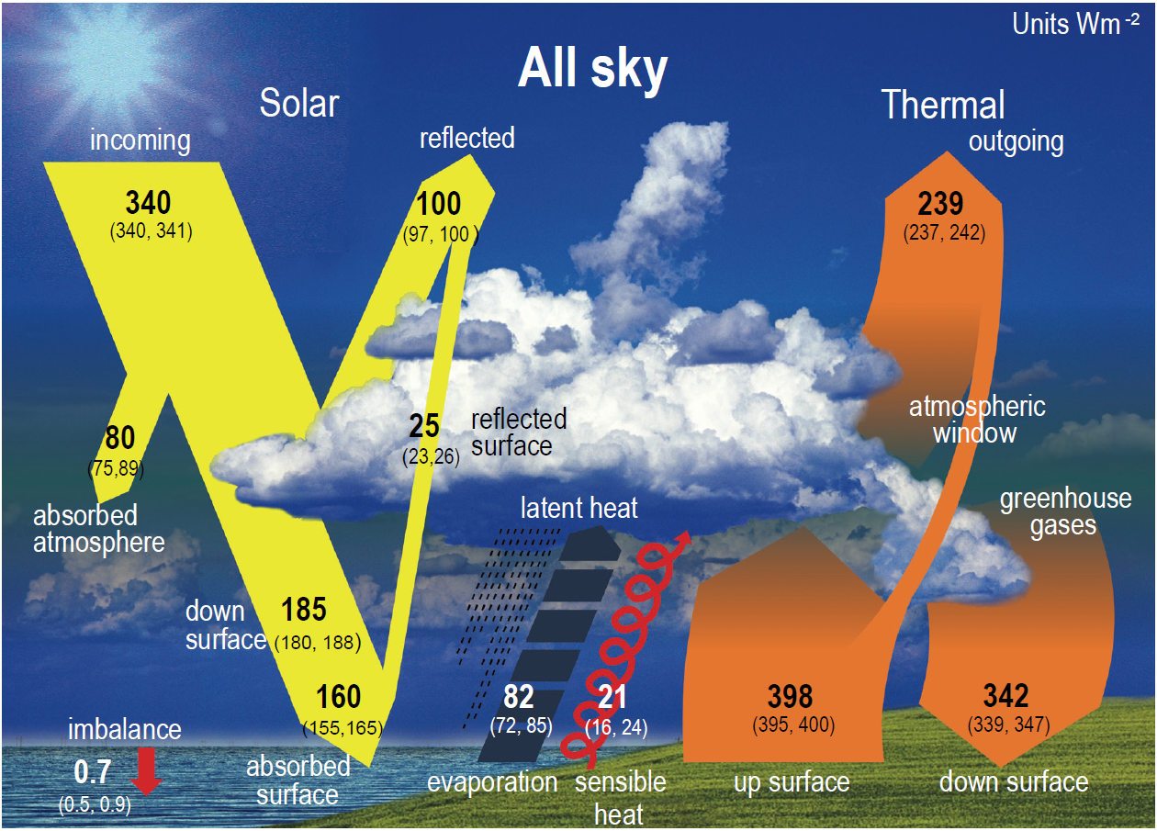
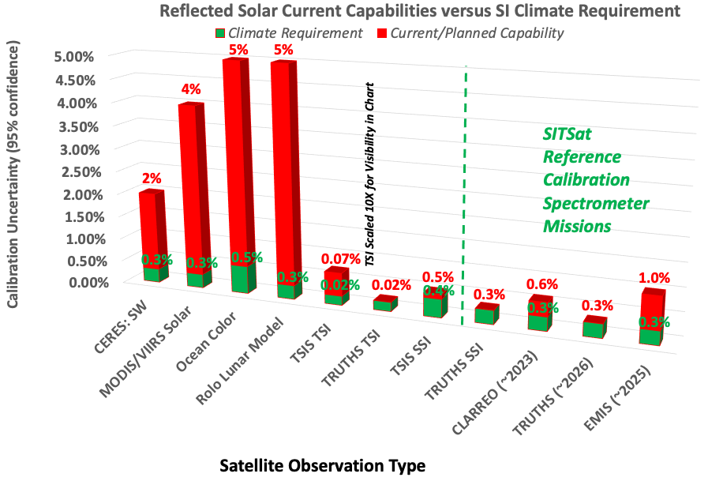
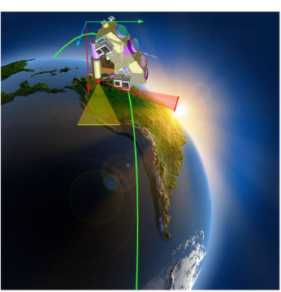
1. Science requirements of SITSat
Credit: IPCC, WGI, 2021.
Credit: SITSCOS Workshop Report, 2019.
Climate change is one of nowadays most compelling issues that impact all of humanity. In the reflected solar spectral region, uncertainty in cloud feedbacks is the main driver of uncertainty in climate sensitivity.
Due to satellite launch and sensor aging in the space environment, Current satellite instrument capabilities cannot meet the climate requirements in the RS spectral region
CLARREO PATHFINDER – NASA
TRUTH – ESA
CSRB – CAS&CMA
SI-Traceable satellites (SITSats) missions (CLARREO, TRUTH, CSRB) will provide a long-term, global climate record with high accuracy, and tie the measurements to the SI primary standards.
Notes:
A series of SI-Traceable space missions are under development (CLARREO, TRUTHS, CSRB). The new instruments will provide higher absolute calibration accuracies than current sensors, and tie the measurements to the SI primary standard using the end-to-end verification with the onboard absolute radiance standards.

Slide 3
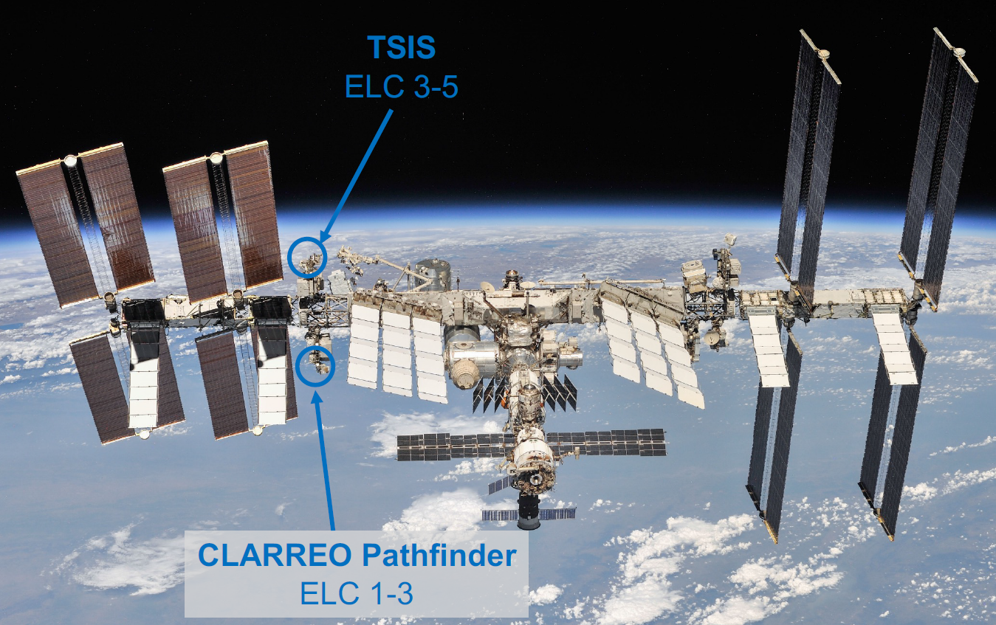
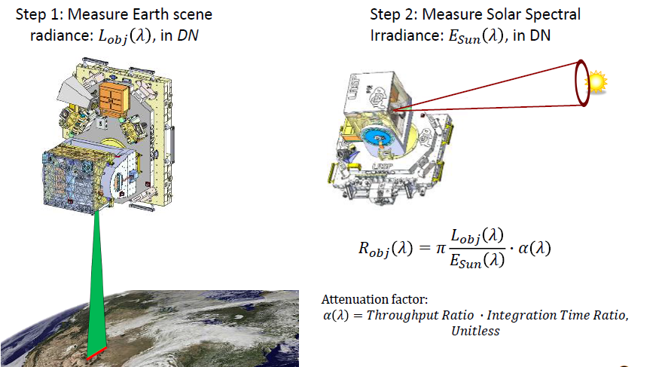
1. Science requirements of SITSat
TRUTHS and CLARREO Pathfinder (CPF) have different routes to obtain SI traceability.
The TRUTHS satellite achieves and evidences its low SI-traceable uncertainty through regular re-calibration of its hyperspectral imaging spectrometer (HIS), on-board, directly linked to a space-borne primary reference standard, a cryogenic solar absolute radiometer (CSAR). (Javier Gorroño, etc. 2024)
The CPF uses a ratio method to determine the Earth reflectance, takes the Sun as an on-orbit reference source, and use the solar spectral irradiance observed by the other solar irradiance spectrometer (such as TSIS/SIM) to trace the reflected-solar radiation to the SI standard for the watt. (Bruce Wielicki, etc. 2013)
Credit: Yolanda L. Shea, et al.
A High-Accuracy On-board Calibrator (HAOC) carried by FengYun-3G satellite is launched to demonstrate the solar cross calibration technique and improve the calibration accuracy of medium-resolution spectral imager (MERSI) of FY-3 satellites.
Credit: Credit: Greg Kopp, et al.
Solar Cross Calibration technique utilized by CPF
Notes:
In order to demonstrate and verify the solar cross calibration technique HySICS, China decided to deploy a HySICS-like instrument in an inclined orbit outside the LIBRA program. This is the High-Accuracy On-board Calibrator (HAOC) onboard FengYun-3G (FY-3G) satellite.

Slide 4
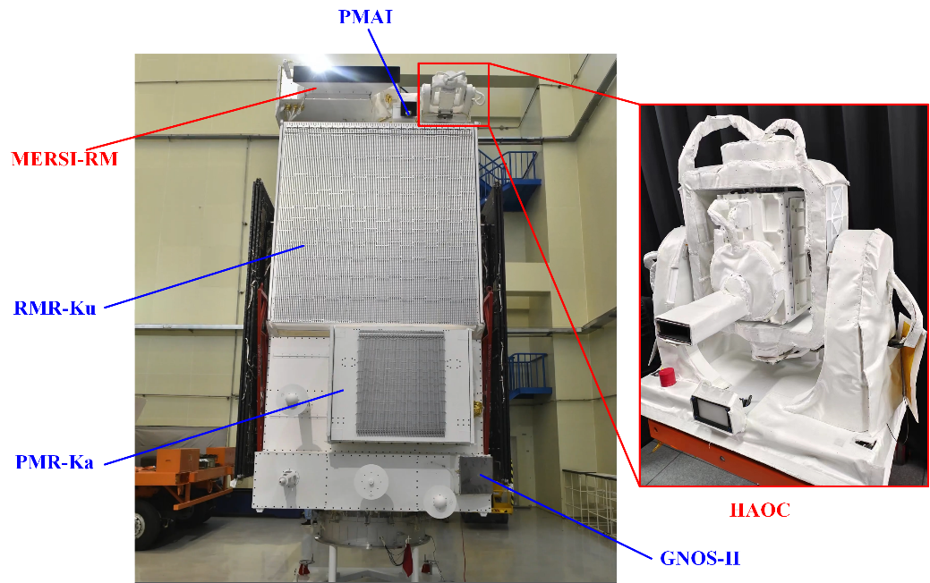
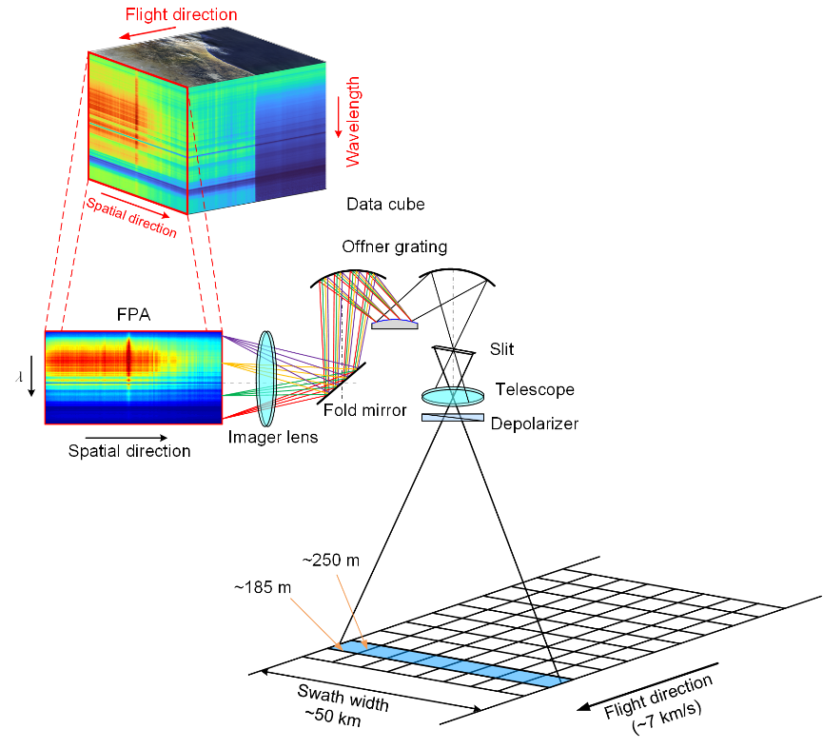
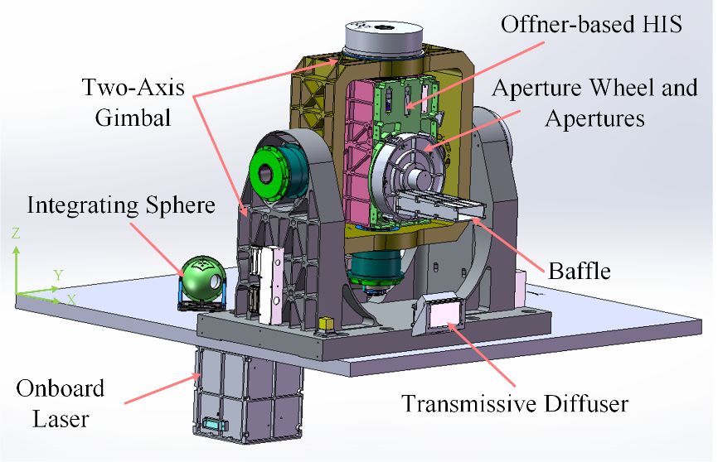
2. Overview of FY-3G/HAOC instrument
Key requirement | Value
Spectral Range | 400 nm – 1060 nm
Spectral Resolution | 4 nm (1.5-nm sampling)
Radiometric accuracy | 2% (k=1)
Polarization Sensitivity | ≤1%
Swath Width | 7° (~50 km at Nadir)
Spatial Sampling | 250 m (Nadir)
The HAOC is an Offner imaging spectrometer incorporating a precision ~10⁻⁶ attenuation system to enable direct measurements of both the Earth and Solar radiances. This is an aperture wheel with five apertures, including three attenuation filters, a transmissive diffuser, and a through hole.
Notes:
The instrument consists of a two-axis gimbal, an aperture wheel with five apertures and a baffle, a depolarizer, a three-mirror anastigmat (TMA) telescope, an optical slit, an Offner convex grating with aft optics, and a CMOS focal plane array (FPA). The detector is a 536×440-pixel FPA. To improve the signal-to-noise ratio (SNR), reduce downlink data volume, 2×2 adjacent pixels with 2 along the spatial direction and 2 along the spectral direction are summed together on board to produce a “super-pixel”. Therefore, the 536 rows are divided into 268 footprints, and 440 columns are divided into 220 spectral channels. A footprint at nadir corresponds to a spatial resolution of 250 m

Slide 5
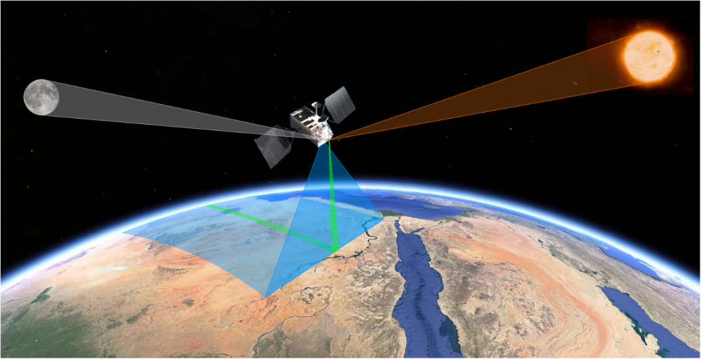
2. Overview of FY-3G/HAOC instrument
HAOC on-orbit Operational Modes
Earth/Lunar Obs.
ES/Lunar reflectance
Science Observation Mode
Solar Irrad. Scan
Solar Irradiance
Dark Image Obs.
On-orbit Modes
Attenuation Test
Attenuation coefficient
APE Flat Field Scan
Flat Field Factor
Self-calibration Mode
Onboard Laser Obs.
Center Wavelength Monitoring
Dark Image Obs.
On-orbit Operational Modes:
Science observation mode: need dark image and solar irradiance observation for Earth/Moon observation and radiometric calibration/reflectivity calculation.
Instrument self-calibration mode: need attenuation coefficients measurement, flat field scan to monitor/calibrate attenuators coefficient and field uniformity, on-board laser observation to monitor spectral calibration stability.

Slide 6
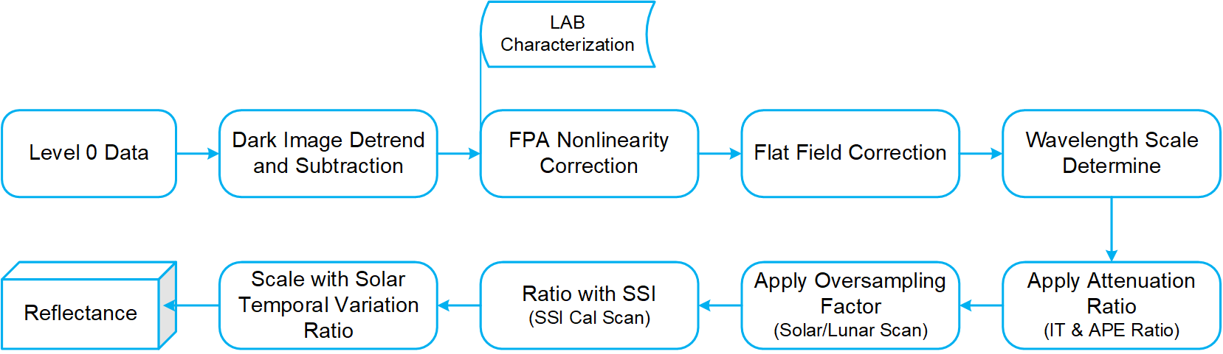
3. Level-1 Processing of HAOC
Level-1 Processing of HAOC on-orbit data
HAOC Earth/Lunar Measurement
R_{obj}: Earth/Lunar reflectance
DN^{obj}: Earth/Lunar scence measurement
DN^{solar}: Solar irrandiance measurement
DN^{dark}: background measurement
Ω_{i}: solid angle of i-th pixel
η: oversampling factor
δ_{λ}: spectral transmittance (or attenuation coefficient) of attenuator
N_{P}: Number of pixels on Solar
N_{F}: Number of frames for Solar scanning
FF_{obj}: Flat Field coefficient for Earth/Lunar observation
FF_{solar}: Flat Field coefficient for Solar observation
A_{obj}: aperture factor for Earth/Lunar observation
A_{solar}: aperture factor for Solar observation
τ_{obj}: integration time for Earth/Lunar observation
τ_{solar}: integration time for Solar observation
Reflectance
Attenuation ratio
HAOC Solar Irradiance Measurement
Flat Field correction coefficients

Slide 7
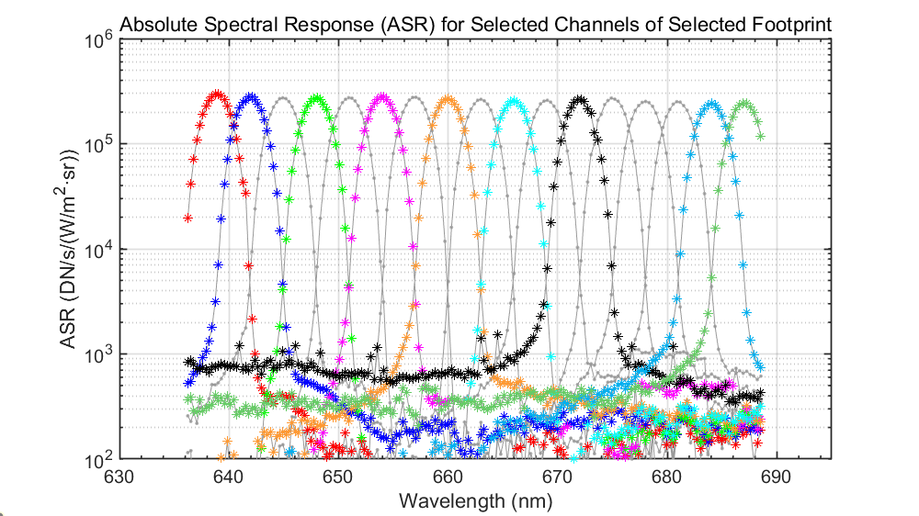
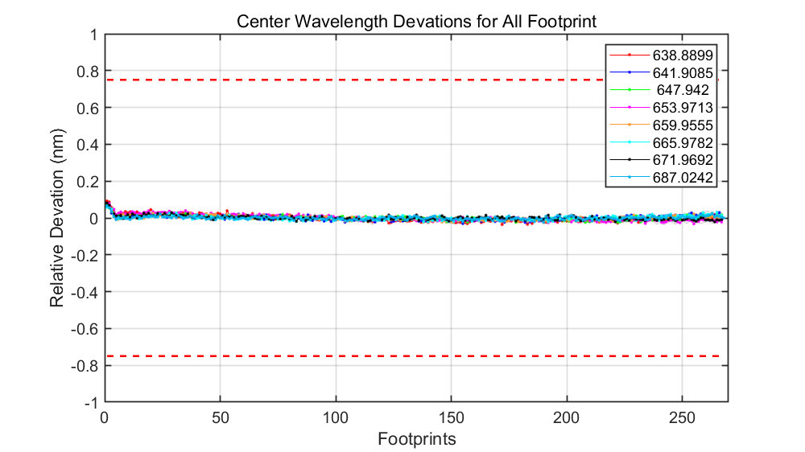
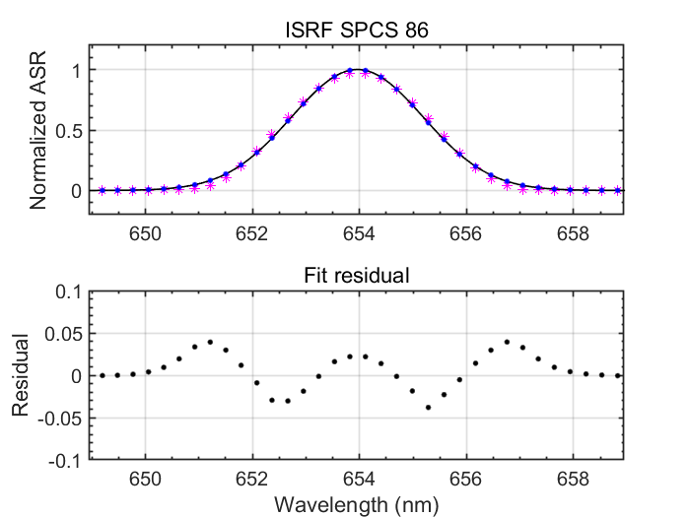
4. On-orbit Performance of HAOC
Spectral Calibration and on-board performance
ASR @ 640 nm channels
“smile” deviations cross spatial direction
ISRF fitting
The Absolute Spectral Responses (ASRs) are measured using tunable lasers in pre-launch test and the Instrument Spectral Response Functions (ISRFs) are fitted by Gaussian-like functions.
The 220 channels are close to coincident on the surface and the center channel of the spectral response across the cross track elements is nearly constant (within 3%). So there is no significant “keystone” or “smile” to correct for HAOC.

Slide 8
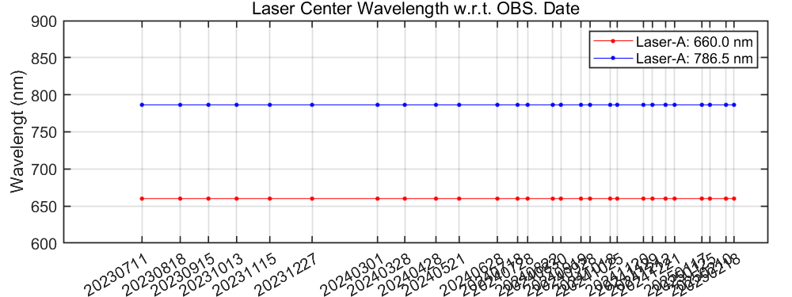
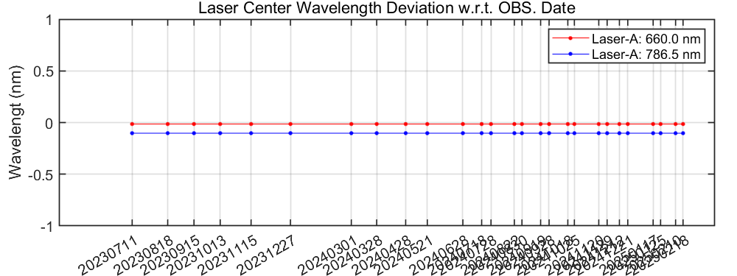
4. On-orbit Performance of HAOC
Spectral Calibration and on-board performance
Time series of center wavelengths
Time series of center wavelength deviations
A dual-wavelength laser provides on-orbit wavelength calibrations at the selected spectral channels. The central wavelength stability is monitored by periodic laser tests. Over the past year and a half, the time series of central wavelengths shown a high stability.

Slide 9
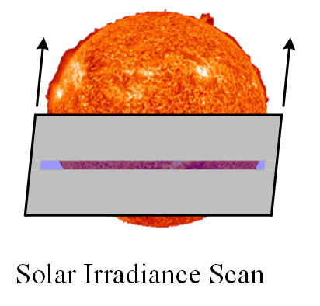
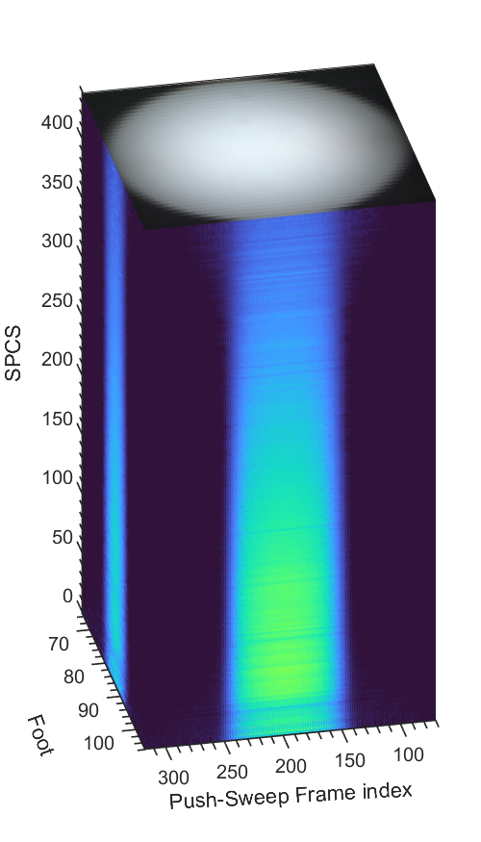
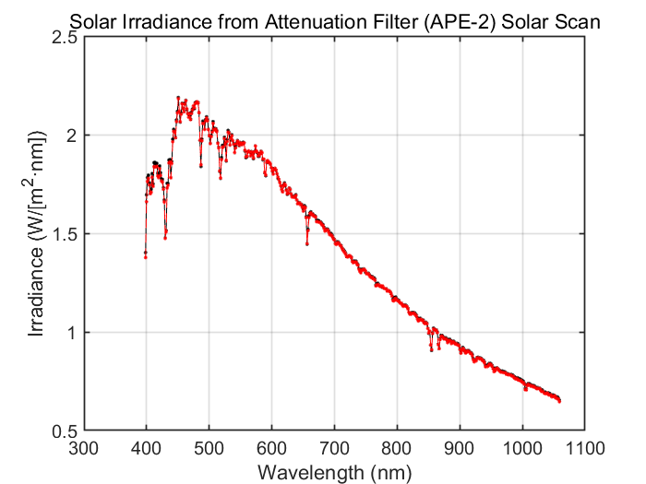
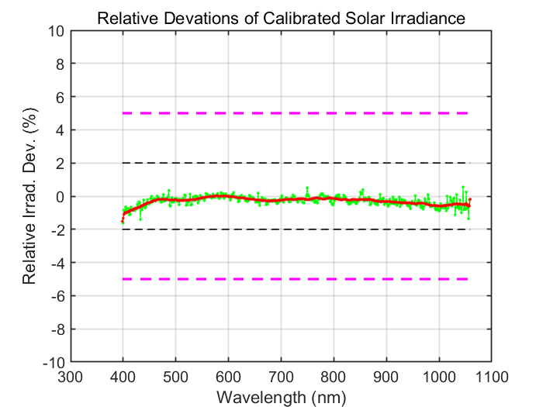
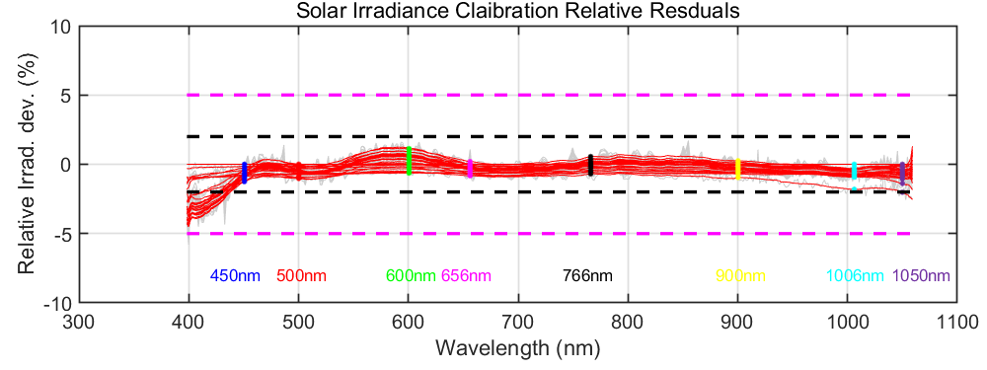
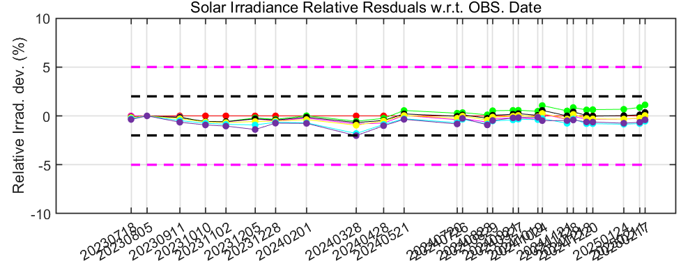
4. On-orbit Performance of HAOC
Radiometric Calibration and on-board performance: Solar Irradiance
Solar Irrad. cube
Cross-slit scans of the Sun give composite measurements of the spectral solar irradiance (SSI), to which the HAOC is radiometrically referenced to SI.

Slide 10
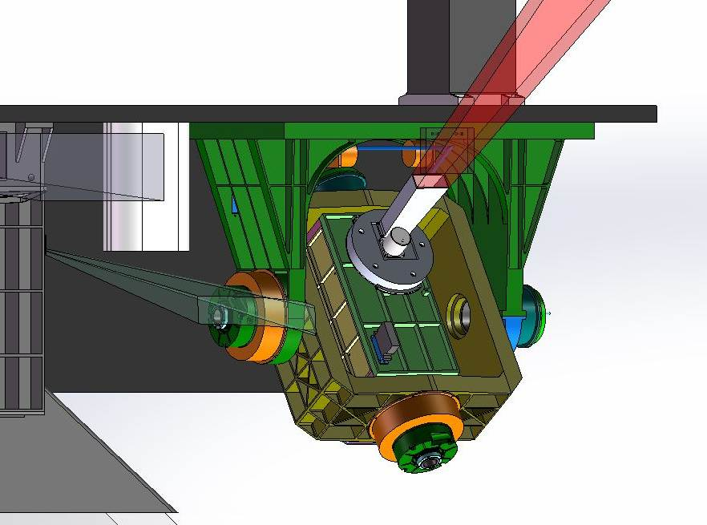
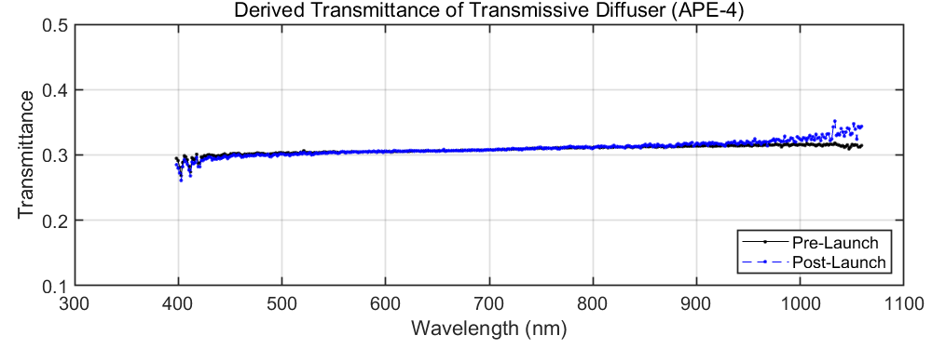
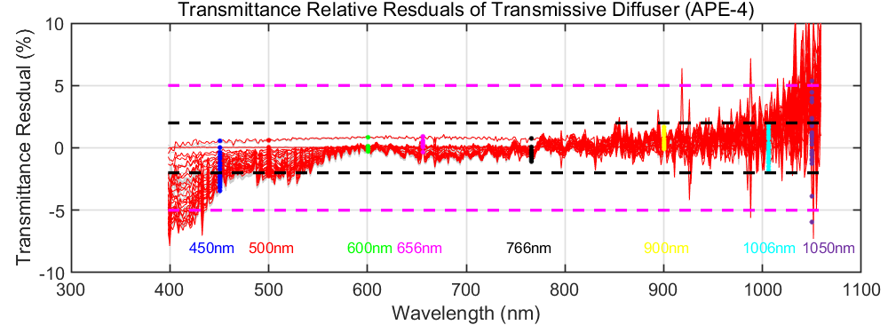

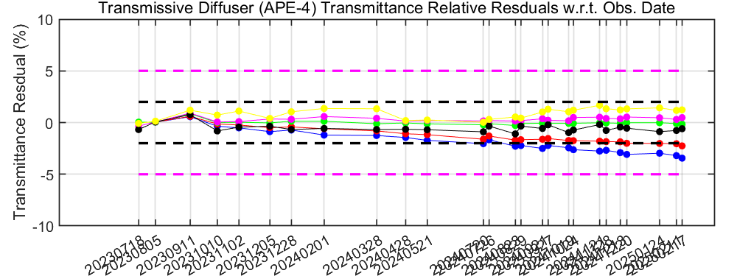
4. On-orbit Performance of HAOC
Radiometric Calibration and on-board performance: Attenuation coefficient test
Solar
Step 1: Attenuated Solar irrad. measured by through hole
Step 2: Attenuated Solar irrad. measured by Transmissive Diffuser

Slide 11
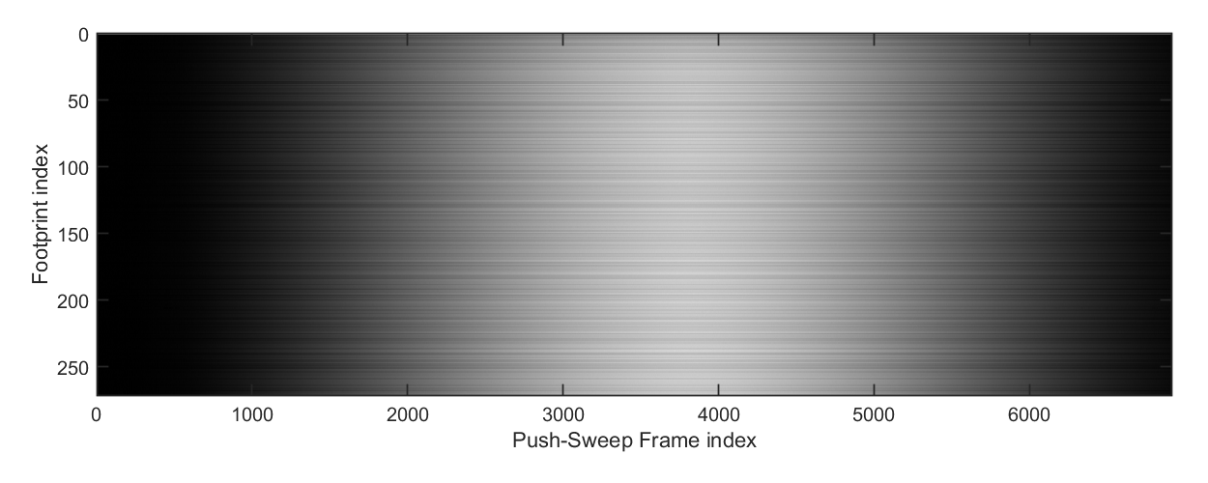
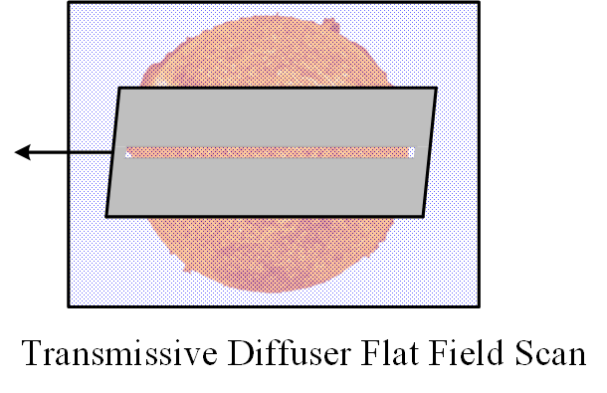
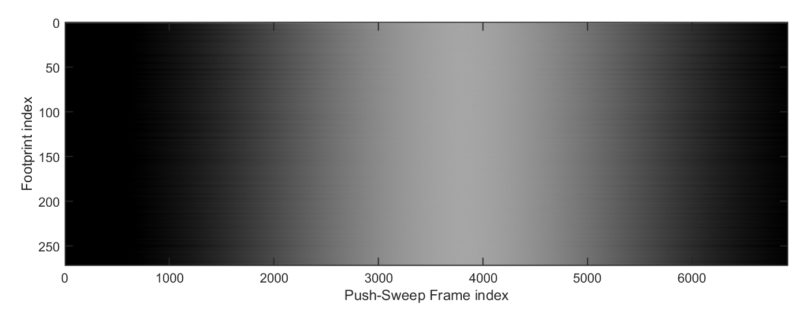
4. On-orbit Performance of HAOC
Radiometric Calibration and on-board performance: Flat Field test
Solar
Along-slit solar scans with a transmissive diffuser in the aperture wheel enables Earth-viewing-geometry (through hole) flat fielding.

Slide 12
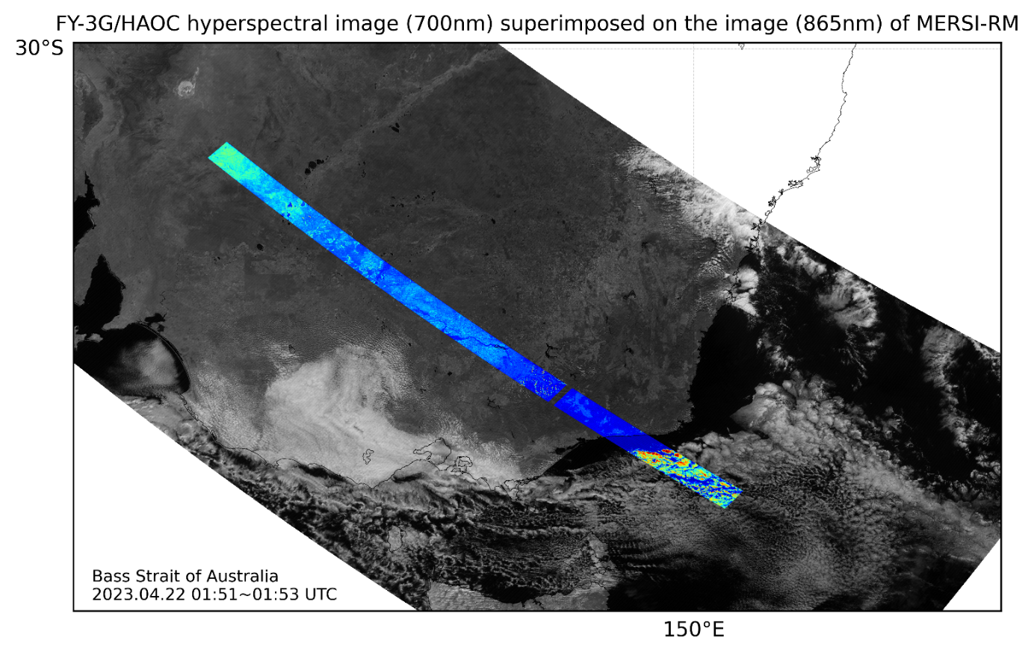
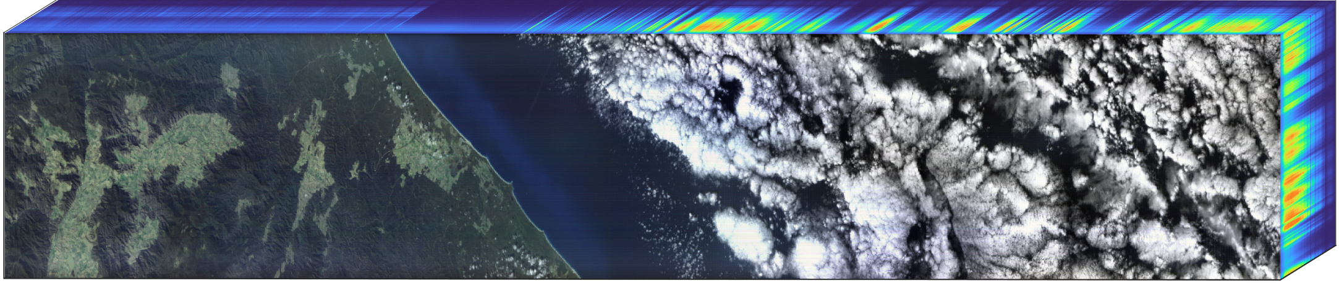
4. On-orbit Performance of HAOC
The first image cube of HAOC in 2023-04-22

Slide 13
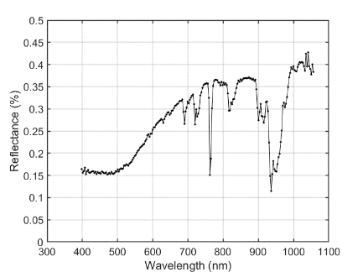
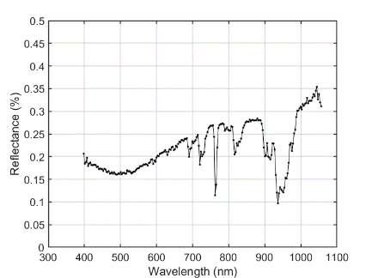
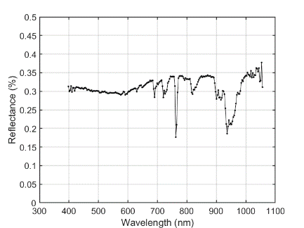
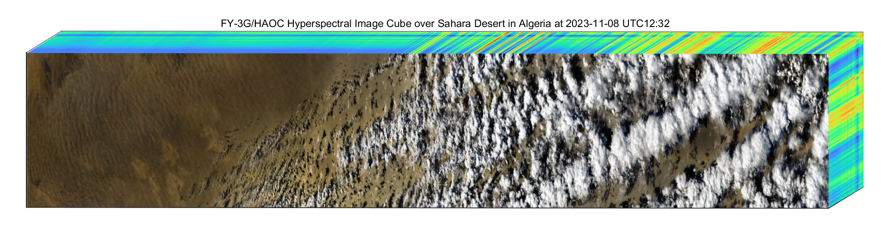
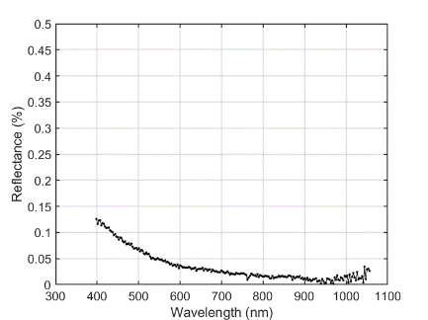
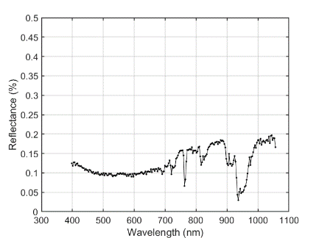
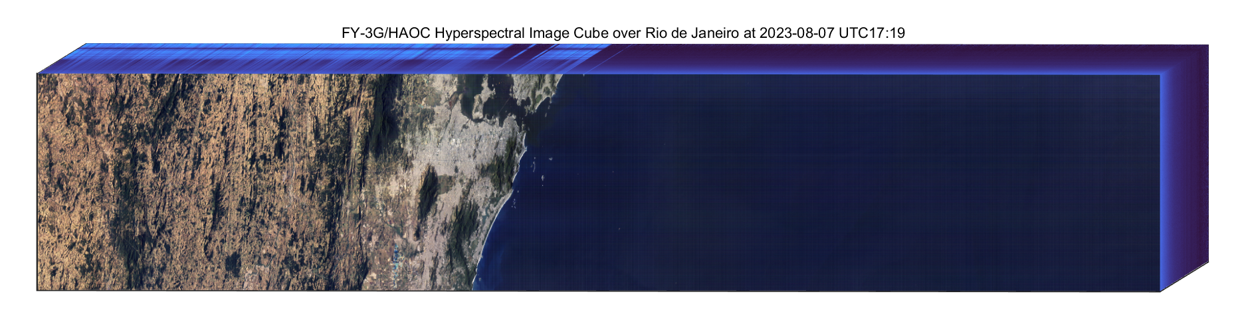
4. On-orbit Performance of HAOC
Earth reflectance data cubes of typical land and ocean scenes

Slide 14
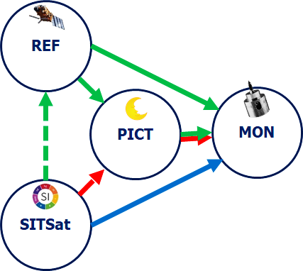
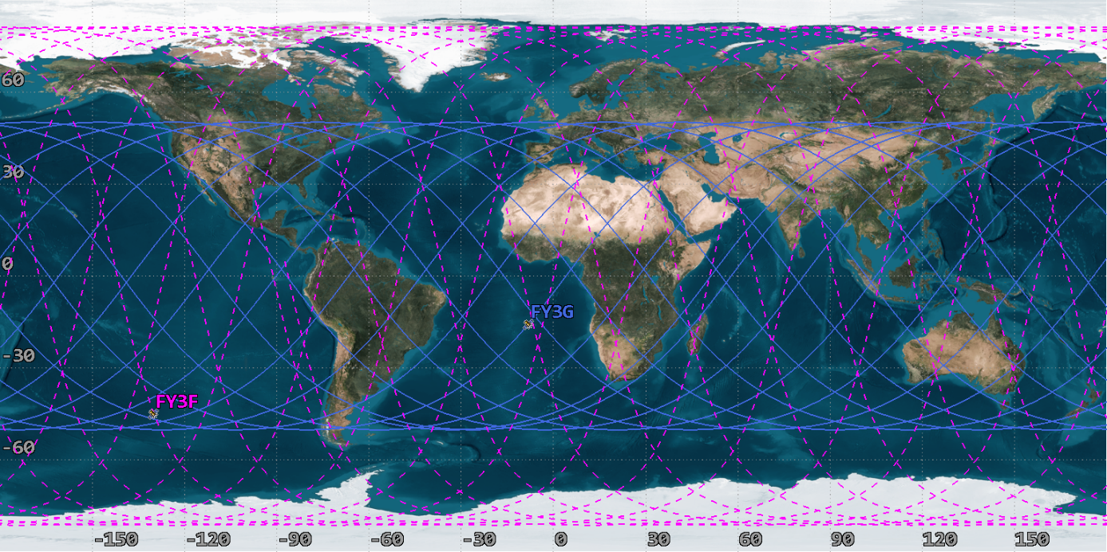
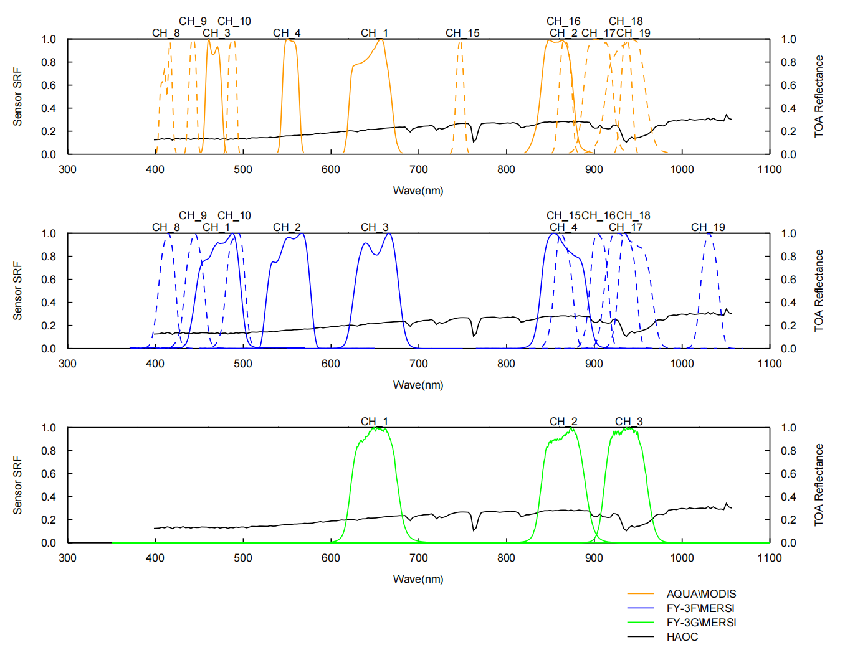
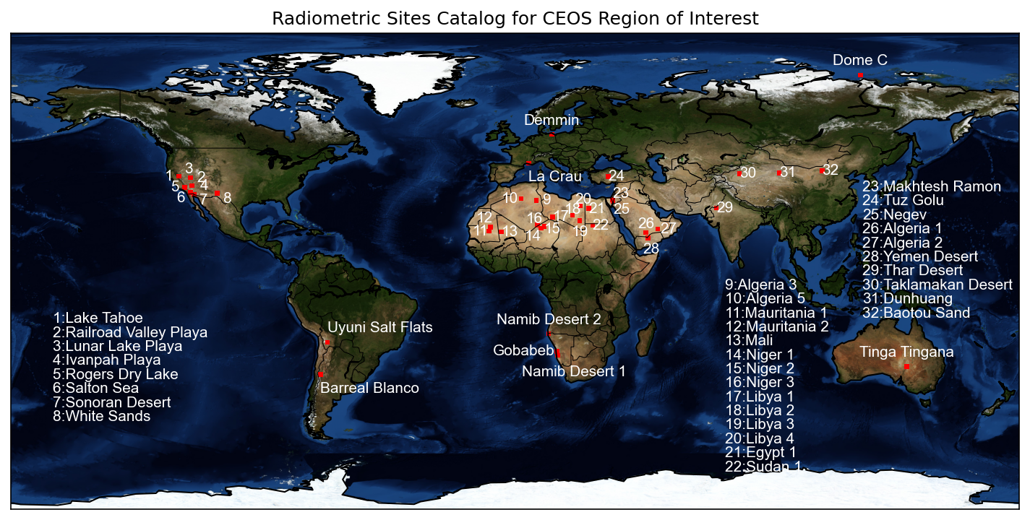
5. Intercalibration Applications using FY-3G/HAOC data
Using SNO
Using PICS
AQUA/MODIS
FY-3F/MERSI
FY-3G/MERSI-RM
SRFs of IMAGERs wrt. HAOC spectral range

Slide 15
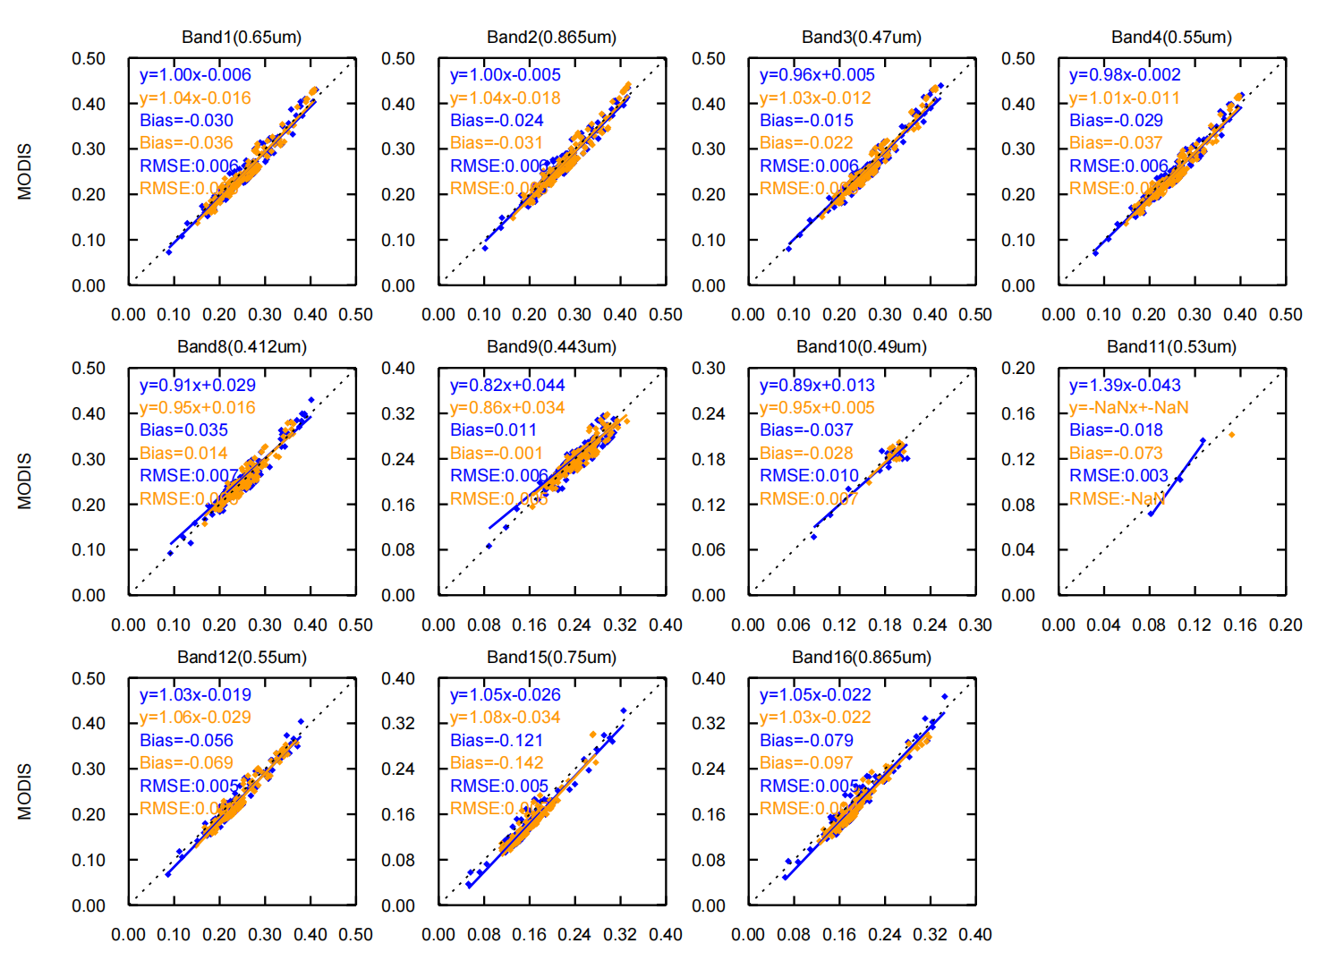
5. Intercalibration Applications using FY-3G/HAOC data
MODIS | Bias |  | RMSE
 | A帧 | B帧 | A帧 | B帧
Band1(0.65um) | -2.97 | -3.62 | 0.0059 | 0.0057
Band2(0.865um) | -2.4 | -3.08 | 0.0059 | 0.0059
Band30.47um) | -1.49 | -2.21 | 0.0062 | 0.0056
Band4(0.55um) | -2.92 | -3.72 | 0.0058 | 0.0056
Band8(0.412um) | 3.53 | 1.42 | 0.0066 | 0.0056
Band9(0.443um) | 1.11 | -0.12 | 0.0061 | 0.005
Band10(0.49um) | -3.73 | -2.77 | 0.0095 | 0.0066
Band17(0.905um) | -12.09 | -14.23 | 0.0045 | 0.0046
Band18(0.936um) | -7.92 | -9.67 | 0.005 | 0.0043
Band19(0.94um) | -2.97 | -3.62 | 0.0059 | 0.0057
Intercalibration of AQUA/MODIS with FY-3G/HAOC (2024.01-2024.04)

Slide 16
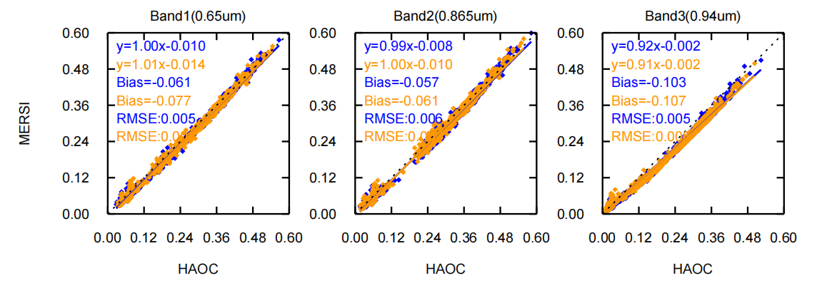
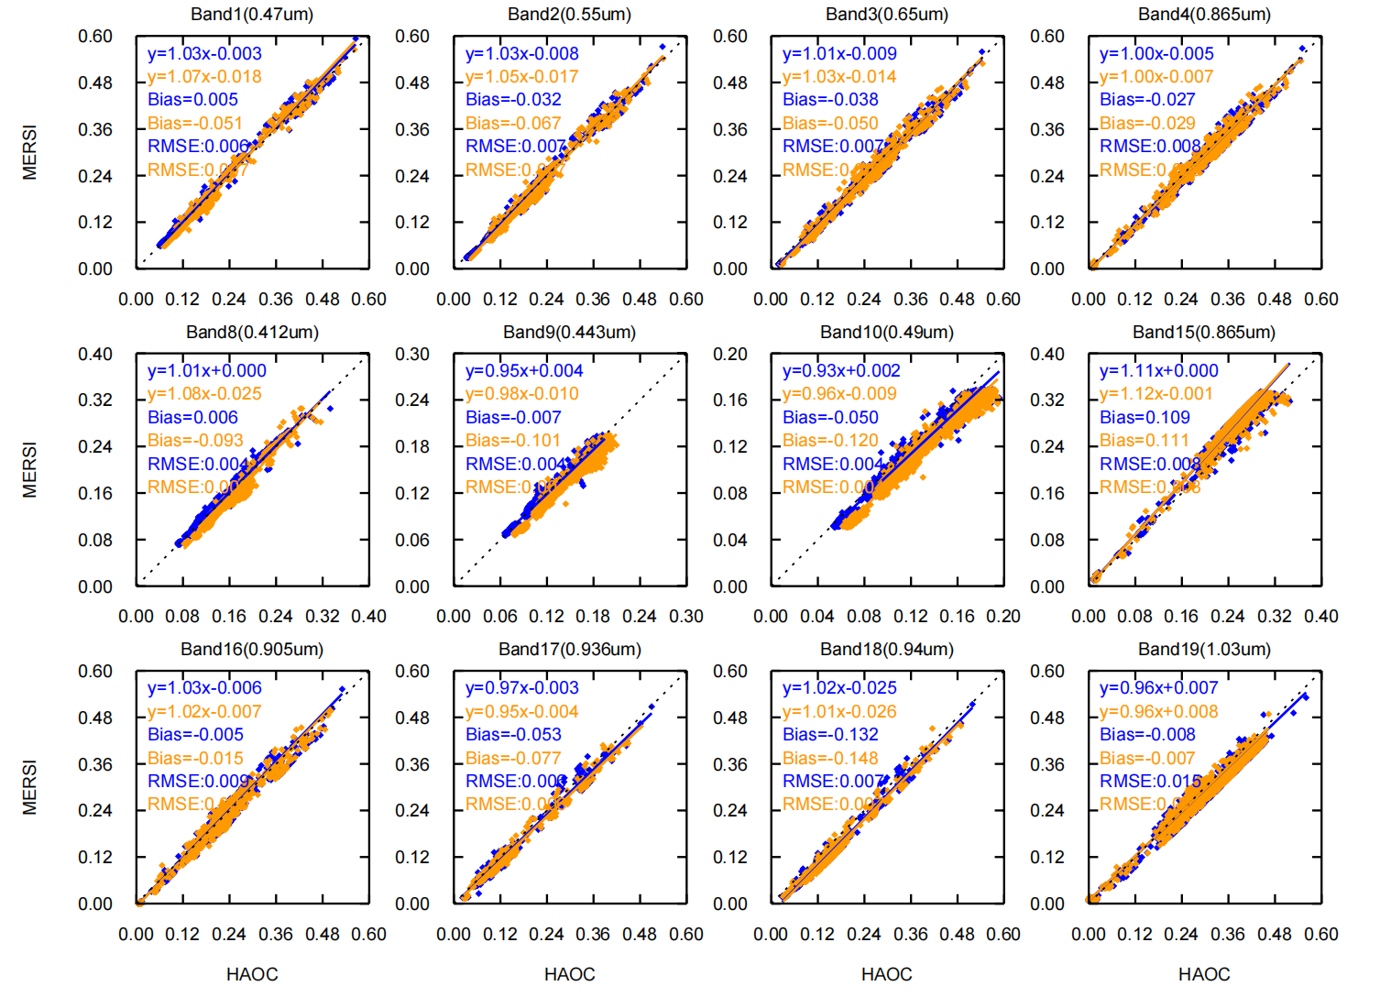
5. Intercalibration Applications using FY-3G/HAOC data
FY-3G | Bias |  | RMSE
 | A帧 | B帧 | A帧 | B帧
Band1(0.65um) | -6.07 | -7.7 | 0.0051 | 0.0055
Band2(0.865um) | -5.74 | -6.13 | 0.0064 | 0.0069
Band3(0.94um) | -10.29 | -10.71 | 0.0055 | 0.0056
Intercalibration of FY-3G/MERSI with FY-3G/HAOC (2024.02.27)
FY-3F | Bias |  | RMSE
 | A帧 | B帧 | A帧 | B帧
Band1(0.47um) | 0.55 | -5.12 | 0.0064 | 0.0068
Band2(0.55um) | -3.21 | -6.67 | 0.0071 | 0.0073
Band3(0.65um) | -3.84 | -5.05 | 0.0072 | 0.007
Band4(0.865um) | -2.71 | -2.92 | 0.008 | 0.0075
Band8(0.412um) | 0.61 | -9.27 | 0.0044 | 0.0056
Band9(0.443um) | -0.74 | -10.14 | 0.0036 | 0.004
Band10(0.49um) | -5 | -12.01 | 0.0037 | 0.0041
Band15(0.865um) | 10.93 | 11.13 | 0.0084 | 0.0083
Band16(0.905um) | -0.47 | -1.54 | 0.0089 | 0.0086
Band17(0.936um) | -5.34 | -7.67 | 0.0063 | 0.0057
Band18(0.94um) | -13.22 | -14.75 | 0.0073 | 0.0069
Band19(1.03um) | -0.83 | -0.66 | 0.0149 | 0.0144
Intercalibration of FY-3G/MERSI with FY-3G/HAOC (2024.01-2024.04)

Slide 17
6. Conclusion
FY-3G/HAOC is first demonstration of solar cross calibration technique on Chinese FengYun satellites, and represents an improvement in on-orbit accuracy over traditional reflectance/radiance measuring instruments.
It uses a relative measurement concept rather than an absolute measurement for Earth/Lunar reflectance
It calibrates itself on-orbit primarily using direct measurements of Solar.
The attenuation coefficient of the attenuator and its absolute accuracy play a key role in SSI measurement and the SI traceability. However, The degradation of the transmission diffuser combined with the decay of the detector responsivity will increase the measurement uncertainty of the SSI and break the chain of SI traceability.
Since there is no instrument for reference SSI measuring deployed alongside HAOC on the satellite (like CPF and TSIS/SIM onboard ISS), HAOC's traceability chain for measuring SSI may also be broken.
More details in
Lu Lee et al. (2025). Post-Launch Calibration and On-orbit performance of the High-Accuracy On-board Calibrator (HAOC) of FengYun-3G satellite. Manuscript submitted for publication

Slide 18
Fin
That’s all Folks
Thank you for your attention
Lu Lee
lilu@cma.gov.cn

