Slide 1
GRWG Report
Mounir Lekouara, GRWG Chair
17.03.2025

Slide 2
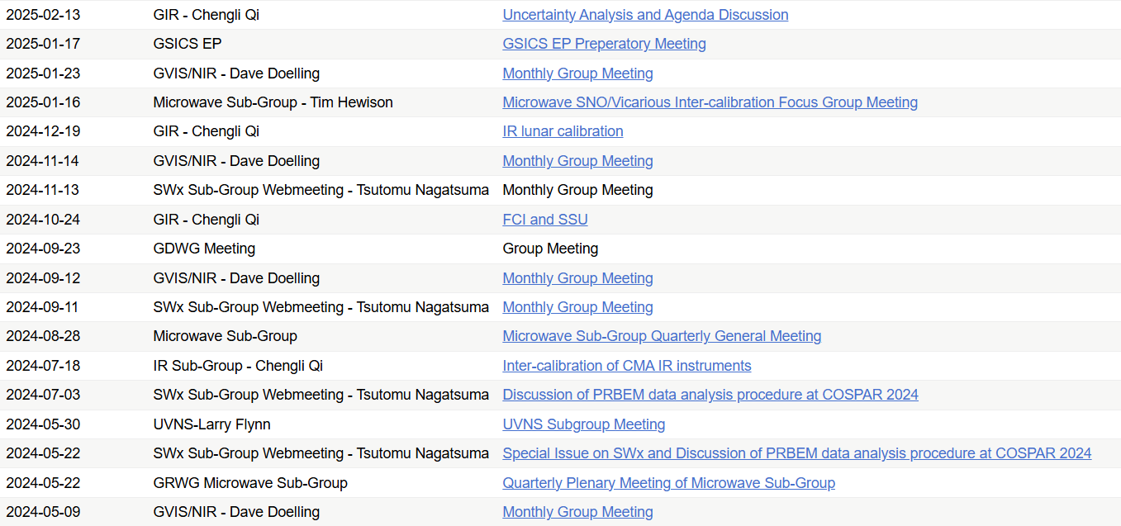
Meetings Organized/Supported in 2024
Organize the 2025 Annual and EP joint meeting
  17-21 March 2025, Changchun, China
  https://gsics.atmos.umd.edu/bin/view/Development/AnnualEP2025
Organized 24 Web-meetings
  VNIR (4)
  SW (4)
  IR (4)
  MW (3)
  UVNS (1)

Slide 3

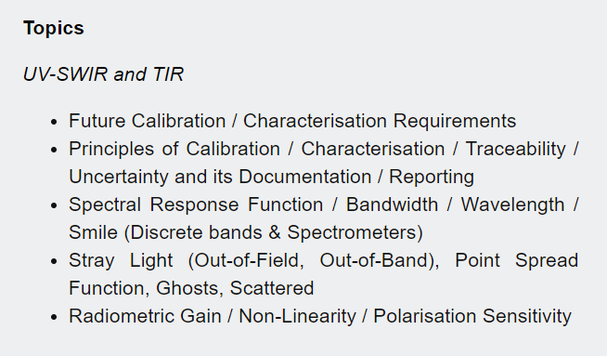
Pre-flight Workshop
Was organized by CEOS WGCV and CGMS GSICS
  19 – 22 November 2024, Norrdwijk, Netherlands
    https://atpi.eventsair.com/pre-flight-calibration-workshop/
Scope:
  Passive optical sensors (200 nm - 50 um) with emphasis on solar reflective domain (<~2500 nm).
  All aspects of pre-flight and related on-board calibration and characterization
  Preparation for next generation or future applications
Detailed report in this annual meeting: item 12q
https://atpi.eventsair.com/pre-flight-calibration-workshop/

Slide 4
State of the Observing System Report
a new SOS report template was developed by Fangfang in 2023
  Moving from PowerPoint to document format
  Including of key monitoring parameters with summary
  Incorporating new content
Discussions at the 2024 annual meeting and EP on the homogenization of the agency inputs, without a consensus. No report was issued in 2024.
The SOS report will be discussed at EP this week: who needs it and under which form. EP will decide whether to produce a report for CGMS-53 plenary (3rd of June 2025) or to discontinue it.

Slide 5
New Products and Product Promotions
No new GSICS product was added to the catalog in the last 12 months.
EUMETSAT have reviewed their GSICS VIS-NIR and IR products, users and will discuss an evolution of the philosophy in items 4k and 10a.

Slide 6
Update of Chairpersons
GRWG Chairs
  Mounir Lekouara (EUMETSAT): 2024 –
Space-Weather (SWx) Subgroup
  Tsutomu Nagatsuma (NICT): the first SW subgroup chair, after his interim term in 2022
Microwave (MW) subgroup
  New elected co-chairs: Flavio Iturbide (NOAA) and Shengli Wu (CMA), 2023 -
Infrared (IR) subgroup
  Chengli Qi (CMA): IR subgroup chair 2024 -

Slide 7
A New GRWG Subgroup Was Coming
GSICS Exec Panel
GSICS Coordination Centre
GSICS Research Working Group
Chair: Mounir Lekouara(EUM)
GSICS Data Working Group
Space Weather
Sub-Group
Chair: Tsutomu Nagatsuma (NICT)
UVN Spectrometer
Sub-Group
Chair: Lawrence Flynn (NOAA)
VIS/NIR
Sub-Group
Chair: David Doelling (NASA)
IR
Sub-Group
Chair: Chengli Qi (CMA)
MW Sub-Group
Co-chairs: Shengli Wu(CMA)
Flavio Iturbide (NOAA)
Lunar Calibration
Sub-Group
Chair: Tom Stone (USGS)
In the last 12 months , lunar calibration is discussed mainly in the VIS-NIR, but also in IR and MW.
To be discussed if the current format should be changed
A new subgroup is being developed using the Moon and extra-terrestrial targets as the reference

Slide 8
SW Subgroup Report
Tsutomu Nagatsuma (NICT)

Slide 9
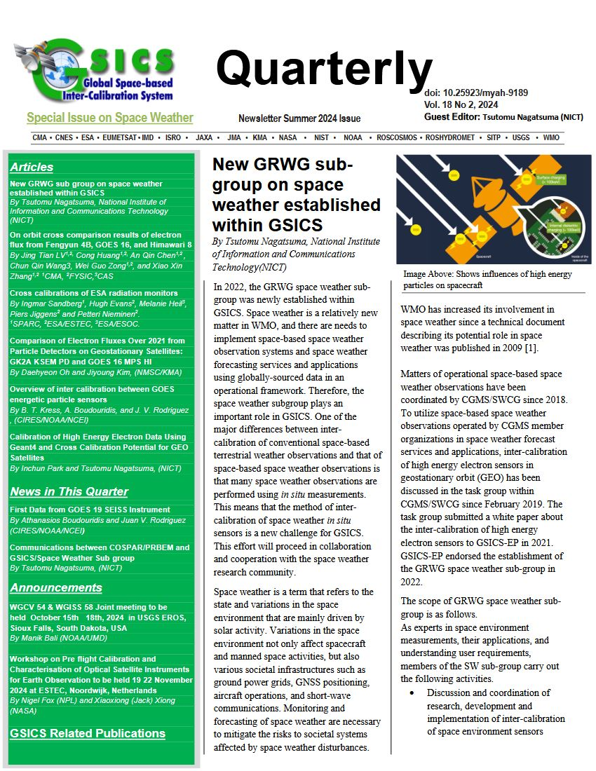
GRWG SW Subgroup Report
Accomplishments and/or activities you would like to share with the GSICS community in the plenary session
  Special Issue on Space Weather was released from GSICS Newsletter (Vol. 18 No 2, 2024)
  The subgroup reviewed the COSPAR/PRBEM document on Standard Data Analysis Procedure, and review results are reported at COSPAR 2025. For standardization of cross-calibration of high energy particle, SW subgroup proposed to COSPAR PRBEM to update the document on Standard Data Analysis Procedure. We will work cooperatively to revise the document in the future.
  (on-going) Collecting definition of data levels in each organization for harmonization
  (on-going) Defining a GSICS product into specific outputs
Issues, challenges and/or recommendations, if any
  Establishing standard cross-calibration procedure

Slide 10
UV/Vis/NIR Spectrometer Subgroup Report
L. Flynn

Slide 11
GRWG Subgroup Report - UVN-S from L. Flynn
Activities
  Participating in the quarterly OCO/GOSAT/TropoMI calibration meetings.
  Held one special topics meeting on analysis and comparisons of solar measurements in June.
  Comparisons to new geostationary instruments (GEMS and TEMPO).
Issues, challenges and/or recommendations
  Develop inter-comparisons using under-flights of GEMS, TEMPO and EPIC.
  Is there a community “approved” Radiative Transfer Model – VLIDORT perhaps?
  What is the current reference instrument(s)/model(s), if available?
    Consider using OMI or S-NPP & NOAA-20 OMPS as stable transfer references.
    We will be discussing the stability of instruments in orbit in the breakout session.

Slide 12
Agenda for Topical Meeting on Solar Analysis and Comparisons on June 2, 2024
OMI and TropoMI Solar Activity Time Series by Matt Deland et al.
TEMPO Solar Measurements by Heesung Chong et al.
TropoMI Solar Measurements by Erwin Loots et al.
Bremen Composite Mg II Index by Mark Weber et al.
Analysis of OMPS Solar Measurements by Larry Flynn et al.

Slide 13
Talks at this year’s meeting
TEMPO instrument calibration status | Hesung Chong
Recent OMPS Calibration efforts for NOAA 20 & 21 | Sriharsha Madhavan
NPP & NOAA-20 OMPS Time- Dependent Calibration; update on ACX | Larry Flynn
OCO-2 and OCO-3 Radiometric Trends | Rob Rosenberg
GOSAT serious calibration and intercomparison with multiple GHG sensors | Kei Shiomi
The Performance of the OMS-Nadir payload on-board the FY-3F satellite | Jinghua Mao
In orbit Calibration and Evaluation of FY-3F OMS Limb. | Yuan Li
Study on EMI decay monitoring and correction in orbit | Fuqi Si
Current status of calibration and validation for GEMS Level 1 Products | Yeeun Lee
Calibration and validation concept of the CO2I/NO2I instrument on-board the CO2M mission | Bernd Sierk
Current status of GOME-2 calibration & outlook for Sentinel-4 & Sentinel-5 | Rasmus Lindstrot
OMI/TropoMI Status Overview | Deborah Stein Zweers
DLER database (surface reflectivity.) | Erwin Loots
L1 UVN status update | Erwin Loots
ESA FDR4ATMOS Project: Status Update and Roadmap | Günter Lichtenberg
On-orbit degradation of FY-3E SSIM UV band | Jin Qi
The Inflight Calibration of the FY-3E SSIM VIS Band | Xiaohu Yang

Slide 14
Introduction to TSIS-1 HSRS Resources
Version 2 of the Total and Spectral Solar Irradiance Sensor-1 (TSIS-1) Hybrid Solar Reference Spectrum (HSRS)
https://lasp.colorado.edu/lisird/data/tsis1_hsrs_p1nm
Odele Coddington et al. 2020: “The TSIS-1 Hybrid Solar Reference Spectrum” https://agupubs.onlinelibrary.wiley.com/doi/abs/10.1029/2020GL091709
Daily values of solar spectral irradiance (SSI) from 1978 to 2021 (inclusive) with 0.1 nm resolution at wavelengths from 115 to 310 nm (on a 0.025 nm grid) and ~0.5 nm resolution at wavelengths from 310 to 500 nm (on a 0.1 nm grid)
https://lasp.colorado.edu/lisird/data/nrl2_ssi_high_res
GSICS 2024, Talk 7.g: Validation of TSIS-1 HSRS in the range 300 nm to 1700 nm using ground-based SI-traceable spectral solar irradiance measurements, by Julian Gröbner, Gregor Hülsen, Saulius Nevas, and Peter Sperfeld. Validation at 1% accuracy. http://gsics.atmos.umd.edu/pub/Development/AnnualMeeting2024/7g-Groebner_mapp_final.pptx
Notes:
Gröbner, J., Kouremeti, N., Hülsen, G., Zuber, R., Ribnitzky, M., Nevas, S., Sperfeld, P., Schwind, K., Schneider, P., Kazadzis, S., Barreto, Á., Gardiner, T., Mottungan, K., Medland, D., and Coleman, M.: Spectral aerosol optical depth from SI-traceable spectral solar irradiance measurements, Atmos. Meas. Tech., 16, 4667–4680, https://doi.org/10.5194/amt-16-4667-2023, 2023.

Slide 15
Sample Agenda for a OCO/GOSAT/TropoMI Quarterly Meeting
13:00- 13:10 Welcome, GOSAT update (Shiomi, Kuze)
13:10- 13:25 OCO update (Rosenberg)
13:25- 13:40 TROPOMI RRV and product update (Kempen, Ludewig)
13:40- 13:50 TEMPO (Liu, Chong)
13:50- 13:55 GSICS activity (Flynn)
Discussion

Slide 16

Six years of NOAA-20
OMPS NP bi-weekly Working Diffuser Soar measurements compared to their average.
(b) Wavelength Shift Patterns. Wavelength shifts track optical bench annual thermal variations.
(c) Solar Activity Patterns. Patterns are Mg II scale factors and track Solar activity.
(d) Differences after subtracting the shift and activity patterns. This shows the combined degradation of the reference diffuser and the instrument’s optical throughput.
Note: The working diffuser’s exposure is 26 times the reference exposure for used annually
(a)
(b)
Newest
(c)
(d)
Oldest

Slide 17
Six years of NOAA-20
OMPS NP annual Reference Diffuser Soar measurements compared to their average.
(b) Wavelength Shift Patterns. Wavelength shifts track optical bench annual thermal variations.
(c) Solar Activity Patterns. Patterns are Mg II scale factors and track Solar activity.
(d) Differences after subtracting the shift and activity patterns. This shows the combined degradation of the reference diffuser and the instrument’s optical throughput.
Note: The working diffuser’s exposure is 26 times the reference exposure for used annually.
(a)
(b)
Newest
(c)
(d)
Oldest

Slide 18
VISNIR contribution 1L GRWG report
March 14, 2025

Slide 19
GRWG Subgroup Report - VNIR
Need more GSICS VIS/NIR calibration products outside of DCC and Lunar
  Need volunteers to lead these efforts, invariant desert targets, etc.
Started Lightening Mapper inter-calibration studies
Current VIS/NIR reference sensor is NOAA20-VIIRS
  NASA and NOAA teams N20 VIIRS RSB calibration differences within 0.2%
  Continue to monitor N20 VIIRS calibration performance
Current solar spectra reference is TSIS-1 HSRS
  Future NASA VIIRS L1B products to use TSIS-1 HSRS
Working with CEOS to synergize desert invariant target methodology – Will have web meeting to discuss PICSCAR
CLARREO to launch in late 2026
Held 4 monthly web meetings with 15 presentations
  If you would like to present at VISNIR web meetings, send title david.r.doelling@nasa.gov
Validated the VIIRS calibration transfer to GEOs using DCC approach

Slide 20
GSICS Lunar Subgroup
Summary of the activities in 2024
Tom Stone
USGS

Slide 21
GSICS Lunar Subgroup
Initial proposal for the creation of the subgroup ➔ December 2023 at the 4th Joint GSICS/IVOS Lunar Calibration Workshop (hosted by EUMETSAT, Darmstadt)
Officially proposed at the GSICS Annual Meeting in 2024 (hosted by EUMETSAT, Darmstadt)
Endorsed by GSICS EP in 2024
Current chair: Tom Stone (USGS)

Slide 22
GSICS Lunar Subgroup
Scope of the Lunar Subgroup enlarged to cover not only the VIS/NIR but also IR and MW
In 2024, web meetings still organised with VIS/NIR subgroup or with IR
Activities focused on LSICS development, in replacement of the current GSICS reference model (GIRO) ➔ see lunar presentations in VIS/NIR session (Monday afternoon)
  Development of LSICS v1 led by NOAA, with the support of the LSICS development team
  Regular technical online meetings to strive the development of LSICS v1 (requirements, interfaces, formats, code structure, functionalities, etc.)
  LSICS v1 currently under testing
  Set up of a GitLab repository for LSICS
  Debriefing on the status of the project in a VIS/NIR subgroup web meeting in November 2024

Slide 23
IR Subgroup Report
Chengli Qi

Slide 24
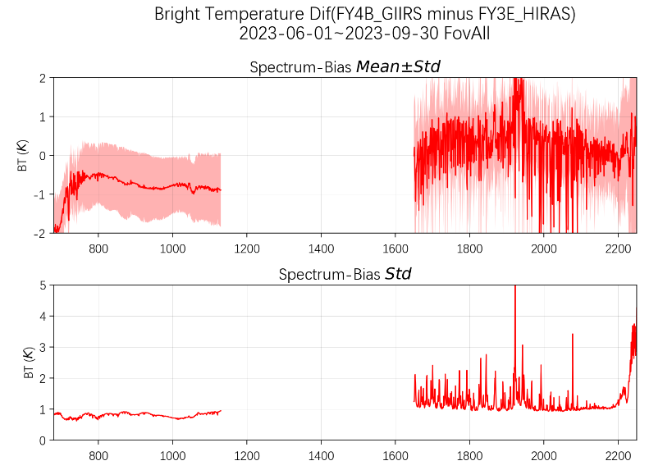
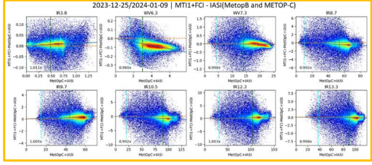
GRWG Subgroup Report - IR
IR group hosted 4 web meeting last year.
  07/18: Inter-calibration of GEO-LEO IR instruments, and FY-3G/MERSI-RM Result of On-orbit Calibration.
  10/24: FCI Commissioning update and Merging SSU with AIRS
  12/19: IR lunar calibration
  02/13: Uncertainy analysis of cross-calibration
The IR group is focused on the inter-calibration algorithms improvements for current GEO-LEO inter-calibration. Some issues are identified for further investigation.
  Regression
  Hot Land Bias issue
  High viewing angles
  Interpolation between GEO images
From Chengli Qi
From Ali Mousivand

Slide 25
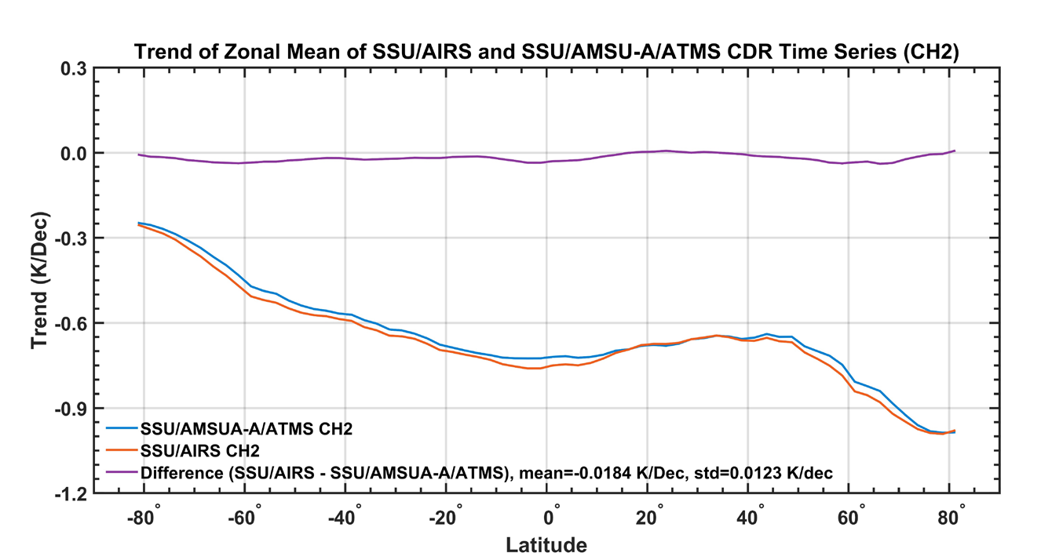
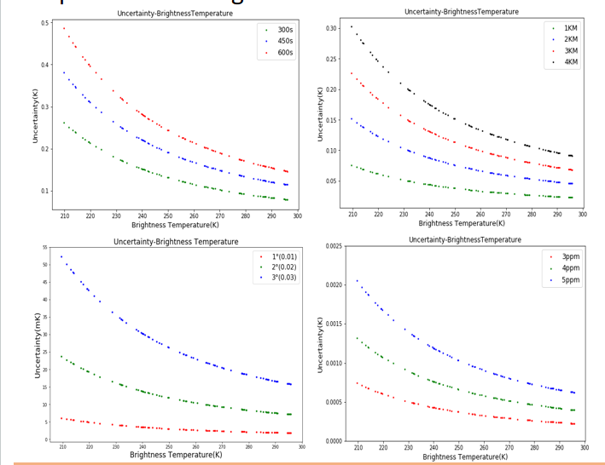
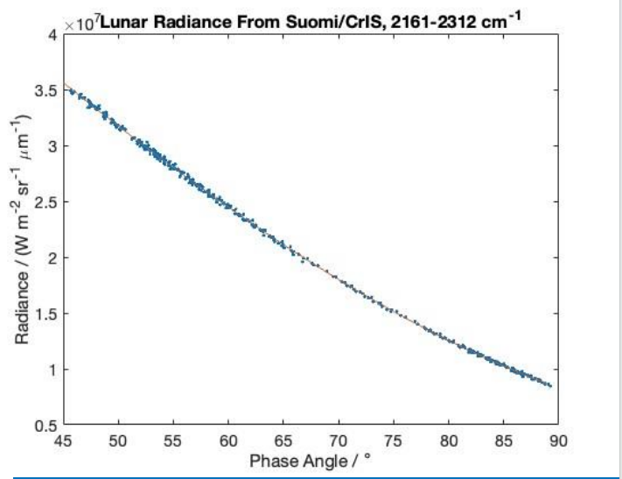
A generalized model for the uncertainty assessment of the SNO cross-calibration method for meteorological satellite infrared channels is constructed.
The IR group continue studying way to use Moon as a potential stable target to inter-calibrate IR sensors when the Moon was within their FOVs.
A method has been successfully developed to convert AIRS hyperspectral data into equivalent SSU observations.
From Likun Wang
From Martin Burgdorf
From Zhong Gu

Slide 26
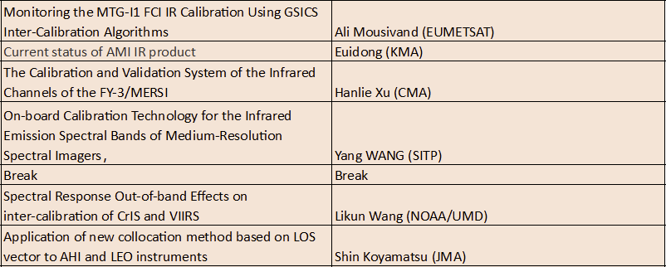
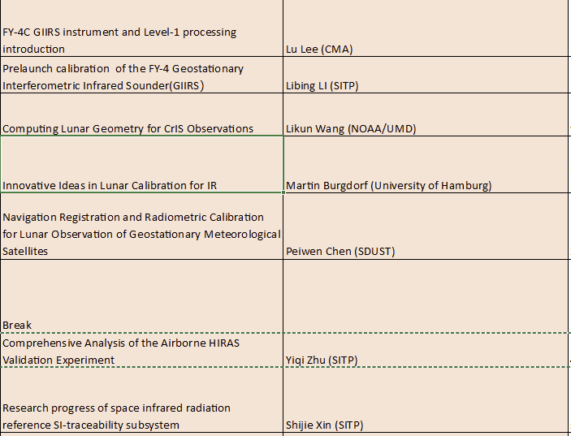
Talks at this year’s meeting
Monitoring of MTG-I1/FCI, AMI, FY-3/MERSI IR calibration.
Cross calibration method and factor influence analysis.
FY-4C GIIRS introduction.
IR Lunar calibration.
Airborne validation experiment.
Space infrared radiation reference SI-traceability subsystem.

Slide 27
Microwave (MW) Subgroup Contributions for GRWG Annual Report 2025
Flavio Iturbide-Sanchez and Shengli Wu, Co-Chairs
Tim Hewison, DaZhen Gu, and Hu Yang, Focus Group Leads
Kun Zhang, GSICS MW Coordinator
03/14/2025

Slide 28
GRWG Subgroup Report - MW
Activities
  Organized 3 MW General Meetings and 9 MW Focus Group Meetings.
  Generated SRF Data Using New GSICS netCDF Convention
  Distributed the Initial Version of MW Lunar Radiative Transfer Software Package to the GSICS Community
  Provided Validated Lunar Observation Datasets from MHS and ATMS instruments
  Reviewed SNO Methods, Collocation Mismatch Uncertainty and Vicarious Inter-calibration Algorithms
Issues, challenges and/or recommendations
  Consolidated Terminology
  Precise Definitions (e.g., random noise, striping, etc.)
  Best Practices (e.g., antenna pattern correction, characterization, etc.)
Opportunities
  Partnership with International Precipitation Working Group (IPWG)
by Flavio Iturbide and Shengli Wu

Slide 29
Meetings Organized/Supported in 2024
Organized the Quarterly Microwave Subgroup General Meetings to Communicate Status and Path Forward Plans for the Focus Groups.
  22 May 2024, Virtual Meeting
  28 August 2024, Virtual Meeting
  24 February 2025, Virtual Meeting
SNO/Vicarious Inter-calibration Focus Group Meetings:
  2024-05-02 - Introducing SNO Focus Group
  2024-08-08 - Review of SNO methods, Collocation mismatch Uncertainty
  2025-01-16 – SNO for FY-3F, RSS Vicarious Inter-calibration for GPM
Microwave Lunar Focus Group Meetings:
  2024-07-25 – Kick off meeting to discuss the working scope
  2024-11-25 – Discuss the different lunar intrusion correction strategy adopt by different satellite agency
  2025-02-22 - Lunar RTM model discussion
Technology & Testing Focus Group Meetings:
  2024-07-31 – Kick off meeting for refining focus group topics
  2024-11-12 – Pre-launch characterisation at NASA
  2025-02-17 – SRFs, Antenna effects, NEDT definition

Slide 30
New Products and Product Promotions
New GSICS SRF netCDF convention:
  Frequency unit in GHz instead of wavelength for improved familiarity in microwave community
  Spectral Response (SR) unit in decibel scale with respect to peak to replace linear scale
  Uncertainty addition to both frequency and SR
Plans:
  Consolidate proposal for a baseline SNO algorithm
    Uncertainty framework
    Independent evaluation by different groups – with different sensors
  Continue review of other vicarious (inter-)calibration algorithms
    Inviting experts to present at web meetings
by Dazhen Gu and Tim Hewison

Slide 31
Achievements from Lunar Calibration WG
Established sharing space through GitHub for data and code exchange within the group
Provided validated satellite lunar observation datasets from MHS and ATMS instruments
Shared the first version of microwave lunar radiative transfer model software package to the GSICS community
by Hu Yang

Slide 32
Challenges and Opportunities
Partnership with IPWG (International Precip. Working Group)
  Key customer for MW inter-calibration
  Establish requirements for inter-calibration:
    Target instruments, channels, dynamic range
    Inter-calibration uncertainty, traceability
    Timeliness – lead time and update frequency
    Form of inter-calibration product: Algorithm, Corrections, Re-calibration, …
  Consolidate terminology!
  Compare requirements with capability of current algorithms
  Propose way forward

Slide 33
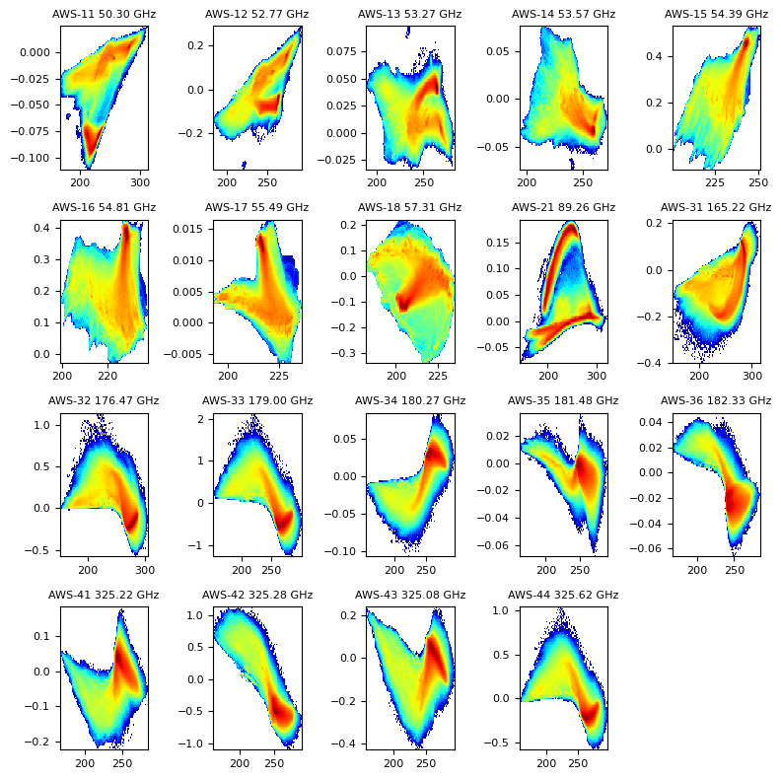
Highlights: SNO/Vicarious Calibration - SRF
RTTOV coefficients
  Real AWS SRF
  Nominal Top Hat SRF
Differences >1K
  183GHz edge channels
  Single-sideband
  Important to communicate to users
Previous experience?
Repeat for ATMS
  DSB 183GHz channels
Repeat for ICI
  Squarer SRFs, DSB 183GHz, 53°
WFs similar (tropics, clear):
  AWS-33 ~ AWS-44
  AWS-34 ~ AWS-43
  AWS-35 ~ AWS-42
  AWS-36 ~ AWS-41
by Tim Hewison

Slide 34
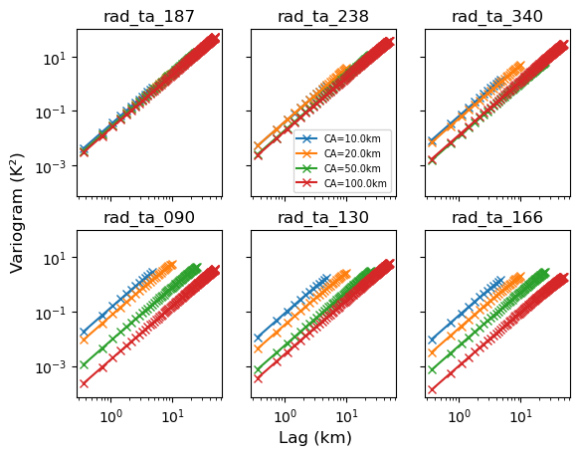
Highlights: SNO/Vicarious Calibration -
SNO Uncertainty
Variability on larger scales is proportionately less than on convective scale
But slope of CA variograms is ~independent of CA size!
Convective scales show variograms slope ~5/3
But uncertainty/CA slope ~2 on all scales
And uncertainty/100km² slope ~2 on all scales
So is slope of uncertainties
Now it seems that increasing the Collocation Area does reduce the overall uncertainty
Although that is a trade-off against the dynamic range
by Tim Hewison

Slide 35
Summary
Another productive year for the GRWG, specifically on the cooperation for inter-calibration/comparison techniques development.
MW and SW sub-groups have quickly shown a good engagement/collaboration in their first year.
The lunar activities (e.g. LSICS) are benefiting from the momentum of the 2023 lunar calibration WS.
General questions to be discussed in this annual meeting:
Lunar subgroup format?
Need and form of the SOS?
VIS-NIR and IR GSICS products user base and future?
How to inject momentum on the polarization activities?
Pre-flight calibration workshop outcomes?

