Slide 1
GSICS Microwave Radiometer Technology and Instrument Pre-Launch Testing and Post-Launch Characterization Focus Group
May 9th, 2025

Slide 2
Meeting Agenda
Recap of last meeting
Discuss recommendation of SRF netCDF convention
Guest presentation by Ed
Action items and closing remarks

Slide 3
Recap
Seven members attended 2025 Q1 meeting on February 17th, 2025.
Refined focus-group topics to three items
  SRF NetCDF convention
  Impact of antenna characteristics
  Noise Equivalent Power and Noise Equivalent Temperature definitions
Tiger presented a technical talk about noise characterization and mitigation for microwave sounding instruments.
Prepared report to annual GSICS meeting
Initiated Overleaf document of recommendation for SRF NetCDF

Slide 4
SRF netCDF – Background
SRF is an aggregated response of the receiver chain, essentially receiver gain
SRF is provided by instrument maker
Obtained by instrument calibration (S-parameter measurement, hot/cold two point calibration)
Prior to 2013, various formats: csv, xml, Microsoft Excel, two-column flat file.
Network Common Data Form unified by Data Management Working Group
Masaya et al developed Python platform built on Google Colab for data extraction and plotting.

Slide 5
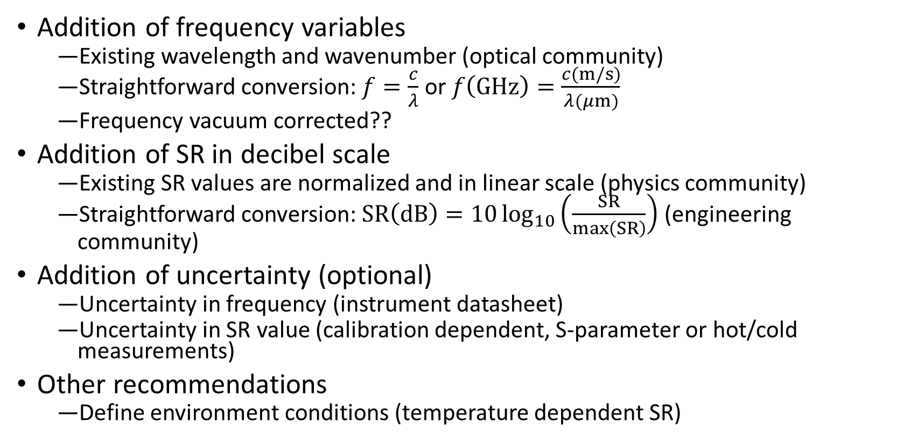
SRF netCDF – Recommendation
Addition of frequency variables
  Existing wavelength and wavenumber (optical community)
  Straightforward conversion: $f=\frac{c}{λ}$ or $f\left(GHz\right)=\frac{c(m/s)}{λ(μm)}$
  Frequency vacuum corrected??
Addition of SR in decibel scale
  Existing SR values are normalized and in linear scale (physics community)
  Straightforward conversion: $SR\left(dB\right)=10\log_{10}\left(\frac{SR}{max\left(SR\right)}\right)$ (engineering community)
Addition of uncertainty (optional)
  Uncertainty in frequency (instrument datasheet)
  Uncertainty in SR value (calibration dependent, S-parameter or hot/cold measurements)
Other recommendations
  Define environment conditions (temperature dependent SR)

Slide 6
Technical Presentation
Ed (NASA Goddard Space Flight Center): SMBA

Slide 7
Action Items
Please accept Overleaf invitation if you haven’t done so. If you prefer not to, please send your edits through email. I will adopt on your behalf.
Need volunteer to take on tasks, in particular investigation of uncertainty of SRF (recommend approaches, references, etc.…)
Generate a sample SRF and include in appendix of the Overleaf document.
To hold next meeting in mid August.
Any other business?

