Slide 1
Future of the EUM IR GSICS products
Mounir Lekouara
EUMETSAT
2025 annual GSICS meeting

Slide 2
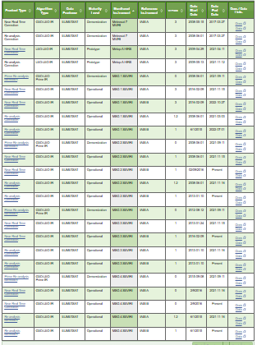
Current EUMETSAT VIS-NIR GSICS products

Slide 3
Inputs to the group discussion (1/2)
EUMETSAT investigated the connections to our GSICS servers and could not identify any regular user.
GSICS correction coefficients are stored in the operational SEVIRI L1 products. EUMETSAT has no knowledge of any user applying those.
MTG-I1 FCI operational L1c are calibrated using MICMICS GEO-LEO (vs IASI-B/C) and monitored with GEO-LEO CrIS and GEO-GEO SEVIRI. Strong GSICS impact on the EUMETSAT L1 operational calibration is acknowledged.
As agreed in the VIS-NIR group, when an agency identifies a radiometric bias in the L1, it should correct it rather than provide a (separate) GSICS correction coefficients product. Note that the radiometric biases that the GSICS correction is susceptible to efficiently correct is a very small subset of the type of radiometric errors our IR sensors are facing.
In the NWP assimilation process, the IR channels are bias-corrected in a much more dynamic way than what the GSICS coefficients, computed over 30 days windows, can do.

Slide 4
Inputs to the group discussion (2/2)
For quality monitoring purposes, EUMETSAT is about to deploy MATRICS (equivalent to NOAA STAR ICVS and CMA L1 monitoring system). This will feature all radiometric (and geometric) user-relevant live monitoring information. In their current form (correction coefficients files), the GSICS are not adapted to an efficient quality monitoring. The GSICS is a useful element of the monitoring.
GEO-ring: EUMETSAT and NOAA (with JMA support) are producing a FCDR from all historical measurements from imagers in geostationary orbit that form the Geostationary Ring. With cross-calibrated mapped radiances and spectral band adjustment factors. The GSICS methods will be employed. L2 users needing cross-calibrated IR acquisitions (e.g. ISCCP) should rather use this type of well-controlled dataset.
EUMETSAT is considering discontinuing its GSICS IR coefficient files products.

Slide 5
EUMETSAT monitored IR instruments
EPS IASI and Sentinel-3 SLSTR: excellent calibration of the IR bands, no need of a separate correction dataset.
MTG-I1 FCI: the IR bands are calibrated with the MICMICS implementation of an enhanced version of the GSICS GEO-LEO algorithm. Thus MTG-I1 is precisely aligned with IASI, and thus does not require a separate correction.
Recurrent FCI models and all SEVIRI: the GSICS correction coefficients aim at compensating the impact of icing.

Slide 6
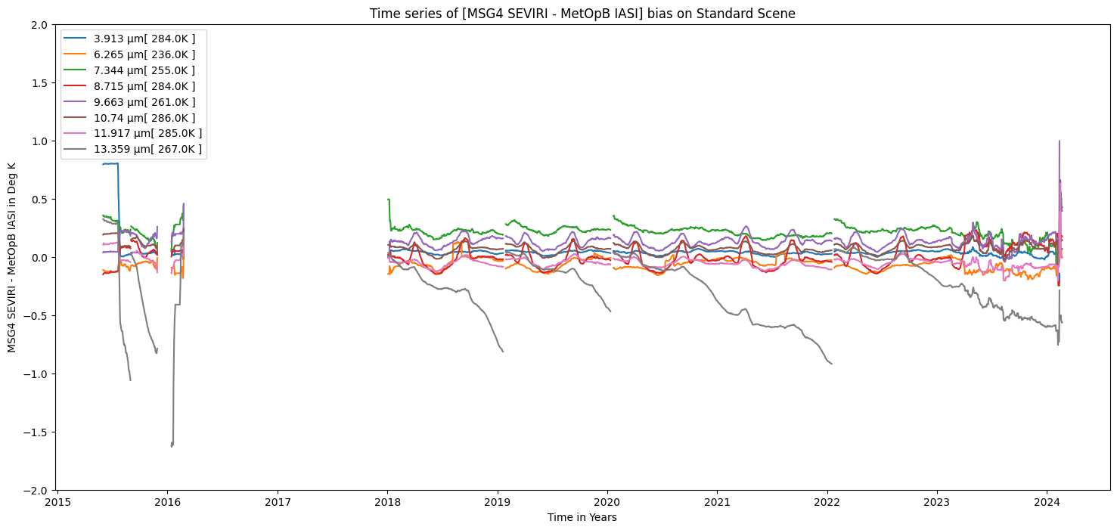
SEVIRI icing

Slide 7
SEVIRI icing
In between decontaminations, and due to the gradual accumulation of water ice on the cold window, the IR13.3 band (mainly) is affected in several ways:
  The throughput is reduced, but the black-body acquisitions allow to adapt the radiometric gain accordingly.
  NEdT increases because of the throughput reduction.
  The SRF is modified (see Hewison paper), with consequences on the black-body radiance calculation and on the utilization of the L1c radiances by the users.
The SEVIRI GSICS correction coefficients are a very imperfect way to correct for the SRF evolutions (hence they have no users).
It is likely feasible to dynamically estimate the IR13.3 SRF and provide it to users (as is done for Sentinel-3 OLCI). Users have historically been reluctant to consider dynamic SRFs, in particular NWP. BUT: the SRF evolution is deterministic as it is a function of the water ice layer thickness on the cold window. So we would be able to pre-process the SRF time series, and associated RTTOV coefficients. The monitoring functions would then determine for the present time, which index to use in the SRF (or RTTOV) pre-processed time-series.
EUMETSAT is considering discontinuing its SEVIRI GSICS IR coefficient files products in favour of a dynamic SRF estimation.

Slide 8
Thank you!
Questions are welcome.

