Slide 1
GSICS Data Working Group 20/03/2025
Paolo Castracane (Starion for ESA)
Manik Bali (NOAA/UMD)

Slide 2
WELCOME TO GDWG BREAKOUT SESSION

Slide 3
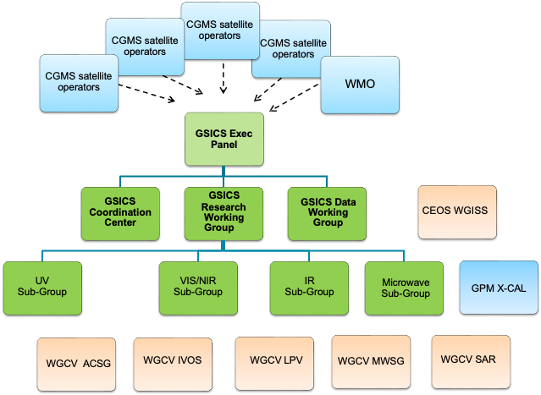


GDWG in the GSICS Framework
GDWG actively supports all aspects of GSICS activities
e.g . systems/metadata/products/wiki/GPPA
Detailed TOR here
Oversee and coordinate the data management activities of GSICS and advise the EP on questions related to GSICS data management including information delivery services

Slide 4
GDWG Membership
Affiliation | First Name | Last Name
CMA | Lin | Tian
ESA | Paolo | Castracane
EUMETSAT | Simon | Elliott
IMD | R.K. | Giri
IMD/Ministry of Earth Sciences | Kamaljit | Ray
ISRO | Nitant | Dube
JMA | Masaya | Takahashi
KMA | Hanbyul | Lee
NOAA | Manik | Bali
ROSHYDROMET | Sergey | Uspensky
WMO | Heikki | Pohjola
https://gsics.wmo.int/en/focal-points

Slide 5
Action 2024 Status [ 2024 ]
Action Id | Summary | Lead | Actual Completion | Deliverable Usage | Status
A.GDWG.20240311.2 | Paolo and Manik to coordinate with the SITsat group (CLARREO, LIBRA, TRUTHS) to define product format, also addressing the way uncertainties shall be reported in the products (with a special care on data volume). | Paolo/Manik | NASA would provide a sample data file |  | Closed
A.GDWD.20240312.1 | Manik Bali to define a format in which the agencies shall provide input for the SOS report. | Manik | Suggested |  | Closed
A.GDWD.20240312.2 | GRWG and GDWG to define a way forward for the generation of the SOS report. | Manik Bali | Script Developed |  | Closed
A.GDWG.20240312.4 | Paolo Castracane (ESA) to lead discussion with GCC and WMO on possible enhancement of GSICS websites following WGCV Cal/Val Portal as example. | Paolo Castracane | Ongoing |  | Open
A.GDWG.20240313.1 | CMA to post daily instrument bias on GPRC website in machine readable form. |  |  |  | Open
A.GDWG.20240313.2 | EUMETSAT (Simon Elliot) to provide IASI L1C reader to ISRO ( Pradeep Thapliyal ) : | Simon/Pradeep |  | Code provided | Closed
A.GDWG.20240313.4 | Paolo to coordinate with Manik on reducing overlap of webpage on solar radiance at ESA, NOAA/wiki and LASP. | Paolo |  |  | Open
A.GDWG.20240313.5 | Masaya to collect new codes of GSICS deliverable filenaming to be added in Common code table C-13 of WMO Manual on Codes. | Masaya |  |  | Open
A.GDWG.20240313.6 | Masaya to work on update of GSICS SRF Convention if GRWG requires any updates. | Masaya |  |  | Open
A.GDWG.20240313.7 | Take steps to integrate GSICS products into WIS | Manik | Exploring integration to EUMETSAT Data Server which is already WIS 2.0 active |  | Closed
A.GDWG.20240313.8 | Suggest format for storing daily bias following CF 1.5 CCC conventions | Manik | A.GDWD.20240312.1 |  | Closed
A.GDWG.20240313.9 | GDWG (NOAA) to find a method for digitally marking LSICS outputs that have been generated by the official GSICS code version and copies thereof and making them distinguishable from outputs that have been generated by LSICS code that has been modified. | Manik | Suggested API |  | Closed
R.GDWG.20240313.1 | CMA to link quality of reprocessed data related document on reprocessing website | Scott |  |  | Open

Slide 6
GDWG Additional Session Day 2 18 March 2025
18 March 2025 GDWG Additional Session
Time UTC+8 | Topic | Presenter | Agenda item
16:00 | GSICS Data and Product Server | Luca Garegnani (remotly) EUMETSAT | 11k
16:45 | Discussion | All
Draft Minute reported within GSCIS tempalte, including actions.
LG uploaded (GDWG Drive) the presentation with EUM Data Store references and documentations

Slide 7
GDWG Breakout Session
GDWG Breakout Session (Day 4 Thu 20 March)
Chair: Paolo Castracane /Co-Chair Manik Bali Minutes: Manik Bali
Time | Title | Presenter
9:00 | Welcome remarks from GDWG Chair | Paolo Castracane (in person) | 11a
9:15 | WMO – status of GSICS WMO website | Heikki Pohjola (in person) | 11b
9:30 | KMA GDWG Report | Hanbyul Lee (Virtually) | 11c
9:45 | JMA GDWG Report | Masaya Takahashi (in person) | 11d
10:00 | CMA GDWG Report - extended talk including CMA Server status | Lin Tian (in person) | 11e
10:30 | IMD GDWG Report | Asim Mitra (he replace Kamaljit). (in person) | 11f
10:45 | NOAA GDWG Report | Manik Bali. (in person) | 11g
11:00 | EUMETSAT GDWG Report | Simon Elliott (in person) | 11h
11:15 | ESA GDWG Report | Paolo Castracane | 11i
11:30 | Topics Discussion: GSICS Data and Product server (current status); Future of GSICS Products; SOS Report; Jupiter Notebook in GSICS. | All | 11j

Slide 8
THANK YOU

