Slide 1
KMA GDWG Activities
2025
Hanbyul Lee
KMA/NMSC

Slide 2
KMA’s GSICS Corrections
Current Status
  Near-Real Time Correction (NRTC)
    GK2A / AMI / IR with reference to IASI(Metop-B/-C) and CrIS(S-NPP and NOAA-20/21) : Demo. phase
    COMS / MI / IR with reference to AIRS(Aqua), IASI(Metop-A/-B): Demo. phase
  Re-analysis Correction (RAC)
    GK2A / AMI / IR with reference to IASI-B/-C and CrIS(S-NPP and NOAA-20/21) : Demo. phase
    COMS / MI / IR with reference to IASI-A : Demo. phase
  NRTC and RAC Correction Data is available in the EUMETSAT GSICS Server from Jan. 15, 2018

Slide 3
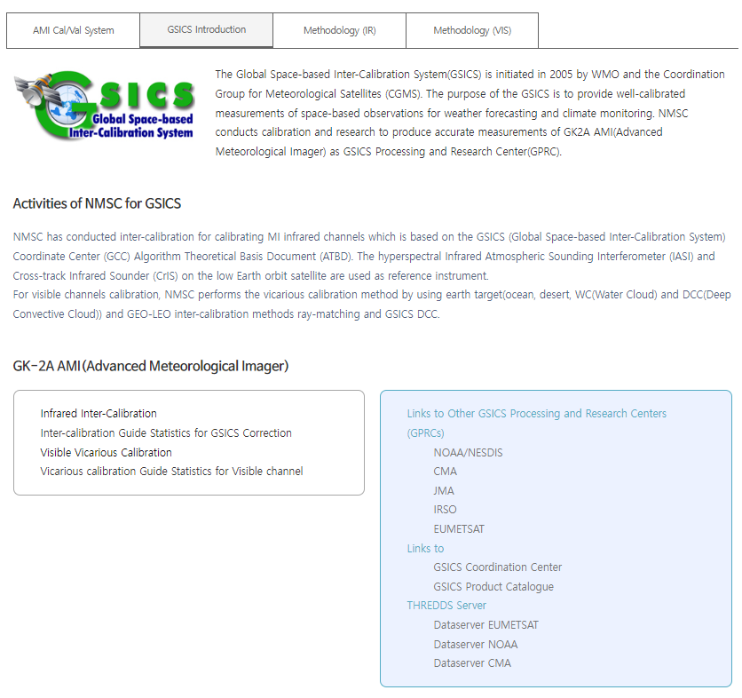
KMA GPRC web pages
Landing page (ACVs)
  https://nmsc.kma.go.kr/homepage/html/gsics/gsicsIntro.do (Korean, open)
  http://nmsc.kma.go.kr/enhome/html/main/main.do (English, will be updated soon)
Monitoring page
  IR (Metop-a/b/c IASI, NOAA-20/21, S-NPP CrIS)
  VIS Ray Matching(Terra MODIS, S-NPP, NOAA-20/21 VIIRS)
  VIS Lunar(GIRO)

Slide 4
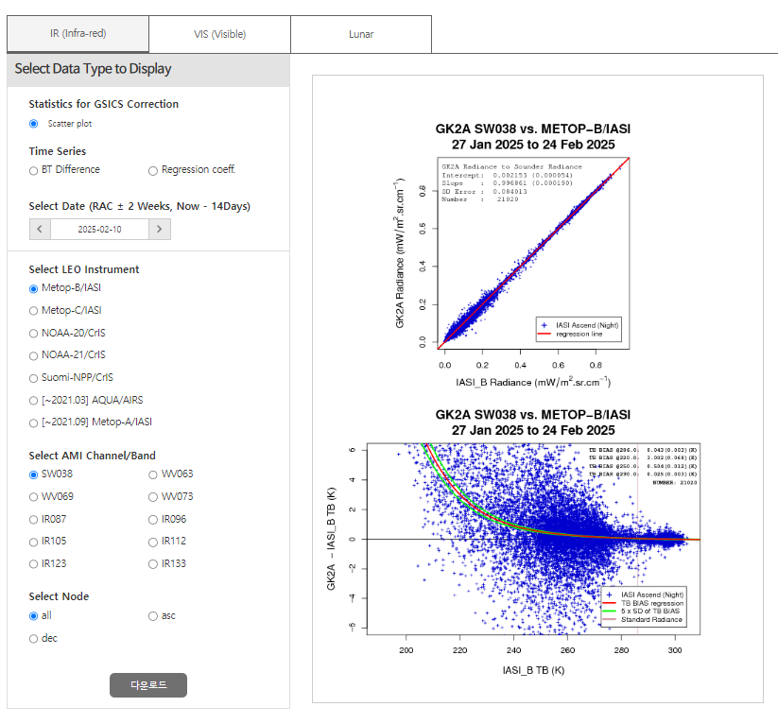
KMA GPRC web pages
AMI Cal/Val System
    GSICS Introduction
    Methodology(IR)
    Methodology(VIS/NIR)
IR Calibration (Scatter plot, Time series)
    Metop-B/C IASI, NOAA-20/21 CrIS, Suomi-NPP/CrIS
    Time series includes BT difference and Regression Coefficent

Slide 5
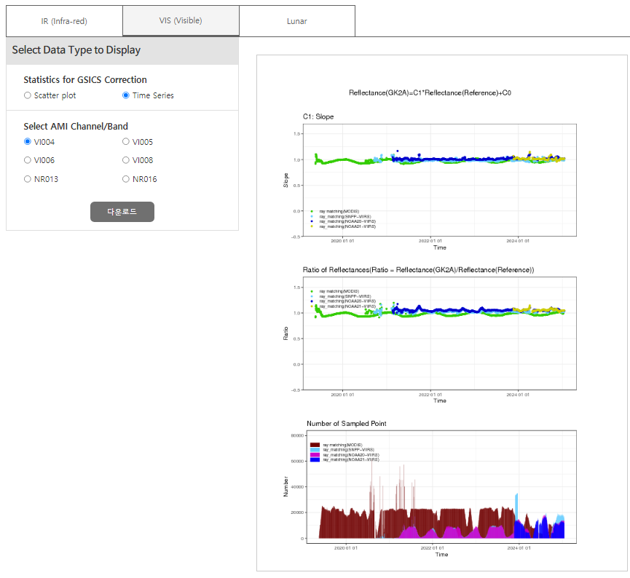
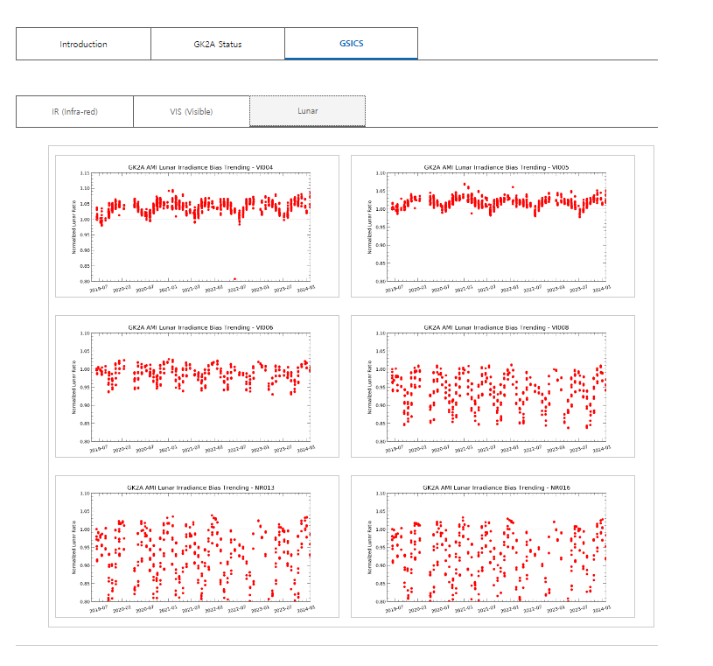
KMA GPRC web pages
AMI Cal/Val System
    GSICS Introduction
    Methodology(IR)
    Methodology(VIS/NIR)
Vis/NIR Calibration (Scatter plot, Time series)
    Ray-matching(Terra MODIS, S-NPP NOAA-/2021 VIIRS)
    Lunar calibration (GIRO)
    GSICS DCC and GEO-GEO will be open in 2025

Slide 6
KMA’s Personnel supporting GSICS
GRWG
  Eun-Jeong Cha (New Member), Hanbyul Lee and Euidong Hwang
  Jaeyoung Byon * (*leave of absence)
GDWG
  Eun Jeong Cha, Hanbyul Lee
Member | GRWG | GDWG | GEO-LEO | DCC RTM | Moon | GEO-GEO
Eun-Jeong Cha(Ms.) | Y | Y | Y | Y | Y | Y
Euidong Hwang (Mr.) | Y |  | Y
Hanbyul Lee (Ms.) | Y | Y | Y | Y | Y | Y

Slide 7
Thank you

