Slide 1


JMA GDWG Report
TAKAHASHI Masaya
Meteorological Satellite Center of Japan Meteorological Agency

Slide 2
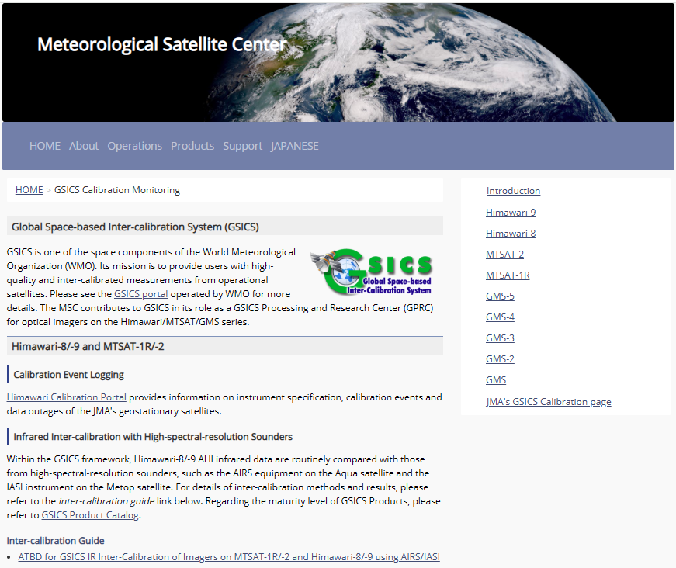
JMA GDWG Activities
Lunar calibration
Development of I/O data Convention for new lunar calibration framework (LSICS)
GSICS SRF Convention
Support to MW instruments
Maintaining JMA GPRC webpage
Calibration landing page
Instrument info (e.g., SRF)
Event logging
IR re-calibration info (GMS to MTSAT-2)
AHI monitoring pages
VNIR Ray-matching
VNIR Vicarious calibration
GEO-LEO-IR
https://www.data.jma.go.jp/mscweb/data/monitoring/calibration.html

Slide 3
Action on Lunar Calibration
A.GDWG.20240313.5: Masaya to collect new codes of GSICS deliverable filenaming to be added in Common code table C-13 of WMO Manual on Codes.
LSICS (Lunar Spectral Irradiance Calibration System) is a new GSICS framework for lunar calibration, under-development by GRWG. M. Takahashi has been involved with the activities as a GDWG member.
LSICS I/O filename conventions have been developed in 2024
Back-compatibility with GIRO (current GSICS standard model for lunar calibration)
Following GSICS naming convention
Two points are related to C-13 of WMO Manual on Codes

Slide 4
LSICS Input/Output File Naming Convention (netCDF)
Differences from existing GSICS convention are highlighted in red and blue.
Red parts are related to Common code table C-13 of WMO Manual on Codes.
Input files
Lunar observation: follows GIRO formats, but supports multiple different observation time data in a file.
Spectral response function: same as GSICS Convention
Output file
Similar to GIRO output, but closer to GSICS products (e.g., GEO-LEO-IR) by adding data type (BIASM), algorithm type (LUNARVNIR), and reference (LSICS+SLIMM)
Single obs: W_XX-EUMETSAT-Darmstadt,VISNIR+SUBSET+MOON,MSG3+SEVIRI_C_EUMG_20130101145644_01.nc
Multiple obs: W_XX-EUMETSAT-Darmstadt,VISNIR+SUBSET+MOON,MSG3+SEVIRI_C_EUMG_20130101145644_20140715153303_01.nc
time for 1st obs time for last obs
W_XX-EUMETSAT-Darmstadt,SATCAL+BIASM+LUNARVNIR,MSG3+SEVIRI-LSICS+SLIMM_C_EUMG_20130101145644_20140715153303_01.nc
calculated MSG-3/SEVIRI lunar irradiance by SLIMM in the LSICS
c.f., GIRO output: W_ XX-EUMETSAT-Darmstadt,SATCAL+ROLOVISNIR, MSG3+SEVIRI_C_EUMG_20130101145644_01.nc
GEO-LEO-IR: W_XX-EUMETSAT-Darmstadt,SATCAL+RAC+GEOLEOIR,MSG3+SEVIRI-MetOpC+IASI_C_EUMG_20190808000000_01.nc
Notes:
BIASM: bias monitoring is one of the application of LSICS output

Slide 5
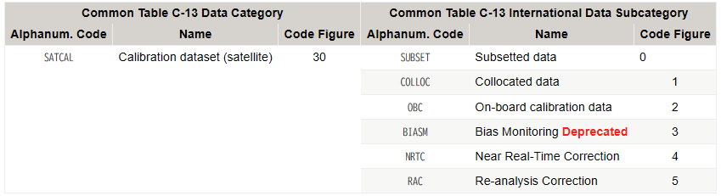
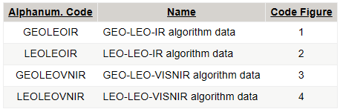
Proposal to Update GSICS File Naming Convention
W_XX-EUMETSAT-Darmstadt,SATCAL+BIASM+LUNARVNIR,MSG3+SEVIRI-LSICS+SLIMM_C_EUMG_20130101145644_20140715153303_01.nc
SATCAL+BIASM+LUNARVNIR is called data designator consists up to 3 fields delimited by the plus character, which is defined Common code table C-13 of WMO Manual on Codes.
DataCategory+InternationalDataSubcategory[+LocalDataSubcategory]
BIASM is categorized as Deprecated on the GSICS Wiki, but still exists in C-13 and we need this for LSICS
Proposal to delete “Deprecated” from the Wiki
Local Data Subcategory is not listed in C-13. If GSICS Wiki is the only place for the definition, we may be able to add LUNARVNIR at any time (need confirmation with WMO expert).
Local Data Subcategory
https://gsics.atmos.umd.edu/bin/view/Development/FilenameConvention

Slide 6
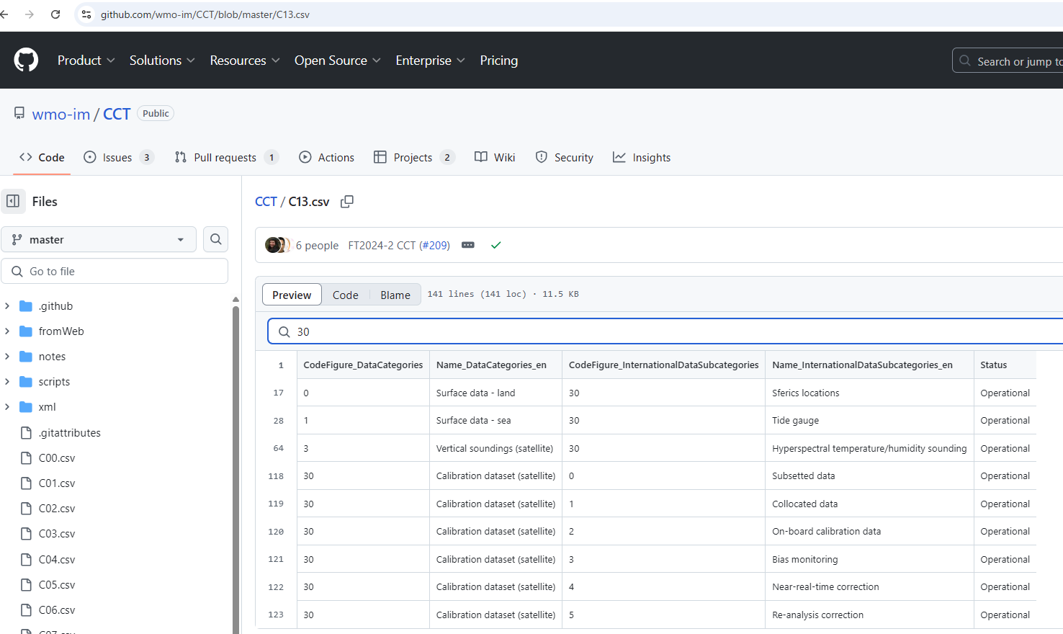
Screenshot took on 2025-03-13

Slide 7
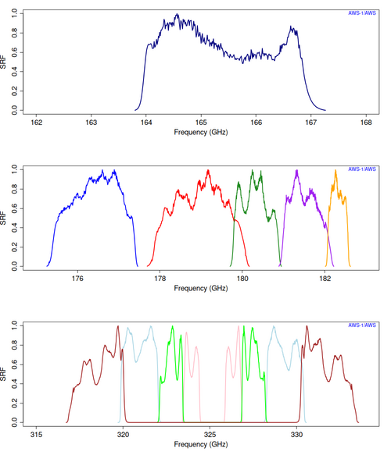
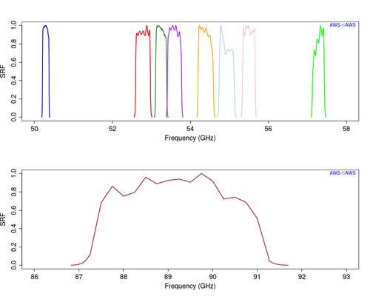
Action on GSICS SRF Convention: Supporting MW Instruments
A.GDWG.20240313.6: Masaya to work on update of GSICS SRF Convention if GRWG requires any updates.
In response to a request from GRWG MW Sub-Group (T. Hewison), sample python script to generate MW instrument’s SRF was prepared in Jan 2025.
AWS (Arctic Weather Satellite) SRFs
The code is based on existing script for VNIR and IR instruments, which was developed in GDWG for internal use.
The sample script was shared with MW Sub-Group for internal use.

Slide 8
Thanks for your attention!

Slide 9
GSICS Conventions
Filenaming Convention
http://gsics.atmos.umd.edu/bin/view/Development/FilenameConvention
Follows the rules given in the General File Naming Conventions section of the WMO Manual on The Global Telecommunication System
netCDF Convention
http://gsics.atmos.umd.edu/bin/view/Development/NetcdfConvention
Follows the netCDF CF (Climate and Forecast) Convention widely used in the netCDF community
Some metadata follows WMO Manual on Codes (e.g., satellite identifier and satellite instruments defined in Common Code Tables C-5 and C-8)
Data versioning: product data versioning is defined using Major version number, Minor version number, and Revision number (e.g., v3.12.5)
SRF Convention
http://gsics.atmos.umd.edu/bin/view/Development/SrfNcdfConvention
Instrument’ Spectral Response Function (SRF) Convention was also defined by following GSICS Filenaming and netCDF Convention

Slide 10
GSICS File Naming Convention
pflag_productidentifier_oflag_originator_yyyyMMddhhmmss[_freeformat].type[.compression]
Note: underscore is a field delimiter
pflag: always W (represents WMO product identifier)
productidentifier: consists of LocationIndicator,DataDesignator,FreeDescription (comma is a delimiter)
LocationIndicator : data producer in 3 fields (i.e. Country-Organization-ProductionCenter)
DataDesignator : data type, consists of up to 3 fields (i.e. DataCategory+InternationalDataSubcategory+LocalDataSubcategory)
FreeDescription : Platform+Instrument[-Platform+Instrument]
oflag: always C (represents CCCC is used in originator field)
originator: international 4-letter location indicator (CCCC) of the station/center originating the file defined in WMO
freeformat (optional): product phase, major version number, ymdhm (data collection/observation/processing) are defined
Examples
Lunar observation: W_XX-EUMETSAT-Darmstadt,VISNIR+SUBSET+MOON,MSG3+SEVIRI_C_EUMG_20140318140112_01.nc
SRF: W_US-NESDIS-STAR,VIS+IR+SRF,GOES16+ABI_C_KNES.nc
GIRO output: W_JP-JMA-MSC,SATCAL+ROLOVISNIR,Himawari9+AHI_C_RJTD_20221130203106_01.nc
GEO-LEO-IR: W_KR-KMA-NMSC,SATCAL+RAC+GEOLEOIR,GK2A+AMI-MetopC+IASI_C_RKSL_20190725000000_demo_01.nc

Slide 11
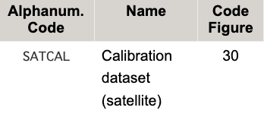
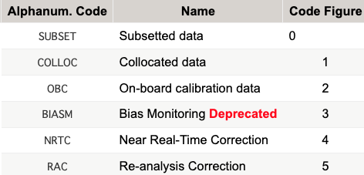
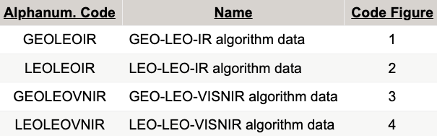
productidentifier: LocationIndicator,DataDesignator,FreeDescription
Lunar observation: W_XX-EUMETSAT-Darmstadt,VISNIR+SUBSET+MOON,MSG3+SEVIRI_C_EUMG_20140318140112_01.nc
SRF: W_US-NESDIS-STAR,VIS+IR+SRF,GOES16+ABI_C_KNES.nc
GIRO output: W_JP-JMA-MSC,SATCAL+ROLOVISNIR,Himawari9+AHI_C_RJTD_20221130203106_01.nc
GEO-LEO-IR: W_KR-KMA-NMSC,SATCAL+RAC+GEOLEOIR,GK2A+AMI-MetopC+IASI_C_RKSL_20190725000000_demo_01.nc
LocationIndicator : data producer in 3 fields (Country-Organization-ProductionCenter)
Country code XX is available for international organizations
ProductionCenter is a production center name or location (city name)
DataDesignator : data type, consists of up to 3 fields (DataCategory+InternationalDataSubcategory+LocalDataSubcategory)
Due to practical reasons, GIRO input/output and SRF files do not fully follow GSICS Convention
DataCategory (mandatory) InternationalDataSubcategory (mandatory) LocalDataSubcategory (optional)
FreeDescription : Platform+Instrument[-Platform+Instrument]
Platform+Instrument-Modellnfo (e.g. MTI1+FCI-LSICS+SLIM) would be OK – GSICS Convention may need to be updated in future
DataCategory and InternationalDataSubcategory are documented in Common Table C-13 of the WMO Manual on Codes Volume I.2 (WMO-No. 306)
Notes:
Working documents by WMO
https://github.com/wmo-im/CCT
Manual on Codes, Volume I.2 – International Codes
https://library.wmo.int/records/item/35625-manual-on-codes-volume-i-2-international-codes#.X18yfpMza3I

Slide 12
oflag and originator
Lunar observation: W_XX-EUMETSAT-Darmstadt,VISNIR+SUBSET+MOON,MSG3+SEVIRI_C_EUMG_20140318140112_01.nc
SRF: W_US-NESDIS-STAR,VIS+IR+SRF,GOES16+ABI_C_KNES.nc
GIRO output: W_JP-JMA-MSC,SATCAL+ROLOVISNIR,Himawari9+AHI_C_RJTD_20221130203106_01.nc
GEO-LEO-IR: W_KR-KMA-NMSC,SATCAL+RAC+GEOLEOIR,GK2A+AMI-MetopC+IASI_C_RKSL_20190725000000_demo_01.nc
oflag: a character or combination of characters indicating how to decode the originator field
“C” is the only one currently available, which represents the originator field will be decoded as a standard CCCC country code
originator: a variable length field which states where the file originated. It should be decoded according to the oflag.
CCCC code: international 4-letter location indicator (CCCC) of the station/center originating the file defined in WMO
In case appropriate CCCC code is not available in the following document, using the Institution Acronym for ProductionCenter of LocationIndicator is proposed in GIRO.
WMO No. 9 - Weather Reporting CCCCs by Location Indicator Volume C1 - Catalogue of Meteorological Bulletins Location Indicators used in the Abbreviated Headings (TTAAii CCCC). CCCC list as of July 2022 is: https://wmoomm.sharepoint.com/:b:/s/wmocpdb/EYVxgH4xKfpOj_tCmwBeIasBgIGb7Bz4P2D6L7_llloNUA?e=JtTJo4
Proposed options for LSICS:
1) to take the same approach as GIRO
2) to use XXXX as invalid info (keeping 4 letters)

Slide 13
freeformat (optional)
Lunar observation: W_XX-EUMETSAT-Darmstadt,VISNIR+SUBSET+MOON,MSG3+SEVIRI_C_EUMG_20140318140112_01.nc
SRF: W_US-NESDIS-STAR,VIS+IR+SRF,GOES16+ABI_C_KNES.nc
GIRO output: W_JP-JMA-MSC,SATCAL+ROLOVISNIR,Himawari9+AHI_C_RJTD_20221130203106_01.nc
GEO-LEO-IR: W_KR-KMA-NMSC,SATCAL+RAC+GEOLEOIR,GK2A+AMI-MetopC+IASI_C_RKSL_20190725000000_demo_01.nc
freeformat field: YYYYMMDDHHMMSS_..._distphase_version
where "..." indicates possible, not yet specified sub-fields.
We can add new sub-field(s) for LSICS, if needed.
YYYYMMDDHHMMSS (optional)
Interpreted as end time in UTC related to data collection, observation, or processing
distphase (optional for Operational phase only)
Distribution phase of file's data (“demo” or “preop”), available only for GSICS products. Operational phase products cannot have this.
version (optional)
Version identifier of file's data. Only the major version number is used in the two-digit format and this must appear last in the freeformat.

Slide 14
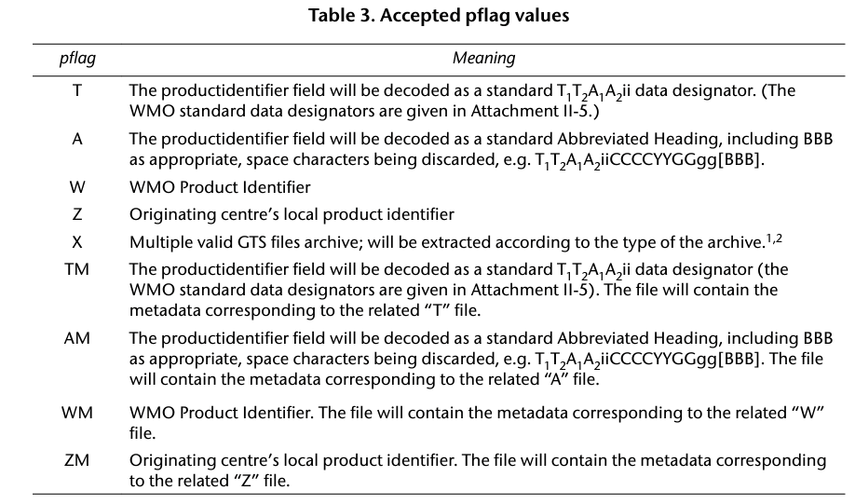
pflag
A character or combination of characters indicating how to decode the productidentifier field. At this time, the pflag field has only the following acceptable value
Notes:
1. Use of file archives for FTP exchange is through bilateral agreement of Centres. Any new Global Information System Centre (GISC) should have this functionality from the start of 2018 and any existing GISC before the end of 2020.
2. For pflag X, only compressed archive file format extension is allowed (tar, tar.gz, tar.xz and .zip).

Slide 15
GSICS Data Versioning (part of GSICS netCDF Convention)
vMajorVersionNumber.MinorVersionNumber.RevisionNumber
Example: "v0.0.1", "v1.5.0", "v2.3.16", "v10.0.3"
Revision number will increase for:
Any change that brings files and data in line with the published documentation. This includes: any global or variable attribute name and its value, variable's name, variable's data, or dimensions and their values.
Minor version number will increase for:
Any addition of new variables, global or variable attributes, or dimensions. Nothing already present in files can change.
ATBD changes that affect only the calculation of uncertainties by less than a factor of 2.
Major version number will increase for:
Any other ATBD change.
Any change in how some data is calculated even if that does not amount to a modification of the ATBD. For example: change of reference calibration targets, etc.
Any change of components except uncertainty estimates already present in files.
Any other change not covered by the minor or revision number changes.

Slide 16
References
Manual on the Global Telecommunication System Annex III to the WMO Technical Regulations (WMO-No. 386)
General File Naming Convention is defined
https://library.wmo.int/records/item/35800-manual-on-the-global-telecommunication-system?offset=9
WMO Manual on Codes, Volume I.2 – International Codes (WMO-No. 306)
Common Code Table is defined
https://library.wmo.int/records/item/35625-manual-on-codes-volume-i-2-international-codes#.X18yfpMza3I
Common Code Table Working documents by WMO
https://github.com/wmo-im/CCT

