Slide 1
CMA GDWG
TIAN Lin

Slide 2
Outline
CMA GDWG TASK
Data Sharing and NSMC-GPRC Website Upgrade

Slide 3
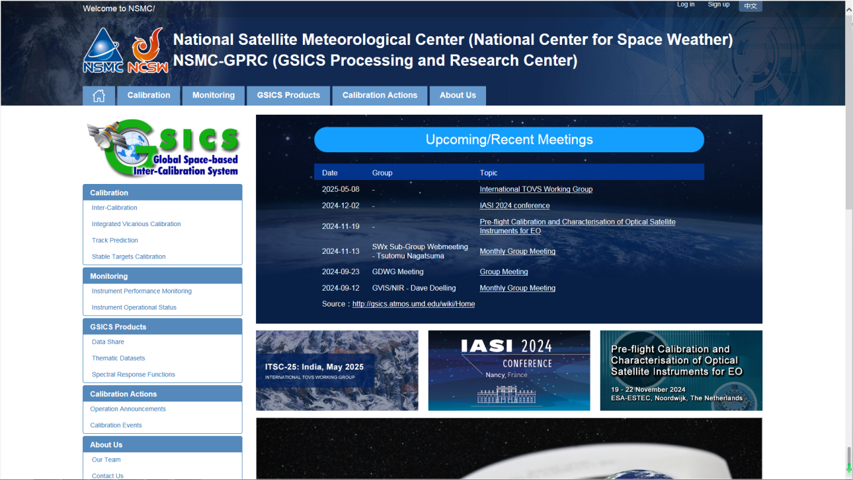
Agency’s support to GDWG Activites
Keep CMA GPRC Website Content updating:
  GPRC Information
  CMA GSICS product sharing (Thredds)
  FengYun Satellites Instrument Operation Status (Landing Pages）
CMA GDWG:
  Website construction and maintain
  New satellite data sharing
  NSMC-GPRC Website Upgrade

Slide 4
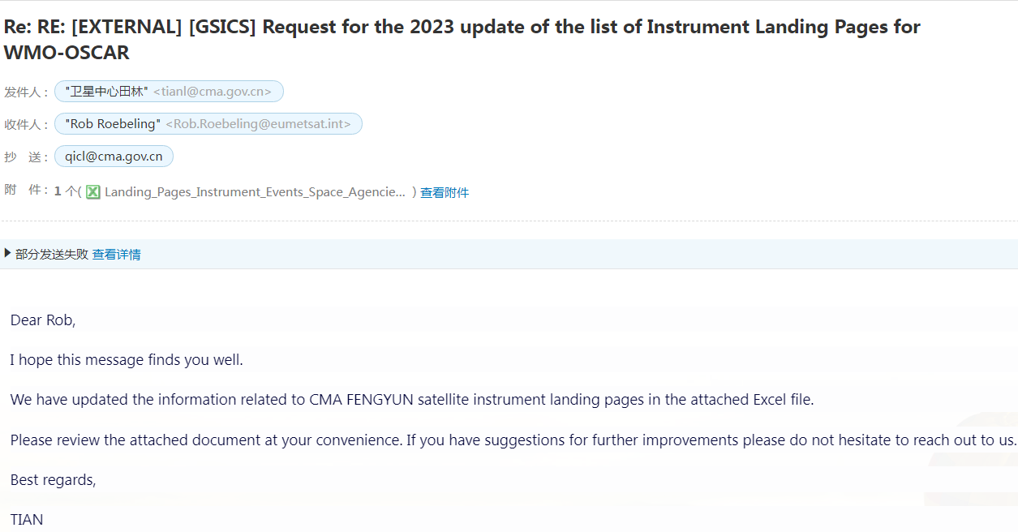
CMA GDWG TASK: Update of the Landing Pages for WMO-OSCAR
Updating the list of new Instrument Calibration and Monitoring Landing Page addresses:
  FY-3F: MERSI-III, HIRAS-2, MWTS-3, MWHS-2, MWRI-2, GNOS-2, OMS-L, OMS-N, EMR-2, SIM-2;
  FY-3G: MERSI-RM, MWRI-RM, GNOS-2, HAOC;

Slide 5
Outline
CMA GDWG TASK
Data Sharing and NSMC-GPRC Website Upgrade

Slide 6
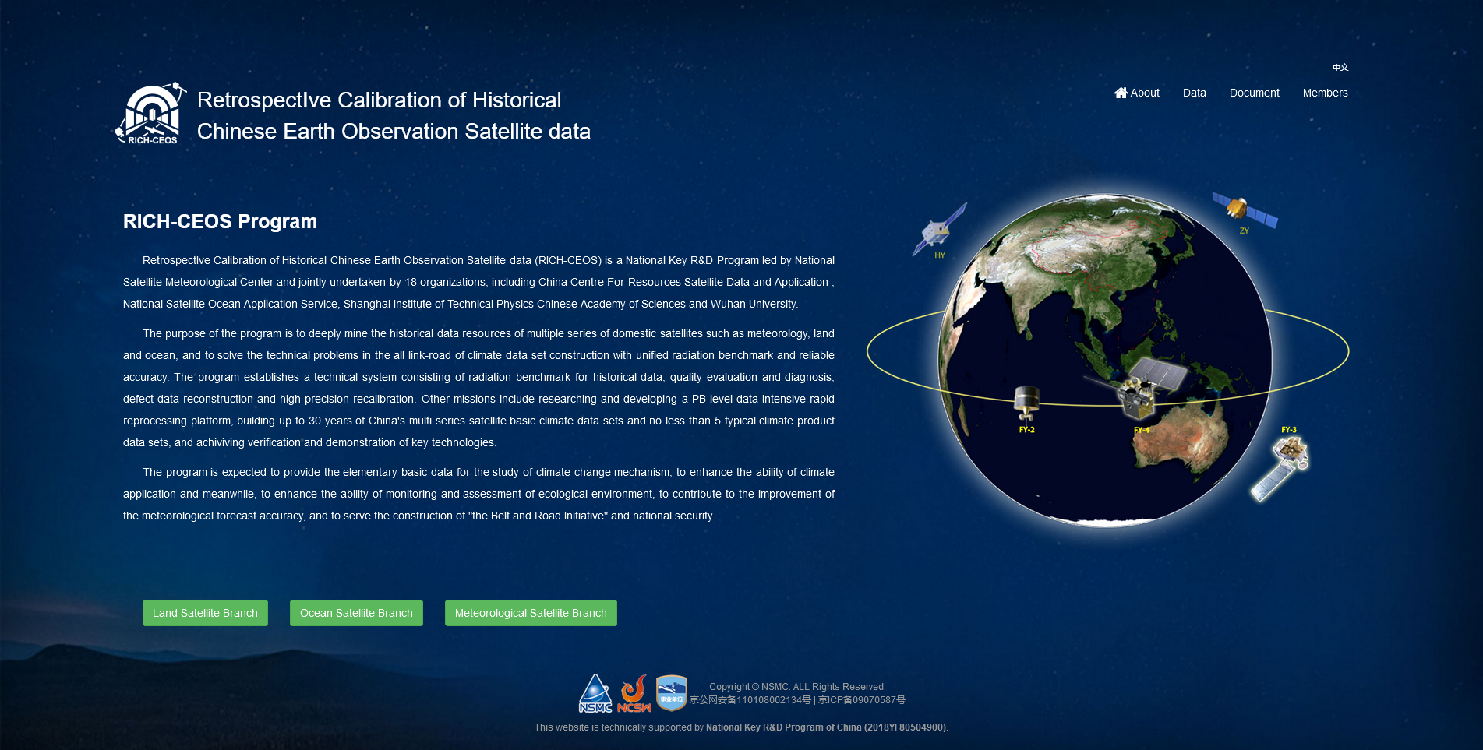
RICH-CEOS Data Website
Up to 30 years of basic climate data of China's multi series satellite such as meteorology, land and ocean.
Climate data sets constructed with unified radiation benchmark and reliable accuracy.
Approximately 300TB data available:
  13 primary climate data sets,
  9 thematic product data sets,
  4 radiation reference data sets.
www.richceos.cn/record/en/index.html

Slide 7
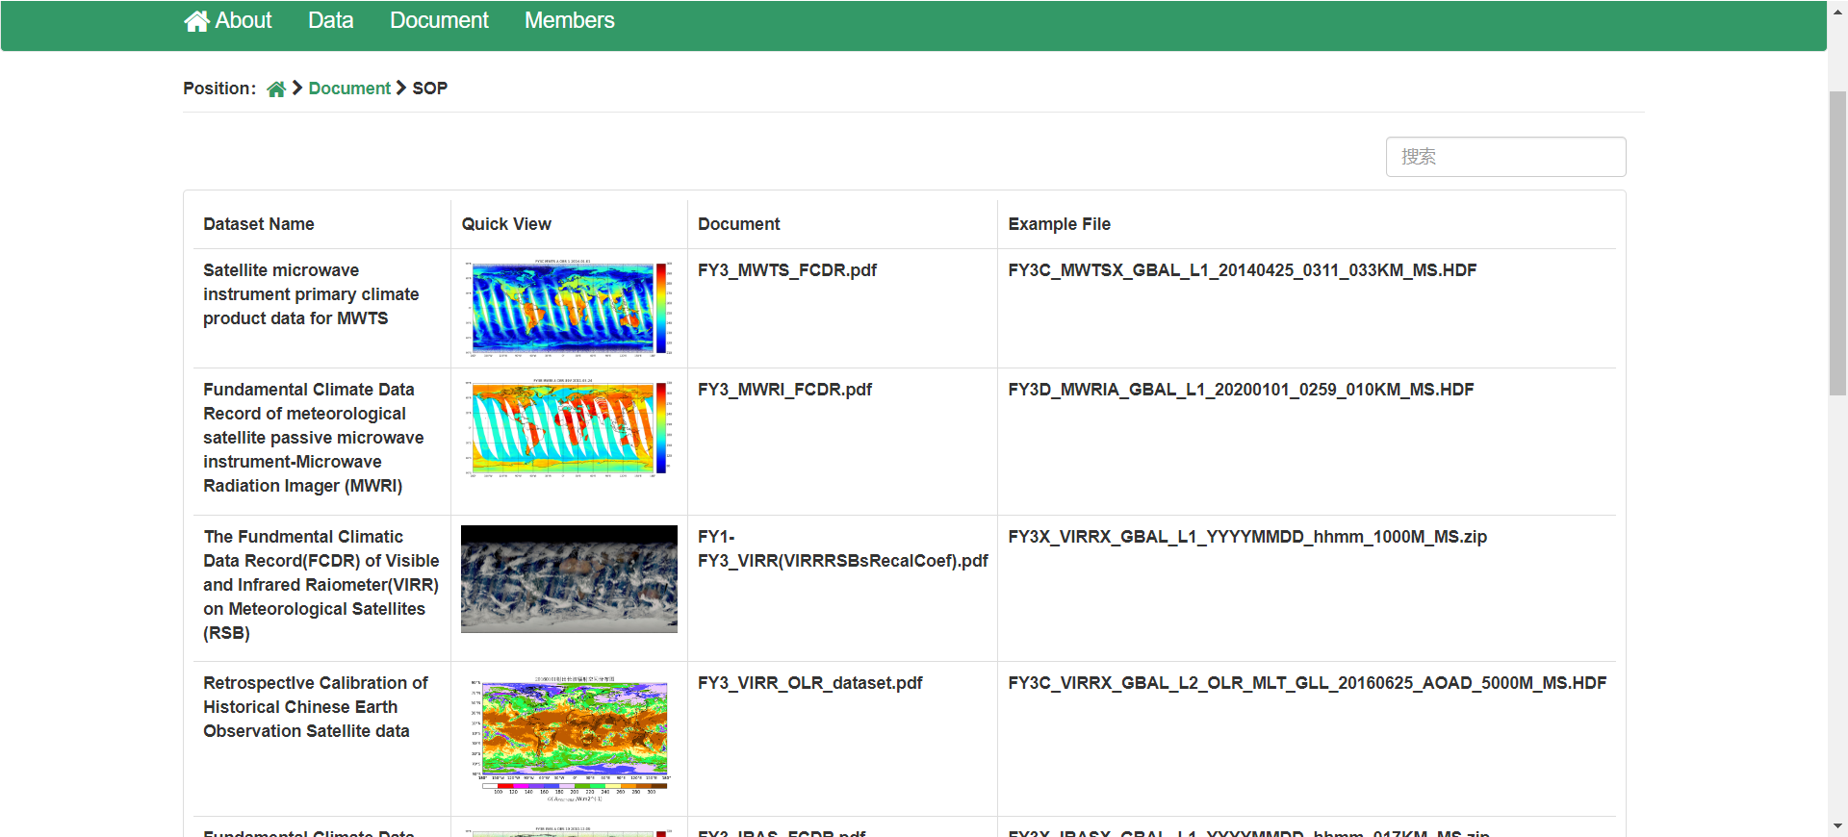
RICH-CEOS Data Website
Actions: Upload the SOP files

Slide 8
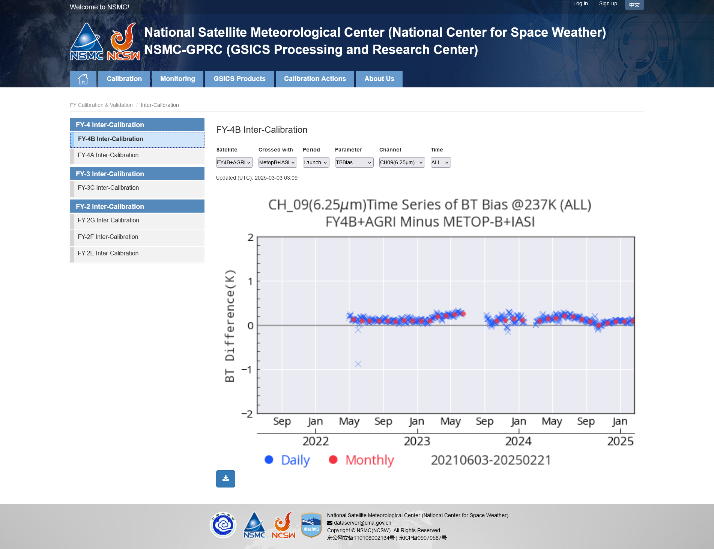
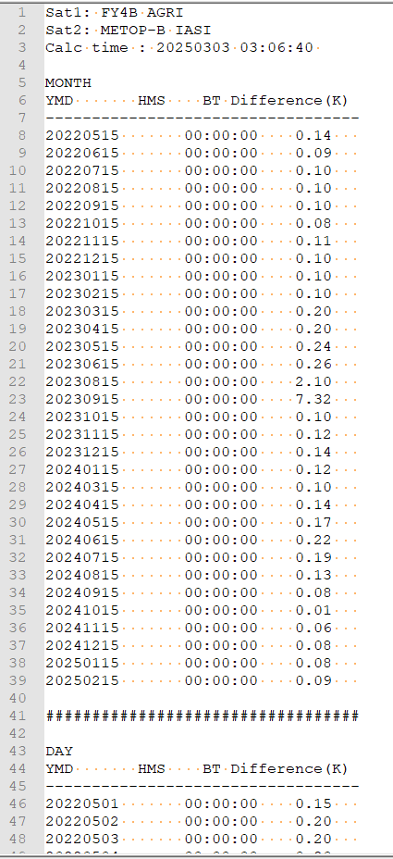
NSMC-GPRC Website Upgrade
Actions: FY-4 inter-calibration results: plotting source files can be downloaded now
Monthly results
Daily results

Slide 9
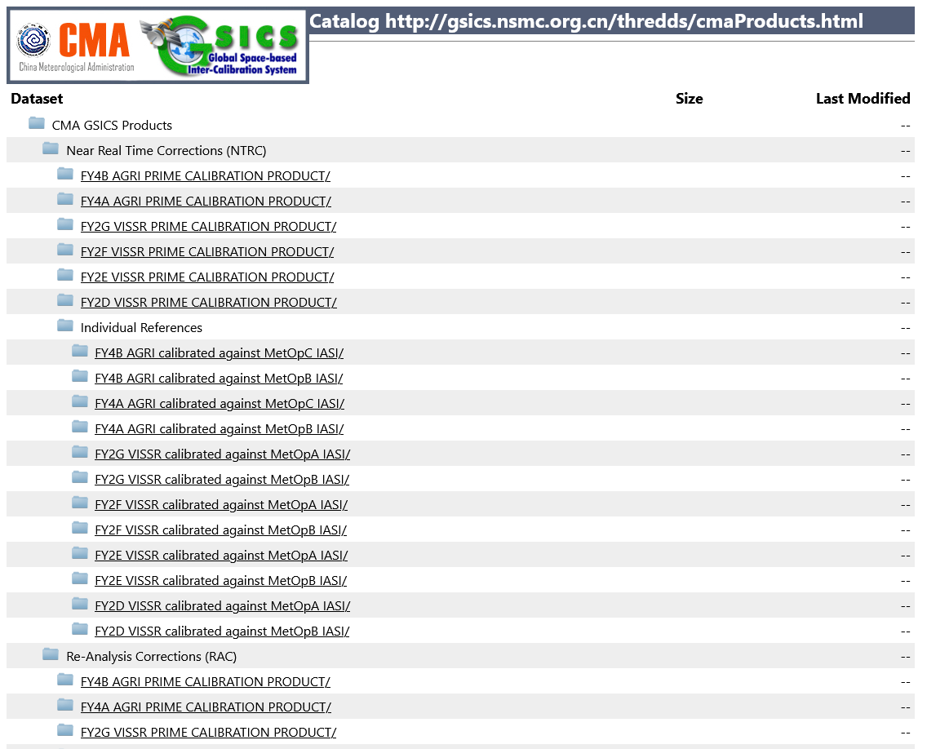
CMA GSICS product sharing (Thredds)
FY-4 inter-calibration results: under verification and will be released soon
http://gsics.nsmc.org.cn/thredds/cmaProducts.html

Slide 10



Thank you for your attention！
Email:
tianl@cma.gov.cn
Notes:
Thank you for your attention. I will stop here. For more information, please visit the following website.
And, if you have any problem, please contact me by email.

