Slide 1
NOAA GDWG
GDWG Breakout Session
GSICS Annual Meeting 2024
20 March 2025
Manik Bali
NOAA GDWG

Slide 2
TABLE OF CONTENT
Introduction
NOAA/GDWG Action Status and new actions
Action Tracker
Alert System
Product Catalog
Moving on to next year

Slide 3
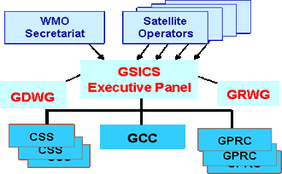
Introduction
GCC
NOAA/GDWG
NOAA GDWG Unique.
Its goals overlaps with GSICS Coordination Center

Slide 4
Actions 2024
A.GDWG.20230301.1 | Manik Bali (NOAA) to add option in tracking tool to label actions as no longer relevant, and ensure a lead is clearly identified for each action | Manik | Closed
A.GDWG.20230904.1 | GDWG to contact the product producers to learn about their views on making their products discoverable in the WIS system on a test basis | Manik | Ongoing
A.GDWG.20230904.2 | GDWG so share lessons learnt with GRWG, Simon and the WIS team. | Manik | Ongoing
A.GEP.20230630.4 | WMO to organize WIS 2.0 presentation in GDWG subgroup meeting | WMO/Manik Bali | Closed
R.GDWG.20230301.5 | Manik Work closely to develop to utilize OSCAR API for retrieving information of interest | Manik | Ongoing

Slide 5
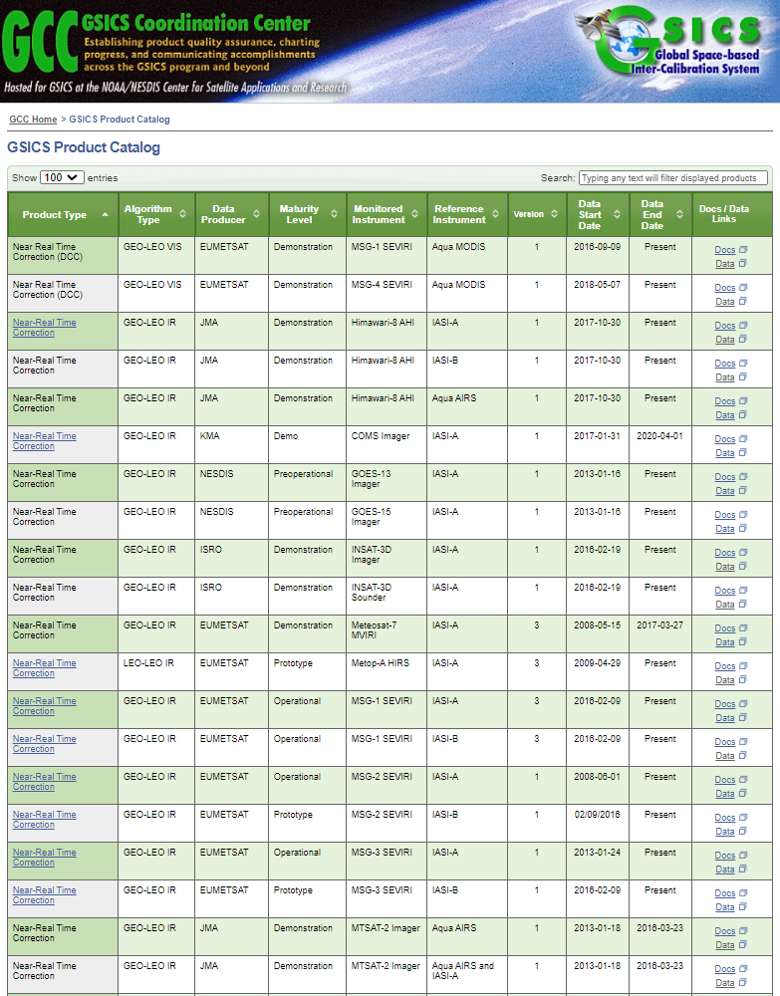
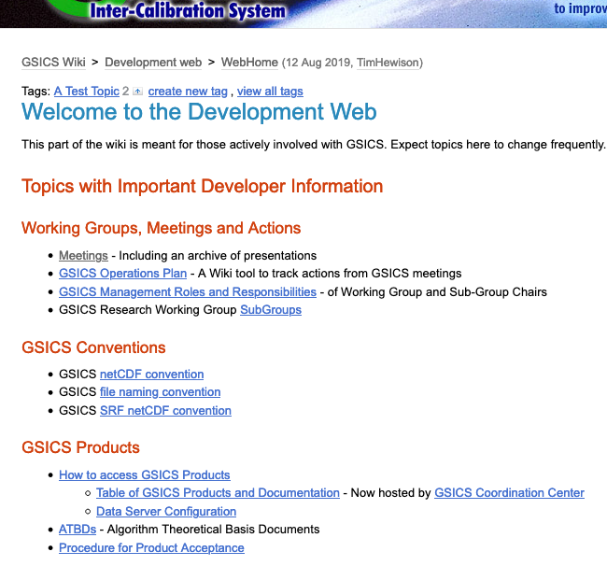
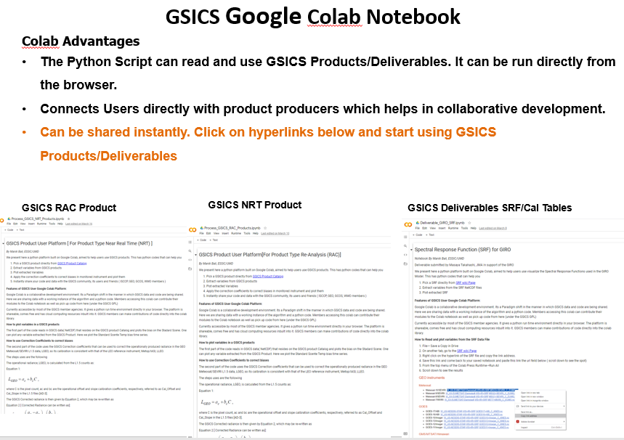
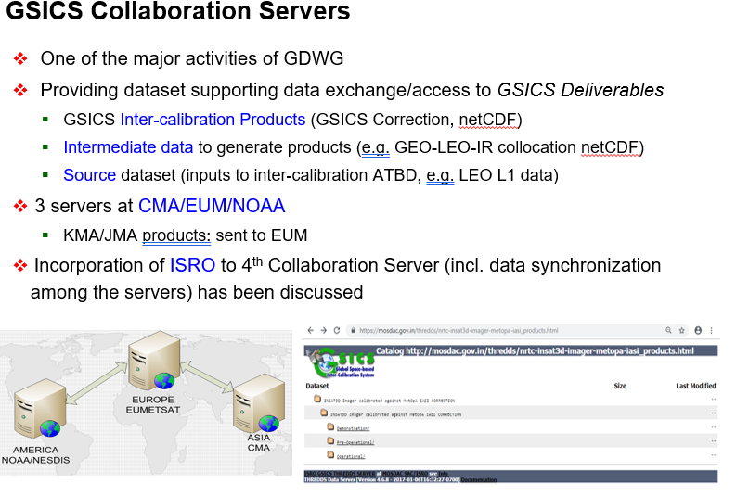
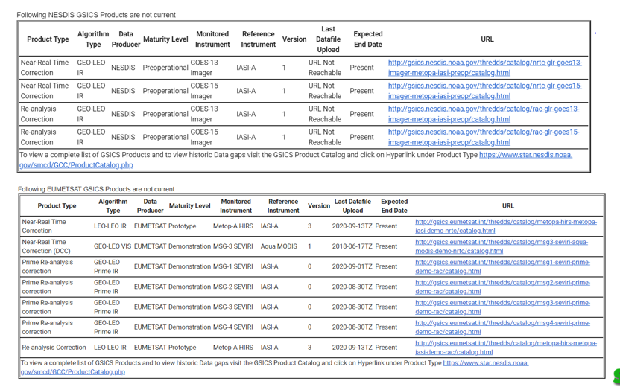
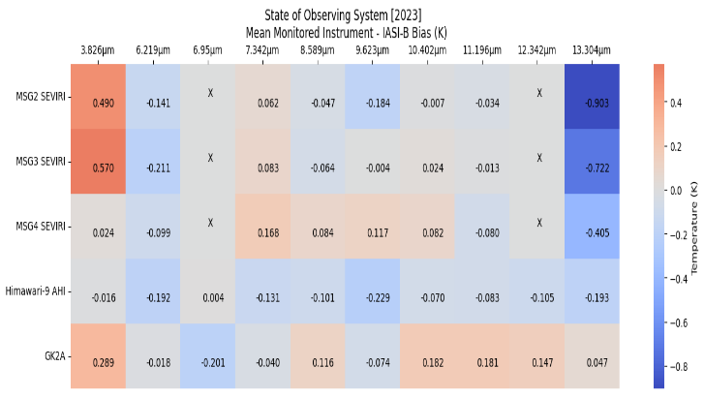
GSICS Product Catalog
GSICS Wiki
GSICS Notebooks
THREDDS Server
Track GSICS products
State of Observing System Heatmap

Slide 6
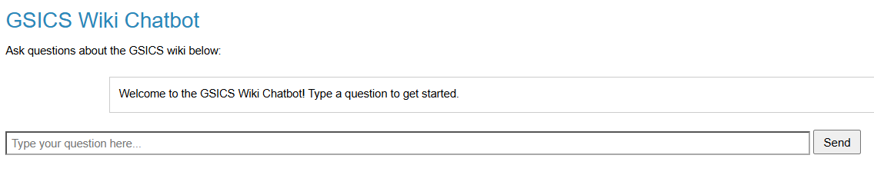
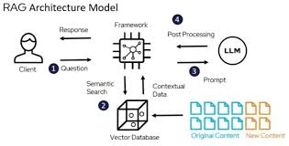
ASK GSICS
As questions about content on Wiki
Meetings
Actions
For Fast and accurate answers
Deploys GenAI Models (GPT-4o) and ADA Embeddings for accurate vector representation
Uses LangChain Vector Data Base
Welcome to have your page Indexed in the Chatbot

Slide 7
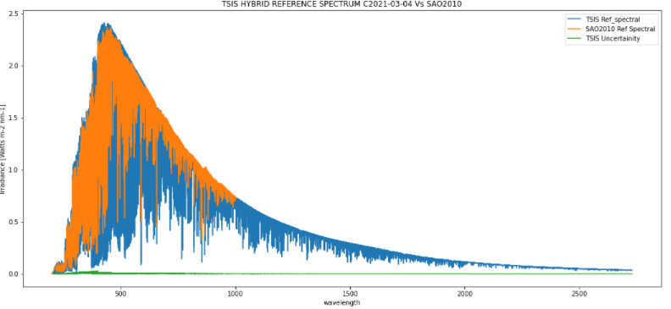
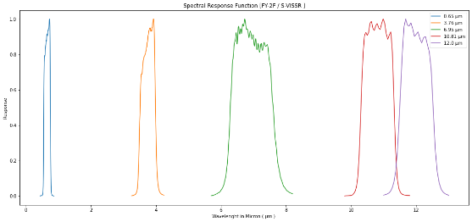
Notebooks:
  From the browser access
  Python Environment
  Processors
  Reader Code
  Correction Code
  Provide Collaborative ecosystem
New Notebooks
Generate SOS Report
Compare Solar Data Sets
GIRO SRF
Process GEMS data**
DCC Product notebook
  This notebook reads DCC products and plots and lists them
GIRO SRF notebook
GSICS Product RAC notebook and NRT notebook

Slide 8
Product Review Colab
The Review NRT Colab file is here
The Review RAC Colab file is here
Features
Tool can be run from browser
Checks metadata
Checks correction equation
Plots uncorrected and corrected biases

Slide 9
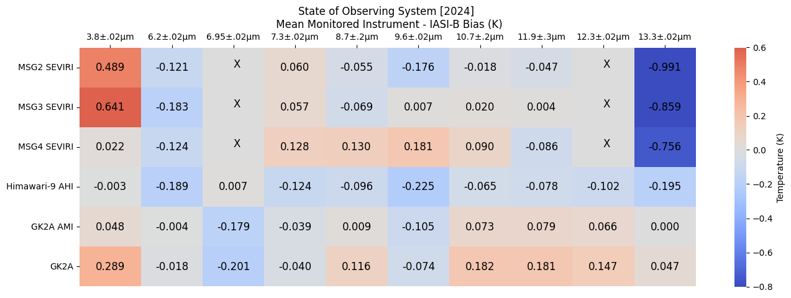
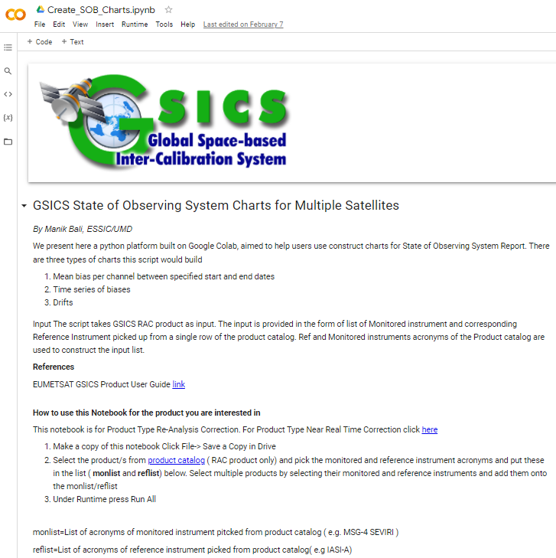
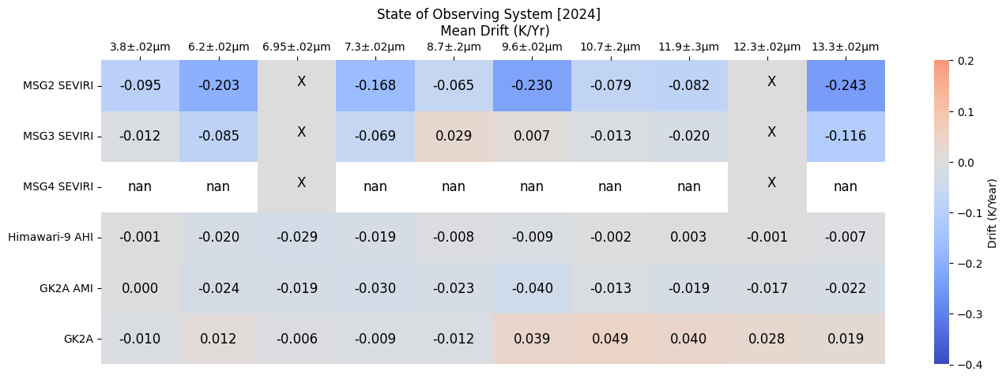
State of Observing System
Generate State of Observing System Charts

Slide 10
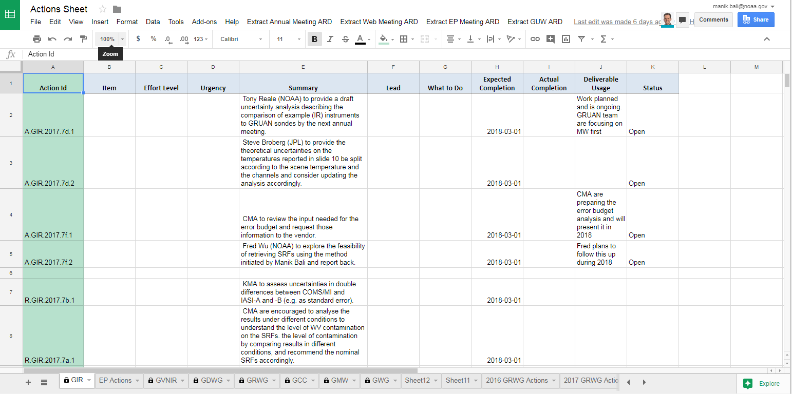
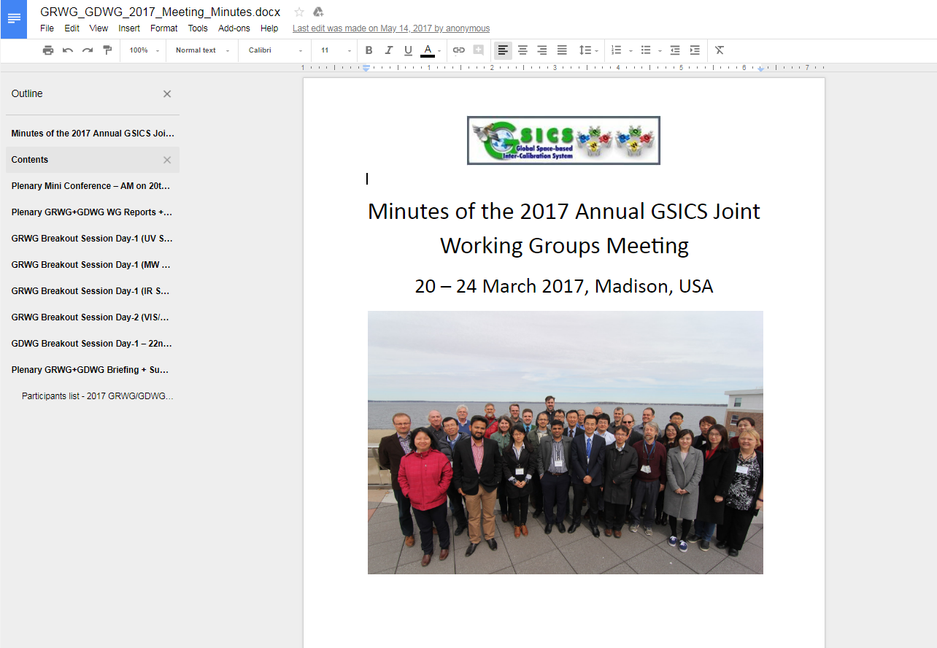
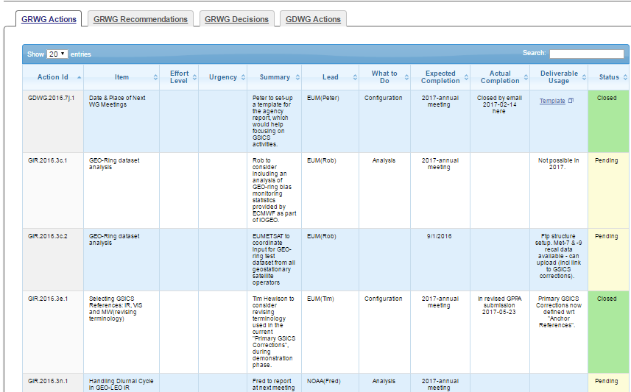
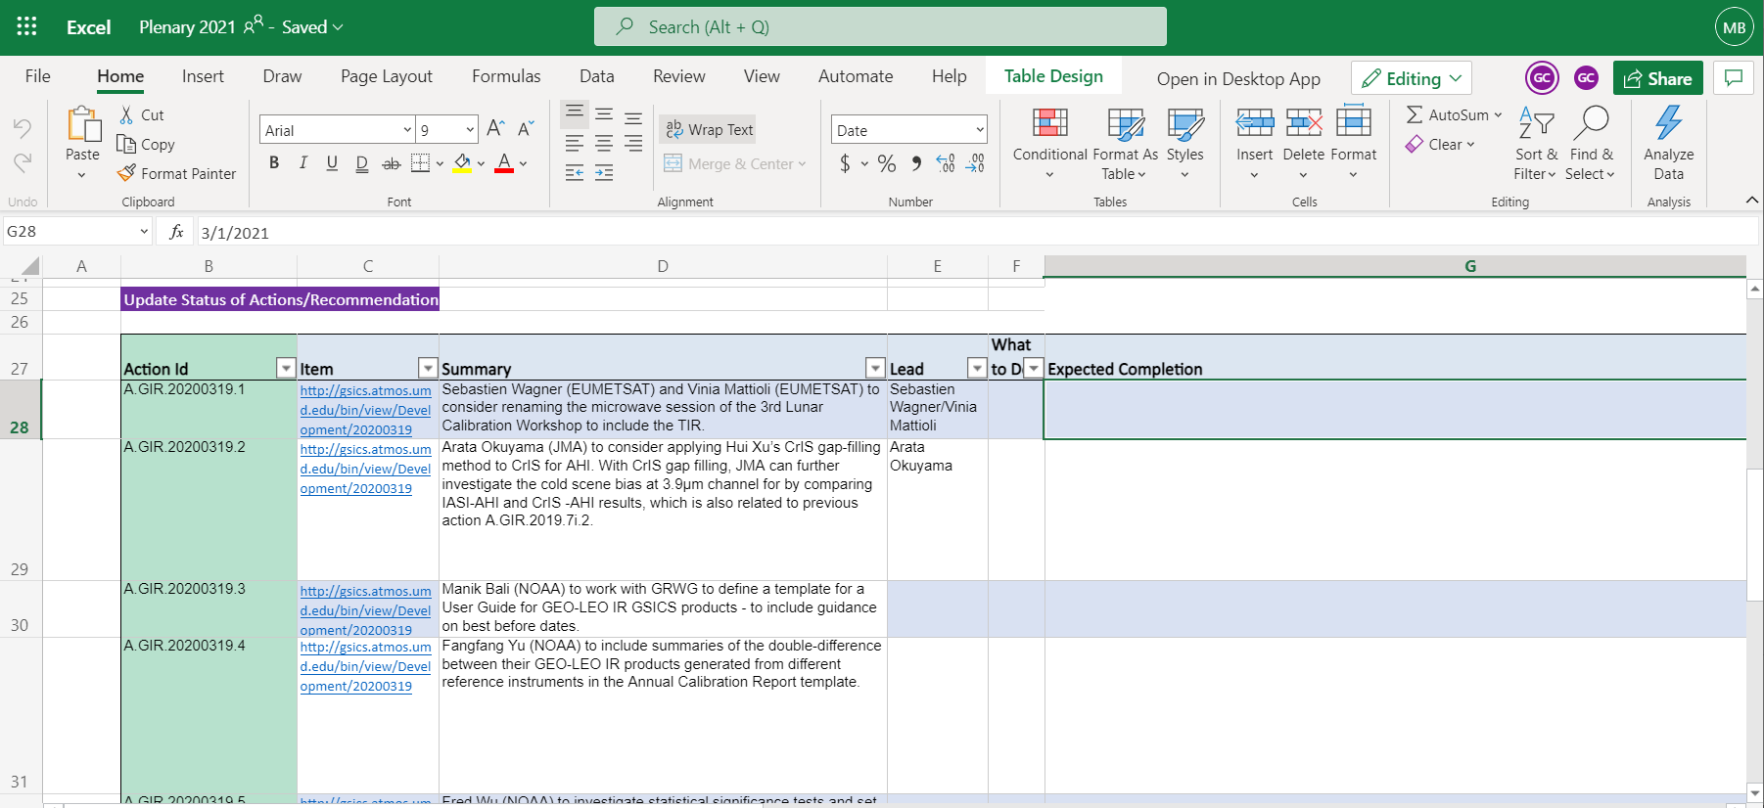
Approach - Google Cloud + Web+GenAI
Google Cloud/Sheet
Adapted for Virtual Annual Meeting and enhanced
Office 365 Sheet
Actions can be read from
  Word Documents
  Google Sheet
  Office 365/Sheet
  Published via GCC website
Testing underway with GenAI.

Slide 11
Summary
Past year supported
  Design the State of Observing System presentation
  Develop script for generating State of Observing System Content
  Migration of GSICS Wiki completed
  Developed of Product Alert/Status System
  Update the Action Tracker
  Built Google Colab sheets for Products and Deliverables
  Support landing of new NOAA products
Planned activities next year
  Add new Analytical features to Alert system
  Machine Learning technique and GenAI Models for Landing Pages
  Support landing of new NOAA products
  Sync GSICS Wiki to GitHub/New H/W
  Support combining GSICS products
  Develop New tools to help users of Deliverables and Products

Slide 12
Summary of links to GSICS tools
Bash script to download GSICS Data http://gsics.atmos.umd.edu/bin/view/Development/DownloadGSICSProducts
Series of notebooks to read, view and process GSICS Data and Deliverables from the browser in a collaborative ecosystem
  DCC Product notebook
    This notebook reads DCC products and plots and lists them
  GIRO SRF notebook
  GSICS Product RAC notebook and NRT notebook
3. Plotting Tool http://gsics.tools.eumetsat.int/plotter
4. GSICS Product Catalog: https://www.star.nesdis.noaa.gov/smcd/GCC/ProductCatalog.php
5. GSICS Product Status registration: Register here

Slide 13
THANK YOU

