Slide 1
Status of WMO GSICS Website
Heikki Pohjola
WMO

Slide 2
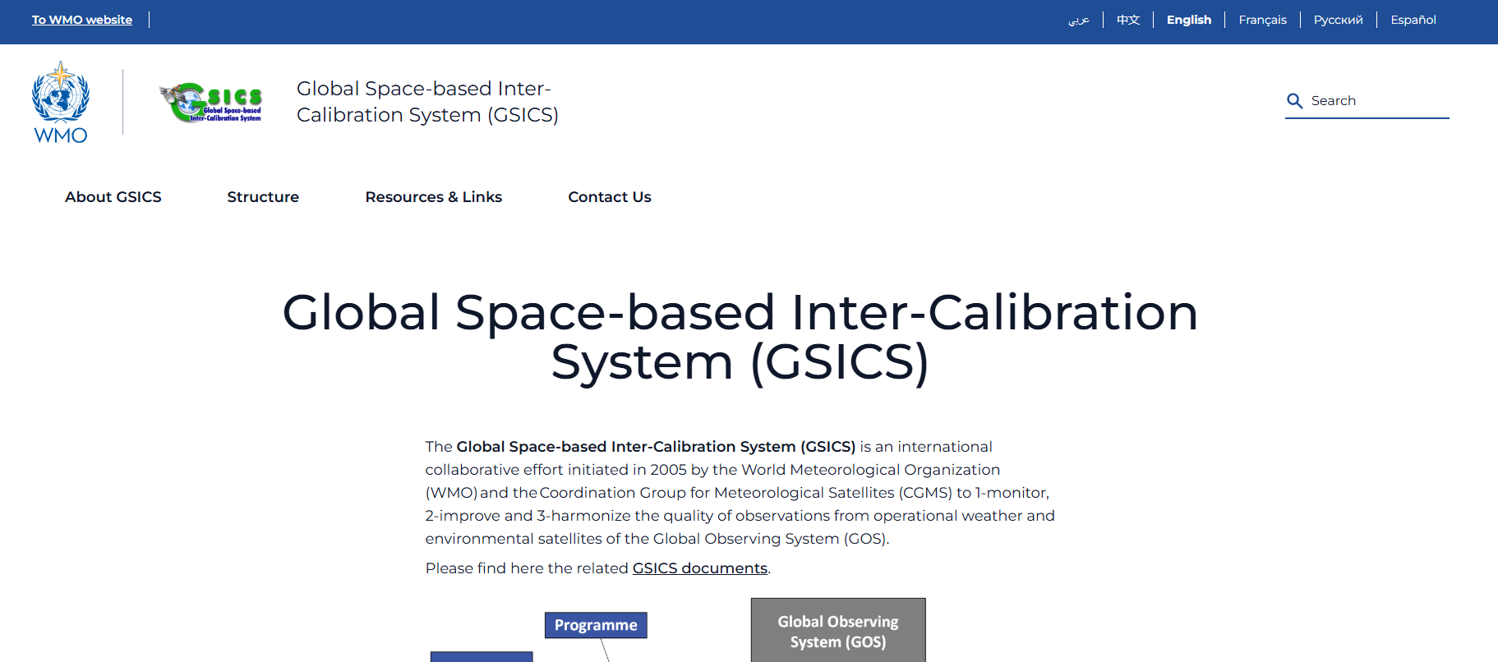
WMO GSICS Website
WMO updated their project website platform: https://gsics.wmo.int/

Slide 3
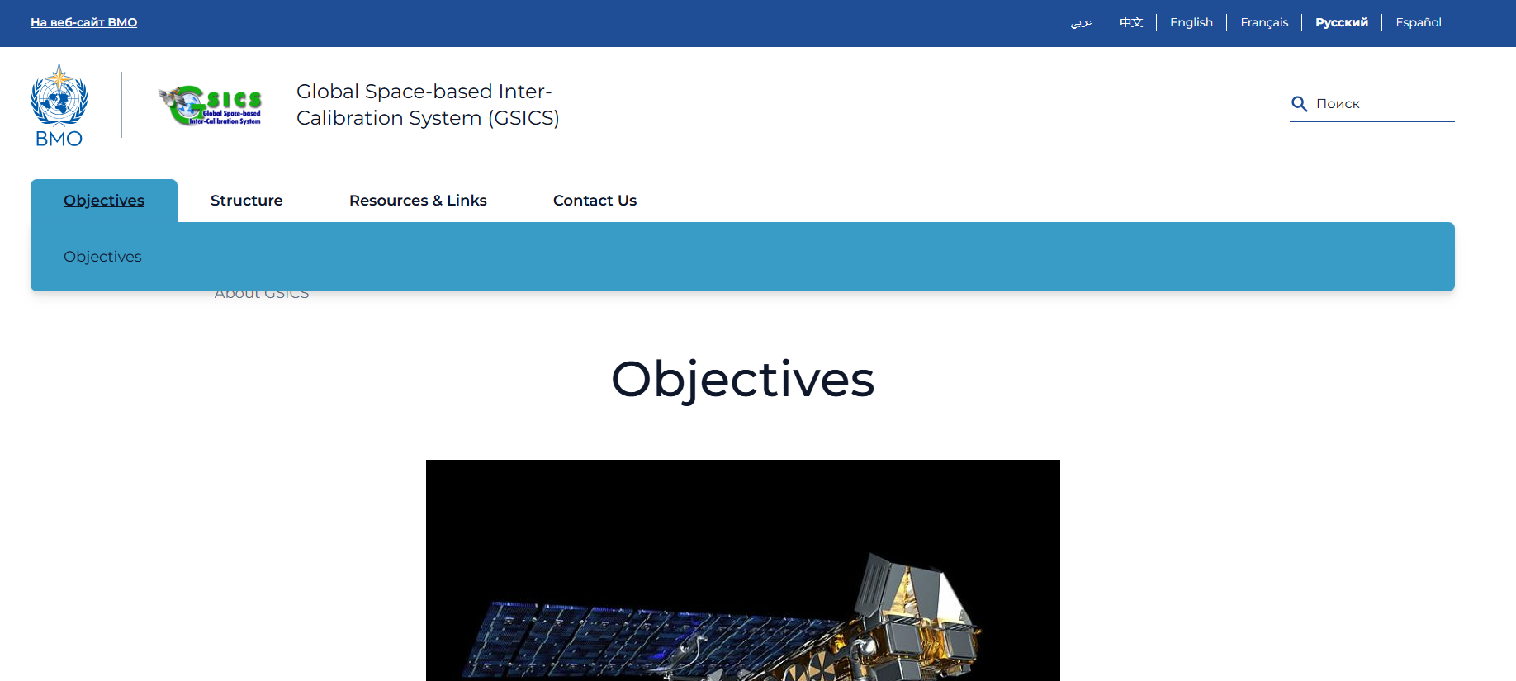
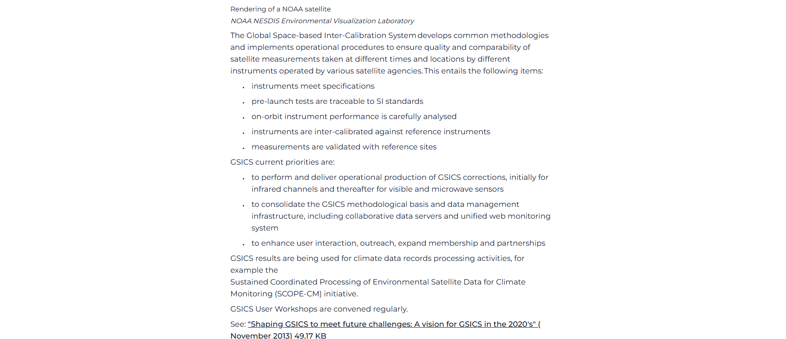

Slide 4
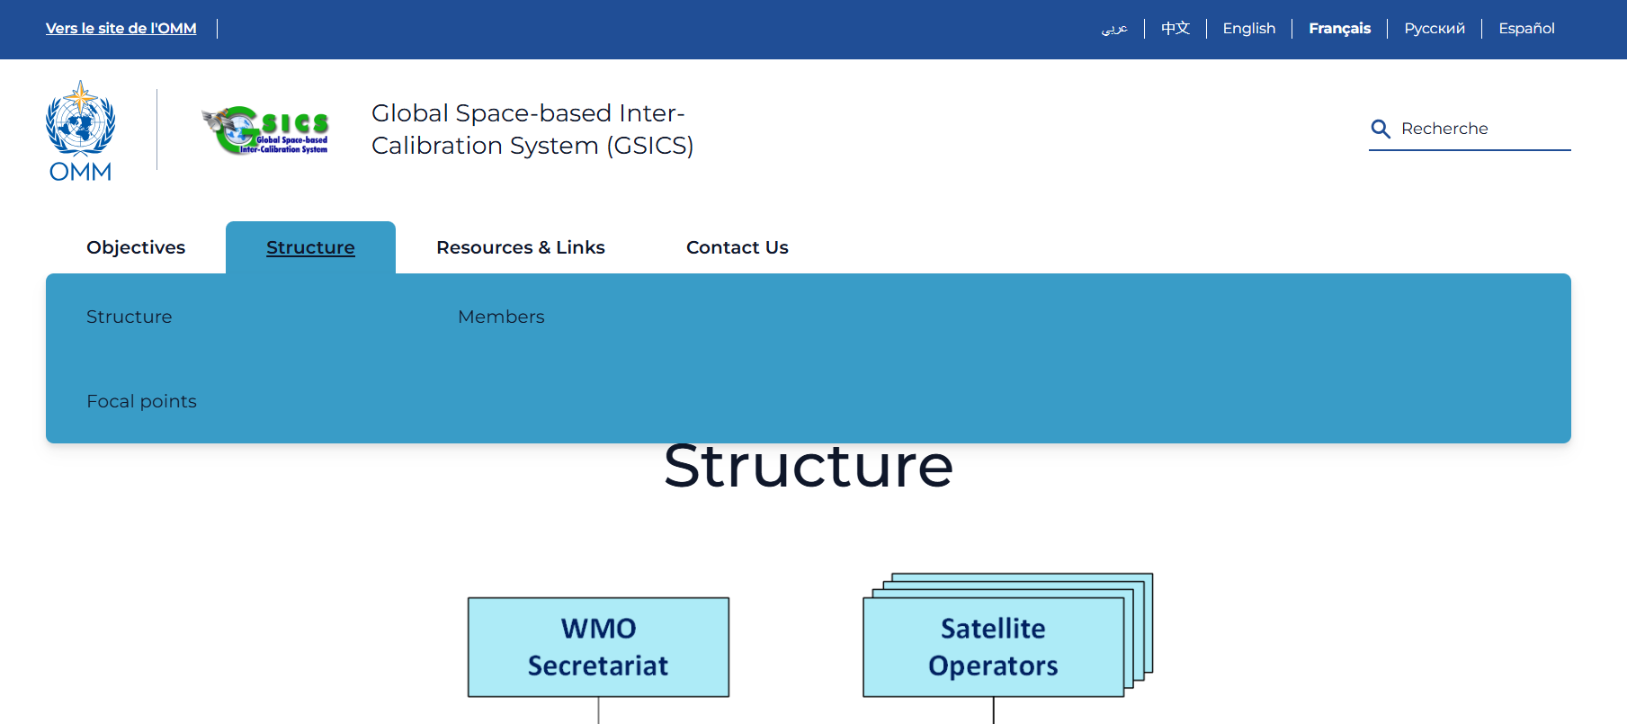

Slide 5
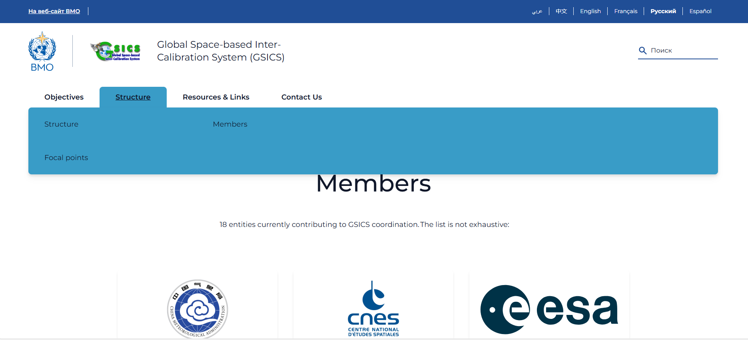

Slide 6
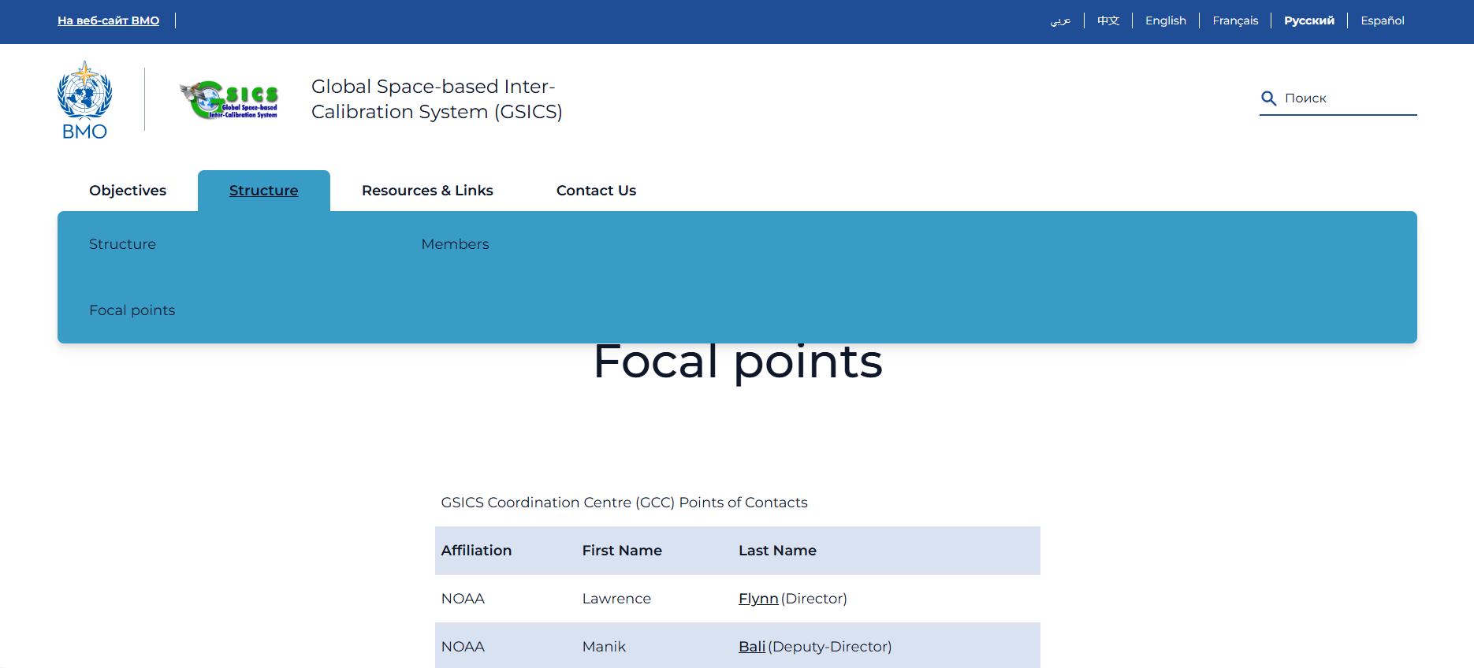

Slide 7
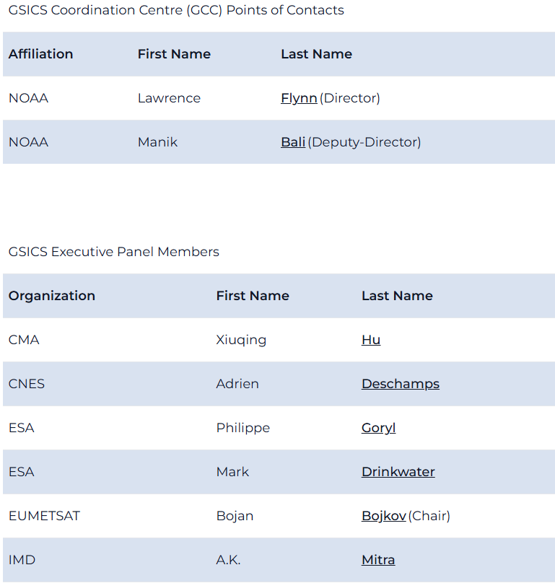
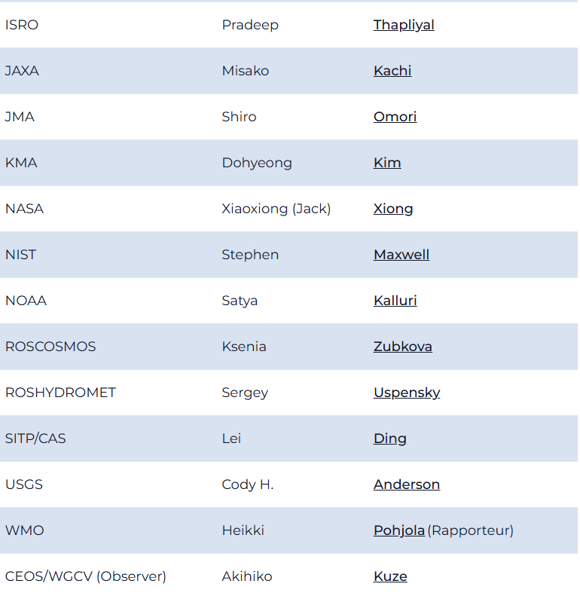

Slide 8
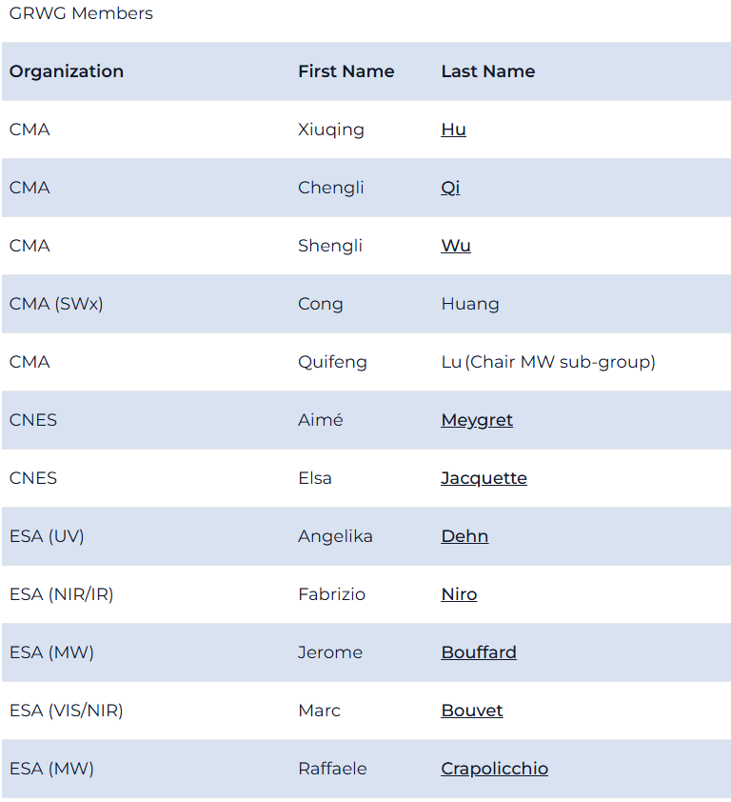
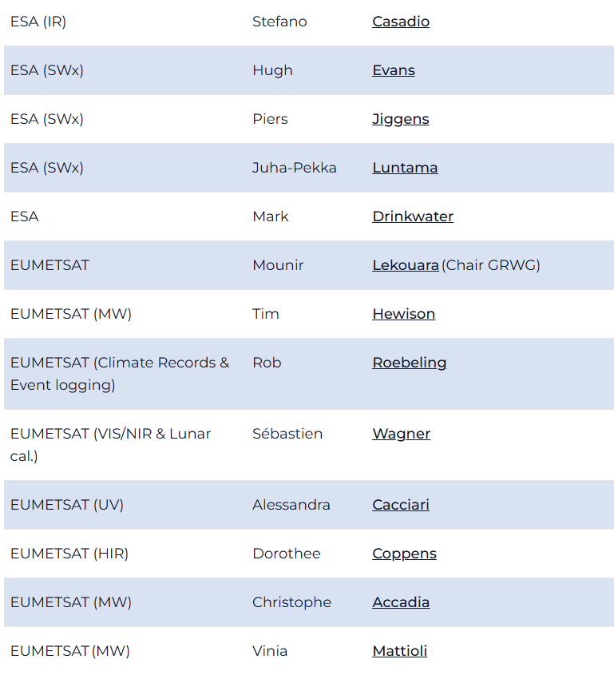

Slide 9
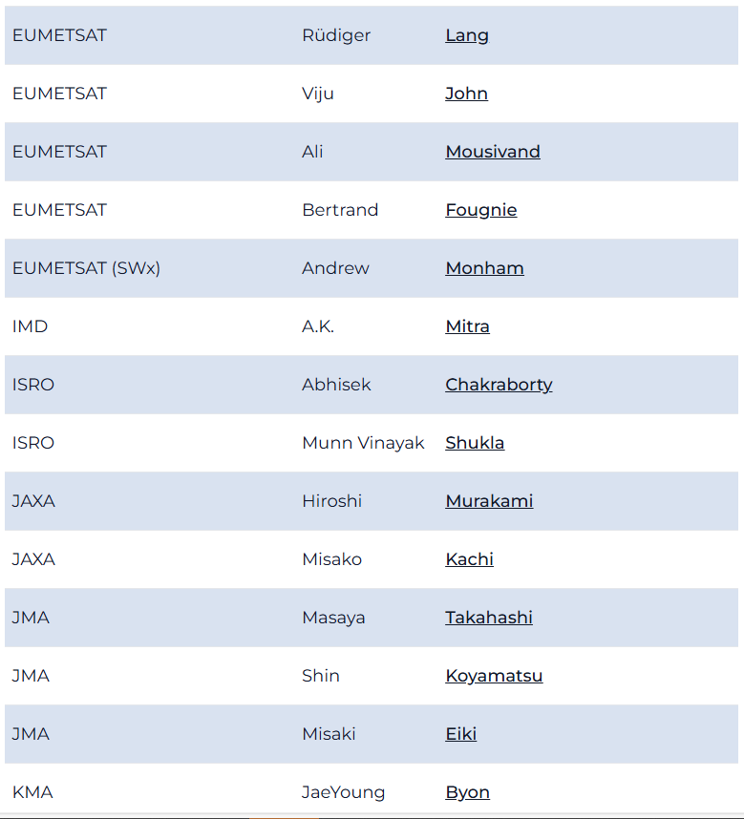
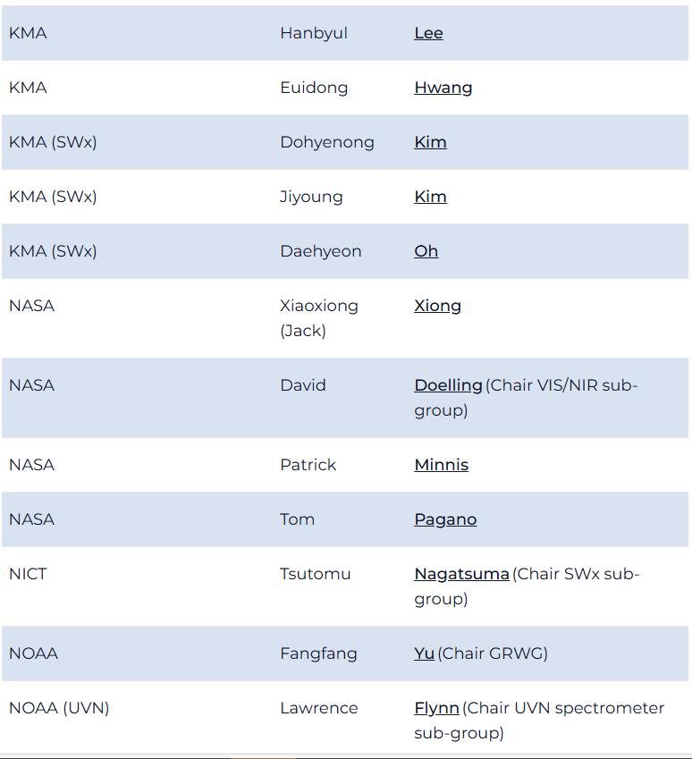

Slide 10
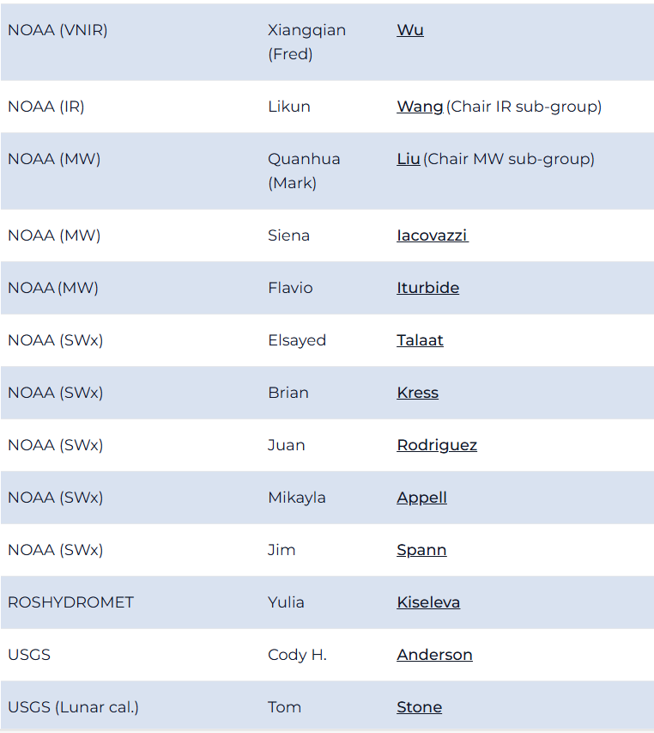
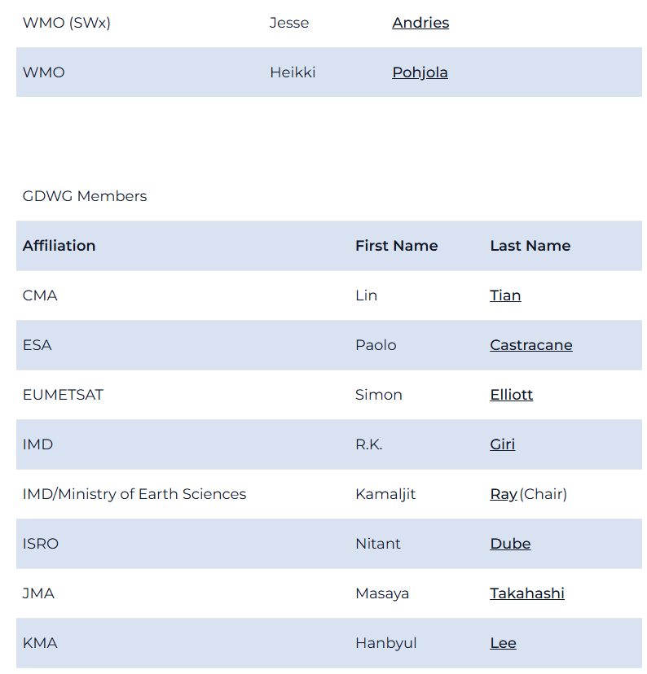

Slide 11
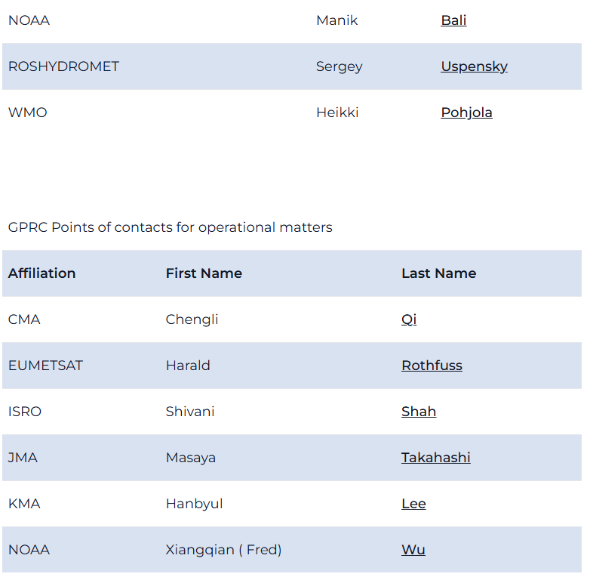

Slide 12
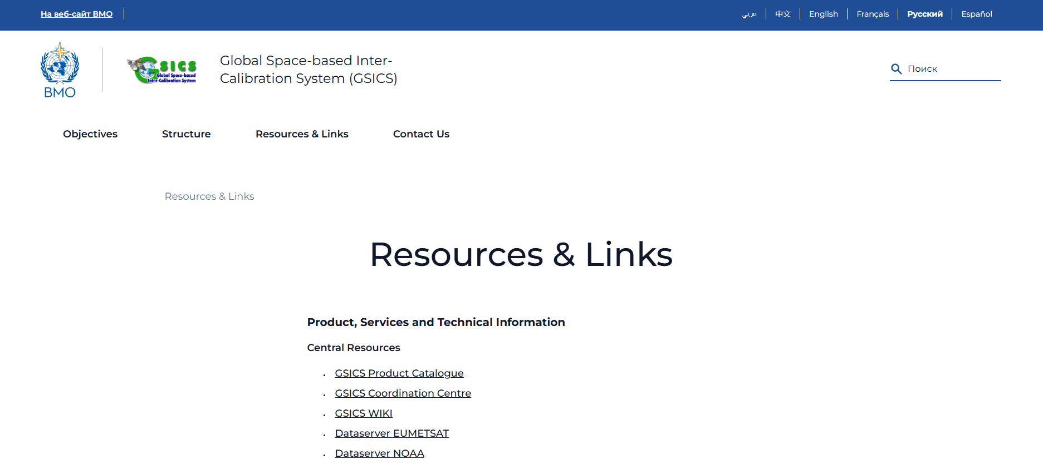

Slide 13
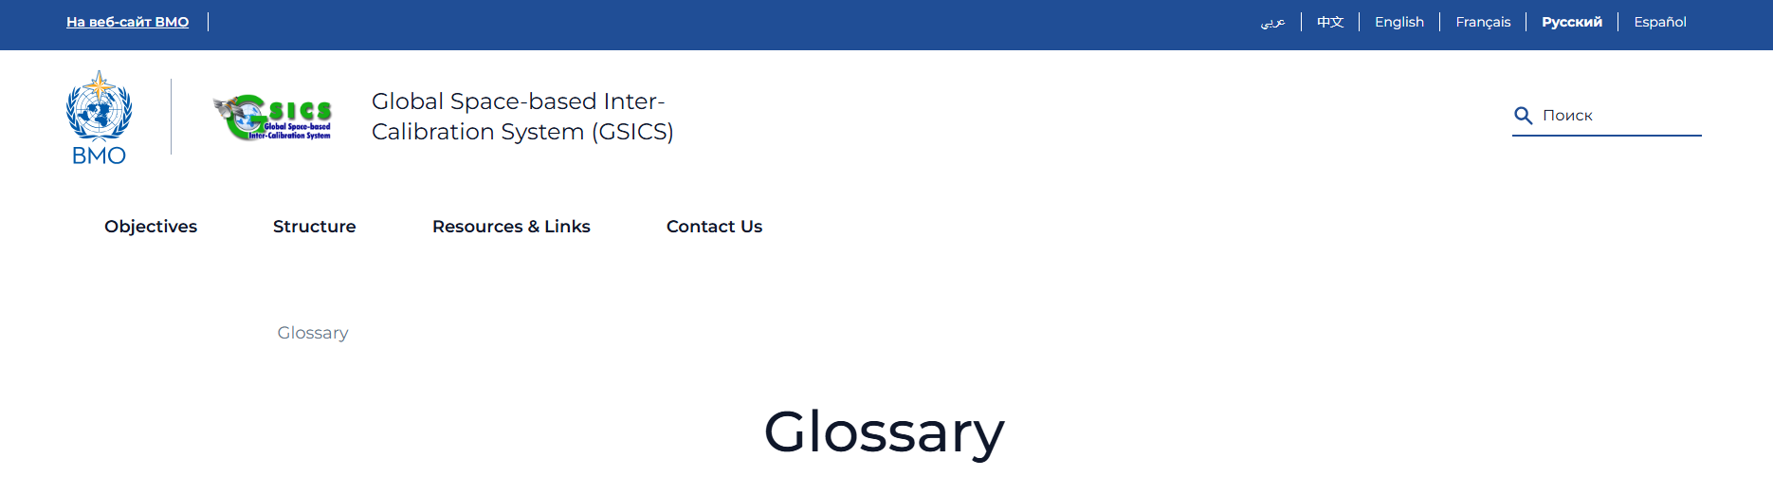
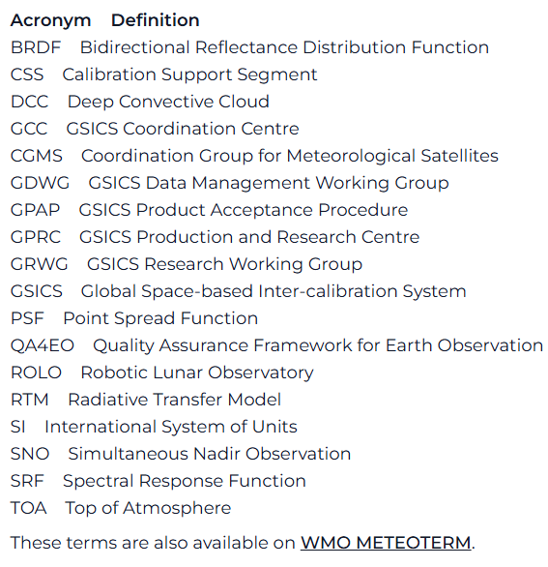

Slide 14
Proposed action
WMO to request GSICS agencies to update their WG and EP members listed on WMO website
Do we want to list all the members or should we list a focal point per agency per WG?
WMO, WG Chairs and EP to update GSICS documents
(GSICS Documentation Plan (2017), Introduction to GSICS, Vision of GSICS, Guide to GSICS Products and Services, Terms of Reference of GCC, EP, GDWG and GRWG, GSICS Service Specification, GIRO and GLOD Dataset Usage Policy, GSICS Implementation Plan (2006), GSICS Terms of Reference (2017))

Slide 15
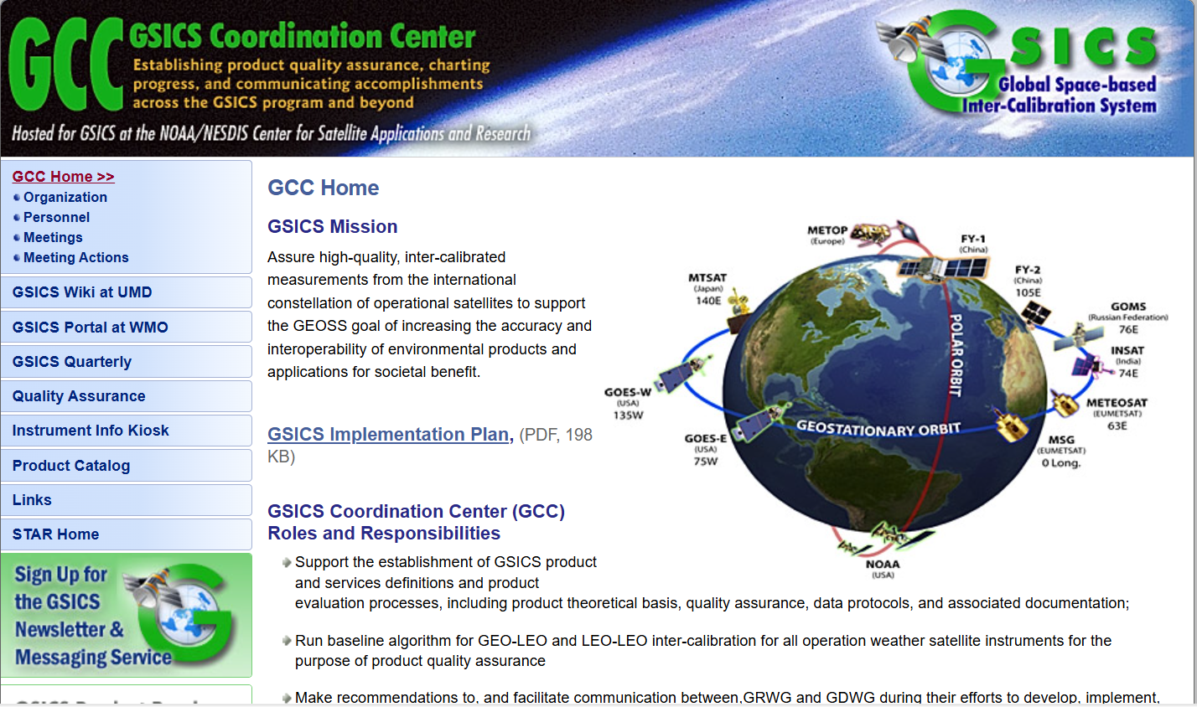

Slide 16
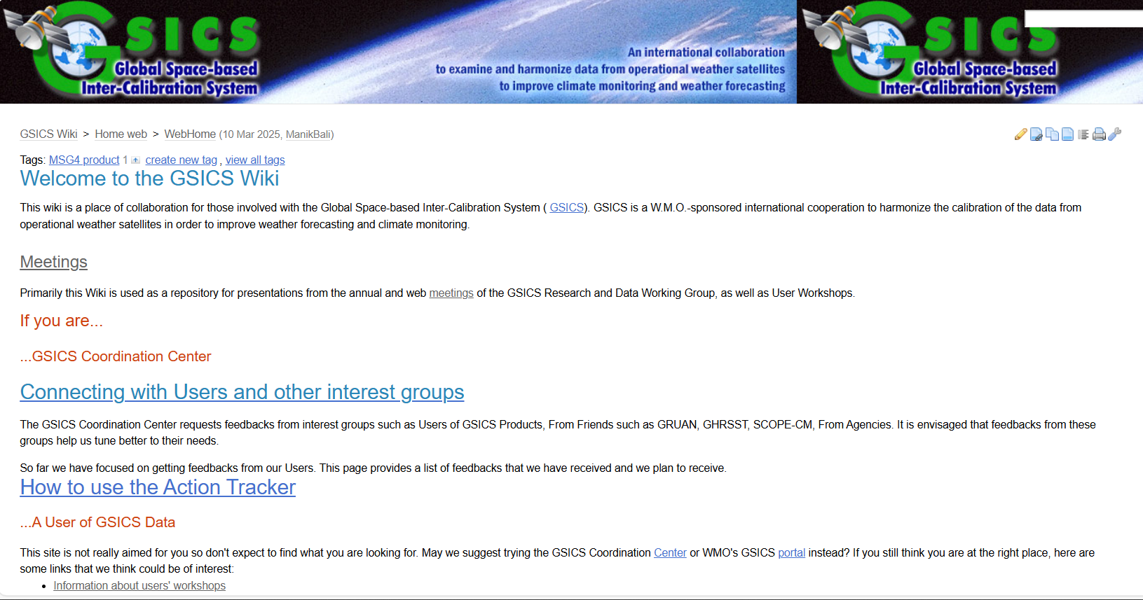

Slide 17
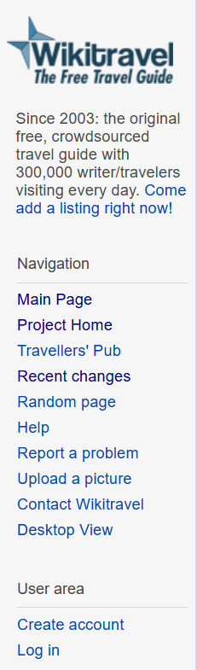
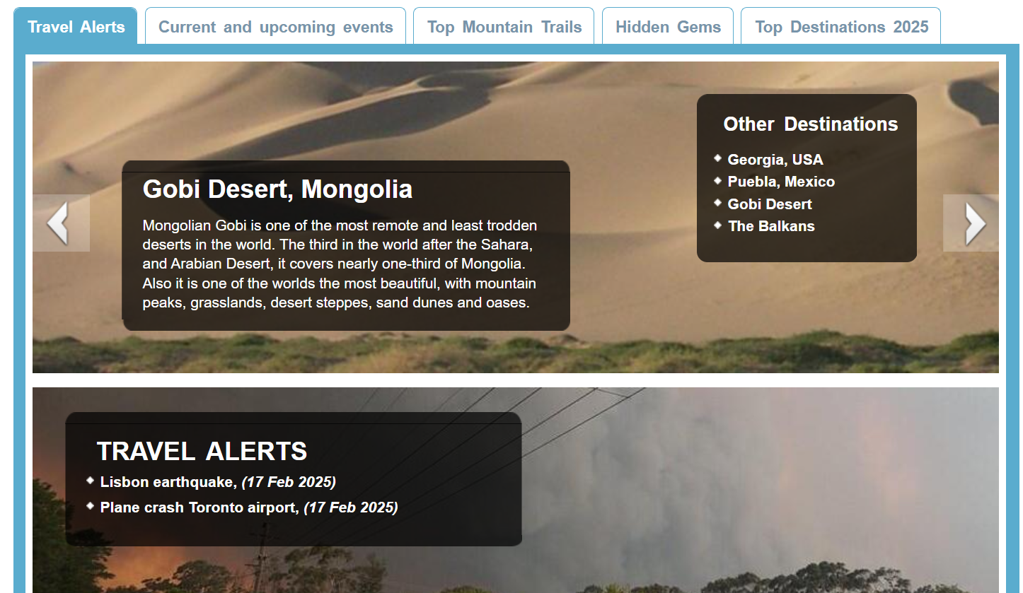
Wikitravel - The Free Travel Guide

Slide 18
Proposed action
Manik with Larry, Heikki and Bojan to update GSICS Wiki page structure

