Slide 1
GDWG Report from ESA
GSCIS Data Working Group March 20th - 2024 Paolo Castracane
Starion for ESA - European Space Agency

Slide 2
Table of Contents
Actions from GSICS 2024
EVDC updates
Pi-MEP Salinity
FRM4SM
CEOS Cal/Val Portal activities
GSICS and CEOS WGCV cooperation

Slide 3
GDWG Actions for ESA
GSICS Actions 2024
Action Id | Summary | Lead | Actual Completion | Status
A.GDWG.20240311.2 | Paolo and Manik to coordinate with the SITsat group (CLARREO, LIBRA, TRUTHS) to define product format, also addressing the way uncertainties shall be reported in the products (with a special care on data volume). | Paolo/Manik | NASA would provide a sample data file | Closed
A.GDWG.20240312.4 | Paolo Castracane (ESA) to lead discussion with GCC and WMO on possible enhancement of GSICS websites following WGCV Cal/Val Portal as example. | Paolo Castracane | Ongoing | Open
A.GDWG.20240313.4 | Paolo to coordinate with Manik on reducing overlap of webpage on solar radiance at ESA, NOAA/wiki and LASP. | Paolo | Ongoing | Open

Slide 4
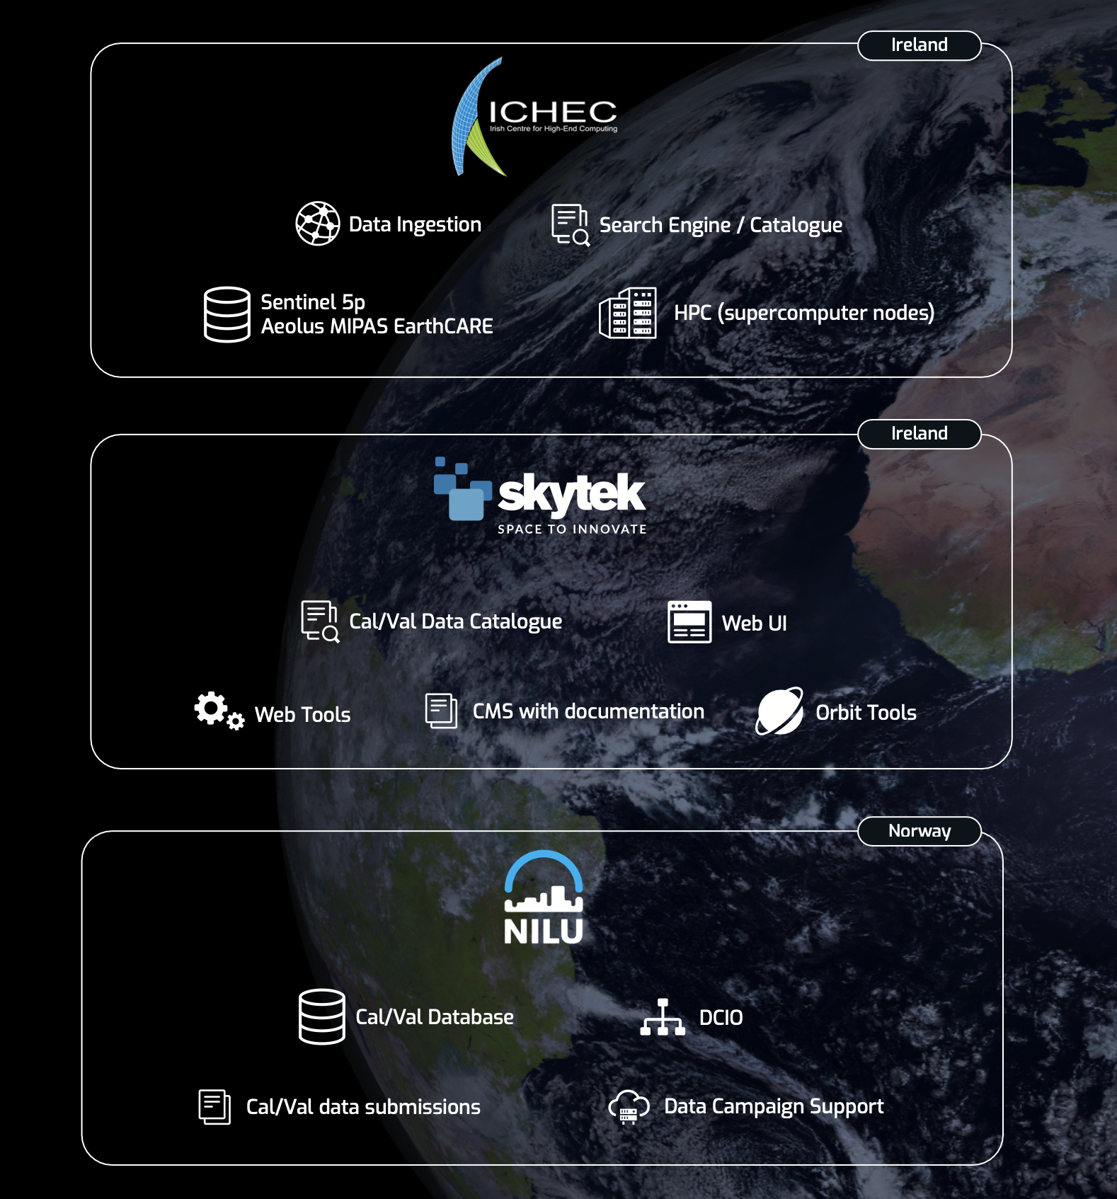
ATMOS 1-5 July | Bologna, Italy
EVDC Overview
The ESA atmospheric Validation Data Centre (EVDC) is the official ESA repository for correlative data in the atmospheric domain . It provides access to:
Groundbased, aircraft and balloon Cal/Val files and Fiducial Reference Measurements (FRMs)
Complete and up-to-date access of Sentinel 5P, Aeolus, MIPAS and the forthcoming EarthCARE products
Tools, processes and documentation for data submitters (GEOMS standarization activities, data sharing agreements)
Tools for data collection campaign planning (Orbit Prediction and Overpass Tool - OPOT)
Collocation Reference Database
Tools for processing data in the cloud (subsetting, merging, visualisation etc)
CWL Based processing system with visual workflow builder, including EarthCARE tools (e.g.: CIS, MSI, Lidar, Radar tools)

Slide 5
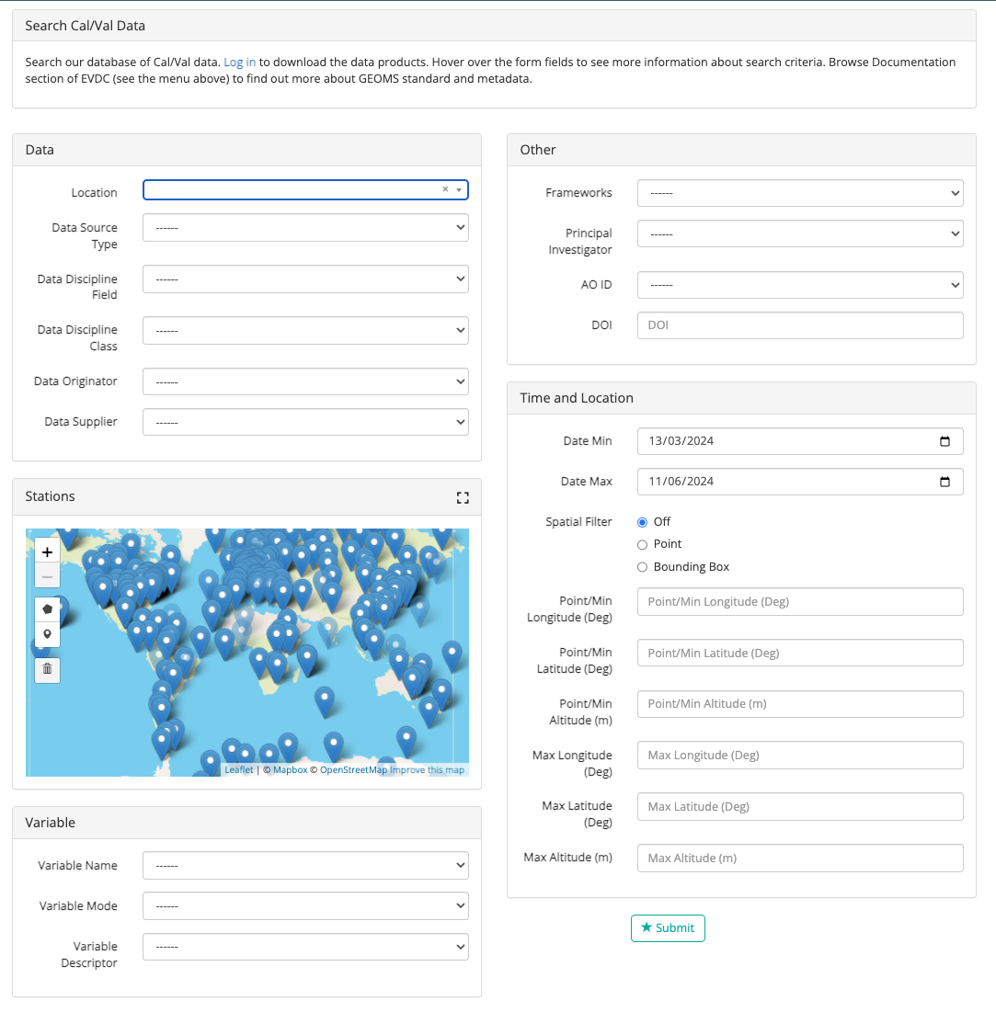
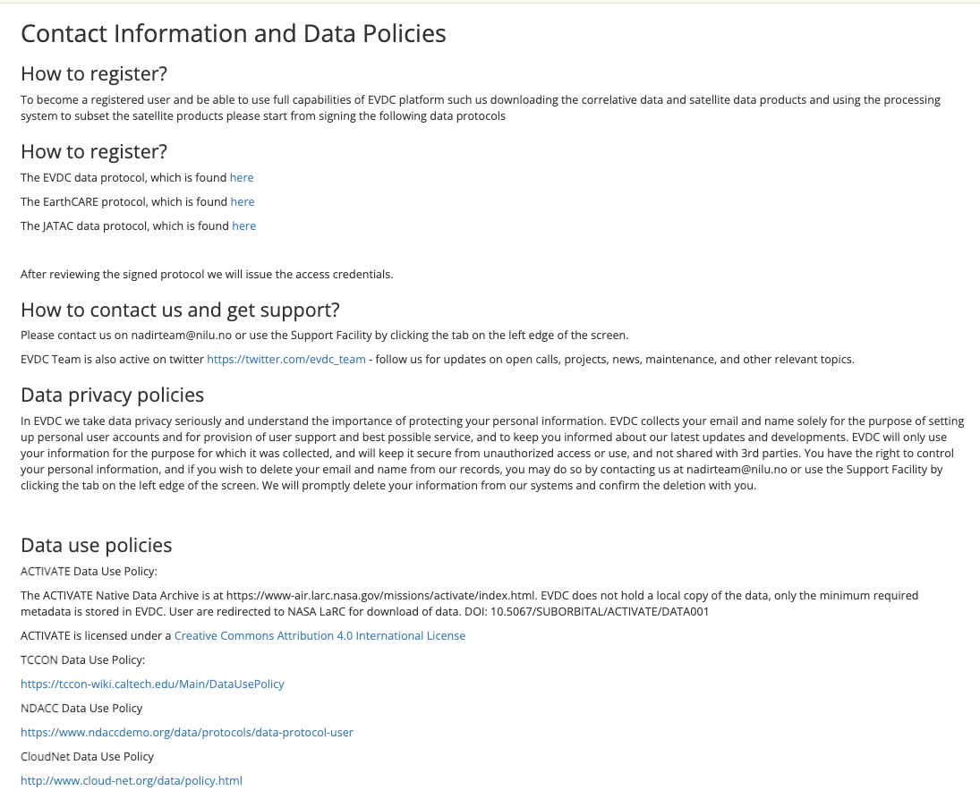
ATMOS 1-5 July | Bologna, Italy
EVDC Cal/Val Database
ESA atmospheric Validation Data Center (EVDC), ESAs in-house Cal/Val database covering:
Data from historical and ongoing campaigns
Remote sensing and in-situ measurements from ground-based and airborne stationary and mobile platforms (aircraft, balloon, bouy, drone, ship)
Operational data in near-real-time from research infrastructures in Europe and America such as ACTRIS (CloudNet, EARLINET), TOLNet, MPLNet, Pandonia Global Network.
Links to other data archives and network e.g. AVDC, NDACC
Data from 1965 until present
More than 1400 users where more than 200 for EarthCARE Cal/Val
Cal/Val search UI
Data Protocols

Slide 6
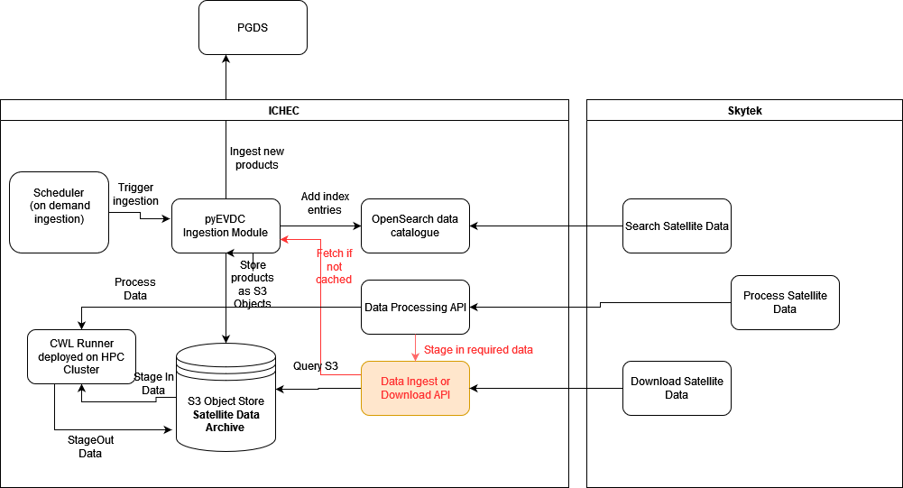
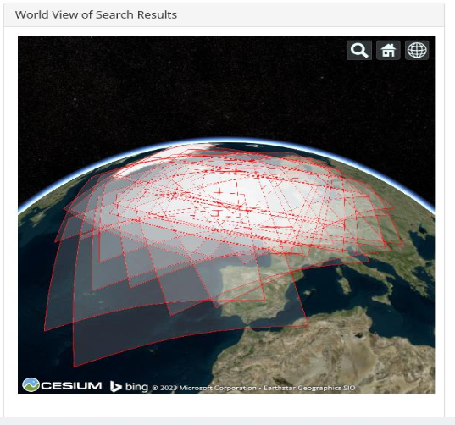
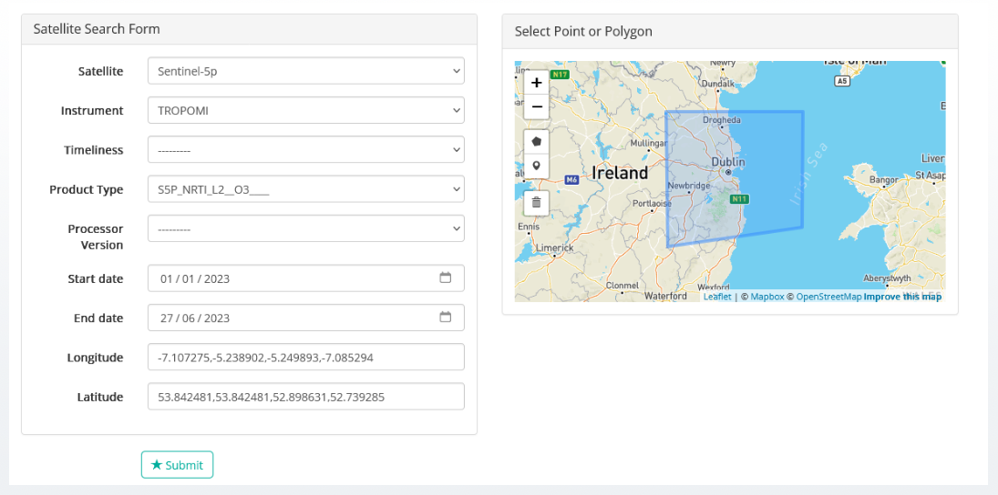
Satellite Element
The EVDC system also provides access to satellite data for specific missions, namely: Sentinel-5P, Aeolus, ENVISAT/MIPAS and EarthCARE.
EVDC – Satellite Data Search UI

Slide 7
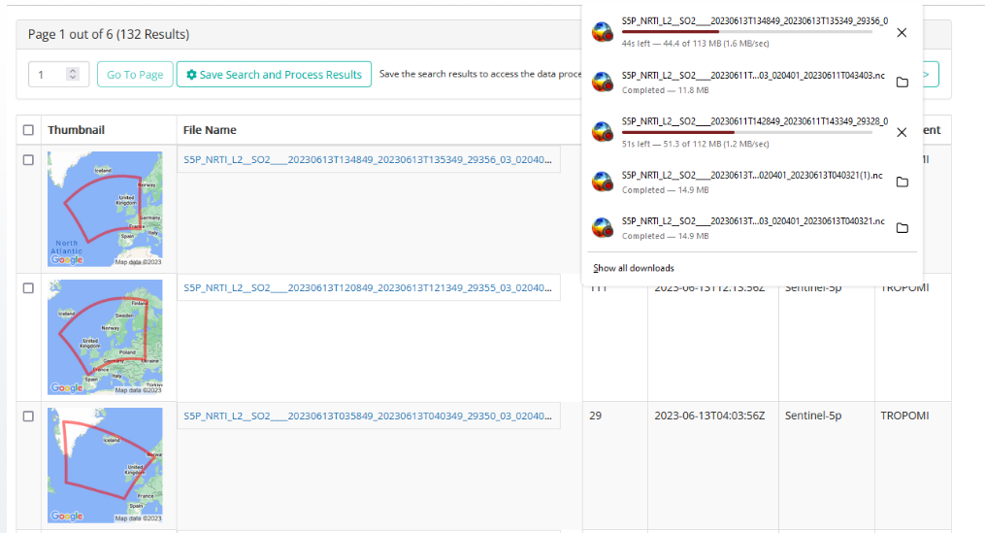
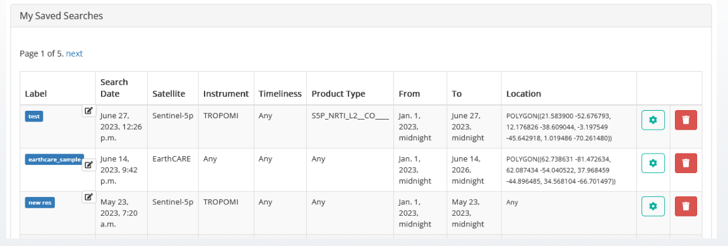
Satellite Element and processing
A set of basic operations are allowed over the satellite product: visualization, selection, download…and processing as subsetting and merging.
Saving files – a mechanism for grouping and tagging the files for further processing.
The processing system is deployed on High-Performance-Computing infrastructure supplied by ICHEC.

Slide 8
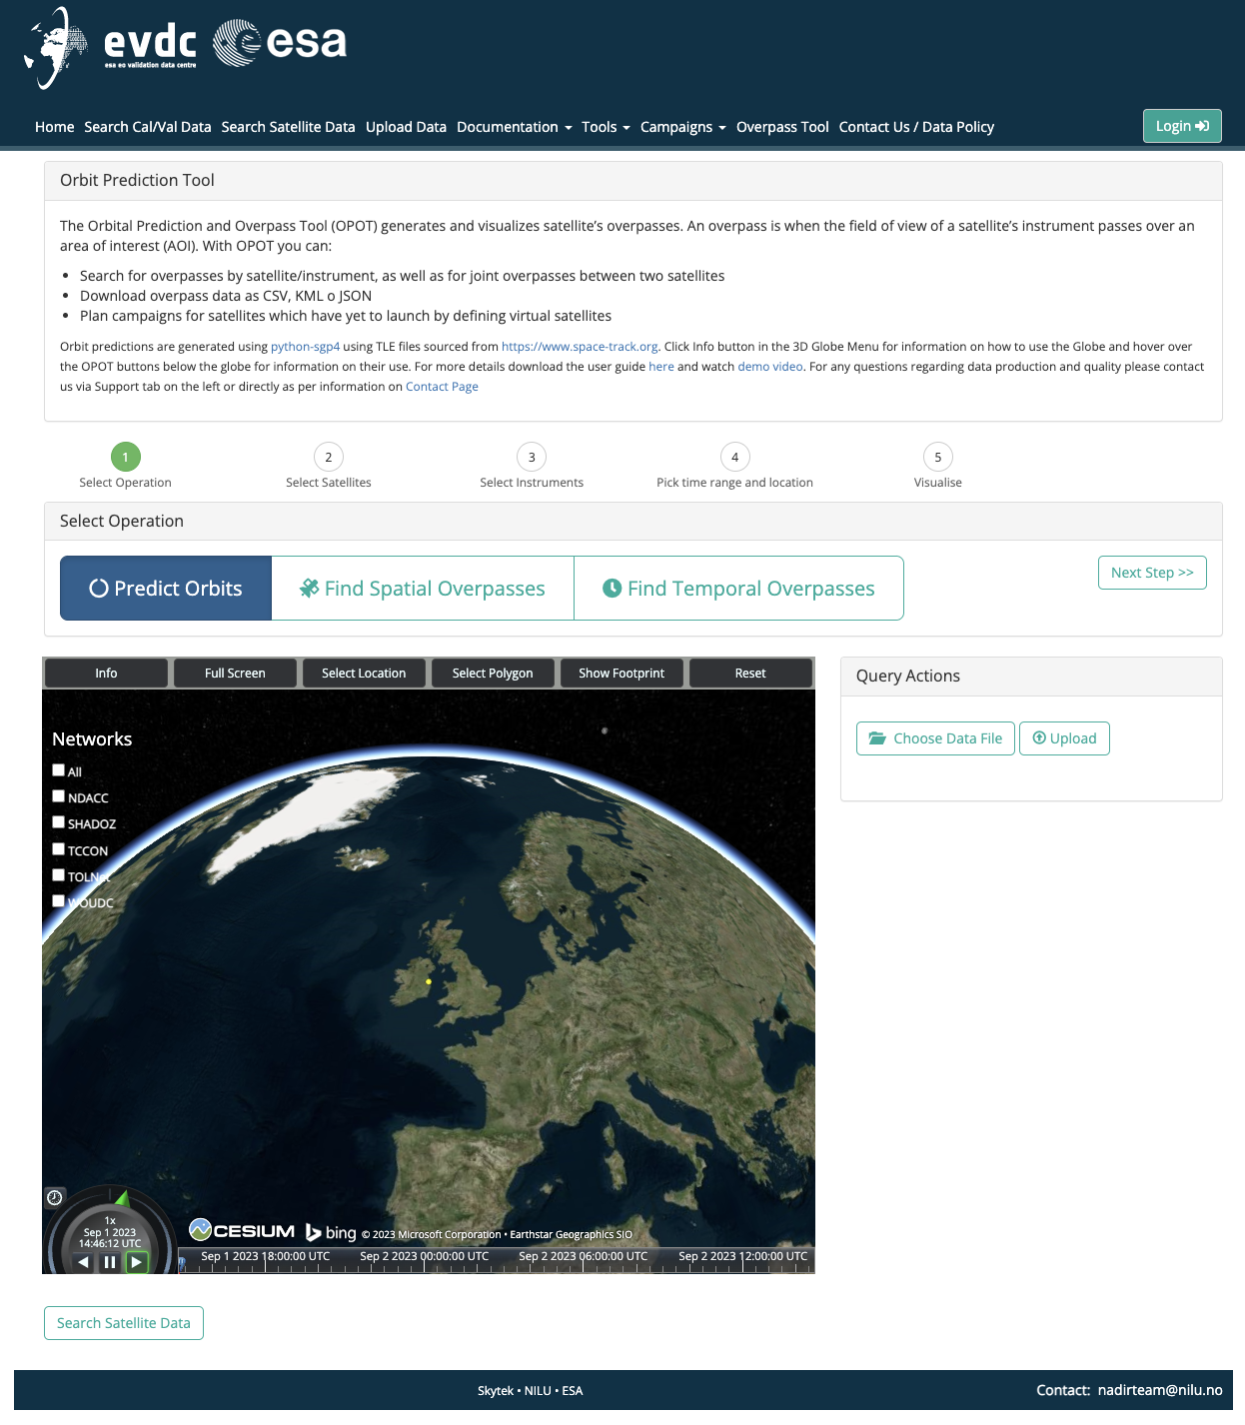
OPOT: Orbit Prediction and Overpass Tool
The Orbital Prediction and Overpass Tool (OPOT) generates and visualizes satellite’s spatial overpasses. An overpass is when the field of view of a satellite’s instrument passes over an area of interest (AOI). With OPOT you can:
Predict Orbits
Search for spatial overpasses by satellite/instrument (in a time range)
Temporal Overpasses: i.e. joint overpasses between two satellites
Download overpass data as CSV, KML o JSON
Cal/Val Networks overlay and info
Plan campaigns for satellites which have yet to launch by defining virtual satellites
Demo available =>https://evdc.esa.int/orbit/
Notes:
Regarding the orbit scenario file good progress has been made with the implementation It can be mentioned that it will be deployed early July and available as an option (tickbox) when running the quries.

Slide 9
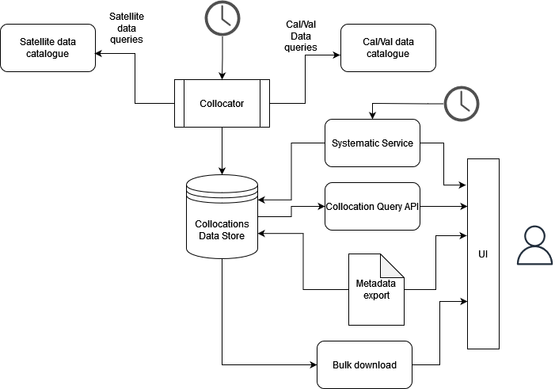
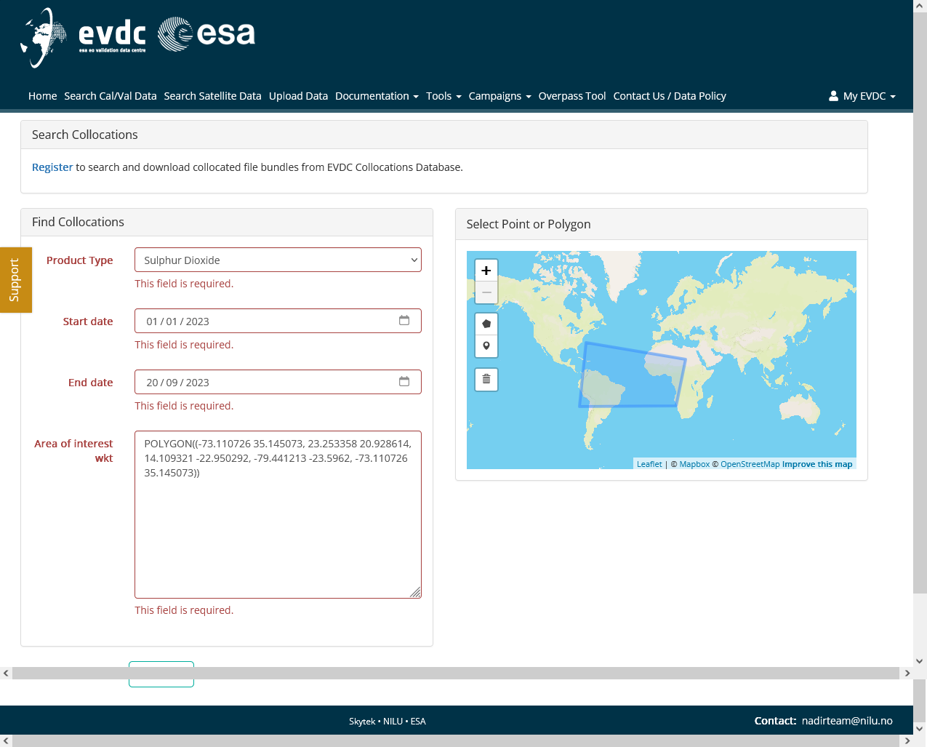
Collocation Reference Database
The Goal:
Automate the collection of broad collocations between satellite and correlative products
Provide users with tools to interact with the archive of pre-collocated data
Allow automated data deliveries based on custom (narrower) collocation criteria
The Architecture:
Collocator as a scheduled service searching for new collocations daily
Data store holding indexed metadata fields of both files (sat and cal/val file)
Query service for interacting with collocation data store
Configuration, variable mapping
Manual config for referencing satellite product variables to correlative variables
Common naming
Possible to configure more detailed mapping details (units, scaling, conversion formulas
Collocation Query API
The purpose is to filter the broad collocations to stricter collocation criteria.
It exposes a few endpoints: product type, start and end date, area of interest (e.g. polygon), max time difference (minutes)

Slide 10
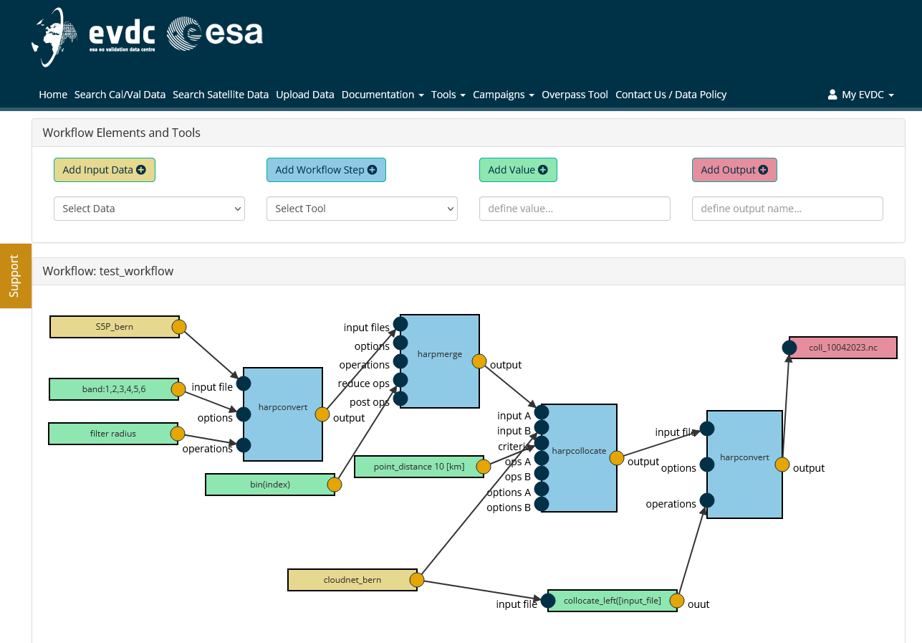
Workflow Builder
The Workflow Builder module allows creating processing graphs out of processing modules available in the system. Users can exploit a workspace for defining the connections between inputs and outputs of the modules or steps of the workflow. The module specifically allows users to:
Create/Save new workflow and export it as CWL script
View the list of available processing modules
Add workflow steps based on either processing modules or ad-hoc python or javascript scripts.
Add input data blocks based on saved search results
Add value blocks that set statically or dynamically the value of input parameters
Define outputs
Draw connections between inputs and outputs of processing modules
Select from product inputs available in the system by assessing:
Satellite query results, Cal/Val query results
Specified locations in the User File Storage
Specify locations of final outputs as locations in User File Storage
Test running individual components with provided inputs
Test running the processing workflow on singular inputs
Schedule operational processing workflow run – either as once off run or as a scheduled service.
Example of workflow visualization: several modules for EarthCARE cal/val activities are available (e.g.: CIS, MSI, Lidar, Radar tools)

Slide 11
Services and supporting materials
DOI and Landing Pages
The EVDC team has developed a new API that allows users to get a DOI for data made available in the data centre. This API generates landing pages automatically from xml input. Landing pages are essential for coining DOIs. To coin a DOI for your dataset and to learn how to use the API, please contact the EVDC team at nadirteam@nilu.no. The EVDC team will assist you with the coining process and support you with setting up the landing pages.
Training Materials (pdf) Introduction to the EVDC Cal/Val database Data Formatting and Data Submission to EVDC EVDC For EarthCARE. Processing tools for Cal/Val. Webinar slides Data Search, Workflow Processing system, Collocation Database. Tutorials | Video Tutorials A set of video tutorials that cover most important functionalities and workflows in the EVDC platform: EVDC Platform overview How to search for Cal/Val data? How to search and process the satellite data? How to use Orbit Prediction Tool? How to format Cal/Val Data? Tutorials on using orbit tool and satellite data search based on real-life scenarios: Exploring Sentinel 5P and Aeolus data covering US west coast wildfires in 2020. Exploring Sentinel 5P SO2 data for Fuego volcano eruption

Slide 12


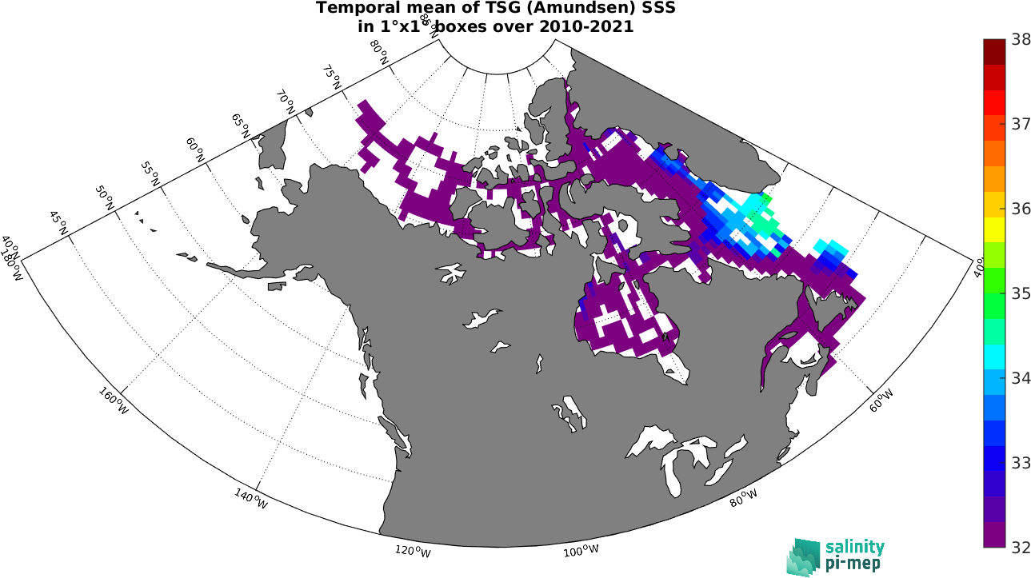
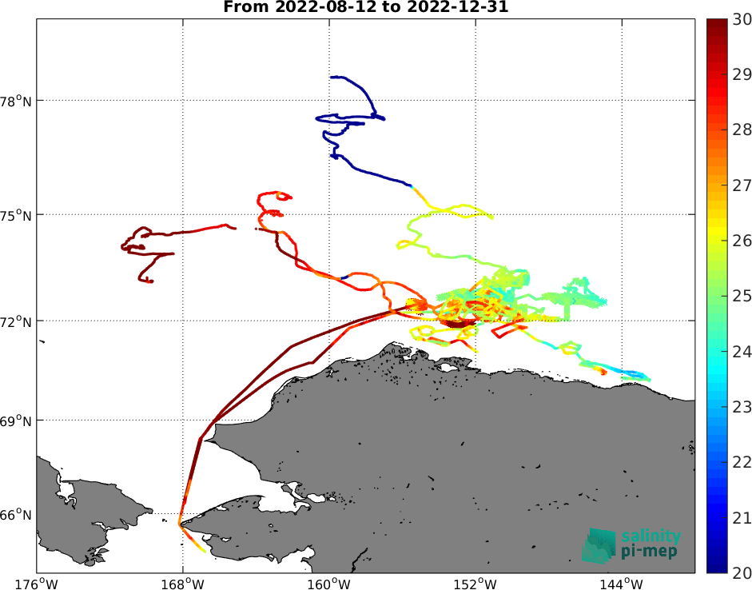
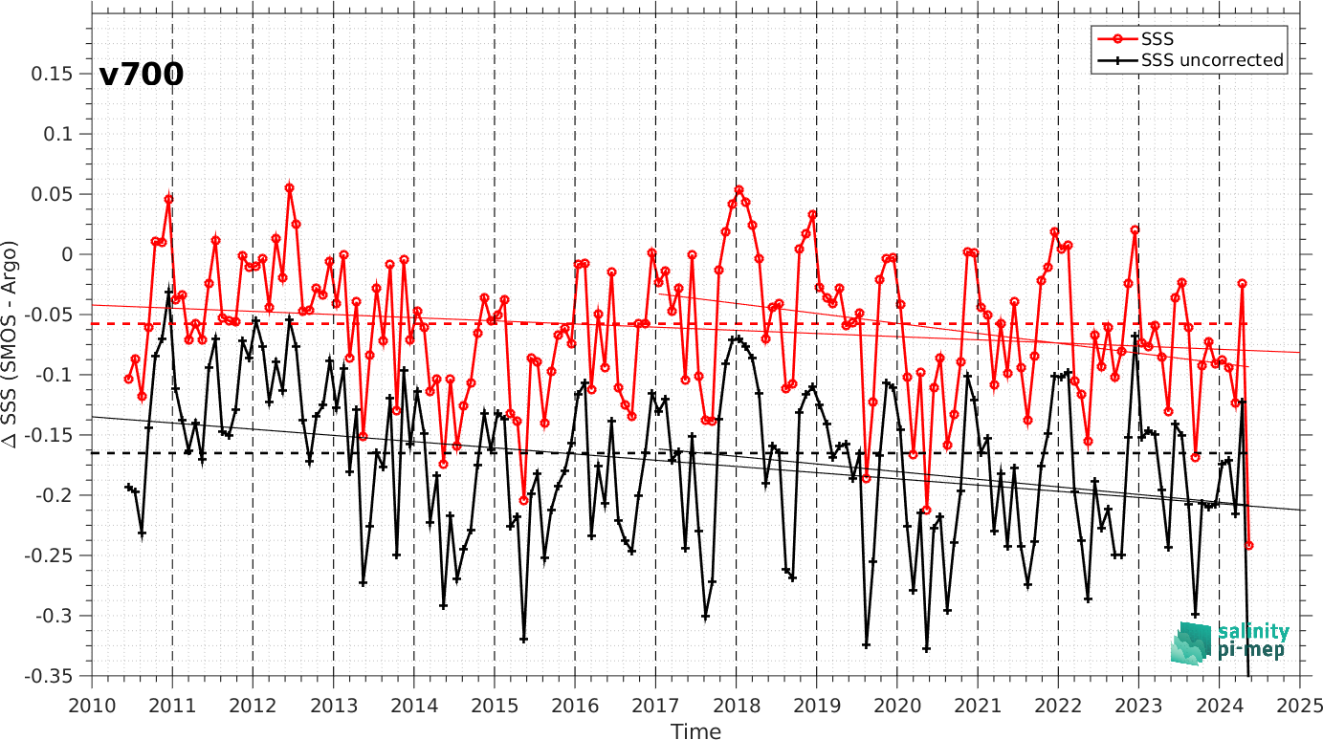
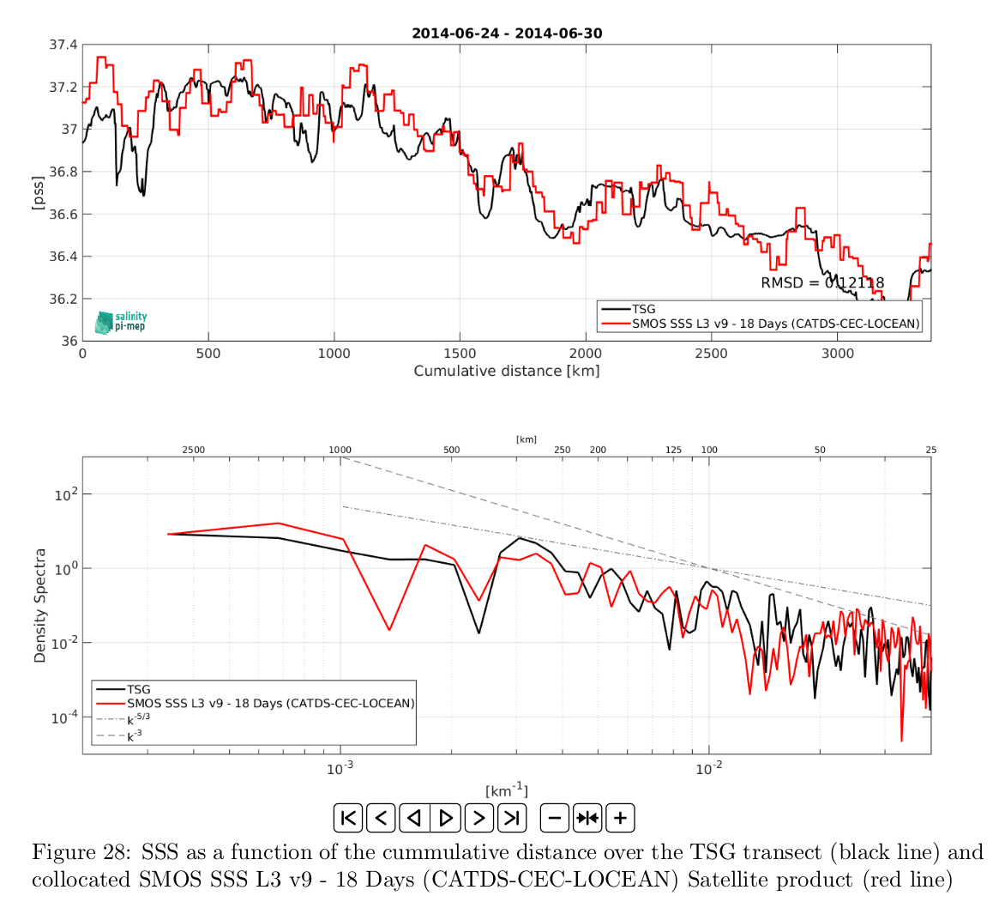
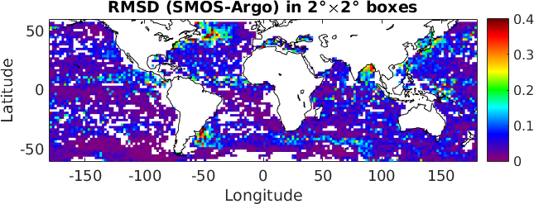
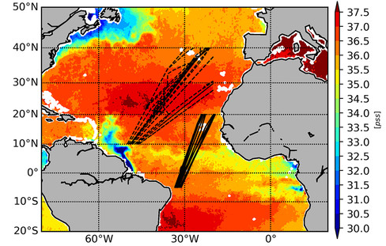
Pilot-Mission Exploitation Platform (Pi-MEP) Salinity
Web-based environment to visualize, validate, monitor, assess and exploit Satellite Salinity data (SMOS, SMAP, Aquarius)
Broad variety of online Tools to extract, inter-compare datasets and compute relevant statistics
Major achievements since GSICS 2024:
www.salinity-pimep.org
Operations
Production of metrics to support Operational QC:
Inclusion of new in-situ datasets: updates to SAMOS, Amundsen, Lauge-Koch, SASSIE
SASSIE
Towards QC-controlled TSG data: contributions from Gael Alory (LEGOS)
TSG Amundsen
Characterization of temporal, horizontal and vertical sampling impact when comparing in-situ & satellite SSS
Spatial resolution contents of SSS products by comparison with high-resolution TSG lines
Factorizing this from RMSD(Satellite – In Situ) approximates true instrumental errors!

Slide 13

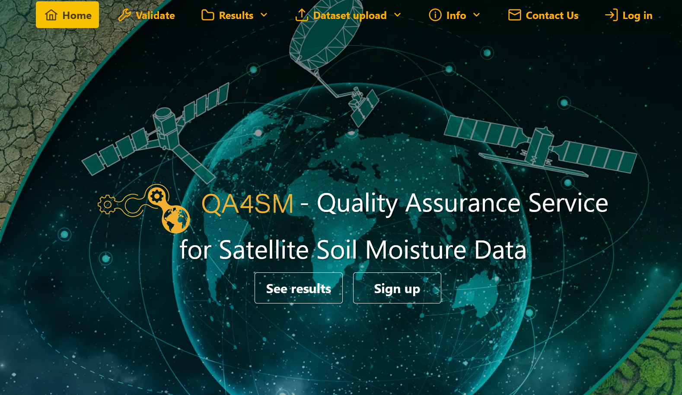
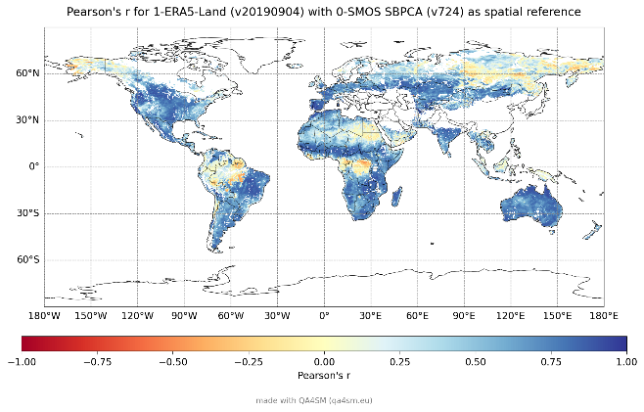
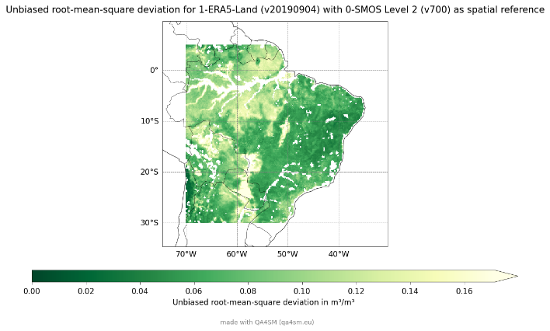
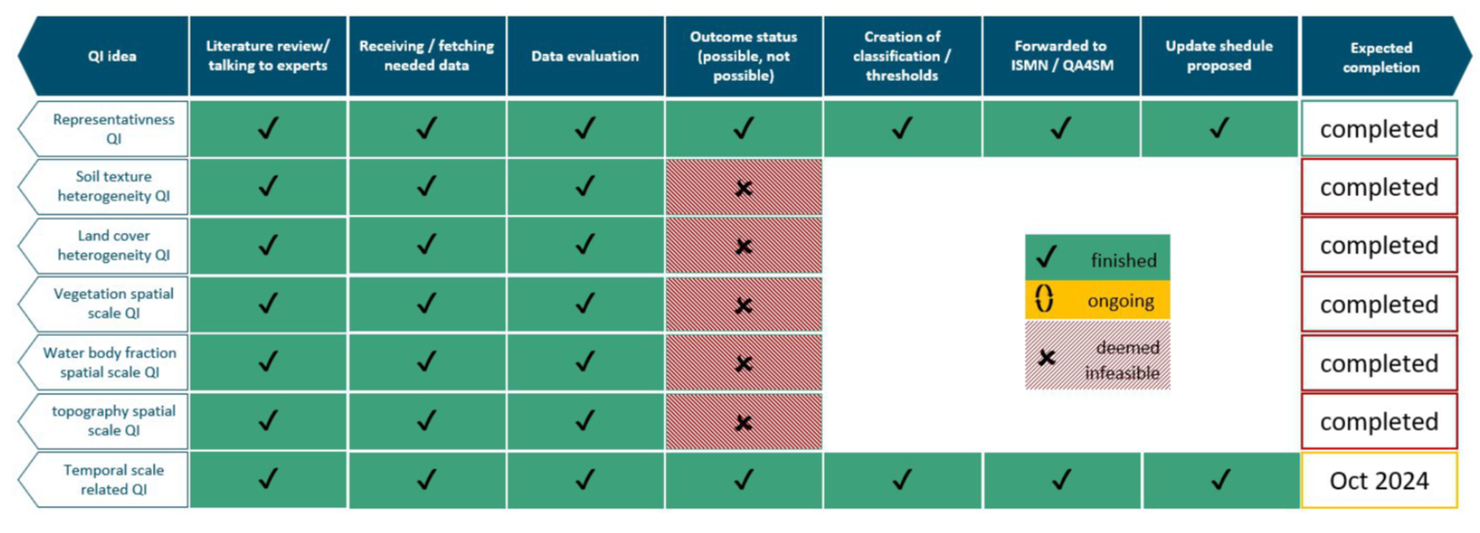
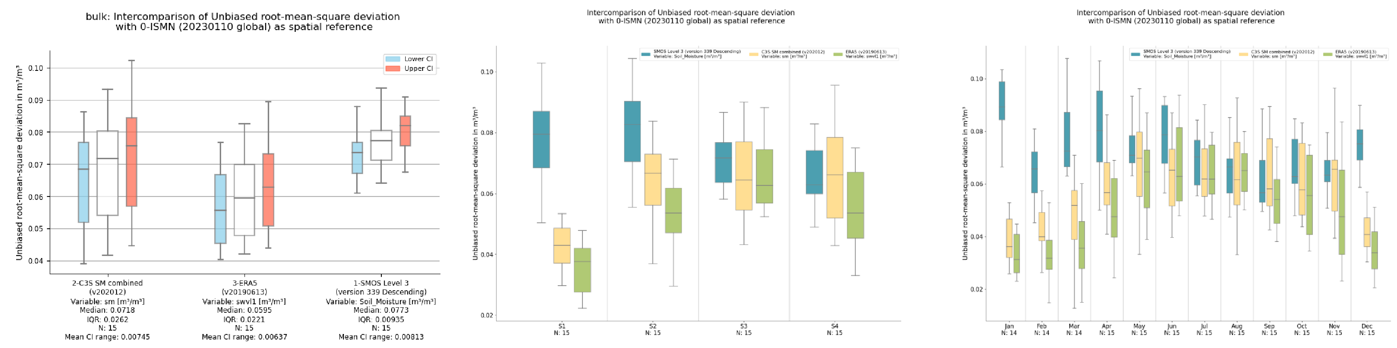
Fiducial Reference Measurements for Soil Moisture (FRM4SM)
FRM4SM
https://qa4sm.eu
FRM4SM Objectives:
defining procedures and protocols to qualify in situ soil moisture measurements as “FRMs”
addressing specific concerns intrinsic to the satellite soil moisture validation strategy (e.g. in situ measurement’s spatial representativeness, and the identification of committed areas for satellite soil moisture validation
The Quality Assurance for Soil Moisture (QA4SM) online validation service is developed as part of FRM4SM implementing qualified R&D outcomes.
Main achievements since GSICS 2024:
New quality indicators,
Automated Report
Seasonal metrics, Temporal stability metrics implemented in V3.0
Research paper “Estimating the uncertainties of satellite derived soil moisture at global scale, Science of Remote Sensing” https://doi.org/10.1016/j.srs.2024.100147
Stakeholders' collaboration: Joint proposal for the EURAMET Green Deal 2024 Selected Research Topic: “Metrology for soil moisture: from ground reference sites towards coherent and traceable global data products”
Phase-2 from 2025 to 2026 including focus on high resolution satellite soil moisture validation
Example of SMOS Validation results vs ERA5Land. (Credits: qa4sm)
New release v3.0 in February 2025 including temporal stability metrics
SMOS, C3S validation results vs ERA5Land: bulk and seasonal. (Credits: qa4sm)

Slide 14
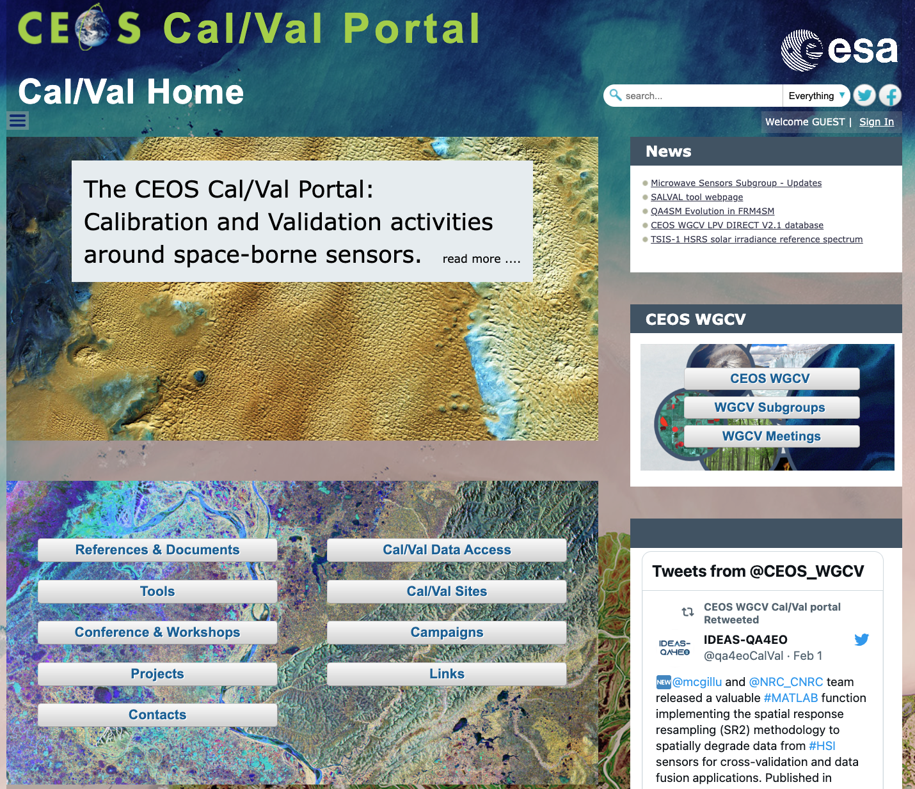
CEOS Cal/Val Portal Overview
https://calvalportal.ceos.org
The CEOS CalVal portal serves as the main forum for exchange and information sharing for the CEOS Working Group on Calibration and Validation (CEOS WGCV).
it provides access to agreed good practices and Cal/Val protocols to the wider Earth Observation community within CEOS and beyond.
It connects users to reference data and networks and provides reliable, up-to-date and user-friendly information useful for Cal/Val tasks, facilitating data interoperability and performance assessment through an operational CEOS coordinated and internationally harmonised Cal/Val infrastructure consistent with QA4EO principles.

Slide 15
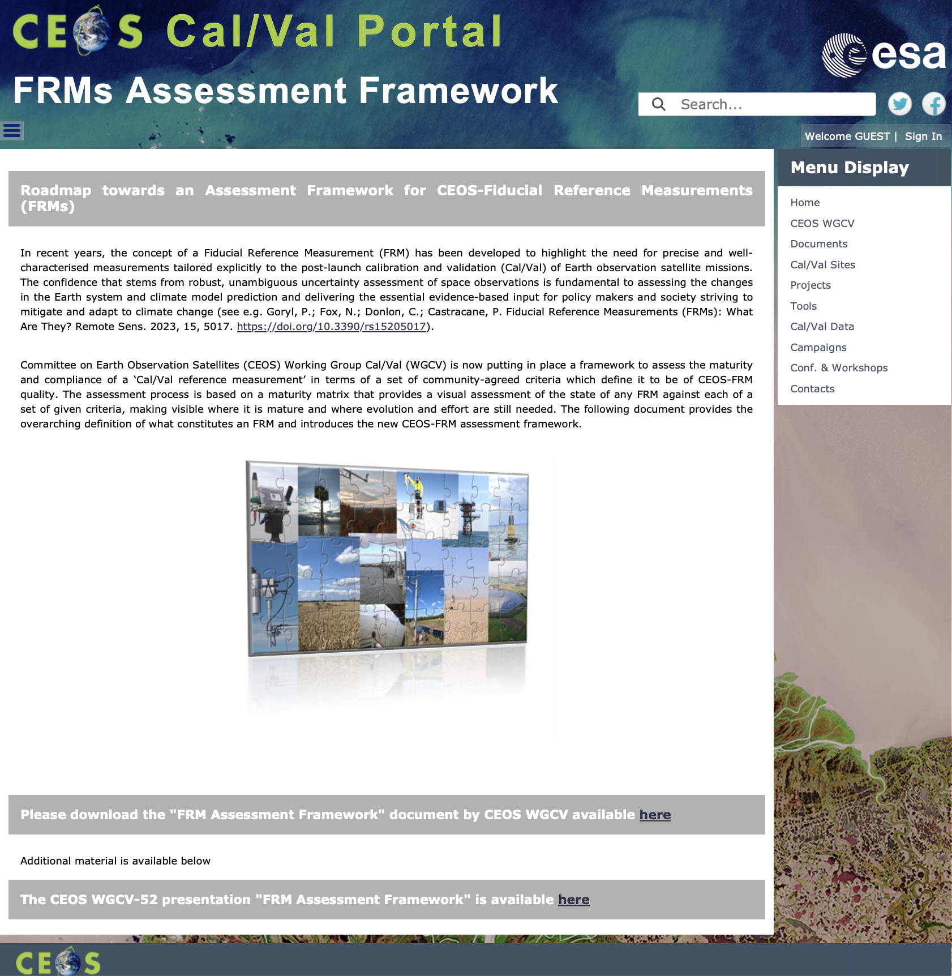
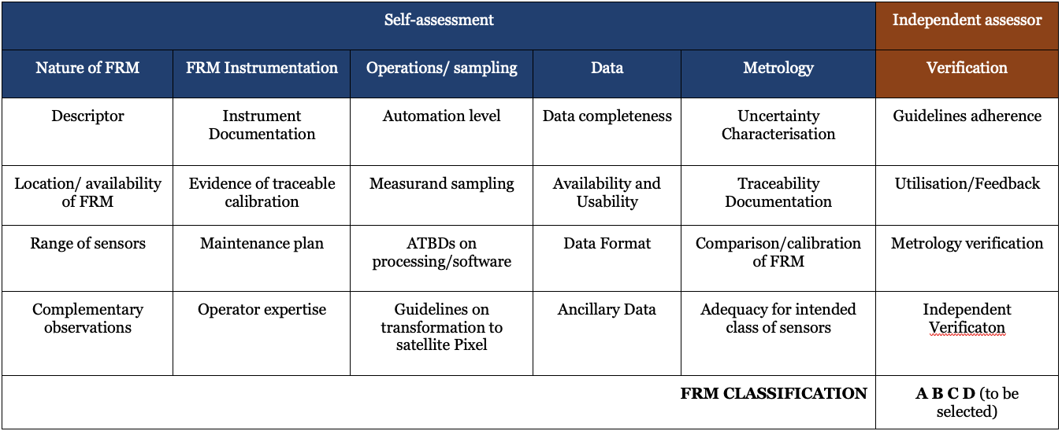
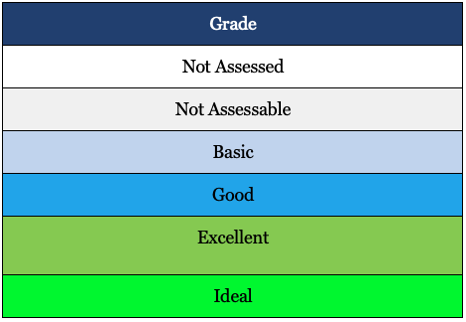
CEOS FRMs Assessment Framework
Roadmap towards an Assessment Framework for Fiducial Reference Measurements (FRM)
https://calvalportal.ceos.org/web/guest/frms-assessment-framework
The purpose of the document is to propose a roadmap towards an assessment framework to endorse a specific class of measurements as a Fiducial Reference Measurement (FRM).
Background and Objectives
FRM Definition and Principles
FRM Endorsement Process
FRM Maturity Matrix
FRM Overall Classification
Goryl, P.; Fox, N.; Donlon, C.; Castracane, P. Fiducial Reference Measurements (FRMs): What Are They? Remote Sens. 2023, 15, 5017. https://doi.org/10.3390/rs15205017.

Slide 16

Pilots for CEOS FRM Assessment
CEOS FRM MM – PGN (Pandonia Global Network) - Stefano Casadio
CEOS FRM MM - RadCalNet (Radiometric Calibration Network) - Marc Bouvet
CEOS FRM MM – ICOS (Integrated Carbon Observation System – Ecosystem Component) - Fabrizio Niro
CEOS FRM MM - FRM4DOAS (Ground-Based DOAS Air-Quality Observations) - Michel Van Roozendael Jean-Christopher Lambert
CEOS FRM MM- BAQUNIN (PREDE-POM LUNAR) – Stefano Casadio
CEOS FRM MM – CSIRO (DION) –Janet Anstee/ Matt Garthwaite/
CEOS FRM MM - Brewer Spectrometer Measurements - Henri Diemoz.
CEOS FRM MM - Hypernets - Nigel Fox. (in progress)
CEOS FRM MM - Brewer Spectrometer - NO2 Vertical Column Densities (VCDs) Measurements - Henri Diémoz (ARPA Valle d’Aosta) – BAQUNIN project
CEOS FRM MM – FRM4GHG 2.0 project –COCCON (EM27/SUN) XCO2, XCH4, and XCO data. – Mahesh Kumar Sha (BIRA) - FRM4GHG team*.
CEOS FRM MM - Tropical Centre for reactive trace gas remote sensing (CREGARS) in ACTRIS – Martine De Mazière (BIRA) – in progress (waiting the V2 of the Guidelines/MM Tool)
Maturity Matrix Tool
https://mmt.skytek.dev
Dedicated credentials provided for all the selected pilots
Support provided by Jarek Dobrzanski (Skytek, Ireland https://skytek.com/)
Slide 16

Slide 17
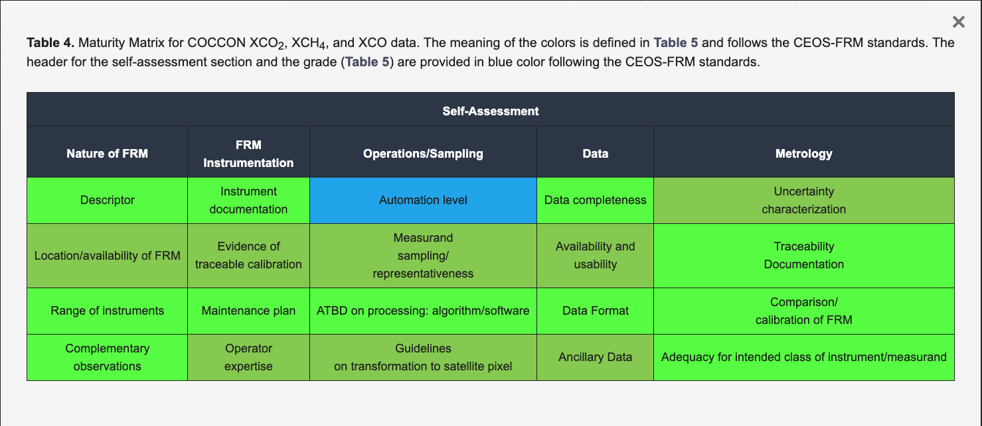
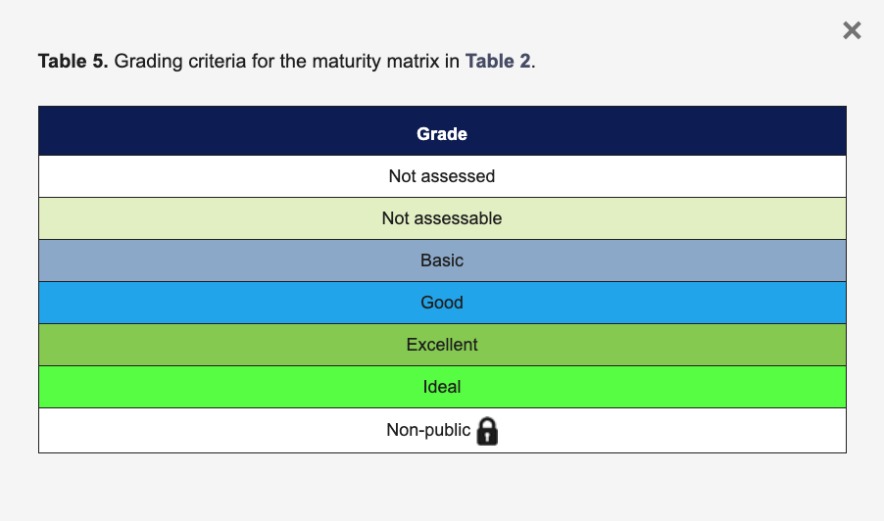
Example of CEOS FRM MM
Sha, M.K.; De Mazière, M.; Notholt, J.; Blumenstock, T.; Bogaert, P.; Cardoen, P.; Chen, H.; Desmet, F.; García, O.; Griffith, D.W.T.; et al. Fiducial Reference Measurement for Greenhouse Gases (FRM4GHG). Remote Sens. 2024, 16, 3525. https://doi.org/10.3390/rs16183525

Slide 18
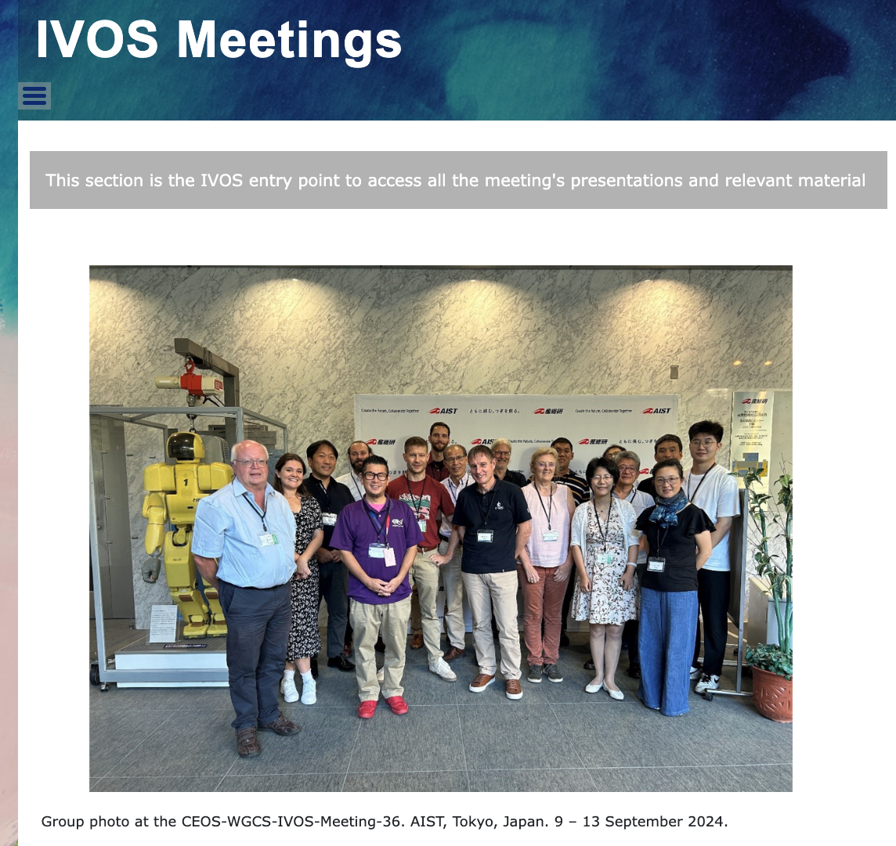
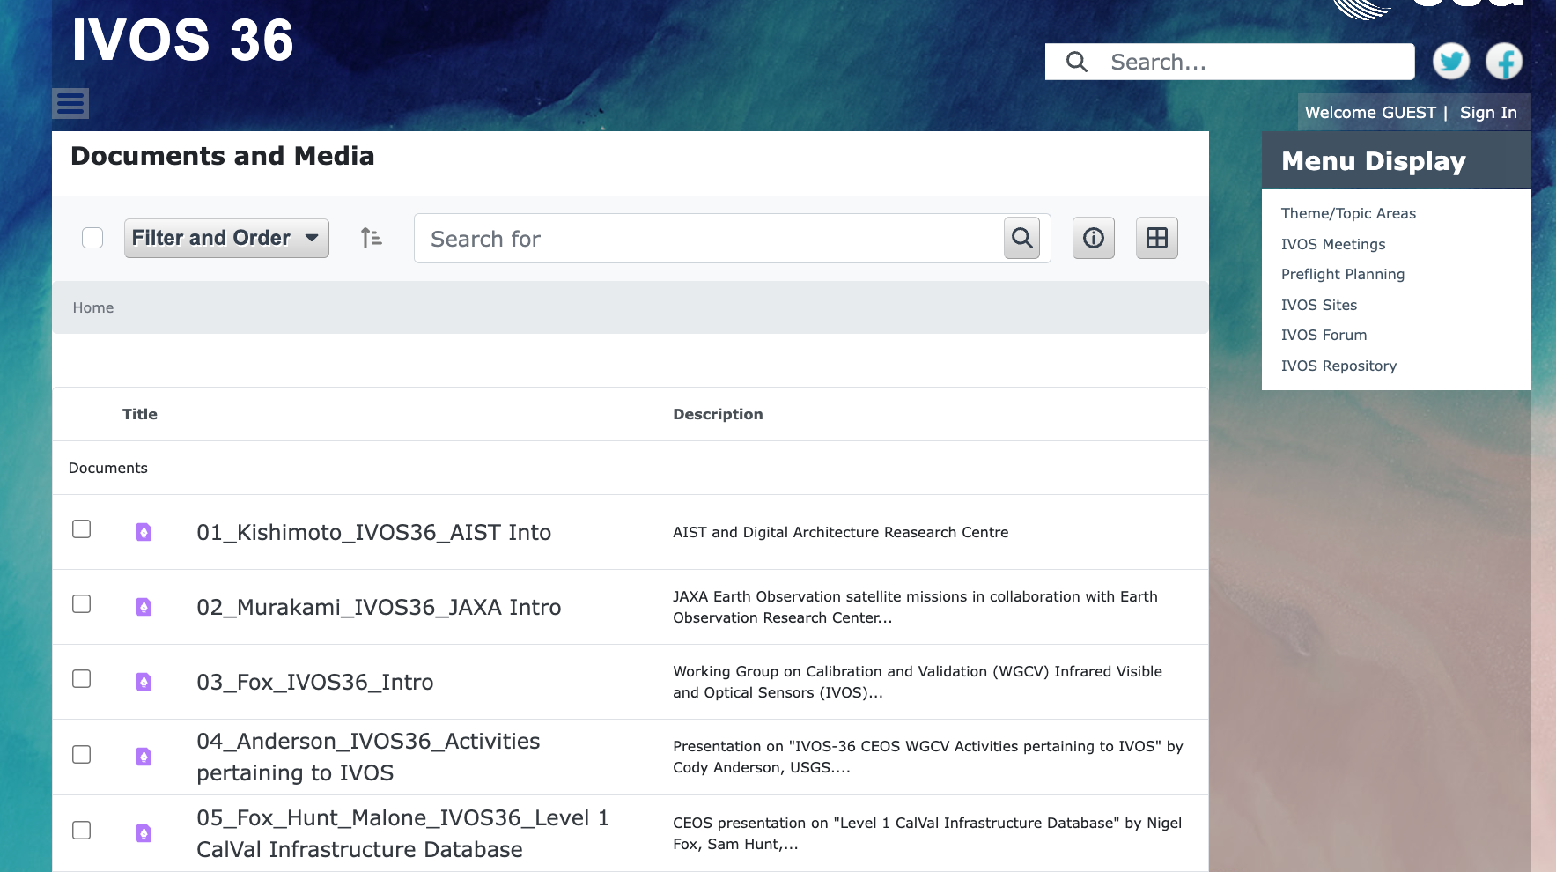
CEOS Cal/Val portal IVOS Meetings – IVOS36
IVOS Meetings
IVOS -36
AIST, Tokyo, Japan. 9–13 September 2024.
Presentations
MoM
Now available on
CEOS Cal/Val Portal!
https://calvalportal.ceos.org/web/guest/ivos-36

Slide 19
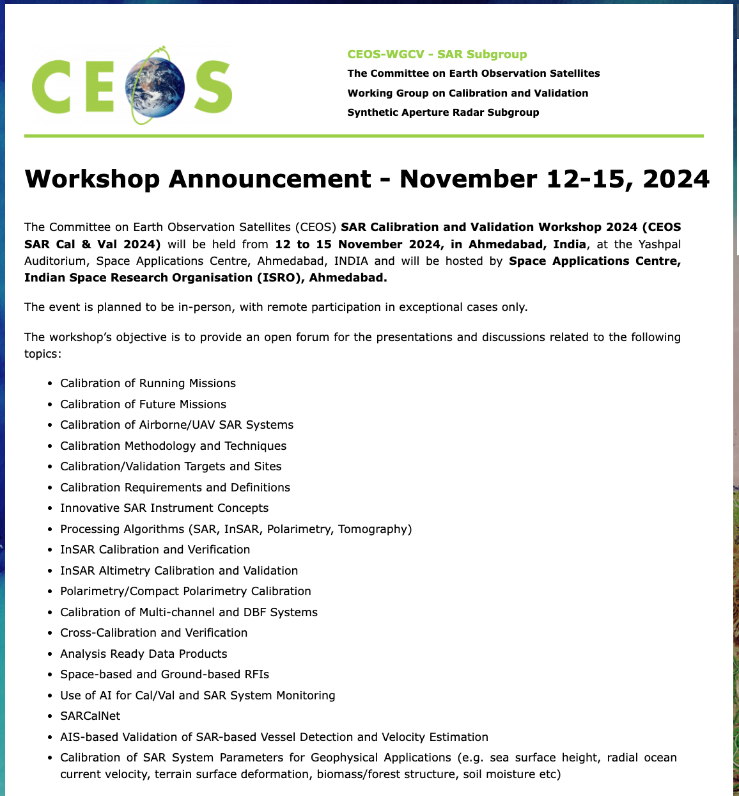
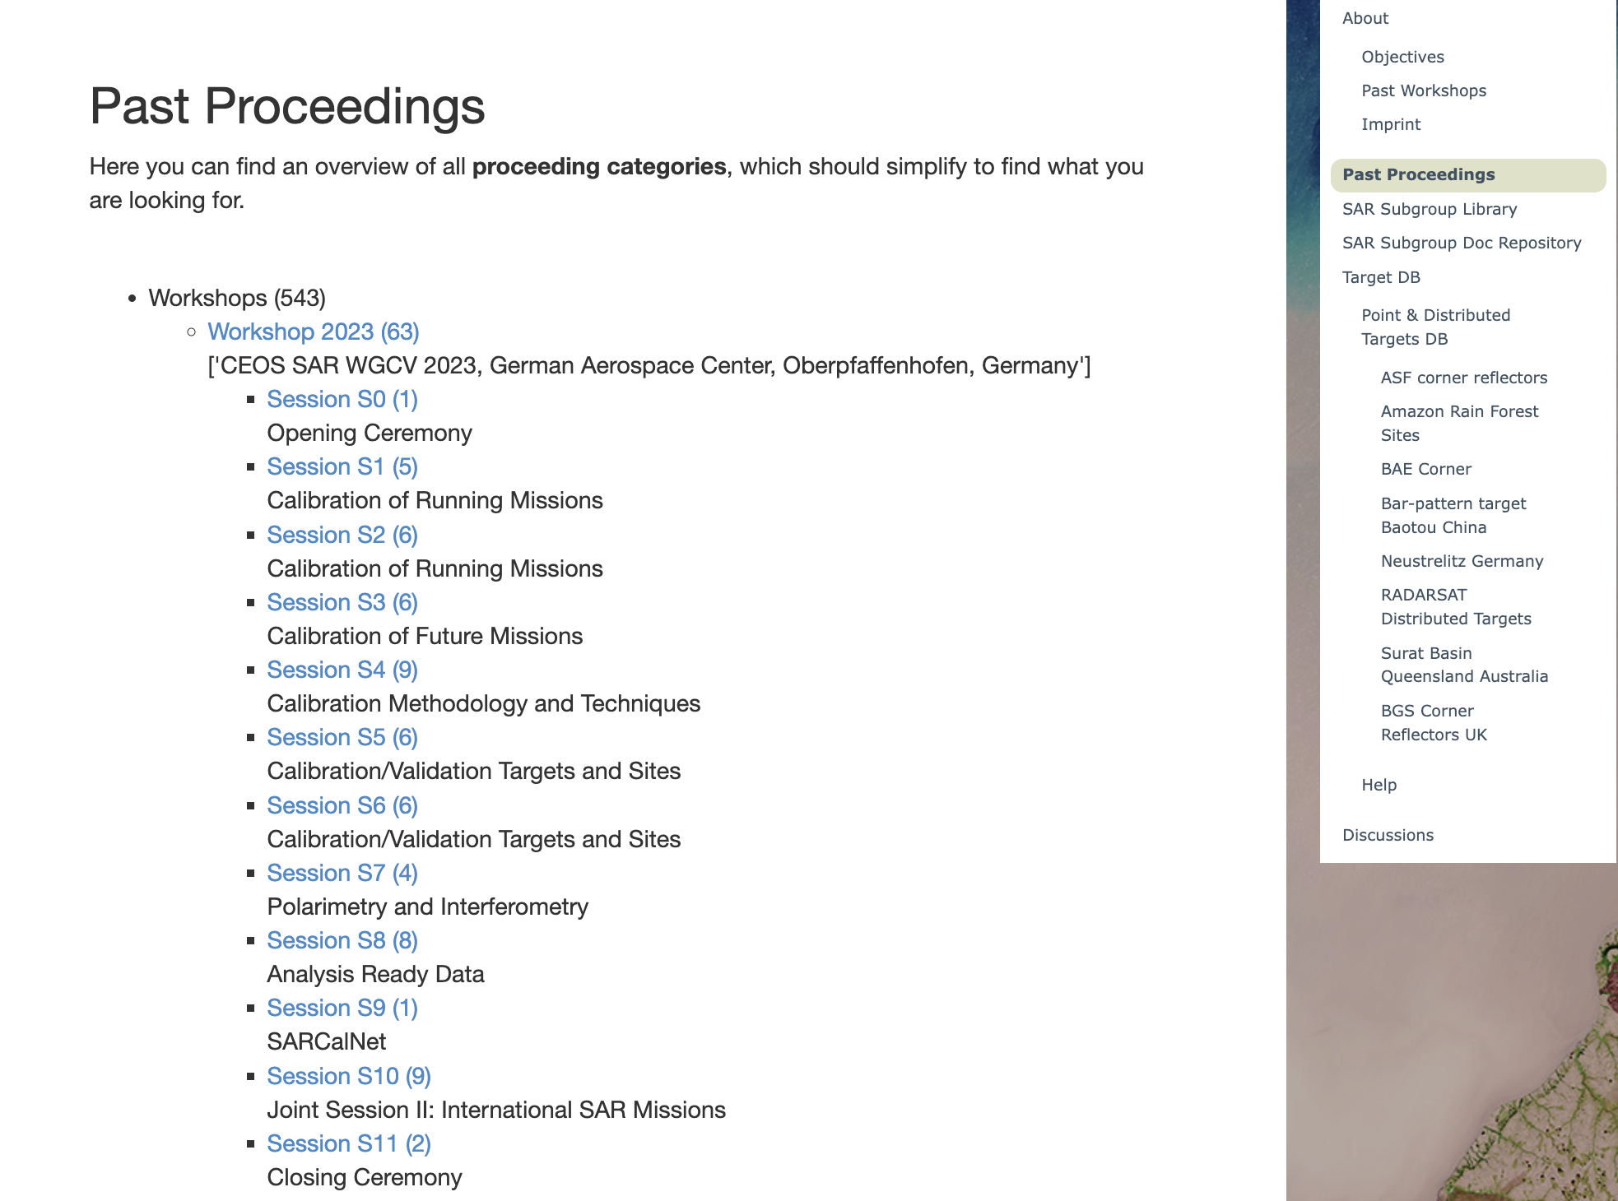
CEOS SAR subgroup
CEOS SAR subgroup Workshop
12-15 November, 2024
Ahmedabad, India
Presentations
Material

Slide 20
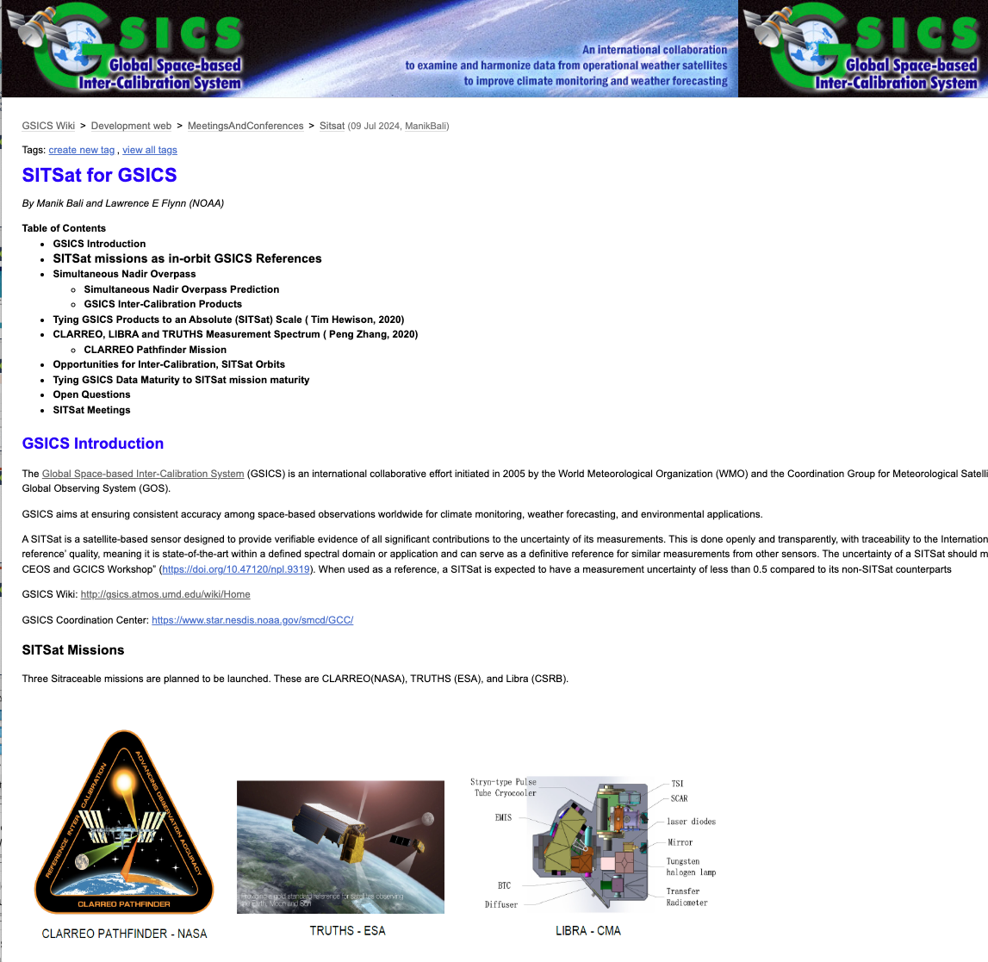
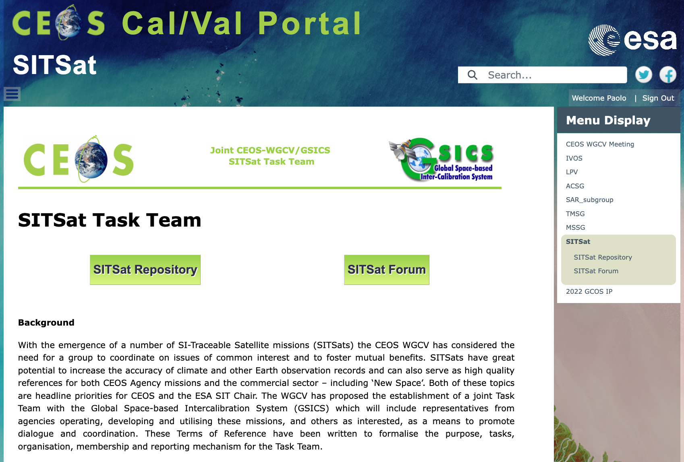
SITSat Task Team
The SITSat webpage has been proposed with
Public information: Background, Definition, Objectives; Organisation and reporting
Relevant links
SITSat Repository
SITSat Forum
Both Repository and Forum restricted to the SITSat members to share documents/materilas and discussions
https://calvalportal.ceos.org/sitsat
The SITSat for GSICS website offers an overview on the SITSat Missions, some key open questions and relevant links.
http://gsics.atmos.umd.edu/bin/view/Development/Sitsat

Slide 21
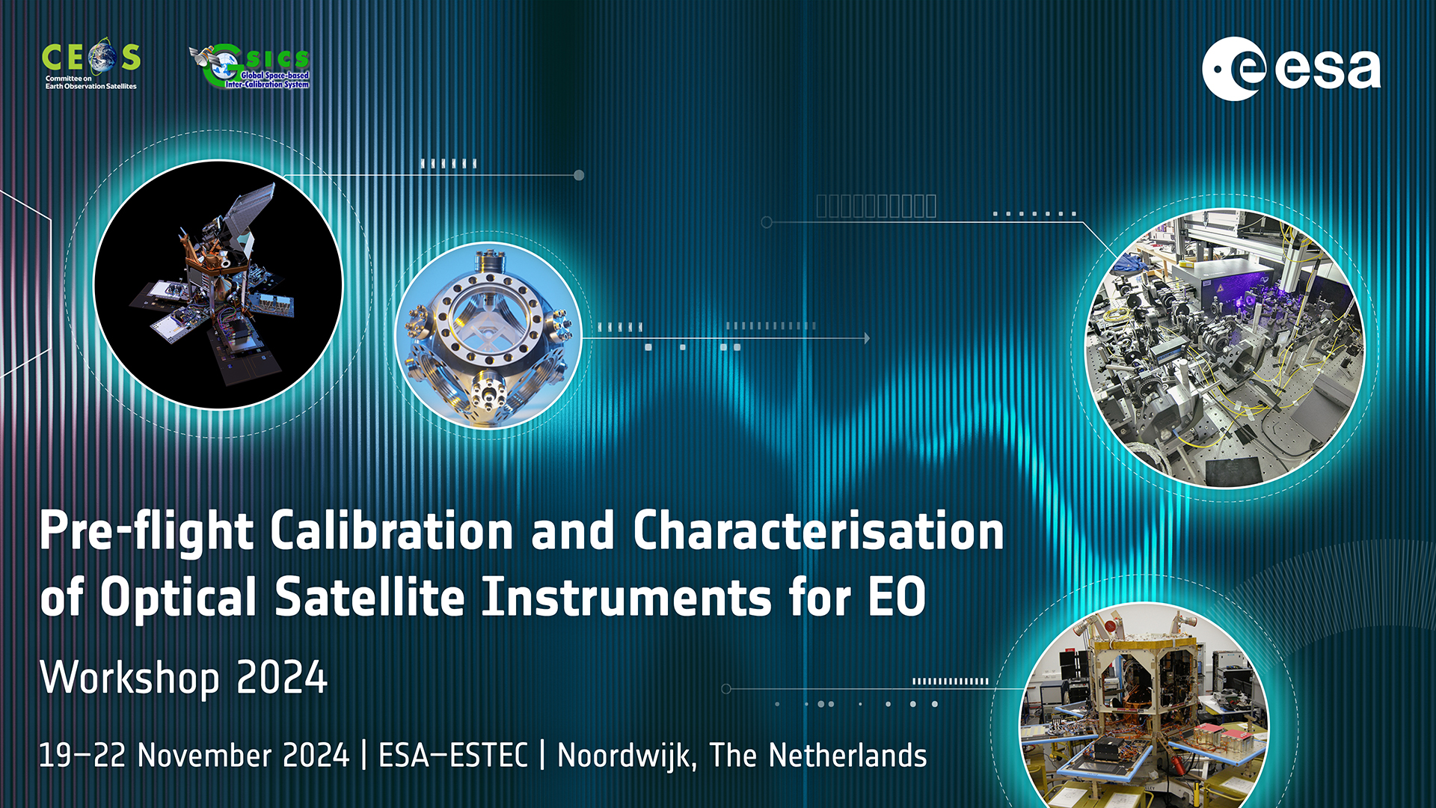
Pre-flight Calibration and Characterisation Workshop
GSICS and CEOS WGCV people in the Organising and Scientific Committee
Website https://atpi.eventsair.com/pre-flight-calibration-workshop/
Presentation and material are available

Slide 22
WGCV and GSICS area of cooperation
The collaboration between CEOS WGCV and GSICS is ever evolving. This collaboration occurs at multiple levels: GSICS Executive Panel Level and at Working group level.
Several areas of work between GSICS and WGCV are being actively pursued. These include methods, protocols, and organization of joint workshops (see e.g. Pre-flight Calibration and Characterization Workshop).
New Space topics: WGCV and GSICS participation at initiatives and workshops as
VH-RODA 2024 and JACIE 2025.

Slide 23
WGCV and GSICS area of cooperation
Maturity Matrix approach: to continue exchange of ideas, in different domines:
Maturity Matrix for products assessment (EDAP). ESA Earthnet is working closely with the NASA Commercial Smallsat Data Acquisition ( CSDA) program to design a Maturity Matrix that can apply maturity to Small Sat data sets.
WGISS Data Management and Stewardship Maturity Matrix (DMSMM) for dataset assessment and evolution
GSICS Procedure for Product Acceptance (GPPA) Workflow derived from QA4EO framework
Outreach: CEOS Cal/Va Portal shares GSICS Tools (colab notebooks), Conferences, Workshops and Projects. GSICS Newsletter (Via X @CEOS_WGCV). GSICS Wiki page – SITSat for GSICS page.

Slide 24
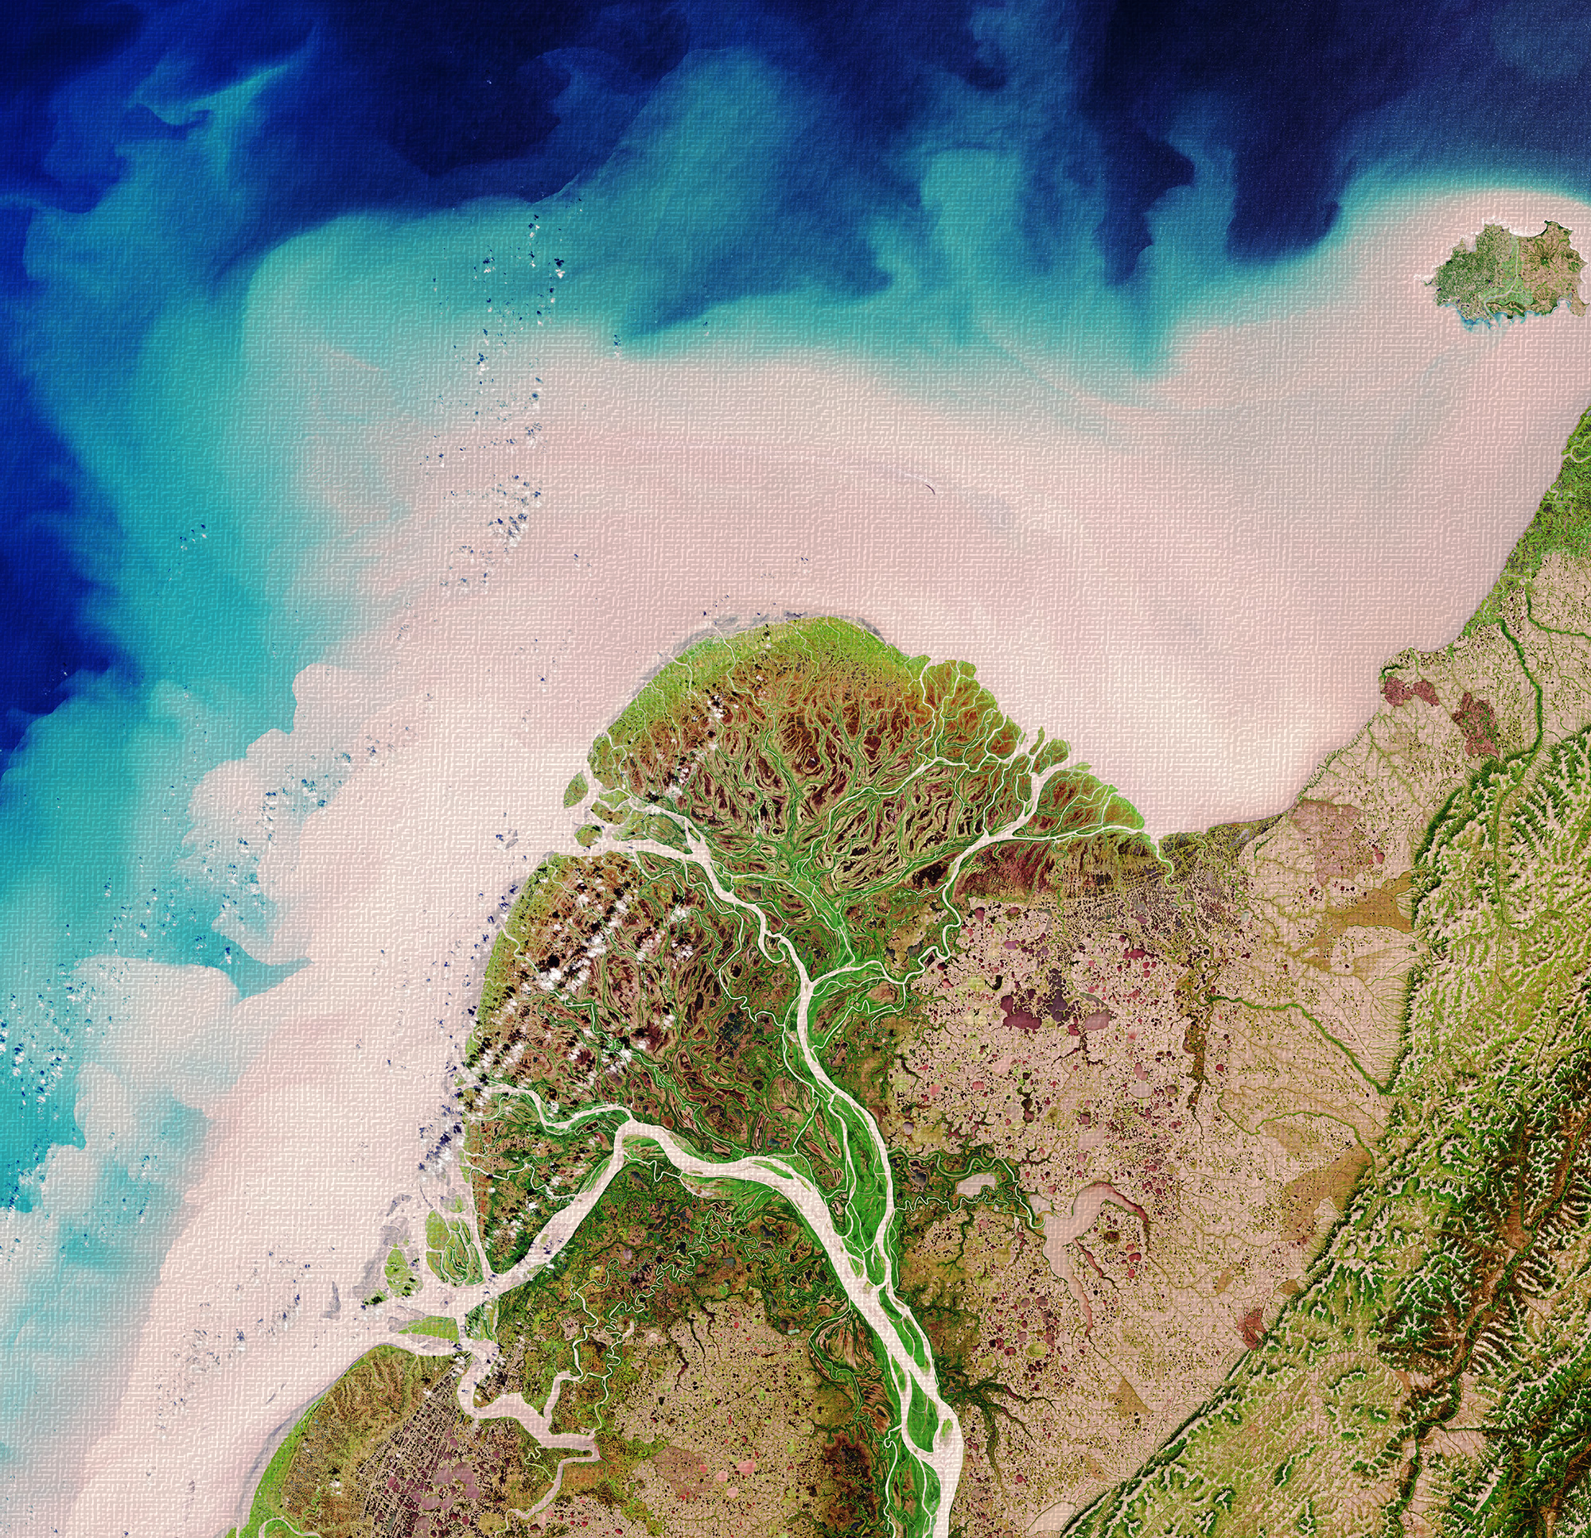
Thank you!

