Slide 1

GSICS Agency Report
2025
Heikki Pohjola
WMO

Slide 2
WMO Space Programme Section
Chief of Section Natalia Donoho (NOAA)
Staff
  Heikki Pohjola
  Zoya Andreeva
  Jesse Andreas
Consultants (25 %)
  Mikael Rattenborg
  Roger Saunders
  Diego Sousa
  Eric Allaix
SSU expert teams:
  ET-SSU, Expert Team on Space Systems and Utilization
    Cochairs Fiona Smith (BoM) and Lihang Zhou (NOAA)
  ET-SWX, Expert Team on Space Weather
    Cochairs Kirsti Kauristie (FMI) and Mpho Tshisaphungo (SAWS)
  ET-RFC, Expert Team on Radio Frequency Coordination
    Cochairs David Franc (NASA), Alec Casey (ECCC) and Kirsty McBeath (MetOffice)

Slide 3
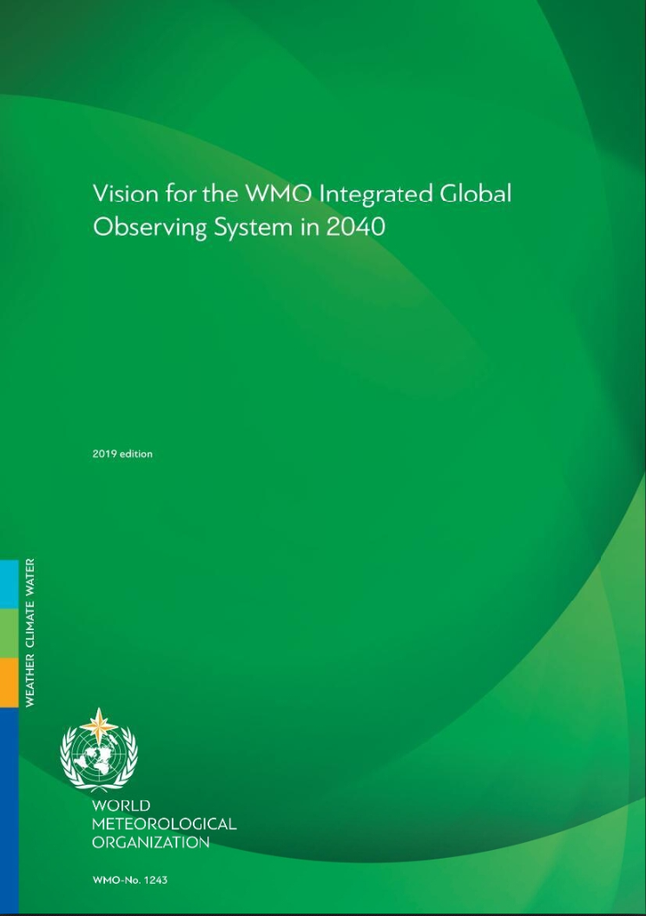
WIGOS Vision Update
Goal of the WIGOS 2050 Vision
Factors Driving the global observing system of the Future
Community Engagement
WIGOS 2050 Vision: Plans & Timeline

Slide 4
Overview of the WIGOS Vision update
General Goal
“The Vision for WIGOS in 2050 presents a likely scenario of how user requirements for observational data may evolve over the next 25 years, and an ambitious, but technically and economically feasible vision for an integrated observing system that will meet them.
Evolution of users and applications requirements
Technology evolution and innovation (HW, Data, AI)
Implementers’ need - observing systems plans and capabilities including public and private sector
Drivers
It provides high-level targets to guide the evolution of the WIGOS in the coming decades. It anticipates a fully developed and implemented WIGOS framework that supports all activities of WMO and its Members within the general areas of weather, climate and water.”

Slide 5
Overview of the WIGOS Vision update
How WIGOS 2040 Vision Was Used in the Past
Helped Connecting Users of Observations (and requirements) with Observing systems owners (space and surface) and trigger innovative observing systems solutions
Influenced Space agencies plans (space agencies or through CGMS). Examples: NOAA, EUMETSAT, JAXA, CMA, etc
Influenced surface observing systems owners in their plans when designing/deploying programs
Helped applications areas owners (especially GNWP) get gradually ready for future Global observing systems
Served as a focal topic to facilitate international, regional coordination of observing systems owners (gap analysis)
99 publications (Google Scholar) included ‘WIGOS 2040’: variety of applications and obs

Slide 6
Overview of the WIGOS Vision update
Expected Benefits
Provide inspiration, motivation to influence design, evolution of the global observing systems in a harmonious way, both space and surface components​
​Facilitate discussions between operators and owners of applications to work in an integrated fashion (space-surface, across Earth system domains, …)​
Provide visibility to and trigger potential adoption of new technologies (hardware, data processing, new capabilities, cost-effective solutions, non-traditional observing systems, etc) ​
Provide high-level recommendations to the international community on how to perhaps enhance interactions, collaborations, to facilitate the vision.

Slide 7
Community engagement
Three components and purposes to the Engagement:​
Collect technical feedback, gaining insight and knowledge to enrich the vision drafting (scientists, users, etc)​
Allow technical review to gain institutional and strategic guidance during drafting​
Conduct formal review by major stakeholders

Slide 8
Community Engagement
Inclusive and Balanced Representation:
- Space/Surface balance
- Geographic representation
- Gender balance
- Applications representation
- Institutions representations
Team members are also reps of or familiar with:
CGMS, CEOS, GOOS, WMO, ET-EOSDE, RRR, NWP, NOAA, NASA, SC-ON, EUMETSAT, SAEON, GBON, JAXA, ET-SSU, BOM, ECMWF, Academia, private sector and non-traditional EO sector
They are also from:
US, Canada, Japan, South Africa, Argentina, Europe, Australia, China, etc
First Circle: Technical Feedbacks
Engage with potential users of the vision (agencies, networks owners, etc) to better understand how this vision could help them in defining, designing, evolving and deciding
WMO-organized WIGOS 2050 Vision workshop
Technical conferences where major users of Observations are represented (ITSC for NWP, IPWG, IROWG, IWWG, AMS (possibly Town Hall, or a presentation), EMS, AGU, AOGS, ESA Living Planet,
CGMS and CEOS working group, strategic implementation team, and plenary sessions.
WMO High-level Consultative Meeting on Satellite Matters.
Technical Conferences where observing systems evolution is discussed (IGARSS, PIERS, ISRSE, NASA Technology Forum, etc.)
GCOS – GCOS Steering Committee mid 2025
GOOS events – JCB meetings
GAW , G3W – data providers/network workshops
GCW and cryosphere com. Events -
Space weather events
Hydrology event-
WMO Core Vision Drafting Team:
Members are expected to reach back to their institutions, communities to collect feedbacks, thoughts and bring it back to the vision drafting
Second Circle: Inclusive and Balanced Review
ET-EOSDE
CGMS
CEOS
GEO
UNESCO/IOC/GOOS
GCOS
GCW
GAW
G3W
WMO Hydrological community
(WMO) Space Weather communities
WMO GBON/RBON/RRR/HLG expert teams and PoCs
UNOOSA
HMEI
Etc
# Prototype engagement package is available.

Slide 9
High-Level Timeline for WIGOS Vision update
2024
2025
2026
Scoping by core group
Consultations with all stakeholders
Review, finalization, recommendation by INFCOM-4
2027
Approval by Cg-20
Stakeholder WS
Drafting the update
Scoping: On-going
Drafting/Technical Reviewing
WMO Approval Process

Slide 10
Summary
An effort has been kick started (Jan 2025) to update the WMO Integrated Global Observing System (WIGOS) vision for the 2050 timeframe, with the purpose of finalizing the product in 2026.
The scope will include space- and surface-based components and will envision a global system to measure the Earth, and address WMO-relevant applications
Many driving factors are expected to influence this vision including technology evolution, applications/users needs, the future landscape of observing systems providers including non-traditional systems and commercial providers, etc.
This effort is expected to provide the community with a vision that will help coalesce efforts toward a cohesive, complementary global observing system.
The vision, should be as well-informed and technically accurate as possible, and should inspire the community to design, evolve and deploy a complementary global observing system that addresses the needs of the future, and leverages the emerging opportunities

