Slide 1


GSICS Agency Report
2025
Misako KACHI*, Hiroshi MURAKAMI,
Keiichi OHARA, Kei SHIOMI, Takeo TADONO,
Kosuke YAMAMOTO, Takuji KUBOTA, Akihiko KUZE
Japan Aerospace Exploration Agency (JAXA)

Slide 2
Summary of Agency’s GSICS Activities, Actions, and Achievements
Current GSICS Activities
  Monthly lunar calibration of GCOM-C/SGLI by GIRO is updated regularly and all GIRO I/O files have been submitted to GLOD
  Lunar calibration of GOSAT-2/CAI-2 by GIRO is updated regularly and the gain degradation is estimated (presented by K. Shiomi at UVN-S Break-out Session, Wed. am., Mar-19)
  ALOS-2/PALSAR-2 calibration activities, geometric accuracy, radiometric accuracy, and polarimetric accuracy of the standard product are regularly evaluated, and the resolution, sidelobe level, noise equivalent sigma zero (NESZ), ambiguity, etc. are measured as the image quality evaluation.
  Preparation of cross-calibration of GOAST-GW/AMSR3 high-frequency channels (166, 183GHz) with GPM-CO/GMI is underway. (presented by M. Kachi at MW Break-out Session, Wed. am., Mar-19)
  Monitoring and analysis of Radio Frequency Interferences (RFIs) found in GCOM-W/AMSR2 C/X-band over 12 years are ongoing.
Status of Agency’s GSICS Actions
  Ongoing discussion/preparation of standardized landing pages for JAXA sensors upon request from GDWG in January 2024
2

Slide 3
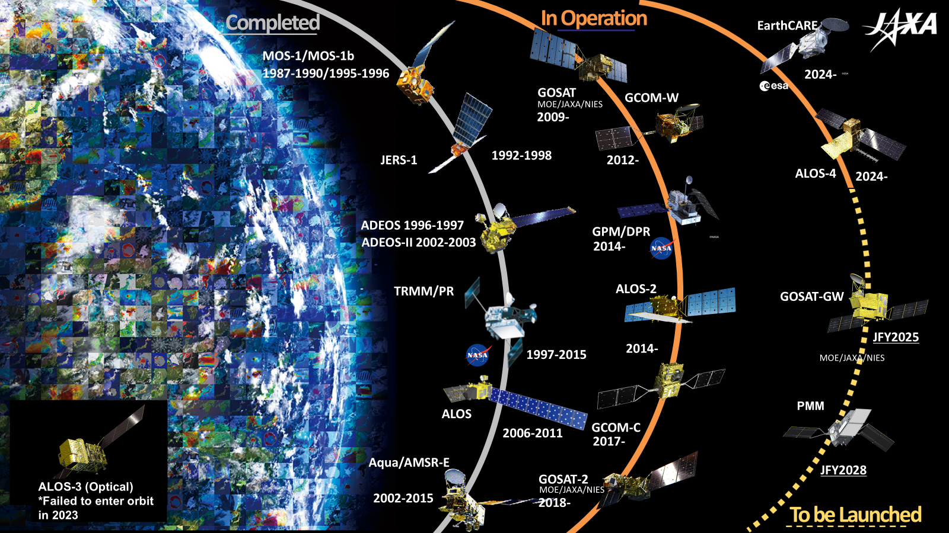
Agency’s Instruments Updates &
Planned launches that are relevant to GSICS
(1) JAXA Missions
(JFY: Japanese fiscal year, April-March)
Summary of current and future instruments
  GOSAT, GCOM-W, GPM Core/DPR, ALOS-2, GCOM-C, GOSAT-2: Operating
  May 2024: EarthCARE launched by Space X Falcon 9, JAXA provides Cloud Profiling Radar (CPR)
  July 2024: ALOS-4 (SAR) launched by H-3 F3 rocket
  Early JFY2025: GOSAT-GW (GHG spectrometers and microwave radiometer) launched by H-IIA F50
3

Slide 4

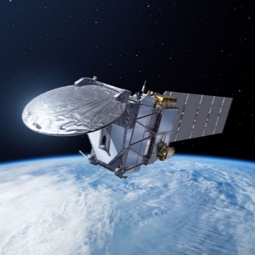
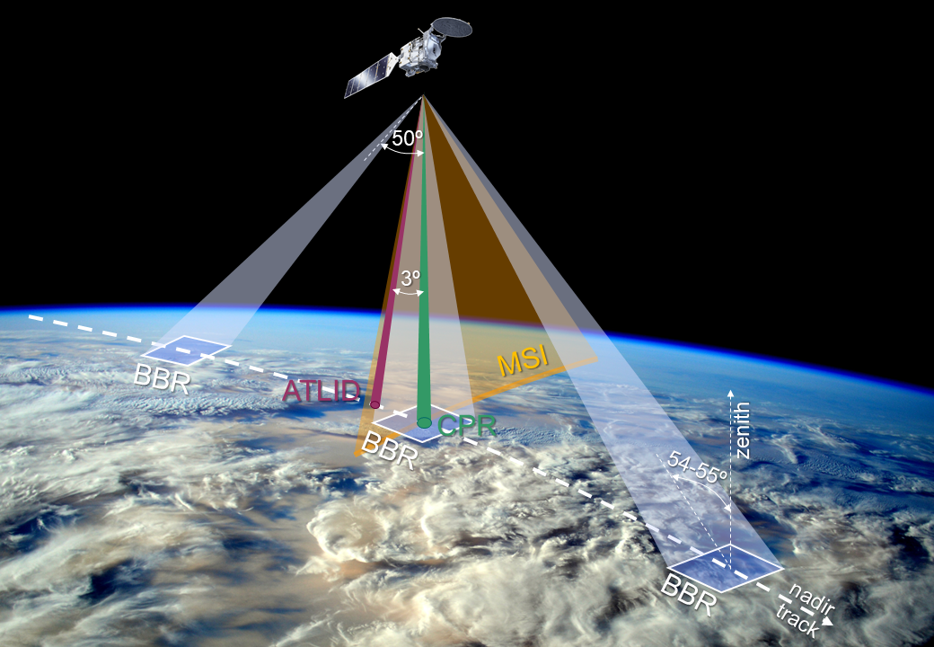
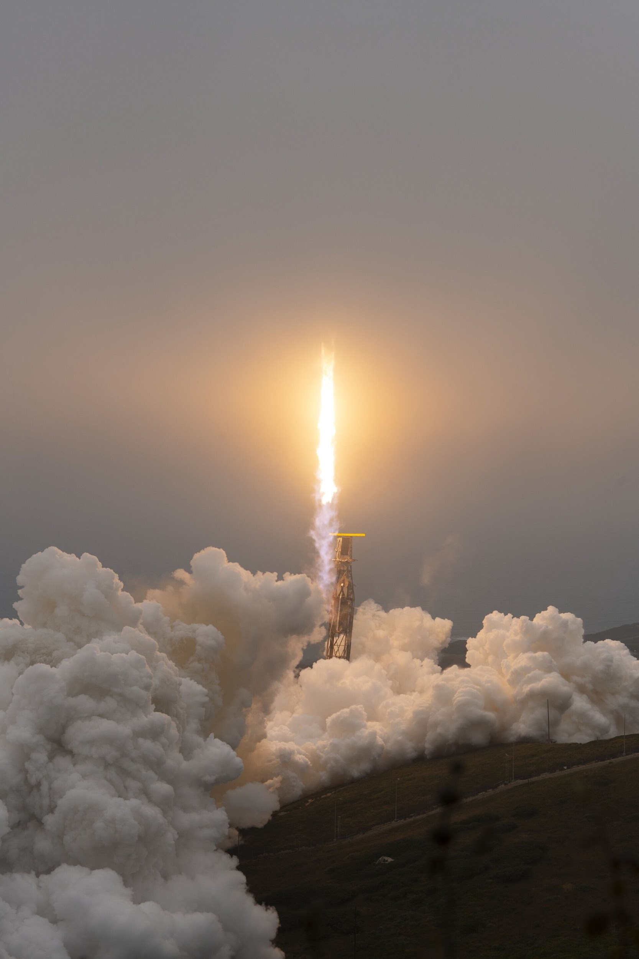
Agency’s Instruments Updates & Planned launches that are relevant to GSICS
(2) Europe-Japan joint EarthCARE was launched successfully
launched on May 29, 2024
Europe-Japan joint mission to obtain Global distributions of cloud & aerosol profiles and radiation budget to contribute to precise understanding of climate change
JAXA and NICT provides world's first satellite-based cloud vertical motion by the Cloud Profiling Radar (CPR) at 94 GHz with Doppler Capability at 0.8 km spatial resolution.
Release schedule of JAXA products:
  Level-1 (Jan. 14, 2025)
  Level-2a and Level-2b CPR-ATLID synergy cloud products (Mar. 17, 2025)
  Level-2b CPR-ATLID-MSI synergy cloud product and 4-sensor synergy radiation budget product (Launch + 18 month)
EarthCARE
EarthCARE Satellite Specifications
Mission Instruments |  | - Cloud Profiling Radar (CPR) by NICT & JAXA - Atmospheric Lidar (ATLID) by ESA - Multi-Spectral Imager (MSI) by ESA - Broad-Band Radiometer (BBR) by ESA
Orbit | Type | Sun-synchronous sub-recurrent orbit
 | Altitude | approx. 400km
 | Local sun time at descending | 14:00
 | Revisit time | 25 days
Satellite Mass |  | Approx. 2.2 tons at launch
Designed lifetime |  | 3 years
Launch |  | May 29, 2024 by Falcon-9 (Space-X)

Slide 5
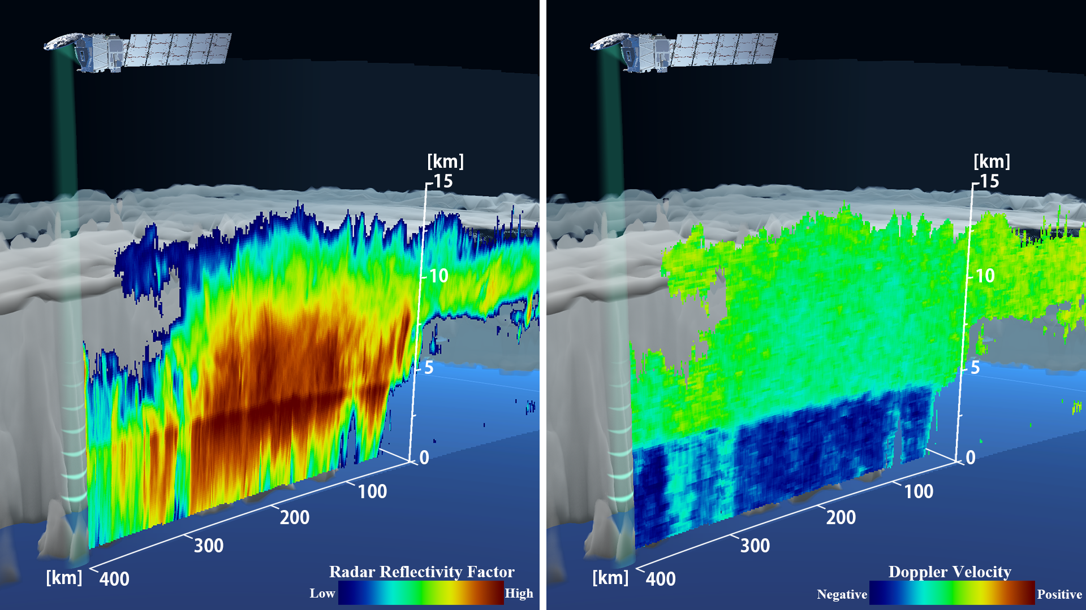
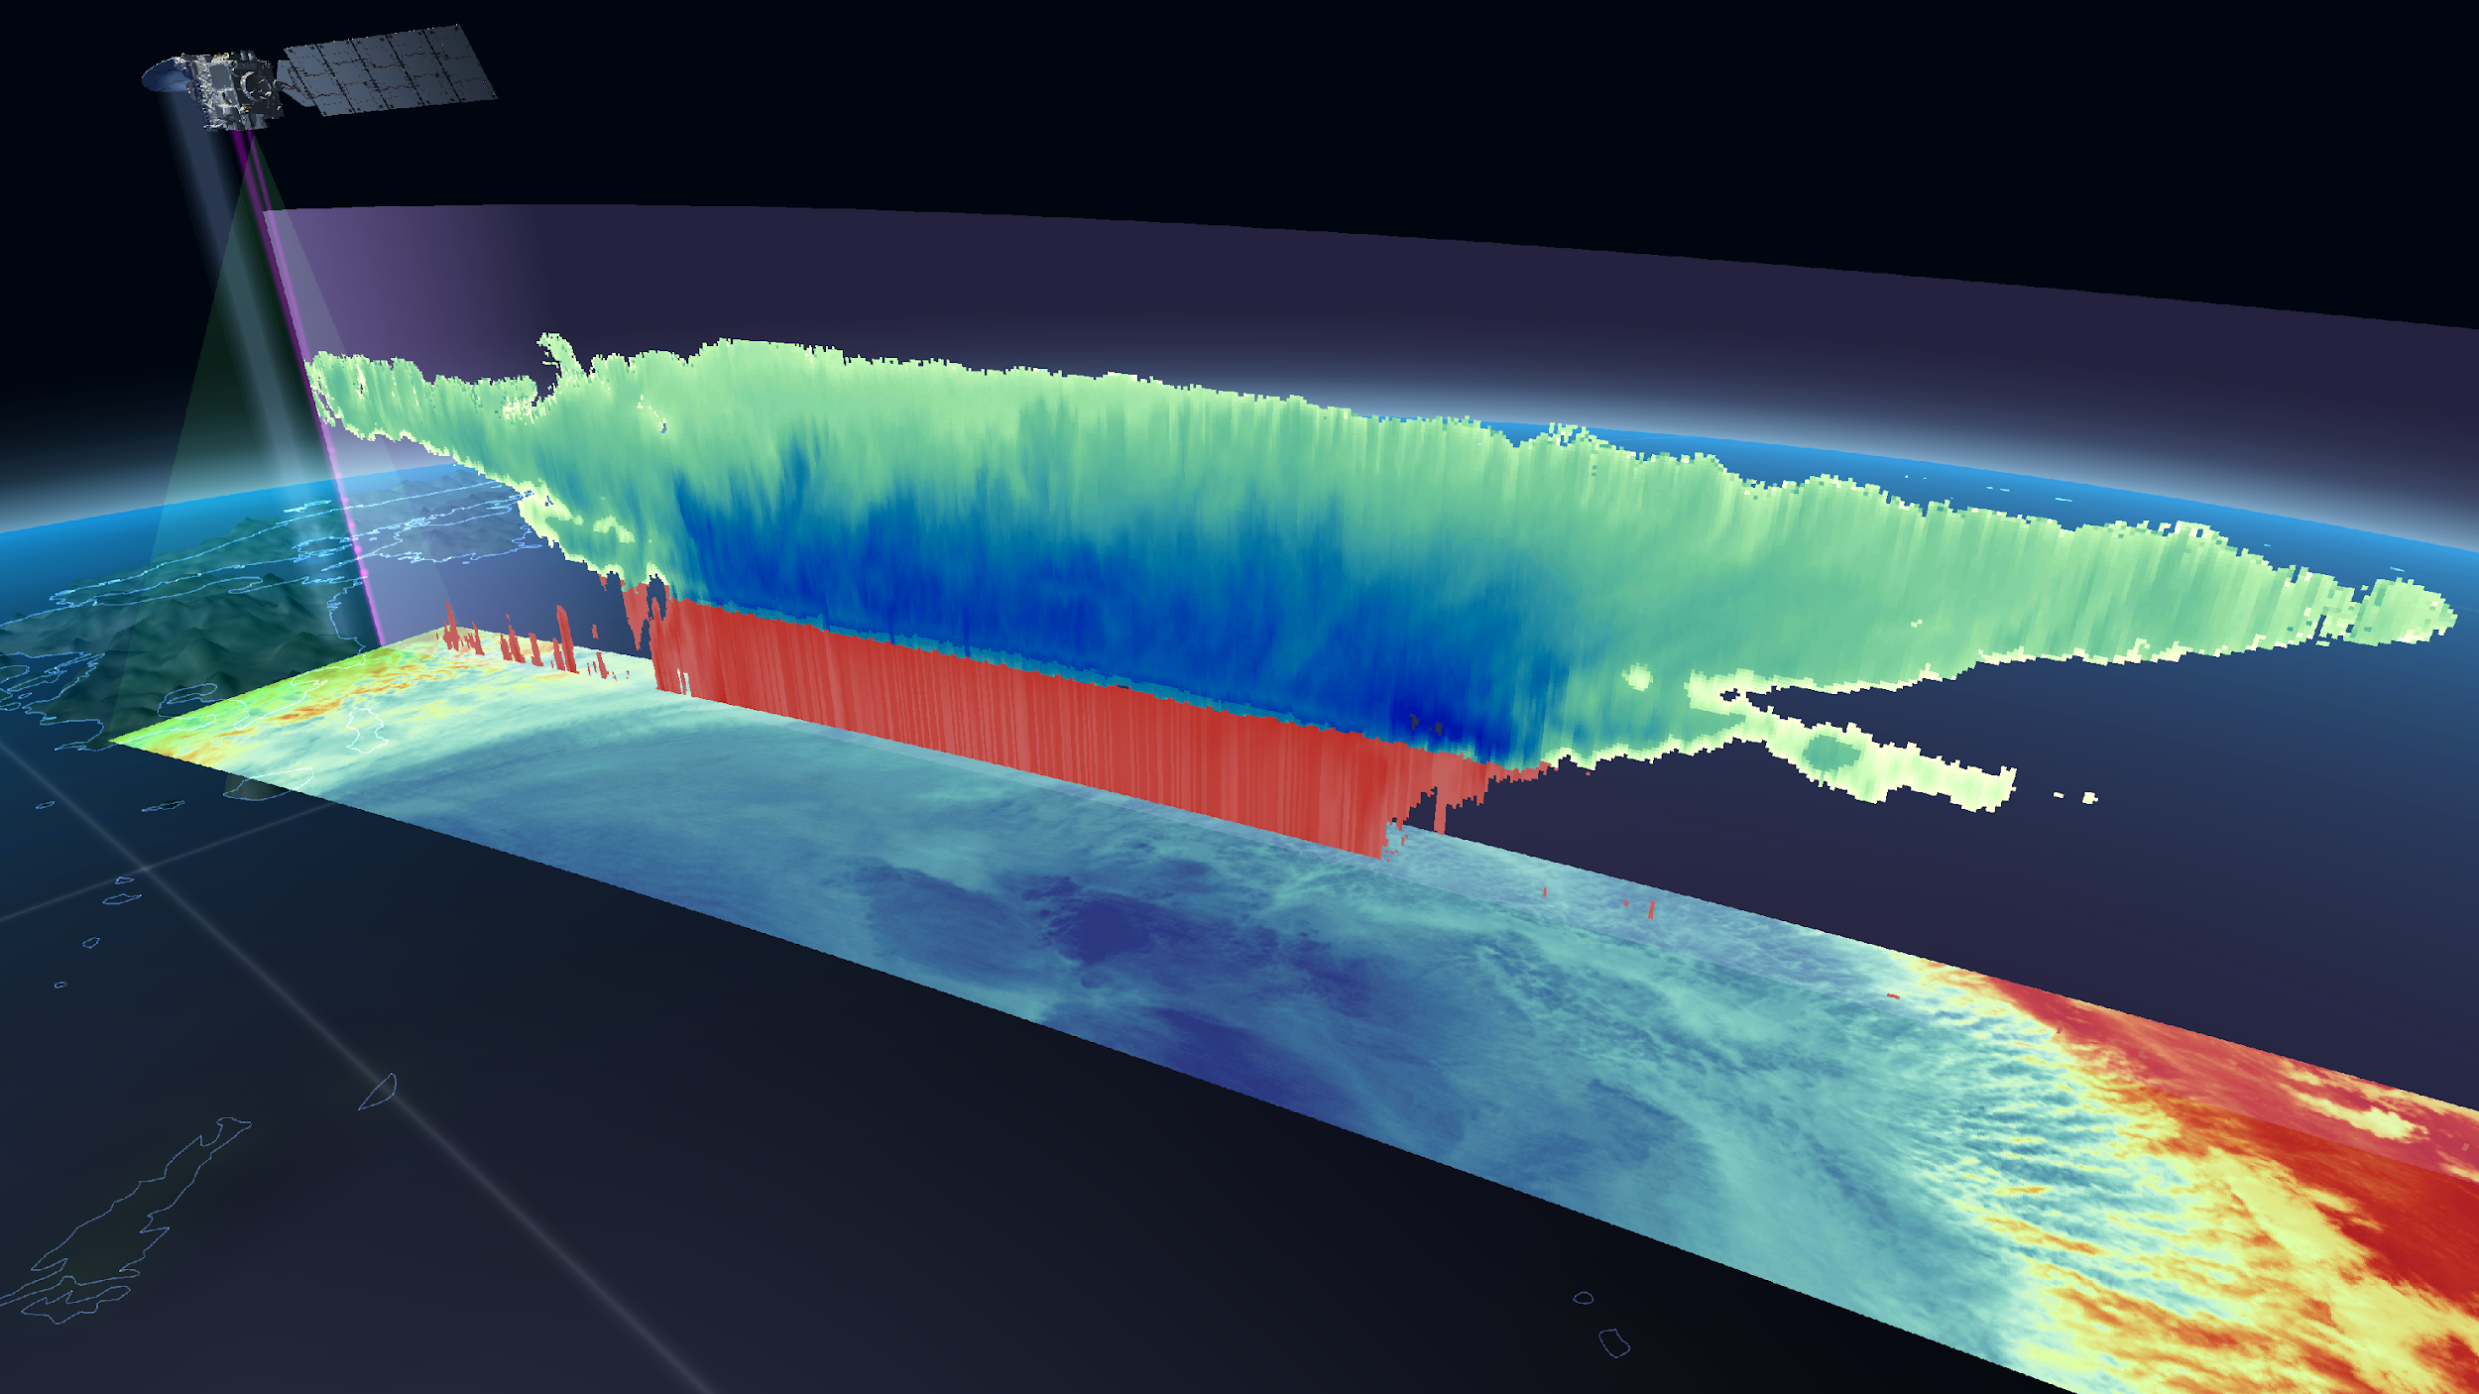
Agency’s Instruments Updates & Planned launches that are relevant to GSICS
(3) EarthCARE First and Synergistic Images
CPR First image (June 2024)
Synergistic cloud images by sensors onboard EarthCARE
Radar Reflectivity Factor
Doppler Velocity
Vertical:
Synergistic images by CPR, Atmospheric Lidar (ATLID), and MSI
Horizontal:
Multi-Spectoral Imager (MSI)
https://global.jaxa.jp/press/2024/06/20240627-1_e.html
World's first measurement of vertical cloud motion from space
(Rainy cloud over the ocean at east of Japan on 13 June)
https://www.satnavi.jaxa.jp/en/news/2024/10/04/9923/index.html
Measure the clouds more accurately to contribute to improvement of the climate model
(Typhoon Shanshan (2024) approaching Japan on 28 August)
5

Slide 6
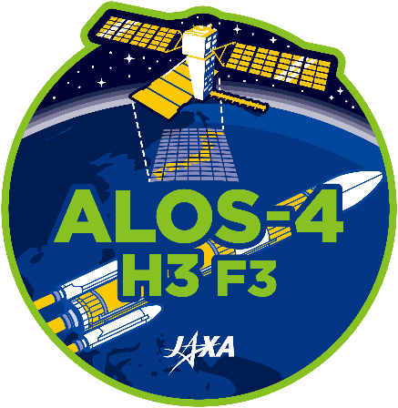
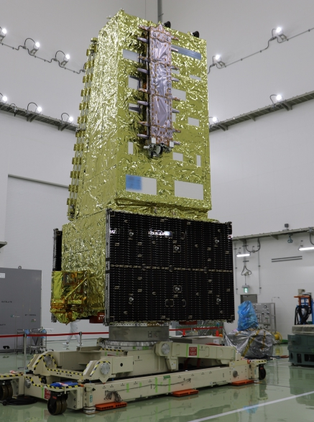
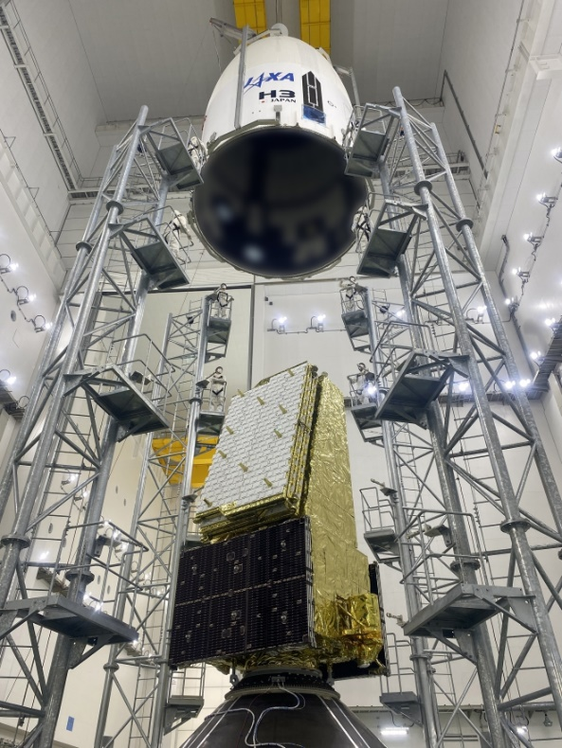
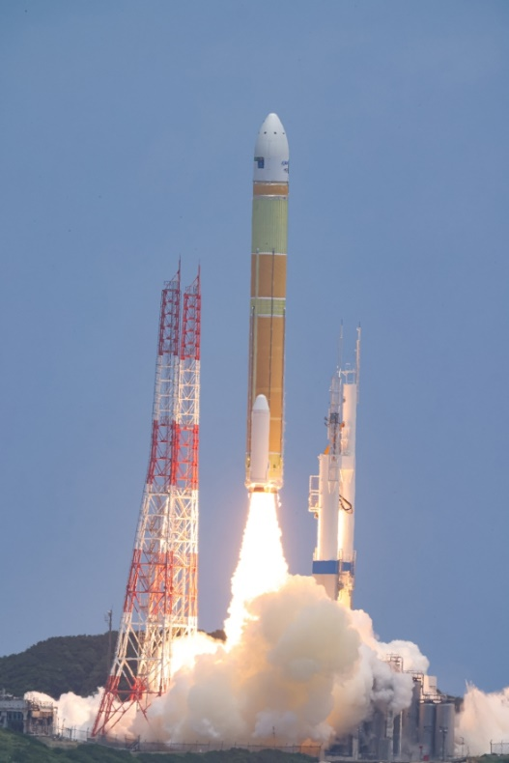
Agency’s Instruments Updates & Planned launches
that are relevant to GSICS
(4) ALOS-4 was launched successfully
H3 launch vehicle Flight 3 (H3 F3) carried on the Advanced Land Observing Satellite-4 (ALOS-4) was successfully launched at 12:06:42 on July 1, 2024 JST.
After two days of the Critical Operations Phase to deploy the solar array paddles and the antennas of PALSAR-3 and SPAISE3 etc., ALOS-4 is confirmed to keep in a stable condition to remain in orbit.
> Conducting the Initial Cal/Val from October 19, 2024 (to March 31, 2025 as planned)
SPAISE3
PALSAR-3
ALOS-4
Stored in the fairing
H3F3 launch
6

Slide 7
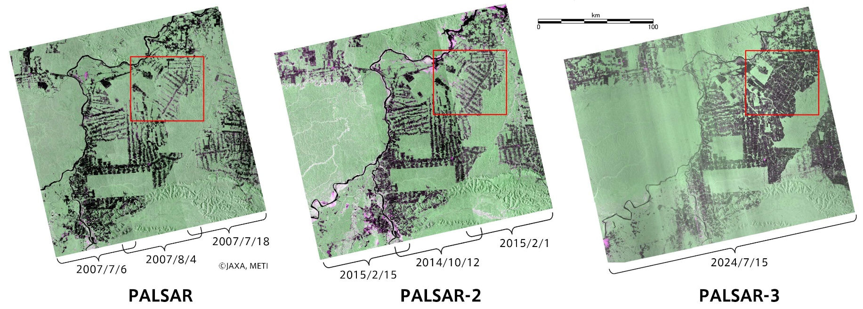
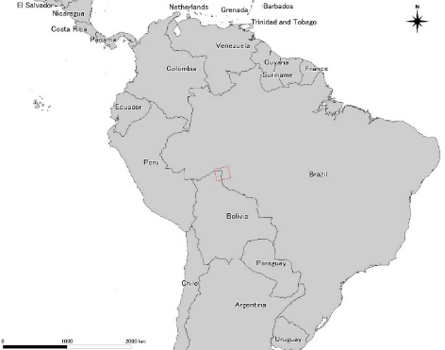
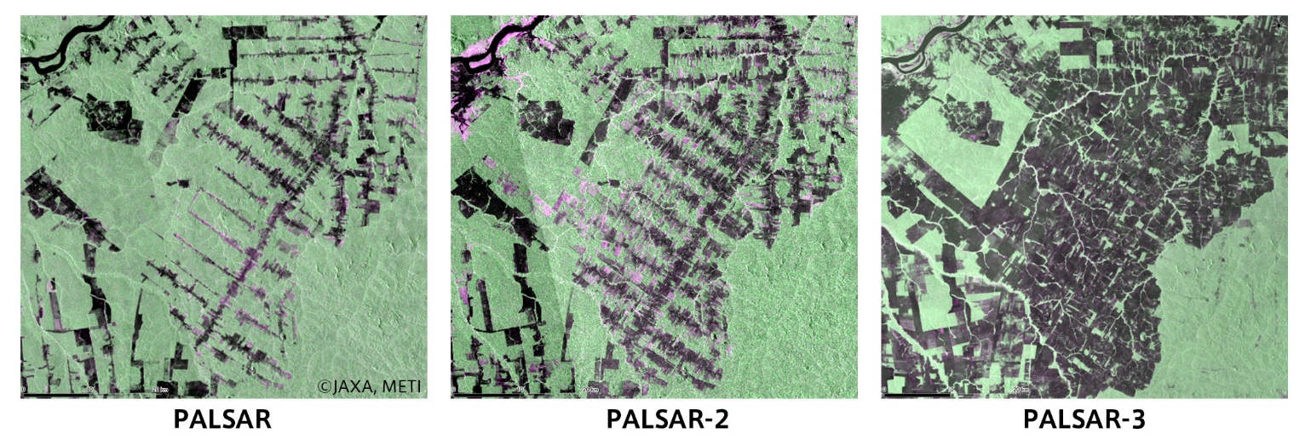
Agency’s Instruments Updates & Planned launches
that are relevant to GSICS
(5) ALOS-4 first light
“Observation Continuity” 10 m resolution, dual-pol, and 200 km of obs. swath width in Rondônia, Brazil (13:43, July 15, 2024 JST)
https://www.jaxa.jp/press/2024/07/20240731-1_j.html
July-Aug. 2007
Oct. 2014 – Feb. 2015
July 15, 2024
7

Slide 8

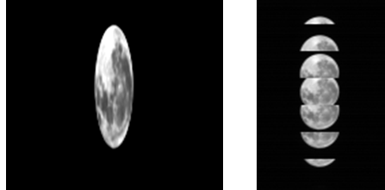
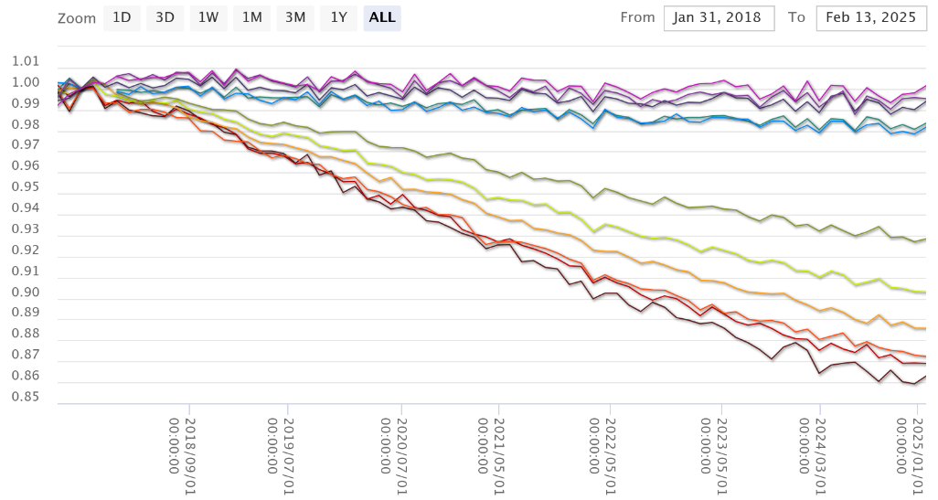
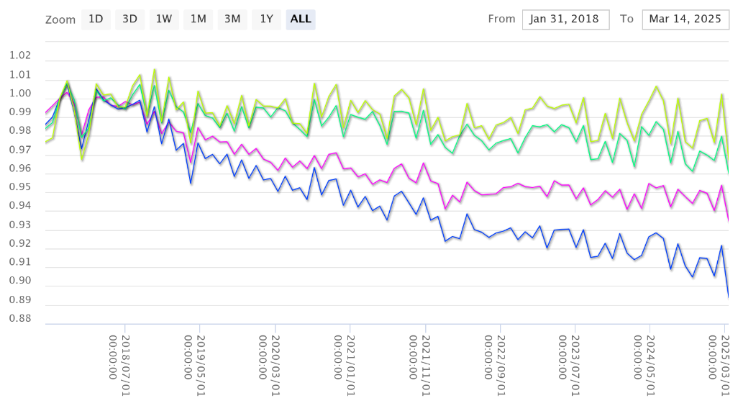
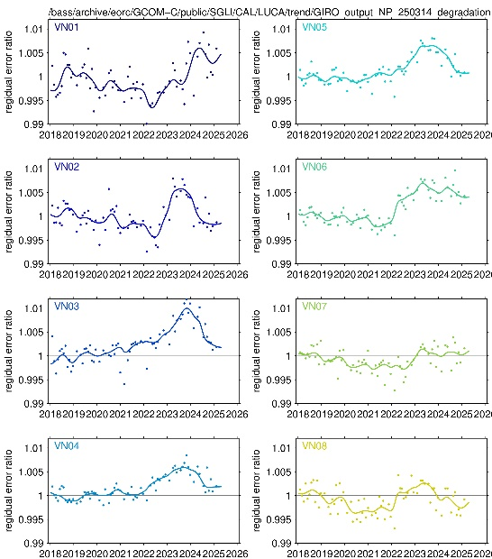


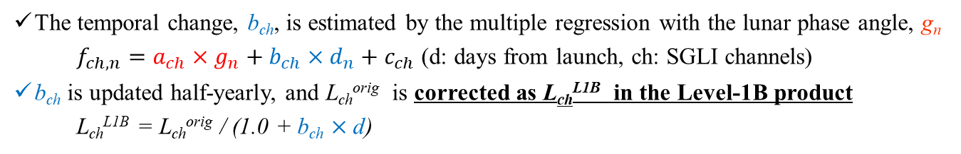
Agency's Calibration Major Updates
(1) SGLI Lunar CAL by GIRO
GCOM-C SGLI lunar calibration is regularly updated by the monthly (phase angle ~+7°) lunar observation operations (by the pitch maneuver; 93 times from Jan. 2018 to Mar. 2025) with GIRO
All SGLI lunar observation data (GIRO input/output files) have been submitted to GLOD
VNR
IRS
The temporal change, b_{ch}, is estimated by the multiple regression with the lunar phase angle, g_{n}
    $f_{ch,n}=a_{ch}×g_{n}+b_{ch}×d_{n}+c_{ch}$ (d: days from launch, ch: SGLI channels)
b_{ch} is updated half-yearly, and L_{ch}^{orig} is corrected as L_{ch}^{L1B} in the Level-1B product
  L_{ch}^{L1B} = L_{ch}^{orig} / (1.0 + b_{ch} $×$d)
Residual errors from the half-year gain update is under investigation because it can affect Level-2 products (e.g., ocean color)
Urabe et al. (2020). DOI: 10.3390/rs12010069;
Urabe et al. (2019) DOI: 10.1109/IGARSS.2019.8897892
1.01
1.02
SGLI/GIRO
SGLI/GIRO
VNR 380nm~865nm
0.90
SWIR 1.05μm~2.21μm
0.85
2018/01
2025/01
2018/01
2025/01
Time series of SGLI/GIRO trend (Normalized by 2018/2/1)
8

Slide 9

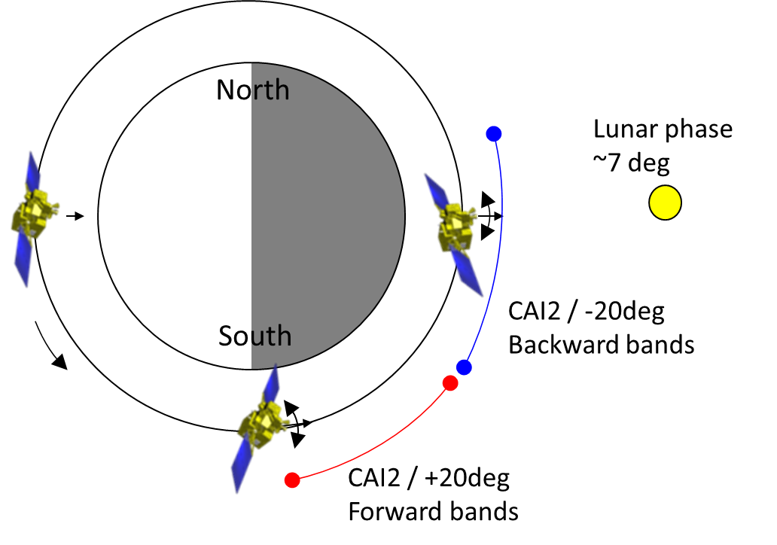
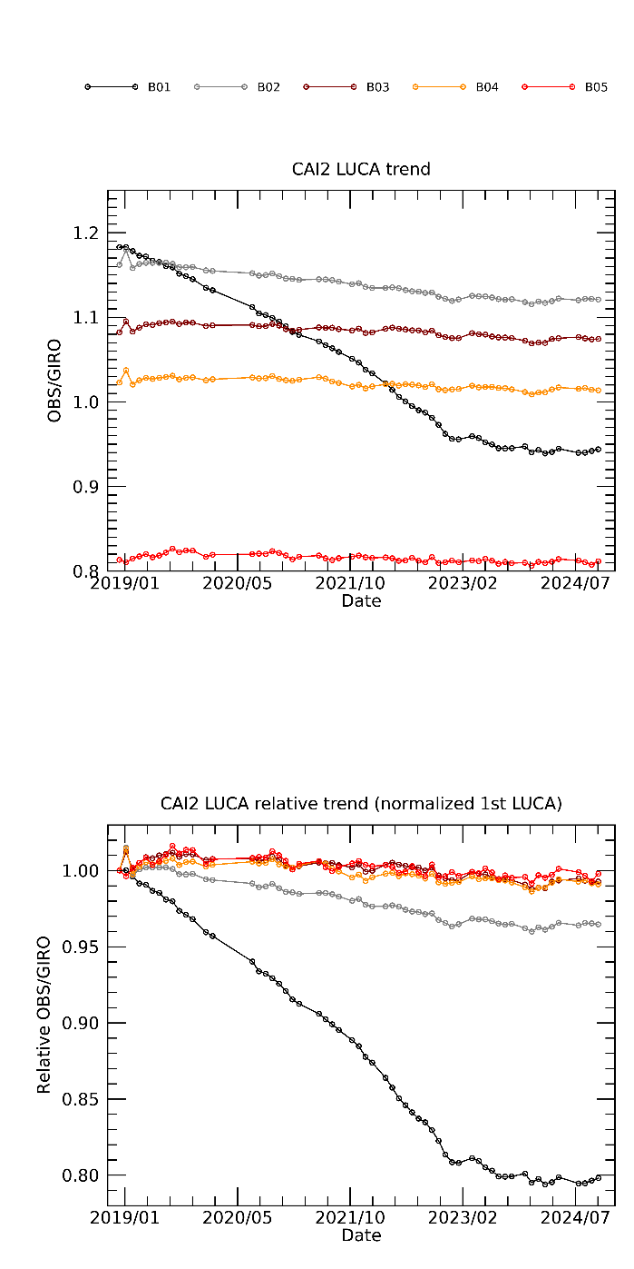
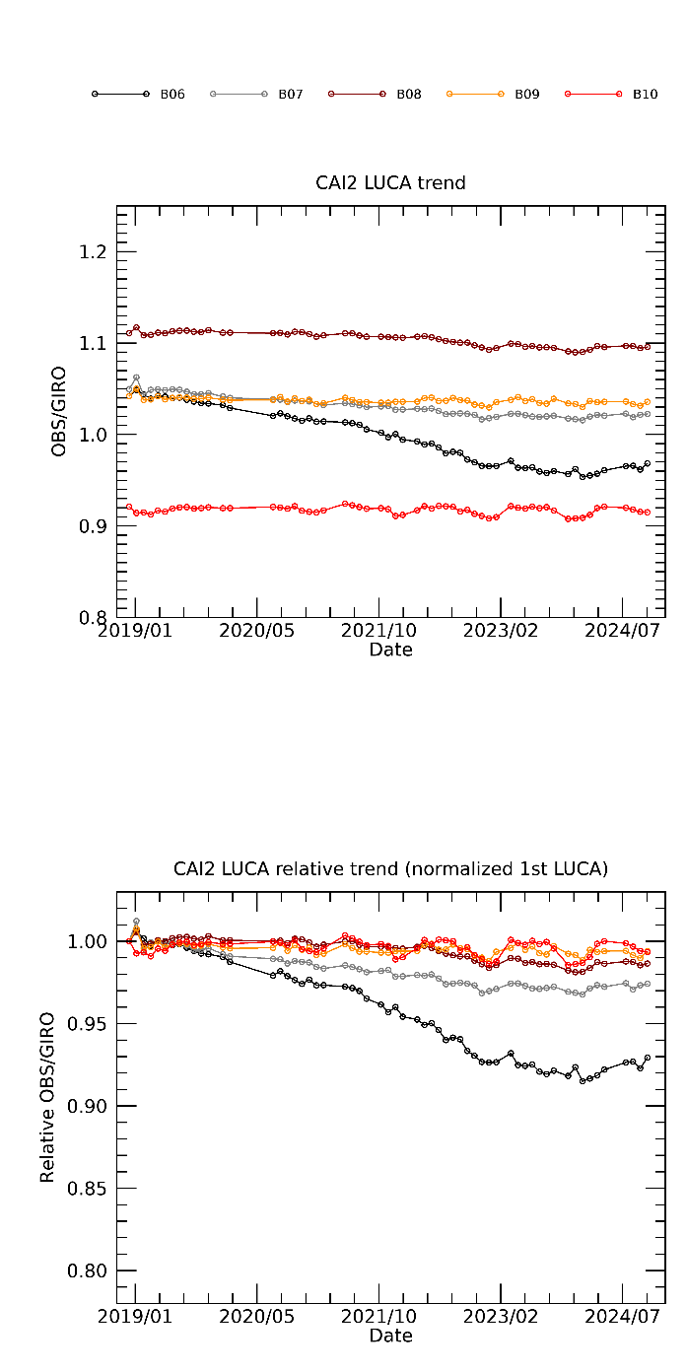
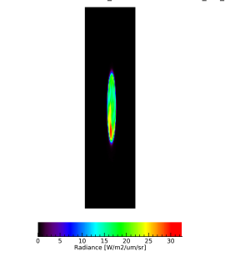
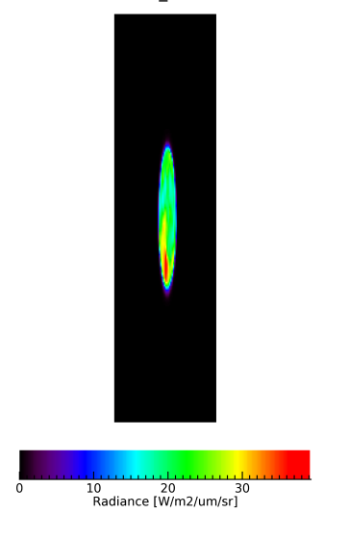
Agency's Calibration Major Updates
(2) GOSAT-2 Lunar CAL by GIRO
CAI-2 has been operated the lunar calibration for radiometric calibration by along-track (AT) scans (satellite pitch rotations) once a month since December 2018. The lunar phase angle is targeted around 7 deg.
CAI-2 observes at 340, 380, 440, 550, 670, 870, and 1630 nm and compered with GIRO. 340nm is compared with the extrapolated model.
CAI-2 B1 340 nm band degraded around 20 %, B6 380 nm band around 8 % in 5 years. Degradation has become slowly since 2023.
CAI-2 radiance degradation factor is implemented to L2 pre-processing.
Details were presented by
K. Shiomi at UVN-S Break-out Session, Wed. am., Mar-19
Illustration of GOSAT-2 lunar calibration
Band1 (340nm)
Band6 (380nm)
B02(0.441μm)
CAI-2 radiance compared with GIRO
B06(0.377μm)
B01(0.339μm)
B01-B05(Forward-view)
B06-B10(Backward-view)
9

Slide 10

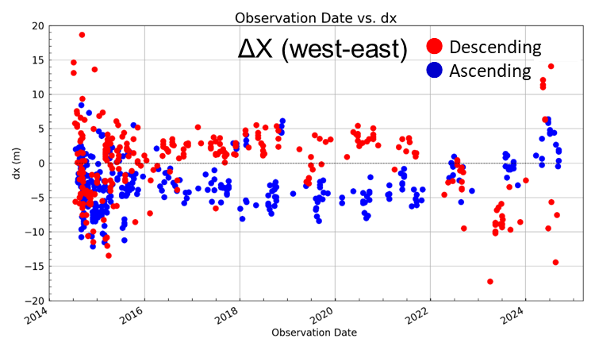
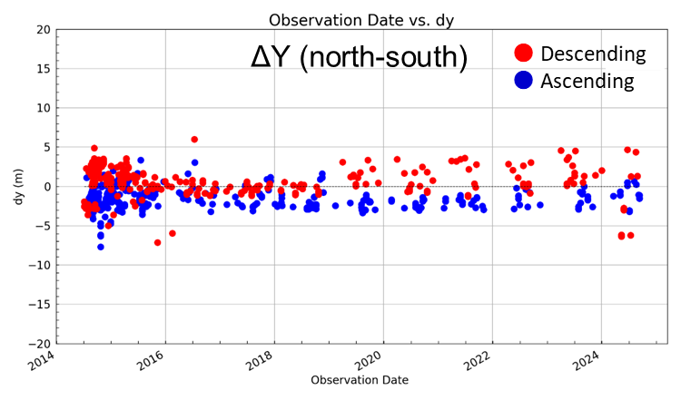
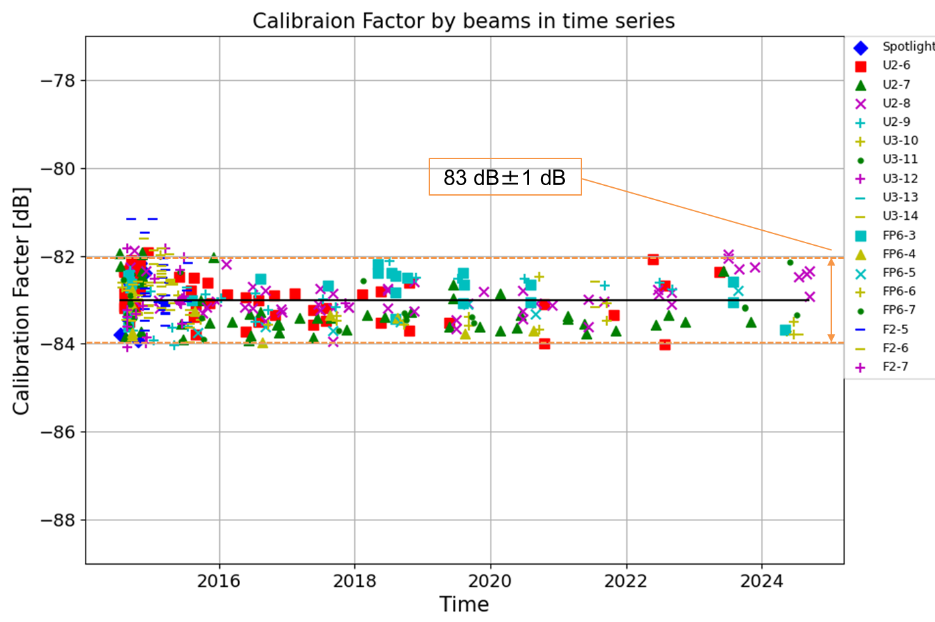
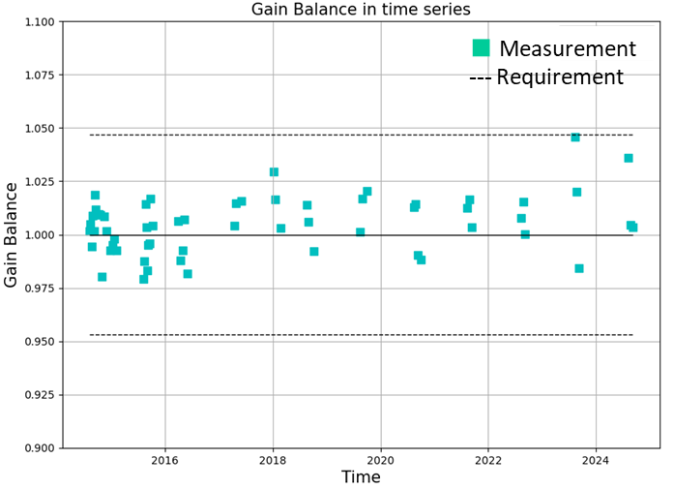
Agency's Calibration Major Updates
(3) ALOS-2 Calibration over 10 years
ALOS-2 currently continues to operate smoothly by PALSAR-2, which is an L-band SAR and suitable for monitoring disasters, forest, agriculture, and infrastructures.
As the calibration activities, geometric accuracy, radiometric accuracy, and polarimetric accuracy of the standard product are regularly evaluated, and the resolution, sidelobe level, noise equivalent sigma zero (NESZ), ambiguity, etc. are measured as the image quality evaluation.
Due to increasing the total electron content (TEC) in ionosphere from 2022, degradation of the geometric accuracy were confirmed. It is necessity to continuously monitoring.
2014
10 years
2024
ALOS-2/PALSAR-2 geometric accuracy
2014
10 years
2024
(b) Time trend of the gain imbalance of VV/HH polarizations.
(a) Time trend of the radiometric accuracy.
ALOS-2/PALSAR-2 radiometric and polarimetric accuracies
10

Slide 11

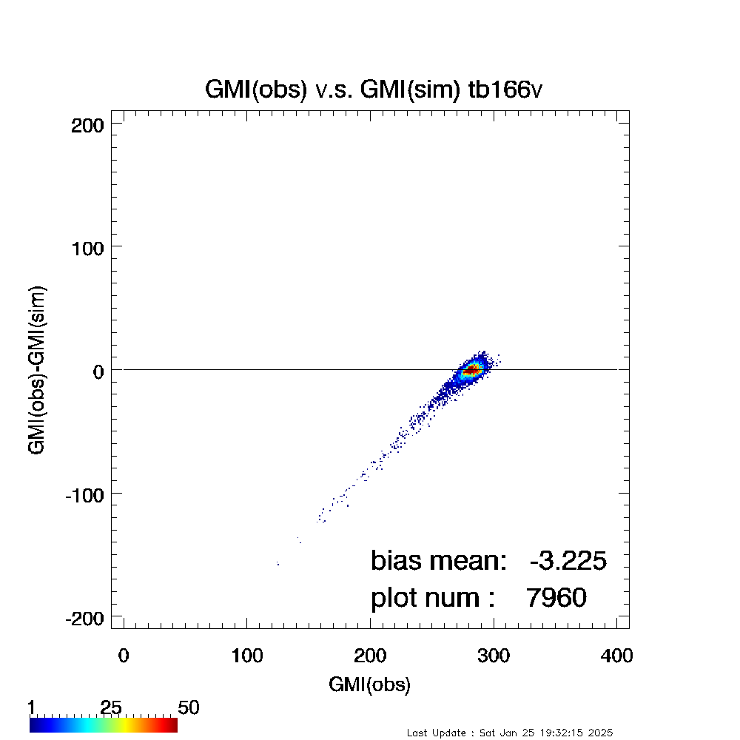
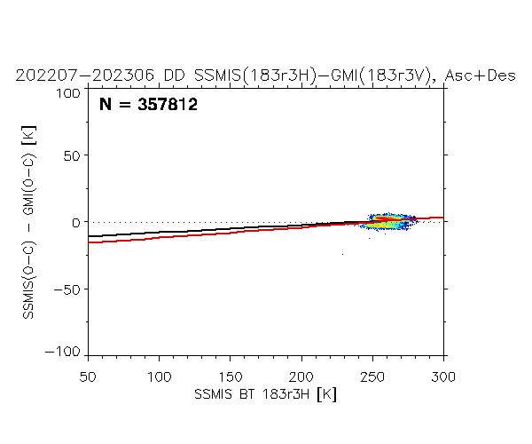
Agency's Calibration Major Updates
(4) Cross-calibration toward AMSR3
①Double Difference
  Inter-satellite calibration using GMI ( & SSMIS for polar regions).
  This method has been used for low-frequency cross-calibration during AMSR-E/2.
② Calibration method using radiosonde observations
  Calibration is performed by comparing the GMI observed Tb with the Tb simulated by the radiative transfer model (RTTOV ver.13) using radiosonde observations (temperature, water vapor, and pressure profiles) as input
  Only data with sufficient water vapor (TPW > 20 kg/m²) are used for calibration to eliminate the influence of land surface radiation.
  Only data with Tb within 3σ are used for calibration to eliminate the influence
  of scattering by clouds and precipitation.
Details were presented by
M. Kachi at MW Break-out Session, Wed. am., Mar-19
Method ①
Observed Tb and simulated Tb agree well in clear sky
Method ②
Double Difference between
GMI and SSMIS
Comparison of GMI Tb and simulated Tb from sonde observation
183±3 GHz
ー：Ocean & Land
ー：Ocean only
Cloud area in geostationary satellite image
11

Slide 12
Agency’s Personnel Supporting GSICS
Points of contacts/meeting participants:
  EP Focal Point: Misako Kachi
  GRWG members: Hiroshi Murakami (optical & IR imager) , Misako Kachi (MW), Kei Shiomi (UVN-S)
  Other Key Agency Personal
    GHGs: Hiroshi Suto
    SAR: Takeo Tadono
    Precipitation radar: Takuji Kubota & Kosuke Yamamoto
    MW: Keiichi Ohara
    Overall coordination: Toshiyuki Kurino

