Slide 1



GSICS Agency Report 2025
TAKAHASHI Masaya, KOYAMATSU Shin
and EIKI Misaki
Japan Meteorological Agency / Meteorological Satellite Center

Slide 2
Summary of JMA GSICS Activities and Actions
Ongoing Activities
Himawari-8/-9 AHI VNIR Ray-matching inter-cal.: algorithm update (e.g., use of low radiance data)
AHI VNIR vicarious cal: input data transition from MODIS to VIIRS
AHI VNIR Lunar cal: improving observed irradiance computation
AHI IR inter-cal: algorithm update (e.g., use of LoS vectors for collocation)
Preparation for Himawari-10 VIS/IR imager (GHMI) and IR sounder (GHMS) inter-cal: just started
Response to open actions
A.GVNIR 20240313.12: JMA to report AHI Ray-matching result at the future web meeting.
To be reported in 2025/2026 web meeting
A.GDWG.20240313.5: Masaya to collect new codes of GSICS deliverable filenaming to be added in Common code table C-13 of WMO Manual on Codes.
To be reported at GDWG Session
A.GDWG.20240313.6: Masaya to work on update of GSICS SRF Convention if GRWG requires any updates.
To be reported at GDWG Session

Slide 3
JMA Support to EP Activities
Response to the decision at 2024 EP Meeting
D.GEP. 20240315.1: Agencies to provide biases of their monitored instruments in Machine-readable format for Geostationary Satellites
Himawari-8/-9 AHI VNIR and IR inter-calibration results are available on JMA/MSC website
IR: https://www.data.jma.go.jp/mscweb/data/monitoring/gsics/ir/monit_geoleoir.html
VNIR Vicarious: https://www.data.jma.go.jp/mscweb/data/monitoring/gsics/vis/monit_visvical.html
VNIR Ray-matching: https://www.data.jma.go.jp/mscweb/data/monitoring/gsics/vis/raymatch/monit_visraymatch.html

Slide 4
JMA Support to GRWG Activities
VNIR
Ray-matching (routinely monitored)
Himawari-8/-9 AHI vs. S-NPP/NOAA-20 VIIRS => Talk on VNIR Session (M. Takahashi)
Vicarious calibration (routinely monitored)
Himawari-8/-9 AHI using Terra/Aqua MODIS L1B and S-NPP/OMPS TCO as inputs for water clouds RT calculation. Transition of MODIS to VIIRS is underway. => Talk on VNIR Session (M. Eiki)
Lunar
Himawari-8/-9 AHI using GIRO. AHI inter-cal. vs. MODIS, lunar radiance cal., and MTF evaluation were tested before, but recently no updates.
DCC
Himawari-8/-9 AHI vs. Aqua MODIS is tested offline.
IR
GEO-LEO (routinely monitored)
Himawari-8/-9 AHI vs. Metop-A/-B/-C IASI, Aqua AIRS, S-NPP/NOAA-20 CrIS. => Talk on IR Session (S. Koyamatsu)
GEO-GEO
Himawari-8/-9 AHIs during parallel observation period was investigated.

Slide 5
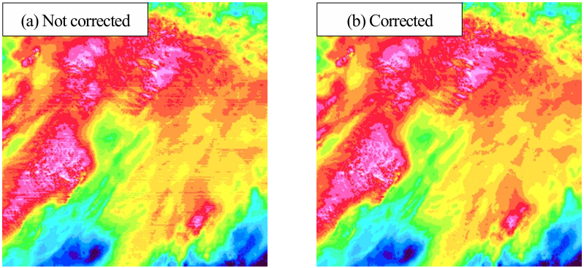
JMA Calibration Major Updates
Reduction of stripe noise for bands 1 to 4 (0.47/0.51/0.64/0.86 μm) of Himawari-9/AHI
To be implemented on 24 March 2025
AHI's north-south (NS) scan data are used to estimate responsivity differences among detectors and to correct radiances for destriping
Announcement is available on JMA/MSC website: https://www.data.jma.go.jp/mscweb/en/index.html
Band 1 reflectivity for cloudy areas in full-disk imagery at 15:10 UTC on 6 August 2023

Slide 6
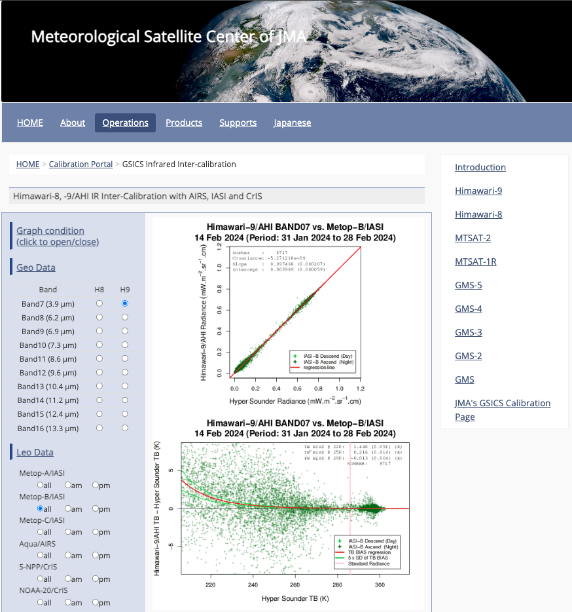
JMA Support to GDWG Activities
Lunar calibration
LSICS I/O data Convention
GSICS SRF Convention
Support to MW instruments
JMA GPRC webpage
Calibration landing page
Instrument info (e.g., SRF)
Event logging
IR re-calibration info (GMS to MTSAT-2)
AHI monitoring pages
VNIR Ray-matching
VNIR Vicarious cal.
GEO-LEO-IR
Talk on GDWG Session
(M. Takahashi)

Slide 7
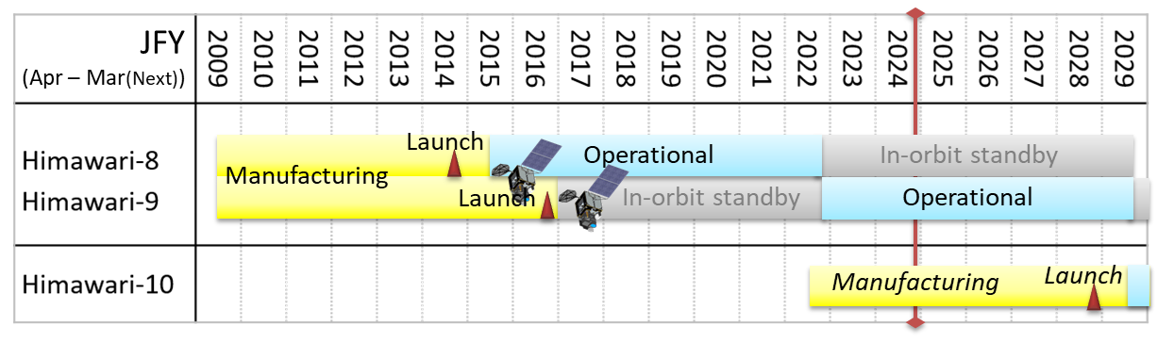
Instruments Updates
Himawari-8 and -9
Instrument: 16-band VIS/IR imager (AHI: Advanced Himawari Imager)
Operation
Himawari-8: 7 Jul. 2015 to 13 Dec. 2022, currently in-orbit standby (backup of Himawari-9)
Himawari-9: 13 Dec. 2022 to JFY 2029
Himawari-10
Instruments
18-band VIS/IR imager (GHMI: Geostationary HiMawari Imager)
IR sounder (GHMS: Geostationary HiMawari Sounder)
Radiation Monitors for Space weather (RMS), GFE by NICT
Operation: to be started in JFY 2029

Slide 8
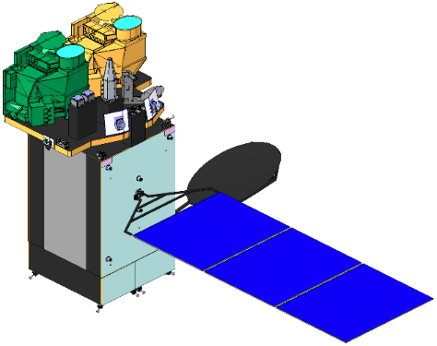
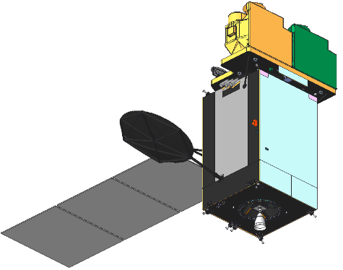
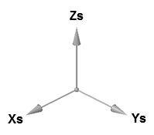
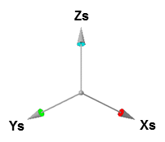
Himawari-10 Overview
JMA contracted manufacturing of Himawari-10 in March 2023, with initiation of operation scheduled for JFY 2029.
Design lifetime
10-y observation + 5-y on-orbit storage
Geostationary position
At around 140.7 deg. E
Missions
Geostationary HiMawari Imager (GHMI)
Geostationary HiMawari Sounder (GHMS)
Data Collection System
Radiation Monitors for Space weather (RMS)
Measures proton & electron flux in geostationary orbit, as a government furnished equipment by NICT.
Satellite Outline
GHMS
GHMI
RMS
Satellite Design
Spacecraft | MELCO standard DS2000 bus
Mass (approx.) | 2.4 t (dry), 6.1 t (with propellant)
Size (approx.) | 4 m x 3 m x 6 m (folded), 11 m (deployed)
Design life | ≥ 15 years (mission period ≥ 10 years)
Communications | Ka-band: Mission data downlink Ku-band: TT/C uplink & downlink UHF-band: DCP uplink

Slide 9
Geostationary HiMawari Imager (GHMI)
GHMI Spectral Band Characteristics
L3Harris’s new 18-band VIS/IR imager based on the same concept with its GeoXO Imager (GXI)
Observing sequence & band configuration changed for Himawari-10
Values in the tables show JMA requirements
 | Center Wavelength [µm] | Bandwidth [µm] | Spatial Resolution at Nadir [km]
VIS | 0.46 - 0.48 | ≤ 0.07 | ≤ 1
 | 0.54 - 0.56 | ≤ 0.05 | ≤ 1
 | 0.63 - 0.65 | ≤ 0.12 | ≤ 0.5
NIR | 0.85 - 0.87 | ≤ 0.06 | ≤ 1
 | 1.375 - 1.385 | ≤ 0.04 | ≤ 2
 | 1.60 - 1.62 | ≤ 0.08 | ≤ 2
 | 2.24 - 2.27 | ≤ 0.06 | ≤ 2
IR | 3.75 - 3.95 | ≤ 0.50 | ≤ 1
 | 5.10 - 5.20 | ≤ 0.20 | ≤ 1
 | 6.05 - 6.45 | ≤ 1.20 | ≤ 2
 | 6.90 - 7.00 | ≤ 0.50 | ≤ 2
 | 7.27 - 7.43 | ≤ 0.60 | ≤ 2
 | 8.44 - 8.76 | ≤ 0.50 | ≤ 2
 | 9.55 - 9.70 | ≤ 0.50 | ≤ 2
 | 10.3 - 10.5 | ≤ 0.90 | ≤ 2
 | 11.1 - 11.3 | ≤ 1.00 | ≤ 2
 | 12.25 - 12.55 | ≤ 1.20 | ≤ 2
 | 13.2 - 13.4 | ≤ 0.70 | ≤ 2
Improvement from Himawari-8/9 AHI
GHMI Observing Area & Interval
Observing Area | Minimum Coverage | Interval
Full Disk |  | 10 min
Japan | EW 2500 km x NS 2000 km | 2.5 min
Target Area1 | EW 1000 km x NS 1000 km | 2.5 min
Target Area2 |  | 2.5 min
Target Area3 |  | 2.5 min
Target Area4 |  | 2.5 min
Target Area5 (*) | EW 1000 km x NS 500 km | 30 sec
*Mainly used for CAL/VAL activities

Slide 10
Geostationary HiMawari Sounder (GHMS)
L3Harris’s new infrared FTS
Values in the tables show JMA requirements
GHMS Observing Area & Interval
GHMS Spatial & Spectral Characteristics
Observing Area (minimum coverage) | Interval
Sounding Disk (LZA ≤ 60 deg) | 60 min
Japan (EW 2500 km x NS 2000 km) | 15 min*
Target Area (EW 1000 km x NS 1000 km) | 15 min
Spatial (horizontal) Resolution |  | ≤ 4.2 km
Spectral Coverage | LWIR | 680 - 1095 cm⁻¹ (14.7 - 9.13 µm)
 | MWIR | 1689 - 2250 cm⁻¹ (5.92 - 4.44 µm)
Spectral Resolution (FWHM) |  | ≤ 0.754 cm⁻¹
Spectral Sampling Distance |  | ≤ 0.625 cm⁻¹
* Sounding Disk observation over Japan area is regarded as one of the "Japan" observations in the 60-min repeat cycle (i.e., three "Japan" observations to be conducted in 60 minutes).

Slide 11
Thanks for your attention!

Slide 12
Additional Slides not Presented
Introduce/Confirm the Agency’s Personnel supporting GSICS

Slide 13
Personnel supporting GSICS
EP
OMORI Shiro (new)
GRWG
TAKAHASHI Masaya
VNIR Ray-matching, Lunar, IR, GEO-GEO
KOYAMATSU Shin (new)
IR
EIKI Misaki
VNIR vicarious calibration (RTM approach using LEO)
GDWG
TAKAHASHI Masaya
GPRC Points of contacts for operational matters
TAKAHASHI Masaya

