Slide 1
GSICS Agency Report
2025
Mounir Lekouara and EUMETSAT team (see last slide)
EUMETSAT

Slide 2
MTG-I1 major events
FCI Level-1c is operational since December 2024
LI Level-2 (flashes) is operational since October 2024
FCI Level-2 is pre-operational

Slide 3
EUMETSAT operational GSICS products
20 IR products for SEVIRI, AVHRR, HIRS, MVIRI
Covering both IR and VIS-NIR
16 operational (IR)
No plans for GSICS products for other present of future monitored instruments (FCI, OLCI, SLSTR, IASI, LI, IRS, UVN, METimage, 3MI, IASI-NG, UVNS, CO2I, MAP, CLIM)
EUMETSAT initiated a review of its GSICS correction coefficients files products and is considering discontinuing them in favour of a more comprehensive public data quality monitoring system (MATRICS).

Slide 4
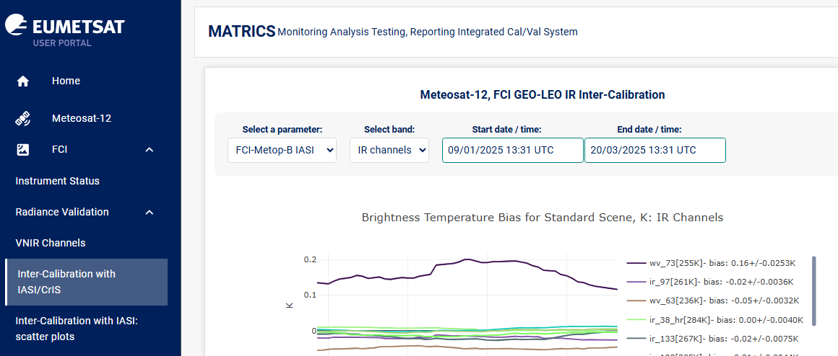
MATRICS

Slide 5
Support to GRWG Activities (i)
Led or contributed to discussions at Web Meetings on:
  Lunar Calibration R&D (LSICS developments).
  VNIR DCC + desert PICS IR: hot-land issue + uncertainty analysis
  MW:
    Focus Group definition - SNO & Vicarious inter-calibration focus group
    netCDF format for sharing SRF data

Slide 6
Support to GRWG Activities (ii)
Ongoing Developments:
  MTG-I FCI and LI are now routinely monitored
  VNIR:
    DCCs, using NOAA-20 VIIRS as a reference (application to all GEOs + SLSTR + OLCI)
    Desert Calibration + Inter-Calibration : two new algorithms for MICMICS
  Lunar:
    Involved in the discussions on LSICS framework + SLIM model as a new lunar calibration community model
    Set-up GitLab repository for LSICS development
    Enhancement of the LESSSR model (lunar model based on SCIAMACHY + RELAB) via external study (LESSR v2.0)
    Inter-calibration between SCIAMACHY and GOME-2 series using the Moon as a transfer target. Done via external study.
  IR:
    Development of improved IR inter-calibration algorithm ​
    MICMICS now facilitates IR inter-calibration, leveraging references from both IASI and CrIS
    EUMETSAT-ECMWF collaboration in preparing for MTG-IRS in NWP using GIIRS (-A/-B) observations
  MW:
    Supported development of work plan for Microwave SNO/Vicarious inter-calibration Focus Group​
  UV:
    Ongoing development and integration of radiometric calibration systems for UVN, UVNS & CO2-I in MICMICS
    Support to ESA project FDR4ATMOS to inter-calibrate SCIAMACHY and GOME-2 Earth data using the moon as a transfer target
See 2h
See 4d
See 5b
See 4d
See 4i
See 2h
See 2j
See 5b
See 7d

Slide 7
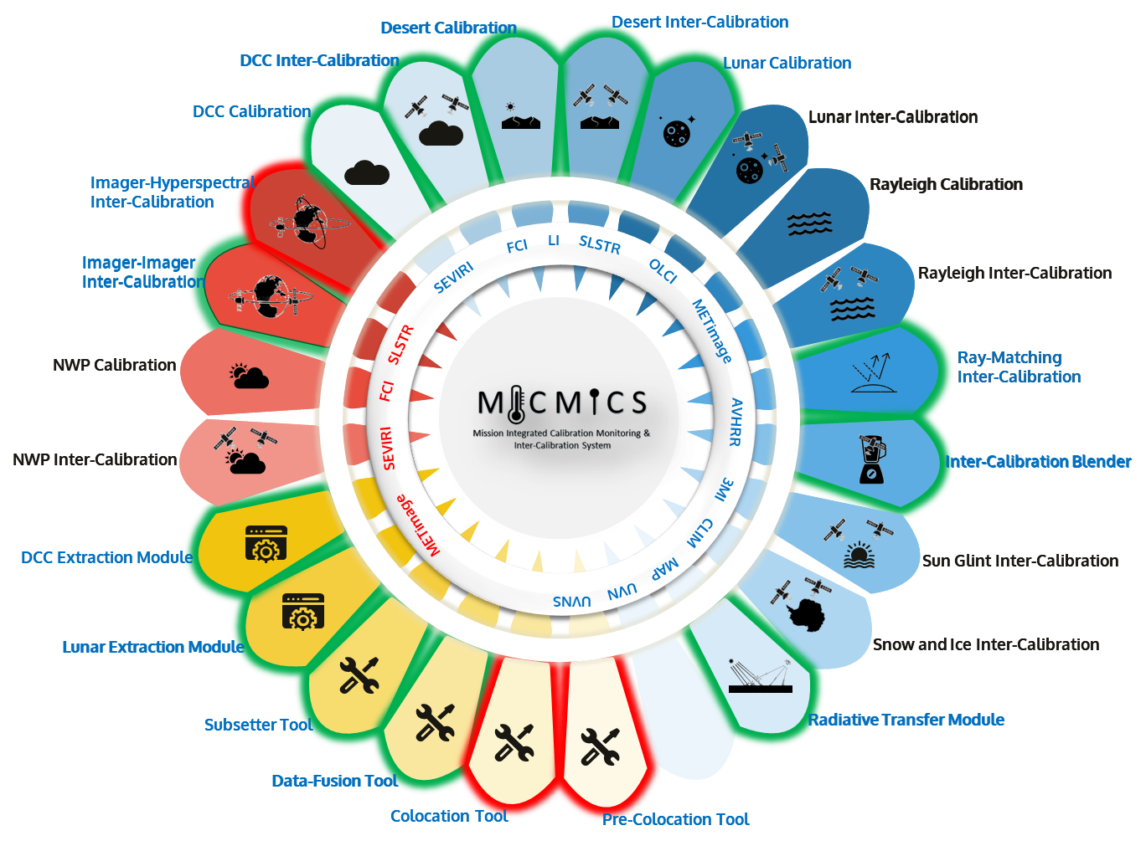
EUMETSAT Other GSICS Activities
MICMICS
  Prototype Development ongoing & Operational System started
  Replacing current GSICS processors is in progress
  New capabilities:
    New MTGI1-FCI IR gain retriever based on the GSICS GEO-LEO IR algorithm
    Lunar Extended Satellite Reflectance Model (LESSR) added to the Lunar Calibration System
    New Raymatching inter-Calibration
    Advancements in Desert Inter-Calibration
    Expanded instrument and channel processing: SEVIRI, FCI, LI, AVHRR, SLSTR, OLCI, METimage, UVN, UVNS, …
  The tool has reached a critical mass of methods and sensors to support new accurate diagnostics

Slide 8
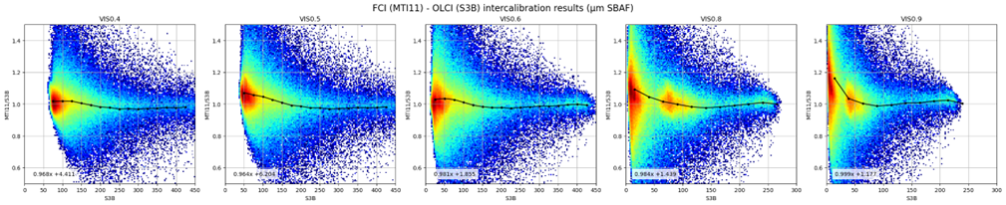
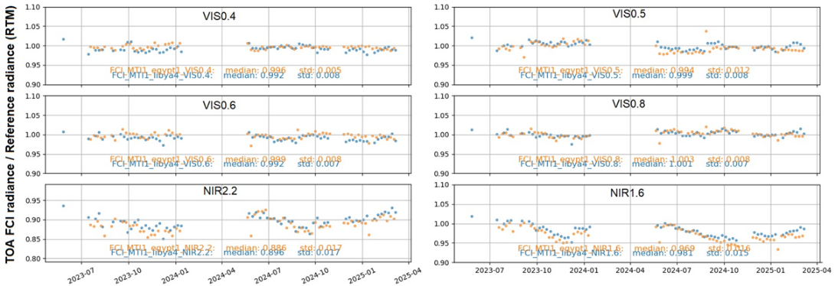

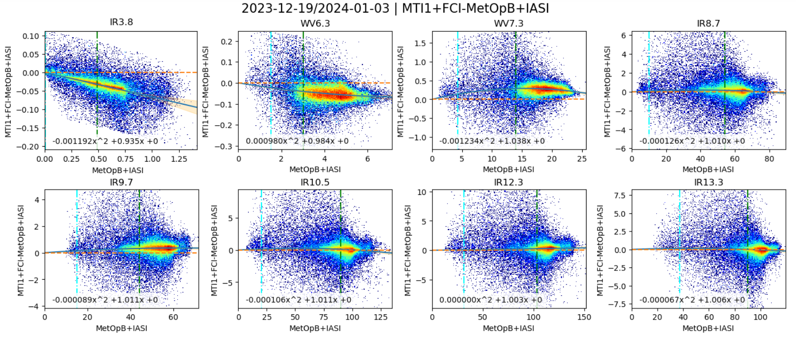
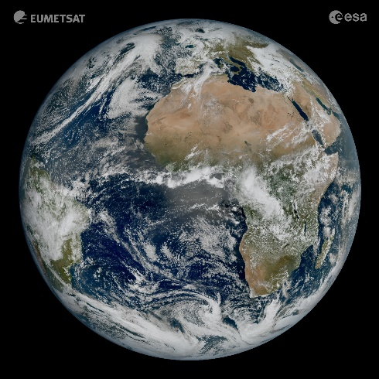
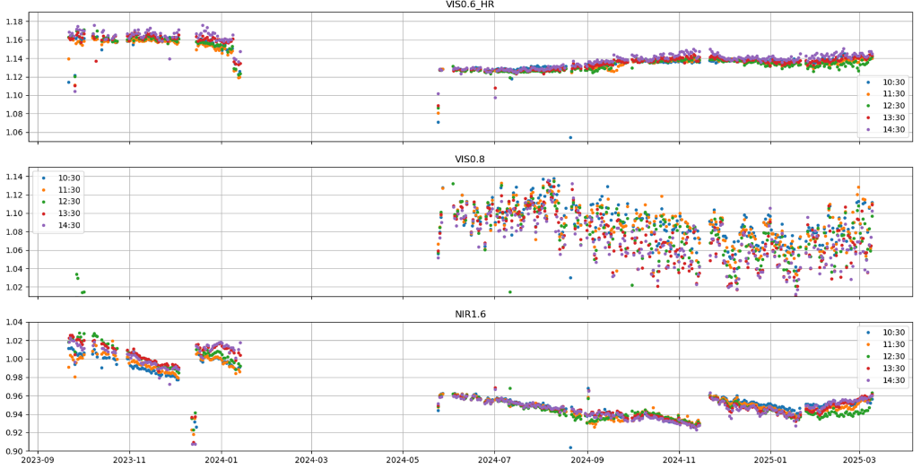


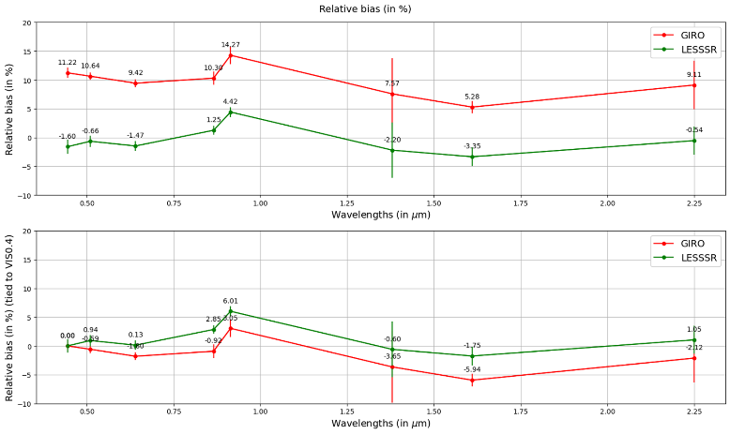
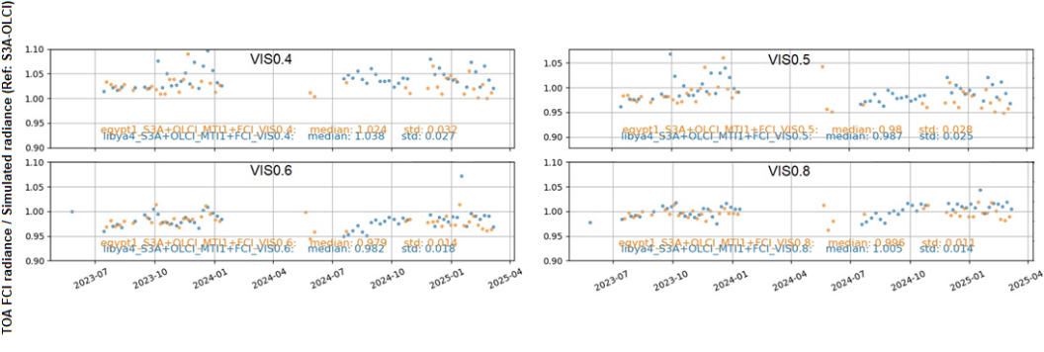



MICMICS analyses for MTG-I FCI
See 1k
Raymatching inter-calibration
DESCS
VNIR absolute calibration and Drift monitoring
IHIC
Monitoring IR channels
VNIR Drift monitoring GEO-GEO
VNIR Drift monitoring Desert Inter-Calibration
DESICS
VNIR Drift monitoring
LCS

Slide 9


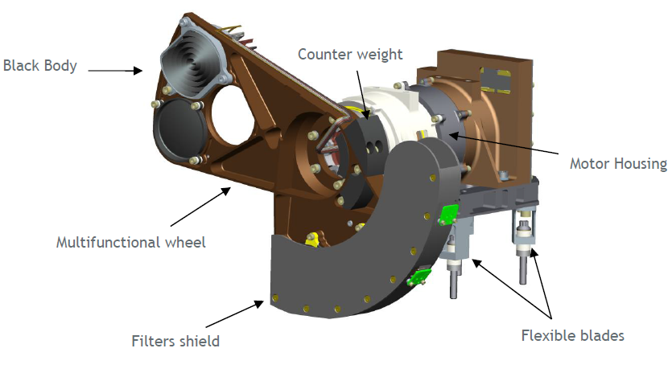
EUMETSAT Calibration Major Updates
SEVIRI VIS-NIR and SLSTR SWIR operational Level-1 products will be corrected (bias + drift) on the basis of MICMICS analyses by the end of 2025.
FCI IR is now continuously calibrated by the MICMICS implementation of the GEO-LEO (vs IASI)
An anomaly in the on-board drive electronics chain of the calibration mechanism of the MTG-I1 FCI was detected in January 2024.
The instrument resumed observation mode on 23 May 2024.
Current results of the investigation show that redundancy on the calibration and obturation mechanism of the FCI has been lost. In order to safeguard the quality of the data and the lifetime of the mission, EUMETSAT have decided to operate the instrument without the on-board calibration mechanism and relying on external calibration techniques.

Slide 10
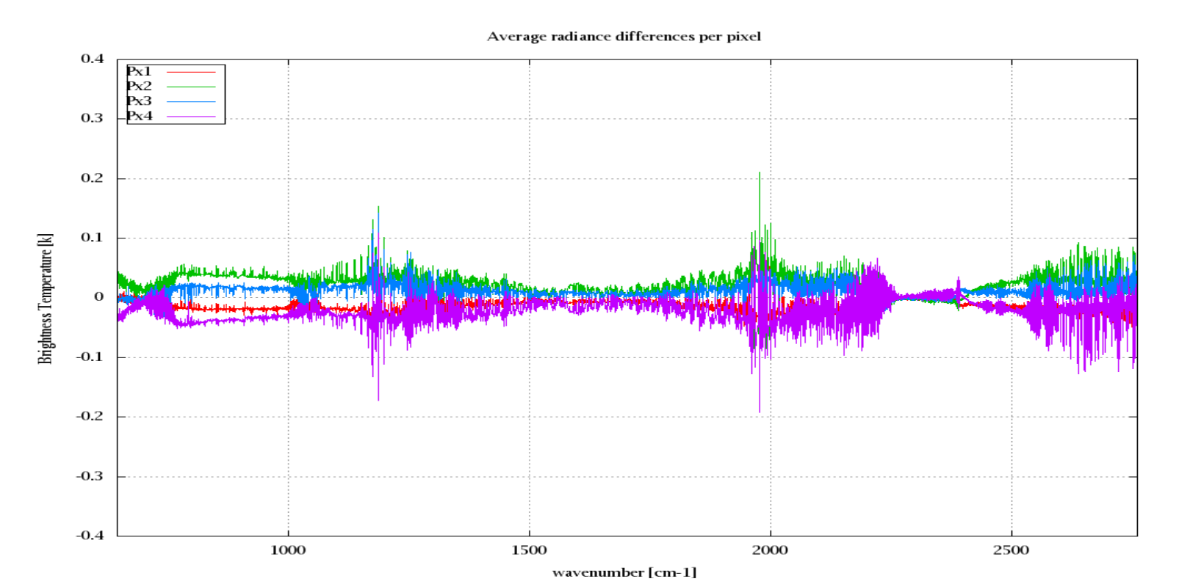
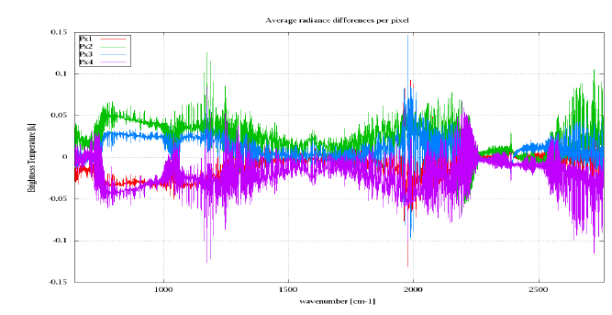
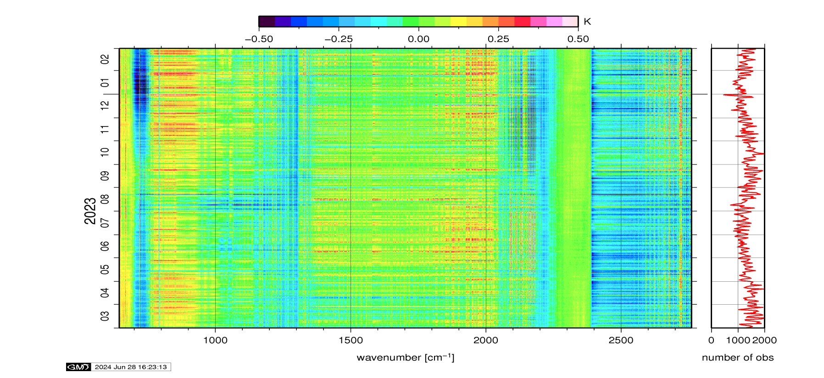
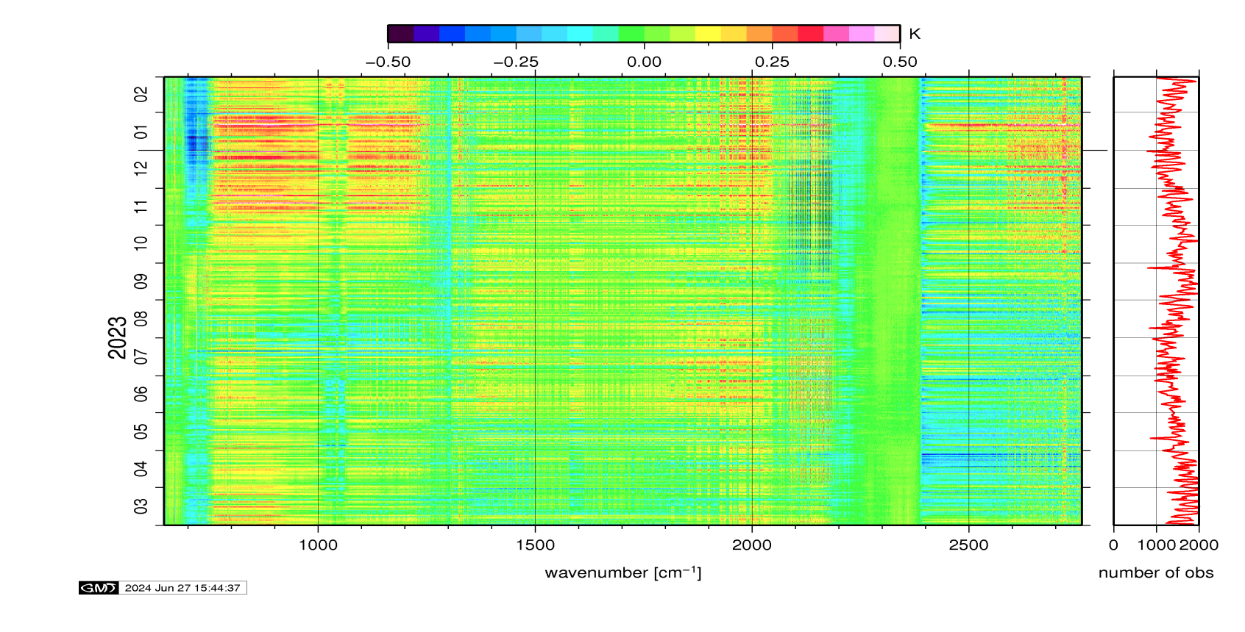
IASI status onboard Metop-B and -C
IASI/Metop-B:
The IASI PFM-R instrument is fully operational and its performance is still nominal. No degradation has been observed.
IASI/Metop-C:
The IASI FM3 instrument is fully operational and its performance is still nominal. No degradation has been observed.
+0.15
+0.15
Inter-pixels consistency
-0.15
-0.15
Radiances anomaly
over the last annual
period report

Slide 11
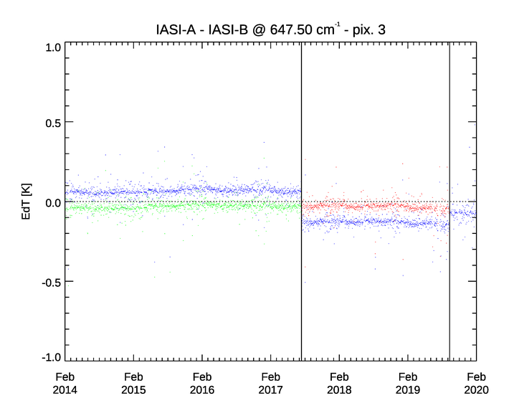
New IASI FCDR release 2.0
Motivation:
The on-board non-linearity (NL) correction has been improved for both IASI-A (in 2019) and IASI-B (in 2017) → But no reprocessing was possible until now;
EUMETSAT has developed a NL post-processing to be applied on the IASI L1c products → To restore the time consistency of the IASI radiance archive in the CO₂ band at 15 mm, as well as the consistency between the instruments.
Example of Pixel 3
The reprocessing has proven that:
The residual error of the on-board non-linearity correction has been corrected with the right order of magnitude;
The temporal consistency of the data record has been reinstated and the inter instrument difference between IASI-A and IASI-B has been corrected, removing the effects of the non-linearity correction update of the instruments in August 2017 and September 2019;
New IASI FCDR version 2 is available.
IASI-A – IASI-B
IASI-A_{rep} – IASI-B
IASI-A_{rep} – IASI-B=A_{rep}
IASI-B update
IASI-A update

Slide 12
Reprocessing activities
IASI FCDR Release 2 has been released (available from ops@eumetsat.int)
SSH FDR Release 1 (available from ops@eumetsat.int from 1 April 2025)
SEVIRI FCDR Release 1 will be available in May 2025, both IR and VIS calibration is updated (available from ops@eumetsat.int from 1 June 2025)
Harmonised Microwave Humidity Sounder FCDR (SSM/T2, AMSU-B, MHS, and ATMS) Release 1 will be released in June 2025 (available from ops@eumetsat.int from 1 July 2025)
OLCI L1 FDR R1 will be released in March 2025 (Available from ops@eumetsat.int from 1April 2025)

Slide 13
EUMETSAT mission planning
MANADATORY PROGRAMME
SATELLITE
2020
2025
2030
2035
2040
2045
2050
Meteosat Second Generation (MSG)
Meteosat-8
Meteosat-9
Meteosat-10
Meteosat-11
Upcoming launches in 2025!
MTG-S1: 1 July 2025
Metop-SGA1: 12 August 2025
Microcarb: June/July 2025
Sentinel-6B: 17 Nov 2025
Meteosat Third Generation (MTG)
MTG-I1
MTG-S1
MTG-I2
MTG-I3
MTG-S2
MTG-I4
EUMETSAT Polar System (EPS)
Metop-A
Metop-B
Metop-C
EUMETSAT Polar System - Second Generation
(EPS-SG)
Metop-SGA1
Metop-SGB1
Metop-SGA2
Metop-SGB2
Metop-SGA3
Metop-SGB3
OPTIONAL AND COPERNICUS PROGRAMME
Jason
Jason-3
Copernicus
Sentinel-3A
Sentinel-3B
Sentinel-3C
Sentinel-3D
Sentinel-6 Michael Freilich
Sentinel-6B
Sentinel-6C
Sentinel-6 NG
CRISTAL
CO2M
Notes:
This is possibly not exactly up to date but gives a clear view on EUMETSAT’s long-term / continuity planning

Slide 14
EUMETSAT presentations at GSICS 2025 meeting
session | item | title | presenter
miniconf | 1m | GRDW report | Mounir Lekouara
 | 1k | MTG-I1 entry into operational phase and MTG-S status | Mounir Lekouara
VIS/NIR + lunar | 2h | Challenges to calibrate MTG/FCI VIS/NIR channels with lunar observations | Sebastien Wagner
 | 2j | LESSR v2.0: an advanced new lunar reflectance model for monitoring spaceborne instruments with moon observations | Matthijs Krijger (Earth Space Solutions)
 | 4d | Monitoring the FCI VIS-NIR and LI Radiometric Performance Using Vicarious Calibration and Inter-Calibration | Ali Mousivand
 | 4i | Challenges and Lessons Learned in Vicarious Desert Calibration: A Critical Review | Ali Mousivand
 | 4k | Future of the EUM VIS-NIR GSICS products | Mounir Lekouara
IR | 5b | Monitoring the MTG-I1 FCI IR Calibration Using GSICS Inter-Calibration Algorithms | Ali Mousivand
 | 5h | Relative SRF retrieval -Application to Metop IASI | Pierre Dussarat
 | 10a | Future of the EUMETSAT GSICS IR products | Mounir Lekouara
UVN-S | 8c | Calibration and validation concept of the CO2I/NO2I instrument on-board the CO2M mission | Bernd Sierk
 | 8d | Current status of GOME-2 calibration & outlook for Sentinel-4 & Sentinel-5 | Rasmus Lindstrot
MW | 7d | Direct MW Radiometer Inter-comparison Method and Vicarious Calibration Focus Group Report | Tim Hewison
 | 7k | Introduction to the EPS-Sterna inter-calibration study | Tim Hewison
 | 7m | Vicarious Radiosonde Calibration Tool - VICIRS | Tim Hewison
 | 7o | Update on the cal/val plans for MWS - postponed to web meeting | Tim Hewison

Slide 15
BACKUP SLIDES

Slide 16
EUMETSAT instruments update: many new sensors to calibrate
mission | launch | instruments | GSICS sub-groups
MTG-I1 | 2022 | FCI | VIS-NIR and IR
 |  | LI | VIS-NIR
MTG-S1 | 2025 | IRS | IR
 |  | UVN | UVN spectrometers
EPS-SG A1 | 2025 | METimage | VIS-NIR and IR
 |  | 3MI | VIS-NIR
 |  | IASI-NG | IR
 |  | UVNS | UVN spectrometers
 |  | MWS | MW
EPS-SG B1 | 2026 | MWI | MW
 |  | ICI | MW
CO2M | 2027 | CO2I | UVN spectrometers
 |  | MAP | VIS-NIR
 |  | CLIM | VIS-NIR

Slide 17
Update on GSICS Actions on EUMETSAT
A.LCWS.2023.2i.3: EUMETSAT & NOAA to continue to develop LSICS spec & circulate, then iterate with group. Seb Wagner needs to check with EUMETSAT. (Actionee: S. Wagner – F. Yu / by 2024-03) – the LSICS development team was created and addressed this action (via regular meetings + communications). Documentation still to be done ➔ Action proposed to be reformulated on the need for documenting LSICS.
A.LCWS.2023.5a.2: Propose way forward with GSICS Lunar Observation Dataset (GLOD) (Actionee: S. Wagner by 2024-03) ➔ Point related to data sharing + infrastructure. Discussed with LSICS subgroup but no progress. Action proposed to be addressed in 2025.
A.GEP.20230630.9: Transfer GSICS report on the State of the Observing System in document format and set working environment for that (Actionee: T. Hewison – M. Bali / no date) - ongoing
A.GIR.20230301.7: EUMETSAT to revise uncertainty analysis for GEO-LEO IR v2 algorithm (Actionee: T. Hewison / by 2024-03) – to be closed
A.GMW.20230302.3: Brief MWSG on experience in developing GSICS products for IR channels of GEO imagers – and uncertainty analysis (Actionees: T. Hewison / by 2024-03) – to be closed
A.GVNIR.2020.16f.1: re-align GIRO and ROLO (Actionees: S. Wagner – T. Stone / 2021.03.01) ➔ LSICS/SLIM will replace GIRO. Action proposed to be closed
A.GVNIR.2020.16f.4: distribution list for the Lunar Cal Community – Action still open
A.GVNIR.2020.19g.2: LCWS actions/recom follow-on – Closed - in preparation of LCWS

Slide 18
EUMETSAT GSICS team
Executive Panel
Bojan Bojkov | EUMETSAT representative
Data Working Group
Simon Elliott | Global Data Exchange Expert
Research Working Group
Mounir Lekouara | incoming vice-chair of GRWG
Tim Hewison | MW Sub-Group PoC
Sébastien Wagner | VIS/NIR + Lunar calibration PoC
Rob Roebeling | Event logging
Rasmus Lindstrot | UVN spectrometers expert
Dorothée Coppens | Hyperspectral IR expert
Christophe Accadia Vinia Mattioli | Microwave experts
Rüdiger Lang | UVN spectrometers and VIS-NIR for CO2M
Viju John | FCDR, IR, MW
Ali Mousivand | MICMICS + Radiative Transfer Modelling + Desert Calibration
Bertrand Fougnie | VIS/NIR polarimetry
Point of Contact for Operational Matters
Simon Elliott

