Slide 1
GDWG Report
Paolo Castracane (Starion for ESA)
Manik Bali (NOAA/UMD)

Slide 2
Table of Contents
GDWG Overview: Membership, Actions
Breakout Session and Additional Section
Discussion and Outcomes
Plan for next year

Slide 3
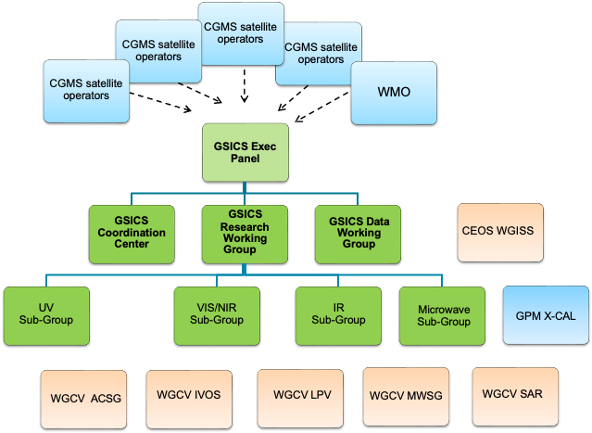
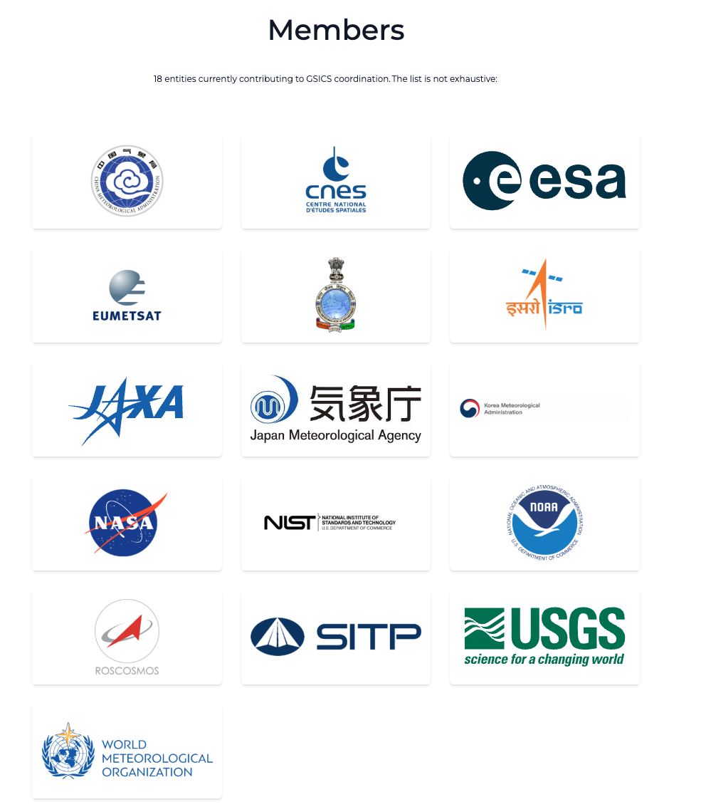

GDWG in the GSICS Framework
GDWG actively supports all aspects of GSICS activities
e.g . systems/metadata/products/wiki/GPPA
Detailed TOR here
Oversee and coordinate the data management activities of GSICS and advise the EP on questions related to GSICS data management including information delivery services

Slide 4
GDWG Membership
Affiliation | First Name | Last Name
CMA | Lin | Tian
ESA | Paolo | Castracane
EUMETSAT | Simon | Elliott
IMD | R.K. | Giri
IMD/Ministry of Earth Sciences | Kamaljit | Ray
ISRO | Nitant | Dube
JMA | Masaya | Takahashi
KMA | Hanbyul | Lee
NOAA | Manik | Bali
ROSHYDROMET | Sergey | Uspensky
WMO | Heikki | Pohjola
https://gsics.wmo.int/en/focal-points

Slide 5
Action 2024 Status [ 2024 ]
Action Id | Summary | Lead | Actual Completion | Deliverable Usage | Status
A.GDWG.20240311.2 | Paolo and Manik to coordinate with the SITsat group (CLARREO, LIBRA, TRUTHS) to define product format, also addressing the way uncertainties shall be reported in the products (with a special care on data volume). | Paolo/Manik | NASA would provide a sample data file |  | Closed
A.GDWD.20240312.1 | Manik Bali to define a format in which the agencies shall provide input for the SOS report. | Manik | Suggested |  | Closed
A.GDWD.20240312.2 | GRWG and GDWG to define a way forward for the generation of the SOS report. | Manik Bali | Script Developed |  | Closed
A.GDWG.20240312.4 | Paolo Castracane (ESA) to lead discussion with GCC and WMO on possible enhancement of GSICS websites following WGCV Cal/Val Portal as example. | Paolo Castracane | Ongoing |  | Open
A.GDWG.20240313.1 | CMA to post daily instrument bias on GPRC website in machine readable form. |  |  |  | Open
A.GDWG.20240313.2 | EUMETSAT (Simon Elliot) to provide IASI L1C reader to ISRO ( Pradeep Thapliyal ) : | Simon/Pradeep |  | Code provided | Closed
A.GDWG.20240313.4 | Paolo to coordinate with Manik on reducing overlap of webpage on solar radiance at ESA, NOAA/wiki and LASP. | Paolo |  |  | Open
A.GDWG.20240313.5 | Masaya to collect new codes of GSICS deliverable filenaming to be added in Common code table C-13 of WMO Manual on Codes. | Masaya |  |  | Closed
A.GDWG.20240313.6 | Masaya to work on update of GSICS SRF Convention if GRWG requires any updates. | Masaya |  |  | Closed
A.GDWG.20240313.7 | Take steps to integrate GSICS products into WIS | Manik | Exploring integration to EUMETSAT Data Server which is already WIS 2.0 active |  | Closed
A.GDWG.20240313.8 | Suggest format for storing daily bias following CF 1.5 CCC conventions | Manik | A.GDWD.20240312.1 |  | Closed
A.GDWG.20240313.9 | GDWG (NOAA) to find a method for digitally marking LSICS outputs that have been generated by the official GSICS code version and copies thereof and making them distinguishable from outputs that have been generated by LSICS code that has been modified. | Manik | Suggested API |  | Closed
R.GDWG.20240313.1 | CMA to link quality of reprocessed data related document on reprocessing website | Scott |  |  | Open

Slide 6
GDWG Additional Session Day 2 18 March 2025
18 March 2025 GDWG Additional Session
Time UTC+8 | Topic | Presenter | Agenda item
16:00 | GSICS Data and Product Server | Luca Garegnani (remotly) EUMETSAT | 11k
16:45 | Discussion | All
Draft Minute reported within GSCIS tempalte, including actions.
LG uploaded (GDWG Drive) the presentation with EUM Data Store references and documentations

Slide 7
GSICS Data and product Service outcomes from GDWG Additional Section 18 March 2025
Presentation by Luca Garegnani EUMETSAT
Advantages: Improved maintenance & security over THREDDS server.
Capabilities: Data filtering, visualization, download, API access and command-line utilities (via EUMDAC),
Performance: Nearly 100% availability, free & open access after registration for most of the data.
Data Organization: GSICS products can be a dedicated collection (excluding source/intermediate data).
Migration Impact (tentatively by Q3/Q4 2025):
Plotting tool replacement.
Updated pickup point links.
OPeNDAP access removal.
Transitional period to support both systems.
References Provided:
EUMETSAT Data Store
EUMETSAT Data Store user guide
EUMETSAT Data Access Client guide
Data Tailor guide

Slide 8
GSICS Data and product Service outcomes from GDWG Additional Section 18 March 2025
Discussion Points
Data Upload: Regular users cannot upload data directly (see actions for EUM and MB)
Latency Concern: Expected to be in minutes (TBC).
Update Alerts: Possible with system adaptation.
Public URL for products: Not available; login required for tracking & statistics.
WIS 2.0 Compatibility: Planned for summer 2025.
Third-Party Data: Already included in the system.
Data Policy & Agreements: Questions raised about agency agreements with EUMETSAT.
Account Registration: Open for all; personal or agency accounts discussed.
Action Items
LG to provide slides of his presentation (CLOSED)
LG to provide MB with the information to upload the data (e.g. sftp site)
MB to upload examples of GSICS datasets to test the system.
Eumetsat to provide Data policy agreement example and provide examples of relevant documentation e.g. Privacy Notice for data protection, legal information etc.
Agencies and WMO inquire whether data agreement needed for migration to the EUM data store.

Slide 9
GDWG Breakout Session
GDWG Breakout Session (Day 4 Thu 20 March)
Chair: Paolo Castracane /Co-Chair Manik Bali Minutes: Manik Bali
Time | Title | Presenter
9:00 | Welcome remarks from GDWG Chair | Paolo Castracane (in person) | 11a
9:15 | WMO – status of GSICS WMO website | Heikki Pohjola (in person) | 11b
9:30 | KMA GDWG Report | Hanbyul Lee (Virtually) | 11c
9:45 | JMA GDWG Report | Masaya Takahashi (in person) | 11d
10:00 | CMA GDWG Report - extended talk including CMA Server status | Lin Tian (in person) | 11e
10:30 | IMD GDWG Report | Asim Mitra (he replace Kamaljit). (in person) | 11f
10:45 | NOAA GDWG Report | Manik Bali. (in person) | 11g
11:00 | EUMETSAT GDWG Report | Simon Elliott (in person) | 11h
11:15 | ESA GDWG Report | Paolo Castracane | 11i
11:30 | Topics Discussion: GSICS Data and Product server; Future of GSICS intercalibration Products; SOS Report; Jupiter Notebook in GSICS. | All | 11j

Slide 10
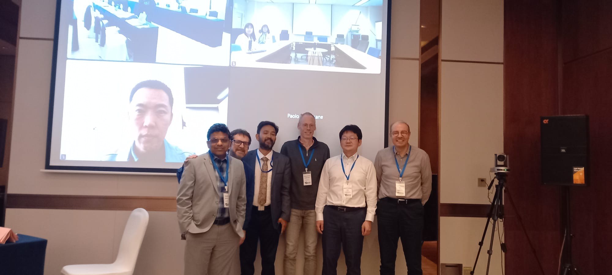
GDWG Group Photo - 20 March 2025, Changchun, China

Slide 11
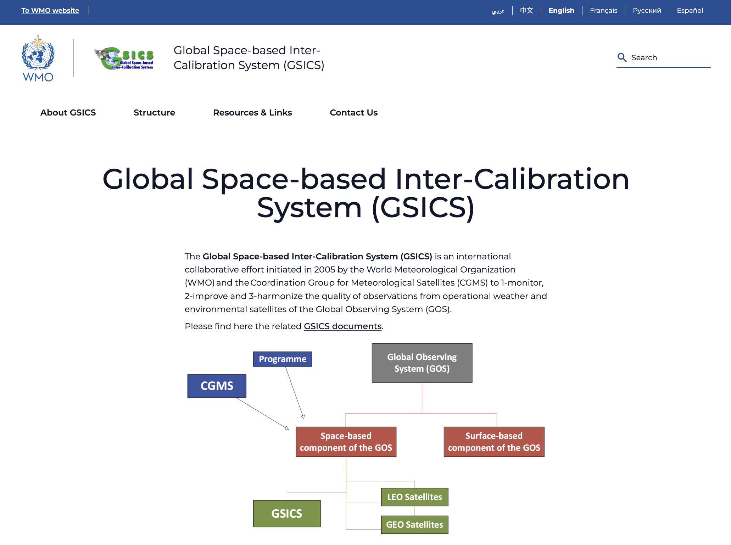
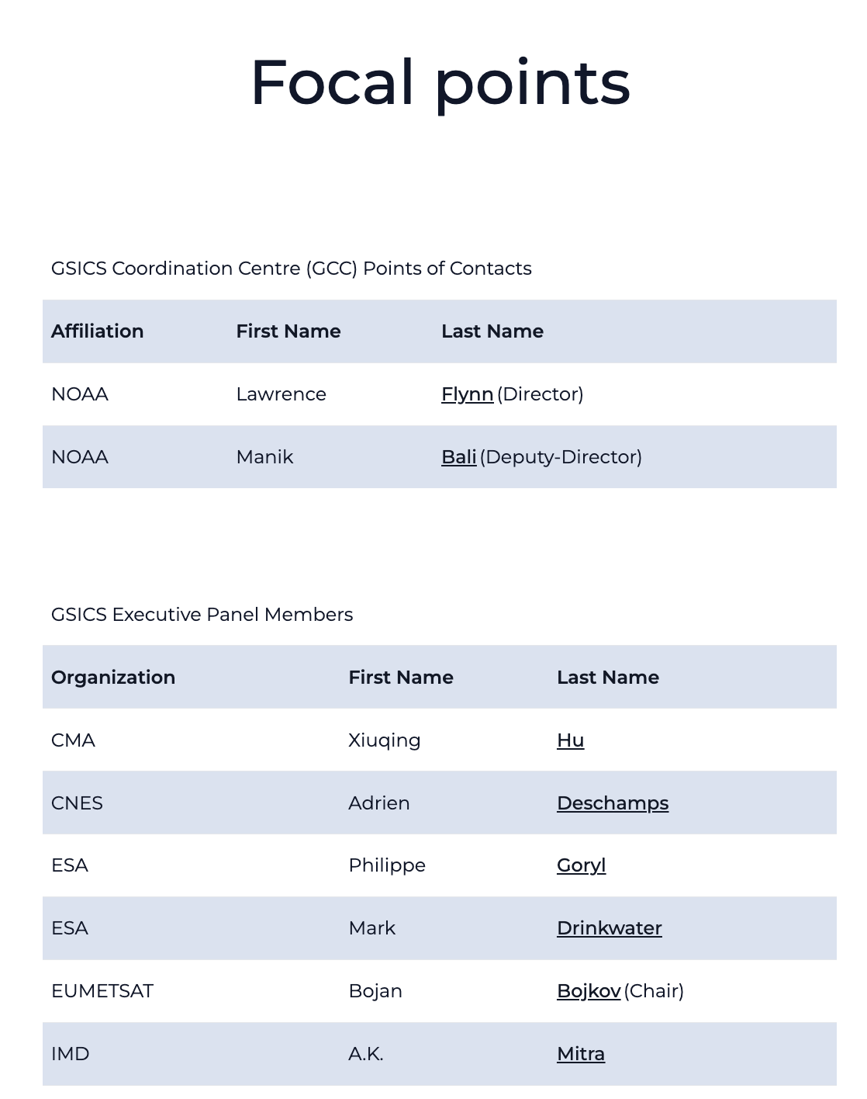
WMO Report - Heikki Pohjola
WMO GSICS website updates – still few technical issues.
Agency focal points may need to be revised
GSICS Resource Documents to be reviewed and updated, especially Terms Of Reference
GCC Website proposed templates provided
The importance of maintaining up-to-date intercalibration products and making them accessible on the GPRC website was emphasized
Glossary

Slide 12
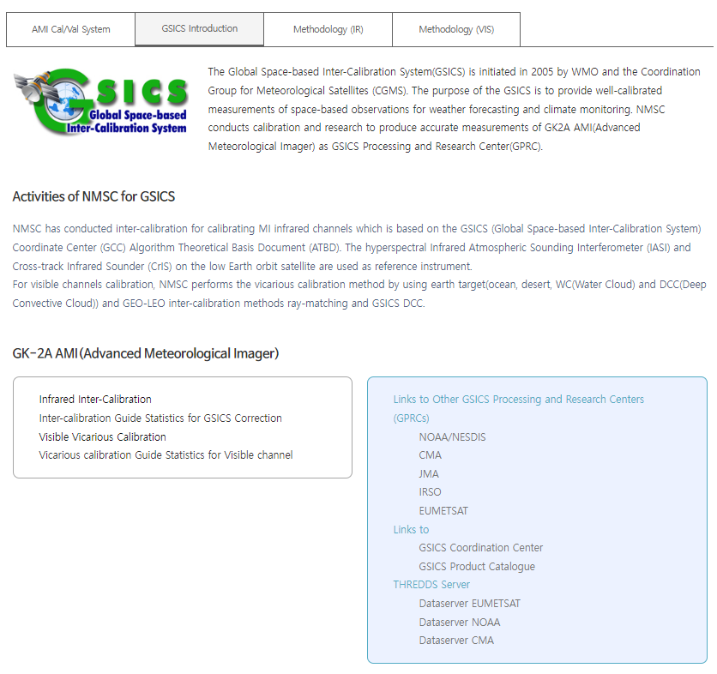
KMA Report - Hanbyul Lee
KMA’s GSICS Corrections
KMA GPRC web pages
Current Status
Near-Real Time Correction (NRTC)
GK2A / AMI / IR with reference to IASI(Metop-B/-C) and CrIS(S-NPP and NOAA-20/21) : Demo. phase
COMS / MI / IR with reference to AIRS(Aqua), IASI(Metop-A/-B): Demo. phase
Re-analysis Correction (RAC)
GK2A / AMI / IR with reference to IASI-B/-C and CrIS(S-NPP and NOAA-20/21) : Demo. phase
COMS / MI / IR with reference to IASI-A : Demo. phase
NRTC and RAC Correction Data is available in the EUMETSAT GSICS Server from Jan. 15, 2018
Landing page (ACVs)
https://nmsc.kma.go.kr/homepage/html/gsics/gsicsIntro.do (Korean, open)
http://nmsc.kma.go.kr/enhome/html/main/main.do (English, will be updated soon)
Monitoring page
IR (Metop-a/b/c IASI, NOAA-20/21, S-NPP CrIS)
VIS Ray Matching(Terra MODIS, S-NPP, NOAA-20/21 VIIRS)
VIS Lunar(GIRO)

Slide 13
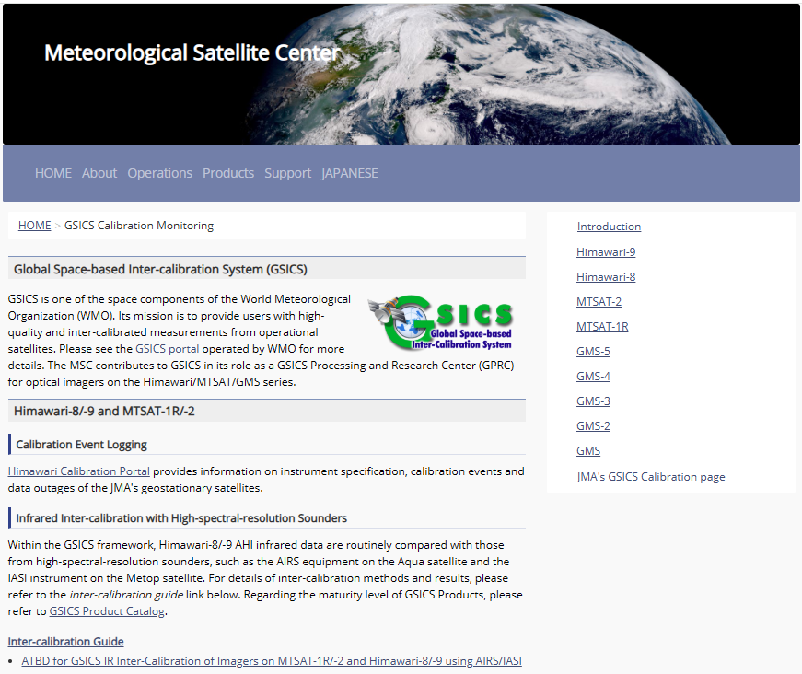
JMA GDWG Activities - Masaya Takahashi
Lunar calibration
Development of I/O data Convention for new lunar calibration framework (LSICS)
GSICS SRF Convention
Support to MW instruments
Maintaining JMA GPRC webpage
Calibration landing page
Instrument info (e.g., SRF)
Event logging
IR re-calibration info (GMS to MTSAT-2)
AHI monitoring pages
VNIR Ray-matching
VNIR Vicarious calibration
GEO-LEO-IR
https://www.data.jma.go.jp/mscweb/data/monitoring/calibration.html

Slide 14
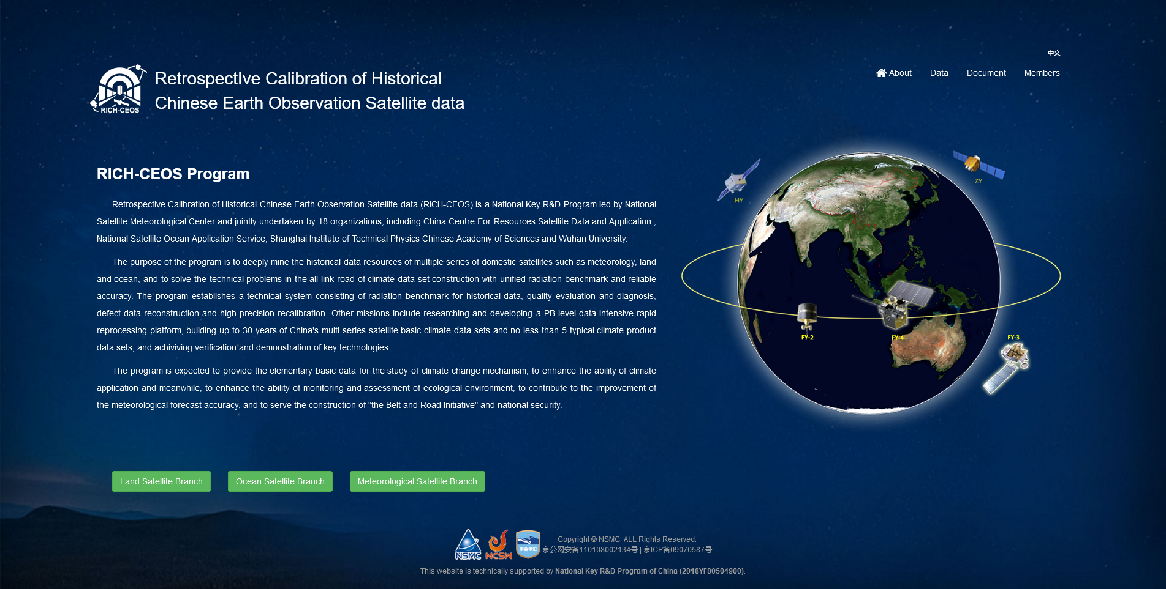
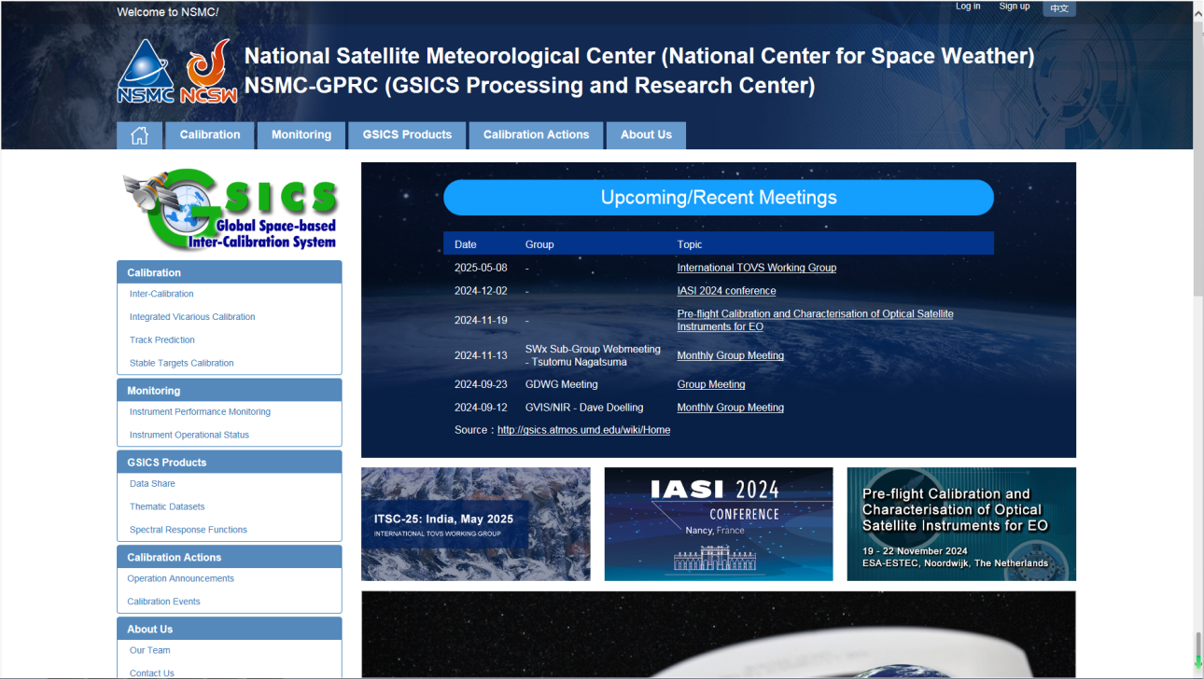
CMA Report - Lin Tian
RICH-CEOS Data Website
Keep CMA GPRC Website Content updating:
GPRC Information
CMA GSICS product sharing (Thredds)
FengYun Satellites Instrument Operation Status (Landing Pages）
CMA GDWG:
Website construction and maintain
New satellite data sharing
NSMC-GPRC Website Upgrade
Up to 30 years of basic climate data of China's multi series satellite such as meteorology, land and ocean.
Climate data sets constructed with unified radiation benchmark and reliable accuracy.
Approximately 300TB data available:
13 primary climate data sets,
9 thematic product data sets,
4 radiation reference data sets.
CMA has been updating its website
CMA GSICS Products are being uploaded on the THREADDS server
CMA will review and update this data to ensure it is current and machine-readable.
www.richceos.cn/record/en/index.html

Slide 15
IMD Activities Ashim Mitra
EUMETSAT Activities
Data processing updates
”Rapid” Tool updates
Cal/Val Portal updates
Activities included integration with WIS 2.0
WIS.2.0 compliant – IMD is the first Agency
EUMETSAT Data Store – Luca Garegani
Simon Elliot WIS 2.0 expert onboard

Slide 16
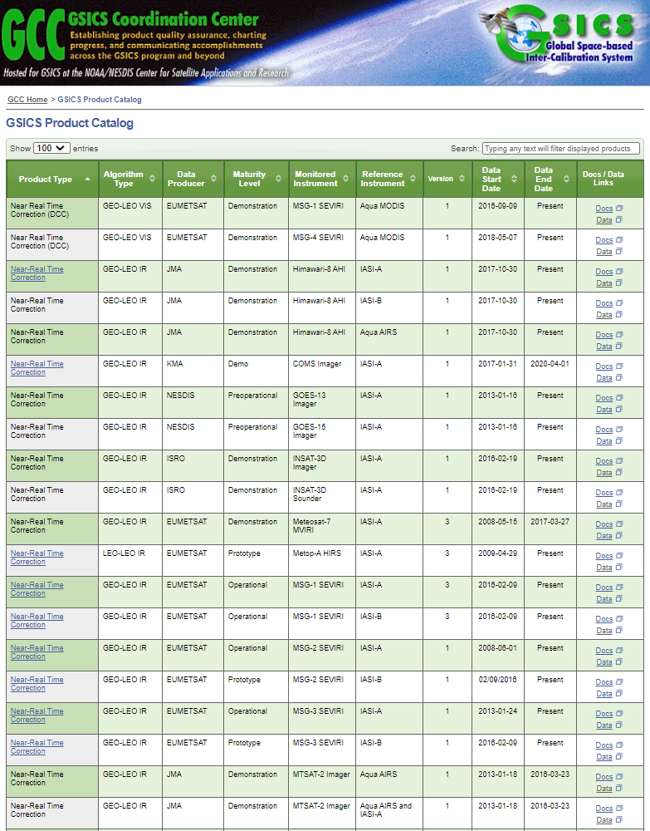
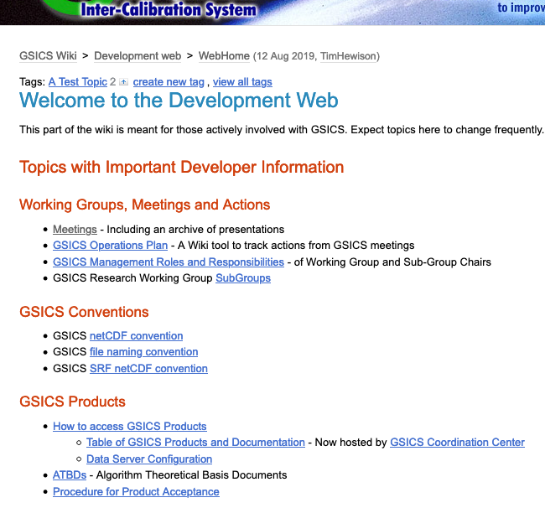
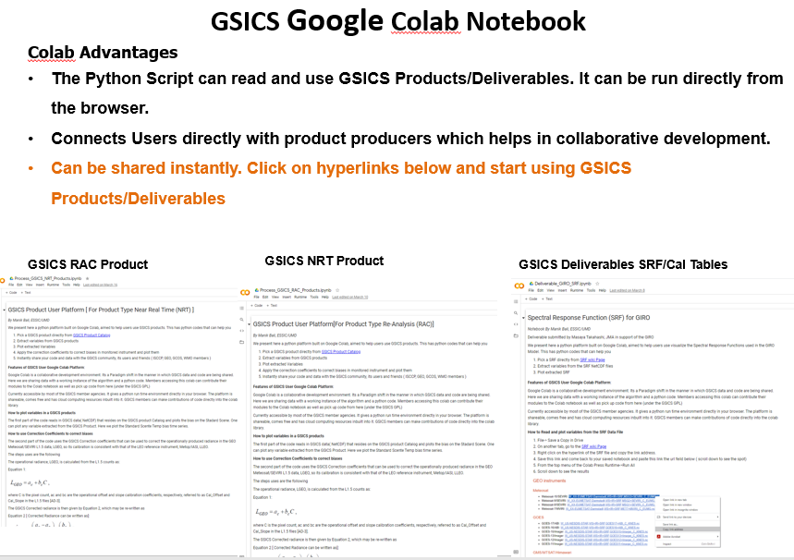
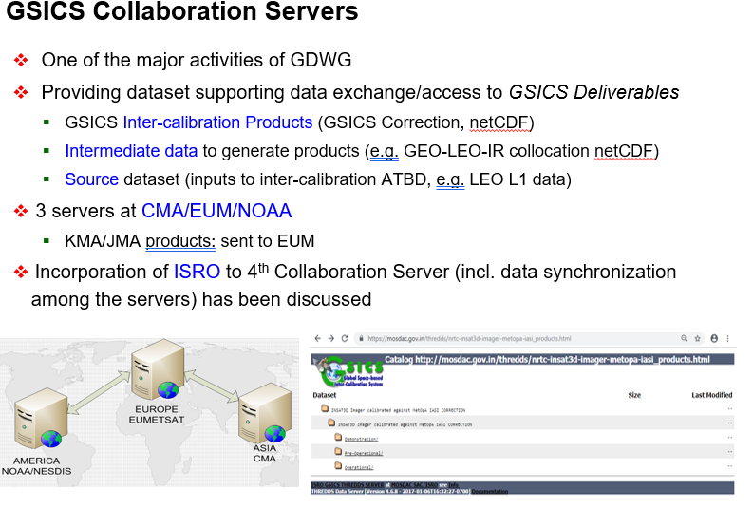
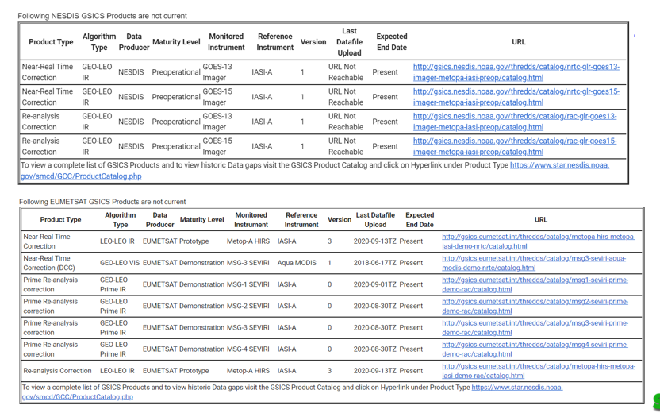
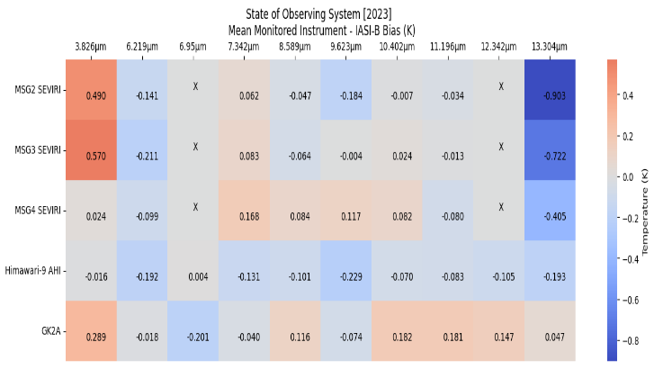
NOAA GDWG Activities – Manik Bali
GSICS Product Catalog
GSICS Wiki
GSICS Notebooks
THREDDS Server
Track GSICS products
State of Observing System Heatmap

Slide 17
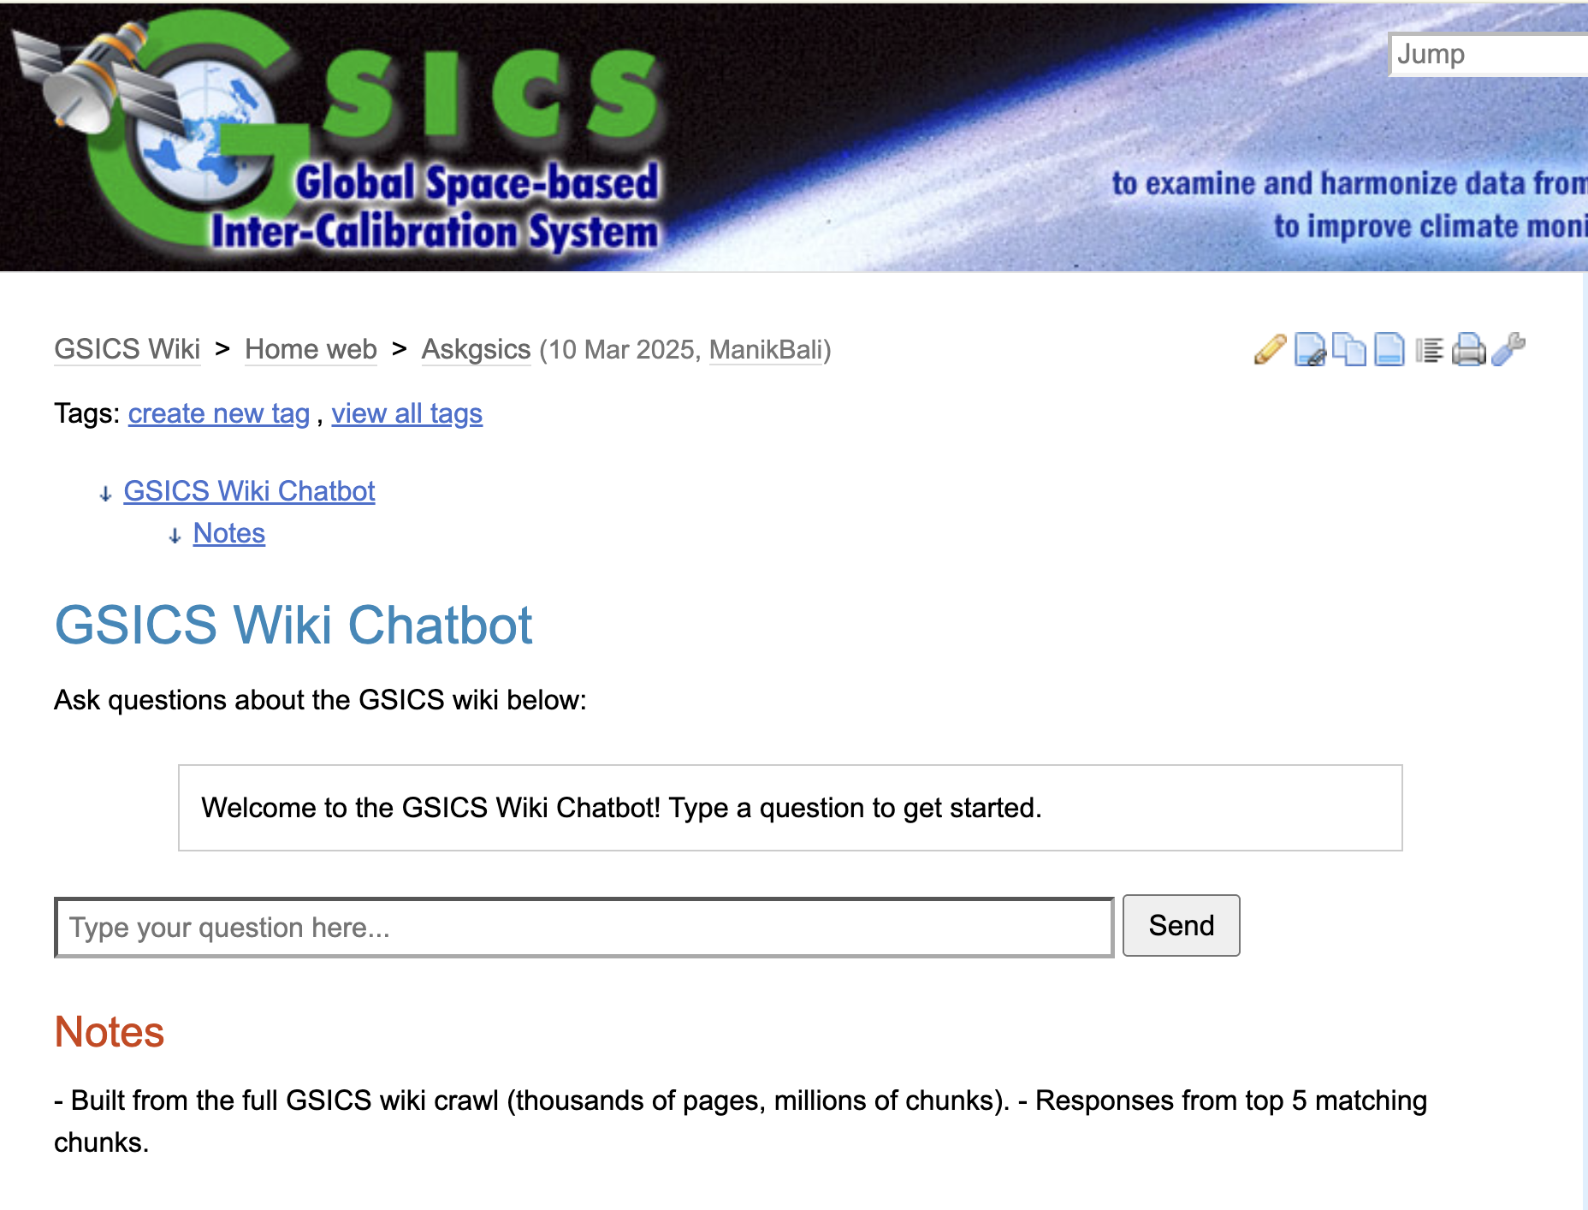
GSICS Wiki Chatbot
In addition to an update of the GSICS WIKI Website structure
Testing of different chatbot approach
We need your partecipation to build trusthable database

Slide 18
Summary GSICS tools
Bash script to download GSICS Data http://gsics.atmos.umd.edu/bin/view/Development/DownloadGSICSProducts
Series of notebooks to read, view and process GSICS Data and Deliverables from the browser in a collaborative ecosystem
DCC Product notebook
This notebook reads DCC products and plots and lists them
GIRO SRF notebook
GSICS Product RAC notebook and NRT notebook
3. Plotting Tool http://gsics.tools.eumetsat.int/plotter
4. GSICS Product Catalog: https://www.star.nesdis.noaa.gov/smcd/GCC/ProductCatalog.php
5. GSICS Product Status registration: Register here

Slide 19
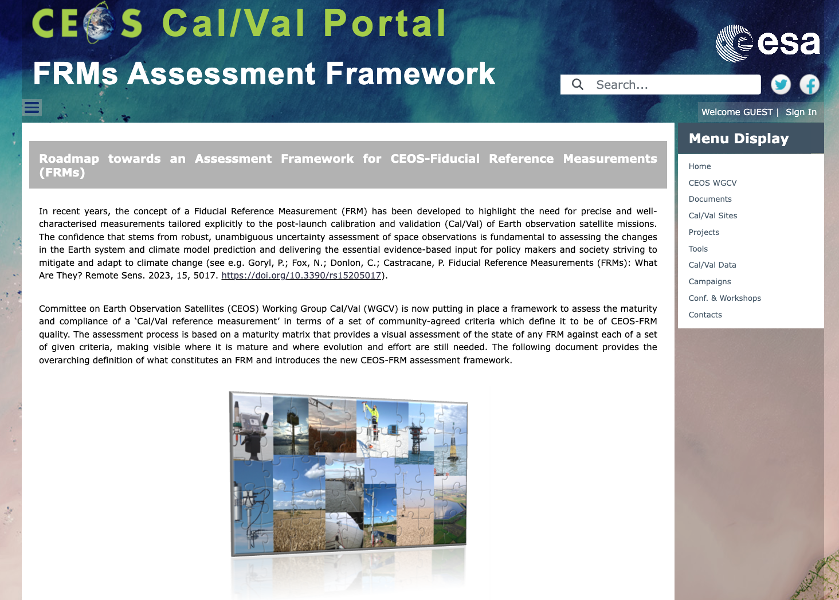
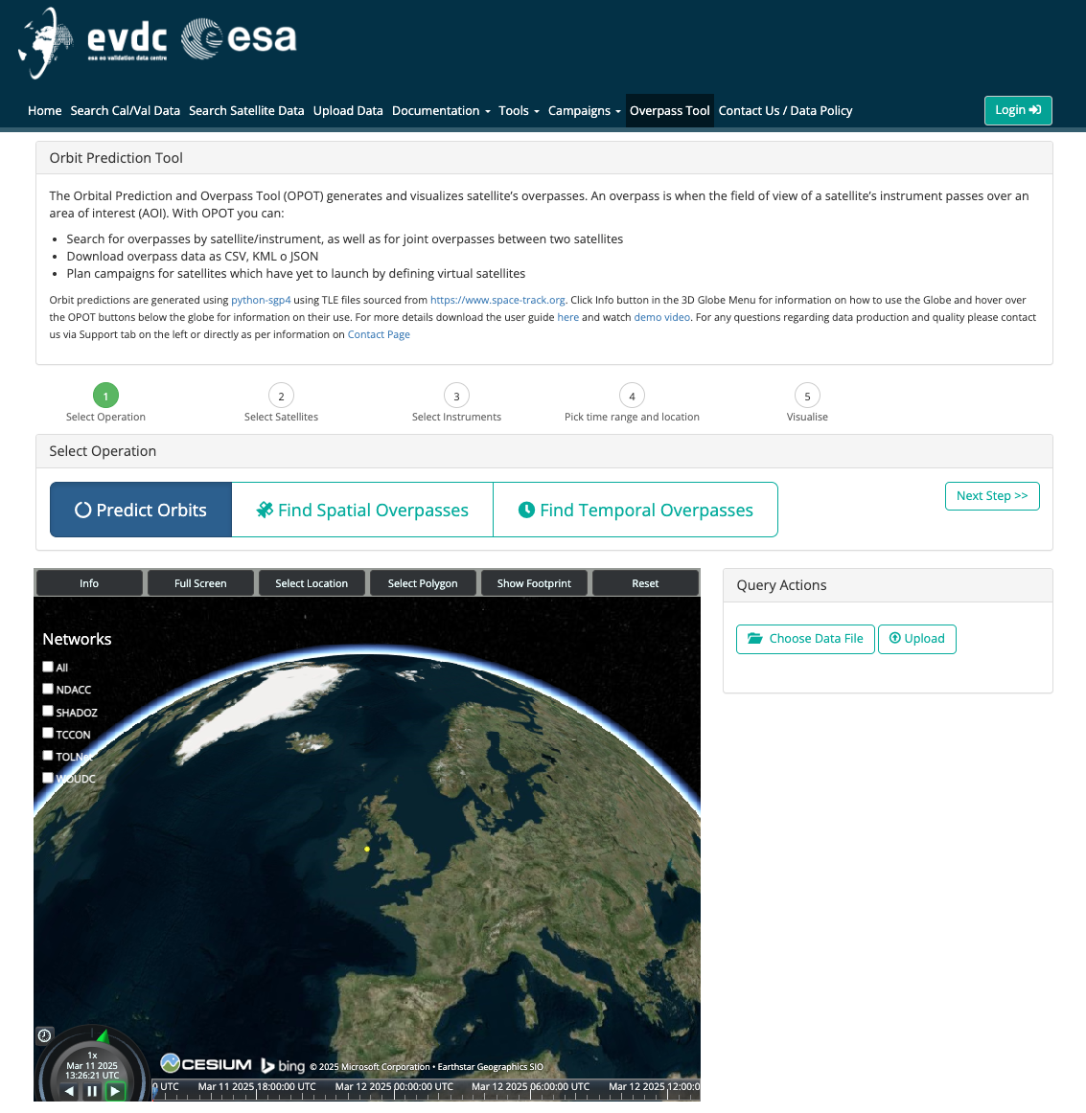
ESA GDWG Activities – Paolo Castracane
Status and updates of the main webportals supporting cal/val activities in different domains:
ESA Atmospheric Validation Data Centre (EVDC) (https://evdc.esa.int/)
with focus on EarthCARE
Pilot-Mission Exploitation Platform (Pi-MEP) salinity (https://www.salinity-pimep.org/)
CEOS Cal/Val portal (https://calvalportal.ceos.org/)
with focus in:
CEOS FRMs Assessment Framework
Area of collaboration GSICS – CEOS WGCV
(see P. Castracane presentation GDWG
breakout Session 20th March AM)

Slide 20
Discussion
GSICS Data and product Server (Day 2 – 16:00-17:00)
Future of the GDWG Products
SOS Report
Jupiter Notebook in GSICS (alternative to Google Colab)

Slide 21
GDWG Plan for next year
Quarterly GDWG meetings to be organized during 2025
Migration to EUM Data Store (Actions)
Update structure of the GSICS Wiki (including add chatbot to facilitate reaserch wrt trustable sources) – (Actions)
Regular check and updates of Agencies focal points and memebers for each WG
Aspects related to naming convection and WIS2.0 format
Follow topic and decision related to the future of the GSICS intercalibration products
To continue and reinforce dialogue and collaboration with CEOS WGCV and WGISS
Following Actions 2024 and 2025 (definition of actions is in progress)

