Slide 1
GRWG Space Weather Sub-group Report
Tsutomu Nagatsuma (NICT)
GSICS Annual Meeting 2025, March 21, 2025 10:18-10:36 CET

Slide 2
GRWG SWx Sub-group Membership
Followings are the members of GRWG SWx Sub-group.
CMA Cong Huang
ESA Piers Jiggens, Hugh Evans, Juha-Pekka Luntama
EUMETSAT Andrew Monham
KMA Dohyeong Kim , Daehyeon Oh
NICT Tsutomu Nagatsuma (Chair)
NOAA Brian Kress, Juan Rodriguez, Christian Naylor, and Athanasios Boudouridis, Jim Spann, Janet Machol, Paul Lotoaniu, Dimitrios Vassiliadis
SPARC Ingmar Sandberg
WMO Jesse Andres

Slide 3
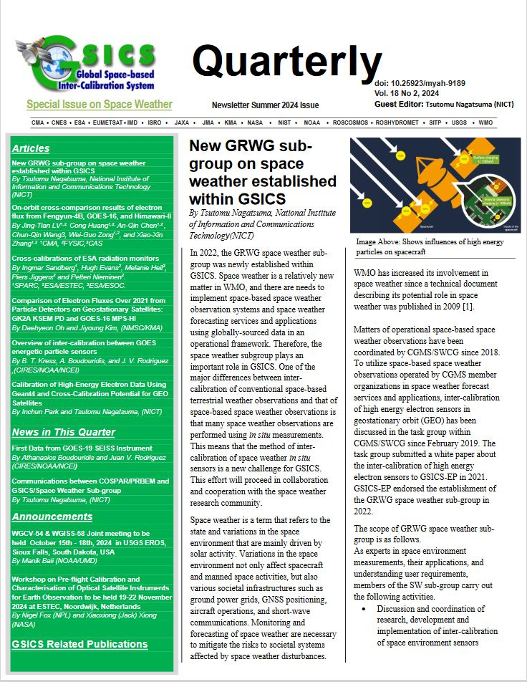
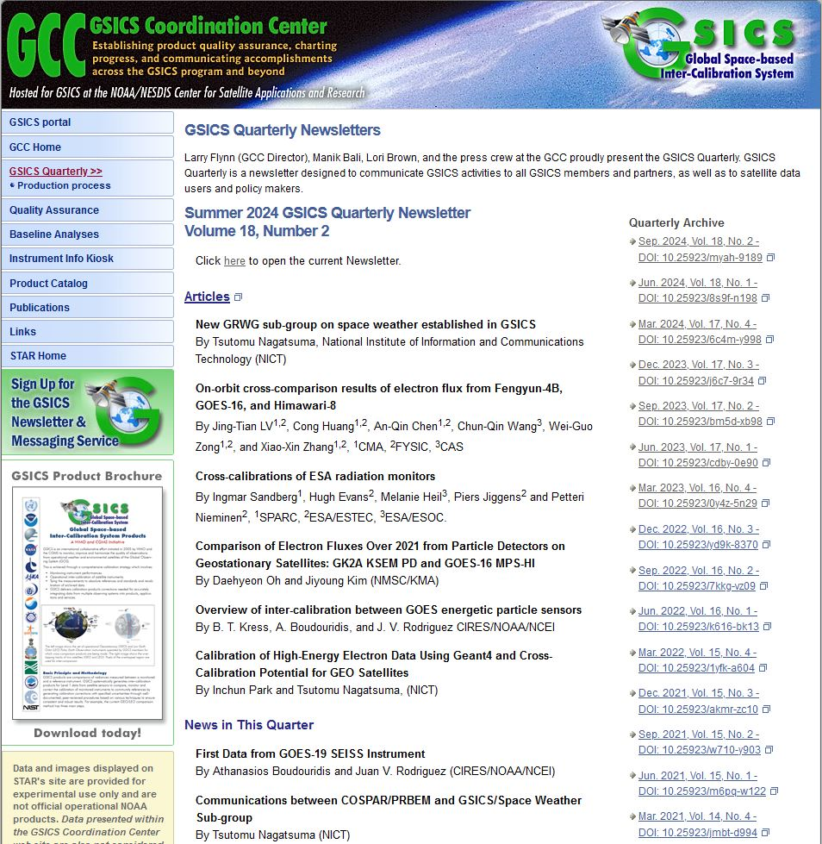
GSICS Quarterly Newsletter Vol. 18, No.2 Special Issue on Space Weather Cross-Calibration
We have published special issue on space weather cross-calibration on Sept. 30, 2024. Six articles are included in this newsletter.
https://doi.org/10.25923/myah-9189

Slide 4
Dialogue with COSPAR/PRBEM
GSICS SWx sub-group is working with COSPAR (Committee on Space Research) / PRBEM (Panel on Radiation Environment Modeling) to establish standardization of cross-calibration procedures on high energy particle sensor.
Based on the review results on the document of PRBEM data analysis procedure, we proposed revisions to the document to COSPAR/PRBEM at COSPAR2024@Busan, which were accepted.
We also wish to discuss with COSPAR/PRBEM about common code base, possible expansion of PRBEM GitLab.
We will have on-line meeting with COSPAR/PRBEM members at Apr. 15, 2025.

Slide 5
Data Levels (Action Item No. 3)
We have received feedback from CMA, KMA, JAXA, NOAA, NICT, and WMO. Thanks for your contribution!
It is apparent that the definition of data levels defined by each organization is different.
To examine the relationship among data levels of each organization, PDS4 processing levels are referred.
Note that this does not mean our group will use PDS4 standard.

Slide 6
PDS4 Processing Levels for SWx Data Sets (Draft)
Level | Definition | CMA | ESA | JAXA | KMA | NOAA | NICT | WMO
Telemetry | An encoded byte system used to transfer data from one or more instruments to temporary storage where the raw instrument data will be extracted. |  |  |  |  | L0
Raw | Original data from an instrument. If compression, reformatting, packetization, or other translation has been applied to facilitate data transmission or storage, those processes will be reversed so that the archived data are in a PDS approved archive format. | L0 | L0 |  | L0 |  |  | L0
Partially processed | Data that have been processed beyond the raw level, but which have not yet reached calibrated status. |  | L1a | L1 |  | L1b |  | L1a
Calibrated | Data converted to physical units, which makes values independent of the instrument. | L1 | L1b L2? | L2 | L1 | L2 | (L1) | L1b
Derived | Results that have been distilled from one or more calibrated data products (for example, maps, gravity or magnetic fields, or ring particle size distributions). Supplementary data, such as calibration tables or tables of viewing geometry, used to interpret observational data should also be classified as ‘derived’ data if not easily matched to one of the other categories. | L2 | L2 L3 | L3 L4 | L2 |  |  | L2

Slide 7
The needs and requirements for Cross-Cal activity for L1 in-situ measurements
“in-situ” solar wind and interplanetary magnetic field (IMF) observations at L1-point is essential for space weather forecasting.
Recently, ISRO was launched Aditya-L1 for the Sun and the Solar wind observations.
Currently, there are several spacecrafts for observing solar wind and IMF (e.g. WIND, ACE, DSCOVR, Aditya-L1). In addition, we will have new spacecraft at L1-point soon (e.g. SWFO-L1, IMAP). This means that it would be a good opportunity to confirm and cross-calibrate solar wind and IMF data.
GSICS SWx sub-group will also deal with the cross-calibration of solar wind measurements at the L1 point.

Slide 8
Breakout session (Mar. 17, 2025) 8 presentations
GOES-19 MPS-HI Calibration: The Newest GOES Radiation Belt Instrument (Athanasios Boudouridis, NOAA)
GOES 16-19 Solar and Galactic Proton Sensor (SGPS) Cross-Calibrations During Oct-Nov 2024 SEP Events (Brian Kress, NOAA)
FengYun-3H/WAI-II Prelaunch Test Results and The Calibration Approach In-orbit (Yafen Yang, CMA)
ADITYA-L1 MISSION OF INDIA AND CROSS-CALIBRATION OF ASPEX, (Dibyendu Chakrabarty, PRL)
In-orbit calibration and flux monitoring comparison of the Solar X-EUV imager on the Fengyun-3E satellite (Bowen Gong, CIOMP)
Multi-Point Geostationary Observations of Major 2024 Space Weather Events: Data from GK2A, Himawari-9, GOES-16 and -18 (Daehyeon Oh, KMA)
Long Term Variation of Cross-calibration results between Himawari8/SEDA and GOES16/MPS-HI (Tsutomu Nagatsuma, NICT)
Cross-calibration of ESA Radiation Monitors (Ingmar Sandberg, SPARC)

Slide 9
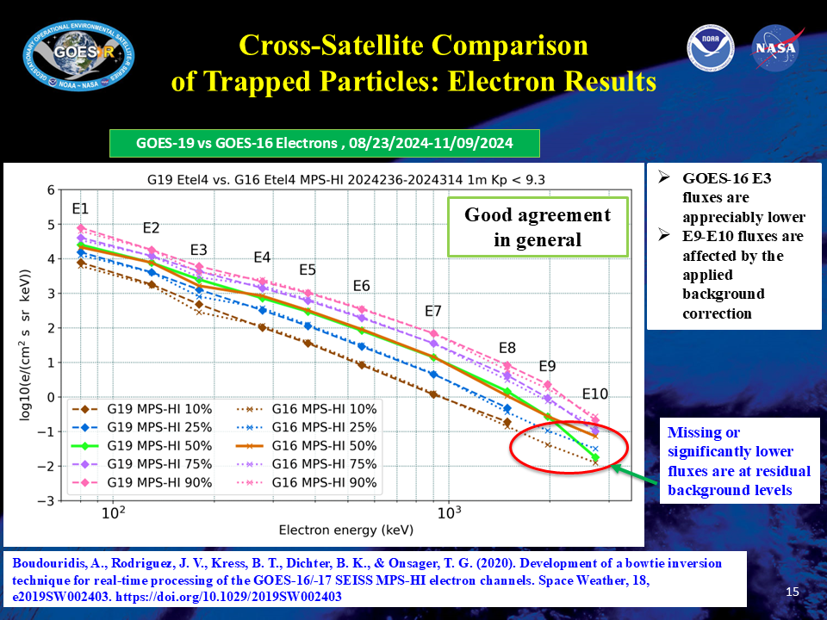
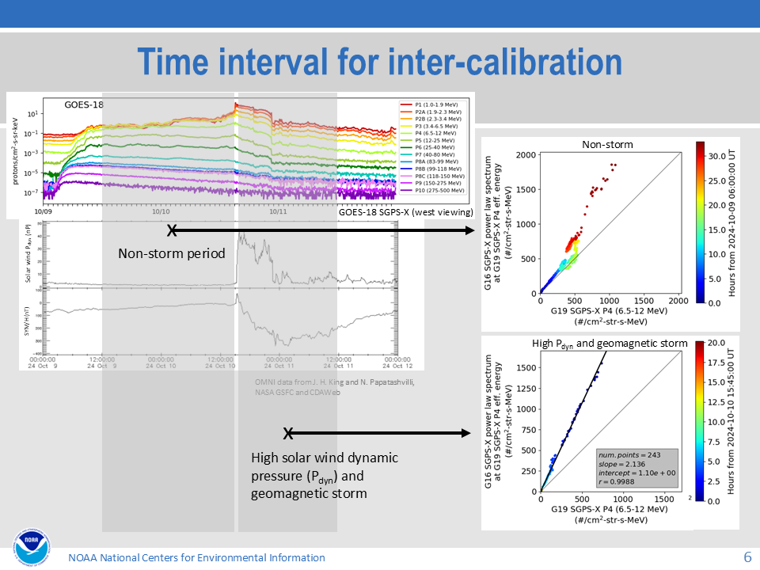
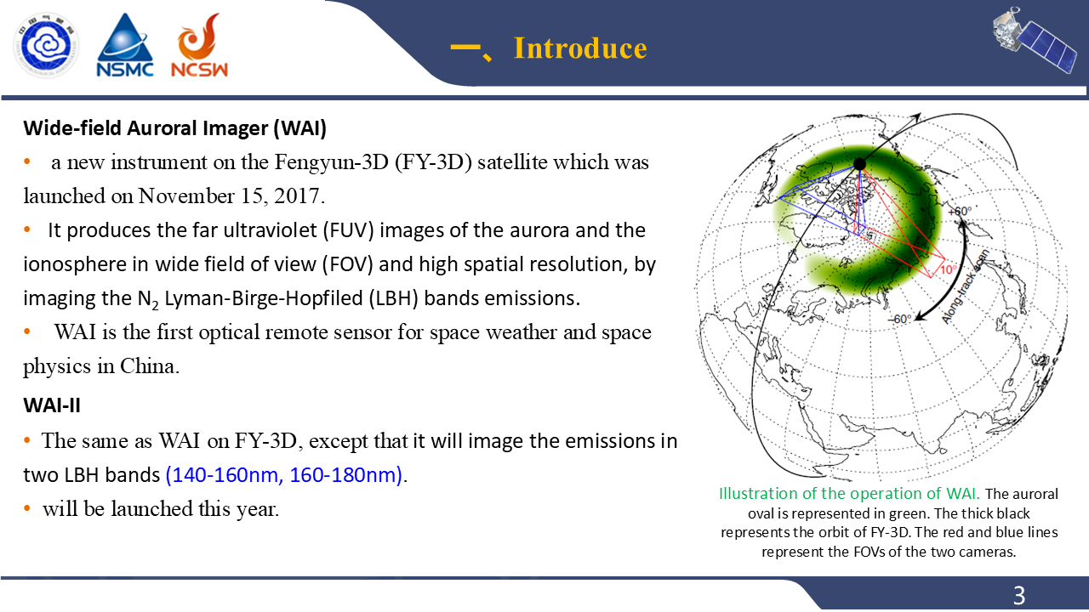
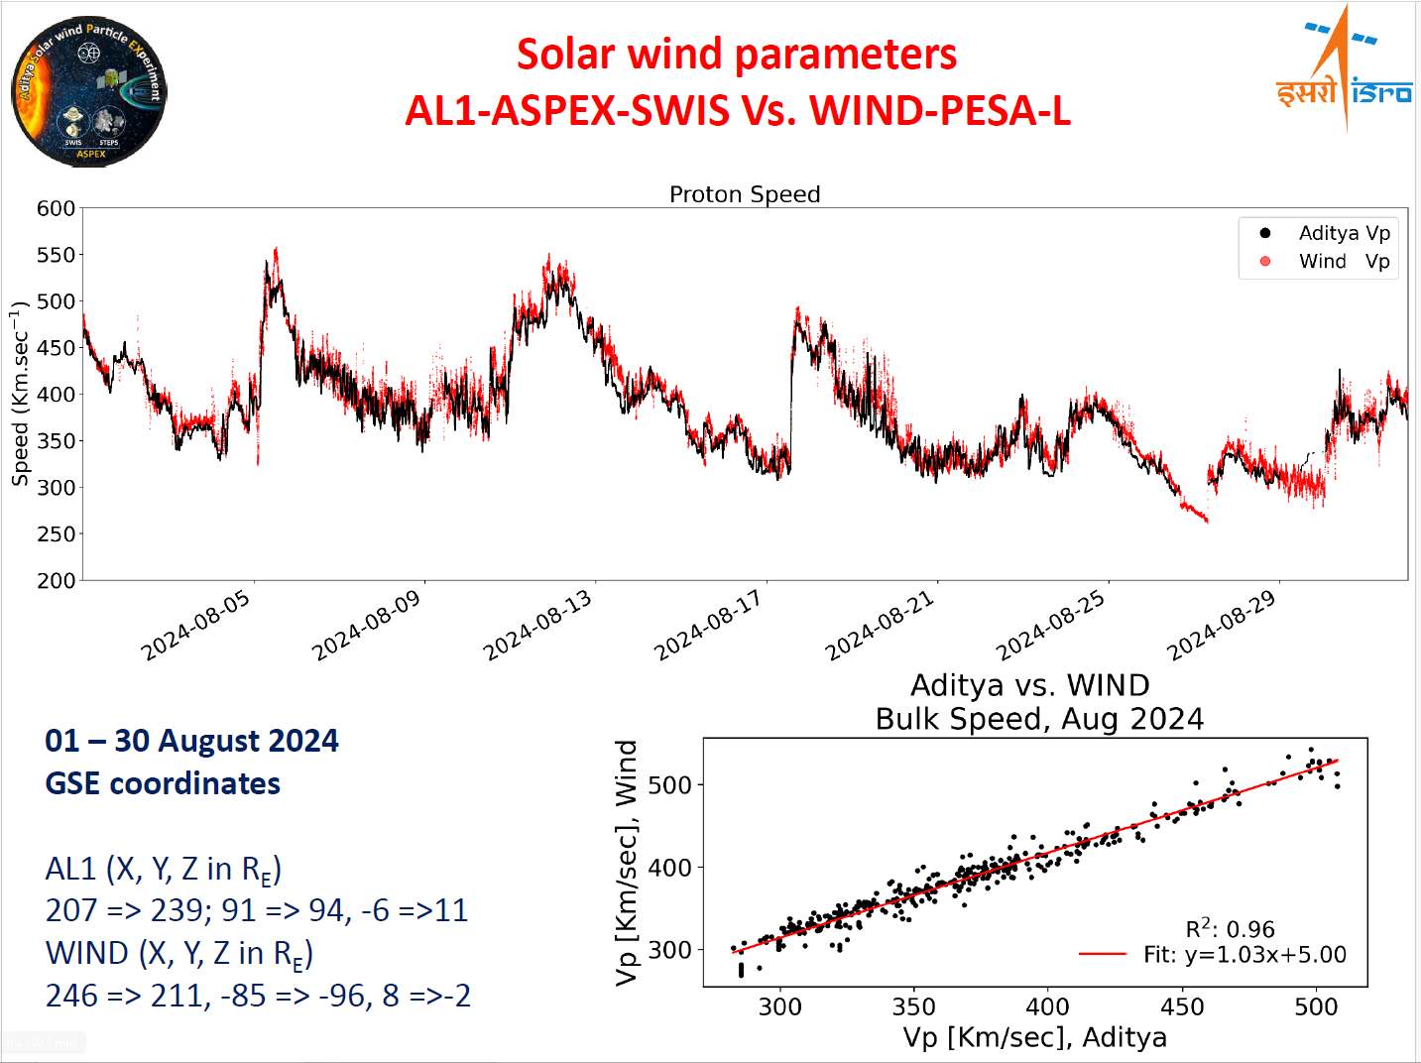
Highlights (1/2)
[Boudouridis]
[Kress]
[Yang]
[Chakrabarty]

Slide 10
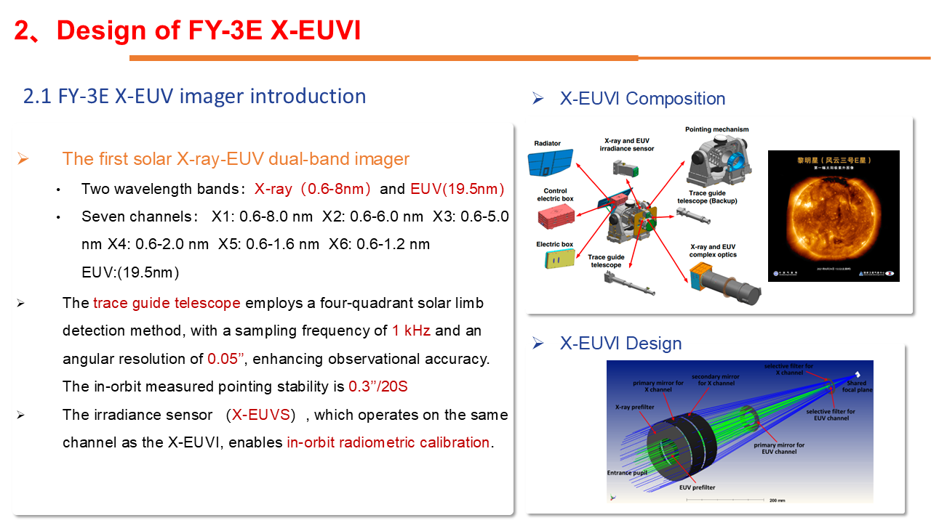
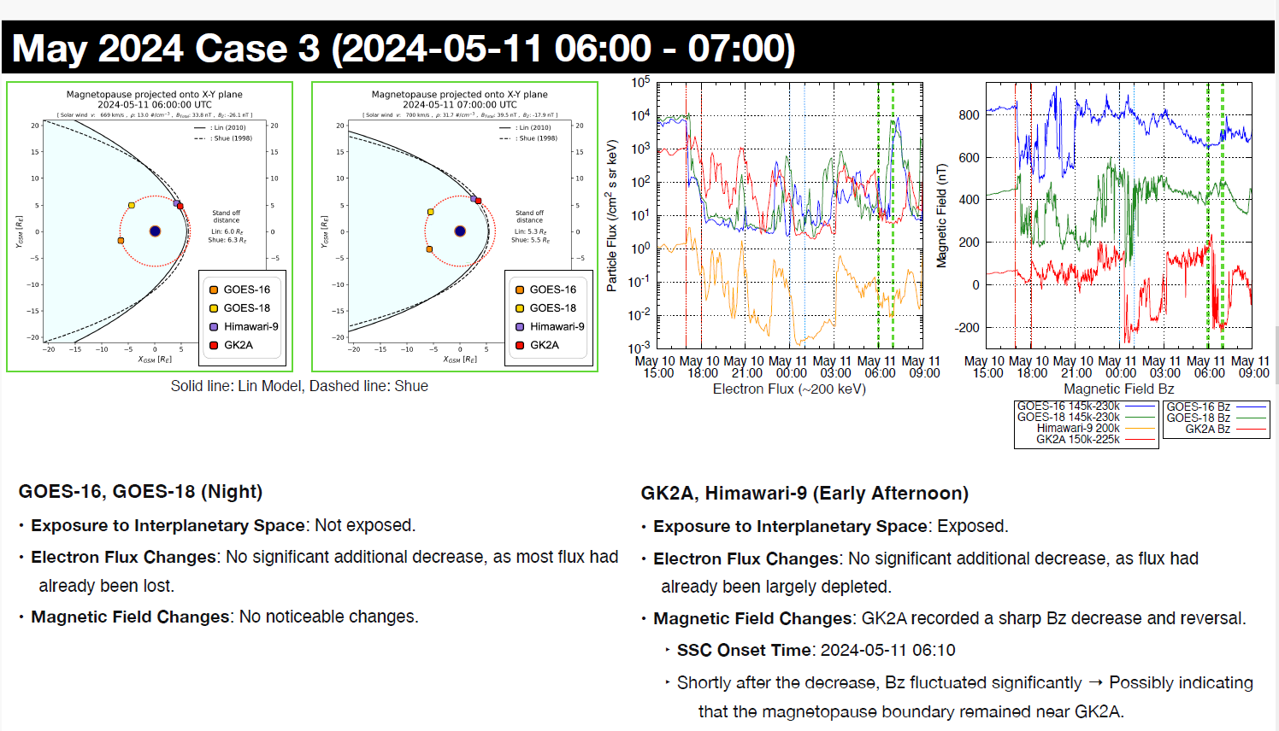
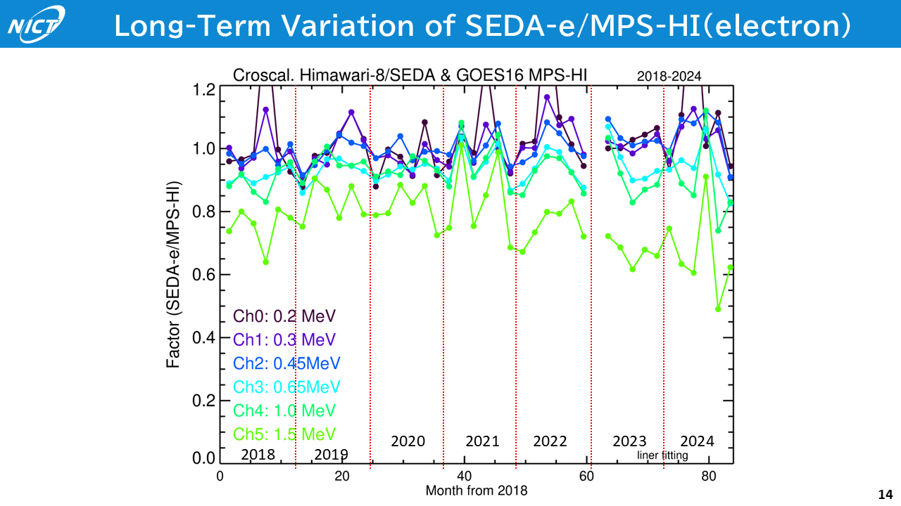
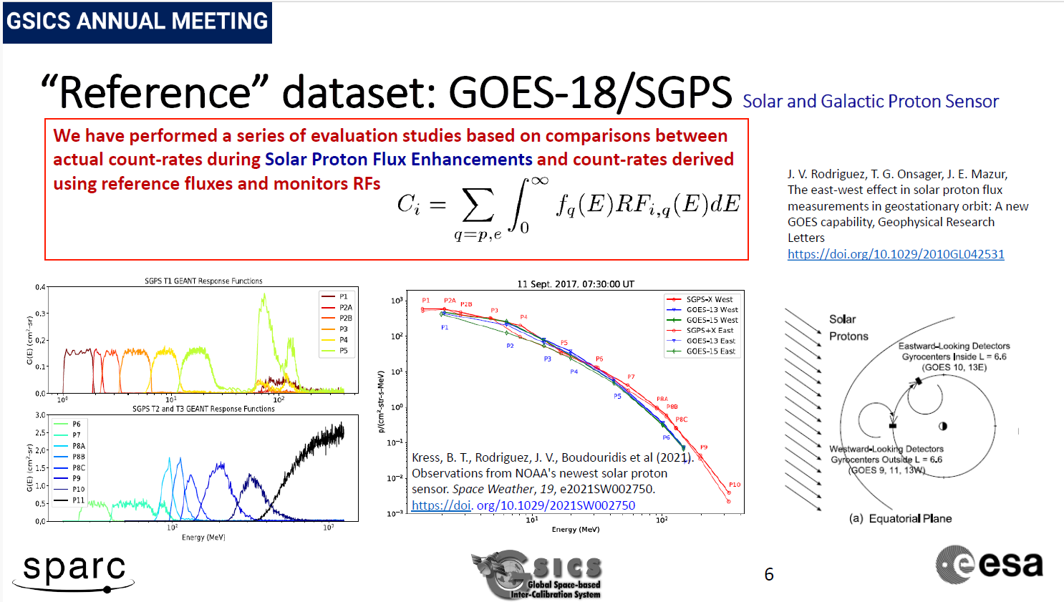
Highlights (2/2)
[Gong]
[Oh]
[Nagatsuma]
[Sandberg]

Slide 11
Summary
The Space Weather Subgroup is working toward standardization of cross-calibration methods for high energy particle sensors and mutual data exchange and utilization through information exchange among members and collaboration with the space weather research community.

Slide 12
Thank You!

