Slide 1
Introduction of FY-3G/MERSI-RM and Preliminary Result of On-orbit Calibration result for IR channels
FY-3G/MERSI-RM On-orbit Test Group
2024-07

Slide 2
Introduction of MERSI-RM
Calibration Test Results for IR Channels
Discussion

Slide 3
目录
PART 01
汇报内容
Introduction of
FY-3G/MERSI-RM

Slide 4
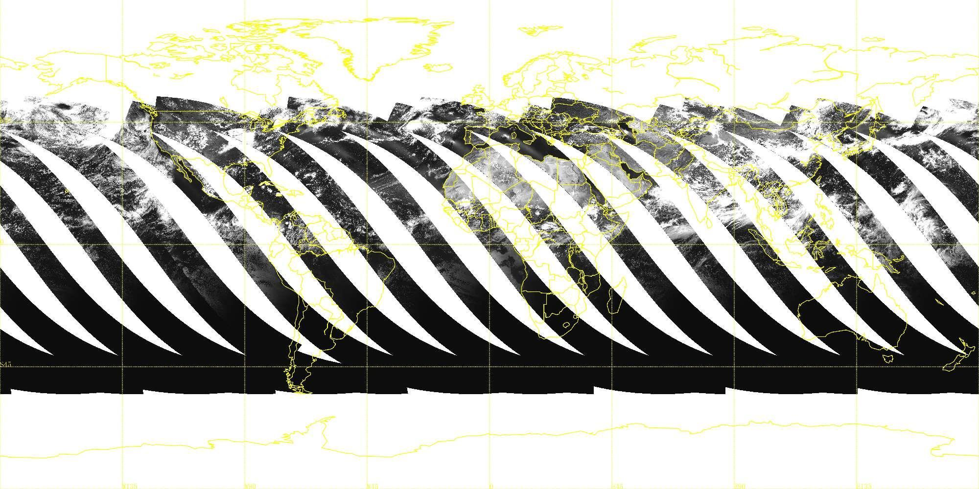
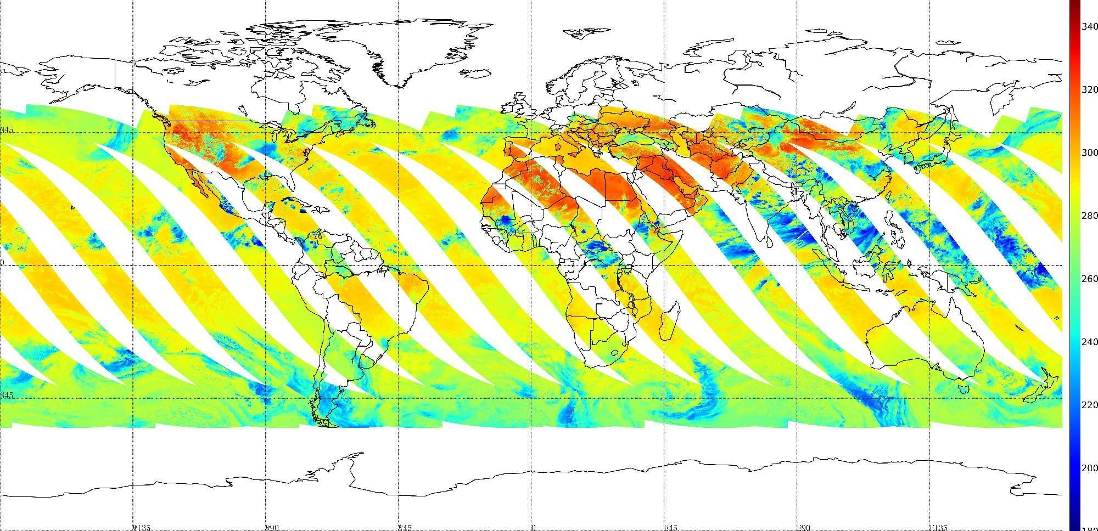
Introduction of MERSI-RM
Precipitation is one of the most parameters in the Earth system but hard to measure. China began to develop the precipitation measurement satellite in second generation polar orbiting Fengyun meteorological series, i.e, FY-3. There are two rainfall missions (RM) have been programmed in FY-3 series. FY-3G is the first China rainfall mission satellite.
FY-3G was launched on April 17th 2023. The FengYun-3G is operate in an inclined orbit with a nominal orbital height of 407km. MERSI-RM is one of the primary instruments aboard the FY-3G satellite and it senses radiation coming up from the Earth in 8 spectral channels, ranging from visible to infrared (center wavelength from 0.65 to 12.0 micrometer).
MERSI-RM retained the channels in FY-3D/MERSI-II that can be used to detect the cloud and precipitation and omitted the ocean color channels, and all channels have a nadir spatial resolution of 500m. MERSI-RM’s earth observation is not global coverage because of its swath is about 1020km.
Swath | ~1020km
Spatial resolution（IFOV） | 500m
RSB：640nm，865nm, 940nm，1380nm, 1640nm；
TEB：3.8um,10.8um, 12.0um

Slide 5
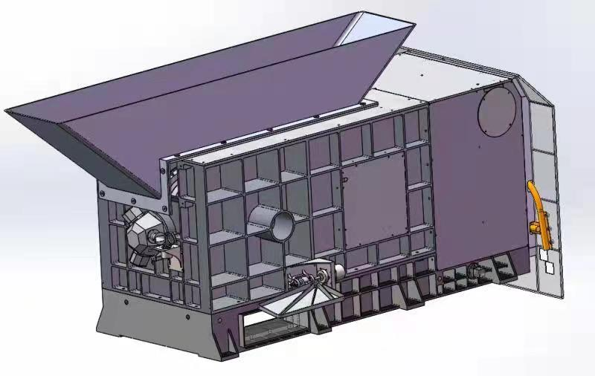
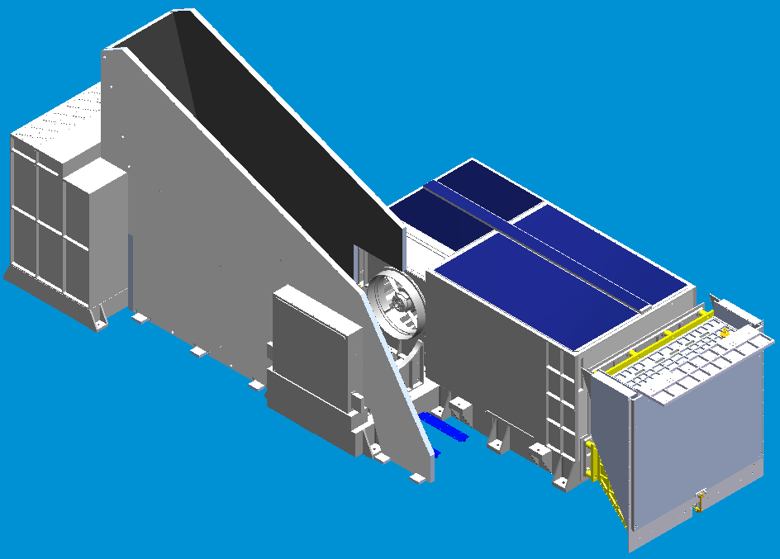
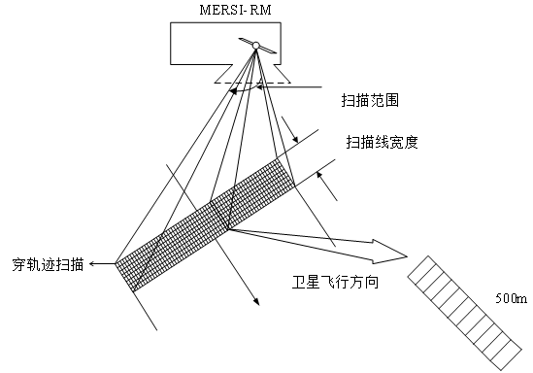
Introduction of MERSI-RM
Although MERSI-RM is called MERSI, but it is a newly designed instrument. The instrument structure, optical design, refrigeration and other aspects have been completely designed. MERSI-RM uses a two-sided scan mirror to achieve earth observation through cross-track-scanning, and the two sides of the scan mirror alternately produce a swath of 1020 km along scan by about 5 km (at nadir) along scan. Secondly, a high-power refrigerator is used to cool the infrared detectors instead of the traditional radiation cooling, and the temperature of IR detectors can be controlled as low as 80K.
As MERSI before, all channels have 10 detectors that are aligned along the track.

Slide 6
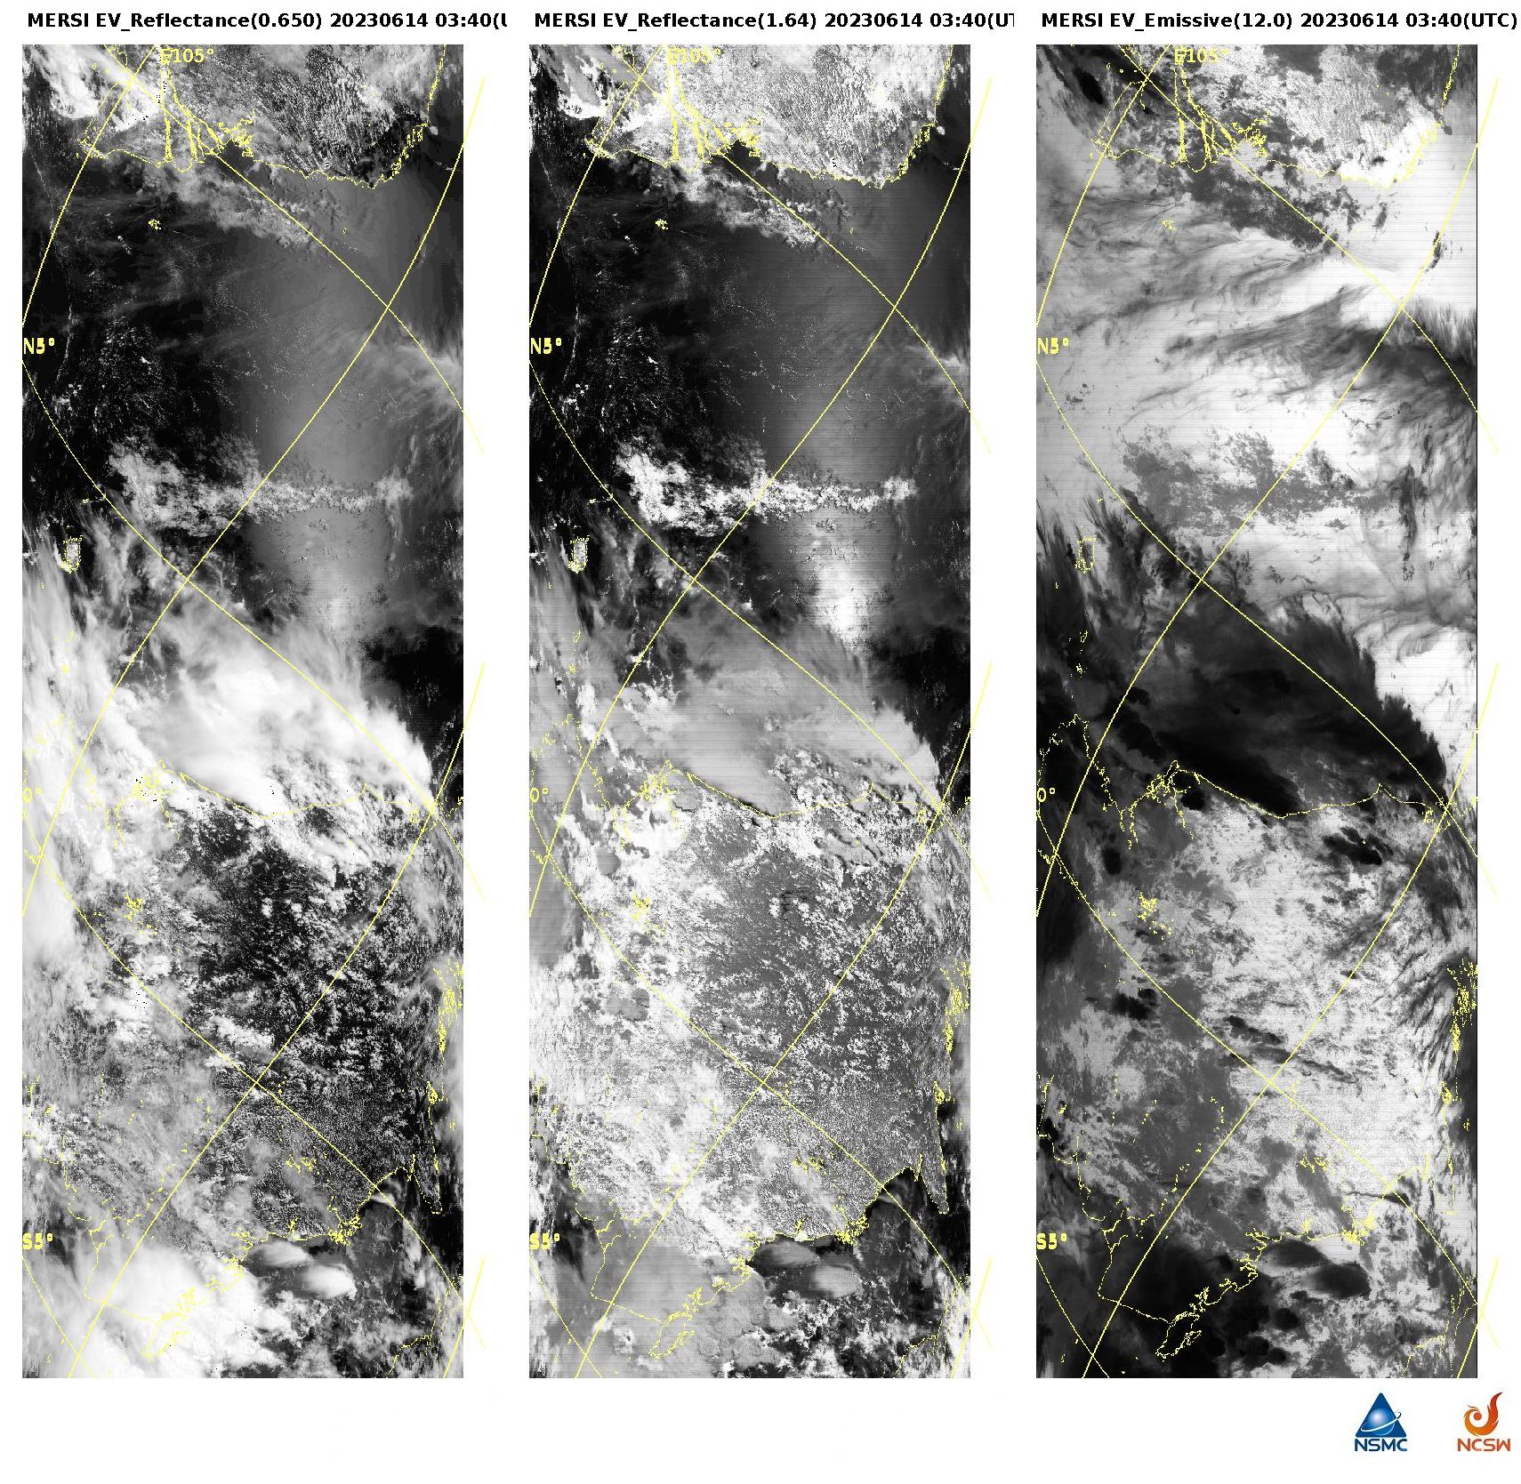
Introduction of MERSI-RM
20230614-0345
VIS
SWIR
LWIR

Slide 7
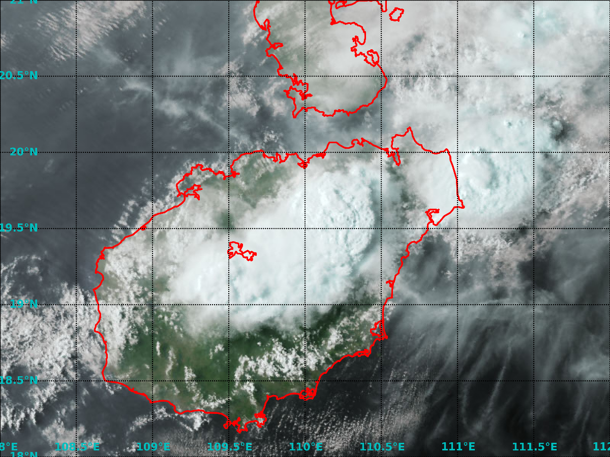
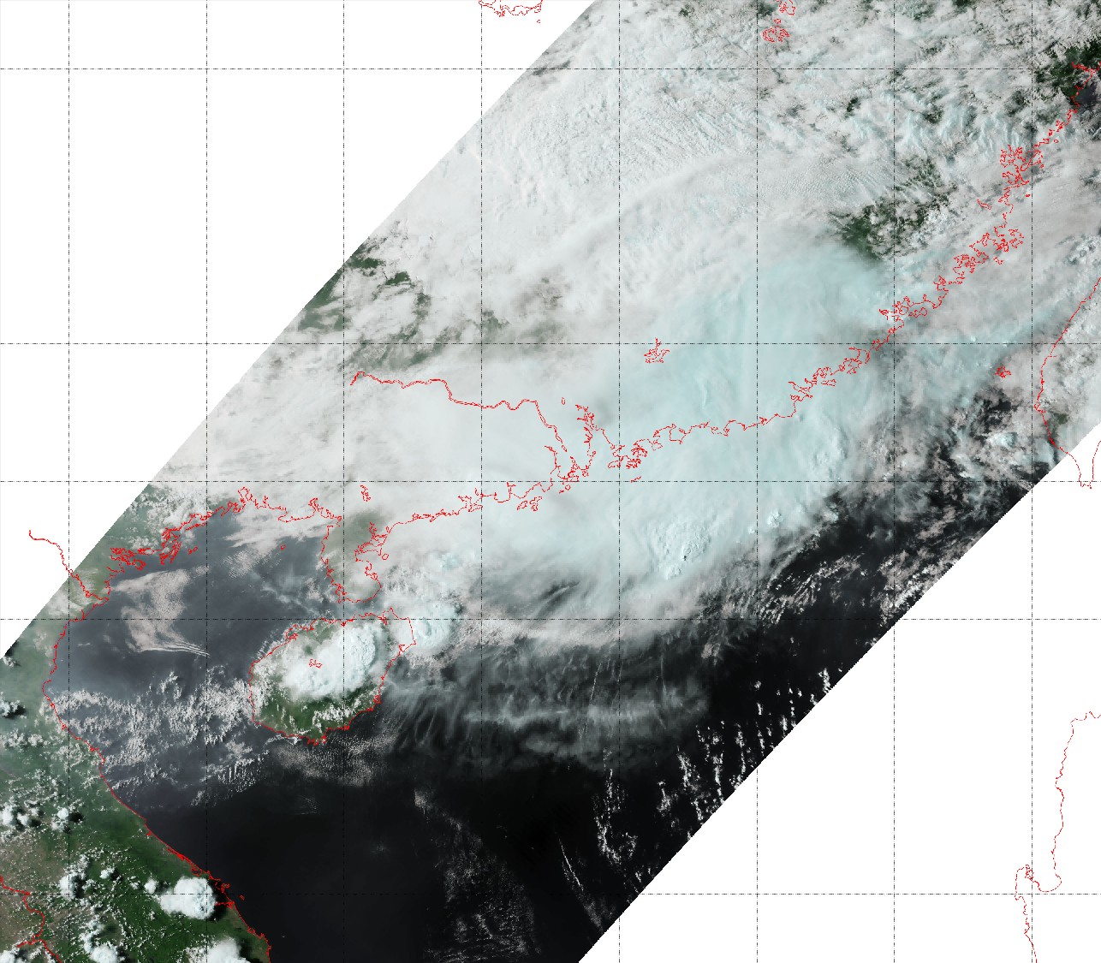
Introduction of MERSI-RM
Visible false-color composite of southeast coastal area of China
（2023年5月7日08:35UTC）
For the first time, MERSI has realized the earth observation with the spatial resolution of 500m of all the channels of the optical imager of China's meteorological satellite;
The visible cloud image clearly shows the cloud top structure of the convective cloud.
The earth observation data of the instrument can not only be used to estimate precipitation directly, but also can be used as an important assistant to judge the existence of precipitation clouds in the precipitation detection of the active and passive microwave instruments.

Slide 8

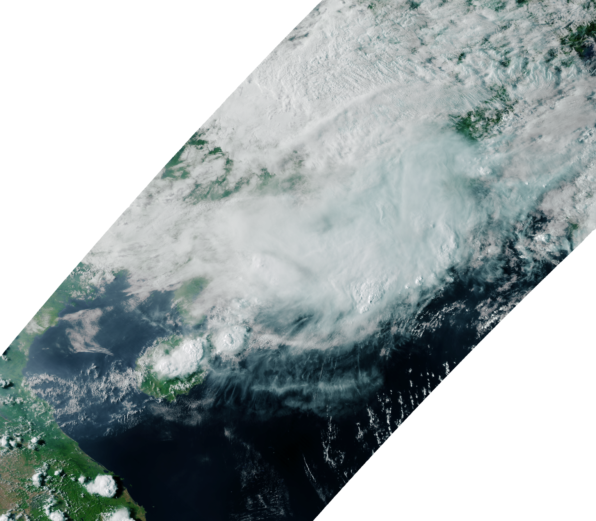
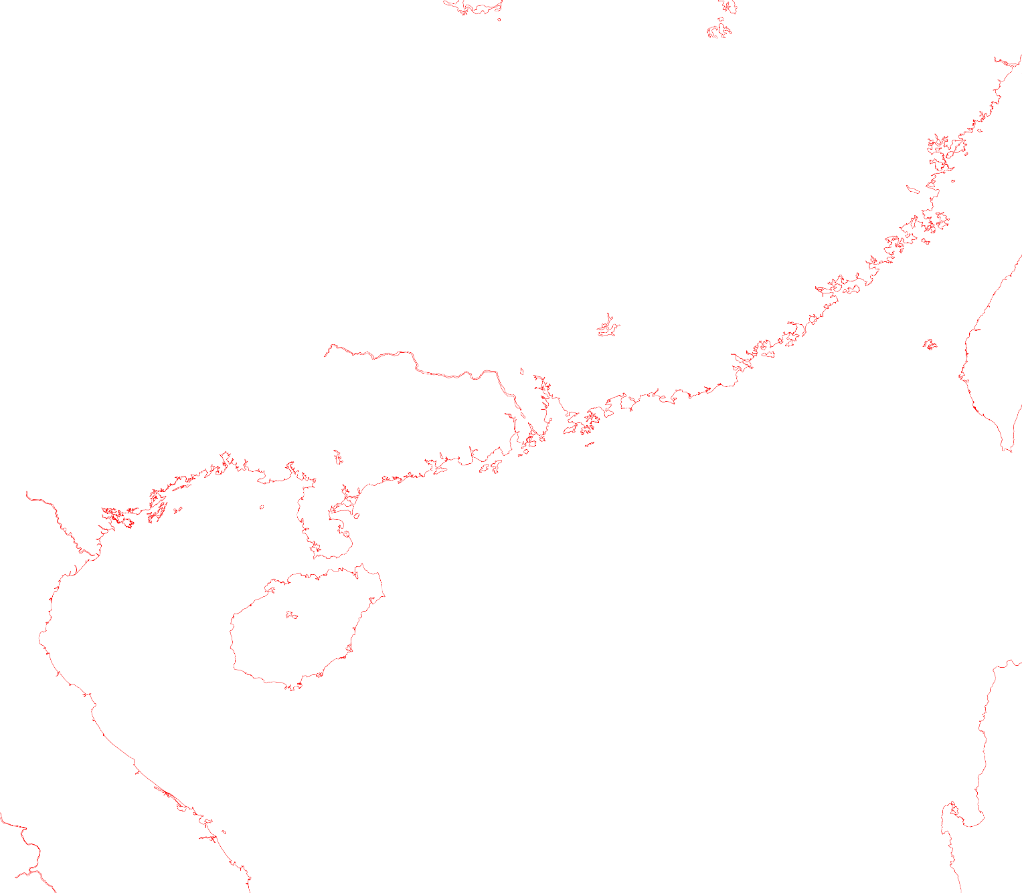
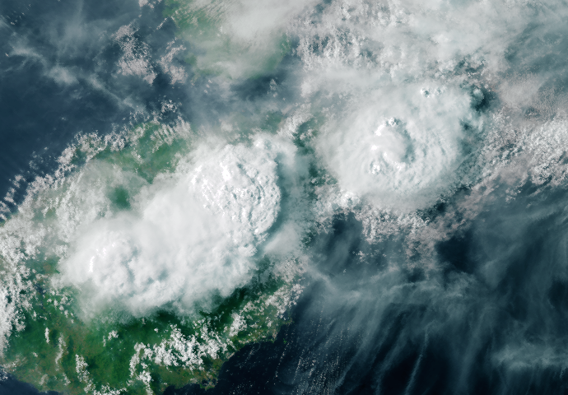
Introduction of MERSI-RM

Slide 9
Introduction of MERSI-RM
No. | Center wavelength(μm) | Bandwidth(nm) | Lmax/TmaxW/m2/mm/sr | Lmin/TminW/m2/mm/sr | Ltyp/TtypW/m2/mm/sr | SNR/NE∆T@Ltyp/Ttyp | Measurementaccuracy (% or T)Minimum/expected
1 | 0.650 | 50 | 554 | 0 | 22 | 150 | 5%/3%
2 | 0.865 | 50 | 349 | 0 | 25 | 150 | 5%/3%
3 | 0.940 | 50 | 250 | 0 | 15.0 | 300 | 5%/3%
4 | 1.38 | 30 | 81 | 2 | 6 | 150 | 5%/3%
5 | 1.64 | 50 | 72 | 0.4 | 7.3 | 400 | 5%/3%
6 | 3.8 | 180 | 350K | 186K | 300K | 0.25K | 0.4K/0.2K
7 | 10.8 | 1000 | 345K | 185K | 300K | 0.10K | 0.4K/0.2K
8 | 12.0 | 1000 | 345K | 185K | 300K | 0.10K | 0.4K/0.2K
The on-board calibrators include a solar diffuse (SD) and solar diffuser stability monitor, and a blackbody and a space view port. MERSI-RM has calibration requirements at least of 5% (the expected requirements reach 3% ) for visible-near infrared channels, and the IR channels calibration requirements are at least 0.4 K and expectation is 0.2 K.

Slide 10
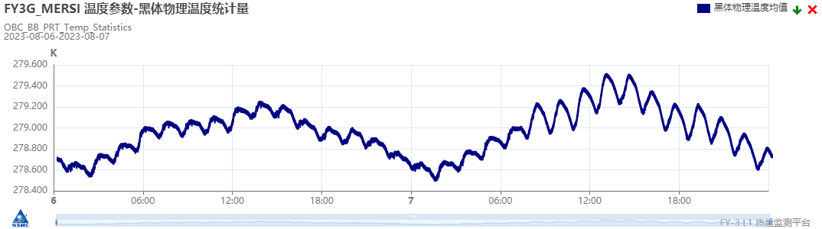
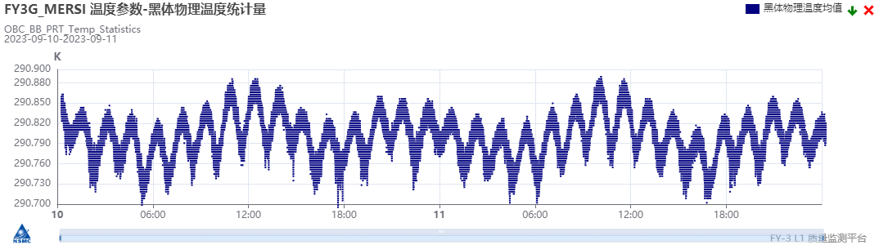
Introduction of MERSI-RM
MERSI-RM's infrared on-board calibrator uses a new design:
The temperature of on-board blackbody can be control in-orbit,the blackbody temperature is controlled at 290K;
A high-power refrigerator is used to cool the infrared detectors instead of the traditional radiation cooling, and the temperature of IR detectors can be controlled as low as 80K.
blackbody temperature uncontrolled
blackbody temperature controlled
 | orbit |  | daily
 | uncontrolled | ~290K | uncontrolled | ~290K
BB temperature change | 0.2~0.3K | ~0.1K | 1K | <0.2K

Slide 11
目录
PART 02
汇报内容
Calibration Test Results for IR Channels

Slide 12
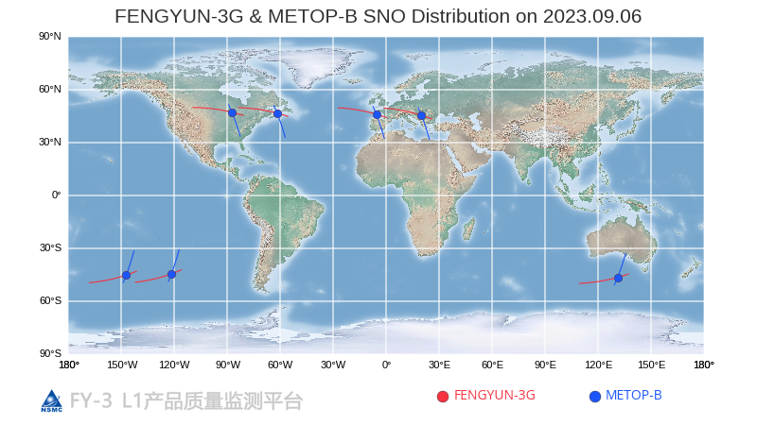
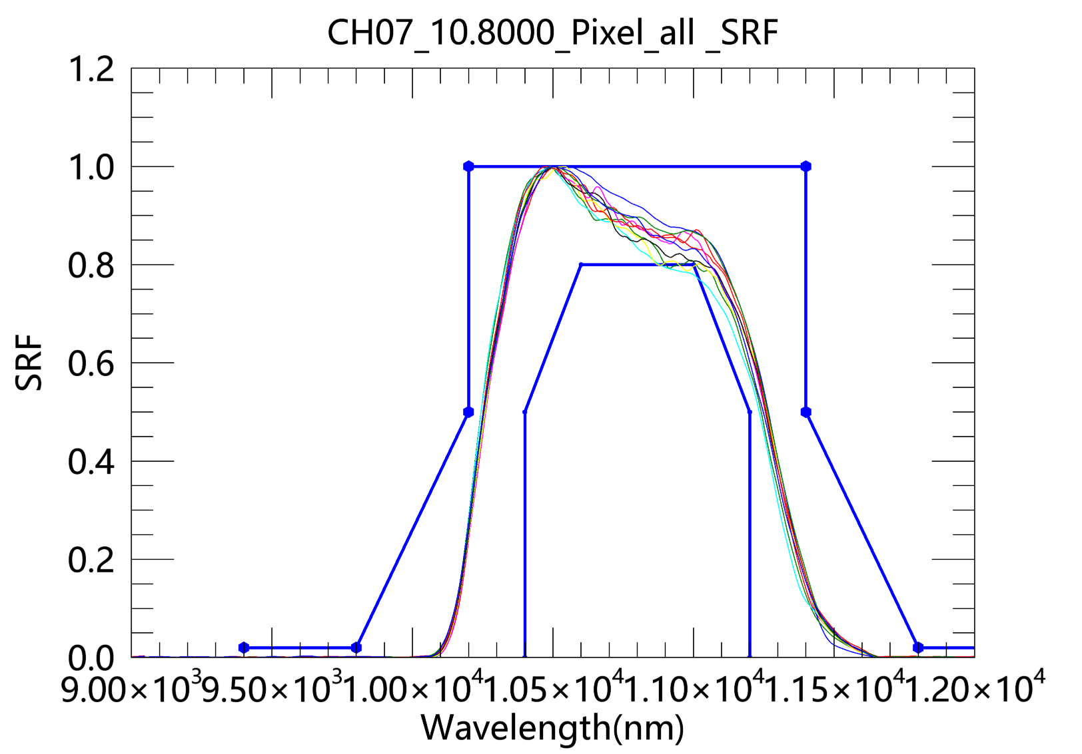
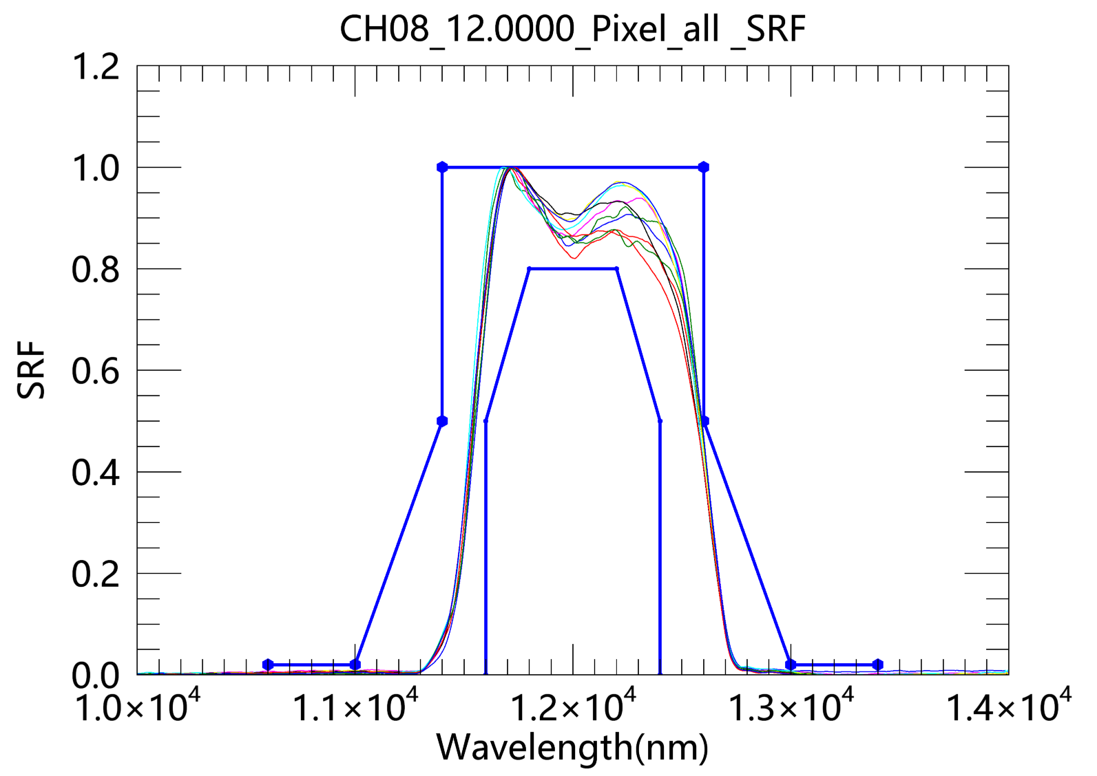
Calibration Test Results for IR Channels
The spectra of channels 7 and 8 are completely covered by IASI, so using Metop/IASI as a radiation reference to check the accuracy of infrared channel radiation calibration.
No. | Center wavelength(μm) | Bandwidth(nm) | Lmax/TmaxW/m2/mm/sr | Lmin/TminW/m2/mm/sr | Ltyp/TtypW/m2/mm/sr | SNR/NE∆T@Ltyp/Ttyp | Measurementaccuracy (% or T)Minimum/expected
6 | 3.8 | 180 | 350K | 186K | 300K | 0.25K | 0.4K/0.2K
7 | 10.8 | 1000 | 345K | 185K | 300K | 0.10K | 0.4K/0.2K
8 | 12.0 | 1000 | 345K | 185K | 300K | 0.10K | 0.4K/0.2K

Slide 13
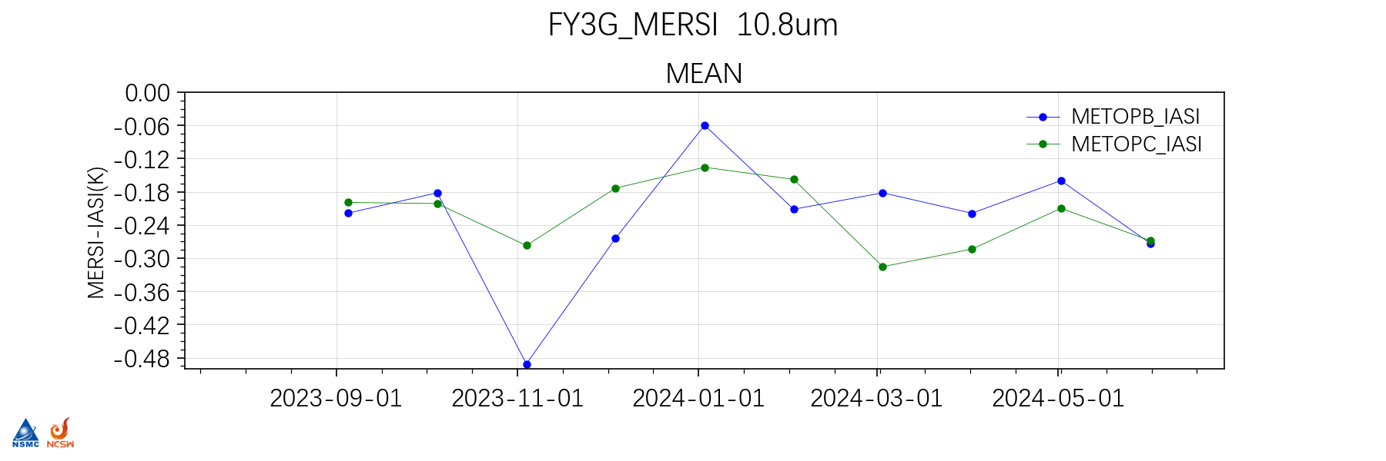
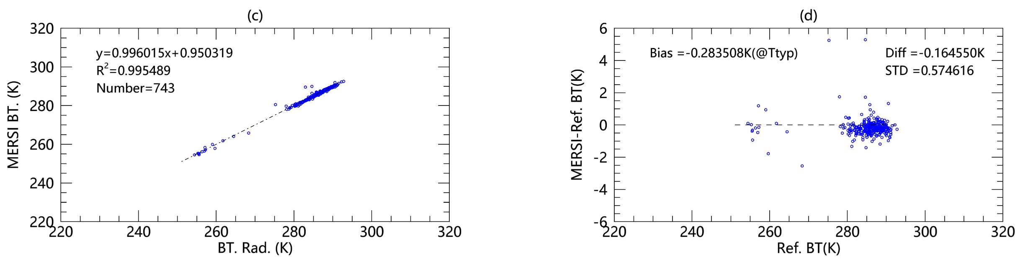
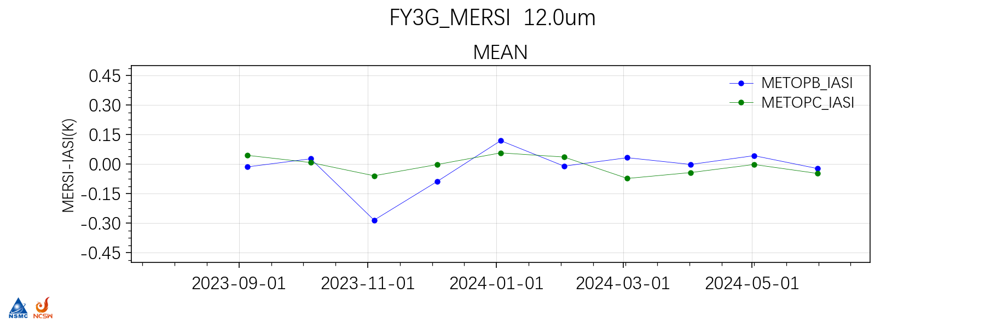
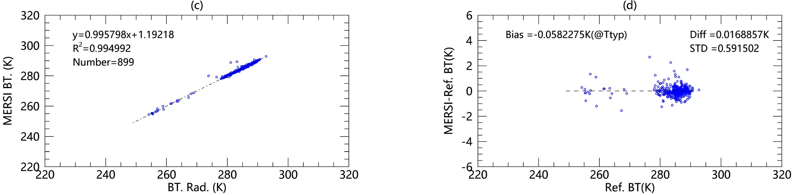
Calibration Test Results for IR Channels
Reference——METOP-B/IASI
20230829-20230906
Channels | Mean Bias（MERSI-RM-IASI,K） | Bias@300K(K)
CH7-10.8um | -0.16 | -0.28
CH8-12.0um | 0.02 | -0.06

Slide 14
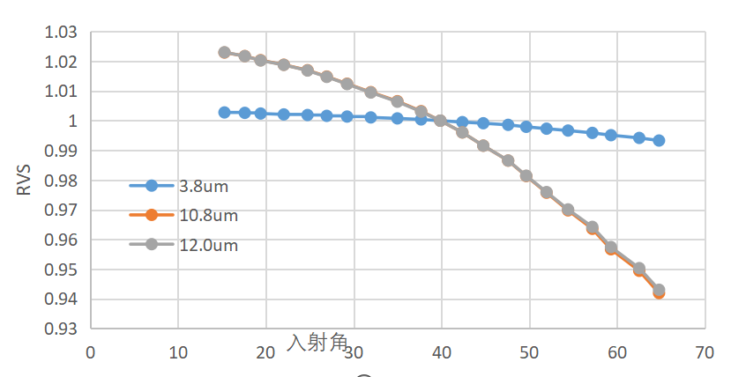
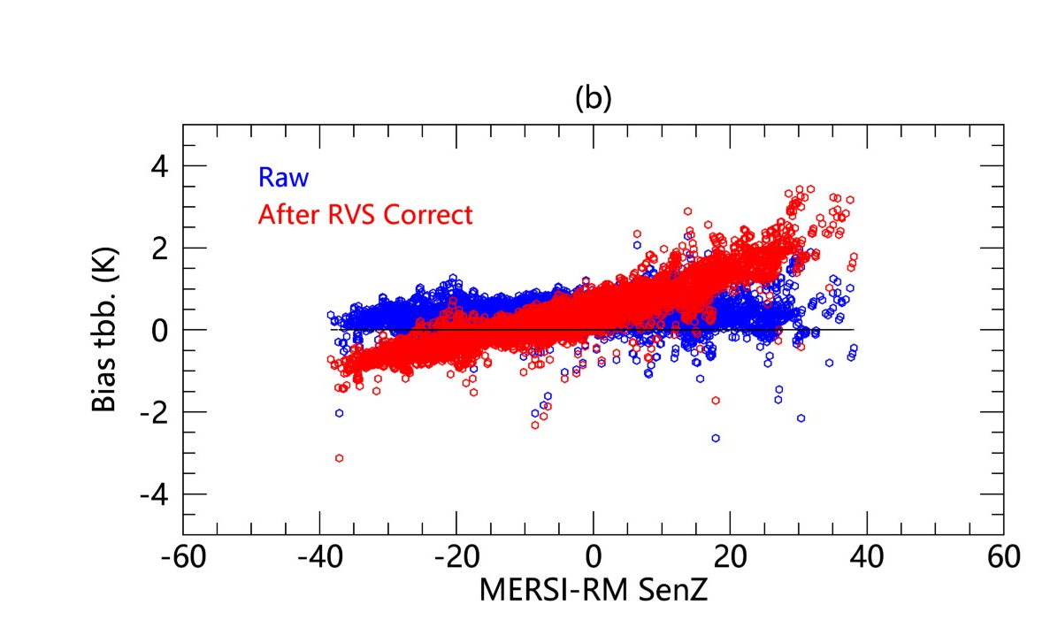
Calibration Test Results for IR Channels
650nm | 865nm | 940nm | 1380nm | 1640nm
-0.2%~0.07% | -0.8%~0.5% | -1.4%~0.6% | -0.3%~0.3% | -0.5%~0.2%
3.8um | 10.8um | 12.0um
-0.6%~0.2% | -5.8%~2.3% | -5.8%~2.3%

Slide 15
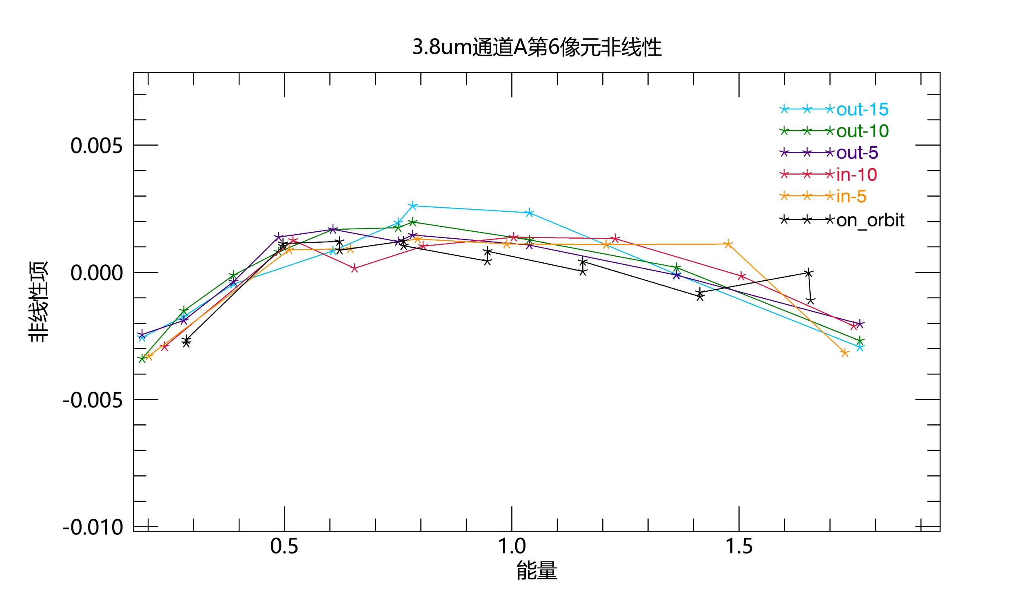
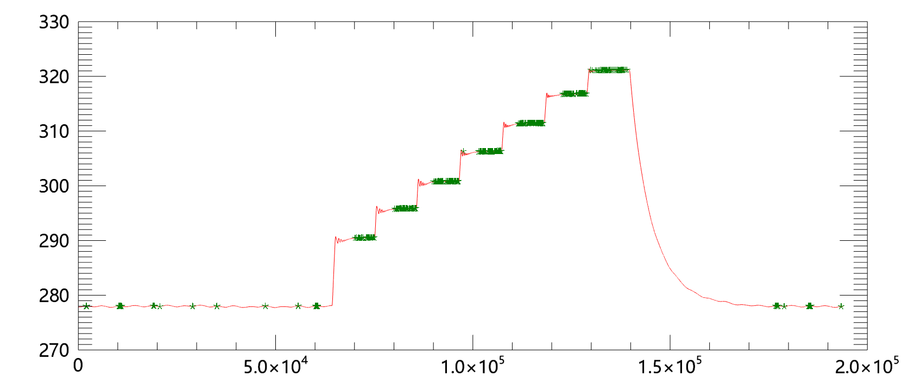
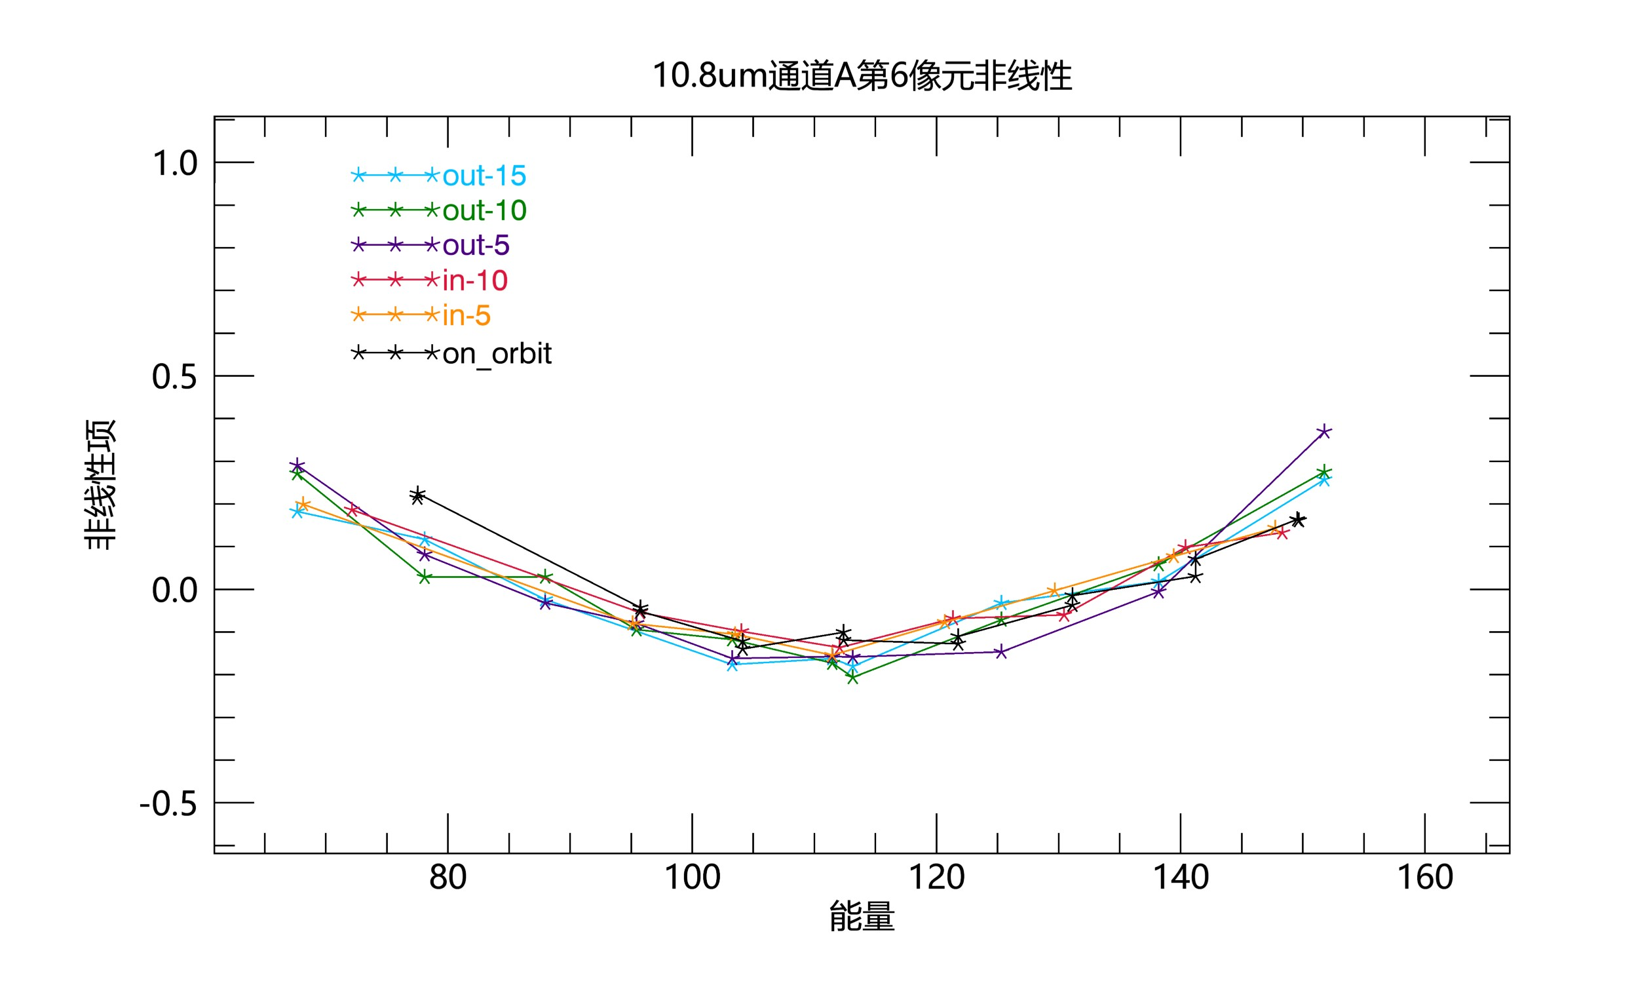
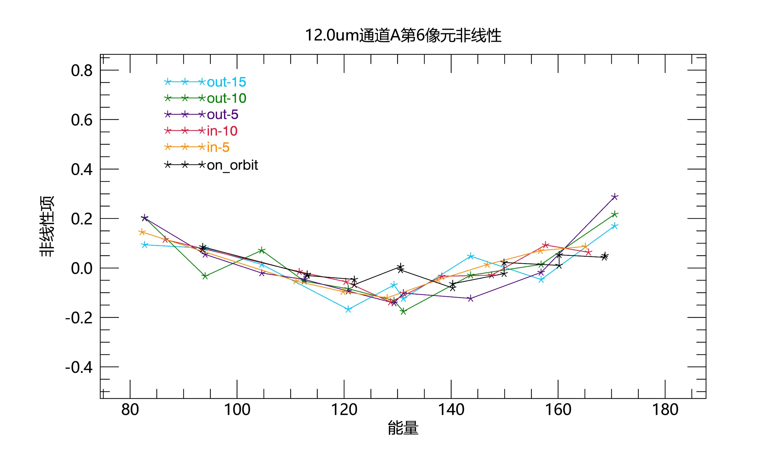
Calibration Test Results for IR Channels
The blackbody on MERSI-RM has the ability of on-board temperature varying from 278K to 320K, which can check the nonlinear coefficients of IR channels on orbit
3.8um
The nonlinear shape of each detector obtained from the temperature change data is consistent with the measured results of the pre-launch test in the same range of blackbody temperature.
The on-orbit temperature change test of the black body on MERSI-RM can test the nonlinear characteristics of the response in the range of temperature change, and provide a basis for the analysis of the nonlinear response change in orbit.
10.8um
12.0um

Slide 16
目录
PART 03
汇报内容
Discussion

Slide 17
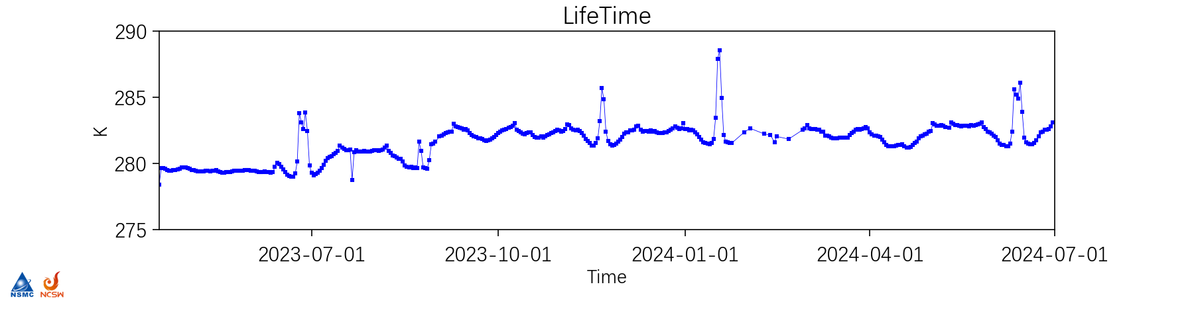
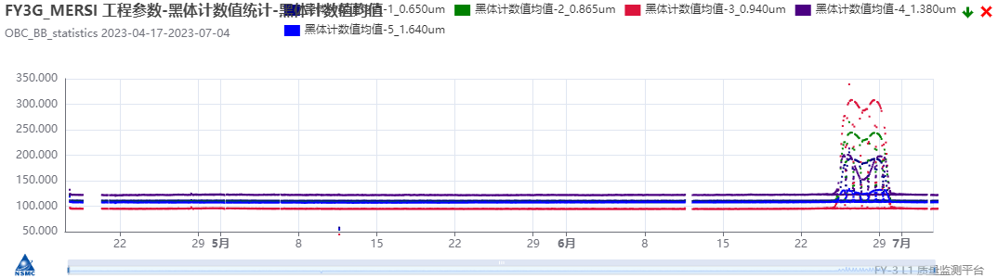
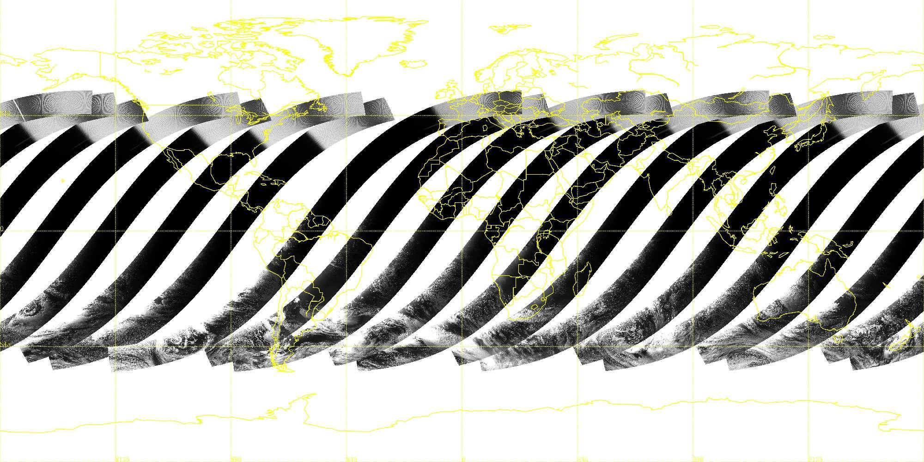
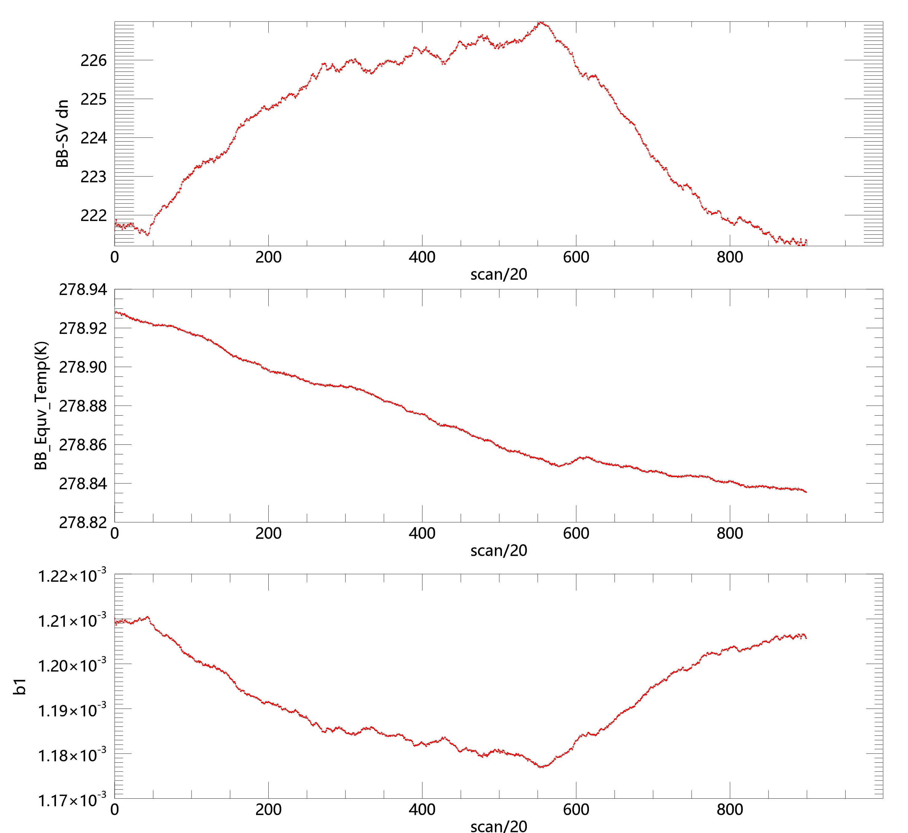
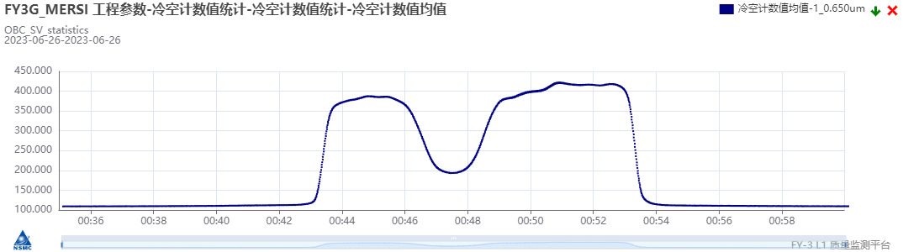
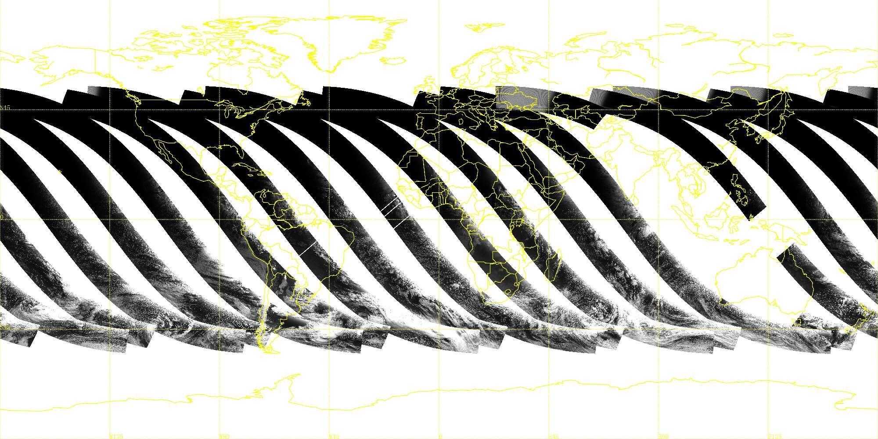
Discussion——Stray light
full illumination period of FY3G
When the satellite is in full illumination period, sunlight can reach the inside of the MERS-RM shield in a certain angle, and form stray light.
Stray light area
BB-SV
calibration coefficient

Slide 18
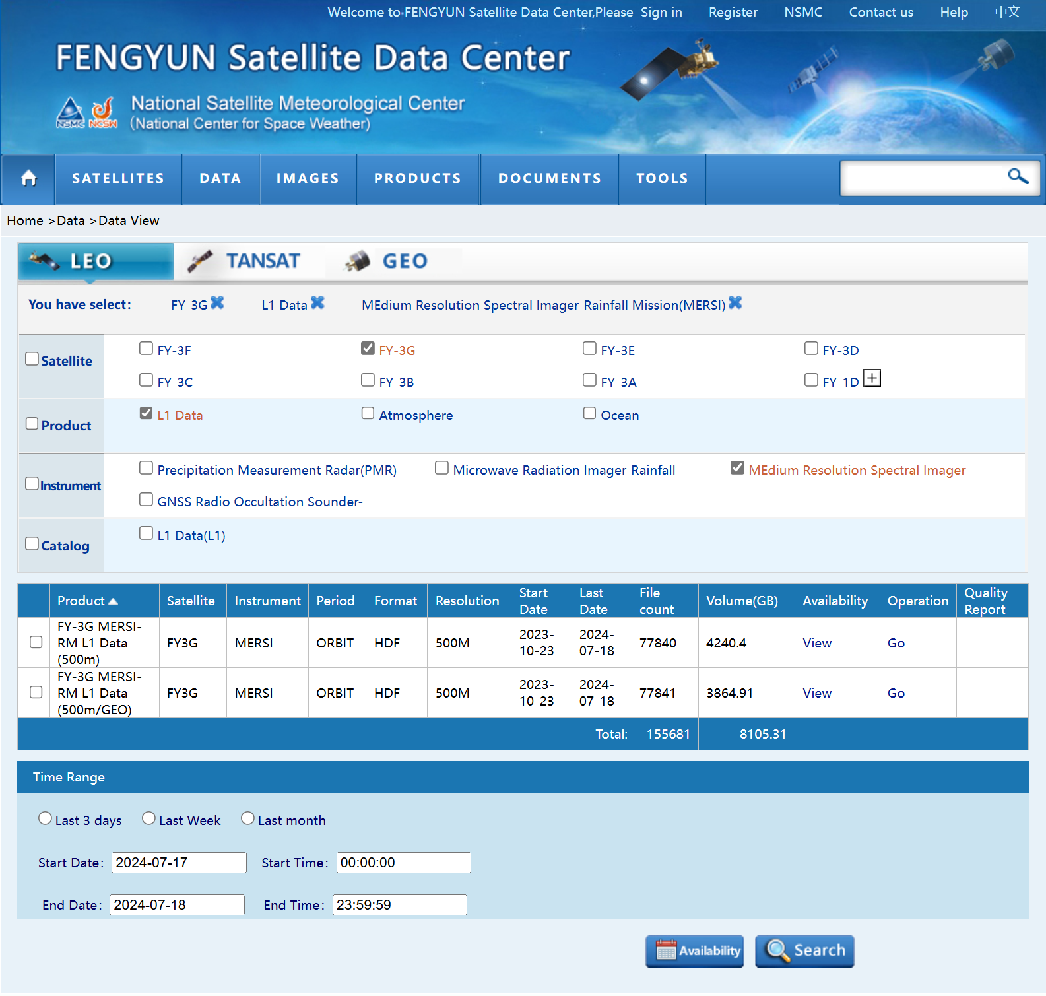
The L1 data of FY-3G/MERSI-RM has been published online, welcome to use FY data!

Slide 19
目录
汇报内容
Thanks for your attation！

