Slide 1
SNO/Vicarious Calibration Focus Group Meeting
Tim Hewison
EUMETSAT
16/01/2025

Slide 2
SNO/Vicarious Calibration Focus Group Meeting 2025-01-16
Yang Guo
  SNO algorithm implemented for MWHS-II on FY-3F
Katherine Wentz
  Absolute Intercalibration of Spaceborne Microwave Radiometers
  focusing on vicarious methods using open ocean and rainforests
Tim Hewison
  Dynamic range v spatial resolution and
  Top Hat v Real Spectral Responses

Slide 3
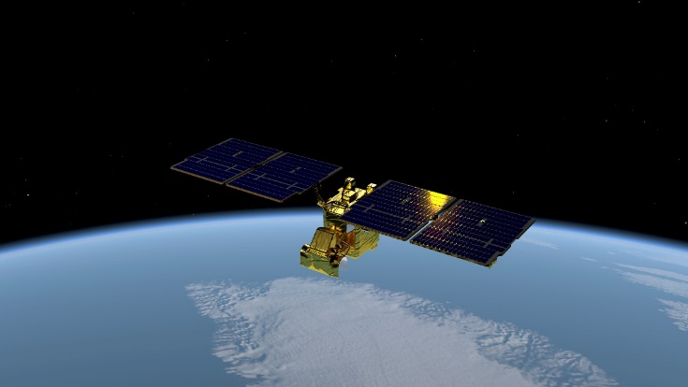
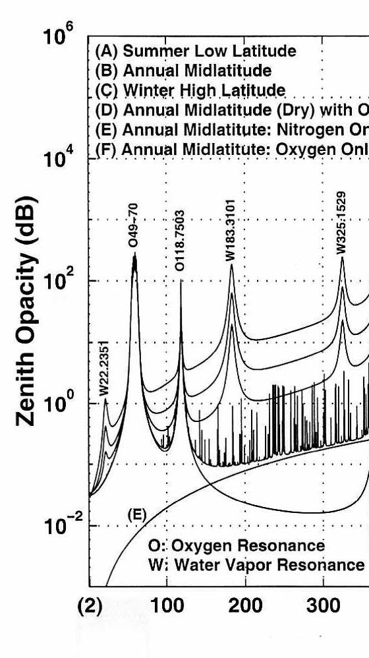
EPS-Sterna / Arctic Weather Satellite (AWS)
Payload:
  MicroWave Radiometer (MWR)
  Scan rate 45 RPM, scan angle ±54.42°
  Swath ~ 2000 km.
Atmospheric spectrum
(Klein and Gasiewski, 2000))
Channel name | Centre Frequency [GHz] | Bandwidth [MHz] | NEΔT [K] | footprint size [km]
STERNA-11 | 50.3 | 180 | <0.6 | ≤ 40 km (±25%)
STERNA-12 | 52.8 | 400 | <0.4
STERNA-13 | 53.246 | 300 | <0.4
STERNA-14 | 53.596 | 370 | <0.4
STERNA-15 | 54.4 | 400 | <0.4
STERNA-16 | 54.94 | 400 | <0.4
STERNA-17 | 55.5 | 330 | <0.5
STERNA-18 | 57.290344 | 330 | <0.6
STERNA-21 | 89 | 4000 | <0.3 | ≤ 20 km (±25%)
STERNA-31 | 165.5 | 2800 | <0.6 | ≤ 10 km (±25%)
STERNA-32 | 176.311 | 2000 | <0.7
STERNA-33 | 178.811 | 2000 | <0.7
STERNA-34 | 180.311 | 1000 | <1
STERNA-35 | 181.511 | 1000 | <1
STERNA-36 | 182.311 | 500 | <1.3
STERNA-41 | 325.15±1.2 | 2x 800 | <1.7 | ≤ 10 km (±25%)
STERNA-42 | 325.15±2.4 | 2x 1200 | <1.4
STERNA-43 | 325.15±4.1 | 2x 1800 | <1.2
STERNA-44 | 325.15±6.6 | 2x 2800 | <1
Courtesy of ESA
AWS:
  Single ESA satellite launched 16 Aug 2024
EPS-Sterna:
  Proposed EUMETSAT constellation 2029-
Spacecraft:
  3-axis stabilised – ion drive
  Sun-sync @ 595km
  Mass: ~135 kg
  Volume: 1.1 x 0.7 x 0.8m
  Power: ~143 W

Slide 4
Test SNO algorithms with AWS Data
AWS testing
  Performance analysis – ongoing
  To inform decision on EPS-Sterna
  L1B data from ESA + EUMETSAT
  Limited data distribution
  Until March 2025
Will apply SNO algorithm with
  AMSU-A/MHS on Metop-B/C
  ATMS on NOAA-20/21
  Trade-off:
    Collocation Target Area
    Collocation Criteria
    Dynamic Range
  Tune algorithm
    SBAF, etc
Sterna Inter-Calibration Study
  With Deimos/UPC
  OCTM & Vicarious Inter-Calibration
  Includes uncertainty analysis (also SNO)
  see presentation on 2025-01-20
AWS-21 (89GHz) TBs from EUM L1B IPP on 13/09/2024

Slide 5
Update to SNO Literature Review Spreadsheet
SharePoint Spreadsheet
  Linked here
  Snapshot here =>
Review published SNO algorithms
Also includes limited review of
  Vicarious inter-calibration
  NWP Double-Difference
Following previous discussion:
Added columns for
  Collocation Area
  Spectral Band / View Angle Adjustment Factor
    SBAF/VAAF
    Unpopulated so far!
Contributions welcome!
Class | Reference | Collocation Area (km) | ds (km) | dt (s) | dVZA (°) | VZAmax (°) | Method | Filter | SBAF /VAAF | L | C | X | K | V | W | F | D | G | H | J | Applicable Sensors
 |  |  |  |  |  |  |  | incl azi angle | Spectral/View adj. | 1.4 | 6.8 | 10.65 | 12-40 | 50-60 | ~89 | ~118 | ~157 | ~183 | ~229 | ~325
Temp Sounders | Zou et al. 2006 | 1x1 | 111 | 100 |  | 5° | SNO |  |  |  |  |  |  | X |  |  |  |  |  |  | MSU Ch2
Temp Sounding | Iacovazzi & Cao, 2007 | 4SDP x 5TDP | 100 | 30 |  | 5° | SNO + bilinear Interp. |  |  |  |  |  | a | X | a |  | a | a |  |  | AMSU-A
 | Iacovazzi & Cao, 2008 | 4SDP x 5TDP | 100 | 30 |  | 5° | SNO + bilinear Interp. | SD<3xNEdT |  |  |  |  | X | X | a |  | a | a |  |  | AMSU-A, ATMS
Temp Sounders | Zou and Wang 2011 | 1x1 | 45 | 50 |  | 5° | SNO |  |  |  |  |  |  | X |  |  |  |  |  |  | AMSU-A , ATMS
Temp+ Humidity Sounding | Ackermann 2020 | 1SDP x 1TDP | 10 | 30 | 10° 3.6° | 10° | SNO + B-G resample |  |  |  |  |  | X | X | X |  | X | X |  |  | AMSU-A AMSU-B+MHS
Humidity Sounding | Moradi et al. 2015 |  | 50 | 3600 |  | Nadir | SNO |  |  |  |  |  |  |  |  |  |  | X |  |  | ATMS SAPHIR
 | John et al. 2012 | 3SDP x 3TDP | 5 | 300 |  | 3.9° | SNO |  |  |  |  |  |  |  |  |  |  | X |  |  | MHS
 | EUMETSAT MHS FCDR 2023 |  | 10 | 300 3600 | 5% | 15° | SNO | SD(3x3)<NEDT *sqrt(2) |  |  |  |  |  |  |  |  |  | X |  |  | MHS
 | Dou et al. 2022 | 1SDP x 1TDP | 3 | 1200 |  | 5° | SNO | +SD(3x3)<1K |  |  |  |  |  |  |  |  |  | X |  |  | MWHS-MHS
 | Xie et al, 2024 | 1SDP x 1TDP | 3 | 900 |  | 5° | SNO |  |  |  |  |  |  |  |  |  |  | X |  |  | MWHS2-ATMS
Window SNO | Yan & Weng, 2008 | 1SDP x 1TDP | 12.5 | 60 |  | All | SCO | SD<1K |  |  |  |  | X | X | X |  |  |  |  |  | SSMIS-SSM/I
 | Song Yang et al., 2011 |  | 3 | 120 |  | All | SCO | SD<2K, |dTb|<10K |  |  |  |  | X |  | X |  |  |  |  |  | SSM/I
 | Zou et al. 2014 |  | 15 | 60 |  |  | SNO + B-G resample | +1-sigma |  |  |  |  | X | X | X |  |  |  |  |  | AMSU-ATMS
 | Yang et al., 2020 "IMICA" | 2SDP x 1TDP | 50-75 | 50 |  | 3.3° | SNO | +SD |  |  |  |  | X |  | X |  |  |  |  |  | AMSU-A
 | Yan et al., 2020 |  | 30 | 80 |  |  | SNO | +SD<2K |  |  |  |  | X | X | X |  |  |  |  |  | AMSU
Generic SNO | Hewison 2023 - Proposal for Sterna inter-calibration (STC) |  | 7.5 | 900 | 5° /1?° | 5° /55?° | SNO+OCTM /SCO |  | SBAF /TBD |  |  |  |  | X | X |  | X | X |  | X | Sterna-MWS/ATMS Sterna-ICI

Slide 6
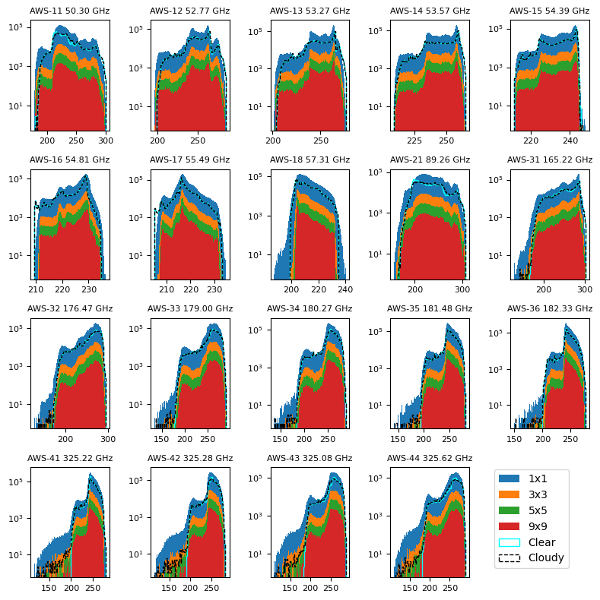
Dynamic Range v Res.
Histograms of AWS observations
  18 November 2024
  Full day - Global distribution
  Different bin resolutions
  Bigger bins => Lower Range
  Esp. >100GHz (scattering in DCC)
RTTOV + Instr. Sim.
  ERA5
  3 days/month for 2018
  00z and 12z
  Clear + Cloudy
  AWS Top Hat SRFs
  Nadir Only
  ~Match for AWS in 4x4 bins

Slide 7
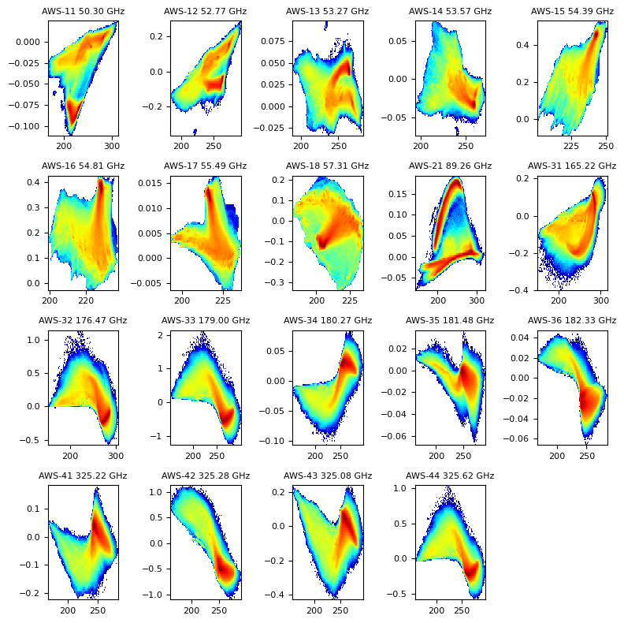
SBAF: Real v Top Hat SRF
RTTOV coefficients
  Real AWS SRF
  Nominal Top Hat SRF
Differences >1K
  183GHz edge channels
  Single-sideband
WFs similar (tropics, clear):
  AWS-33 ~ AWS-44
  AWS-34 ~ AWS-43
  AWS-35 ~ AWS-42
  AWS-36 ~ AWS-41
Repeating for ATMS
  DSB 183GHz channels
Repeating for ICI
  Squarer SRFs, DSB 183GHz, 53°
Any other experience?
Difference in nadir TOA Tb clear sky simulated from 72 2018 ERA5 profiles
x: Tb (TopHat)
y Tb(SRF)-Tb(TopHat)

Slide 8
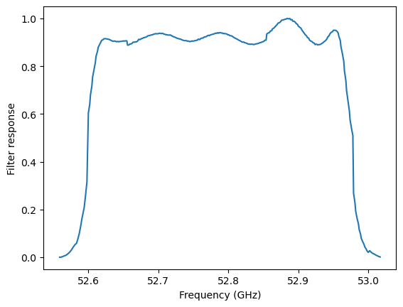
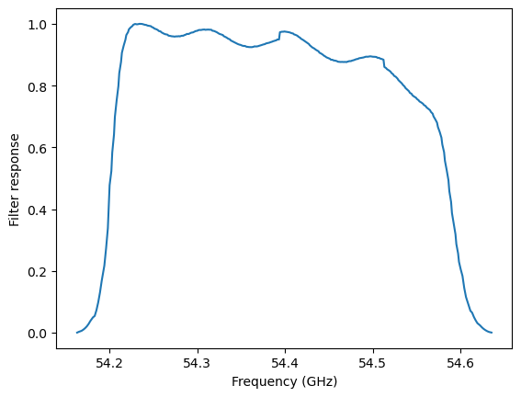
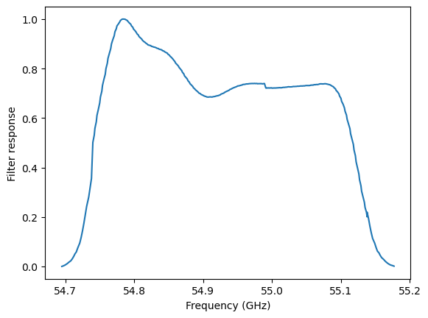
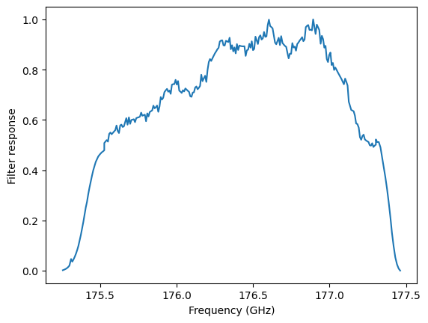
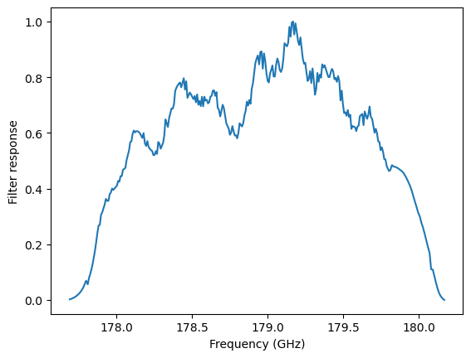
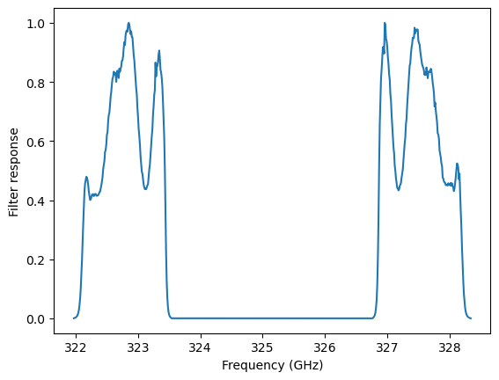
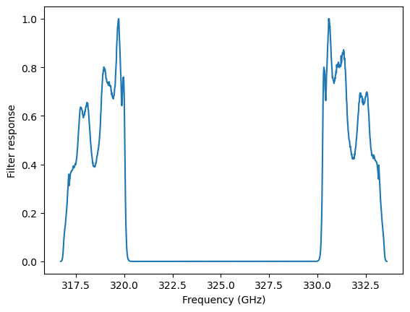
AWS-PFM SRFs from NWP-SAF (showing rough bands)
Ch05
AWS-15
54.40 ± 0.20
Ch02
AWS-12
52.80 ± 0.20
Ch06
AWS-16
54.94 ± 0.20
Ch11
AWS-32
176.311 ± 1.000
Ch12
AWS-33
178.811 ± 1.000
Ch17
AWS-42
325.15 ± 2.400
± 0.600
Ch19
AWS-44
325.15 ± 6.600
± 1.400

Slide 9
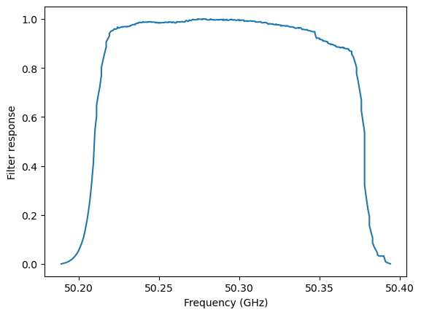
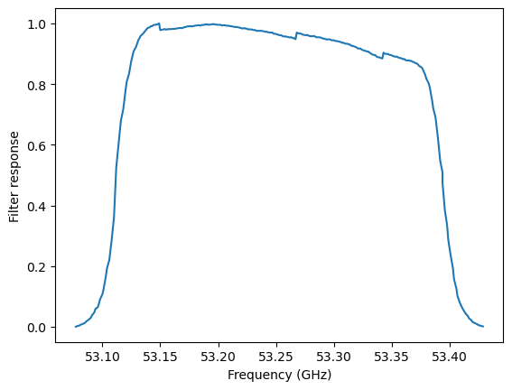
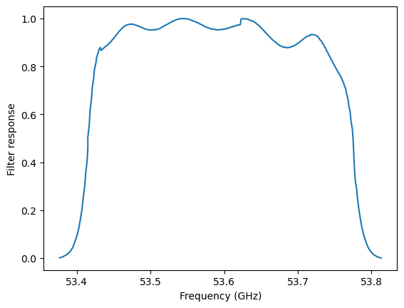
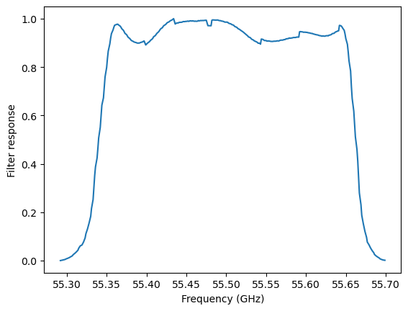
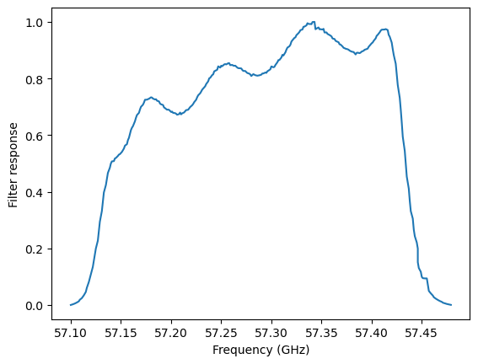
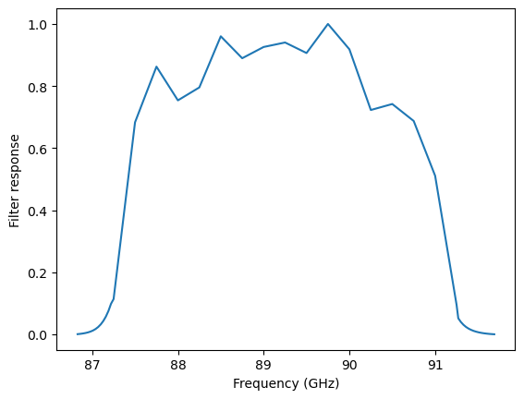
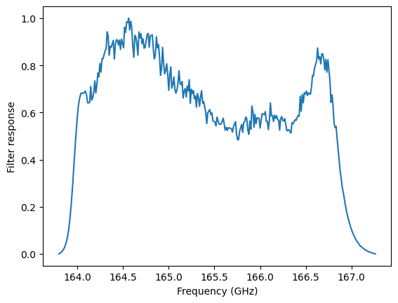
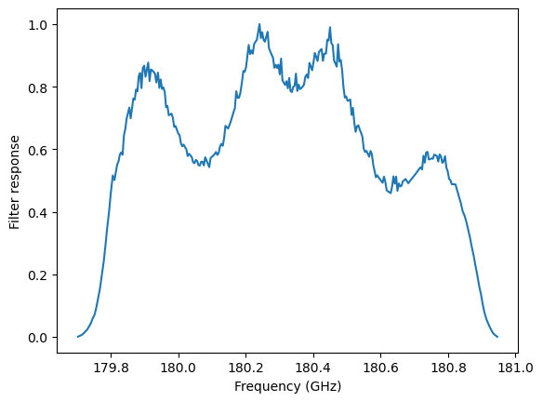
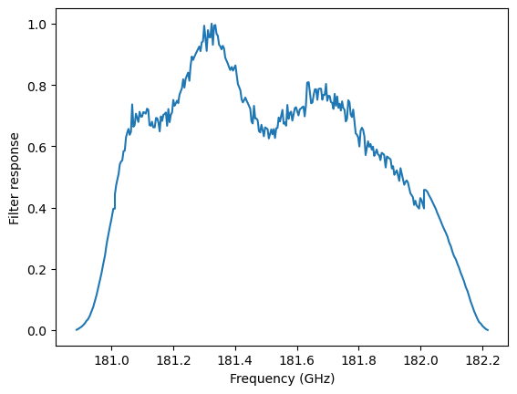
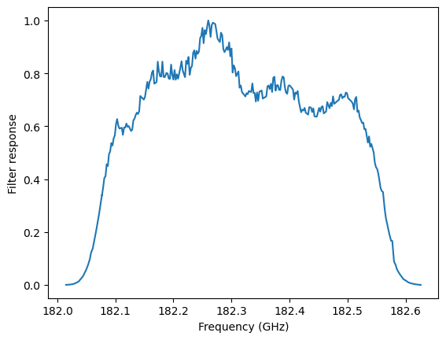
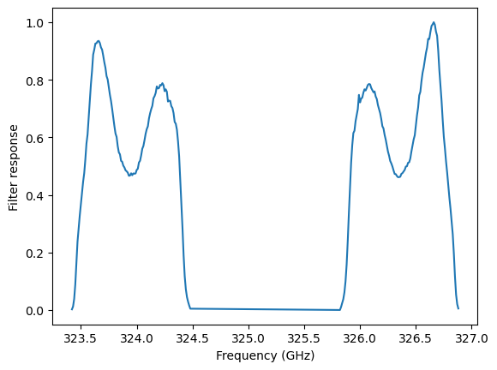
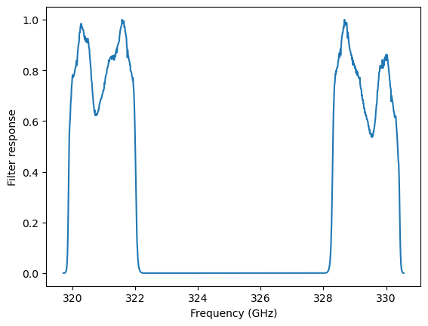
ATMS-20 Ch20
183.311 ± 3.000
Ch01
AWS-11
50.300 ± 0.090
Ch02
AWS-12
52.800 ± 0.150
Ch03
AWS-13
53.246 ± 0.150
Ch04
AWS-14
53.596 ± 0.185
Ch05
AWS-15
54.400 ± 0.200
Ch06
AWS-16
54.94 ± 0.200
Ch07
AWS-17
55.50 ± 0.175
Ch08
AWS-18
57.290 ± 0.175
Ch09
AWS-21
89 ± 2
Ch10
AWS-31
165.5 ± 1.4
Ch11
AWS-32
176.311 ± 1.000
Ch12
AWS-33
178.811 ± 1.000
Ch13
AWS-34
180.311 ± 0.500
Ch14
AWS-35
181.511 ± 0.500
Ch15
AWS-36
182.311 ± 0.250
Ch16
AWS-41
325.15 ± 1.200
Ch17
AWS-42
325.15 ± 2.400
Ch18
AWS-43
325.15 ± 4.100
Ch19
AWS-44
325.15 ± 6.600
Ch14
AWS-35
181.511 ± 0.500

Slide 10
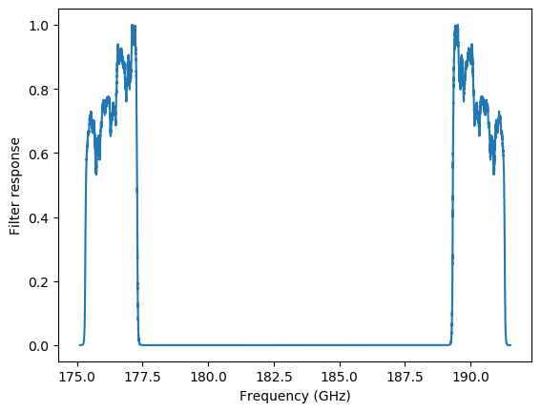
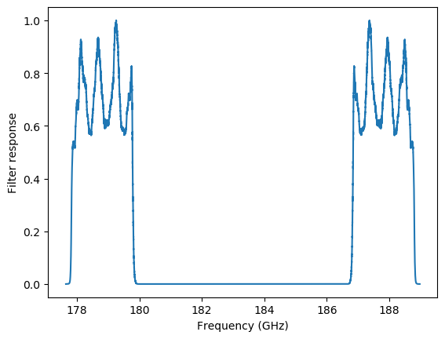
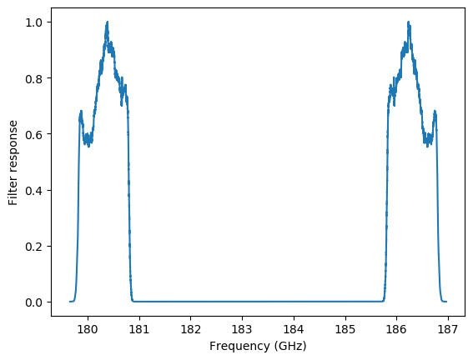
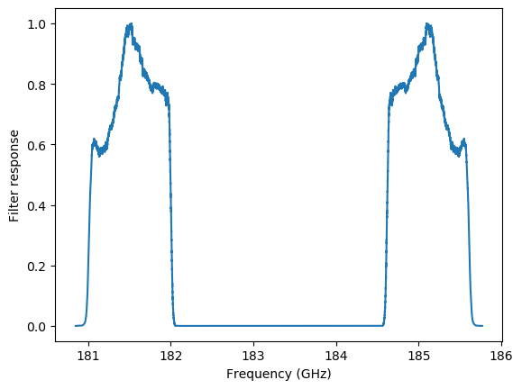
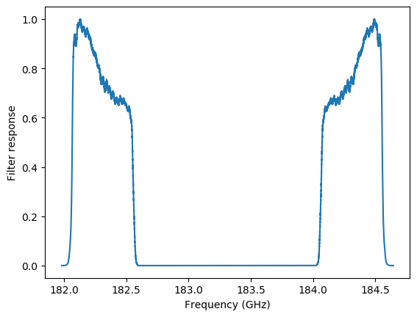
ATMS 183GHz SRFs compared to AWS-PFM SRFs
ATMS-20 Ch18
183.311 ± 7.000
ATMS-20 Ch19
183.311 ± 4.500
ATMS-20 Ch20
183.311 ± 3.000
ATMS-20 Ch21
183.311 ± 1.800
ATMS-20 Ch22
183.311 ± 1.000
Ch11
AWS-32
176.311 ± 1.000
Ch12
AWS-33
178.811 ± 1.000
Ch13
AWS-34
180.311 ± 0.500
Ch14
AWS-35
181.511 ± 0.500
Ch15
AWS-36
182.311 ± 0.250

