Slide 1
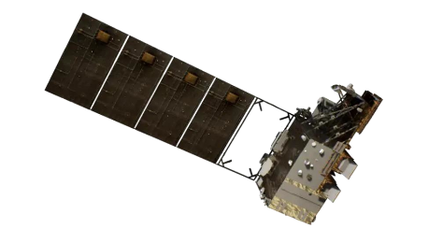
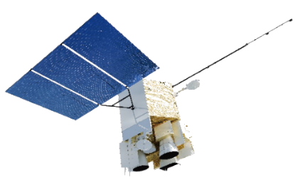
Global Pseudo-Invariant Pixels (GPIPs) Selection:
A Big Data Approach for Radiometric Calibration
Junwei Wang
National Satellite Meteorological Center (NSMC), CMA
Notes:
Hello everyone, Thank you for being here. My name is Junwei Wang from the CMA. Today, my topic is Global Pseudo-Invariant Pixels (GPIPs) Selection, and its application in radiometric calibration.

Slide 2
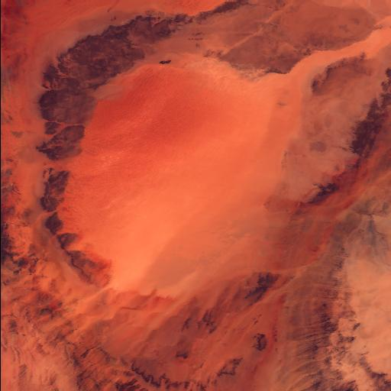

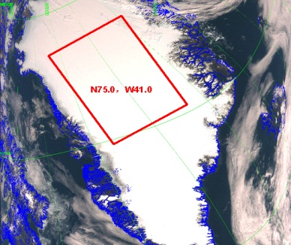
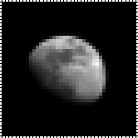

Background and Motivation
Traditional Vicarious calibration(VC) methods:
Earth surfaces with suitable characteristics have long served as benchmark or test sites to verify the post-launch radiometric calibration performance of satellite instruments.
Field campaigns on reference standard test sites (eg. Dunhuang, Railroad Valley Playa)
Pseudo-invariant calibration sites (PICS)
Ice or snow fields (Greenland, Dome C, Tibetan Plateau Glaciers)
Deep convective clouds (DCC) /Liquid water cloud
Rayleigh scattering
Sun glint
The Moon
Limitations:
Site selection based on prior knowledge
Large and homogenous regions
Number of these targets are limited, resulting in low calibration frequency and narrow dynamic ranges
Notes:
Let’s begin with a brief background introduction and the motivation behind this study. We know that traditional vicarious calibration methods primarily rely on sites with suitable characteristics. they have long served as benchmarks or test sites to verify the post-launch radiometric calibration performance of satellite instruments. For example, reference test sites for field campaigns, like Dunhuang in China, and desert PICS, ice and snow targets such as Greenland and Dome C, cloud targets like DCC, as well as oceanic targets and the Moon.
Typically, these targets are selected based on prior knowledge. The identification of these PICS relies on careful criterion selection for characteristics such as spatial extent, temporal stability, and spatial uniformity. The number and types of these targets are limited, which will result in low calibration frequency and narrow dynamic ranges

Slide 3
Motivation
Is it possible to automatically determine targets in the scene for sensor calibration?
Can we expand the existing calibration PICS to include a wider variety of sample types, a broader dynamic range of reflectance, and more frequent calibration checks and updates?
This study extends PICS to pseudo-invariant pixels (PIPs) to monitor the long-term degradation of the spaceborne sensors, and also provides prior information and guidance for further global PICS selection
Notes:
The motivation for this work includes two key aspects: Is it possible to automatically determine targets in the scene for sensor calibration? Can we expand the existing calibration PICS to include a wider variety of sample types, a broader dynamic range of reflectance, and more frequent calibration checks and updates?
This study extends PICS to pseudo-invariant pixels (which I will refer to as PIPs) to monitor the long-term degradation of the spaceborne sensors, and also provides prior information and guidance for further global PICS selection

Slide 4
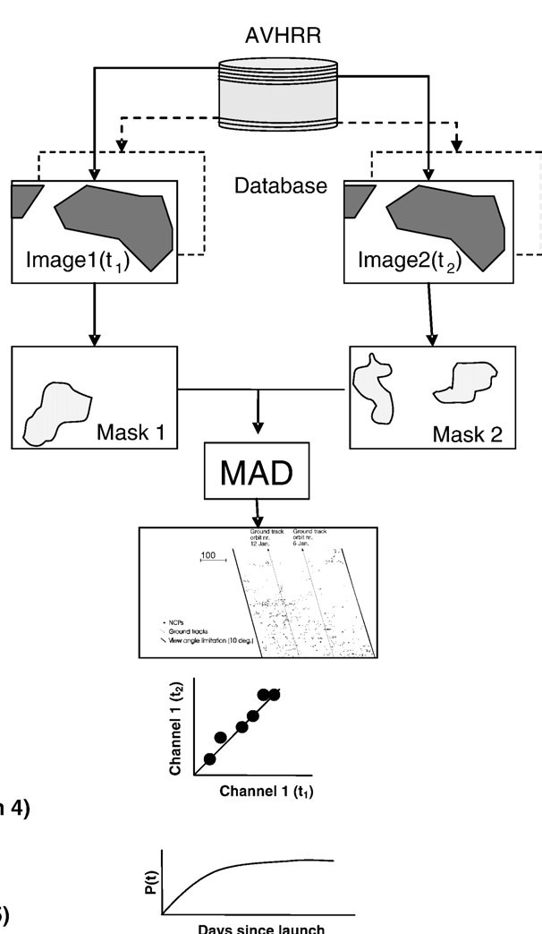
IR-MAD technique for PIPs selection
Image pairs
IR-MAD：iteratively re-weighted multivariate alteration detection (MAD)
The IR-MAD technique was first proposed for change detection by Nielsen (1998,2007), and later used in the radiometric normalization (Canty et.al, 2004, 2008), radiometric calibration of AVHRR (Schmidt, 2008)
Consider an image pair (F, G) composed of two images acquired at different times by the same sensor
The most intuitive way to detect change or no-change in the scene is to calculate the difference of the two images, but is overly naive to synthesize changes information across all bands
Nielsen (1998) suggests transforming the original data into a feature space to better synthesize information from all bands by a linear transformation of F and G to achieve the maximum variance of the MAD variates.
(Schmidt, 2008)
Notes:
Here, I will provide a detailed explanation of the IR-MAD (Iteratively Reweighted Multivariate Alteration Detection) technique used for selecting PIPs.
The IR-MAD technique was first proposed for change detection by Nielsen, and later used in the radiometric normalization, radiometric calibration of AVHRR.
Consider an image pair of two multi-spectral images with N bands acquired at time t1 and t2 over the same geographical region as random vectors (F, G).
The most intuitive way to detect change or no-change in the scene is to calculate the difference of the two images. In this way, regions with significant changes will exhibit large absolute values, while areas with no-change will have low or zero absolute values. However, this approach is overly naive to synthesize changes information across all bands, as some changes may be evident in certain bands but not in others. Nielsen suggests transforming the original data into a feature space to better synthesize information from all bands, facilitating the detection of changes or no-change in the scene. The MAD variates in feature space can be determined by a linear transformation of F and G with coefficients vectors a and b to achieve the maximum variance of the MAD variates.

Slide 5
IR-MAD technique for PIPs selection
Image pairs
The coefficients vectors a and b can be resolved by a canonical correlation analysis. There are two important properties associated with MAD variates, which are highly relevant to the identification of PIPs:
The MAD variates are invariant under linear transformations of either or both of the original images, thus is insensitive to the differences in gain and offset settings of the sensor
The MAD variates are mutually orthogonal (uncorrelated), which will ideally follow a multivariate normal distribution with a diagonal covariance matrix
The random variate Z would follow a chi-square distribution .
Typically, the k value is set to the 0.9 upper percentile of the chi-square distribution
Pixels that meet this criterion are designated as PIPs and can be used for calibration
The PIPs in the scene are statistically selected without a prior knowledge of the surface.
(Schmidt, 2008)
Notes:
The coefficients vectors a and b can be resolved by a canonical correlation analysis. There are two important properties associated with MAD variates, which are highly relevant to the identification of PIPs:
first ) The MAD variates are invariant under linear transformations of either or both of the original images. This implies that they are insensitive to the differences in gain and offset settings of the sensor, hence an accurate relative radiometric calibration is superfluous;
second) The MAD variates are mutually orthogonal (uncorrelated). According to the Central Limit Theorem, the MAD variates, which are determined through several additions and subtractions across all bands, will ideally follow a multivariate normal distribution with a diagonal covariance matrix.
Let the sum of the squares of the standardized MAD variates as the random variate Z, as shown in the Equation below, where sigma_i is the standard deviation of the MAD_i
Then, the random variate Z would follow a chi-square distribution with N degrees of freedom. a decision threshold k can be set to select PIPs within the scene. Typically, the k value is set to the 0.9 upper percentile of the chi-square distribution. Meaning that pixels whose probability of no-change is greater than 90% will be designated as PIPs. Therefore, the only differences in PIPs between the two images are attributed to slight random effects, such as instrument noise and atmospheric fluctuations, rather than changes in the targets themselves. The PIPs in the scene are statistically selected without a prior knowledge of the surface.

Slide 6
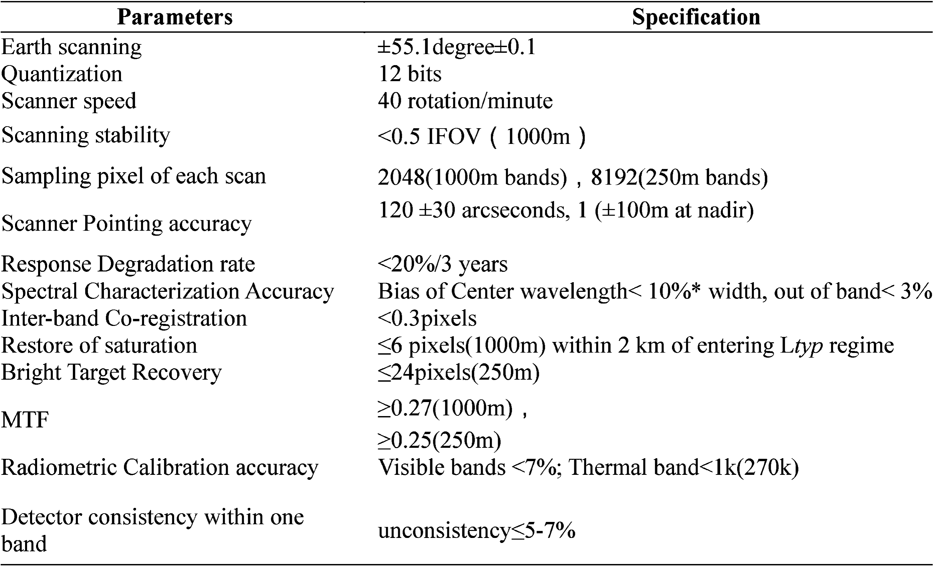
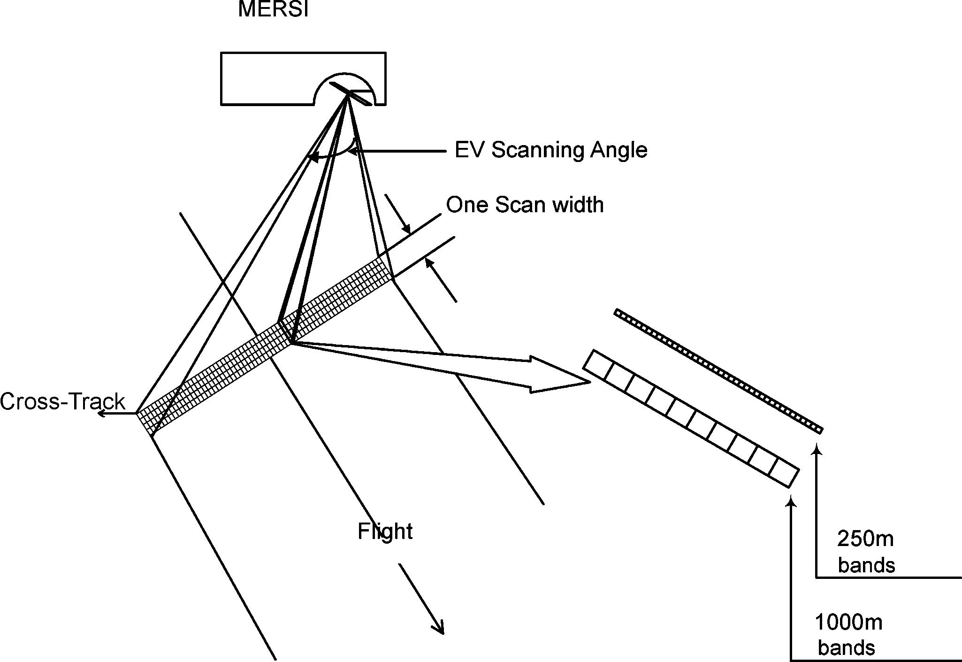
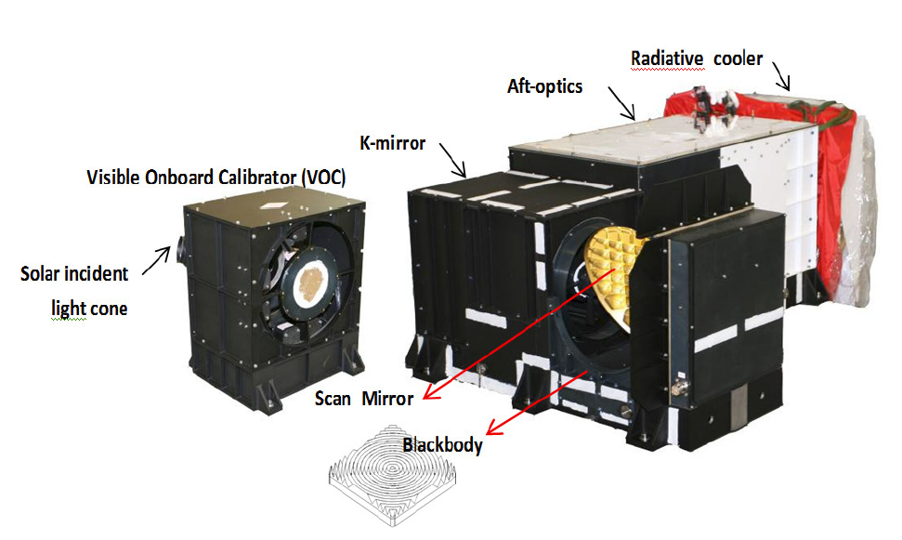
Dataset: FY-3D/MERSI-II, 2018-2023
Medium Resolution Spectral Imager
Notes:
The data used in this study comes from the MERSI-II onboard the FY-3D satellite, covering the time period from 2018 to 2023. MERSI-II has 25 spectral bands, of which 19 are reflective solar bands (RSBs) and 6 are thermal emissive bands (TEBs), MERSI-II has two onboard calibrators: a visible onboard calibrator (called VOC) for reflective solar bands. Nevertheless, due to the limitations and inherent degradation of the VOC, MERSI-II still relies on vicarious calibration methods for regular radiometric calibration updates of reflective solar bands.
This study exclusively uses 10 RSBs for the determination of PIPs. Band 5 is the cirrus cloud band characterized by low energy, and bands 8-15 are the ocean color bands that may saturate in bright targets. Therefore, these bands are not considered in this analysis. Based on the identified PIPs, we can analyze the long-term degradation of MERSI RSBs during this period.

Slide 7
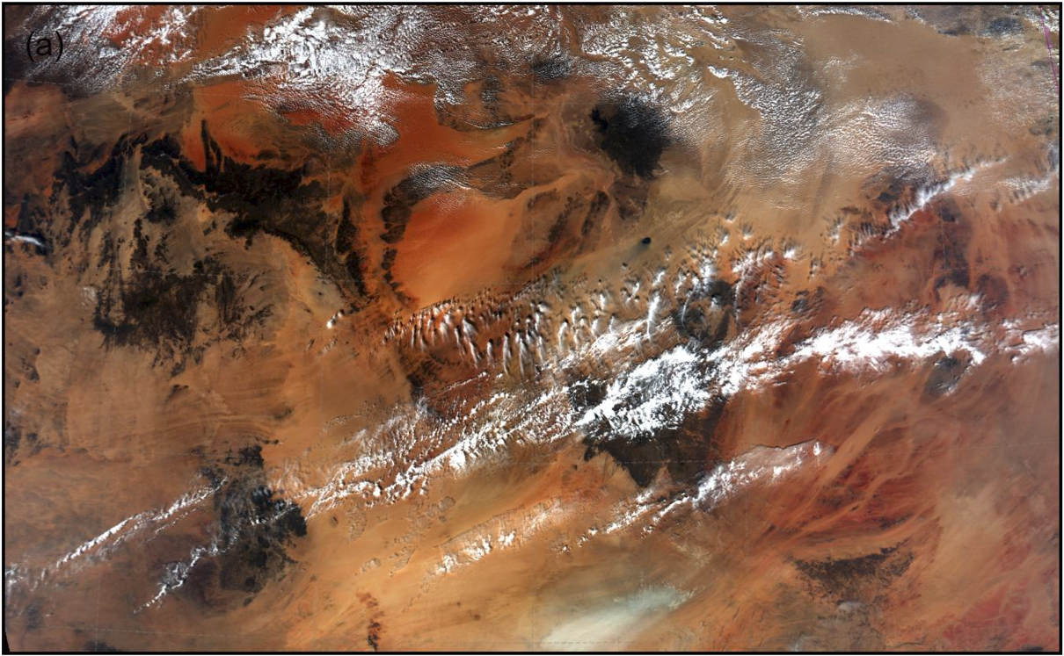
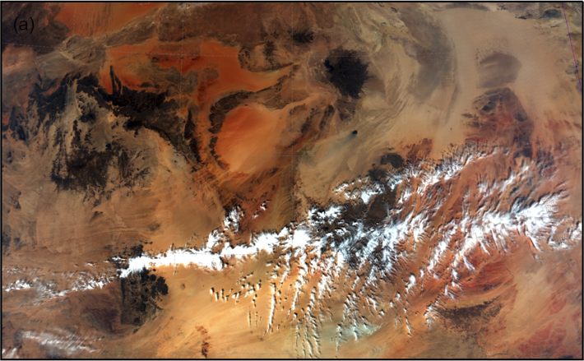
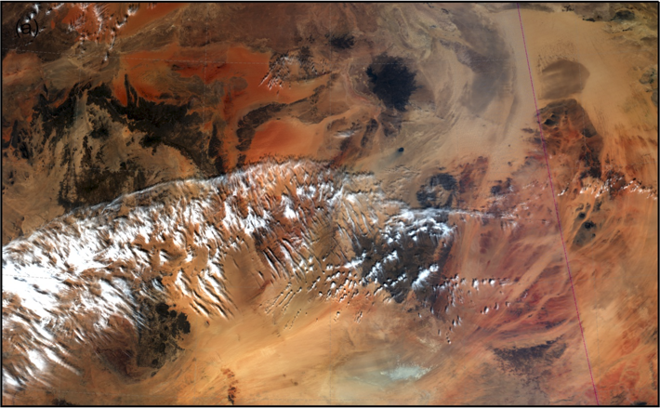
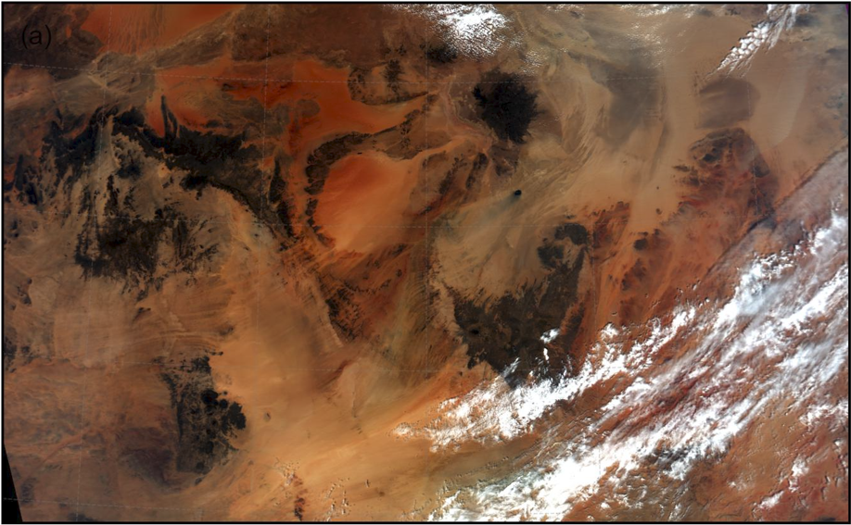
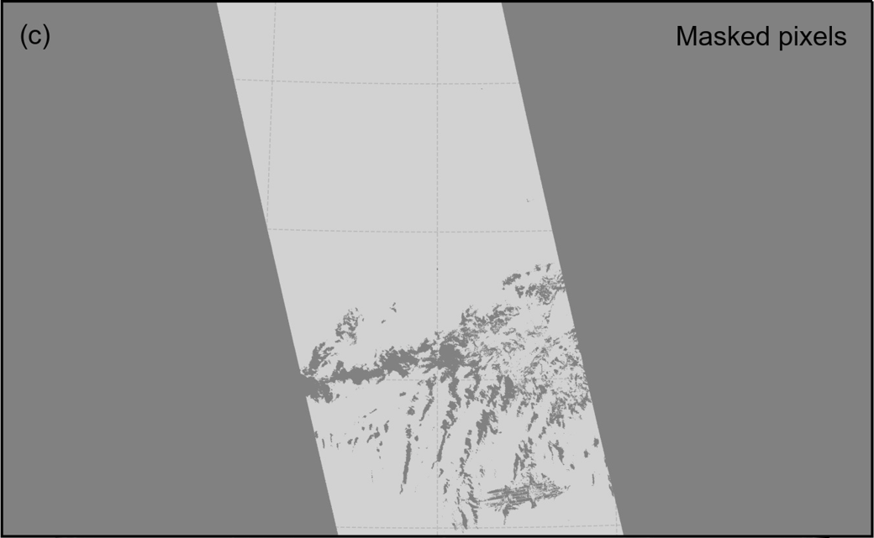
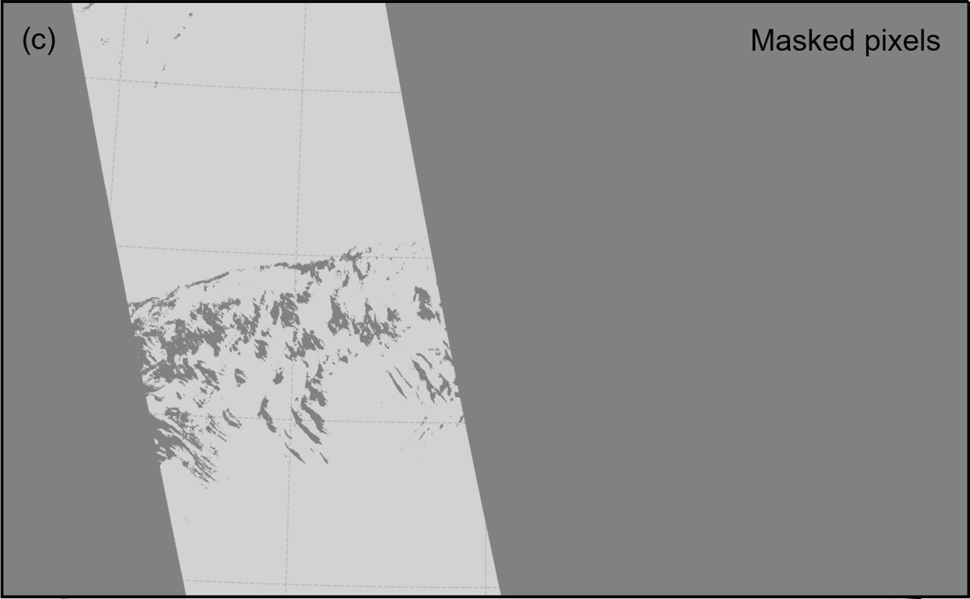
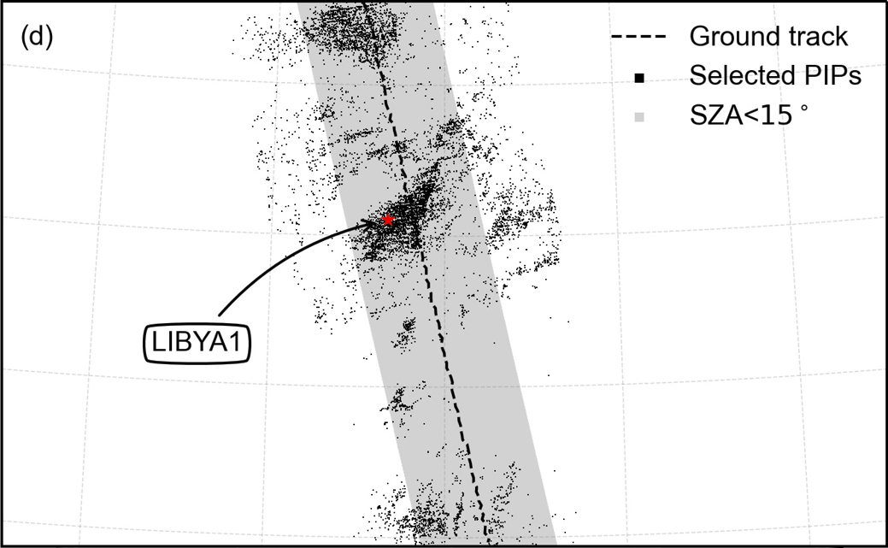
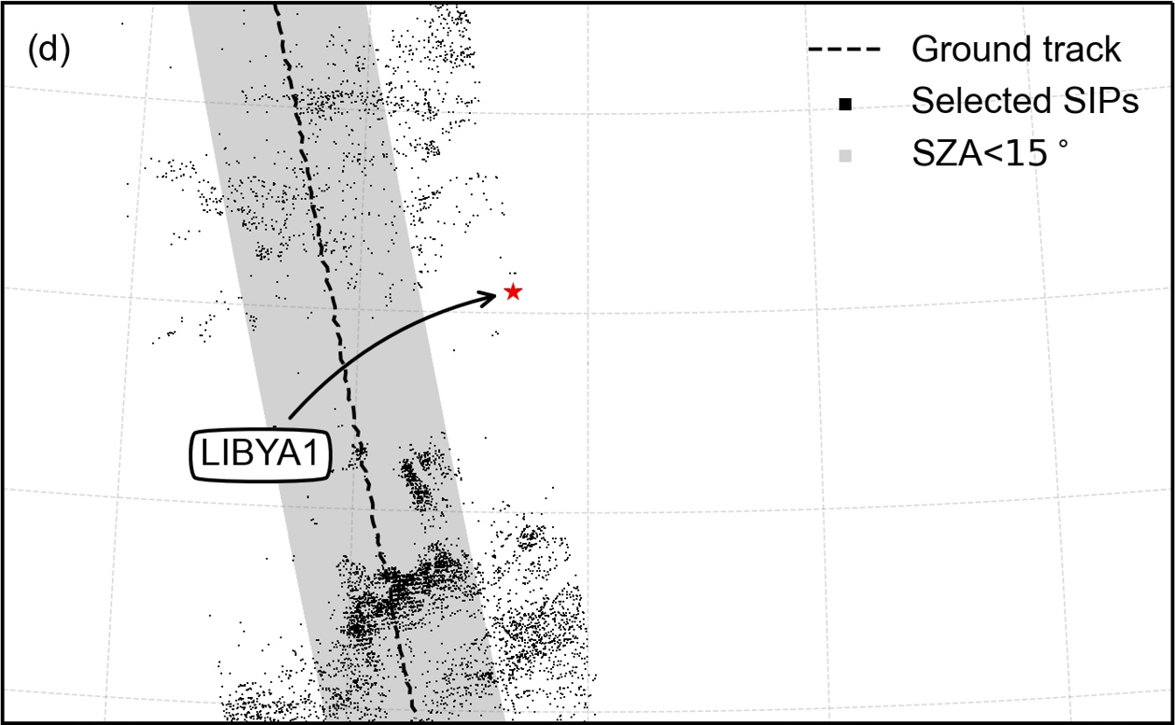
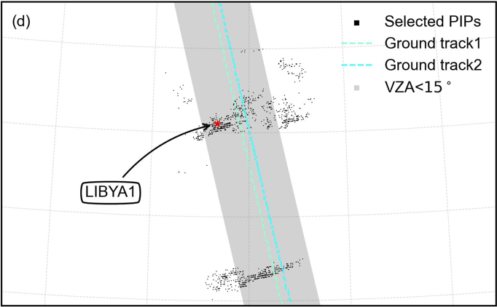
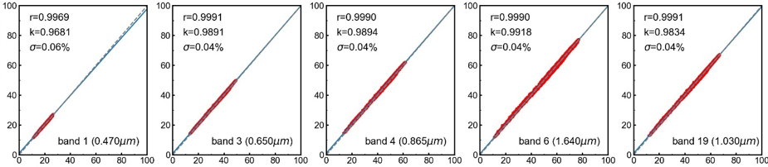
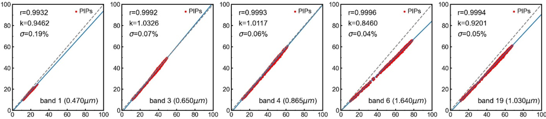
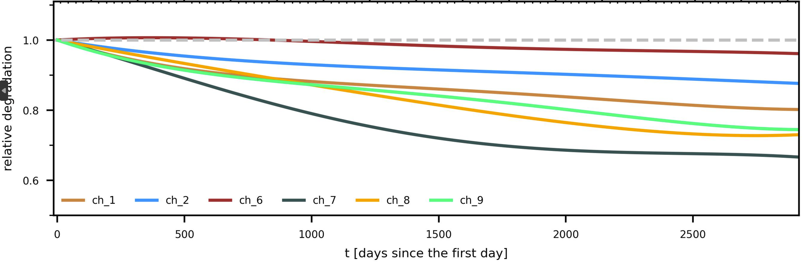
Flowchart of PIPs-based calibration
Processing Flowchart：
timeline
t₁
t₂
t₃
t_{n}
Reproject the long-term data onto a common geographic grid and construct the image-pairs.
Mask out cloudy pixels (not strict) and pixels with sensor zenith angles greater than 30°.
Select pseudo-invariant pixels (PIPs) by the IR-MAD technique
Regression on PIPs to get regression slope, which is a measurement of the relative degradation
Polynomial fitting for long-term degradation trends
Dataset:
…
Mask:
…
…
…
IR-MAD
…
IR-MAD
…
IR-MAD
…
PIPs:
…
…
…
Degradation:
…
…
Degradation trend:
Notes:
Here is the flowchart for PIPs-based calibration, which consists of five main steps. I will provide the specific details of these steps later.
First, Reproject the long-term data onto a common geographic grid and construct the image-pairs.
And then, Mask out cloudy pixels (not strict) and pixels with sensor zenith angles greater than 30°.
Then, Select pseudo-invariant pixels (PIPs) by the IR-MAD technique
Next, Regression on PIPs to get regression slope, which is a measurement of the relative degradation
Finally, Polynomial fitting for long-term degradation trends

Slide 8
Implementation details
We assume that the differences in PIPs between the two images stem solely from the linear effects caused by variations in sensor gain or sensor degradation. Therefore, other potential factors that may contribute to differences should be eliminated or minimized as much as possible.
For a given image, another image can be compared with it when satisfying the following criteria:
The ground tracks of satellite orbit should be similar ( 100 km) to reduce the impact of BRDF effect;
The time interval between the two images should be within 365.25*y ±20 days (y=0, 1, 2, 3,. . . years) to minimize seasonal differences, such as surface changes, solar declination and atmospheric conditions.
To compare image pairs and select PIPs, set a mask with the following criteria:
Masking cloud and ocean pixels in the scene to enhance the sensitivity of the IR-MAD method
Limiting pixels with sensor zenith angle (VZA) ＜30° for IR-MAD analysis and selecting only PIPs with VZA＜15 ° to minimize registration errors between the two images and the impact of BRDF effect.
A set of criteria for filtering out invalid image-pair comparisons includes:
Image pairs without enough samples for statistical analysis will be discarded.
For an image pair, comparisons will be discarded if the number of PIPs is less than 500 or the regression line correlation is less than 0.95.
Notes:
Here are some implementation details aimed at reducing errors and uncertainties during the calibration process. We assume that the differences in PIPs between the two images stem solely from the linear effects caused by variations in sensor gain or sensor degradation. Therefore, other potential factors that may contribute to differences should be eliminated or minimized as much as possible.
First, when constructing image pairs, For a given image, another image can be compared with it when satisfying the following criteria:
One is the ground tracks of satellite orbit should be similar ( 100 km) to reduce the impact of BRDF effect;
The time interval between the two images should be within a time window of plus or minus 20 days around the anniversary date applied to minimize seasonal differences, such as surface changes, solar declination and atmospheric conditions.
Second, to compare image pairs and select PIPs, set a mask with the following criteria: Masking cloud and ocean pixels in the scene to enhance the sensitivity of the IR-MAD method, and Limiting pixels with sensor zenith angle (VZA) less than 30 degrees for IR-MAD analysis and selecting only PIPs with sensor zenith angle less than 15degrees to minimize registration errors between the two images and the impact of BRDF effect.
Third, set a set of criteria for filtering out invalid image-pair comparisons includes:
Image pairs without enough samples for statistical analysis will be discarded.
For an image pair, comparisons will be discarded if the number of PIPs is less than 500 or the regression line correlation is less than zero point nine five.

Slide 9
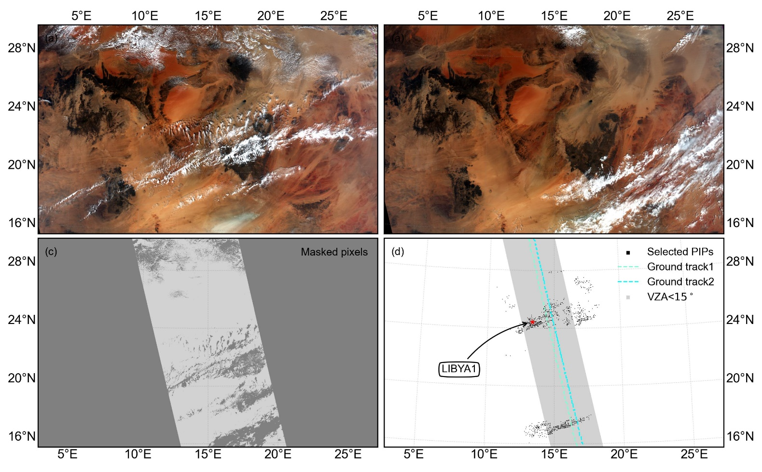
An example of PIPs selection
An example of PIPs selection applied to two images (one image-pair) acquired at different times by FY-3D/MERSI-II.
Pixels with large view zenith (>30◦) angle and contaminated by clouds are masked.
Despite the fact that the selection of (PIPs) does not require any prior knowledge of the targets, the LIBYA1 is automatically included in the PIPs.
Notes:
Here is an example of PIPs selection applied to two images acquired at different times by MERSI-II.
In this comparison, Pixels with large view zenith angle (greater than 30 degrees) and contaminated by clouds are masked.
It can be seen that despite the fact that the selection of (PIPs) does not require any prior knowledge of the targets, the LIBYA1 is automatically included in the PIPs.

Slide 10
PIPs Aggregation for GPIPs
PIPs from one image-pair only reflects pseudo-invariant pixels within the scene for that specific time interval under the current atmospheric conditions.
Aggregate PIPs from a substantial number of image-pairs with varying atmospheric conditions, time periods and intervals:
The aggregated PIPs with high frequency reflect surface characteristics that are more Lambertian, with lower atmospheric water vapor and aerosol loading, lower cloud cover probability, and higher temporal stability.
Notes:
PIPs from one image-pair only reflects pseudo-invariant pixels within the scene for that specific time interval under the current atmospheric conditions.
Aggregate PIPs from a substantial number of image-pairs with varying atmospheric conditions, time periods and intervals:
The aggregated PIPs with high frequency reflect surface characteristics that are more Lambertian, with lower atmospheric water vapor and aerosol loading, lower cloud cover probability, and higher temporal stability.

Slide 11
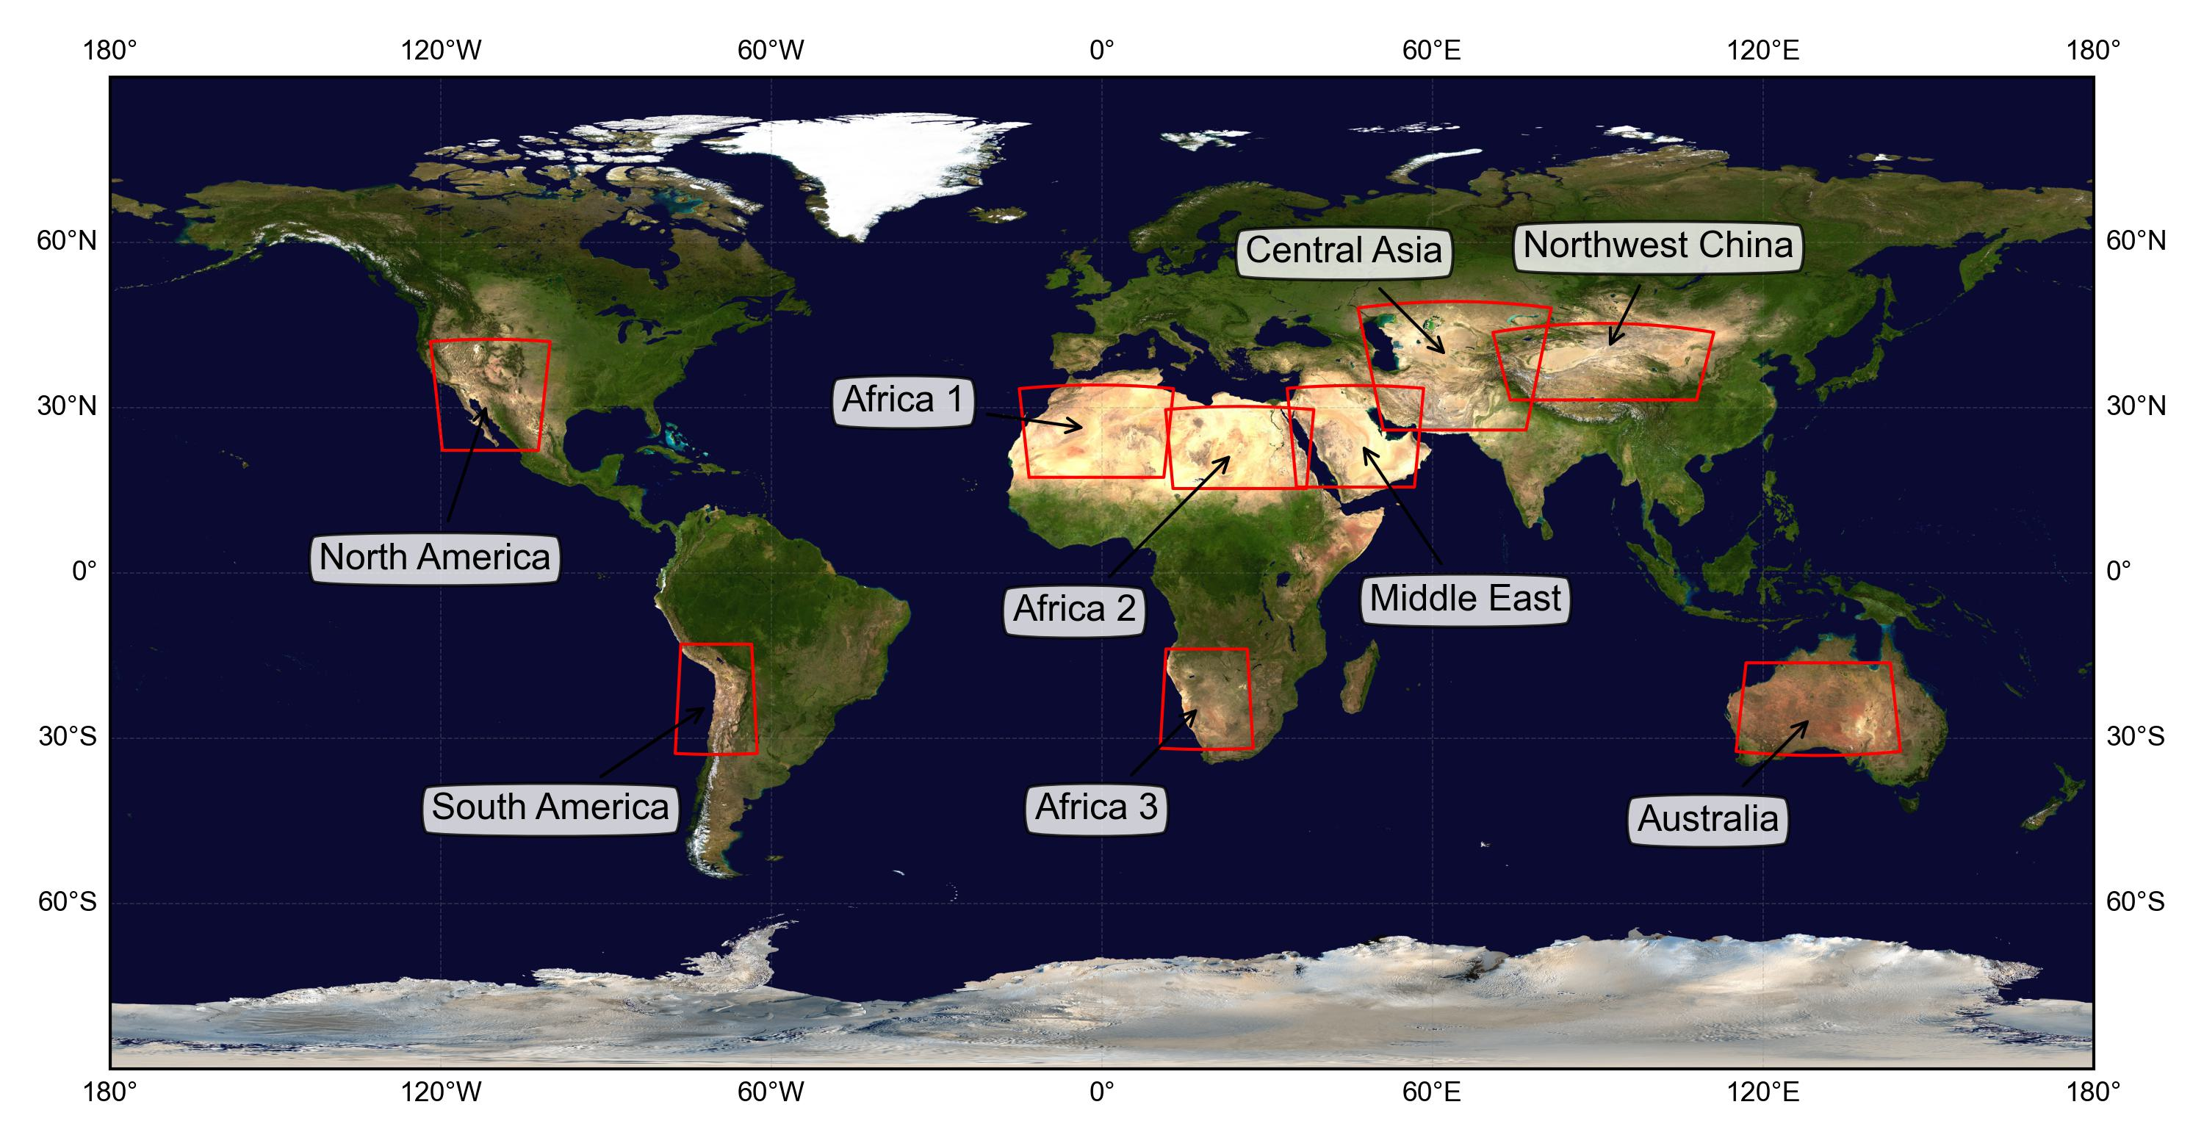
Global PIPs (GPIPs): data and ROI
On a global scale, select global PIPs (GPIPs) based on long-term time series big data analysis.
The FY-3D/MERSI-II L1 data spanning a period exceeding five years (from 20180101 to 20230901)
Notes:
We can search for PIPs on a global scale. We have selected nine potential PIPs-containing regions and conducted the same study in these areas to observe the consistency of sensor degradation results across regions, and to identify the PIPs distribution in each region.

Slide 12
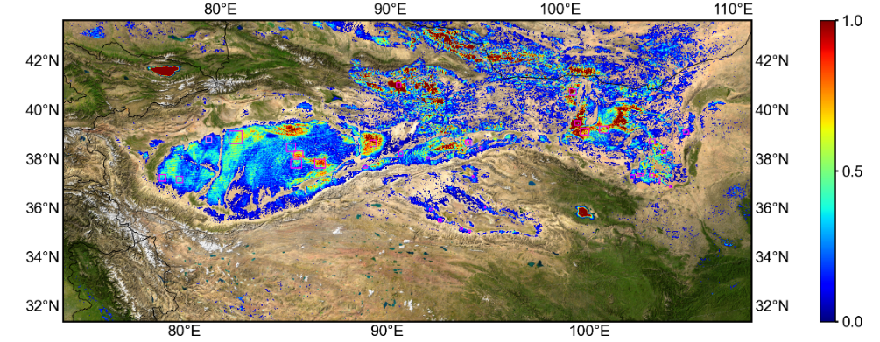
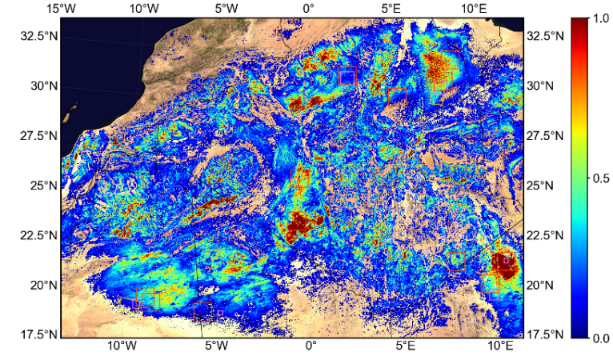
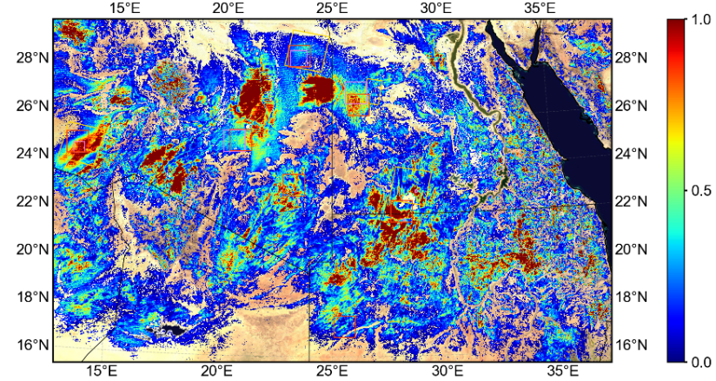
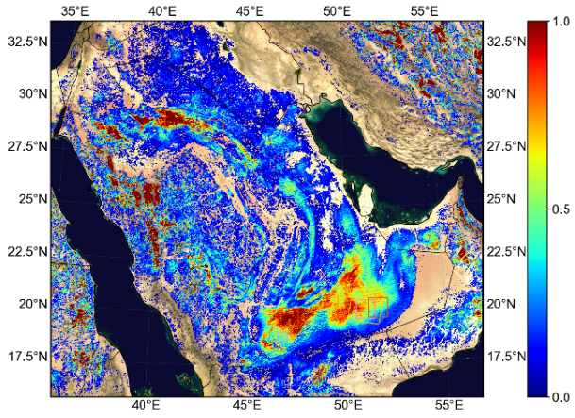
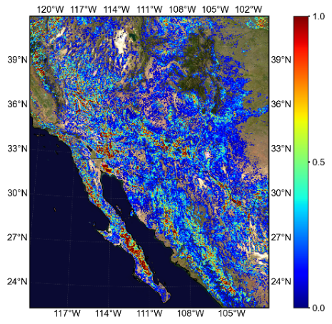
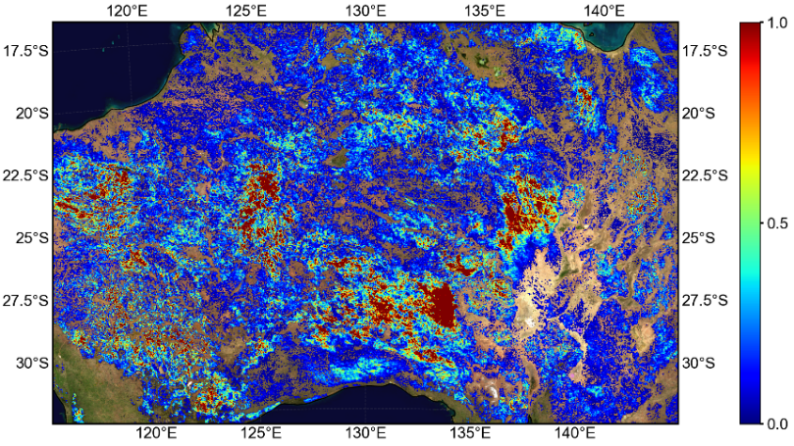
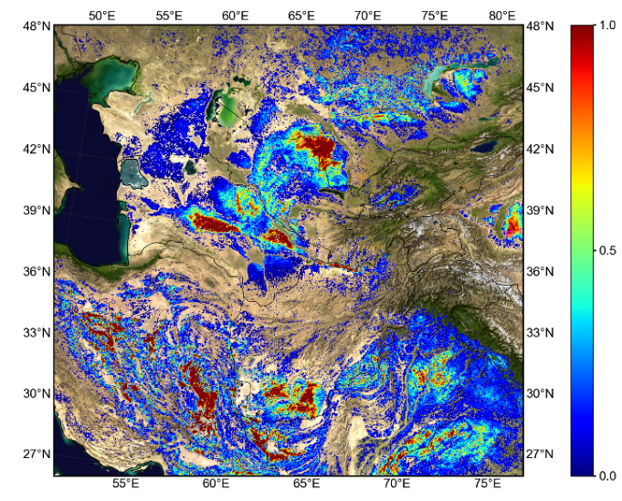
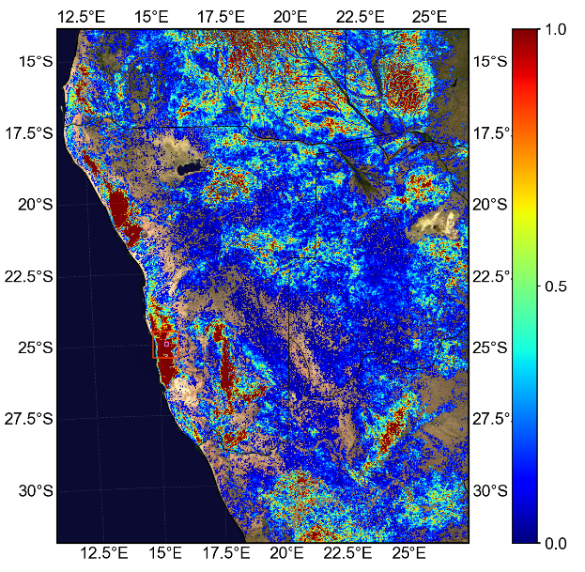
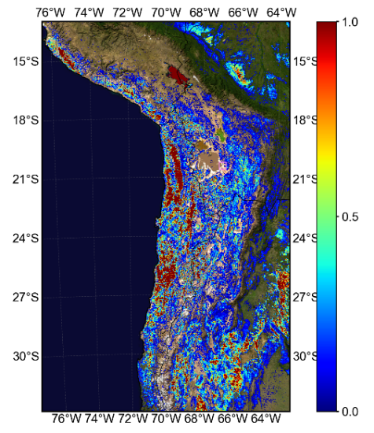
GPIPs distribution
The GPIPs align with traditional PICS, but additional hotspots areas were also identified, providing direction for further selection of PICS.
Notes:
Here is the PIPs distribution for the nine selected regions mentioned earlier. The GPIPs align with traditional PICS, but additional hotspots areas were also identified, providing direction for further selection of PICS.

Slide 13
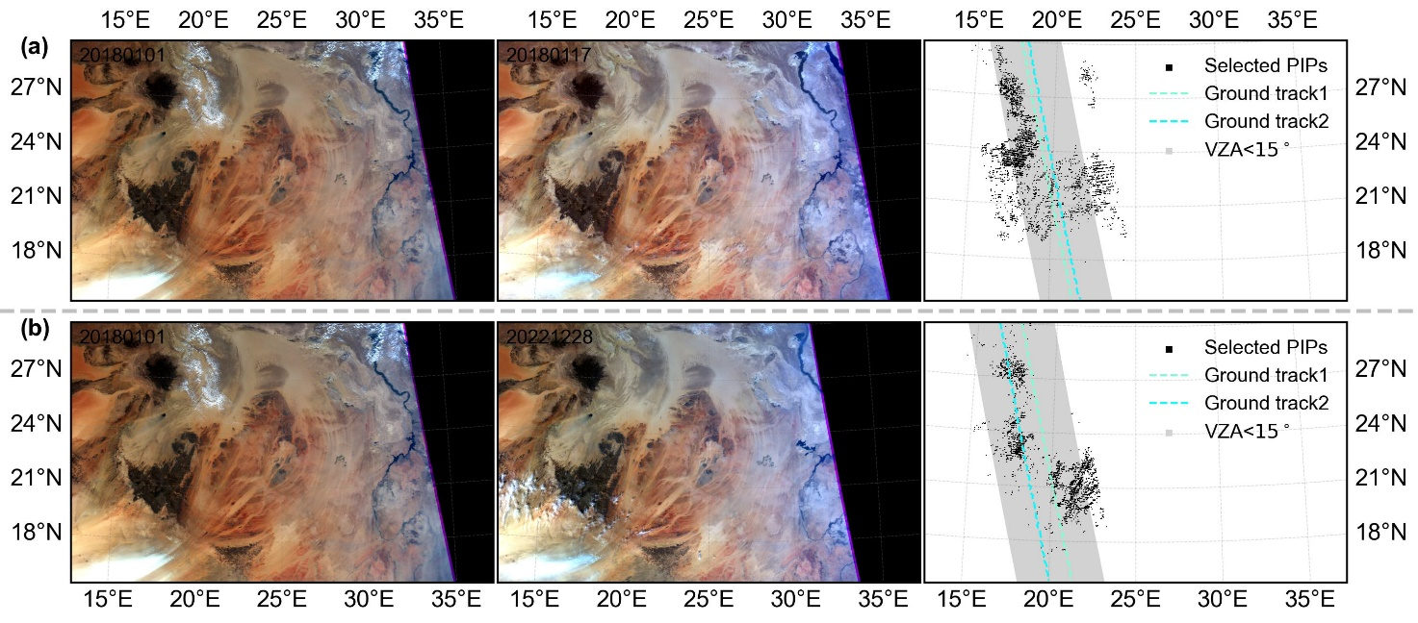
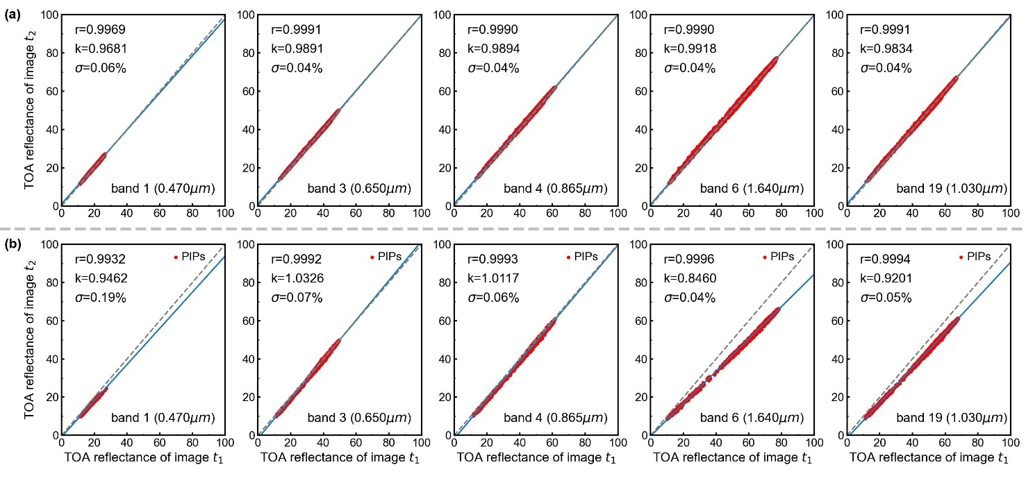
Relative Sensor degradation for image-pairs
Analyze the PIPs location and the relative degradation of the sensor with two image pairs that have different acquisition time intervals.
16 days
≈5 years
The two image pairs show consistent spatial distributions of PIPs
The regressions have high correlation, the slopes reflects the relative degradation of the sensor for each band over the time interval
The PIPs reflect targets with high temporal stability, and aggregating them yields PICS
Notes:
Here are the PIPs locations and the relative degradation of the sensor with two image pairs that have different acquisition time intervals. One image pair has a 16-day interval, while the other has a 5-year interval.
It can be seen that the two image pairs show consistent spatial distributions of PIPs. And the regressions have high correlation, the slopes reflects the relative degradation of the sensor for each band over the time interval
The PIPs reflect targets with high temporal stability, and aggregating them yields PICS

Slide 14
Sensor degradation trend fitting
For each comparison of image-pairs, the regression slope on the TOA reflectance of PIPs for each channel represents the measurement of relative degradation of the sensor during the time interval
For long-time series data, a large dataset of regression slopes from a substantial number of image-pairs with varying time periods and intervals can be created.
The long-term trend of sensor degradation over time can be modeled by a polynomial P_{i}(t) for each band i:
the coefficients of the polynomial (c_{l}) can be determined by minimizing:
Where the m_{i}(t₁, t₂) represents the measurement of relative degradation of the sensor band i during the time interval from t₁ to t₂.
The whole process is automatic and requires no prior knowledge of the targets, extending the calibration sites to the pixel-level targets.
Notes:
For each comparison of image-pairs, the regression slope on the TOA reflectance of PIPs for each channel represents the measurement of relative degradation of the sensor during the time interval
Then, For long-time series data, a large dataset of regression slopes from a substantial number of image-pairs with varying time periods and intervals can be created.
The long-term trend of sensor degradation over time can be modeled by a polynomial Pi(t) for each band i.
the coefficients of the polynomial can be determined by minimizing the equation below. Where the m_{i}(t₁, t₂) represents the measurement of relative degradation of the sensor band i during the time interval from t₁ to t₂.
For long-term data series , the whole process is automatic and requires no prior knowledge of the targets, also extending the calibration sites to the pixel-level targets.

Slide 15
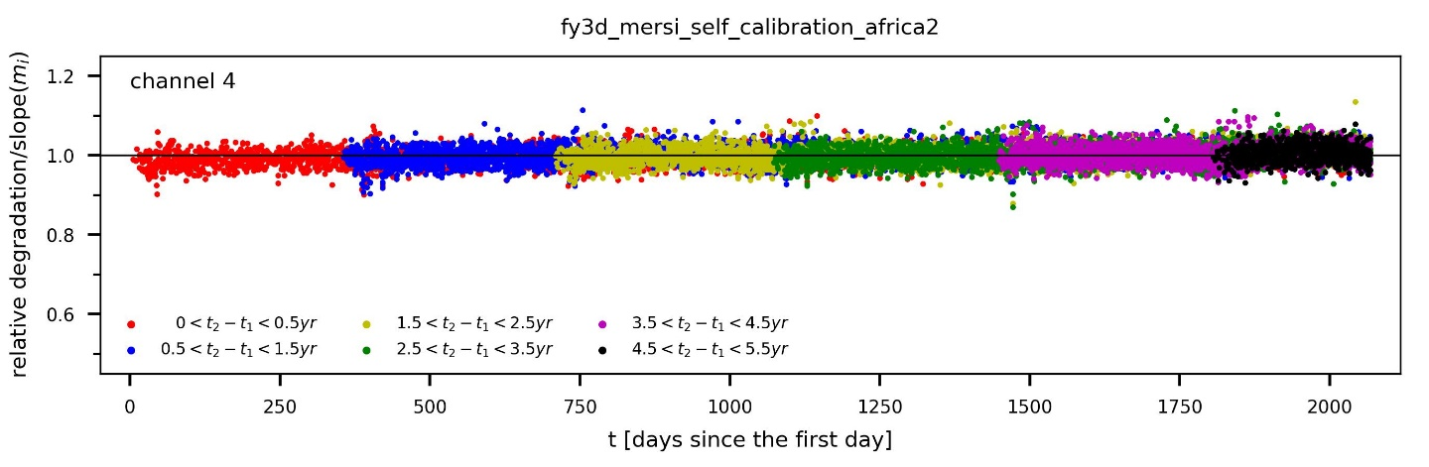
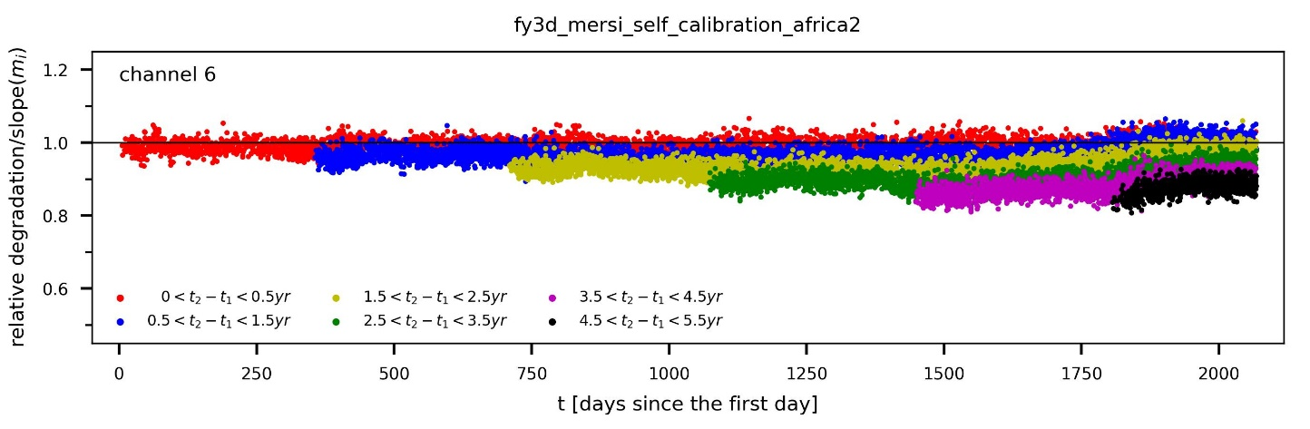
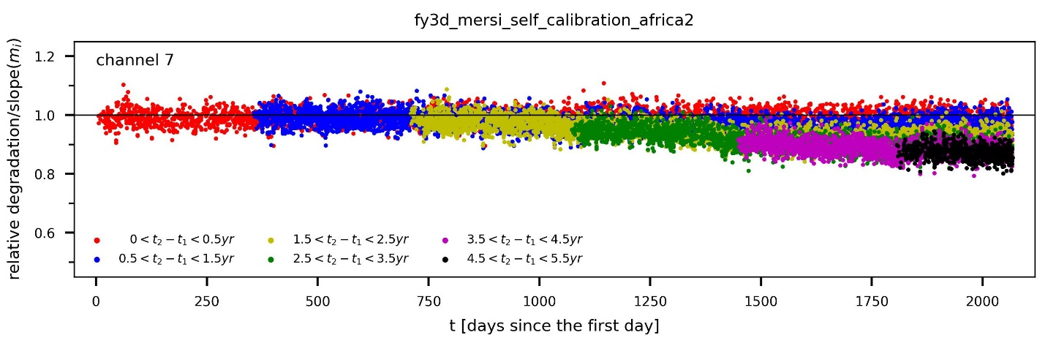
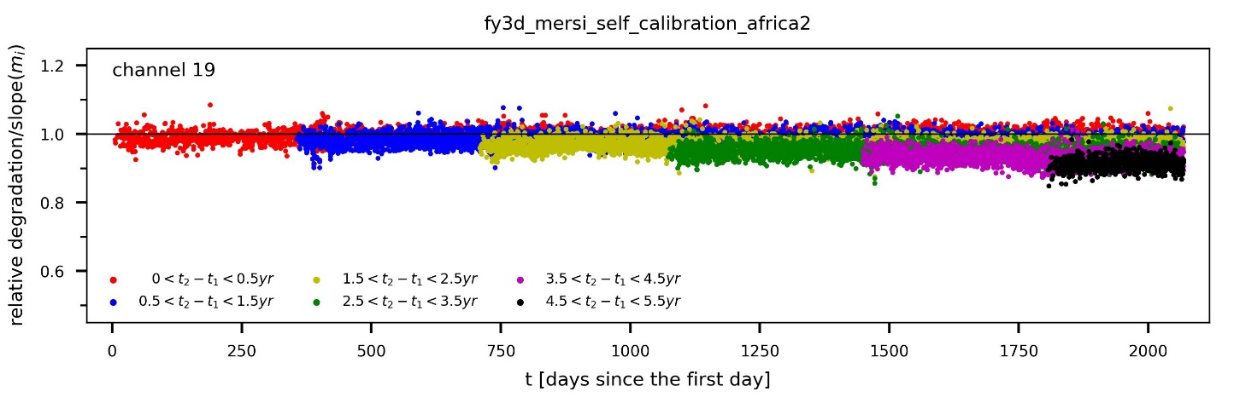
Implementation for long-term data series
Construct image pairs and perform same PIPs analysis on all image pairs for long-term FY-3D/MERSI-II data from January 1, 2018, to August 31, 2023, spanning over five years.
The dots with different colors represent regression slopes from image pairs with different time intervals
Image pairs with longer intervals exhibit more pronounced sensor degradation.
Notes:
Construct image pairs and perform same PIPs analysis on all image pairs for long-term FY-3D/MERSI-II data from a period spanning over five years. Here, we present the long-term results for four typical bands, Among them, band 4 is relatively stable. And other bands exhibiting varying degrees of degradation.
The dots with different colors represent regression slopes from image pairs with different time intervals. For a regression slope of one image pair, plot the data with the later date, that is t2​, on the x-axis.
It can be seen that Image pairs with longer intervals exhibit more pronounced sensor degradation.

Slide 16
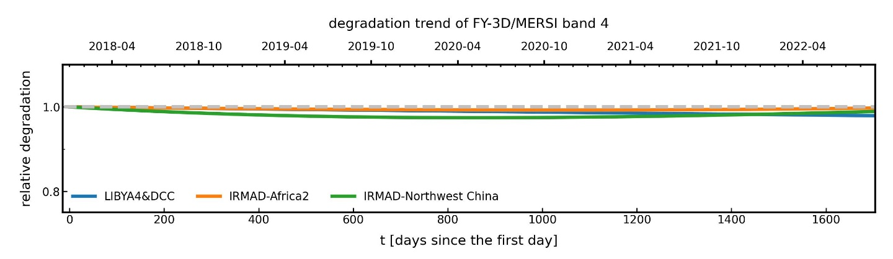
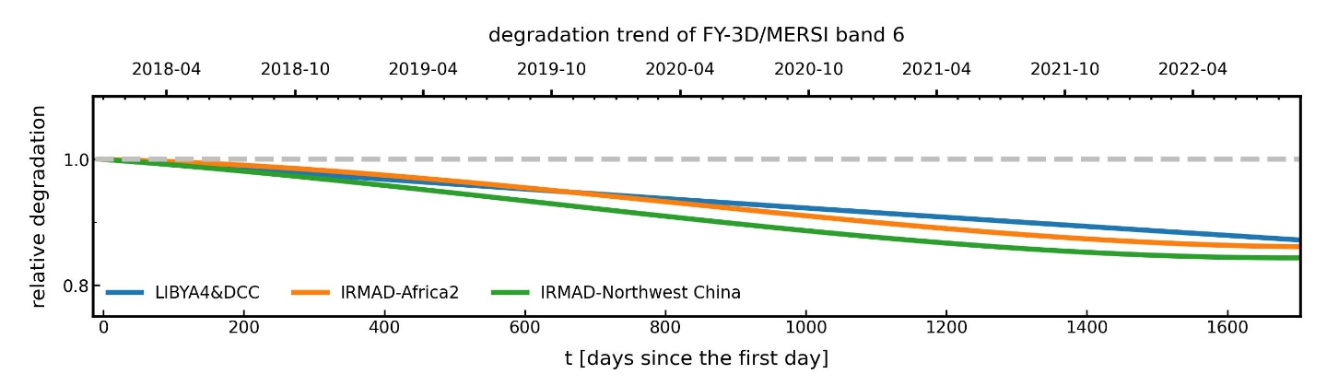
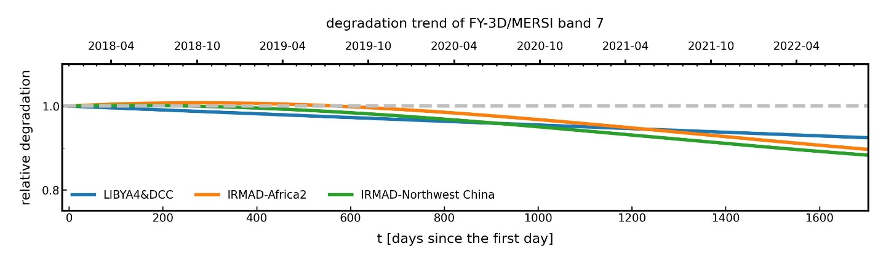
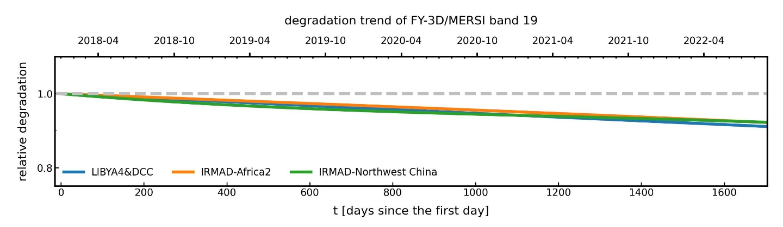
FY-3D/MERSI-II degradation trend
Obtaining sensor degradation over time through polynomial fitting and comparing it with traditional degradation monitoring method
Results of the PIPs based method are consistent with those from traditional PICS&DCC method
The PIPs based method yields consistent results across different regions.
Notes:
Using the method described earlier, we can obtain sensor degradation over time through polynomial fitting and comparing it with traditional degradation monitoring method.
From the results, we can see that the PIPs-based method aligns well with the traditional PICS and DCC methods.
We also conducted the same experiments at two different sites: North Africa and Northwestern China.. The PIPs-based approach provides consistent results across different regions.

Slide 17

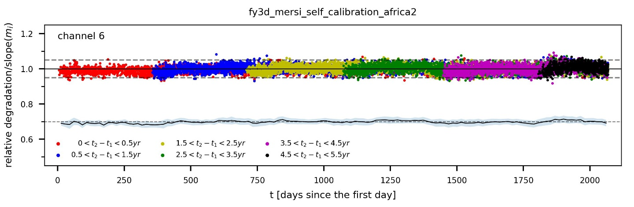
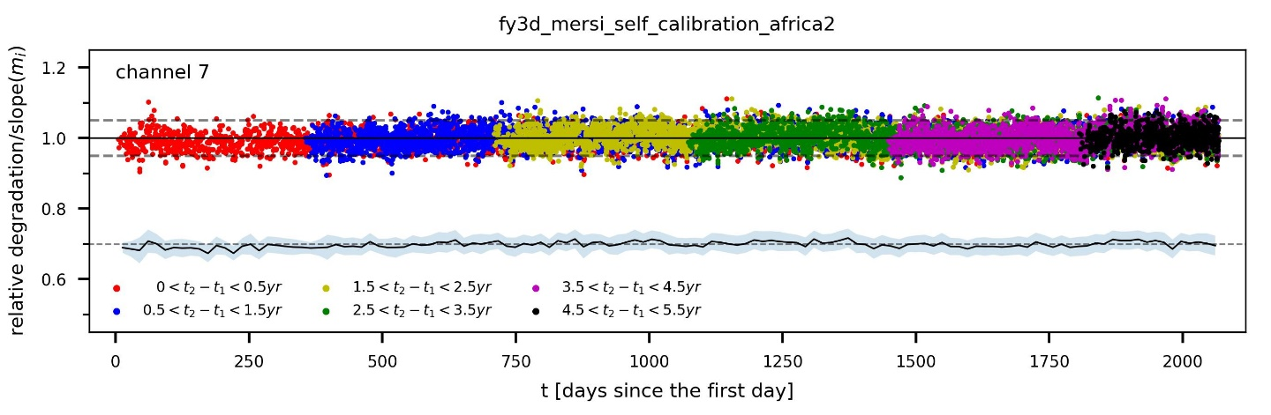
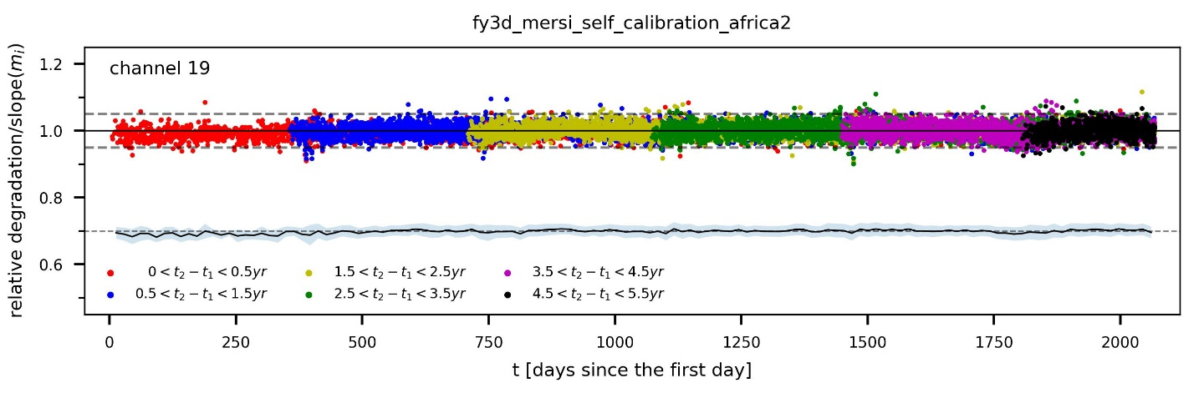
Normalization of the regression slopes
For each band, normalize the regression slopes of each image pair using the fitted long-term degradation trends
After normalization, the regression slopes are distributed around 0.95-1.05 with a mean of 1, indicating that the instrument decay trend has been fitted well.
The standard deviation represents the uncertainty of relative degradation for individual image pairs.
Notes:
For each band, normalize the regression slopes of each image pair by using the fitted long-term degradation trends, This allows us to assess the quality of the polynomial fitting.
After normalization, the regression slopes are distributed around zero point nine five to one point zero five with a mean of 1, indicating that the instrument degradation trend has been fitted well.

Slide 18
Uncertainty for image-pairs
The standard deviation of normalized regression slopes represents the uncertainty of relative degradation for individual image pairs.
Band | 1 | 2 | 3 | 4 | 6 | 7 | 8 | 9 | 10 | 11 | 16 | 17 | 18 | 19
CW (μm) | 0.47 | 0.55 | 0.65 | 0.865 | 1.64 | 2.13 | 0.412 | 0.443 | 0.49 | 0.555 | 0.905 | 0.936 | 0.94 | 1.03
Africa2 | 3.87% | 2.72% | 2.23% | 2.11% | 1.96% | 2.66% | 4.90% | 4.34% | 3.60% | 2.71% | 6.74% | 14.82% | 12.58% | 1.87%
Africa1 | 5.08% | 3.64% | 2.65% | 2.42% | 2.16% | 3.37% | 6.24% | 5.67% | 4.80% | 3.60% | 7.63% | 16.31% | 13.80% | 2.14%
MidEast | 4.92% | 3.83% | 3.08% | 2.78% | 2.26% | 3.31% | 5.75% | 5.36% | 4.67% | 3.77% | 7.51% | 15.42% | 13.19% | 2.57%
Xinjiang | 7.73% | 6.01% | 4.64% | 3.99% | 3.03% | 3.17% | 8.87% | 8.35% | 7.36% | 5.85% | 6.61% | 13.85% | 11.87% | 3.91%
This method is susceptible to the influence of atmospheric conditions, blue bands and water vapor absorption bands exhibit higher uncertainty.
Note that this uncertainty pertains to the relative degradation for individual image pairs.
In long-term degradation trend analysis, the mean effects of atmospheric and BRDF influences tend to be ZERO. Consequently, the actual uncertainty in long-term degradation trend is lower.
Notes:
The standard deviation of normalized regression slopes represents the uncertainty of relative degradation for individual image pairs. Here, the uncertainty results for each band at the four regions are presented.
From the results, it can been found that our method is susceptible to the influence of atmospheric conditions, blue bands and water vapor absorption bands exhibit higher uncertainty.
It should be Noted that this uncertainty pertains to the relative degradation for individual image pairs. In long-term degradation trend analysis, the mean effects of atmospheric and BRDF influences tend to be ZERO. Consequently, the actual uncertainty in long-term degradation trend is lower.

Slide 19
Conclusion & Future work
Different from the traditional vicarious calibration methods that primarily rely on invariant or pseudo-invariant targets, this study employs big data analysis of global PIPs to monitor the long-term degradation of space-borne sensors:
The PIPs are determined by the IR-MAD technique requiring no prior knowledge
PIPs can extend the PICS to the pixel-level targets
The spatial distribution of selected PIPs involves the traditional PICS sites.
Instrument degradation trending across different regions are consistent, which also meet well with those traditional vicarious calibration methods
This method is not sensor-specific and can significantly enhance the frequency of vicarious calibration with low uncertainty
Notes:
OK, here are the conclusions.
Different from the traditional vicarious calibration methods that primarily rely on invariant or pseudo-invariant targets, this study employs big data analysis of global PIPs to monitor the long-term degradation of space-borne sensors:
The PIPs are determined by the IR-MAD technique requiring no prior knowledge
PIPs can extend the PICS to the pixel-level targets and The spatial distribution of selected PIPs involves the traditional PICS sites.
Instrument degradation trending across different regions are consistent, which also meet well with those traditional vicarious calibration methods
This method is not sensor-specific and can significantly enhance the frequency of vicarious calibration with low uncertainty

Slide 20
Thanks for your attention!
Junwei Wang, wangjw@cma.gov.cn
Notes:
Thank you for your attention. For further discussion, I’m available at this email. please feel free to reach out to me.

