Slide 1


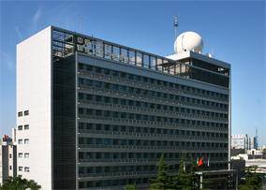
国家卫星气象中心
National Satellite Weather Center
FY-3F MERSI-III Reflective Solar Band On-orbit Calibration Methodology and Performance
Wang Ling, Hu Xiuqing, Niu Xinghua, Chen Shuaishuai, Xu Hanlie, Wang Yang
2025.03.17

Slide 2
Outline
Introduction to FY-3F MERSI-III
On-orbit Calibration Methodology for RSBs
On-orbit Calibration Performance Assessment
Summary and Future Work

Slide 3
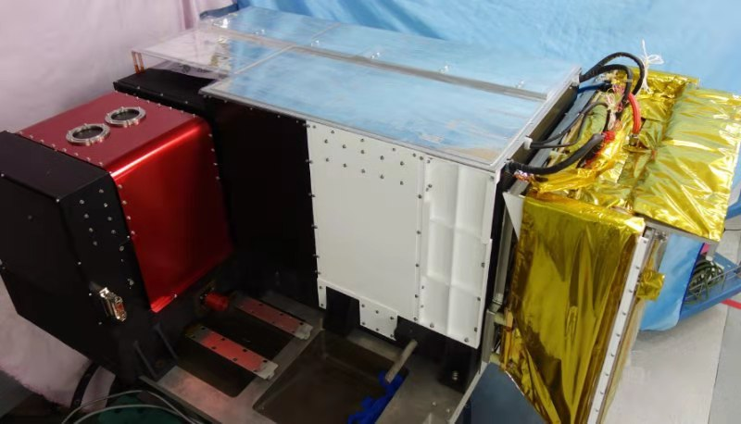
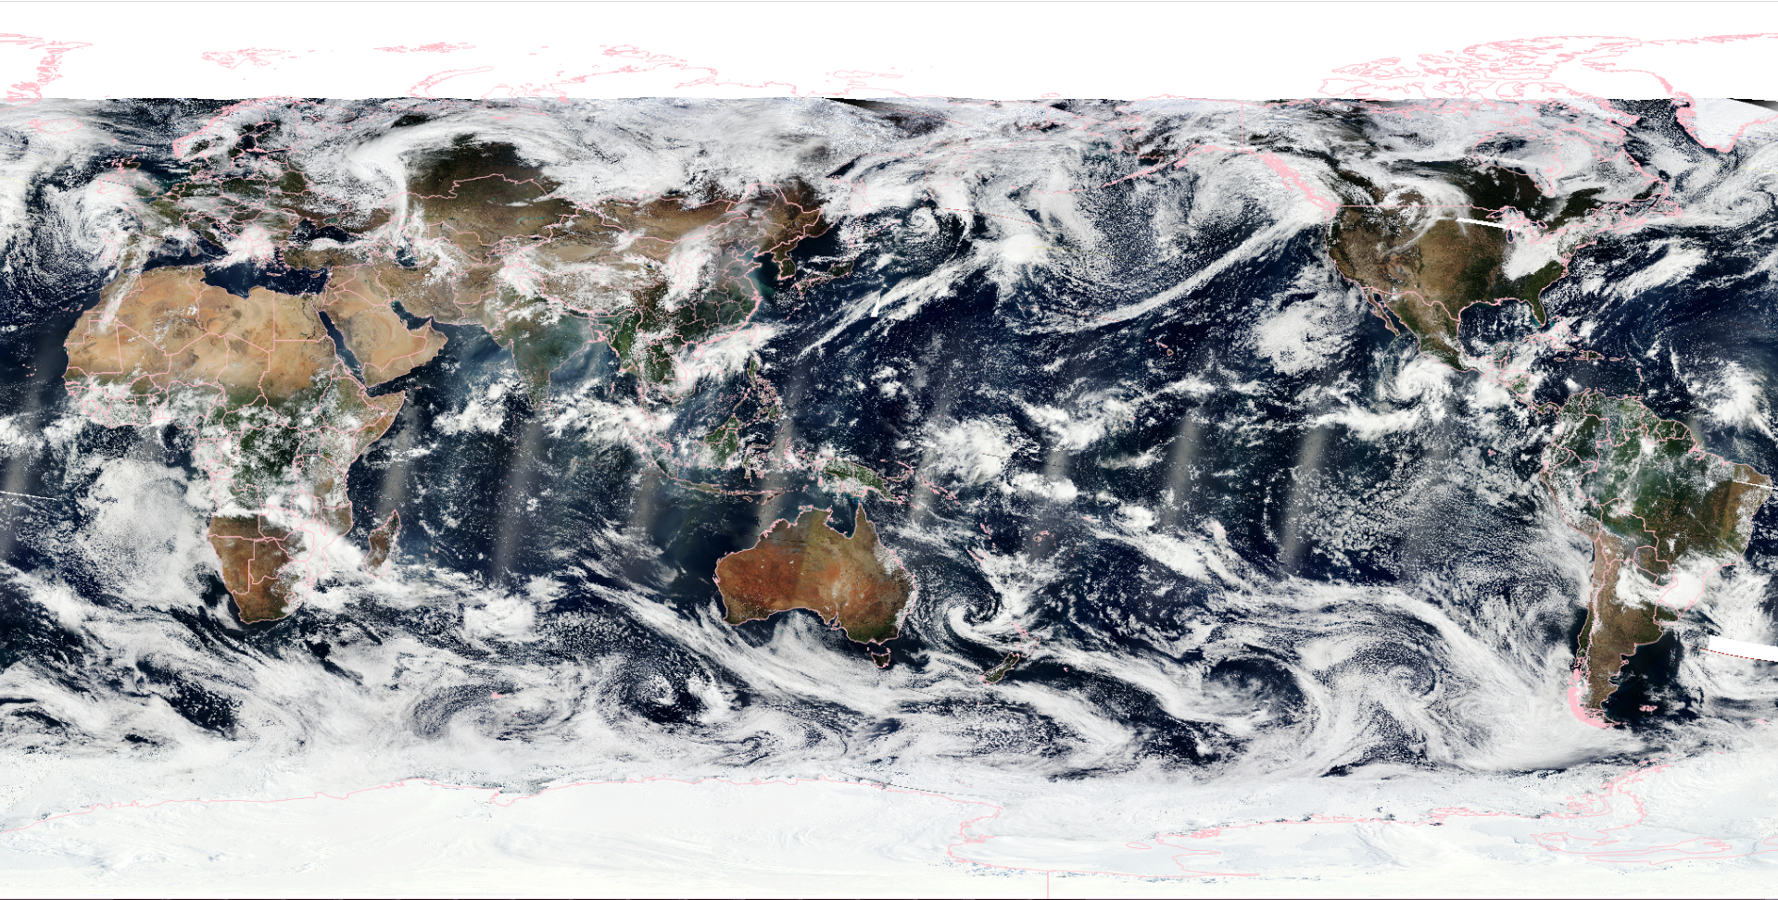
1. Introduction to FY-3F MERSI-III
MERSI-III is the third generation of the MERSI series. It is a key optical imager on-board FY-3F, launched on Aug. 3, 2023.
The design of MERSI-III is primarily based on MERSI-II, the second-generation MERSI on-board FY-3D.
The channel settings are identical to MERSI-II, ranging from 0.4-12.5 μm.
Significant improvements: enhanced detection sensitivity, improved radiometric performance, extended life time.
Global Observation Capabilities:
provides daily global coverage obsevations for land, oceans, and atmosphere.
The local sun time of FY-3D is 1:30 P.M, whereas that of FY-3F is 10:00–10:20 A.M.
Enables twice daily global coverage with the same spectral channels, significantly enhancing the capability to monitor global environment and climate change.
Photo of FY-3F MERSI-III Instrument
Global RGB Composite Image from FY-3F MERSI-III (October 15, 2023)

Slide 4
Technical Specifications of different MERSI Instruments
Instrument | MERSI | MERSI-II | MERSI-III
Satllite | FY-3A/B/C | FY-3D | FY-3F
Launch Time | 2008/2010/2013 | 2017.11.15 | 2023.08.03
Channel Count | 20: 19 RSBs + 1TEB | 25: 19 RSBs + 6 TEBs | 25: 19 RSBs + 6 TEBs
Spectral Range | 0.4-11.25 μm | 0.4-12 μm | 0.4-12 μm
Spatial Resolution | 250 m，1000 m
Radiometric accuracy ^{①} | RSB: 5-7% TEB: 1K | RSB: 5% TEB: 0.5K/0.4K | RSB: 5%/3% TEB: 0.4K/0.2K
Radiometric Stability | -- | -- | 1% per year
TEB NE∆T | 0.54K | 0.25-0.4K | 0.25-0.3K
RSB SNR ^{②} | 0.07-0.45， 0.05-0.1 (Ocean Color) | 100-200， 300-500 (Ocean Color) | 110-300， 450-600 (Ocean Color)
Mission Life | 3/3/5 years | 5 years | 8 years
The second one is the desired requirement.
For MERSI, SNR is measured as NEdρ
Continuous Improvement include:
Detection Capability and Performance: The number of TEBs increased from 1 to 6. The detection sensitivity was improved for the ocean color channels (improved by 50%+) and the longwave IR (0.54 K -> 0.4 K->0.3 K).
Radiometric accuracy and Stability
Mission Lifetime: from 3 to 8 years
Notes:
The technical specifications of the instruments are continuously improving The key improvements

Slide 5
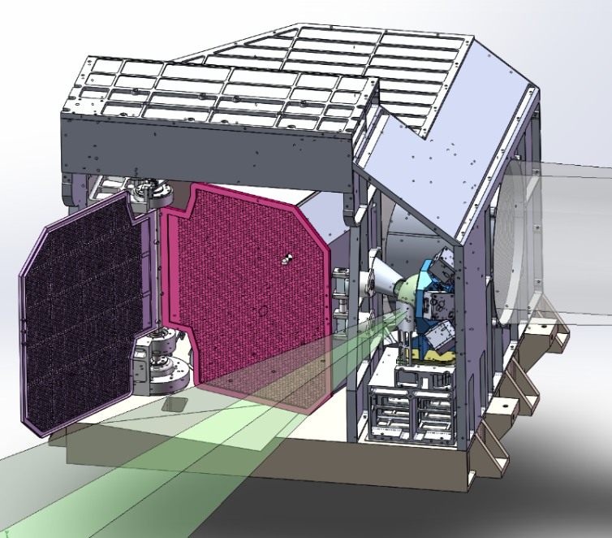
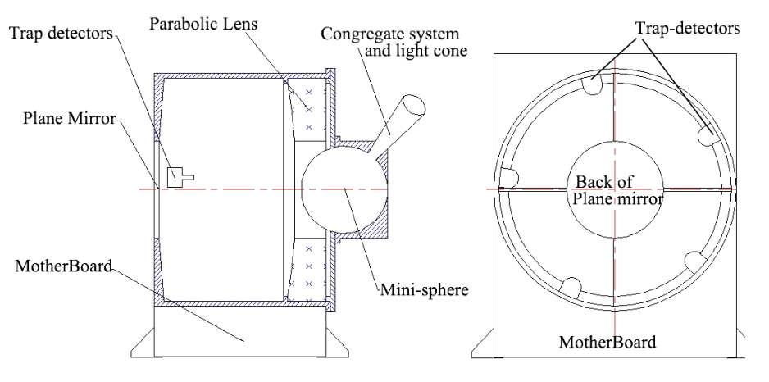
Enhancements of MERSI-III on-board calibrator for RSBs (VOC)
Development and Changes of FY-3 MERSI VOC
MERSI, and MERSI-II:
CS: Mini SIS + Standard Lamp+Sun
CS monitor: Trap Detector
MERSI-III
CS:Solar Diffuser (SD)+Solar Attenuation Plate (SAP)
CS monitor: Ratioing Radiometer (SDDM)
MERSI and MERSI-II
MERSI-III
Trap Detector
Sun Incident Port
SD
SDDM
Mini SIS
SAP
Challenges with MERSI & MERSI-II
Failed to achieve absolute radiometric calibration objectives.
Issues included self-attenuation of the trap detector and inadequate pre-launch calibrator characterization.
Improvements for MERSI-III
A new VOC design and Enhanced pre-launch testing based on previous experiences and lessons learned.
On-Orbit Calibration Schedule and Current Status
Initial on-orbit SD calibration began shortly after VIS bands turned on (August 19, 2023)
Now MERSI-III and its VOC are operating normally with effective calibration parameters are derived routinely.
Notes:
onboard calibrators (OBCs), designed and improved based on the experience and lessons from MERSI and MERSI-II
To meet the requirements of higher calibration accuracy and stability, MERSI-III adopted a newly designed on-board calibrator

Slide 6
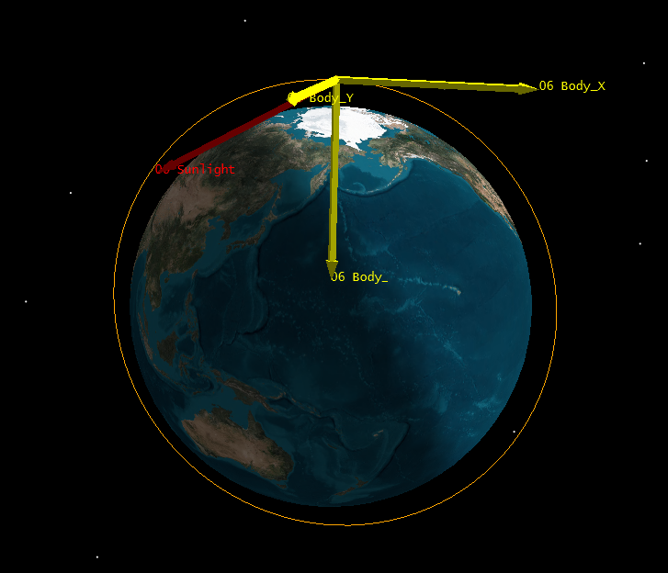
2. In-orbit Calibration Methodology for RSBs
On-board Calibration Timing
Calibration Frequency
During the On-orbit Test Phase (2023.08-2024.03)
VIS/SWIR bands turned on: once every two days; conduct three calibration events
At Other Times: once per week
After the On-orbit Testing Ends (2024.04-)
before 2025.01.21: Biweekly
after 2025.01.21: changed into once per week
VOC is fully illuminated.
Solar zenith angle within 90-100°(instrument's coordinate system)
Occurs at the North Pole when the instrument emerges from Earth’s shadow

Slide 7
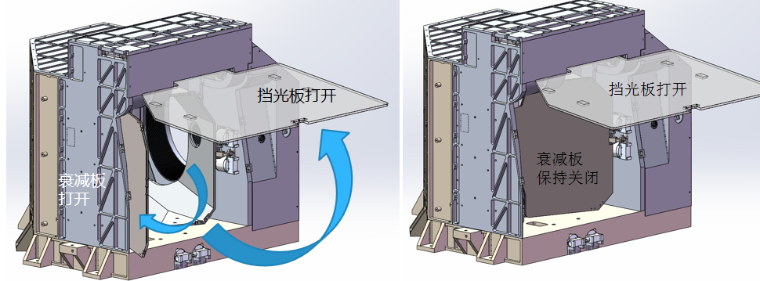
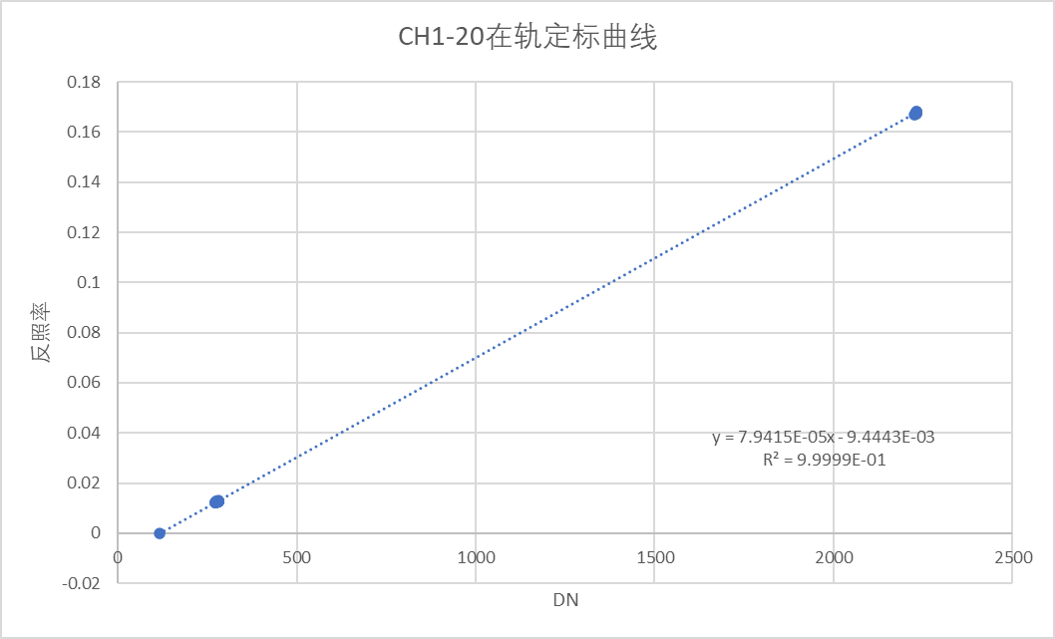


RSB Calibration Using SD, SAP and SDDM
The SAP in front of SD enables high and low energy level calibrations.
Meets both ocean color and land/atmosphere channel’s calibration needs.
$$ρ_{SD}=π∙BRDF∙τ_{SAS}∙∆_{SD}$$
calibration reference
$$ρ_{SD}∙cosθ_{s}/d^{2}=k_{0}+k_{1}∙{DN}_{SD}$$
BRDF：obtained from pre-launch measurements
τ_{SAS}：SAP transmittance, obtained from pre-launch
Δ_{SD}：degradation of the SD BRDF, in-orbit measured by SDDM, need to obtain SDDM ratio pre-launch
k₀, k₁: calibration offset and slpoe
SAP close
SAP open
High Energy Level
Low Energy Level
SV
MERSI-III’s Response to SD during onboard calibration
Onboard Calibration Coefficient Acquisition

Slide 8
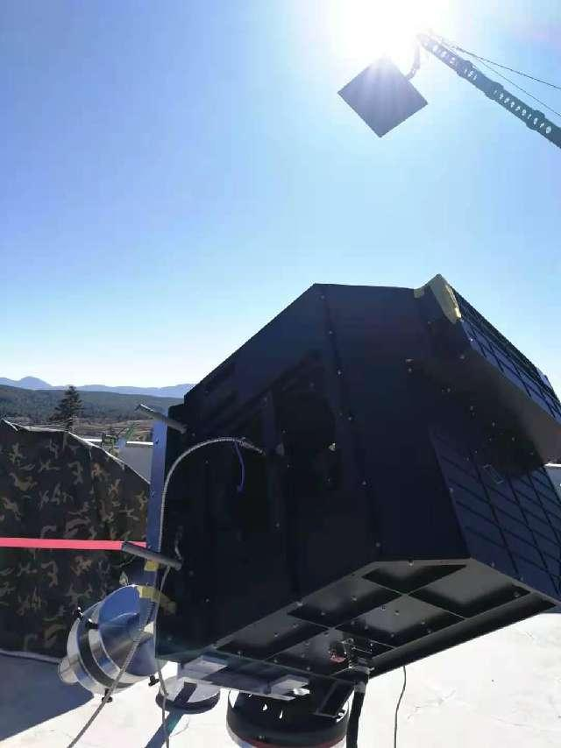
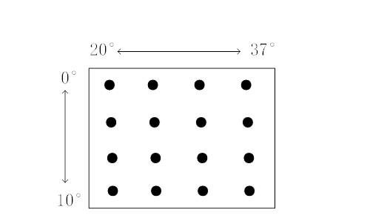
Onboard Calibrator Parameters: Pre-launch Measurement
(1) Field Measurments
Location：Lijiang, Yunnan
Time：2022.02.16-19
Sun Light
VOC
SD
SR4500
2D turntable
SDDM
SAP
Sun Light
Light Source: Sun
Standard Source: SR4500A Spectrometer
Goniometric System: High-Precision Equatorial Mount
Sun Angles: 0-10 (vertical), 20-37(horizontal); 1°Intervals
Measurment uncertainty in SD BRDF: <2.5%
Obtained Parameters: SD BRDF, SAP Transmittance, ratio between the SD and SUN view of SDDM
测量太阳角度方位
Azimuth Angle
Elevation Angle

Slide 9
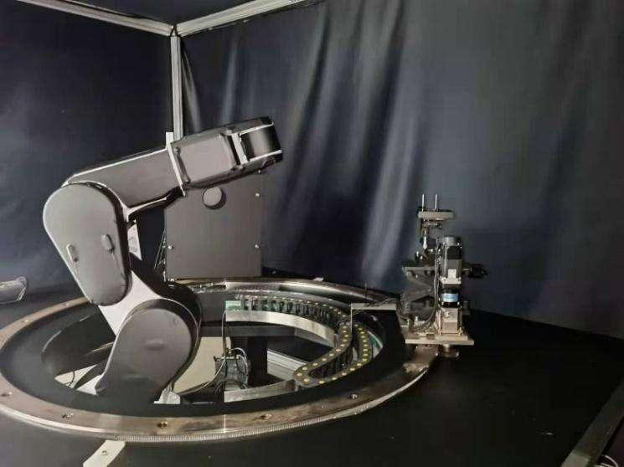
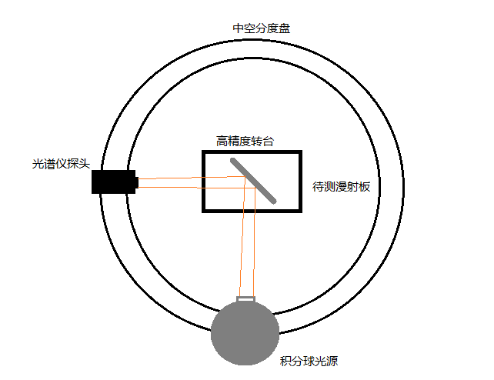
(2) Lab Measurments
Laboratory testing system for SD BRDF
Hollow graduated disk
turntable
SR4500 probe
SD
Integrating sphere
System Components: a light source, angle-changing components, and a detector
Testing Performance: SD BRDF uncertainty is better than 1.5%

Slide 10
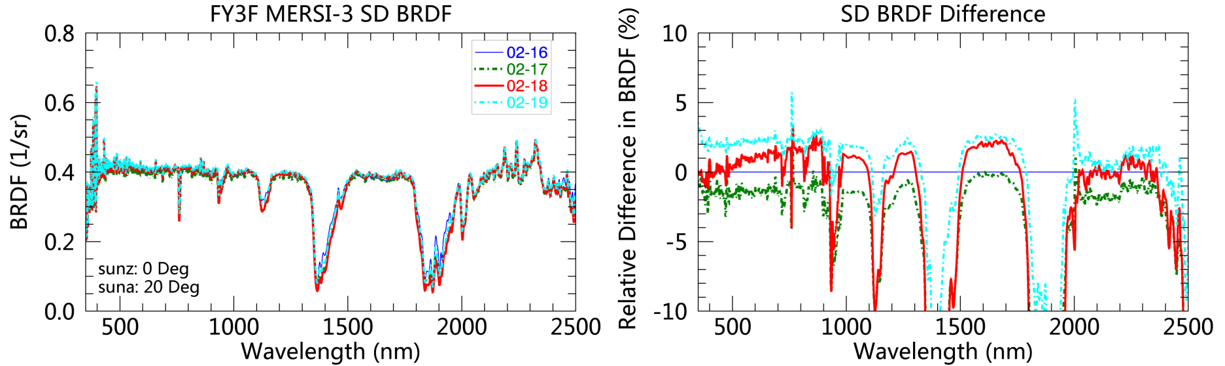
Measurement Consistency and Variability Analysis
(1) Consistency of BRDF Measurements from Multiple Days in Field Experiments
Across the entire spectral range (excluding water vapor absorption bands), differences in BRDF values obtained on different days are within ±2%.
Notes:
show excellent consistency across different experiments

Slide 11
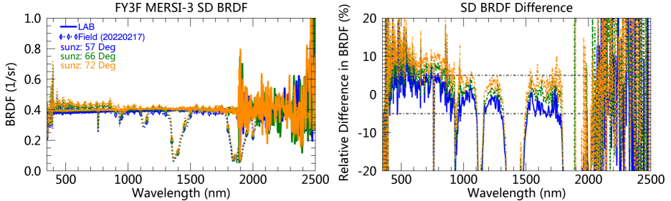
(2) Field vs Laboratory Comparisons
Field（2022.02.17）vs Lab*
CW (nm) | LAB 66° | Field 66° | Diff.(%) 66° | Diff.(%) 72°
412 | 0.394 | 0.390 | -0.7 | 3.0
555 | 0.391 | 0.414 | 5.8 | 8.2
670 | 0.393 | 0.415 | 5.6 | 8.1
865 | 0.397 | 0.394 | -0.8 | 1.7
940 | 0.404 | 0.367 | -7.6 | -4.0
* 66°and 72°are the solar zenith angle in the SD Coordinate System
Comparisons in NIR band show less than 5% difference excluding water vapor absorption bands.
Due to aerosol scattering and water vapor absorption, BRDF measurement differences at blue-green bands and water absorption bands show significant variability
Differences increase with the solar zenith angle.
Differences beyond 1800 nm are significantly associated with instrument measurement noise.

Slide 12
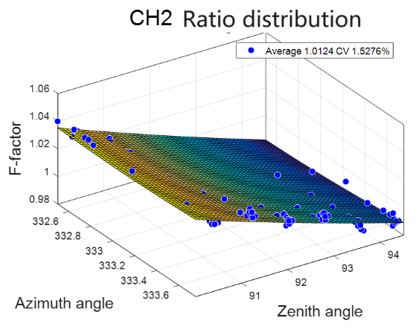
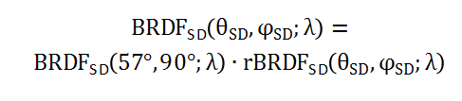
VOC Characteristic Parameters Used in Onboard Calibration
SD BRDF: Field +Lab Measurements
Agular Distribution of SDSM Ratio
SDDM detector central wavelength:
412, 443, 555, 670, 865 nm
Field: provide angular distribution
rBRDF: Normalized BRDF to the reference angle (57°, 90°)
SAP transmittance and fitting residual distribution
rBRDF and fitting residual distribution
Lab: provide spectral distribution. BRDF spectral at the reference angle (57°, 90°)
BRDF_{SD} (57°, 90°, λ)

Slide 13
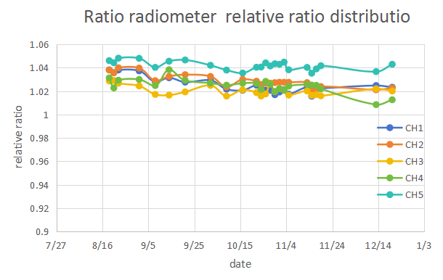
MERSI-III Onboard Calibration Results During in-orbit Test
SDDM response during onboard calibration
6 - 8 valid SDDM ratios can be obtained during one calibration event.
In subsequent SD BRDF trending, the ratios corresponding to solar zenith angles between 90° and 91° are utilized.
The first two blue bands show approximately 1% degradation, but the magnitude of the ratio time series also exhibits ~1% variability.
Accumulating data over a longer period is essential for obtaining more accurate SD BRDF varation information. In the initial phase, the SD degradation waso not consider.
SD View
SUN View
Dark View
Solar Azimuth Angle of each calibration event
Normalized SDDM Ratios During 2023.08- 2023.12

Slide 14
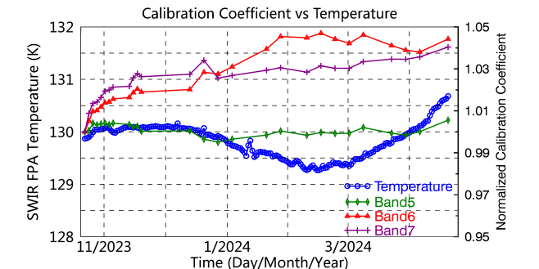
Timeseries of calibration coefficient of MERSI-III RSBs during the first 5 months
Radiometric Response Stability
Calibration coefficient of most channels fluctuated within ±1%, indicating the stability of MERSI-III.
Channels with Significant Fluctuations
Some channels (bands 6, 7, and 19) experienced fluctuations exceeding 2%
Influencing Factors
calibrator characterization uncertainty, temperature effect, and radiometric degradation....
Future Directions
Understand and correct these fluctuations, enhance the calibration accuracy.
Temp vs Cali. Coef

Slide 15
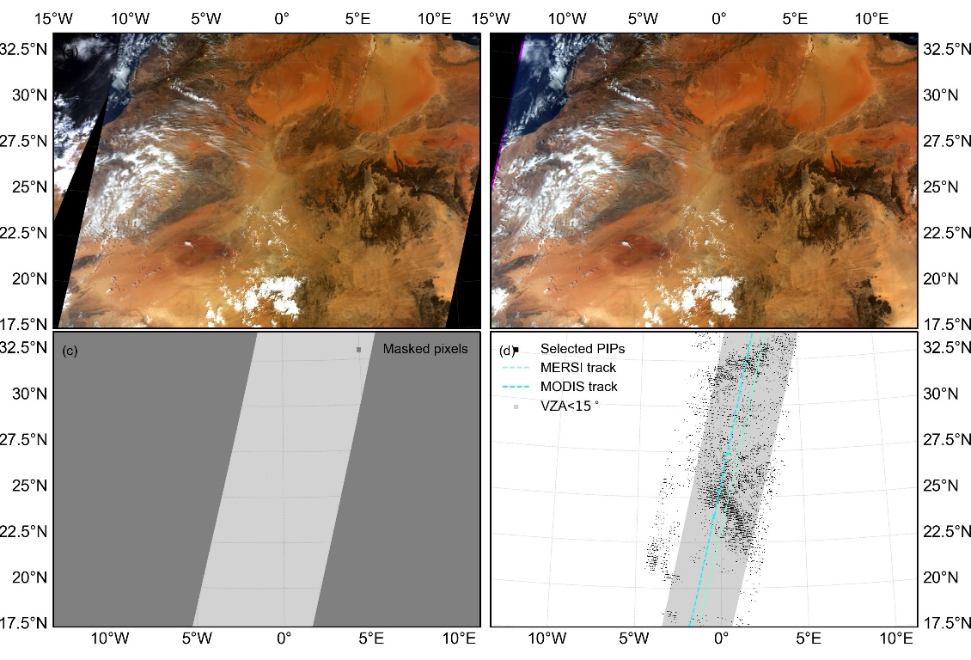
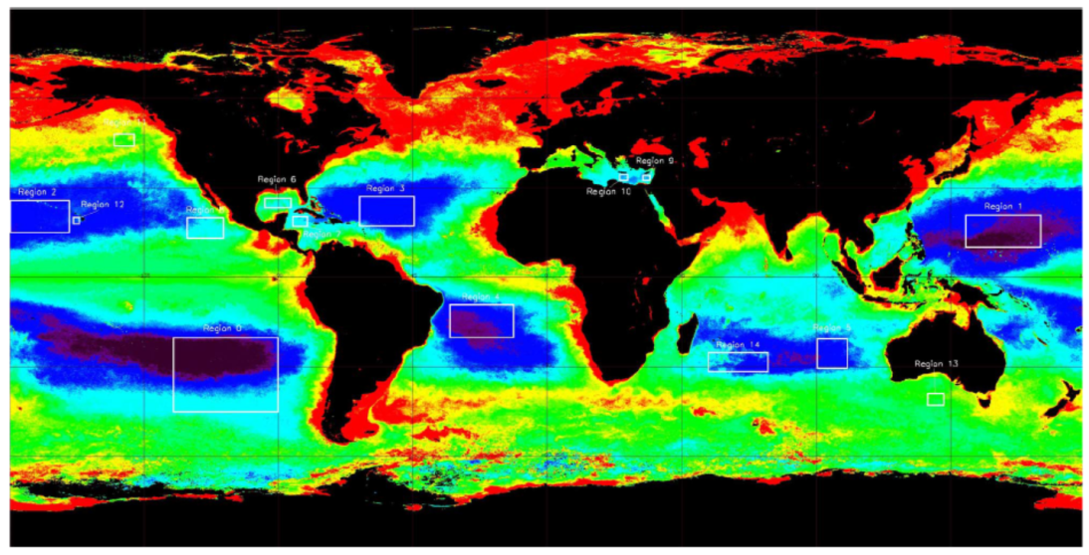
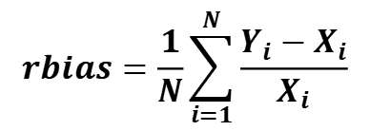
3. On-orbit Calibration Performance Assessment
Validation Method: Integrated Use of Multiple Vicarious Calibration Methods (IVC)
Inter-comparison based on PIPs: MODIS as reference
Rayleigh scattering calibration method: 6SV as reference
Multi-site calibration method: 6SV as reference
Validation Period: Oct. to Dec. 2023
Strategy of combined multiple calibration methods:
Divide reflectance into 50 sub-regions, with 2% intervals
Average samples in each sub-region for inter-comparison
Calibration Accuracy Evaluation Metrics
$$rbias=\frac{1}{N}\sum_{i=1}^{N}{\frac{Y_{i}−X_{i}}{X_{i}}}$$
Xi​: Reflectance of the reference
Yi: MERSI-III Reflectance
N: Number of validation samples
Rayleigh Scattering Region
(Fougnie et al., 2013)
Selection of PIPs based on IR-MAD
(Wang et al., 2024)
Notes:
combines multiple VC methods to evaluate as many bands as possible.
pseudo-invariant pixels

Slide 16
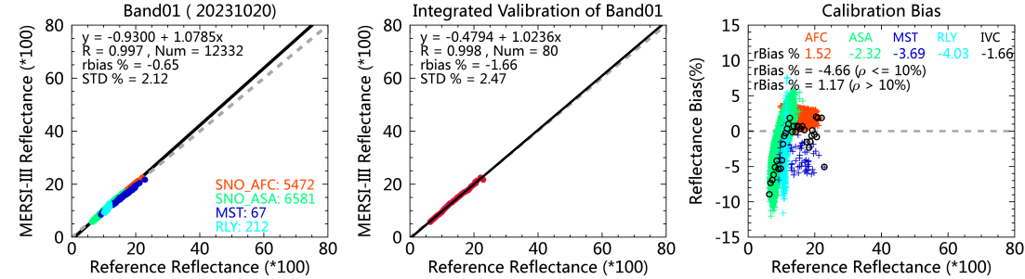
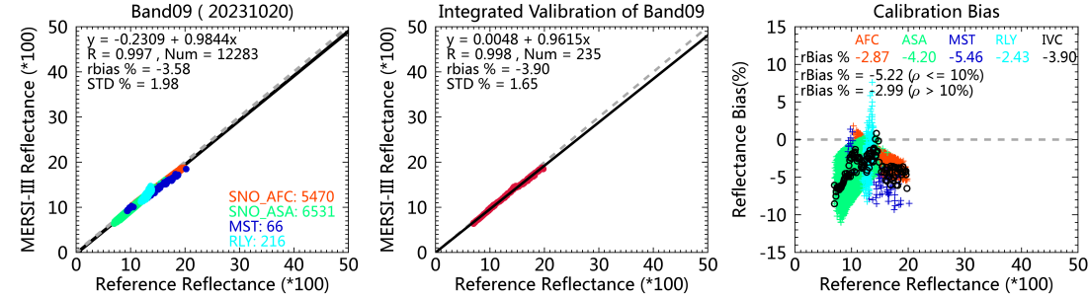
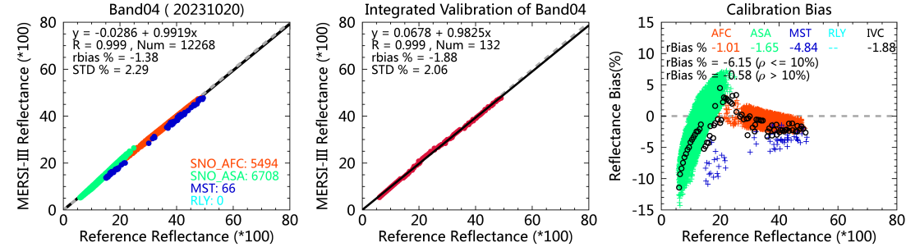
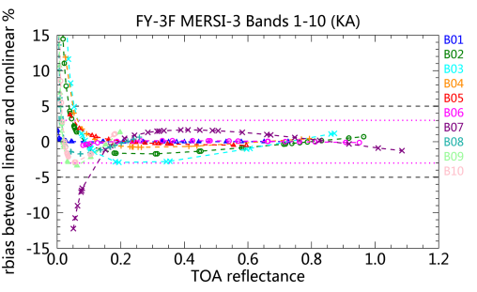
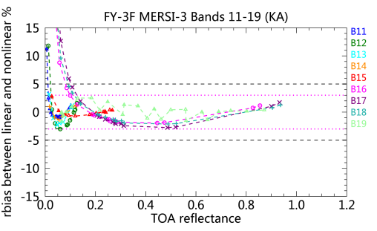
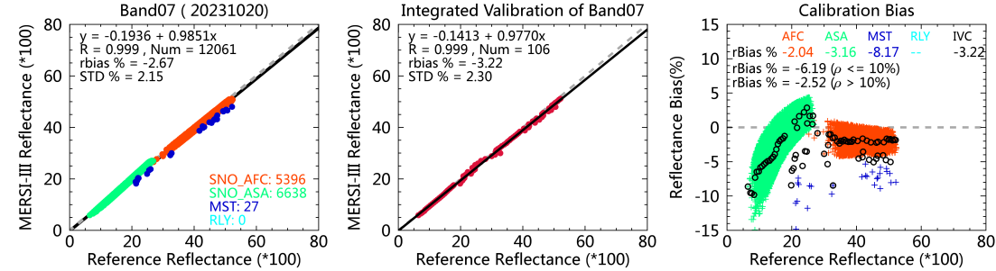
Validation results
14 bands out of the 19 RSBs can be validated
exceptions: bands 5 (Cirrus Cloud), 13 to 14 (Saturation), and 17 to 18 (water absorptin)
Case results obtained on October 20
VIS
Ocean color bands
NIR
Different VC methods showed high consistency, with R > 0.995
Calibration bias increases at lower reflectance levels. Related to MERSI-III nonlinear behavior?
SWIR
Prelaunch Nonlinearity Assessment of MERSI-III

Slide 17
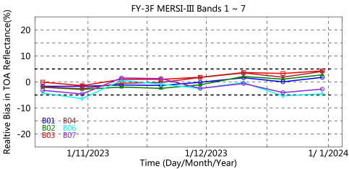
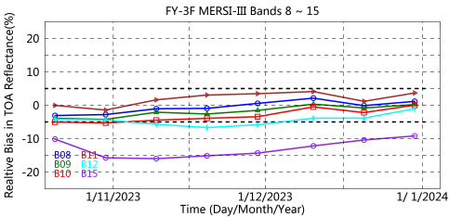
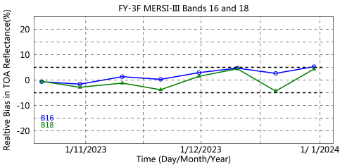
Time series of on-board calibration accuracy from Oct. to Dec. 2023
On-orbit calibration accuracy are stable, except the band 18 (940 nm) the water absorption bands .
Of 14 channels validated, 13 met <5% in relative bias; 7 bands achieved <3%, meet the radiometric ralibration accuracy requirements.
Band 15 shows larger calibration bias (>10%), possibly due to its sensitivity to surface or atmospheric conditions or calibration process issues.

Slide 18
4. Summary and Future Work
MERSI-III VOC achieved accurate on-orbit absolute calibration. 13 of 14 RSBs met the basic requriment of relative bias less than 5% bias, and 7 RSBs met the desired requirement of < 3%.
Most RSBs showed negative bias vs. MODIS/6SV RTM, indicating that the baseline of the on-board calibration source is systematically low.
Calibration bias increases at lower reflectance levels (<10%), highlighting nonlinearity and need for caution.
Investigate SD degradation over time to refine calibration accuracy of RSB L1 data products.
Improve instrument performance at lower reflectance levels to enhance data reliability and accuracy.
Further analyze SDDM data fluctuations to better understand and correct observed anomalies.
Future Work

Slide 19
Thanks for your attention!

