Slide 1


Current status of transition from MODIS to VIIRS for AHI vicarious calibration
EIKI Misaki
Meteorological Satellite Center of Japan Meteorological Agency

Slide 2
Outline
Motivation and background
Overview of AHI vicarious calibration
Methodology
Comparison of regression slope
Comparison of long-term variation of regression slope
Summary and future work

Slide 3
Motivation
Current JMA/MSC vicarious calibration uses MODIS for input data to retrieve aerosol and cloud parameters.
We try to transfer input data from MODIS to VIIRS which is recommended for reference sensor on GSICS.
→Current approach was developed for MODIS
We need to reconsider setting up for VIIRS
We also try to improve the accuracy of this approach.
Enables accurate results to be calculated with shorter data periods
Useful when we want evaluation results in a short period of time
→Suitable selection of the calculation targets
We need to choose good thresholds

Slide 4
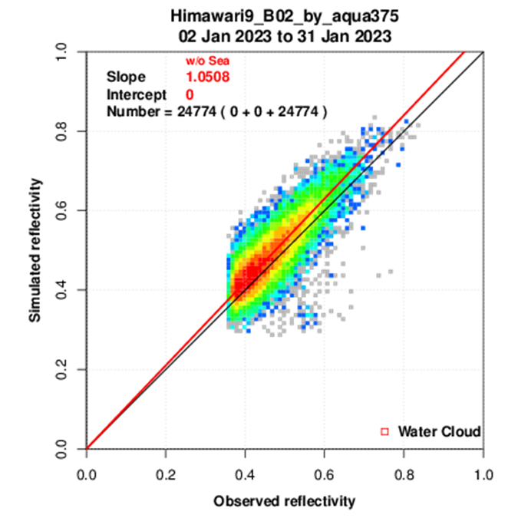
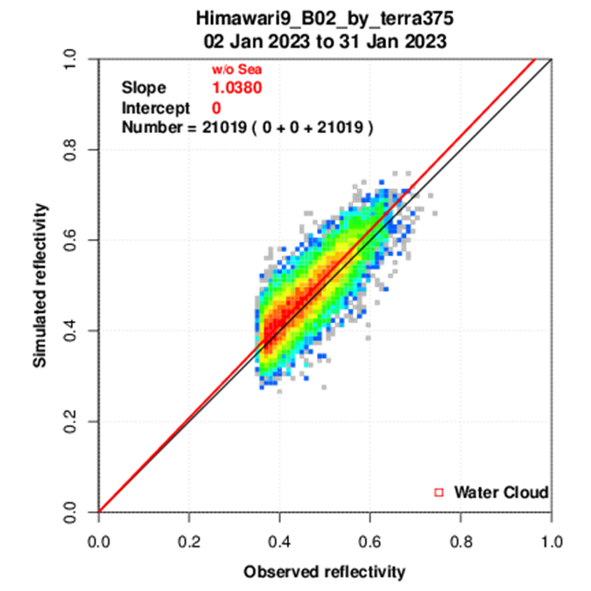
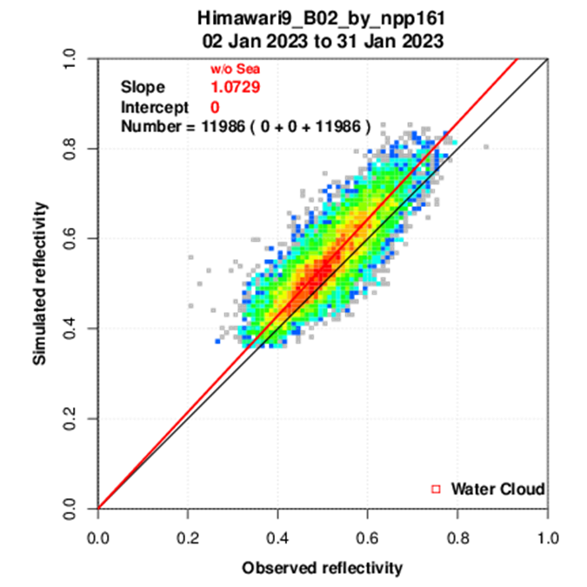
GSICS annual meeting 2024
Aqua/MODIS
Terra/MODIS
SNPP/VIIRS
Slope 1.0508
Slope 1.0380
Slope 1.0729
・Compare to current approach(Aqua/MODIS and Terra/MODIS) and the approach which uses SNPP/VIIRS and changes water cloud’s thresholds
・VIIRS’s slope is larger than MODIS

Slide 5
Background
In the GSICS annual meeting 2024’s presentation, the cloud parameter thresholds considered by different approaches were mixed and applied
→Evaluate the impact of thresholds by separating those for different approaches
We checked only one month’s results in the GSICS annual meeting 2024
→ Check the results of long-term analysis

Slide 6
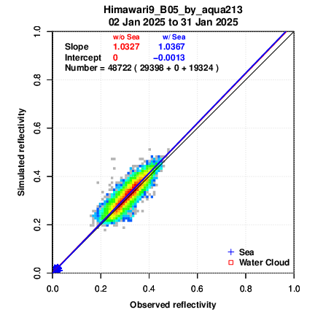
AHI VNIR vicarious calibration
REAP
aerosol
analysis
package
CAPCOM
cloud
analysis
package
MODIS L1B
RSTAR
Radiative transfer calculation
Simulated reflectivity
Aerosol
Atm profile
JRA-3Q (JMA‘s reanalysis data)
Cloud
Simulated reflectivity
Ozone
SNPP/OMPS Ozone L3
Water cloud
Radiative transfer calculation using the model "RSTAR" for targets water cloud and sea surface
Sea surface
used in
B03-B06(0.64-2.3um)
Observed reflectivity

Slide 7
Cloud retrieval package “CAPCOM”
Cloud parameters(optical thickness and effective radius) are obtained from MODIS L1B data using CAPCOM cloud analysis package(Nakajima and Nakajima,1995)
This approach utilizes three MODIS bands,
Band 1(0.645um),Band31(11.03um),Band 7(2.130um) or 20(3.750um)
Band 7 is used for validation of AHI B05 and B06
Band 20 is used for validation of AHI B01, B02, B03, and B04

Slide 8
Transition from MODIS to VIIRS
target of calculation
・Transition input data from MODIS to VIIRS
Aqua and Terra MODIS → SNPP/VIIRS
(We will try to transition to NOAA-20/VIIRS in the future)
・Improve the accuracy of this approach
→Select thicker and flatter cloud (We now consider good value about cloud parameters)
→ Strict thresholds
(optical thickness and effective radius etc.)
・We change the input data from MODIS to VIIRS
・We also change the value of cloud parameters which are input radiative transfer calculation
We also need to adapt aerosol analysis package to VIIRS and consider aerosol parameter’s value. This is future task
flat cloud
(ex. stratocumulus)
small cloud (ex. small cumulus)
→exclusion from calculation

Slide 9
Comparative experiment
・Utilize VIIRS for input data
M05(0.67um),M15(10.8um), and M10(1.61um)
・Change the thresholds of optical thickness, effective radius, and so on for VIIRS
→4 cases are set up and compare to each other
(Details on next slide)
・Compare to current approach (Aqua/MODIS and Terra/MODIS) and VIIRS approaches
→MODIS L1B C61(MYD02SSH,MOD02SSH) via NASA EearthData
MYD02SSH and MOD02SSH are 5km subsampled data
・Period：07/01/2018-09/30/2021

Slide 10
Comparative experiment
cloud parameters | Case1 (Same as current method) | Case2 (Same as last year’s meeting) | Case3 | Case4
optical thickness τ | 10≦τ≦100 | 25≦τ≦70 | 25≦τ≦70 | 10≦τ≦100
effective radius r | 1≦r≦100 | 20≦r≦35 | 20≦r≦35 | 1≦r≦100
GEO LEO observation time difference | ≦30min | ≦5min | ≦30min | ≦5min
B03 count mean | ≧600 | ≧300 | ≧10 | ≧400
B03 count standard deviation | ≦500 | ≦200 | ≦200 | ≦100
B03 count max-min | ≦1000 | ≦1000 | ≦1000 | ≦400
LEO VIS reflectance | ≧0.3 | ≧0.15 | ≧0.3 | ≧0.2

Slide 11
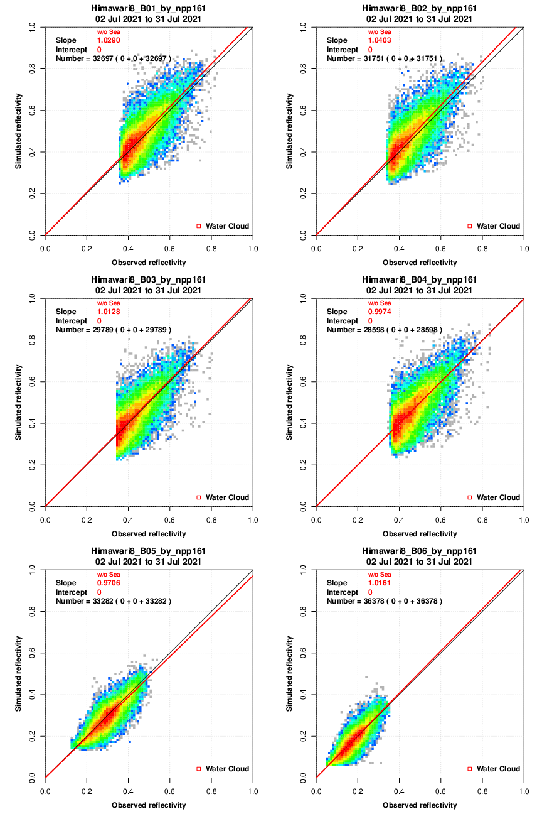
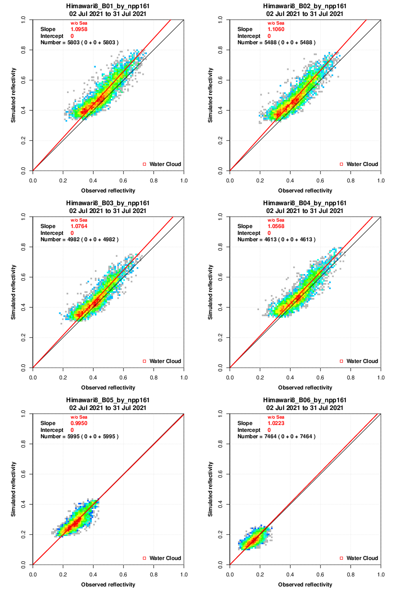
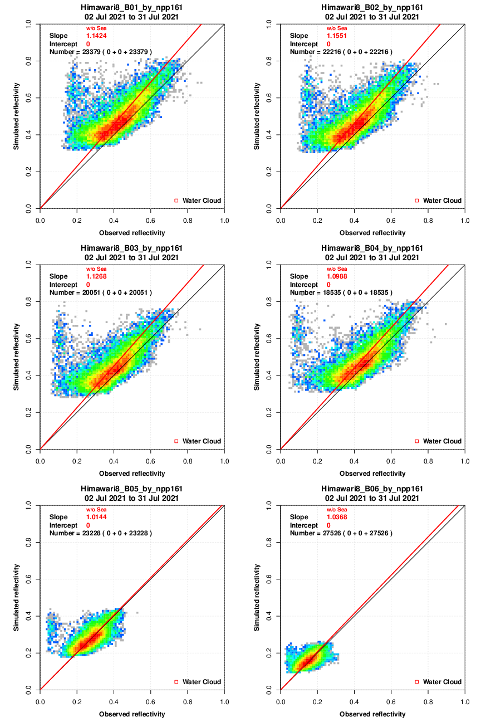
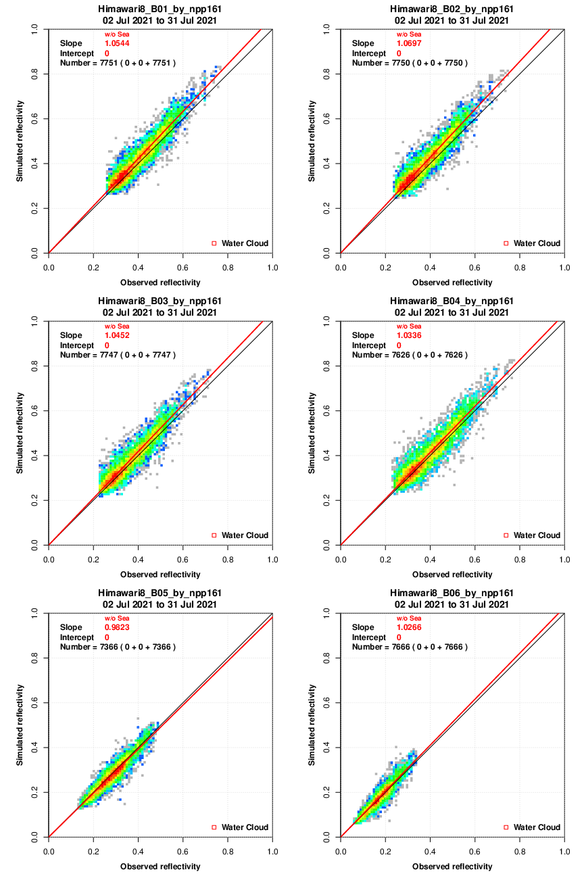
Himawari-8 regression slope
Case1
Case2
Case3
Case4
B01
B02
B01
B02
B01
B02
B01
B02
B03
B04
B03
B04
B03
B04
B03
B04
B05
B06
B05
B06
・Case1’s distribution too spread
・Case2 B06 shows the spread of plot
・Overestimation is seen in Case3
・Case4’s regression slopes appear to be calculated moderately well
→Case4(or Case2) might be appropriate?
B05
B06
B05
B06

Slide 12
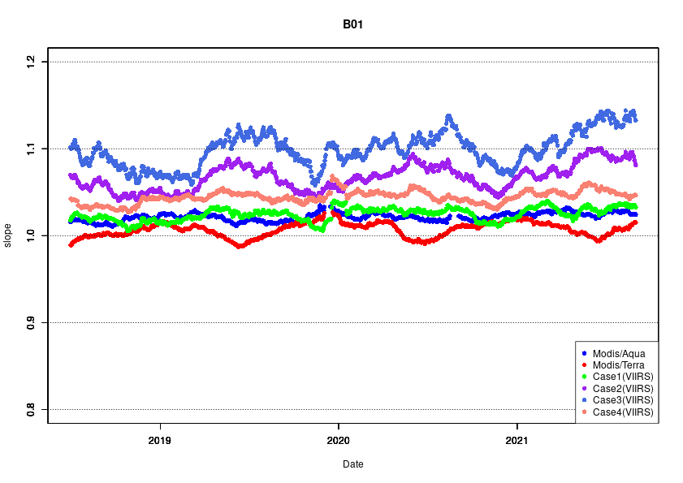
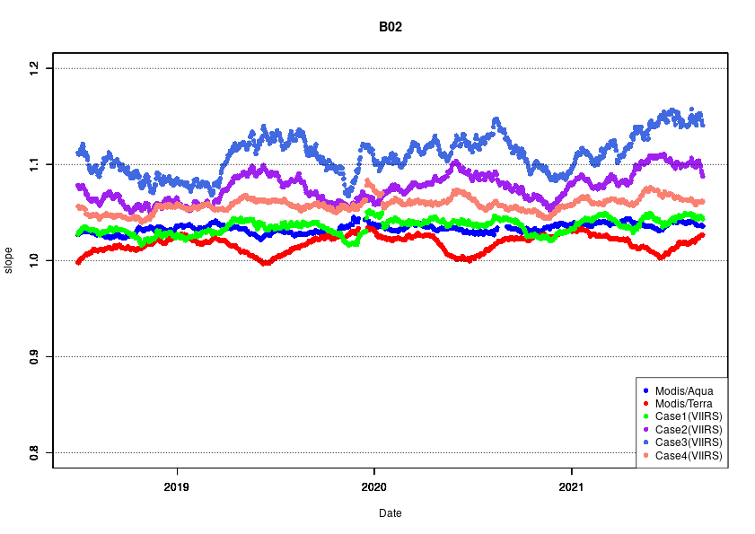
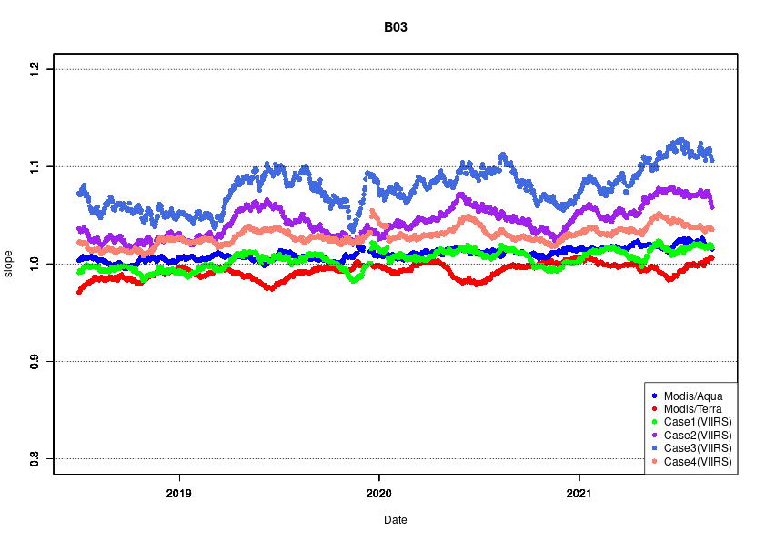
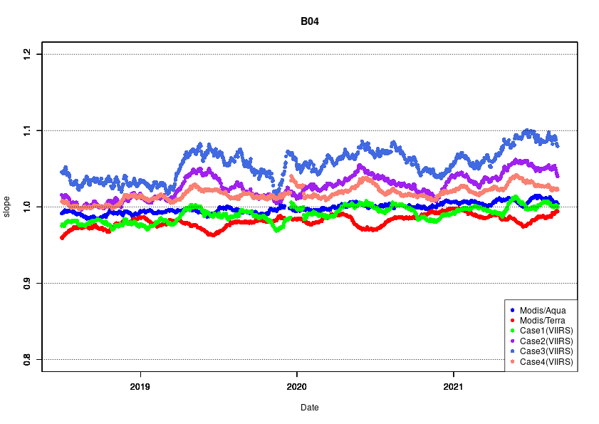
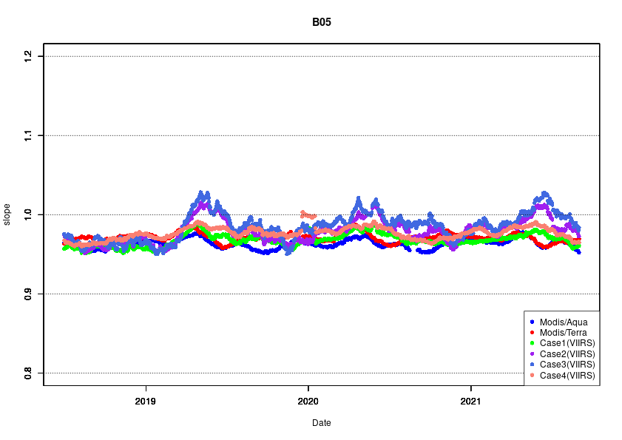
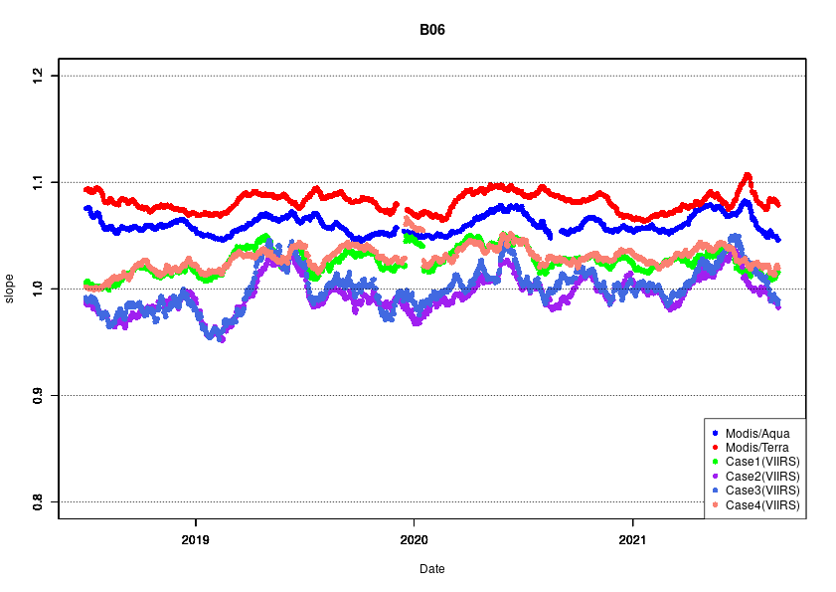
Himawari-8 long-term regression slope
B01(0.47um)
B02(0.51um)
B03(0.64um)
B04(0.86um)
B05(1.6um)
B06(2.3um)
・Case1(green) and Case4(pink) are similar in trend to Modis(red and blue)
・Case2(purple) and Case3(pale blue) are more variable than Modis(red and blue)
■：VIIRS data anomaly

Slide 13
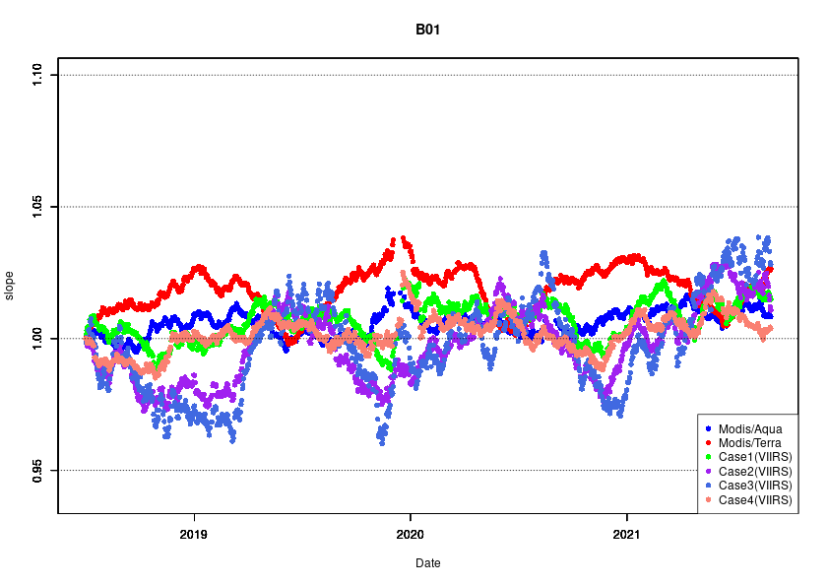
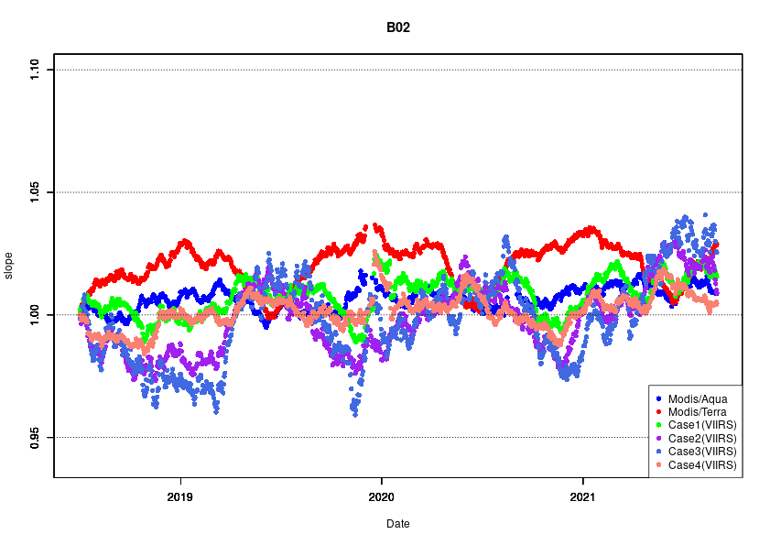
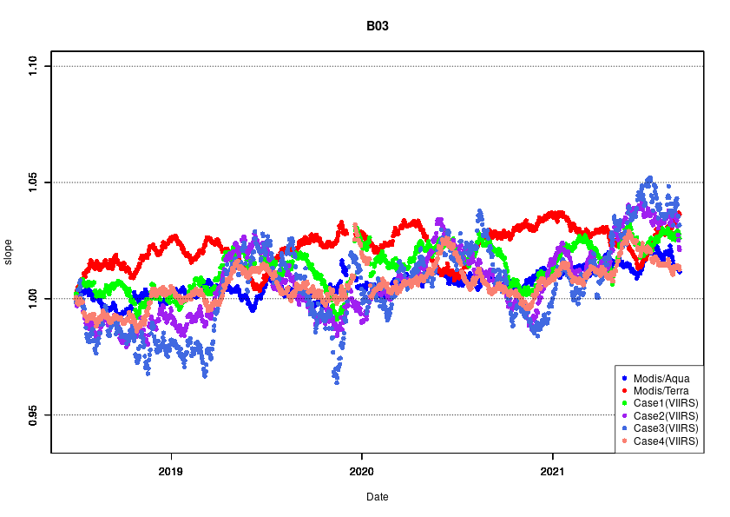
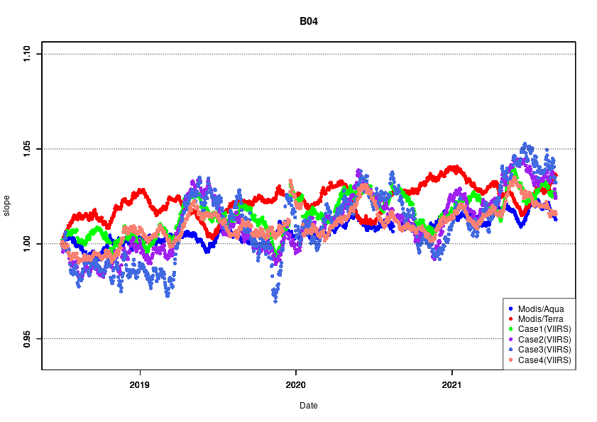
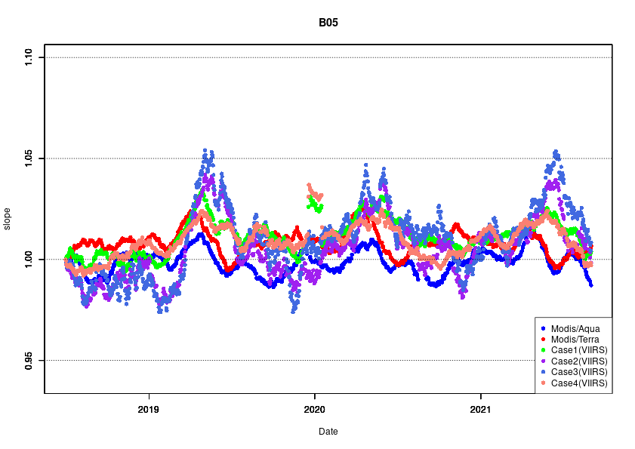
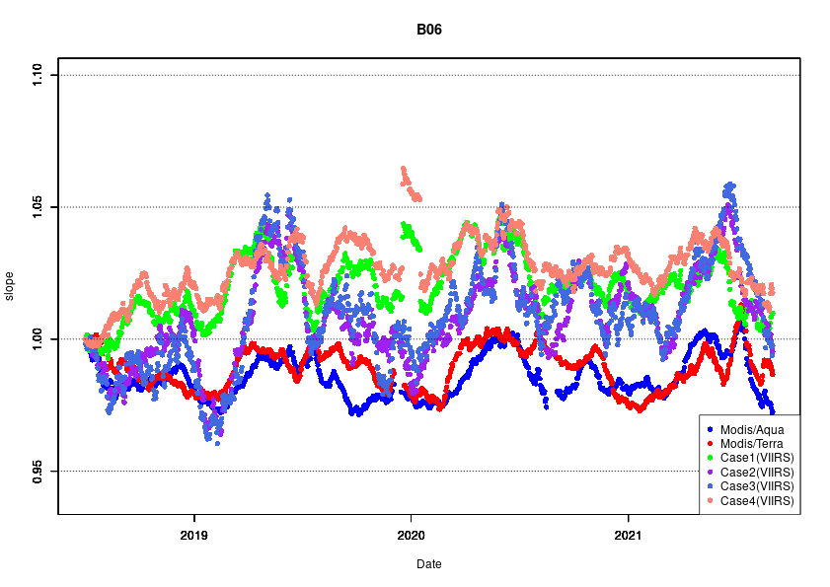
Himawari-8 long-term regression slope (normalization)
B01(0.47um)
B02(0.51um)
B03(0.64um)
・Case1(green) and Case4(pink) show the same trend
・Case2(purple) and Case3(pale blue) also show the same trend
・Case2(purple) and Case3(pale blue) are more variable than Modis(red and blue), Case1(green), and Case4(pink)
→Case1 or Case4 are more suitable
B04(0.86um)
B05(1.6um)
B06(2.3um)
■：VIIRS data anomaly

Slide 14
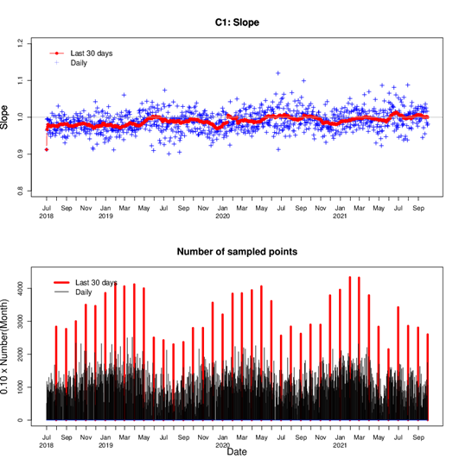
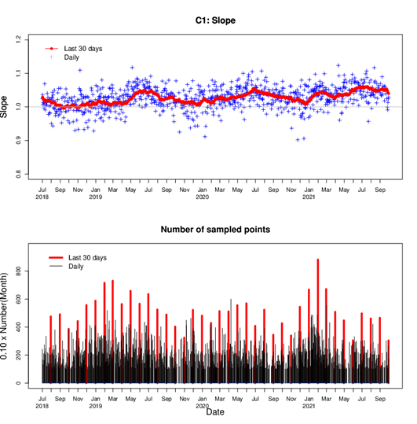
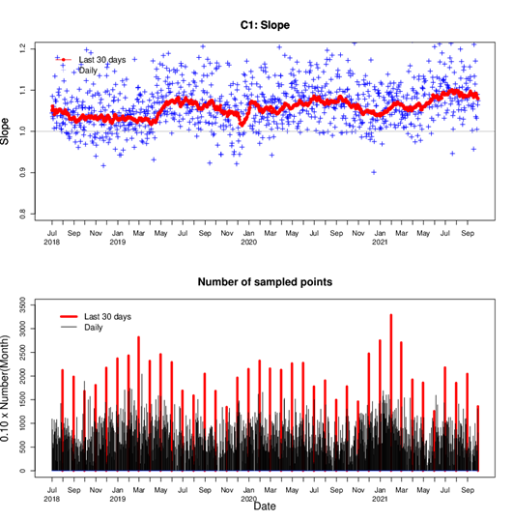
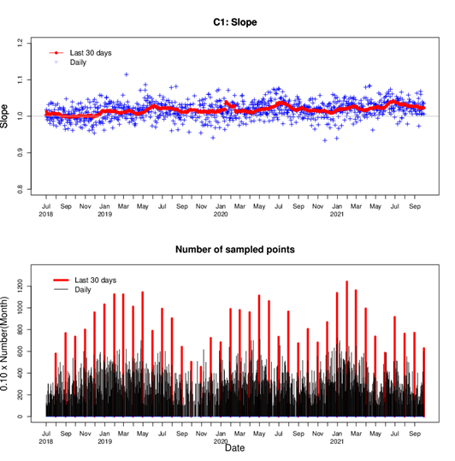
Himawari-8 B04(0.86um) slope and number of samples
Case1
Case2
Case3
Case4
・The spread of the distribution of daily slope points in Case3 is larger than other
・Case1 has the largest number of samples
・Case2’s number of sample is the fewest(The threshold is too strict?)
・The same trend is seen in other AHI’s VIS/NIR bands

Slide 15
Summary and Future work
We try to transfer input data from MODIS to VIIRS and improve the accuracy of this approach
We changed the thresholds of cloud parameters which are used in radiative transfer calculation
We compare to current approach(Aqua/MODIS and Terra/MODIS) and the approach which uses SNPP/VIIRS
The VIIRS approaches are changed water cloud’s thresholds and these are executed with several patterns
Case4 is the best thresholds in this case
Check results in detail and if necessary, reconsider the water cloud’s thresholds
Transition to VIIRS since SNPP in order
Adaptation REAP to VIIRS

Slide 16
Thank you for your attention

Slide 17
References
RSTAR
Nakajima, T. and M. Tanaka, (1988) Algorithms for radiative intensity calculations in moderately thick atmospheres using a truncation approximation, J. Quant. Spec. Rad. Trans., 40, pp. 51-69
CAPCOM
Nakajima, T.Y. and T. Nakajima, (1995) Wide area determination of cloud microphysical properties from NOAA AVHRR measurement for FIRE and ASTEX regions, J. Atmos. Sci., 52, pp. 4043-4059
REAP
Higurashi, A. and T. Nakajima, (1999) Development of a Two Channel Aerosol Retrieval Algorithm on Global Scale Using NOAA/AVHRR., J. Atmos. Sci., 56, pp. 924-941
Higurashi, A. and T. Nakajima, (2002) Detection of aerosol types over the East China Sea near Japan from four-channel satellite data., Geophys. Res. Lett., 29, pp. 1836-1839

Slide 18
Aerosol retrieval package “REAP”
Aerosol parameters(optical thickness and Angstrom exponent) are obtained from MODIS L1B data using REAP aerosol analysis package(Higurashi and Nakajima,1999)
This approach utilizes three MODIS bands,
Band 1(0.645um)
Band2(0.858um)

Slide 19
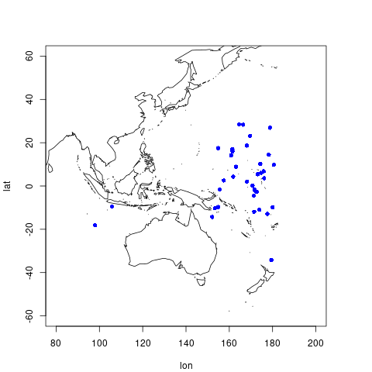
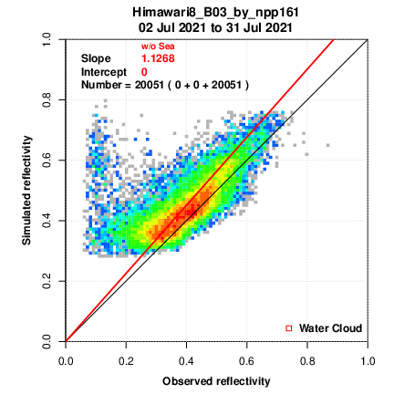
Himawari-8 regression slope
Mostly on the Pacific side
●Observed reflectivity < 0.15

Slide 20
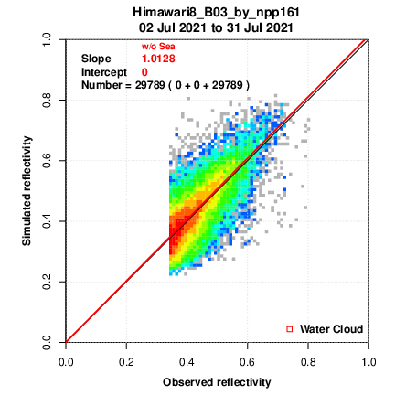
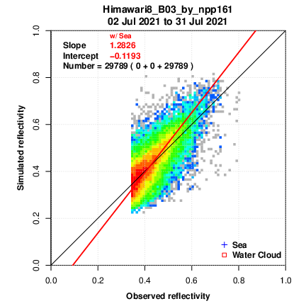
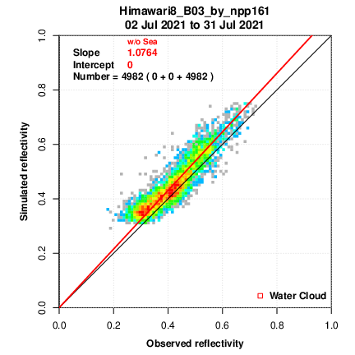
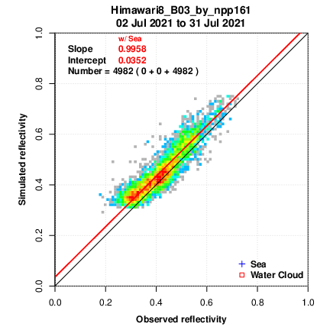
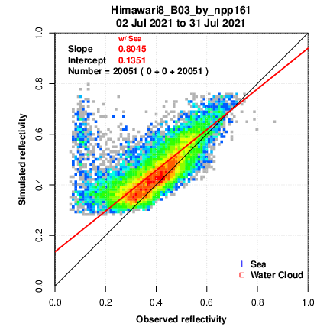
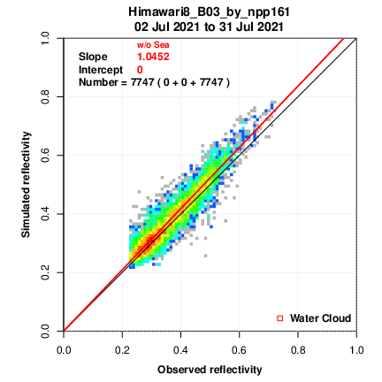
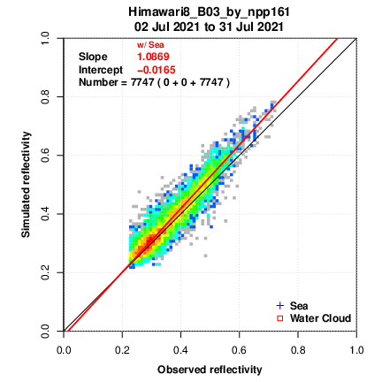
Intercept
The intercept is fixed at zero in this experiment.(left fig)
The right figure does not fix the intercept.
VIIRS_1
VIIRS_2
VIIRS_3
VIIRS_4

