Slide 1
Introduction to the Lunar Calibration Subgroup Session
Tom Stone
USGS

Slide 2
The GRWG Lunar Calibration Subgroup was formally established following a proposal to the EP at the March 2024 annual meeting.
At past meetings lunar talks have been presented in the VisNIR session
also in 2025, but fewer lunar talks and many more on other VisNIR topics
Future meetings should accommodate a half-day lunar calibration session
depending on contributions from the community

Slide 3
Update on the NIST Mauna Loa LUSI Project
Tom Stone (USGS) and Steve Maxwell (NIST)

Slide 4
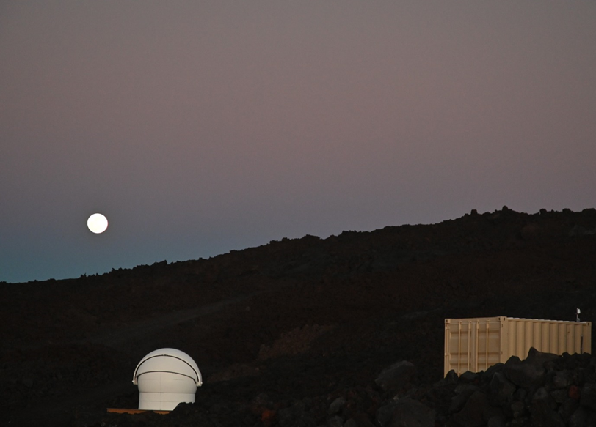
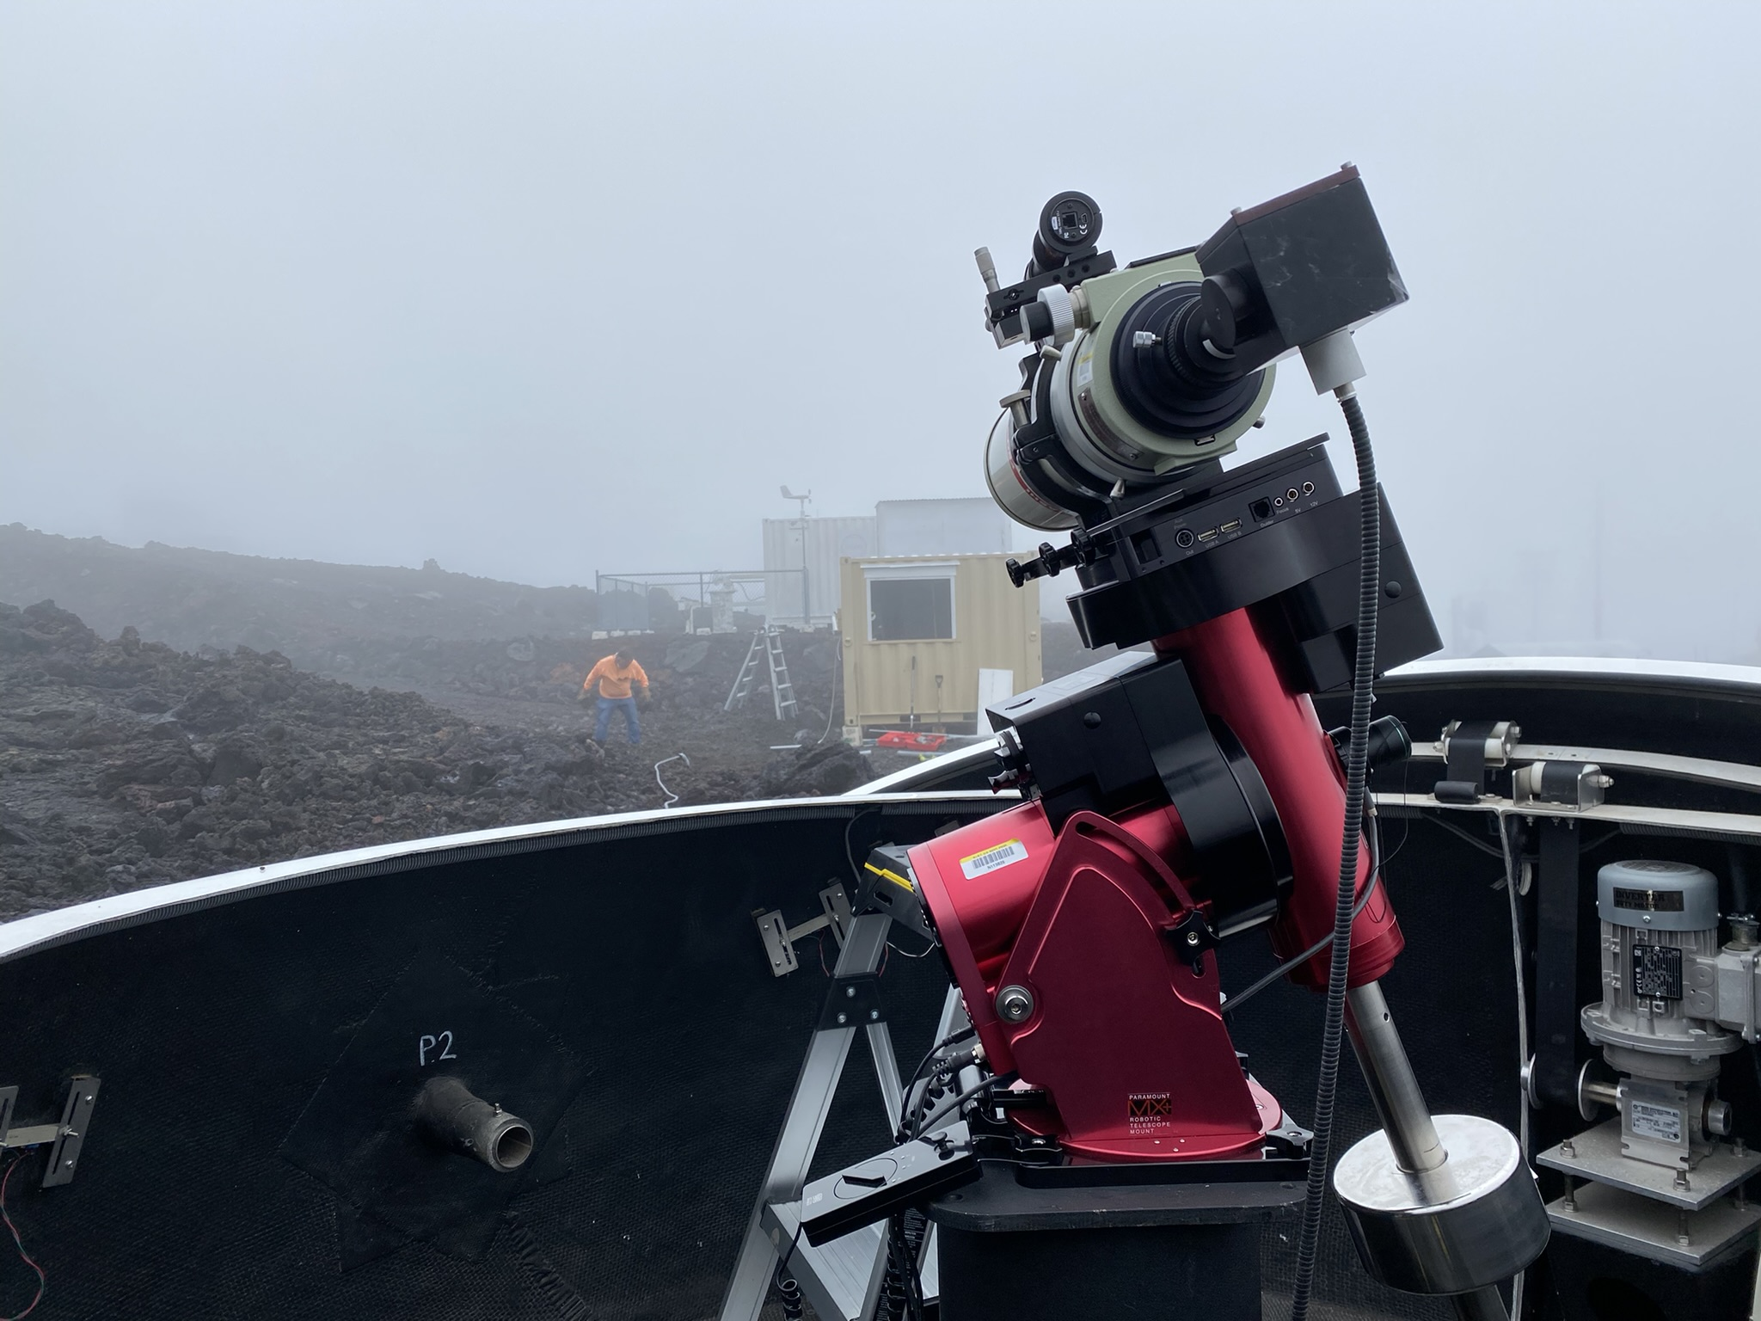
Installation at the Mauna Loa Observatory Site, 2022
The dome containing the telescope, and the hut containing the calibration source.
The telescope pointed to the calibration hut.
photos: Stephen Maxwell

Slide 5
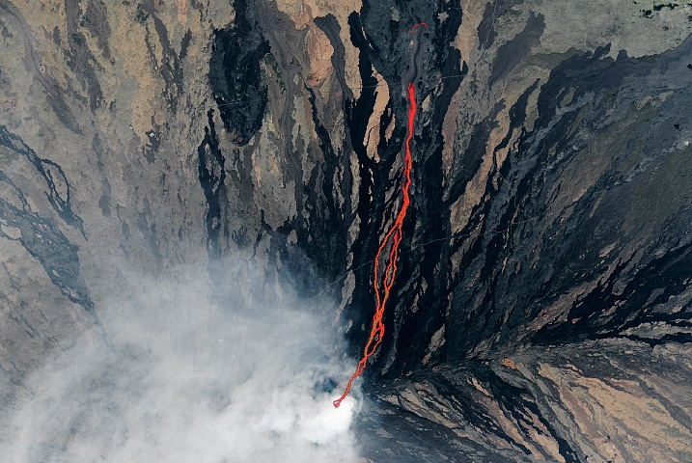
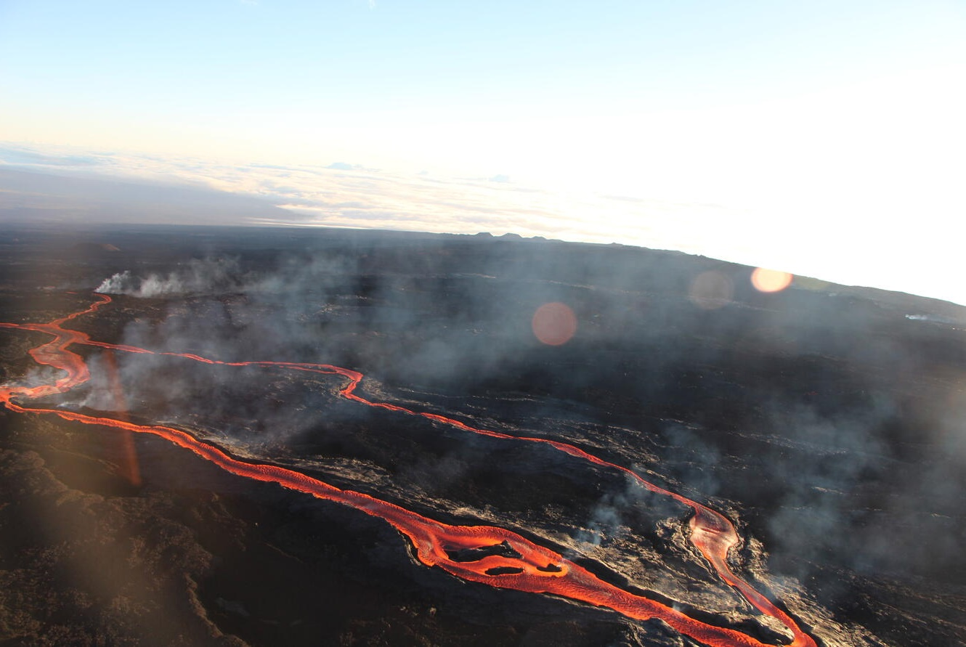
Eruption in November 2022
November 27, 2022: Mauna Loa erupts, destroying power lines and covering 1.8 km of the access road with lava, to a depth up to 15 meters
photos: Stephen Maxwell

Slide 6
Current Status
MLO staff make regular trips to maintain observatory core functions
Some solar power has been installed at the site, brought in by helicopter
NIST obtained cost estimates for a solar power system for the LUSI equipment, and transport to the mountaintop
In 2024 the MLO-LUSI project PI moved to a different division of NIST
NIST is looking at options for the LUSI installation:
transfer ownership to another institution
agreement with an outside entity to operate the system
removal from the MLO site (source of funding is uncertain)

