Slide 1


Improved Deep Convective Cloud Characterization Designed to Monitor the VIIRS Reflective Solar Band Stability
Prathana Khakurelª, David Doelling^{b}, Conor Haneyª, Rajendra Bhatt^{b}, Arun Gopalanª, Benjamin Scarino^{b}
AMS 2025 annual meeting, Jan 16, 2025,
New Orleans, LA
ªAnalytical Mechanics Associates
^{b}NASA Langley Research Center

Slide 2
Background
NASA’s CERES Project, provides long-term global 1° gridded regional broadband fluxes to monitor the Earth’s climate.
CERES instruments are onboard Terra, Aqua, SNPP, and NOAA-20 satellites
Radiances are converted to fluxes using scene specific angular directional models, requiring stable MODIS and VIIRS analogous radiances for consistent cloud properties.
The CERES Imager and Geostationary Calibration Group ensures accurate calibration for cloud and flux measurements
Deep convective clouds (DCCs) serve as the brightest tropical Earth invariant targets (IT) located at the top of the atmosphere to monitor imager calibration stability.
DCC-IT approach, introduced by Hu et al. (2004), monitored the stability of the CERES SW radiance using the PDF mode statistics after applying the Hu BRDF, based on the CERES instrument Rotating Azimuth Plane Mode Scan radiances
Hu BRDF model is suited for visible channels
SWIR channel specific Empirical BRDF monthly models is best suited for capturing the seasonal variability of DCC reflectances.

Slide 3
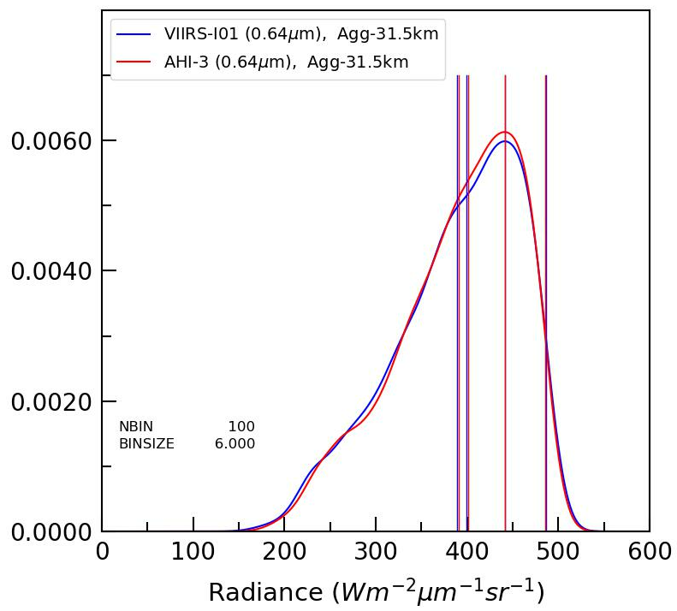
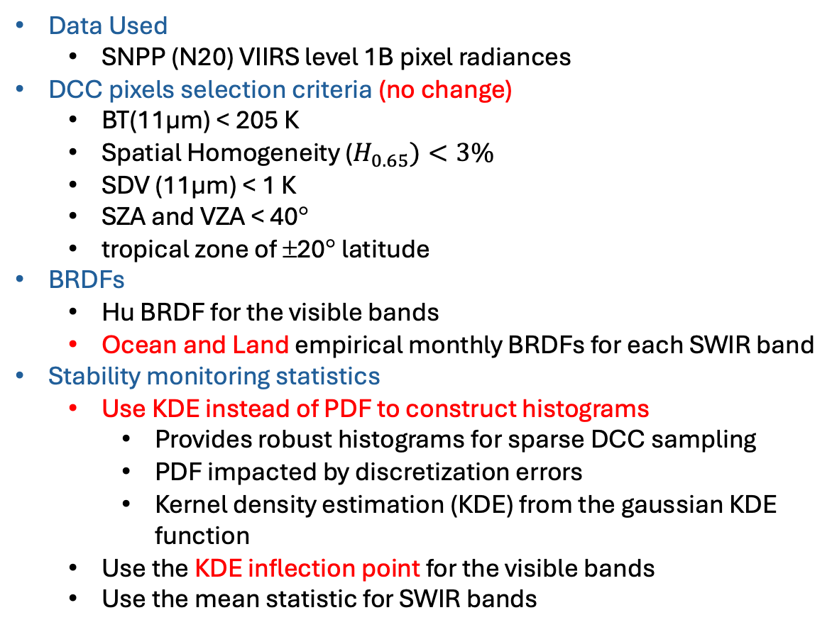
Current VIIRS DCC Methodology
Data Used
SNPP (N20) VIIRS level 1B pixel radiances
DCC pixels selection criteria (no change)
BT(11µm) < 205 K
Spatial Homogeneity ($H_{0.65})<3\%$
SDV ($\text{11µ}\text{m}$) < 1 K
SZA and VZA < 40°
tropical zone of ±20° latitude
BRDFs
Hu BRDF for the visible bands
Ocean and Land empirical monthly BRDFs for each SWIR band
Stability monitoring statistics
Use KDE instead of PDF to construct histograms
Provides robust histograms for sparse DCC sampling
PDF impacted by discretization errors
Kernel density estimation (KDE) from the gaussian KDE function
Use the KDE inflection point for the visible bands
Use the mean statistic for SWIR bands
VIIRS I1
AHI B3
Median
Mode
Mean
Inflection
Mean = average of the pixel radiances
Median = radiance where half of the pixels have a lower and higher radiance
Mode = radiance with the greatest frequency
Inflection point = radiance where the 2nd order derivative (curvature) sign changes usually near the half maximum
* Red text highlights the updated approach

Slide 4
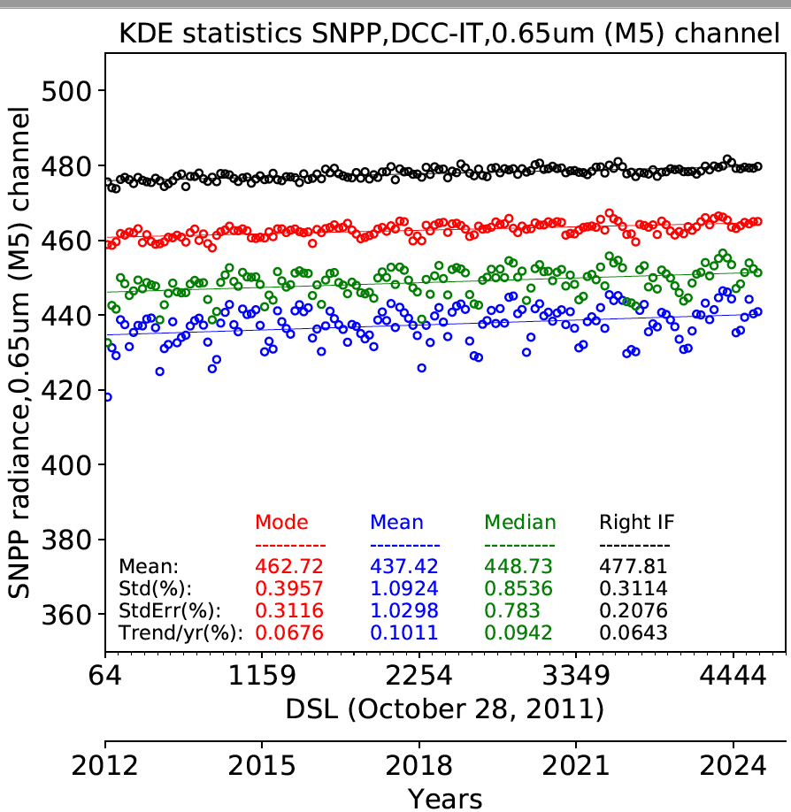
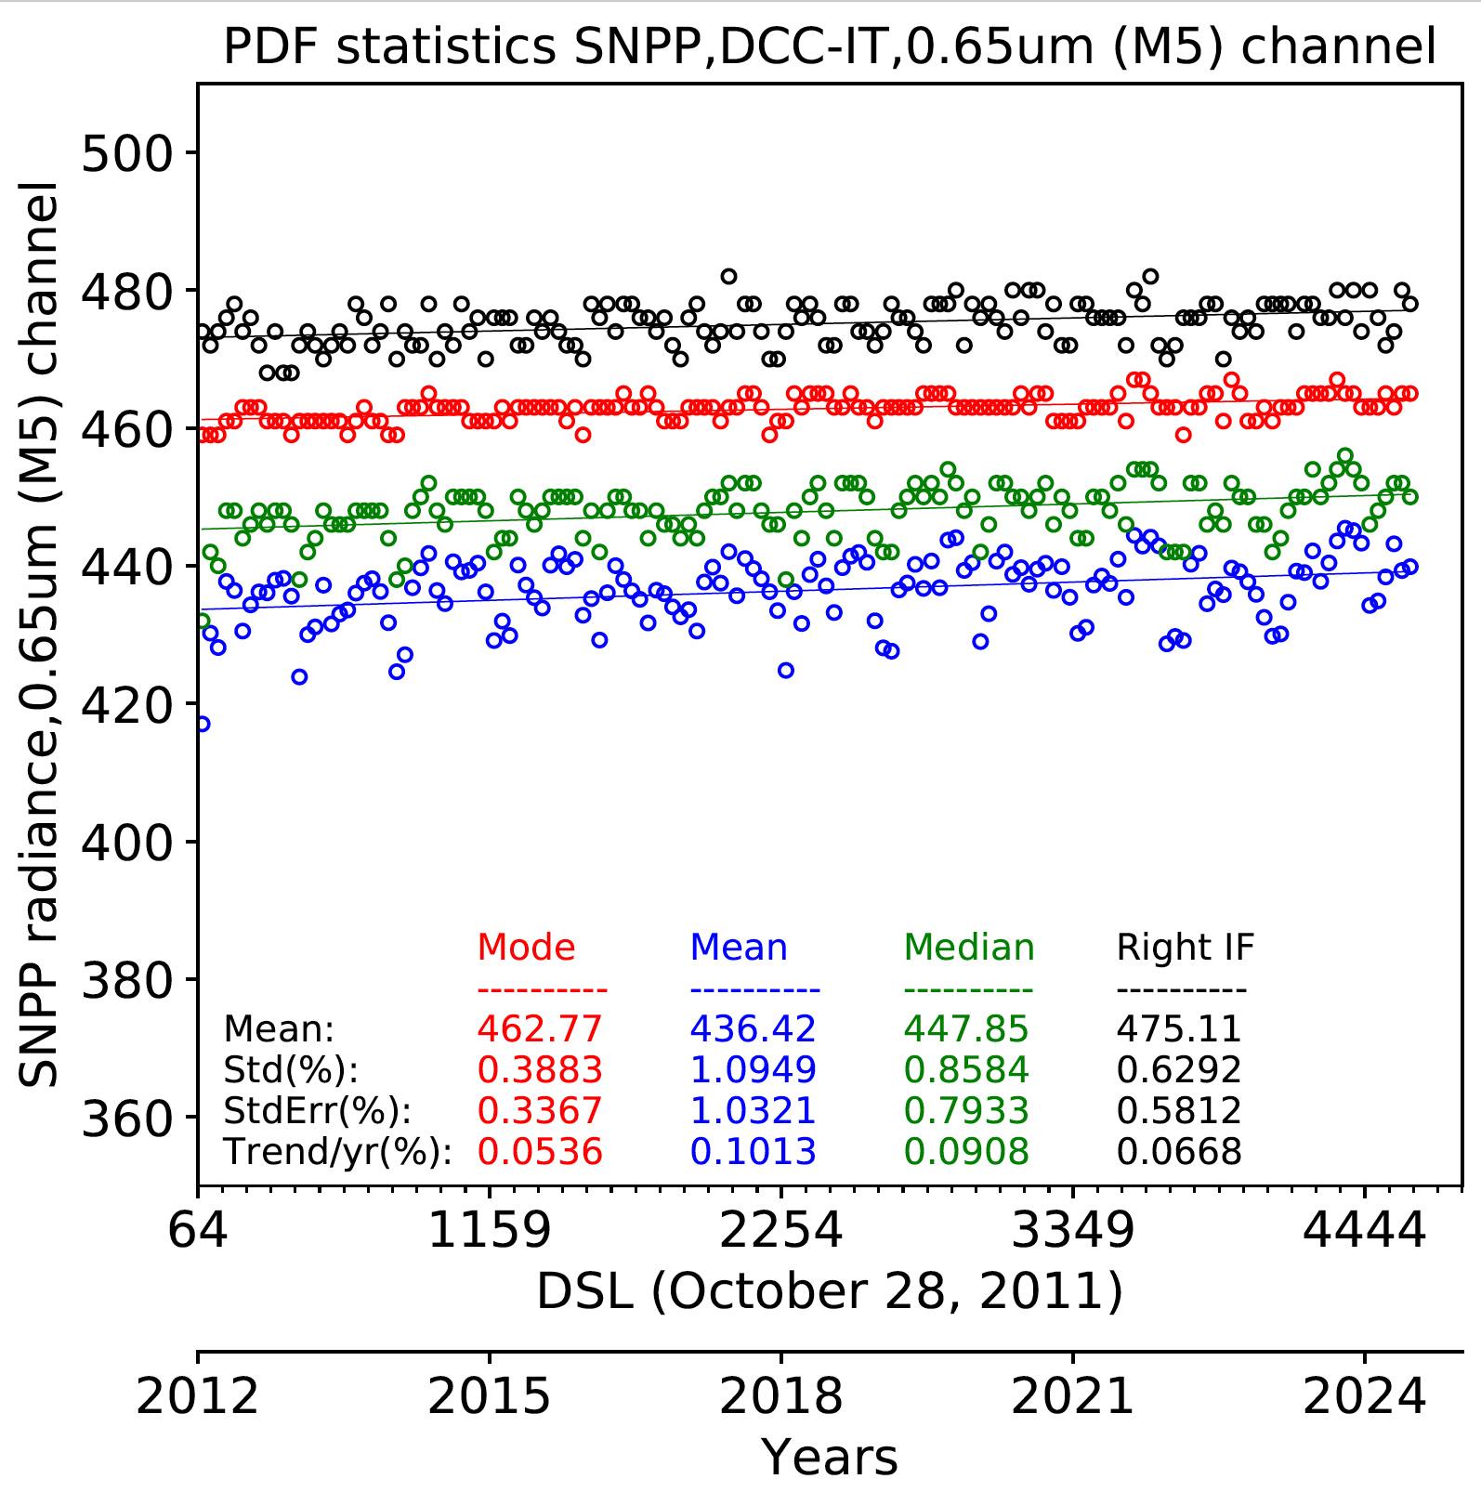
KDE vs PDF statistics
KDE
PDF
KDE
• For visible bands the KDE mode and inflection point standard error are more stable than the PDF
• The KDE inflection point is the most stable KDE statistic

Slide 5


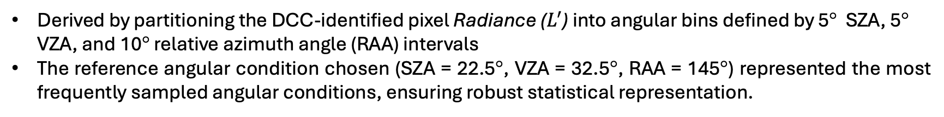
Monthly Land-Ocean BRDF models
Derived by partitioning the DCC-identified pixel Radiance ($L^{′}$) into angular bins defined by 5° SZA, 5° VZA, and 10° relative azimuth angle (RAA) intervals
The reference angular condition chosen (SZA = 22.5°, VZA = 32.5°, RAA = 145°) represented the most frequently sampled angular conditions, ensuring robust statistical representation.
$L_{corrected−monthly}$=$L^{′}x\frac{BRDF(22.5°,32.5°,145°, annual)}{BRDF(SZA,VZA,RAA, month)}$
Where,
$L_{corrected−monthly}$ = BRDF corrected radiances after applying monthly BRDF
$L_{{corrected}_{ocean}}={L^{′}}_{{ocean}_{}}x\frac{{BRDF}_{ocean}(22.5°,32.5°,145°, annual)}{{BRDF}_{ocean}(SZA,VZA,RAA,month)}$
${L^{′}}_{{corrected}_{land}}=$ ${L^{′}}_{{land}_{}}x\frac{{BRDF}_{ocean}(22.5°,32.5°,145°,annual)}{{BRDF}_{land}(SZA,VZA,RAA, month)}$
$$L_{{corrected}_{combined}}={L^{′}}_{{corrected}_{land}}+ L_{{corrected}_{ocean}}$$
Takes into account the brightness difference between land and ocean
Where,
$L_{{corrected}_{land}}$= BRDF corrected radiances after applying monthly land BRDF
$L_{{corrected}_{ocean}}$= BRDF corrected radiances after applying monthly ocean BRDF.

Slide 6
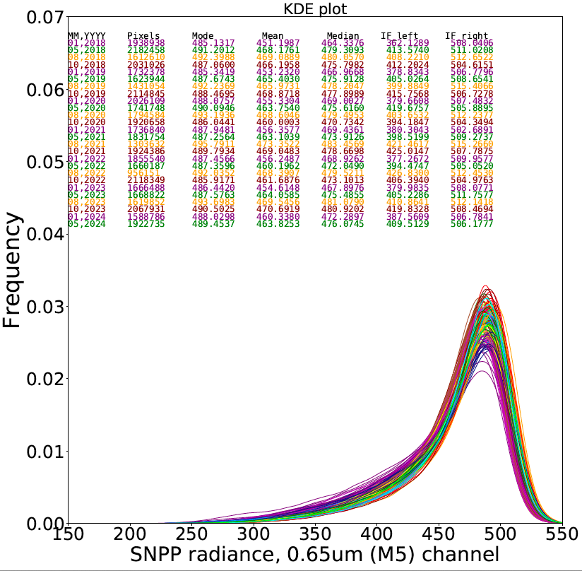
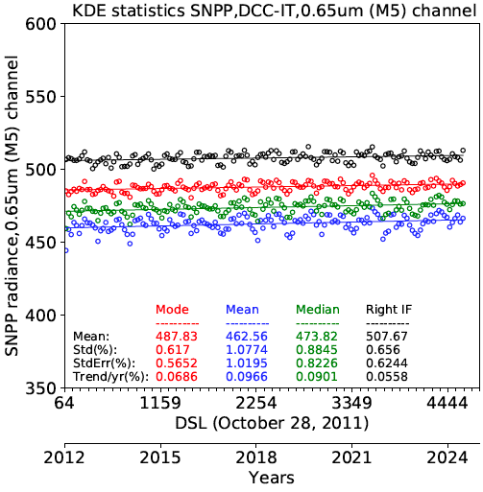
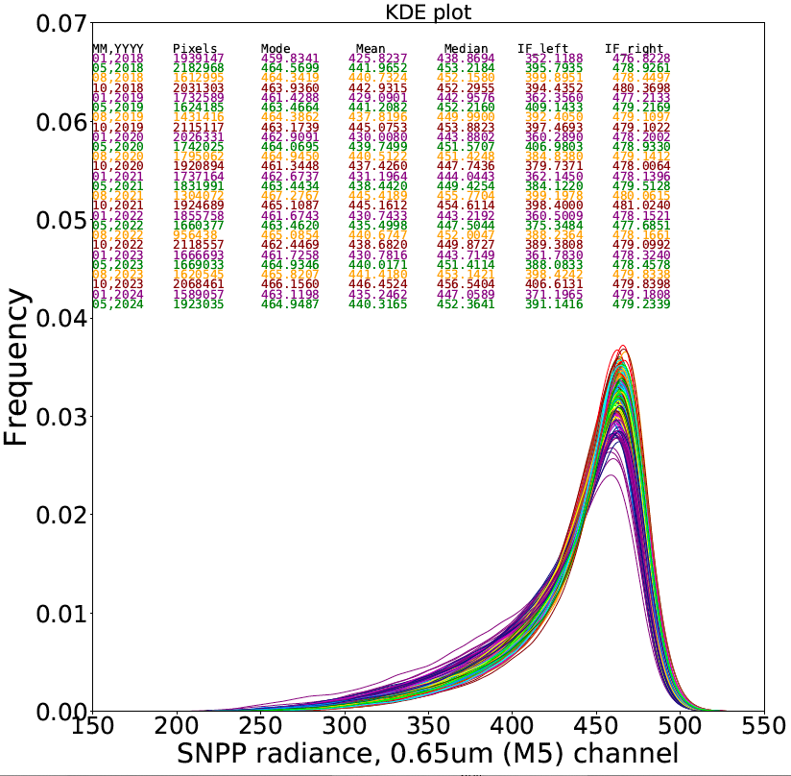
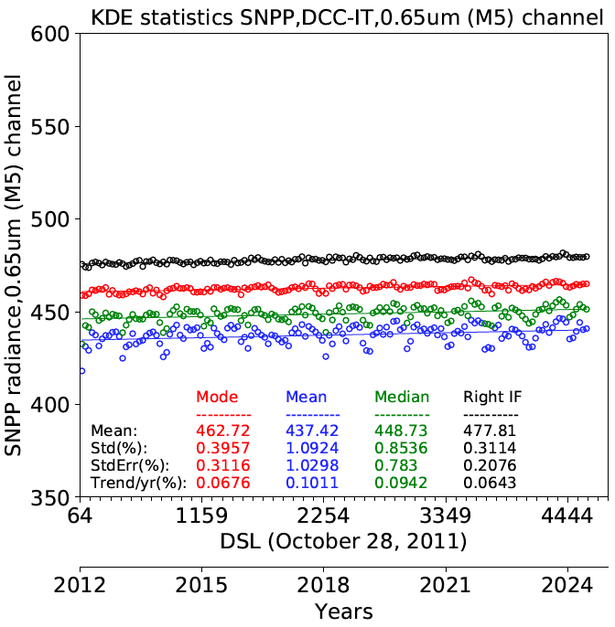
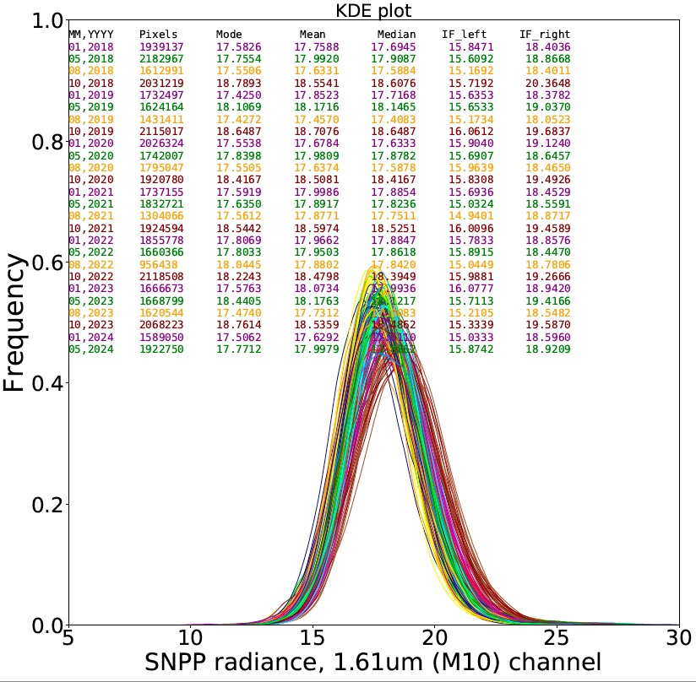
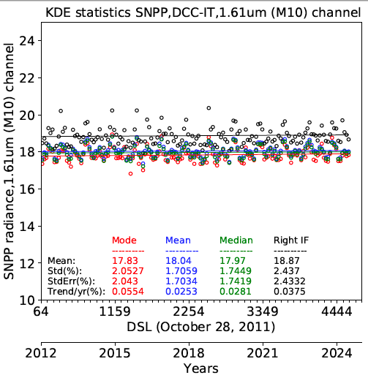
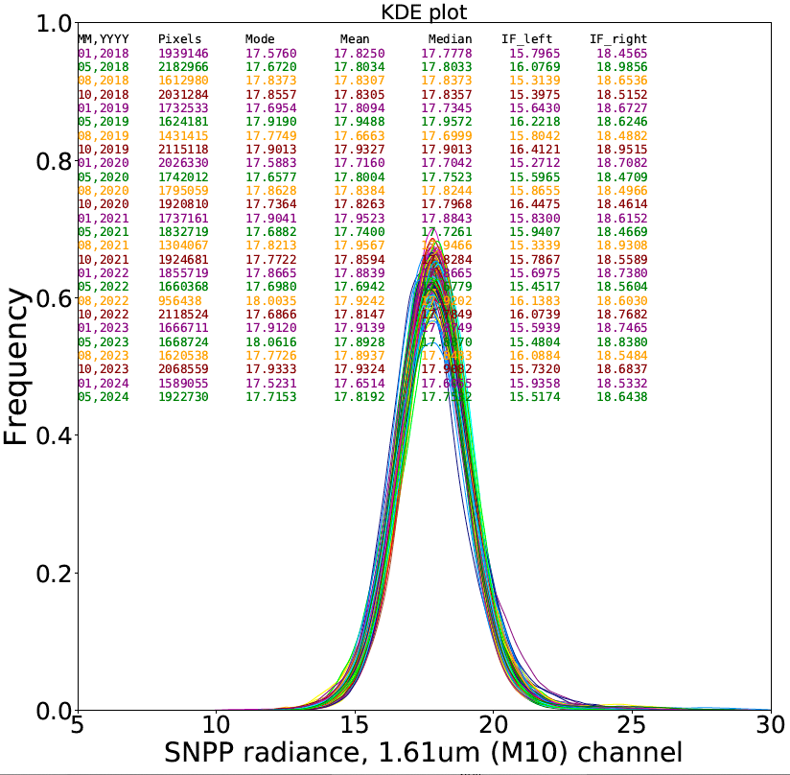
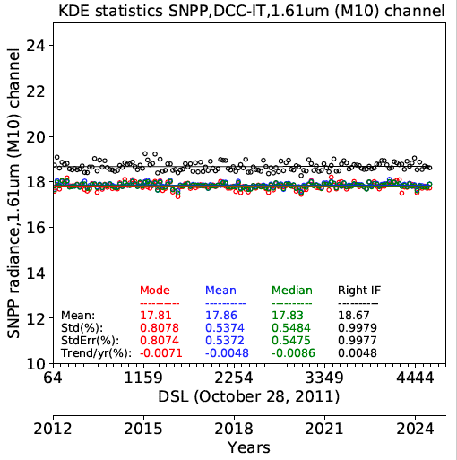
Application of Hu and Land/Ocean BRDF models
0.65 µm channel
No BRDF
0.65µm
Hu BRDF
SE = 0.21%
~66% reduction
SE = 0.62%
0.65 µm channel
No BRDF
0.65µm
Hu BRDF
1.61 µm channel
No BRDF
1.61 µm
Monthly land/ocean BRDF
SE = 0.54%
~68% reduction
1.61µm
No BRDF
SE = 1.7%
1.61 µm
land/ocean BRDF

Slide 7
Trend standard errors (%) by KDE statistics
VIIRS channel | Standard error (%)
 | No BRDF |  |  |  | Hu model and land/ocean seasonal BRDFS
 | KDE mode | KDE mean | KDE median | KDE inflection | KDE mode | KDE mean | KDE median | KDE inflection
M3 | 0.57 | 1.00 | 0.83 | 0.67 | 0.35 | 1.03 | 0.81 | 0.25
M4 | 0.60 | 1.00 | 0.82 | 0.70 | 0.33 | 1.00 | 0.77 | 0.25
I01 | 0.58 | 0.99 | 0.80 | 0.73 | 0.31 | 1.00 | 0.76 | 0.24
M5 | 0.57 | 1.01 | 0.82 | 0.62 | 0.31 | 1.03 | 0.78 | 0.21
M7 | 0.48 | 0.93 | 0.69 | 0.51 | 0.25 | 0.97 | 0.64 | 0.23
M8 | 0.50 | 0.62 | 0.53 | 0.67 | 0.28 | 0.31 | 0.26 | 0.55
M9 | 1.29 | 1.36 | 1.31 | 1.27 | 0.82 | 0.65 | 0.61 | 1.70
I03 | 2.06 | 1.71 | 1.75 | 2.44 | 0.82 | 0.54 | 0.55 | 1.08
M10 | 2.04 | 1.70 | 1.74 | 2.43 | 0.81 | 0.54 | 0.55 | 1.00
M11 | 1.51 | 1.28 | 1.30 | 1.81 | 0.55 | 0.42 | 0.42 | 0.86
<-Visible bands->
<-SWIR bands->
• Bold text indicates the lowest trend standard errors
• Mean and Median shows consistent SWIR band stability

Slide 8
Monthly Regional DCC BRDF models
The tropical land and ocean stratification was a simple solution to address their distinct radiative properties:
Examine the monthly 10° latitude-longitude regional DCC radiances
To verify the Hu and land/ocean monthly BRDF model improvements
Use January 2012 to July 2024 to build the monthly regional DCC dataset
To increase sampling use a 3-month running mean to define each month
Incorporate a monthly 10° latitude-longitude regional BRDF for SWIR bands to improve the imager stability monitoring statistics
$L_{{corrected}_{reg}}=L_{global}x\frac{{BRDF}_{annual}(22.5°,32.5°,145°, annual)}{{BRDF}_{global}(SZA,VZA,RAA,month,lat,lon)}$

Slide 9
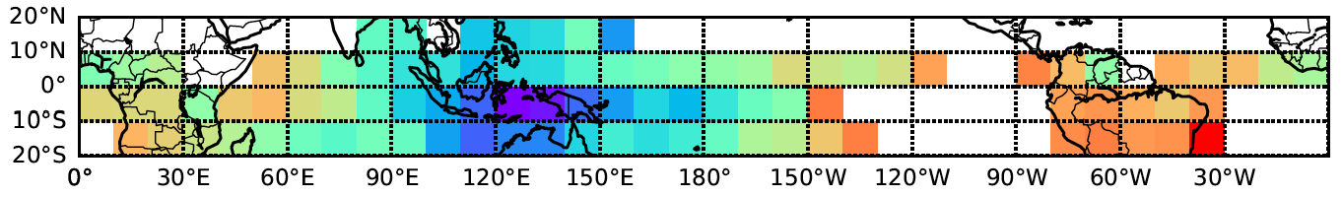
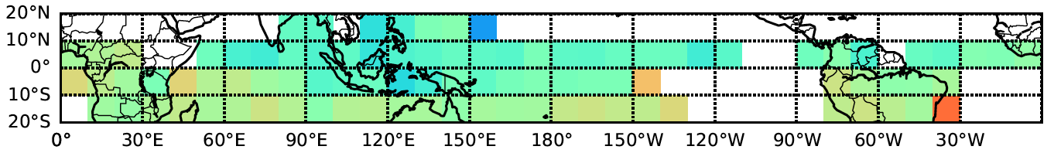
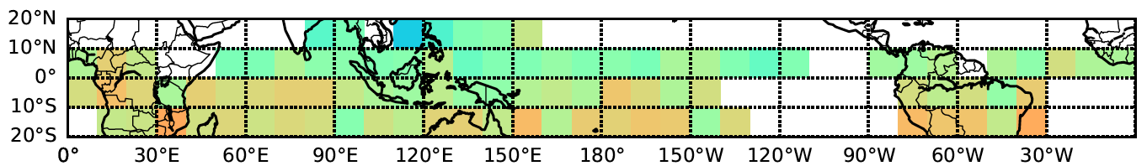
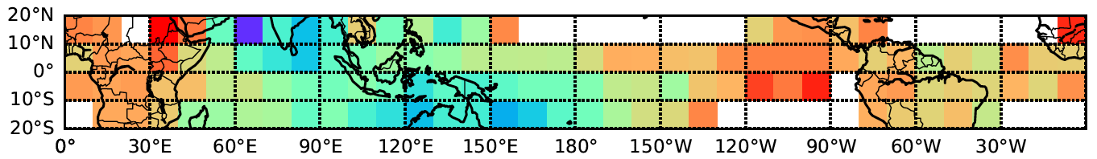
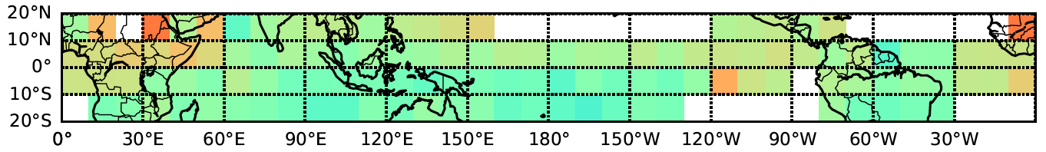
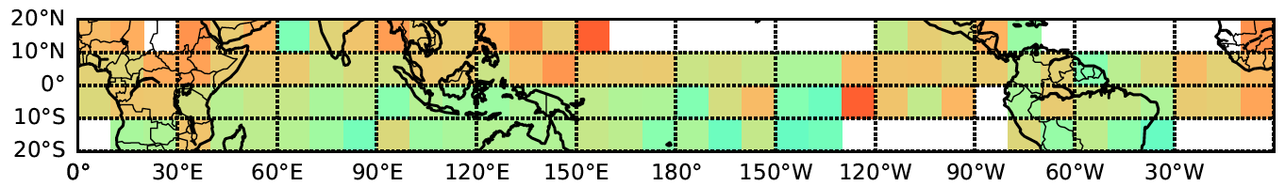

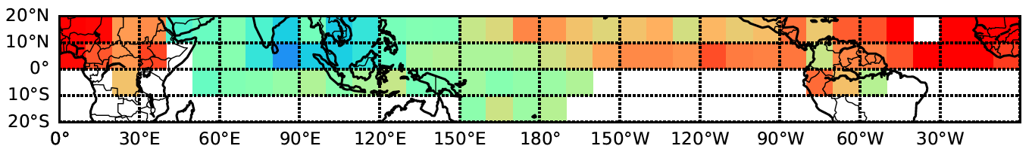
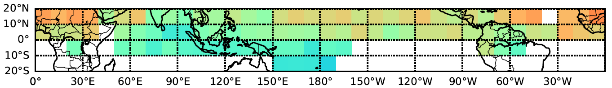
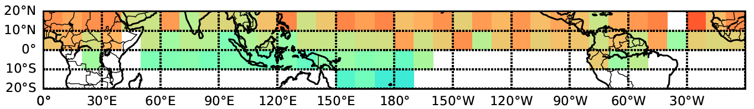
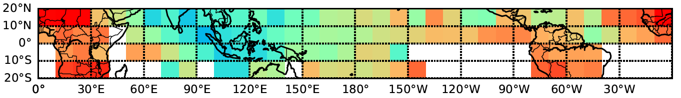
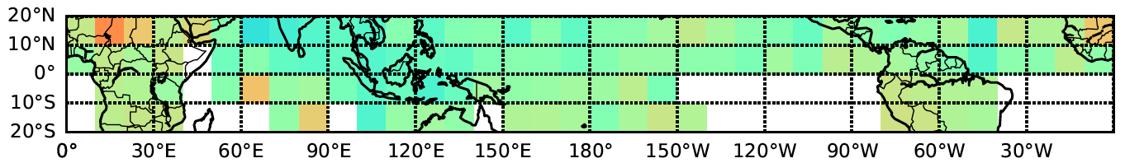
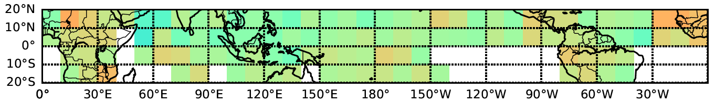
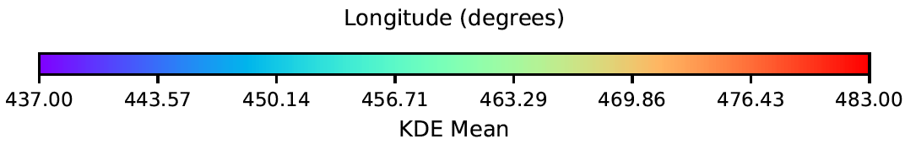
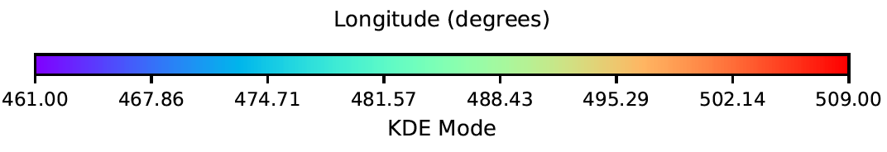
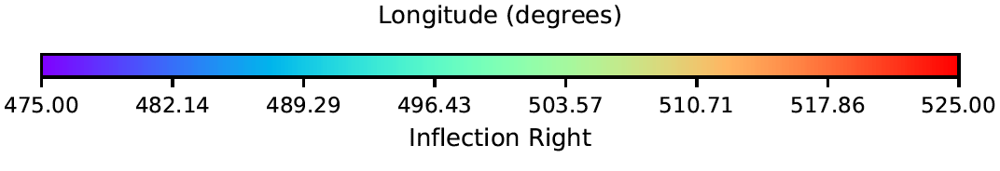
Regional Monthly NPP 0.65µm DCC Reflectance
No BRDF
Mean
Mode
Inflection Point
NPP,Jan,M5
NPP,Jan,M5
NPP,Jan,M5
NPP,April,M5
NPP,April,M5
NPP,April,M5
NPP,July,M5
NPP,July,M5
NPP,July,M5
NPP,October,M5
NPP,October,M5
NPP,October,M5

Slide 10

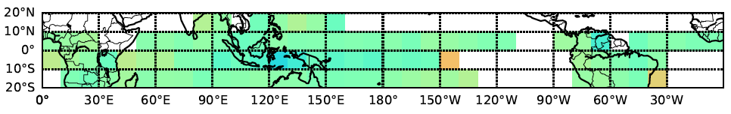
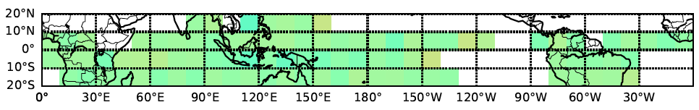
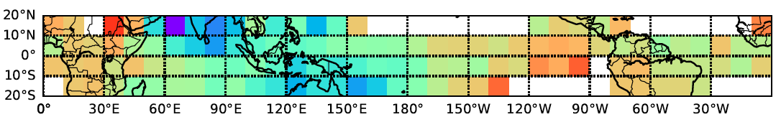
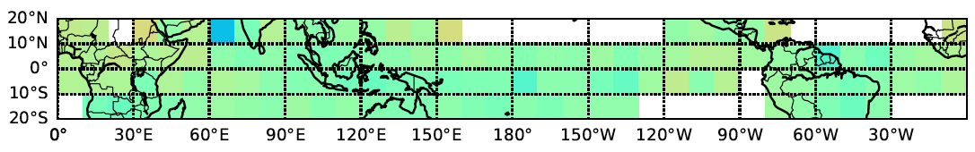
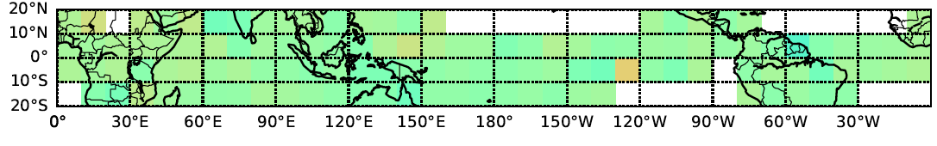
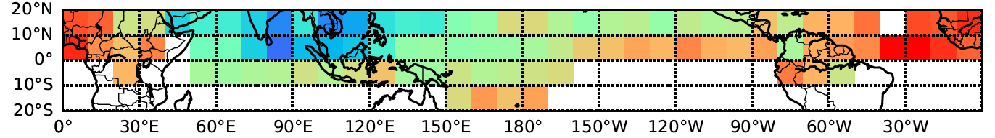
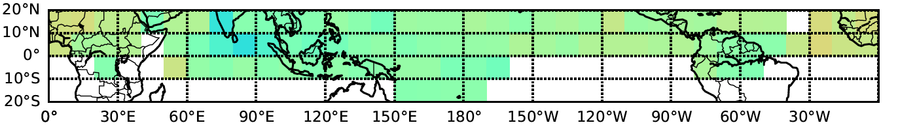
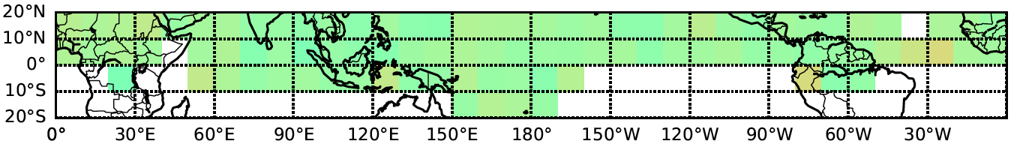
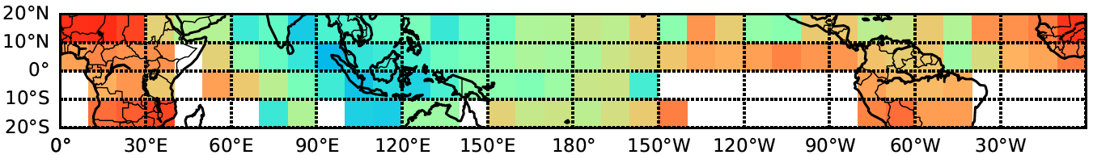
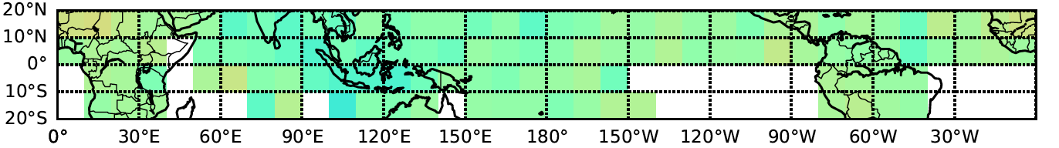
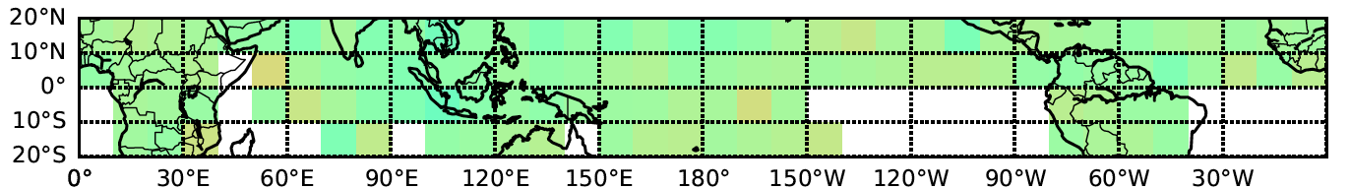
Regional Monthly NPP 0.65µm DCC Reflectance
With Hu BRDF
Mean
Mode
Inflection Point
NPP,Jan,M5
NPP,Jan,M5
NPP,Jan,M5
NPP,April,M5
NPP,April,M5
NPP,April,M5
NPP,July,M5
NPP,July,M5
NPP,July,M5
NPP,October,M5
NPP,October,M5
NPP,October,M5

Slide 11
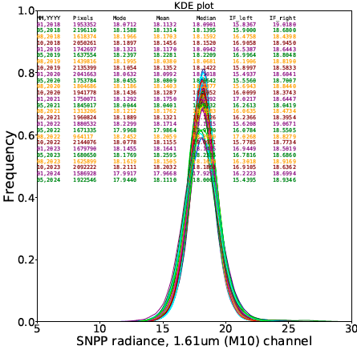
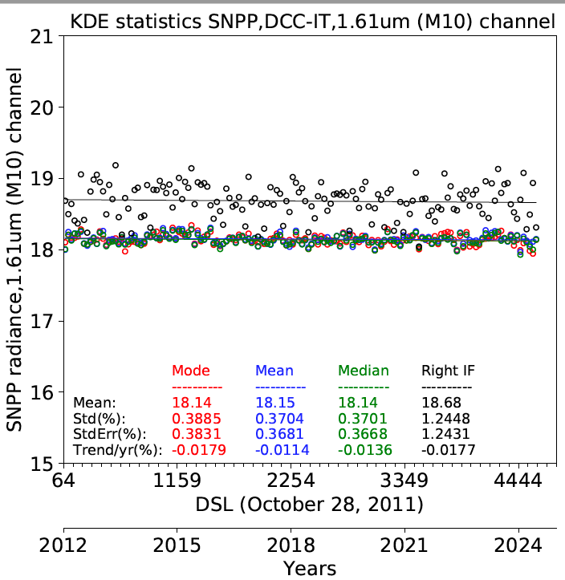
Application of Regional BRDF model SWIR bands
1.61µm
No BRDF
1.61 µm
land/ocean BRDF Monthly BRDF
1.61 µm channel
No BRDF
1.61 µm
Monthly land/ocean BRDF
SE = 0.54%
~68% reduction
1.61 µm
Monthly regional BRDF
SE = 0.37%
~78% reduction
SE = 1.7%

Slide 12
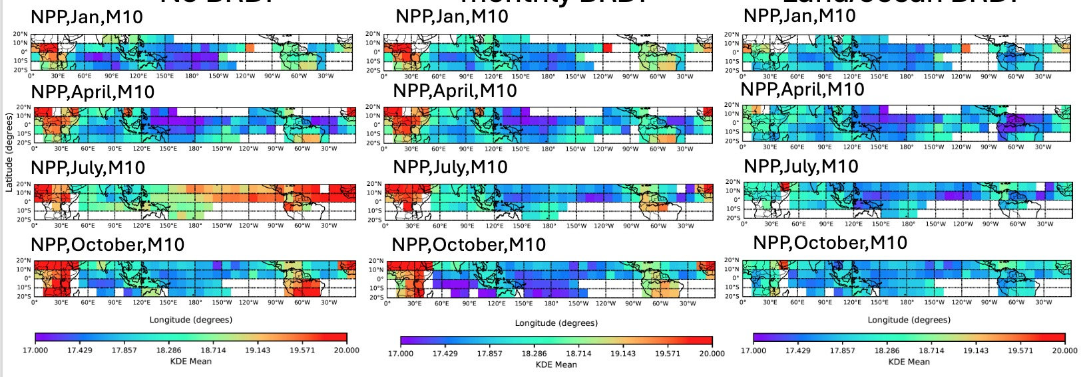
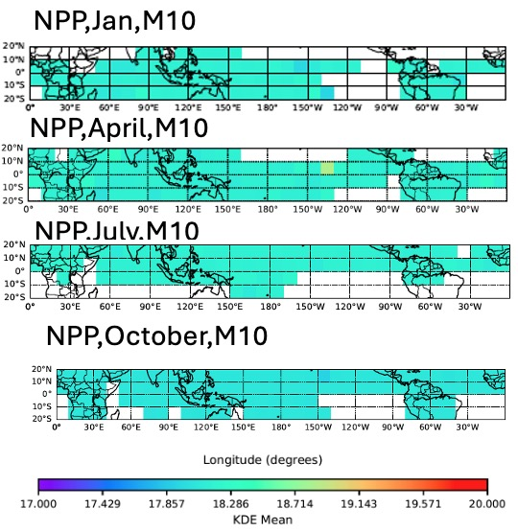
Regional Monthly NPP 1.61µm DCC Reflectance
KDE mean
No BRDF
monthly BRDF
Land/ocean BRDF
Regional BRDF

Slide 13
Trend standard errors summary
VIIRS channel | Standard error (%) |  |  |  |  |  | Improvements (% reduction) With Hu model
 | No BRDF |  | Hu Model |  | Regional BRDF
 | KDE mean | KDE inflection | KDE mean | KDE inflection | KDE mean | KDE inflection
M3 | 1.00 | 0.67 | 1.03 | 0.25 | 0.38 | 0.88 | 63%
M4 | 1.00 | 0.70 | 1.00 | 0.25 | 0.42 | 0.92 | 64%
I01 | 0.99 | 0.73 | 1.00 | 0.24 | 0.40 | 0.95 | 67%
M5 | 1.01 | 0.62 | 1.03 | 0.21 | 0.40 | 0.94 | 66%
M7 | 0.93 | 0.51 | 0.97 | 0.23 | 0.34 | 0.76 | 55%
VIIRS channel | Standard error (%) |  |  | Improvements (% reduction) With Regional BRDF
 | No BRDF | Monthly Land/Ocean BRDF | Regional BRDF
 | KDE mean | KDE mean | KDE mean
M8 | 0.62 | 0.31 | 0.21 | 66%
M9 | 1.36 | 0.65 | 0.47 | 65%
I03 | 1.71 | 0.54 | 0.37 | 78%
M10 | 1.70 | 0.54 | 0.37 | 78%
M11 | 1.28 | 0.42 | 0.3 | 77%

Slide 14
Conclusions
Recent DCC characterization enhancements include
Using a Kernel Density Estimation (KDE) or Gaussian smoothing function designed for limited sampled datasets to avoid discretization errors
Using the PDF-inflection point and applying the Hu-BRDF model to monitor visible band stability providing NPP VIIRS C2.1 between 0.2% to 0.3% stability uncertainties
Using the PDF-mean and applying monthly regional BRDFs to monitor SWIR band stability providing NPP VIIRS C2.1 between 0.2% to 0.5% stability uncertainties
The Hu-BRDF provided more consistent regional PDF-mode and PDF-inflection point radiances but did not improve the PDF-mean
The Hu-BRDF works best for the brightest DCC radiances
The monthly regional BRDFs normalizes the DCC PDF-mean response by season and spatially and is viable due to the much smaller DCC inter-annual variability
For visible bands the NPP VIIRS C2.1 PDF-mean stability is reduced from 1.0% to 0.4%
For SWIR bands the NPP VIIRS C2.1 PDF-mean stability is reduced an additional 25% from the land/ocean BRDF

Slide 15
Thank you !

Slide 16
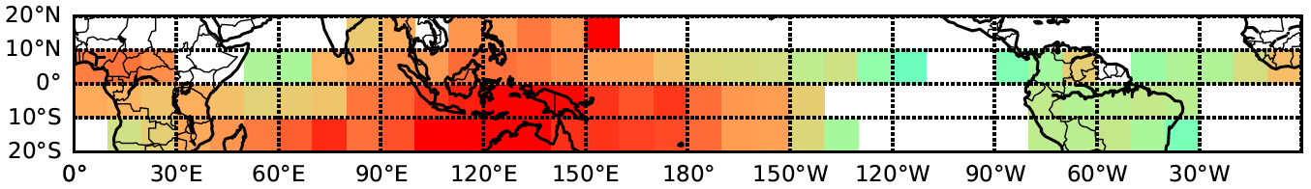
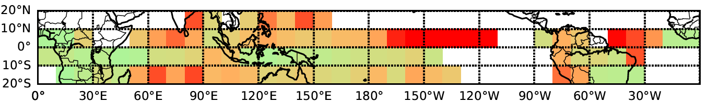
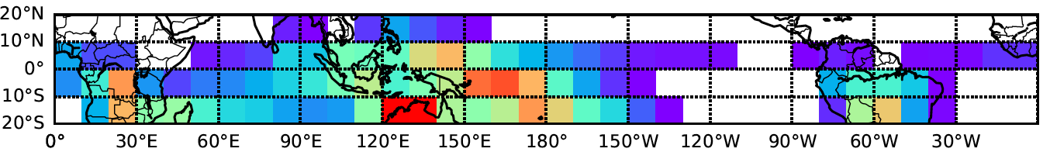
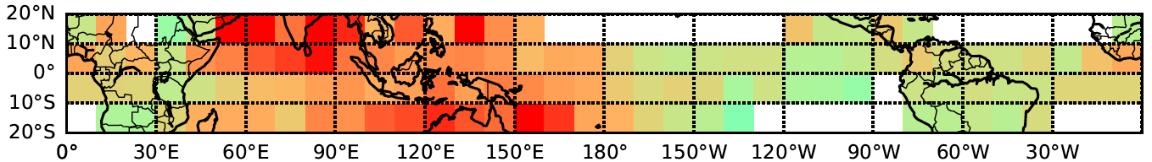
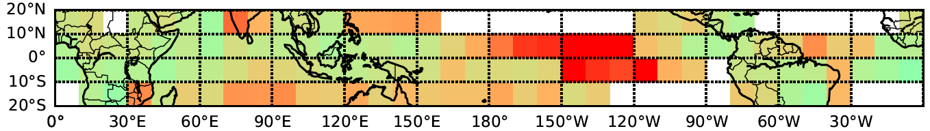
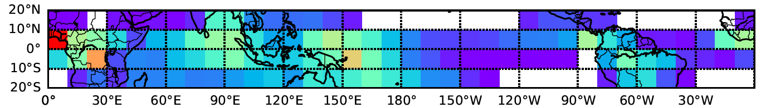
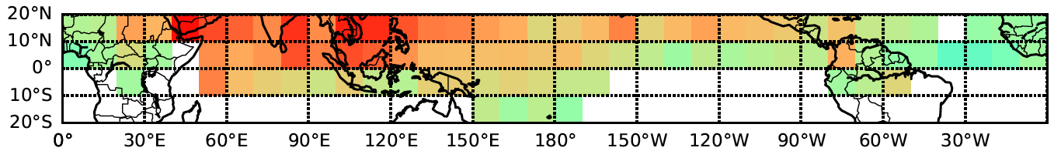







Regional Monthly NPP 1.61µm DCC Reflectance
0.65µm Std Dev
1.61µm Std Dev
Frequency
NPP,Jan,M5
NPP,Jan,M10
NPP,Jan
NPP,April,M5
NPP,April,M10
NPP,April
NPP,July,M5
NPP,July,M10
NPP,July
NPP,October,M5
NPP,October,M10
NPP,October

