Slide 1
Improving the deep convective cloud invariant target methodology to radiometrically scale Himawari-8 AHI to VIIRS
Conor Haneyª, David Doelling^{b}, Rajendra Bhatt^{b}, Prathana Khakurelª, Benjamin Scarino^{b}, Arun Gopalanª
AMS annual meeting,
15th Conference On Transition Of Research To Operations (15R2O)
New Orleans, LA, 13-17, January 2025
ªAnalytical Mechanics Associates
^{b}NASA Langley Research Center

Slide 2
Background
The NASA CERES project provides the scientific community global regional broadband fluxes designed for long-term climate monitoring.
  The CERES Imager and Geostationary Calibration Group (IGCG) provides independent assessment of the NASA VIIRS L1B imager radiances and inter-calibration coefficients between MODIS, VIIRS, and geostationary imagers (GEO) to provide consistently retrieved clouds and GEO-derived broadband fluxes
The CERES imager and GEO intercalibration uses all-sky tropical ocean ray-matching as the primary method to inter-calibrate VIIRS and GEO, and verifies the inter-calibration with Deep Convective Cloud (DCC) ray-matching, desert targets, and DCC invariant targets (DCC-IT)
DCCs are spectrally uniform, near-Lambertian natural diffusers offering high signal-to-noise ratio and stable radiometric response in the VIS-NIR spectrum
DCC-IT are used to monitor visible imager stability as well as to transfer the calibration for over 20 years. The technique is based on a large ensemble statistical method that relies on sufficient sampling of DCC pixels over the tropics
  Monthly PDF shapes being consistent temporally indicates sensor stability
The goal of this study is to improve the VIIRS and GEO inter-calibration using DCC invariant targets for visible channels
  Himawari-8 AHI band 3 (0.64µm) will be compared with NOAA-20-VIIRS band I01 (0.64µm)

Slide 3
Motivation
PDF statistics for DCC-IT are used to monitor instrument stability and transfer calibration between sensors
  Mode, mean, median, and inflection point
In order to test which DCC-IT PDF statistic is most suited to radiometrically scale HIM8 AHI B3 to NOAA-20-VIIRS I01, AHI radiances are inter-calibrated with VIIRS by performing DCC ray-matching
  DCC ray-matched VIIRS and AHI 30-km radiance pairs are linearly regressed to compute the gain from observed AHI counts
  Optimal DCC-IT PDF statistic is the one that most closely matches the relative ratio between the VIIRS and HIM8 radiances
The DCC PDF statistics and the AHI/VIIRS ratios between them are tracked over time from 2018-2022 in order to assess the statistics that demonstrate the optimal spot between consistent PDF stability and lower noise

Slide 4
Data
NOAA20-VIIRS
  L1B Collection 2.1 subset retrieved from Atmospheric Science Data Center Distributed Active Archive Center (ASDC DAAC)
  6-minute granules
  Band I01 (0.64µm), natively at 375-m, averaged and subsampled to 1.5-km
    Band M15 used for 10.763µm DCC IR brightness temperature (BT) criteria (also subsampled to 1.5-km)
NPP-VIIRS
  Same as NOAA-20-VIIRS, except using L1B Collection 2
Himawari-8 AHI
  Retrieved from the Man computer Interactive Data Access System (McIDAS) from the Space Science and Engineering Center (SSEC) at the University of Wisconsin-Madison
  10-minute imagery
  Band 3 (0.64µm), natively at 0.5-km subsampled to 2-km
    Band 14 (11.2µm) used for DCC IR BT criteria, natively at 2-km

Slide 5
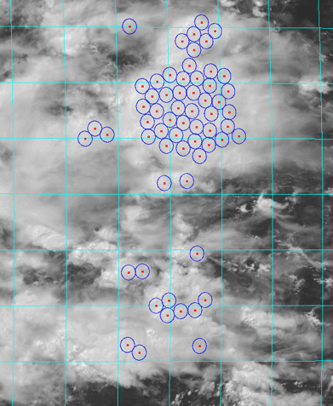
DCC Ray-matching
• Follows the DCC Ray-matching approach of:
Doelling, D. R., C. O. Haney, B. R. Scarino, A. Gopalan, and R. Bhatt, 2016: Improvements to the Geostationary Visible Imager Ray-Matching Calibration Algorithm for CERES Edition 4. J. Atmos. Oceanic Technol., 33, 2679-2698, https://doi.org/10.1175/JTECH-D-16-0113.1.
Parameter | Ray-matching Criteria
VZA | <40°
SZA | <40°
RAA | 10°<RAA<170°
BT (11µm) | <220K
VIS_{hom} | <0.2
IR_{hom} | <7.5K
∆GMT | <5 minutes
∆VZA | <15°
∆SZA | <5°
∆RAZ | <15°
∆SCAT | <15°
Footprint | 30-km
latitude | -20°<lat<20°
longitude | 100°<lon<180°
VIIRS data and HIM8 AHI data are aggregated to ~30km
DCC ray-matching criteria are listed in the table to the right
DCC are filtered to make sure there are no overlapping cells

Slide 6
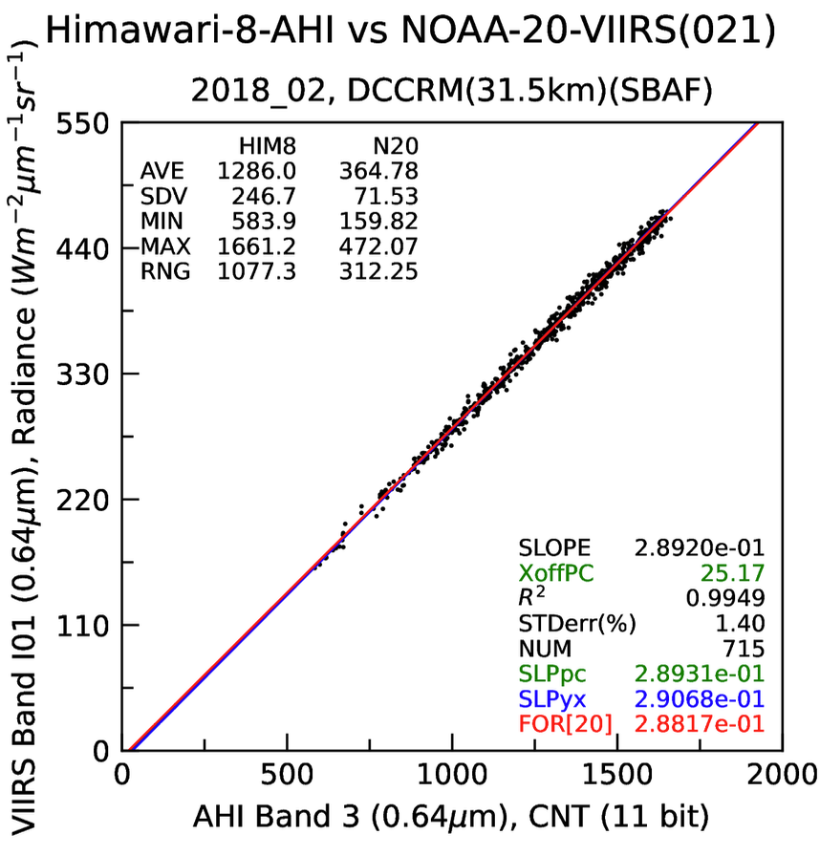
Gain Calculation
• The gain calculated here can be used to convert a HIM8 count into a radiance, using the regression forced through the published visible space count of 20
• The DCC-RM gain is computed monthly to ensure that the DCC-IT statistics can be accurately evaluated
Rad_{VIIRS}•SBAF_{VIIRS->GEO} = (Cnt_{HIM8} - Cnt_{offset})•gain•[cos(SZA_{VIIRS})/cos(SZA_{HIM8})]

Slide 7
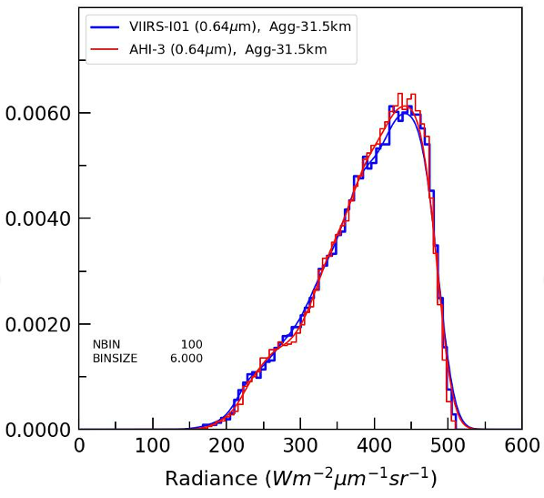
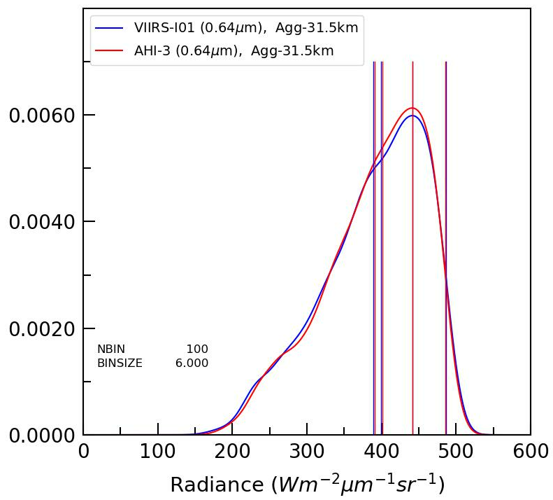
Kernel Density Estimation(KDE) & PDF Statistics
VIIRS I01
AHI B3
VIIRS I01
AHI B3
Smooth line = KDE
Median
Mode
In order to overcome the bin discretization, this study utilizes a kernel density estimation (KDE) from the gaussian_kde function from the SciPy Python package
Mean
Inflection
Frequency
Mean = Average of the pixel radiances
Median = Radiance where half of the pixels are a smaller radiance and half of the pixels are larger radiance
Mode = Radiance from the KDE with the greatest frequency
Inflection point = Radiance where the KDE curvature sign changes (only after the mode and before 20%*max frequency)
The relative calibration ratio for each statistic between AHI and VIIRS are analyzed to test how well the dataset statistics compare

Slide 8
DCC Datasets for Comparison
Parameter | DCC-IT 30-km (Ray-matched) | DCC-IT L1b 1-km (Time-matched)
VZA | <40° | <40°
SZA | <40° | <40°
RAA | 10°<RAA<170° | 10°<RAA<170°
BT (11µm) | <205K | <205K
VIS_{hom} | <0.2 | <0.03
IR_{hom} | <7.5K | <1K
∆GMT | <5 minutes | <5 minutes
∆VZA | <15°
∆SZA | <5°
∆RAZ | <15°
∆SCAT | <15°
Footprint | 30-km | 1-km
latitude | -20°<lat<20° | ±20°
longitude | 100°<lon<180° | 100°<lon<180°
Two sets of datasets are used for this study:
Ray-matched 30-km DCC cells
Time-matched DCC-IT 1-km data is using the operational DCC-IT method, but only using the VIIRS granules and HIM8-AHI images where a ray-matched 30-km footprint exists and has met the DCC ray-matching criteria
Both DCC datasets are retrieved for both HIM8-AHI and VIIRS

Slide 9
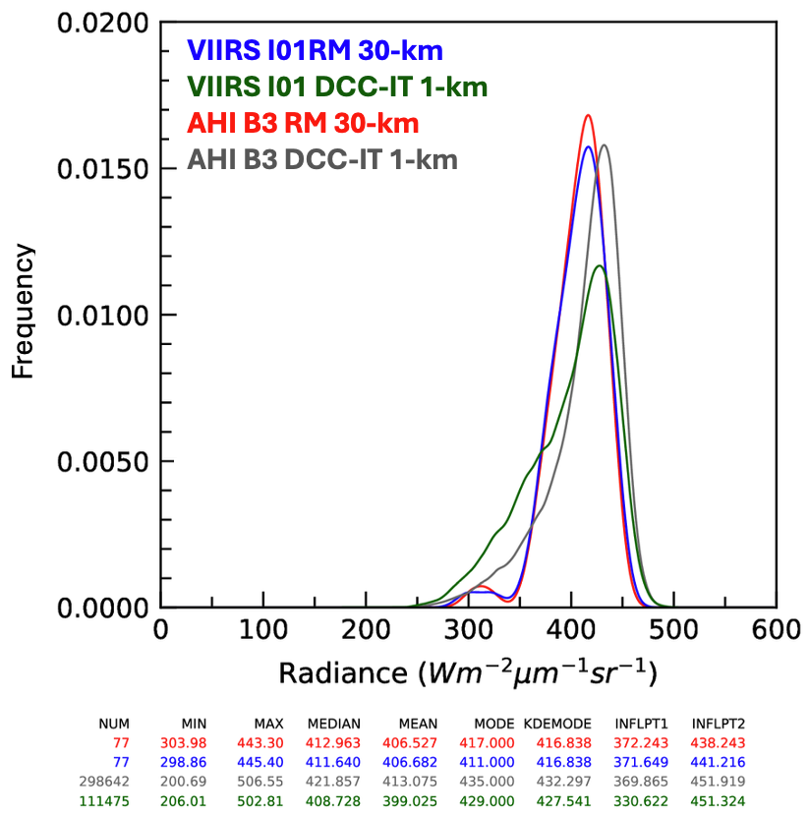
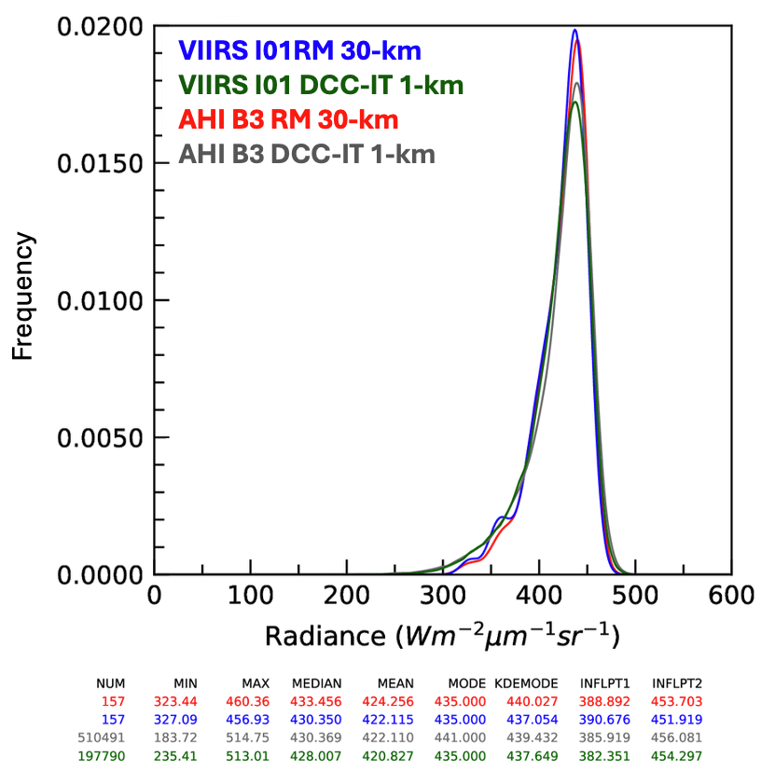
Comparison of Datasets & PDF Statistics
2022_12
2022_05
Some months have similar PDFs across all datasets, while some have differences between DCC-RM and DCC-IT
However, the AHI/VIIRS for DCC-RM are always similar and the AHI/VIIRS for DCC-IT are always similar
This indicates that the AHI raw count to VIIRS radiance calibration is working very well

Slide 10
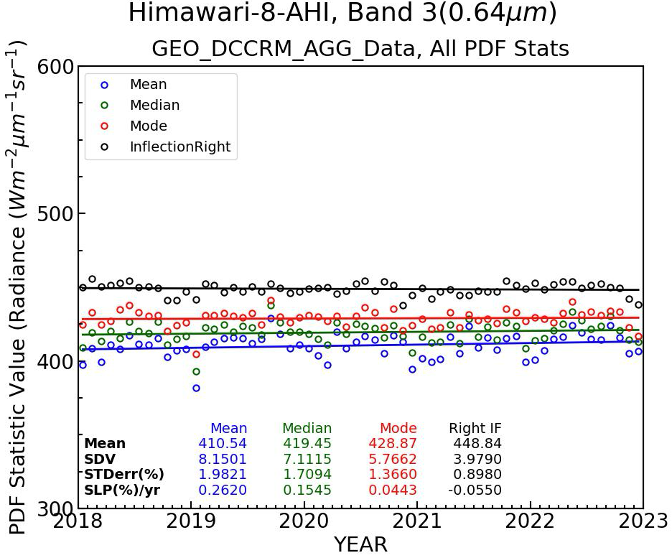
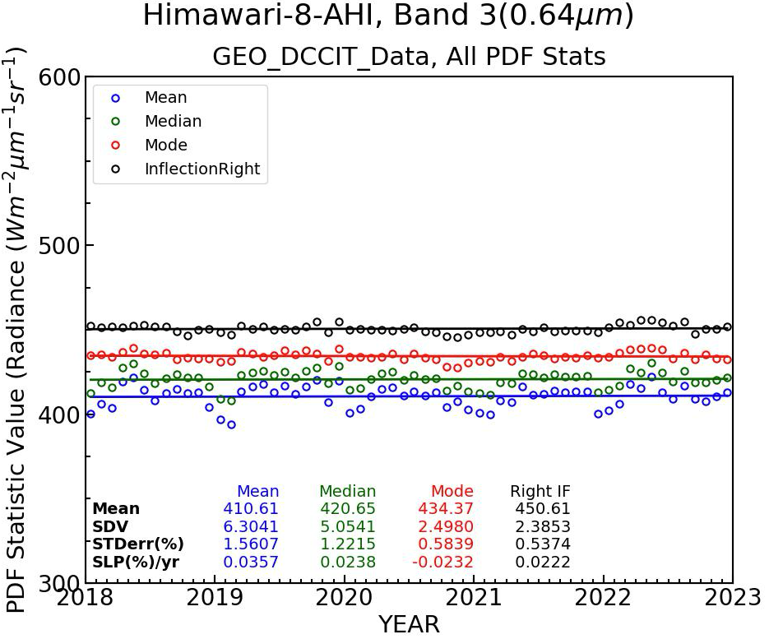
PDF Statistics Time Series
Ray-matched-30km
Time-matched 1km
Inflection provides the best stability for both 30-km and 1-km datasets
  Lowest standard error
  SLP%/yr < 0.06% for all datasets

Slide 11
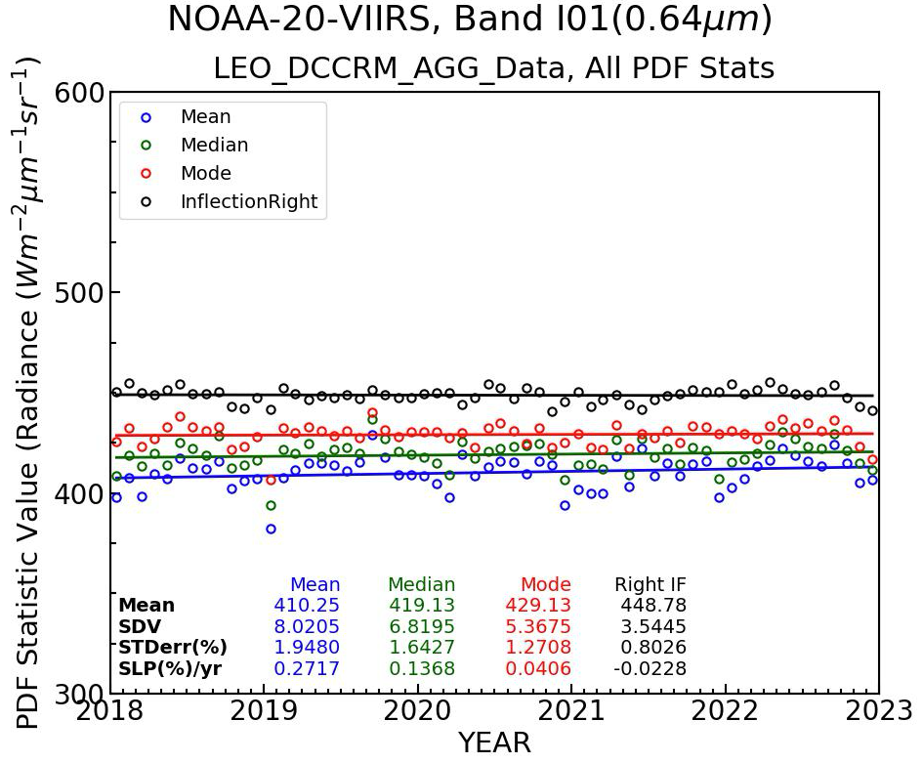
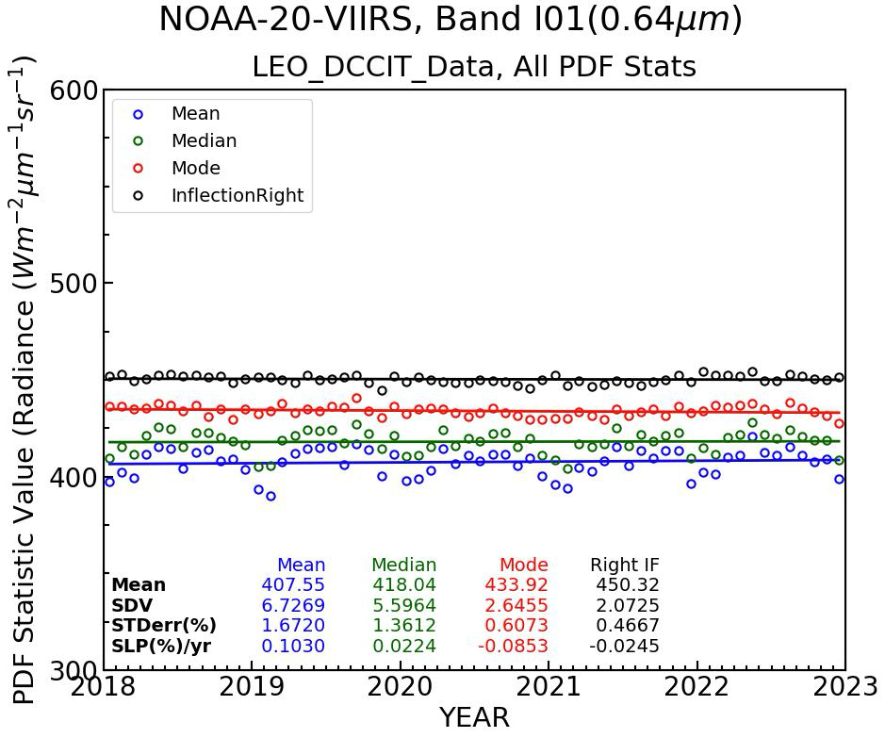
PDF Statistics Time Series
Ray-matched-30km
Time-matched 1km
Inflection provides the best stability for both 30-km and 1-km datasets
  Lowest standard error
  SLP%/yr < 0.06% for all datasets

Slide 12
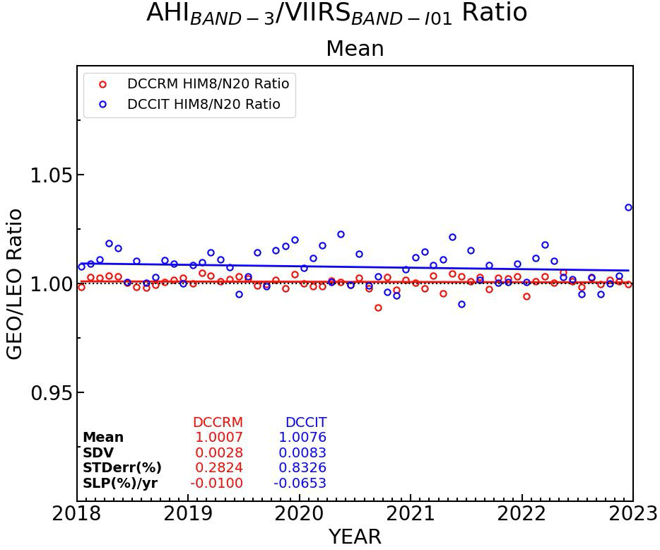
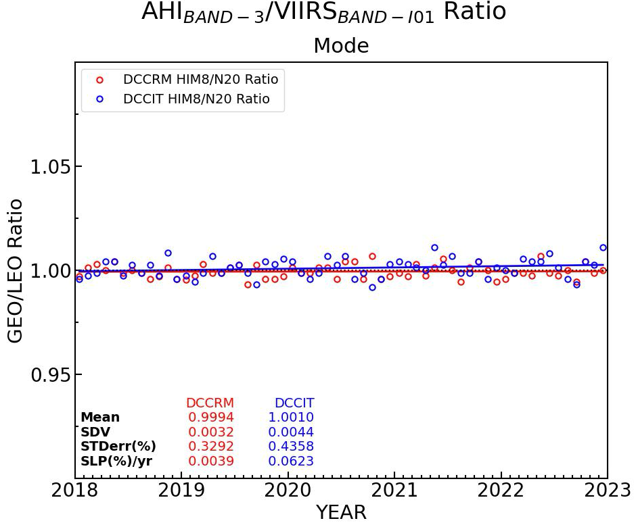
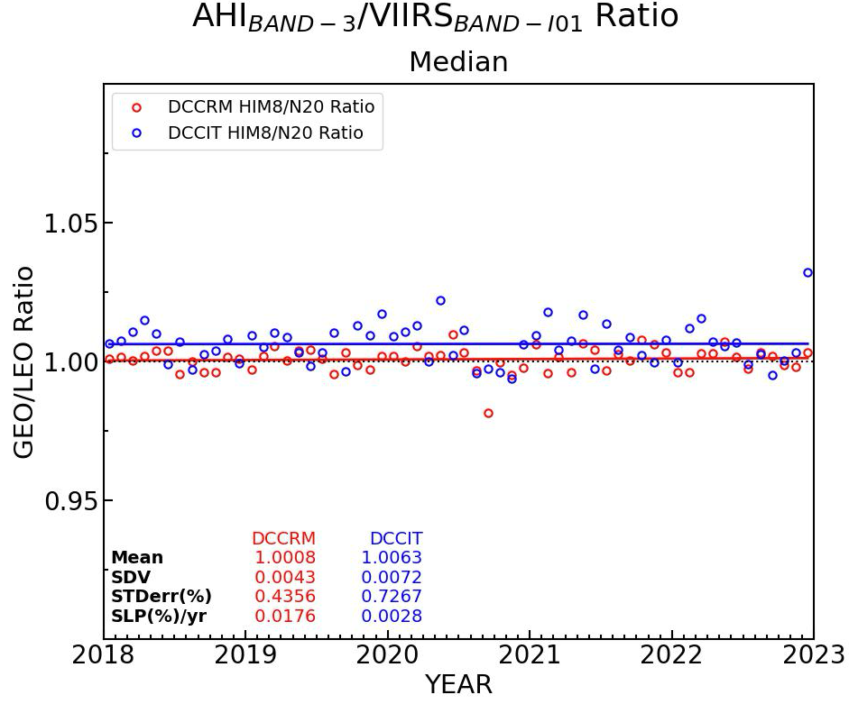
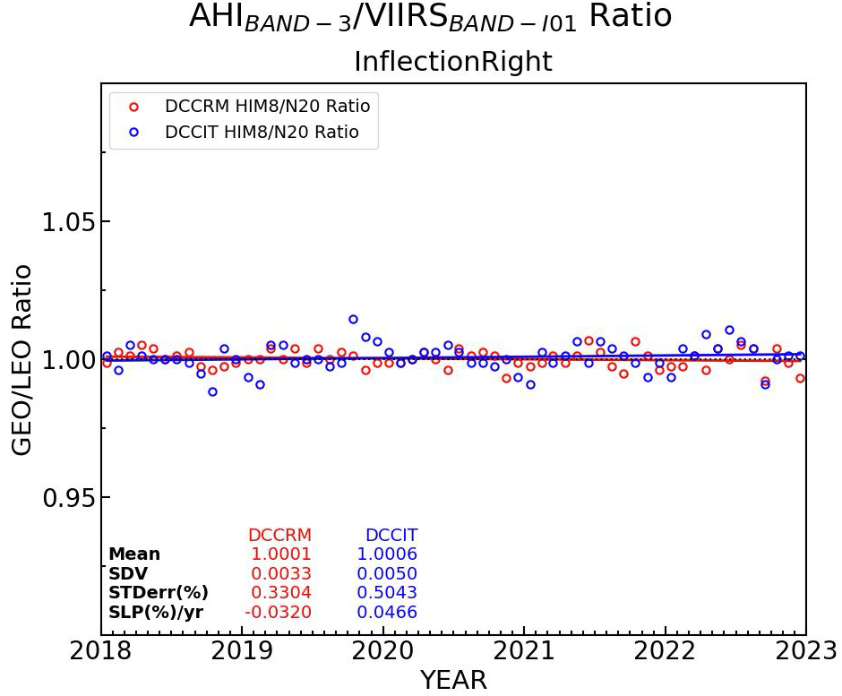
AHI/N20-VIIRS Ratio of PDF Statistics
MEAN
MODE
DCC-RM 30-km Ratio
DCC-IT 1-km Ratio
Mode and Inflection both provide ratios very close to 1.0, while for mean and median there is a small bias between DCC-RM and DCC-IT
Median
Inflection

Slide 13
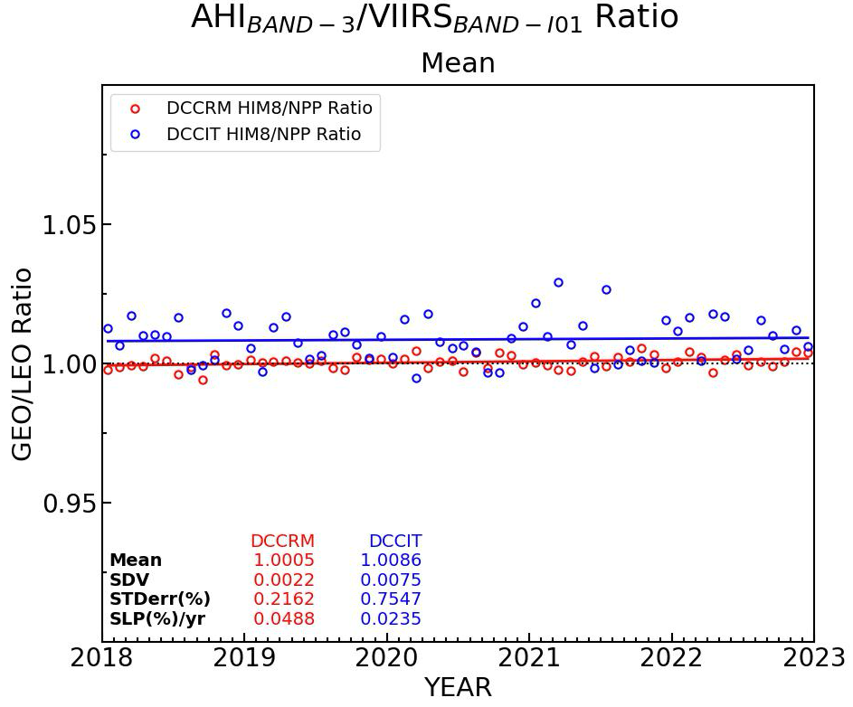
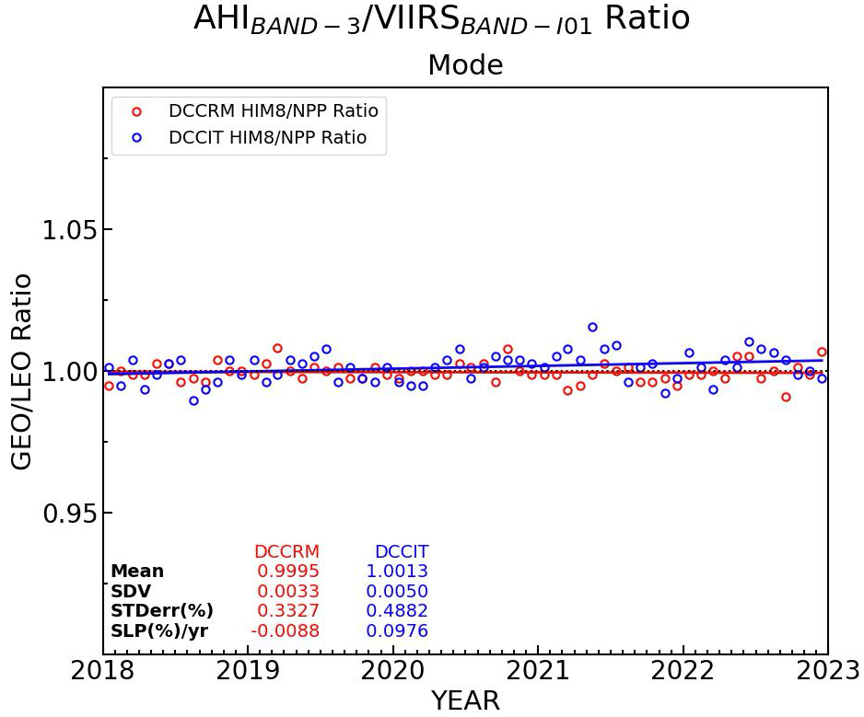
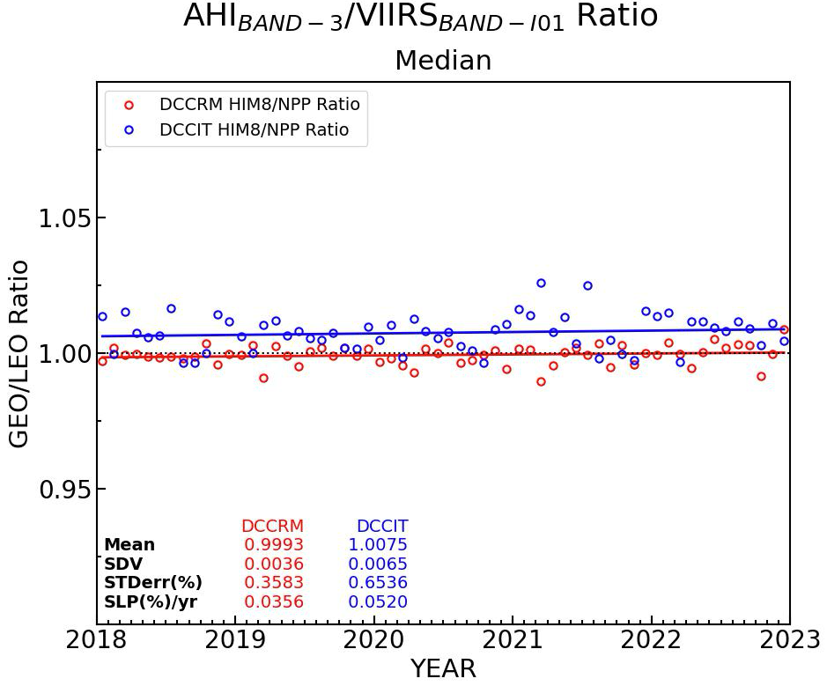
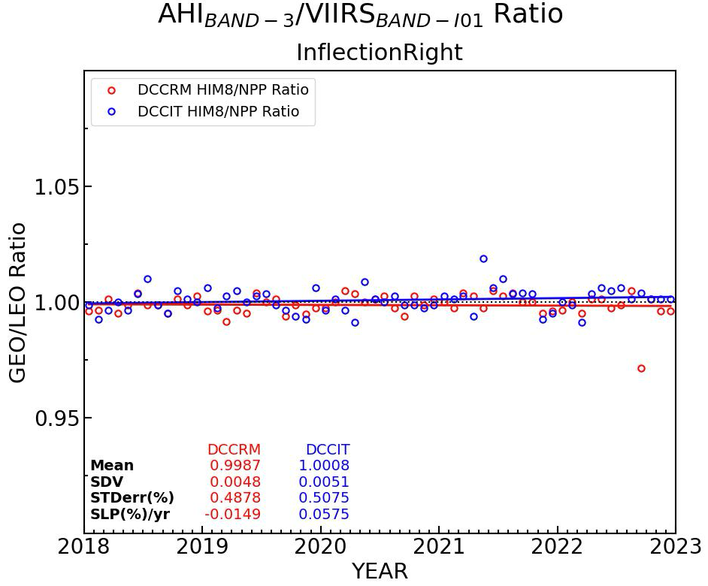
AHI/NPP-VIIRS Ratio of PDF Statistics
MEAN
MODE
DCC-RM 30-km Ratio
DCC-IT 1-km Ratio
Doing the same for AHI/NPP yields very similar results to AHI/N20
Median
Inflection

Slide 14
AHI/VIIRS PDF Ratio Results
AHI/N20VIIRS | Mean | Median | Mode | Inflection
Ratio 30-km | +0.07% | +0.08% | -0.06% | +0.01%
Ratio 1-km | +0.76% | +0.63% | +0.10% | +0.06%
Sigma 30-km | 0.28% | 0.43% | 0.33% | 0.33%
Sigma 1-km | 0.83% | 0.73% | 0.44% | 0.50%
AHI/NPPVIIRS | Mean | Median | Mode | Inflection
Ratio 30-km | +0.05% | -0.07% | -0.05% | -0.13%
Ratio 1-km | +0.85% | +0.74% | +0.13% | +0.08%
Sigma 30-km | 0.22% | 0.36% | 0.33% | 0.49%
Sigma 1-km | 0.75% | 0.65% | 0.49% | 0.51%
The DCC 30-km dataset is expected to have a ratio of 1.0
The best PDF statistic provides the closest ratio to 1.0 and smallest sigma
1-km sigmas are expected to be larger than the 30-km
Mode and Inflection point seem to be the best case

Slide 15
Summary and Future Work
PDF statistical comparisons were made between Himawari-8 AHI and NOAA20-VIIRS for two datasets:
  DCC ray-matched 30-km cells
  Image-matched DCC-IT 1-km cells in images that contained AHI/VIIRS 30-km footprints
The PDF statistics were tracked over a time series on a monthly basis from 2018-2022
  The mode and inflection point PDF statistics appear to be the most robust statistics for inter-calibrating using DCC
  Inflection point has the lowest standard error
  Mode and inflection show the AHI/VIIRS ratio closes 1.0
Similar results were found for AHI/NPP-VIIRS as with AHI/NOAA-20-VIIRS
Future work involves performing this analysis for other channel-pairs for AHI and VIIRS in the VIS-NIR, and testing different BRDFs

