Slide 1


Toward the improvement of Ray-matching inter-calibration for AHIs on Himawari-8 and -9
TAKAHASHI Masaya
Meteorological Satellite Center of Japan Meteorological Agency

Slide 2
Contents
Introduction
Current status of Ray-matching inter-calibration for AHI VNIR bands
Toward the improvement of Ray-matching algorithm
  Revisit of criteria on collocation and spatial resolution for Himawari-9/AHI vs. NOAA-20/VIIRS
Summary and future plans

Slide 3
Introduction
Ray-matching inter-calibration is one of JMA’s methods to validate radiometric performance and trends of AHI VNIR bands on Himawari-8/-9.
  Vicarious calibration is also operationally implemented, lunar calibration and DCC inter-calibration are under development.
  Ray-matching and vicarious calibration results are generally in good agreement, but there would still be a room for further improvements toward the future Himawari-10 mission.
  For example, temporally stable results by using shorter time window for statistics (i.e., smaller sample size) are needed to achieve quick validation in the commissioning phase.
Following the study last year by K. Kodera, potential use of low radiance scene data and other solution will be presented in this talk.

Slide 4
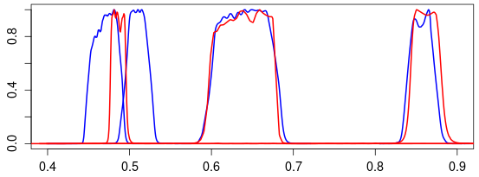
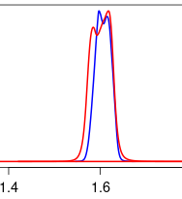
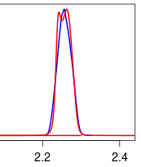
Current status of Ray-matching inter-calibration for AHI VNIR bands
AHI (Himawri-8/-9)
  Solar calibration results are not applied to radiances after operation start
  Spatial resolution: 2 km (1-km B01, B02, B04 and 0.5-km B03 data are averaged)
  Dark scenes are excluded due to inconsistent AHI/VIIRS ratio with bright scenes
  Target domain: SSP +/- 20 deg.
    Recently, the domain was shrunk to SSP +/- 10 deg. due to internal Internet bandwidth
  GEO-LEO-IR-like stats (i.e., t +/- 14d or t -15d)
VIIRS (S-NPP/NOAA-20)
  NOAA’s operational SDR via NOAA CLASS
Himawari-9/AHI and S-NPP/VIIRS SRFs
B01 B02 B03 B04 B05 B06
M3 I1 M7 M10 M11
Himawari-8/9 AHI | B01 0.47 μm | B02 0.51 μm | B03 0.64 μm | B04 0.86 μm | B05 1.6 μm | B06 2.3 μm
S-NPP/NOAA-20 VIIRS | M3 0.49 μm |  | I1 0.64 μm | M7 0.87 μm | M10 1.6 μm | M11 2.3 μm
Collocation criteria
Spectral Band Adjustment Factor (SBAF)
  Bands 1-5: All-sky Tropical Ocean, force/linear fitting from NASA LaRC tool
  Band 6: derived from RT simulation
Observation time diff | < 5 min.
Sunglint angle (AHI only) | > 25 deg.
TB @ 10.4 μm (AHI only) | < 273.15 K
CoV of radiance/reflectance | < 0.3
Satellite zenith angle diff | < 10 deg.
Satellite azimuth angle diff | < 10 deg.
Solar zenith angle diff | < 10 deg.
Solar azimuth angle diff | < 10 deg.

Slide 5
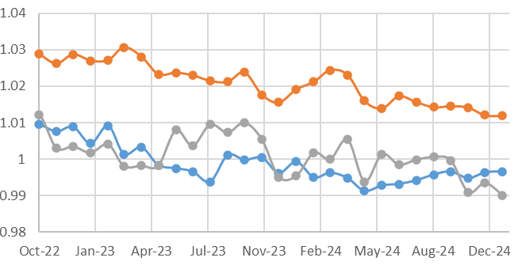
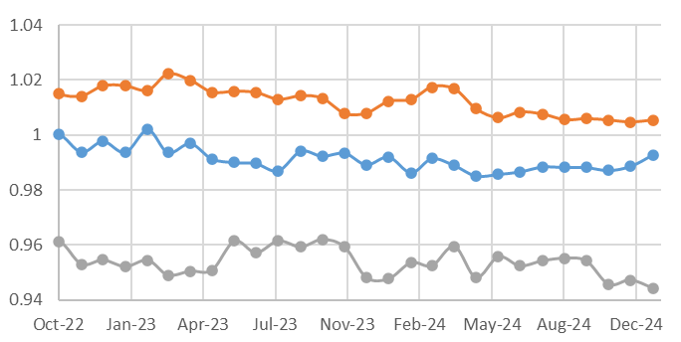
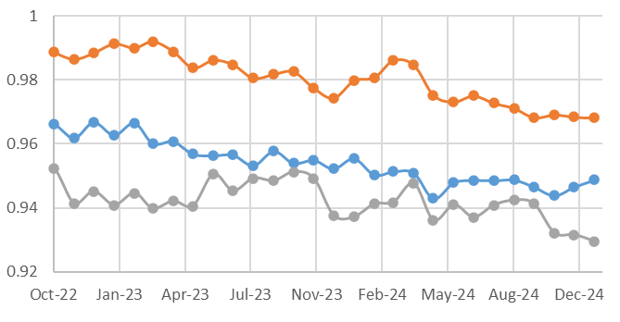
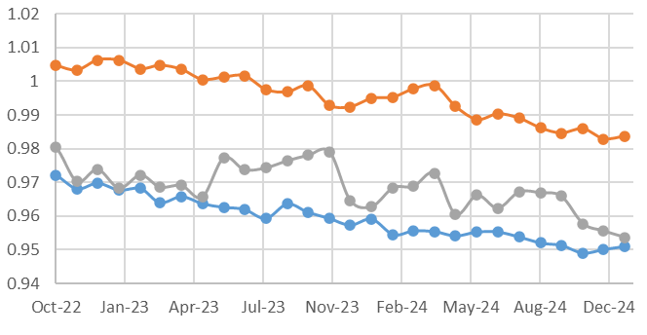
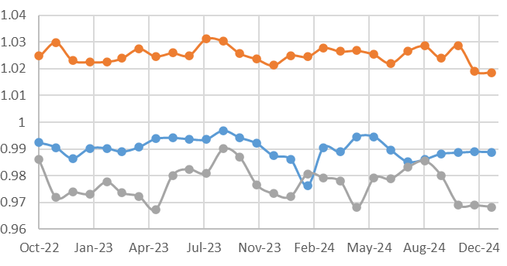
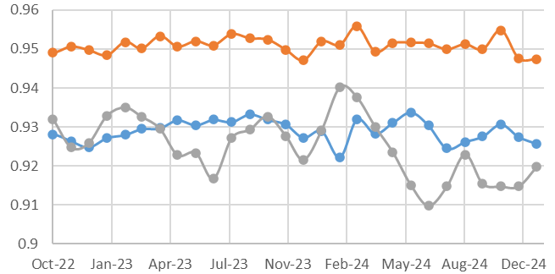
Himawari-9/AHI radiometric trends (monthly stats)
Differences among references are generally in good agreement with earlier studies (e.g., Doelling et al., 2021, Uprety et al., 2020, Wu 2021).
Ray-matching results are stabler than vicarious calibration, but temporal variation exists.
Ray-matching w/ S-NPP/VIIRS
Ray-matching w/ NOAA-20/VIIRS
Vicarious calibration using Aqua/MODIS C6
B01 (0.47 μm) B02 (0.51 μm) B03 (0.64 μm)
AHI / Reference
B04 (0.86 μm) B05 (1.6 μm) B06 (2.3 μm)
AHI / Reference

Slide 6
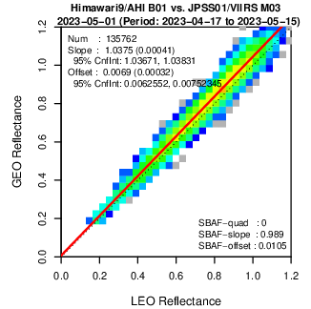
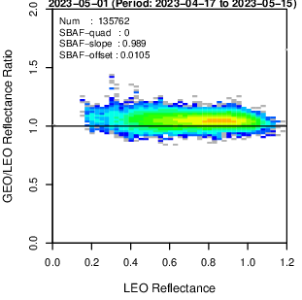
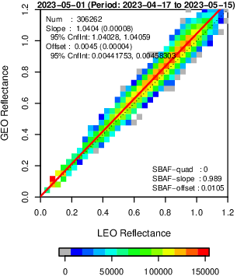
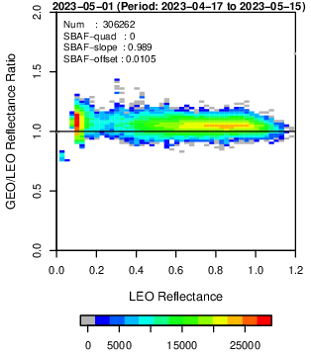
Toward the improvement of Ray-matching algorithm
Potential parameters to revisit
  Collocation criteria
    Use of dark (low radiance) scenes
    Tighter satellite/solar zenith angle difference
  Spatial resolution for regression
    AHI’s original resolution or averaged to coarser resolution (e.g, 0.1/0.25/0.5 deg. grids)
  SBAF
    Force/linear/quadratic fitting, Clear-sky/All-sky SBAF (scene dependent SBAF)
  Regression equation
    Force (linear fit w/ zero offset) /Linear/Quadratic fitting w/ weighted/non-weighted, consideration of Y-axis uncertainty
  And more…
H9 AHI B01 (0.47 μm) vs. N20 VIIRS M03 (0.49 μm)
29-d stats (2023-04-17/05-15)
Operational config
~140000 samples
Operational config + Dark scenes
~300000 samples

Slide 7
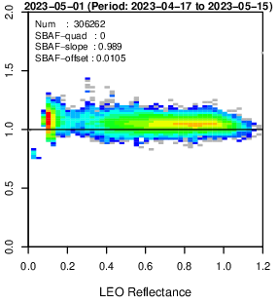
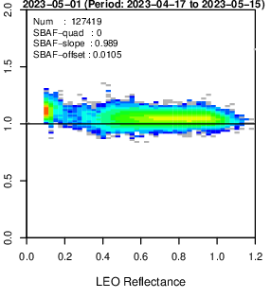
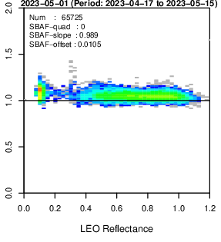
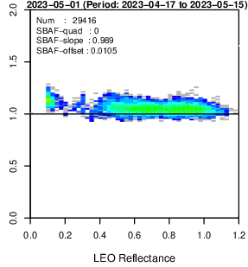


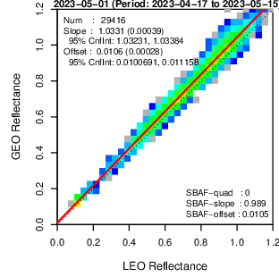

Sensitivity to collocation criteria - H9 AHI B01 (0.47 μm) vs. N20 VIIRS M03 (0.49 μm)
c) b + min. sunglint ang d) b + max. Δ sat/sol zenith
25 => 40 deg ang 10 => 5 deg
a) Operational b) a + dark scene e) c + d
Sample size relative to operational configuration
100% 226% 94% 48% 22%
  c: tighter sunglint angle threshold removes outliers.
  d: tighter satellite/solar zenith angle difference removes collocation data w/ large biases.
  c+d result seems reasonable, but inconsistency of GEO/LEO ratio at dark/bright scenes still exists.
    Need further investigation on the inconsistency.
    Reduced sample size is acceptable at least for monthly stats.

Slide 8
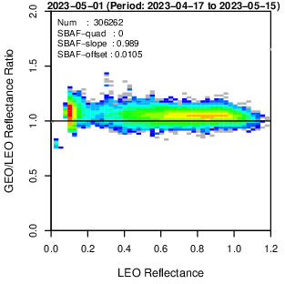
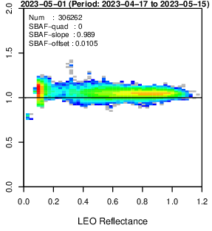
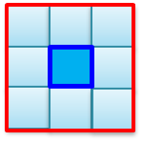
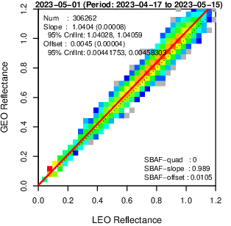
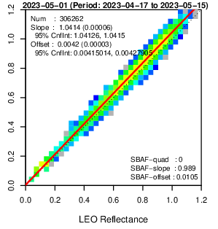
Impact of spatial resolution on inter-calibration
A) Operational config
+ dark scene
B) Same as A), but 6 x 6 km averaged AHI & VIIRS data
Operational configuration is 2 x 2 km
  VIIRS M/I bands and AHI 1-km B01, B02, B04 and 0.5-km B03 samples are averaged.
Environmental area (6 x 6 km) data for both AHI and VIIRS were tested to see the impact of smoothed data on GEO-LEO comparison.
6 x 6 km
  GEO-LEO large discrepancy at mid-to-high reflectance scenes is reduced as expected
  Original observation information may be overwrapped in (B). Sample size would be reduced in proper configuration.
2 x 2 km

Slide 9
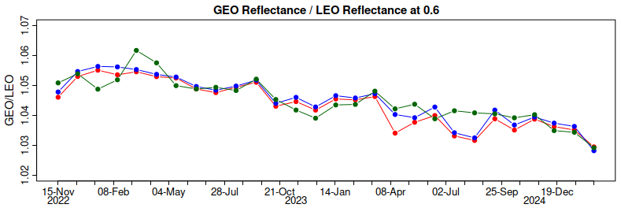
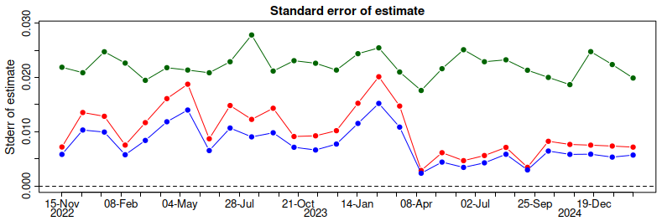
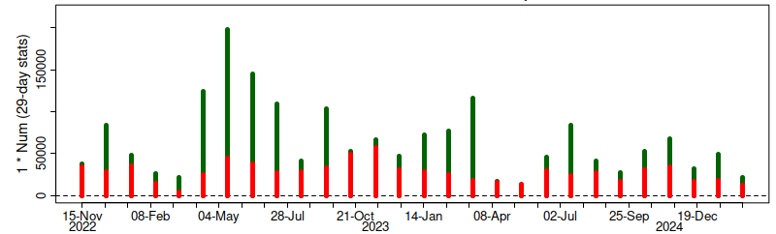
1) Operational configuration
2) 1 + dark scenes + updated collocation criteria (“e” in slide#7)
3) Same as 2, but 6 x 6 km averaged samples
Inter-calibration trends
GEO/LEO ratio at reflectance=0.6
Updated collocation criteria and larger spatial resolution (6 x 6 km) samples resulted in temporally stable trend estimation with lower uncertainty
  Sunglint angle < 40 deg. (25 deg. in operation)
  Satellite/Solar zenith angle < 5 deg. (10 deg. in operation)
Reduction of sample size has few impacts on monthly statistics, but further investigation is needed to apply 2) or 3) to shorter time window
Standard error of linear regression
Number of collocation samples

Slide 10
Summary and future plans
Ray-matching inter-calibration for Himawari-8/-9 AHI VNIR bands is important method to monitor and validate AHI’s radiometric performance.
  For daily monitoring and/or quick validation within a limited time (e.g., in preparation for future Himawari-10 commissioning phase activities), updates of collocation criteria and spatial sample resolution were investigated.
  Tighter sunglint angle (< 40 deg.), satellite/solar zenith angle difference (< 5 deg.), and larger spatial resolution (6 x 6 km) resulted in temporally stable trend estimation with lower uncertainty.
  Need further investigation for dark (low radiance) scenes.
Other parameters such as minimum sample size for stable results, SBAF (e.g., fitting equation, consideration of scene dependence), and regression method would also be investigated in future.

Slide 11
Thanks for your attention!

Slide 12
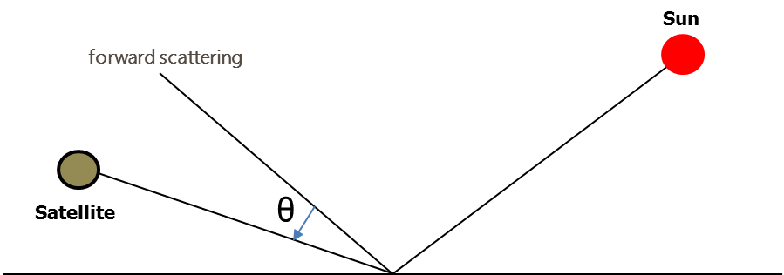
Operational configuration for AHI Ray-matching inter-calibration
Table A
Table B
Ray-Matching criteria | Ray-Matching threshold
Time matching difference | < 5 minutes
Solar zenith angle (SZA) difference | <10°
View zenith angle (VZA) difference | <10°
Relative azimuthal angle (RAA) difference | <10°
Scattering angle difference | -
Sun glint angle (Scattering angle) | >25°for AHI only
Linear regression, regression through space offset | Linear regression with offset and linear regression via the origin (force-fit regression)
Ray-Matching ATBD 2011 (NASA)​ | Ray-Matching threshold​
Timeline temporal resolution​ | Monthly and daily​
Outlier Filter​ | -
Other criteria​ | -
Temporal regression​ | -​
θ： Sun glint angle

