Slide 1
Improvements of CrIS and VIIRS Inter-Calibration
Likun Wang
Cooperative Institute for Satellite Earth System Studies (CISESS)
Earth System Science Interdisciplinary Center (ESSIC),
University of Maryland, College Park, Maryland
Email address: wlikun@umd.edu

Slide 2
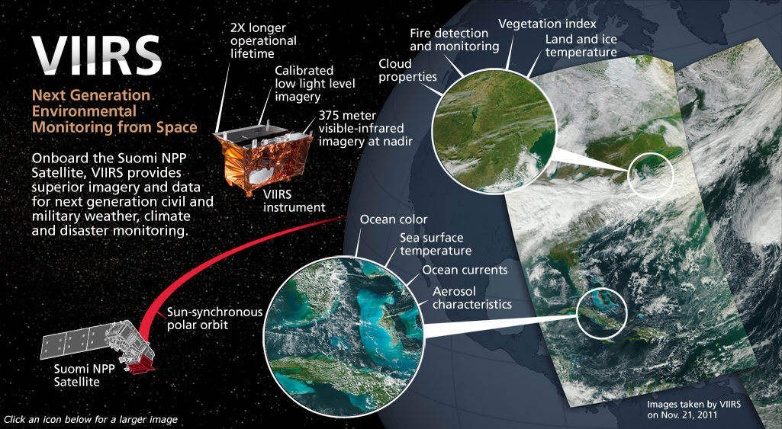
Imager: VIIRS Instrument
16 M-bands (750m); 5 I-Bands (375m); 1 DNB Band (750m)
Copied from Raytheon Website
Notes:
1) VIIRS provide imagery of the Earth Surface, it has very high resolution
1) 22 bands 3) all kinds of EDR, vegetation, land, cloud, ice, Aerosol

Slide 3


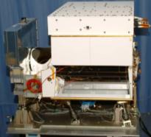
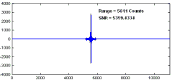

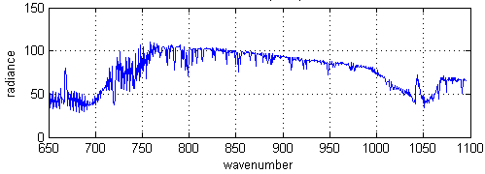
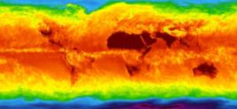
Sounder: CrIS Operational Concept
CrIS on NPP
RDR = Raw Data Record
SDR = Sensor Data Record
EDR = Environmental Data Record
±50°
Cross track Scans
Downlink
RDRs
RDRs
Decode Spacecraft Data
30 Earth Scenes
Interferograms
Ground Station
SDRs
2,200 km Swath
CrIS SDR Algorithm
Calibrated / Geolocated Spectra
3x3 Array of CrIS FOVs (Each at
14-km Diameter)
EDRs
Co-Located ATMS SDRs
NWP, EDR Applications
Global Temperature, Moisture, Pressure Profiles
Copied from ITT Website

Slide 4
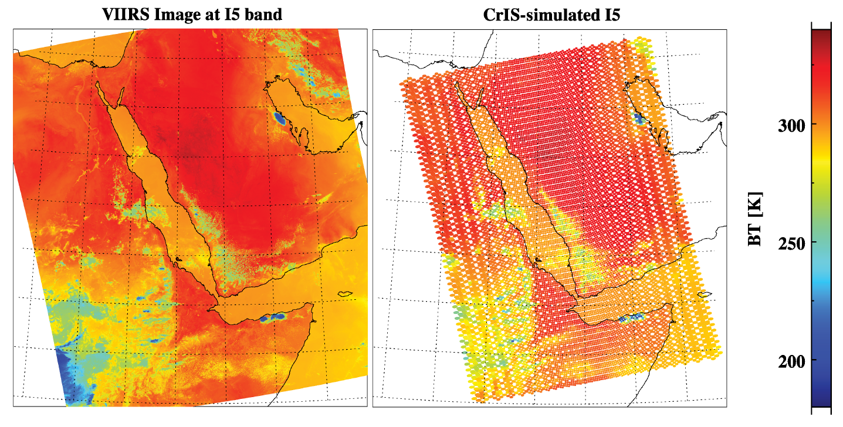
VIIRS vs. CrIS: Spatially
VIIRS I5 bands
CrIS at 900 cm⁻¹
Resolution: 375m (I) or 750m (M) 14.0km nadir
Scan Angle: 58.3° 48.3 °
Sampling: Continuous Sub-sample

Slide 5
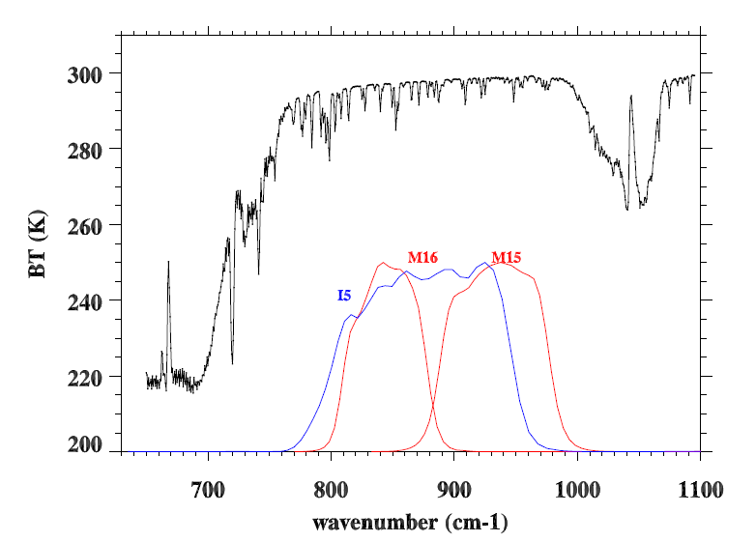
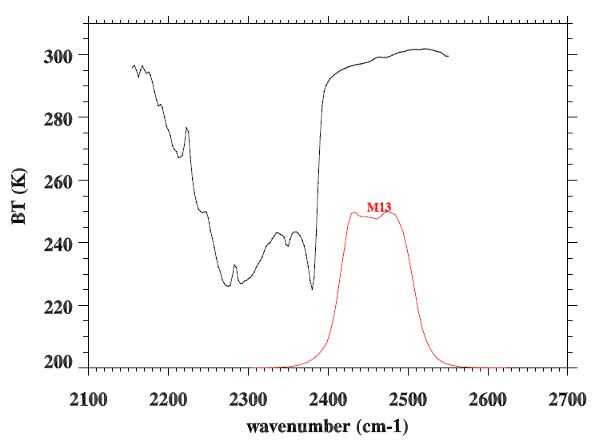
VIIRS vs. CrIS: Spectrally
CrIS spectra are overlapped with VIIRS SRFs for M13, M15, and M16, and I5
12.0 µm
10.8 µm
4.05 µm

Slide 6
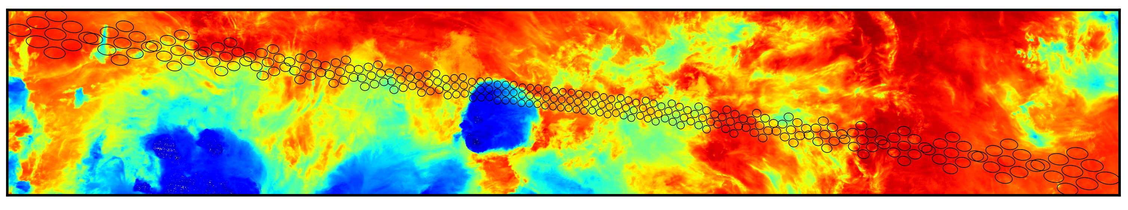
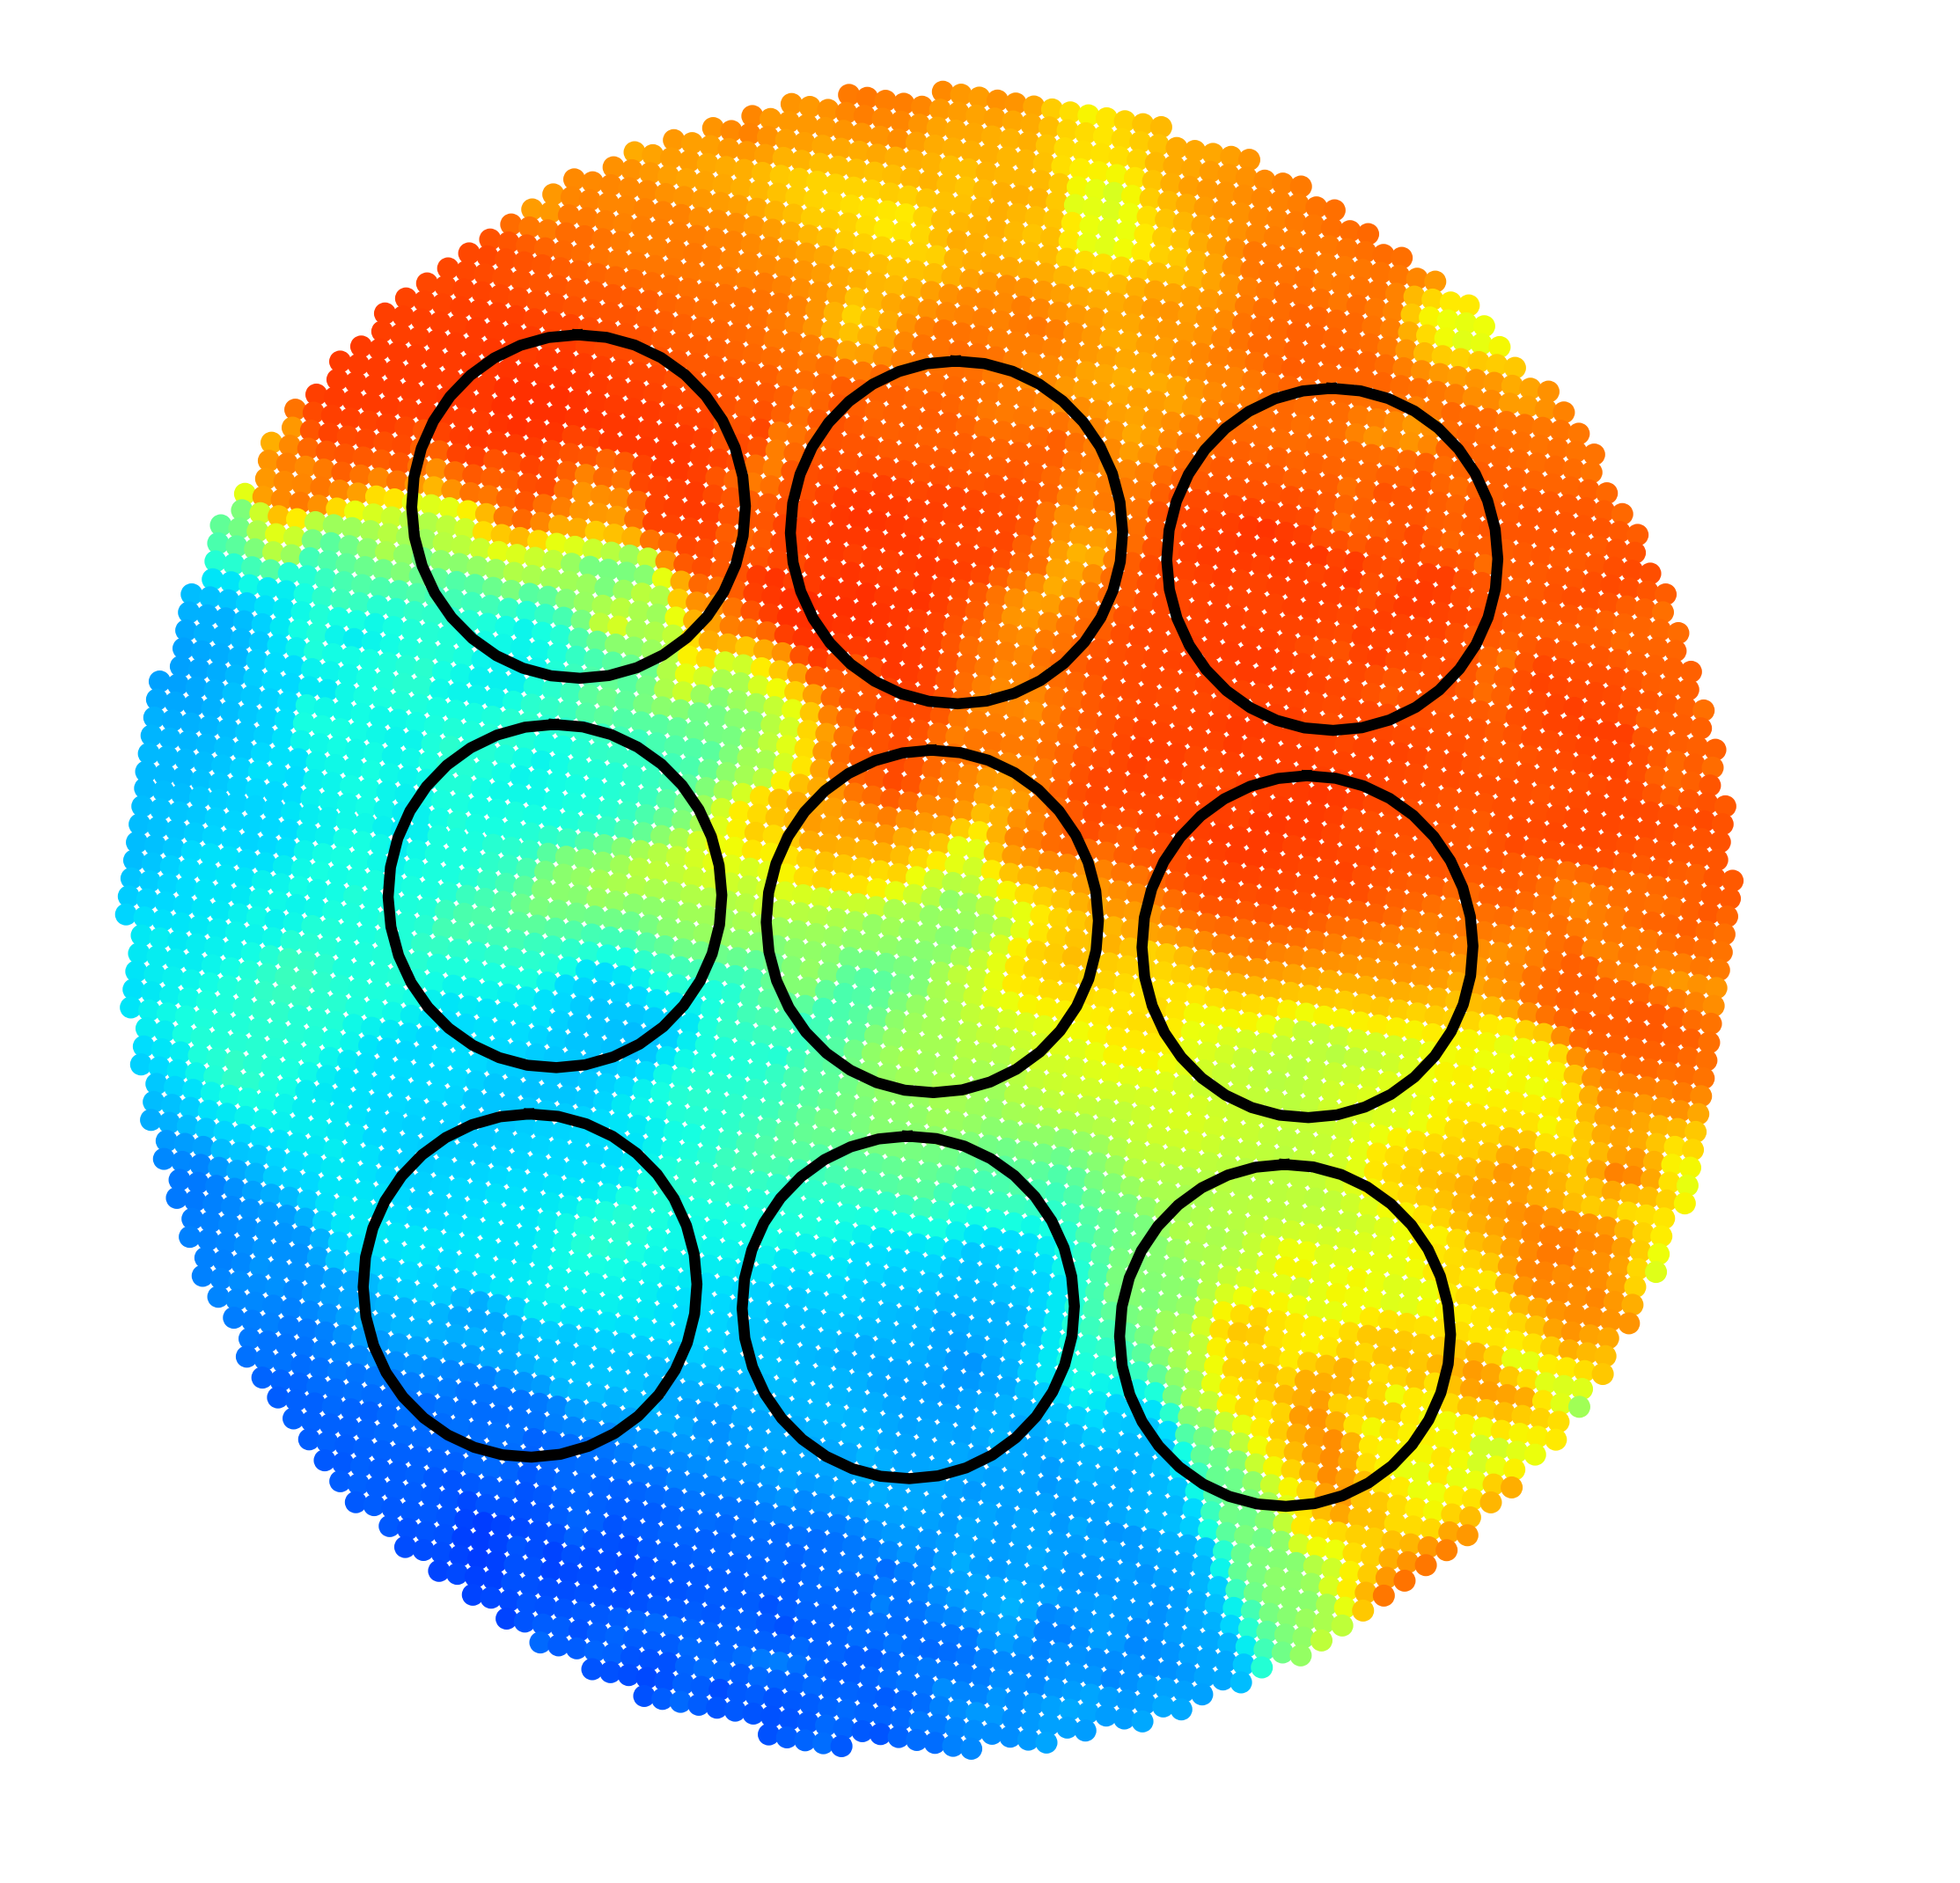
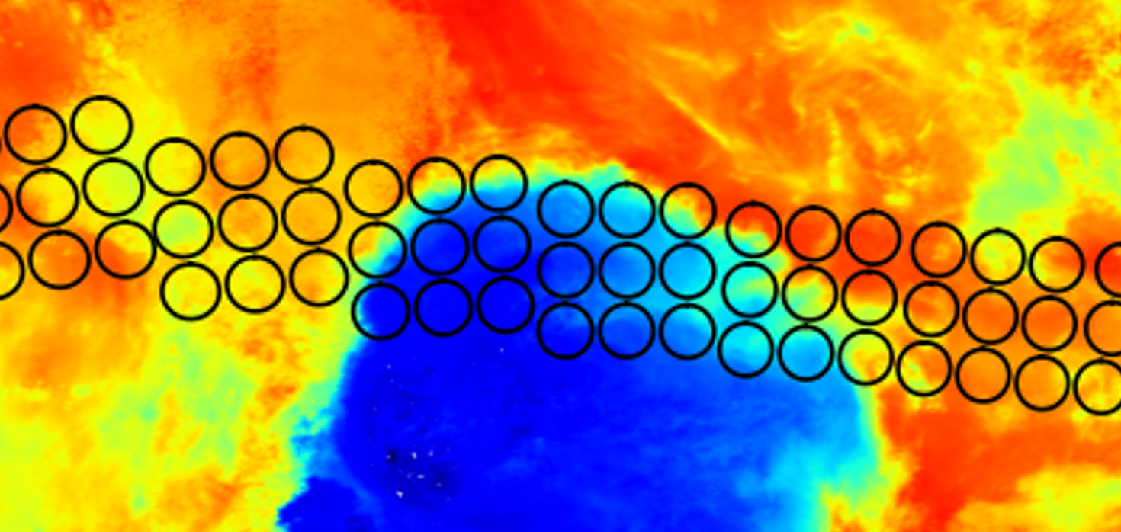
CrIS FOV overlapped with VIIRS Image
Collocating VIIRS observations with CrIS

Slide 7
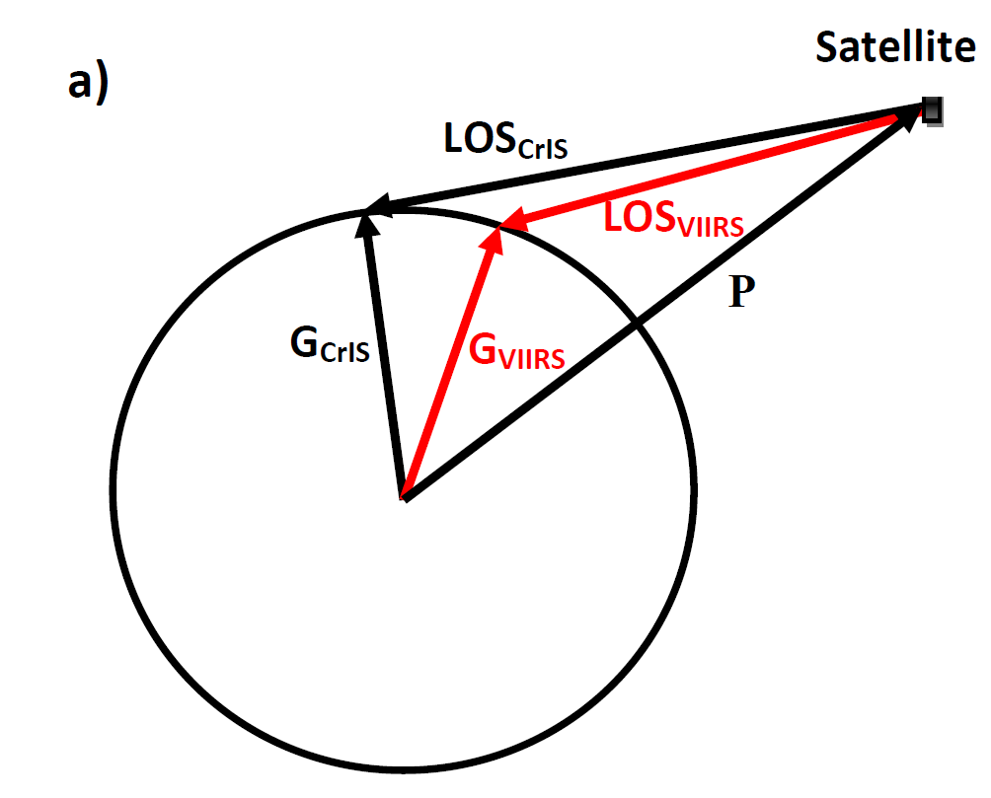
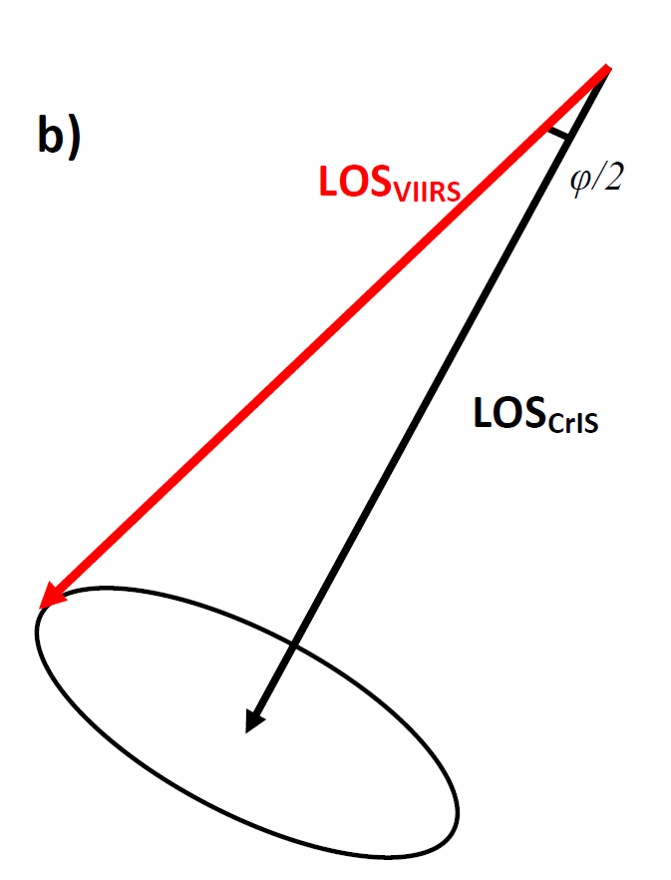
Collocation of CrIS with VIIRS
Using line-of-sight vector
It is better to collocate CrIS and VIIRS in space instead of on the Earth Surface
If we can retrieve line-of-sight vector of CrIS and VIIRS
The collocation of VIIRS and CrIS can be simplified as examining the angles between two vectors.
  No worry about FOV distortion

Slide 8
Motivation
land surface
cloud properties
Combination of sounder (CrIS) and Imager (VIIRS)
Applications:
Inter-calibration for radiometric calibration
Sounder Geolocation Assessment
3) NWP data assimilations: Providing sub-pixel information for quality control of CrIS data assimilation

Slide 9
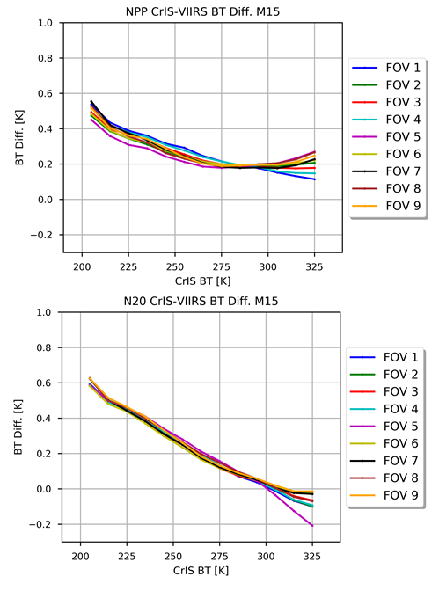
Using VIIRS checking CrIS Nonlinearity
Assuming VIIRS as a reference, inter-calibration between CrIS and VIIRS can be also be used to check the CrIS detector nonlinearity
CrIS-VIIRS M15 BT differences vary with CrIS BTs for Nine(9) different FOVs for SNPP and NOAA-20
  NOAA20 is better than SNPP
  Hot scenes for both NOAA-20 and SNPP show some divergency
SNPP
NOAA-20

Slide 10
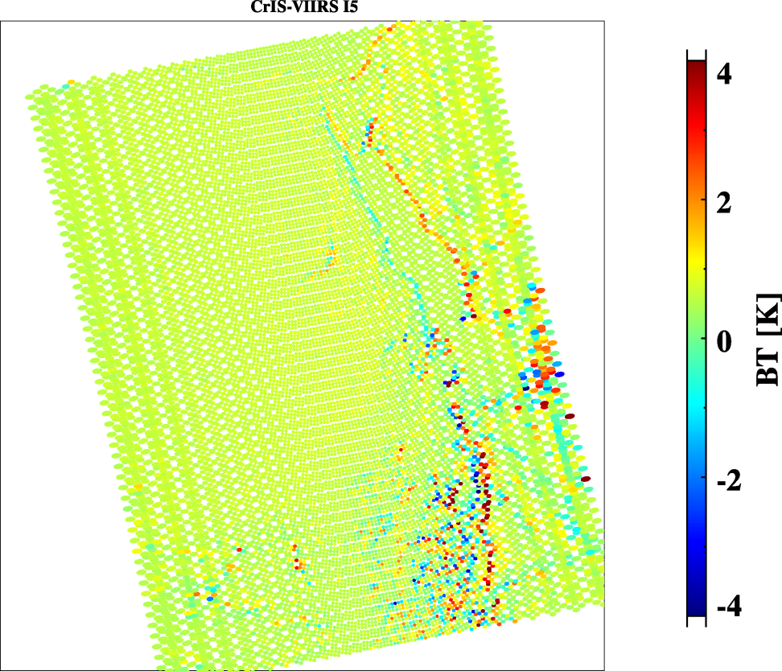
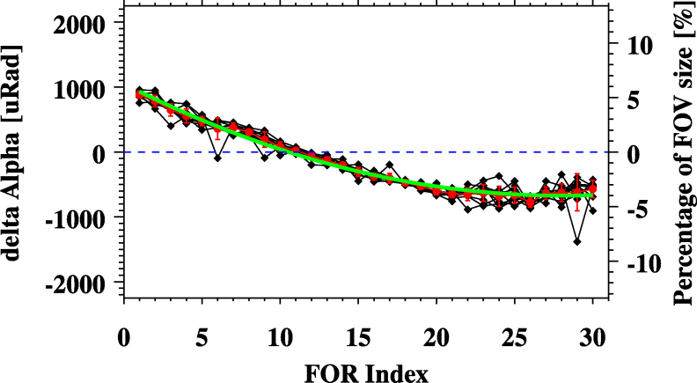
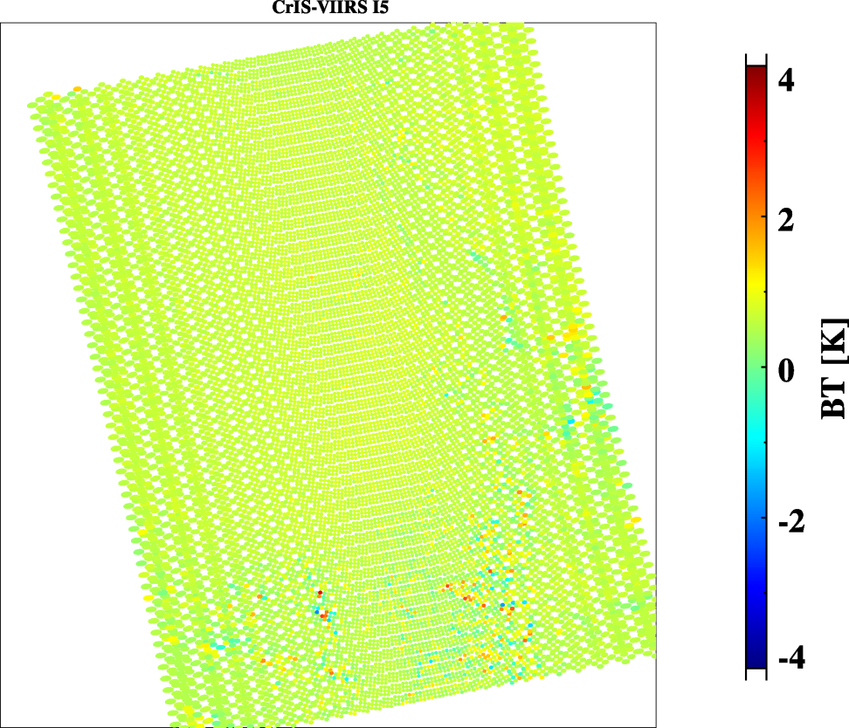
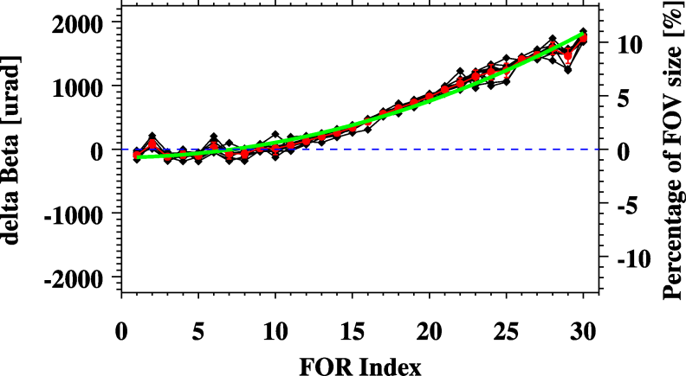
Before and After Geometric Angle Adjustment
CrIS alignment relative to VIIRS at different scan position
In track direction
CrIS-VIIRS Images
Before angle adjustment
Cross track direction
CrIS-VIIRS Images
After angle adjustment

Slide 11
Issue #1: Retirement of VIIRS Non-TC Geolocation
VIIRS has two different types of geolocation datasets
  Geolocation on ellipsoid (GMODO, GIMGO): Non-TC geolocation
  Geolocation with terrain correction (GMTCO, GITCO): TC geolocation
VIIRS geolocation dataset on ellipsoid retired on February 24, 2025 and only terrain correction geolocation dataset will be generated.
CrIS only has geolocation dataset on ellipsoid (GCRSO)
For data fusion (e.g., VIIRS cluster analysis) and inter-calibration (VIIRS and CrIS), it is needed to accurately collocate VIIRS and CrIS data.

Slide 12
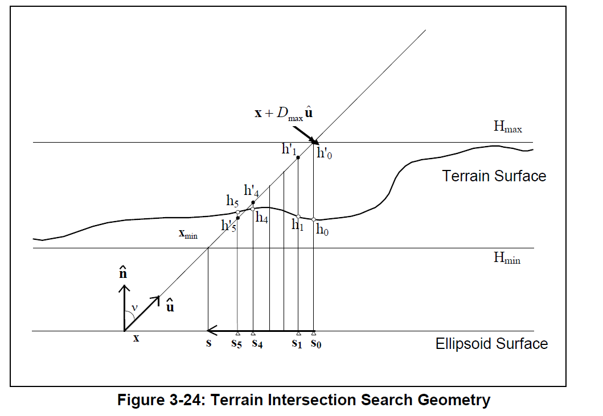
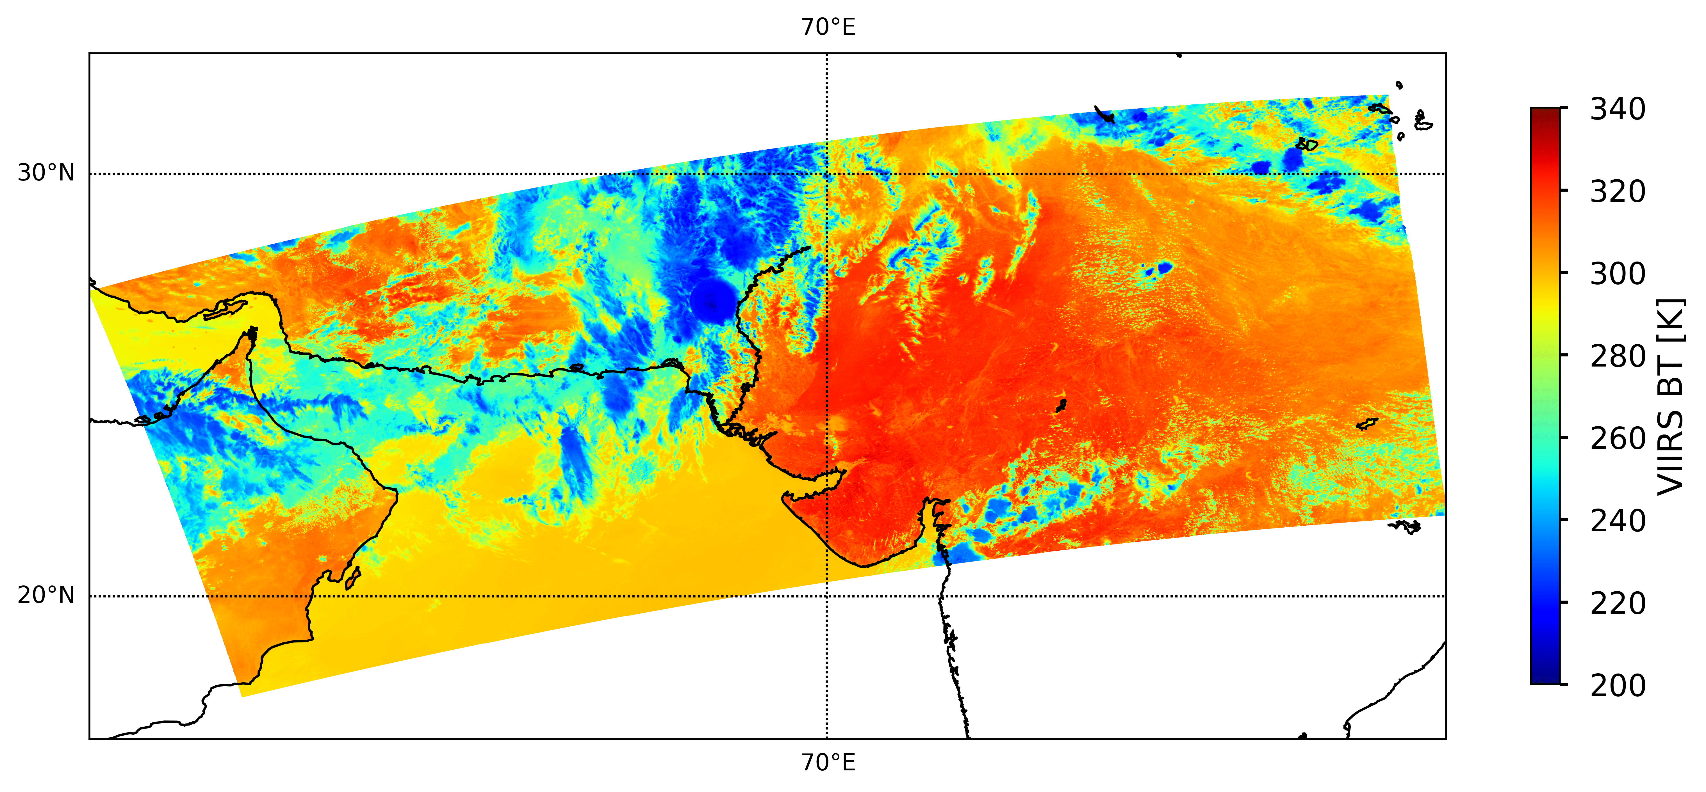
VIIRS Terrain Correction
Using TC and Non-TC geolocation datasets to make VIIRS images
Image shift due to TC
Light of Sight
The image shifts happen at off-nadir regions with Complex Terrain
Non-TC geolocation
TC geolocation

Slide 13
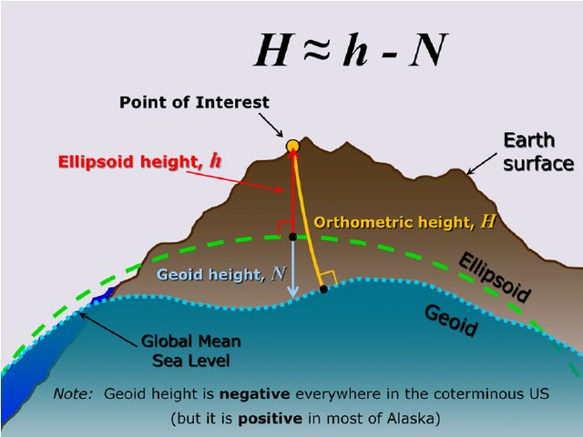
Relationship between
Orthometric height, Ellipsoid height, and Geoid height
Ellipsoid height is needed to derive the line-of-sight vector at latitude and longitude
It can be calculated from Geoid height and Orthometric height (height above the sea level)
Geoid height can be negative and positive values.
Line of sight
https://www.researchgate.net/publication/273133676_Evolution_of_NAD_83_in_the_United_States_Journey_from_2D_toward_4D/figures?lo=1

Slide 14
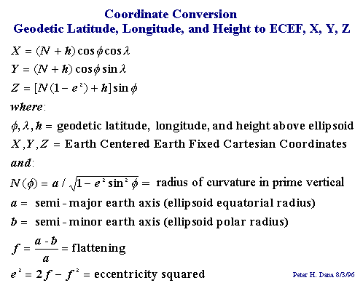
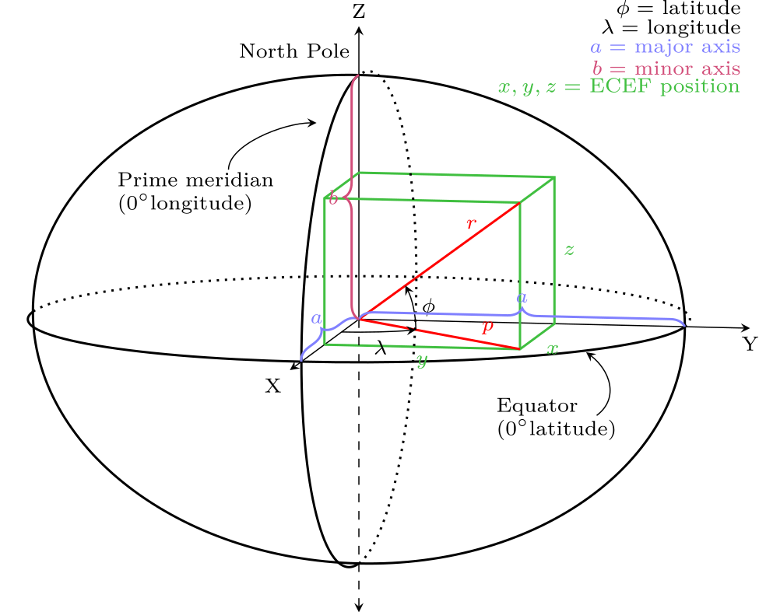
From LLA (lon, lat, h) to ECEF (x, y, z)
h: Geoid height + Terrain height
Geoid height: static Dataset
Terrain height: saved in the data
By Krishnavedala - Own work, CC BY-SA 3.0, https://commons.wikimedia.org/w/index.php?curid=37182608

Slide 15

Collocation of CrIS with VIIRS
Control Run and Method One Use the Same Method but different inputs
It is better to collocate sounder and imager in space instead of on the Earth Surface
  No worry about FOV distortion
Retrieving line-of-sight vector of sounder from (lon, lat, satellite zenith, azimuth angles , and range)
The satellite position for sounder can be computed as:
  G_s = P_s + LOS_s
The imager LOS vector viewing from the sounder can expressed as:
  LOS_i = G_i – P_s
The collocation of imager and sounder can be simplified as examining the angles between two vectors, i.e. LOS_i and LOS_s

Slide 16
Collocation of VIIRS within CrIS
Control Run: collocating VIIRS Radiances with CrIS FOVs using VIIRS Non-TC latitude and longitude as inputs (no height)
Method One: Same as the control one, but using VIIRS TC latitude and longitude as inputs (no height)
Method Two: Collocation method using TC latitude, longitude, and ellipsoid heights as inputs

Slide 17
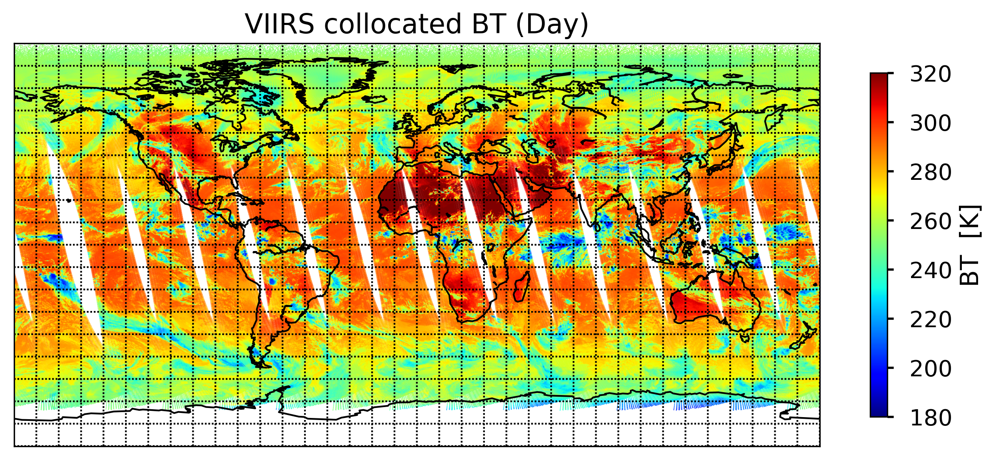
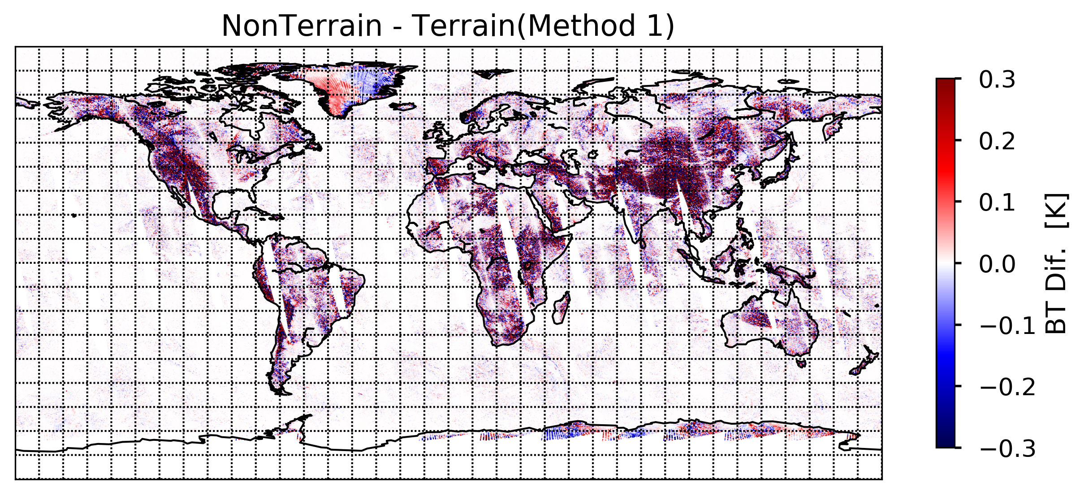
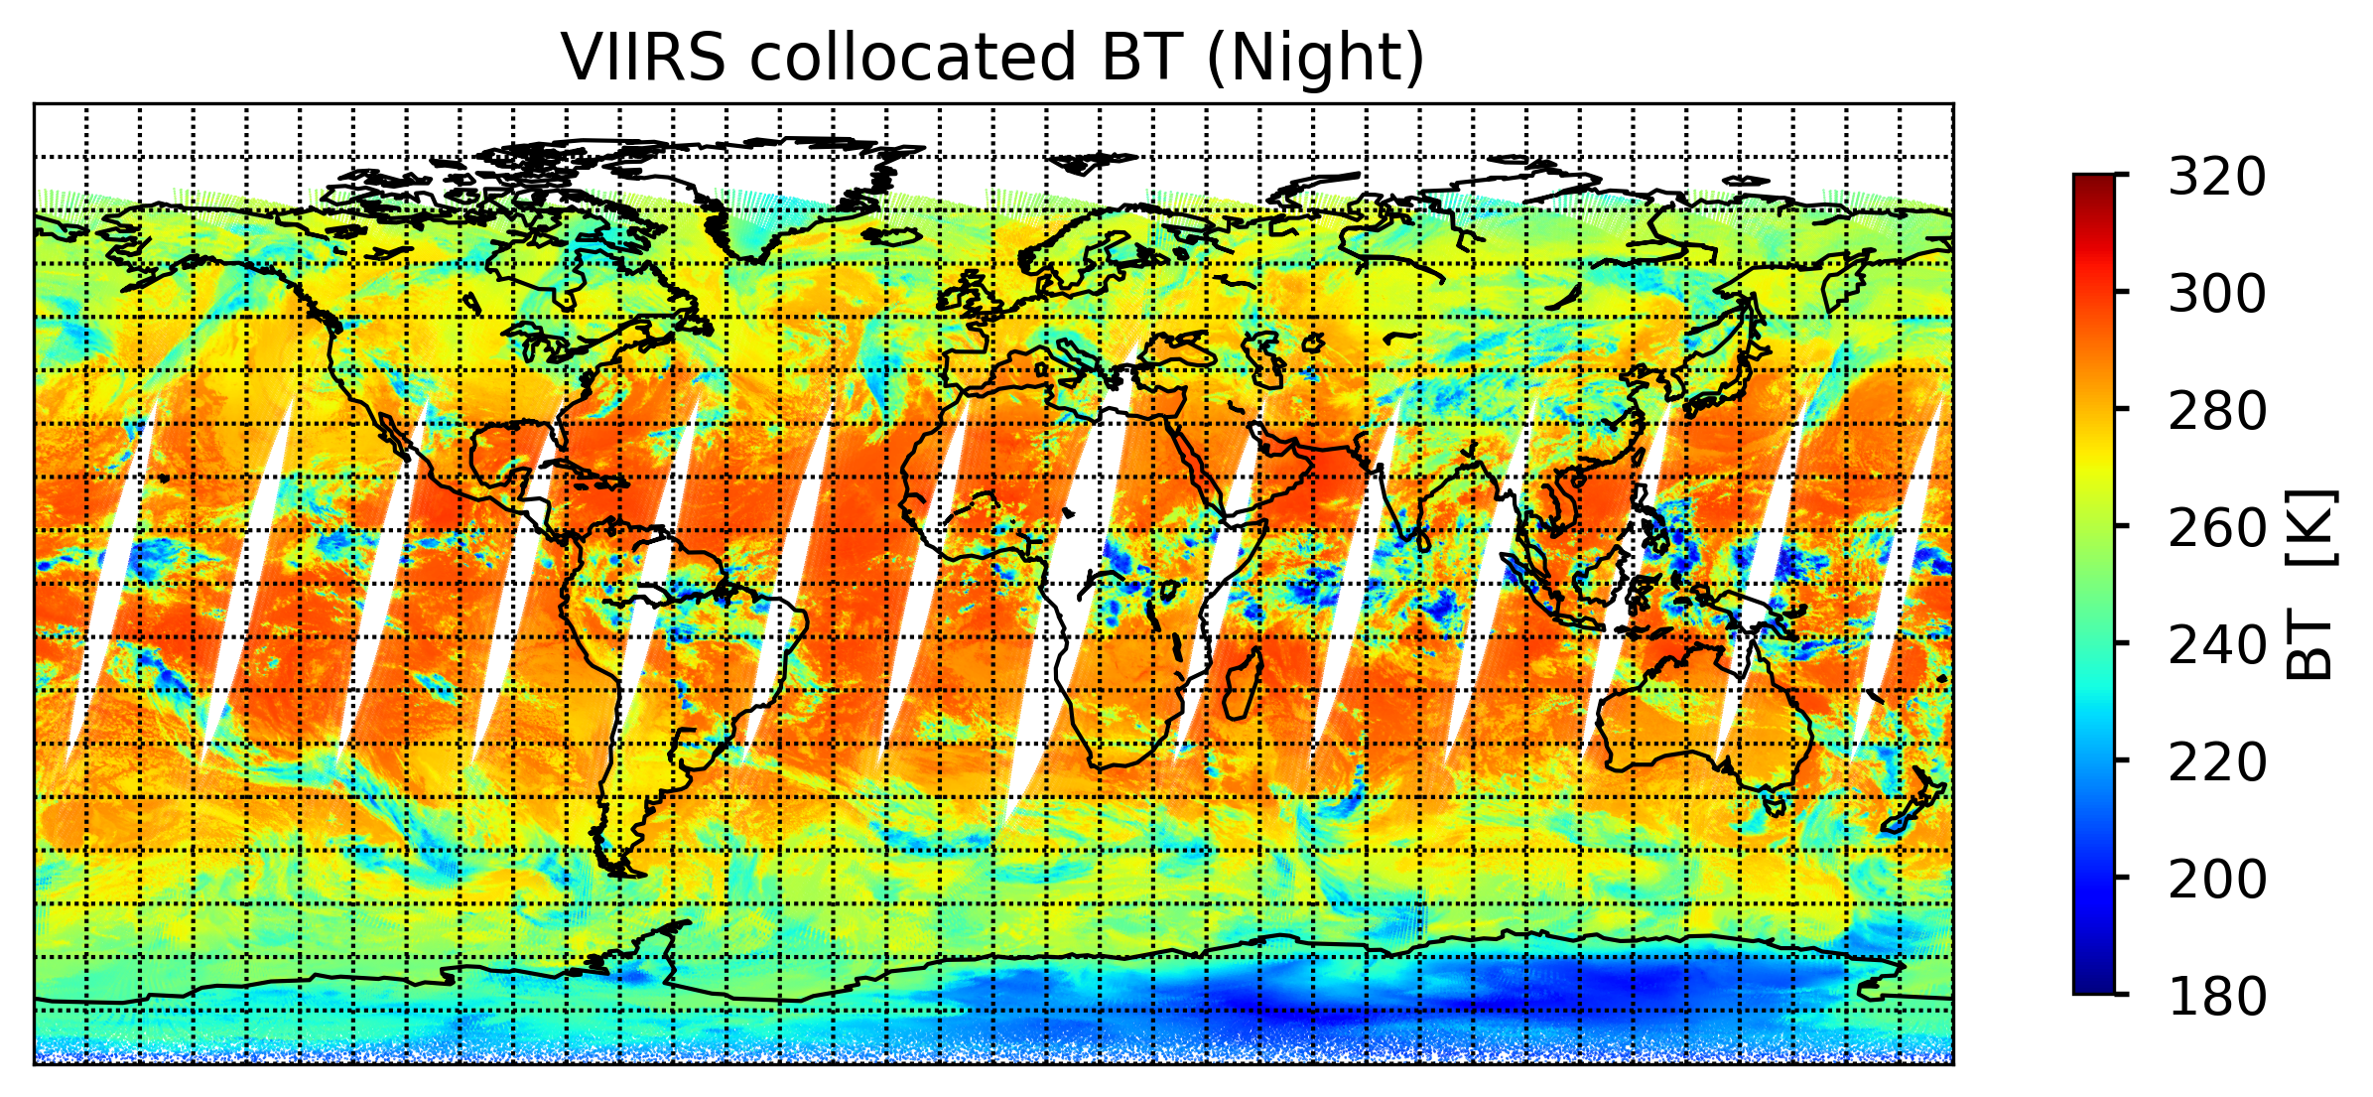
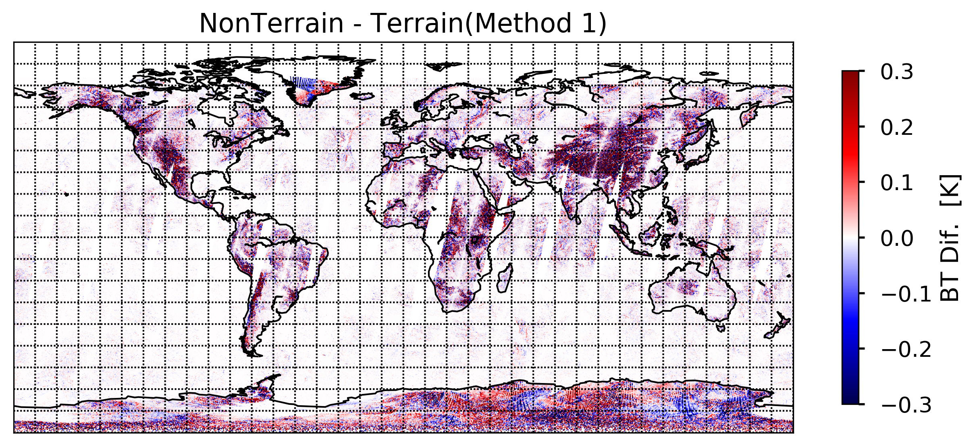
Control Run minus Method One
Control Run and Method One use the same collocation method but with different VIIRS geolocation datasets.
It clearly shows the large difference if one does not account for terrain effects.

Slide 18
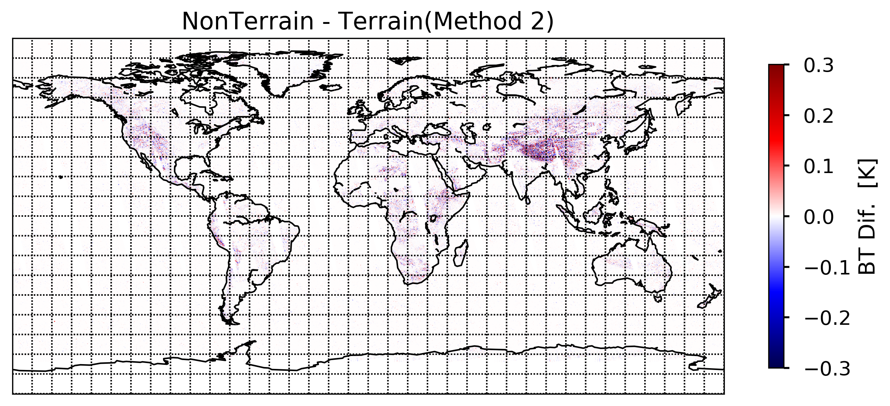
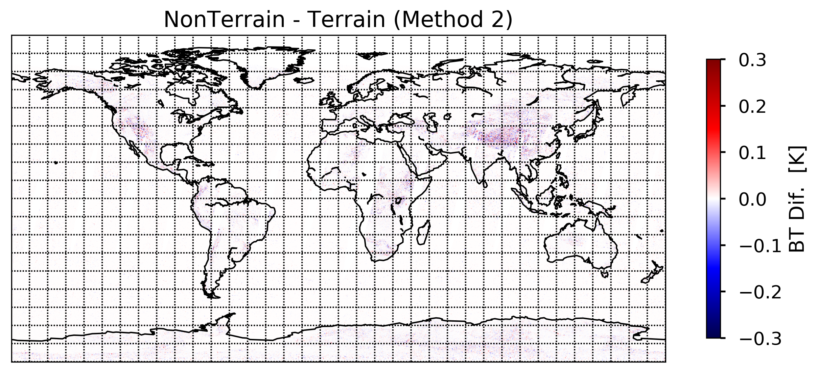
Control Run minus Method Two
Method Two uses the new collocation method with TC geolocation data as inputs. Control Run uses the old colocation method with Non-TC geolocation as inputs. The difference between Method Two and Control Run
Is very small.

Slide 19
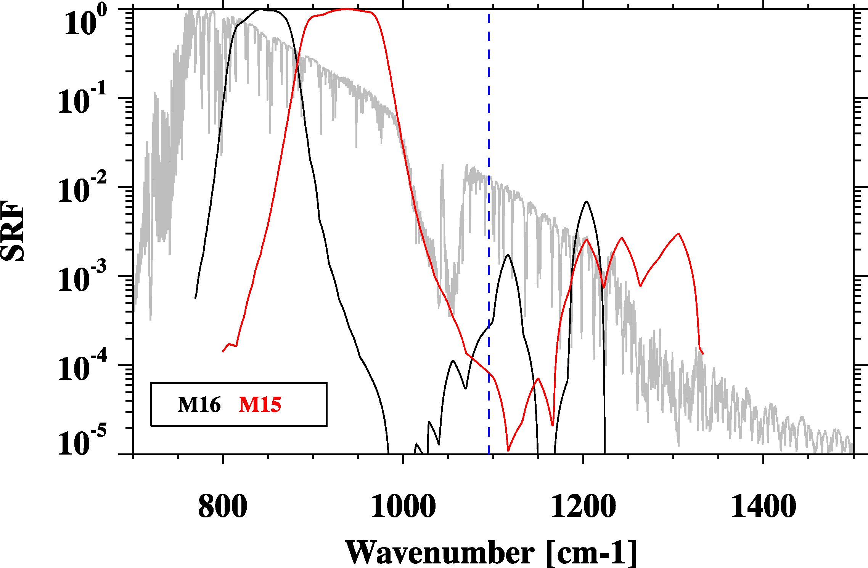
Issue 2: Out of Bands Effects
CrIS Band 1 end point
VIIRS SRFs :
M15 and M16
Center wavenumber and band correction coefficients are calculated using the above SRFs.

Slide 20
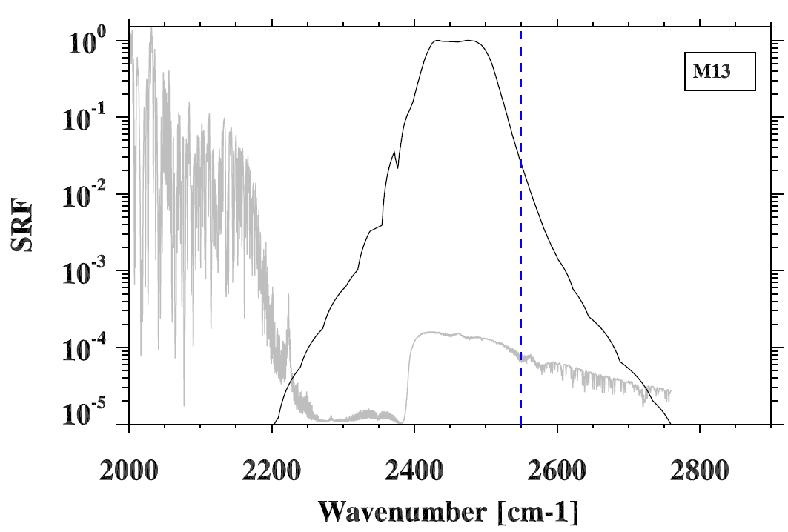
VIIRS SRFs (IDPS Version) : M13
CrIS Band 3 end point

Slide 21
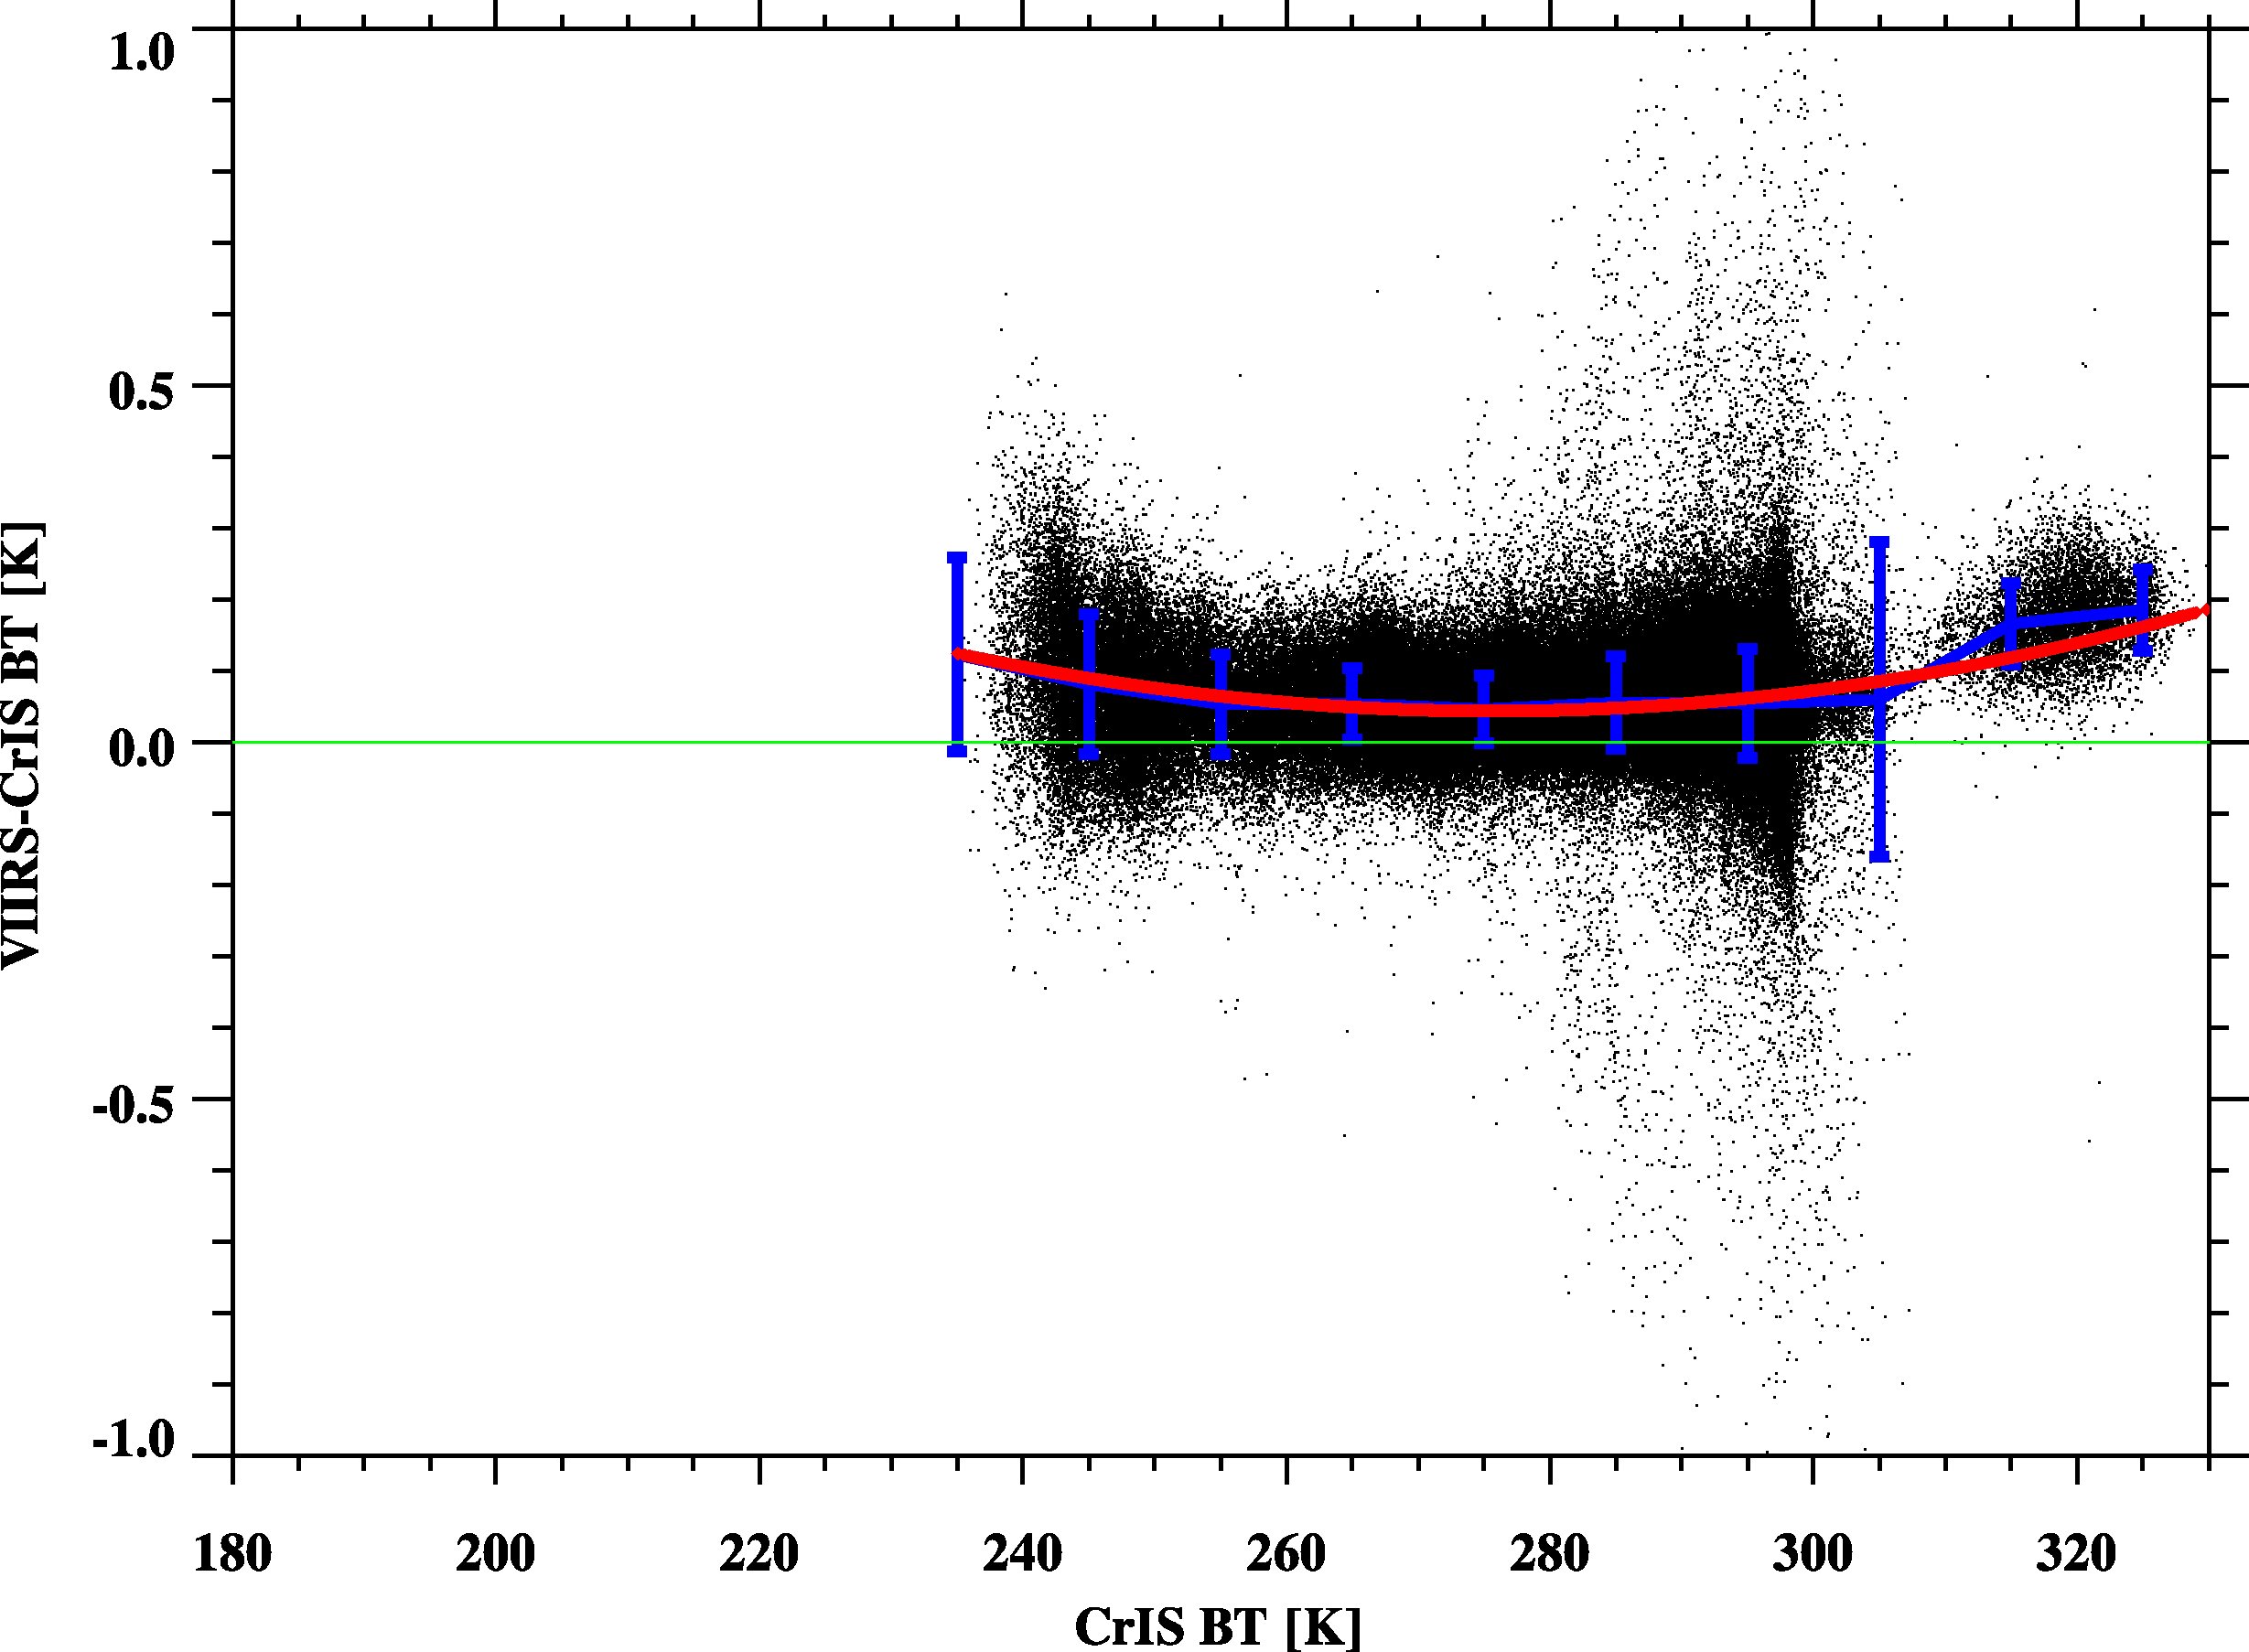
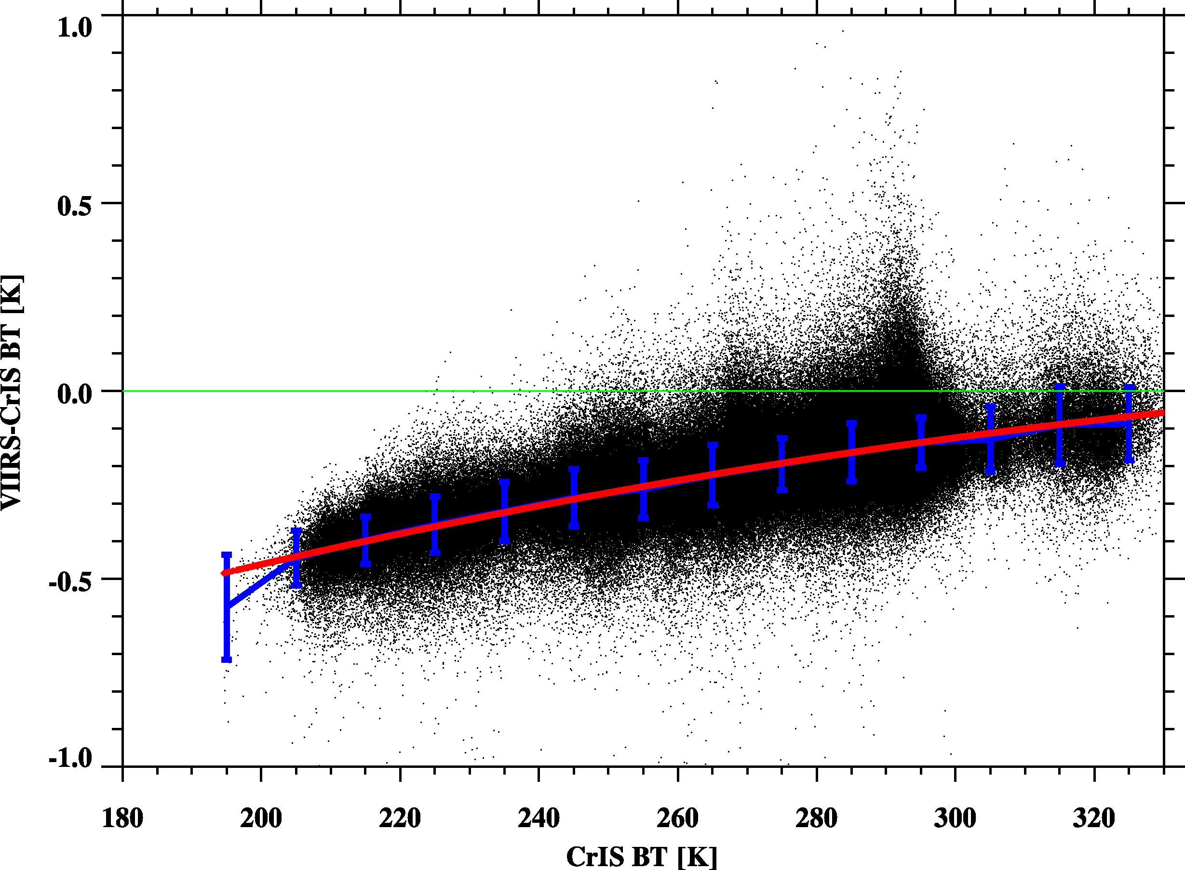
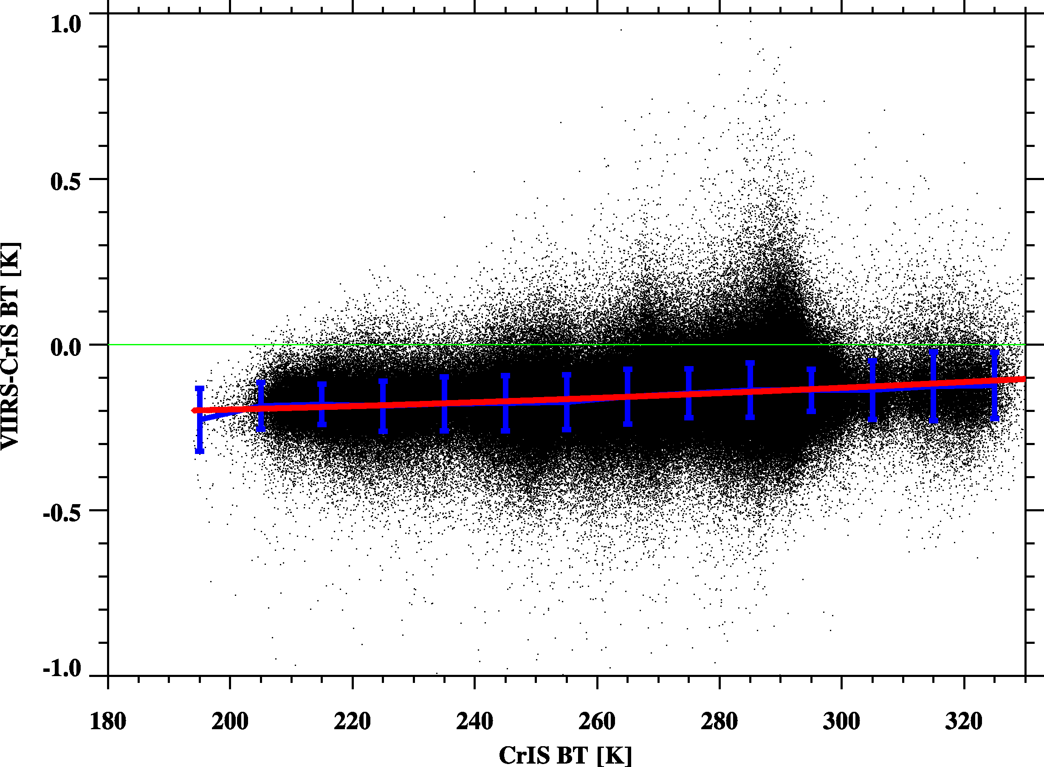
VIIRS-CrIS
Scene Dependence
Red Line: Fitting Line
Blue Line: Bin Average
M13
Without OOB correction
M15
M16

Slide 22
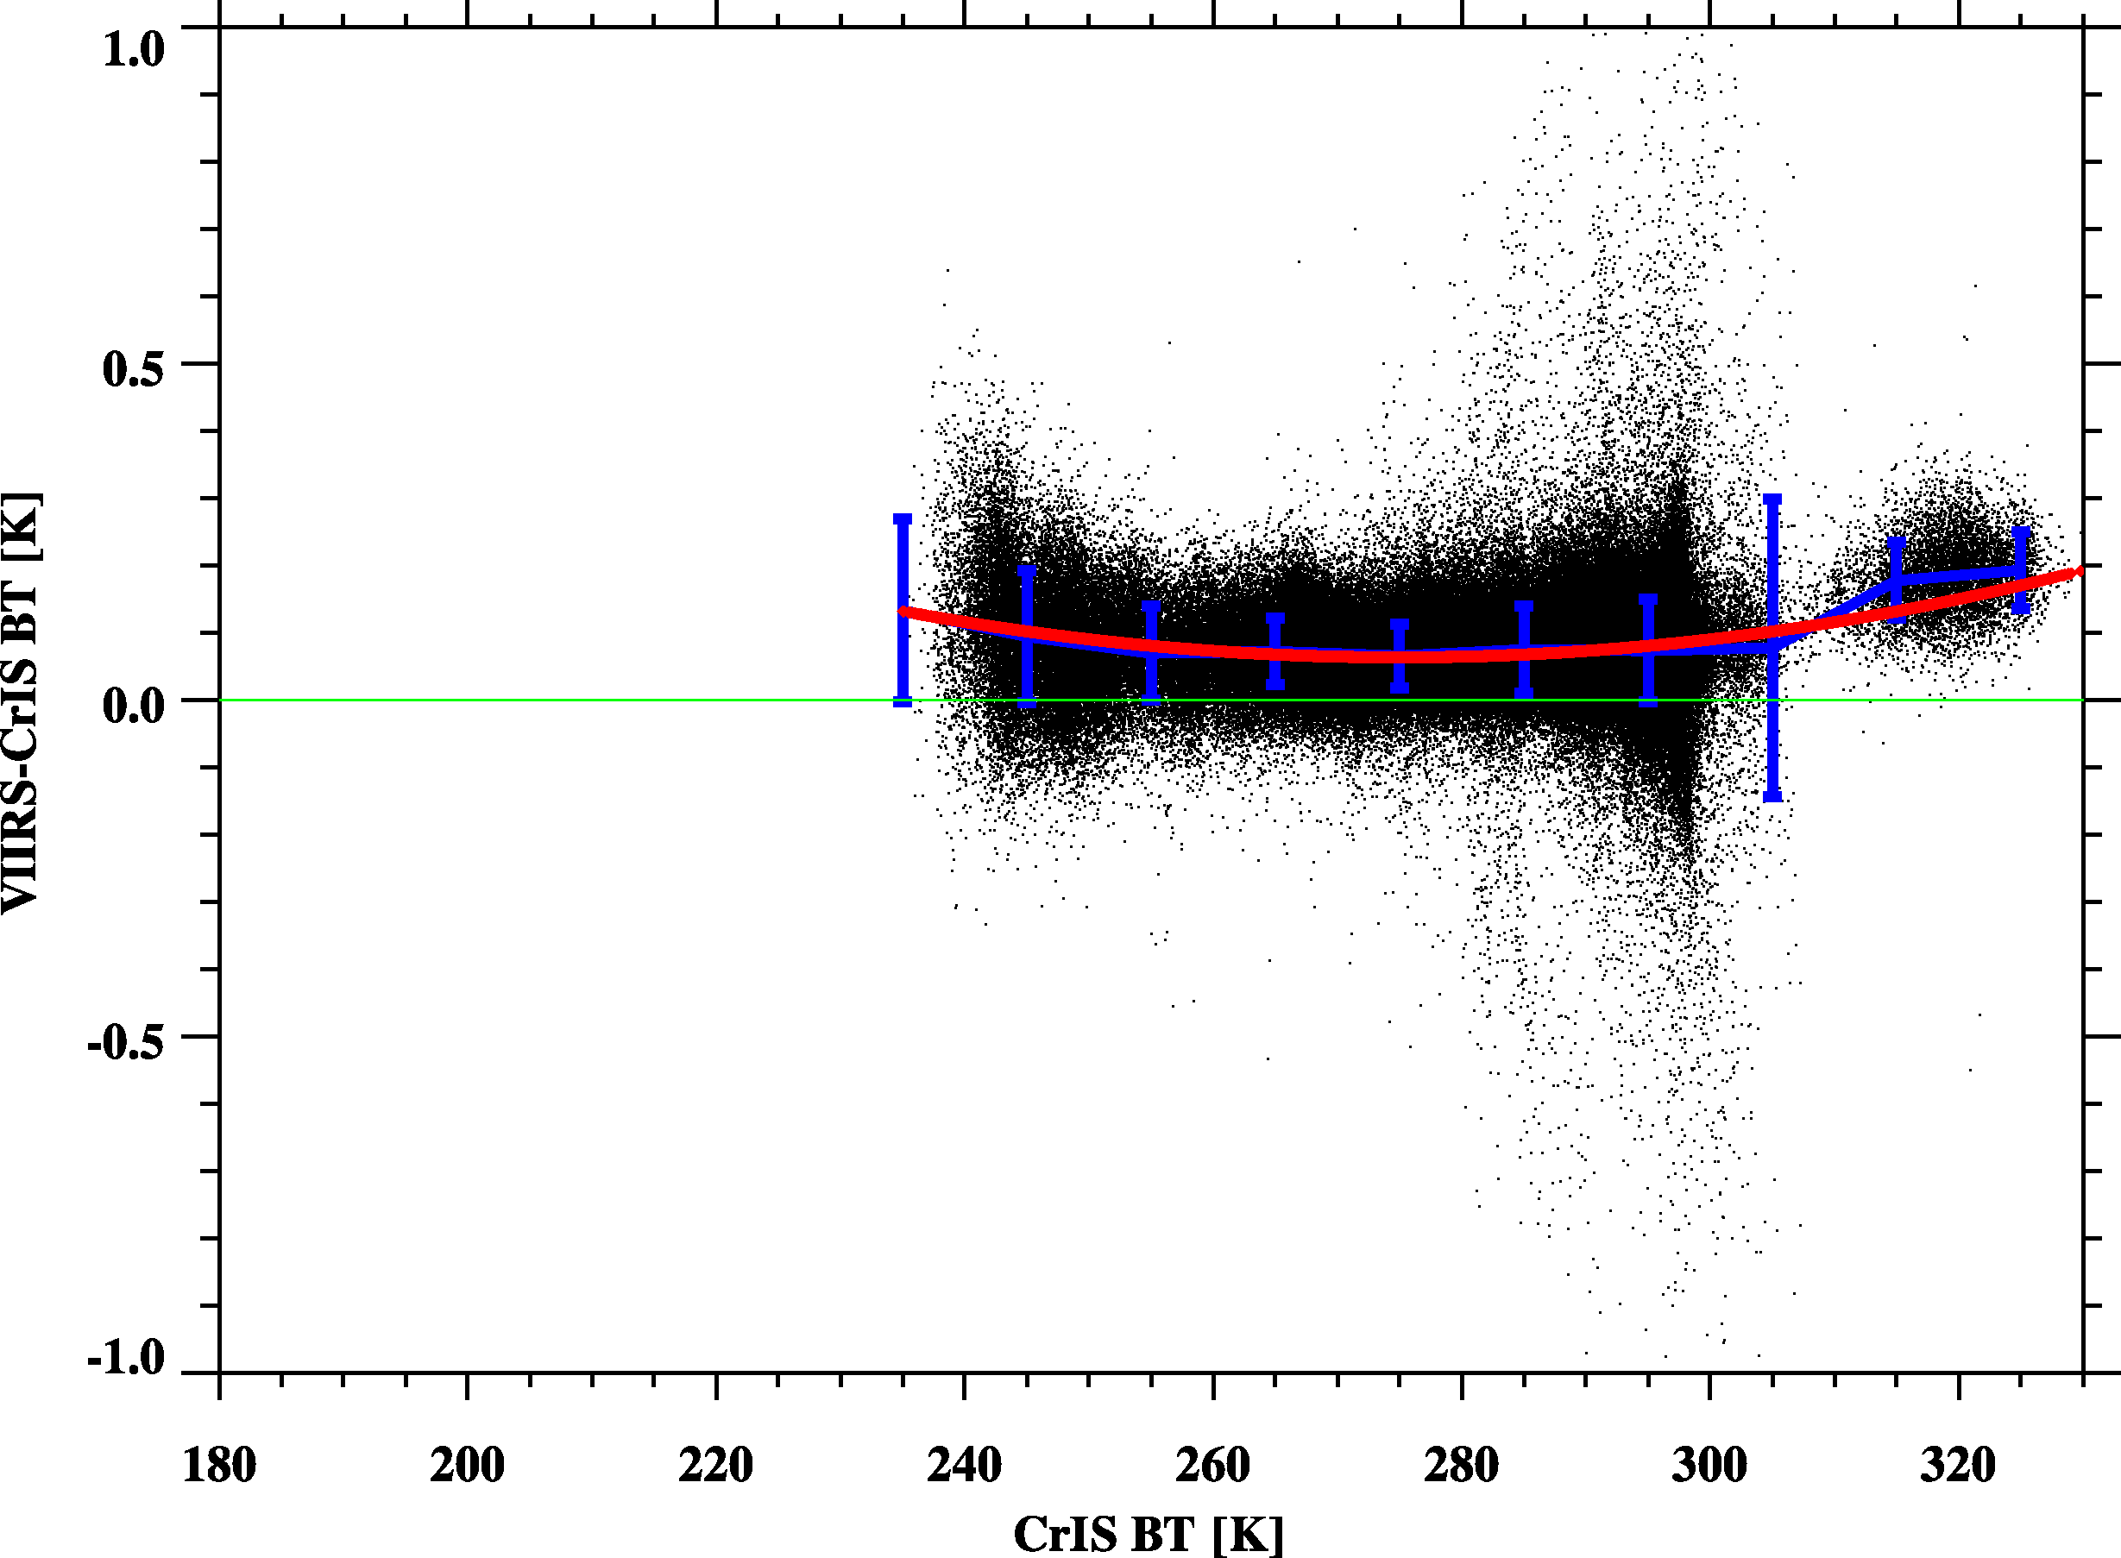
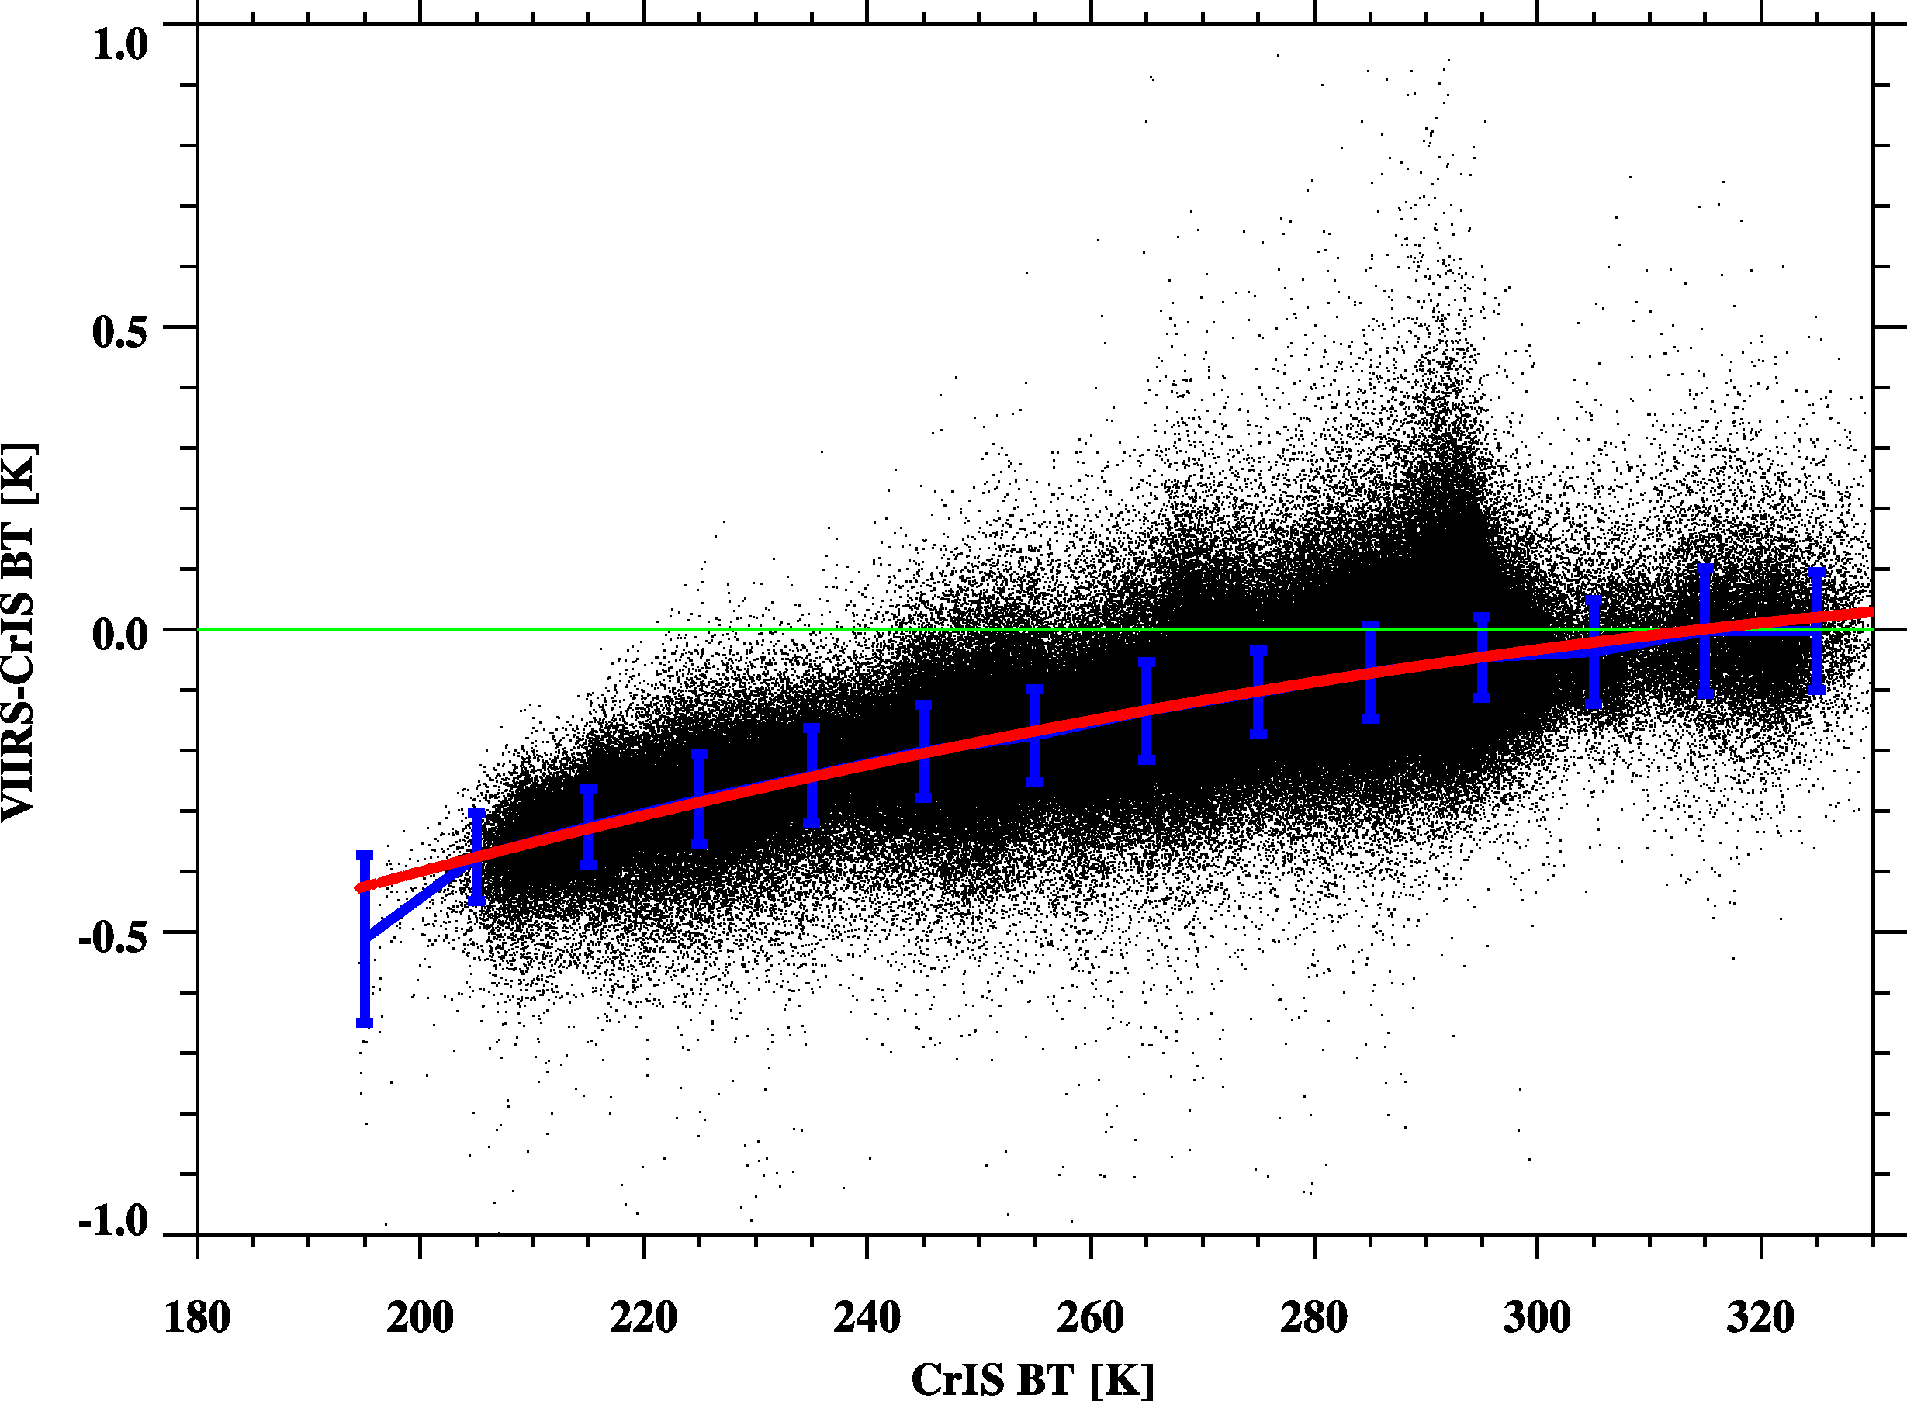
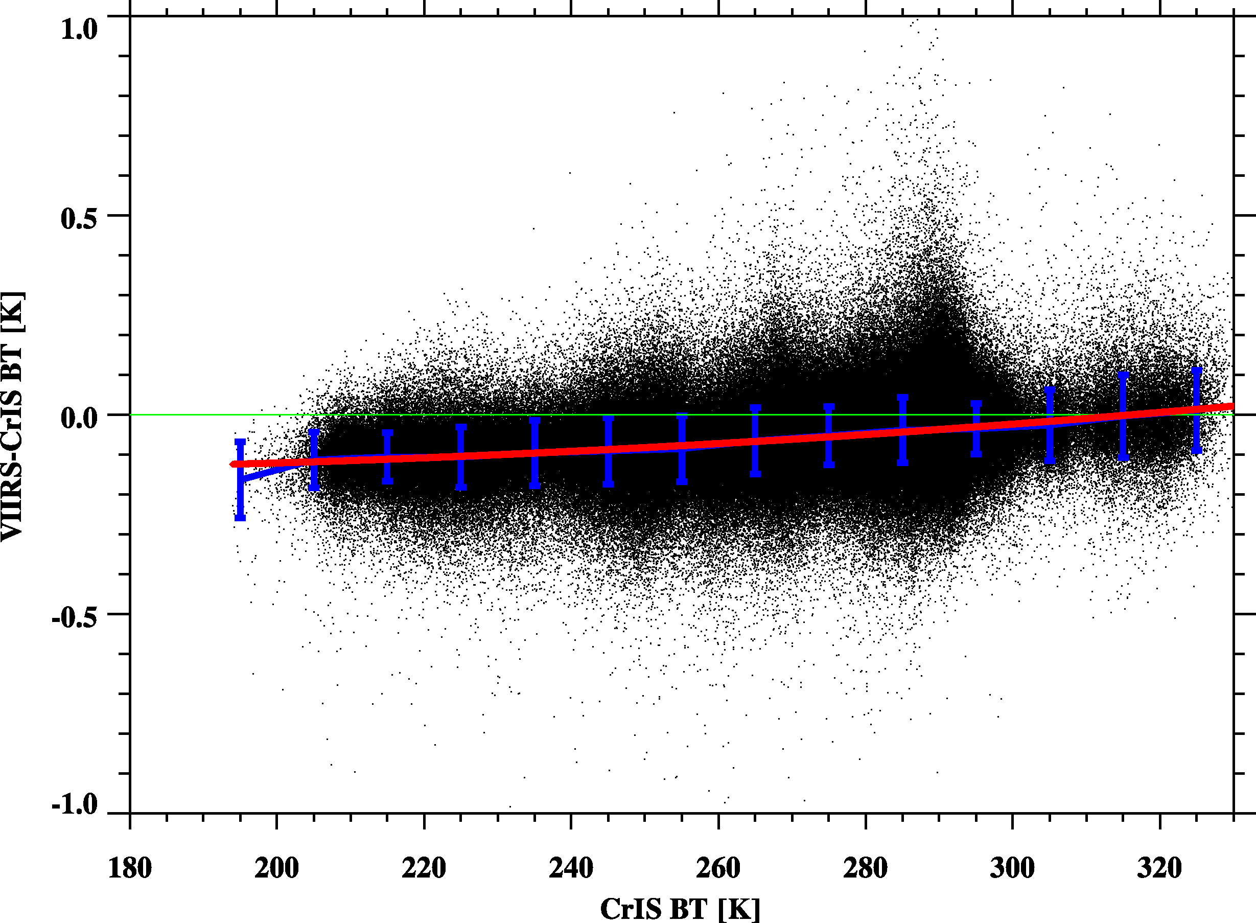
VIIRS-CrIS
Scene Dependence
Red Line: Fitting Line
Blue Line: Bin Average
M13
With OOB correction
M15
M16

Slide 23
Conclusion
CrIS and VIIRS inter-calibration plays a very import role for radiometric and geometric calibration assessment.
Incorporating the geoid height (from the static dataset) and terrain height (already stored in the VIIRS geolocation data), the collocation method can be modified to achieve results comparable to those obtained with non-TC data.
The out-of-band effects of VIIRS should be accounted for by using CrIS gap filling method to reduce the inter-comparison bias between CrIS and VIIRS .

