Slide 1



Application of New Collocation Method Based on LOS Vectors to AHI and LEO Instruments
Japan Meteorological Agency / Meteorological Satellite Center
KOYAMATSU Shin

Slide 2
Overview
Collocation between GEO instruments and LEO infrared sounders is an important step in the inter-calibration activity.
One of the issues in the current algorithm is how to deal with the parallax effects.
New collocation method based on Line-of-Sight (LOS) vectors was proposed by Wang et al. (2016).
As one of the IR Sub-Group activities for GEO-LEO-IR v2 algorithm development, this new method was applied to AHI and LEO reference observations.
Collocation and subsequent regression results will be reported in this presentation.
Notes:
Wang, L., Tremblay, D., Zhang, B., & Han, Y. (2016). Fast and Accurate Collocation of the Visible Infrared Imaging Radiometer Suite Measurements with Cross-Track Infrared Sounder. Remote Sensing, 8(1), 76. https://doi.org/10.3390/rs8010076

Slide 3
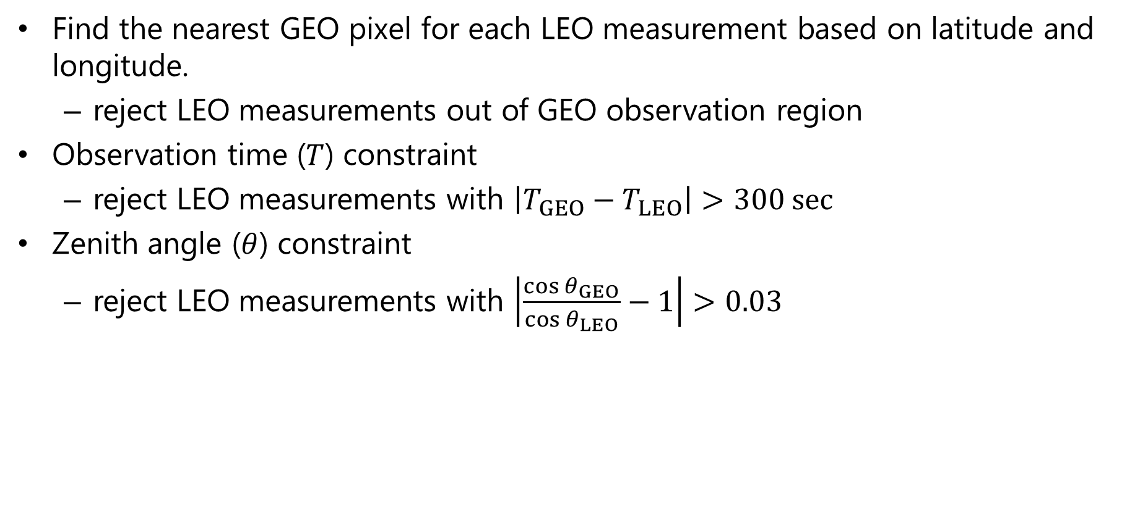
Current Algorithm
Find the nearest GEO pixel for each LEO measurement based on latitude and longitude.
  reject LEO measurements out of GEO observation region
Observation time ($T$) constraint
  reject LEO measurements with $\left|T_{GEO}−T_{LEO}\right|>300 sec$
Zenith angle ($θ$) constraint
  reject LEO measurements with $\left|\frac{\cos{θ_{GEO}}}{\cos{θ_{LEO}}}−1\right|>0.03$

Slide 4
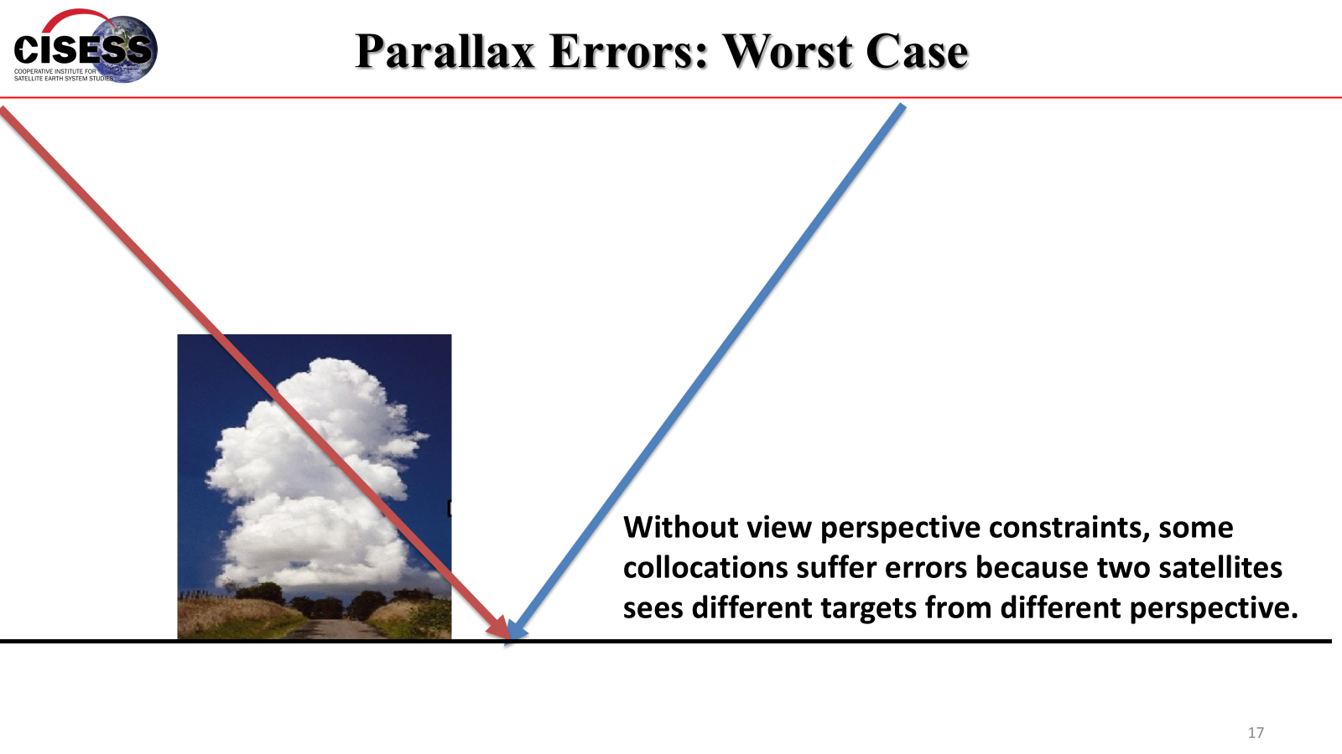
Parallax Effects
Likun Wang, GSICS Annual Meeting 2024

Slide 5
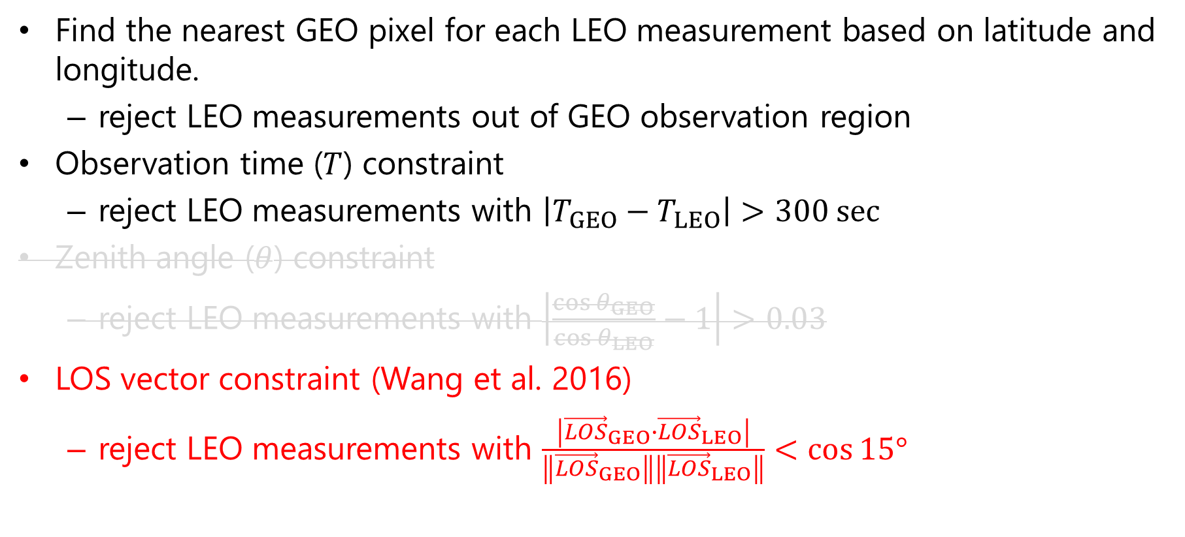
New Algorithm
Find the nearest GEO pixel for each LEO measurement based on latitude and longitude.
  reject LEO measurements out of GEO observation region
Observation time ($T$) constraint
  reject LEO measurements with $\left|T_{GEO}−T_{LEO}\right|>300 sec$
Zenith angle ($θ$) constraint
  reject LEO measurements with $\left|\frac{\cos{θ_{GEO}}}{\cos{θ_{LEO}}}−1\right|>0.03$
LOS vector constraint (Wang et al. 2016)
  reject LEO measurements with $\frac{\left|{\vec{LOS}}_{GEO}∙{\vec{LOS}}_{LEO}\right|}{\left\|{\vec{LOS}}_{GEO}\right\|\left\|{\vec{LOS}}_{LEO}\right\|}<\cos{15°}$

Slide 6
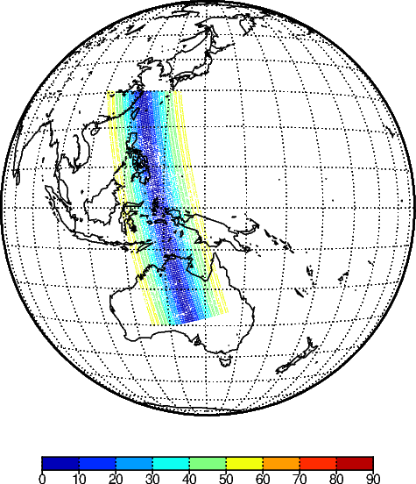
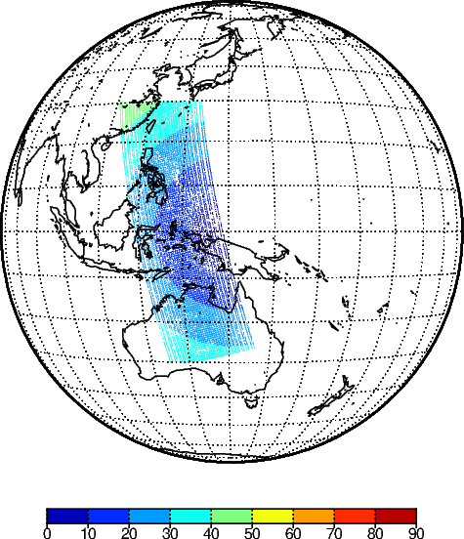
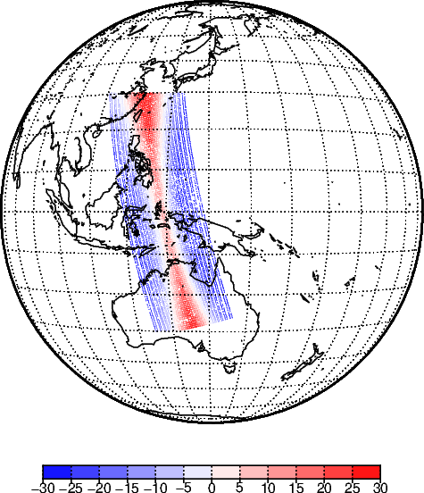
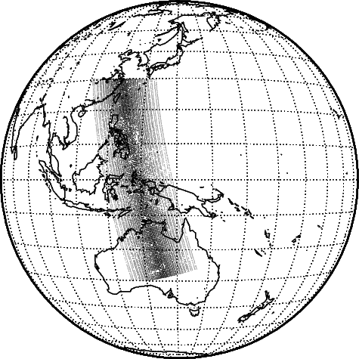
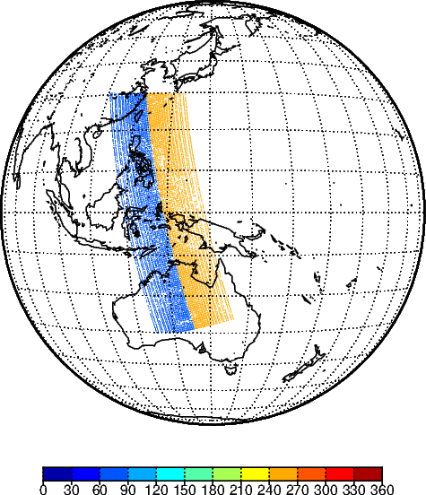
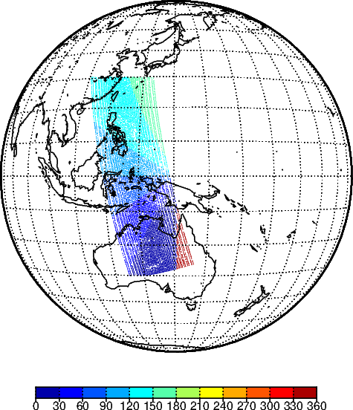
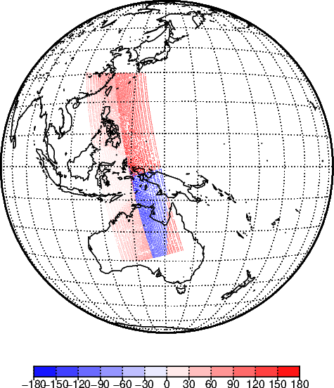
Angle Difference between GEO and LEO
LEO
GEO
DIFF
Without an angle difference constraint, 12919 samples were selected for Metop-B/IASI 1-hour observation (2025-01-01 12-13UTC).
Satellite Zenith Angle
(degree)
Satellite Azimuth Angle
(degree)

Slide 7
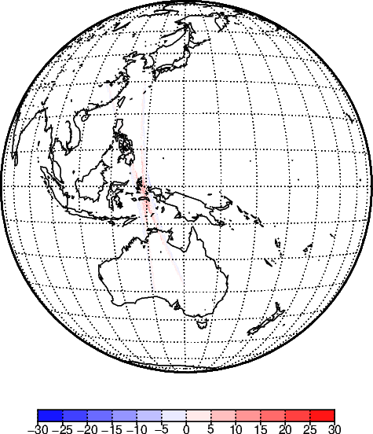
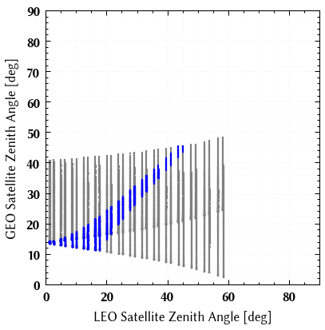
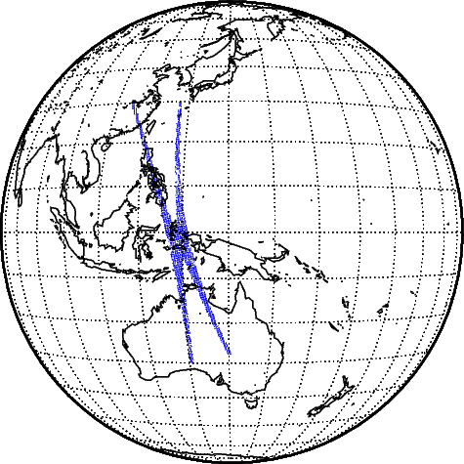
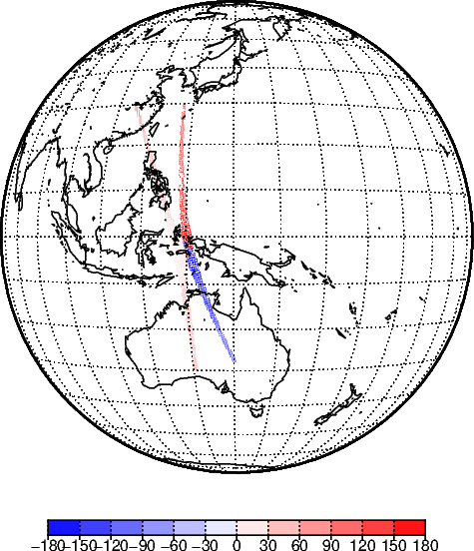
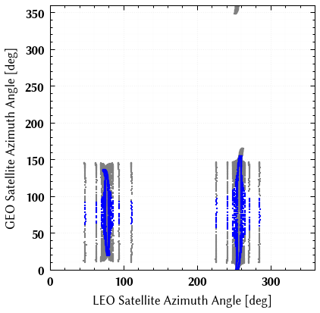
Angle Constraint with Satellite Zenith Angle
Satellite Zenith Angle Difference
Selected samples: 2209 / 12919
Metop-B/IASI
2025-01-01 12-13UTC
Satellite Azimuth Angle Difference

Slide 8
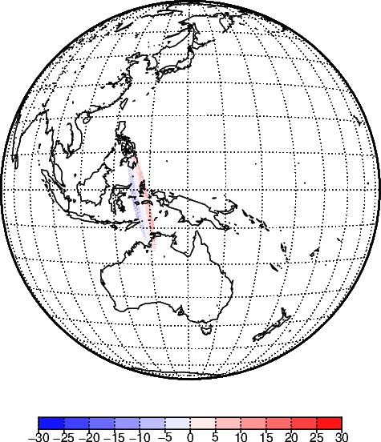
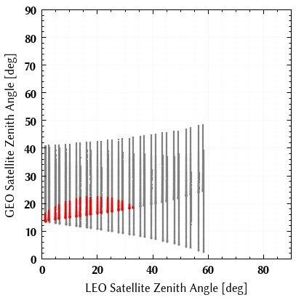
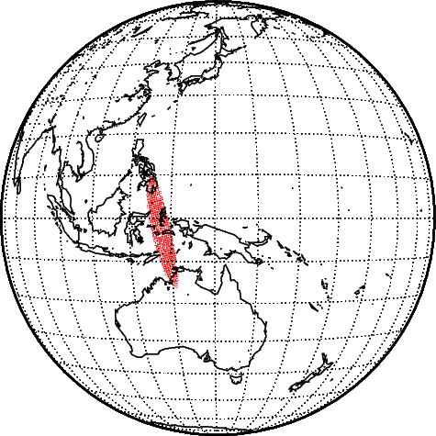

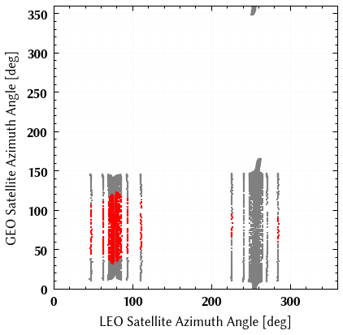
Angle Constraint with LOS vectors
Satellite Zenith Angle Difference
Selected samples: 1264 / 12919
Metop-B/IASI
2025-01-01 12-13UTC
Satellite Azimuth Angle Difference

Slide 9
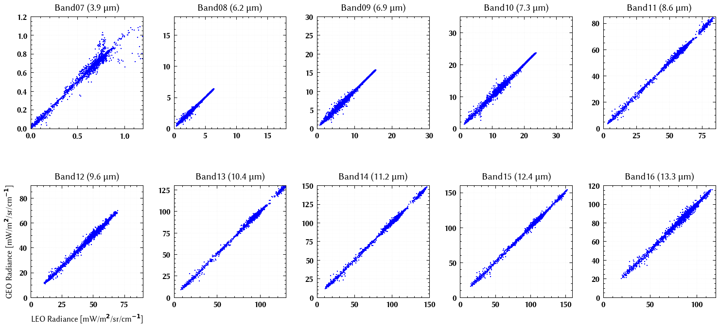
Regression with SZA Collocation
Metop-B/IASI 1-day (2025-01-01)

Slide 10
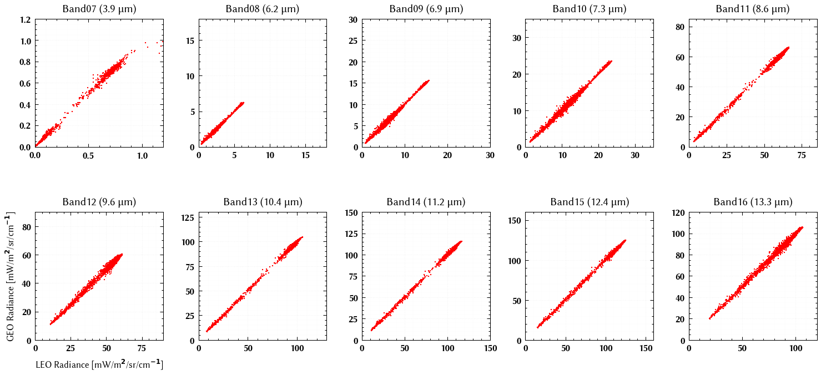
Regression with LOS Vector Collocation
Metop-B/IASI 1-day (2025-01-01)

Slide 11
Summary
Collocation with the conventional angle constraint by satellite zenith angle could be contaminated by parallax effects.
A new collocation method based on LOS vectors was applied to Himawari-9/AHI and LEO reference observations.
The new algorithm based on LOS vectors rejects LEO measurements closer side to the GEO SSP, where the azimuth angle difference is greater.
It may be a problem that the collocation locations are limited to low latitudes.
No significant differences were found in the regression results. Further investigations over a longer period are needed.

