Slide 1
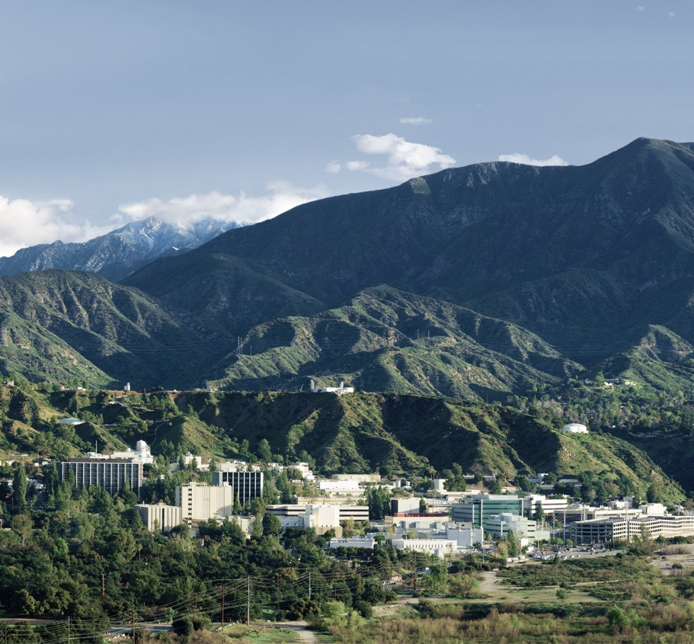
GSICS Annual Meeting
UVNS Breakout Session 6D
Changchun, China (remote)
19 Mar 2025, 09:00-09:15 [UTC+8]
OCO-2 and OCO-3 Radiometric Trends
Rob Rosenberg, Graziela Keller, Richard Lee, Virgil Adumitroaie, Abhishek Chatterjee, Vivienne Payne
Contact Email: Rob.Rosenberg@jpl.nasa.gov
© 2025 California Institute of Technology. Government sponsorship acknowledged.

Slide 2
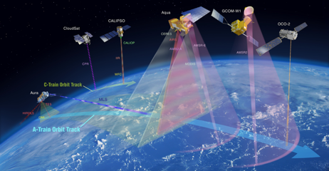
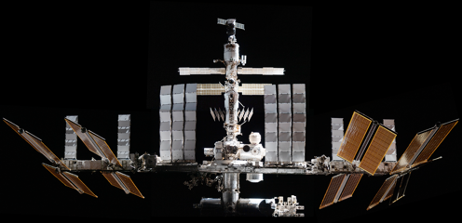
Outline
Orbiting Carbon Observatory
Watching The Earth Breathe…Mapping CO₂ From Space
Mission Operations Highlights
Past and Future Reprocessing Campaigns
OCO-2 Trending:
  Lamp, Solar, Lunar
OCO-3 Trending:
  OCO-3 Three Lamps at varied cadence

Slide 3
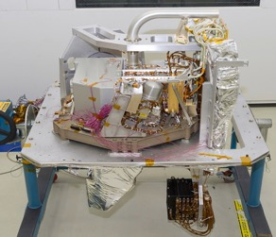
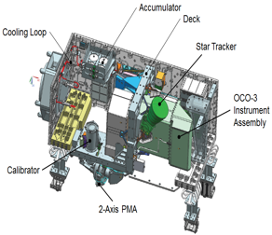
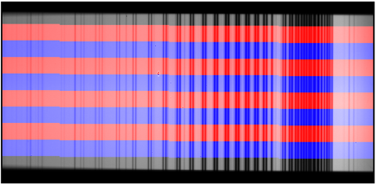
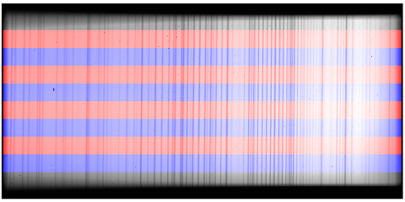
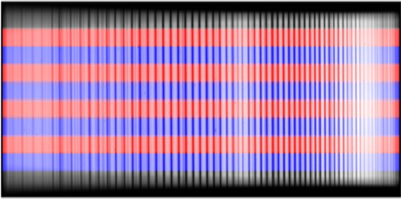
Instrument Basics
Orbiting Carbon Observatory
Three-Channel Grating Spectrometer with Common Entrance Optics
Science goals require X_{CO2} retrievals with precision better than 1 ppm (less than 0.25%), placing strict demands on preflight & inflight calibration
O₂ A 758-772 nm
Weak CO₂ 1591-1621 nm
Strong CO₂ 2043-2082 nm

Slide 4
Mission Operations
Routine Decontaminations Remove Water Ice from Focal Plane Arrays
OCO-2
12 [~1 week] decontamination procedures Oct 2014 - Mar 2019
Annual campaigns in late Jan / early Feb (pre-drawdown) from 2020-2023
Since contamination rate has slowed, changed to every 2 years, most recent ended February 17, 2025
OCO-3
Extended through ISS end of life
Relocated from JEM-EF Site 3 to Site 4 on November 13, 2023, stored for 7.7 months, Reinstalled July 4, 2024, science gap 3812 “solar days”
3 decontaminations since, will continue 4.5-month cadence

Slide 5
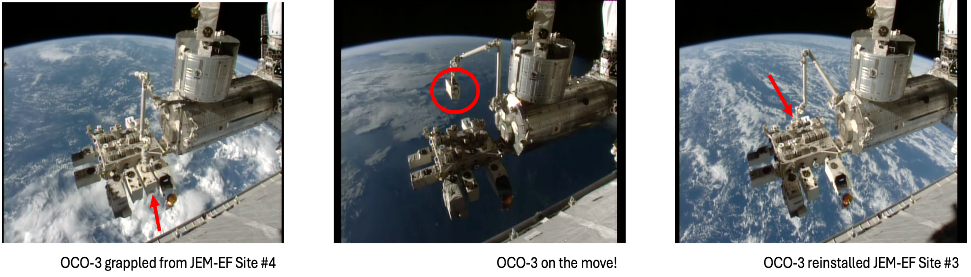
Reinstallation Photos
Mission Operation Systems team flawlessly executed In-orbit Checkout #2
Image Credit: Gary Spiers & YouTube “Live High-Definition Views from the International Space Station (Official NASA Stream)”

Slide 6
Reprocessing History and Forecast
Calibration is refined simultaneously with Level 2 retrieval algorithm
OCO-2
OCO-3
# | Cal Deliv Date | Degradation
7 | Jun 2015 | All Instrument
8 | May 2017 | All Solar
10 | Jun 2019 | Lunar, linear
11 | Jan 2022 | Lunar, nonlinear
12* | Summer 2025 | Lunar & vicarious
# | Cal Deliv Date | Degradation
Early | Jun 2020 | N/A
10 | May 2021 | All Instrument
11 | Feb 2023 | All Lamp 1
12* | TBD | In-between
* Pending formal NASA review & approval
In addition to the long-term degradation trend, new versions feature refined spectral, geometric, dark, stray light, noise, and detector artifact exclusion

Slide 7
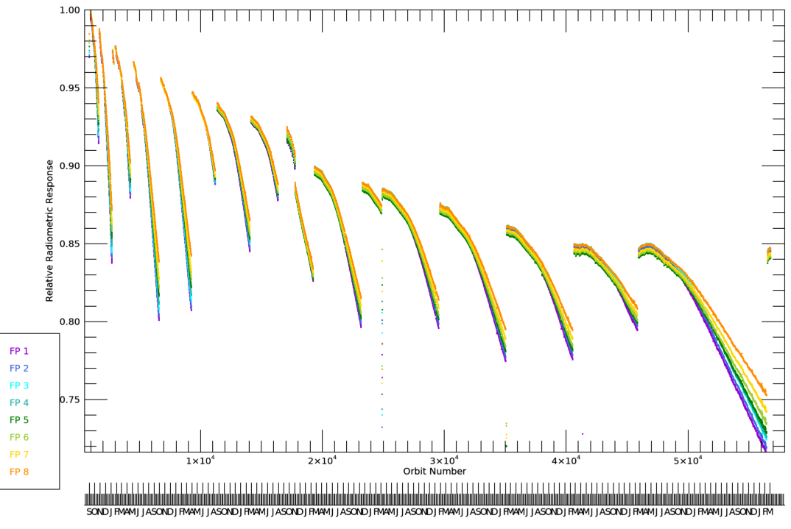
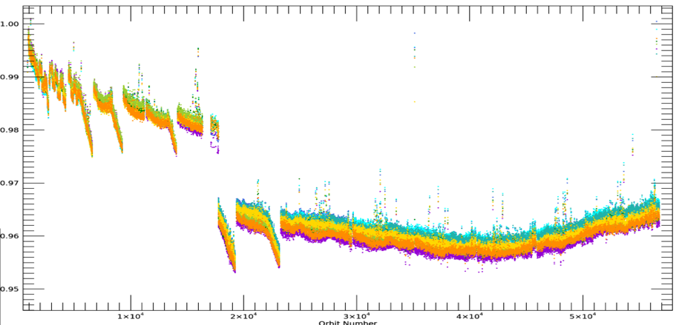
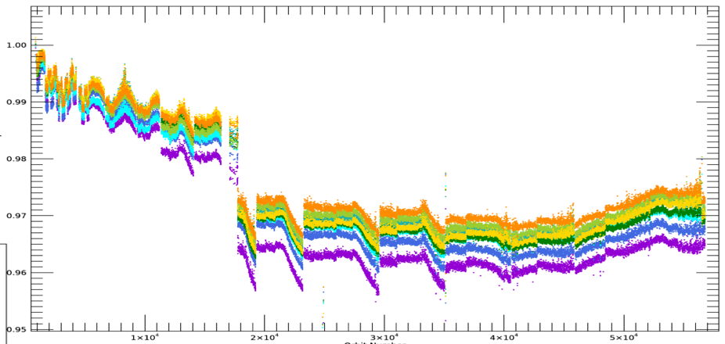
OCO-2 Solar Trend Relative to Aug 2014 (to Orbit 56785)
Orbiting Carbon Observatory
~12 measurements per day, aging much faster than instrument
ABO2
WCO2
SCO2

Slide 8
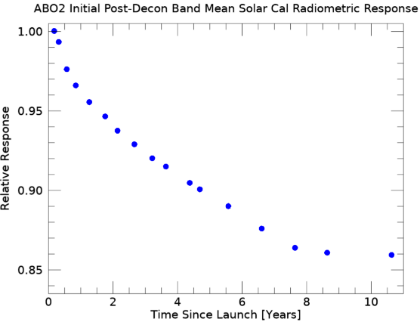
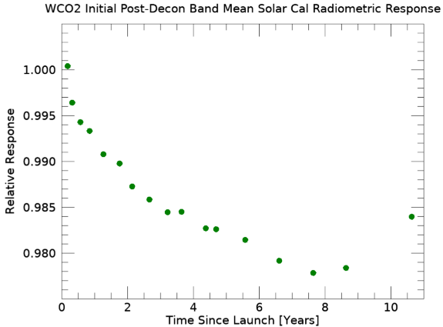
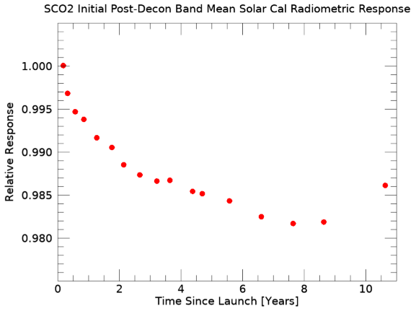
OCO-2 Post-Decon Solar Trends
Interpolate & extrapolate “clean” measurements

Slide 9
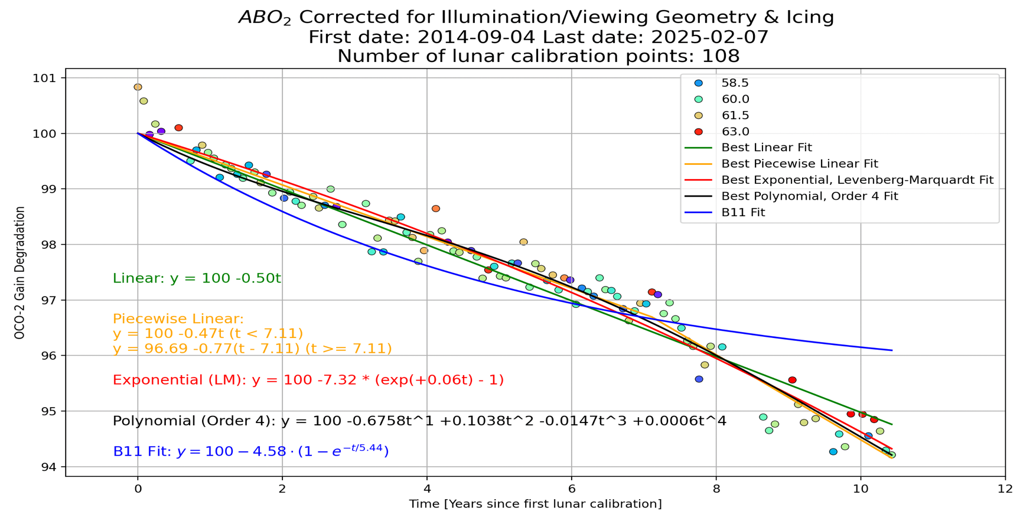
OCO-2 Waxing Gibbous Lunar Trending
Not fully independent from solar because of icing correction

Slide 10
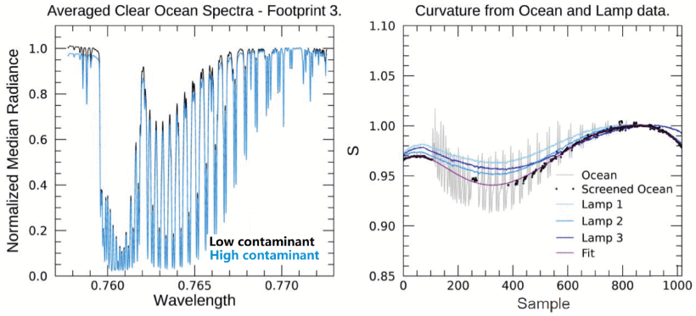
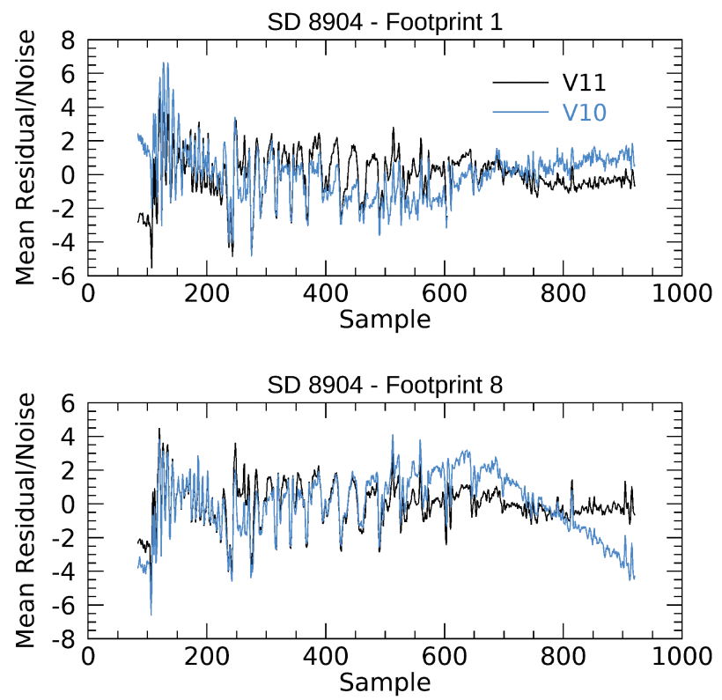
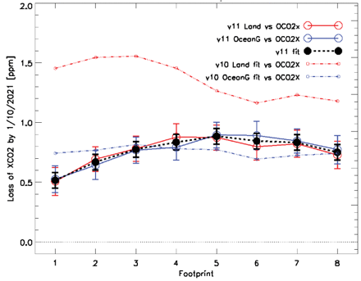
Publication in IEEE TGRS January 23, 2025
New Inflight Calibration of OCO-3’s A-Band for Version 11 Products
https://doi.org/10.1109/TGRS.2025.3532216
Graziela R. Keller*, Robert A. Rosenberg, Aronne Merrelli, Christopher W. O’Dell, Gary D. Spiers, Vivienne H. Payne, and Abhishek Chatterjee
IEEE Transactions on Geoscience and Remote Sensing, vol. 63, pp. 1-12, 2025, Art no. 1000412
Fig. 1 – (Left) clear ocean spectra, (Right) ratio of spectra and similar curves from lamps data. Curves show different profiles, so ocean data used to calculate the spectral shape of changes in response.
Fig. 2 – OCO-3 median residuals between Earth observations and forward modeled radiances for footprints 1 (top) and 8 (bottom) for Versions 10 (blue) and 11 (black). Over 1000 soundings from solar day 8904 were used. In v10, curvature in the residuals showed strong dependence on footprint. This was resolved in v11.
Fig. 3 – Loss of XCO₂ by the end of OCO-3’s longest period of contaminant accumulation for Versions 10 (dashed) and 11 (solid). In v11, the loss of XCO₂ was reduced to < 1 ppm for all footprints.

Slide 11
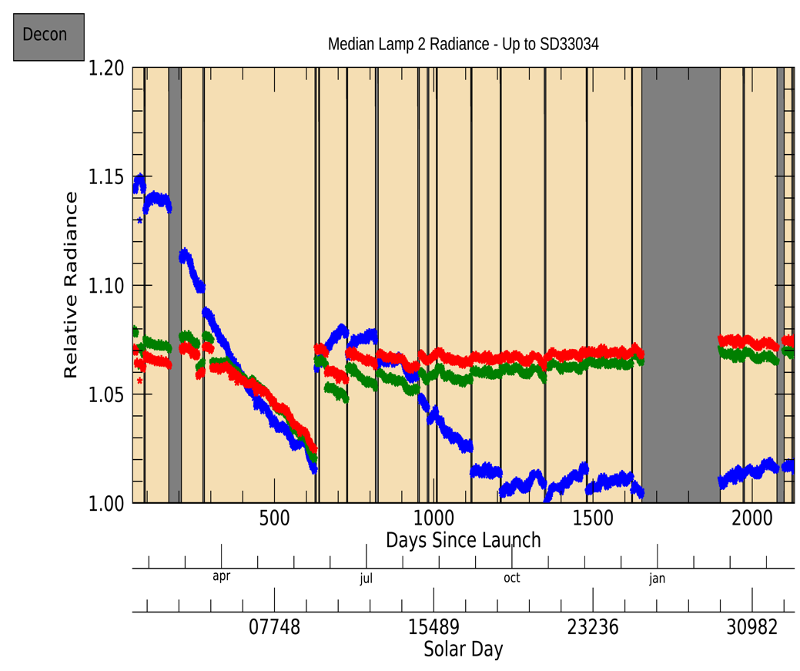
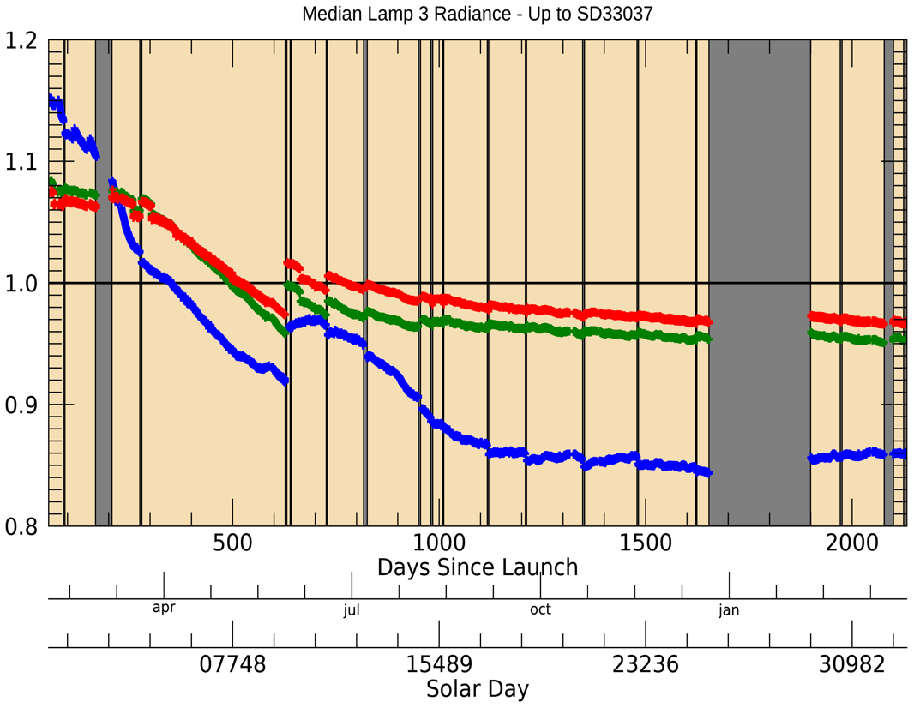
OCO-3 Lamp 2 & 3 Trends Relative to Prelaunch (to Mar 6)
Lamp 2: 19 % of sequences, Lamp 3: 80 % of sequences
ABO2
WCO2
SCO2

Slide 12
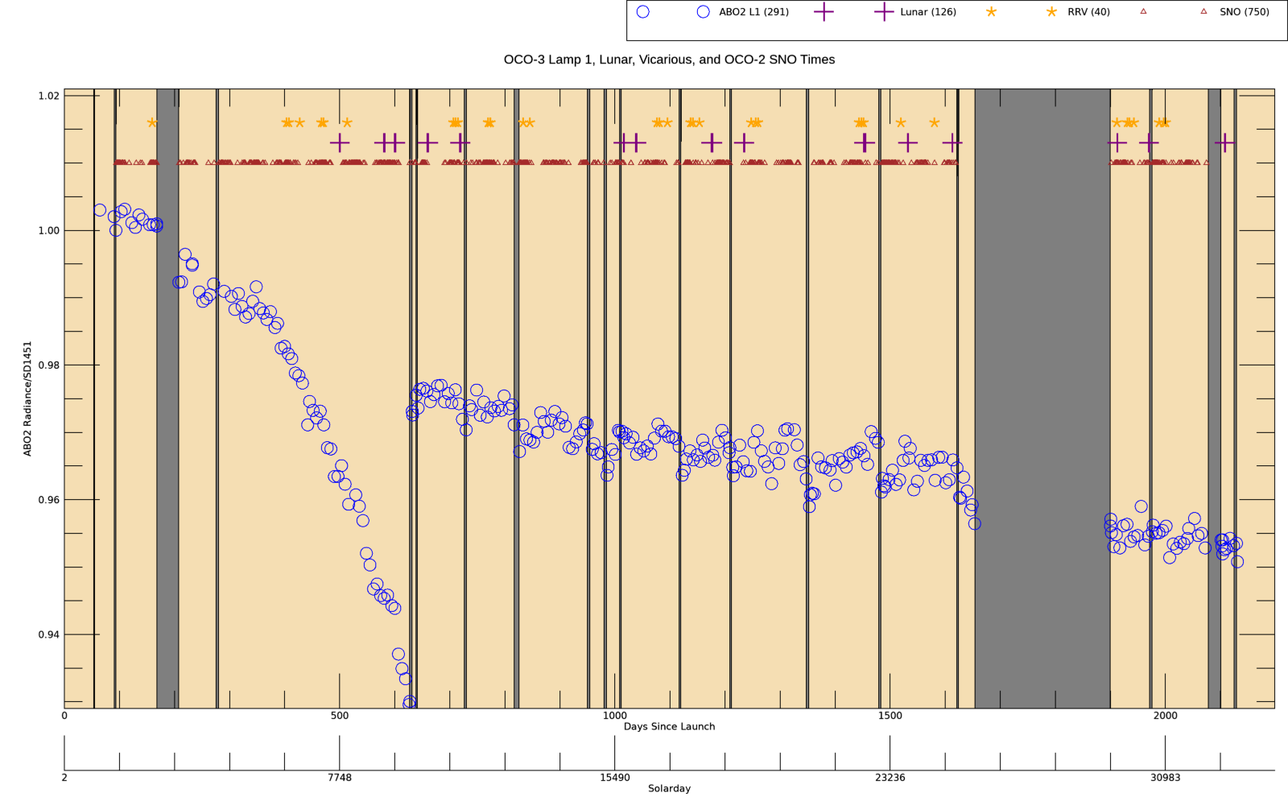
OCO-3 Lamp 1 Trend & Special Calibration Times (ABO2)
Orbiting Carbon Observatory
Symbols above for lunar, vicarious, and OCO-2 crossings indicate times
Symbols below show actual (median) lamp radiance ratios vs Sep 2019
V. Haemmerle, D. Fu, T. Kurosu

Slide 13
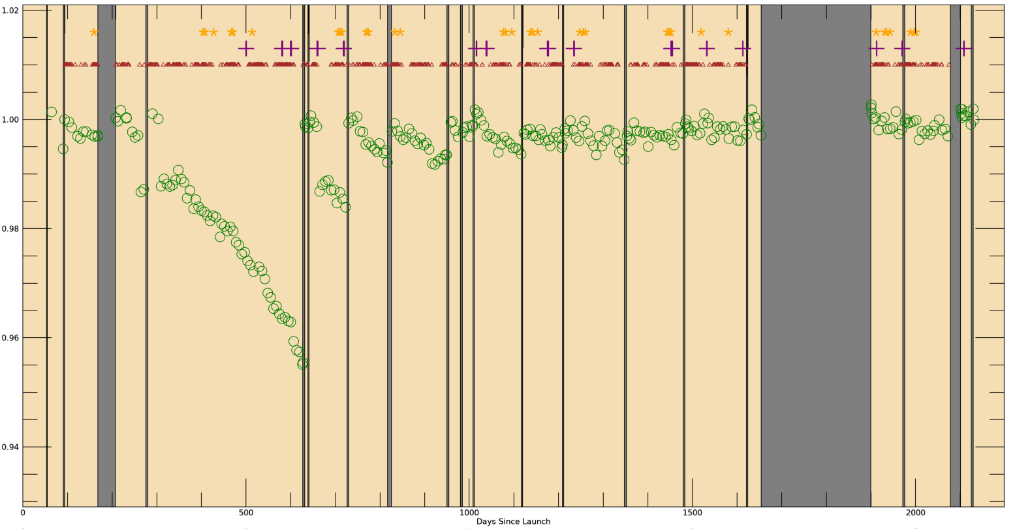
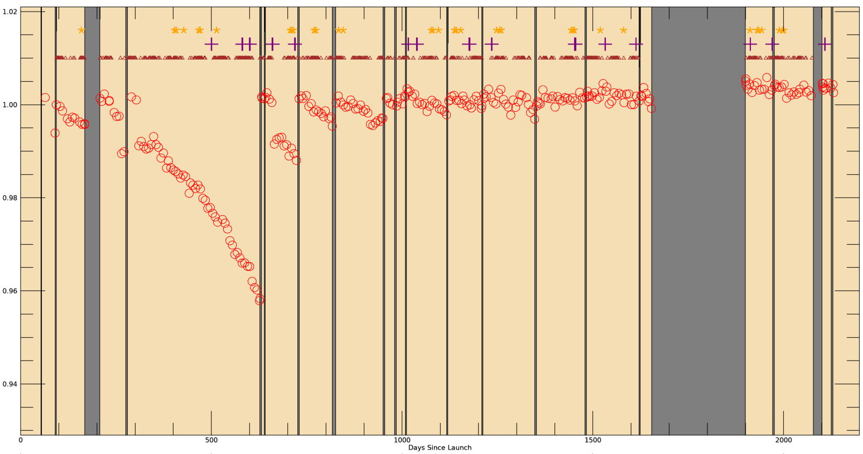
OCO-3 Lamp 1 Trend & Special Cal Times (WCO2 & SCO2)
Orbiting Carbon Observatory

Slide 14
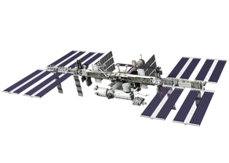

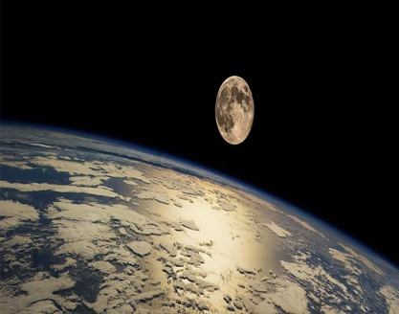
Conclusion
Orbiting Carbon Observatory
Consistently accurate calibration is vital for carbon cycle science
As record lengthens, reprocessing campaigns cost more, take longer, and are less frequent
Continuing to monitor detector health using daily dark & lamp measurements, very stable
Maturing analysis techniques & extending time series for vicarious calibration, simultaneous nadir overpasses, and lunar calibration
Data accessible to the public:
https://disc.gsfc.nasa.gov/
L1B ATBD updated Feb 6. 2024

