Slide 1
GOSAT serious calibration and intercomparison with multiple GHG sensors
6e
Kei SHIOMI (JAXA)
GSICS Annual Meeting 2025, UVN-S Breakout Session, CMA, Changchun / Hybrid, March 18, 2025

Slide 2
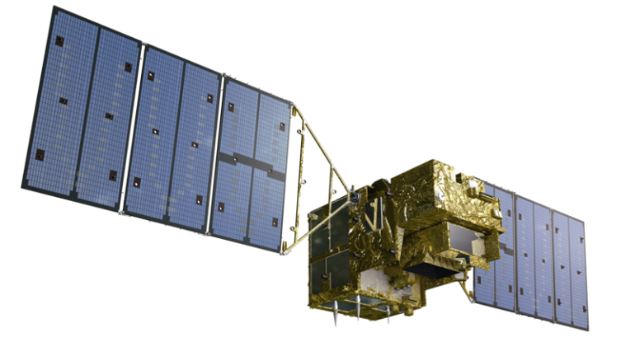
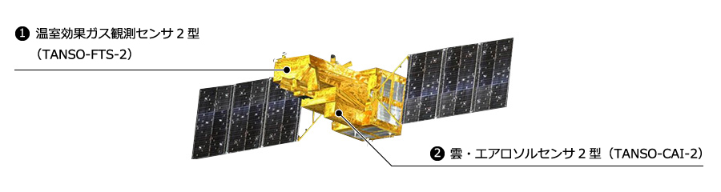
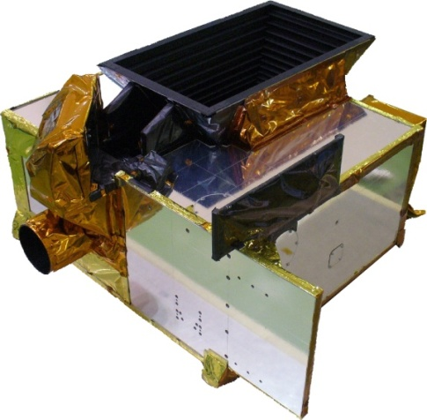
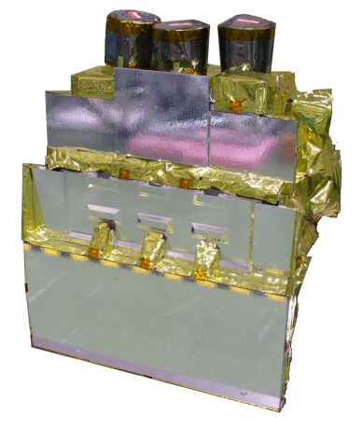
GOSAT and GOSAT-2 satellites
GOSAT (2009~)
GOSAT-2 (2018~)
FTS-2
CAI-2
FTS-2
O2A(0.76μm)
WCO2,CH4(1.6μm)
SCO2, CO (2μm)
2 TIR bands (5-15μm)
High spectral resolution 0.2cm⁻¹
Enhanced pointing mechanisms
FTS
O2A(0.76μm)
WCO2,CH4(1.6μm)
SCO2(2μm)
TIR (5-15μm)
High spectral resolution 0.2cm⁻¹
Pointing mechanism
CAI
UV-SWIR
4 bands linear array
Nadir view
CAI-2
UV-SWIR
10 bands linear array
5 forward view bands, 5 backward view bands

Slide 3
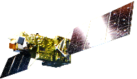
GOSAT and GOSAT-2 status
Long term (16-year Jan. 2024)
calibrated and validated dataset
Satellite Condition
Enough fuel to operate for at least another 10-year
All four batteries are healthy
Since Jan. 2024, the monthly-used back-side solar diffuser has not been available due to rotation anomaly, but the front-side is in normal operation every orbit.
Level 1 V300.300 (released in March 2023)
Best-estimate radiance spectra using TSIS-HSRS and long-term vicarious-calibration data.
Intense target observations using
flexible and wide angle pointing
Oct30,2023, 5-year operation review.
The operation has been extended.
Feb. 2021, anomaly occurred in the solar diffuser plate mechanism. The solar irradiance calibration has been suspended since then, Lunar calibration is normal.
Level 1 V220.221 (released in March 2024)
TIR calibration updated in large-AT angles (V220.220)
SWIR radiometric degradation update (V220.221)
IGM-domain correction (DC fluctuation, low-freq.) (Next ver.)
3

Slide 4
Calibration strategy
 | GOSAT (2009~) | GOSAT-2 (2018~)
Relative radiance degradation
Solar diffuser | Backside diffuser is only exposed Once / month (2009-2023) Suspended due to the rotation trouble Frontside diffuser operation Once /orbit | Diffuser is only exposed a few minutes Once /orbit (2018-Feb2021) Suspended due to the shutter trouble
Lunar calibration | 1-2 times / year (2009-2014) Suspended due to the solar paddles rotation stop | 2 times / month Both before and after full moon
Absolute radiance
Vicarious Calibration | Field campaign at Railroad Valley (RRV) playa, Nevada conducted every summer with OCO team | Same as the GOSAT
Inter-comparison
Simultaneous observation with other GHG sensors | Simultaneous observations At RRV target At orbit crossing | Same as the GOSAT
4
Notes:
Relative radiance degradation in time series is estimated by onboard calibration such as solar diffuser and lunar calibration.
GOSAT radiance degradation is estimated from solar diffuser. The backside diffuser is only exposed to solar light once per month.
Lunar calibration has been suspended since 2014 due to the satellite solar paddles rotation stop.
GOSAT-2 radiance degradation is estimated from lunar calibration, which is operated twice per month both before and after full moon.
Solar diffuser calibration has been suspended since Feb2021 due to the diffuser shutter trouble.
Absolute radiance is evaluated from vicarious calibration, which is conduced at railroad valley every summer with OCO team since 2009 over 15 years.
Inter-comparison between GHG sensors is effective to confirm the radiometric accuracy.
Simultaneous observation at RRV target observation, long-term coincidence at orbit crossing.

Slide 5
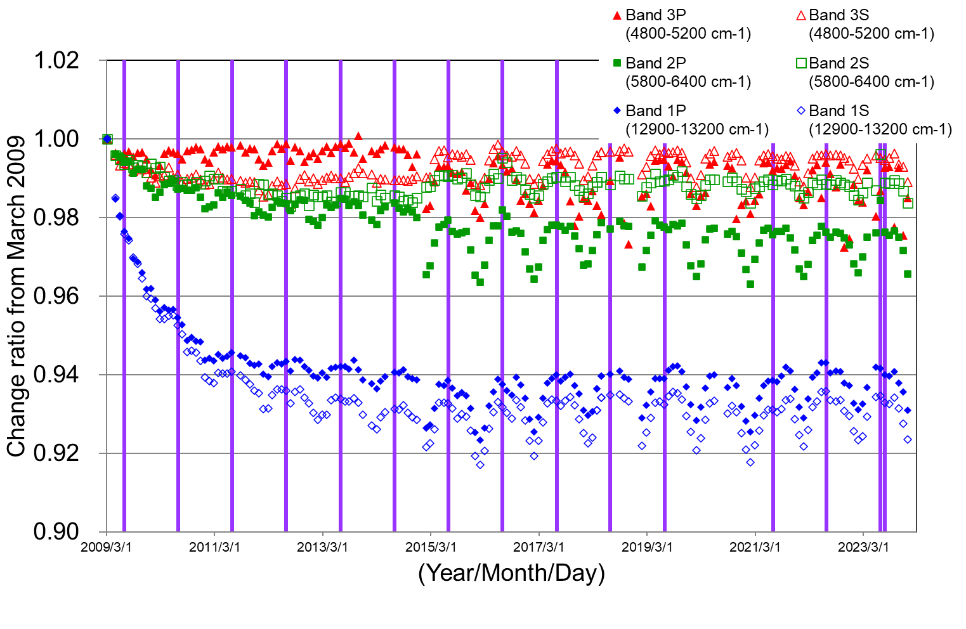
GOSAT solar diffuser calibration as on-orbit main calibrator
GOSAT backside diffuser is exposed only once a month
Over 15 years
High-spectral resolution
Collaborated with TSIS team
The GOSAT radiance degradation curve was estimated from solar diffuser calibration.
This curve will be scaled to the Railroad Valley Vicarious Calibration results over 15 years.
5
Notes:
GOSAT solar diffuser calibration is conducted as on-orbit main calibrator for relative radiometric degradation in time series.
GOSAT backside diffuser is exposed only once a month. We have over 15 years solar data

Slide 6
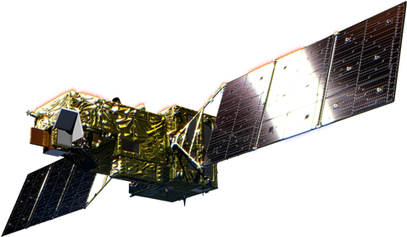
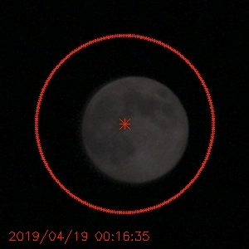
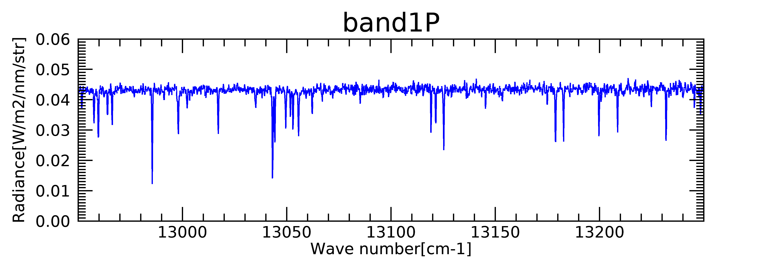
GOSAT-2/FTS-2 lunar calibration as on-orbit main calibrator
GOSAT-2 Lunar Calibrations are operated in two days around full moon (phase angle ~ ±7-8 [deg]).
■day1 : Waxing gibbous moon
Keep looking at the moon, integrate for 4 [sec] per sounding and observes 10-30 soundings.
Used for the evaluation of radiometric degradation.
FTS-2 modulation efficiency depends on orbital ambient temperature, so, we only used the timing② data.
Moon
Moon
integrate 4 [sec] each sounding
FTS-2(band1)
: timing①
■day2 : Waning gibbous moon
FTS-2 footprint
0.77[μm]
0.75[μm]
Moon
The advantage of FTS-2 lunar calibration data
  High-frequency observation (almost every month)
  Long-term dataset (over 5 years)
  phase angle around ±7-8[deg], less lunar polarization (Coyne and Pellicori, 1969, Toledano et al., 2023)
FTS-2(band1~3)
: timing③
FTS-2(band1~3)
: timing②
6
Notes:
When the FTS-2 keeps looking at the moon

Slide 7
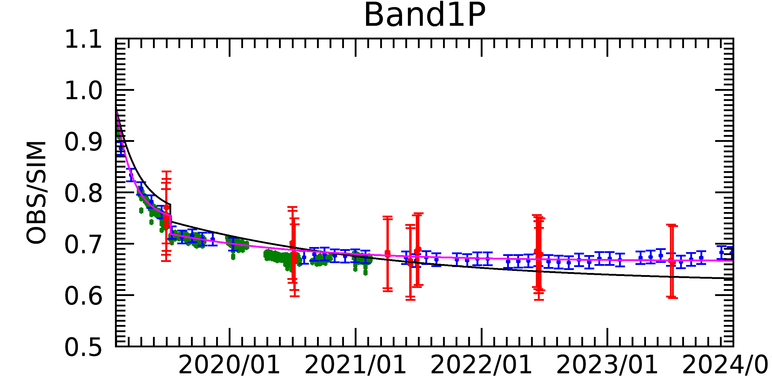
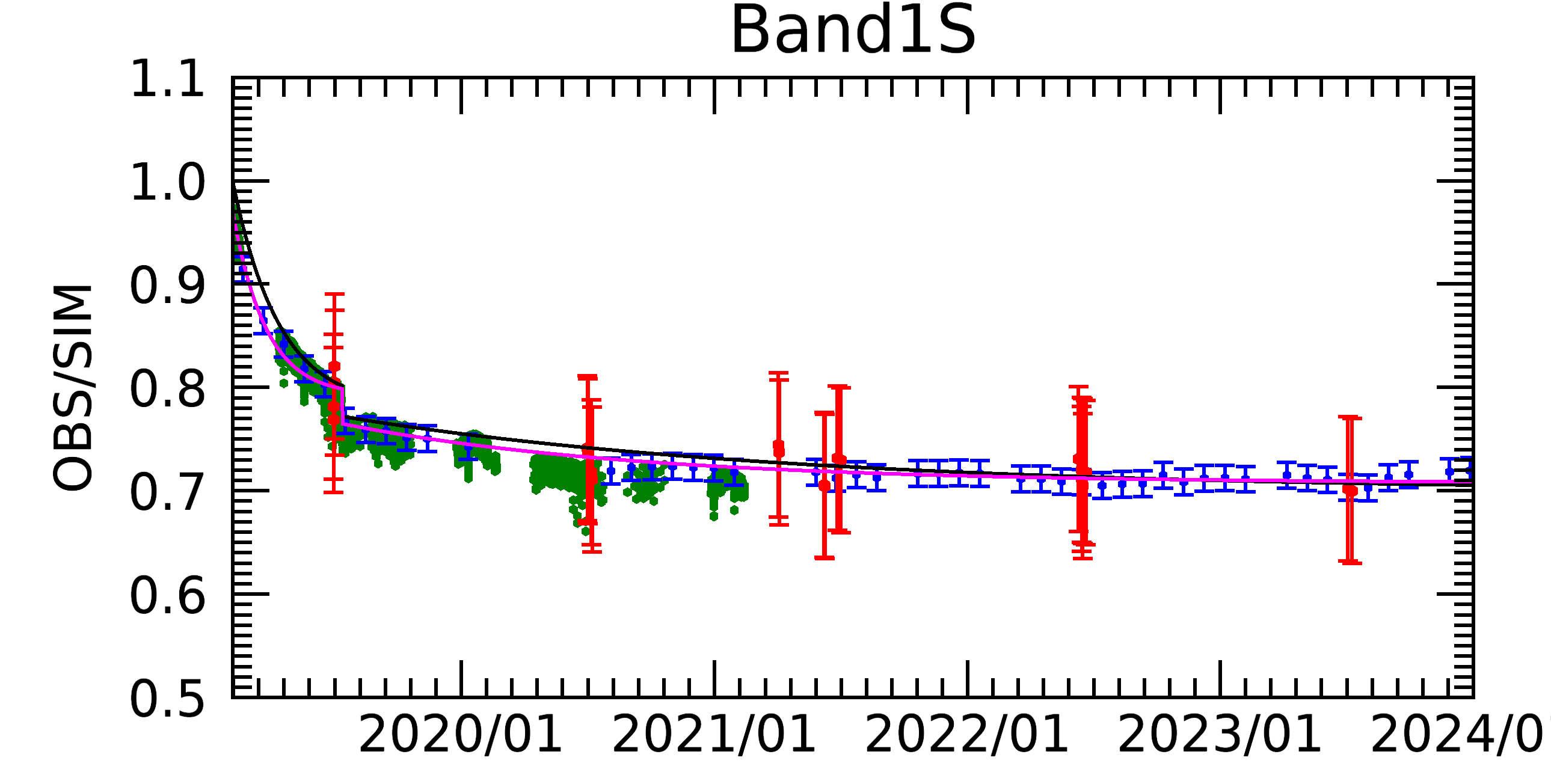
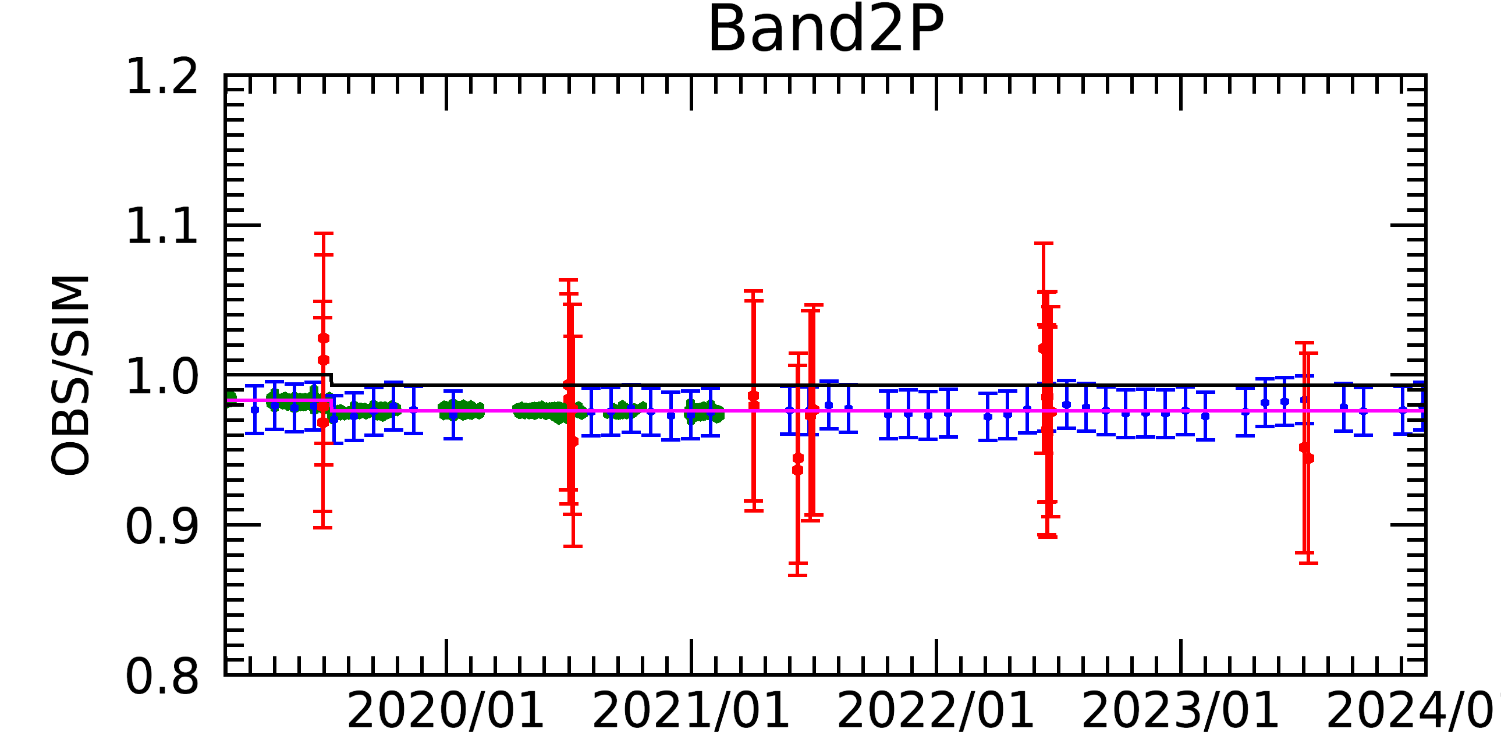
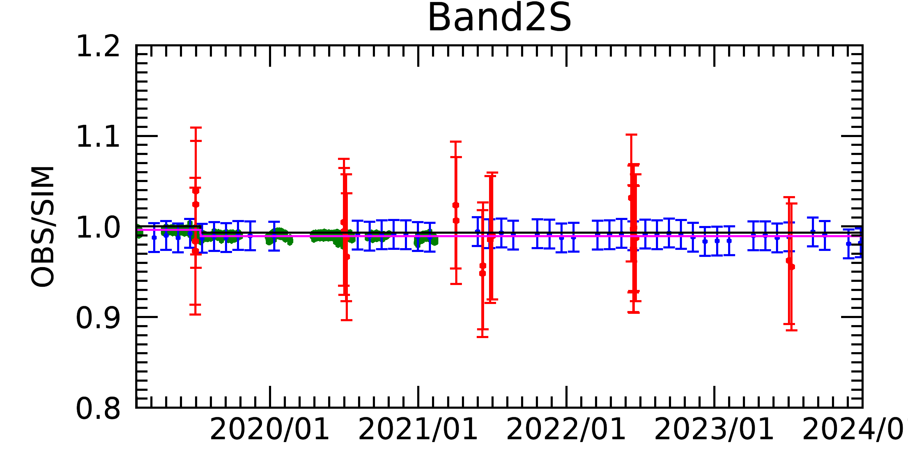
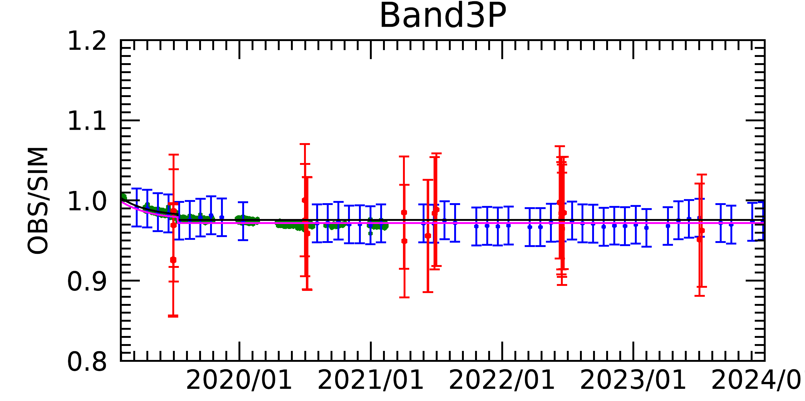
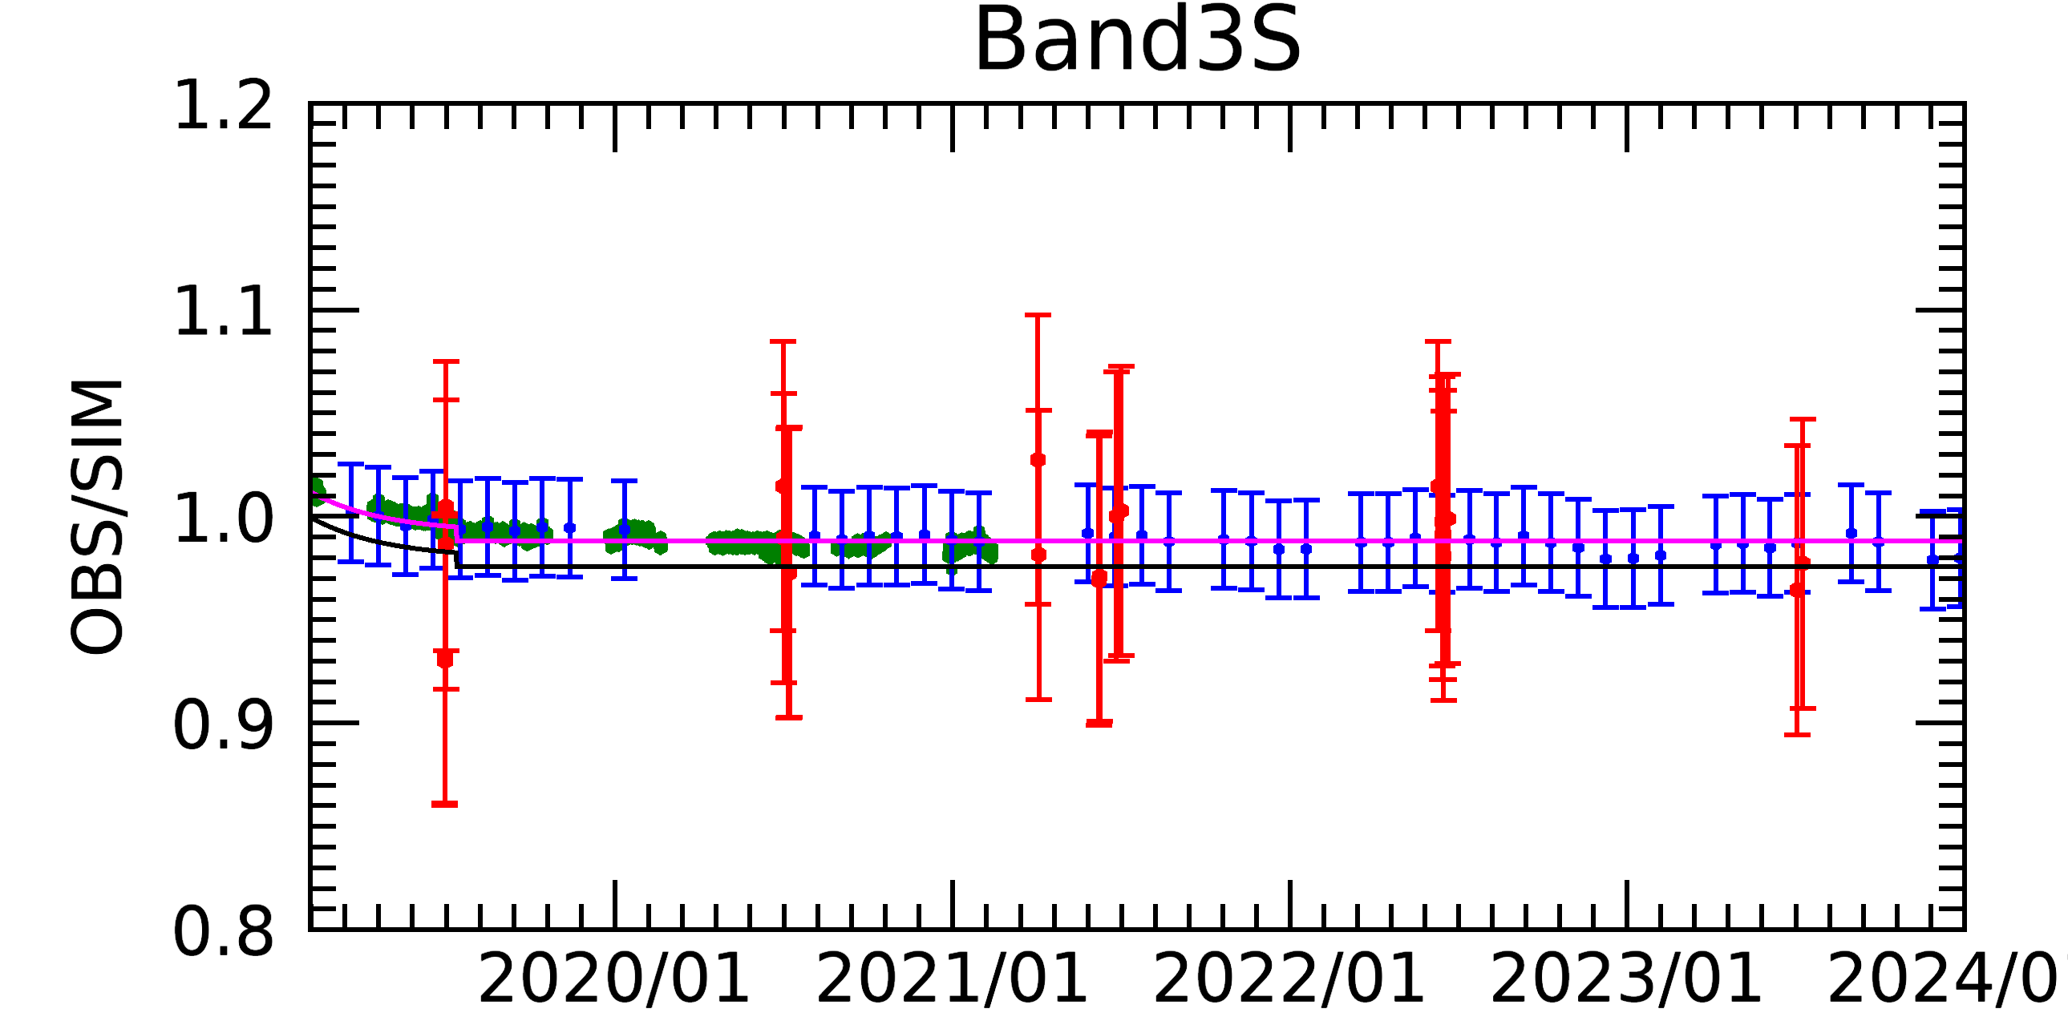
GOSAT/FTS-2 radiance degradation
ーRDF2024 (L1B V220.221) New
ーRDF2021 (L1B V220.220) Old
・Solar diffuser calibration
・Lunar calibration
・RRV vicarious calibration
The GOSAT-2 radiance degradation curve was estimated from solar diffuser calibration before.
New radiance degradation curve was estimated from 5-year lunar calibration.
This curve was scaled to the Railroad Valley vicarious calibration results.
Notes:
Old RDF (Black) was estimated from Solar diffuser calibration in 2020
New RDF (Pink) was estimated from 5-year Lunar calibration for degradation curve and 5-year Railroad Valley Vicarious calibtarion (Red) for absolute scaling.
Especially B1P degradation is improved 5% in 2024.

Slide 8

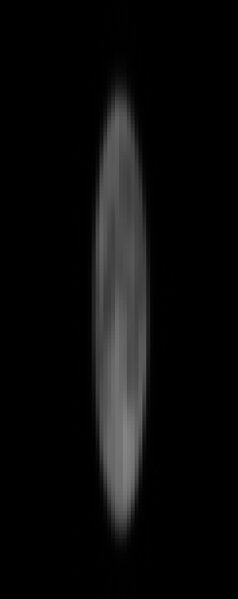
GOSAT-2/CAI-2 lunar calibration
GOSAT-2 Lunar Calibrations are operated in two days around full moon (phase angle ~ ±7-8 [deg]).
■day1 : Waxing gibbous moon
■CAI-2 Lunar Calibration
CAI-2 CT scan
Moon
●Cross Track(CT) Scan in day1 path
・Scanning in the CT direction only once.
・Used for the evaluation of pixel-to-pixel sensitivity difference.
●Along Track(AT) Scan in day2 path
・Scanning in the AT direction 4 times
・Used for the evaluation of radiometric degradation.
Moon
Array detectors
Moon
■day2 : Waning gibbous moon
CAI-2 AT scan
Moon
The advantage of CAI-2 lunar calibration data
  High-frequency observation (almost every month)
  Long-term dataset (over 5 years)
Array detectors
~12 pixels
8

Slide 9
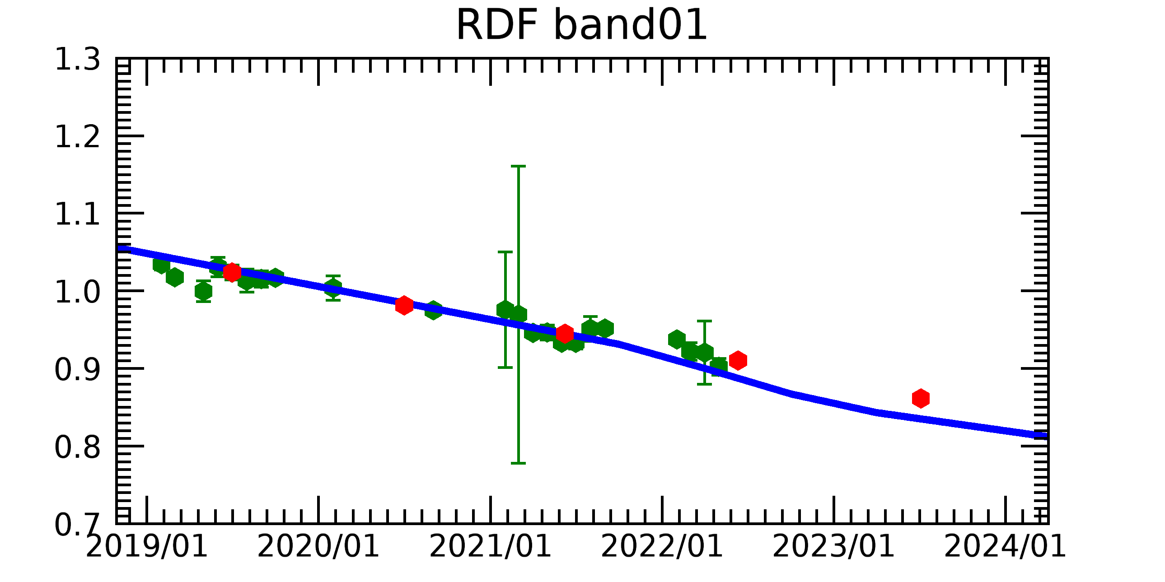
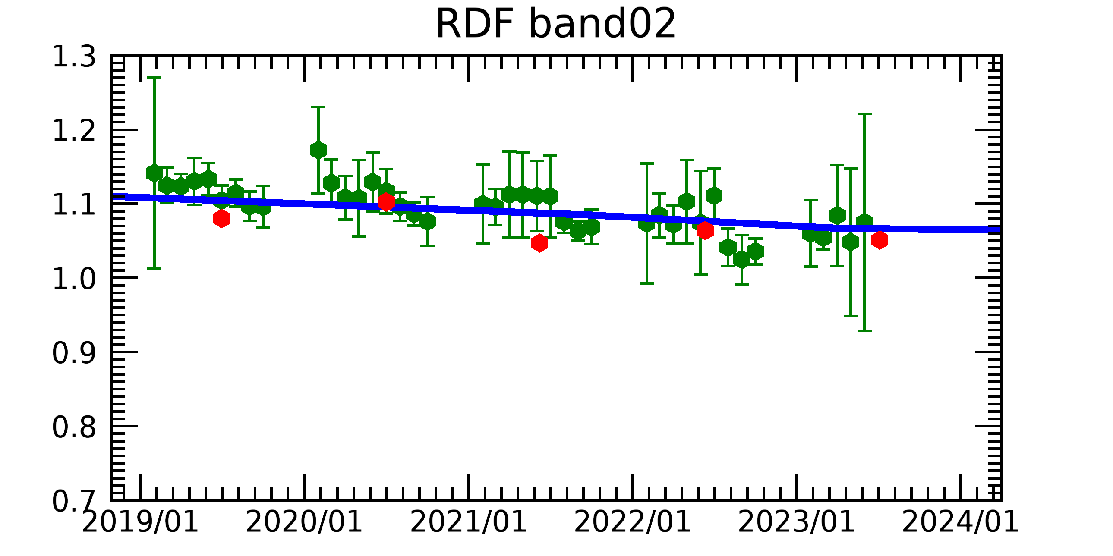
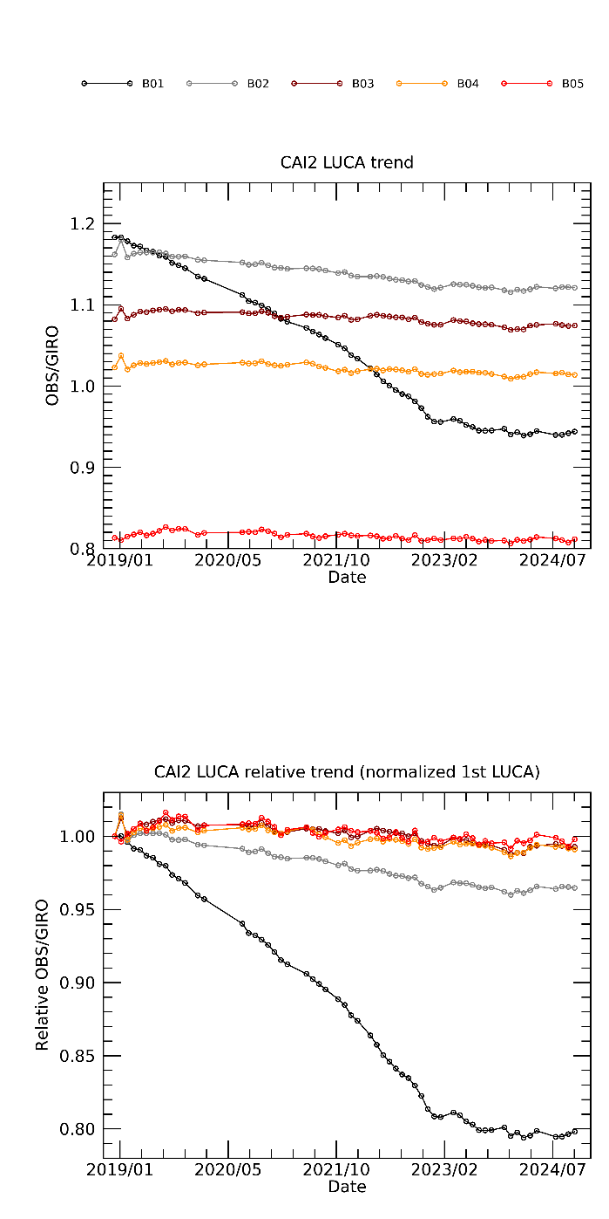
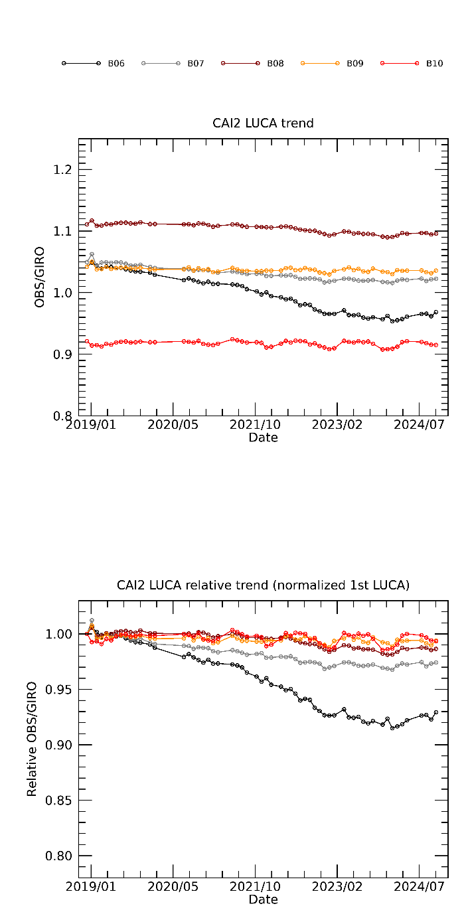
GOSAT-2/CAI-2 radiance degradation
■Radiance degradation factor combined with Lunar calibration and Vicarious calibrations
B01(0.339μm)
B02(0.441μm)
  Vicarious calibration results that evaluated at the Railroad Valley, USA
  Cross-calibration results using other satellite data (ex. VIIRS)
  Degradation curve estimated from Lunar Calibration results
OBS/SIM
OBS/SIM
■Radiance degradation curve estimated from Lunar calibration
The shorter wavelength bands have larger degradation.
After Jan. 2023, the degradation curve has changed and became slowly.
The changing looks the same between forward-view and backward-view bands. B1/B6 use the common before-optics as well as B2/B7.
B02(0.441μm)
B07(0.546μm)
B06(0.377μm)
B01(0.339μm)
B01-B05(Forward-view)
B06-B10(Backward-view)
9
Notes:
Radiacen degradation curve is estimated from lunar calibration. The shorter wavelength bands B1, B2, B6, B7 have larger degradation/
Radiance degradation factor is combined with lunar calibraion and Vicarious calibration at RRV and Cross-calibration using other satellite data.

Slide 10
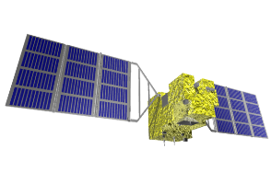
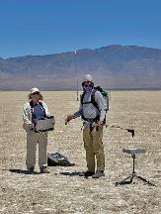
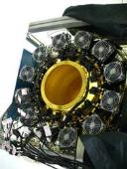

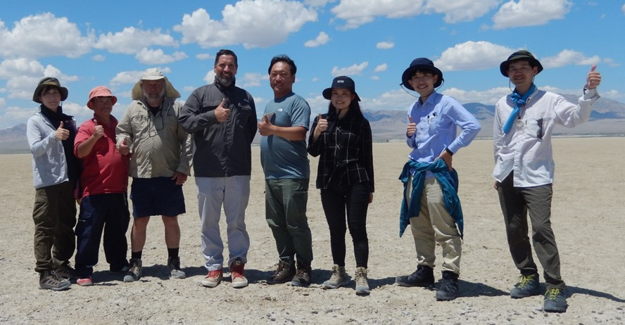
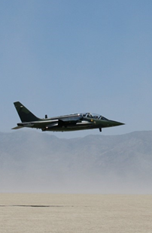
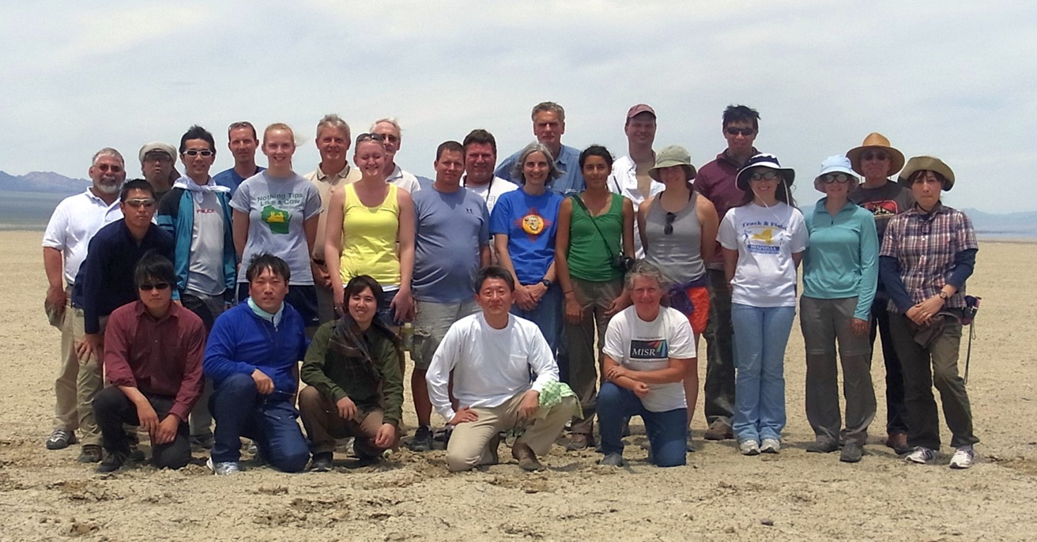
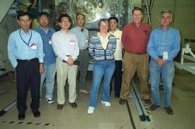
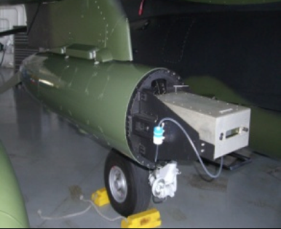
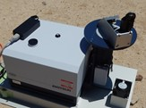
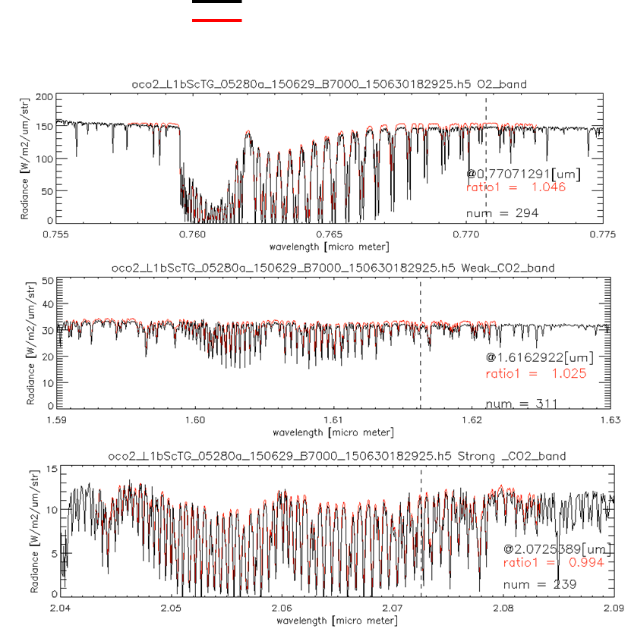
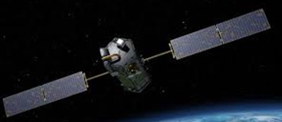




International collaboration for GHG sensors calibration
2008 09 10 11 12 13 14 15 16 17 18 19 20 21 22 23 24
Radiometric calibration
Prelaunch
X-CAL
Annual Vicarious Calibration at the desert playa in Nevada
CO₂ & CH₄ profile
In situ CO₂ and CH₄ on AJAX
XCO₂ & XCH₄
Column with EM-27 FTS
GOSAT OCO-2
Coincident Target
Calibrated GOSAT and OCO-2 radiance spectra agrees within 5% for all bands.
10
Notes:
We started the OCO-GOSAT collaboration in pre-launch radiometric cross-calibration of the laboratory standard lamp integrating sphere.
After the GOSAT launch, we conducted the annual vicarious calibration campaign at Railroad Nevada for radiometric calibration on orbit.
NASA AMES team take CO2 CH4 profile by AJAX airplane experiment.
JAXA deploys the portable FTS for total column averaged CO2 and CH4.
After the OCO-2 launch 2014, we have coincident target measuemrents RRV, and then TROPOMI 2017, GOSAT-2 2018, OCO-3 2019 joined.
GHG is strongly related to the air pollution such as NO2, which is originated from the same combustion process of industry activity, transportation.
We cover the UV-VIS measurement. TEMPO the US geostationary air pollution mission have joined the RRV campaign by making special target 2024.

Slide 11
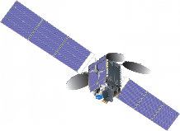
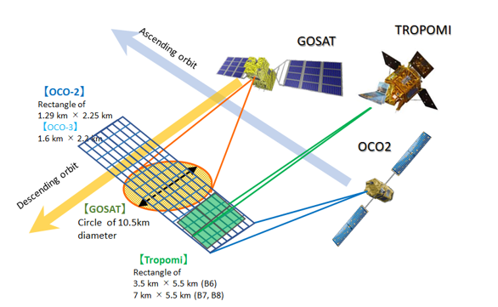
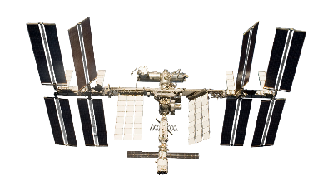
Railroad Valley target by 5 GHG & AQ sensors
GOSAT-2
TEMPO
RRV 2024 Summer Campaign Schedule
(91degW, EQ)
144degVAz, 51degVZA from SE
Date | DoW | OCO-2 path | GOSAT path | GOSAT-2 path | TROPOMI InstZA [deg]
12-Jun-24 | Wed |  |  | 74 | 28.0 | RRV
13-Jun-24 | Thu |  | 36 |  | 53.6 | RRV
14-Jun-24 | Fri | 138 | 37 |  | 8.1 | RRV
15-Jun-24 | Sat |  |  |  | 6.9 | RRV
16-Jun-24 | Sun | 136 | 36 | 72 | 46.3 | RRV
17-Jun-24 | Mon |  | 37 | 73 | 31.7 | RRV
18-Jun-24 | Tue |  |  | 74 | 46.6 | RRV
Good conditions for all sensors come every 48 days.
 | Nadir footprint size
GOSAT | Circle of 10.5km diameter
GOSAT-2 | Circle of 9.6km diameter
OCO-2 | Rectangle of 1.3 km * 2.3 km
OCO-3 | Rectangle of 1.6 km * 2.2 km
TROPOMI | Rectangle of 3.5 km * 5.5 km (B6) 7 km * 5.5 km (B7, B8)
OCO-3
11
Notes:
GOSAT, GOSAT-2, OCO-2, TROPOMI are 1pm afternoon orbit.

Slide 12
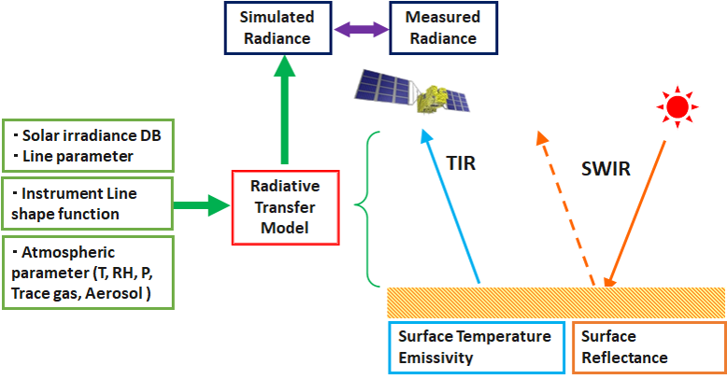
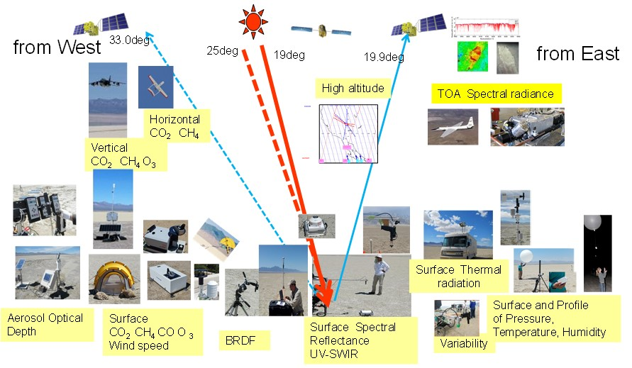
RRV vicarious calibration for GHG and AQ sensors
Key parameters
(1) Surface reflectance inhomogeneity correction
(2) Surface BRF correction
(3) Solar database
(4) Atmospheric parameter
We will calculate all sensors for validating radiometric calibration accuracy by the same target.
12

Slide 13
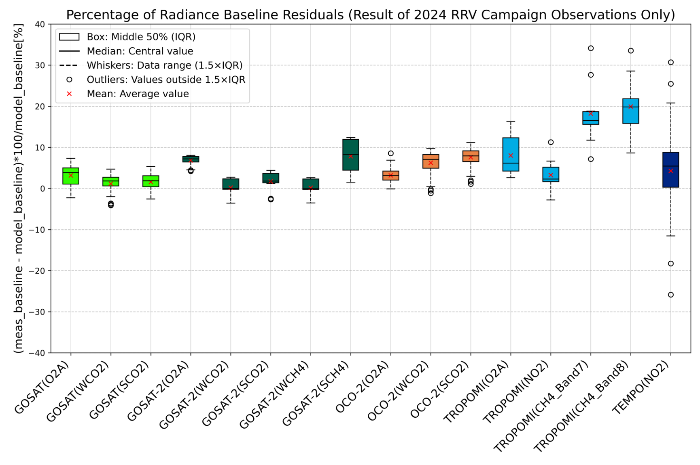
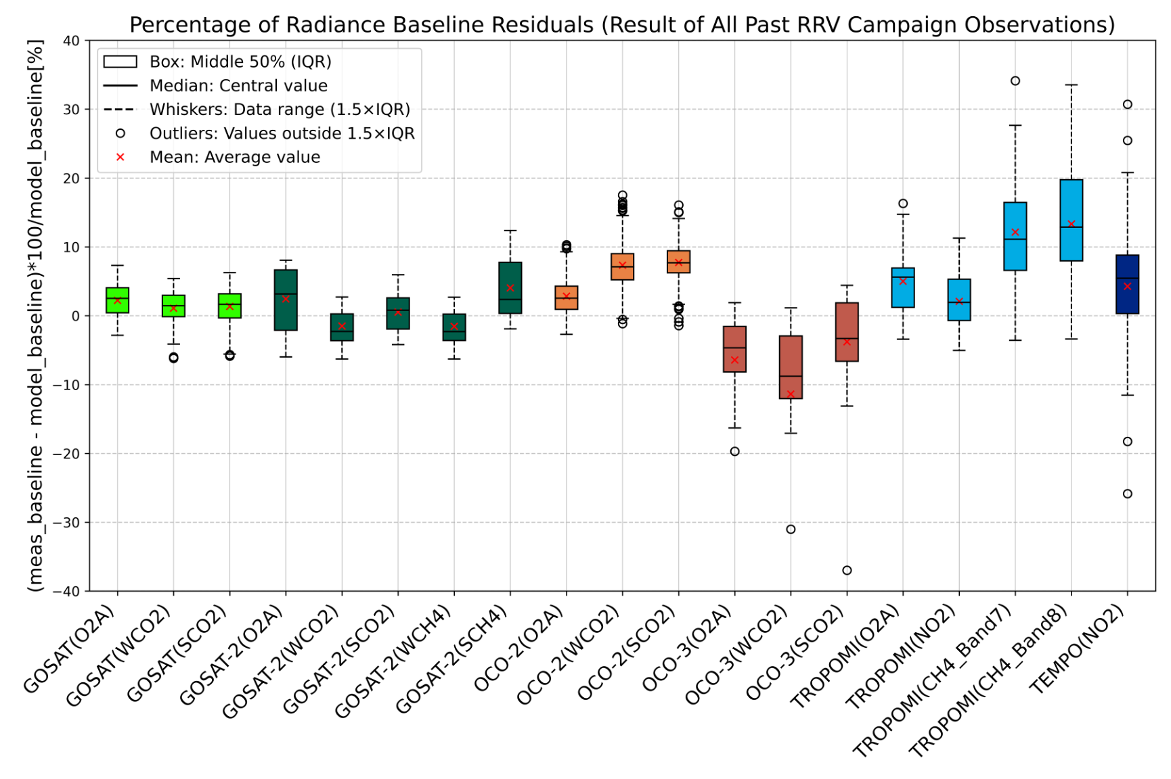






Multiple sensors VCAL results for RRV2024 and averaged all RRV campaigns (Latest result)
+/-5% variation
Evaluation periods:
GOSAT: 2019 – 2024 (except.2020)
OCO-2: 2019 – 2024 (except.2020)
GOSAT-2: 2019 - 2024
TROPOMI: 2021 -2024
OCO-3: 2021
TEMPO: 2024
Evaluation periods: Only use 2024
Large off-nadir conditions TROPOMI, TEMPO are challenging.
To reduce errors, good data qualifications are needed.
Ishida et al., AGU24

Slide 14
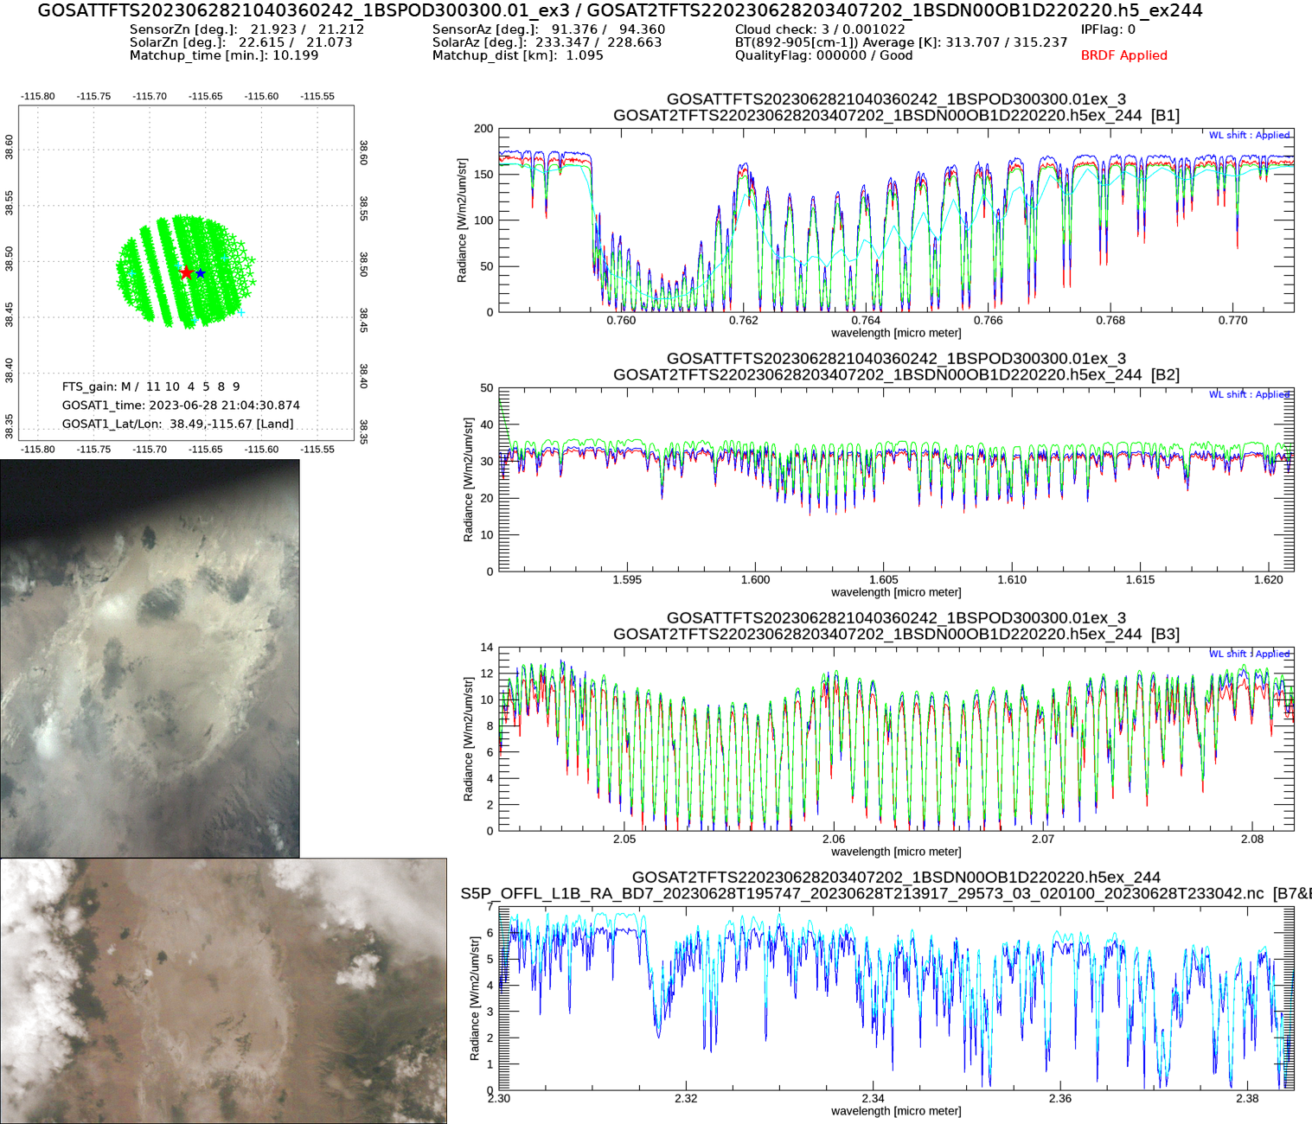
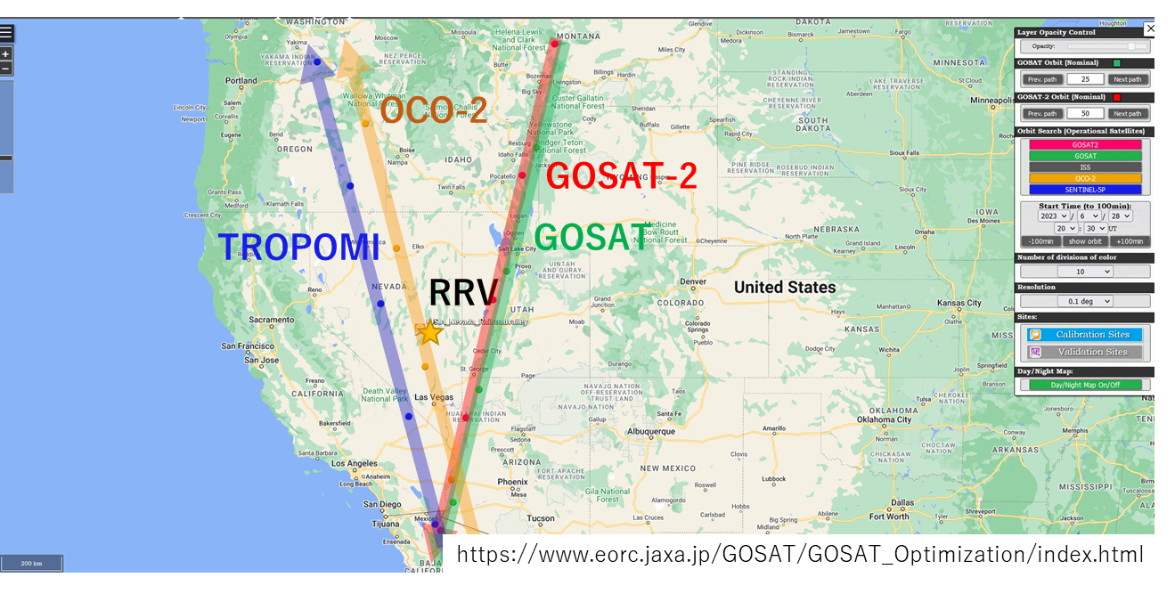
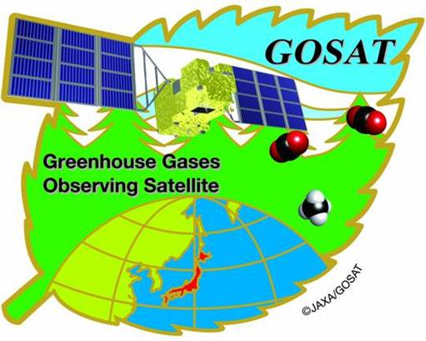


Intercomparison of GHG sensors simultaneous measurements at RRV
BRDF applied
2023/06/28
GOSAT (21:04) V300
GOSAT-2 (20:54) V200
OCO-2 (20:53) B11r
OCO-3
TROPOMI(20:51)
All sensors SatZA=20-23deg
14
Notes:
When the GHG sensors target the RRV, We can compare the radiance directly.
June 23, 2023 The GOSAT GOSAT-2 OCO-2 and TROPOMI observed the RRV around 21UTC with Satellite Zenith around 20-23deg.
After the BRDF correction, the four sensors observed radiance

Slide 15
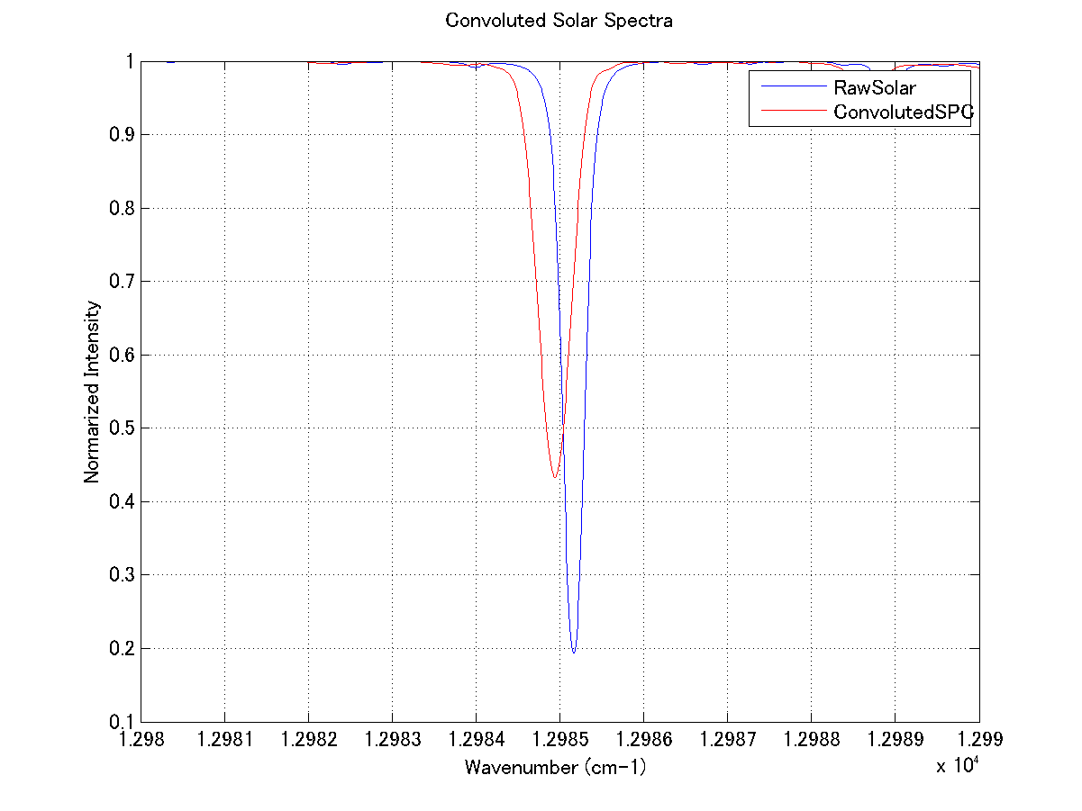
Long-term observation of High-resolved solar spectra (TSIS collaboration)
Is there any change of Solar Fraunhofer lines (FL) from GOSAT long-term solar observation spectra?
GOSAT can provide non-atmospheric contaminated spectra. If we found any change signals on GOSAT solar observation spectra, we hope it will contribute to understand the solar physics.
Variation of width
Variation of depth
Step1: The modeled Solar spectra (provided by MPI) will be convoluted with the best-estimated GOSAT ILS
Step2: Check the impact on FL with typical solar activity in modeled spectra
Step3: Compare between modeled spectra and GOSAT observation, especially for depth and width of FL
Collaborated with CU, MPI from TSIS team
15

Slide 16
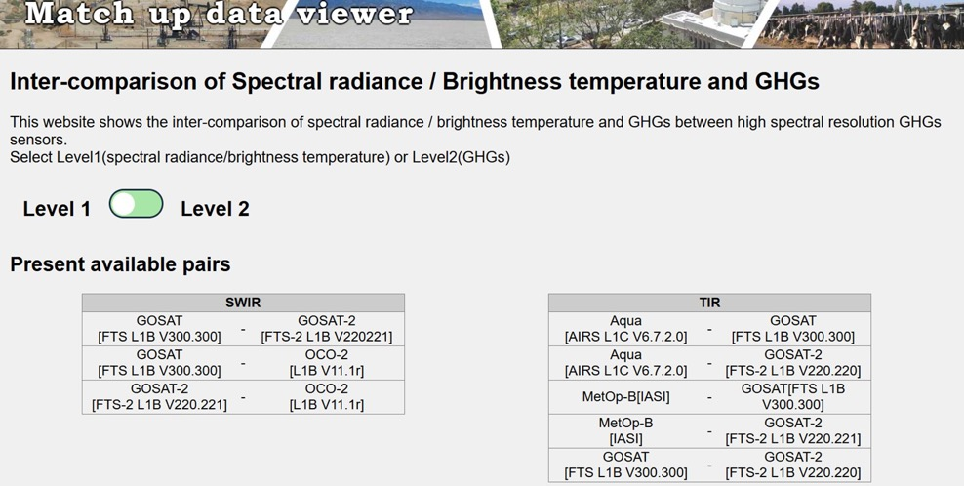
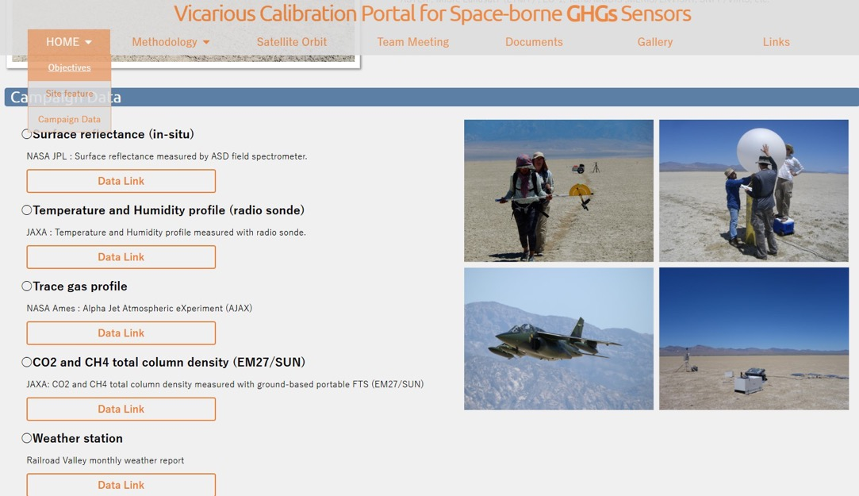
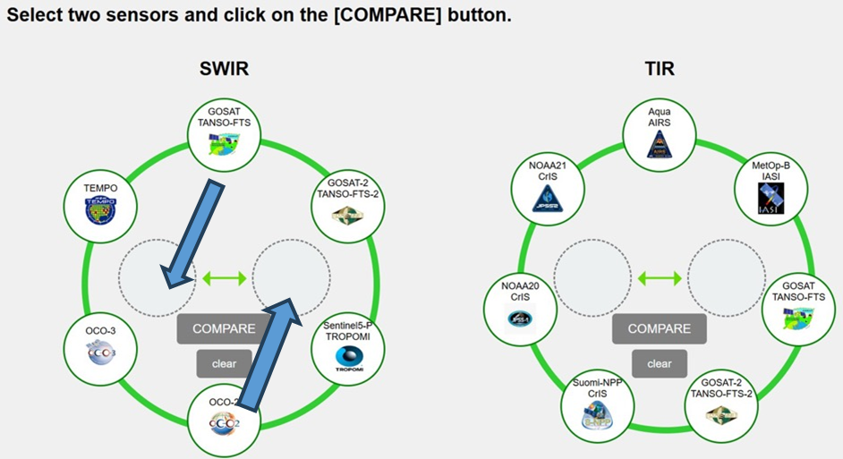
Summary
VCAL portal site update
Match-up data viewer newly release!
Coincident match-ups
For SWIR
(1) Calibrated radiance
XCO2, XCH4, SIF, AOT
For TIR
(1) Calibrated radiance
(2) Brightness temperature
Updated
New
https://www.eorc.jaxa.jp/GOSAT/GHGs_Vical/index.html
https://www.eorc.jaxa.jp/GOSAT/Matchup_forCal/top_matchup_viewer.html
The Railroad Valley field data are available from VCAL portal site.
VCAL team meeting is held every 3-4 months. Next meeting: 12-13UTC, Friday, May 9, 2025.
RRV2025 summer (May30-Jun05): Good for OCO-3 target, TEMPO and hopefully MethaneSAT
RRV2025 fall plan: Good for OCO-3 target, hopefully GOSAT-GW in the initial phase
16

