Slide 1
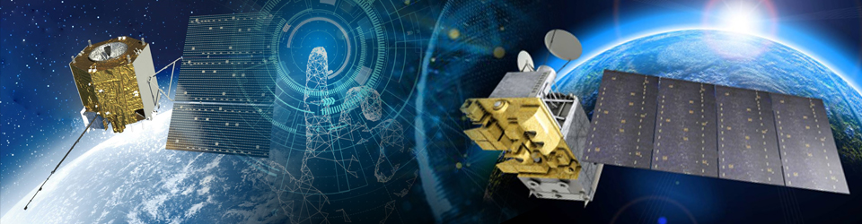
In-orbit Calibration and Performance Analysis for OMS-Limb
Li Yuan¹, Li Zhanfeng², Liu Song¹, Lin Guanyu², Wang Jiachen¹,
Zhao Yu³, Jiang Ruonan³, Li Haochen², Zhang Xiaoyun³, Zheng Bingnan³
2025 GSICS Annual Meeting, Changchun, China, 17 to 21 March
Notes:
Hello everyone. Today I will introduce the in-orbit calibration and performance analysis of OMS Limb. The work is jointly completed by Li Yuan, Li Zhanfeng, Liu Song and other technicians.

Slide 2
Outline
1
Instrument introduction
2
In-orbit performance
3
Accuracy verification
4
Summary and Future Work
Notes:
My report will cover four parts: instrument introduction, in-orbit performance, accuracy verification and future plans.

Slide 3
Instrument: Background & Specifications
Background：The Ozone Monitoring Suite-limb (OMS-L) is CMA's payload for atmospheric detection. It is manufactured by CIOMP. OMS-L launched on August 3, 2023, and entered autonomous operation on September 19, 2023.
Applications：It can observe multiple gases (O₃, NO₂, SO₂, BrO, HCHO, and OClO ), providing products for climate research.
Features：With unique side-viewing and scanning features, it offers high-vertical-resolution data.
Specifications
SN | Parameter Name | Specification Requirements
1 | Spectral Range | 290-500nm
2 | Spectral Resolution | 0.6nm@290-500nm
3 | Spectral Sampling Rate | Continuous sampling pixel by pixel
4 | Wavelength Calibration Accuracy | 0.01nm
5 | Scanning Mode | Along the vertical height direction of the Earth's limb
6 | Scanning Field of View Angle | Better than ±1.8° (vertical, direction of the Earth's limb)
7 | The Pointing Accuracy of The Scanning Mirror | Better than ±0.01°
8 | Spatial Resolution | Better than 3km(vertical, direction of the Earth's limb)
9 | Instantaneous Field of View | 2.3° (horizontal)×0.045 ° (vertical)
10 | Dynamic Range | 10⁵
11 | Relative Radiometric Calibration Accuracy | Better than 2%
12 | Calibration Accuracy of Diffuse Reflector | Better than 3%
13 | Absolute Radiometric Calibration Accuracy | Better than 3%
14 | Signal to Noise Ratio | >300@0.1μw/cm²⋅sr⋅nm(radiance)
15 | Spectral Stray Light | 10⁻⁵
OMS-L can achieve continuous spectral limb detection in the range of 290nm-500nm, at an altitude of 0-100km, with a spectral resolution of 0.6nm.
2025 GSICS Annual Meeting, Changchun, China, 17 to 21 March
Notes:
The OMS-L, a limb-viewing ultraviolet high-resolution ozone detector, is China's payload for atmospheric detection. Launched in 2023, it entered autonomous operation in September. It can observe multiple gases, providing products for climate research. With unique side-viewing and scanning features, it offers high-vertical-resolution data.

Slide 4
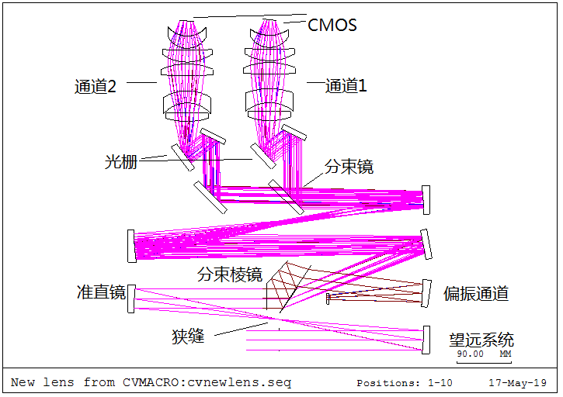
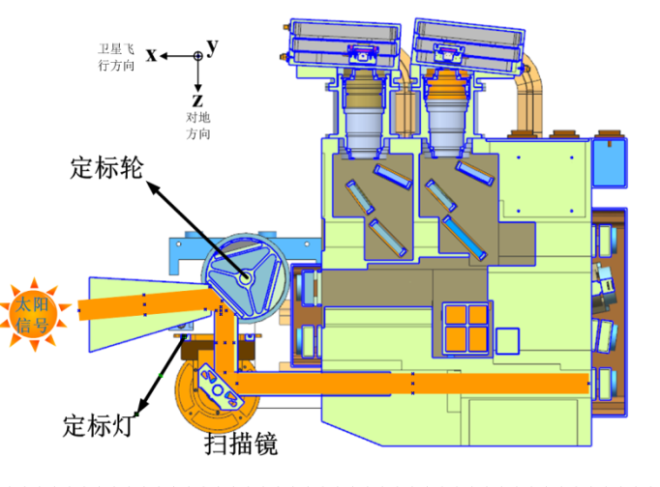
Detection and Calibration Optical Design
Detection Optical Design ：The telescope system employs an off-axis parabolic mirror. A prism and grating work together for dispersion. And a cooled 2D CMOS detector forms images.
Calibration Optical Design ：
For radiometric calibration, we use the Sun with main/backup diffuser panels, and a tungsten lamp.
For spectral calibration, we use the Sun, and a mercury lamp with the main diffuser panel.
Detection Optical Design
Calibration Optical Design
Calibration Optical Path =
Detection Optical Path + Diffuser Panel
2025 GSICS Annual Meeting, Changchun, China, 17 to 21 March
Notes:
About Detection and Calibration Optical Design of OMS-L, A prism and grating work together for dispersion. For radiometric calibration, we use the Sun with main/backup diffuser panels, and a tungsten lamp. For spectral calibration, we use the Sun, and a mercury lamp with the main diffuser panel. The calibration path is completely consistent with the detection path except for an additional diffuser panel.

Slide 5
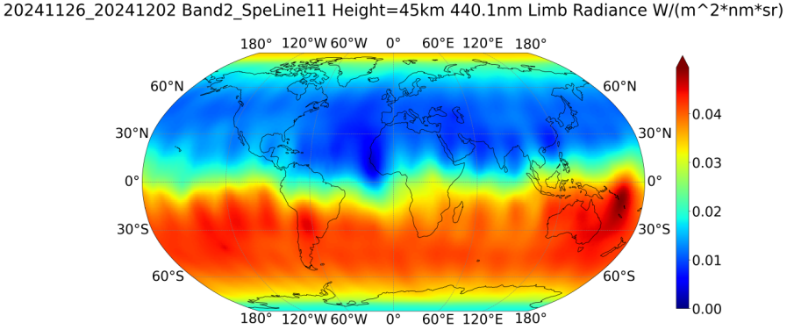
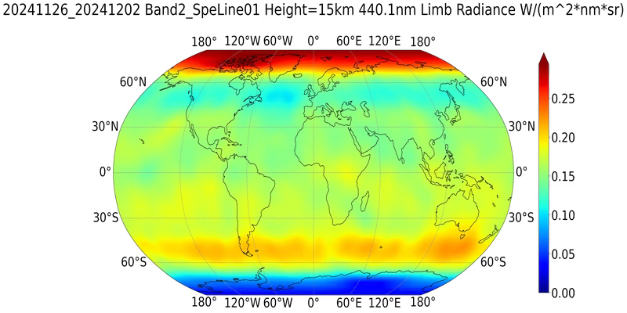
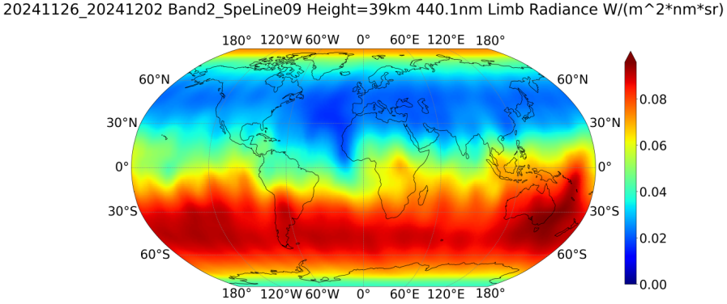
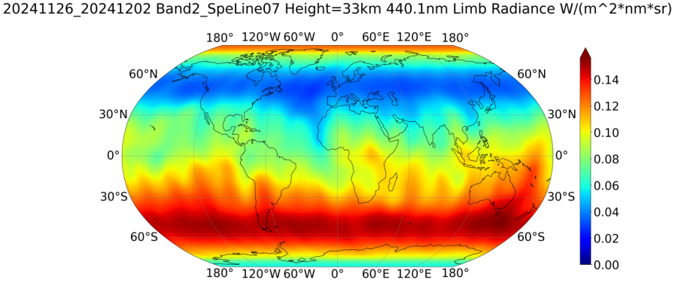
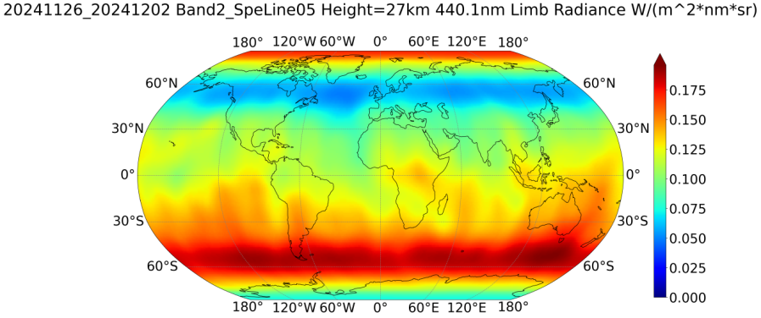
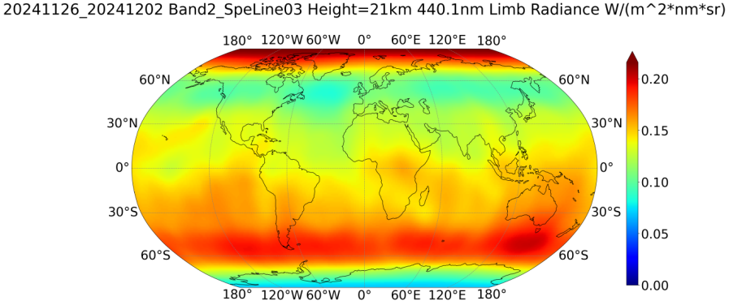
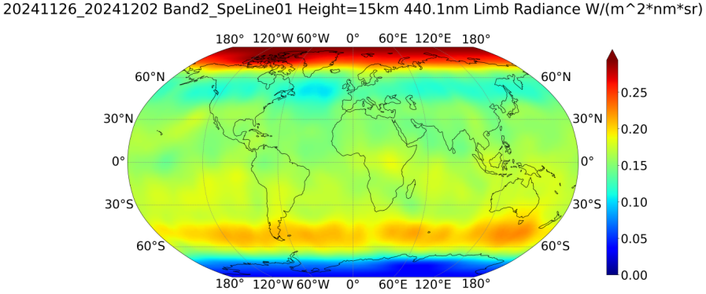
Product Specifications
OMS-L L1 products are pre-processed from level 0 data through multiple calibrations (quality inspection, geographical positioning, spectral calibration, and radiometric calibration).
Data since June 9, 2024 can be downloaded from http://data.nsmc.org.cn/DataPortal/cn/data/dataset.html
OMS-L L2 products, global ozone profiles, are still under testing.
We adjusted the tangent height layers on October 18, 2024. Since then, the vertical scope has changed from 15-60 km (15 layers) to 9-84 km (25 layers).
The observed weekly (20241126-20241202) global composite jigsaw limb-scattered radiance data(440.1nm)
2025 GSICS Annual Meeting, Changchun, China, 17 to 21 March
Notes:
The L1 products are pre-processed from level 0 data through multiple calibrations. The L2 products, global ozone profiles, are still under testing. We adjusted the tangent height layers on October 18, 2024. Since then, the vertical scope has changed from 15-60 km to 9-84 km.

Slide 6
Outline
1
Instrument introduction
2
In-orbit performance
3
Accuracy verification
4
Summary and Future Work
Notes:
Next, I will introduce the work about in-orbit performance

Slide 7
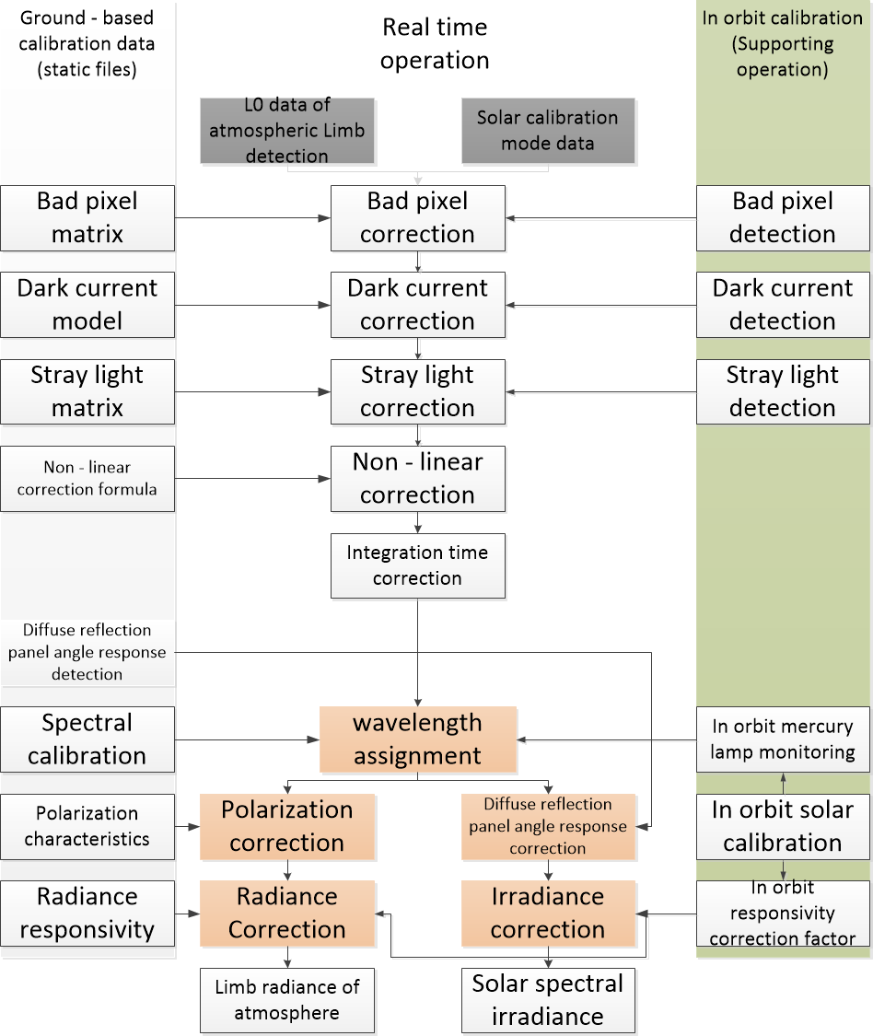
L1 Product Processing Operation
Nonlinear correction, wavelength registration, and polarization correction are key steps in the real-time operation. Supporting operations ensure data quality through spectral and radiometric calibration as well as monitoring. All these efforts aim to generate reliable L1 products.
Bad pixel correction
dark current correction
Stray light correction
Nonlinear correction
Integral time correction
Wavelength registration for each pixel
Polarization correction
Correction of angle response of diffuse reflection panel
Radiometric correction
Bad pixel detection
Dark current detection
Stray light detection
Spectral calibration and monitoring
Radiometric calibration and monitoring
Responsiveness correction
Real time operation
Supporting operation
Processing Flowchart for OMS-L L1 Product
2025 GSICS Annual Meeting, Changchun, China, 17 to 21 March
Notes:
This slide presents the processing flowchart for the OMS-L1 product. It involves ground-based calibration data, real-time, and supporting operations. Nonlinear correction, wavelength registration, and polarization correction are key steps in the real-time operation. Supporting operations ensure data quality through spectral and radiometric calibration as well as monitoring. All these efforts aim to generate reliable L1 products.

Slide 8
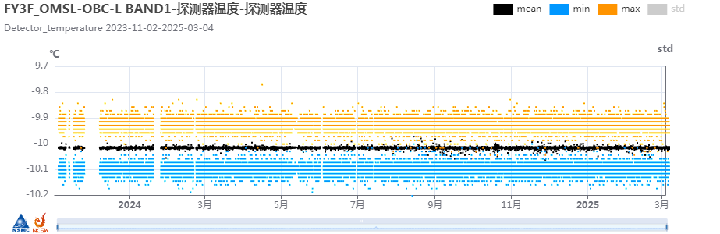
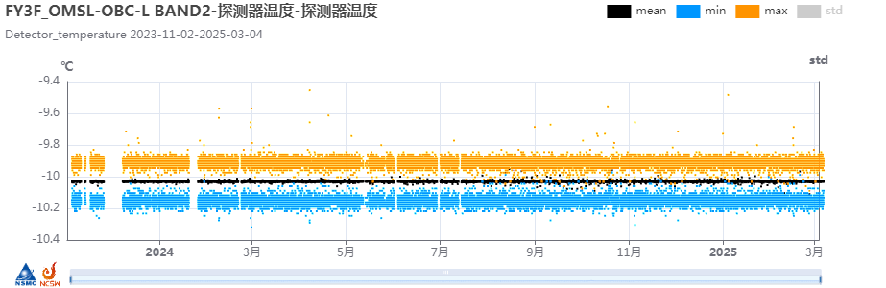
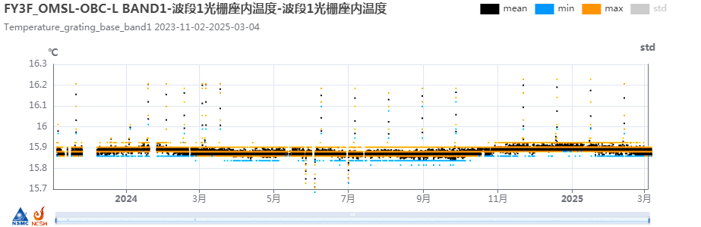
In-orbit Thermal Performance
Since being in orbit , instrument thermal stability is maintained well.
Detector temperatures in Band 1 and 2 indicate responsivity change. It’s stable within a narrow range.
the temperatures mainly ranging from -10.2°C to -9.8°C.
There is no obvious upward or downward trend, and the data is relatively concentrated.
The temperature of the grating base, related to spectral registration, also shows minimal variation, with only a few discrete points induced by tungsten calibration.
the temperature change has been basically stable between 15.8°C and 16°C, without obvious upward or downward trends.
There are some discrete points caused by tungsten lamp calibration, most of them fluctuate between 15.7°C and 16.2°C, with no obvious abnormal temperature changes.
Temperature changes of BAND1 detector
Temperature changes of BAND2 detector
Temperature changes of the grating holder of Band 1

Slide 9
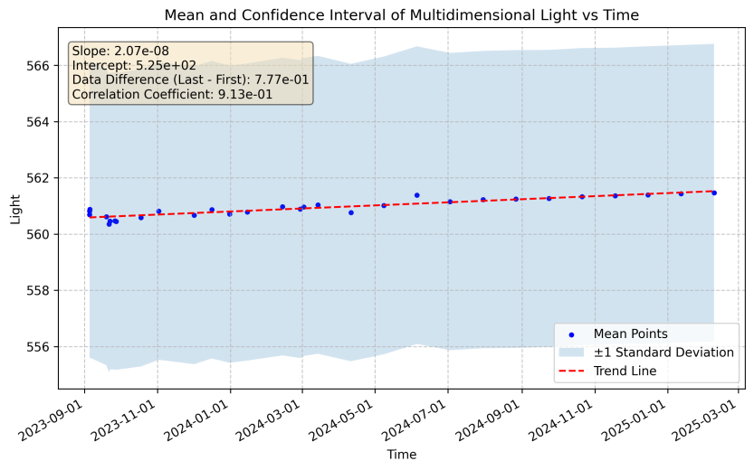
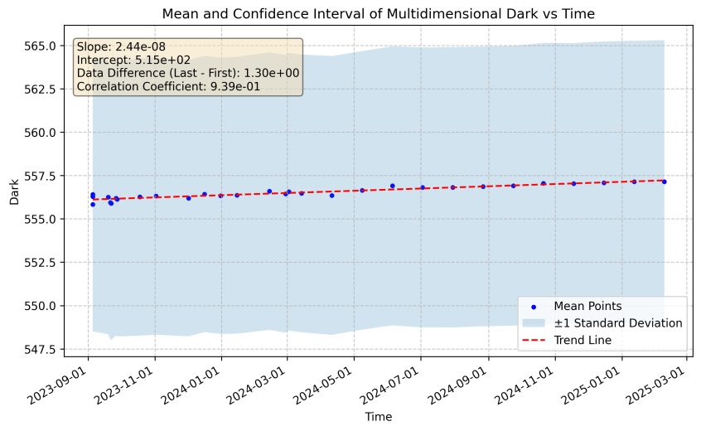
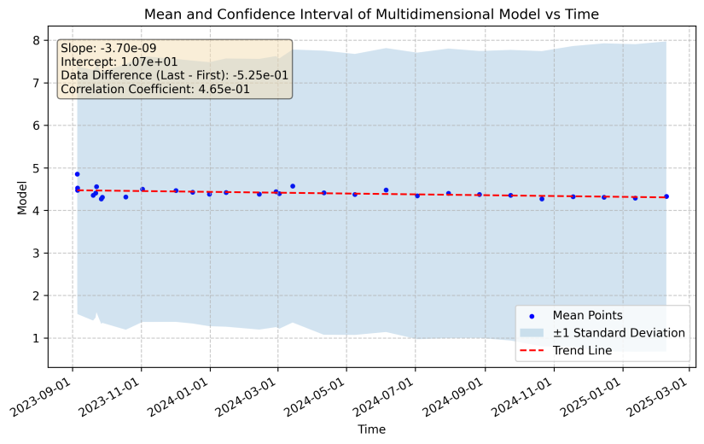
Dark Current Correction
During limb atmospheric detection, OMS-L transmits currents from illuminated and dark reference areas of the CMOS detector. The dark current of the illuminated area is estimated by combining the dark reference area current and a pre-calculated dark current model.
Regular switches of dark observations help monitor its changes. Post-launch data shows minor (0.003% of the maximum count) fluctuations, proving the detector's stable performance.
Dark current in the illuminated area with an increase of 0.77
Dark current in the dark area with an increase of 1.30
Dark current model with an decrease of 0.53
2025 GSICS Annual Meeting, Changchun, China, 17 to 21 March

Slide 10
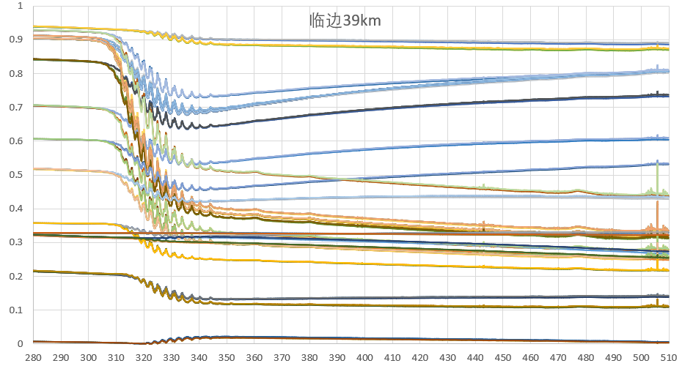
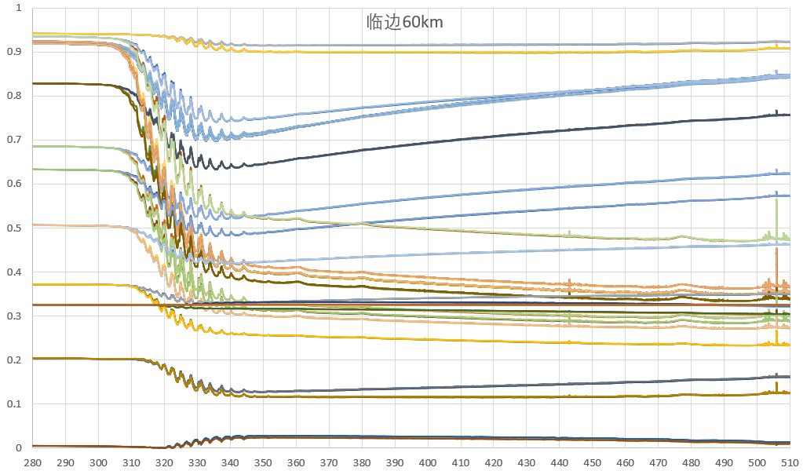
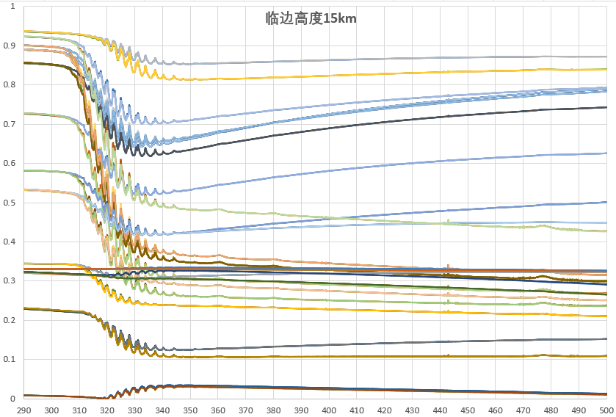
In-orbit Polarization Correction
An in-orbit radiometric calibration polarization correction model was built. Use SCIATRAN to simulate atmospheric polarization spectral variation at different tangent heights. Different algorithms for three wavelength segments were designed . Stokes elements q and u for bands 1 and 2 were calculated via polarization degree of band 3.
small value
Quadratic fitting
Atmospheric polarization degree
GDF
wavelength variation curves of limb atmospheric polarization under different lighting conditions simulated by SCIATRAN
2025 GSICS Annual Meeting, Changchun, China, 17 to 21 March

Slide 11
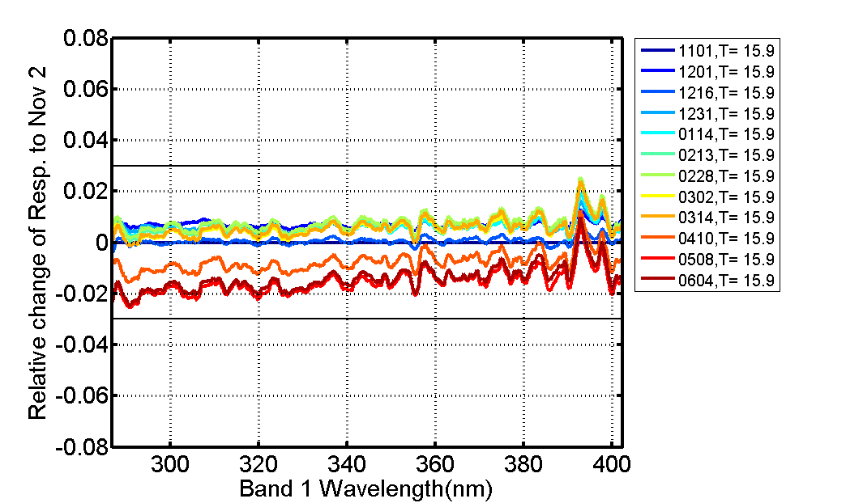
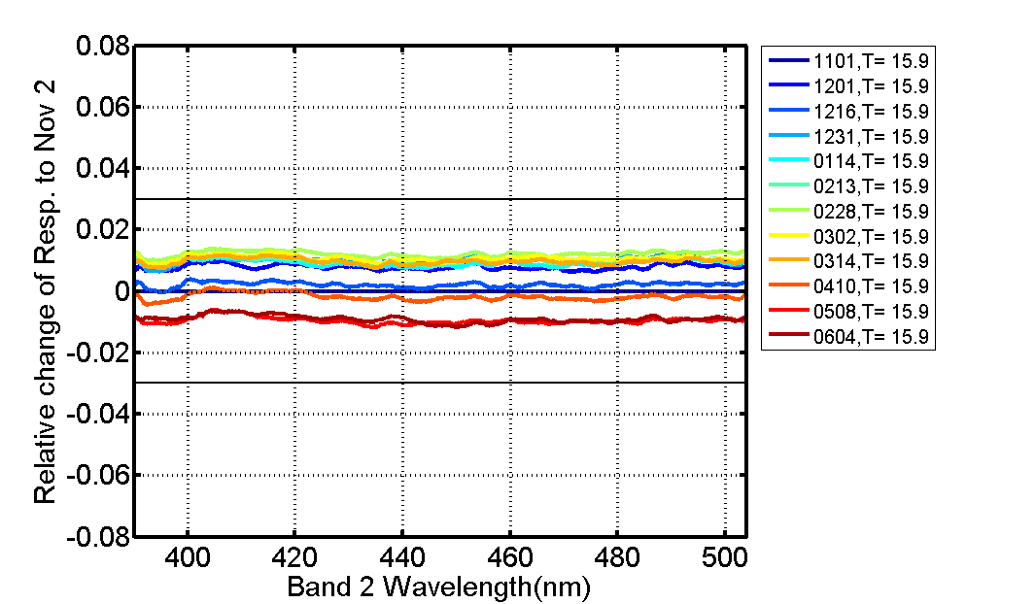
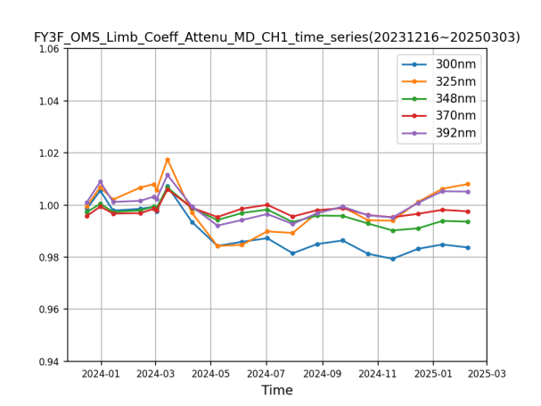
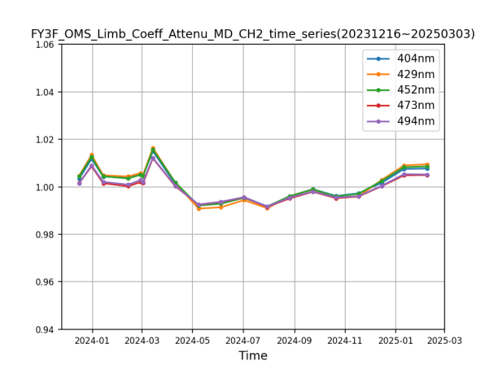
Radiation Performance
The main reference panel operates once a month, and the backup reference panel is observed once every six months. A collaborative evaluation mechanism for main and backup reference panels has been set up to assess detector radiation attenuation precisely.
OMS-L shows stable in-orbit radiation performance. Its radiation responsivity change is within 2% compared to the initial in-orbit stage (November 2, 2023), well within the acceptable range.
Spectral changes of solar calibration in orbit radiation responsivity (left: band 1, right: band 2)
Time variation of solar calibration in orbit radiation responsivity (left: band 1, right: band 2)
2025 GSICS Annual Meeting, Changchun, China, 17 to 21 March

Slide 12
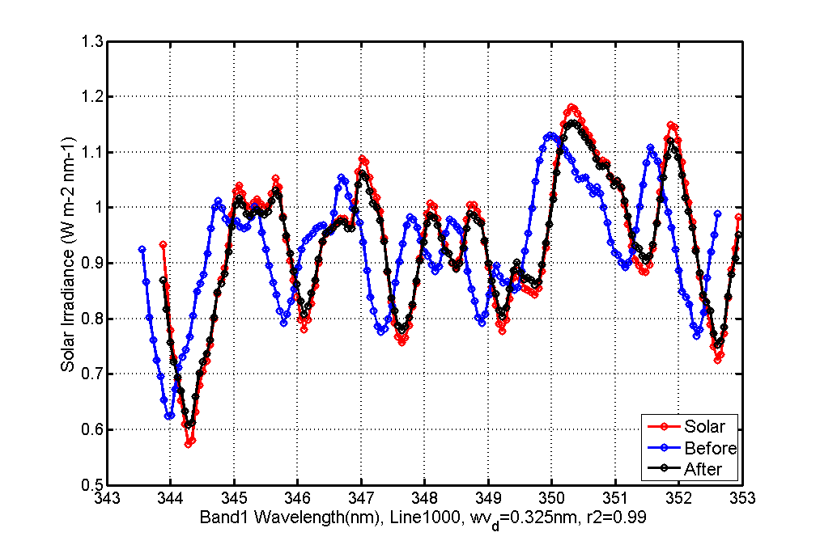
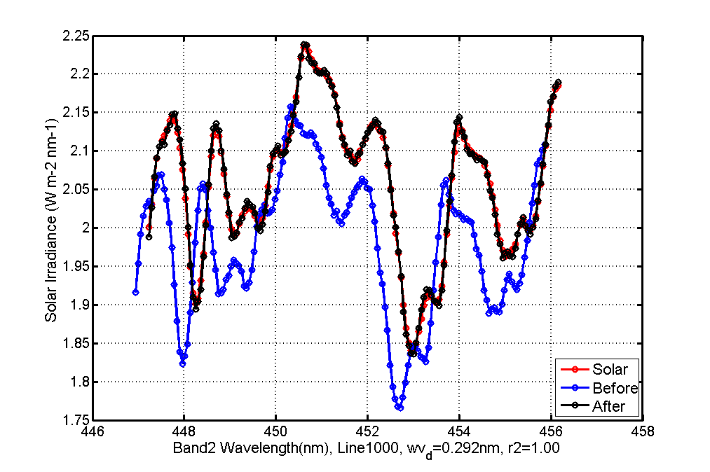
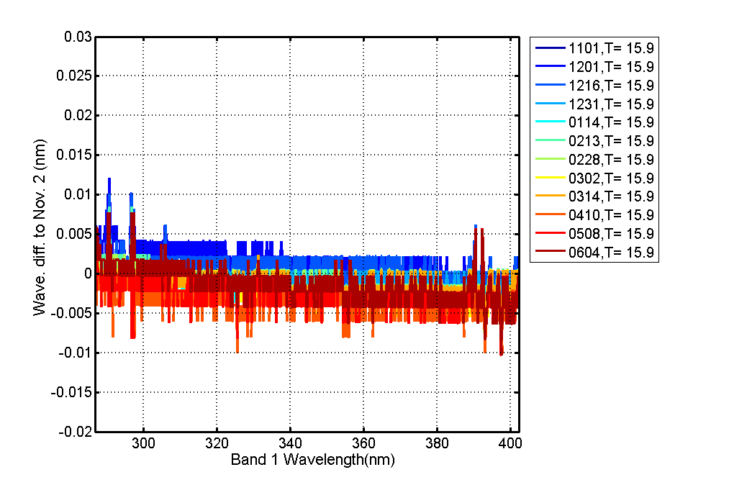
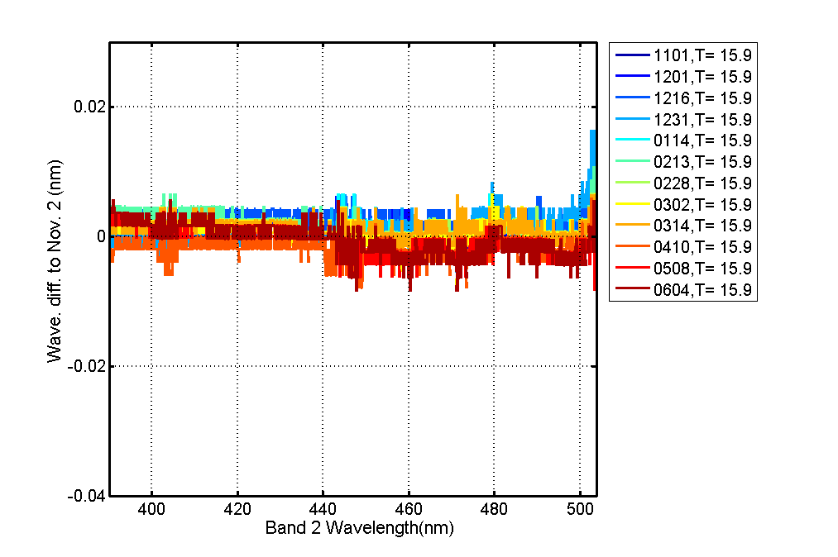
Stable In – Orbit Wavelength Registration
A sliding window regression calibration algorithm has been developed.
The upper graph shows that the "After" curve has better synchronization with the "Solar" curve at turning points compared to the "Before" one.
The lower graph indicates that wavelength registration changes are minor and mostly within the acceptable range (-0.01nm to 0.01nm) since the initial in-orbit stage(November 2, 2023).
Window sliding solar spectrum calibration
(left: Band 1, right: Band 2)
Solar calibration in orbit spectral changes
(left: band 1, right: band 2)
2025 GSICS Annual Meeting, Changchun, China, 17 to 21 March

Slide 13
Outline
1
Instrument introduction
2
In-orbit performance
3
Accuracy verification
4
Summary and Future Work
Notes:
Let's move on to the Accuracy verification .

Slide 14
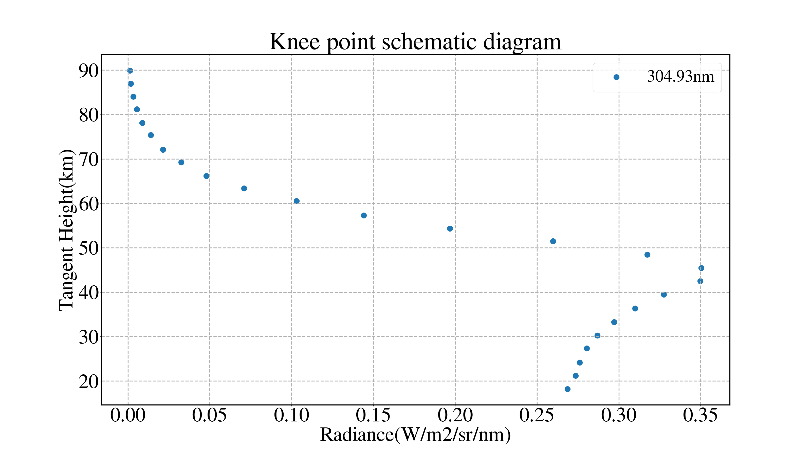
Tangent Height Accuracy Verification
In the UVB (280-320nm) band, the "knee" feature appears due to ozone absorption. The radiation intensity first increases and then decreases as the tangent height increases, forming a maximum value of radiation intensity.
The SCIATRAN tangent height correction is used to simulate the radiance of the OMSL 304.93nm channel. The comparison with observed radiance helps check the tangent height accuracy.
Pressure profiles
OMS-L
SCIATRAN
Temperature profiles
Observed knee point
(@ 305 nm)
Simulated knee point
(@305 nm)
Ozone profiles
Tangent height registration
Knee point diagram (Event: 10, FY3F_OMS-L_ORBT_L1_20241110_1209_3000M_V0.HDF )
Knee point tangent height accuracy verification process
2025 GSICS Annual Meeting, Changchun, China, 17 to 21 March

Slide 15
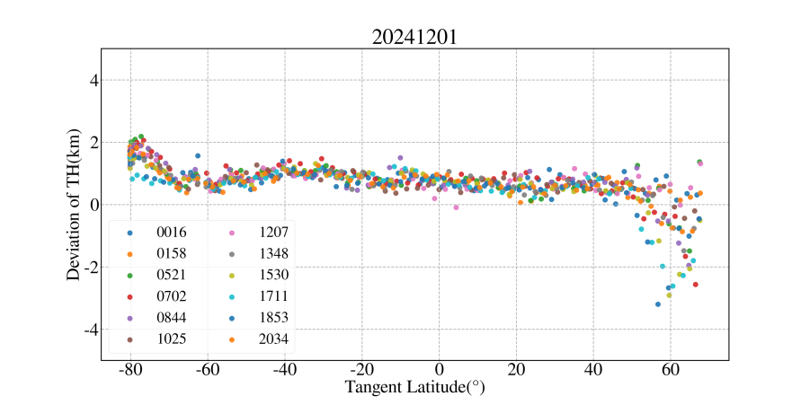
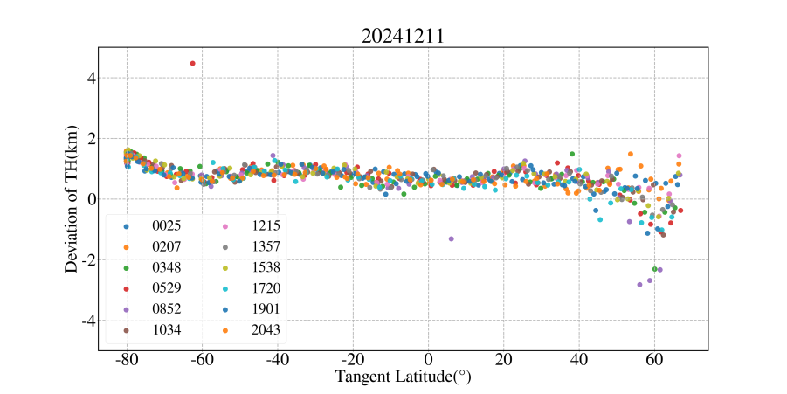
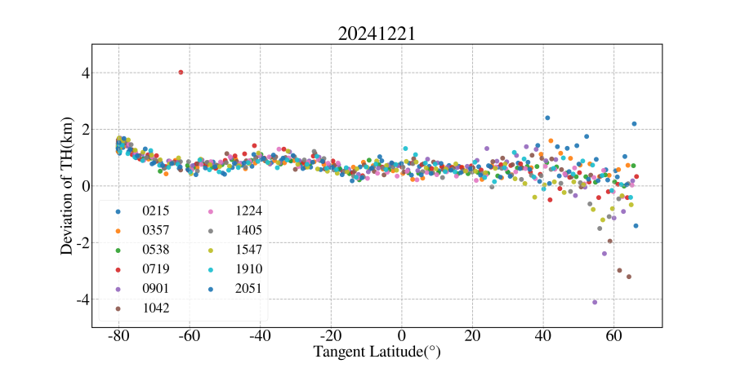
Analysis of Tangent Height Deviations
The comparison results showed similar trends on different dates imply stable instrument observations.
The observed values are approximately 0.5 km higher than the simulated values. The deviations vary with latitude, being stable between -60° and 40°, but more dispersed above 40°. Most of the deviations are within the range of 3 km, which is the designed specifications.
20241201 of tangent height deviation (km)
20241211 of tangent height deviation (km)
20241221 of tangent height deviation (km)
2025 GSICS Annual Meeting, Changchun, China, 17 to 21 March

Slide 16
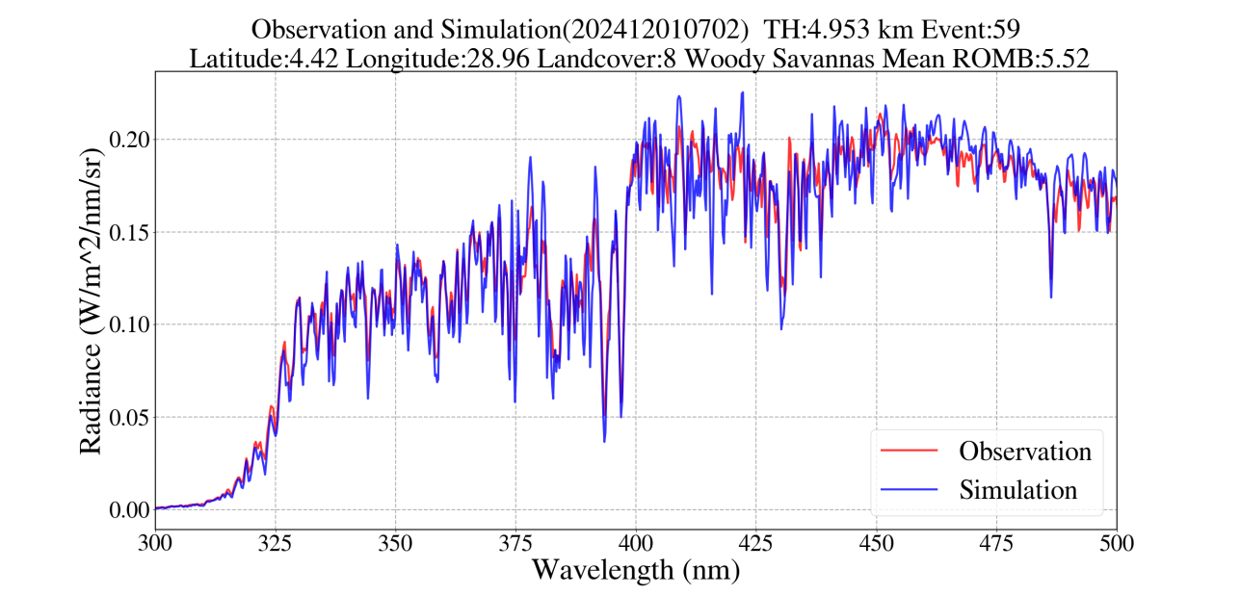
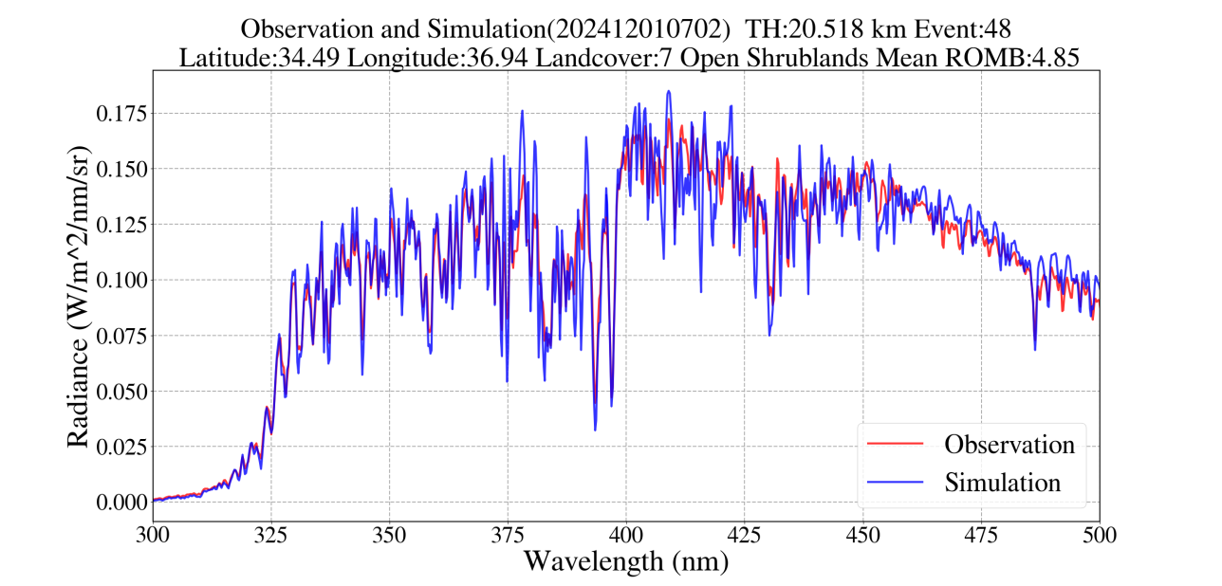
In-Orbit Radiation Calibration Evaluation
With specific parameter configurations, the graph shows a good match between simulated and observed values in multiple aspects (Observation value is 4.3% lower than simulation, sample size 1055). The in-orbit radiation calibration algorithm was proved reliable.
The simulated values are relatively consistent with the observed values in terms of wavelength registration, radiation values, and overall trends.
There are small fluctuations, especially between 400nm and 500nm.
Main Parameter Settings of SCIATRAN
Spherical Scattering Model: Scalar Mode
Ozone Profile: ERA5 data spliced with B2D ozone climatology data
BRDF: MCD43 product
Solar Flux Data Set: TSIS (TSIS-1 Hybrid Solar Reference Spectrum)
Line-by-Line Gas Absorption Database: HITRAN2020
Enable Rayleigh Scattering Calculation
Calculate the contribution of trace gases to total absorption
OMB results at 5.0km tangent height above Woody savannas land cover
OMB results at 20.5km tangent height above Shrub lands land cover
2025 GSICS Annual Meeting, Changchun, China, 17 to 21 March

Slide 17
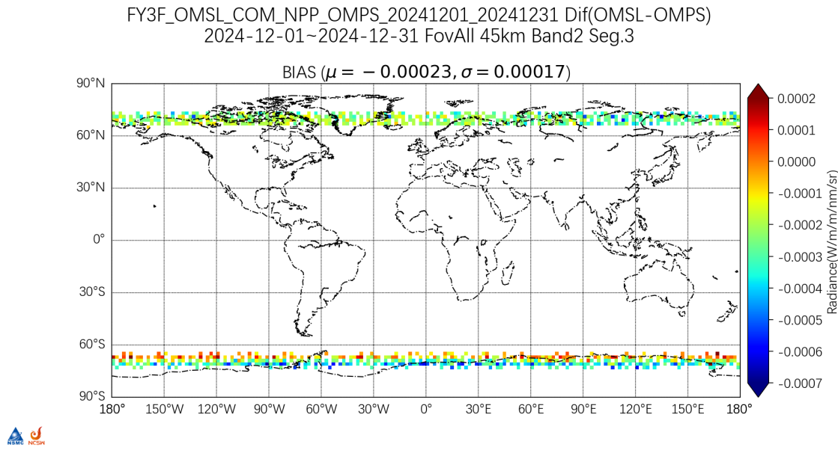
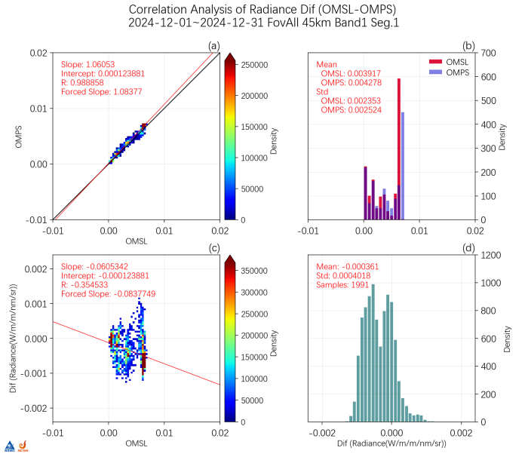
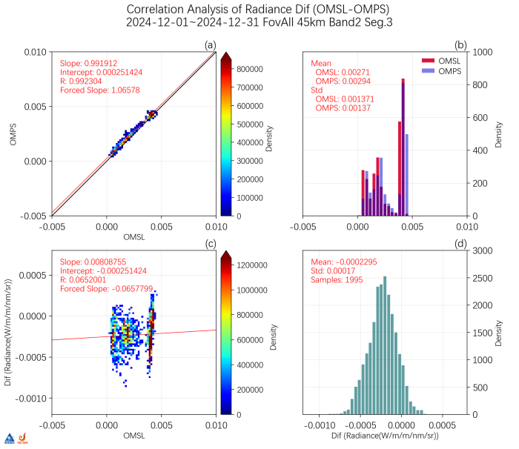
The cross-comparison with NPP-OMPS LP
A cross-comparison with NPP-OMPS LP was made under given thresholds (time diff. 35 min, spatial dist. 100 km, zenith angle diff. 10°, azimuth angle diff. 10°, tangent height diff. 1.5 km).
Most matching points had large solar zenith angles (>84°) and weak signals, causing relatively large fluctuations in the differences. At 45-km tangent height, OMSL deviated by 6.05% at 315 nm and 0.81% at 500 nm.
Radiance_Dif (OMSL-OMPS)_2024-12_FovAll_45km_500nm
Radiance_2024-12_FovAll_45km_315nm.png
Radiance_2024-12_FovAll_45km_500nm.png
2025 GSICS Annual Meeting, Changchun, China, 17 to 21 March

Slide 18
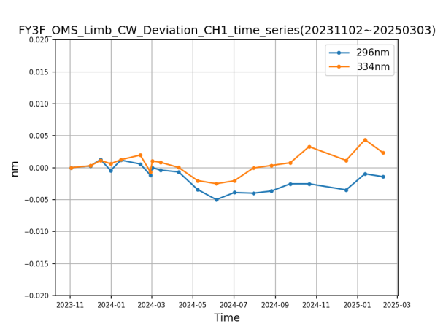
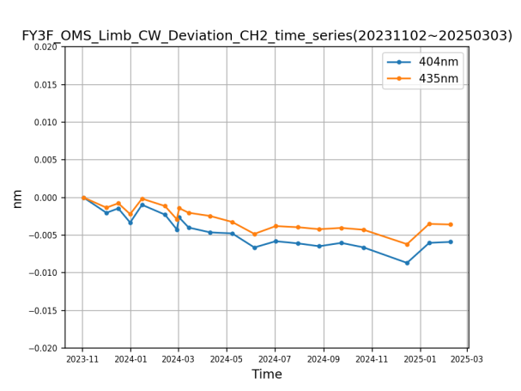
In-Orbit Spectral Calibration Evaluation
OMS-L in-orbit wavelength calibration was realized by the Solar spectral calibration. The accuracy is better than 0.01nm evaluated by fitting the characteristic spectral lines of mercury lamp using the Gaussian method.
Analysis of spectrum drift at different in-orbit times shows that as of Feb. 2025, compared to the initial in-orbit stage in Nov. 2023, OMS-L spectral performance is stable with wavelength drift < 0.01nm.
Date | Central Wavelength (nm)
20230919 | 296.811 | 334.245 | 404.773 | 435.966
20230921 | 296.809 | 334.246 | 404.767 | 435.962
20230922 | 296.807 | 334.244 | 404.766 | 435.961
20230926 | 296.810 | 334.247 | 404.766 | 435.962
20230927 | 296.809 | 334.247 | 404.766 | 435.962
Solar spectral calibration (nm) | 296.809 | 334.246 | 404.768 | 435.963
STD(nm) | 0.001 | 0.001 | 0.003 | 0.002
Mercury spectral(nm) | 296.815 | 334.245 | 404.771 | 435.956
Solar-Mercury(nm) | -0.006 | 0.001 | -0.003 | 0.007
Evaluation of Spectral Calibration Accuracy in the Initial Stage of Orbit
Time variation of the center wavelength of mercury in Band 1
Time variation of the center wavelength of mercury in Band 2
2025 GSICS Annual Meeting, Changchun, China, 17 to 21 March

Slide 19
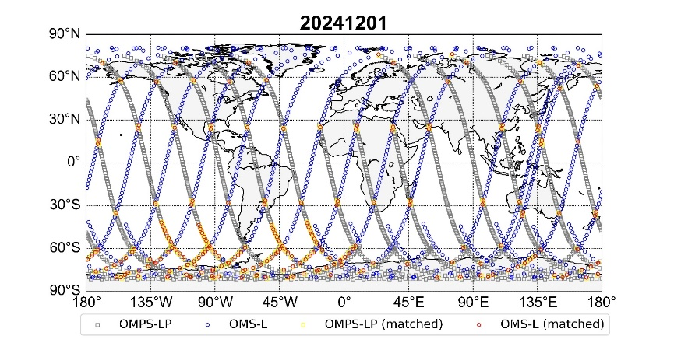
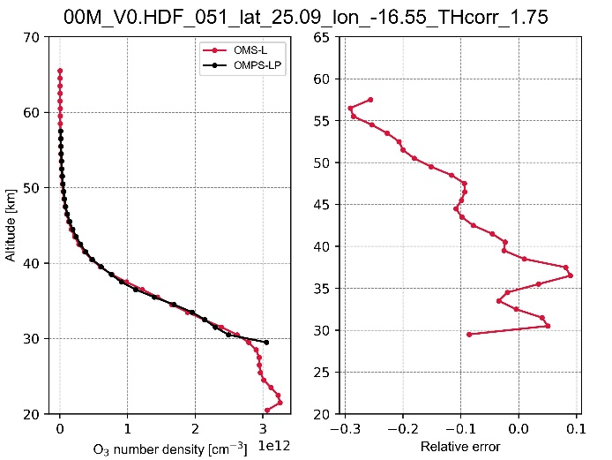
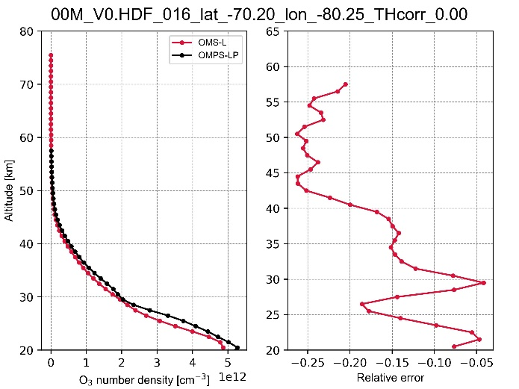
L2 Product validation
The L2 Product is still under testing yet. By using OMPS-LP v2.6 product for verification, we've found that the distribution of ozone number density with height is fairly accurate. But there are notable fluctuations in the relative retrieval error at various altitudes. Above 45 km, the error grows, likely due to lower ozone amounts.
Global distribution of satellite matching data
Relative error of retrieval of ozone number density cm ^ (-3) at position 1
Relative error of retrieval of ozone number density cm ^ (-3) at position 2
2025 GSICS Annual Meeting, Changchun, China, 17 to 21 March

Slide 20
Outline
1
Instrument introduction
2
In-orbit performance
3
Accuracy verification
4
Summary and Future Work
Notes:
Let's move on to the Future plans.

Slide 21
Summary and Future Work
In-Orbit Temperature Stability
The temperatures of the detectors in Bands 1 and 2 are stable within the range of-10.2°C to-9.8°C, showing no obvious upward or downward trends.
Calibration and Positioning Stability
OMS-L shows stable in-orbit radiation performance. Its change in radiation responsivity is within 2%.
The temperature of the grating base, which is related to spectral registration, varies minimally and is basically stable between 15.8°C and 16°C. Only some discrete points are generated during tungsten lamp calibration.
The spectral performance of OMS-L is stable with a wavelength drift of less than 0.01nm.
The positioning difference of the knee-point tangent height is about 0.5km.
Four plans in this year will be of great significance for the normal operation and scientific data accuracy of our in-orbit mission. They are:
Optimization of Integration Time for Different Tangent Heights.
In-orbit Tracking and Correction of
Radiation Responsivity
Polarization Degradation
Spectral Shift
2025 GSICS Annual Meeting, Changchun, China, 17 to 21 March

Slide 22

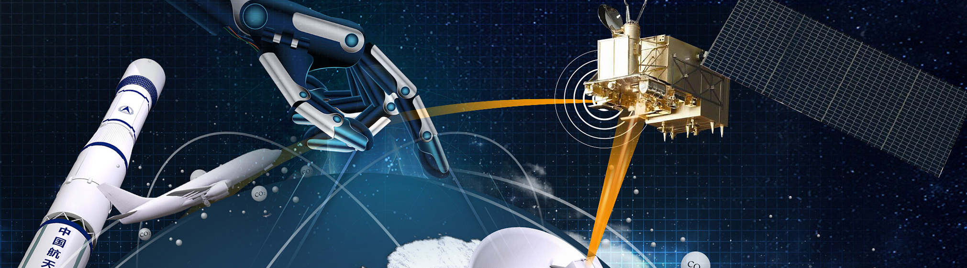
Thanks
2025 GSICS Annual Meeting, Changchun, China, 17 to 21 March

