Slide 1
EPS-Sterna Inter-Calibration Study
Tim Hewison
EUMETSAT
GSICS Annual Meeting 2025-03-19

Slide 2
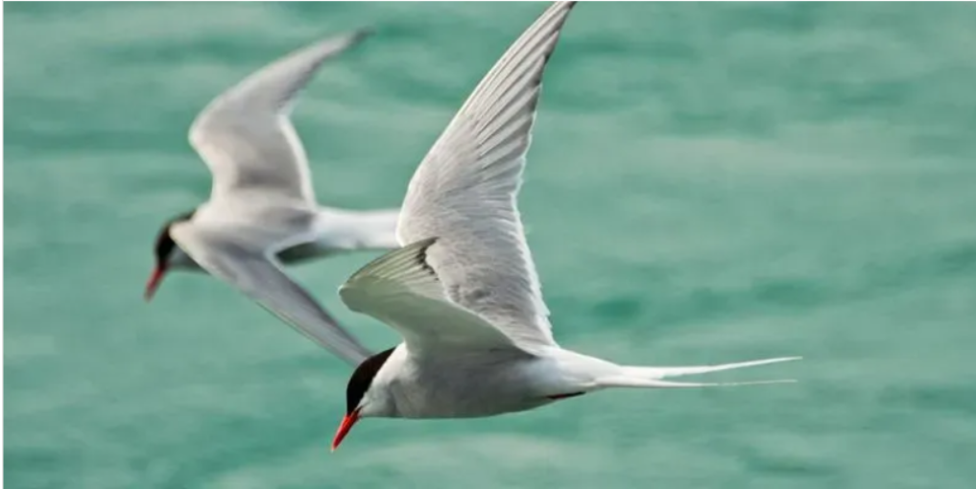
Key programmatic features of EPS-Sterna
EUMETSAT identified a constellation of small microwave sounding satellites, complementing the reference EUMETSAT Polar System (EPS-SG) /Microwave Sounder (MWS), as a potential additional contribution to the realisation of the WMO Integrated Global Observation System (WIGOS) Vision 2040, in line with objective 4 of the EUMETSAT strategy “Destination 2030”.
EPS-Sterna will be a EUMETSAT programme; EUMETSAT will be responsible for the overall system, the development and provision of the ground segment, the procurement of the launch services, the LEOP, the system operations including the management of the constellation.
The EPS-Sterna space segment will be procured in cooperation with ESA. It will capitalise on the experience from the ESA mission Arctic Weather Satellite (AWS) which is a technology demonstrator launched in August 2024. Minor modifications are expected for the constellation.
A successful outcome of the AWS in-orbit demonstration in 2024-2025 represents an opportunity to expand the products envelope of the EPS-SG mission for its users, by implementing the EUMETSAT Polar System Sterna.
EPS-Sterna overall operational mission duration will be 13 years with the initial constellation expected in 2029.
Arctic Tern
Latin: Sterna

Slide 3
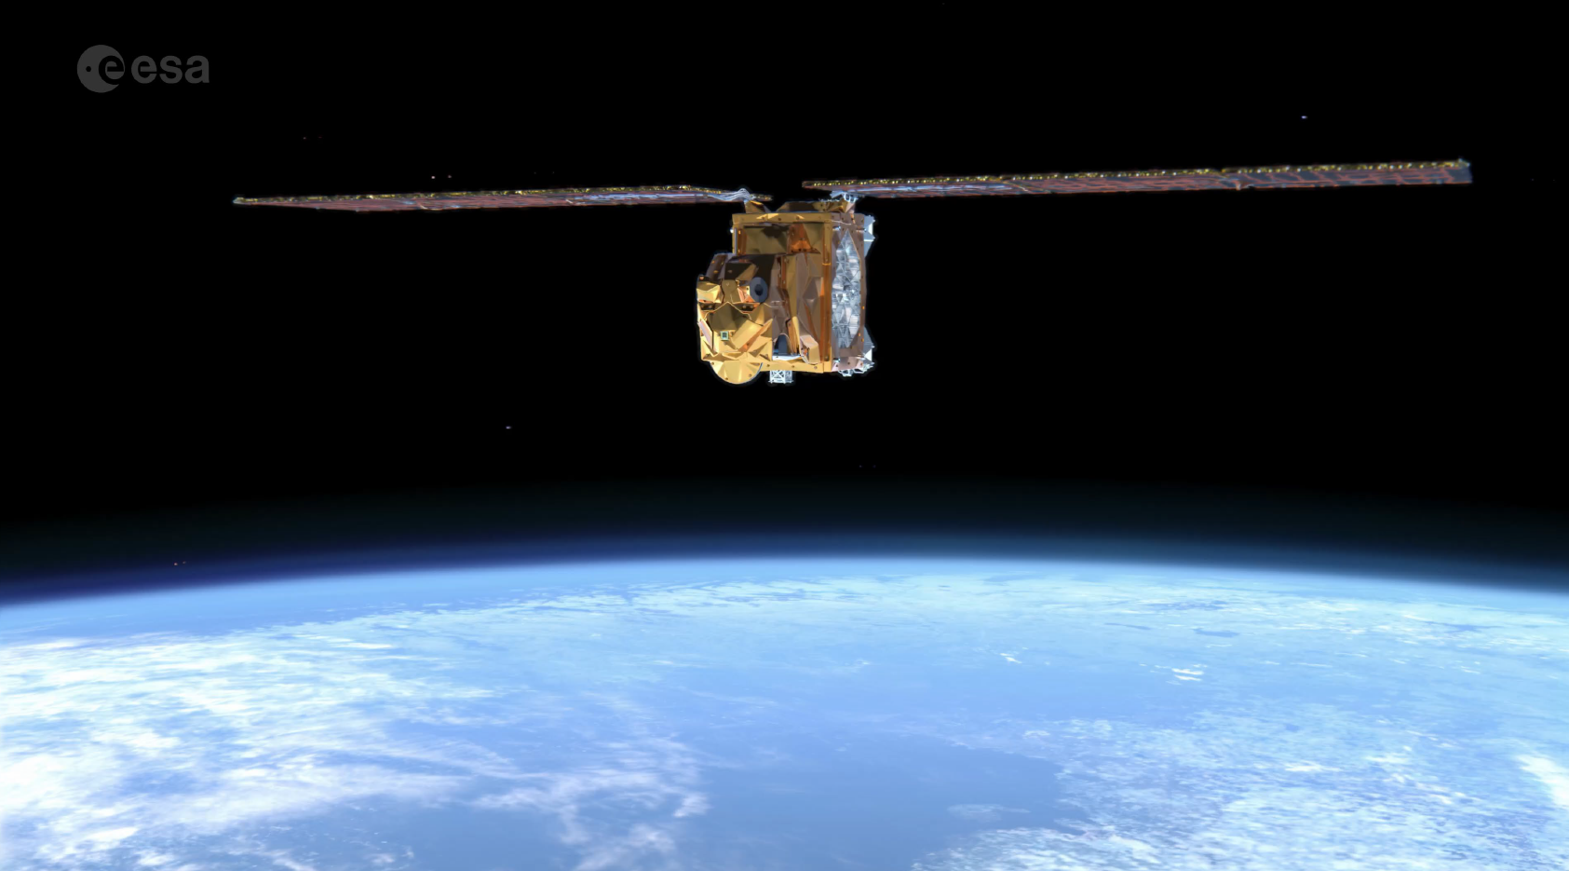
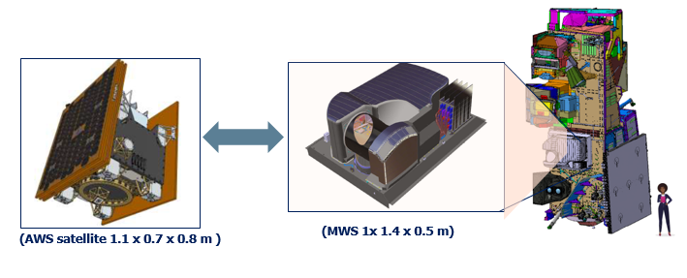
Satellite & Payload Overview
Spacecraft- three axis stabilised with electric propulsion:
  Mass: ca. 135 kg;
  Volume: 1.1x 0.7 x 0.8m;
  Power (nominal): ca. 143 W;
  Science data : L band (1.707 GHz);
  Command and Control: S band (2.230/2.053 GHz).
Payload : Passive Microwave Radiometer:
  Mass: 30 kg ( MWS on EPS-SG ca.150 kg);
  Power: ca. 35 W (MWS ca.120W);
  Data rate: 60 kbps;
  Scan rate 45 RPM, scan angle ±54.42°;
  Swath ~ 2000 Km.
  19 channels
AWS: Arctic Weather Satellite (ESA)
  Proto Flight Model for EPS-Sterna
  Launched 16 August 2024
Courtesy of Airbus

Slide 4
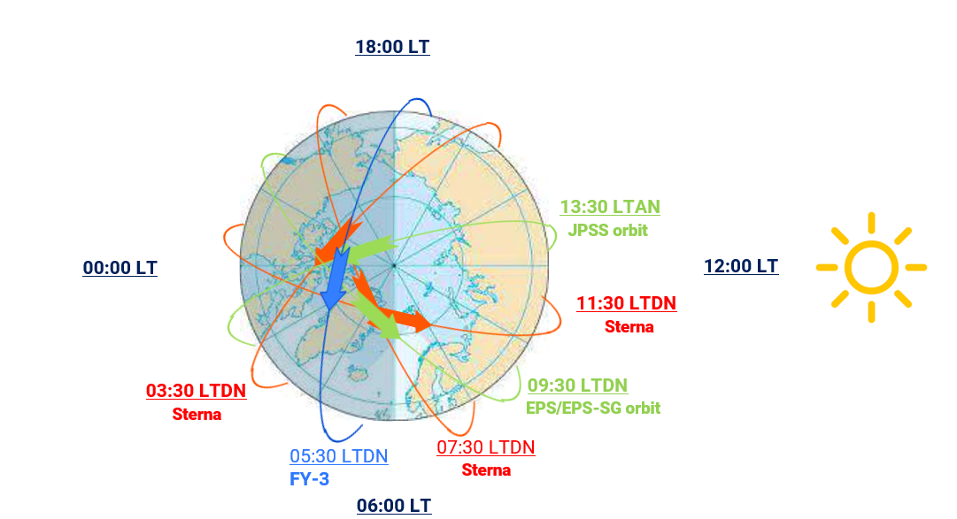
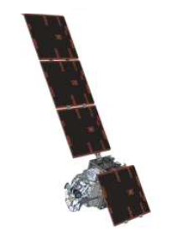
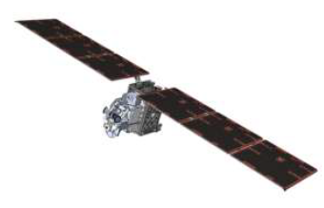
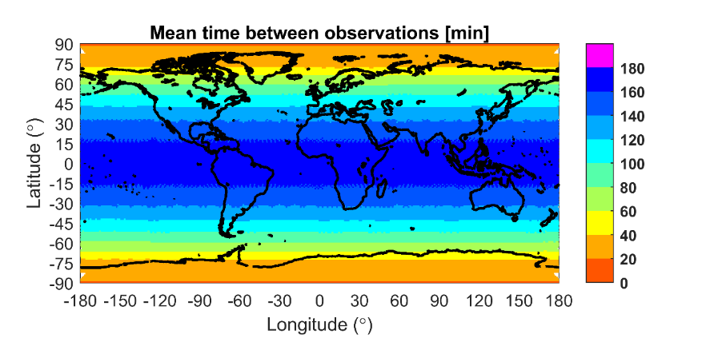
Complementarity of EPS-Sterna with EPS-SG and JPSS
  Orbits selected in order to minimize
  the global time-to-coverage of Sterna + EPS-SG + JPSS
  LTDN 03:30, 07:30, 11:30 – complementary to EPS-SG and JPSS orbits;
Constellation performance:
Time to achieve 90% coverage:
EPS-Sterna only: 3.1-4.7 hours;
EPS-Sterna + EPS-SG +JPSS: 2.4-3.8 hours.
Mean time between observations (with 6 satellites): 20 min-3 hours.

Slide 5
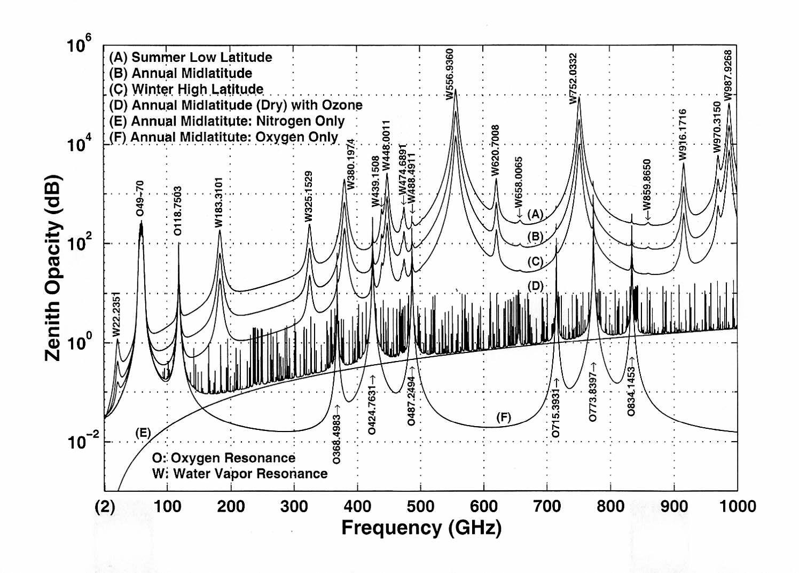
EPS-Sterna Spectral Bands and Channels
Channel name | Centre Frequency [GHz] | Bandwidth [MHz] | NEΔT [K] | Footprint at nadir
STERNA-11 | 50.3 | 180 | <0.6 | ≤ 40 km (±25%) | Temperature Sounding
STERNA-12 | 52.8 | 400 | <0.4
STERNA-13 | 53.246 | 300 | <0.4
STERNA-14 | 53.596 | 370 | <0.4
STERNA-15 | 54.4 | 400 | <0.4
STERNA-16 | 54.94 | 400 | <0.4
STERNA-17 | 55.5 | 330 | <0.5
STERNA-18 | 57.290344 | 330 | <0.6
STERNA-21 | 89 | 4000 | <0.3 | ≤ 20 km (±25%) | Window and Cloud detection
STERNA-31 | 165.5 | 2800 | <0.6 | ≤ 10 km (±25%) | Window/humidity sounding
STERNA-32 | 176.311 | 2000 | <0.7
STERNA-33 | 178.811 | 2000 | <0.7 |  | Humidity sounding
STERNA-34 | 180.311 | 1000 | <1
STERNA-35 | 181.511 | 1000 | <1
STERNA-36 | 182.311 | 500 | <1.3
STERNA-41 | 325.15±1.2 | (2x) 800 | <1.7 | ≤ 10 km (±25%) | Humidity sounding/cloud detection
STERNA-42 | 325.15±2.4 | (2x) 1200 | <1.4
STERNA-43 | 325.15±4.1 | (2x) 1800 | <1.2
STERNA-44 | 325.15±6.6 | (2x) 2800 | <1

Slide 6
EPS-Sterna Requirements for Inter-Calibration
Requirement STERNA-EURD-00025
  The performance of the Level 1b data derived from instruments of the constellation shall be characterised by cross-calibration against a reference, throughout the mission
  This important support activity should be considered early on in the development phase, in order to size adequately the on-ground monitoring facilities to support the constellation.
Presentation summarises EPS-Sterna Inter-Calibration Concept
  Proposes possible solutions and
  Introduces study to develop and demonstrate their suitability for operational implementation
Focus on Level 1b - Radiometric Calibration
  Inter-comparisons also apply to L2 products and Geolocation
STERNA-EURD-00110 The Sterna radiometric bias shall be less than 1 K for all channels and for the Sterna Earth Scene Dynamic Range …
  Primary requirement to be verified by inter-calibration
  Aim to verify this within 1 month

Slide 7
Inter-Calibration Algorithms
Reviewed various possible inter-calibration methods:
  Simultaneous Nadir Overpass
  Opportunistic Constant Target Matching
  NWP double-differencing
  Vicarious double-differencing
Others considered, but not currently being pursued directly for Sterna:
  GNSS Radio Occultation
    Sterna channels weighting functions focus on troposphere
  Forward-modelled Radiosondes
    Large uncertainties due to sampling, cloud and quality
  Zonal average statistics
    Sensitive to diurnal variations

Slide 8
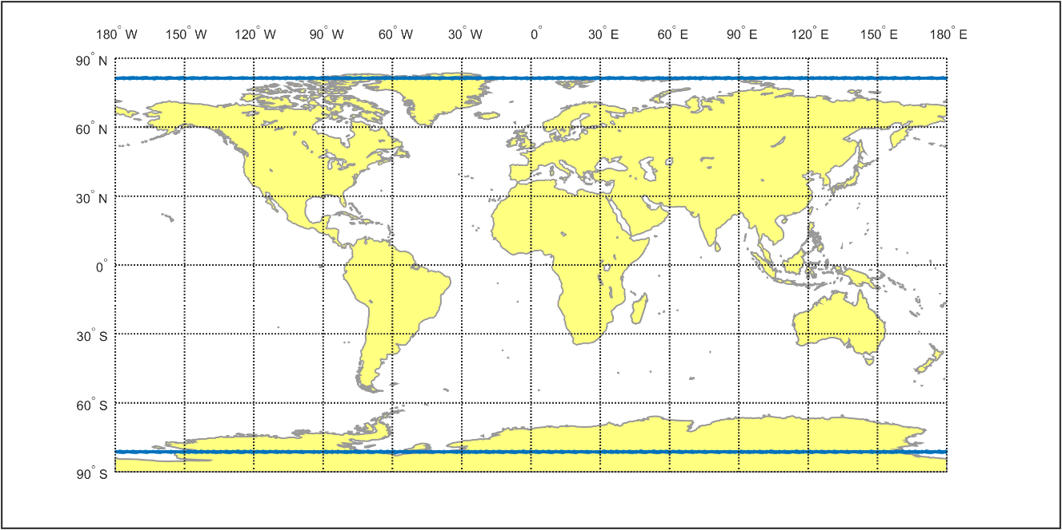
Inter-Calibration Algorithm - SNO
Simultaneous Nadir Overpasses
Compare observations
  spectrally matched channels
  near-nadir – to minimise
    scan-angle dependence
    polarisation differences
Initial criteria:
  Max viewing angle: nadir±5°
  Max time difference: 15min
  Max distance: 10km
  Predictions from Daniel Aguilar Taboada (EUM)
  Thousands of match-ups/year
  High latitudes – limited dynamic range
Extension to high viewing angle
  Allow comparison with ICI 325GHz
  Increased uncertainty
Geographic distribution of 1 year’s predicted matchups between EPS-Sterna and Metop-C with 23:30 and 21:30 local equator crossing times
for 5° max viewing angle, 15min max time difference
EPS-Sterna Satellite LECT | Reference Satellite LECT | Typical Latitude [°N/S] | Mean Matchup Duration | Matchups per year
15:30 | 13:30 NOAA-21 | 80 | 24.6 s | 1835
 | 21:30 Metop-C | 78 | 9.1 s | 2447
19:30 | 13:30 NOAA-21 | 78 | 9.1 s | 2454
 | 21:30 Metop-C | 80 | 24.6 s | 1833
23:30 | 13:30 NOAA-21 | 60 | 6.6 s | 5931
 | 21:30 Metop-C | 80 | 24.7 s | 1826

Slide 9
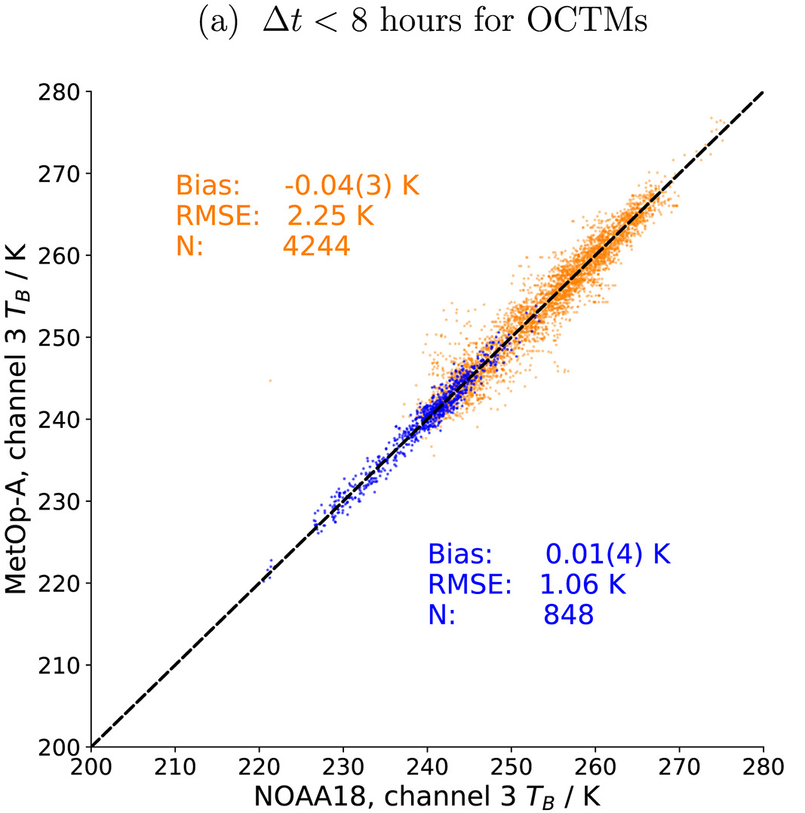
Inter-Calibration Algorithm - OCTM
Opportunistic Constant Target Matching (Buehler et al. 2020)
  Aims to improve dynamic range of SNO method
  By identifying stable conditions
  E.g. in sub-tropic subsidence zones
  where time window can be extended to many hours +
  Based on analysis of geostationary imager data
Relatively immature – but Highly Promising
  Applied only to microwave humidity sounders so far
  Applicable to temperature sounding channels?
    e.g. Using 13.3µm CO2 channel – or IRS – or WV channels?
  Needs further development
    to identify channels with similar weighting functions,
    implement, tune collocation criteria
    and conduct an uncertainty analysis
Matchup scatterplot of MHS 183±1GHz on NOAA 18 v. Metop A
Orange points mark OCTMs.
Blue points mark classic SNO matchups. (From Buehler et al. 2020)

Slide 10
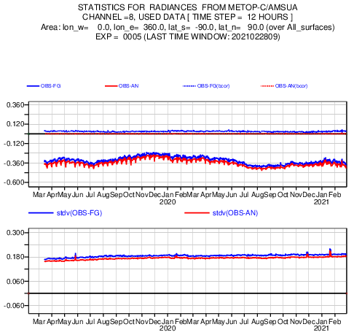
Inter-Calibration Algorithm - NWP
NWP: Best Estimate of atmosphere
Observations – First Guess
  Typical biases ~1K (AMSU/MHS/ATMS)
  Standard Deviations:
    ~0.15K for 52-58GHz oxygen channels
    ~3K for water vapour channels
    ~7K for window channels
    Dominated by representativity errors
Residual biases
  e.g. surface emissivity, cloud
  Cancelled out by double-differencing
  May need precipitation screening
Big Data!
  Can diagnose sensitivity to many variables
NWP Bias Monitoring Statistics
For Metop-C/AMSU-A Ch 8 over 2 years
(From ECMWF)
Notes:
Confirms AMSU/MHS/ATMS stable, well-calibrated – suitable references

Slide 11
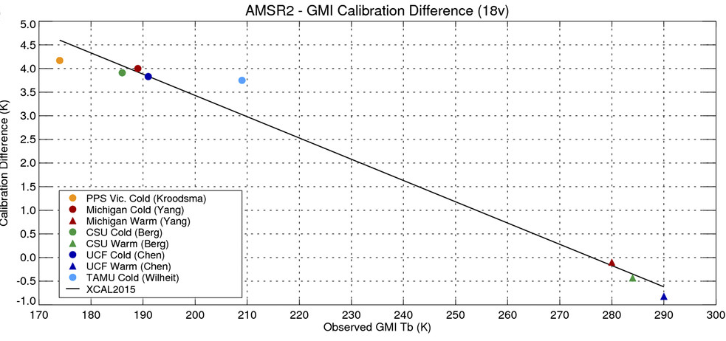
Inter-Calibration Algorithm - Vicarious
Vicarious calibration
Uses natural targets
  With low temporal
  and spatial variability
  Ocean in cold, dry conditions
  Tropical Rainforests
TOA radiance can be modelled
  With low uncertainty
Extend to inter-calibration
  Using double-differencing
  Accounting for sensor differences
    Spectral, geometric, polarisation, …
Popular for window channels of microwave imagers
  Applicable to 50.3GHz, 89, 166GHz ?
  Need to filter precipitation (and cloud?)
Vicarious Inter-calibration results for AMSR2 vs GMI 18.7 GHz V-pol. Independent results from each of the contributing groups shown for radiometrically cold scenes (non-precipitating oceans)
and warm scenes (vegetated non-polarized land).
(From Berg et al., 2016)

Slide 12
Applicability of Inter-Calibration Algorithms
Different methods
  applicable to different bands
Initial summary
  Priorities, P1-P4
  Or Not Applicable (N/A)
  OCTM to be demonstrated for O2 channels
To be refined
  following more accurate uncertainties and limitations
  During studies
  After applying to AWS data
Channel Frequencies | Channel Type | SNO (1) | OCTM (2) | NWP DD (3) | Vicarious DD Cold/Warm
≤50GHz | Low Freq. Window | P1 | N/A | P3 | P2
52-57GHz | Oxygen Band | P1 | N/A | P2 | N/A
89-166GHz | High Freq. Window | P1 | N/A | P3 | P2
~183GHz | Water Vapour | P1 | P2 | P3 | N/A
~325GHz | Water Vapour | P3 (High Angle) | P4 (High Angle) | P2 | N/A
Table 2: Initial Summary of Applicability of Inter-Calibration Algorithms to EPS-Sterna
(1) Simultaneous Nadir Overpasses,
(2) Opportunistic Constant Target Matching,
(3) Double Differencing
P1 = Highest Priority for each band
P4 = Lowest Priority for each band
N/A = Not Applicable to each band
Notes:
Could combine with Slide 5

Slide 13
Inter-Calibration References
Select Reference Instrument
  Operational missions
  Long-term stability
  Similar channels
  Scan geometry
  Account for small differences
Ideally non-sun-synchronous
  But none suitable
Proposed reference instruments:
  MWS, ATMS primary choice
  ICI for 325GHz
  AMSU/MHS for AWS demo
  MWTS-3/MWHS-2 on FY-3E ?
Transfer calibration within Sterna
  using double-differences
AWS Channel | Frequency [GHz] | Bandwidth [MHz] | Footprint at nadir | MWS Channel | ATMS Channel | MWI-ICI Channel | AMSU-MHS
AWS-11 | 50.3 | 180 | ≤ 40 km (±25%) | MWS-3 | ATMS-3 | MWI-4 | AMSU-3
AWS-12 | 52.8 | 400 |  | MWS-4 | ATMS-5 | MWI-5 | AMSU-4
AWS-13 | 53.246 | 300 |  | MWS-5 | x | MWI-6 | x
AWS-14 | 53.596 | 370 |  | MWS-6 | ATMS-6 | MWI-7 | AMSU-5
AWS-15 | 54.4 | 400 |  | MWS-8 | ATMS-7 | x | AMSU-6
AWS-16 | 54.94 | 400 |  | MWS-9 | ATMS-8 | x | AMSU-7
AWS-17 | 55.5 | 330 |  | MWS-10 | ATMS-9 | x | AMSU-8
AWS-18 | 57.290344 | 330 |  | MWS-11 | ATMS-10 | x | AMSU-9
AWS-21 | 89 | 4000 | ≤ 20 km | MWS-17 | ATMS-16 | MWI-8 | MHS-1
AWS-31 | 165.5 | 2800 | ≤ 10 km (±25%) | MWS-18 | ATMS-17 | x | MHS-2
AWS-32 | 176.311 | 2000 |  | MWS-19 | ATMS-18 | ICI-1 | MHS-5
AWS-33 | 178.811 | 2000 |  | MWS-20 | ATMS-19 | x | x
AWS-34 | 180.311 | 1000 |  | MWS-21 | ATMS-20 | ICI-2 | MHS-4
AWS-35 | 181.511 | 1000 |  | MWS-22 | ATMS-21 | ICI-3 | x
AWS-36 | 182.311 | 500 |  | MWS-23 | ATMS-22 | x | MHS-3
AWS-41 | 325.15±1.2 | (2x) 800 |  | x | x | x | x
AWS-42 | 325.15±2.4 | (2x) 1200 |  | x | x | ICI-7 | x
AWS-43 | 325.15±4.1 | (2x) 1800 |  | x | x | ICI-6 | x
AWS-44 | 325.15±6.6 | (2x) 2800 |  | x | x | ICI-5 | x
Notes:
Delete footprint column?

Slide 14
Requirements
Primary requirement to be verified by inter-calibration: “Radiometric Bias <1K”
  Aim to verify this within 1 month
  Within a given uncertainty (k=2), proposed in table below
  Compromise between what is technically possible and what is needed
Channel Type | Expected Dynamic Range | Threshold Uncertainty | Breakthrough Uncertainty | Objective Uncertainty
Window or pseudo-window | 90K | 2.0K | 1.0K | 0.5K
Temperature-sounding | 30K | 0.5K | 0.2K | 0.1K
Humidity- sounding | 50K | 1.0K | 0.5K | 0.2K
Proposed Uncertainty Requirements (k=2) for Inter-Calibration Algorithm defined per Sterna channel type based on requirements for monthly calibration monitoring
(Excluding uncertainty of Reference Instruments’ calibration)
If calibration is stable,
  uncertainties could be further reduced by an order of magnitude over the operational lifetime for FCDR generation
  analysis over an extended period may demonstrate bias variability within one scan or one orbit
    STERNA-EURD-00140, STERNA-EURD-00120, resp.
    This relies on sufficient statistics to allow breakdown by scan angle or latitude, which will depend on the algorithm details
Notes:
Discussion!

Slide 15
Inter-Calibration Study
1-year study running through 2025
  Deimos: Diego Lozano, Jorge Gil
  UPC: Adriano Camps, Miriam Pablos, Mercè Vall-Llossera
Task 1:
  Development of Opportunistic Constant Target Matching inter-calibration method
Task 2:
  Development of Vicarious Inter-calibration algorithm
Task 3 (Optional):
  Analysis of Uncertainty of SNO method
All based on data provided by EUMETSAT
  With support of Climate Team (Viju John & Timo Hanschmann)
Final presentation ~Jan 2026

Slide 16
Thank you!
Questions are welcome.

