Slide 1




Development of VIcarious Calibration for MWI and ICI using RadioSoundings: introducing the VICIRS tool
Elisabetta Ricciardelli⁽¹⁾, Christophe Accadia⁽²⁾, Vasileios Barlakas⁽⁶⁾, Fabien Carminati⁽³⁾, Domenico Cimini⁽¹⁾, Francesco De Angelis⁽²⁾, Maria Pia De Natale⁽¹⁾, Francesco Di Paola⁽¹⁾, Sabrina Gentile⁽¹⁾, Tim Hewison⁽²⁾, Salvatore Larosa⁽¹⁾, Fabio Madonna⁽⁴⁾, Fabrizio Marra⁽¹⁾, Vinia Mattioli⁽²⁾, Mario Montopoli⁽⁵⁾, Filomena Romano⁽¹⁾, Marco Rosoldi⁽¹⁾, Emanuele Tramutola⁽¹⁾, Mariassunta Viggiano⁽¹⁾
⁽¹⁾ Institute of methodologies for environmental analysis, National Research Council of Italy
⁽²⁾ European Organisation for the Exploitation of Meteorological Satellites (EUMETSAT)
⁽³⁾ Met Office UK
⁽⁴⁾ Università degli Studi di Salerno, Italy
⁽⁵⁾ Institute of Atmospheric Sciences and Climate, National Research Council of Italy
⁽⁶⁾ HE Space Operations GmbH, Germany
EUMETSAT Meteorological Satellite Conference 2024 - Würzburg, Germany, 30 September - 4 October 2024

Slide 2
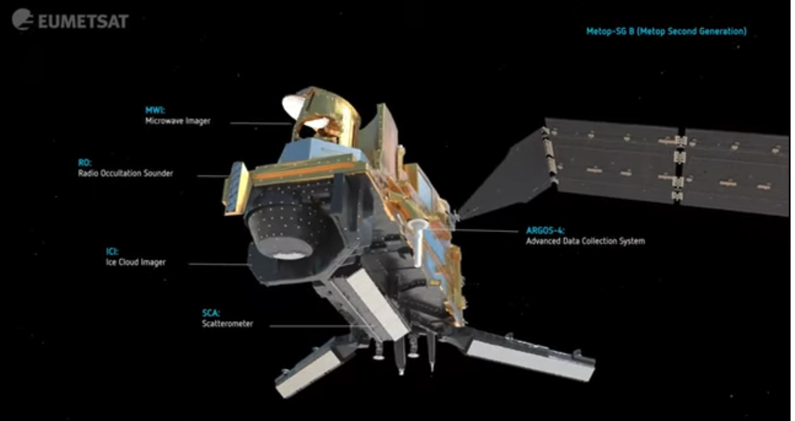
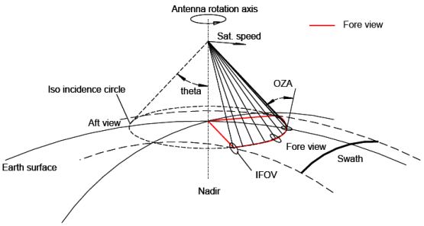
Introduction
In response to EUMETSAT Invitation Tender ITT 22/224312
Objective: develop a vicarious calibration and validation (Cal/Val) tool to compare MWI and ICI observations against radiosoundings.
Vicarious calibration: post-launch calibration based on targets imaged near-coincidently by the sensor to be calibrated and by one or more well-calibrated sensors (from satellites, aircraft, balloon or ground).
MicroWave Imager (MWI) and Ice Cloud Imager (ICI) are conical-scanning microwave radiometers that will fly from 2026 onward aboard the 2nd generation European Polar Satellites (METOP-SG-B).

Slide 3
Introduction
MWI
26 channels centred at 18 frequency bands (from 18 to 183 GHz)
Main applications:
cloud/precipitation in support of NWP
ocean surface (wind speed, sea ice)
MW legacy in support of long-term climate records
Channel | Frequency (GHz) | Bandwidth(MHz) | NEDT (K) | Radiometric Bias (K) | Polarization | Footprint Size at 3dB (km)
MWI-1 | 18.7 | 200 | 0.8 | 1.0 | V, H | 50
MWI-2 | 23.8 | 400 | 0.7 | 1.0 | V, H | 50
MWI-3 | 31.4 | 200 | 0.9 | 1.0 | V, H | 30
MWI-4 | 50.3 | 180 | 1.1 | 1.0 | V, H | 30
MWI-5 | 52.7 | 180 | 1.1 | 1.0 | V, H | 30
MWI-6 | 53.24 | 400 | 1.1 | 1.0 | V, H | 30
MWI-7 | 53.750 | 400 | 1.1 | 1.0 | V, H | 30
MWI-8 | 89.0 | 4000 | 1.1 | 1.0 | V, H | 10
MWI-9 | 118.7503±3.20 | 2x500 | 1.3 | 1.0 | V | 10
MWI-10 | 118.7503±2.10 | 2x400 | 1.3 | 1.0 | V | 10
MWI-11 | 118.7503±1.40 | 2x400 | 1.3 | 1.0 | V | 10
MWI-12 | 118.7503±1.20 | 2x400 | 1.3 | 1.0 | V | 10
MWI-13 | 165.5±0.75 | 2x1350 | 1.2 | 1.0 | V | 10
MWI-14 | 183.31±7.0 | 2x2000 | 1.3 | 1.0 | V | 10
MWI-15 | 183.31±6.1 | 2x1500 | 1.2 | 1.0 | V | 10
MWI-16 | 183.31±4.9 | 2x1500 | 1.2 | 1.0 | V | 10
MWI-17 | 183.31±3.4 | 2x1500 | 1.2 | 1.0 | V | 10
MWI-18 | 183.31±2.0 | 2x1500 | 1.3 | 1.0 | V | 10
Incidence angles within 53°±2°
Observations acquired ± 65° in azimuth in the fore view (about 1700 km swath)
Footprints overlap ≥20%.
Spatial sampling: ~9 km along track ,~2.5 km across track.

Slide 4
Introduction
ICI
13 channels centred at 11 frequency bands (from 183 to 664 GHz)
Main applications:
ice cloud products for climate monitoring
information on non-precipitating ice
Channel | Frequency (GHz) | Bandwidth (MHz) | NEDT (K) | Radiometric Bias (K) | Polarization | Footprint Size at 3dB (km)
ICI-1 | 183.31±7.0 | 2x2000 | 0.8 | 1 | V | 16
ICI-2 | 183.31±3.4 | 2x1500 | 0.8 | 1 | V | 16
ICI-3 | 183.31±2.0 | 2x1500 | 0.8 | 1 | V | 16
ICI-4 | 243.2±2.5 | 2x3000 | 0.7 | 1.5 | V, H | 16
ICI-5 | 325.15±9.5 | 2x3000 | 1.2 | 1.5 | V | 16
ICI-6 | 325.15±3.5 | 2x2400 | 1.3 | 1.5 | V | 16
ICI-7 | 325.15±1.5 | 2x1600 | 1.5 | 1.5 | V | 16
ICI-8 | 448±7.2 | 2x3000 | 1.4 | 1.5 | V | 16
ICI-9 | 448±3.0 | 2x2000 | 1.6 | 1.5 | V | 16
ICI-10 | 448±1.4 | 2x1200 | 2.0 | 1.5 | V | 16
ICI-11 | 664±4.2 | 2x5000 | 1.6 | 1.5 | V, H | 16
Incidence angles within 53°±2°
Observations acquired ± 65° in azimuth in the fore view (about 1700 km swath)
Footprints overlap ≥40%.
Spatial sampling: ~9 km along track ,~2.5 km across track.

Slide 5
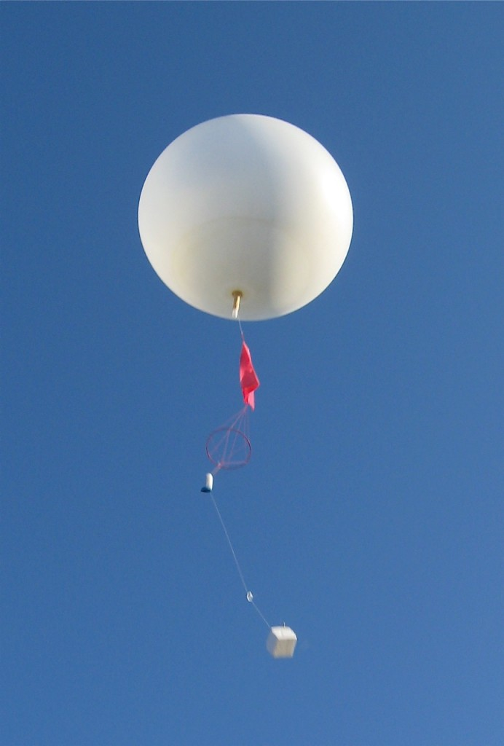
INTroduction
  Why vicarious calibration against radiosoundings?
  Crucial for unprecedented channels
  (ICI-4 : ICI-11), (MWI-9 : MWI-12)*
  Processed with RTM to compute simulated
  Brightness Temperature (BT)
  How to characterize the uncertainty of simulated BT?
* Except for TROPICS

Slide 6
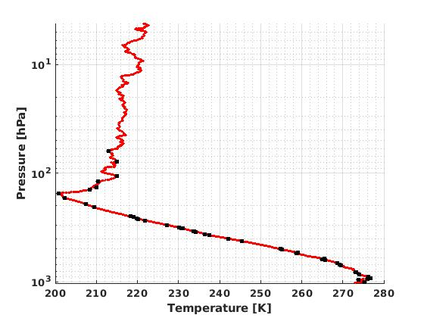
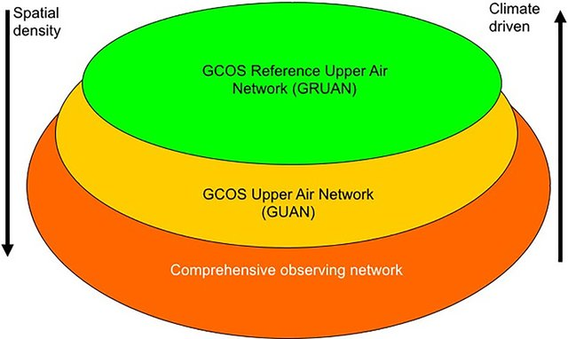
Introduction
  Propagating radiosounding uncertainties to simulated BT
RS 2020-01-12, 00GMT
GRUAN RS
RHARM RS
RHARM RS
  What radiosonde archive?
GCOS tiered-network concept
Seidel et al., 2009

Slide 7
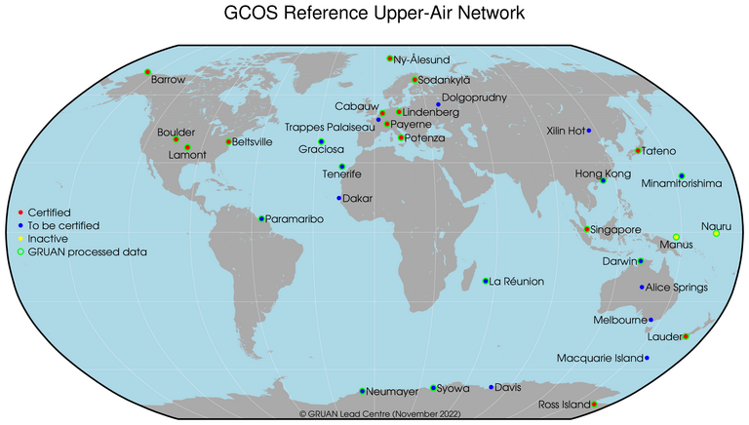
Radiosonde observations
Global Climate Observing System (GCOS) Reference Upper-Air Network (GRUAN)
homogeneous and fully traceable - with quantified uncertainties
• 31 sites, 14 of which have been GRUAN certified
• 23 with active data streams (other under implementation)
(Bodeker et al., 2016)

Slide 8
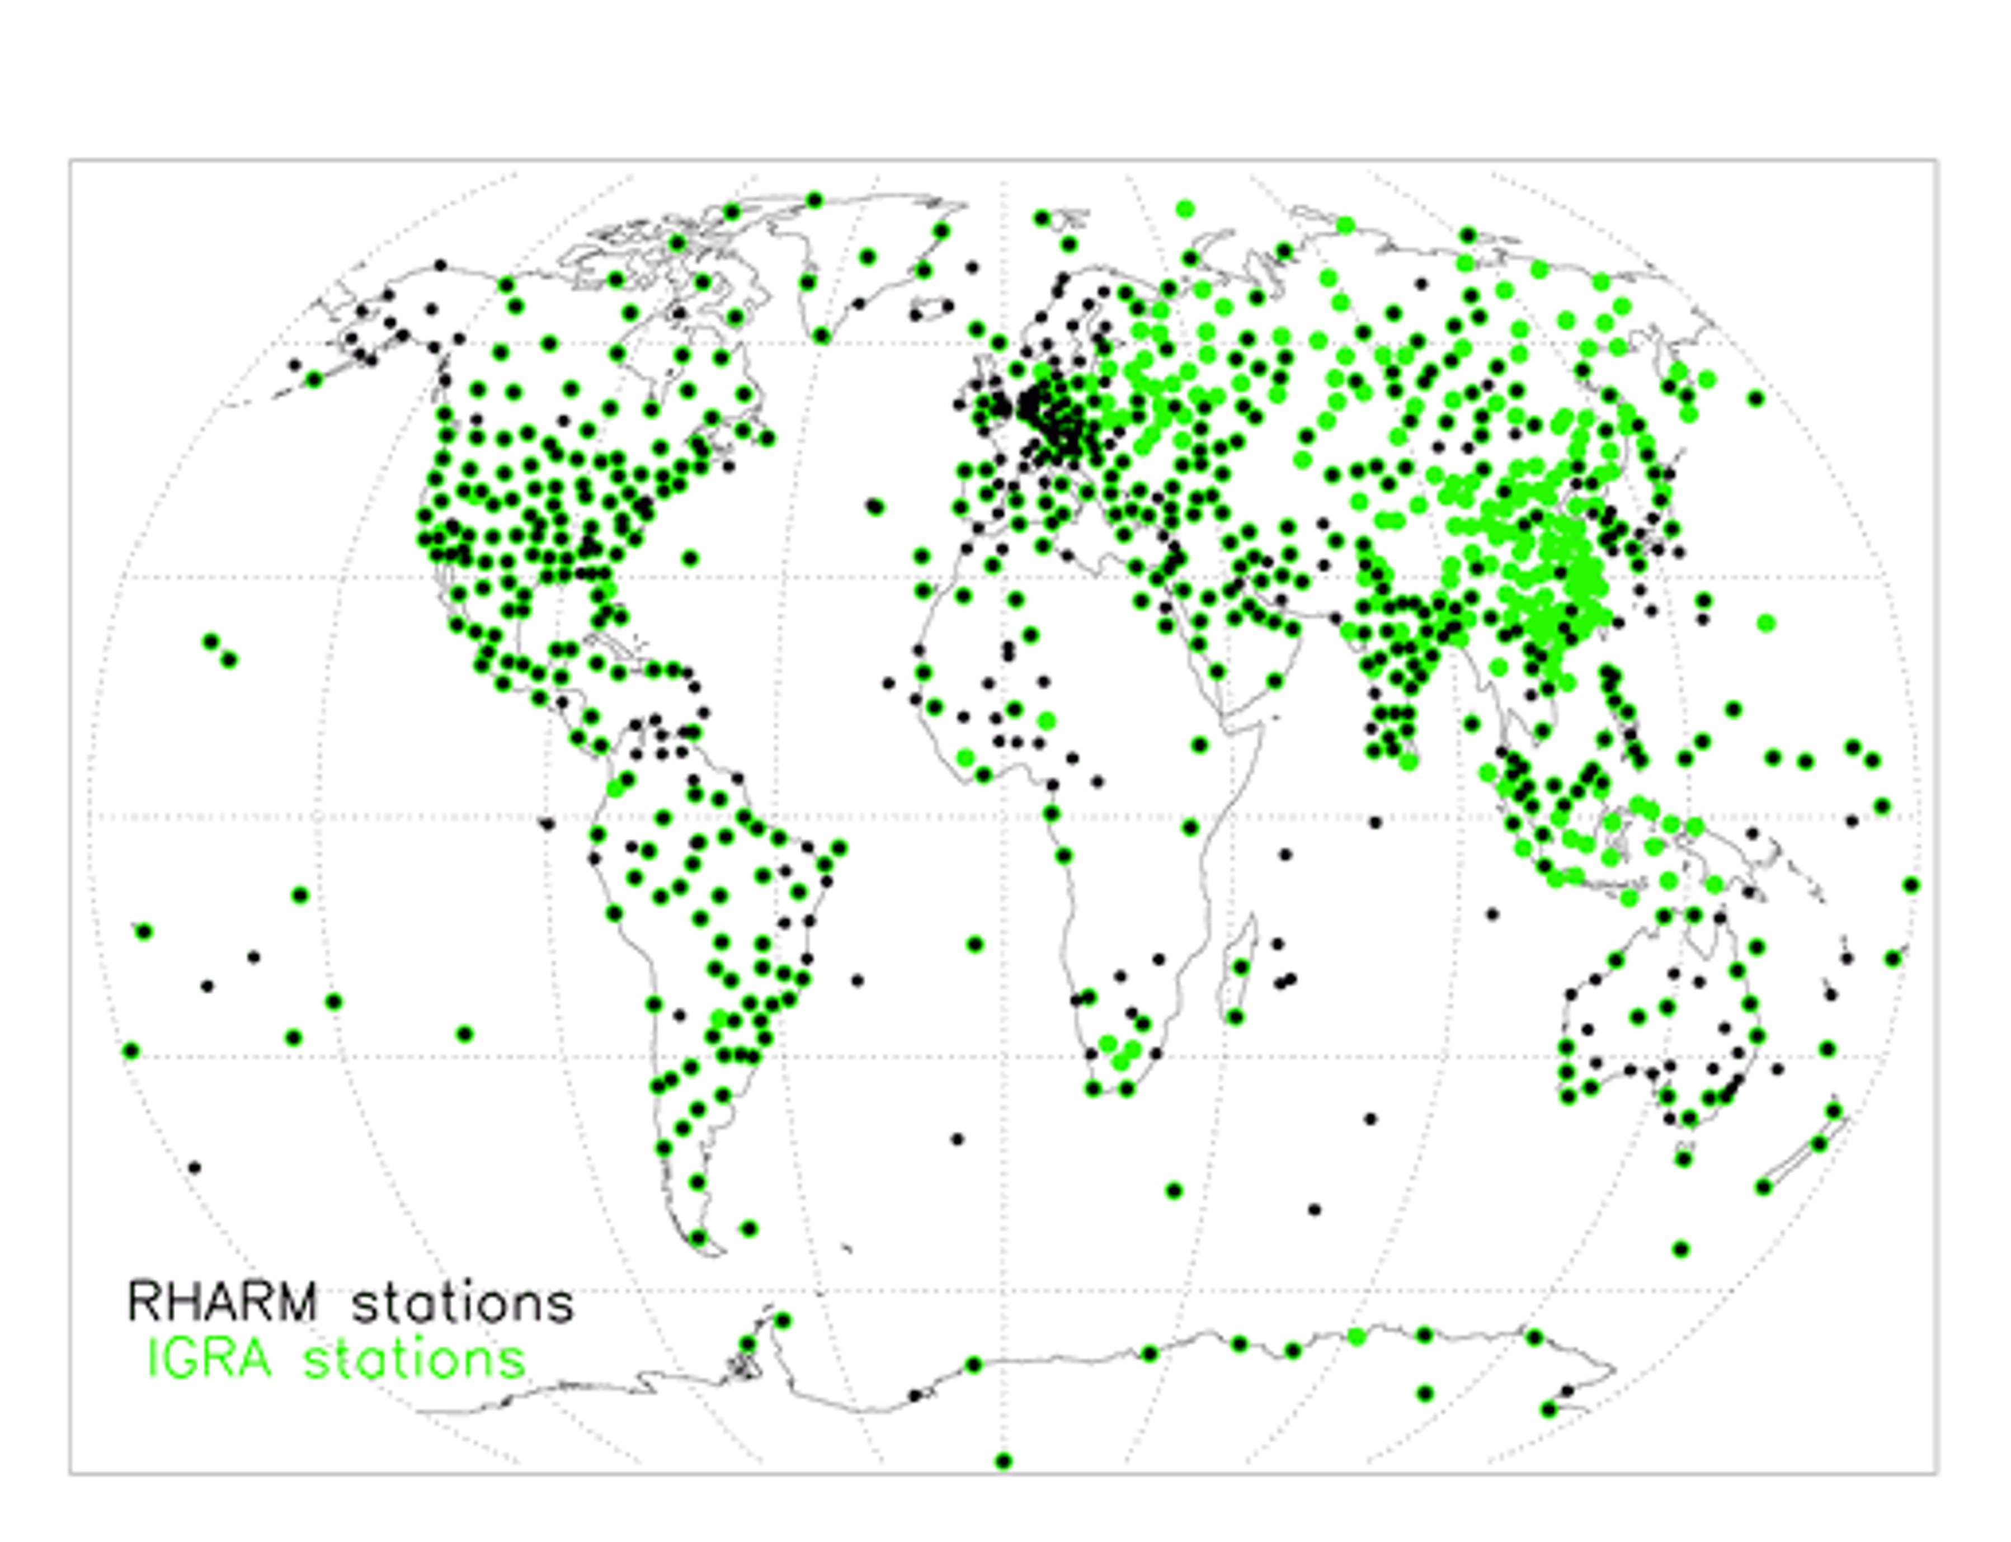
Radiosonde observations
Copernicus Climate Change Service (C3S), Radiosounding HARMonization (RHARM)
bias-adjusted radiosounding observations from the Integrated Global Radiosonde Archive (IGRA)
estimated uncertainties (building on GRUAN expertise and intercomparison data)
• 700 sites (+ ships)
(Madonna et al., 2022)

Slide 9
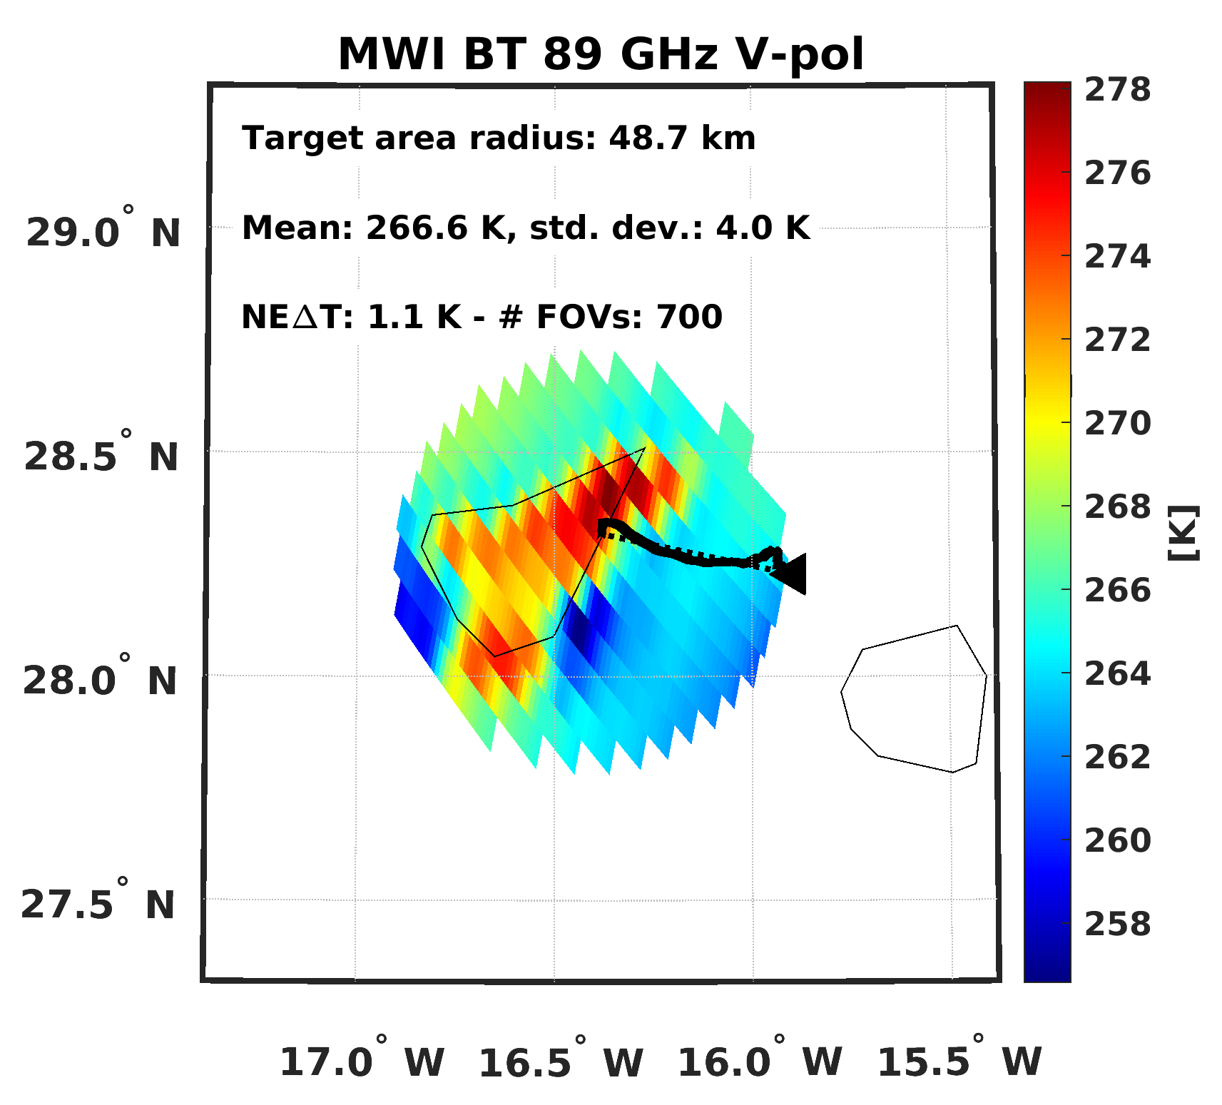
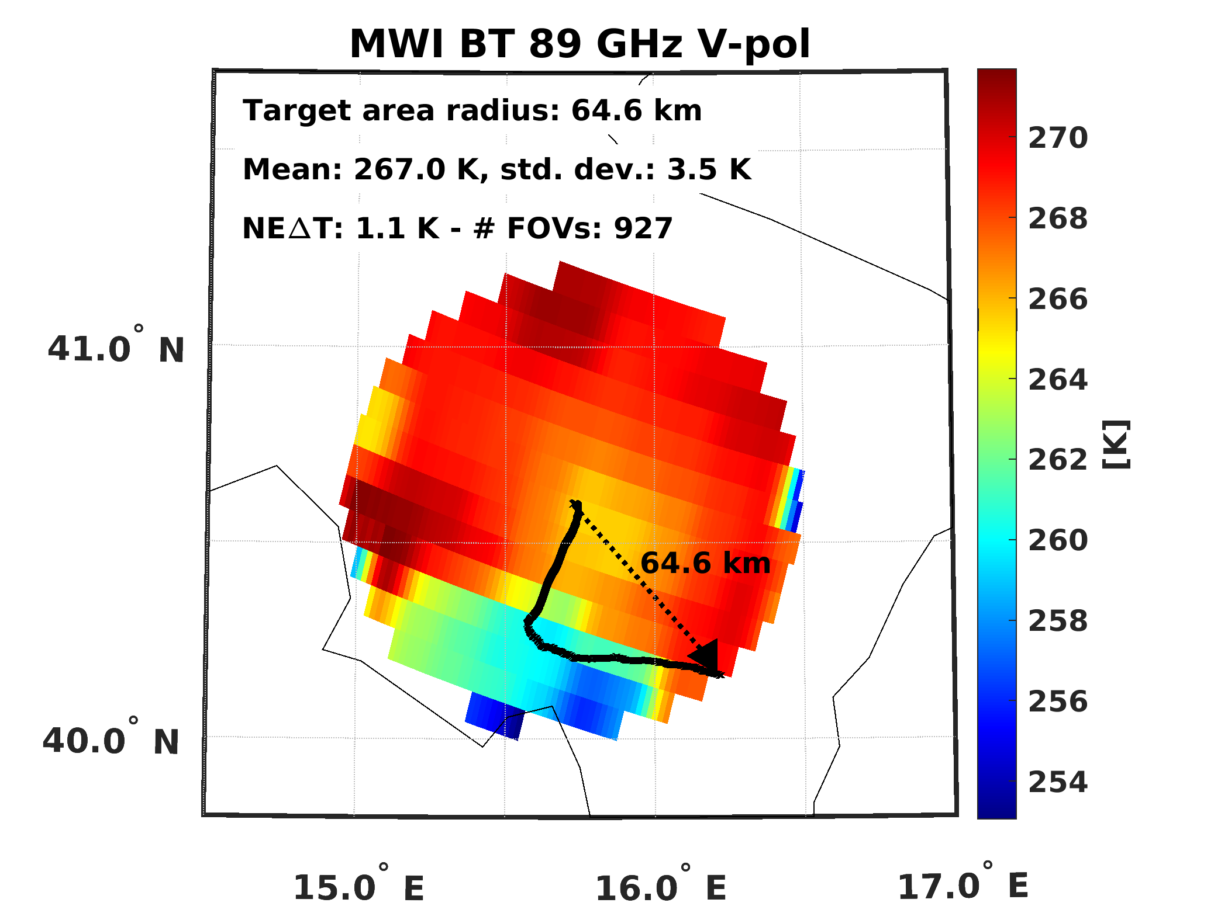
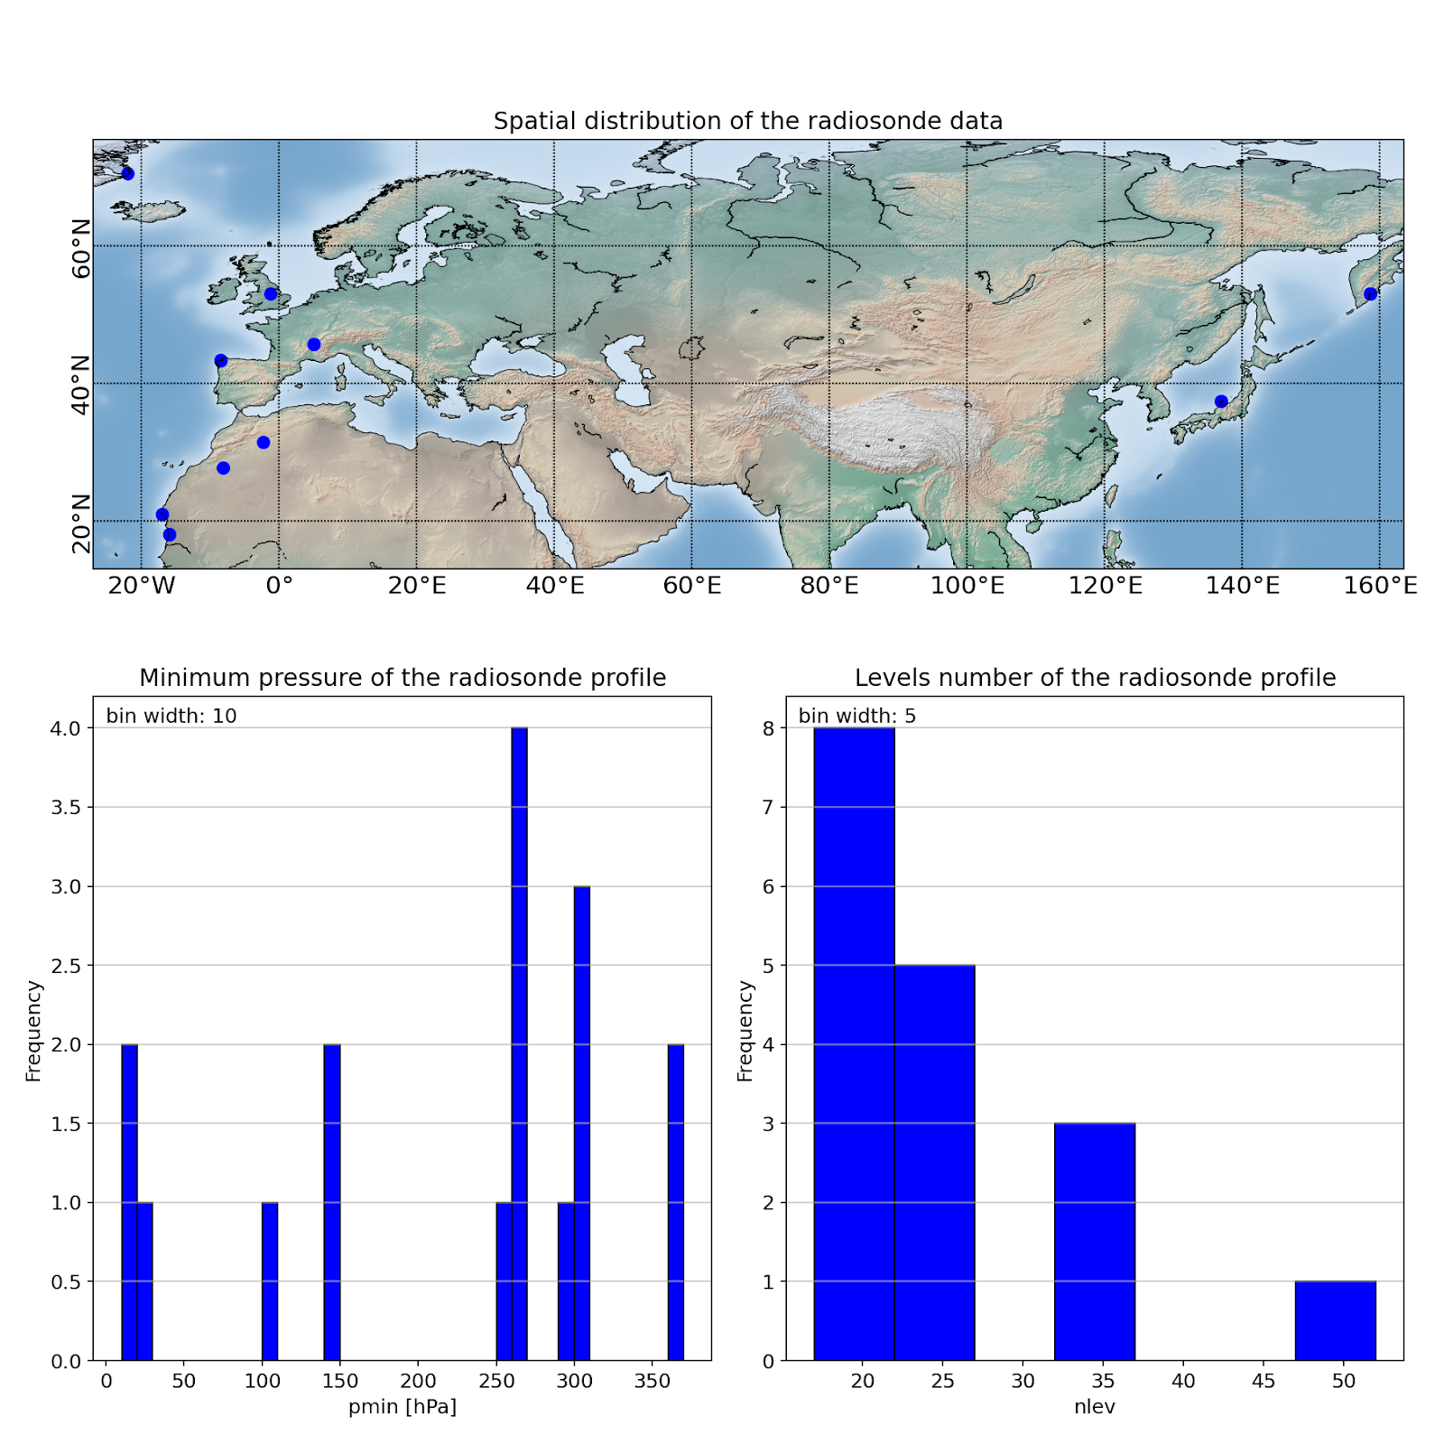
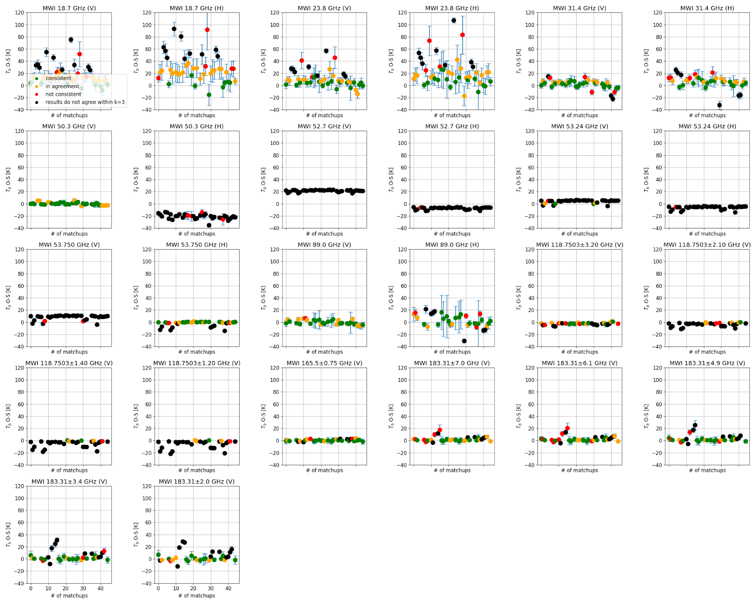
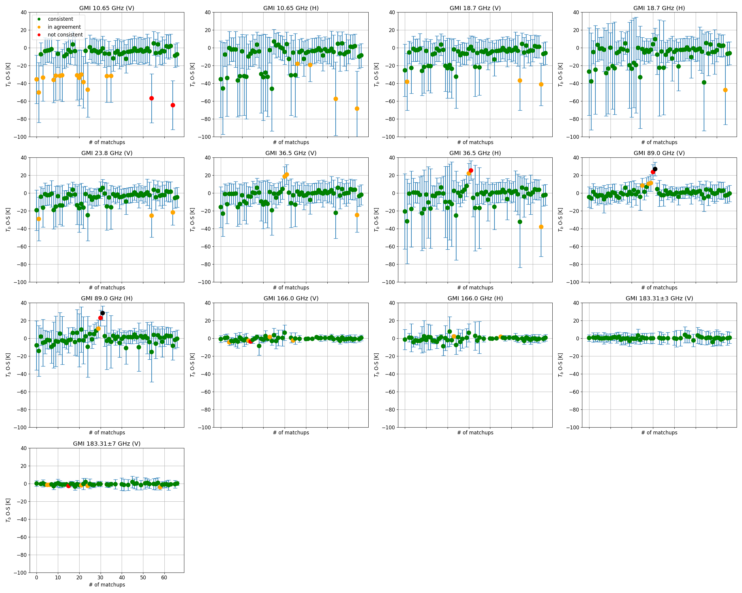
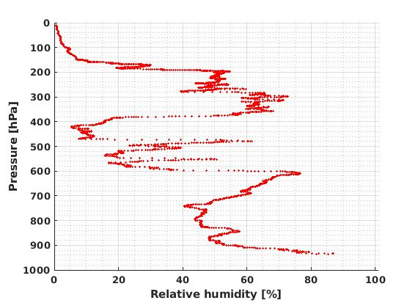
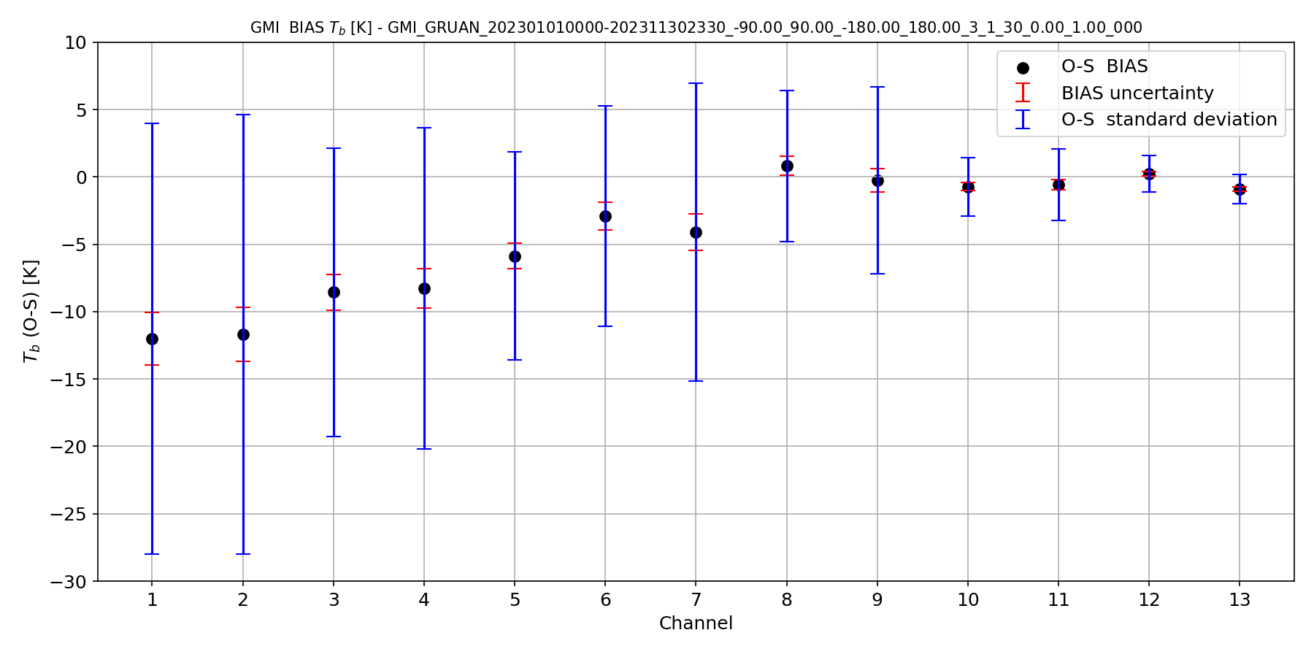
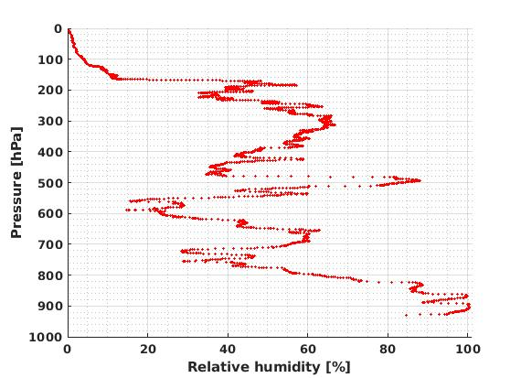
Introduction to VICIRS tool
output
input
VICIRS TOOL
input collection
Input analysis
simulation of BT from RS (NWP)
BT(obs)–BT(sim) analysis and
uncertainty analysis
multisource analysis (NWP)

Slide 10
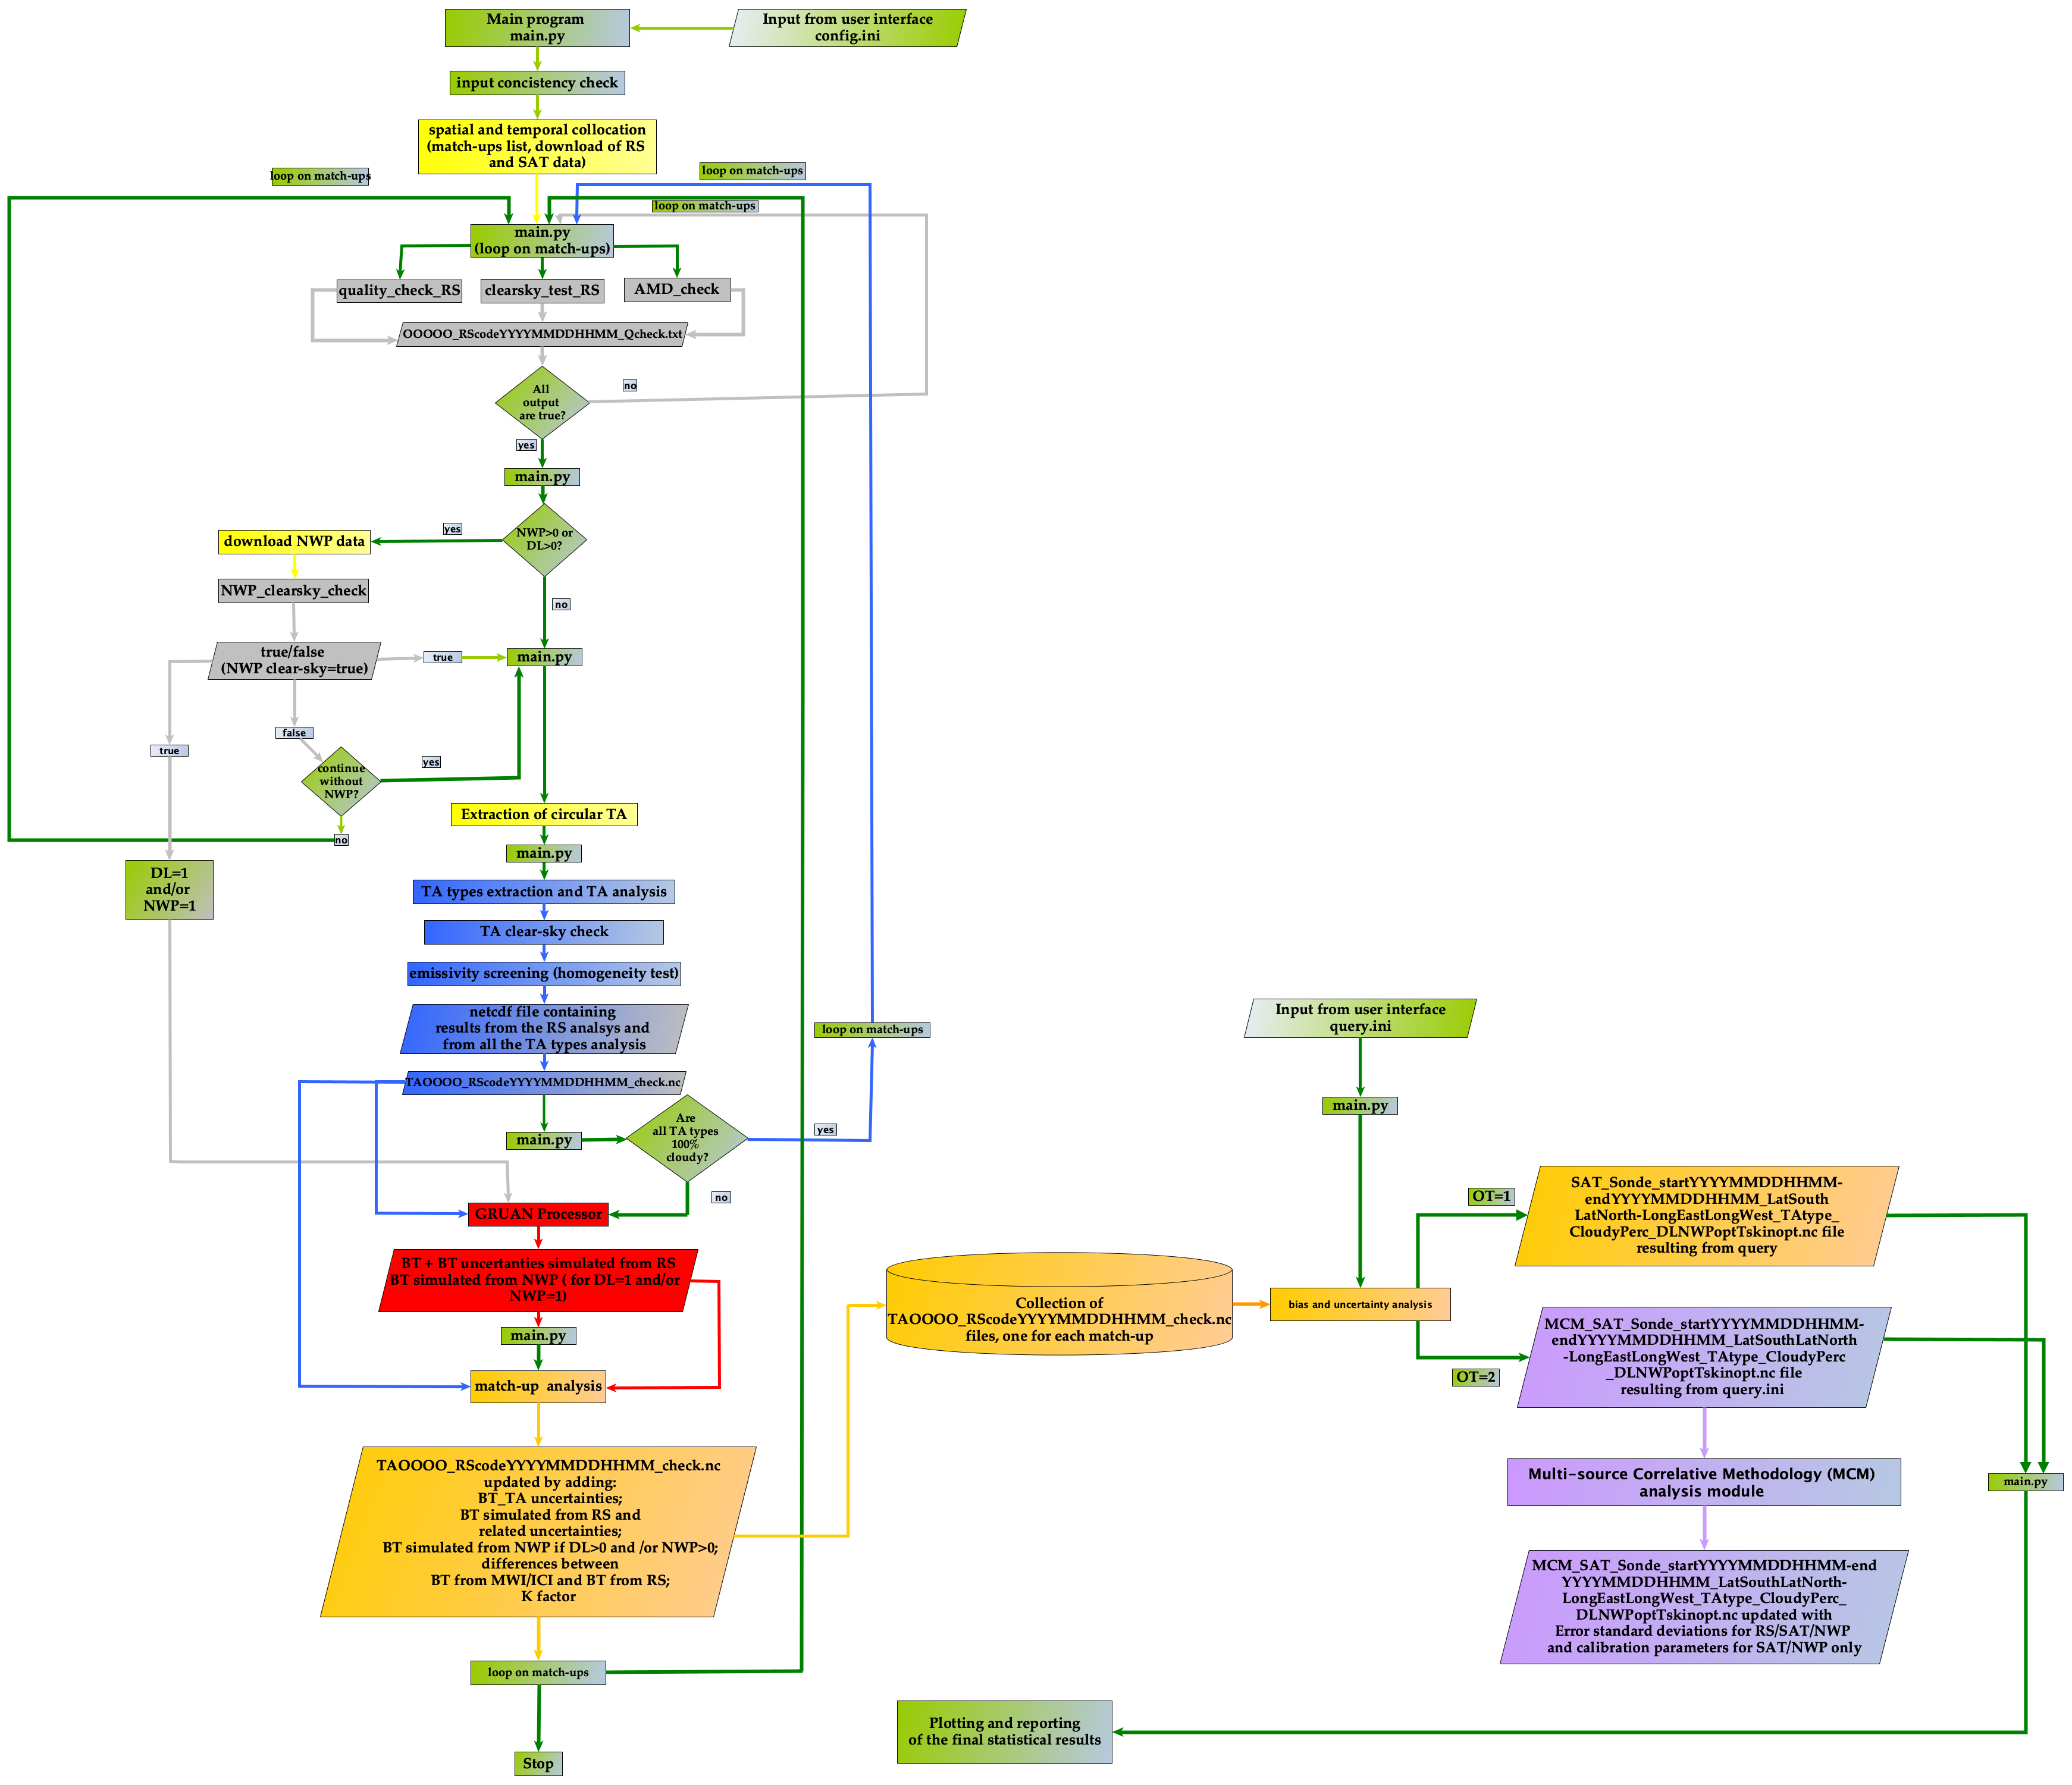
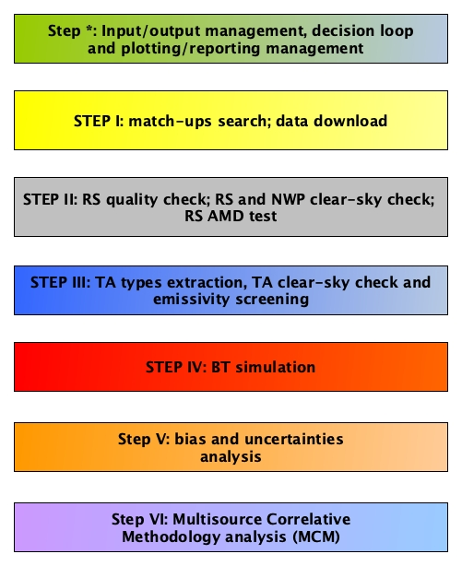
VICIRS tool flowchart

Slide 11
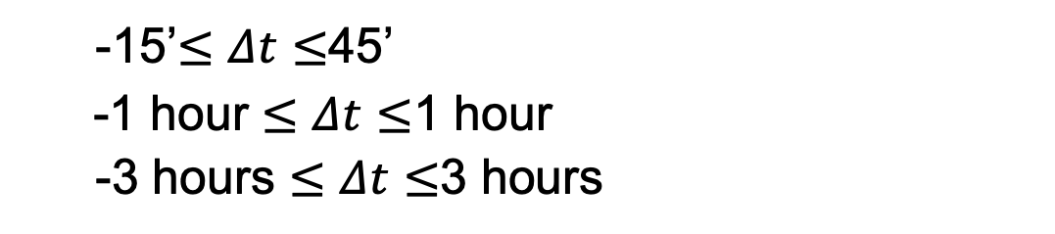
FIRST PHASE: Data collection
Flexible input
radiosonde archive:
temporal range:
temporal distance:
spatial range:
land fraction (LF):
multisource:
GRUAN & RHARM
yyyy-mm-dd hh:mm (start) to yyyy-mm-dd hh:mm (end)
-15’$≤Δt≤$45’
-1 hour $≤$ $Δt≤$1 hour
-3 hours $≤Δt≤$3 hours
lat North/long West/lat South/long East
  maximum value of MWI/ICI FOV
  Dedicated RS & NWP

Slide 12
RS quality check
RS 2023-10-10, 22:00GMT
GRUAN RS
Clear-sky
Is RS useful for calibration process?
RS quality check
number of pressure levels
pressure minimum value
air mass displacement (Buehler et al. 2004)
clear-sky test (Zhang et al. 2010)
RS 2023-10-17, 20:30 GMT
GRUAN RS
Cloudy

Slide 13
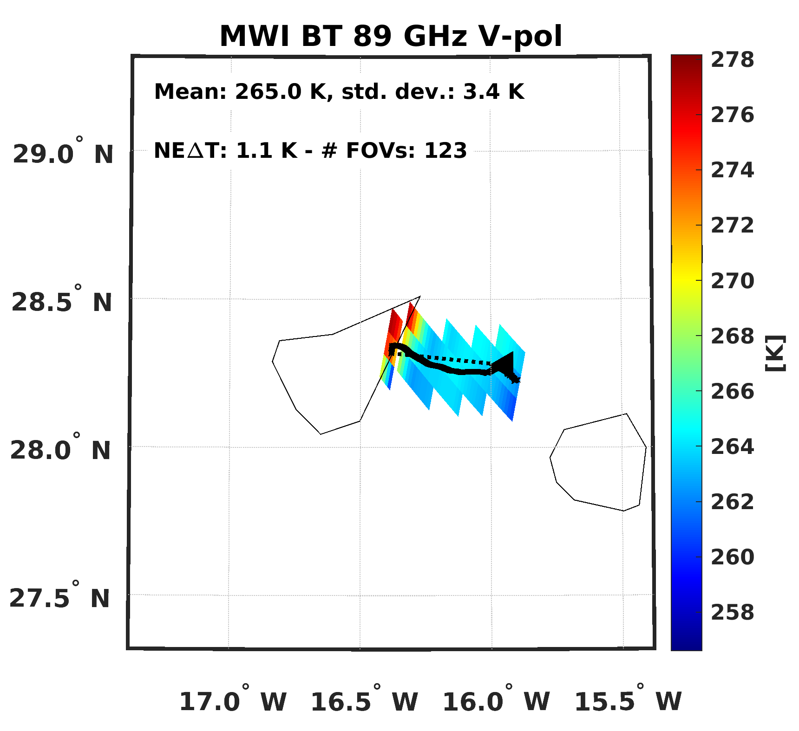
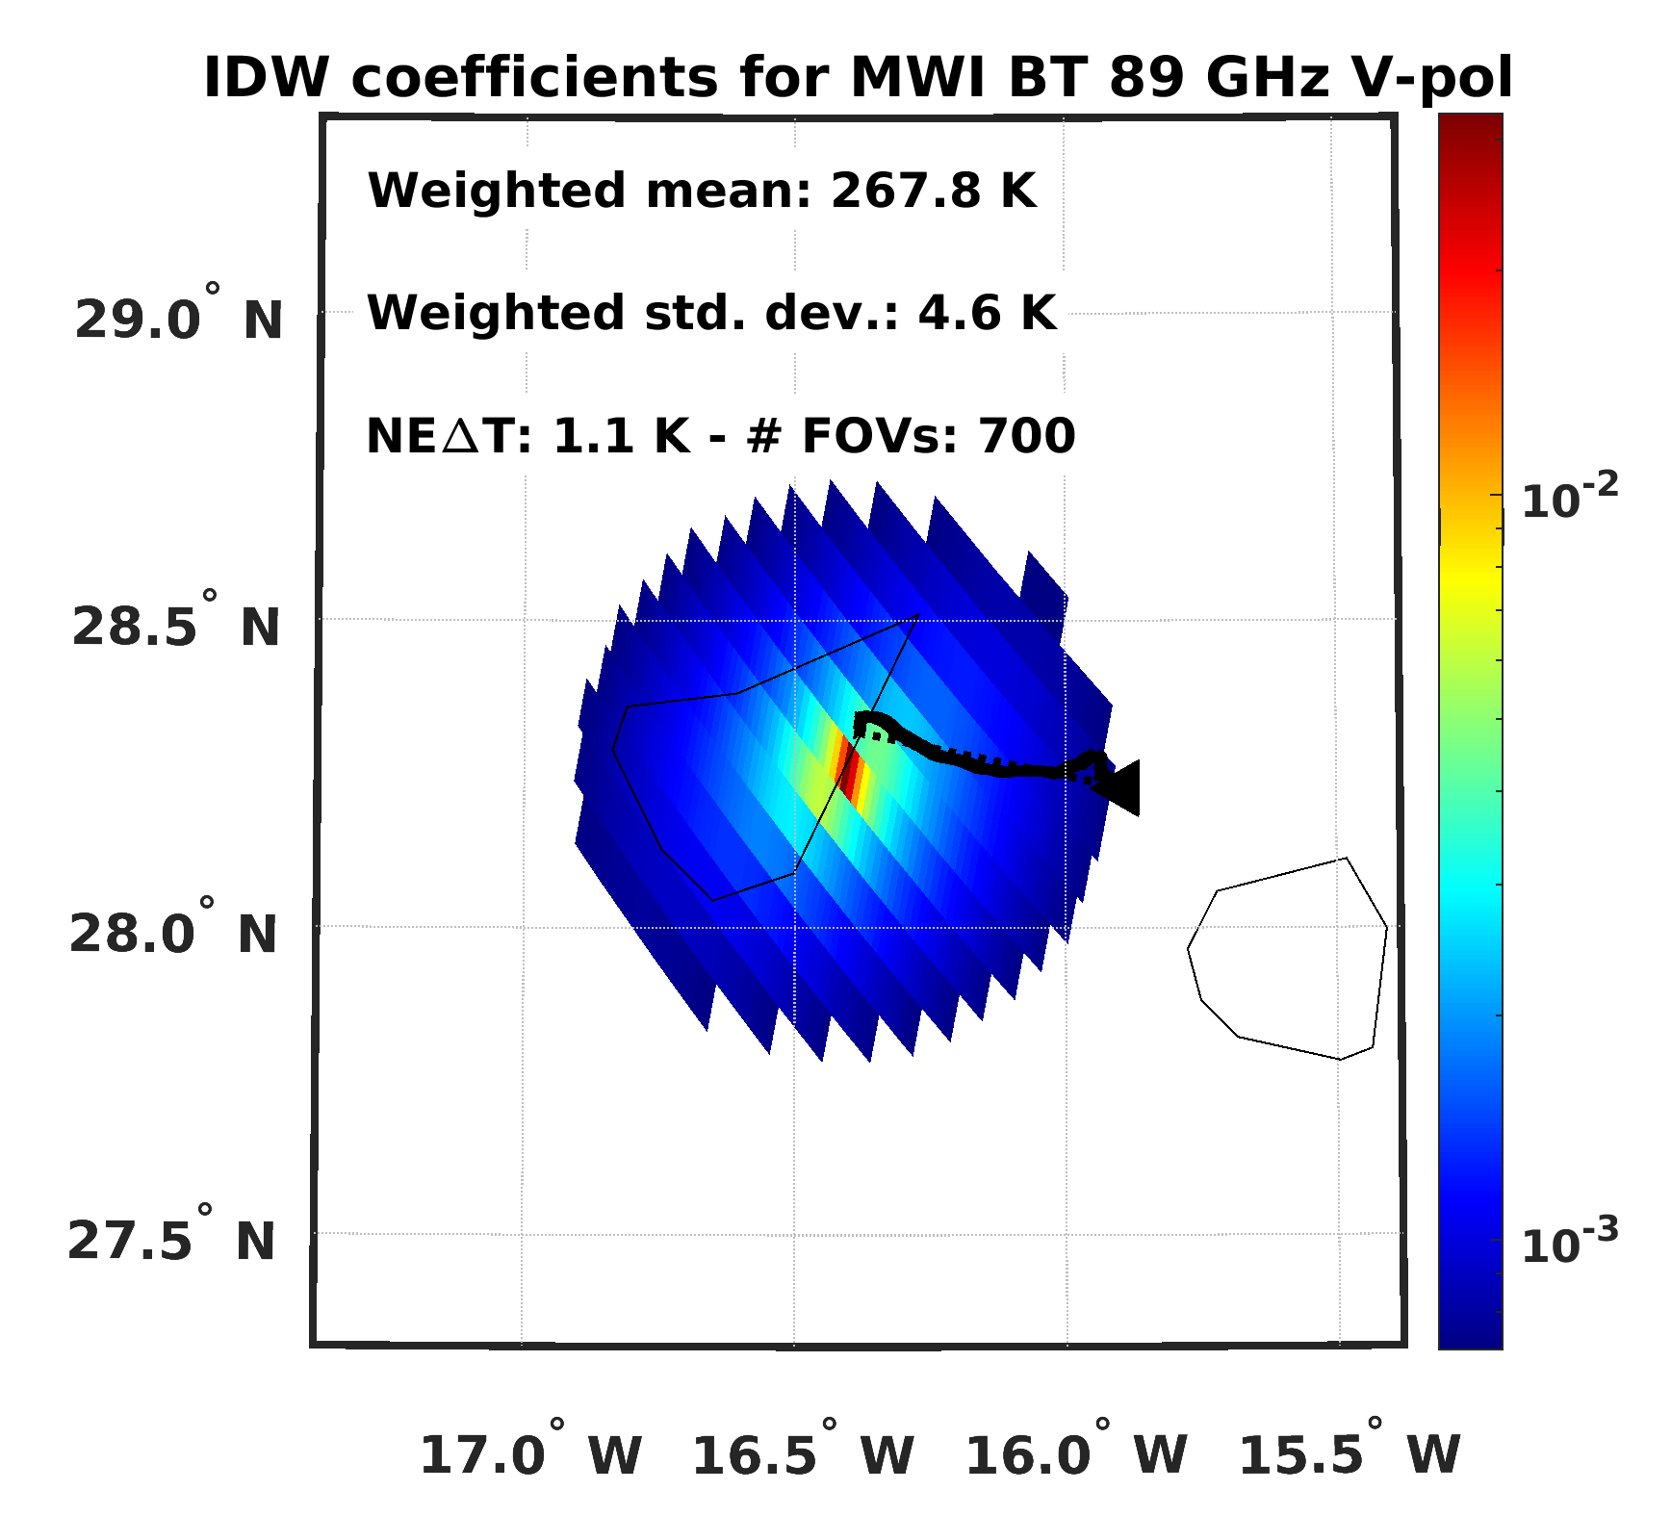
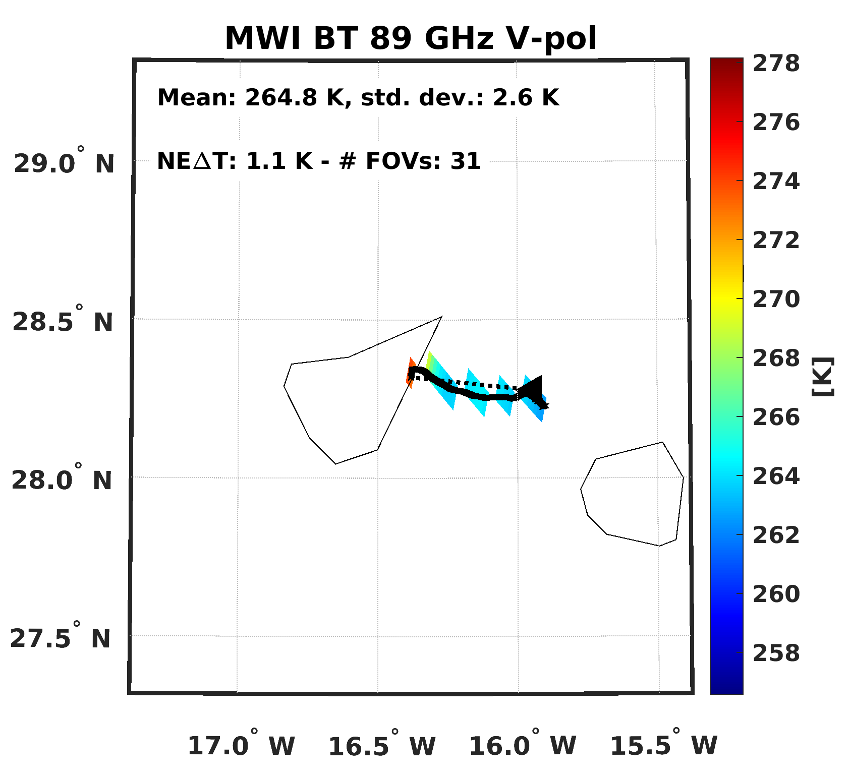
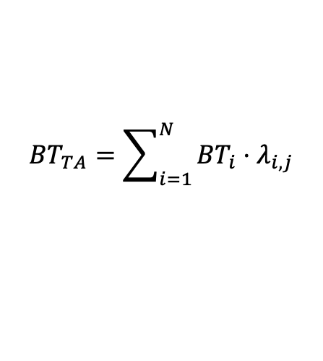

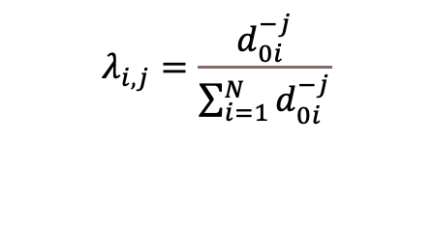
VICIRS tool: TA analysis
Target Area (TA) analysis
TA types | 1: circular TA
 | 2: circular TA (inverse distance weight)
TA types | 3: circular TA (inverse squared-distance weight)
 | 4: RS-driven TA
 | 5: RS-driven TA (3x3)
$${BT}_{TA}=\sum_{i=1}^{N}{{BT}_{i}⋅λ_{i,j}}$$
$$λ_{i,j}=\frac{d_{0i}^{−j}}{\sum_{i=1}^{N}{d_{0i}^{−j}}}$$
Homogeneity test
SD_BT_{TA} < NE$∆T$ (Buehler et al, 2004)
Clear sky test (Buehler et al, 2004; Hong et al 2005; Yaping et al, 2008; Gong and Wu, 2017)

Slide 14

BT simulation
GRUAN Processor v6.3.b.0.1
upgraded to work with
  latest RTTOV (v13.2)
  latest GRUAN RS (RS41)
  RHARM RS
  latest emissivity model
GRUAN Processor v6.3
developed by Carminati et al. (2019)
to process GRUAN RS
and propagate RS uncertainties
based on RTTOV and RadSim
  (from NWP-SAF)
${BT}_{RS}=LF_{TA}∙{BT}_{RS}_l+(1−LF_{TA})∙{BT}_{RS}_s$
$u{BT}_{RS}=\sqrt{{LF_{TA}(i,j)}^{2}⋅{u{BT}_{RS}_l(i)}^{2}+{(1−LF_{TA})}^{2}⋅{u{BT}_{RS}_s}^{2})}$
LF_{TA}=Land Fraction

Slide 15
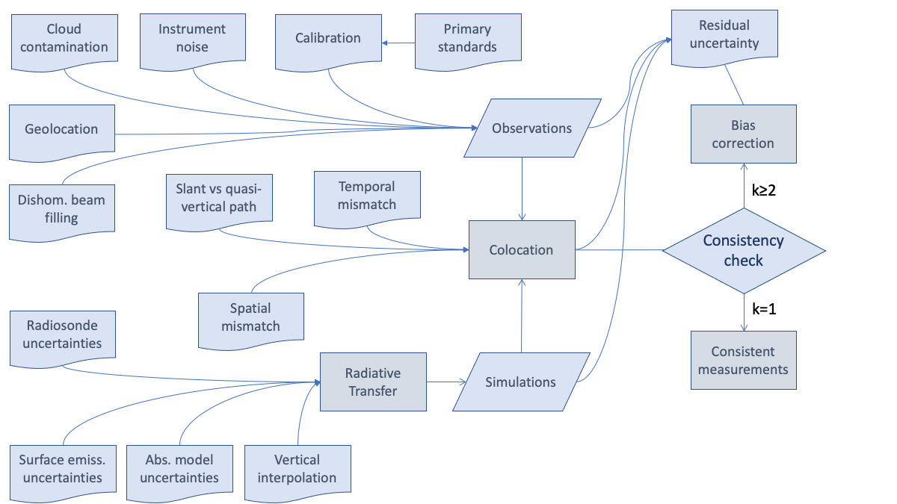




UncErtainty MODEL DIAGRAM
SAT OBS
RS SIM
COL
$$u_all=\sqrt{u_{OBS}^{2}+u_{SIM}^{2}+u_{COL}^{2}}$$
$${BT}_{TA}−{BT}_{RS}≤k⋅u_all$$
  (Immler et al. 2010)

Slide 16
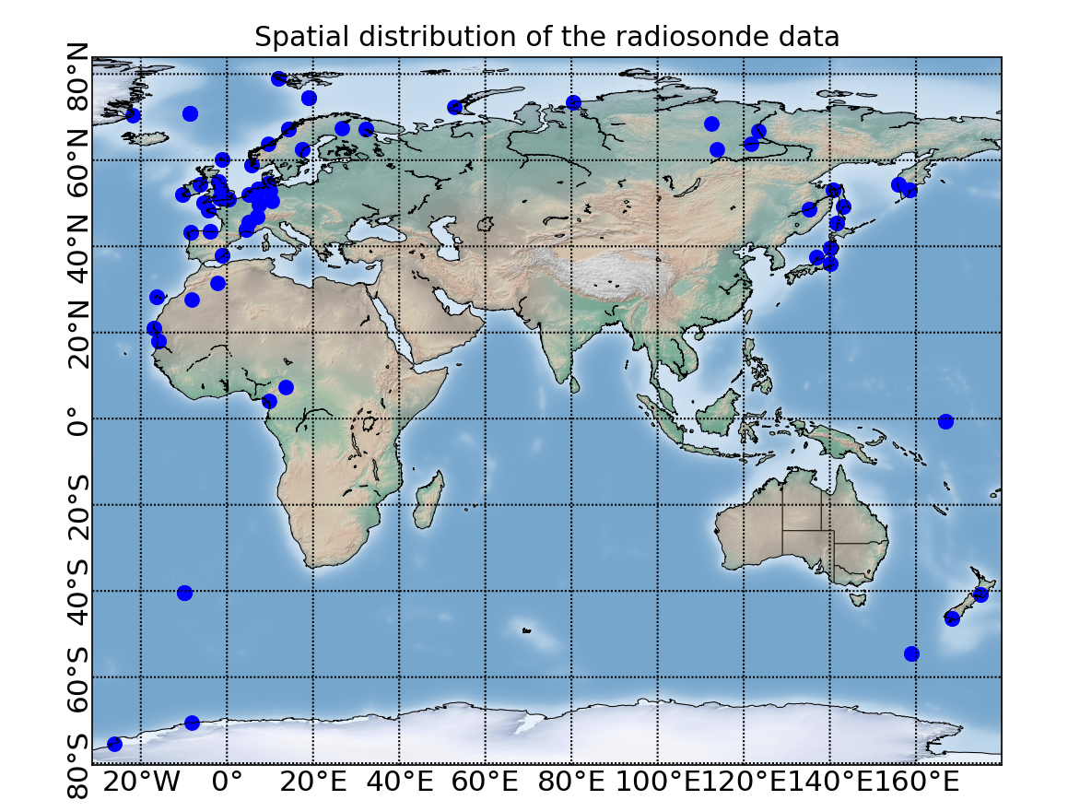
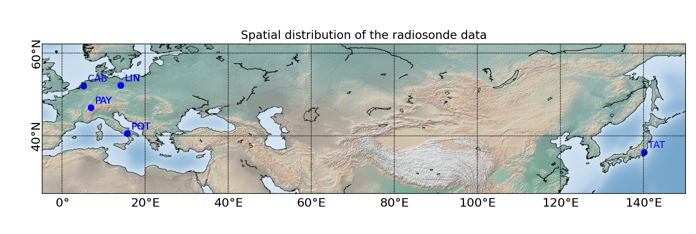
Demonstration of VICIRS tool
Simulated dataset (160 match-ups)
MWI and ICI L1B simulated dataset
Spatially & temporally collocated RSs
  from RHARM archive
    2007-09-12 08:00 to 2007-09-12 12:00
    2008-02-23 08:30 to 2008-02-23 10:30
Real observations (37 match-ups)
NASA Global Precipitation Measurement (GPM) Microwave Imager (GMI) obs
Spatially & temporally collocated RSs
  from GRUAN Archive
  2023-09-01 00:00 to 2023-12-30 23:59

Slide 17
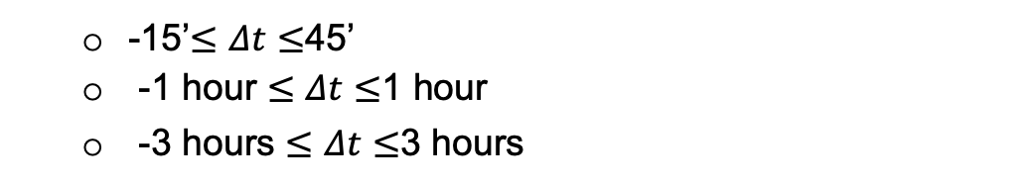
Demonstration of VICIRS tool
SECOND PHASE: DATA QUERY
radiometer
radiosonde archive
temporal range
temporal distance
spatial range
target area
land fraction range
target area cloudy percentage
dedicated launches;
NWP (and option for skin temperature)
homogeneity flag
MCM analysis
MWI, ICI, GMI
GRUAN, RHARM
yyyy-mm-dd hh:mm (start) to yyyy-mm-dd hh:mm (end)
-15’$≤Δt≤$45’
-1 hour $≤$ $Δt≤$1 hour
-3 hours $≤Δt≤$3 hours
spatial range;
1, 2, 3, 4, 5
[LFmin: LFmax]
maximum value for cloudy percentage
0,1
0,1 (1,2)
0 all TAs, 1 only homogeneous TA
0=no, 1=yes

Slide 18
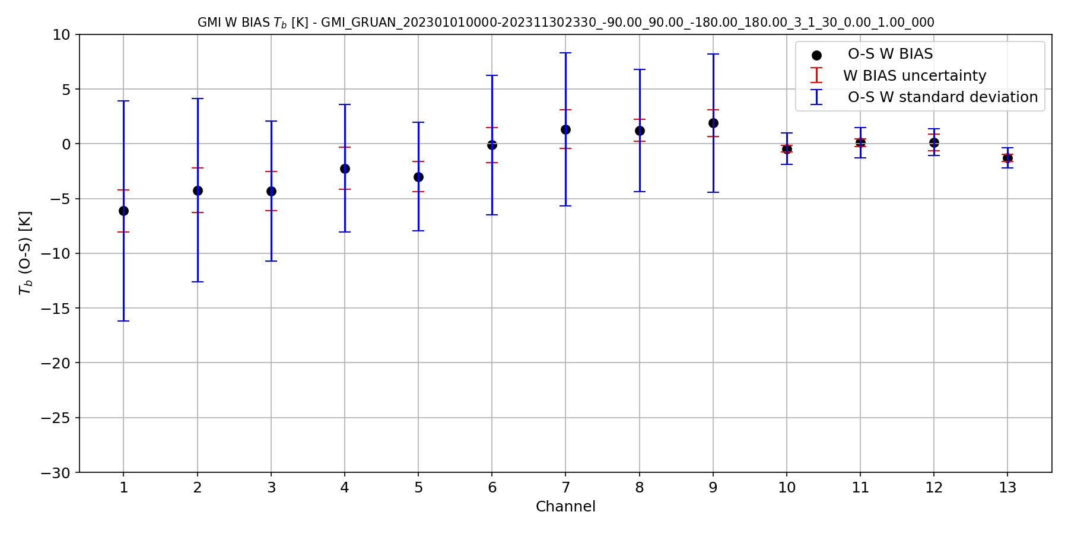
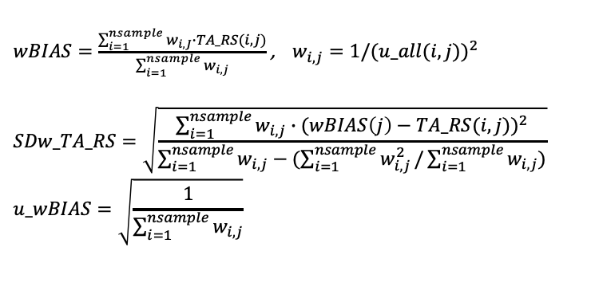
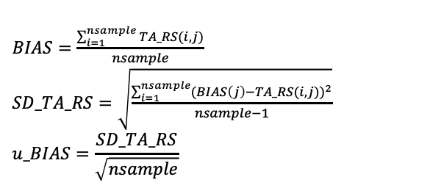



QUERY ON MATCH-UPS: OUTPUT
$${BT}_{TA}−{BT}_{RS}≤k⋅u_all$$
$$BIAS$$
$$weighted BIAS$$
166, 183GHz
$BIAS=\frac{\sum_{i=1}^{nsample}{TA_RS(i,j)}}{nsample}$
$SD_TA_RS=\sqrt{\frac{\sum_{i=1}^{nsample}{{(BIAS\left(j\right)−TA_RS(i,j))}^{2}}}{nsample−1}}$
$$u_BIAS=\frac{SD_TA_RS}{\sqrt{nsample}}$$
$wBIAS=\frac{\sum_{i=1}^{nsample}{w_{i,J}∙TA_RS(i,j)}}{\sum_{i=1}^{nsample}{w_{i,j}}}$ , $w_{i,j}=1/{(u_all(i,j))}^{2}$
$$SDw_TA_RS=\sqrt{\frac{\sum_{i=1}^{nsample}{{w_{i,j}∙(wBIAS\left(j\right)−TA_RS(i,j))}^{2}}}{\sum_{i=1}^{nsample}{w_{i,j}}−(\sum_{i=1}^{nsample}{w_{i,j}^{2}}/\sum_{i=1}^{nsample}{w_{i,j}})}}$$
$$u_wBIAS=\sqrt{\frac{1}{\sum_{i=1}^{nsample}{w_{i,j}}}}$$
k=1 (data are consistent);
k=2 (data are in statistical agreement);
k=3 (data are significantly different);.
results do not agree within k=3
for all the match-ups and for all the frequencies
for all the frequencies

Slide 19
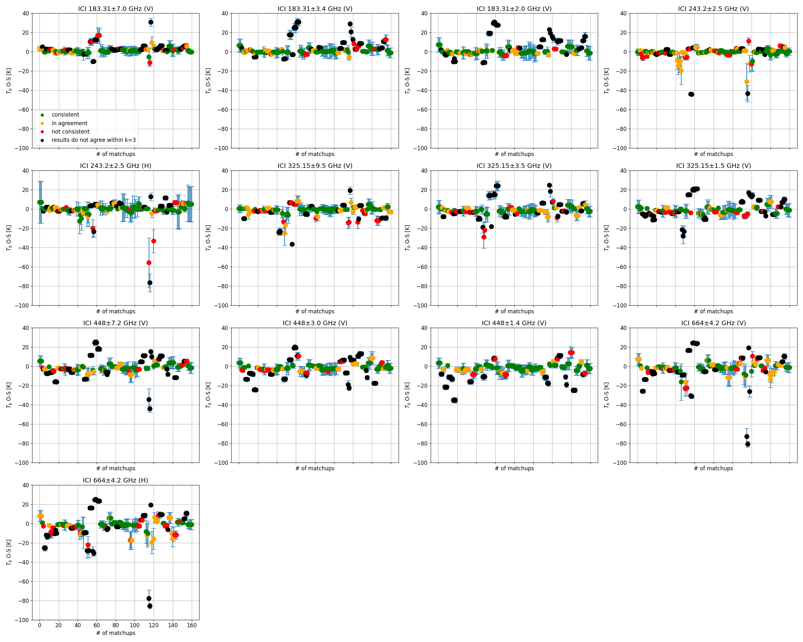
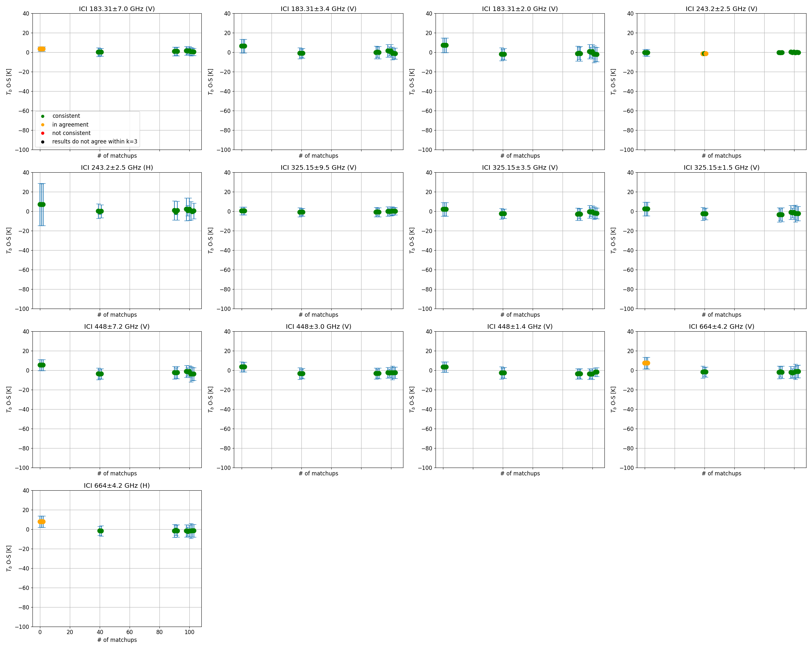


RESULTS for simulated dataset:
ICI L1B – RHARM, $LF∈[0:100]$
ALL DATA (UNFILTERED)
FILTERED (n_{lev,} P_{min})
ICI-RHARM 160 match-ups, $Rharm Pmin∈\left[10:400\right]hPa, nlev≥15$
ICI-RHARM 15 match-ups, $Rharm Pmin∈\left[10:100\right]hPa, nlev≥40$
k=1 (data are consistent);
k=2 (data are in statistical agreement);
k=3 (data are significantly different);.
results do not agree within k=3
$${BT}_{TA}−{BT}_{RS}≤k⋅u_all$$

Slide 20
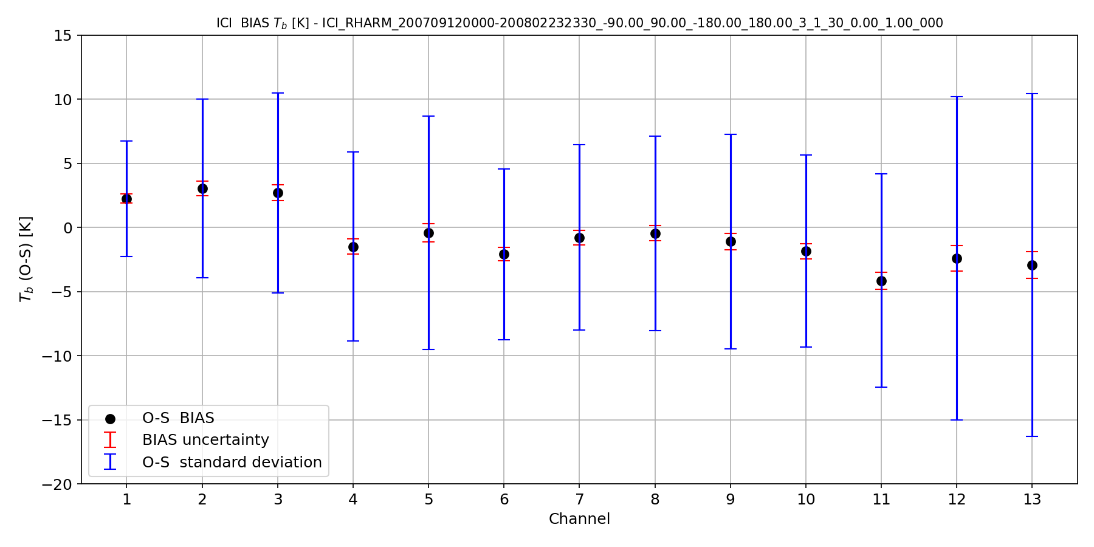
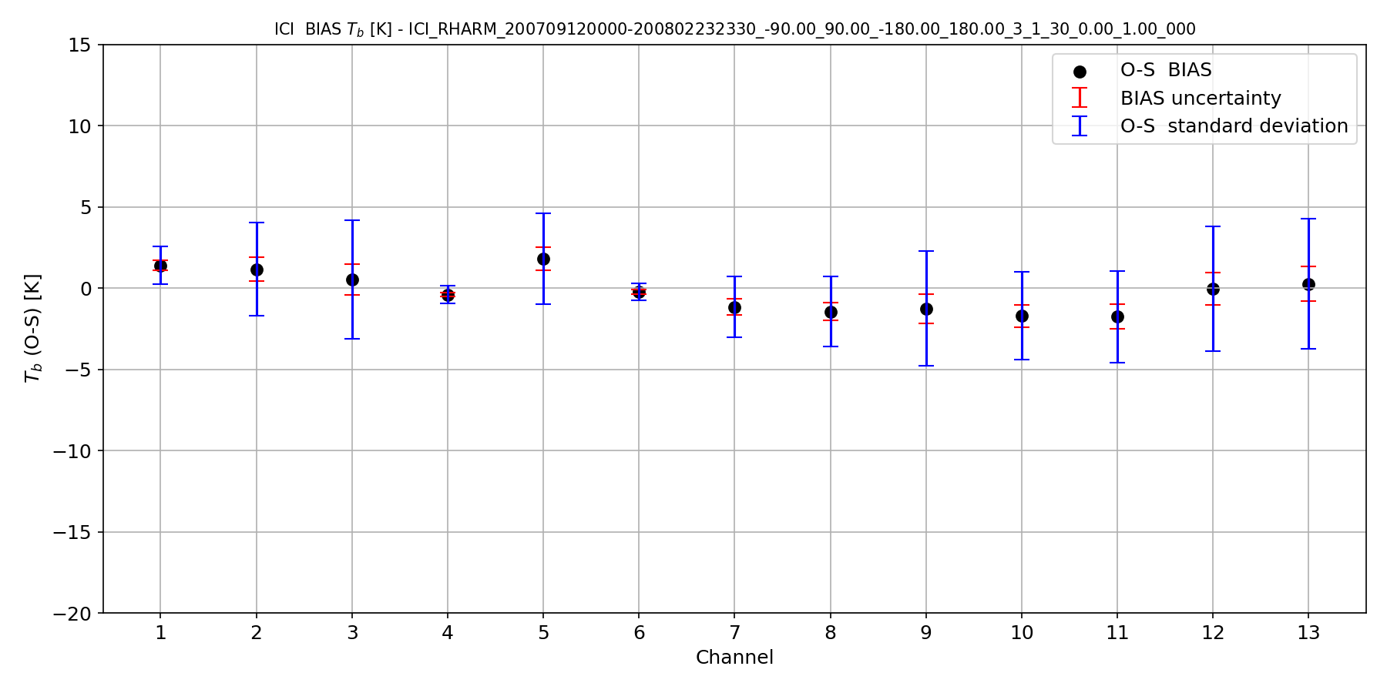
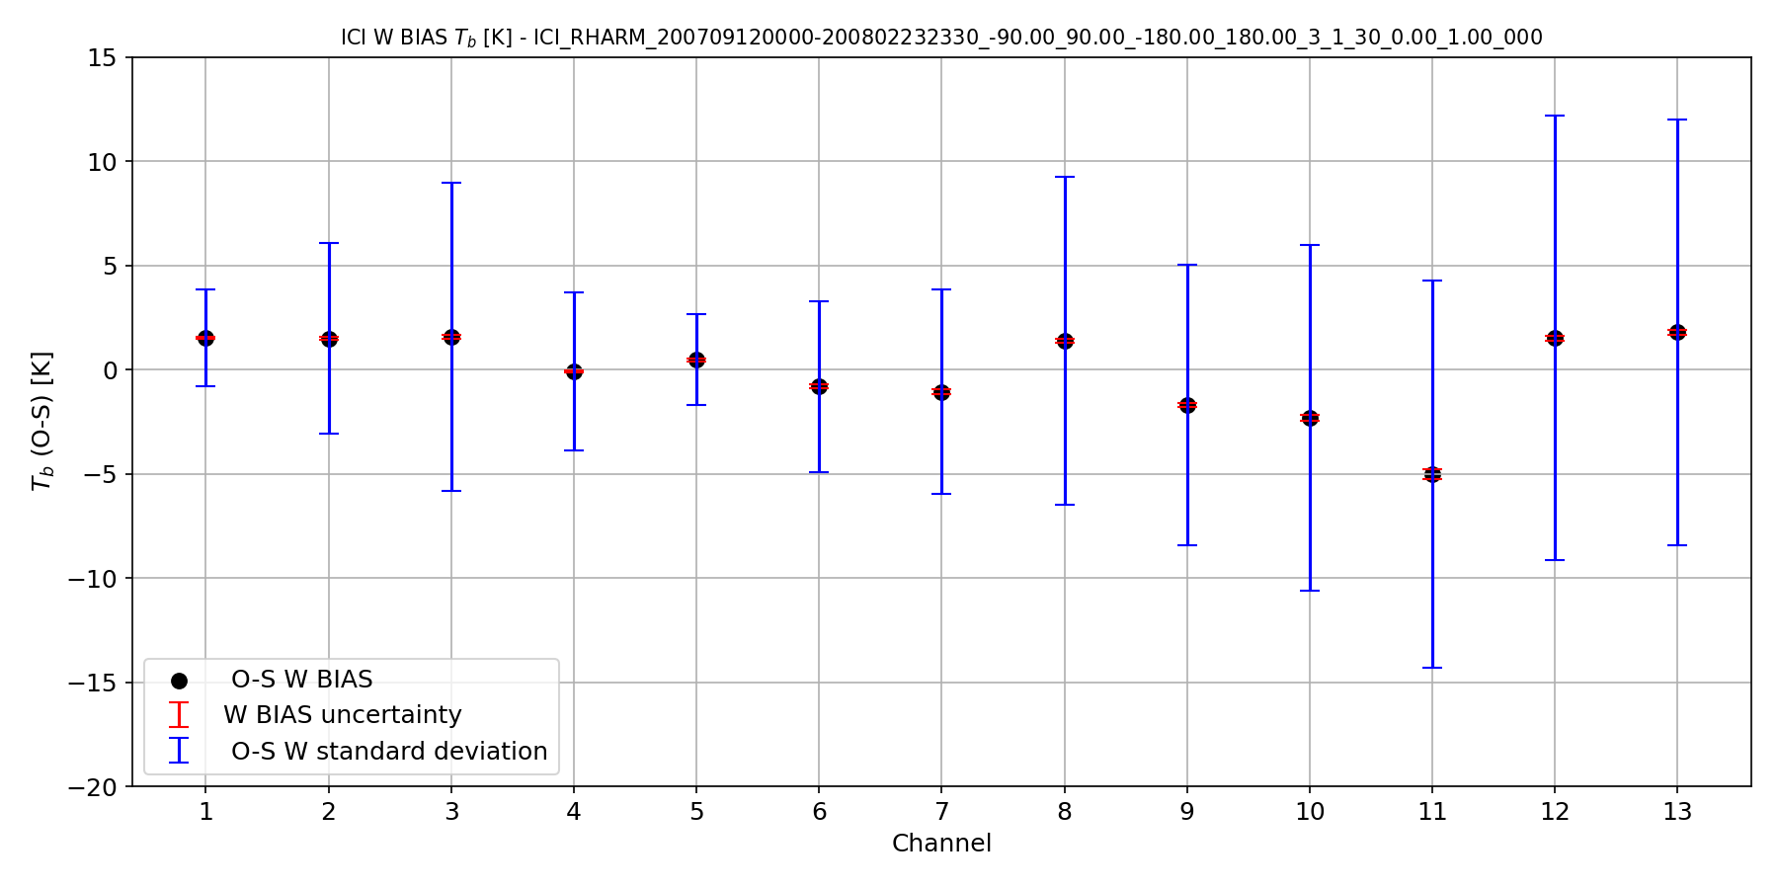
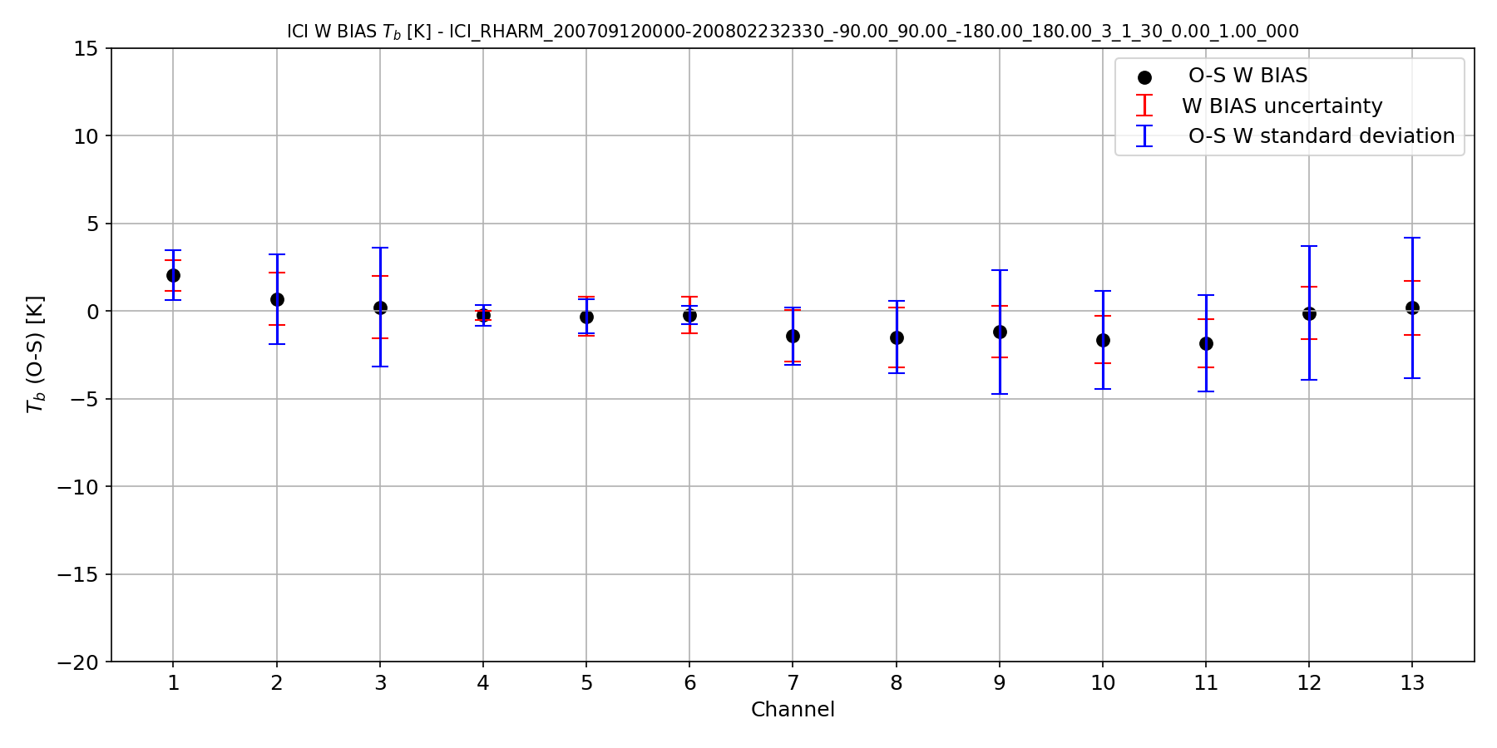


RESULTS for simulated dataset:
ICI L1B – RHARM, $LF∈[0:100]$
ALL DATA (UNFILTERED)
FILTERED (n_{lev,} P_{min})
160 match-ups, $Rharm Pmin∈\left[10:400\right]hPa, nlev≥15$
15 match-ups, $Rharm Pmin∈\left[10:100\right]hPa, nlev≥40$
$$BIAS$$
$$weighted BIAS$$

Slide 21
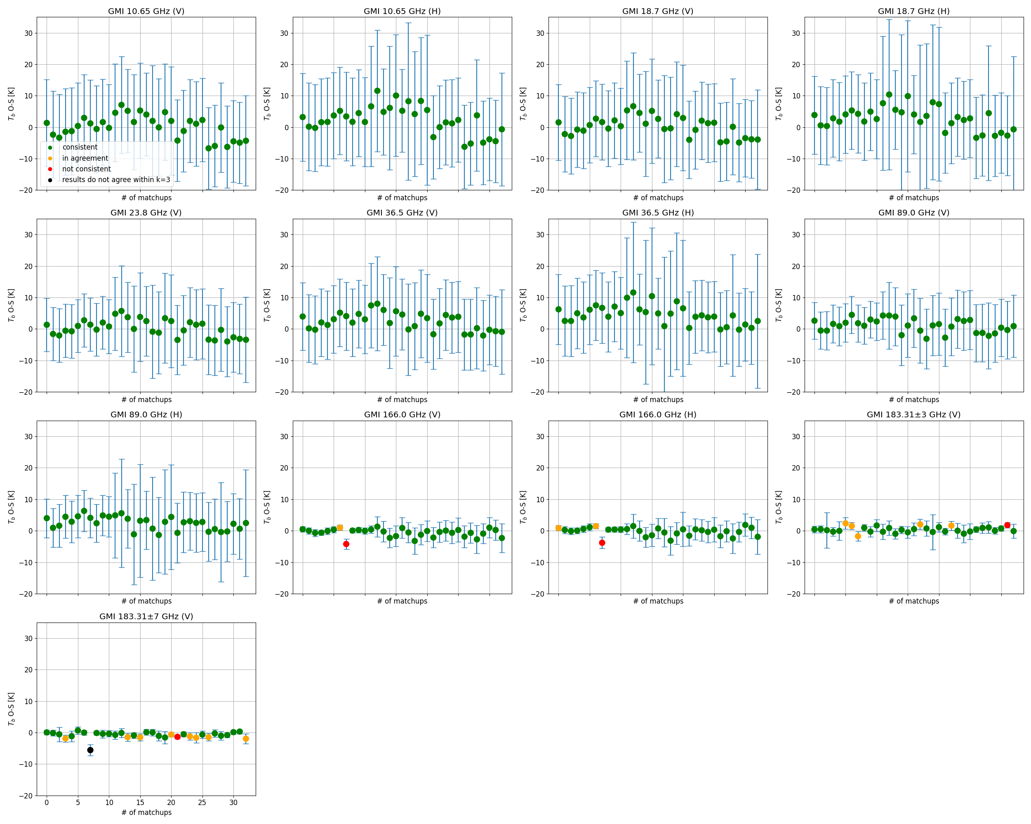
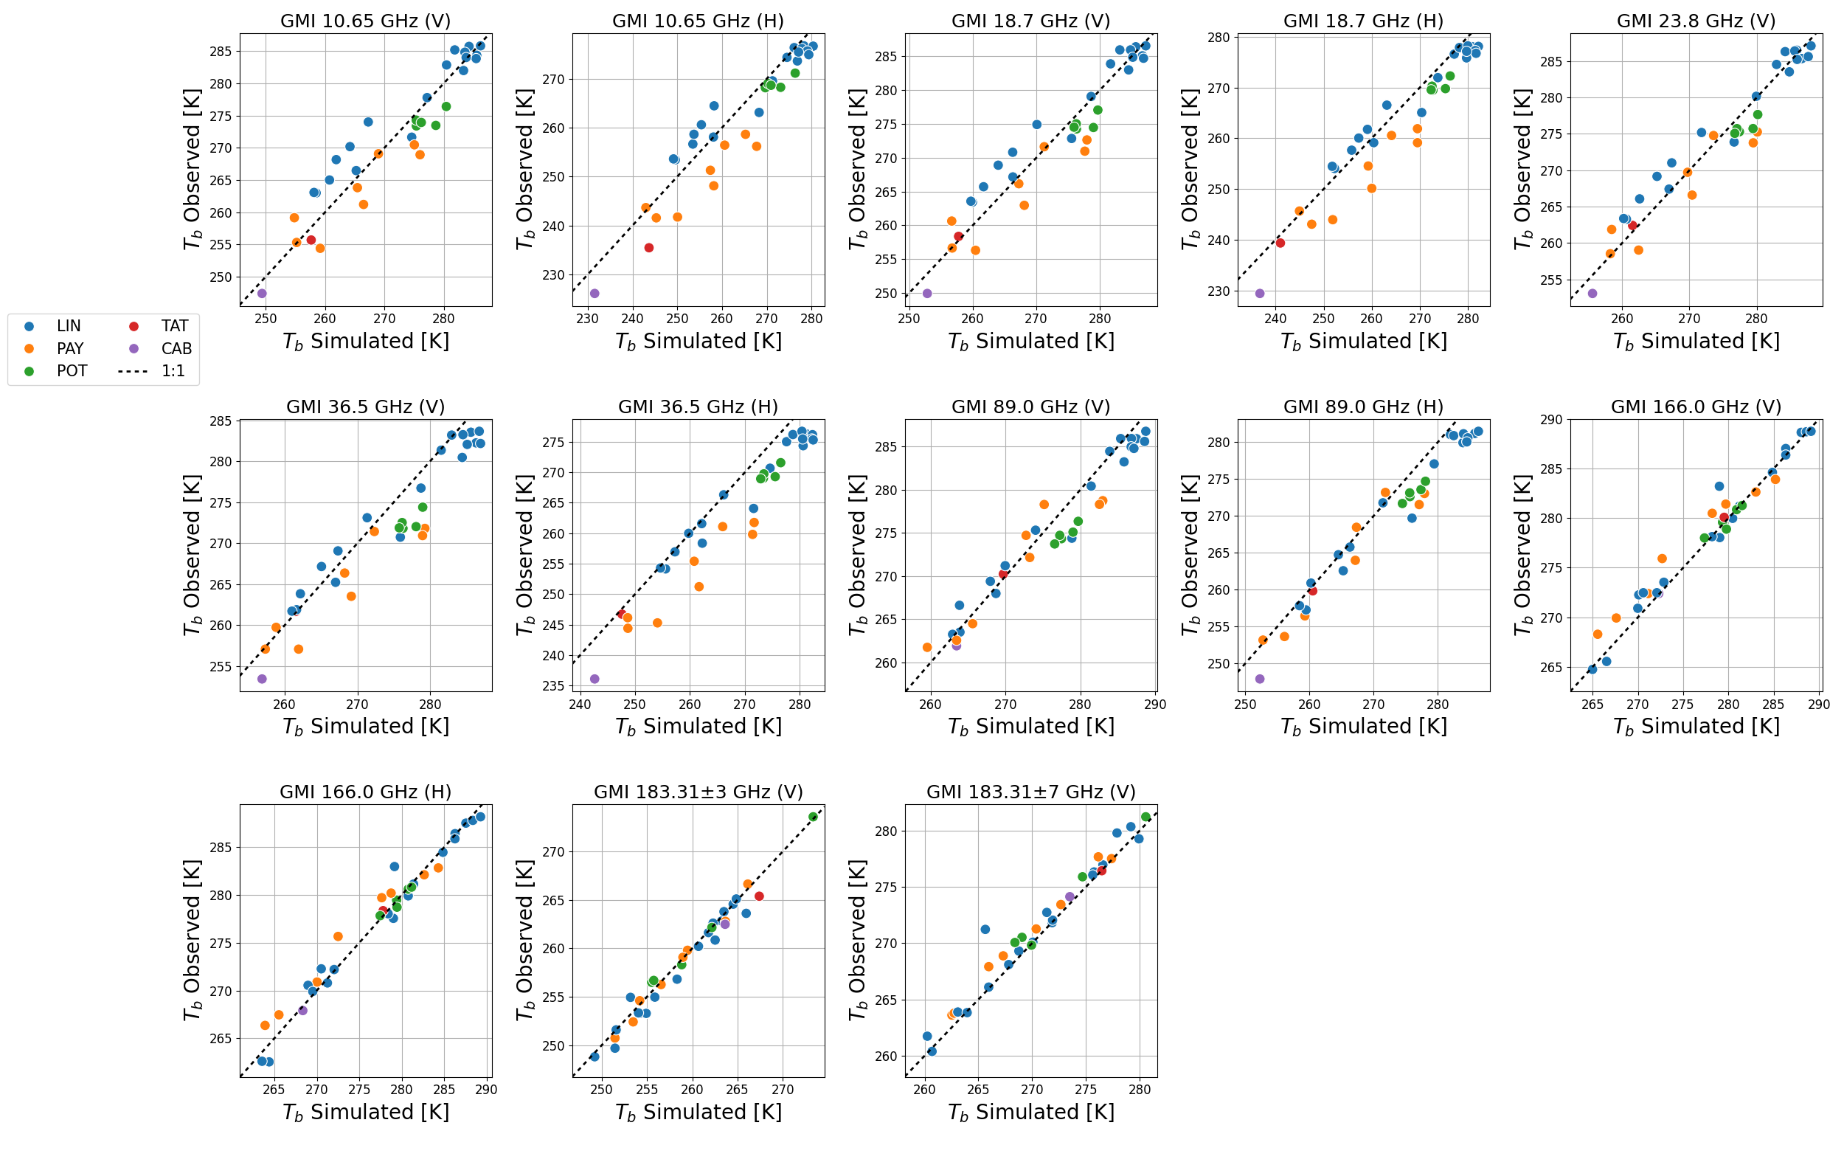


RESULTS for REAL OBSERVATIONS:
GMI – GRUAN, $LF∈[0:100]$
GMI-GRUAN 34 match-ups, $temporal distance:\text{−3 }\text{hours} ≤Δt≤\text{3 }\text{hours}$
k=1 (data are consistent);
k=2 (data are in statistical agreement);
k=3 (data are significantly different);.
results do not agree within k=3
$${BT}_{TA}−{BT}_{RS}≤k⋅u_all$$

Slide 22
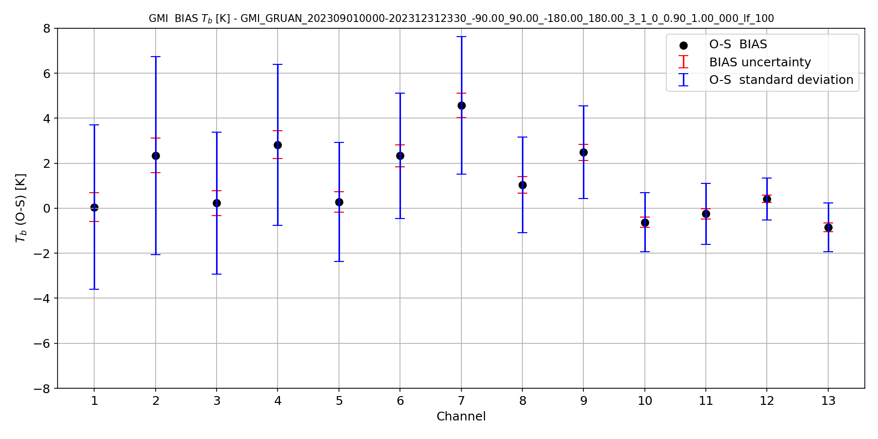
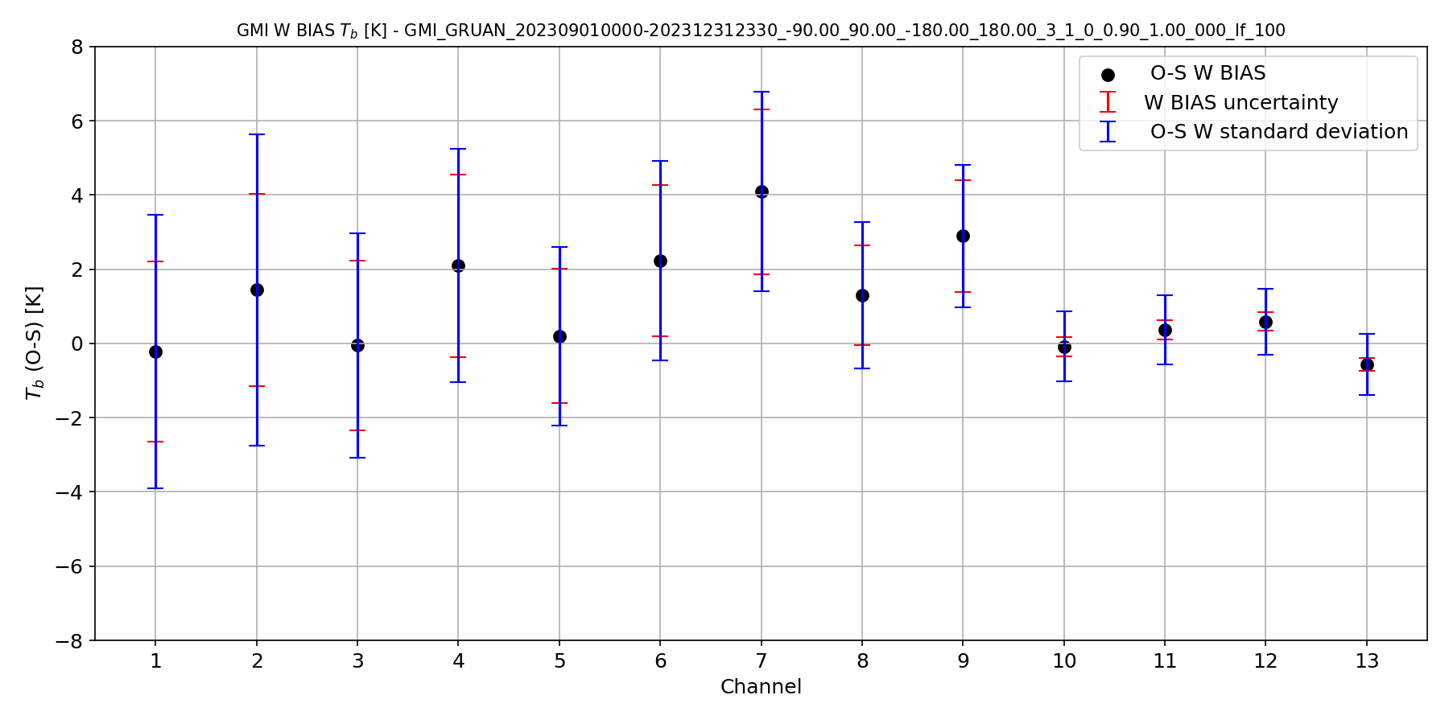

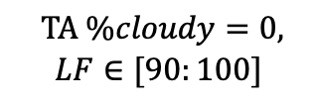

RESULTS for REAL OBSERVATIONS:
GMI – GRUAN
$$TA \%cloudy=0,$$
$$LF∈[90:100]$$
GMI-GRUAN 34 match-ups$, temporal distance:\text{−3 }\text{hours} ≤Δt≤\text{3 }\text{hours}$
$$BIAS$$
$$weighted BIAS$$
166, 183GHz

Slide 23
SUMMARY & CONCLUSIONS
VICIRS tool for the vicarious calibration of MWI/ICI observations against radiosonde observations
Flexible and user friendly
GRUAN and RHARM RS
uncertainty characterization & multisource analysis
tested with simulated and real observations
  MWI/ICI & GMI
New EUMETSAT Service for dedicated GRUAN(-like) Radiosonde launches to support commissioning of MWS/MWI/ICI from 2026-2029 – see agenda item 13c
Future work
  further uncertainty characterization
  assess overall quality of estimated bias and accuracy
    vs. RS quantity and quality
  after launch, adopt VICIRS tool within the MWI/ICI Cal/Val activities

Slide 24

Thank you very much
for the attention!

Slide 25
BACK-up slides

Slide 26
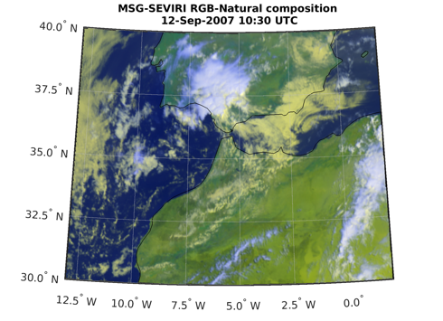
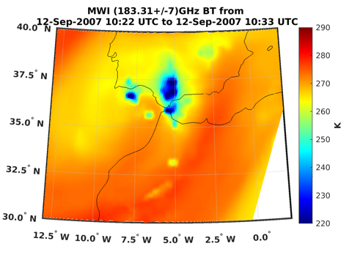
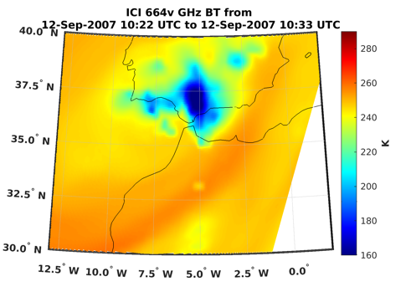
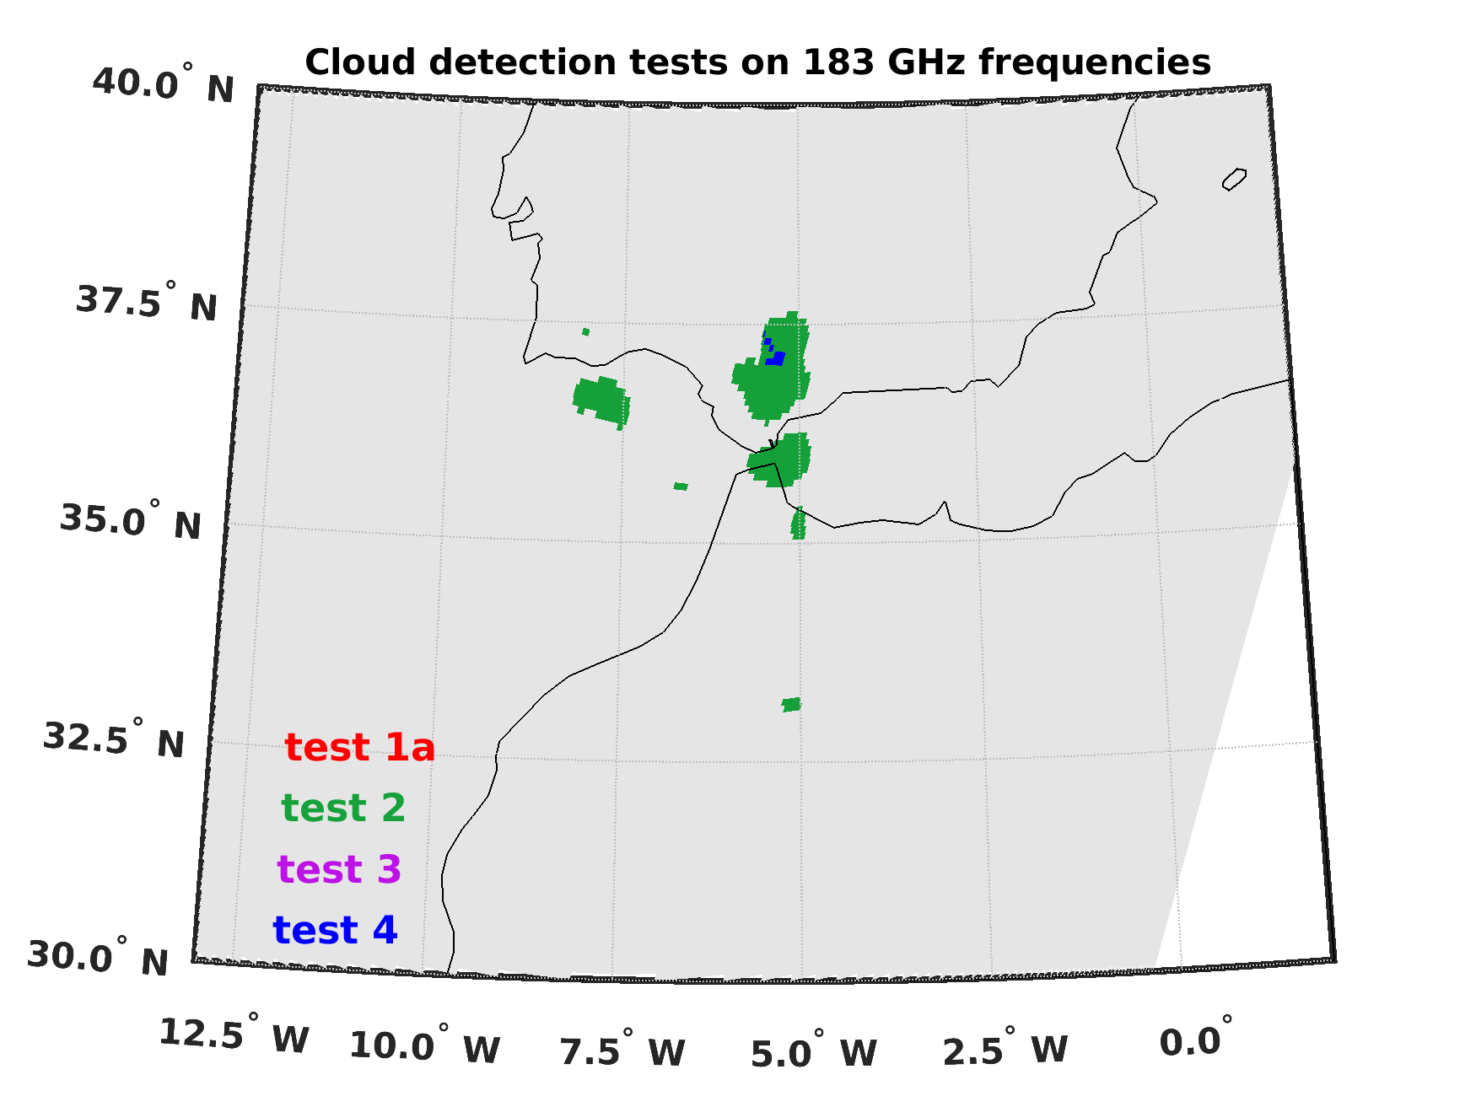
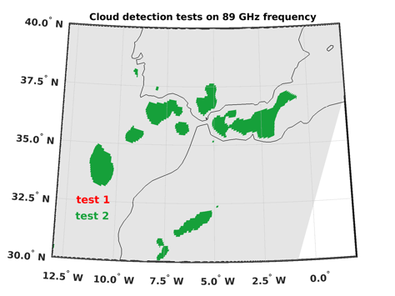
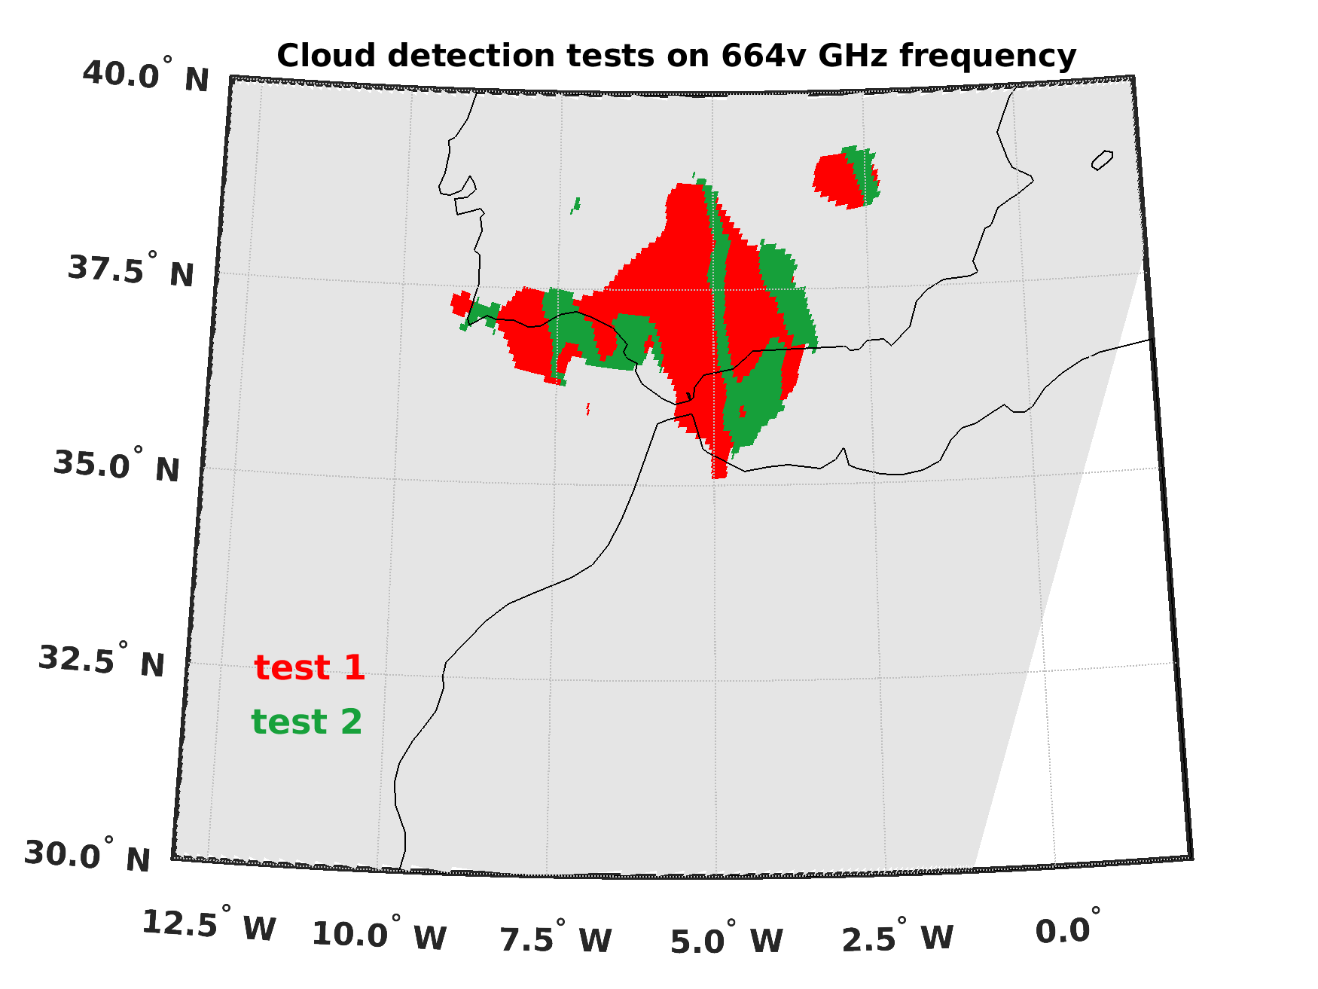
Cloud Screening
 | 183 GHz | 89 GHz | 165 GHz | 664v GHz
MWI | Buehler et al, 2007 Hong et al, 2005 Clain et al, 2005 | over land: Yaping et al, 2008 over sea: Gong and Wu, 2017 | Yaping et al, 2008
ICI |  |  |  | Gong and Wu, 2017
MWI/ICI level 1B data orbit 4656
(20070912102225 to 20070912120114) simulated from 2007-09-12 10:00 UTC ERA-5 data
MSG-SEVIRI image acquired on 2007-09-12 10:15 UTC

Slide 27
VICIRS tool: RS clear sky test
RS is in clear sky. The presence of cloudy layers is verified by comparing the RH values with the reference values for clear sky as determined by Zhang et al. (2010). It outputs the number of levels contaminated by low, middle and high clouds.
GRUAN site | POD (%) | FAR (%) | Bias | Accuracy
LAU | 94 | 8.62 | 1.03 | 0.87
GVN | 99 | 10.4 | 1.10 | 0.89
LIN | 95 | 7.98 | 1.03 | 0.88
PAY | 88 | 2.16 | 0.89 | 0.87
SNG | 100 | 0.00 | 1.00 | 1.00
RH test (Zhang et al. 2010) vs RS-GRUAN SynopClouds
Dichotomous statistical scores between cloud detection methods

Slide 28
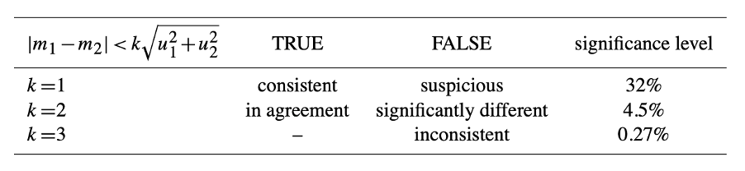








The metrological approach
${ε=m}_{1}−$ $m_{2}$
Error
$$u_{1}$$
Random uncertainty of $m_{1}$
$$u_{2}$$
(1-𝜎 level)
Random uncertainty of $m_{2}$
GRUAN
  Immler et al. 2010
  VIM
  GUM
$$σ$$
Uncertainty of matching
Consistency check between two measurements (m₁ and m₂)
$$\left|m_{1}−m_{2}\right|<k\sqrt{σ^{2}+u_{1}^{2}+u_{2}^{2}}$$
k: coverage factor
From Immler et al., 2010

Slide 29
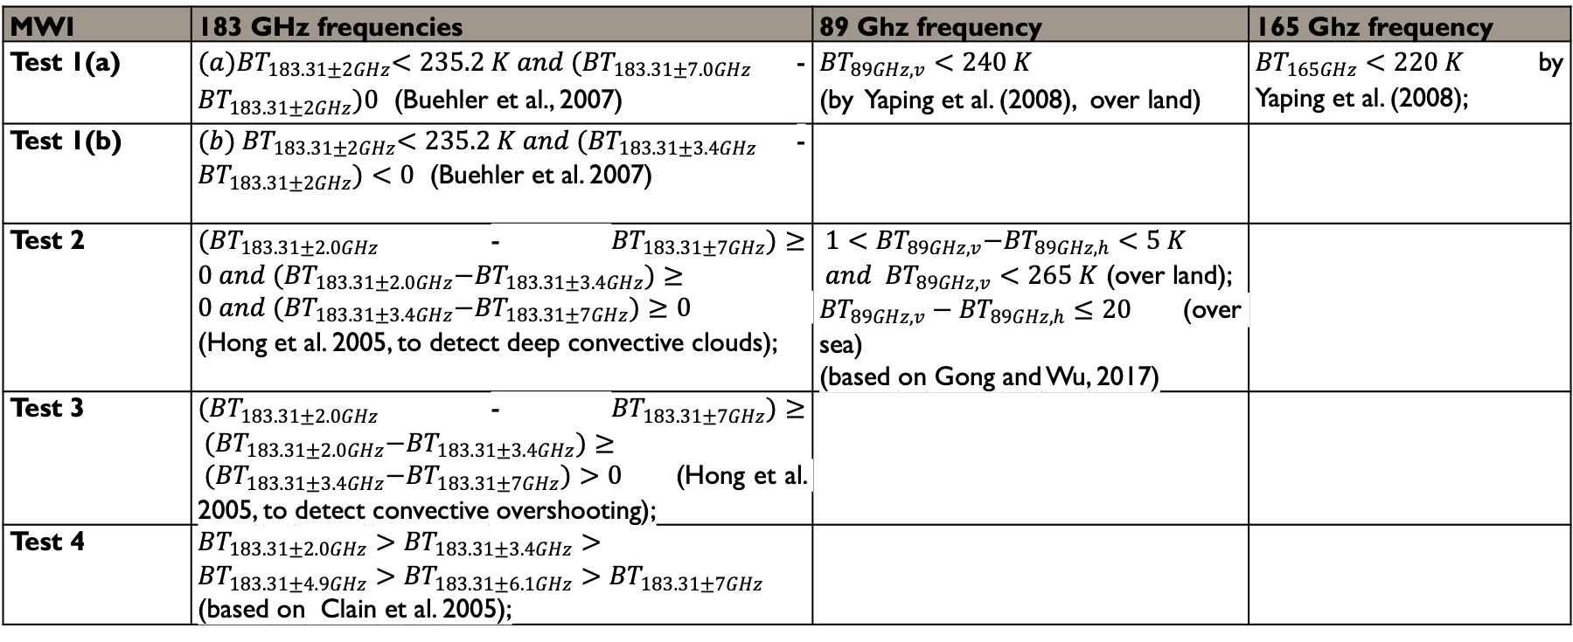
Cloud tests for MWI
MWI | 183 GHz frequencies | 89 Ghz frequency | 165 Ghz frequency
Test 1(a) | ${(a)BT}_{183.31±2GHz}<235.2 K and {(BT}_{183.31±7.0GHz}$-${BT}_{183.31±2GHz})0$ (Buehler et al., 2007) | ${BT}_{89GHz,v}<240 K$ (by Yaping et al. (2008), over land) | ${BT}_{165GHz}<220 K$ by Yaping et al. (2008);
Test 1(b) | ${(b) BT}_{183.31±2GHz}<235.2 K and {(BT}_{183.31±3.4GHz}$-${BT}_{183.31±2GHz})<0$ (Buehler et al. 2007)
Test 2 | ${(BT}_{183.31±2.0GHz}$-${BT}_{183.31±7GHz})≥0 and {(BT}_{183.31±2.0GHz}−{BT}_{183.31±3.4GHz})≥0 and {(BT}_{183.31±3.4GHz}−{BT}_{183.31±7GHz})≥0$ (Hong et al. 2005, to detect deep convective clouds); | ${ 1<BT}_{89GHz, v}−{BT}_{89GHz, h}<5 K$ $and { BT}_{89GHz, v}<265 K$ (over land); ${BT}_{89GHz, v}−{BT}_{89GHz, h}≤20$ (over sea) (based on Gong and Wu, 2017)
Test 3 | ${(BT}_{183.31±2.0GHz}$-${BT}_{183.31±7GHz})≥ {(BT}_{183.31±2.0GHz}−{BT}_{183.31±3.4GHz})≥ {(BT}_{183.31±3.4GHz}−{BT}_{183.31±7GHz})>0$ (Hong et al. 2005, to detect convective overshooting);
Test 4 | ${BT}_{183.31±2.0GHz}>{BT}_{183.31±3.4GHz}>{BT}_{183.31±4.9GHz}>{BT}_{183.31±6.1GHz}>{BT}_{183.31±7GHz}$ (based on Clain et al. 2005);

Slide 30
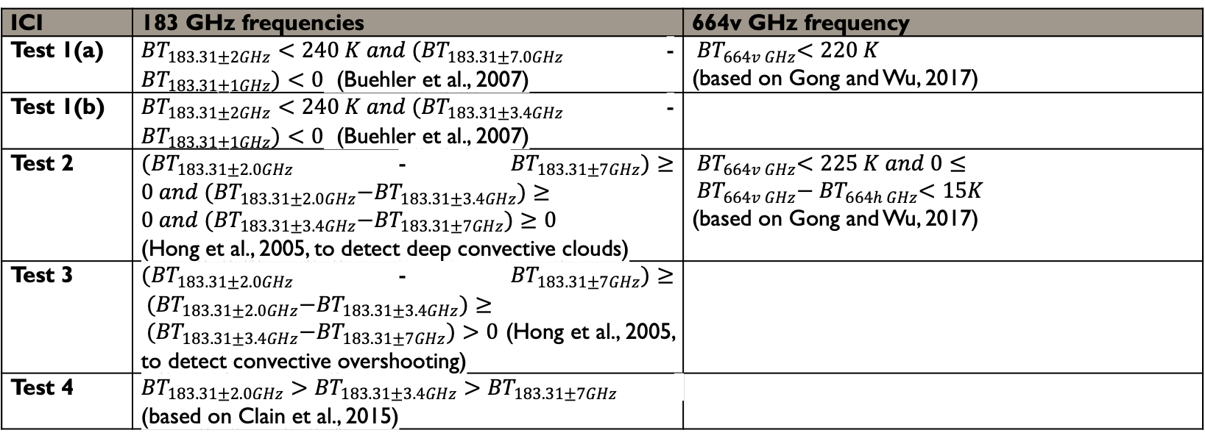
Cloud tests for ICI
ICI | 183 GHz frequencies | 664v GHz frequency
Test 1(a) | ${BT}_{183.31±2GHz}<240 K and {(BT}_{183.31±7.0GHz}$-${BT}_{183.31±1GHz})<0$ (Buehler et al., 2007) | ${ BT}_{664v GHz}<220 K$ (based on Gong and Wu, 2017)
Test 1(b) | ${BT}_{183.31±2GHz}<240 K and {(BT}_{183.31±3.4GHz}$-${BT}_{183.31±1GHz})<0$ (Buehler et al., 2007)
Test 2 | ${(BT}_{183.31±2.0GHz}$-${BT}_{183.31±7GHz})≥0 and {(BT}_{183.31±2.0GHz}−{BT}_{183.31±3.4GHz})≥0 and {(BT}_{183.31±3.4GHz}−{BT}_{183.31±7GHz})≥0$ (Hong et al., 2005, to detect deep convective clouds) | ${ BT}_{664v GHz}<225 K and 0≤{ BT}_{664v GHz}−{ BT}_{664h GHz}<15K$ (based on Gong and Wu, 2017)
Test 3 | ${(BT}_{183.31±2.0GHz}$-${BT}_{183.31±7GHz})≥ {(BT}_{183.31±2.0GHz}−{BT}_{183.31±3.4GHz})≥ {(BT}_{183.31±3.4GHz}−{BT}_{183.31±7GHz})>0$ (Hong et al., 2005, to detect convective overshooting)
Test 4 | ${BT}_{183.31±2.0GHz}>{BT}_{183.31±3.4GHz}>{BT}_{183.31±7GHz}$ (based on Clain et al., 2015)

Slide 31
UNCERTAINTY ANALYSIS
UNCERTAINTY SOURCE | STATUS OF UNDERSTANDING
Radiometric sensors | Quantification available by instrument characterization and calibration. (EUMETSAT documents such as ICI and MWI Calibration and Validation plan)
Radiosonde sensors | Quantification available at point measurement level. (Madonna et al., 2022; Von Rhoden et al., 2022; Dirksen et al.; 2020, Carminati et al., 2019)
Geolocation | Quantification available in terms of geolocation uncertainty. Mapped into BT using MWI and ICI test data (one orbit) within the VICIRS study. (Papa et al., 2021)
Collocation (temporal, spatial) | Recommendations to reduce the uncertainty and provide a rough estimate (Calbet et al., 2022, 2018; Bobryshev et al., 2018; Brogniez et al., 2016; Verhoelst et al., 2015; Ignaccolo et al., 2015; Fassò et al., 2014; Buehler et al., 2004)
Discretization | Recommendations are available to reduce the uncertainty and provide a rough estimate. A study focusing on ATMS extended to MWI and ICI channels within the VICIRS study, with limitations for high-opacity channels. (Buehler et al., 2004; Hocking, 2014)
Absorption model | Quantification is available for 16-700 GHz range and for MWI, ICI, MWS, and ATMS channels. (Gallucci et al., 2024)
Surface emissivity | Quantification is available in terms of surface emissivity uncertainty at some channels and in certain conditions. Suggested surface emissivity uncertainty propagated to BT within the VICIRS study. (Wang et al., 2017; Pringet et al., 2017)

Slide 32
GMI
Central frequency (GHz) | Bandwidth (MHz) | Polarizations | NEΔT | IFOV | Pixel
10.65 | 100 | V, H | 0.96 K | 30x50 km | 24x12.8 km
18.7 | 200 | V, H | 0.84 K | 17x29 km | 12x12.8 km
23.8 | 400 | V | 1.05 K | 14x24 km | 12x12.8 km
36.5 | 1000 | V, H | 0.65 K | 13x22 km | 6.0x12.8 km
89.0 | 6000 | V, H | 0.87 K | 6.9x11 km | 3.0x12.8 km
166.0 | 3000 | V, H | 1.5 K | 6.9x11 km | 3.0x12.8 km
183.31 ± 3 | 3500 | V | 1.5 K | 6.9x11 km | 3.0x12.8 km
183.31 ± 7 | 4500 | V | 1.5 K | 6.9x11 km | 3.0x12.8 km

