Slide 1
Calibration and validation concept of the CO2I/NO2I instrument on-board the CO2M mission
Bernd Sierk, Rüdiger Lang, Josef Gasteiger, Catherine Hayer, Bernd Husemann, Pepe Phillips
EUMETSAT
GSICS, March 18 2025

Slide 2
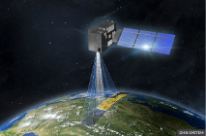
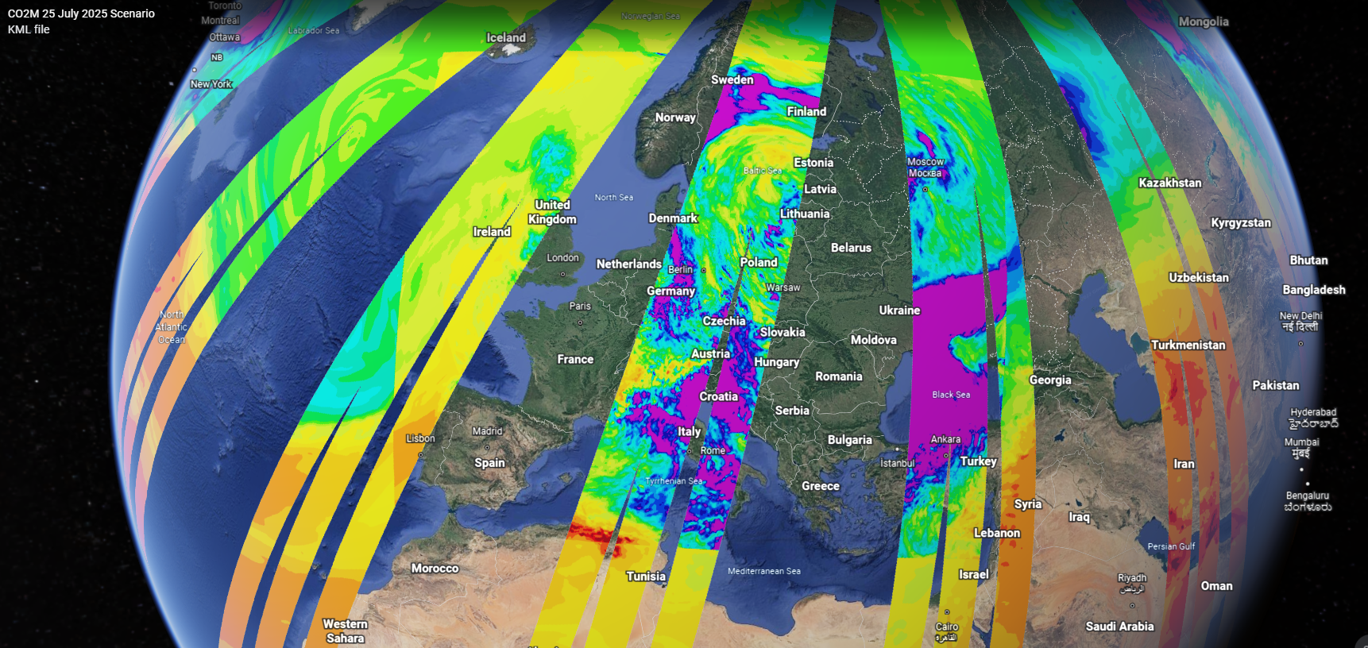

The CO2M greenhouse-gas monitoring constellation
Mission goals
Continuous mapping and monitoring of anthropogenic CO2 emissions
Quantification of biogenic sources and sinks
Provide “actionable information” for policy makers
Up to three satellite missions each with >250 km swath:
Providing greenhouse-gas data for the UNFCCC 2nd global stocktake (GST) in 2028
Orbit:
Sun-synchronous orbit 14 5/11
159 orbits repeat cycle (~11 days)
735 km altitude, 11:30 LTDN
Platforms in same orbital plane
Three instruments:
CO2/NO2 push-broom grating spectrometer (CO2I/NO2I)
Multi-Angle Polarimeter (MAP)
Cloud Imager (CLIM)
CO2M test-data study
Total column CO2 concentrations [ppm]
Three platform CO2M constellation
Product | Spatial resolution | Precision | Bias
CO2 | 4 km² | 0.7 ppm | <0.5 ppm
CH4 | 4 km² | 10 ppb | <5 ppb
NO2 | 4 km² | 1.5x10¹⁵ molec/cm² | <3.5x10¹⁵ molec/cm²
SIF* | 4 km² | 0.7 mW m⁻² sr⁻¹ nm⁻¹ | <0.2 mW m⁻² sr⁻¹ nm⁻¹
Aerosols | 16 km² | 0.05 AOD, 500 m LH | <0.05 AOD, 500 m LH
Clouds | 4 km² | <1% of FOV
*Solar Induced Fluorescence

Slide 3

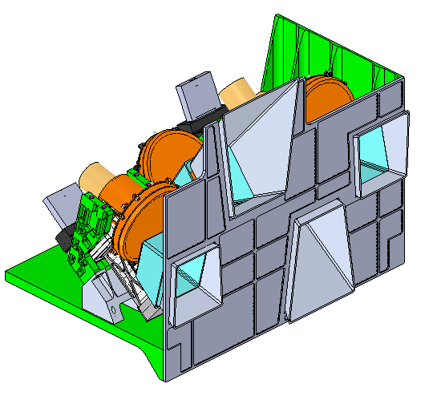
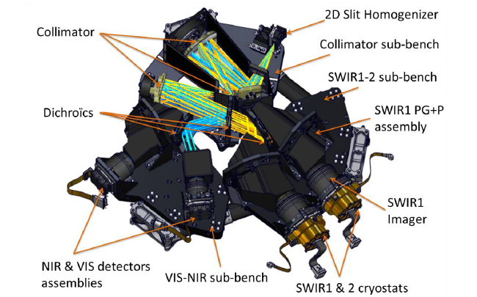
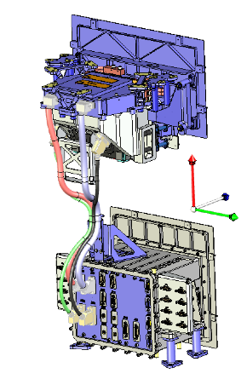
CO2M instruments
CO2I/NO2I push-broom grating spectrometer
Target species: CO2, CH4 & NO2
Spatial resolution: 4 km²
Multi-angle polarimeter
Target species: Aerosol
Spatial resolution (native): 1 km²
43 views (0 > OZA < 60º) (out of 48 native)
Spatial resolution (aerosol product): 4 km²
MAP Band | Wavelength / (FWHM)
VNIR-1 | 410 nm (20nm)
VNIR-2 | 443 nm (20nm)
VNIR-3 | 490 nm (20nm)
VNIR-4 | 555 nm (20nm)
VNIR-5 | 670 nm (20nm)
VNIR-6* | 753 nm (9 nm)
VNIR-7 | 865 nm (40nm)
Band | Spectral range | Spectral resolution
VIS | 405–490 nm | 0.3 nm
NIR | 747–773 nm | 0.2 nm
SWIR-1 | 1590–1675 nm | 0.3 nm
SWIR-2 | 1990–2095 nm | 0.35 nm
Credit © TAS-UK
* Channel used for cross calibration purposes with less views
Cloud imager
Target species: Clouds
Spatial resolution: 100 / 200 m
CLIM Band | Wavelength / (FWHM)
CLIM-1 | 670 nm (20nm)
CLIM-2 | 753 nm (9nm)
CLIM-3 | 1370 nm(15nm)
Credit © OIP (Belgium)
Credit © TAS-France

Slide 4
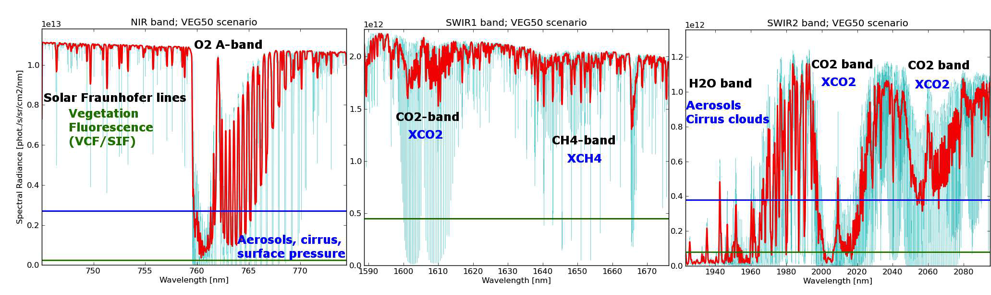
Copernicus CO2M: CO2I/NO2I imaging spectrometer

Slide 5
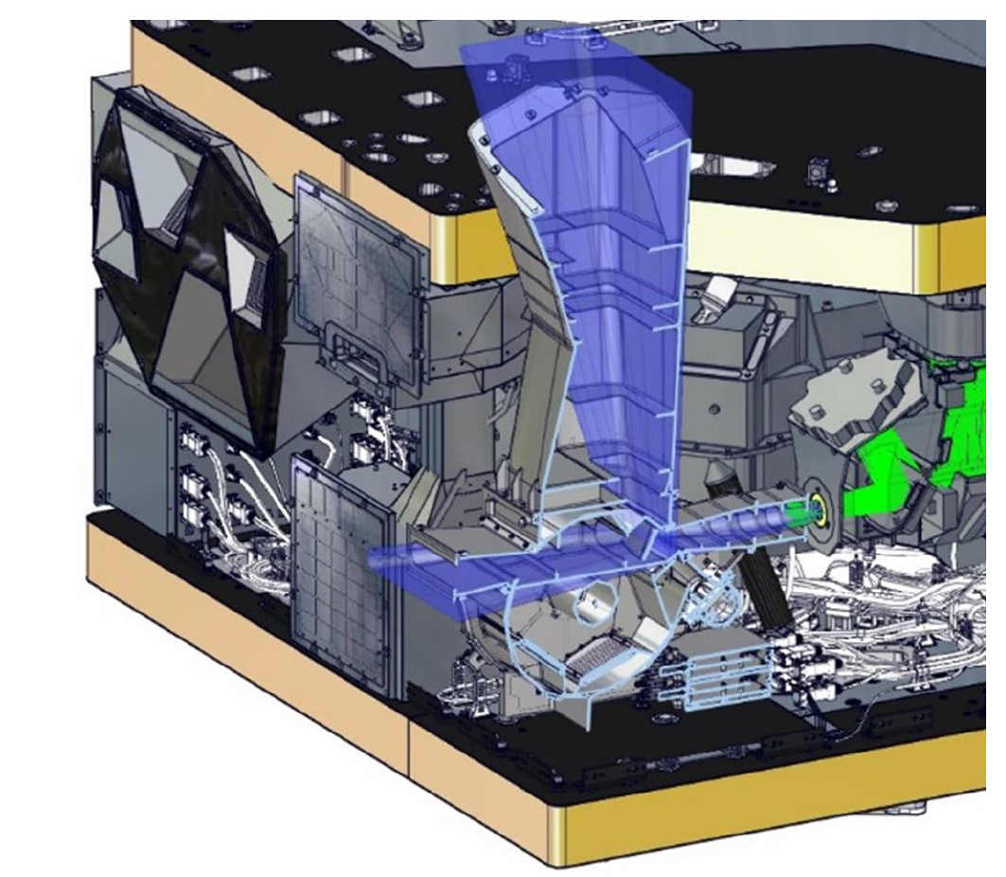
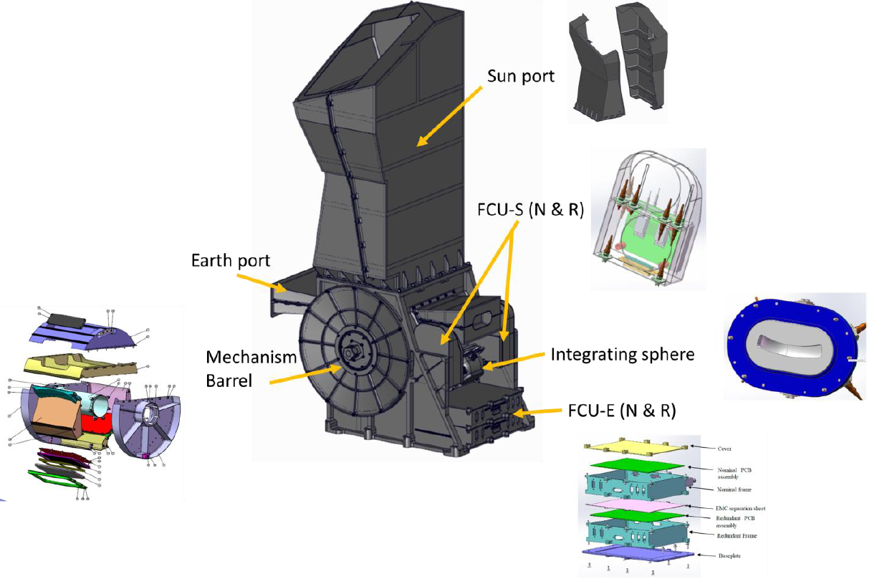
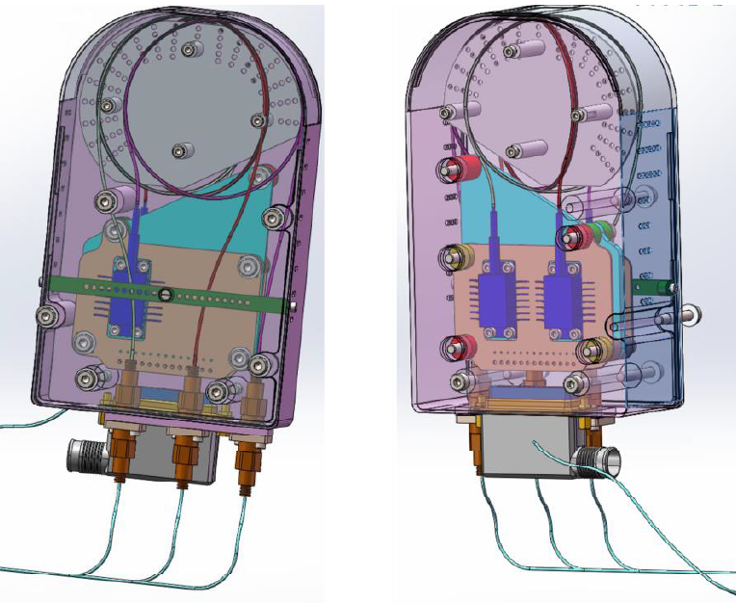
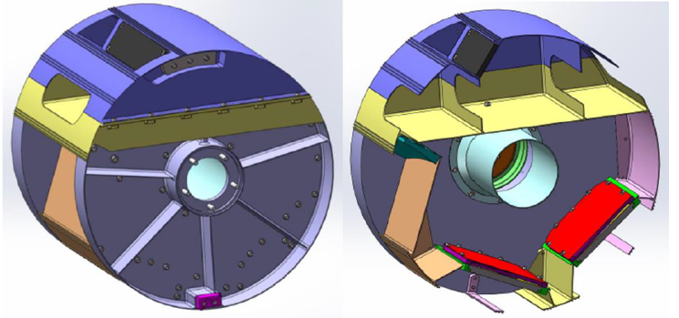
CO2I/NO2I: Flight Calibration Unit
“Classical” calibration barrel selecting various light sources
Two reflective diffusers for solar calibration (nominal and reference)
White Light Source (tungsten halogen) for PRNU and detector monitoring
3 DFB laser diodes for ISRF calibration in NIR, SWIR1 and SWIR2

Slide 6
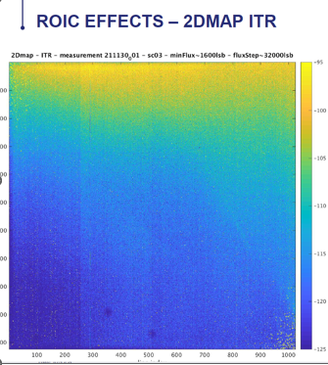
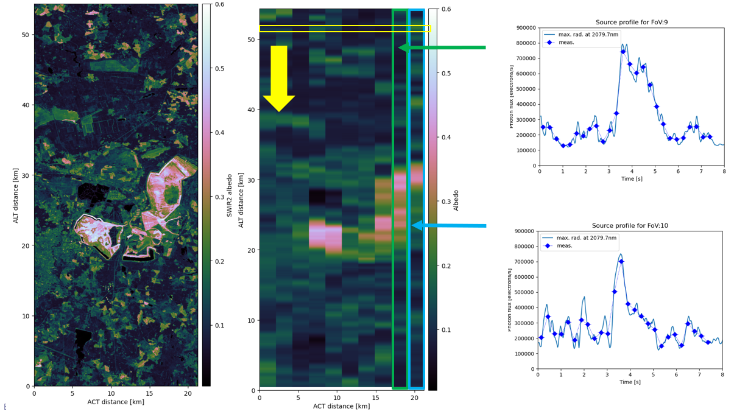
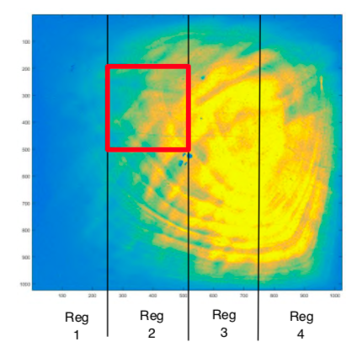
CO2I/NO2I: Remanence or memory effects
Memory (signal persistence) effects identified in SWIR and VIS/NIR detectors
Large amplitude, not easily correctable (non-linear with input radiance, different time scales, dependent on scene contrast)
Mixture of several effects, both in ROIC (parasitic capacitances) and PV layer (electron trapping/de-trapping)
Complex correction models have been developed by industry (and at EUMETSAT)
Need to be validated, corrected and updated
=> Vicarious calibration with (sufficiently) well known contrast scenes (e.g. coastlines)
Trapping/de-trapping

Slide 7
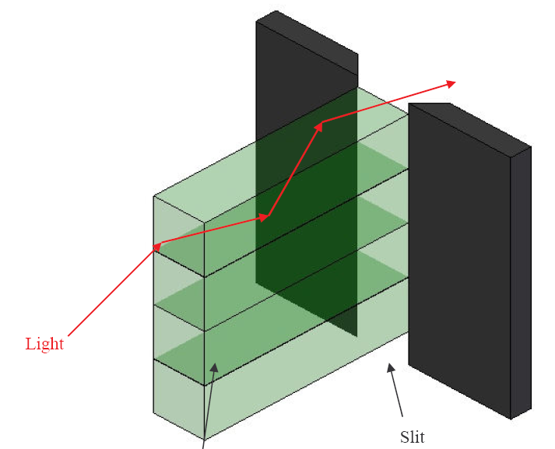
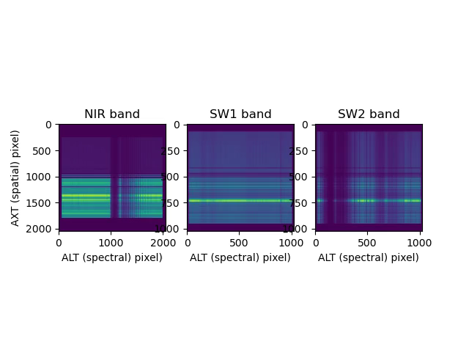
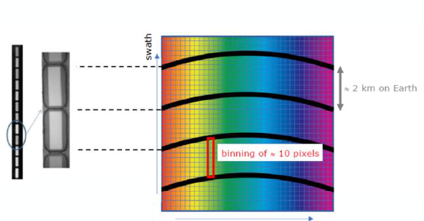
CO2I/NO2I: Fibre-based slit homogeniser
“2-dimensional “ slit homogenizer (feeding all 4 spectrometers)
Fiber-based entrance slit made of stacked rectangular multi-mode fibers
Each fiber defines instantaneous FOV and slit width (core dimensions: 319µm x 121 µm)
Homogenization performance in both ALT and ACT directions
Stable ISRF (slit function) independent of ground scene contrast
Quasi-perfect spatial co-registration (between spectral channels): Cladding “stripes” allow for distinction ground pixels
Relative contribution from each ground pixel is constant and known +> Can be used to “undo” the on-board binning
“Fibre map” will be regularly checked in flight by WLS calibration
Figures courtesy of TASiCH

Slide 8
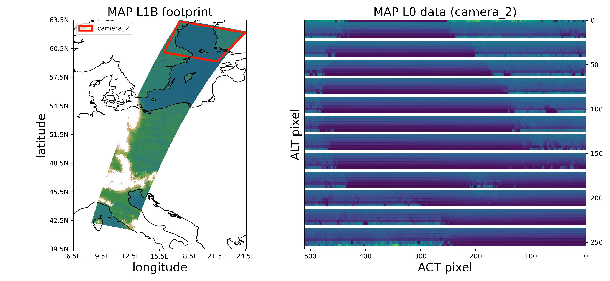
Simulation of MAP L0 data

Slide 9
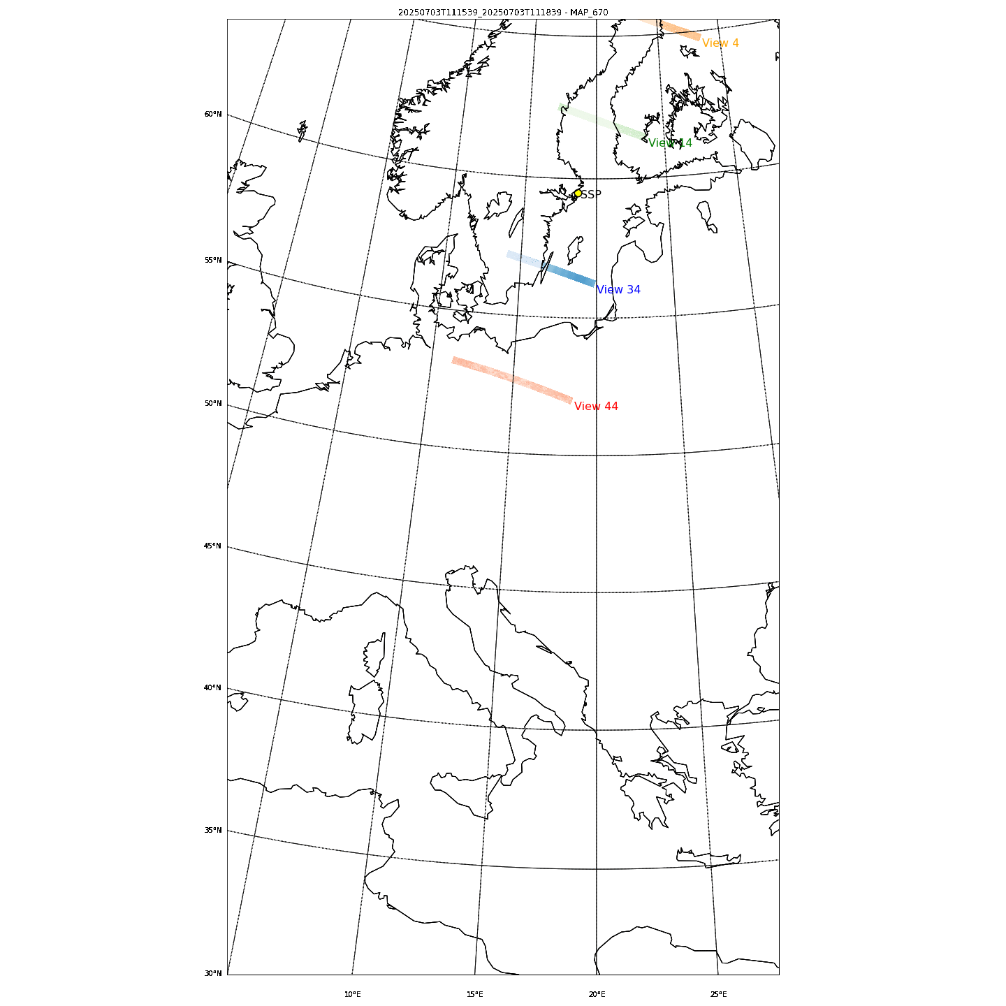
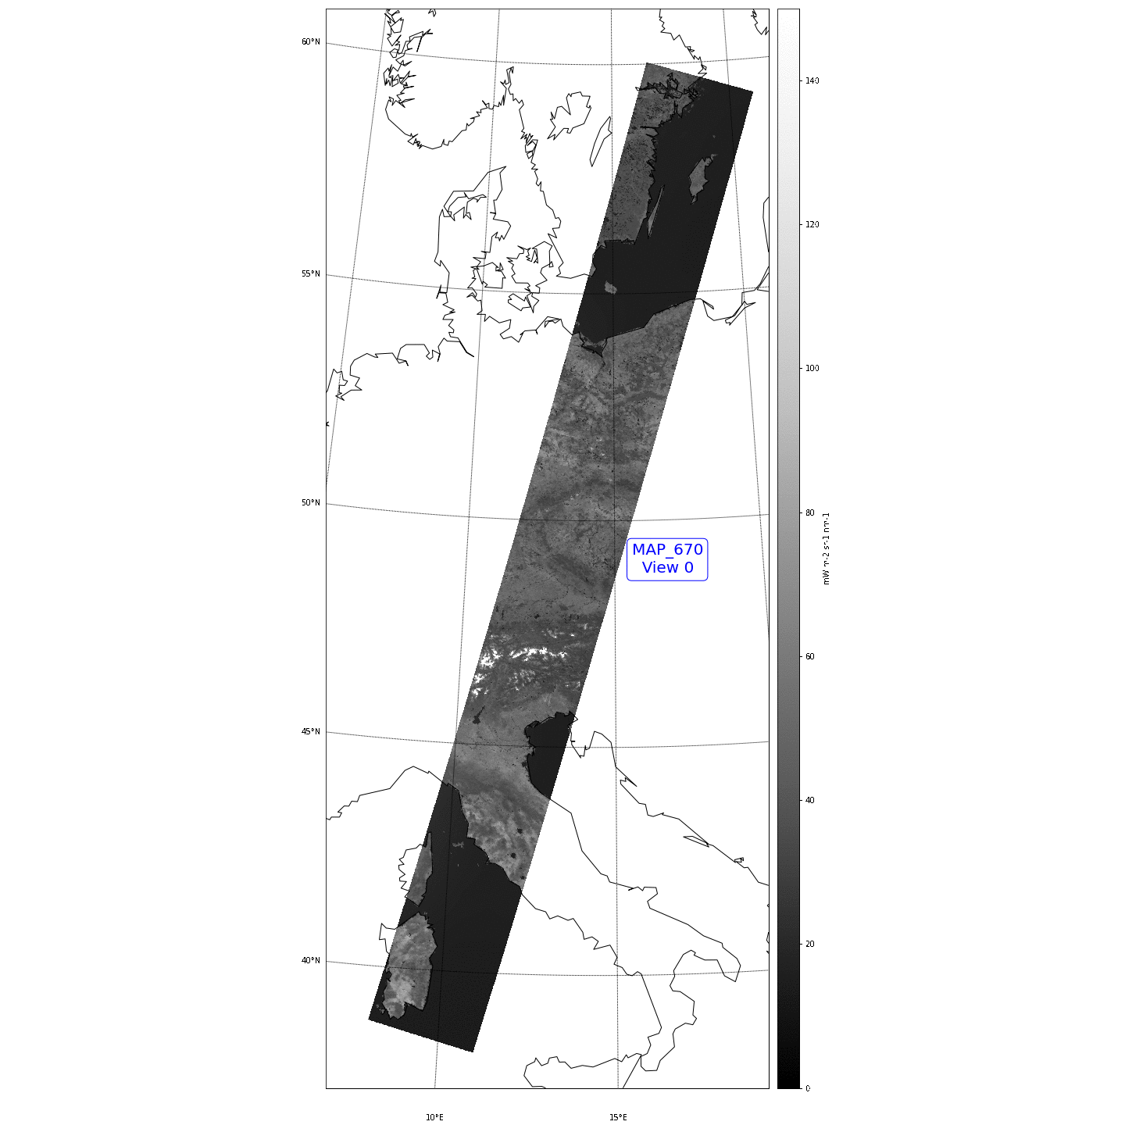
Update wrt. MAG #15/6 – MAP level-1b/c
The CO2M MAP L1B
2 granules
(total 6 minutes)
Nadir pointing
4 views out of 48 are shown
The CO2M MAP L1C
2 granules
(total 6 minutes)
Nadir pointing
45 Co-registered views

Slide 10
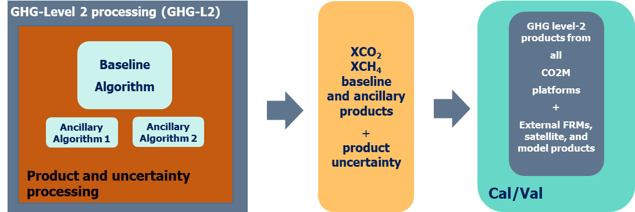

Overall GHG level-2 retrieval approach
CO2- spectrometer radiances
(SWIR/NIR Level-1B)
One baseline GHG algorithm, two support algorithms:
Polarimeter co-registered polarised radiances
(MAP Level-1C)
Aerosol Properties
(MAP Level-2)
Candidate algorithms for baseline:
RemoTAP (SRON)
FUSIONAL-P (University of Bremen / University of Leicester)
FOCAL (University of Bremen)
Aggregated cloud, CLIM radiance and NWP/CAMS model fields
(SCENE Level-2)
Cloud fraction, obstruction, type, scene-homogeneity,
nwp/cams temperature, humidity, and trace gases (CO2/O3/NO2/CH4), cams aerosol fields, u-v wind, and chlorophyll

Slide 11
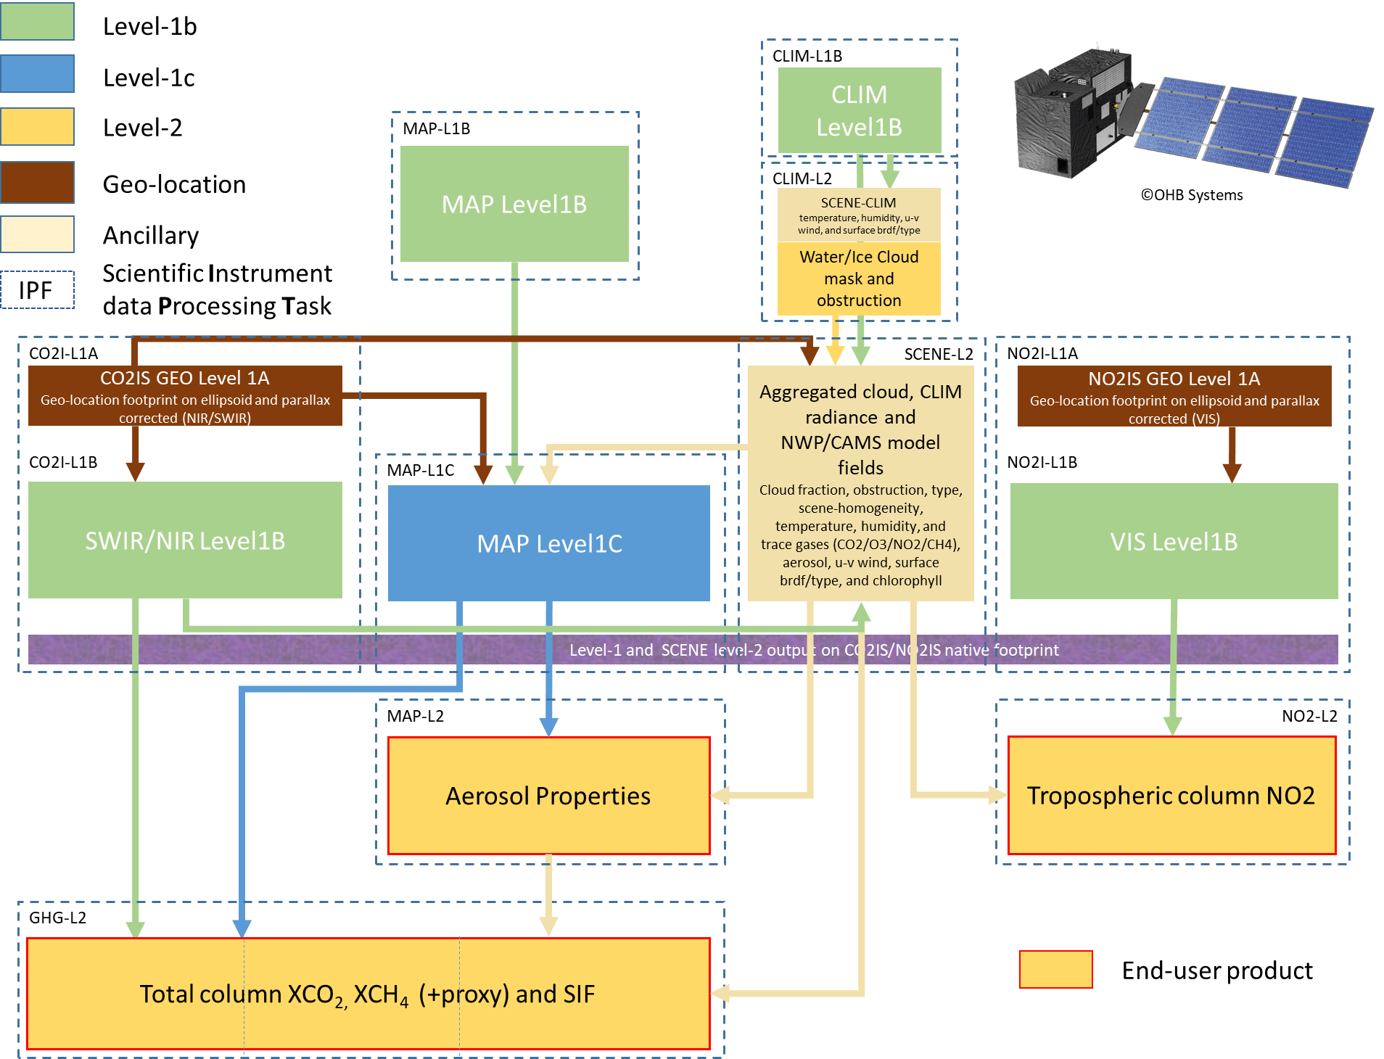
EUMETSAT CO2M MDPS scientific processing tasks
CO2M
Mission Data Processing System
Make one
“hyper-GHG/NO2-instrument”
out of three!
Below this level: everything is co-registered or provided at the CO2I/NO2I spectrometer footprint
Need for XCO₂, XCH₄
NO₂ and AOD validation

Slide 12
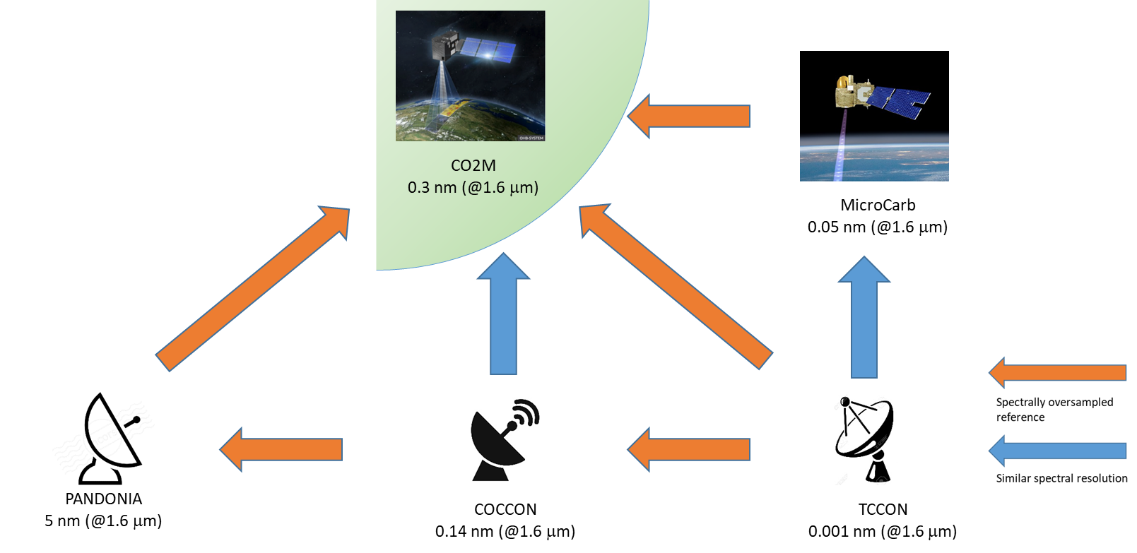
“Four+-pillar” CO2M validation
On-board Cal:
Source | CO2I | MAP | CLIM | Frequency
SUN | X | X |  | daily
Moon | X | X | X | Irreg.
WLS | X |  |  | weekly
Tuneable LED | X (ISRF)
Dark | X | X | X | orbit
SNOs
Ref. Targets
etc.
Cross-Cal
CO2M product Cal/Val plan
GSICS
GSICS
MicroCarb, OCO-x, GOSAT-x, S5, etc.
Vicarious Cal
“as needed”
~
Product VAL
Product Cal/Val
Product Cal/Val
Product Cal/Val
CO2M Cal/Val Phase II
(including GBP processing and data delivery) (KO: Q3 2024)
Scientific support service on ground-based product requriments (LMU) Phase I
Scientific support service on ground-based network product processing (KIT)
Cross-Cal
Cross-Cal
Ground-based network reference product requirements
PaNIR
2.5 nm (@1.6 μm)
0.005
Scientific feasibility study for PaNIR
“Four-pillar” CO2M operational product validation and monitoring space-to-ground and space-to-space approach
+ NDACC- FTIR CH4 + Pandonia/NDACC NO2 + Aeronet for AOD + Galion for Aerosol profiles

Slide 13
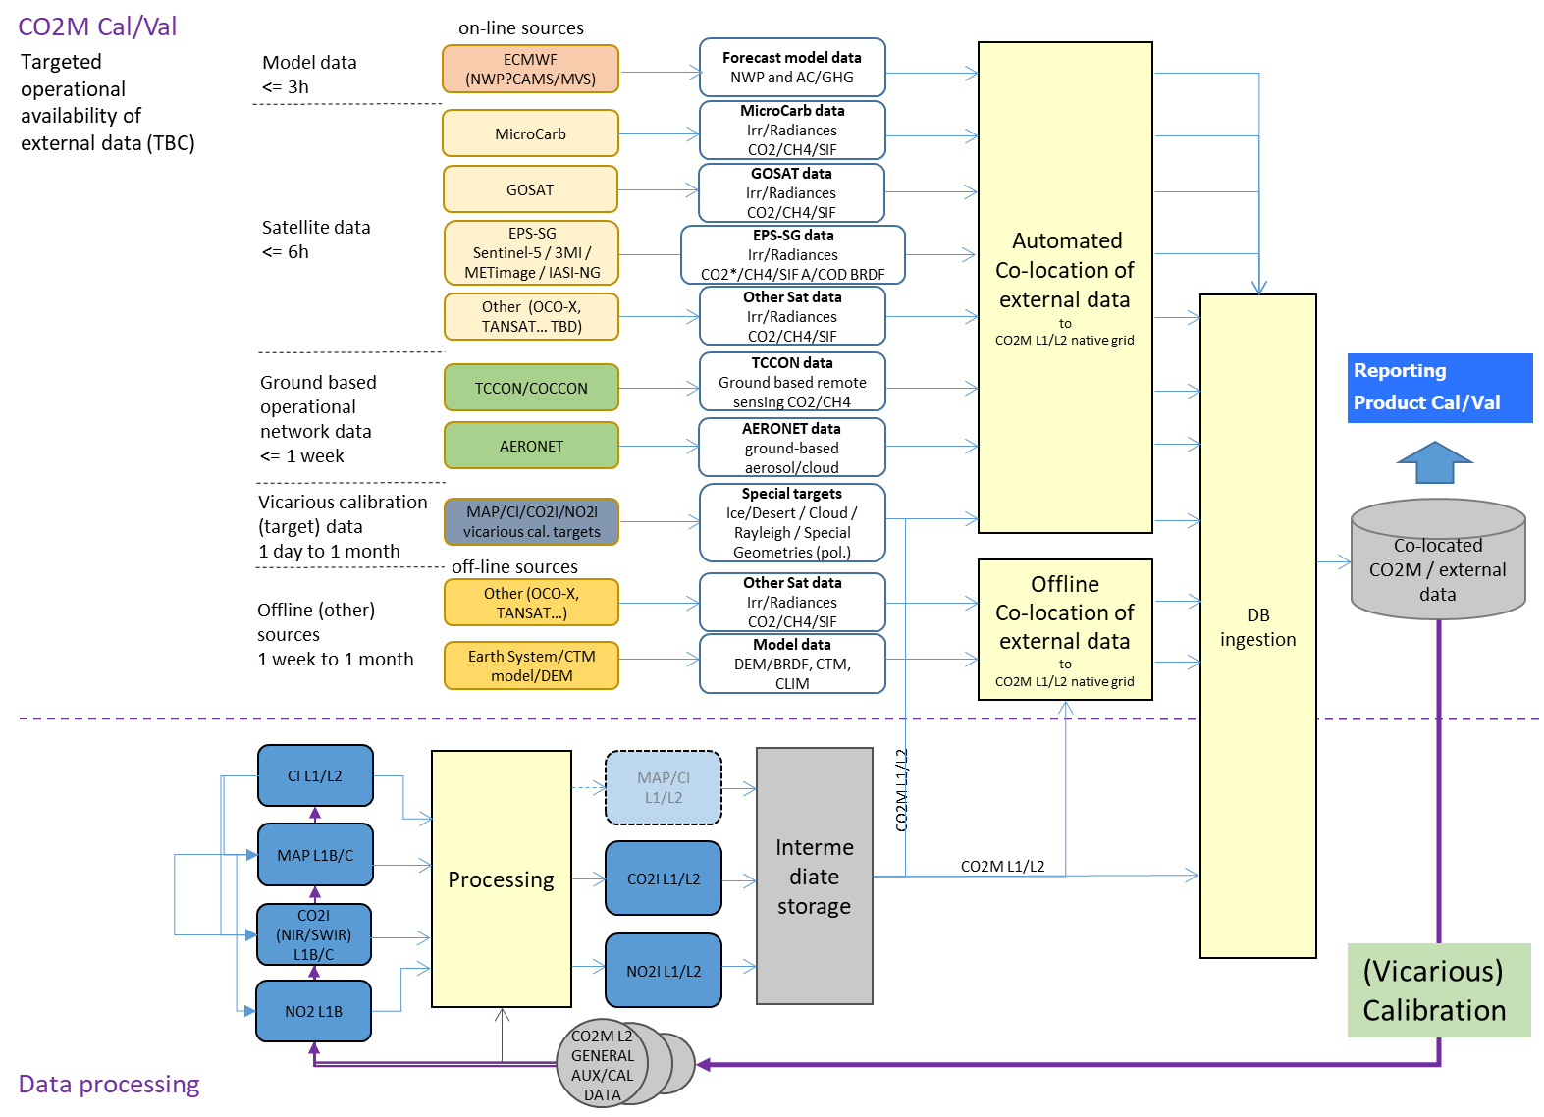
CO2M product Cal/Val system
Product Cal/Val and continuous product quality monitoring:
Level-1 calibration:
Other satellite data (Microcarb, Sentinel-4/5, GOSAT/OCO/Tansat follow-ons)
  via international partner collaboration, partner agencies, GSICS, WG-Climate, CEOS AC/VC.
Solar, on-board and vicarious calibration targets
Level-2 GHG/NO₂ (and ancillary) product validation and verification:
TCCON / COCCON / PaNIR / NDACC
Other ground-based (MAX-DOAS, Aeronet, etc.)
Model data (CO₂ MVS, NWP, CTM and Earth system)

Slide 14
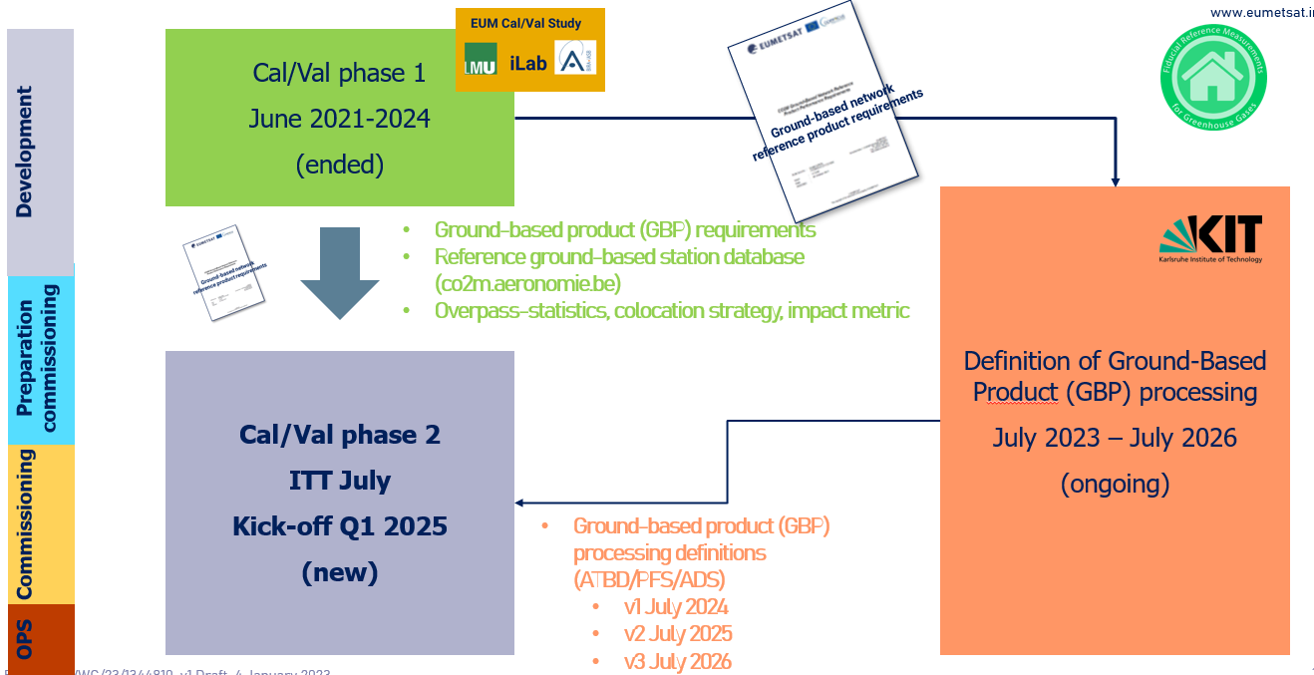
Summary Status of Cal/Val developments
Phase 1 of CO2M product validation study (GBP requirements, network-status, and validation methods) ended in June 2024.
Definition of Ground-Based Product (GBP) ongoing. First version of ATBDS and Input/Output definition expected for Summer 2025 (ongoing).
Phase 2 of CO2M product validation study (Commissioning preparation, evolution of validation methods, interface for provision of network/validation data, provision and processing of data to be kicked-off Q3/4 2024.

Slide 15
Summary and Outlook
CO2M mission for monitoring of anthropogenic greenhouse gas emissions
  Multi-instrument payload (“hyper instrument”) with combined retrieval of CO2 (and CH4)
    CO2I/NO2! Push-broom imaging spectrometer for measurement of XCO2 and XCH4
    Multi-Angle Polarimeter (MAP for Aerosol measurement
    Cloud Imager (CLIM) for sub-sample cloud flagging/characterisation
CO2I/NO2I “special features”
  Fibre-based slit homogenizer with implications on (un-)binning strategy
  Detector lag/persistence/memory effects require detailed models and corrections
    Development of correction algorithms are on-going, to be implemented in operational L1b processor
    Will require vicarious (re-)calibration at Level-1 (contrast scenes)
Product Cal/Val system under development
  Four–pillar approach,
    Cross-calibration with other missions (OCO-2/3, GOSAT-1/2/GW, MicroCarb, Sentinel-5/4)
    Product validation with ground networks (YTCCON, COCCON, PanIR, Aeronet, …)
  Development of system for continuous quality monitoring
    GBP requirements established
    Implementation phase kicked off

Slide 16
Backup Slides

Slide 17
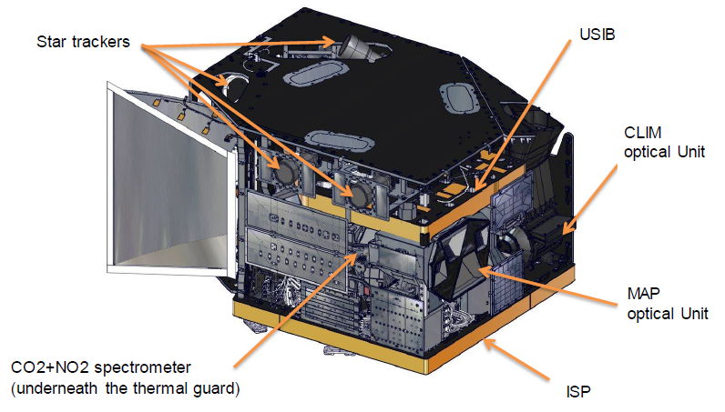
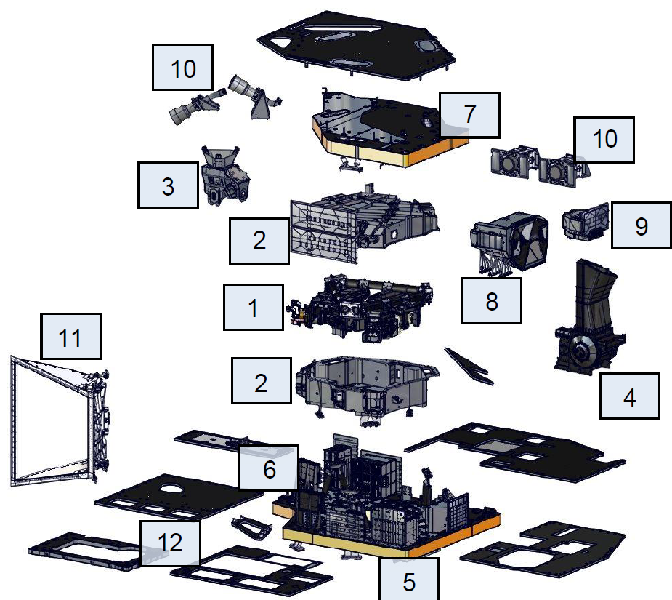
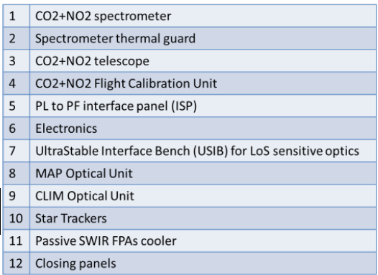
CO2M Payload overview

