Slide 1
Status of GOME-2 calibration and outlook for Sentinel-4 & Sentinel-5
Rasmus Lindstrot
CAM – Atmospheric Chemistry
Pieter Valks, Nan Hao, Gabriele Poli, Philipp Köhler, Yang Wang, Sebastian Gimeno Garcia, Frank Rüthrich, Vinod Kumar, Myojeong Gu, Malcolm Taberner, Catherine Hayer, Malcolm Taberner, Alexandre Caseiro
GSICS Annual Meeting, 17-21 March 2025, UVN-S subgroup

Slide 2
Agenda
GOME-2 on MetOp-B/C
Radiometric degradation
Mitigation of solar visibility gap (GOME-2B)
Copernicus spectrometers
Sentinel-4, Sentinel-5
Cal/Val preparation

Slide 3
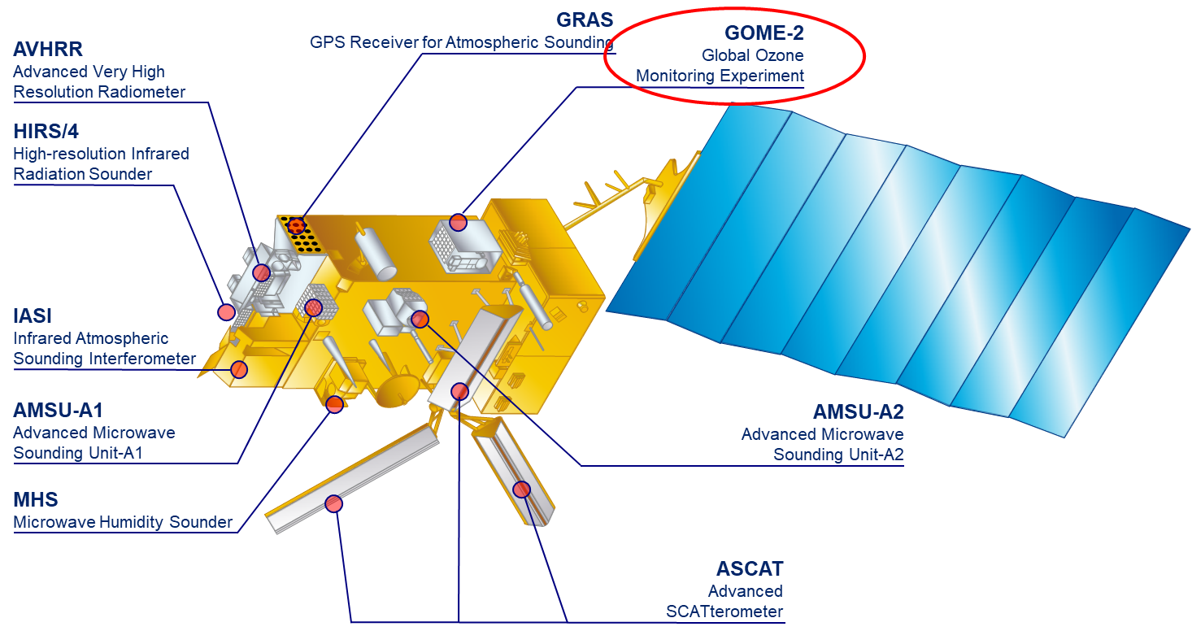
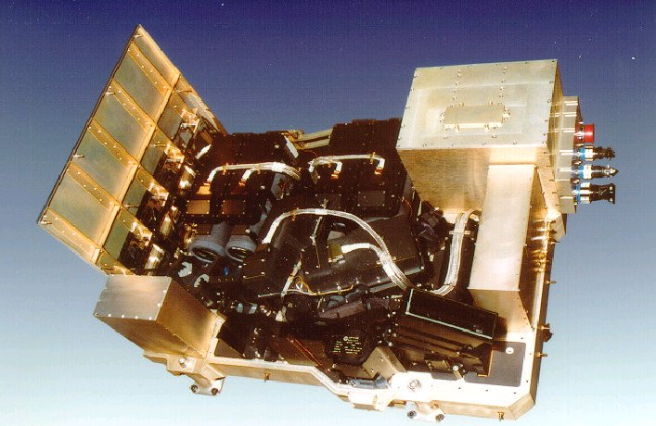
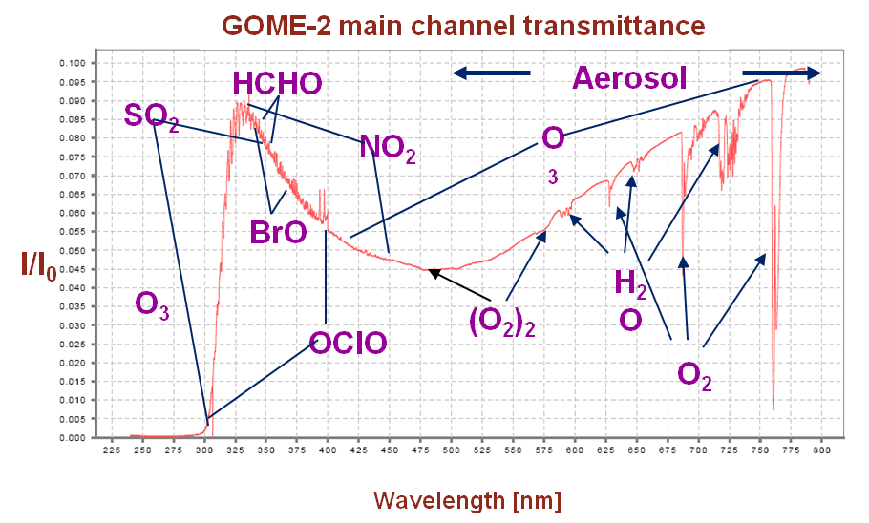
EPS GOME-2
Series of 3 instruments on Metop A/B/C
sun-synchronous orbit, 09:30
412 orbits (29 days) repeat cycle
Global coverage 1.5 days
240 nm to 800 nm
0.25 to 0. 5 nm spectral resolution (FWHM)
4 channels with 4098 energy measurements of polarisation corrected radiances (40 x 80 km²)
2 channels with 512 energy measurements of linear polarised light in perpendicular direction (S/P) (40 x 10 km²)

Slide 4
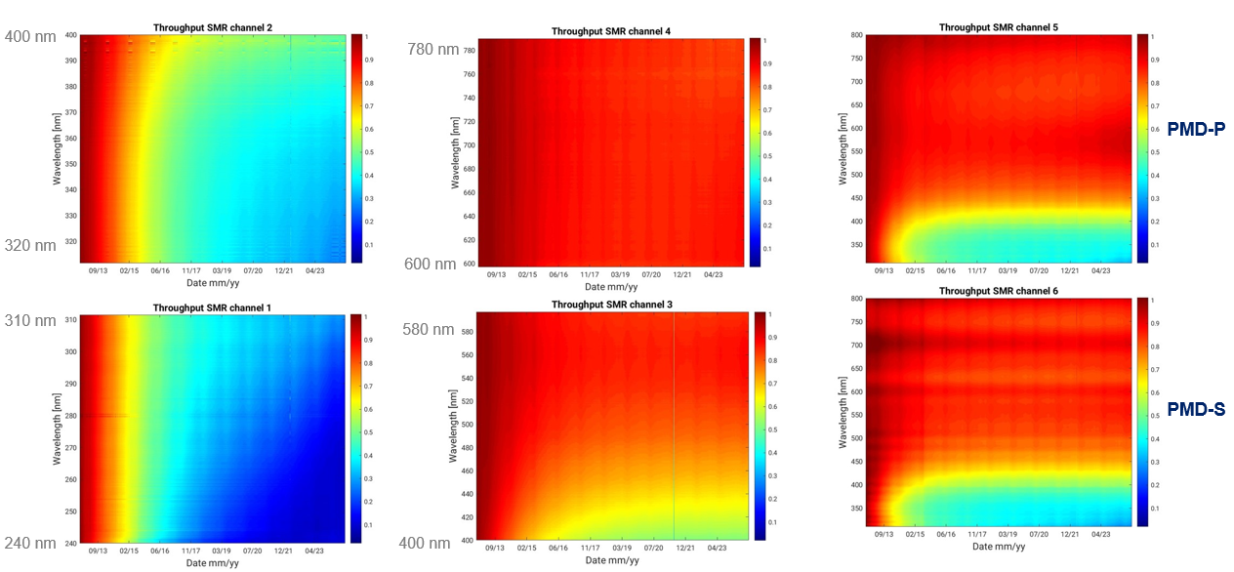
Metop-B GOME-2: Radiometric degradation

Slide 5
Metop-B GOME-2: Radiometric degradation
All GOME-2 flight models show a similar type of radiometric degradation.
Main root cause is assumed to be a combination of scan mirror and detector degradation.
Operational GOME-2 L1 data is not corrected for it.
Cancels out in reflectance to a large degree (-> daily sun measurements).
Degradation correction factors are available separately for radiance and irradiance, on user request.
Specific degradation corrections are applied for some L2 retrievals (AC SAF).

Slide 6
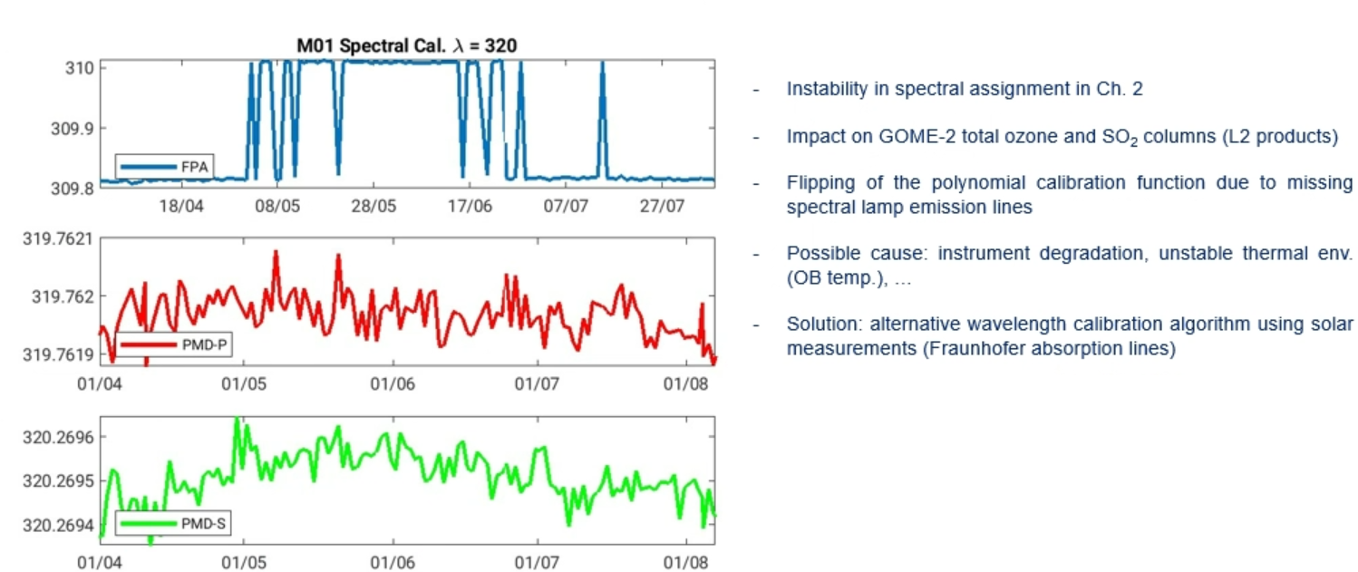
Metop-B GOME-2: Spectral assignment instability

Slide 7
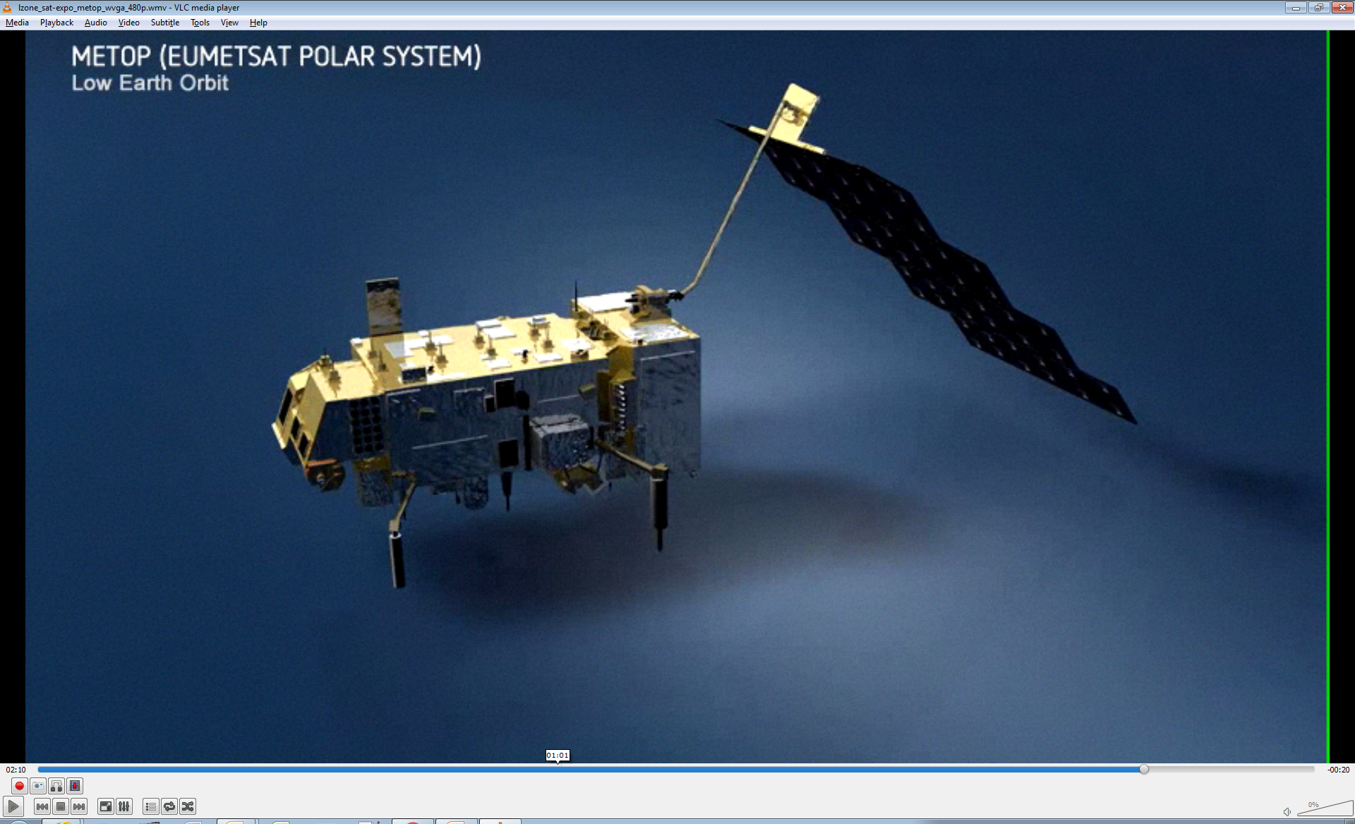
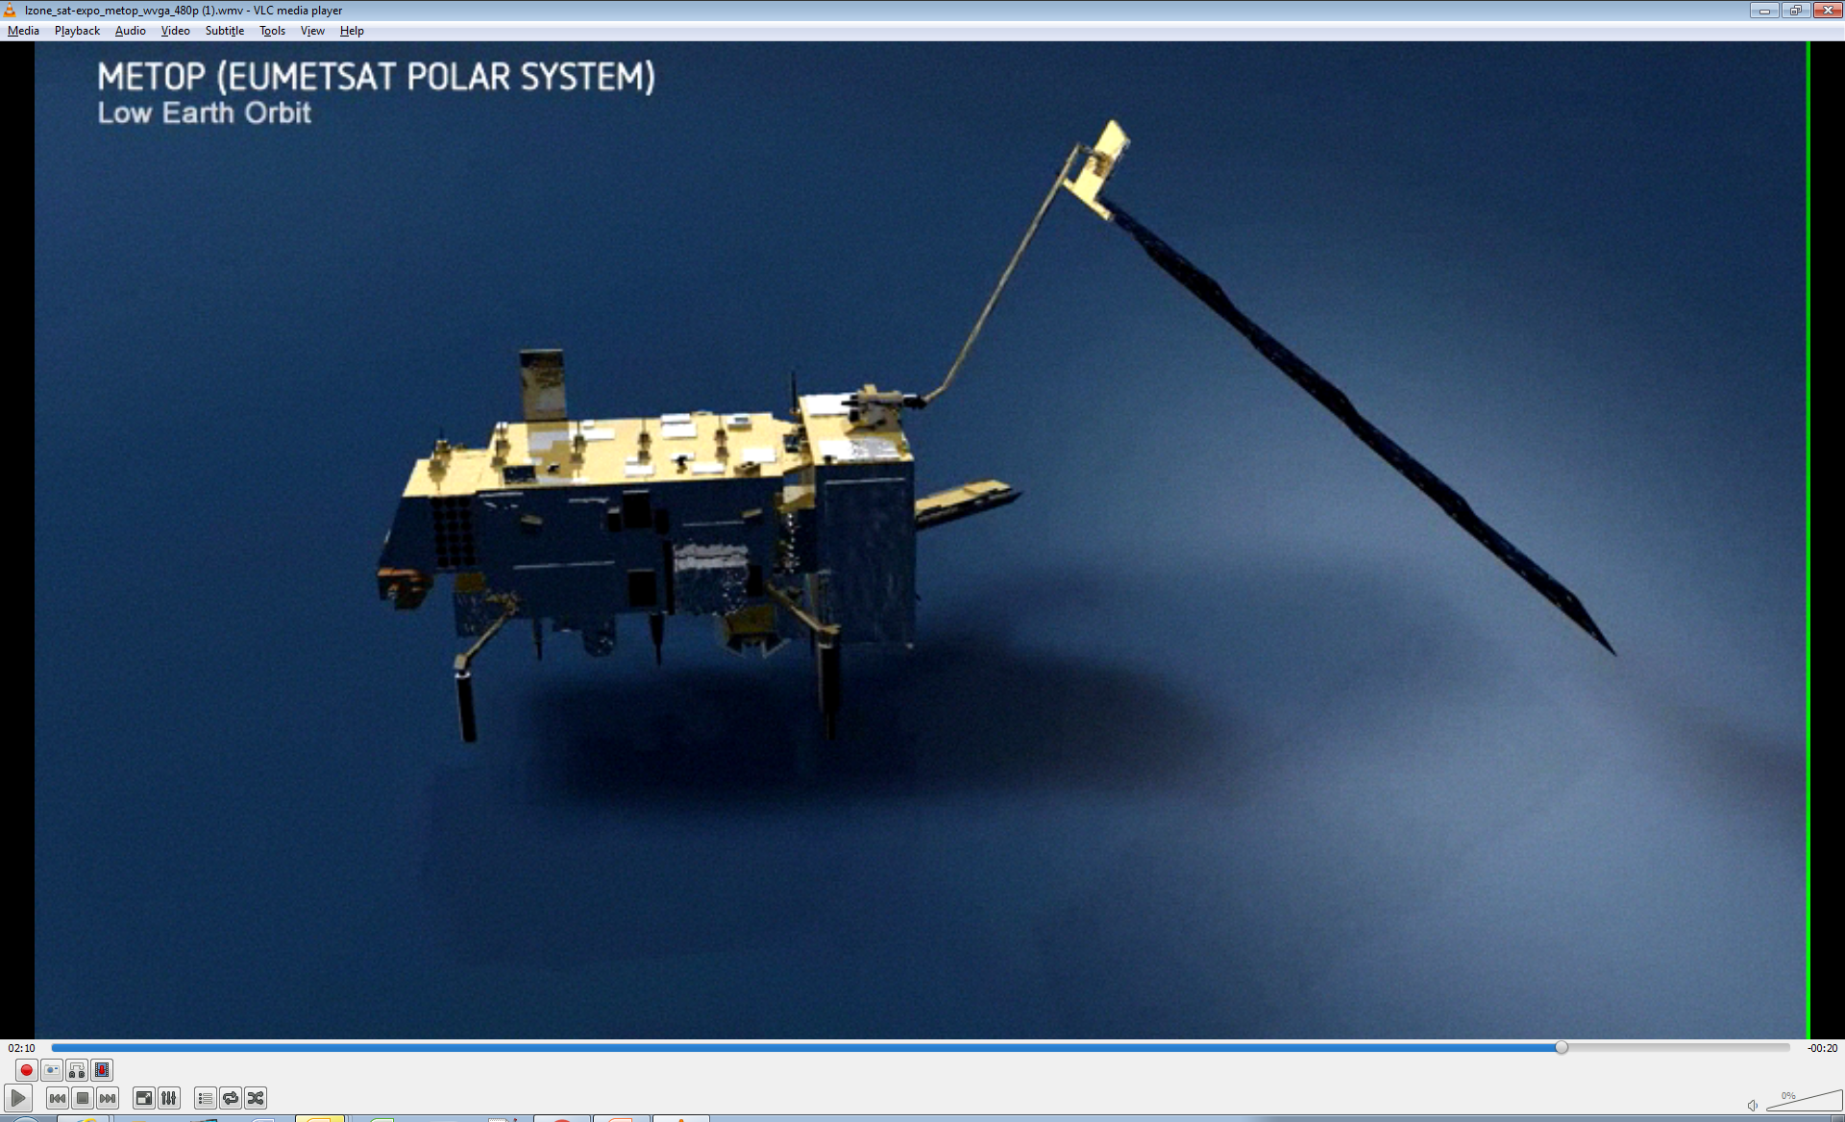
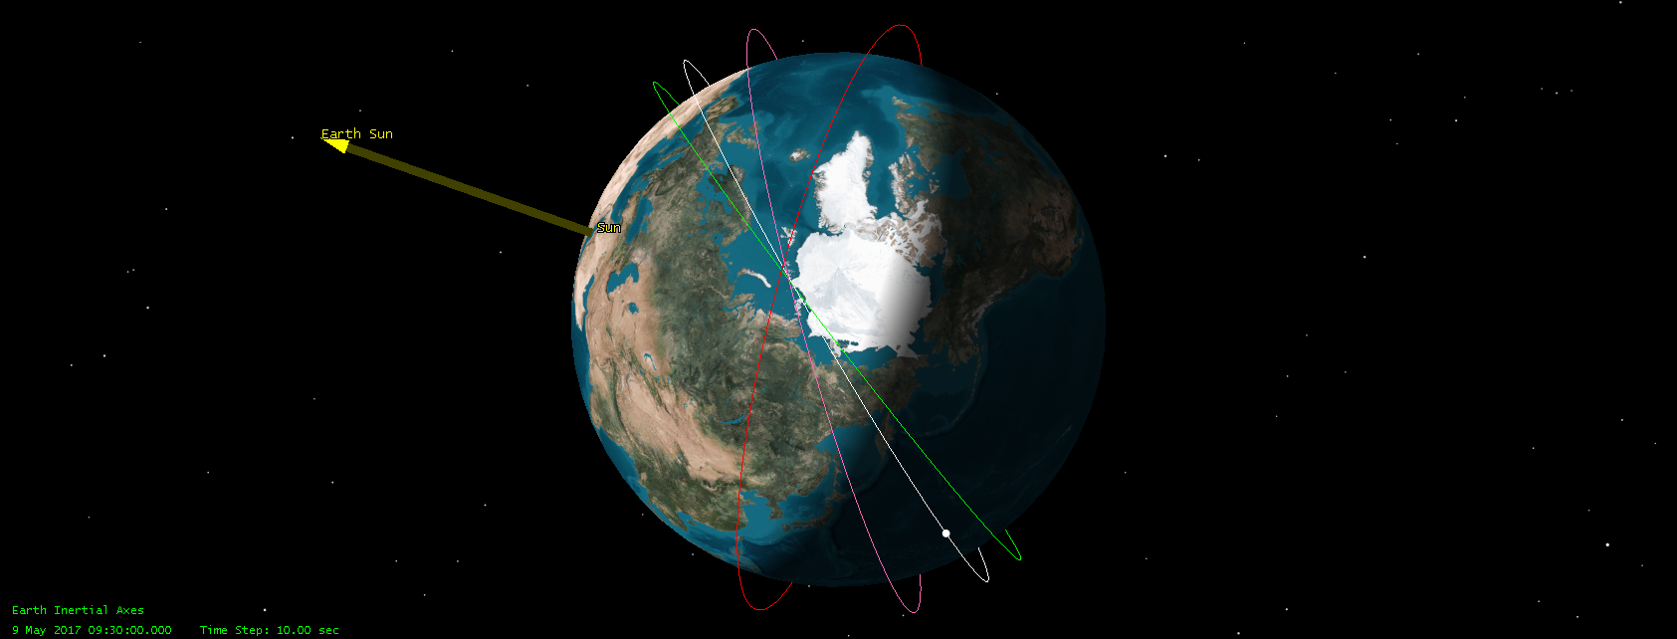
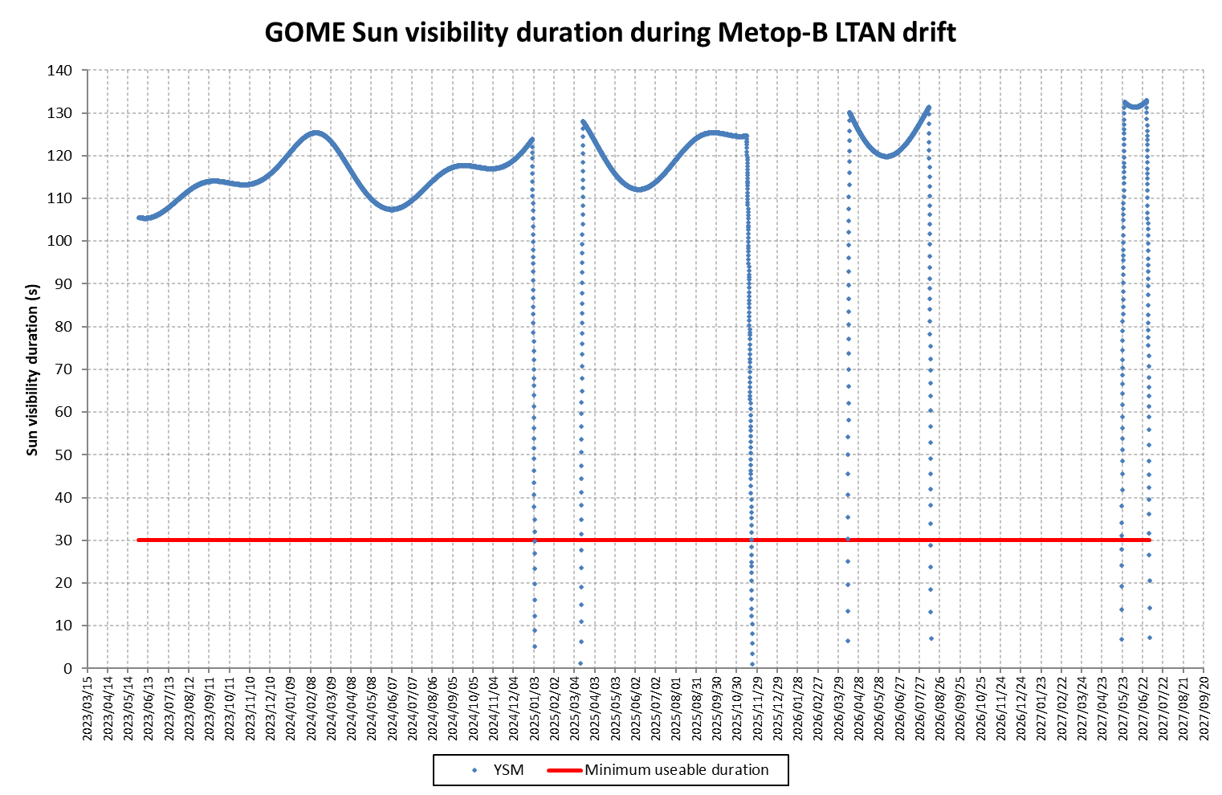
Metop-B GOME-2: Loss of Sun Visibility
Orbit with nominal LTDN
Orbit with decayed LTDN
Metop Orbit decaying Local Time of Descending Node
(LTDN)
Satellite Flight Direction
To Sun
Satellite Flight Direction
To Sun
Green LTDN 09:30 UTC
Grey LTDN 09:00 UTC
Pink LTDN 08:00 UTC
Red LTDN 06:00 UTC
  Sun enters FOV of Sun Port for Solar calibrations
  Eclipses allow other calibrations without stray-light pollution
  No Sun in FOV of Sun Port
  No eclipses so other calibrations suffer stray-light pollution.
Solar Gap GOME-2 / Metop-B
 | Start | Stop
1st | 28.12.2024 | 18.03.2025
2nd | 10.11.2025 | 14.04.2026
3rd | 09.08.2026 | 26.05.2027
4th | 24.06.2027 | End of mission
Current period

Slide 8
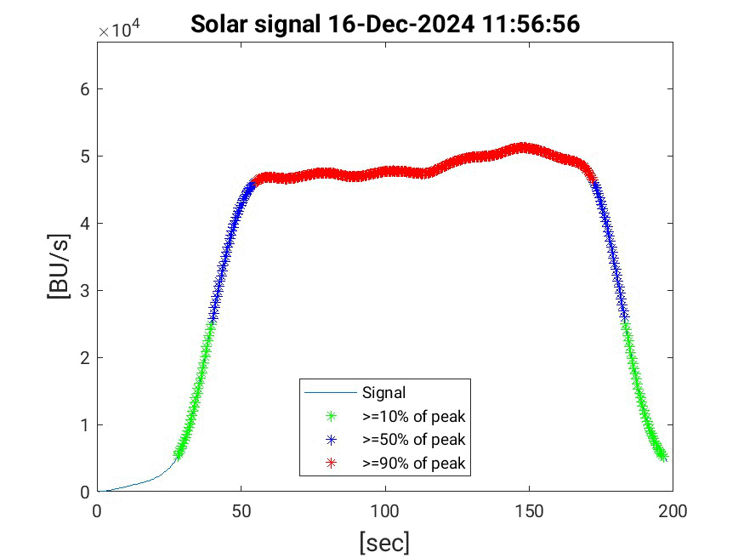
Current GOME-2/Metop-B solar gap period (Dec. 2024 – Mar. 2025)
Current GOME-2/Metop-B solar gap period (Dec. 2024 – Mar. 2025)
Solar signal – level-0

Slide 9
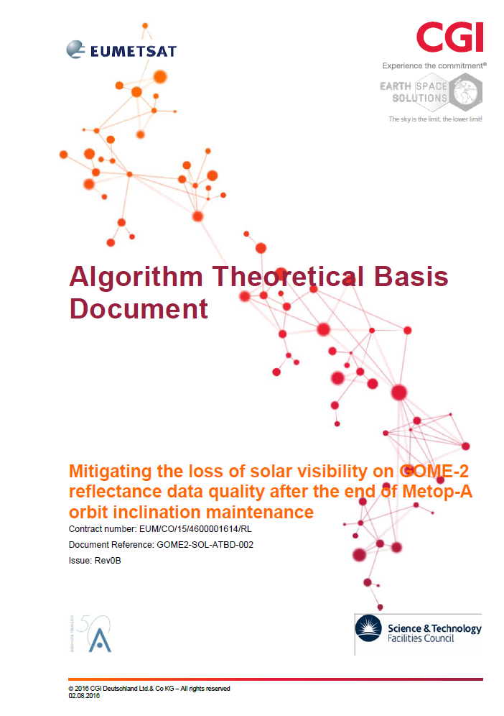
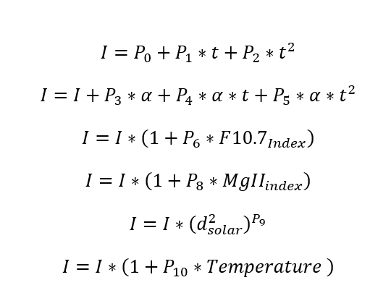
Empirical solar model for GOME-2 / Metop-B - Mitigating the loss during gaps of solar visibility
Aux data
Derived from GOME-2C
GOME-2B OBM
Coefficients P₁ to P₁₀ together with the external parameters are fully describing the information content and evolution of the GOME-2 solar main channel measurement

Slide 10
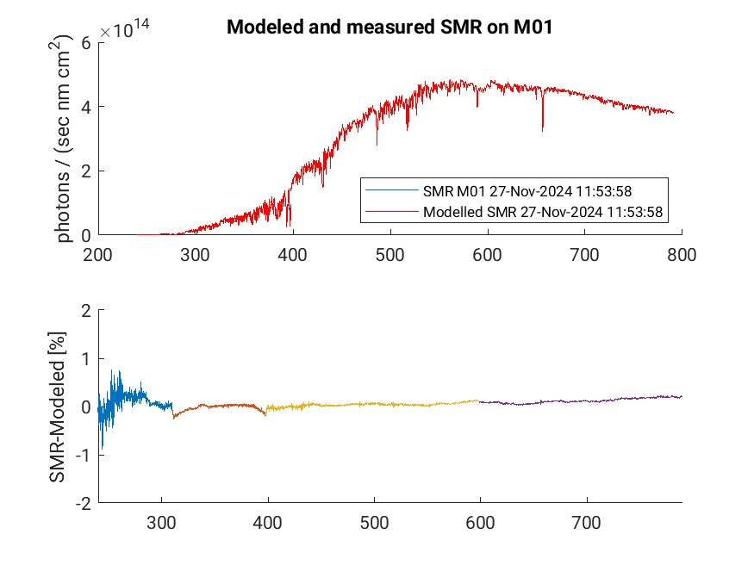
GOME-2 Solar Model performance
Analysis for current solar gap – Model vs GOME-2B SMR before start of gap

Slide 11
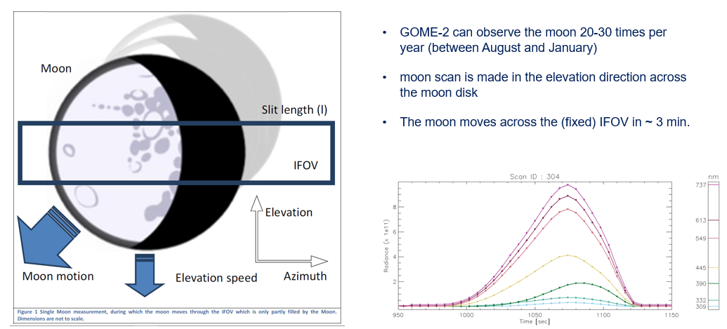
GOME-2: Lunar measurements

Slide 12
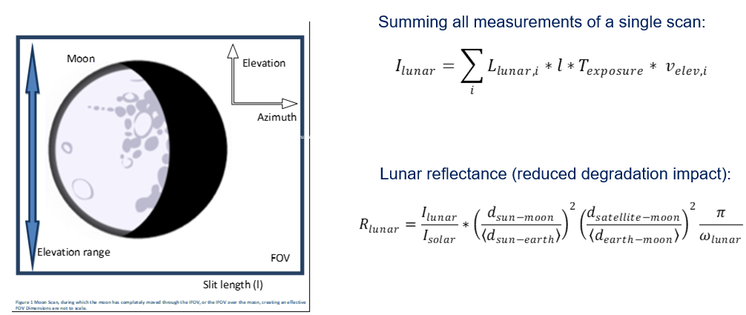
GOME-2: Derivation of lunar irradiance and reflectance

Slide 13
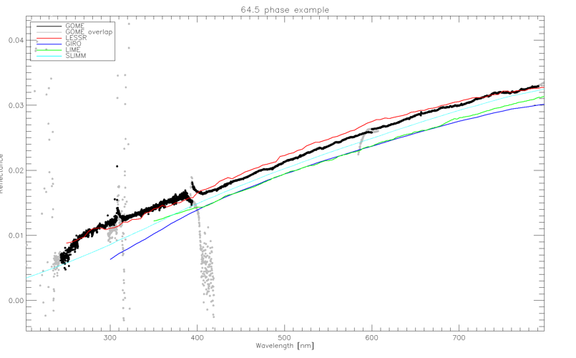
Comparison of GOME-2 Lunar refl. with models
Courtesy of Matthijs Krijger, ESS

Slide 14
EUMETSAT mission planning
MANADATORY PROGRAMME
SATELLITE
2020
2025
2030
2035
2040
2045
2050
Meteosat Second Generation (MSG)
Meteosat-8
Meteosat-9
Meteosat-10
Meteosat-11
Upcoming launches in 2025!
MTG-S1: 1 July 2025
Metop-SGA1: 12 August 2025
Microcarb: June/July 2025
Sentinel-6B: 17 Nov 2025
Meteosat Third Generation (MTG)
MTG-I1
MTG-S1
MTG-I2
MTG-I3
MTG-S2
MTG-I4
EUMETSAT Polar System (EPS)
Metop-A
Metop-B
Metop-C
EUMETSAT Polar System - Second Generation
(EPS-SG)
Metop-SGA1
Metop-SGB1
Metop-SGA2
Metop-SGB2
Metop-SGA3
Metop-SGB3
OPTIONAL AND COPERNICUS PROGRAMME
Jason
Jason-3
Copernicus
Sentinel-3A
Sentinel-3B
Sentinel-3C
Sentinel-3D
Sentinel-6 Michael Freilich
Sentinel-6B
Sentinel-6C
Sentinel-6 NG
CRISTAL
CO2M
Notes:
This is possibly not exactly up to date but gives a clear view on EUMETSAT’s long-term / continuity planning

Slide 15
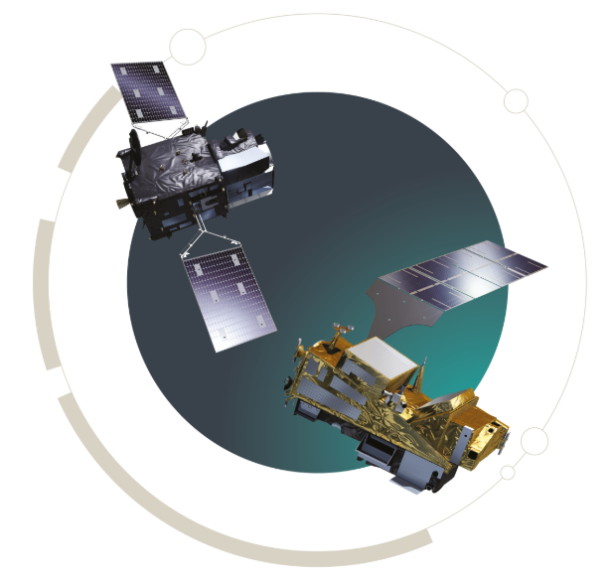

Copernicus Sentinel-4 and Sentinel-5
The S4/UVN (on MTG-S) and S5/UVNS (on EPS-SG A) are Copernicus missions. Their implementation is delegated to the European Space Agency (ESA) and the European Organisation for the Exploitation of Meteorological Satellites (EUMETSAT).
ESA is responsible for the development of the S4/UVN and S5/UVNS instruments and a number of prototype processor elements.
EUMETSAT is responsible for the development of the operational ground-segments, mission operations as well as the continuous validation and full scientific exploitation of S4/UVN and S5/UVNS.

Slide 16
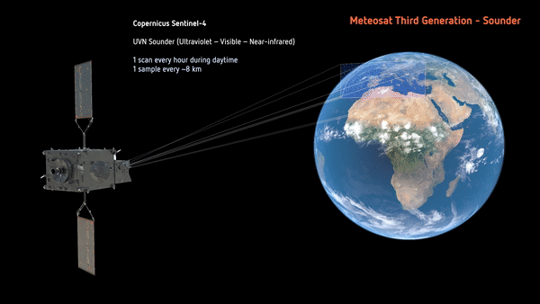
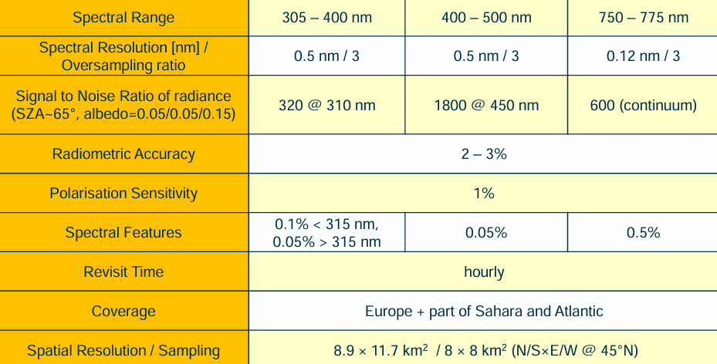
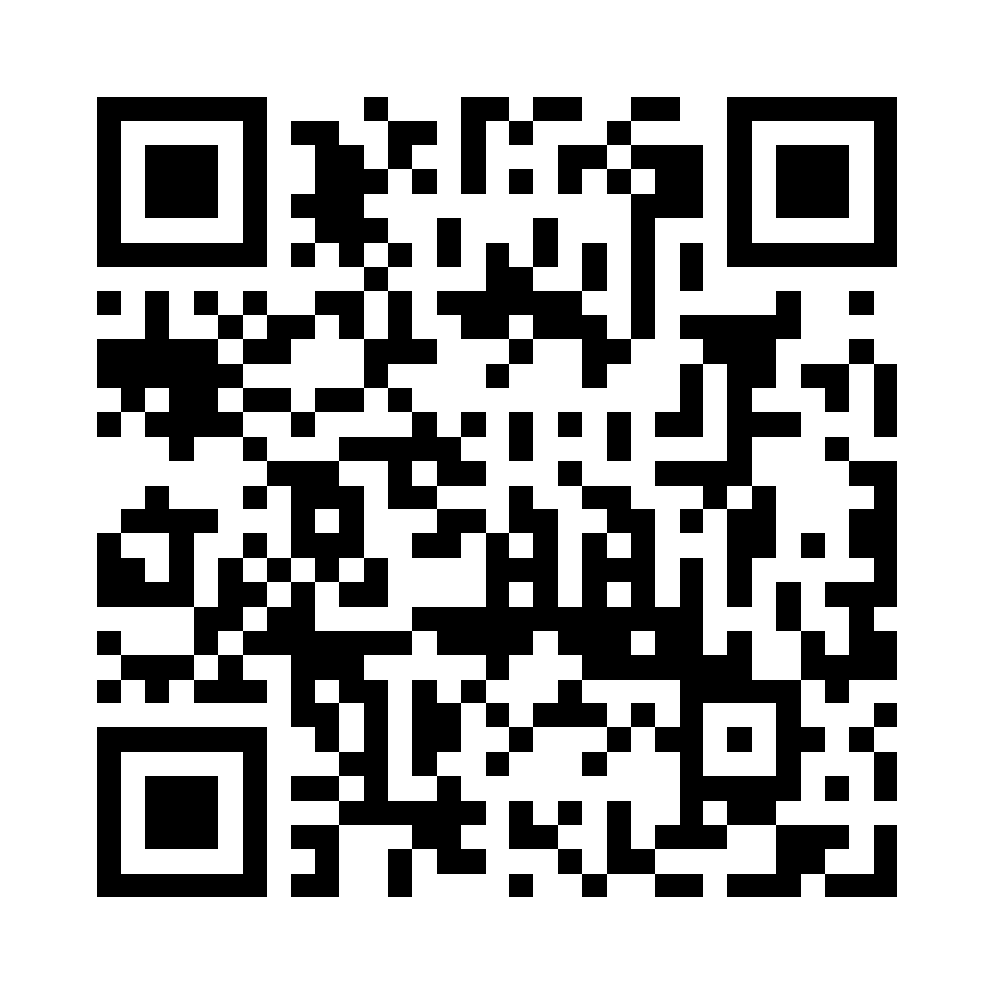
Meteosat Third Generation – Sounder / Copernicus Sentinel-4
Copernicus Sentinel-4/UVN will be the first European Air Quality mission in a geostationary orbit
Observation area from 30 to 65º N in latitude and 30º W to 45º E in longitude. With an observation repeat cycle period of approximately one hour, an observation of the diurnal cycle of air quality and trace gases will be possible.
Launch planned for 1 July 2025

Slide 17
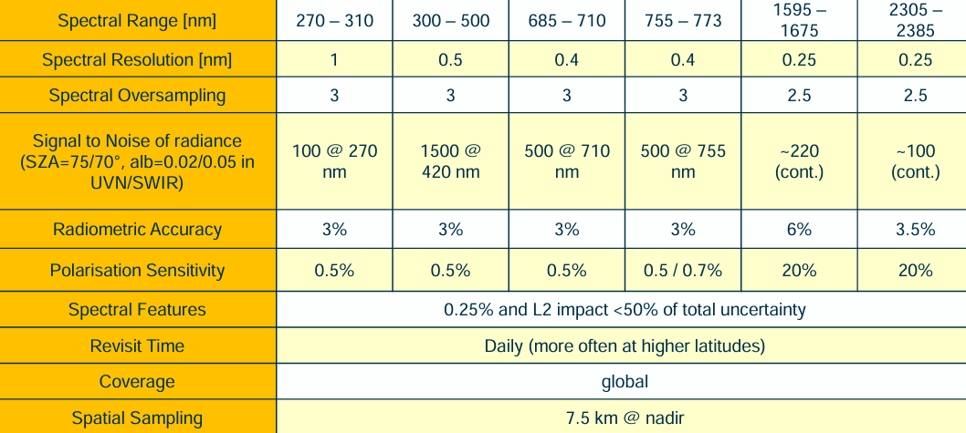
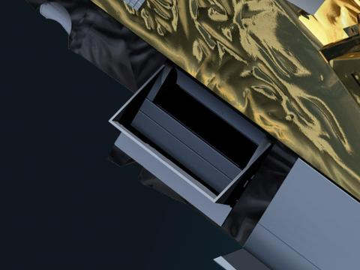

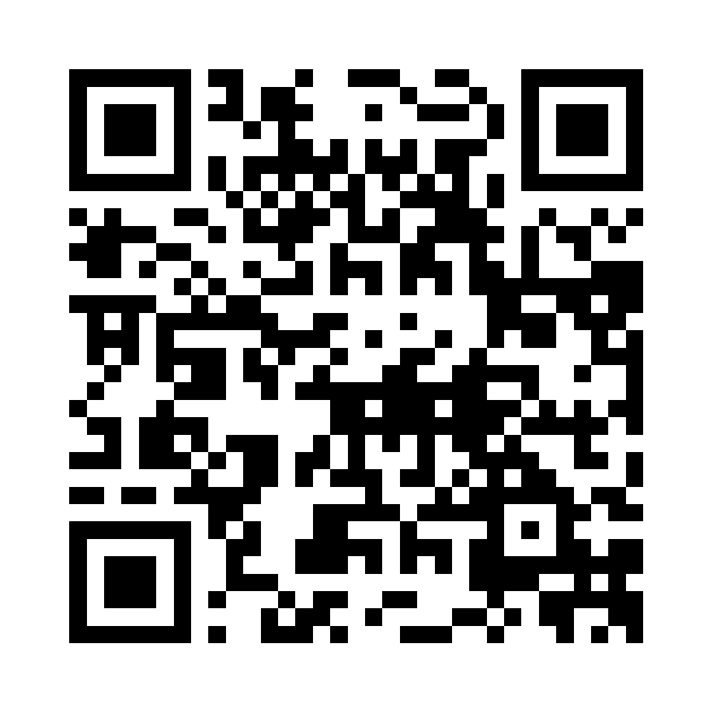
EPS-SG A / Copernicus Sentinel-5
Copernicus Sentinel-5/UVNS will provide operational monitoring of trace gas concentrations for atmospheric chemistry and climate applications from a polar orbit, providing daily global coverage.
TBW
Launch planned for 12 August 2025
Sentinel-5P data, Courtesy of J. van Gent, BIRA-IASB

Slide 18
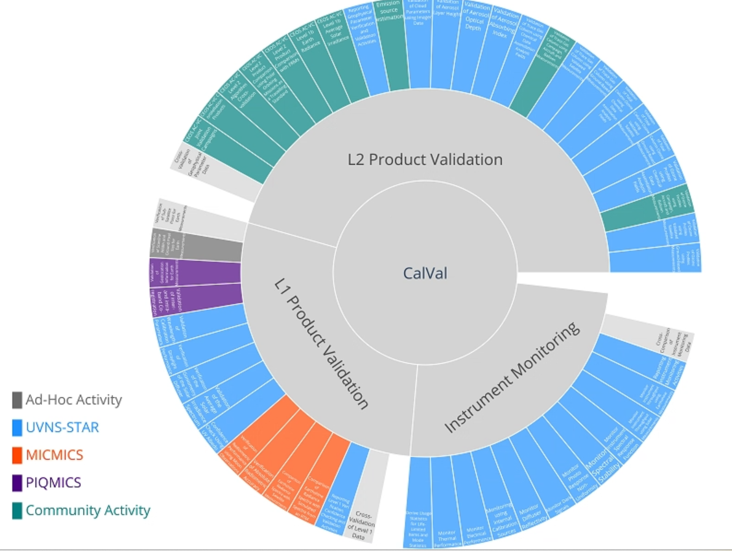
Sentinel-4 / Sentinel-5 Cal/Val and monitoring
The in-orbit instruments verification activities are conducted under the responsibility of the instrument prime (Airbus DS).
After IOV: Sentinel-4 and Sentinel-5 Cal/Val plan describes instrument monitoring activities, Level 1 and Level 2 product verification, confidence checking, validation and long-term monitoring activities.

Slide 19
S4 / S5 Cal/Val and monitoring: tools developed at EUMETSAT
Purpose | Tool | Functionality
Instrument and housekeeping monitoring | UVNS-STAR / UVN-STAR L0 | Monitoring / reporting of thermal and electrical performance, life-limited items status
L1 product quality and on-board calibration monitoring | UVNS-STAR / UVN-STAR L1 | Monitoring / reporting of L1 product quality, on-board calibration sources, solar irradiance
Geolocation validation and monitoring | PIQMICS | Verification / validation / monitoring of geolocation, intra-band and inter-band co-registration
Radiometric calibration verification and monitoring | MICMICS | Verification and monitoring of radiometric bias and stability, using PICTs (desert, DCC, ….), Satellite inter-comparisons (imager & hyperspectral) and lunar calibration.
L2 product quality monitoring and continuous validation | UVNS-STAR / UVN-STAR L2 | Monitoring / reporting of L2 product quality, continuous validation against Fiducial Reference Measurements and comparison against other satellite retrievals

Slide 20
S4 / S5 radiometric performance monitoring
S4/UVN and S5/UVNS will be added in EUMETSAT’s multi-mission framework MICMICS, for verification and monitoring of radiometric bias and stability. Some opportunities and limitations (incomplete list):
Satellite Inter-Comparisons (imagers -> spectral binning, hyperspectral).
  Good colocation statistics S5-MetImage, S5-3MI, S5-OLCI, S5-GEMS, …
  Hyperspectral LEOs in different orbits than S5/UVNS
  S4/UVN field of view centred on Europe -> No “real” colocations other than with MTG-I/FCI.
Pseudo-Invariant Calibration Targets (PICTs).
  All PICTs usable for S5/UVNS. Some PICS visible for S4/UVN.
  S4/UVN field of view centred on Europe, excluding most PICSs, DCCs, Rayleigh sites.
Moon Observations.
  S4/UVN will observe the moon.
  S5/UVNS will only observe the moon in case of dedicated platform manoeuvres.

Slide 21

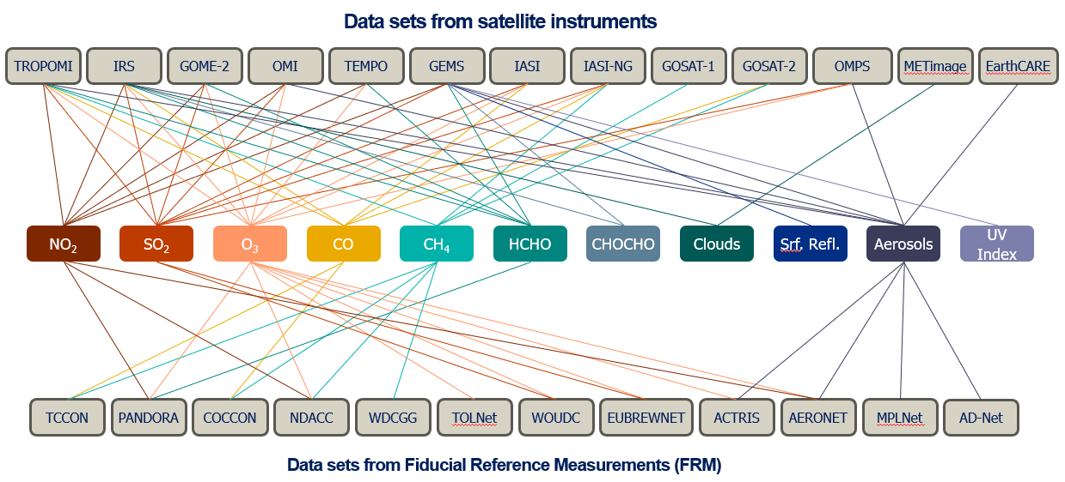
Level-2 validation efforts
ESA and EUMETSAT have jointly issued an Announcement of Opportunity call for Cal/Val activities for Sentinel-4 and Sentinel-5, to
a) Assess and establish the initial post-launch data quality of the mission products
b) Support the consolidation of the processors
c) Support the verification of mission product requirements
Proposals have been received, from Europe, China, Korea, USA
EUMETSAT will
complete the level-2 commissioning and perform continuous validation of operational level-2 mission products.
This will be based on validation against Fiducial Reference Measurements and comparisons with other satellite retrievals.
Cal/Val prep workshop to take place on 16-18 June at EUMETSAT to form the validation team and get organized

Slide 22
Thank you!
Questions are welcome.

