Slide 1
(GOME-2 and) TROPOMI directional surface albedo
Erwin Loots ^{1 ,} Gijsbert Tilstra ¹, Martin de Graaf ¹, Olaf Tuinder ¹, Ping Wang ¹, Maarten Sneep ¹, Henk Eskes ¹, Folkert Boersma ¹, Piet Stammes ¹
¹KNMI, Royal Netherlands Meteorological Institute, De Bilt, The Netherlands

Slide 2
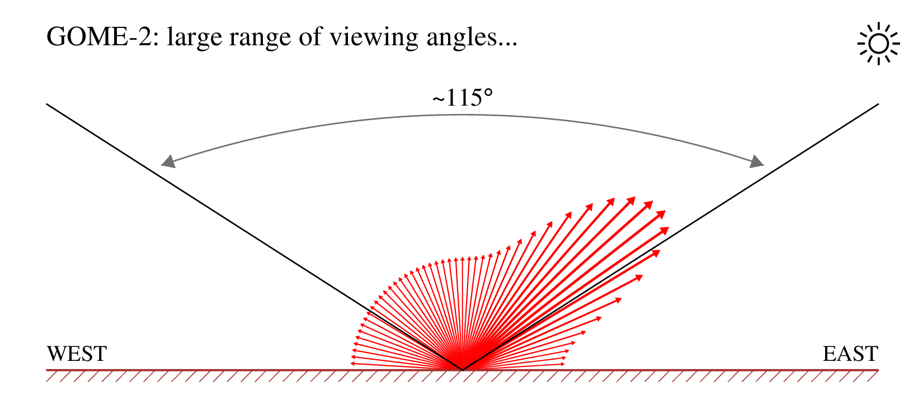
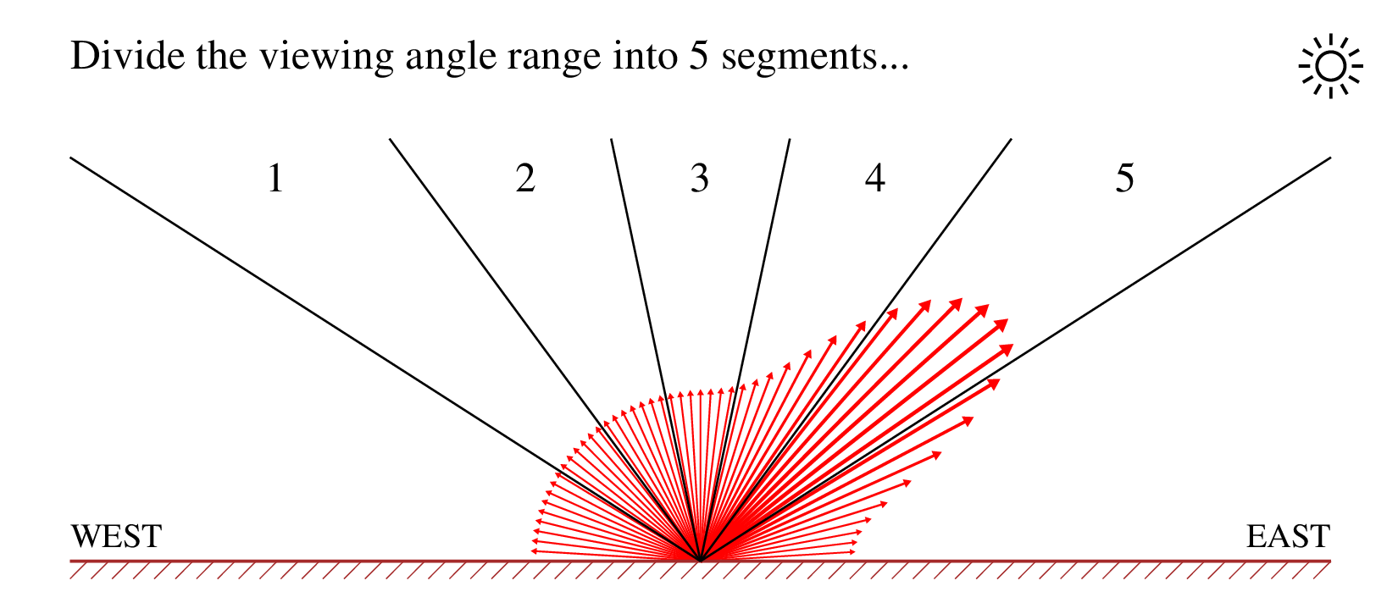
Creating a directional surface LER database: DLER
Lambertian model:
The surface LER (=Lambertian-equavalent reflectivity) retrieval is focused on the minimum LER value because of the statistical cloud screening. The resulting LER underestimates the albedo in the backscattering direction.
Directional surface LER:
Define 5 viewing angle ranges (segments) and calculate the surface LER for each of the 5 viewing angle segments.
Result: 5 databases for each of the 5 viewing angle segments.
19 March 2025
GSICS Annual Meeting 2025 - TROPOMI DLER database

Slide 3
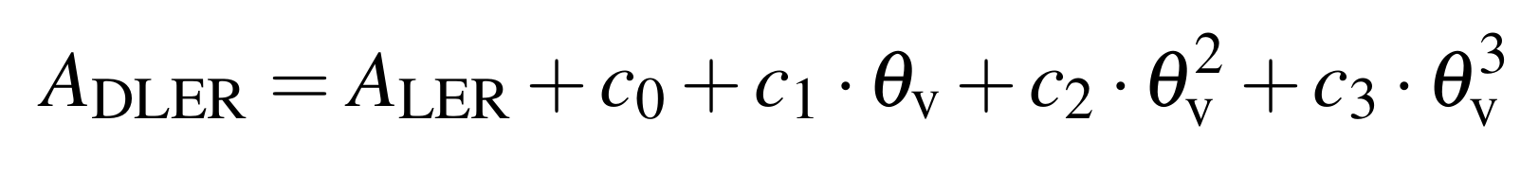
Expansion; databases
DLER is constructed/defined as a polynomial expansion on top of the traditional LER:
(GOME-2 DLER database)
(TROPOMI DLER database)
where θ_{v} is the viewing angle, by definition positive for the west side of the orbit swath, and negative for the east side of the orbit swath.
The polynomial coefficients c_{i} are stored in the GOME-2 and TROPOMI surface DLER databases.
The retrieval code can determine the surface DLER based on the latitude, longitude, time, wavelength and the viewing angle θ_{v}.
19 March 2025
GSICS Annual Meeting 2025 - TROPOMI DLER database

Slide 4
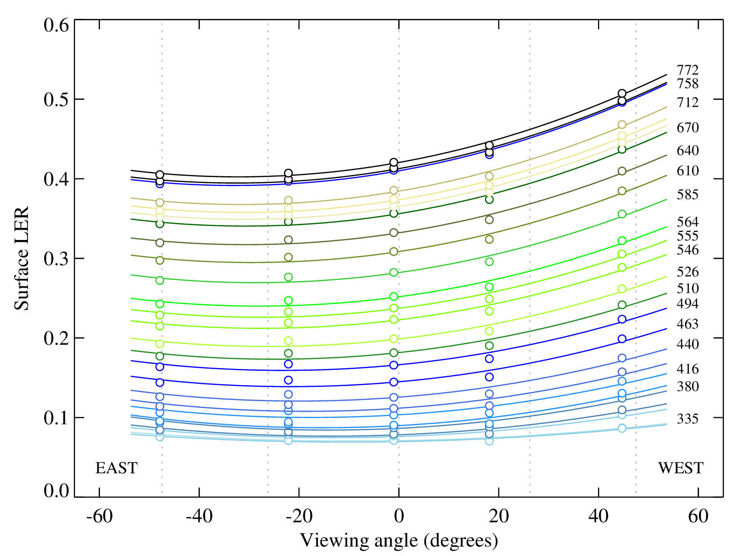
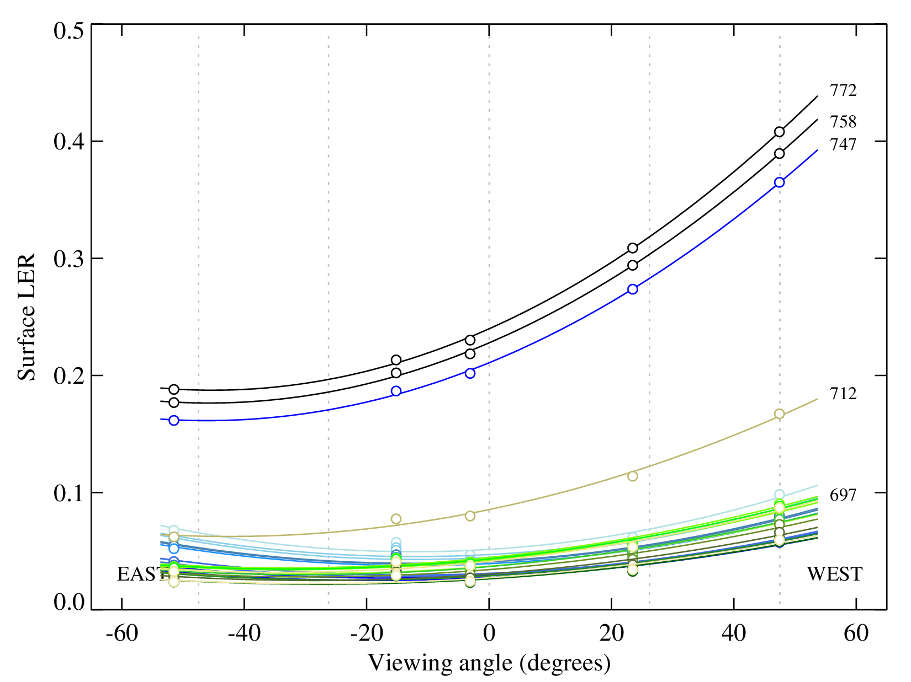
Examples of directionality for GOME-2
Sahara desert
Amazonian rainforest
Curves: parabolic fits to the 5 data points taking into account the reliability of the individual data points.
Desert: difference between “West” and “East” ~0.1 at 758/772 nm.
Vegetation: difference between “West” and “East” of a factor of ~2 at 758/772 nm.
West viewing directions underestimated by the traditional non-directional surface LER databases.
19 March 2025
GSICS Annual Meeting 2025 - TROPOMI DLER database

Slide 5
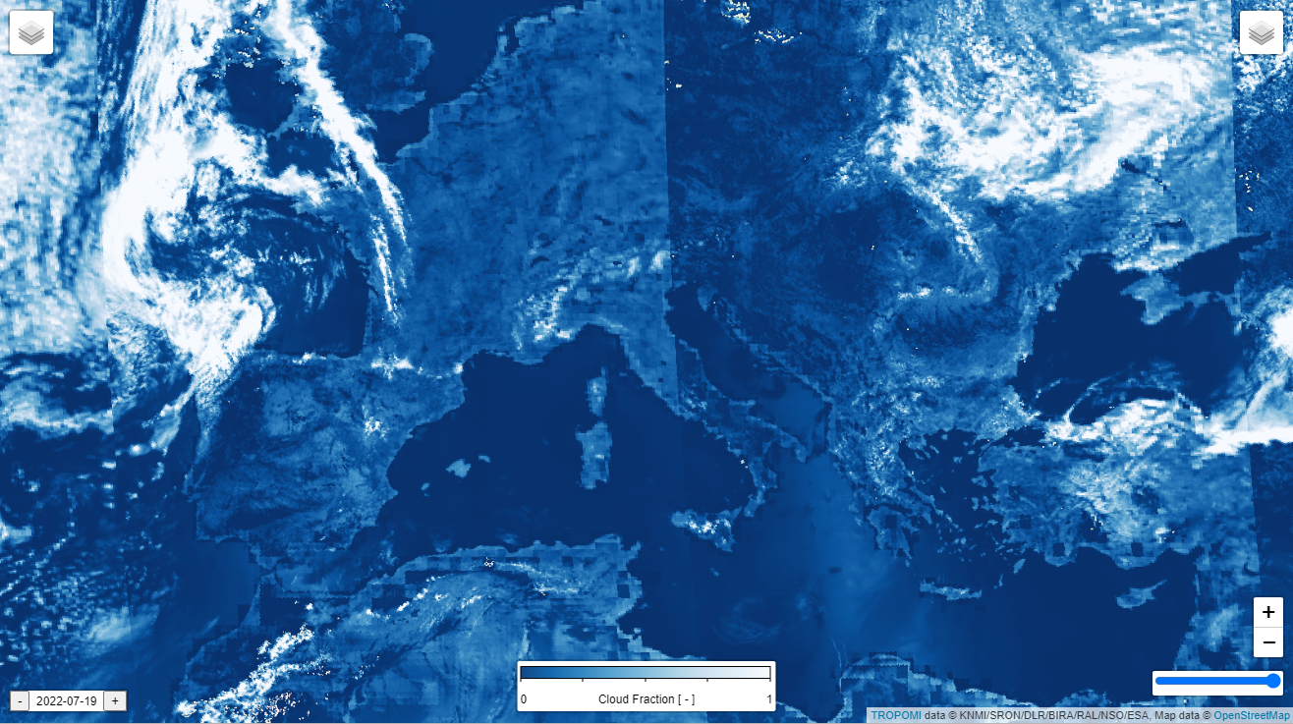
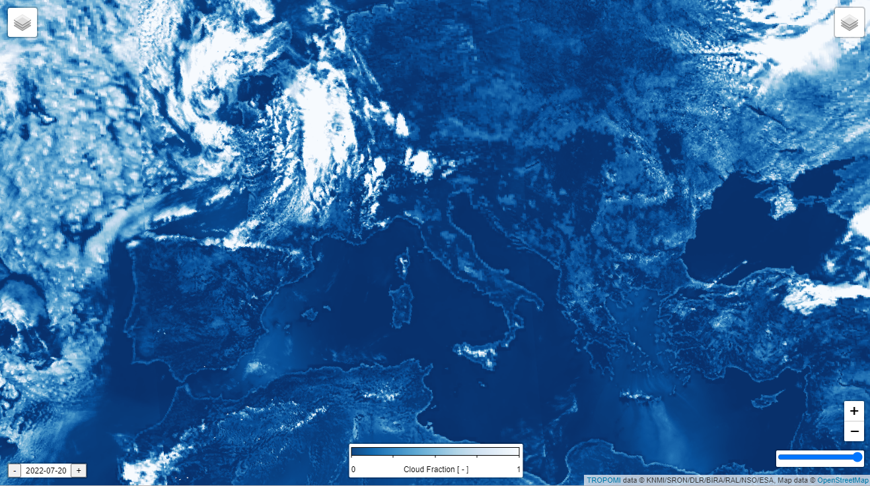
Example of application: S5P/FRESCO cloud product
FRESCO CF with GOME-2 LER:
FRESCO CF with TROPOMI DLER:
Overlapping TROPOMI orbits swaths clearly visible for cloud-free conditions because of underestimation at the east side of the orbit swath in non-directional surface LER
Orbit edges not visible, homogeneous background
19 March 2025
GSICS Annual Meeting 2025 - TROPOMI DLER database
5

Slide 6
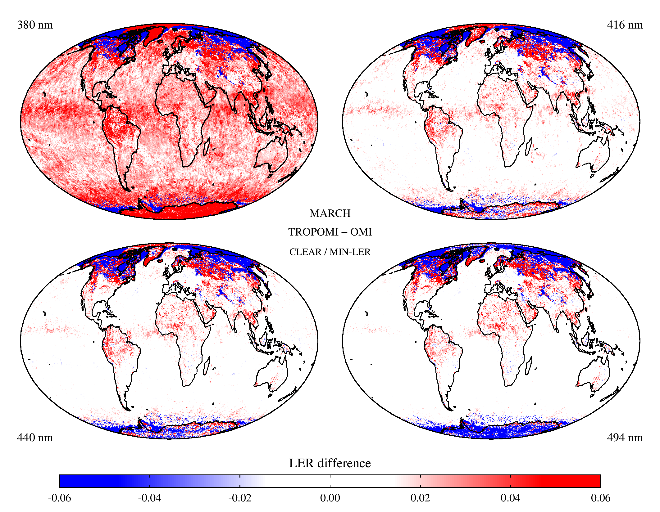
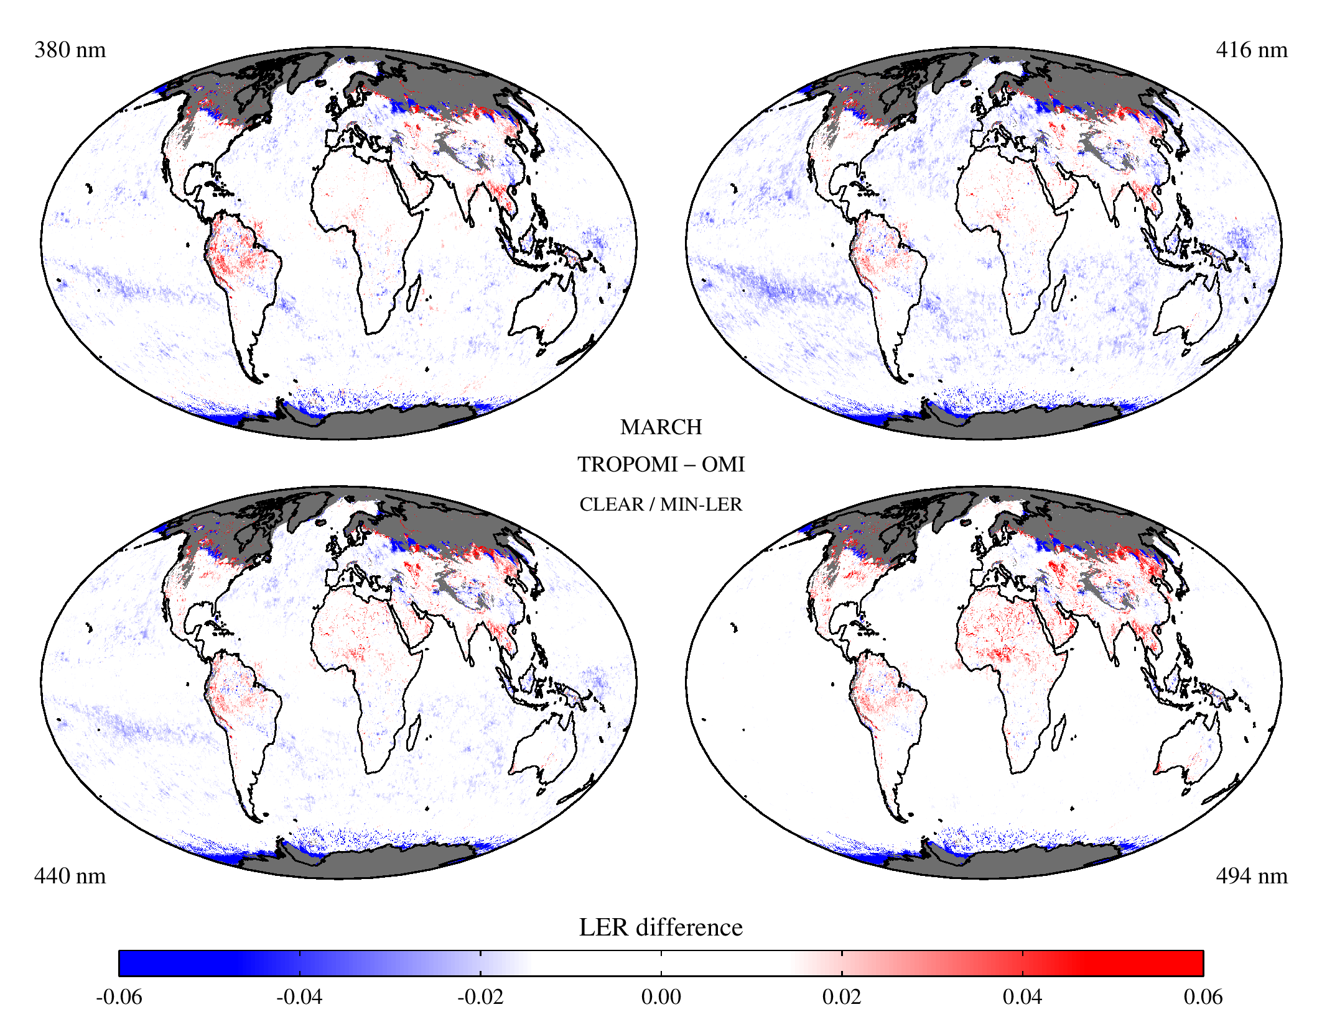
TROPOMI surface DLER database v2.1
Based on Collection-3 L1B data — calibration issues in TROPOMI bands 3 and 4 solved
version 1.0
version 2.1
6
19 March 2025
GSICS Annual Meeting 2025 - TROPOMI DLER database

Slide 7
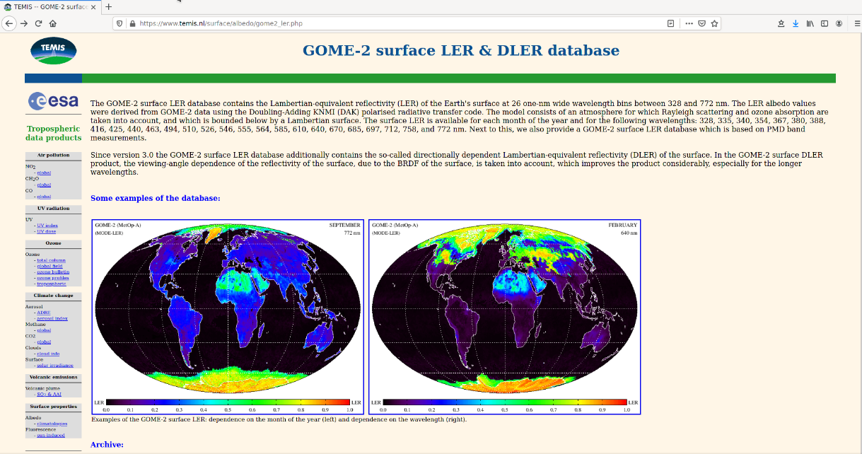
Summary and outlook
Superiority DLER vs LER
Superiority TROPOMI Collection 3 (with IFC corrections, viz. instrument degradation)
Directional surface LER databases: viewing angle dependence included
Databases are available for download: www.temis.nl/surface/albedo.html
TROPOMI DLER supported by ESA (via S5p+I project) and S&T (via S5P-PAL hosting)
Database will continue to be updated (to maintain consistency with newer S5P versions)
DLER will also be built for Sentinel-4 and Sentinel-5 within the AC SAF (CDOP-4/5)
On TEMIS:
GOME-1 LER
SCIAMACHY LER
MERIS BSA
OMI LER
GOME-2 DLER
GOME-2 PMD-DLER
TROPOMI DLER
19 March 2025
GSICS Annual Meeting 2025 - TROPOMI DLER database
Notes:
AC SAF: atmosph. Compositions Satellite Application Facility
CDOP: continuous development and operations phases

