Slide 1


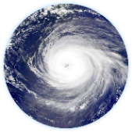
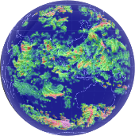

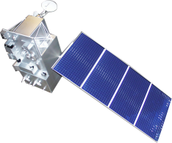
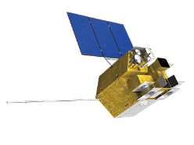

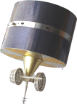
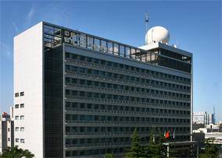


On-orbit status of FY-3E SSIM UV band
Jin Qi, Hong Qiu, Ling Sun
National Satellite Meteorological Center (NSMC)
Yu Huang , Zhanfeng Li, Yue Li
Changchun Institute of Optics, Fine Mechanics and Physics (CIOMP)
Contact email: qijin@cma.gov.cn
GSICS_2024
19 Mar. 2025

Slide 2
Outline
Introduction of SSIM
On-orbit performance
Degradation of UV band
Summary and Future plan

Slide 3
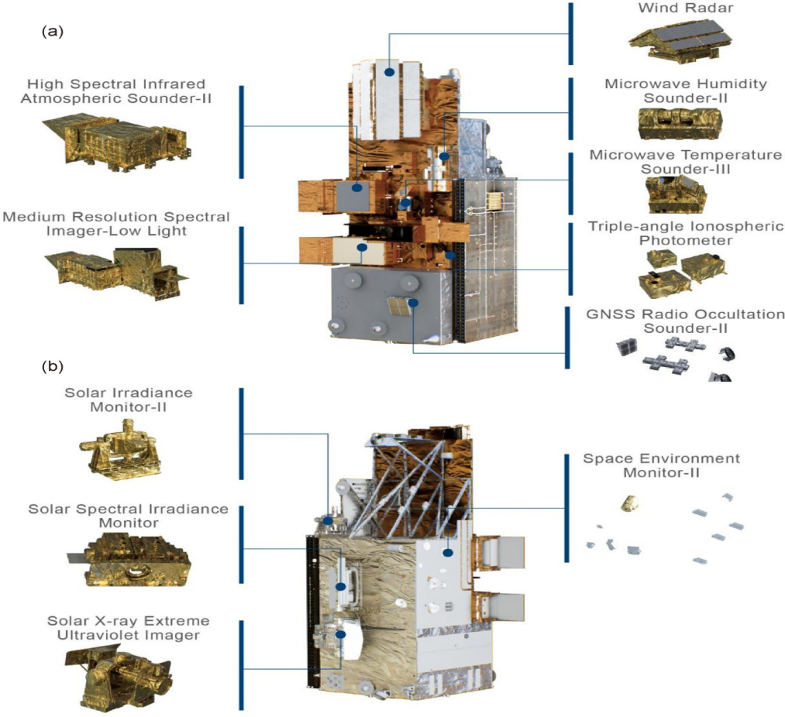
1. Introduction of SSIM
FY-3E
Solar Spectral Irradiance Monitor (SSIM) is a new payload onboard FY-3E satellite for measuring the solar spectral irradiance from 165 nm to 2400 nm (1650nm to 2400nm is in experimental stage);
SSIM is designed for capturing continuous record of solar spectral irradiance to detect solar variability;
With near - simultaneous observation of SIM-II, the total and spectral solar irradiance are first time recorded by the same satellite platform in China.

Slide 4
SSIM design
Instrument requirement
Parameters | UV band | VIS band | NIR band
Spectral Range (nm) | 165-320 | 285-700 | 650-2400*
Spectral Resolution (nm) | ≤1 | ≤1 | ≤8
Wavelength accuracy (nm) | ≤0.05 | ≤0.05 | ≤0.1
Spectral Sampling (nm) | 0.1 | 0.25 | 1
Accuracy | 160nm~240nm≤3% 240nm~320nm≤2% | ≤2% | ≤2%
Reporting Frequency | 1 spectra per day
 | Band | Spectral Range | Function | Detector | Working Mode
UV | UV1 | 165~320 | Detection | PMT | Photons Counting
 | UV2 | 165~320 | Calibration | PMT | Photons Counting
VIS | VIS | 280~700 | Detection | PMT | Modulated Current
NIR | NIR1 | 650~1650 | Detection | InGaAs cell | Modulated Current
 | NIR2* | 1560~2400 | Detection | InGaAs cell | Modulated Current
*1650nm-2400nm is experimental band.

Slide 5
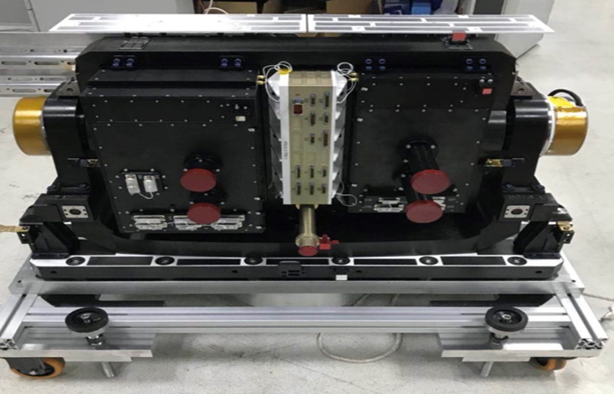
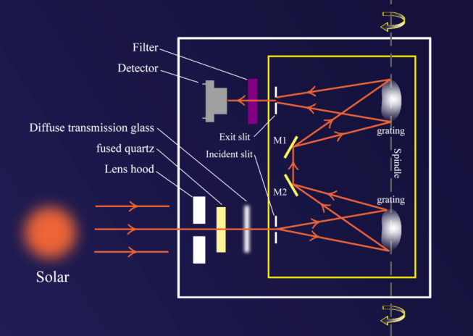
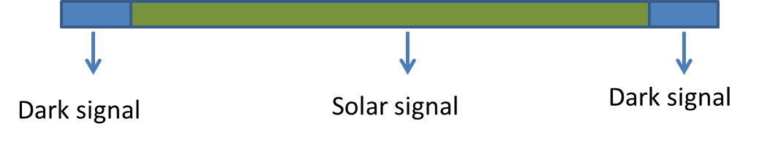
VIS/NIR
UV
Each detector has a quartz plate in front of slit for protection;
Each band has two quartz to cover the spectrum range;
Each band observation contains dark signal and solar signal information, dark signal is performed at begin and end of observation for 21 times.

Slide 6
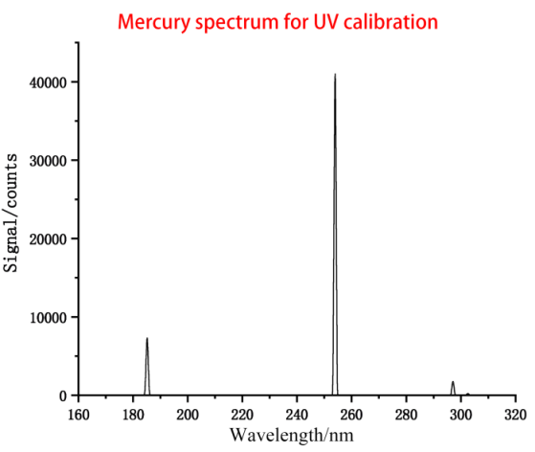
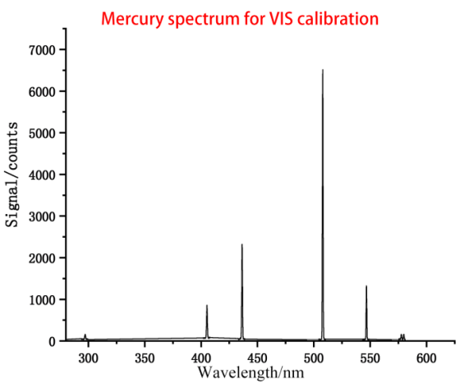
Spectral calibration
Using Mercury lamp to monitor UV1, UV2 and VIS band wavelength drift;
The calibration is designed to perform monthly.
 | UV1
wavelength | 184nm | 253nm | 296nm
1 | 0.959 | 0.896 | 0.855
2 | 0.956 | 0.894 | 0.856
3 | 0.955 | 0.895 | 0.856
4 | 0.960 | 0.893 | 0.860
5 | 0.950 | 0.892 | 0.857
Spectral Resolution /nm | 0.956 | 0.894 | 0.857

Slide 7
Radiometric calibration
The calibration is usually divided into quartz and detector, each quartz plate has a backup to monitor the relative change;
UV detector has a backup detector (UV2) to perform the calibration;
VIS detector use Tungsten lamp .
UV band calibration design
Aim | method | Frequency
UV1 quartz | The backup UV1 quartz | weekly
UV1 detector | The backup detector(UV2) | monthly
UV2 quartz | The backup UV2 quartz | yearly

Slide 8
Calibration cycle design
The calibration cycle is designed to be performed automatically using orbit number which counting by the instrument.
The yearly calibration
Orbit | aim
N | Solar measurement
N+3 | UV1 back up quartz
N+5 | Dark current mode
N+8 | Whole spectrum backup mode
N+11 | UV2 back up quartz
Day 1
Orbit | aim
N+14 | Solar measurement
N+17 | Spectral calibration
N+20 | Tungsten lamp2 for VIS detector
N+23 | Tungsten lamp1 for VIS detector
Day 2

Slide 9
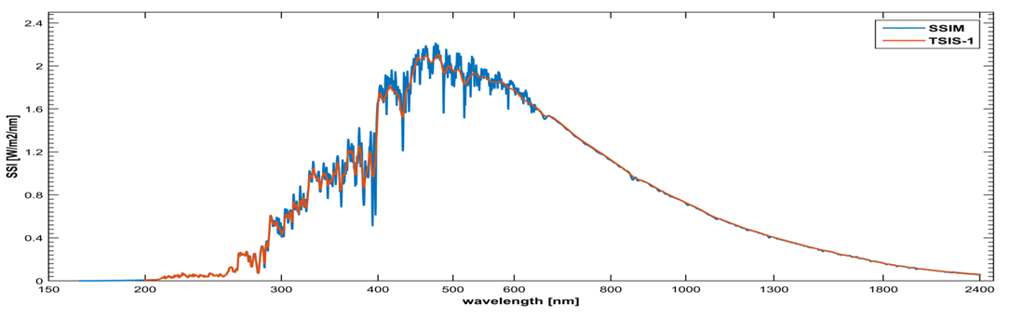
2. On-orbit status
21.7.5 | Fengyun-3E was launched
21.7.10 | SSIM was powered on and then turned to standby
21.7.11-8.29 | Gas-off stage
21.8.30 | Adjusted instrument parameters
21.8.31 | First light of the sun
21.9.1-9.23 | More testing, such as SNR
21.9.24 | Switched to operation mode

Slide 10
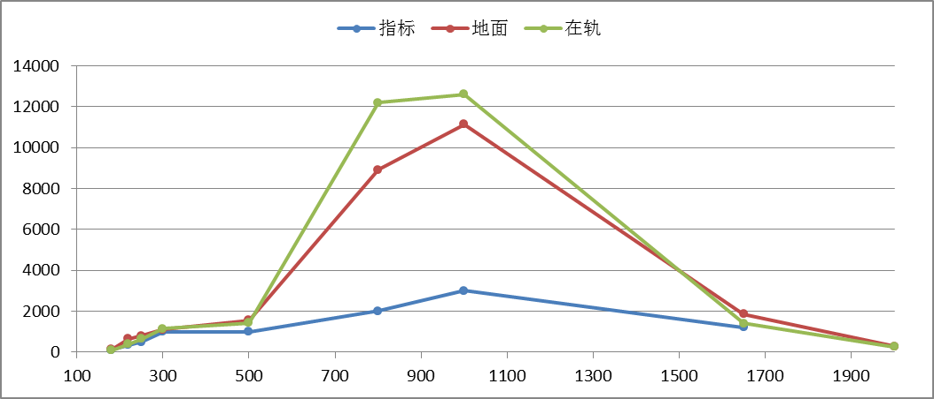
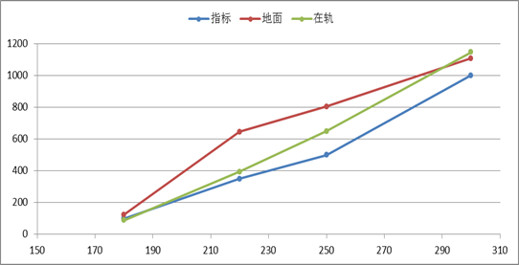
UV1 detector failed to load voltage @1500V
SNR testing results @1300V
blue- design required, red-ground, green-on-orbit
UV1 failed to load voltage @1500V, so we changed it to 1300V, the working temperature changed from 11℃ to 6℃;
Big influence:
  The absolute response of UV1 band which we got from the ground calibration couldn’t be used, it was under 1500V;
  We use NRLSSI data +TSIS HSRS as new reference;
Good news: the SNR under 1300V is still match the requirement.
180nm SNR is a little lower

Slide 11
Solar particle events are frequent
Big influence:
  The anomaly is random, sometimes it can be found in time, sometimes not. The data continuity is interrupted.
  The instrument orbit counting is stopped. This means the calibration cycle can not working automatically.

Slide 12
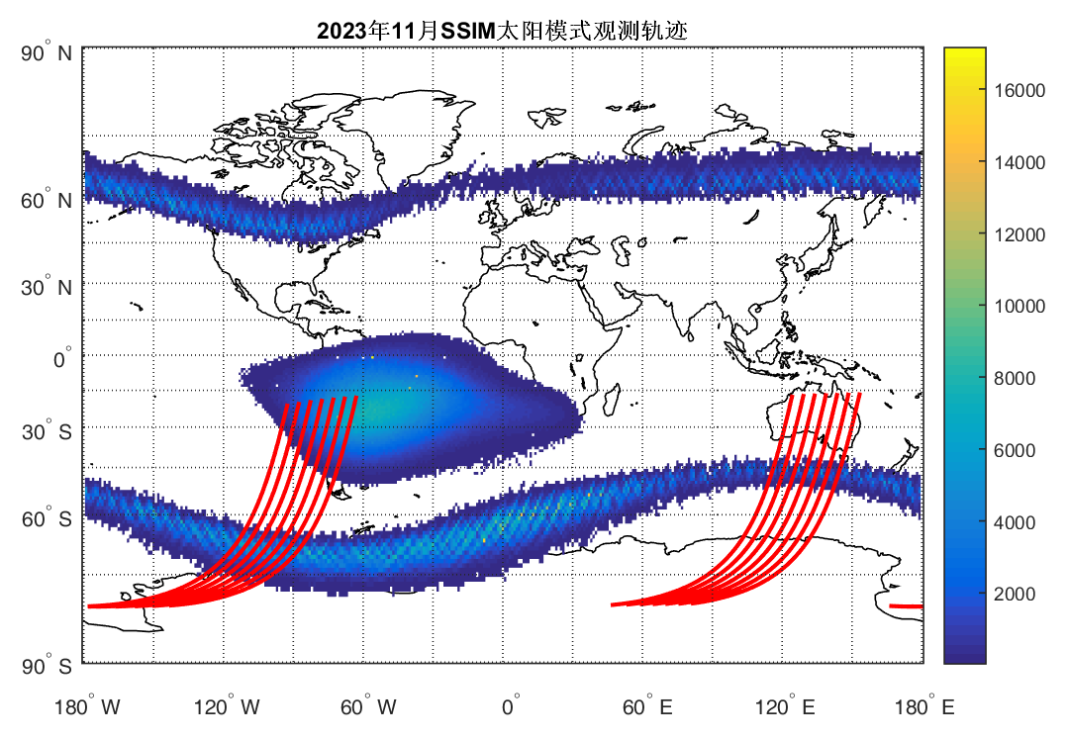
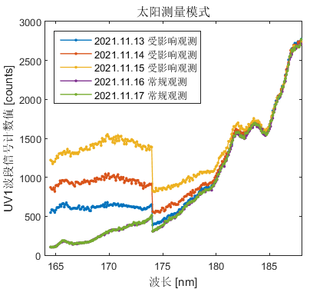
UV band are affected by South Atlantic Anomaly (SAA) region
2023.11 observation track
Big influence:
  UV band is always be affected;
  for the calibration cycle especially in monthly and yearly , the data quality is affected frequently.
Solar mode

Slide 13
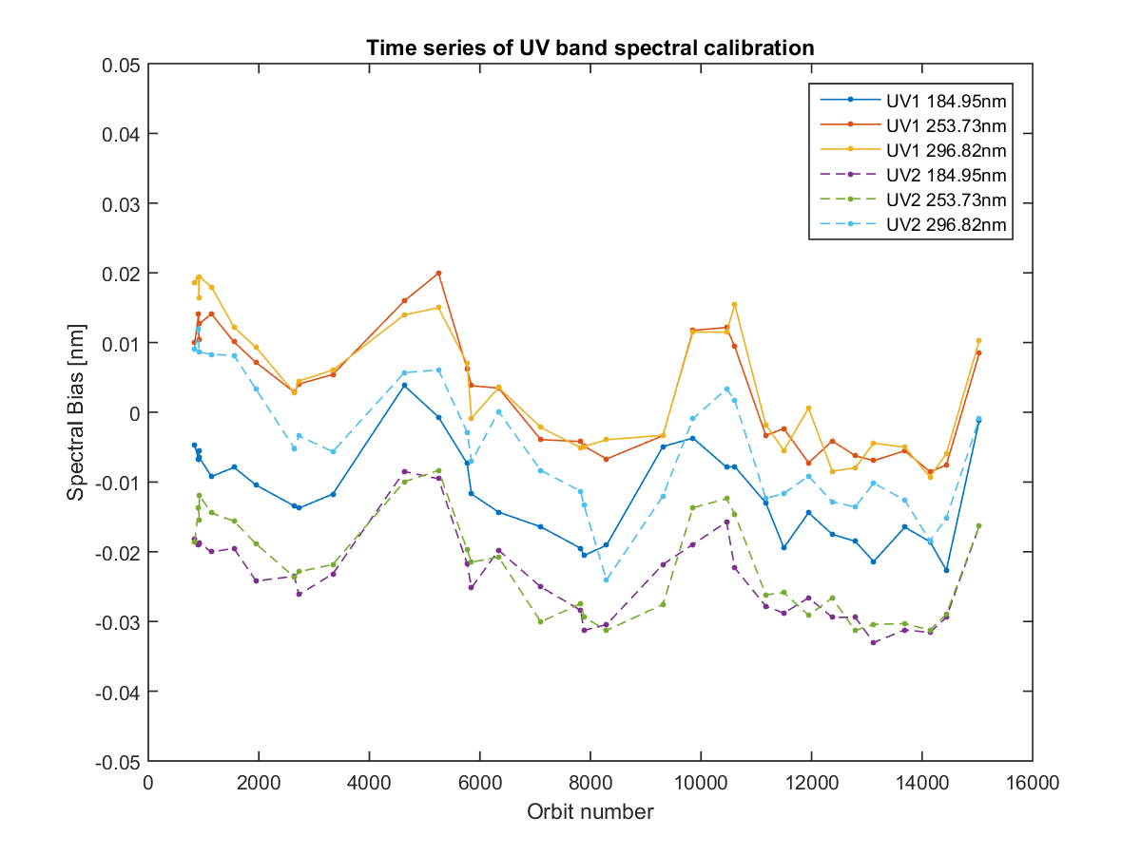
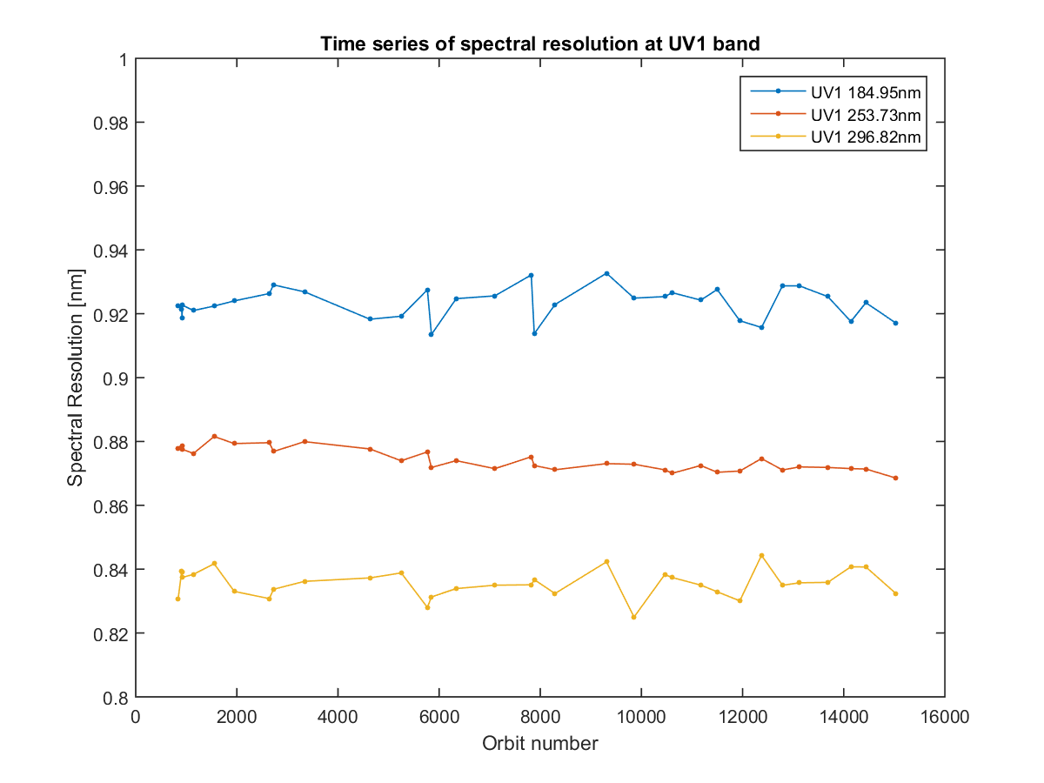
3. Degradation of UV Band
some dark current mode results:
  Stray light testing was performed by dark current observation with and without tracking;
  The mean value of dark current from solar mode has an upward trend.
spectral calibration results:
  Wavelength drift shows a pattern affected by temperature;
  The spectral resolution shows stable pattern.

Slide 14
Weekly results
UV1 with backup quartz compare to its first observation
Ratio of UV1 normal compare to UV1 with backup quartz

Slide 15
monthly results
UV1 with the third quartz compare to UV2 with normal quartz

Slide 16
yearly results
UV1 compare to UV2 with backup quartz
UV2 normal quartz compare to backup quartz

Slide 17
4. Summary and Future plan
The Solar particle events and South Atlantic Anomaly region has an influence on data quality, especially on UV band;
UV band spectral calibration show a stable pattern, since the spectral accuracy matched the requirement, no correction is applied;
Based on the calibration ratio results, wavelength drift correction is needed;
The UV band degradation is significant, mostly from the detector, and we need to consider it from instrument design;
We will have another SSIM on-board FY-3I. Some optimization have already been implemented.

Slide 18

谢 谢！
Make the data better and easier to use !

