Slide 1


Comparison between FY-4/GIIRS and FY-3/HIRAS
Chengli Qi, Lu Lee
NSMC/CMA
GSICS IR Subgroup Web Meeting, July 18 2024

Slide 2

Contents
01
Background and introduction of GIIRS and HIRAS
02
Procedures for GIIRS-HIRAS Inter-Comparison
03
Comparison results
04
Summary

Slide 3
1.1 Background
2023 Annual Meeting Actions
Action Id | Summary | Lead | Due | Completed | Notes | Status
A.GIR.20230301.2 | investigate 1) diurnal variations | Chengli Qi | 3/1/2024 | 3/1/2024 | See Xingwei’s talk in IRWG meeting | closed
 | 2) GEO and LEO hyperspectral sounder comparison | Chengli Qi | 3/1/2024 | 18/7/2024 | IR Subgroup webmeeting | To be closed
 | 3) GSICS correction | Chengli Qi | 3/1/2024 |  |  | Open
Notes:
This work trace to 2023 annual meeting action: item 2, Fengyun satellites have LEO and GEO hyperspectral sounders both on orbit, so we can compare the measurement of these two instruments, the spectral resolution are same, so we did it recently and get some preliminary results.

Slide 4
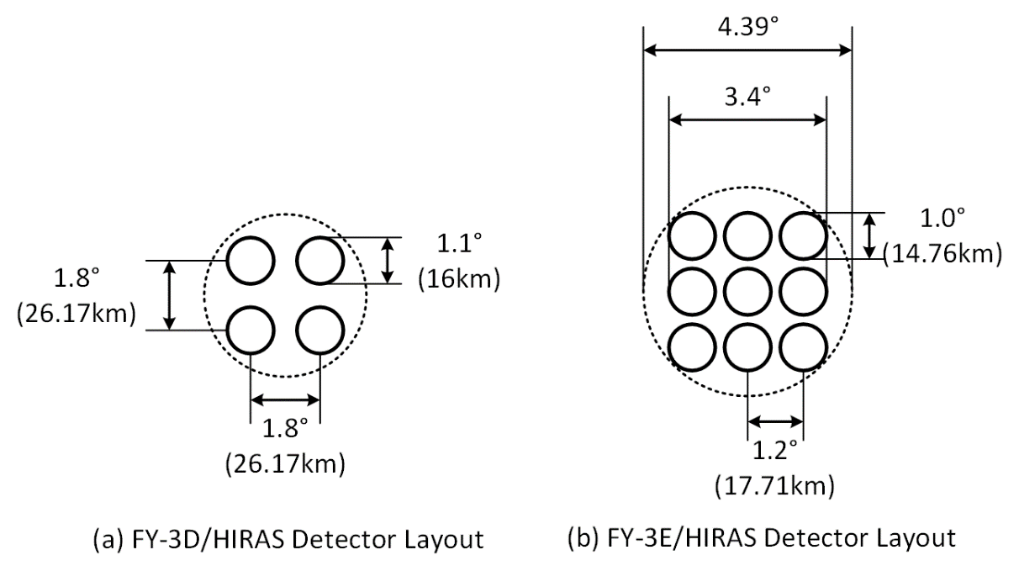
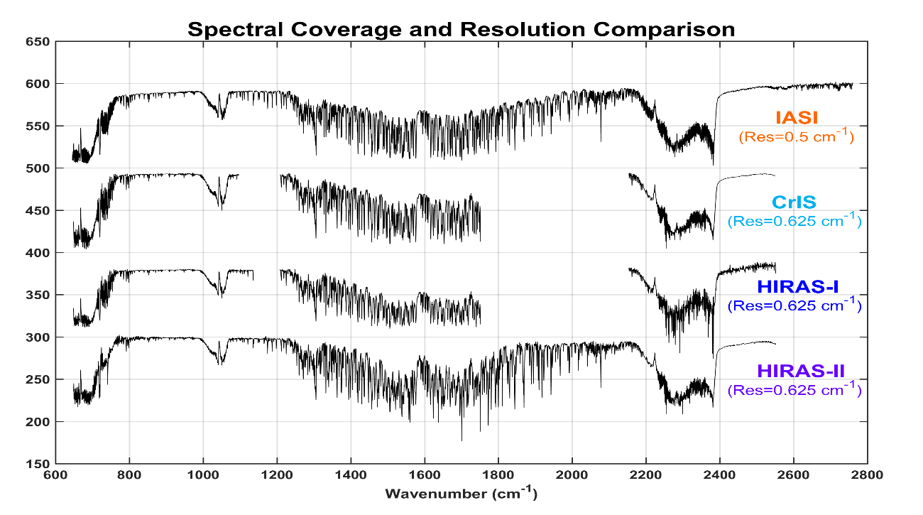
1.2 FY-3/HIRAS instruments
Band | Spectral Range (cm⁻¹) | Spectral Resolution (cm⁻¹) | Sensitivity (NEΔT@280K) |  |  | Radiometric Accuracy |  | Spectral Uncertainty
 |  |  | FY-3D | FY-3E/F/H |  | FY-3D | FY-3E/F/H | FY-3D | FY-3E/F/H
LWIR | 650～1168.125 （15.38 μm～8.56 μm） | 0.625 | 0.4 K | 650 ～667 cm⁻¹ | 0.8 K | 0.7 K | 1.0 K | 10 ppm | 7 ppm
 |  |  |  | 667～689 cm⁻¹ | 0.4 K |  | 0.5 K
 |  |  |  | 689～1000 cm⁻¹ | 0.2 K |  | 0.4 K
 |  |  |  | 1000～1136 cm⁻¹ | 0.4 K |  | 0.5 K
MWIR | 1168.75～1920 （8.55 μm～5.21 μm） | 0.625 | 0.7K | 1210～1538 cm⁻¹ | 0.2 K | 0.7 K | 0.4 K
 |  |  |  | 1538～1750 cm⁻¹ | 0.3 K |  | 0.5 K
SWIR | 1920.625～2550 （5.21 μm～3.92 μm） | 0.625 | 1.2 K | 2155～2300 cm⁻¹ | 0.3 K | 0.7 K | 0.5 K
 |  |  |  | 2300～2550 cm⁻¹ | 0.5 K |  | 0.6 K

Slide 5
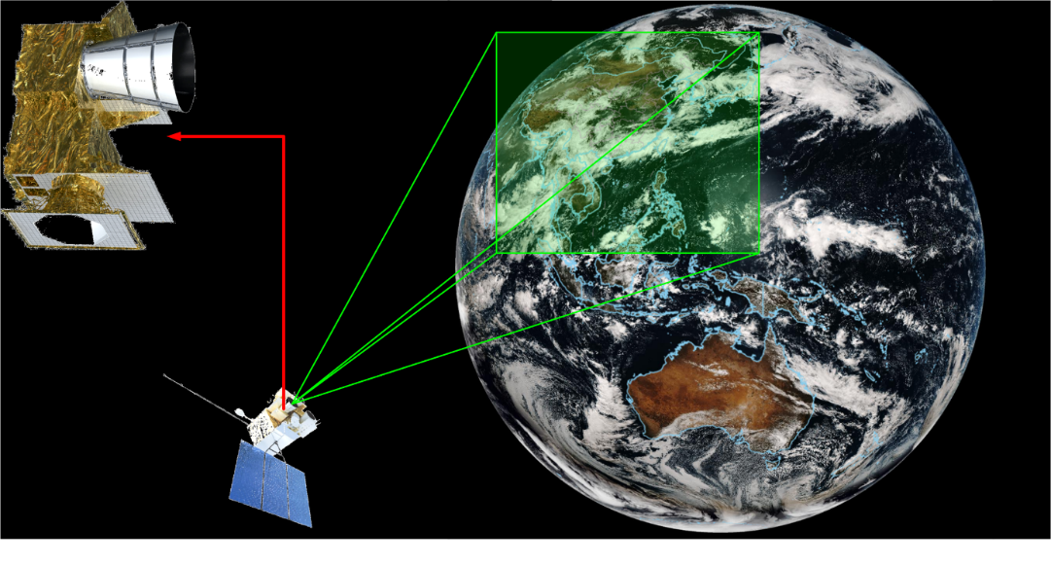
1.2 FY-4/GIIRS instruments
Spec | FY-4A | FY-4B
Spectral Range | LWIR: 700~1130 cm⁻¹ MWIR: 1650~2250 cm⁻¹ | LWIR: 680~1130 cm⁻¹ MWIR: 1650~2250 cm⁻¹
Spectral Sampling | 0.625 cm⁻¹ | 0.625 cm⁻¹
Sensitivity | LWIR: 0.5~1.1 r. u. MWIR: 0.1~0.14 r. u. | LWIR: less than 0.5 r. u. MWIR: less than 0.1 r. u.
Spectral accuracy | 10 ppm (nominal) | Less than 7 ppm
Radiometric accuracy | 1 K (nominal) | 0.7 K
Detector Matrix | 32×4, sparse layour | 16×8, sparse layour
Spatial Sampling | 16 km @ s.s.p. | 12 km @ s.s.p.
Observation Coverage | China and its surroundings @ 86.5°E | China and its surroundings @ 105°E
Repeat Cycle Duration | 2.0 hours | 1.5 hours
VIS Integrated Imager | 2 km @ s.s.p. | 1 km @ s.s.p.
FY-4A and FY-4B satellites successfully launched on Dec 11, 2016 and June 3, 2021 respectively.
From March 5, 2024, FY-4A is drifting to 86.5 degrees East for Backup and ground reception and real-time data services stopped.
FY-4B shifted from 133 degree East to 105 degree East, replacing Fengyun-4A to provid the main operational data service.
r. u.: radiance unit, mW/[m²·sr·cm⁻¹]
s.s.p.: sub-satellite point
Notes:
From March 5, 2024, FY-4A ground reception and real-time data services stopped. Fengyun 4A is drifting to 86.5 degrees East longitude for Backup. Fengyun-4b shifted from 133 degrees East longitude to 105 degrees East longitude, replacing Fengyun-4A to achieve the replacement of the main operational position observation system.

Slide 6
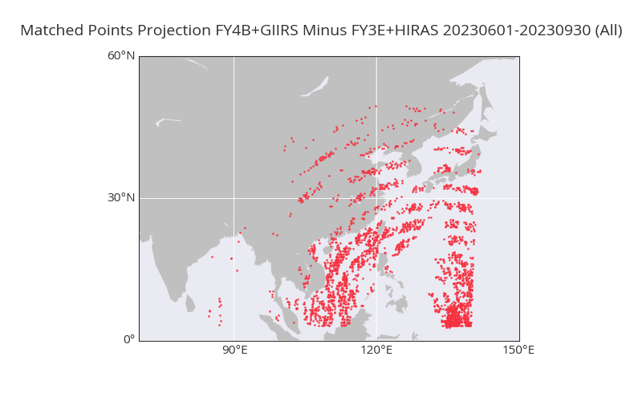
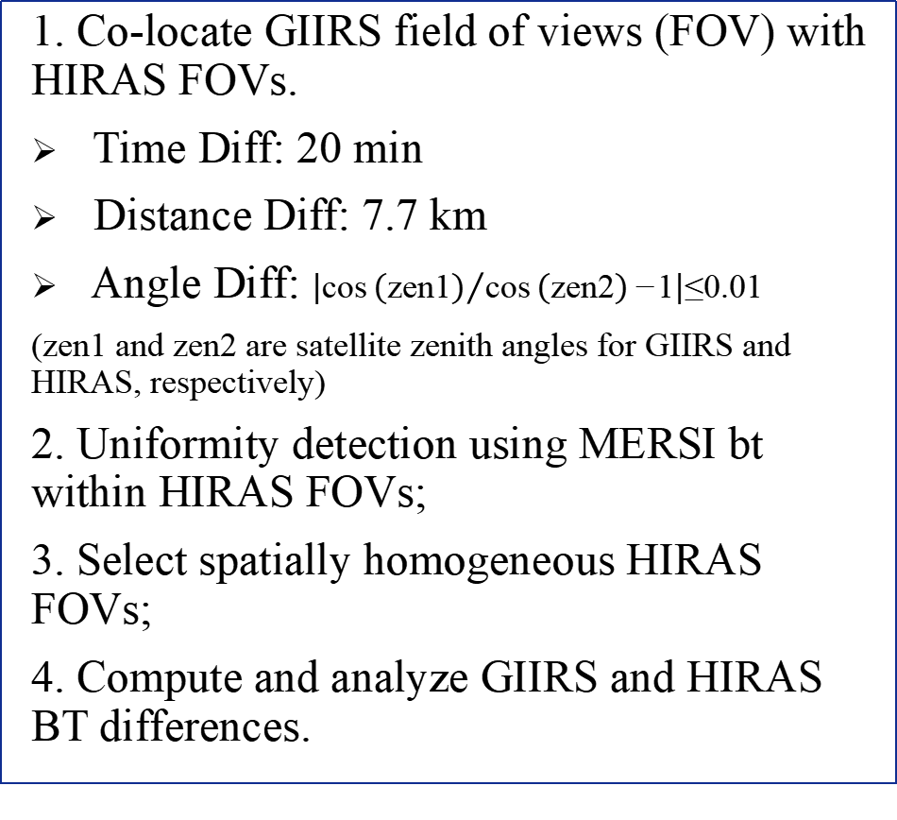
Procedures for GIIRS-HIRAS Inter-Comparison
1. Co-locate GIIRS field of views (FOV) with HIRAS FOVs.
Time Diff: 20 min
Distance Diff: 7.7 km
Angle Diff: $\left|{\text{cos}\left(\text{zen}\text{1}\right)}/{\text{cos}\left(\text{zen}\text{2}\right)\text{−}\text{1}}\right|\text{≤}\text{0}\text{.}\text{01}$
(zen1 and zen2 are satellite zenith angles for GIIRS and HIRAS, respectively)
2. Uniformity detection using MERSI bt within HIRAS FOVs;
3. Select spatially homogeneous HIRAS FOVs;
4. Compute and analyze GIIRS and HIRAS BT differences.
Matched samples projection
数据时间：2023.6.01-2023.9.30

Slide 7
Procedures for GIIRS-HIRAS Inter-Comparison
Sensors：FY4B_GIIRS and FY3E_HIRAS
Data ：20230601~20230930
Spectral comparison
Selected chs for comparison
 | Ch No | Ch id | Central WL(um) | Central WN(cm-1) | Ref BT（K）
LW | 1 | CH_0037 | 14.22 | 703.125 | 220、225、230
 | 2 | CH_0352 | 11.11 | 900 | 260、280、300
 | 3 | CH_0464 | 10.31 | 970 | 260、280、300
 | 4 | CH_0594 | 9.51 | 1051.25 | 240、255、270
MW | 5 | CH_0927 | 5.62 | 1778.75 | 240、255、270
 | 6 | CH_1032 | 5.42 | 1844.375 | 220、230、240
 | 7 | CH_1189 | 5.15 | 1942.5 | 225、240、260
 | 8 | CH_1503 | 4.68 | 2138.75 | 275、285、295

Slide 8
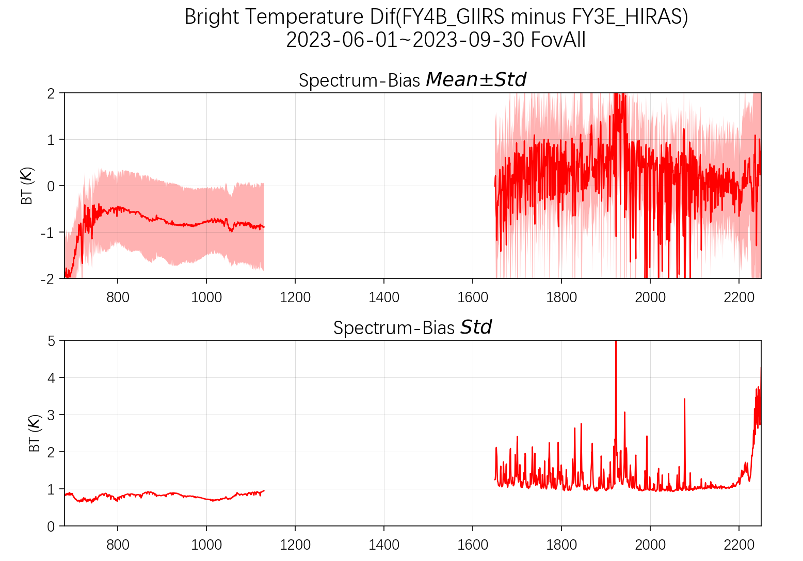
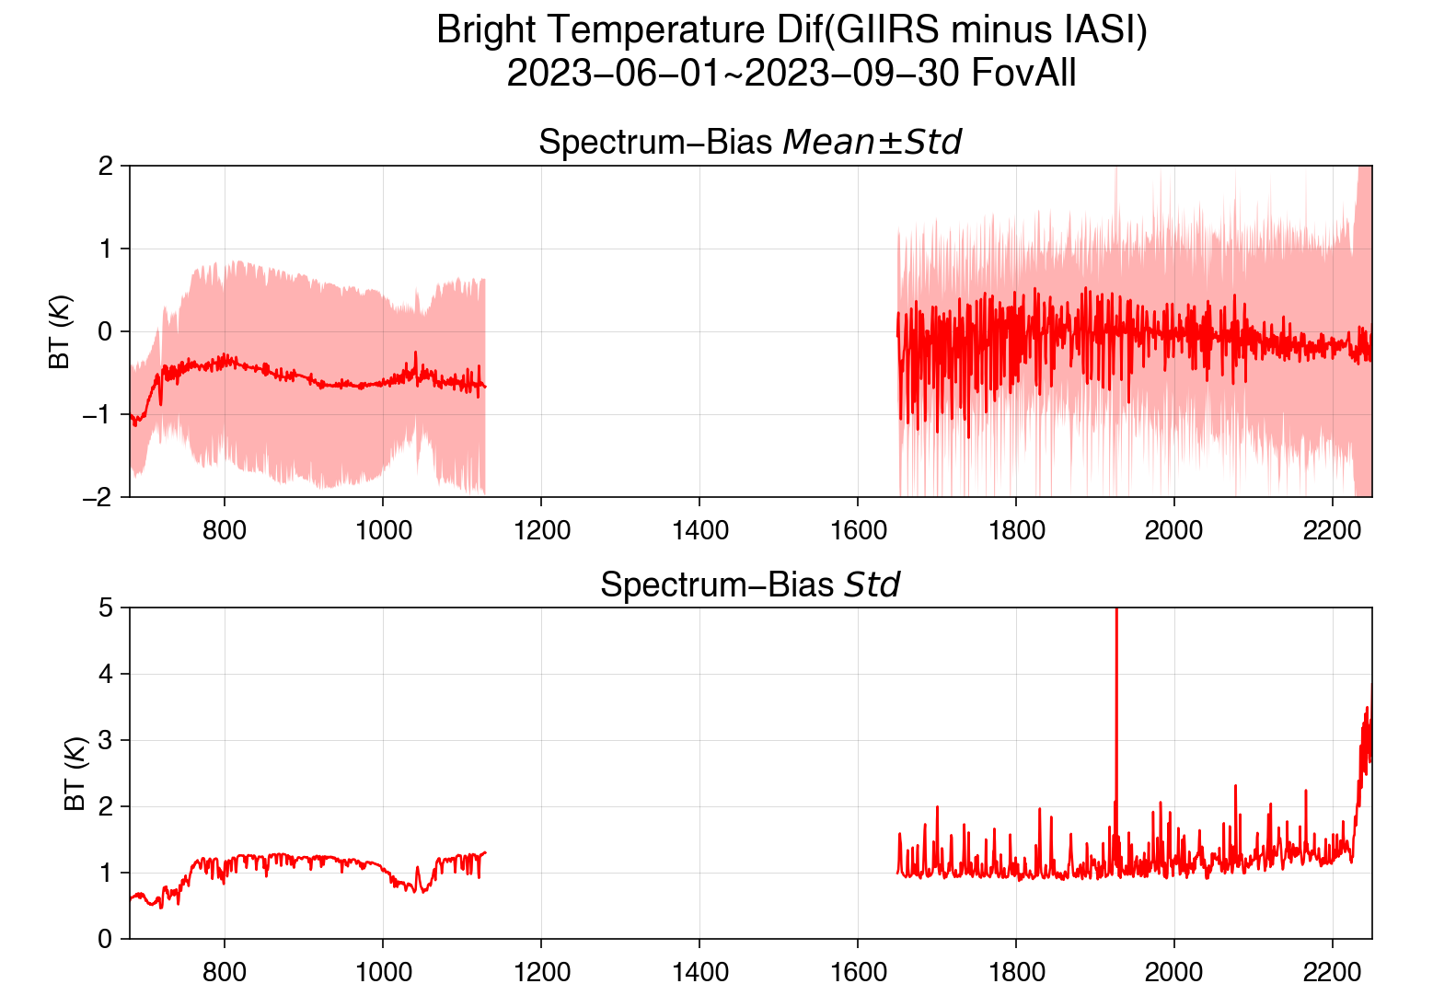
Comparison results
SNO：FY4B_GIIRS minus FY3E_HIRAS
SNO：FY4B_GIIRS minus METOP-C_IASI

Slide 9
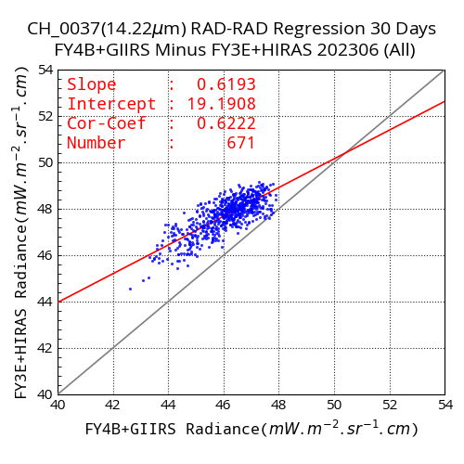
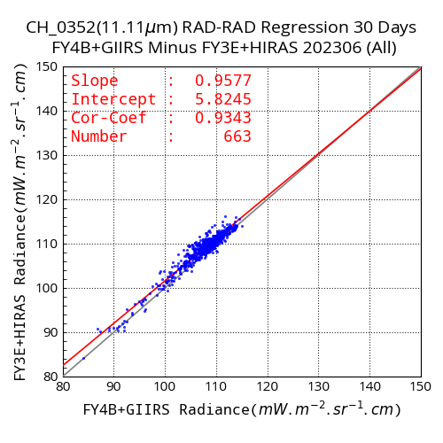
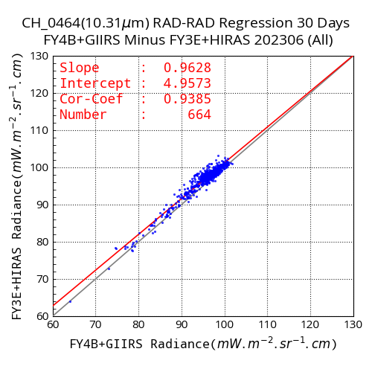
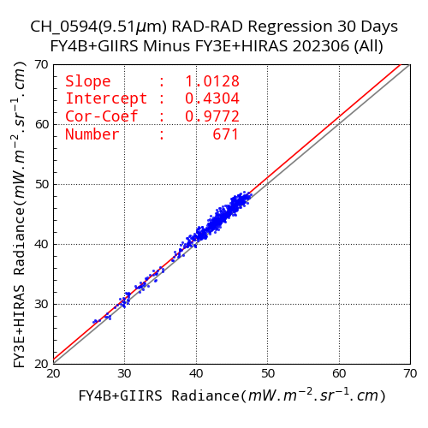
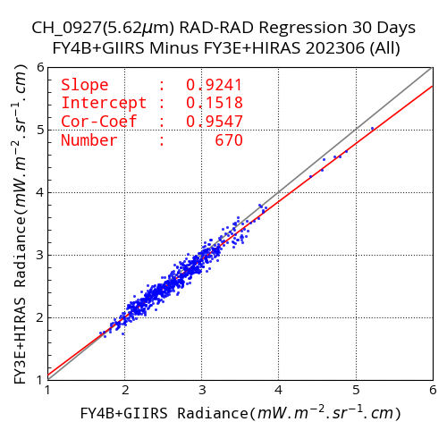
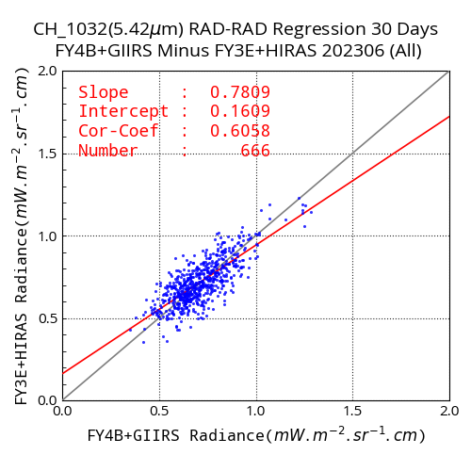
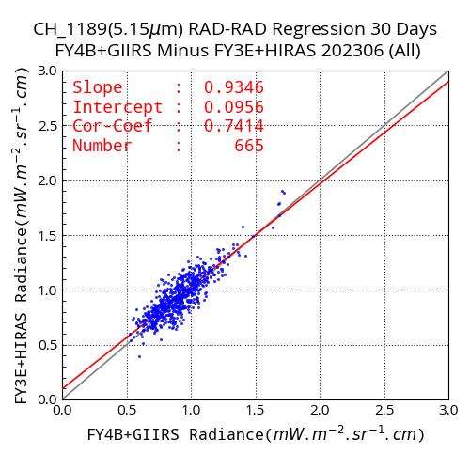
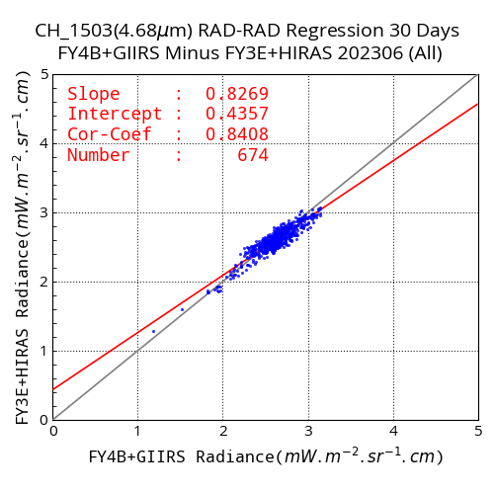
RAD scatplot Date：2023.6.01-2023.6.30
703cm⁻¹
900cm⁻¹
970cm⁻¹
1051cm⁻¹
1778cm⁻¹
1844cm⁻¹
1942cm⁻¹
2138cm⁻¹

Slide 10
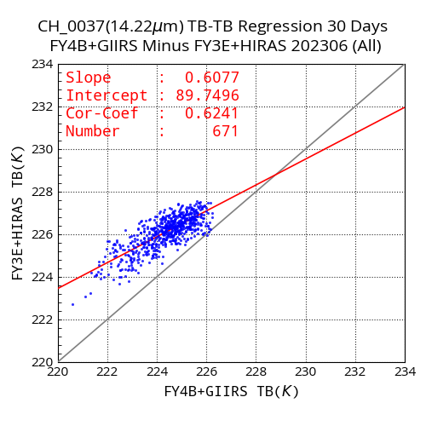
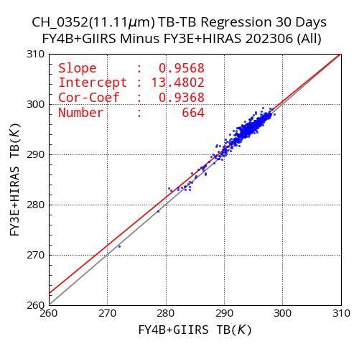

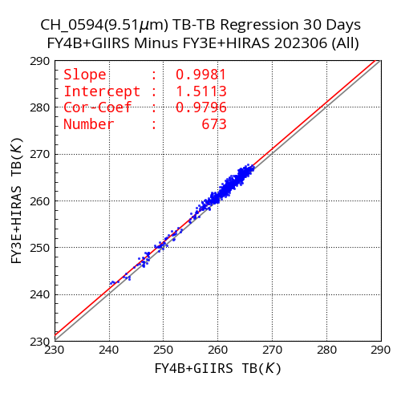
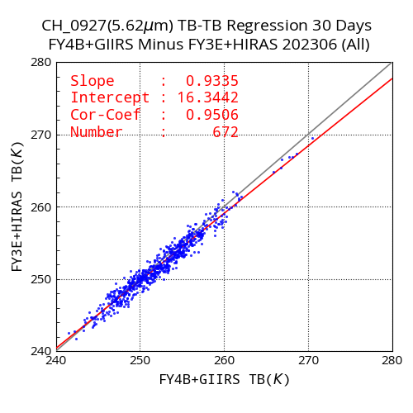
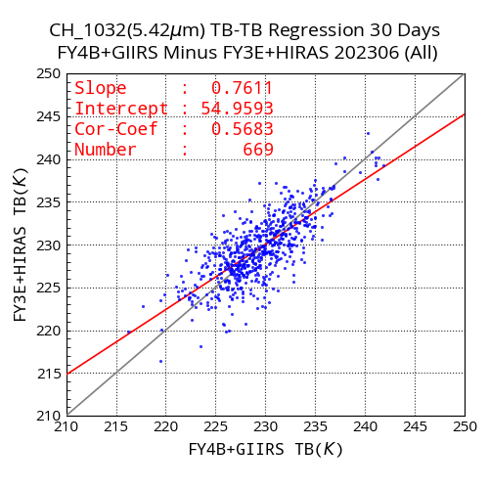
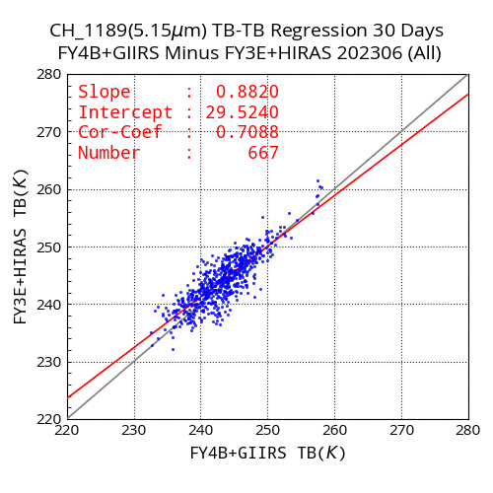
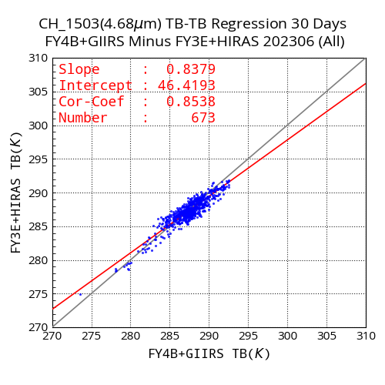
TBB scatplot Data：2023.6.01-2023.6.30
703cm⁻¹
900cm⁻¹
970cm⁻¹
1051cm⁻¹
1778cm⁻¹
1844cm⁻¹
1942cm⁻¹
2138cm⁻¹

Slide 11
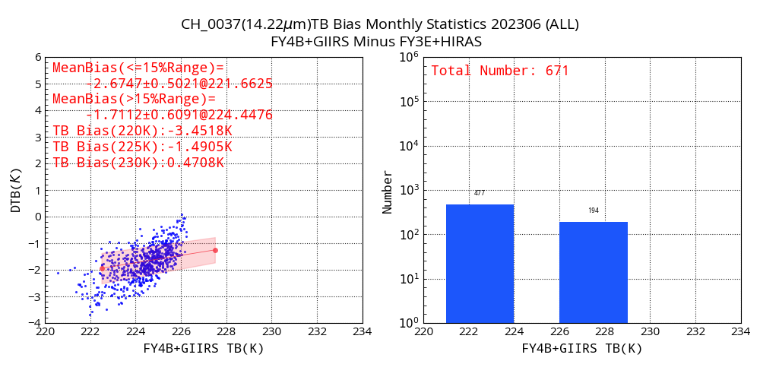
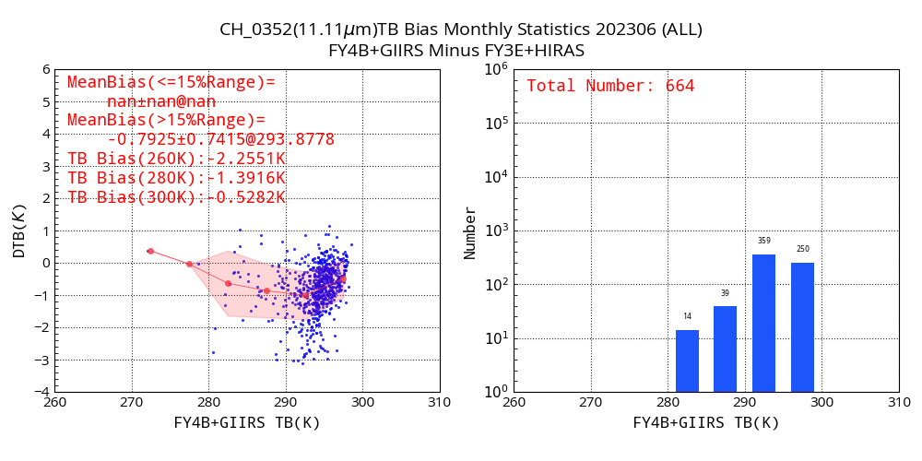
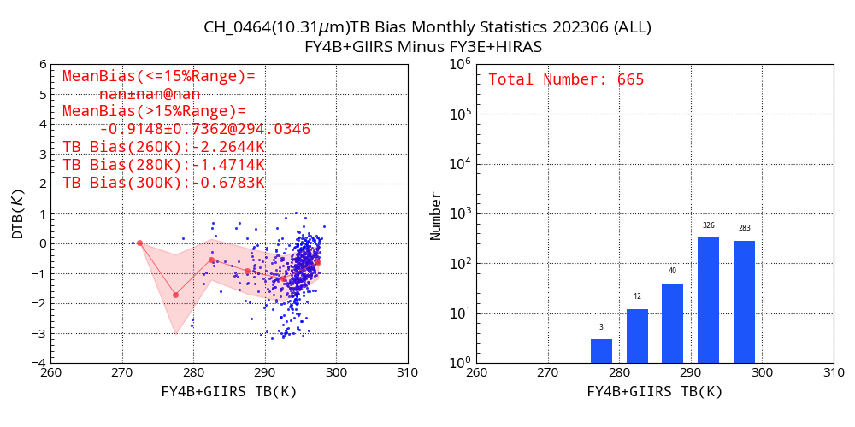
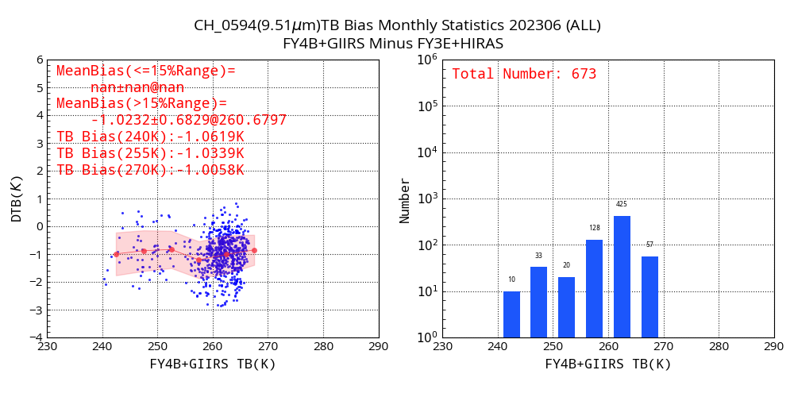
TBB Bias Monthy Statistics data：2023.6.01-2023.6.30
703cm⁻¹
900cm⁻¹
970cm⁻¹
1051cm⁻¹

Slide 12
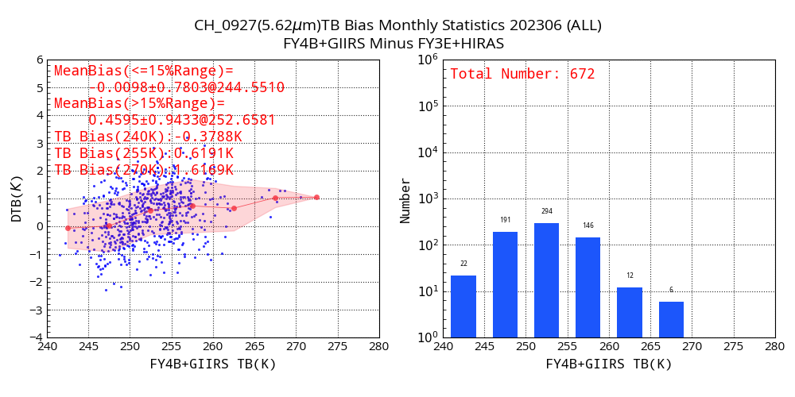
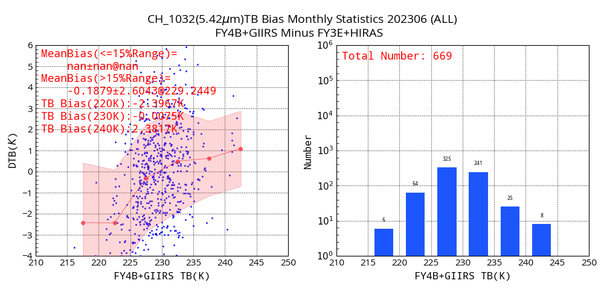
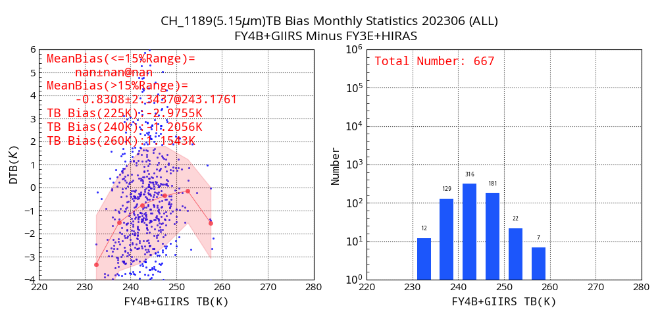
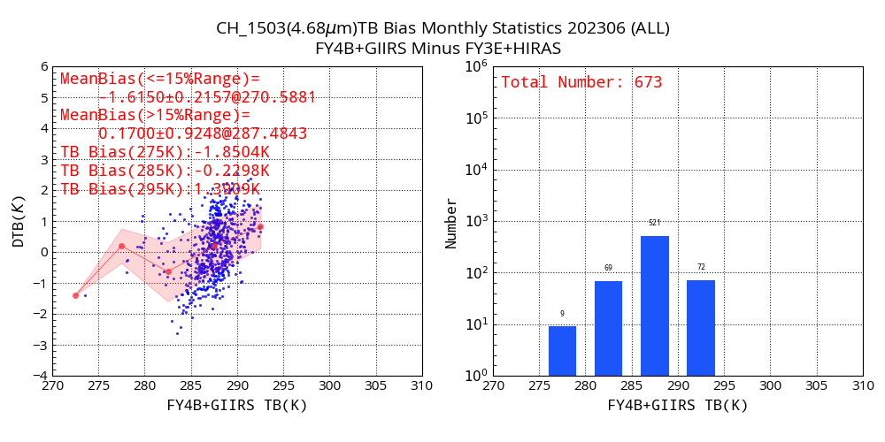
TBB Bias Monthy Statistics Data：2023.6.01-2023.6.30
1778cm⁻¹
1844cm⁻¹
1942cm⁻¹
2138cm⁻¹

Slide 13
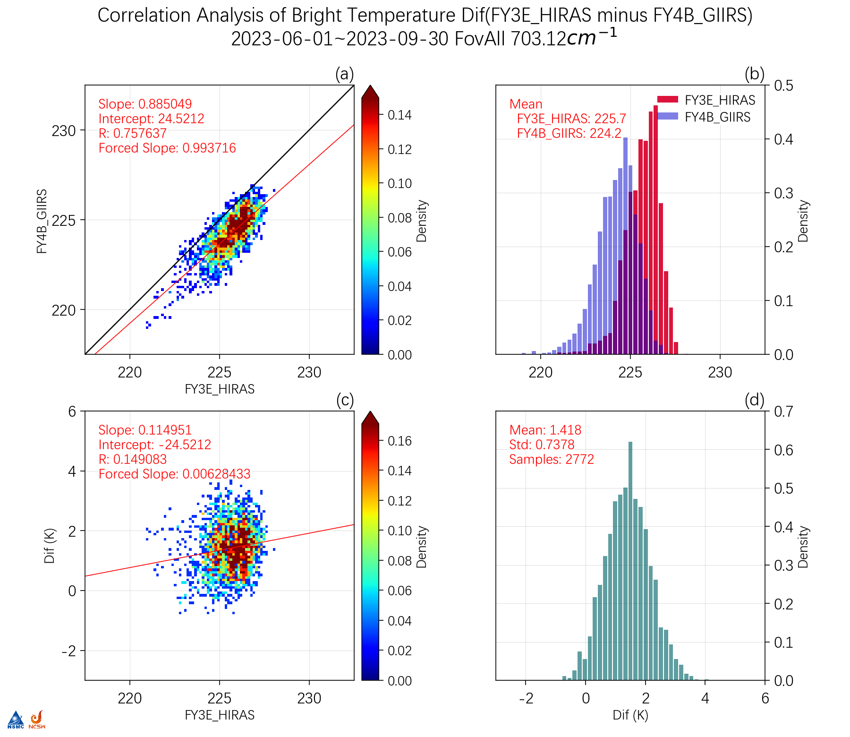
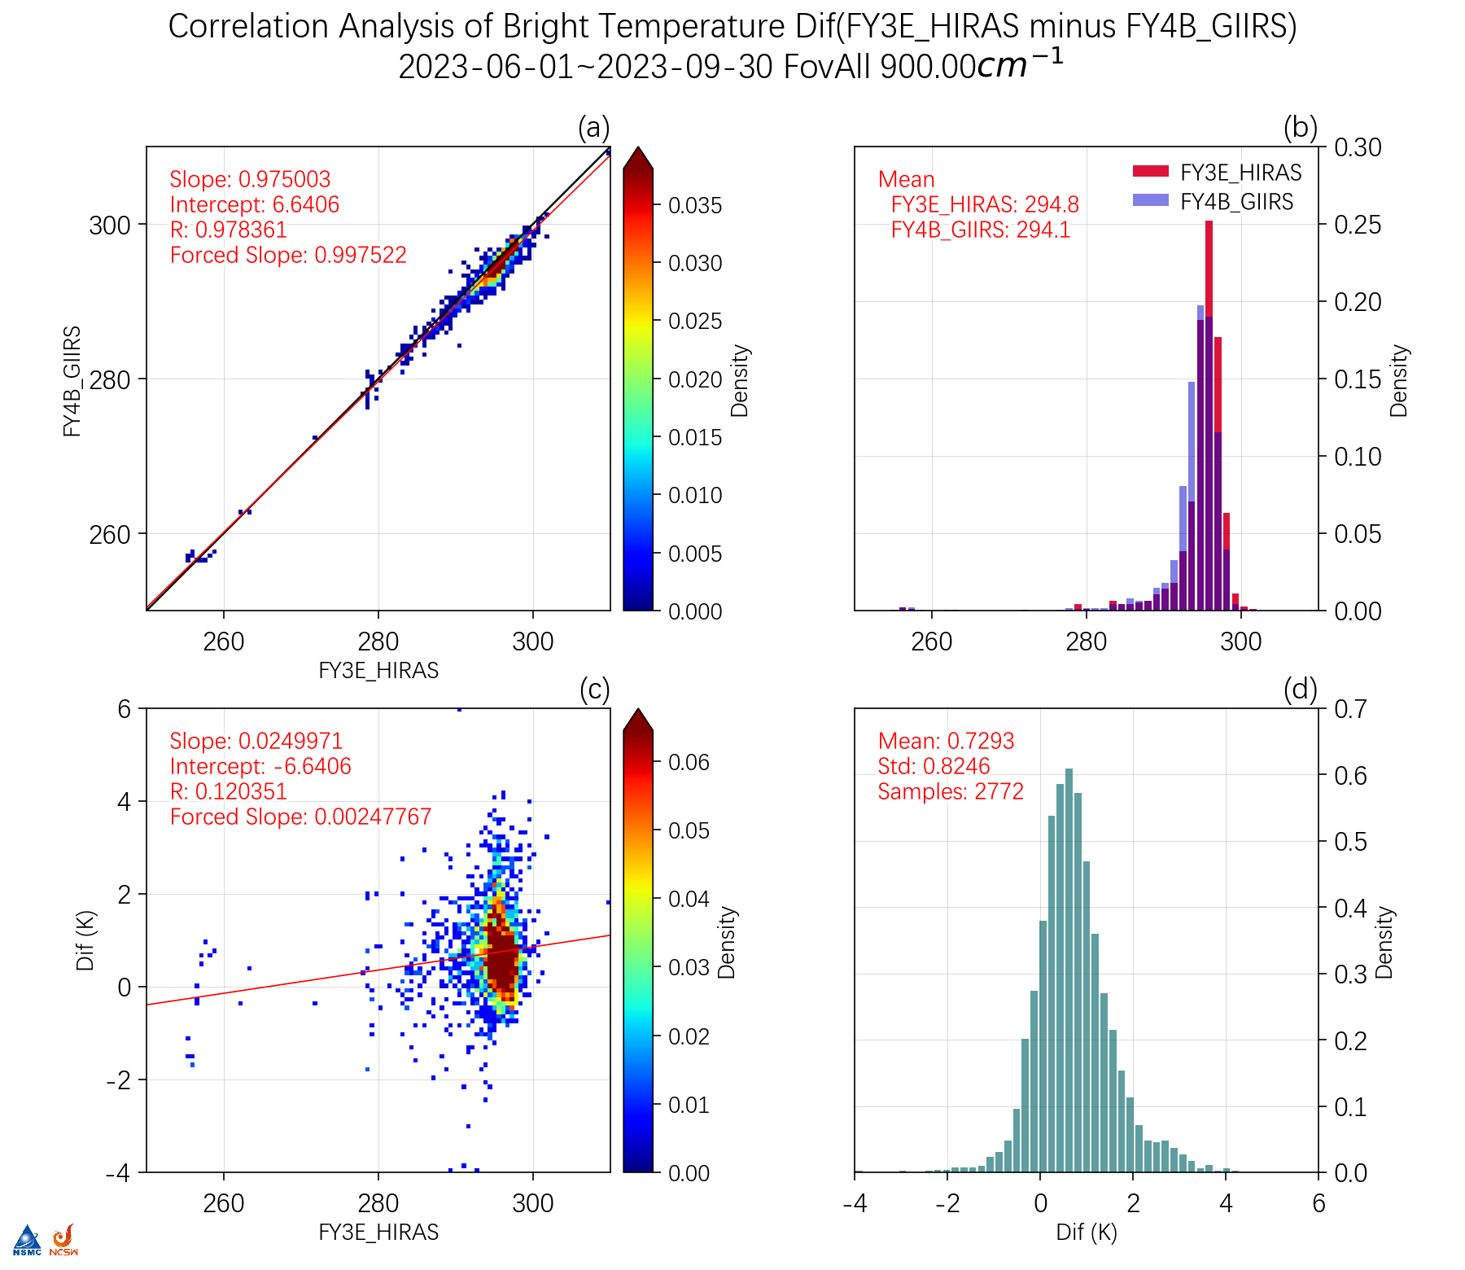

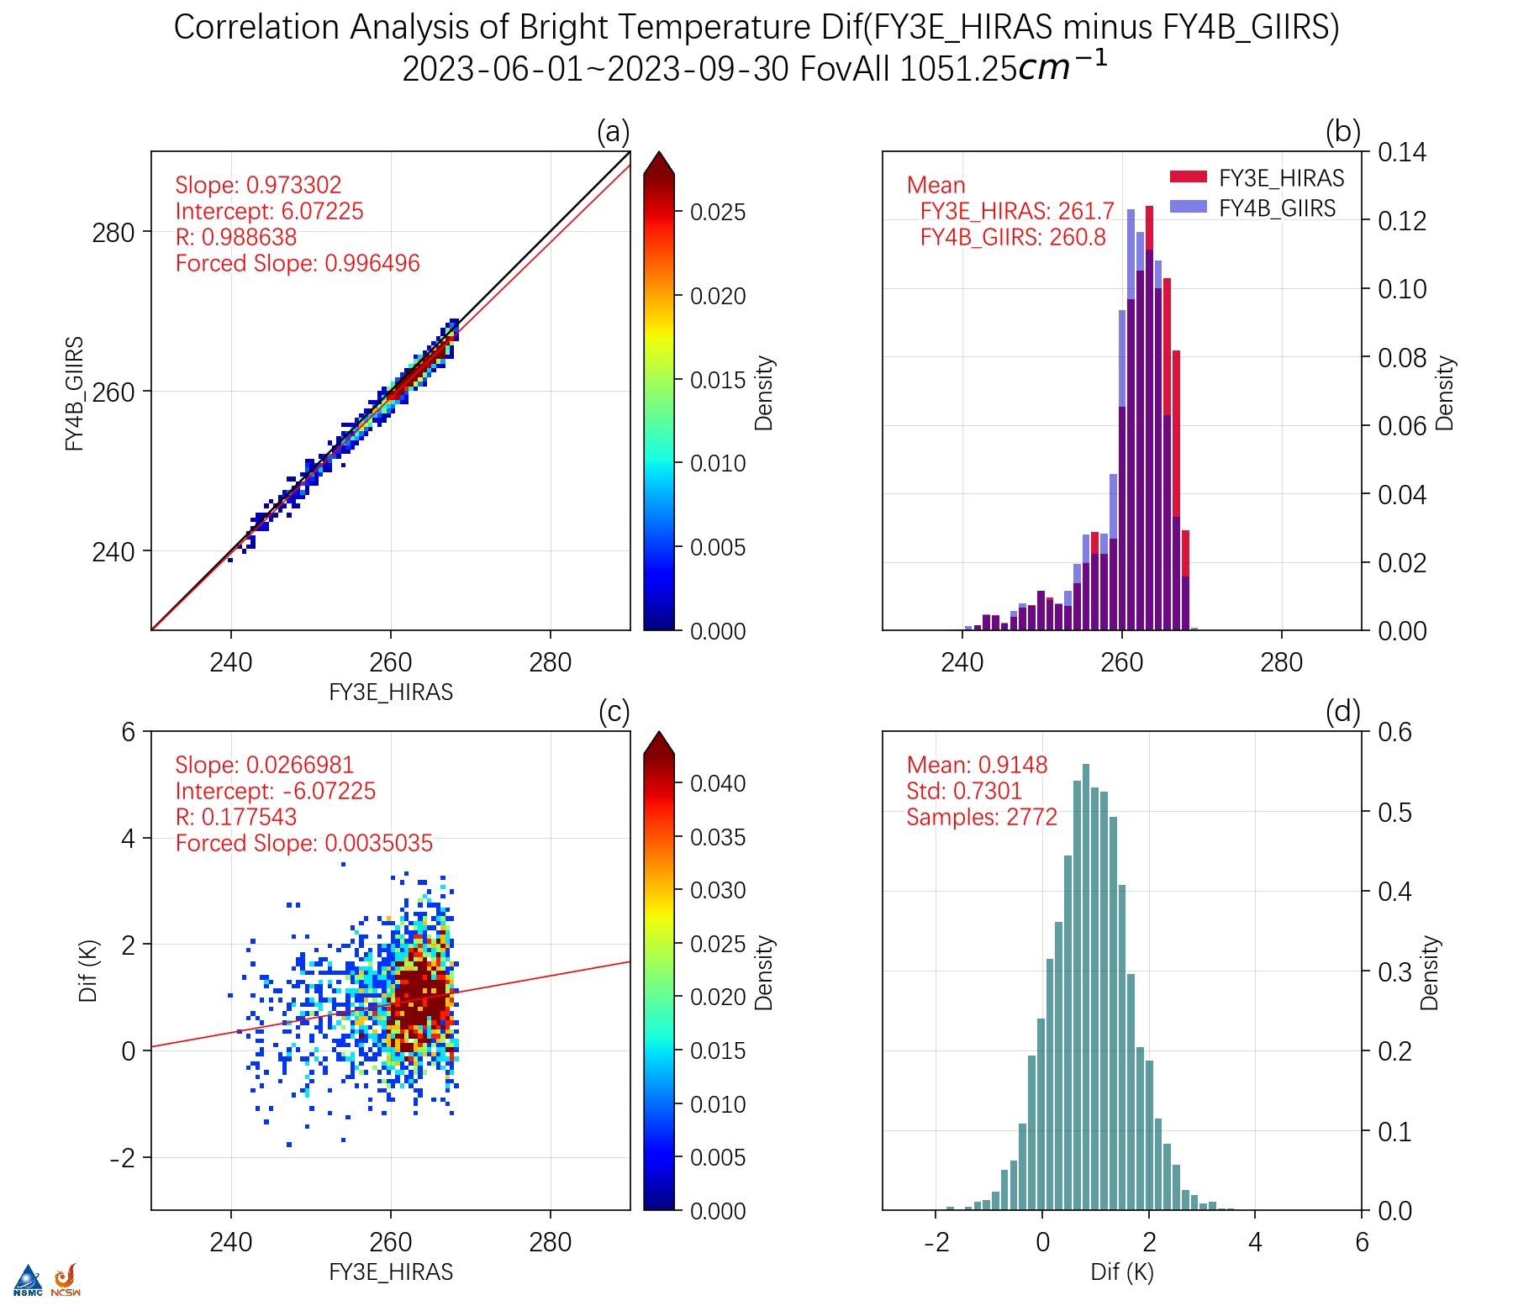
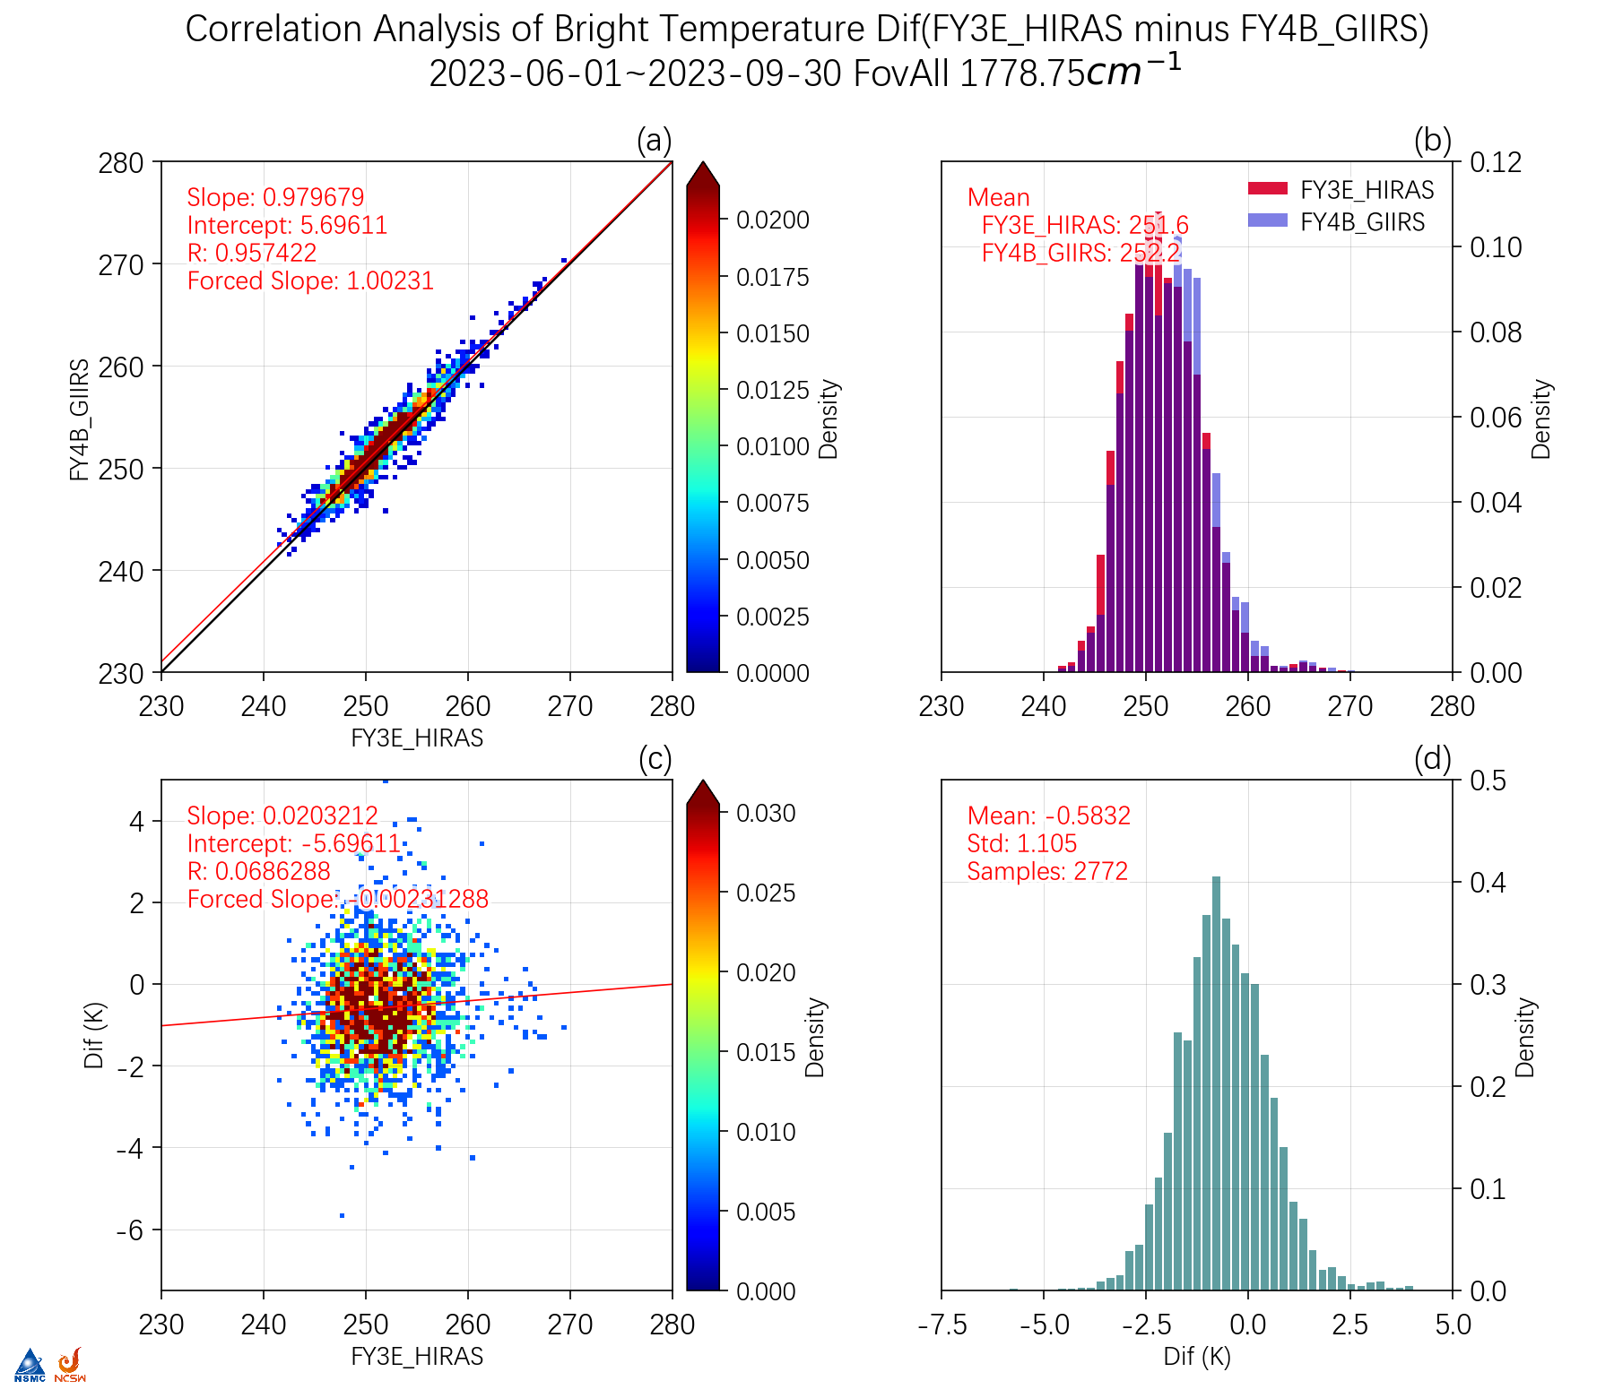
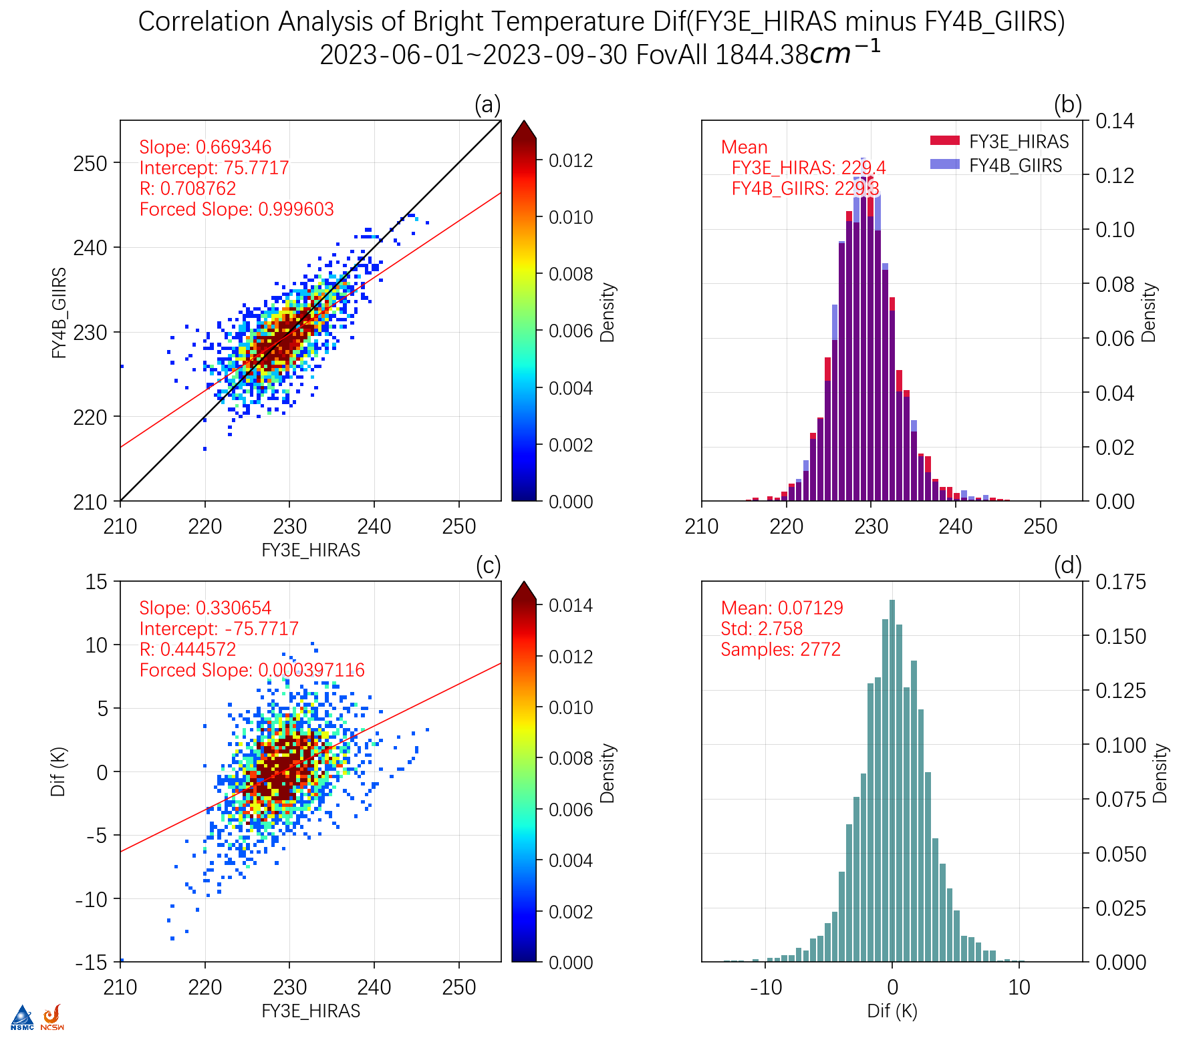
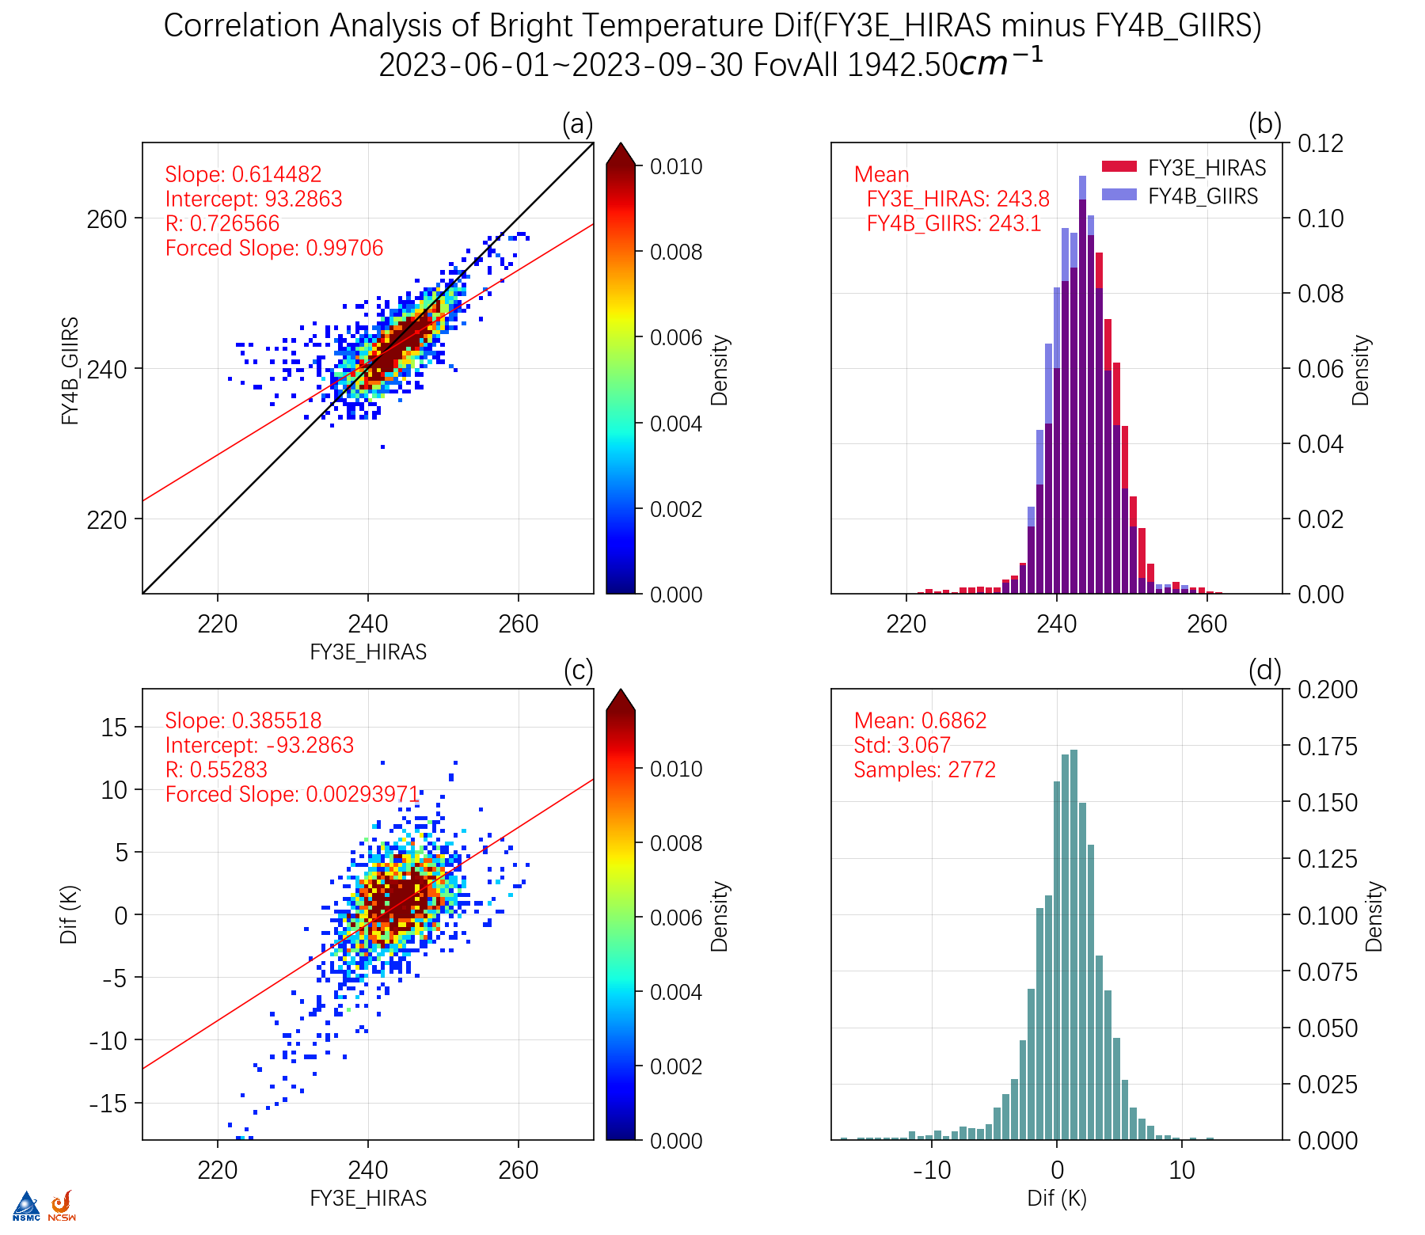
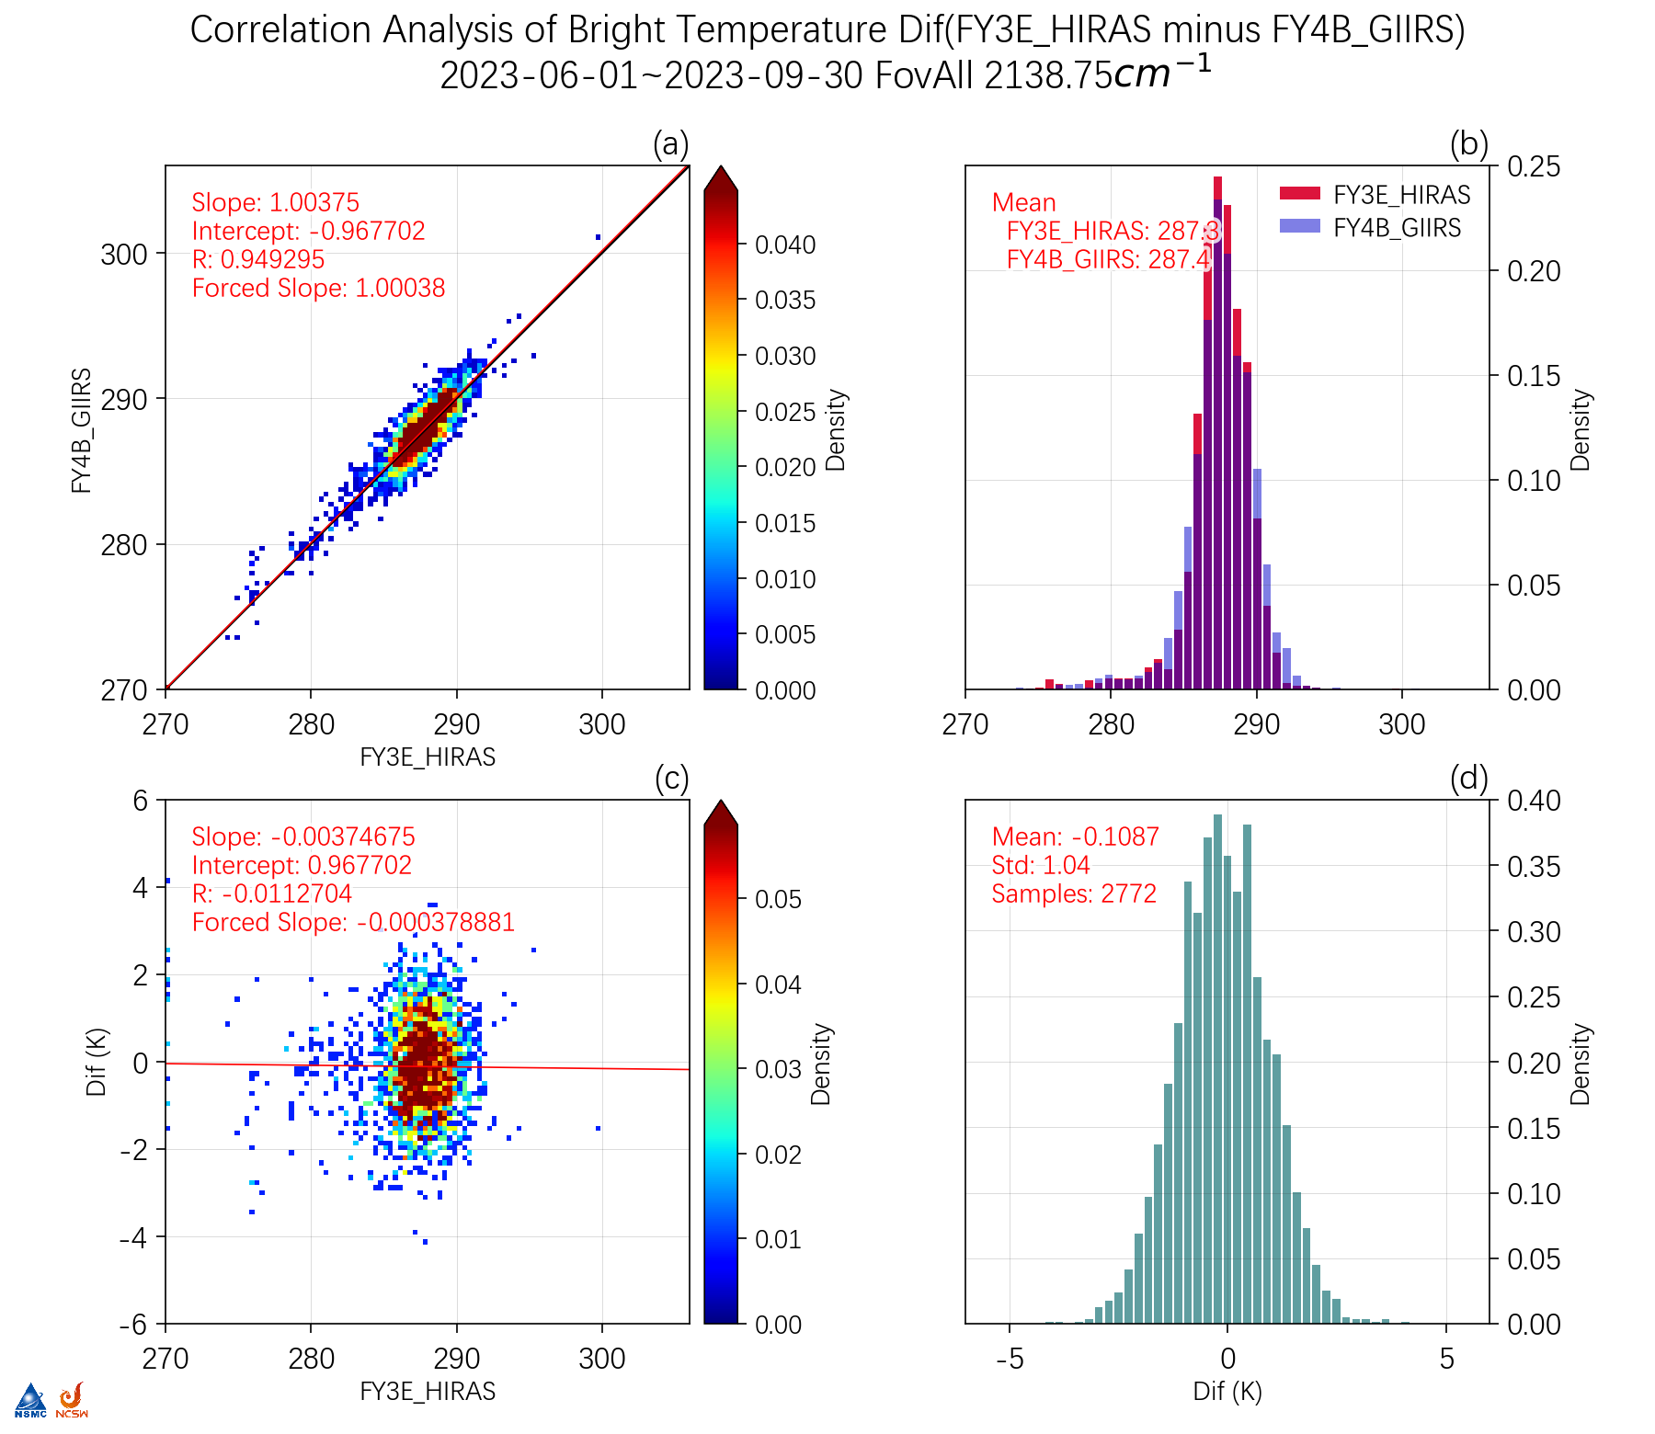
TBB Correlation Analysis Data：2023.6.01-2023.9.30
703cm⁻¹
900cm⁻¹
970cm⁻¹
1051cm⁻¹
1778cm⁻¹
1844cm⁻¹
1942cm⁻¹
2138cm⁻¹

Slide 14
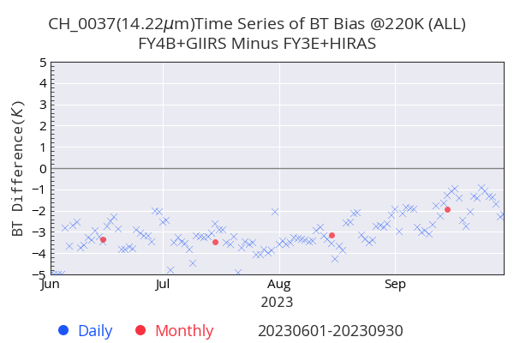
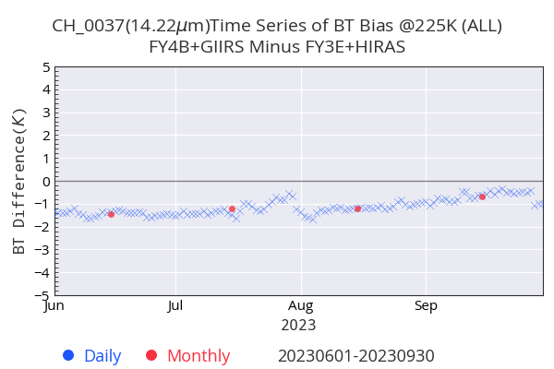
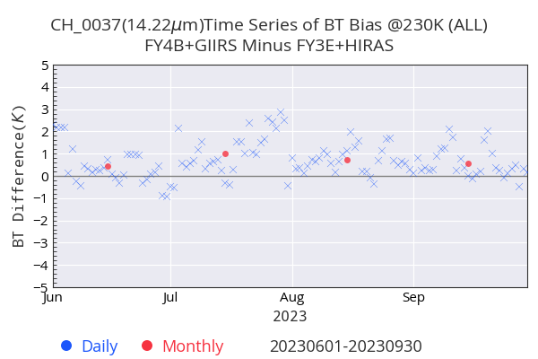
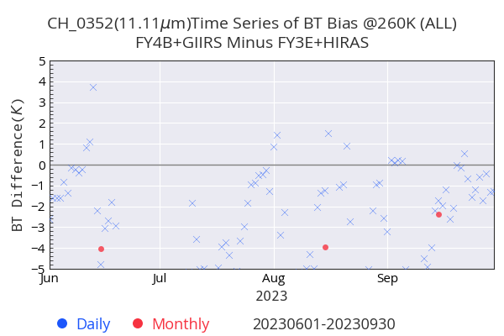
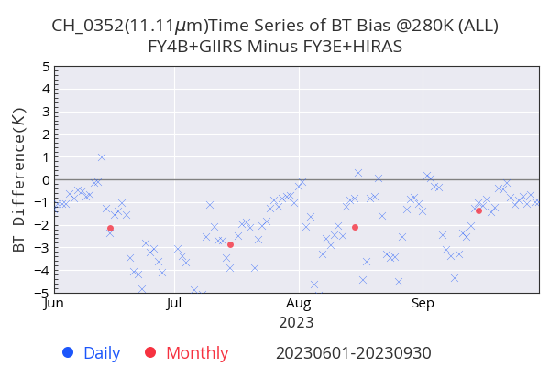
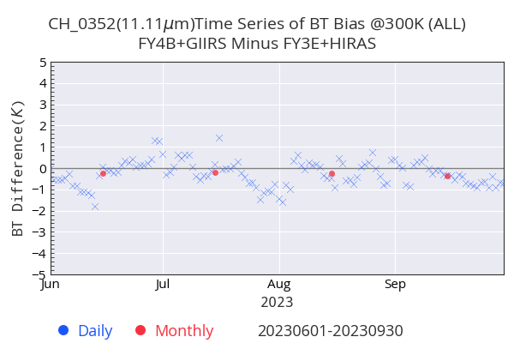
TBB Bias Time Series (a)(b)(c) for different Ref bt data：2023.6.01~2023.9.30
220K
225K
230K
（a）
（b）
（c）
703cm⁻¹
260K
280K
300K
（a）
900cm⁻¹
（b）
（c）

Slide 15
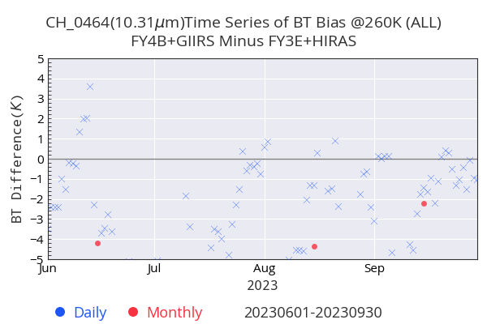
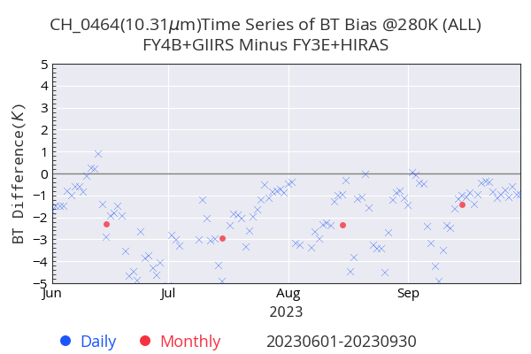
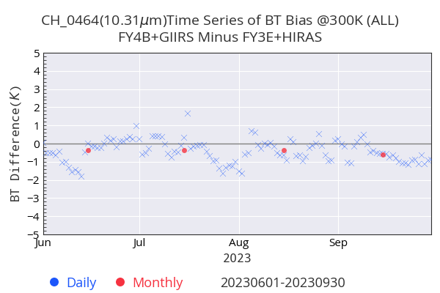

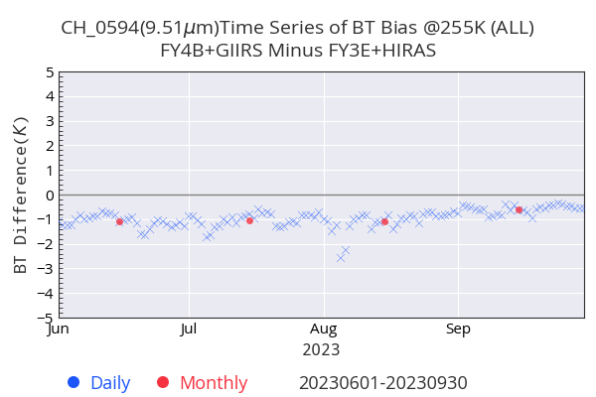
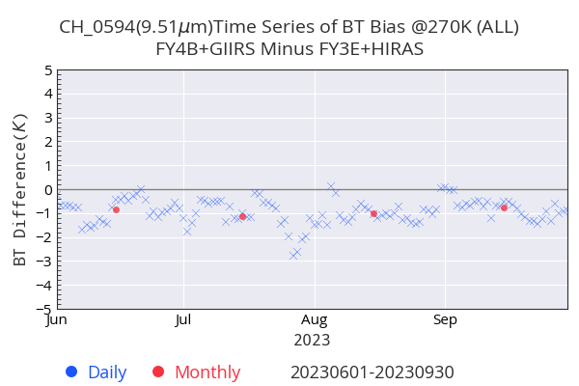
TBB Bias Time Series (a)(b)(c) for different Ref bt data：2023.6.01~2023.9.30
260K
280K
300K
（a）
970cm⁻¹
（b）
（c）
240K
255K
270K
1051cm⁻¹
（a）
（b）
（c）

Slide 16
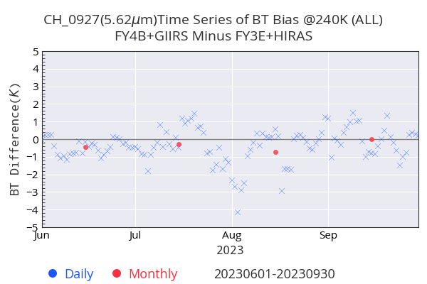

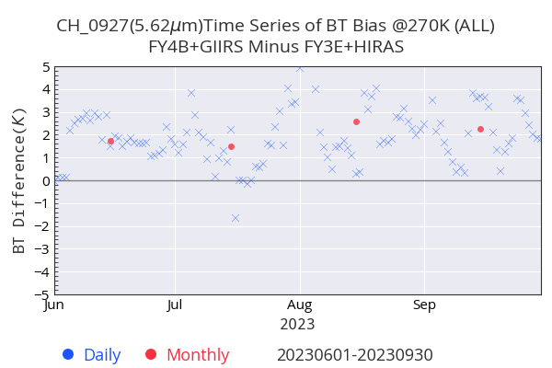



TBB Bias Time Series (a)(b)(c) for different Ref bt data：2023.6.01~2023.9.30
240K
255K
270K
（a）
（b）
（c）
1778cm⁻¹
220K
230K
240K
1844cm⁻¹
（a）
（b）
（c）

Slide 17






TBB Bias Time Series (a)(b)(c) for different Ref bt data：2023.6.01~2023.9.30
225K
240K
260K
（a）
（b）
（c）
1942cm⁻¹
275K
285K
295K
2138cm⁻¹
（a）
（b）
（c）

Slide 18








TBB Mean Bias Time Series data：2023.6.01~2023.9.30
703cm⁻¹
900cm⁻¹
970cm⁻¹
1051cm⁻¹
1778cm⁻¹
1844cm⁻¹
1942cm⁻¹
2138cm⁻¹

Slide 19








TBB Mean STD Time Series data：2023.6.01~2023.9.30
703cm⁻¹
900cm⁻¹
970cm⁻¹
1051cm⁻¹
1778cm⁻¹
1844cm⁻¹
1942cm⁻¹
2138cm⁻¹

Slide 20
Summary
Set up GEO and LEO hyperspectral sounder comparison framework and get preliminary result.
Next work:
Improve high level channels ( 703cm-1 ) calibration accuracy of GIIRS and HIRAS.
Analysis on viration of TBB Bias Time Series.
NL coefficient tuning.
Spectral calibration improvement of both GIIRS and HIRAS(especially for MW IR).

