Slide 1
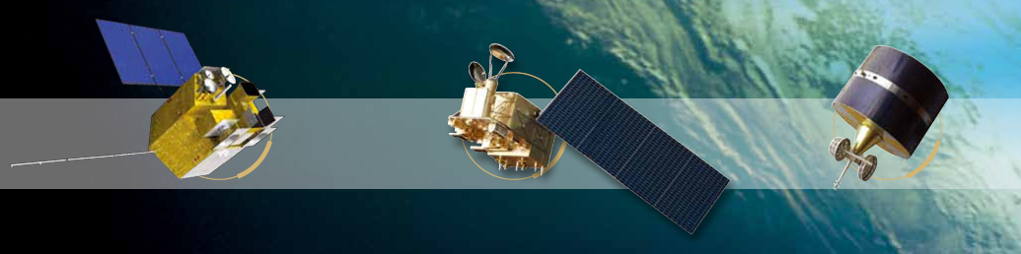



The Uncertainty of SNO Cross-calibration for Satellite Infrared Channels
Zhong Gu, Lin Chen, HuiXing Dai, XiuQing Hu, Peng Zhang
February 13, 2025

Slide 2
01. Background
02. Methods and Models
03. Results and discussions
OUTLINE
04. Summary

Slide 3
01. Background
02. Methods and Models
03. Results and discussions
OUTLINE
04. Summary

Slide 4
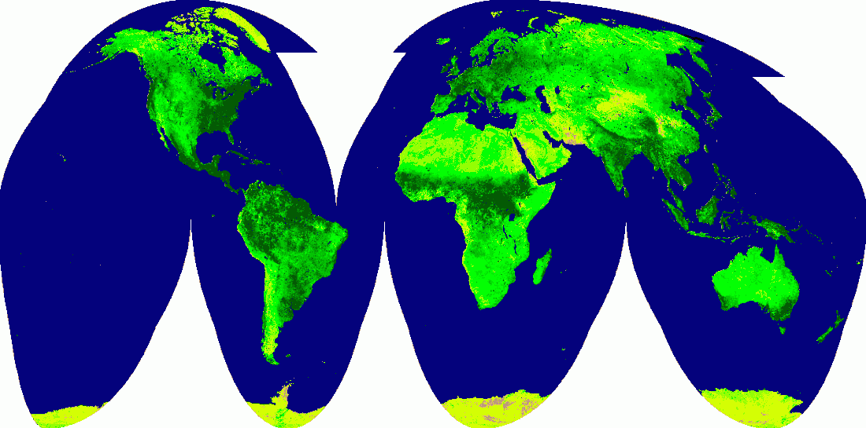
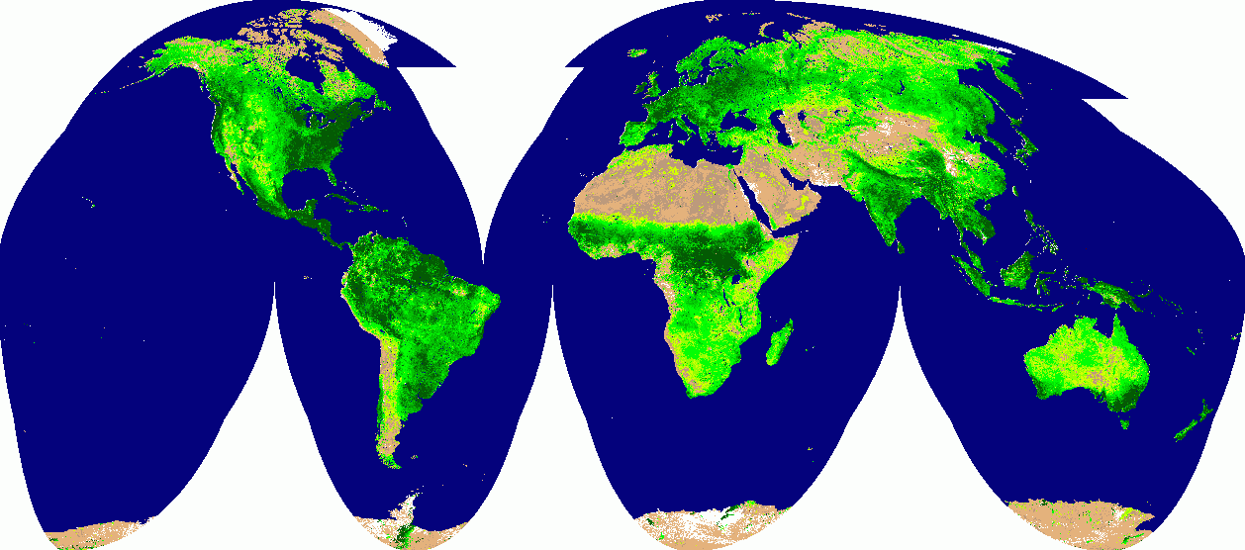
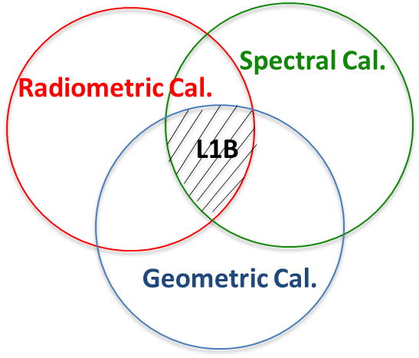
1 Background
Acquisition of Earth image data for qualitative analysis of weather and resource environment conditions
earth observation (EO) by meteorological satellites
Obtain quantitative information of the ground and gas system, and form a variety of quantitative remote sensing products after numerical data processing
Stable and reliable calibration of satellite-based remote sensors is an important prerequisite for a series of tasks such as extraction, evaluation and assimilation of quantitative remote sensing information, and remote sensor calibration in wide definition includes spatial, spectral and radiometric calibration.
Before radiation calibration
"Desert is recognized as an oasis"

Slide 5
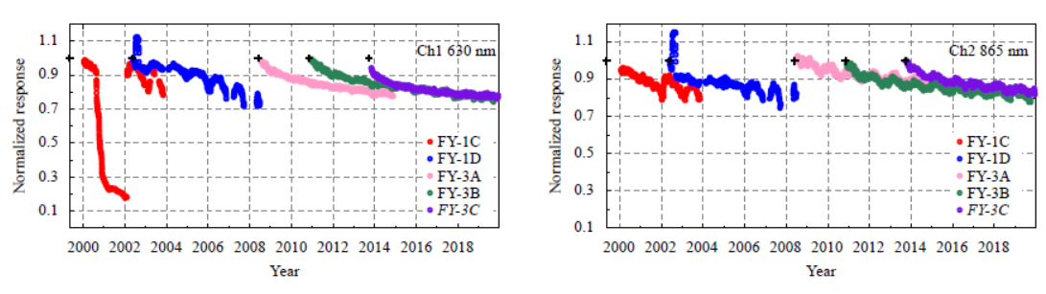
1 Background
Concept
Radiation calibration is a comparison of the digital output value (Digital Number, DN) of the sensor with the radiance value at the influx of the pupil from a radiance standard source. This results in a correspondence between them (generally a linear reaction).
Current Status
During the long-term operation of the satellite in orbit, the remote sensor usually has a certain response attenuation characteristics due to device aging, and the attenuation characteristics of different instruments differ, and the attenuation characteristics of different wavebands for a long time are different
Therefore, in order to realize the long-term quantitative application of satellite data, it is very important to evaluate and track the accuracy of on-orbit satellite radiometric calibration.
Sun, L., H. Qiu, R. Wu, et al., 2022: Long-term consistent recalibration of VIRR solar reflectance data record for Fengyun polar-orbiting satellites. Journal of Meteorological Research, 35, 926-942, doi:10.1007/s13351-021-1049-3.

Slide 6
01. Background
02. Methods and Models
03. Results and discussions
OUTLINE
04. Summary

Slide 7
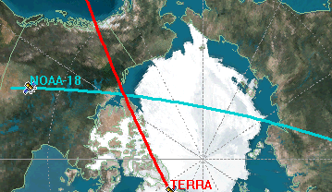
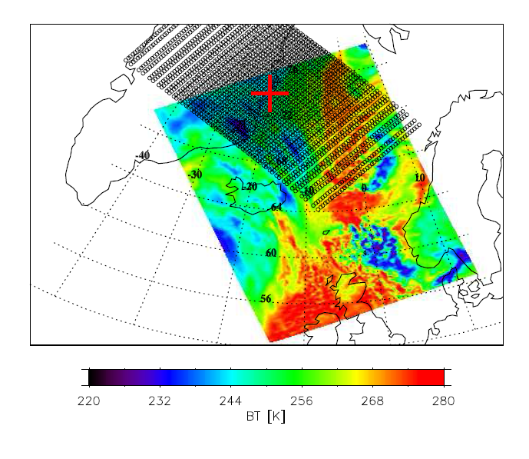
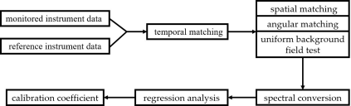
2 Methods and Models
2.1 Introduction of SNO Cross-calibration Method
A widely used calibration method is the cross-calibration based on the Simultaneous Nadir Observation (SNO), which uses remote sensing instruments with high radiometric calibration accuracy (reference instruments) to calibrate other onboard remote sensing instruments with lower accuracy (monitored instruments).
Core
The same target, the same moment and the same view as the matching condition
Chander, G., T. J. Hewison, N. Fox, et al., 2013: Overview of intercalibration of satellite instruments. IEEE Transactions on Geoscience and Remote Sensing, 51, 1056-1080.

Slide 8
2 Methods and Models
2.1 Introduction of SNO Cross-calibration Method
purpose
The uncertainty of the SNO calibration method itself is evaluated, and the uncertainty of the results themselves is evaluated. This work can also be a guide for the selection of the time and space matching thresholds, environmental uniformity, and even the performance parameter indicators of the reference instrument required in the cross-calibration process.
question
The problem of using actual observation data to assess the uncertainty of its calibration results is that the actual observation data will be affected by satellite remote sensor noise and its own calibration uncertainty, which cannot truly represent the uncertainty of the SNO method itself.
solution
In this study, we propose to analysis from two aspects, namely, sample matching error and sample fitting method error. According to the error transmission chain analysis of the SNO cross-calibration method, a generalized model for the uncertainty assessment of the SNO cross-calibration method for meteorological satellite infrared channels was constructed.

Slide 9
2 Methods and Models
2.2 Derivation of a generalized model for SNO cross-calibration uncertainty assessment
To solve this problem, this work described a method that started from the GUM uncertainty assessment method and uses the actual satellite parameters (spatial resolution, spectral resolution, PSF parameters et al.) to construct data for evaluation the uncertainty (not use the actual satellite data), which can avoid the measurement noise.
Methods of uncertainty assessment
ISO Guide to the Expression of Uncertainty in Measurement（ISO GUM）
Core
The quantitative representation of the factors in the measurement observation that affect the measurement result, and the sum of squares to obtain the synthetic uncertainty of the measurement value

Slide 10
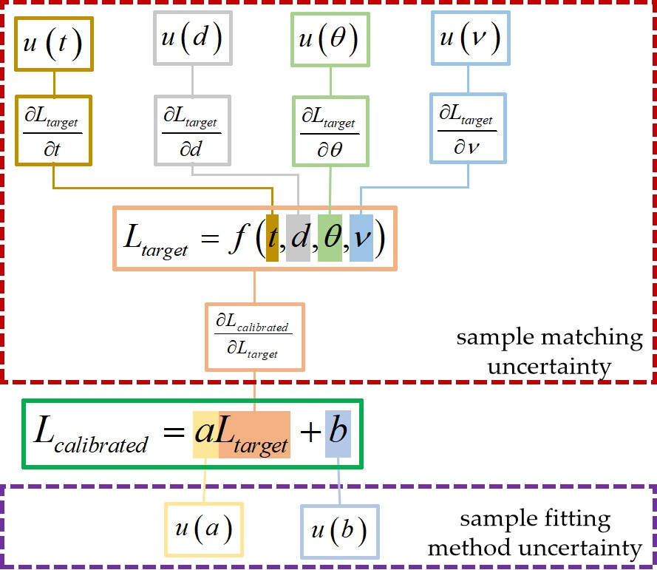
2 Methods and Models
2.2 Derivation of a generalized model for SNO cross-calibration uncertainty assessment
The above analysis shows that the sample matching and fitting methods during the cross-calibration process are the two major sources of errors in the cross-calibration method. The generalized model for uncertainty assessment of the SNO cross-calibration method self is thus described from these two aspects.
Uncertainty

Slide 11
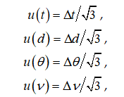


2 Methods and Models
2.2 Derivation of a generalized model for SNO cross-calibration uncertainty assessment
sample matching uncertainty
Since each parameter has equal occurrence probability in the threshold range, it can be assumed that each parameter difference satisfies the rectangular distribution.
sample fitting method uncertainty

Slide 12
01. Background
02. Methods and Models
03. Results and discussions
OUTLINE
04. Summary

Slide 13
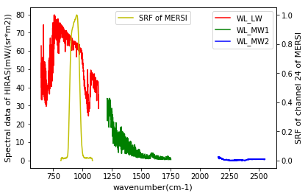

3 Results and discussions
3.1 Design of Simulation Test
Cross-calibration of the reference instrument (HIRAS carried by FY-3D) and the monitored instrument (MERSI) and their payload parameters was used to construct simulated data conforming to the observation. In this study, MERSI Band 24 (10.8 μm) was selected as the simulating channel.
Figure. Spectral data of HIRAS and the spectral response function of MERSI Band 24 (10.8 μm).

Slide 14
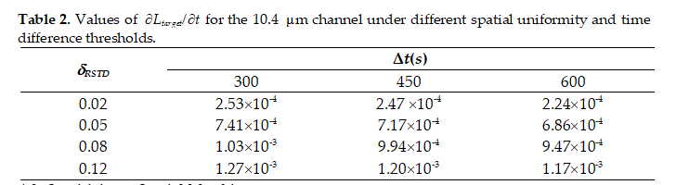
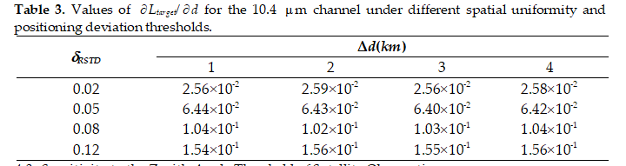


3 Results and discussions
3.1 Sensitivity Analysis of Error Transmission
Sensitivity to Temporal Matching
Sensitivity to Spatial Matching
Sensitivity to the Zenith Angle Threshold of Satellite Observations
Sensitivity to Instrument Spectral Matching

Slide 15
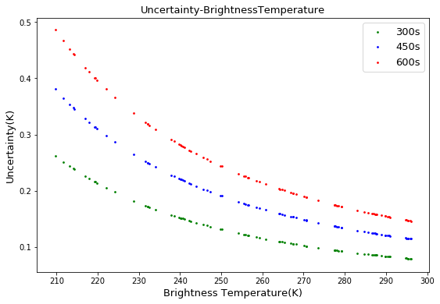
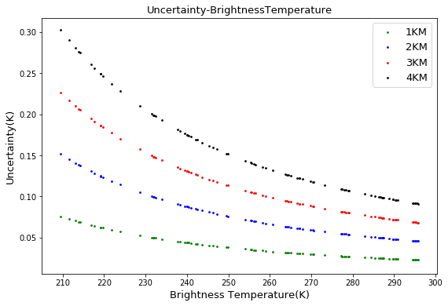
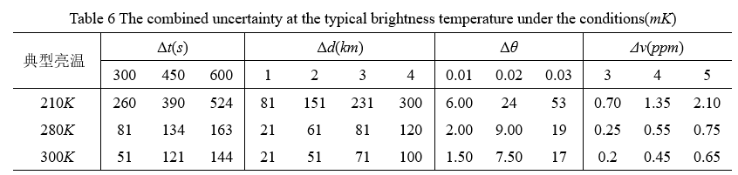
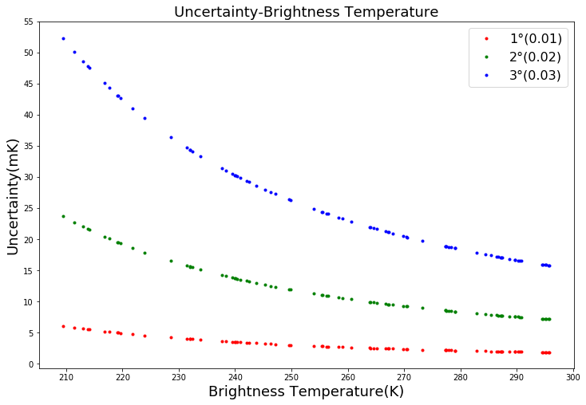
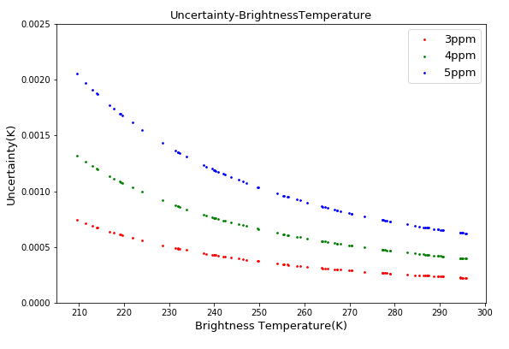
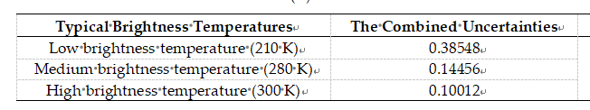
3 Results and discussions
3.2 Uncertainty Assessment of SNO Cross-Calibration
In calculating the sub-standard uncertainty of each influencing factor in the sample matching, the relative standard deviation of the environmental region was firstly chosen to set 0.05. The standard uncertainty of the bright temperature caused by these four error factors was calculated under different settings of time matching, space matching, angle matching and spectral matching conditions.
In order to more intuitively analyze the variability of the uncertainty of calibration results introduced by sample matching in the SNO cross-calibration method under different bright temperature environments, three typical bright temperatures were selected in turn: low temperature (210K), medium temperature (280K) and high temperature (300K)
With the increase of bright temperature, the standard uncertainty of each influencing factor tends to decrease

Slide 16
01. Background
02. Methods and Models
03. Results and discussions
OUTLINE
04. Summary

Slide 17
4 Summary
(1) The generalized model establishes a generalized model for uncertainty assessment of SNO cross-calibration at satellite infrared channels in the forward direction. Moreover, it provides guidance for the selection of temporal and spatial matching thresholds, environmental uniformity, and even parameters of reference instruments, when a certain radiometric calibration accuracy of the SNO cross-calibration method is required. (2) The payload parameters of Hyperspectral Infrared Atmospheric Sounder (HIRAS) and Medium Resolution Spectral Imager (MERSI) onboard the FY-3D are used to build the simulation data sets and discuss the uncertainty of SNO cross-calibration method under different parameters.The SNO cross-calibration matching data is simulated through setting two-dimensional PSF parameters, instrument spatial resolution, and spatial uniformity. The sensitivities of target radiance to temporal matching, spatial matching, angular matching and spectral drift are investigated. Besides, the errors in the fitting method for sample points are also considered. Finally, a generalized model for the uncertainty assessment of the SNO cross-calibration method for meteorological satellite infrared channels is constructed.

Slide 18

Thanks

