Slide 1

Absolute Intercalibration of Spaceborne Microwave Radiometers
Katherine Wentz, Thomas Meissner, Frank Wentz, and Andrew Manaster
Remote Sensing Systems

Slide 2
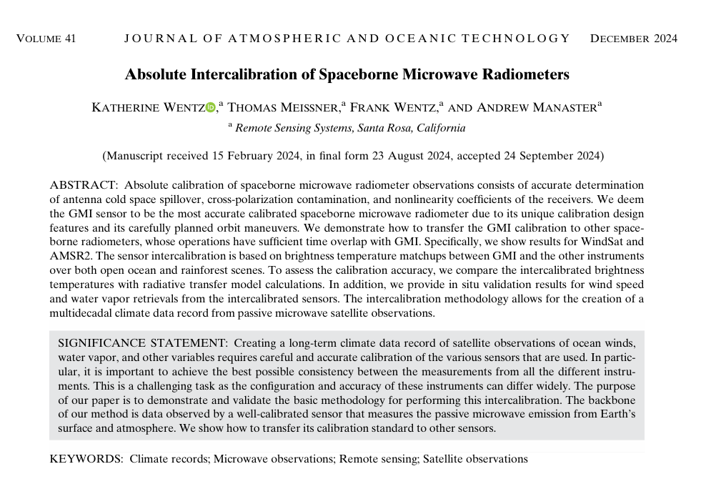
Wentz, K., Meissner, T., Wentz, F., & Manaster, A. (2024). Absolute Intercalibration of Spaceborne Microwave Radiometers. Journal of Atmospheric and Oceanic Technology, 41(12), 1121-1138.
doi: 10.1175/JTECH-D-24-0024.1

Slide 3
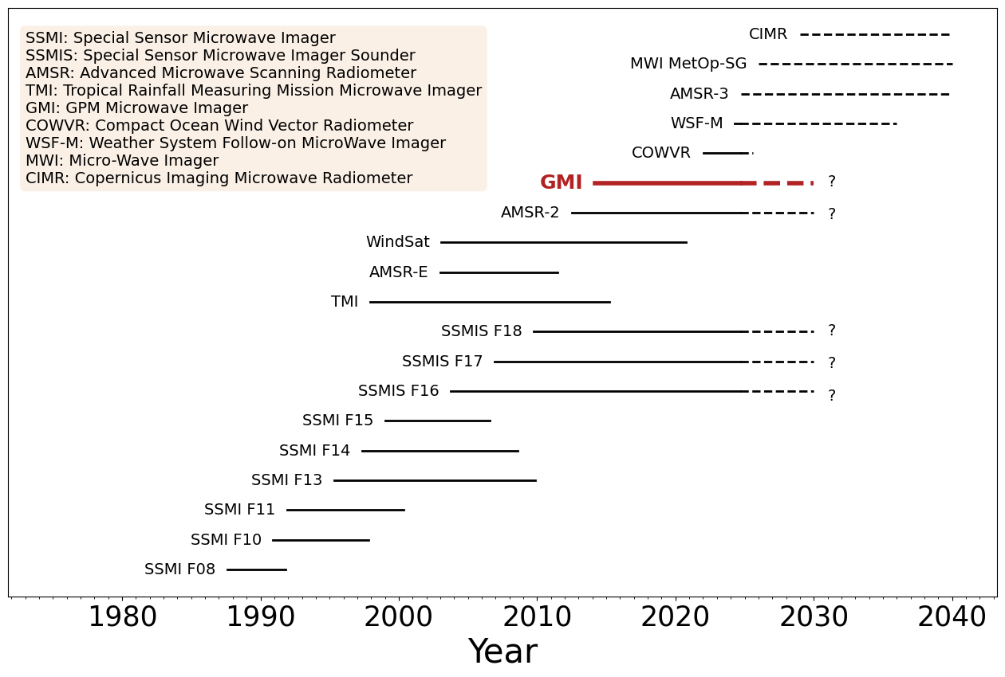
Motivation
The creation of a multidecadal CDR of MW geophysical retrievals requires accurate absolute intercalibration of TBs from multiple operating sensors
GMI is expected to be in orbit at least till 2030.
Possibly later if orbital boost is performed.
Adequate follow-on: WSF-M MWI
(polar orbit 18:00 LANT).

Slide 4
Absolute Radiometer Calibration
Determination of calibration parameters: ΔT_{NL} (a_{NL}), η, C_{pq}
Ideally this would be done pre-launch
In practice this is difficult to do to high accuracy, so post-launch calibration is needed
  Applies particularly to spillover, η. Antenna backlobes are difficult to measure.
Other calibration issues to be dealt with:
  Scan position dependent biases due to intrusion of spacecraft or sensor into Earth FOV
  Hot load thermal gradients due to solar intrusion
  Emissive reflector antenna
  The above anomalies are observed with many sensors (TMI, SSMIS, AMSR-E, WindSat) and are important to correct, but not the subject of this presentation

Slide 5
TA to TB Equations
Non-linearity Correction
Initial TA
Non-Linearity ΔT_{NL}
The Non-linearity correction accounts for the relationship between counts and antenna temperature deviating from linear
T’_{A} = Antenna Temperature with Non-Linearity
C_{E} = Earth Counts
C_{H} = Hot Load Counts
C_{C} = Cold Space Counts
T_{H} = Hot Load Temperature
T_{C} = Cold Space Temperature
a_{NL} = Non-Linearity coefficient, note the ΔT_{NL} term is small and quadratic for WindSat
T_{A}
T_{H}
T_{A,E}
T_{C}
Counts
C_{C}
C_{E}
C_{H}

Slide 6
TA to TB Equations
Spillover Correction
T_{A} = Antenna Temperature with Cold Space Spillover and Non-Linearity
T’_{A} = Antenna Temperature with Non-Linearity
T_{C} = Cold Space Temperature
η = Cold Space Spillover into Earth Scene
The Spillover correction accounts for the intrusion of cold space Cosmic Microwave Background (CMB) into the Earth field of view through antenna backlobes where the CMB fraction (η) is a few percent

Slide 7
TA to TB Equations
Cross-polarization Correction
T_{BV}, T_{BH} = Top of the atmosphere brightness temperature after calibration for V-pol and H-pol
T_{AV}, T_{AH} = Antenna Temperature with Cold Space Spillover and Non-Linearity for V-pol and H-pol
C_{p,q} = Values for cross-polarization mixing of q into p where p is V-,H-pol and q is V-,H-pol; note, C_{VH}=1-C_{VV} and C_{HV}=1-C_{HH}
The Cross-polarization correction accounts for the mixing of V-pol into H-pol (and vice versa) that is received by the antenna

Slide 8
GMI TBs are an Absolute Calibration Reference
GMI TBs are absolutely calibrated to within 0.2—0.3 K when compared to the RTM, and are therefore used as a reference TB for other MW sensors
  No vicarious Earth targets required. No specific radiative transfer model (RTM) required.
  4-point Calibration consists of hot load and cold sky view + internal noise diodes
    T_{C} T_{C} + T_{ND} T_{H} T_{H} + T_{ND}
    Noise diodes check for nonlinearities, fill in for the cold-sky view during orbit maneuvers, monitor the temperature stability of the hot load, and check for intrusions into the cold-sky view
    Pre-launch determination of antenna patterns and non-linearity were accurate
  On-Orbit Maneuvers include (1) deep space maneuver for along-scan bias removal, (2) inverted backlobe maneuver for cold space spillover removal, and (3) nadir look for determining bias offsets in V-pol and H-pol (ability to disentangle biases from cross-polarization effects)
  No calibration anomalies or drifts in GMI TBs (hot load solar intrusion, emissive reflector, …)
  Wentz, F. and D. Draper 2016 paper

Slide 9
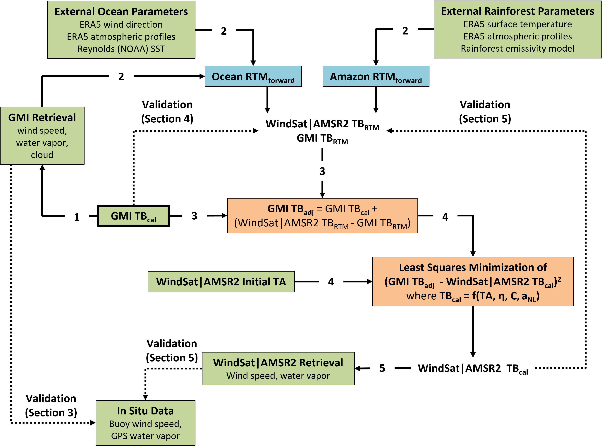
Intercalibration of MW TBs to GMI

Slide 10
Intercalibration of MW TBs to GMI
The core of the absolute intercalibration methodology is matchups between GMI and other sensors’ TBs [WindSat and AMSR2] over the Open Ocean and Amazon Rainforest
1 hour time window, all data resampled onto 0.25-deg grid; GMI has shifting LANT so can find match-ups with any polar orbiting sensor
Determine calibration parameters for WindSat|AMSR2 in multiple linear regressions that minimize the following cost function
Above, i is the V-pol or H-pol polarization, j is the Open Ocean or Amazon Rainforest observation
We solve for the parameters for each channel separately (10 VH, 18 VH, 23V, 36 VH, 89 VH)
Note, a computationally effective method is to solve for Spillover over Amazon scenes, and then, solve for Non-linearity and Cross-polarization over Open Ocean scenes

Slide 11
Adjustment to GMI TBs to Account for Different Configuration
Sensor intercalibration method does not depend on a specific RTM
  The method uses an RTM only for a small adjustment to GMI TBs (~ 1 K) in order to match the frequencies and EIA of WindSat|AMSR2
  The TB results are very robust towards changing the RTM or the geophysical input to the RTM

Slide 12
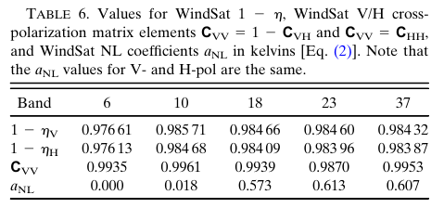
Calibration Parameter Results: WindSat
WindSat TBs based on prelaunch calibration parameters are ~1-2 K higher over the open ocean and ~3 K higher over the Amazon Rainforest as compared to calibrated TBs

Slide 13
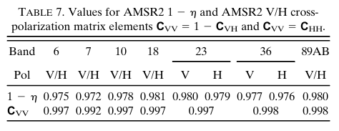
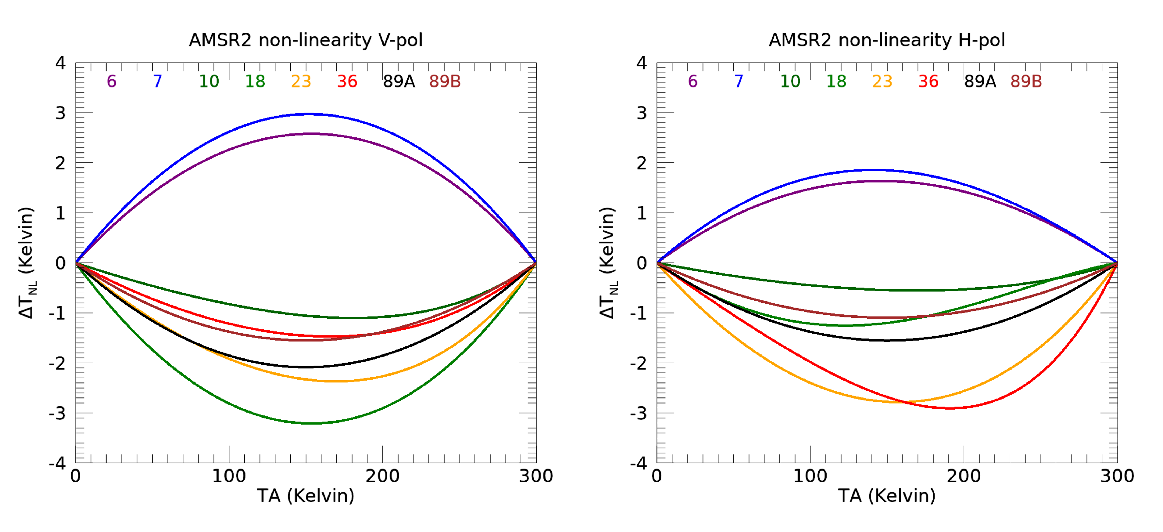
Calibration Parameter Results: AMSR2
AMSR2 non-linearities are large and not always quadratic
JAXA TB (not intercalibrated) – RSS TB Open Ocean
6V | 1.7 K | 6H | 1.7 K
7V | 1.9 K | 7H | 2.3 K
10V | 4.1 K | 10H | 2.8 K
18V | 4.6 K | 18H | 2.9 K
23V | 3.4 K | 23H | 4.3 K
36V | 2.3 K | 36H | 3. 6 K
89V | 2.3 K | 89H | 2.7 K
We used passband center frequencies for the 18H and 23V that differ from the nominal values because the nominal values result in fits for the NL terms that switch sign over the TA range. 18H is 100 MHz lower than nominal value of 18.7 GHz and the 23V is 70 MHz lower than nominal value of 23.8 GHz.

Slide 14
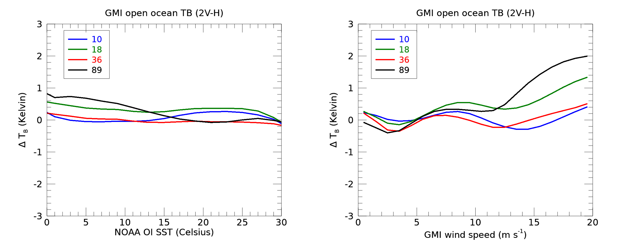
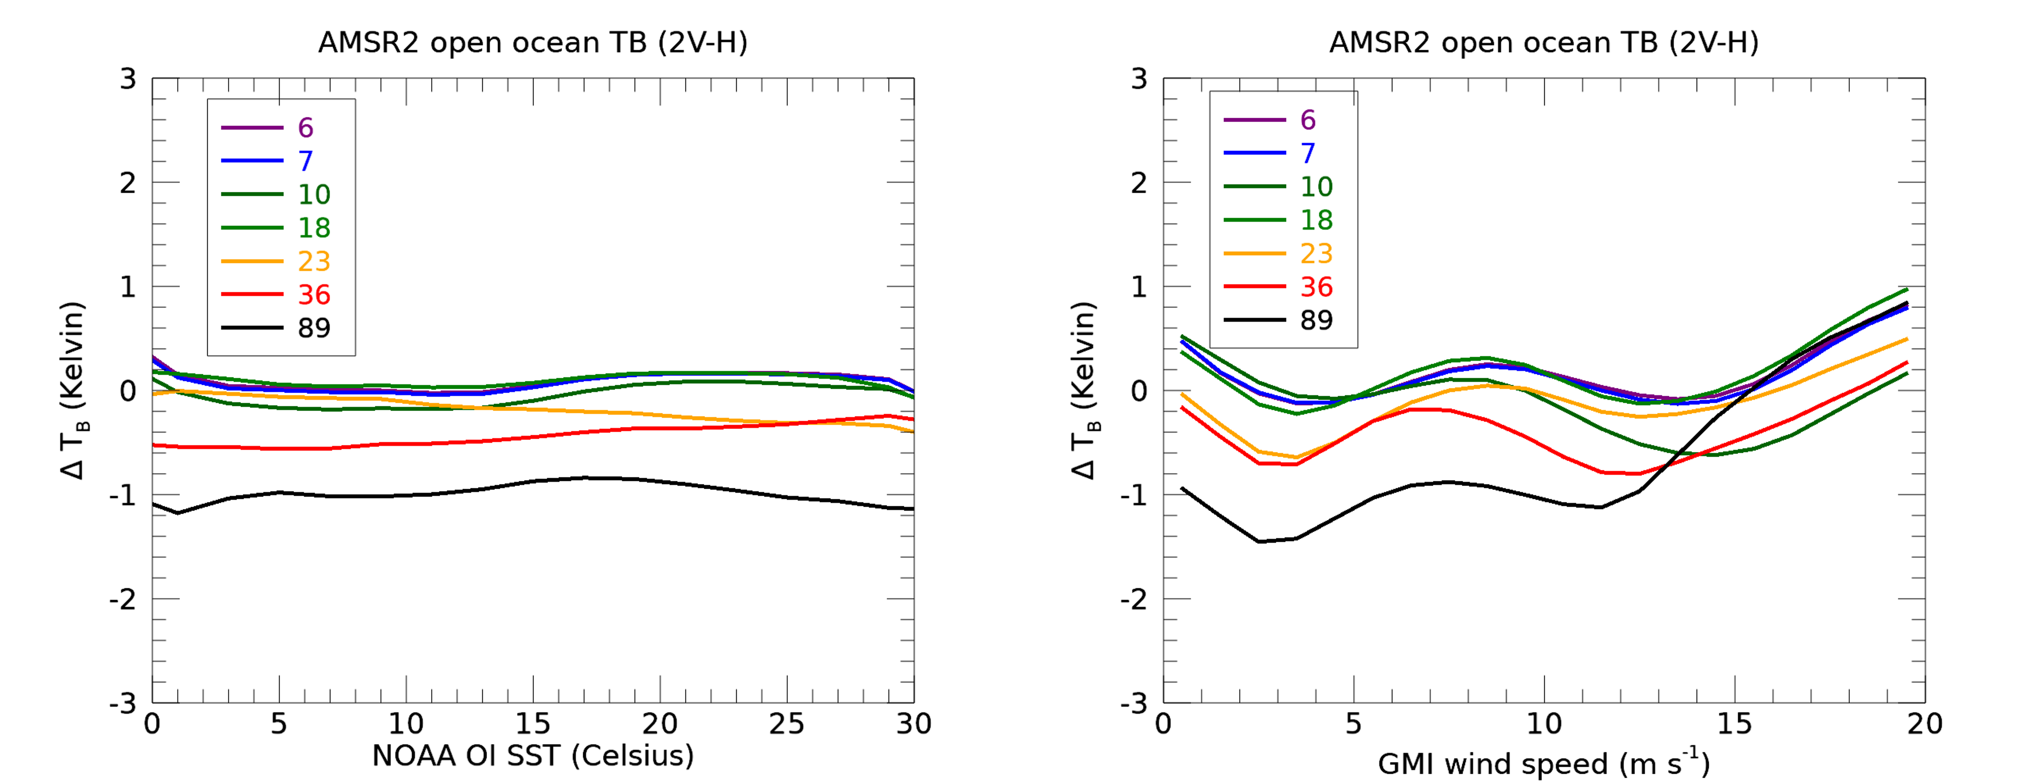
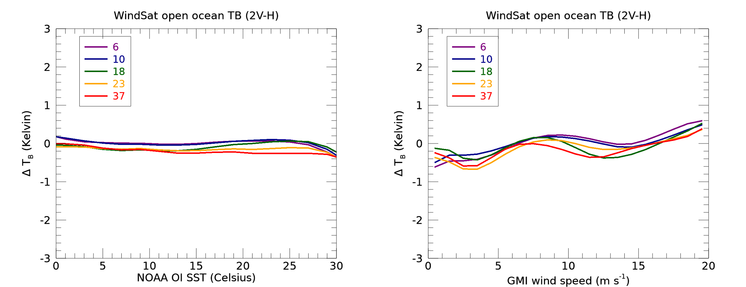
Open Ocean
TB Calibration Results
TB (calibrated) – TB (RTM) results for Open Ocean scenes
2 V – H mitigates sensitivity to error in atmospheric input (clouds, vapor)
The undulating nature of the TB errors when binned by wind speed is likely a result of uncertainty in the RTM surface roughness model which models the ocean surface emissivity as a function of a fifth-degree polynomial in wind speed
The larger biases in the 89 GHz may be a result of misclassifying clouds in the RTM, which uses cloud profile data from ERA5 (scaled to match GMI); note, the 89 GHz cloud absorption is 2.5x 37 GHz absorption
GMI Reference
AMSR2
WindSat
2017-2019 Matchups

Slide 15
Sources of Uncertainty
Open Ocean Scenes
Monte Carlo simulation is used to determine Ancillary Datasets Uncertainty:
± 0.8 m/s wind speed
± 0.5 K SST
± 1.5 mm water vapor
± 0.1 mm cloud
± 15˚ wind direction
The random uncertainty in TB Calibration contains errors associated with neglecting the dependence of Non-linearity on receiver physical temperature
 | Channel | GMI TB Calibration and RTM Uncertainty | AMSR2 TB Calibration and RTM Uncertainty | WindSat TB Calibration and RTM Uncertainty | Ancillary Datasets Uncertainty | NEDT
RMSE | 10 | 0.25 | 0.24 | 0.05 | 0.2 | 0.1
 | 18 | 0.34 | 0.20 | 0.16 | 0.2 | 0.1
 | 36 | 0.05 | 0.48 | 0.28 | 0.2 | 0.1
 | 89 | 0.35 | 1.21 | - | 0.4 | 0.1
2017-2019 Matchups, Values in Kelvin

Slide 16
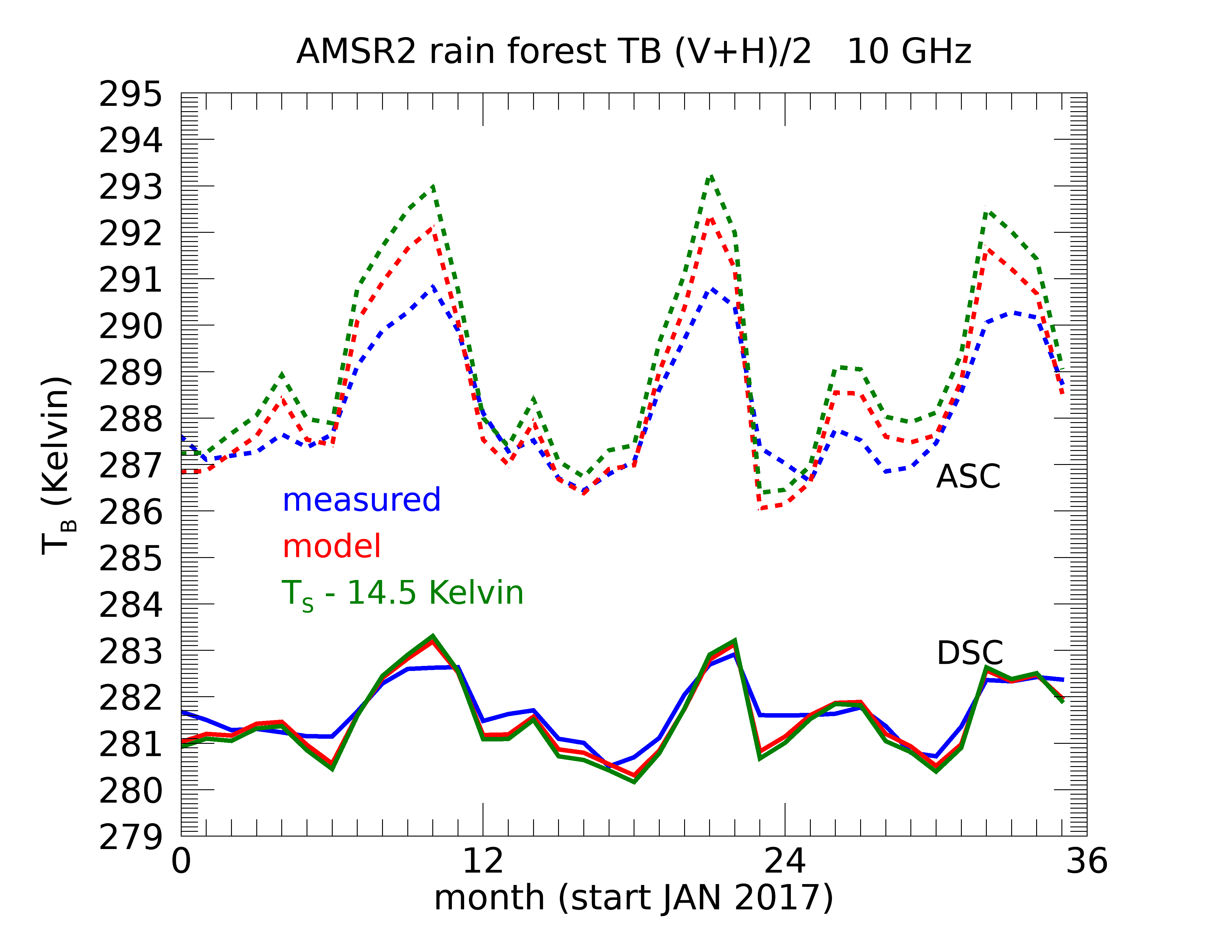
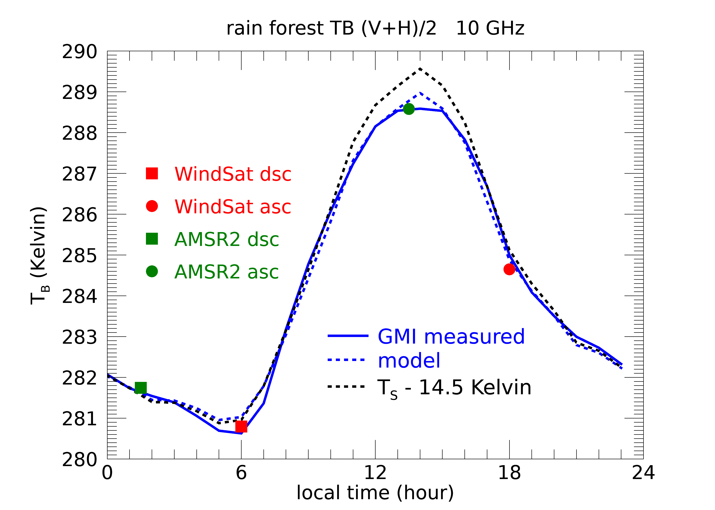
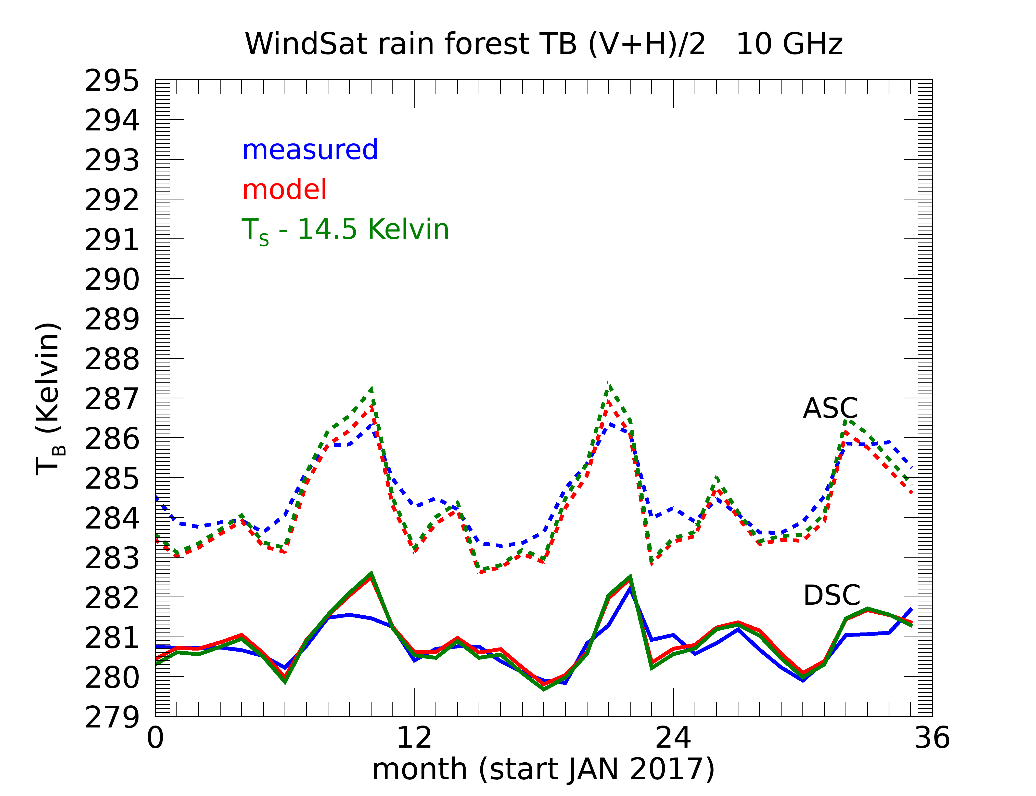
Amazon Rainforest TB Calibration Results
AMSR2
TB (calibrated) results for Amazon Rainforest scenes
The results for the descending morning passes are better than for the ascending afternoon passes; the ERA5 ancillary fields for SST and clouds/rain that are used in the RTM are more accurate in the local morning time when cloud/rain is less likely and SSTs are more stable
Although it is not shown here, there are large TB biases in the 89 GHz channel likely due to misclassification of clouds in the RTM
GMI Reference
WindSat
2017-2019 Matchups

Slide 17
Sources of Uncertainty
Amazon Rainforest scenes
MODIS LST vs in-situ data has an RMSE of 1.5 K, which dominates the ancillary dataset uncertainty and the overall standard deviation of GMI, AMSR2, and WindSat errors
 | Channel | GMI TB Calibration and RTM Uncertainty | AMSR2 TB Calibration and RTM Uncertainty | WindSat TB Calibration and RTM Uncertainty | Ancillary Datasets Uncertainty (Mostly Surface Temperature) | NEDT
RMSE | 10 | 0.01 | 0.45 | 0.33 | 1.5 | 0.1
 | 18 | 0.04 | 0.42 | 0.32 | 1.5 | 0.1
 | 36/37 | 0.04 | 0.33 | 0.36 | 1.5 | 0.1
 | 89 | 0.01 | 0.37 | - | 1.5 | 0.1
2017-2019 Matchups, Values in Kelvin, using Ascending data for AMSR2 and WindSat

Slide 18
Absolutely Calibrated TB Data Available on RSS Webpage
Available during validation time period: 2017-2019
WindSat TB Data Available at:
https://data.remss.com/TB/intercalibration/windsat_TB_maps_daily_025deg/
Meissner et al., Remote Sensing Systems WindSat TB, V08.0, doi:10.5067/WSA80-1CRTB
GMI TB Data Available at:
https://data.remss.com/TB/intercalibration/gmi_TB_maps_daily_025deg/
T. Meissner et al., Remote Sensing Systems GMI TB, V08.2
AMSR2 TB Data Available at:
https://data.remss.com/TB/intercalibration/amsr2_TB_maps_daily_025deg/
T. Meissner, K. Wentz and F. Wentz, 2023: RSS AMSR2 TB on daily 0.25 grid, Version 8.2, Remote Sensing Systems, Santa Rosa, CA, https://doi.org/10.56236/RSS-bk

Slide 19
Summary and Conclusions
GMI is the best absolute calibrated MW imager
  The inclined orbit and shifting LANT allows match-ups with other MW imaging satellites
  GMI is expected to be in orbit at least till 2030
  Adequate follow-on: WSF-M MWI (polar orbit 18:00 LANT)
Intercalibration of other sensors with GMI
  Performed at TB level: TB Accuracy ~ 0.5 Kelvin or better
  Open ocean + Amazon → Valid over the whole dynamical range of Earth TB
Not dependent on a specific RTM
Backbone of constructing climate data record (CDR) of air-sea essential climate variables (AS-ECV) from intercalibrated satellite microwave imagers
  Wind Speed, SST, Precipitable Water Vapor, Liquid Cloud Water, Precipitation Rate, Sea Ice

Slide 20
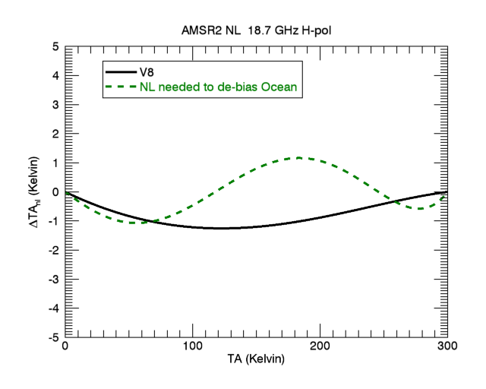
Estimate 18H Non-Linearity to De-Bias Ocean
strange behavior
the NL would need to change sign over the ocean dynamic range
Non-Linearity Correction

Slide 21
Red Curves are JAXA values for non-linear correction.
Black Curves are values coming from RSS analysis on 2014.
These are the AMSR2 NL form the old Version (V7), which was calibration to the ocean RTM.
The 18H NL did exactly that sign change!

Slide 22
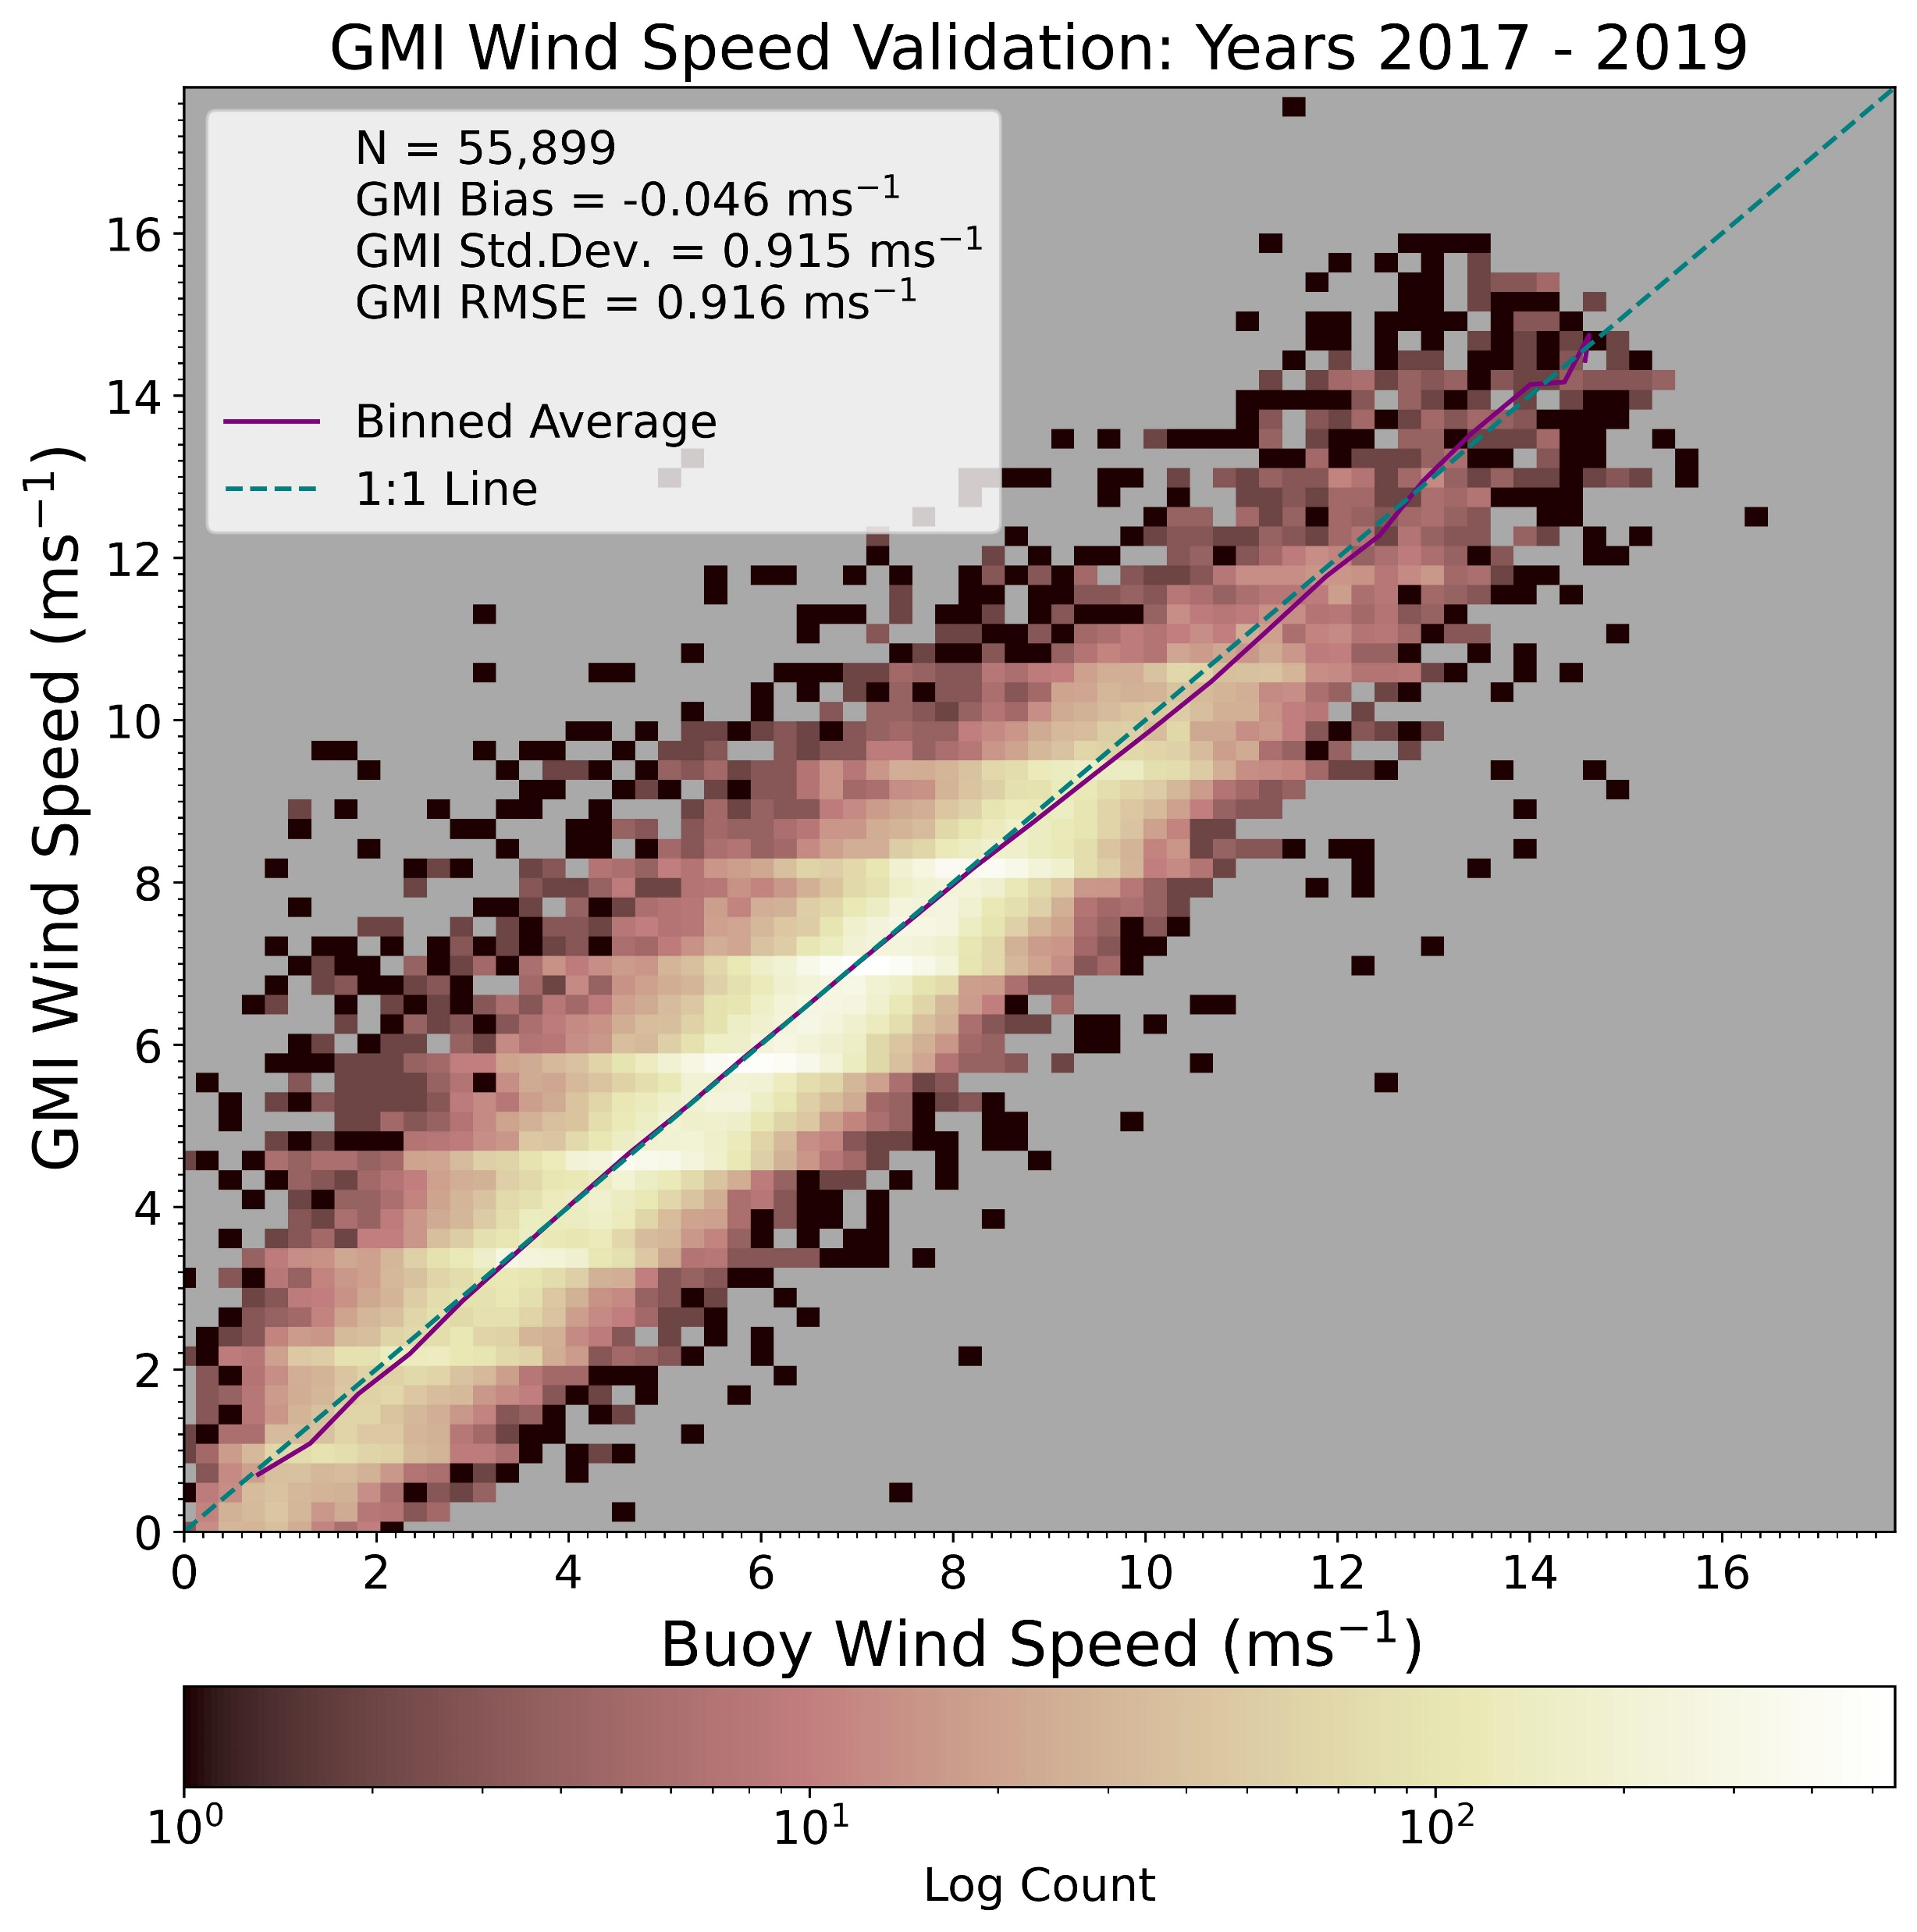
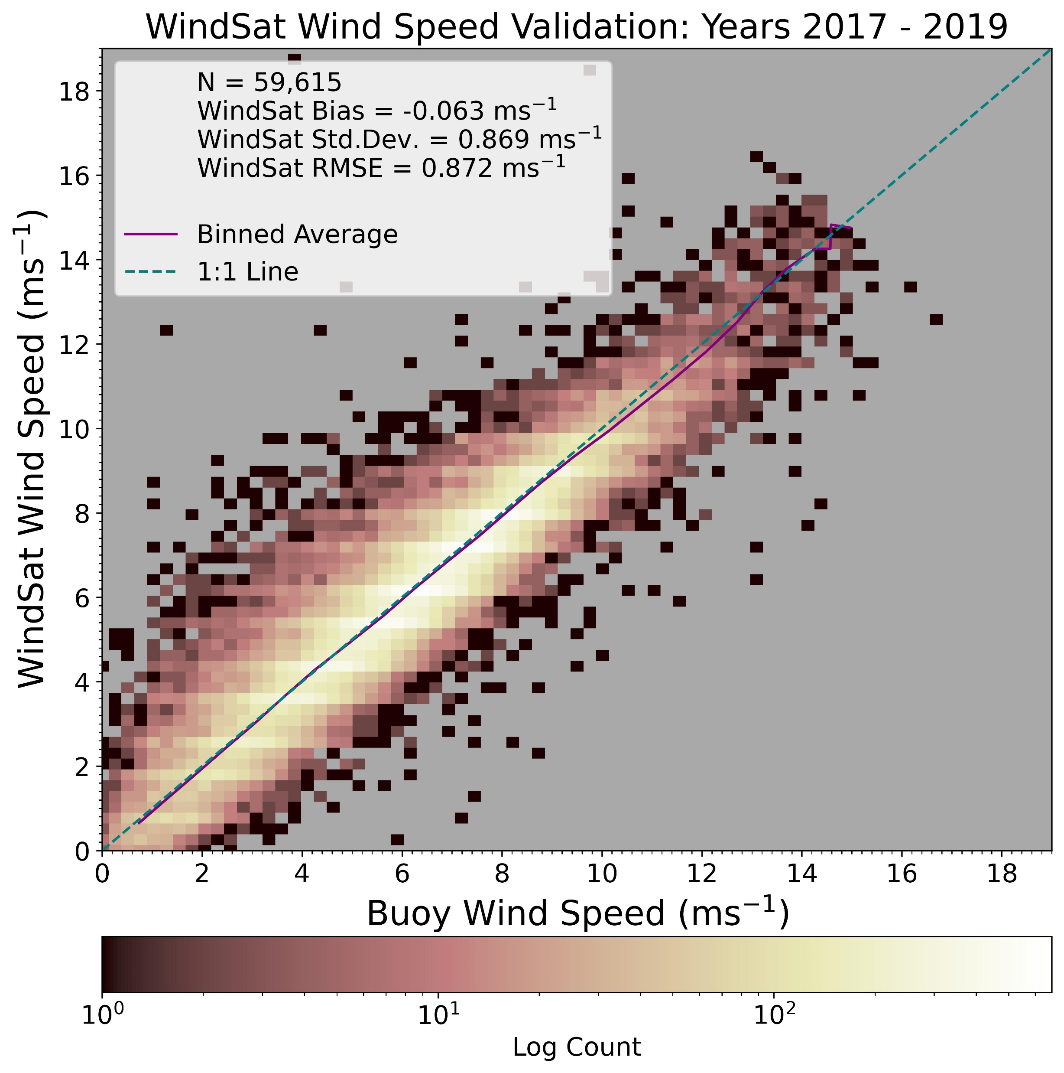
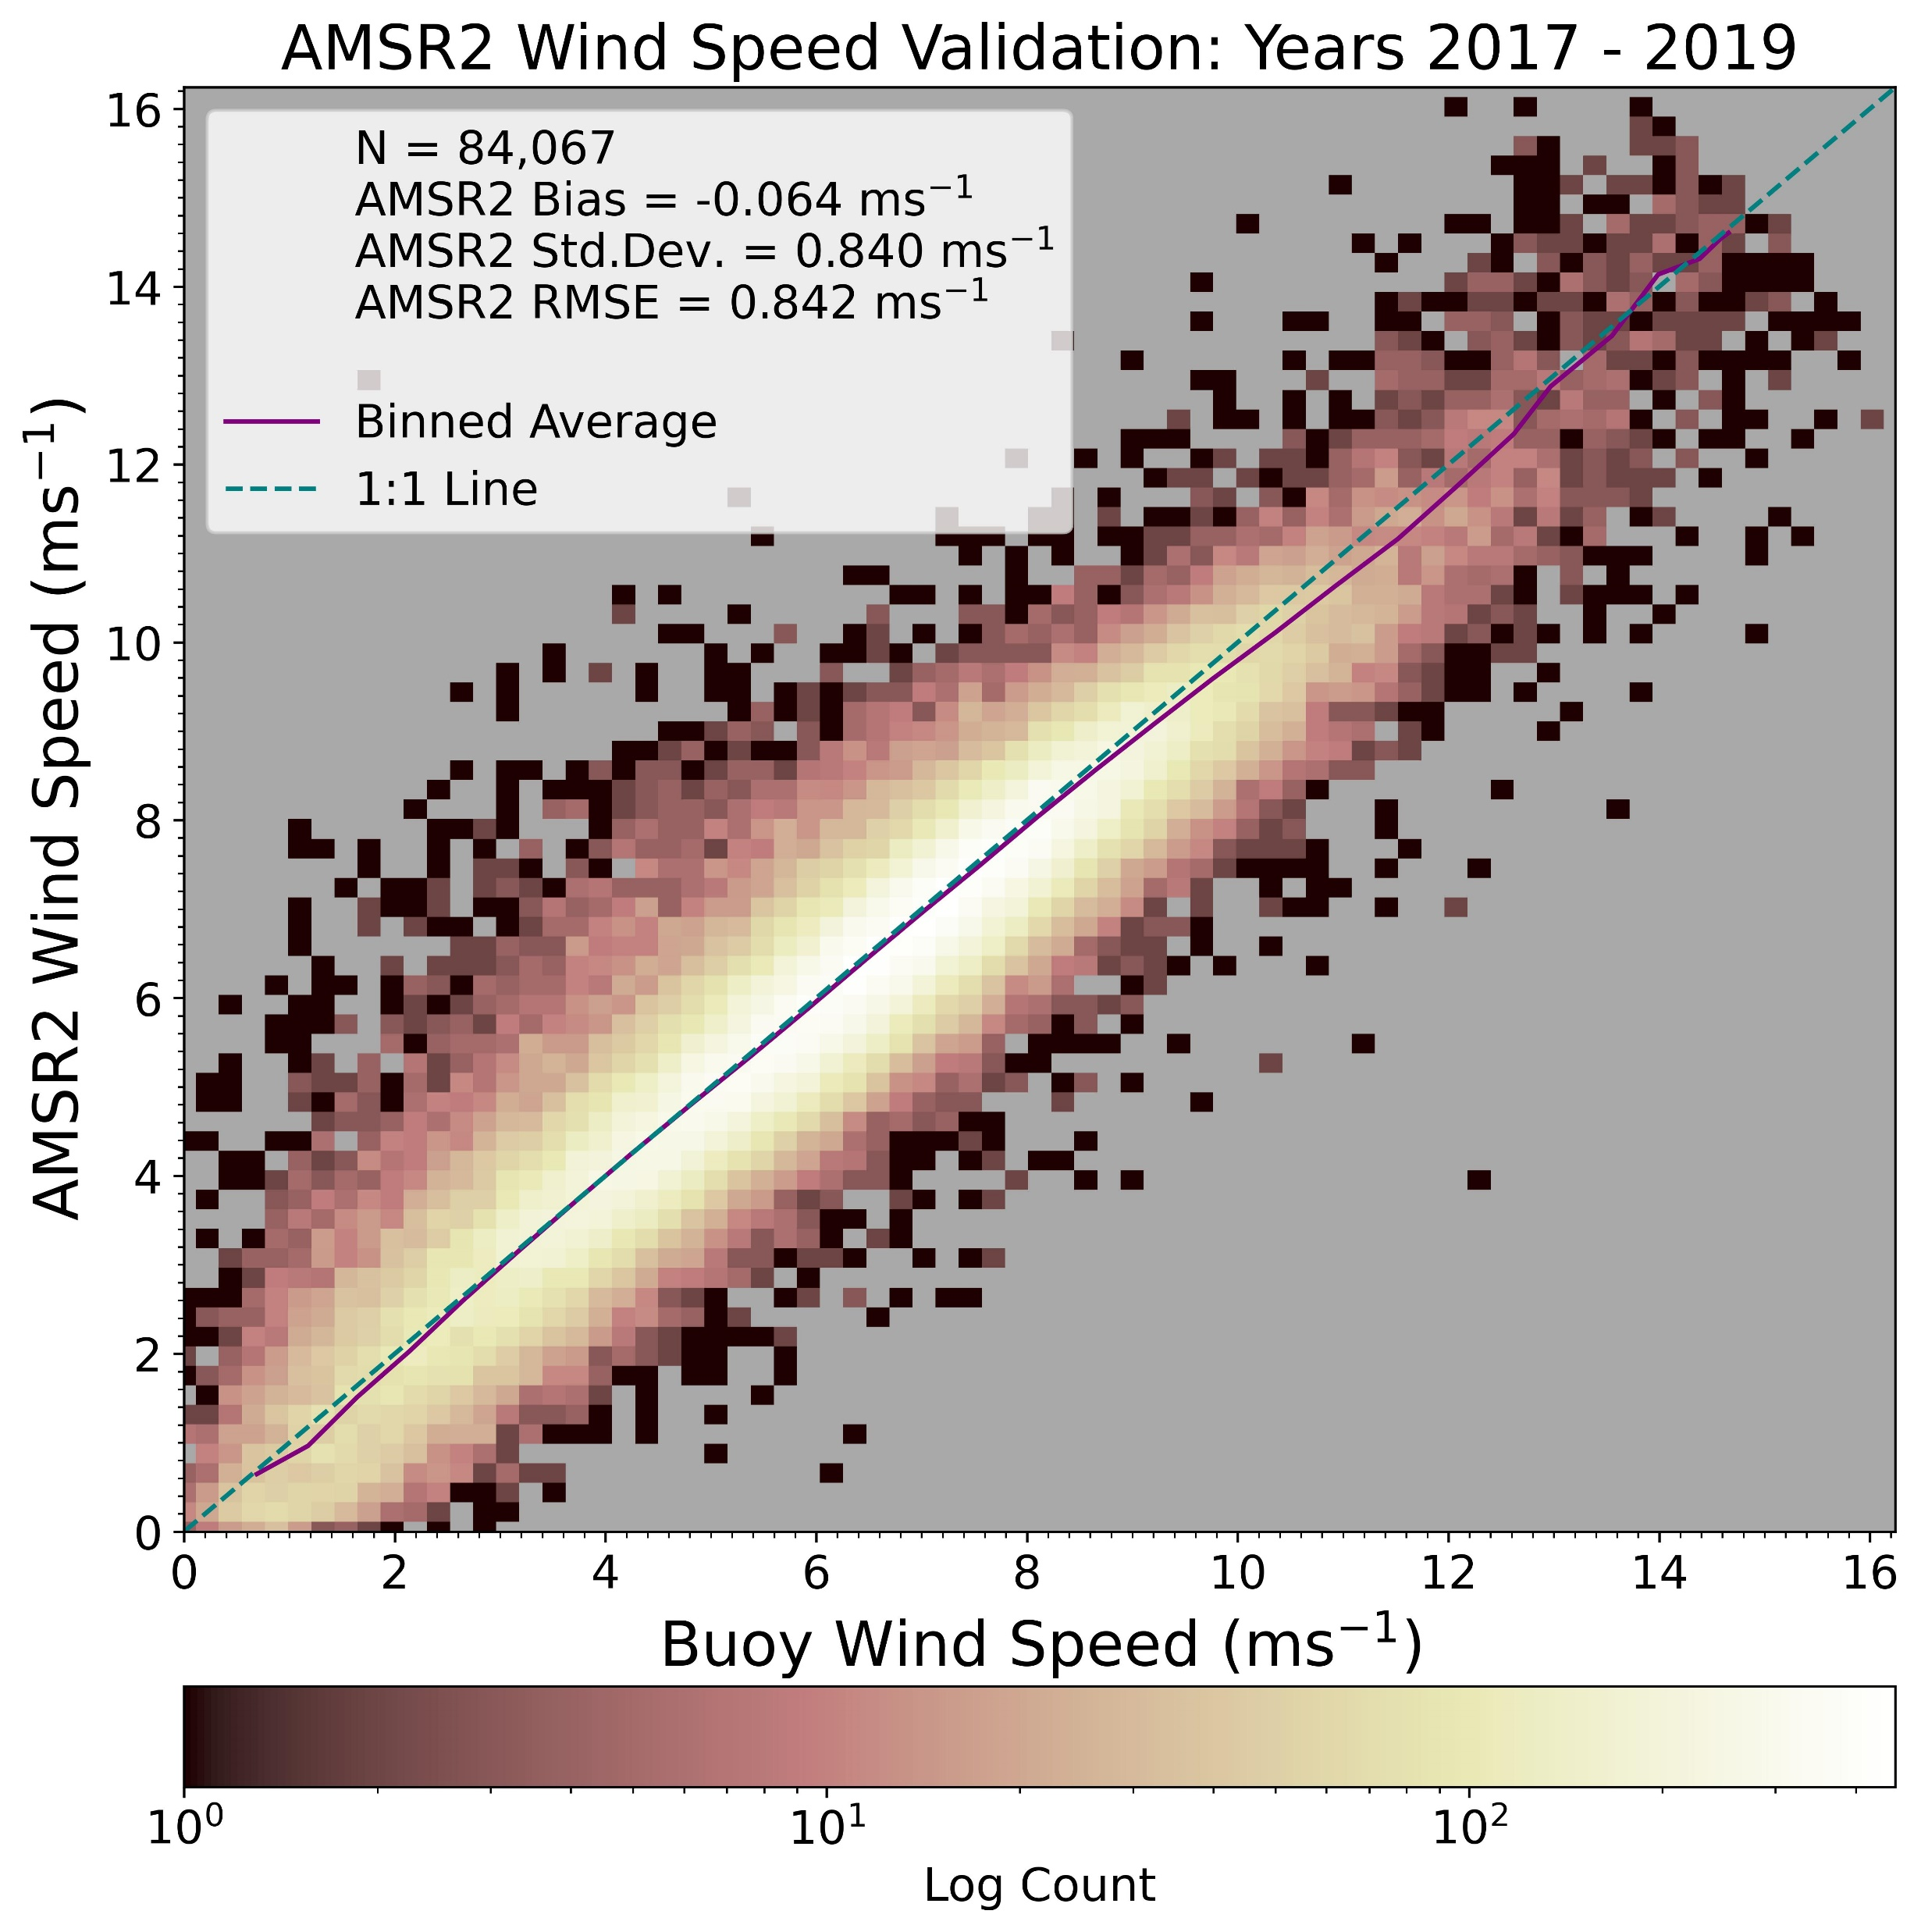
Ground Truth Validation
Wind Speed Retrievals versus Buoys
RMSE: 0.92 m/s
RMSE: 0.87 m/s
RMSE: 0.84 m/s

Slide 23
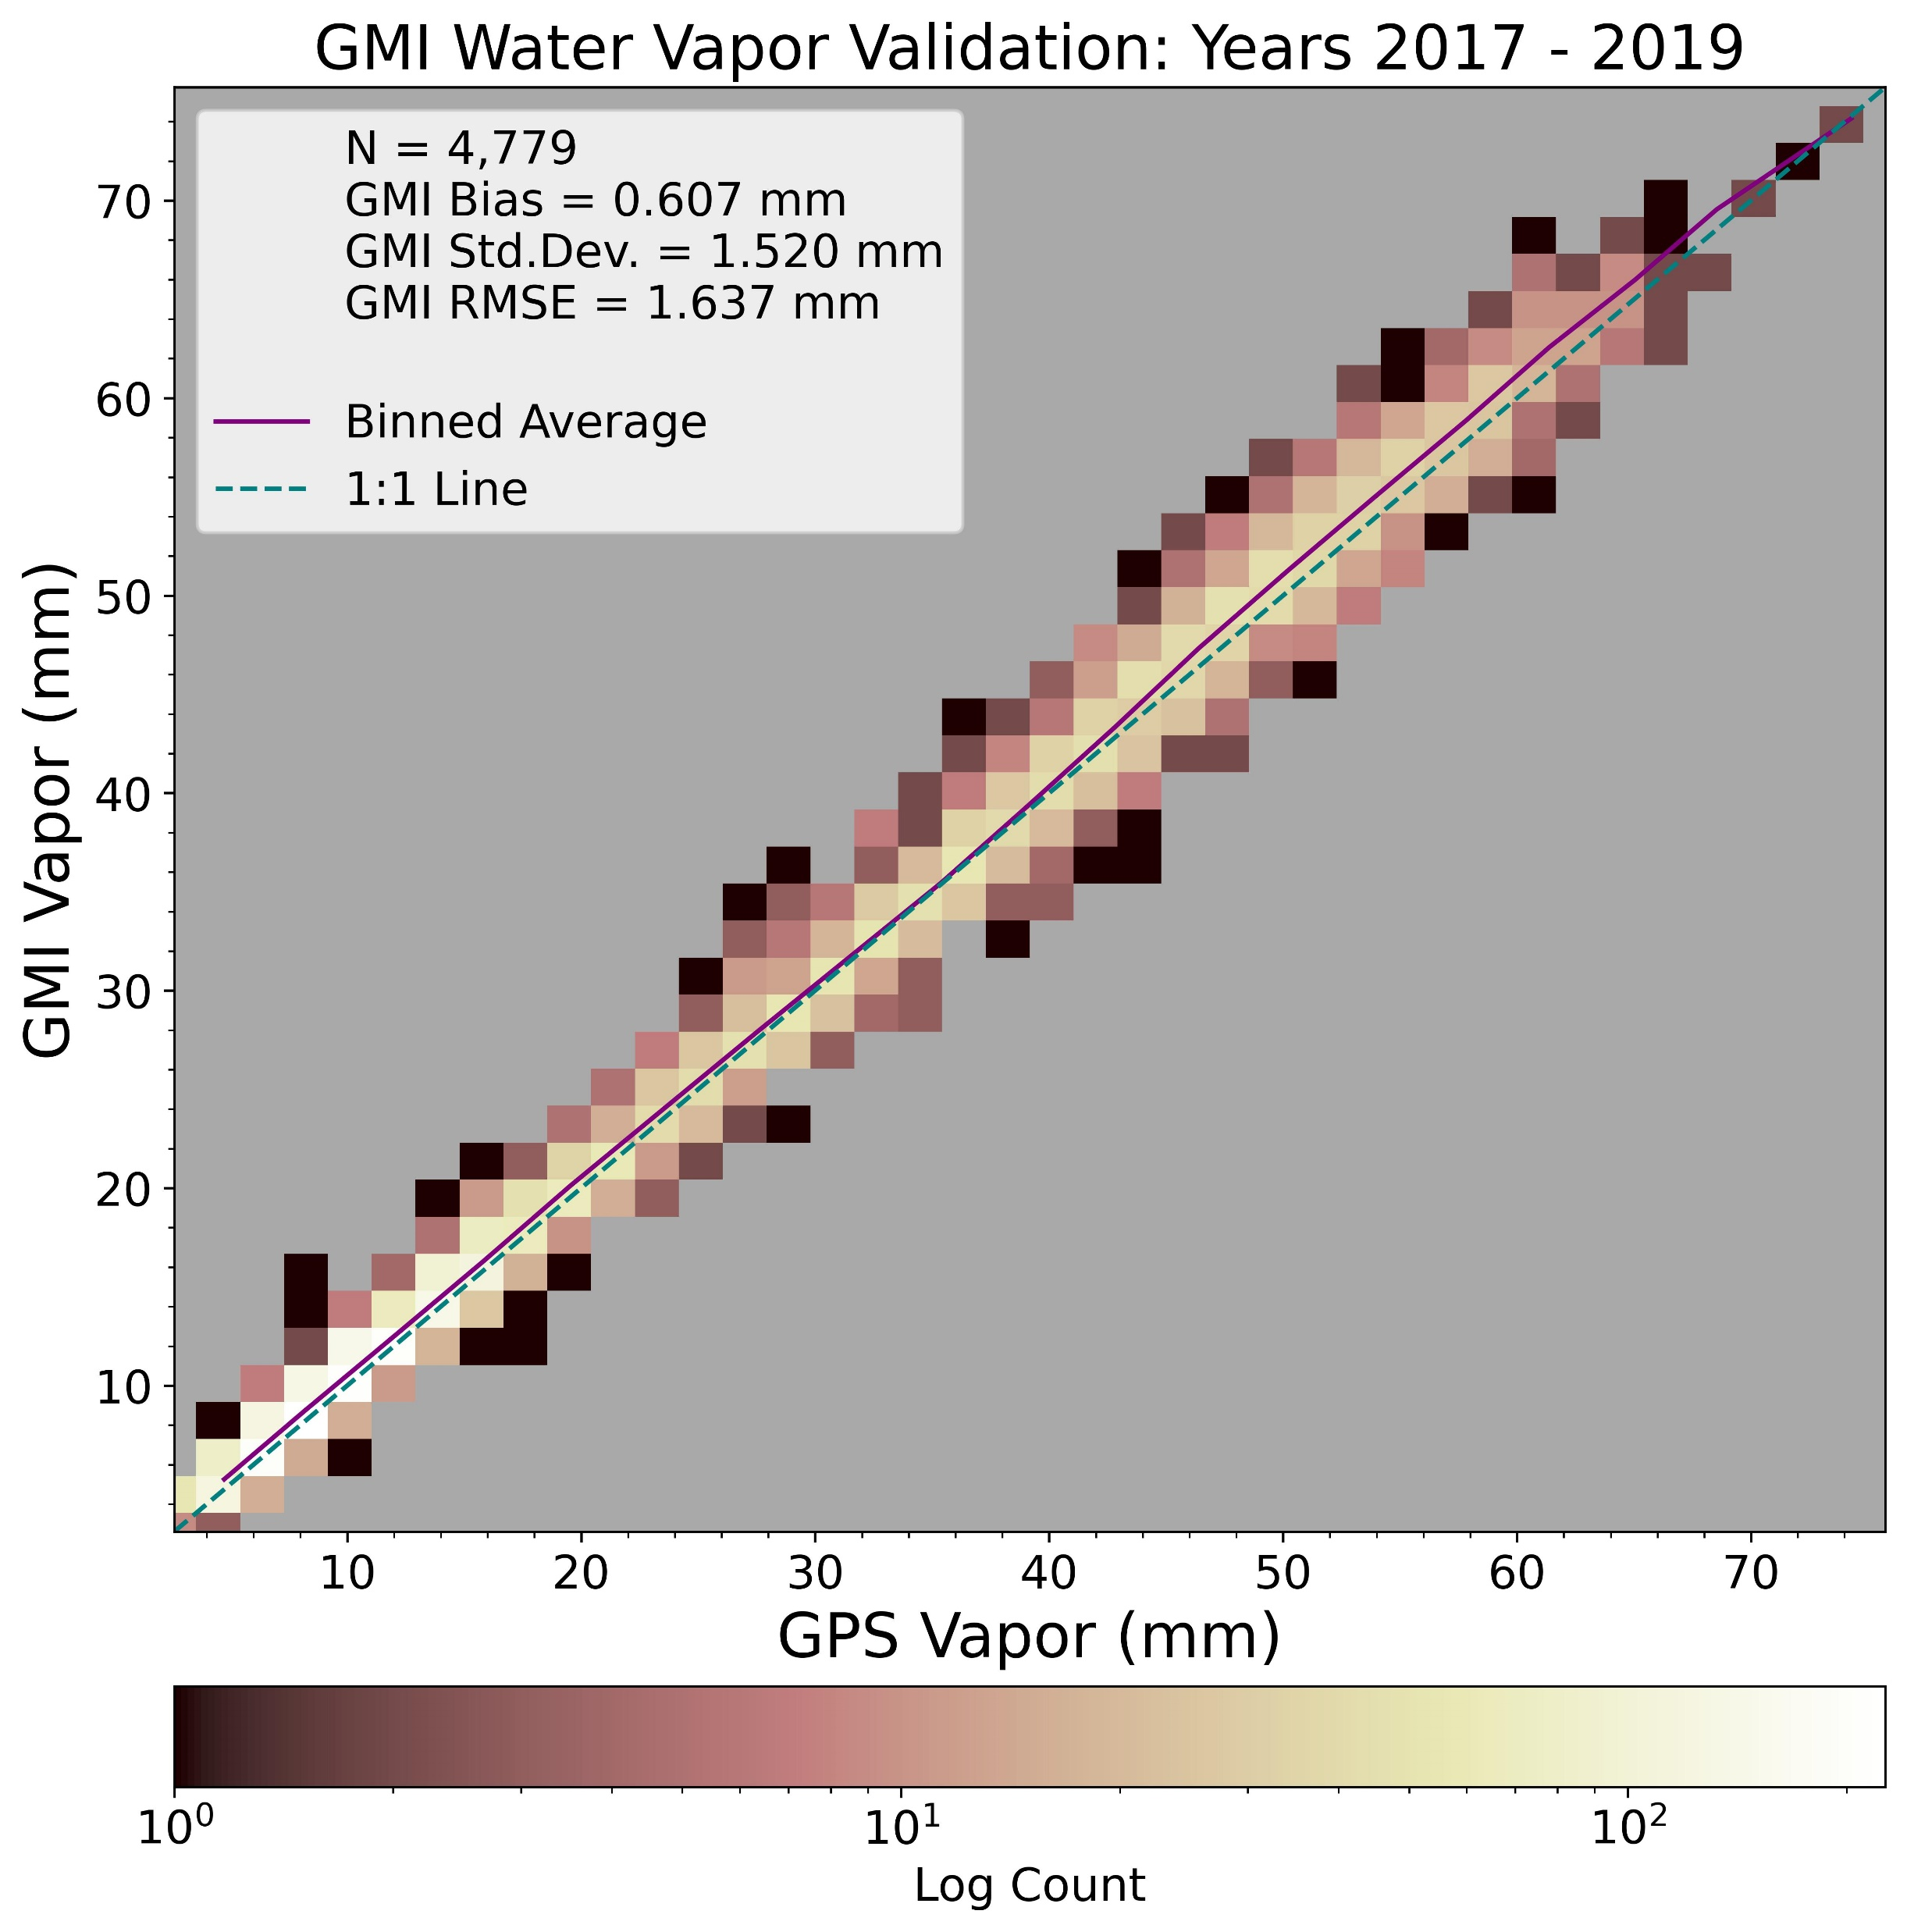
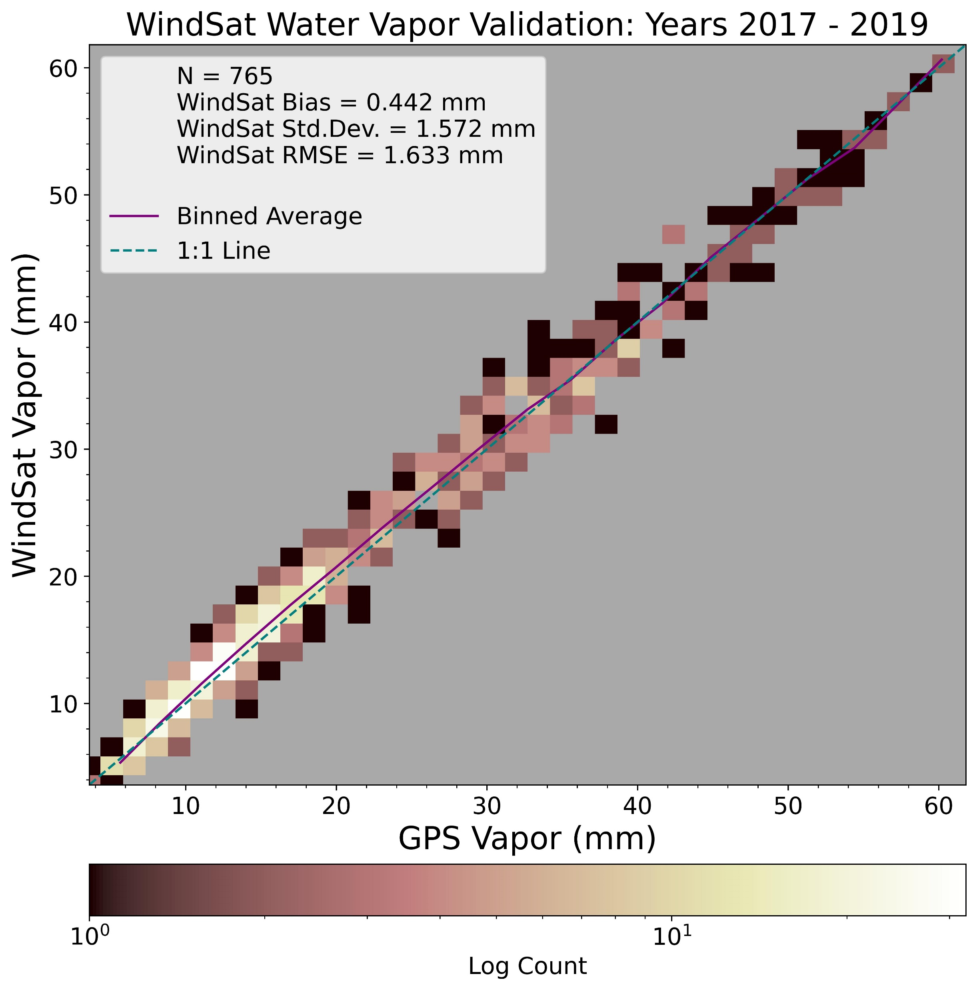
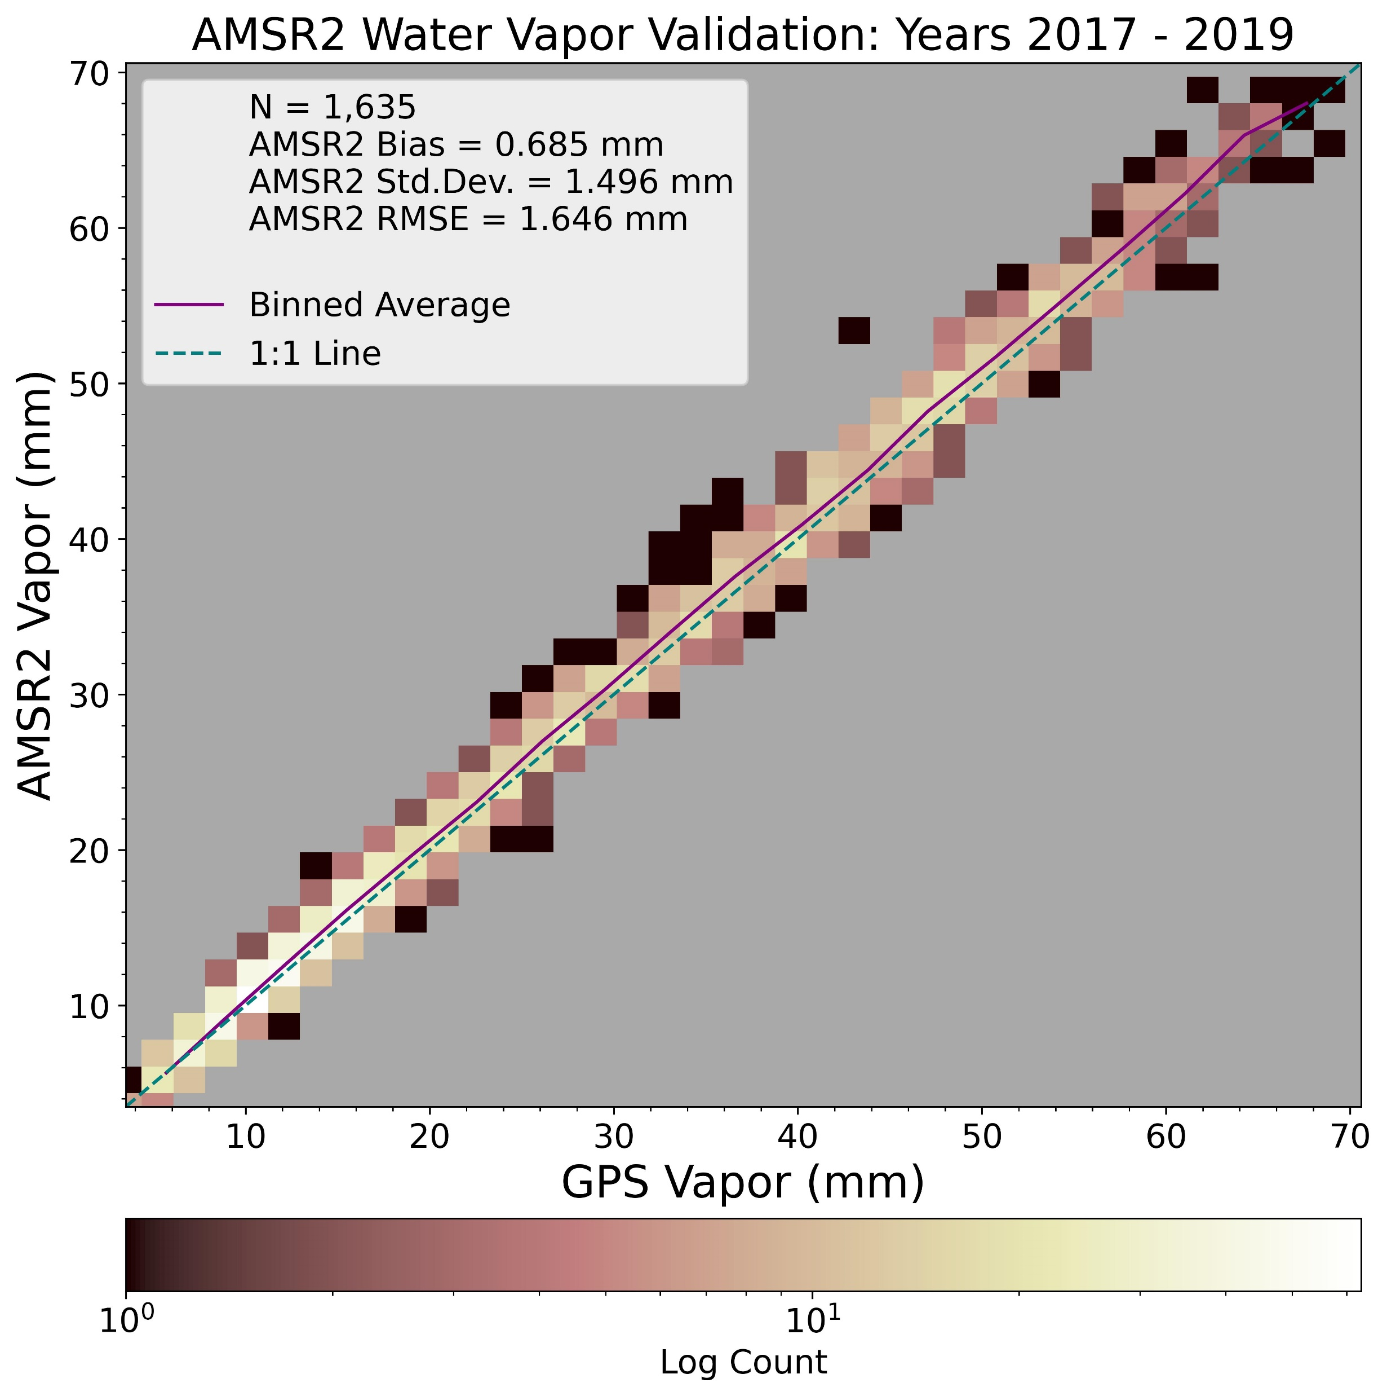
Ground Truth Validation
Precipitable Water Retrievals versus GPS Stations
RMSE: 1.6 mm
RMSE: 1.6 mm
RMSE: 1.6 mm

