Slide 1
Microwave Radiometer Direct Inter-Calibration (“SNO”) Method Focus Group
Focus Group Members
Cheng-Zhi Zou (NOAA)
Flavio Iturbide (NOAA)
Siena Iacovazzi (GST @ NOAA)
Tim Hewison (EUMETSAT)
Yang Guo (CMA)
+ Your contributions are welcome!

Slide 2
SNO Focus Group Way of Working
From Annual Meeting: http://gsics.atmos.umd.edu/pub/Development/AnnualMeeting2024/8i_Microwave_SNO_Focus_Group_Hewison_Yang.pptx
Regular Web Meetings
Review existing algorithms
Identify issues
Conduct analysis to optimise algorithms
Integrating uncertainty framework
Combine algorithms for robust coverage over full dynamic range
Apply algorithm variants to different instruments
Compare experiences
Learn!
Aim to define
Common baseline algorithm
Common calibration correction function
Common monitoring framework
e.g. define standard Tb scenes to evaluate radiance-dependent bias
Focus Group Members Cheng-Zhi Zou (NOAA)
Flavio Iturbide (NOAA)
Siena Iacovazzi (GST @ NOAA)
Tim Hewison (EUMETSAT)
Yang Guo (CMA) + Your contributions are welcome!

Slide 3
General Statement on SNO
SNO collocation criteria and other tuning thresholds depend on:
Channels - their frequencies, polarisations, sampling, footprint size and view angle range
Time window to analyse collocations depends on:
Instrument, orbit and platform stability
And the form of any inter-calibration comparison depends on
Likely form of any biases, based on root cause analysis – iterative
The Measurement Model (e.g. radiometer equation)
These should be optimised for each case
Based on careful uncertainty analysis

Slide 4
Generalised Algorithm Recommendations
Aim to recommend general algorithms for specific instrument/channel bands
Example instrument/channel classes:
~60GHz temperature sounding channels - near nadir
~60GHz temperature sounding channels - near 53° VZA
~183GHz humidity sounding channels - near nadir
~183GHz humidity sounding channels - near 53° VZA
(Pseudo-) Window channels - near nadir
(Pseudo-) Window channels - near 53° VZA - matching polarisations
118GHz temperature sounding channels?
325GHz humidity sounding channels?
Compare uncertainties of the different approaches
to identify our "development" priorities

Slide 5
Review Existing SNO Methods*
Started Shared Spreadsheet
Summarising basic elements of different SNO Methods
Based on publications over the last 20 years
Collocation area - area over which observations are compared
Collocation criteria:
ds (km) - Maximum separation between collocation centres
dt (min) - maximum time difference between instruments
dVZA(°/%) - maximum difference in Viewing Zenith Angle
VZAmax(°) - maximum VZA
Basic Method, Filters, Applicable Spectral Bands & Instruments
* Review includes some NWP Double-Difference and Vicarious Inter-calibration methods – please feel free to copy!

Slide 6
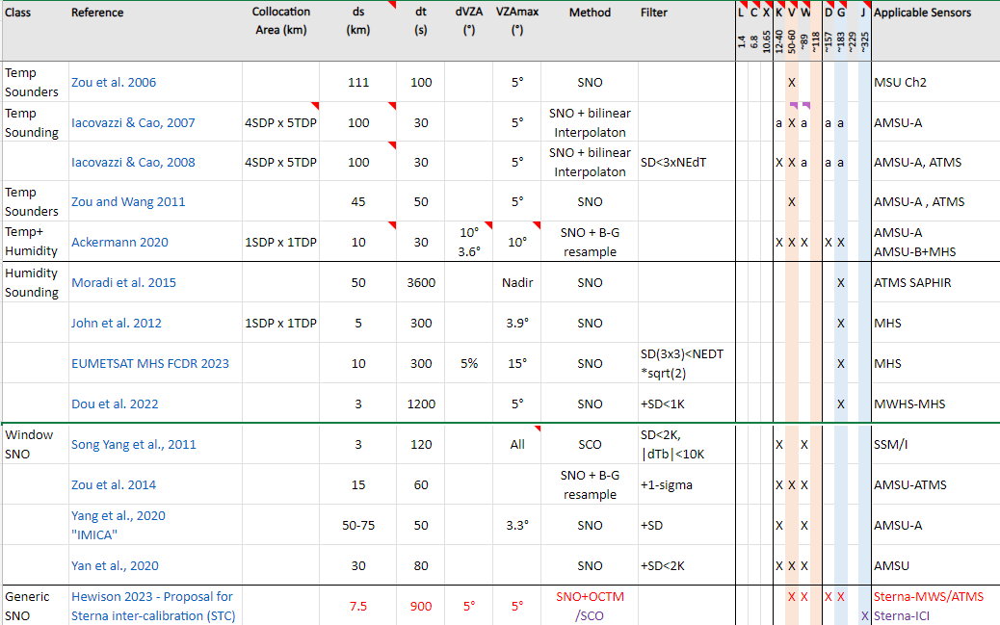
Snapshot of Spreadsheet

Slide 7
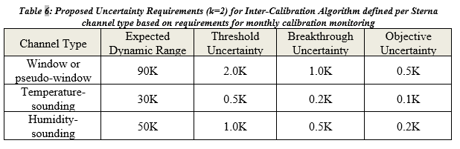
Inter-Calibration Algorithm Uncertainty Requirements
Inter-calibration can be used characterise radiometric bias
For operational meteorological purposes, we consider levels of uncertainty needed to verify this requirement within a period of ~1 month.
Different uncertainty levels are proposed here,
considering realistic dynamic range expected to be observed
based on distribution of ATMS observations
together with the sensitivity of their applications
to define requirements for inter-calibration system by channel type
Only uncertainty inter-calibration algorithm,
exclude uncertainty of inter-calibration reference instrument.
Threshold Level:
needed to provide any meaningful information on bias
Objective level:
Highest performance which could be usefully exploited to improve the calibration
further improvement brings no additional benefit
Breakthrough
compromise
If calibration is stable:
these levels could be further reduced by an order of magnitude by combining inter-calibration results over the operational lifetime of each instrument.
Analysis over an extended period can provide a limited capability to demonstrate bias variability within one scan or one orbit. This relies on sufficient statistics to allow breakdown by scan angle or latitude, which will depend on the algorithm details.

Slide 8
Inter-Calibration Algorithm Uncertainty Requirements
Ohring et al., 2005 gives the following accuracy requirements for MW channels to provide info on:
Precipitation (window channels): 1.25K
Cloud liquid water (window channels): 0.3K*
Tropospheric temperature: 0.5K
Stratospheric temperature: 1.0K
Water Vapor: 1.0K
Assumed these refer to k=2 uncertainties (but not specified)
correspond approximately to my Threshold requirements
*CLW requirement was considered unachievable
SITSAT Workshop Report, 2019:
Temperature sounding channels: ±0.1K (k=1)
This corresponds to my Breakthrough requirement

Slide 9
Example Collocation Areas

