Slide 1
Progress of Microwave Radiometer Direct Inter-Calibration (“SNO”) Method Focus Group 2024-08-28 Microwave Sub-Group Meeting
Focus Group Members
Cheng-Zhi Zou (NOAA)
Flavio Iturbide (NOAA)
Siena Iacovazzi (GST @ NOAA)
Tim Hewison (EUMETSAT)
Yang Guo (CMA)
+ Your contributions are welcome!

Slide 2
Presentation – see below
I shared ideas to expand the review of existing SNO methods
(see SharePoint spreadsheet).
We agreed:
It is important to be clear which is used,
and use data after Antenna Pattern Correction, if possible
to note any azimuth angle constraints under “Filters” column is spreadsheet
to add column for Spectral/Geometric Corrections in spreadsheet
to aim to provide “Recipe” for how to define SBAFs/GAFs
as part of recommended SNO algorithm
I shared an analysis of the variograms from Sentinel-6/AMR
to evaluate uncertainty contributions from spatial variability and mis-aligned SNOs

Slide 3
Discussions
Siena shared details of a complementary approach to characterise the uncertainty on SNOs
Iacovazzi and Cao, 2008: https://doi.org/10.1175/2007JTECHA1020.1
due to spatial variability of constituent pixels
relative to NEDT
ratio increase by 2 orders of magnitude from sounding to window channels
used as a basis for rejecting SNOs with excessive spatial variability
We discussed the potential benefit of adopting a weighted averaging approach instead
This could also provide an uncertainty on the mean SNO bias
Would be interesting to compare with expectations from variogram analysis
We discussed ideas to characterise temporal variability
E.g. using data from static balloons or special aircraft manoeuvres

Slide 4
Development Plans
Plans to implement SNO methods
I shared plans to implement SNO method based on EUMETSAT MHS FCDRs to inter-calibrate data from ESA Arctic Weather Satellite (AWS) with ATMS and AMSU-A/MHS.
Hope to have results to share in Fall 2024
Siena may also have other results to share then
Aim for next meeting then
AOB:
Link to ECMWF Bias Monitoring pages via NWP SAF:
https://nwp-saf.eumetsat.int/site/monitoring/nrt-monitoring/
Includes links to monitoring pages from UKMO, MeteoFrance, NCEP and others

Slide 5
Discussions in 2024-08-28 Meeting
Use of many collocations
Trade-off uncertainty of each SNO,
number of SNOs,
dynamic range and
frequency with which calibration updates can be provided
Dealing with asymmetry in collocations:
E.g. biases due to small differences in viewing angle
These can be included in Geometric Correction Factor
Important to include check that collocations are symmetric in ATBD!
Tim to consider whether this can be included in variogram analysis

Slide 6
Slides presented at SNO Focus Group meeting 2024-08-08
With some updates!

Slide 7
Review Existing SNO Methods*
Started Shared Spreadsheet
Summarising basic elements of different SNO Methods
Based on publications over the last 20 years
Collocation area - area over which observations are compared
Collocation criteria:
ds (km) - Maximum separation between collocation centres
dt (min) - maximum time difference between instruments
dVZA(°/%) - maximum difference in Viewing Zenith Angle
VZAmax(°) - maximum VZA
Basic Method, Filters, Applicable Spectral Bands & Instruments
* Review includes some NWP Double-Difference and Vicarious Inter-calibration methods – please feel free to copy!

Slide 8
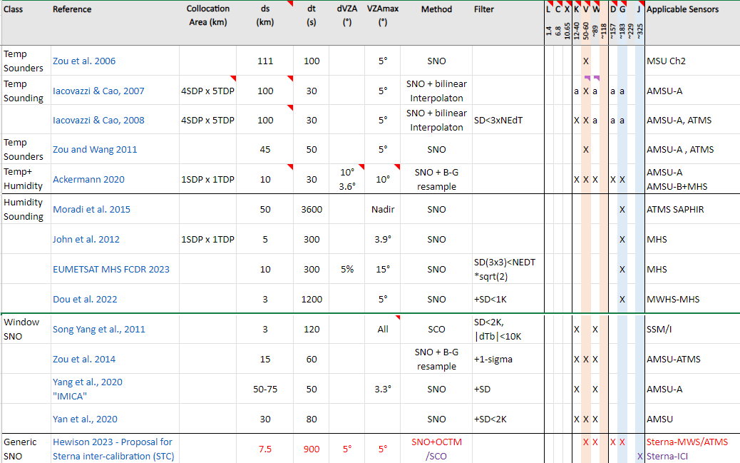
Snapshot of Spreadsheet

Slide 9
Since last meeting 2024-05-02
From “Notes” tab in spreadsheet:
Added 118GHz and 229GHz bands to spreadsheet
Agreed further bands could be added later if needed
Agreed to include any uncertainty assessments published for methods
Aim to develop generic uncertainty analysis for SNO methods
Terminology
Agreed “Collocation Area”
SDP = Scan-Direction Pixels x TDP = Track-Direction Pixels
Need to complete details of Collocation Areas for more methods – all 1x1?
Added new worksheet to show regions covered by SNOs from different sensor combos

Slide 10
Open Questions for SNO review + answers
Do we need to include azimuthal angle constraints?
Often not used in microwave SNOs – especially near nadir
Useful for window channels? E.g. for conical imagers?
Agreed to note any constraints under “Filters” column is spreadsheet
Do we need to review any Spectral Band Adjustment Functions?
Used in published algorithms to account for SRF differences
And “Geometric Adjustment Functions”?
To account for systematic differences in viewing angle/polarisation
E.g. to compare different conically-scanning microwave imagers
Agreed to add column for Spectral/Geometric Corrections in spreadsheet
Aim to provide “Recipe” for how to define SBAFs/GAFs – as part of recommended SNO algorithm
How to account for antenna patterns?
Or just compare antenna temperatures? Noted instruments with different sidelobes can appear biased
Agreed important to be clear which is used, and use data after Antenna Pattern Correction, if possible

Slide 11
Example Collocation Areas

Slide 12
Towards Uncertainty Analysis
Quantify differences between centres of Collocation Areas
+ Scale spatial variability accordingly?
Statistics from aircraft measurements – e.g. COSMIR on ER-2 ~1km²
E.g. analysis of Sentinel-6/AMR data…
1-D case

Slide 13
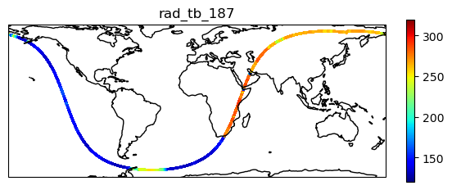
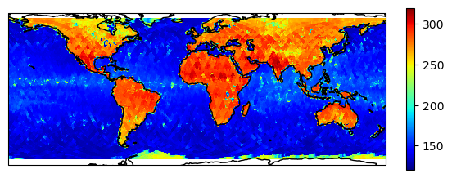
Spatial Variability from S6/AMR
Sentinel-6 “Michael Freilich” Orbital Characteristics (ref)
Type | non-synchronous
Altitude | 1336km
Inclination | 66.039°
Repeat cycle | 9.9156 days
Ground track velocity | 5.8 km/s
Channel/GHz | 18.7 | 23.8 | 34 | 89 | 130 | 166
Bandwidth/MHz | 200 | 400 | 700 | 5000 | 5000 | 5000
NEDT | 0.13? |  |  | <0.1 | <0.1 | <0.1
Swath | Nadir only |  |  | Nadir+x° only
FWHM/km | 40 | 34 | 31 | 5 | ~4 | ~3
Sampling/Hz | 16/8 |  |  | 16
Sampling/km | 0.36/0.72 |  |  | 0.36
High spatial sampling (up to 360m)
High radiometric resolution (TBC)
But 1-D sampling only!
Not in protected bands – prone to RFI
1 month coverage (2024-05)

Slide 14
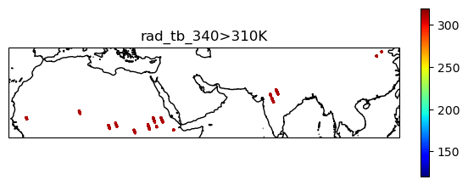
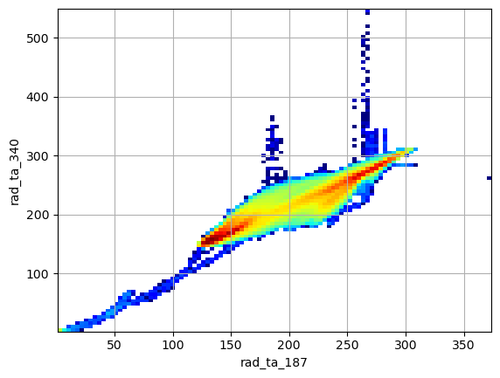
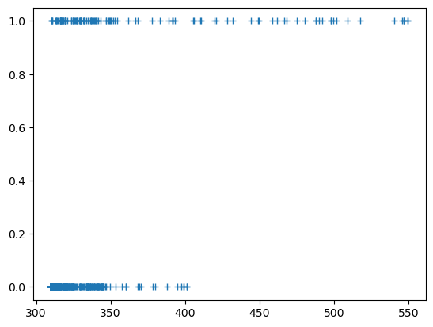
Example of RFI at 34GHz
Not all bands protected
34GHz prone to RFI
Not always flagged as bad radiometric quality
Only use unflagged data from now…

Slide 15
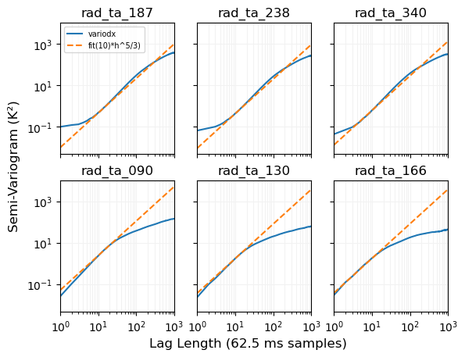
Variogram Analysis
Evaluate variability
Using Variograms
RMSD of Tb differences sampled over various intervals
In time
Equivalently, space
Slope=5/3
Kolmogorov cascade
Turbulent sub-range?
Noise Floor

Slide 16
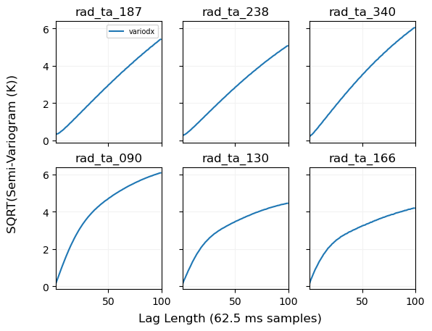
SNO Uncertainty due to spatial variability
How much uncertainty on collocation due to misalignment?
Plotted on linear scale
E.g. 50 samples = 18km,
SQRT(variogram) ~4K
At 10 samples = 3.6km,
SQRT(variogram) ~1K
Includes ocean & land
Clear & cloudy
Only 1-D
Repeat with 2-D data
LPF to mimic larger FOV

Slide 17
Expected Temporal Variogram
Log(Semi-variogram)
Seasonal Variations (6m max, 1y min)
Diurnal Variations (12h max, 24h min)
Convective
Scale ~1min
Effective Range (95% sill)
Nugget (Noise)
log(lag(time))

Slide 18
Expected Spatial Variogram
Log(Semi-variogram)
Global Scale (10000km max, 20000km min)
Synoptic
Scale ~300km
Convective
Scale ~1km
Effective Range (95% sill)
Nugget (Noise)
log(lag(distance))

Slide 19
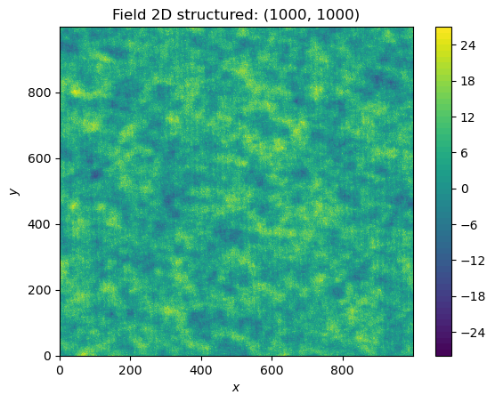
Generate Synthetic 2-D Image
From Variogram
Used to evaluate uncertainty
For different collocation areas
Overlaps with various lags

Slide 20
SNO Uncertainty due to temporal variability
In principle can analyse temporal variability
in same way as spatial
But don’t have MWRs staring at same scene
Could use balloon-borne radiometers?
Could use aircraft observations
E.g. when flying in a circle, observing at an angle
In discussion with NASA-GSFC for ER-2/COSMIR
As part of WH²yMSIE campaign Oct/Nov 2024

Slide 21
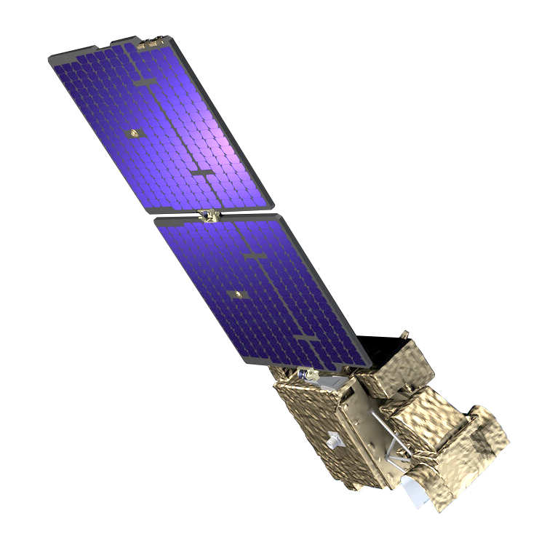
AWS
AWS = Arctic Weather Satellite
ESA’s New small satellite
Earth Watch Programme Element
50-57, 166, 183, 325 GHz
Launched 2024-08-16
Plan to implement EUMETSAT MHS FCDR SNO algorithm for AWS data
Compare with ATMS, AMSU-A/MHS
Data From October 2024

Slide 22
Post-meeting Additions
Backup slides showing some details of Further analysis…

Slide 23
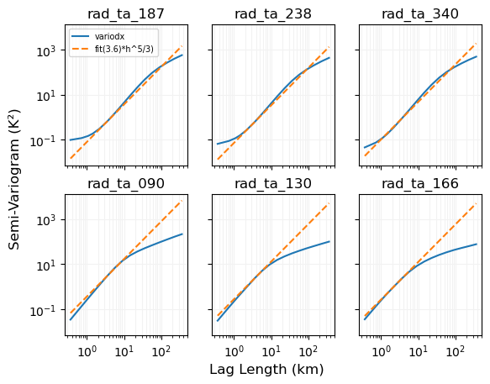

Slide 24
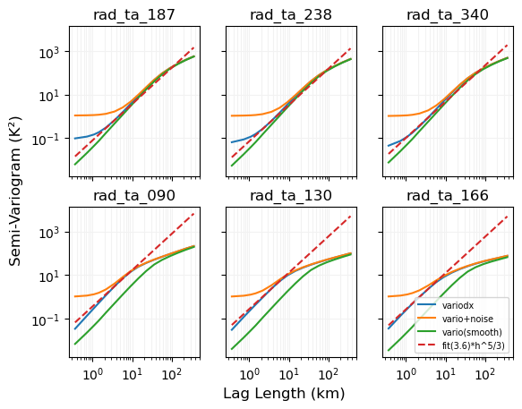
Channel (GHz) | 18.7 | 23.8 | 34 | 89 | 130 | 166
NEDT | 0.13? |  |  | <0.1 | <0.1 | <0.1
FWHM (km) | 40 | 34 | 31 | 5 | ~4 | ~3
Sampling (Hz) | 16/8 |  |  | 16
Sampling (km) | 0.36/0.72 |  |  | 0.36
Shaded areas:
Max lag=FWHM
Min lag =Departs from 5/3
Thin black line:
- fit to >FHWM by eye

Slide 25
