Slide 1
SNO algorithm implemented for MWHS-II on FY-3F
Yang Guo
Xinxin Xie, Jieying He, Xiaoyu Yu, Anyong Hu, Songyan Gu, Naimeng Lu, Shengwei Zhang
CMA
2025-01-16

Slide 2
Outline
Instrument: FY MWHS-II
SNO algorithm
Summary

Slide 3
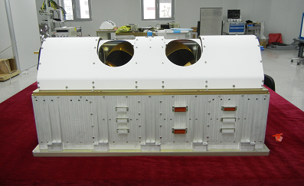
FY MWHS-II
Channel central frequencies of MWHS
Channel frequency (GHz) | FY-3A/B MWHS-I | FY-3C/D MWHS-II | FY-3E/F MWHS-II
89 |  | √ | √
118.75±0.08 |  | √ | √
118.75±0.2 |  | √ | √
118.75±0.3 |  | √ | √
118.75±0.8 |  | √ | √
118.75±1.1 |  | √ | √
118.75±2.5 |  | √ | √
118.75±3.0 |  | √ | √
118.75±5.0 |  | √ | √
150 | √* | √
166 |  |  | √
183.31±1 | √ | √ | √
183.31±1.8 |  | √ | √
183.31±3 | √ | √ | √
183.31±4.5 |  | √ | √
183.31±7 | √ | √ | √
Microwave humidity sounder (MWHS) onboard FY-3 satellites
*MWHS-I onboard FY-3A/B has both quasi- vertical (QV)
and horizontal (QH) polarization channels at 150 GHz.
Satellite | Microwave Humidity Sounder | Launch Time (yyyy-mm-dd) | Equatorial Crossing Time* | Current Status
FY-3A | MWHS-I | 2008-05-27 | 09:05 (D) | Not operational
FY-3B | MWHS-I | 2010-11-05 | 13:40 (A) | Not operational
FY-3C | MWHS-II | 2013-09-23 | 10:15 (D) | Operational
FY-3D | MWHS-II | 2017-11-15 | 14:00 (A) | Operational
FY-3E | MWHS-II | 2021-07-05 | 05:30 (D) | Operational
FY-3F | MWHS-II | 2023-08-03 | 10:15 (D) | In-orbit testing
Equatorial crossing time of FY-3 satellite series.
*D and A are abbreviated from the equatorial crossing time in the descending and ascending nodes, respectively.

Slide 4
FY MWHS-II
Channel central frequencies of MWHS
Channel frequency (GHz) | FY-3A/B MWHS-I | FY-3C/D MWHS-II | FY-3E/F MWHS-II
89 |  | √ | √
118.75±0.08 |  | √ | √
118.75±0.2 |  | √ | √
118.75±0.3 |  | √ | √
118.75±0.8 |  | √ | √
118.75±1.1 |  | √ | √
118.75±2.5 |  | √ | √
118.75±3.0 |  | √ | √
118.75±5.0 |  | √ | √
150 | √* | √
166 |  |  | √
183.31±1 | √ | √ | √
183.31±1.8 |  | √ | √
183.31±3 | √ | √ | √
183.31±4.5 |  | √ | √
183.31±7 | √ | √ | √
*MWHS-I onboard FY-3A/B has both quasi- vertical (QV)
and horizontal (QH) polarization channels at 150 GHz.

Slide 5
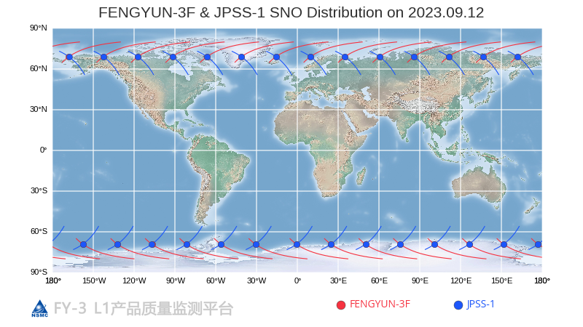
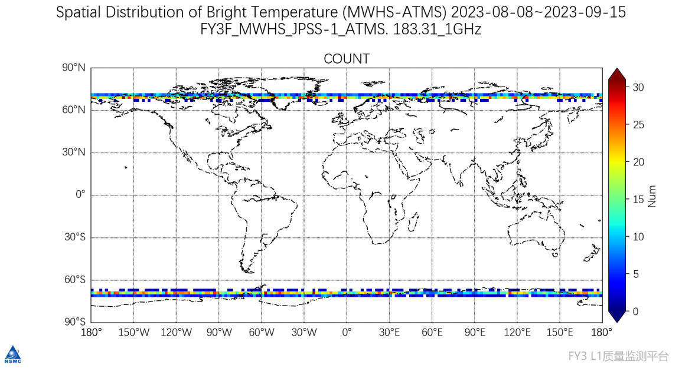
SNO algorithm
The SNO data with a time difference greater than 15 min and spatial distance greater than 3 km are rejected in the comparison. The data used in this study is within an earth-viewing-angle of ±5°
Compared Channel
Center Frequency （GHz） | MWHS-II (Channel Number) | ATMS (Channel Number)
183.31±1 | 11 | 22
183.31±1.8 | 12 | 21
183.31±3 | 13 | 20
183.31±4.5 | 14 | 19
183.31±7 | 15 | 18

Slide 6
SNO results

Slide 7
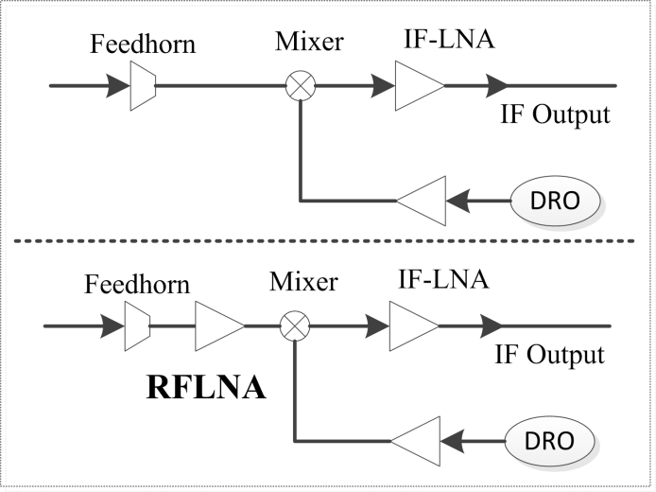
SNO for FY-3C/D/E
FY-3C/D MWHS-II
FY-3E/F MWHS-II
Schematic diagram of the MWHS-II receiver system.
SNO results between MWHS-II onboard FY-3C/D/E and ATMS at 183.31±4.5 GHz.

Slide 8
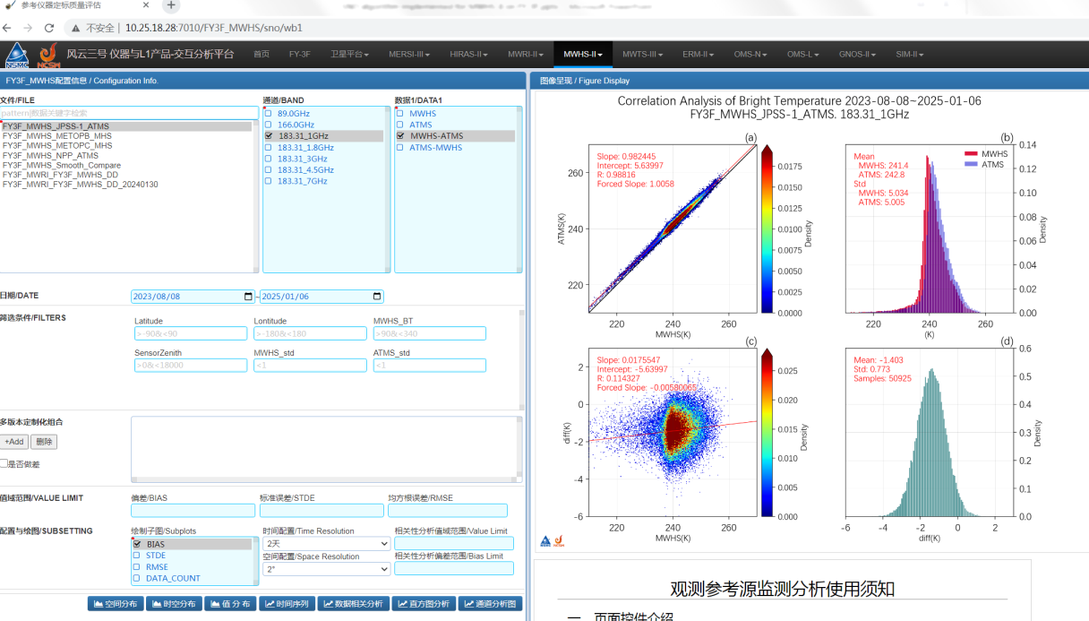
SNO results-Monitoring Tools

Slide 9
Summary
SNO algorithm used to evaluate the calibration accuracy of the MWHS
Intercalibration

Slide 10
Thank you for your attention
Email：guoyang@cma.gov.cn

